Slide 1
GARD Roadmap Update 2026 - RF Controls
P. Varghese, Fermilab
A. Ratti, LBNL
03 March 2026

Slide 2
Outline
Input from LLRF 2025 Workshop Panel Discussions
Challenges from accelerator projects worldwide – current and future
Highlights from GARD RF Controls virtual workshop – Feb 27, 2026
4. Perspectives and near term research interests from the LLRF community
a) Technical challenges related to performance improvement
b) Adoption of newer FPGA hardware and features that enable new
architectures and implementation of complex control algorithms
c) Using the widespread application of AI/ML techniques to improve
accelerator performance, reliability and reduced operations cost

Slide 3
Amplifiers and RF Sources
Solid State Amplifiers(SSA) today use mostly LDMOS power
conversion semiconductor technology. Efficiency ~ 40%
Newer processes such as GaN SSA’s can provide higher efficiencies > 60%
Amplifier operating modes(classes) are chosen based on various
tradeoffs. Explore optimization techniques for higher efficiency.
Partner with industry to advance the research
Explore lower cost RF sources such as Magnetrons
LLRF controller development is critical to maintain stable and efficient
operation for these non-linear amplifiers

Slide 4
LLRF Technology
FPGA technology has advanced at a rapid pace providing a vast
amount of computing and logic resources at reasonable cost
SOC FPGAs and Direct RF FPGAs or RFSOCs offer new architectures
that can reduce system cost
CW vs Pulsed operation – Microphonics suppression and Lorenz Force Detuning
Both modes may need to be supported on the same machine
Improved Resonance control can be accomplished using control algorithms aided by AI/ML methods

Slide 5
Machine Learning and Artificial Intelligence
Use ML/AI analysis on long term data trends to enhance accelerator performance.
Data acquisition for long-term archiving for ML applications should be triggered by anomalous behavior.
Retrofitting older systems for machine learning data acquisition is a challenge. Investigate economical ways of facilitating this data acquisition without having to replace the entire hardware.
ML algorithms can help operators to tune the accelerator to higher efficiencies.
ML/AI techniques can be used to provide a greater degree of automation in various stages of accelerator component testing and operation.

Slide 6
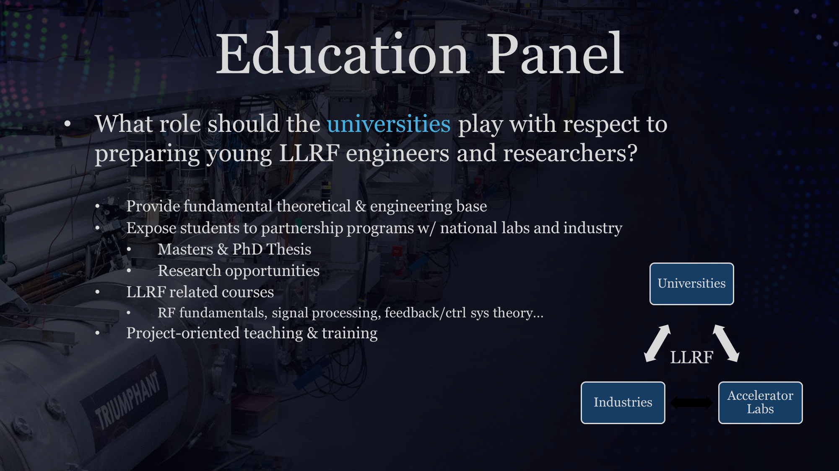

Slide 7
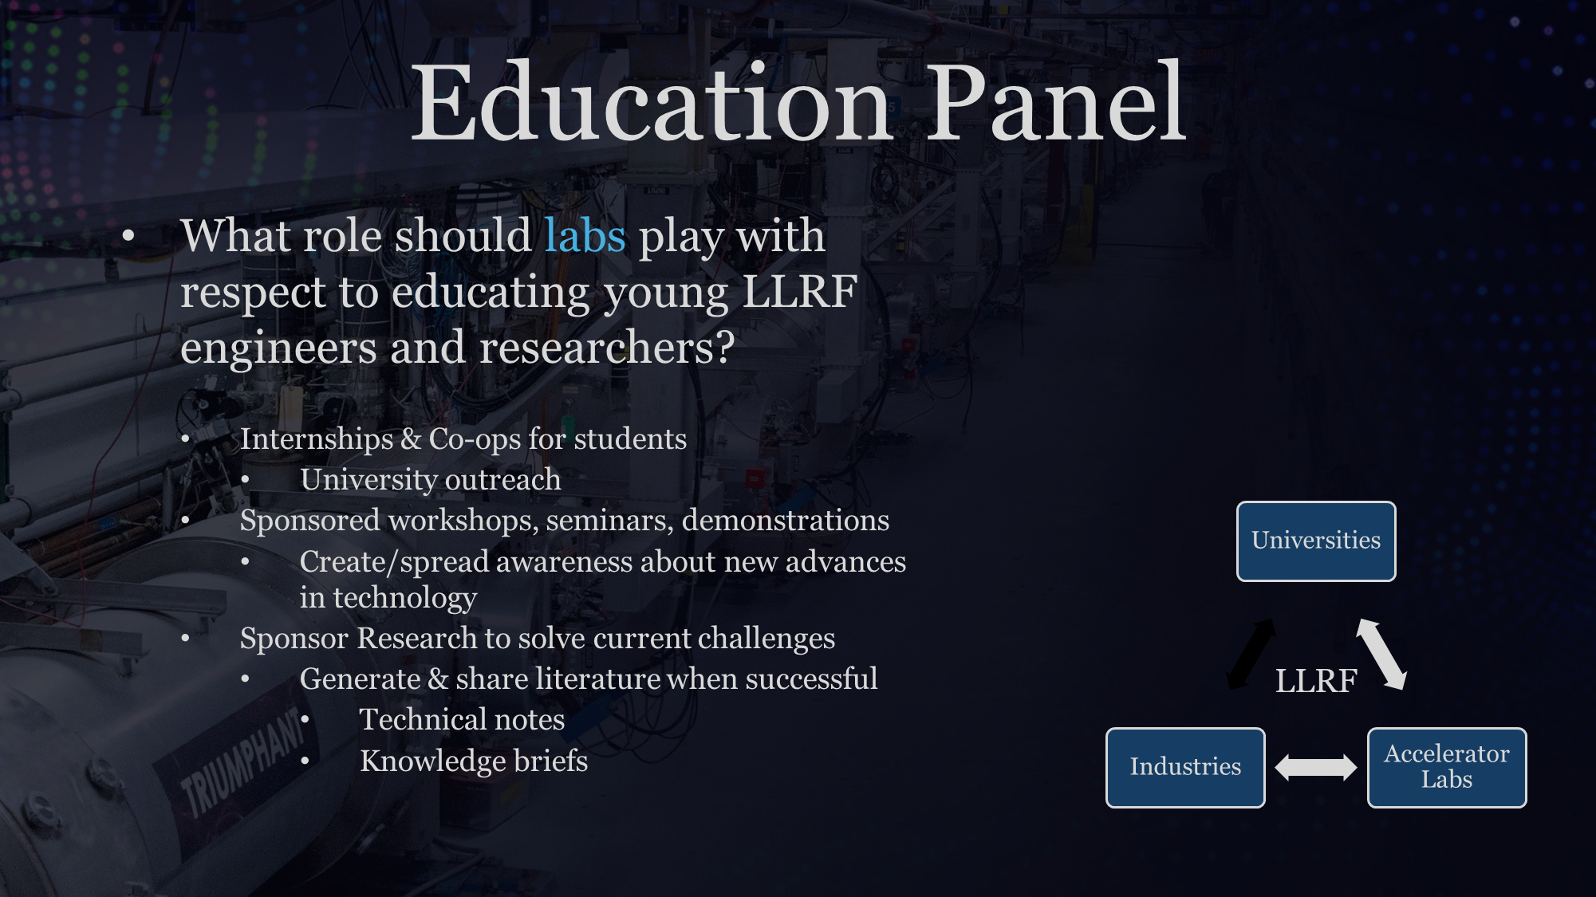

Slide 8
Challenges from Ongoing and Future Accelerator Projects
PIP-II, LBNF-DUNE (FNAL) – Pulse Mode operation of PIP-II to
reduce operational costs and heat load on the cryo-system.
EIC (BNL) – Achieving the performance requirements for crab cavities in terms of low latency, low noise and high gain feedback.
FCC, HL-LHC (CERN) – Various operational modes have a large
variability in voltage requirement which is achieved by reverse phase operation. Anomaly detection using ML at the PS RF system
ILC Research (KEK) – Machine Learning base Resonance Control,
Advanced modeling and control on a RFSOC hardware platform

Slide 22
Narrowband Active Noise Cancellation at LCLS-II

Slide 23
Narrowband Active Noise Cancellation at LCLS-II

Slide 24
DESY Perspectives on Research Priorities
Improve Efficiency and Sustainability - Reduce operating costs
Improve Performance (push the regulation limit)
Modernize controls – Investigate advanced feedback algorithms.
Explore benefits of combining RF and Resonance Control
Exploit Increased FPGA Capabilities
Improve anomaly detection, model optimization

Slide 25
Conclusion
New FPGAs offer great opportunities to try more advanced control
Algorithms and signal processing methods
Direct sampling with RFSOC FPGAs looks promising to reduce cost and
complexity of RF controls.
Resonance control for microphonics control and LFD can explore adaptive control algorithms and novel techniques like NANC to increase performance
AI/ML methods look promising for anomaly detection, resonance control.
improved system models and more reliable operations

Slide 26
Thank You !

