Slide 1
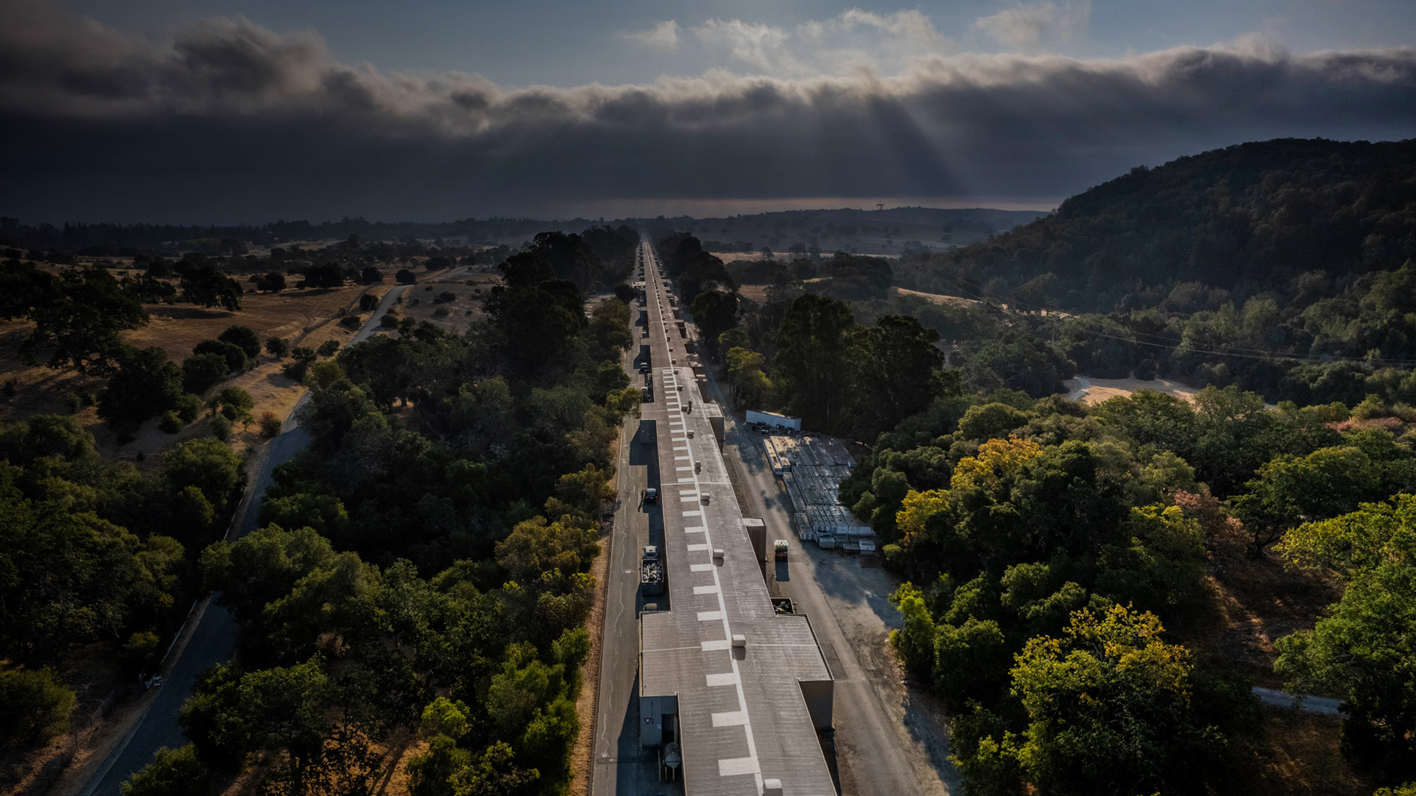

GARD HEP RF Roadmap
RF Sources Subtopic
3 & 4 March 2026
Galen Aymar
John Moss
Ali Nassiri

Slide 2
Key Motivations
What is the RF Source Subgroup trying to do?
1. Summarize existing rf sources
2. Highlight key technologies
3. Find approaches to higher-performing sources (efficiency, compactness, cost effectiveness, etc.)
4. Encourage collaboration and participation (accelerator facilities, industries, universities)
5. Identify key areas that require sustained R&D (priority-based)

Slide 3
Summary of Subtopic Meeting
The RF Source subtopic agenda and speakers
Large Science Projects – Fulvia Pilat, ORNL
Covered existing and future facilities to provide context
High Efficiency RF Sources – Chiara Marelli, CERN and Mohamed Othman, SLAC
Discussed the status and future developments of HE vacuum electronic devices
Solid State Amplifiers – Doug Horan, ANL and John Lyles, LANL
Described the latest developments in high power RF transistor technology – LDMOS and GaN
Modeling – Alexander Vlasov (NRL), Cho-Kuen Ng (SLAC)
Described the latest effort in vacuum tube code development
Advanced Manufacturing – Julian Merrick, SLAC, Amy Elliot, ORNL and Paul Pritchard, ORNL
Discussed the latest in advanced manufacturing techniques and their application to RF devices
Community Contributions:
High Efficiency RF Source development at CCR – Lawrence Ives
Needs for RF Sources at SACLA and SPring-8 – Takahiro Inagaki
RF R&D at JLAB – Robert Rimmer
ALBA RF Source Needs – Pol Solans Rossell
Recent HPRF Efforts at FRIB – Shen ZHao

Slide 4
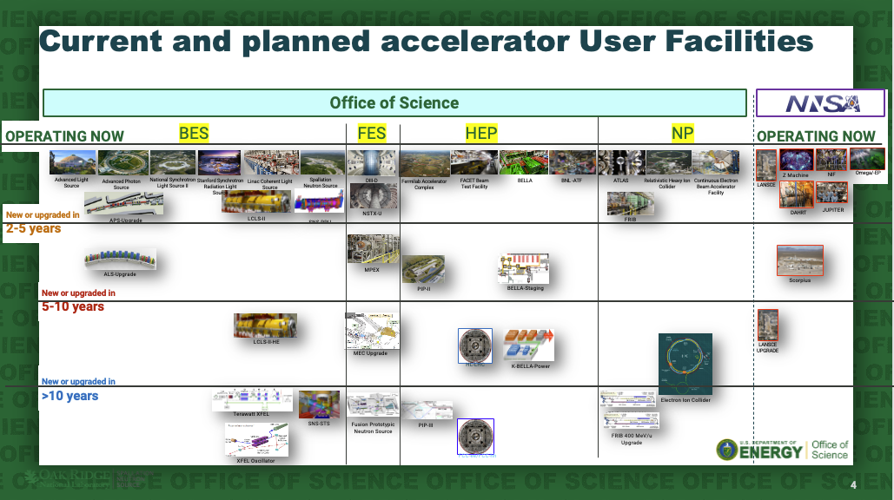

Slide 5
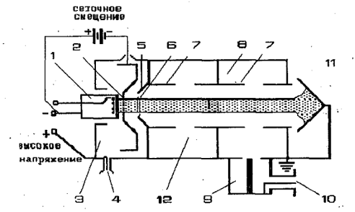
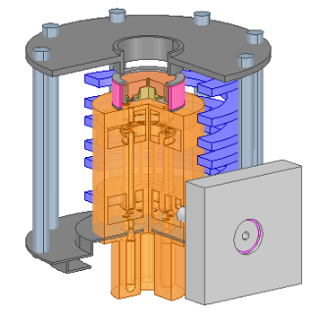
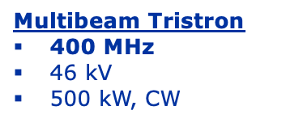
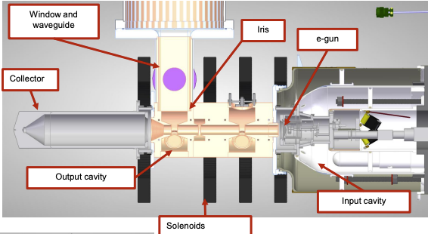
Key Highlights from Subtopic Meeting
HE RF Sources
Vacuum electron devices dominate
CERN recently redesigned the TH2167 klystron for higher efficiency (60 -> 70%)
SLAC working on retrofit of 5045 to increase efficiency (45 -> 55%) and a retrofit of the 75XP4 using PPM to increase efficiency by 6%
Work on new sources:
Parallel efforts on 1.2 MW MB IOTs with efficiency of 70%
1MW MBK with efficiency of 80%
400kW MB Tristron – hybrid between a klystron and IOT with predicted efficiency > 80%
100kW HE-IOT with efficiency > 80%
Next step is 90%!
Tristron (A.D. Sushkov et. al. 1967)
C. Marelli (CERN) and M. Othman (SLAC). Presented at the GARD RF Sources Subtopic Virtual Workshop 2026.
HE-IOT

Slide 6
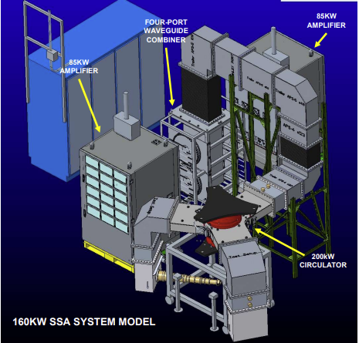
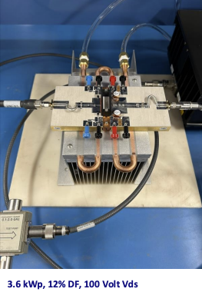
Key Highlights from Subtopic Meeting
Solid State Amplifiers
Two primary transistor types – LDMOS and GaN
LDMOS dominates installation < 500MHz
Efficiency greater than 60%
Low phase variation (~5 degrees from 10 – 90% of output power)
GaN making inroads at higher frequencies – example is the 805MHz, 1.2MW SSA at LANL
3.6kW peak on transistor test pallet
5kWp chips are in test now
Challenges
Floor space – Comparable VEDs take up less real estate
Heat dissipation/power density – making progress with new technologies like GaN on SiC (225 deg C)
"Other" electronic components
Power combining
Workforce
160kW CW SSA at ANL
GaN on SiC transistor under test – 3.6kWp
D. Horan (ANL) and J. Lyles (LANL). Presented at the GARD RF Sources Subtopic Virtual Workshop 2026.

Slide 7
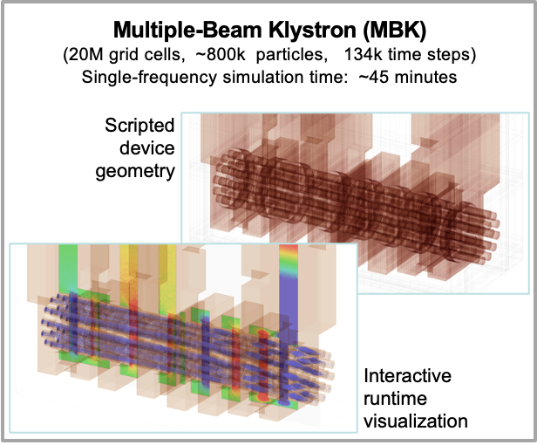
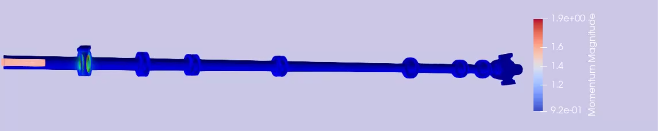
Key Highlights from Subtopic Meeting
Modeling
Model codes are constantly updated to meet the latest goals in source development (HE, higher power, more compact, etc)
Primary code types
PIC (Neptune, MICHELLE)
Hybrid/Parametric (CHRISTINE, TESLA, MAGY, ACE3P)
Key Challenges
Time scales, complex device geometry, complex beam dynamics
Extending cooperation between DOE, DOW, US Industry
Workforce
Developments
Parameterized optimization of RF source design
Unstructured mesh, parallel simulation (multi-GPU, HPC) for PIC codes
Multi-frequency, non-symmetric beam, beam tunnel variation, complex geometries for Hybrid codes
Incorporation of AI
NEPTUNE simulation of an MBK
75XP4 Klsytron Start-to-End Simulation in ACE3P
A. Vlasov (NRL) and C. Ng (SLAC). Presented at the GARD RF Sources Subtopic Virtual Workshop 2026.

Slide 8
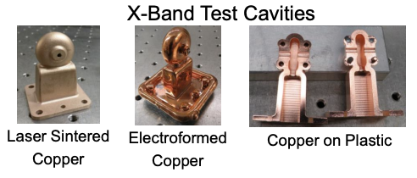
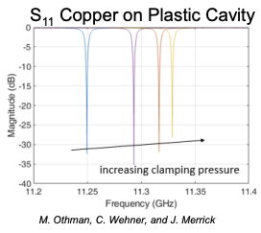
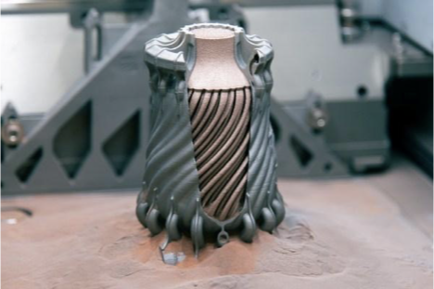
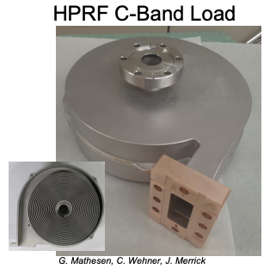
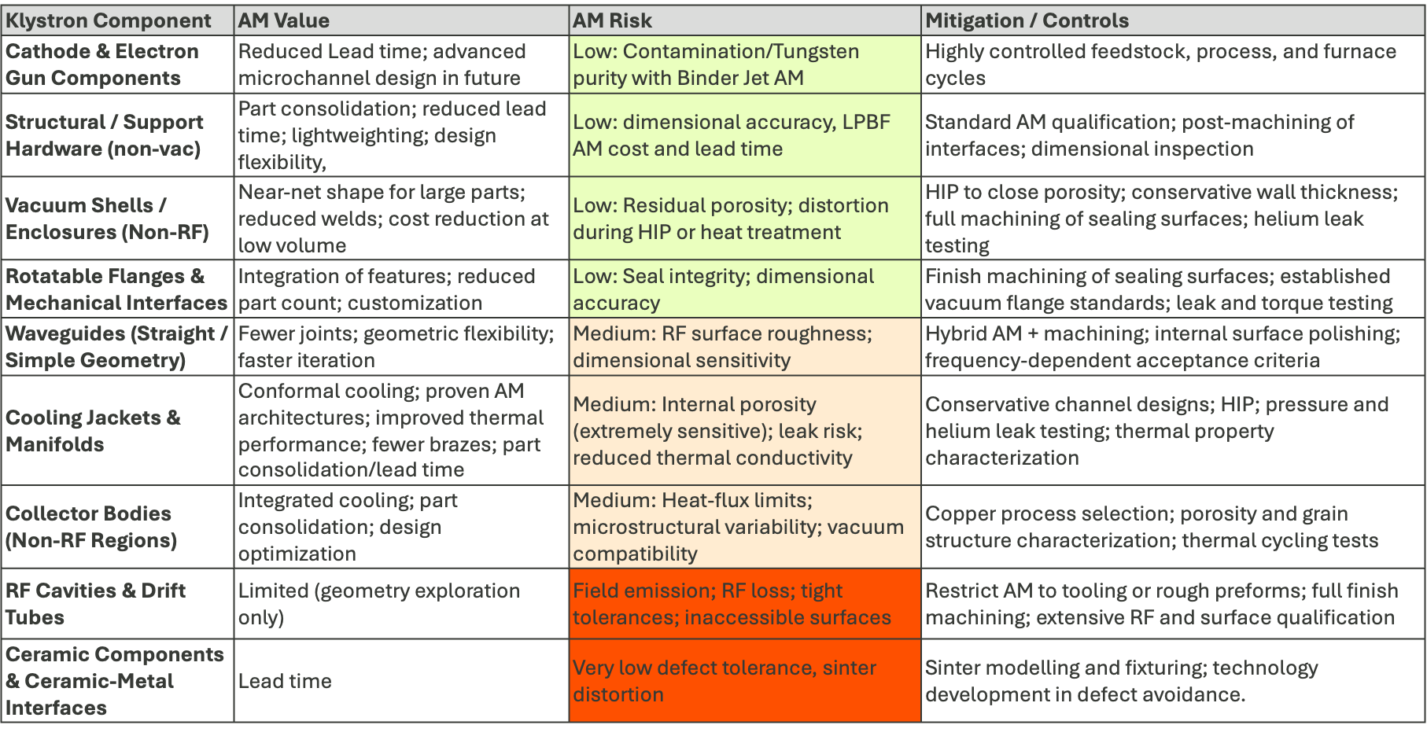
Key Highlights from Subtopic Meeting
Manufacturing
Use of advanced manufacturing (AM) holds the potential to drastically reduce cost and time of RF source production
Can be applied wholistically – think all RF system components, not just source
Can pass to industry at MRL/TRL 5 – 6
Can apply techniques to both SSA and VEDs
Good for complex geometries
Challenges
"Vacuum facing" components – RF surfaces, porosity
Thermal conductivity
Field emission
Inaccessible surfaces
AI-designed, multi-material component fab'd with AM
J. Merrick (SLAC), A. Elliot (ORNL), and P. Pritchard (ORNL). Presented at the GARD RF Sources Subtopic Virtual Workshop 2026.
Risk evaluation for AM applied to Klystron Fab

Slide 9
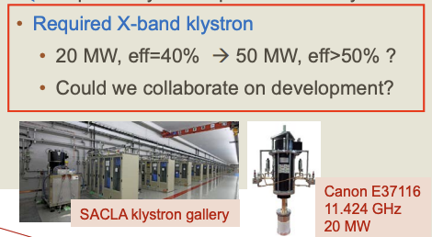
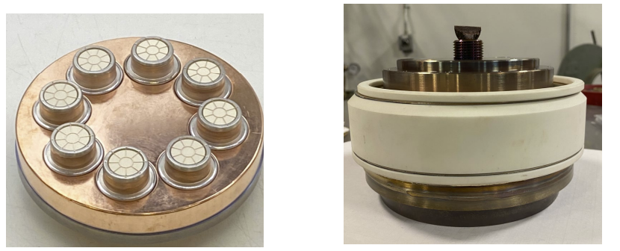
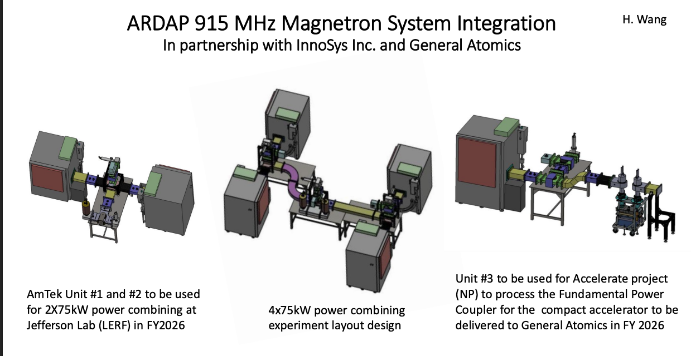
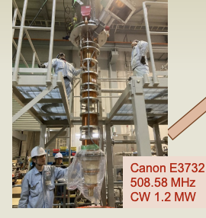
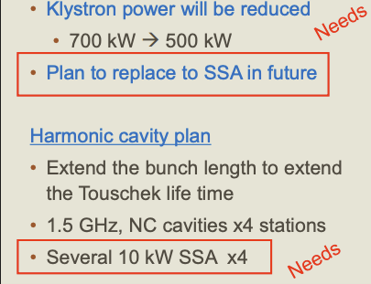
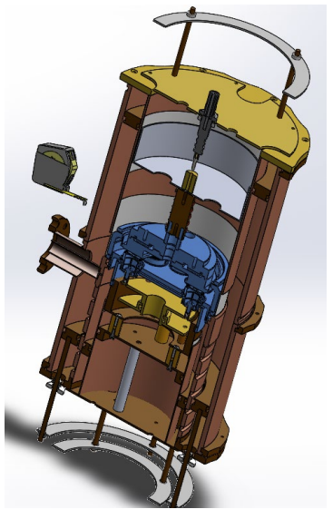
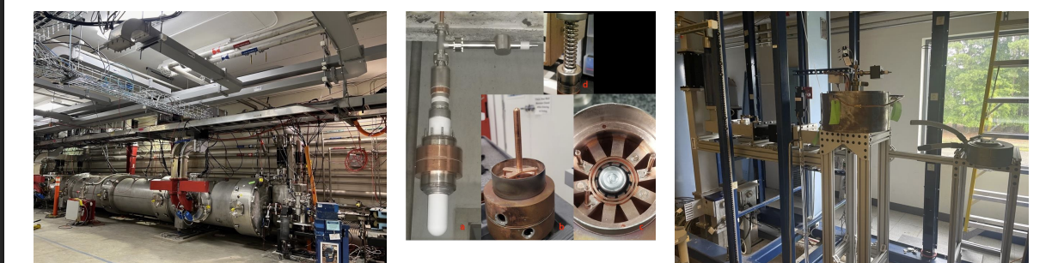
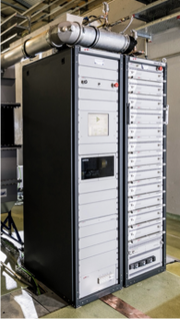
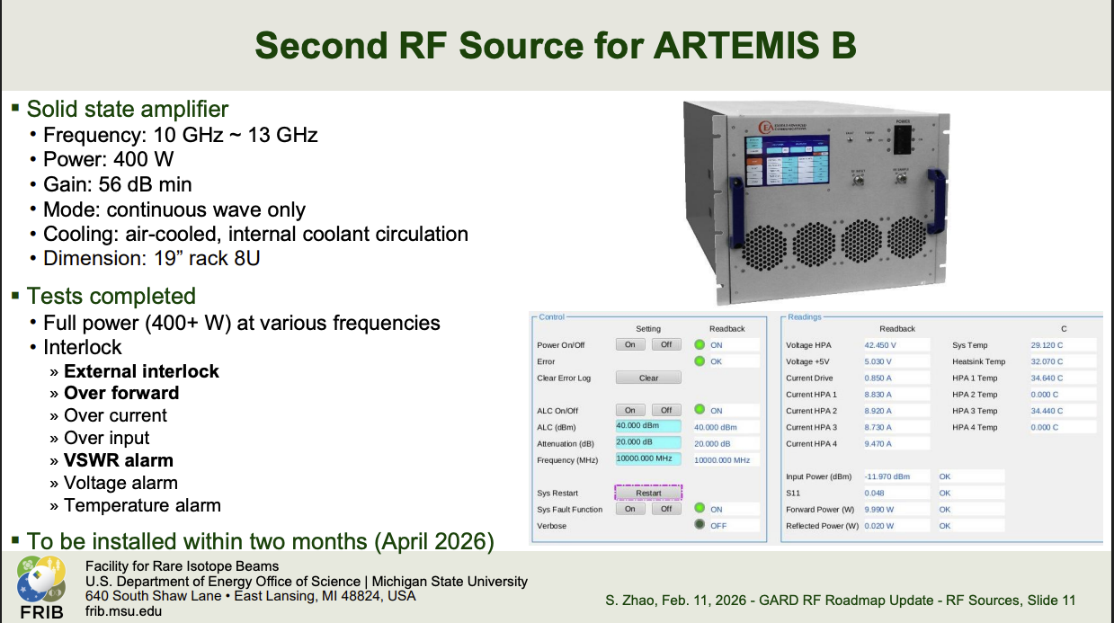
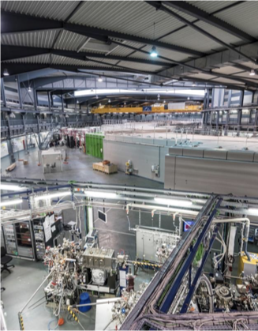
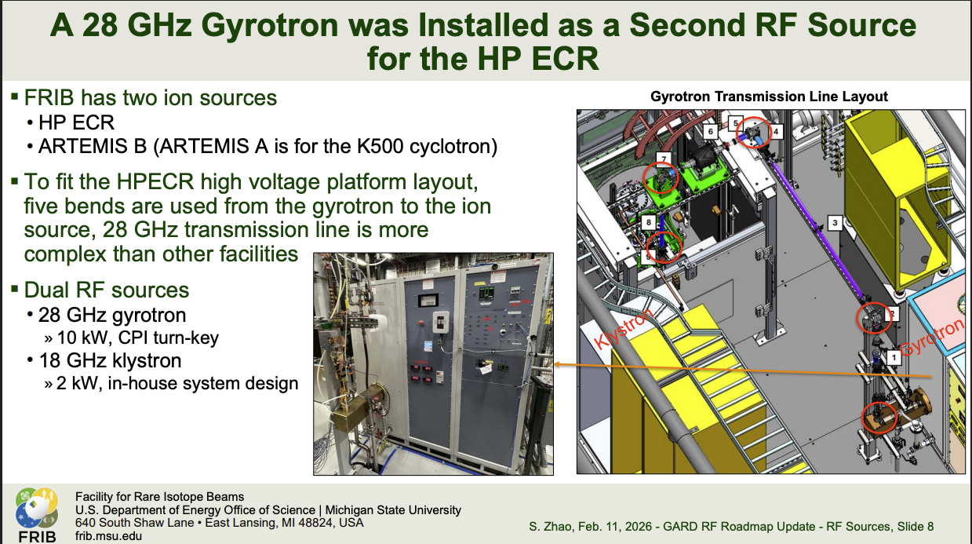
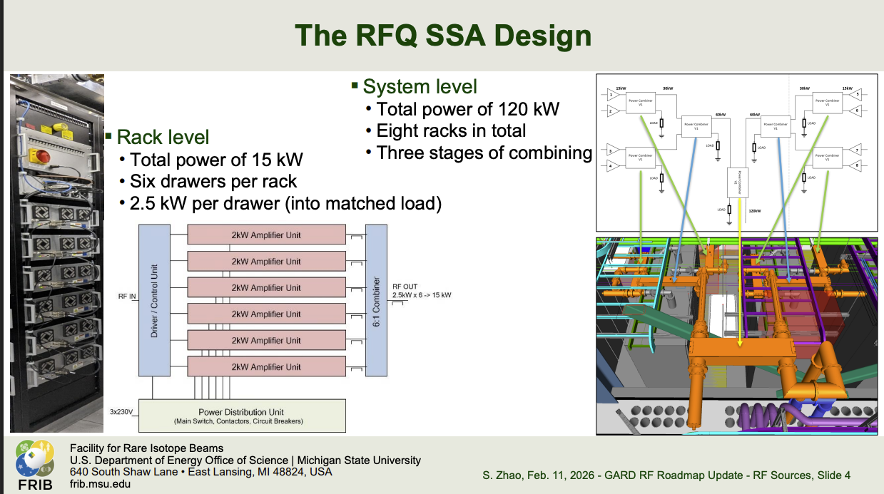
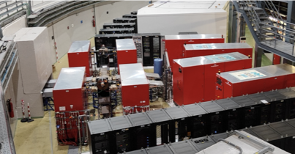
Key Highlights from Subtopic Meeting
Community Contributions
The community is driving many of the advancements we see today on a variety of sources. Members are actively seeking collaborators to help meet their individual challenges.
Magnetron work at JLab shows promise for ADS!
Multibeam Triode in development at CCR – estimated cost of $0.50/watt!
RF source developments at SPring-8 – seeking collaborators!
ALBA II: 4th Generation is on the way in Barcelona.
A variety of new RF sources in use/design at FRIB!
L. Ives (CCR), T. Inagako (SPring8), R. Rimmer (JLab), P. Rossell (ALBA), S. Zhao (FRIB) Presented at the GARD RF Sources Subtopic Virtual Workshop 2026.

Slide 10
Challenge Areas – Part 1
Here are the high-level points from the RF Source workshop:
Increasing RF source efficiency (VED and SSA)
Critical for future facilities – EIC, FCC
Create new (or revisit old) VED topology
Continue to iterate transistor design for higher power density - don’t forget ancillary electronic components!
Develop common (suite of) RF sources
Systematic tracking of new source developments versus needs, with a centralized database
Combiner schemes to allow lowest common source to be scaled up for various uses
Reducing cost
AM holds much potential, especially for VED fabrication
Common RF sources between facilities
Keeping industry involved ( Active collaboration and participation)
Pass technology along to industry at TRL > 5 – keep them actively involved from onset
Include industry in technical workshops

Slide 11
Challenge Areas – Part 2
A few more:
Funding necessary R&D developing/enhancing rf sources through separate channels
Common "developments" (sources, manufacturing techniques, etc.) - the more facilities that benefit, the higher probability of funding?
Workforce
"Centralized" training program – USPAS? CERN Accelerator School? - for both engineering and technical craft students
Universities roles?
Mentoring – is a "centralized" mentorship program viable?

Slide 12
Milestones
Short term (1-3 years)
Determine performance requirements for common RF sources (global)
Form working groups with industry aligned along VED and SSA technology
Include modeling and analysis
Start "centralized" workforce development program
Common curricula – CERN AS, USPAS? Universities?- for engineer/scientists and technicians
Open to public and private participants
"Proof of Concept" prototyping of high impact (expensive, long lead) RF components using AM
Medium term (3 – 5 years)
Prototype VED with AM
"Graduate" first class from workforce development program
Prototype first common RF source from multiple manufacturers
Long term (> 5 years)
Routine use of AM in RF components
Routine fabrication of common RF sources
Graduate 20 or more technical professionals from workforce development program per year

Slide 13
Questions For Discussion
Let's start back at slide 10 and discuss the Challenge Areas and Milestones
Let's take the challenges one at a time. Is there more (or less) detail that needs to be captured?
Are there other challenges not captured that you believe are important?
Same for the milestones – are they adequate? What else might be a good addition (or subtraction)?

