Slide 1
Workshop Introduction
Emilio Nanni & Sam Posen
GARD RF Roadmap Update
3 March 2026

Slide 2
Goals of Workshop
Assemble compelling list of grand challenges, milestones, and key motivations
Exciting but not outrageous R&D targets for the next 10 years
Focus on impact – what are the highest impact outcomes for the next decade (and how do we define impact?)
Discuss to hone ideas, make sure that nothing critical is missed
Begin to assemble compelling set of supporting information: workforce development, tables of facilities, synergies, etc.

Slide 3
Framing the Discussion with Convener Presentations
Request to conveners:
Summarize the content of the virtual meetings
Develop a list of 3-5 “Challenge Areas” for your topic. This terminology comes from the recent DOE Fusion Roadmap, which seems to have a nice framework for future priorities: https://www.energy.gov/sites/default/files/2025-10/fusion-s%26t-roadmap-101625.pdf - see pages 34-42
Present a short list of proposed milestones for your topic in the short, medium, and long term
Overview key motivations for your topical challenge areas, such as current and future DOE projects and operations, as well as synergy with US industry needs and non-accelerator DOE programs

Slide 4

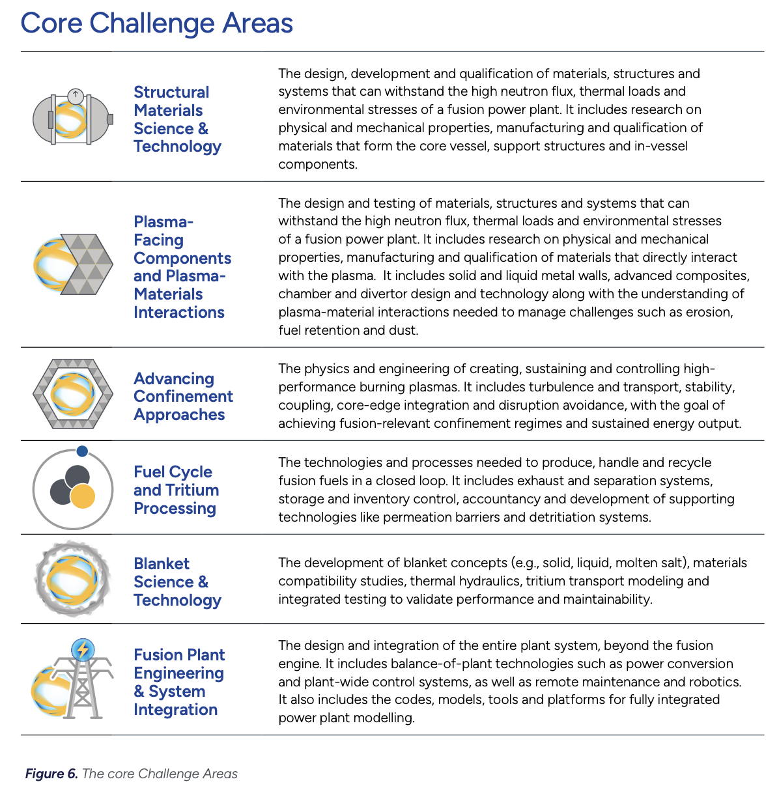
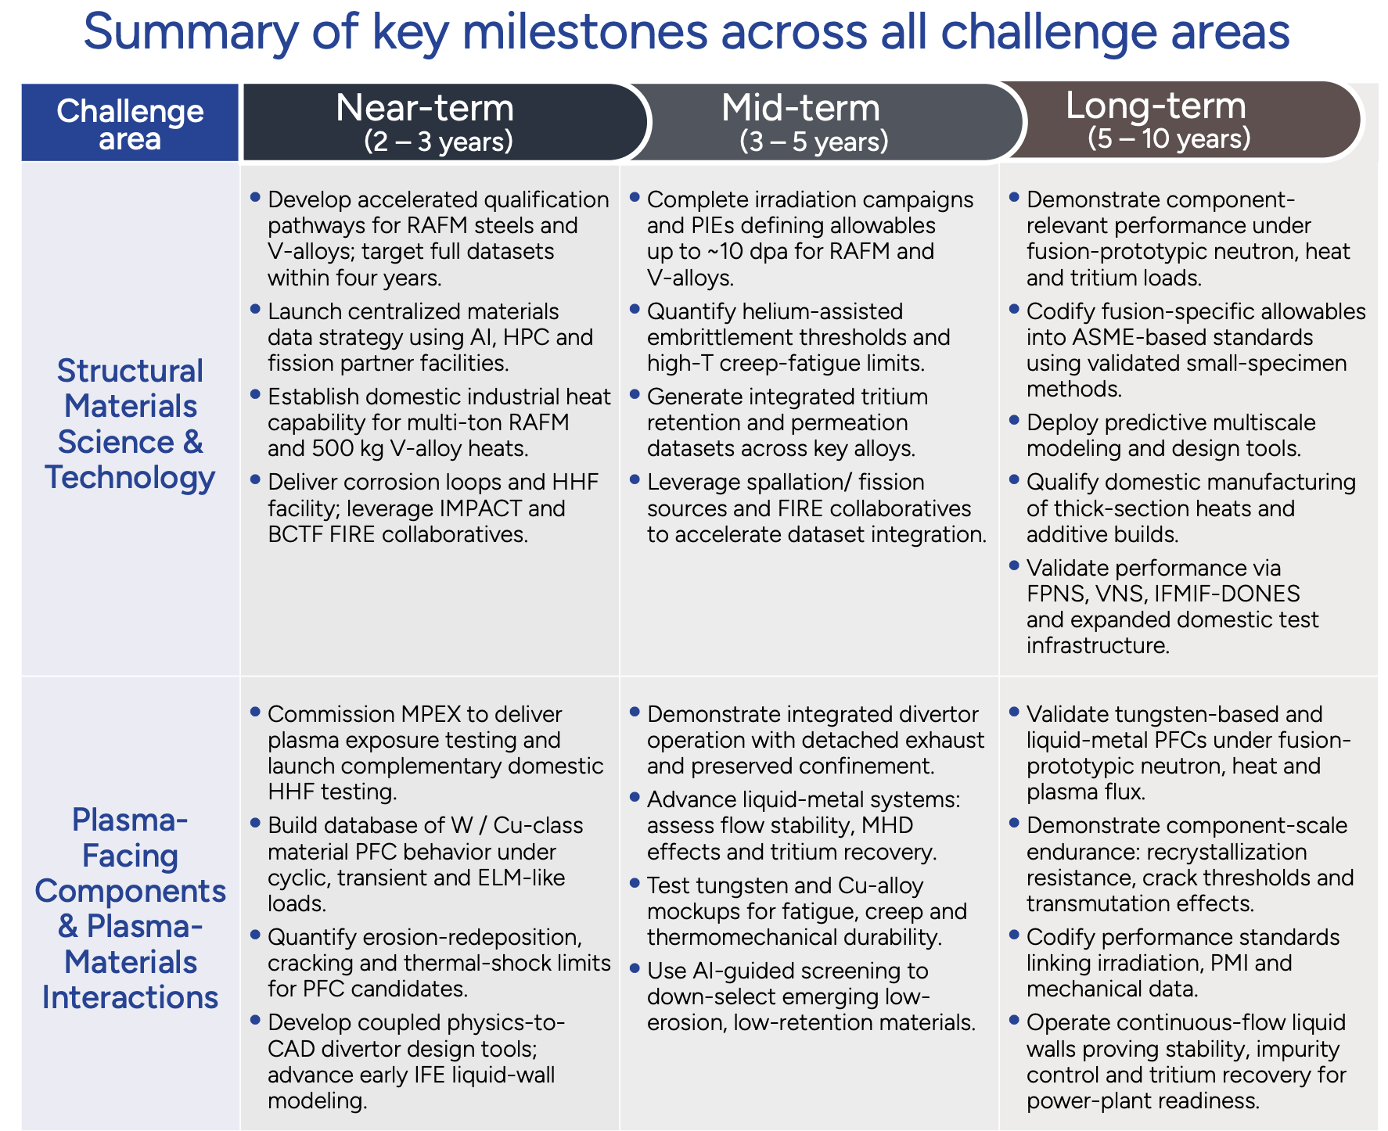
Challenge Areas & Milestones
Example from 2025 fusion roadmap

Slide 5
Virtual Workshops
Aimed for a wide-survey of DOE-HEP, DOE-SC and accelerator community
4 virtual meetings - SRF, NCRF, RF Sources, RF Control
203 Domestic / 65 International
198 National Lab, 45 Industry, 24 Academia, 1 Government
https://indico.slac.stanford.edu/event/10359/page/301-subtopic-workshops-other-references

Slide 6
What We Need From You
We already have a lot of technical input – now focus on assembling the roadmap
We have lots of discussion time! Please participate
We want compelling, actionable, measurable goals

Slide 7
Workshop Logistics
Food and coffee at breaks
Lunch on your own – SLACafe recommended – Sandhill kitchen is a walk off-site
Can leave your things in the room during lunch if you’d like
For logistical issues:
Emilio Nanni nanni@slac.stanford.edu
Basia Kucharska basiak@slac.stanford.edu 650 926 3243
Please sign in at the desk outside
Needed for dosimeters for tour

Slide 8
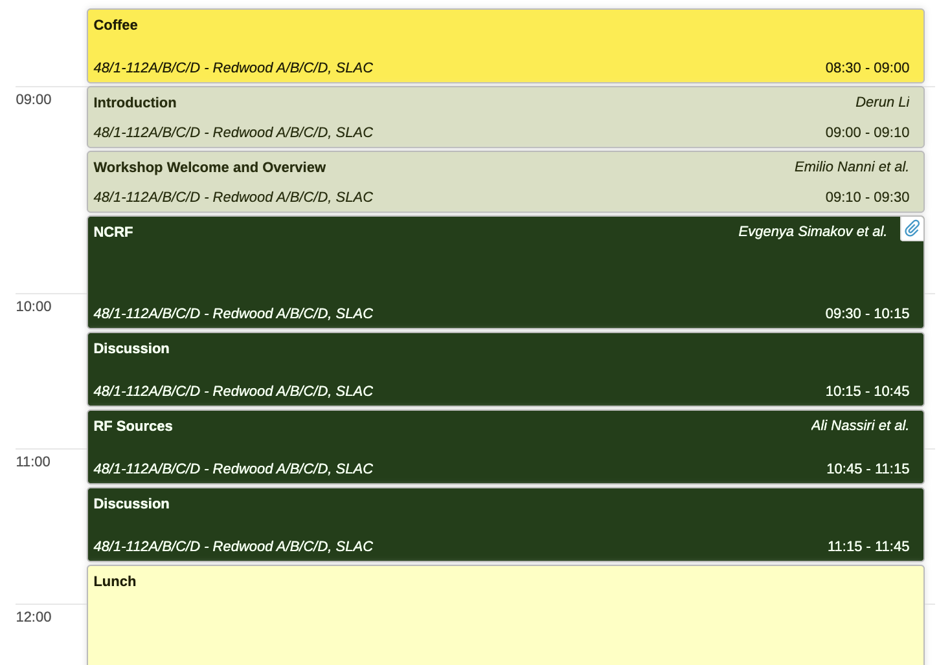
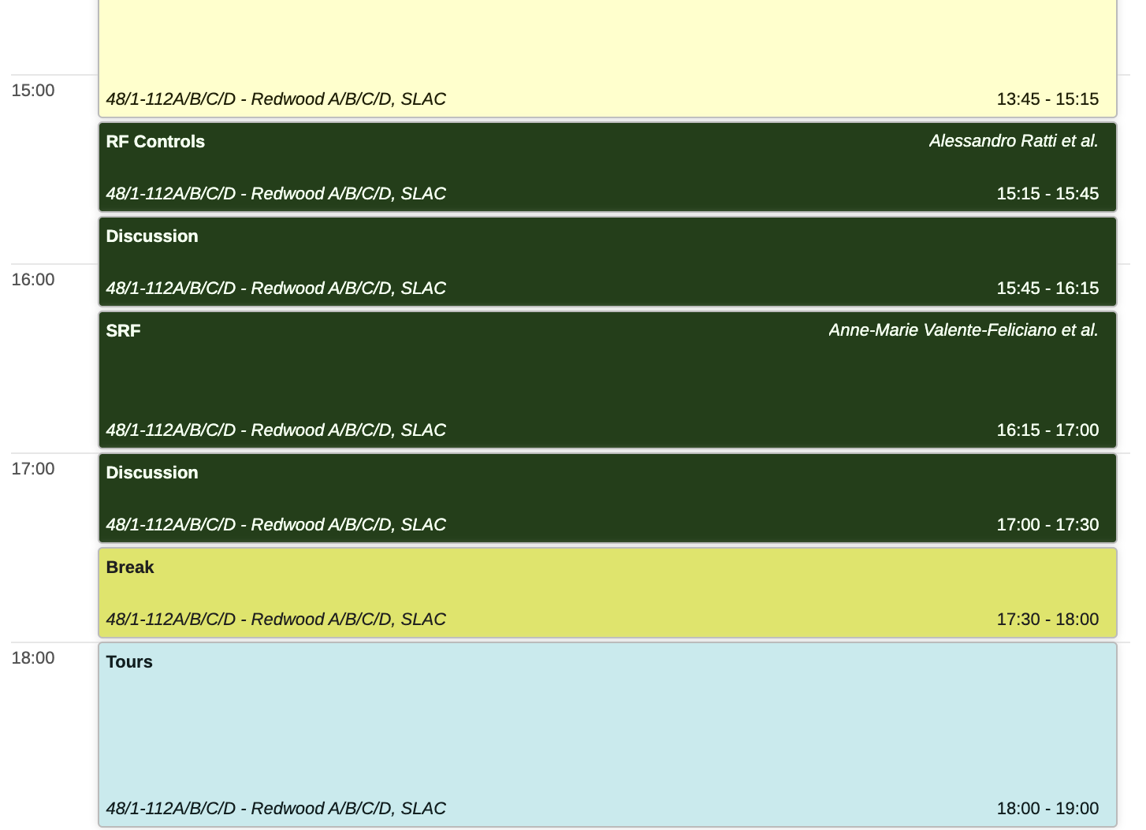
Day 1

Slide 9
Workshop Photo
During break in the afternoon today, before the tours
Don’t walk away after talks!

Slide 10
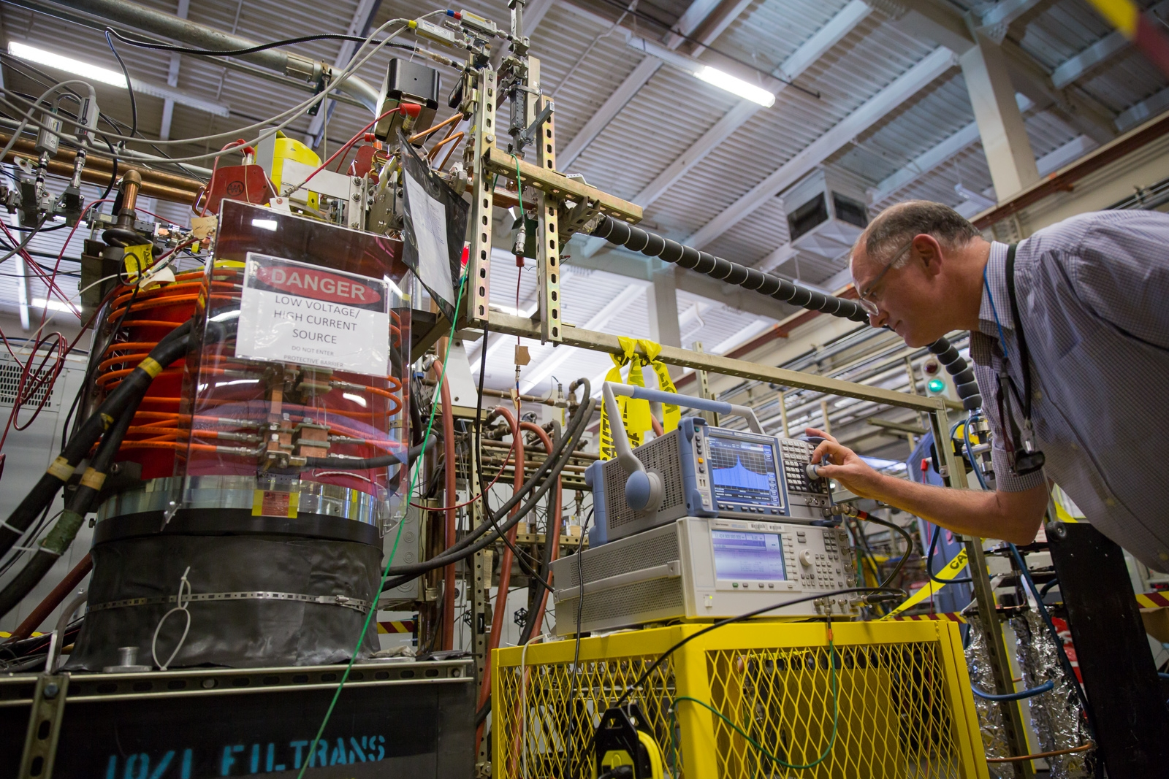
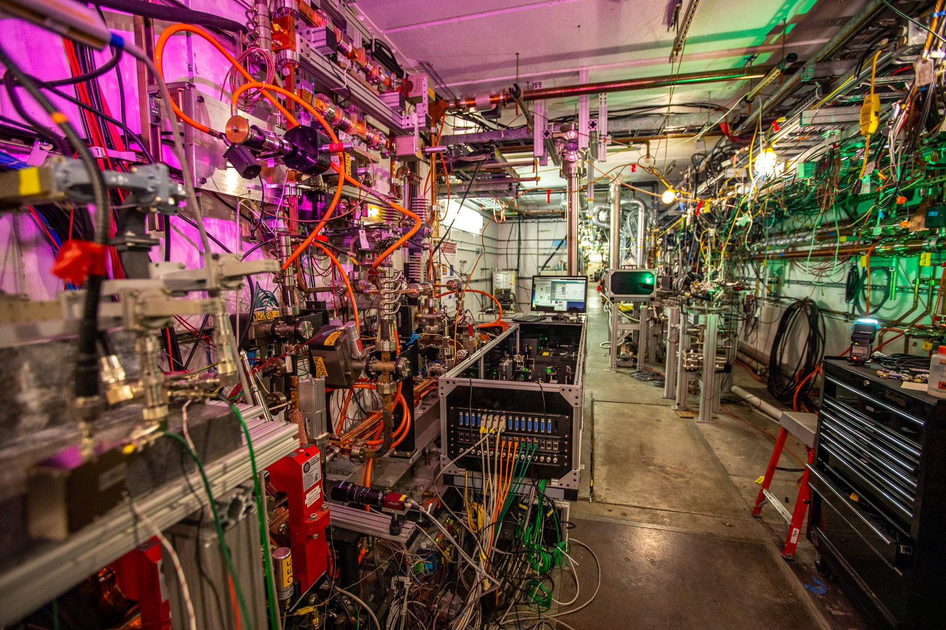
Tours
2 Locations
Building 44: klystron R&D, production, & test facilities
Building 62: NLCTA bunker – high power RF test facilities and XTA beamline
30 minutes in each location, 15 minute travel time between
You can walk or there will be a van
Klystron Test Lab
NLCTA

Slide 11
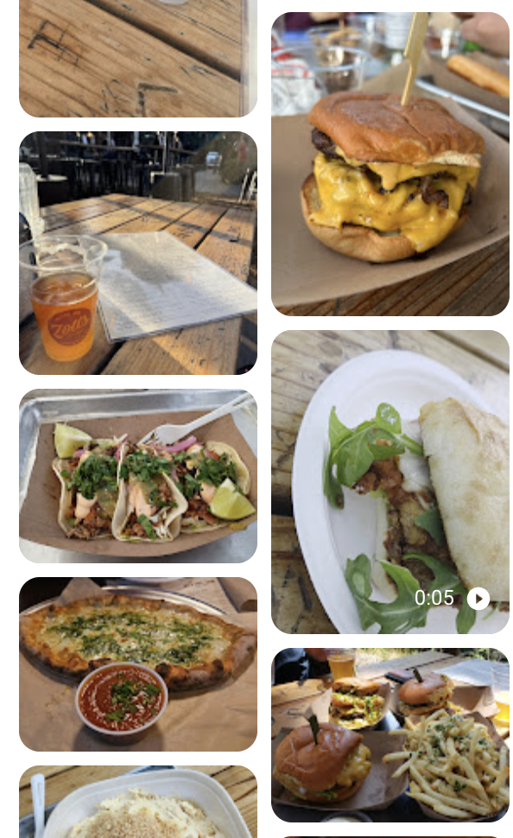
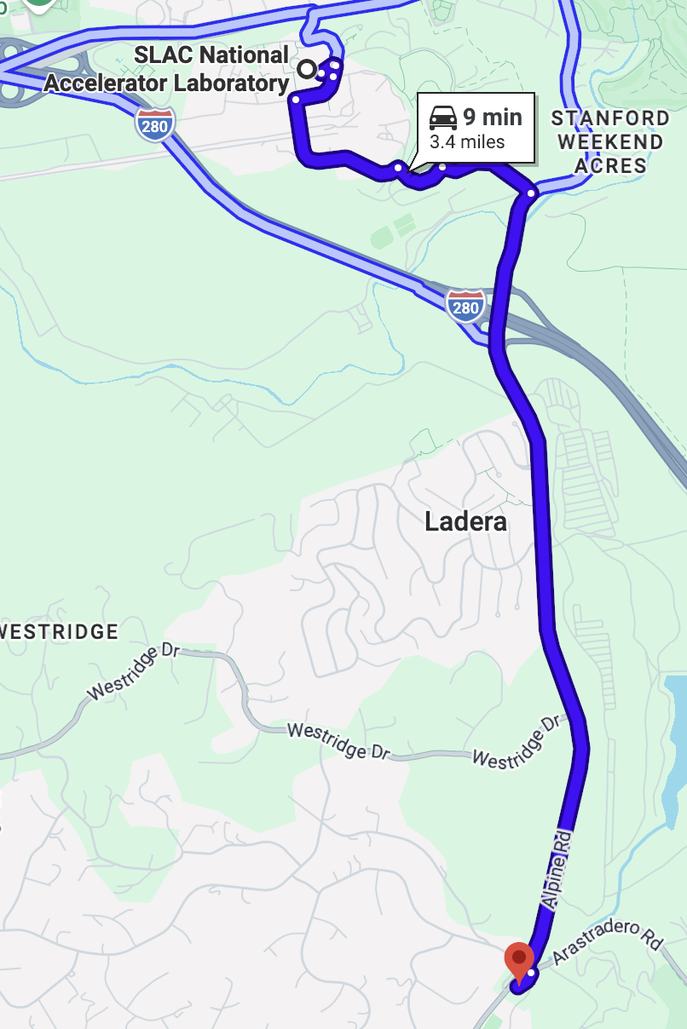
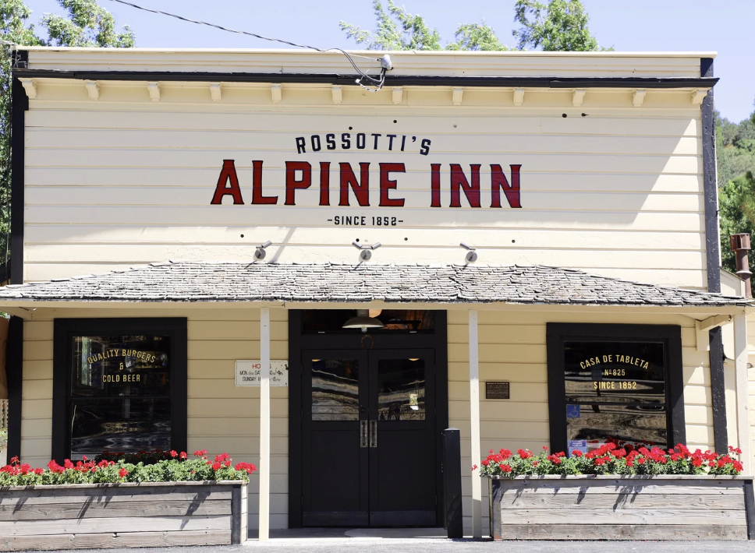
No-Host Dinner Tonight
Alpine Inn
People who need rides meet at the guest house at 6 pm
Headcount

Slide 12
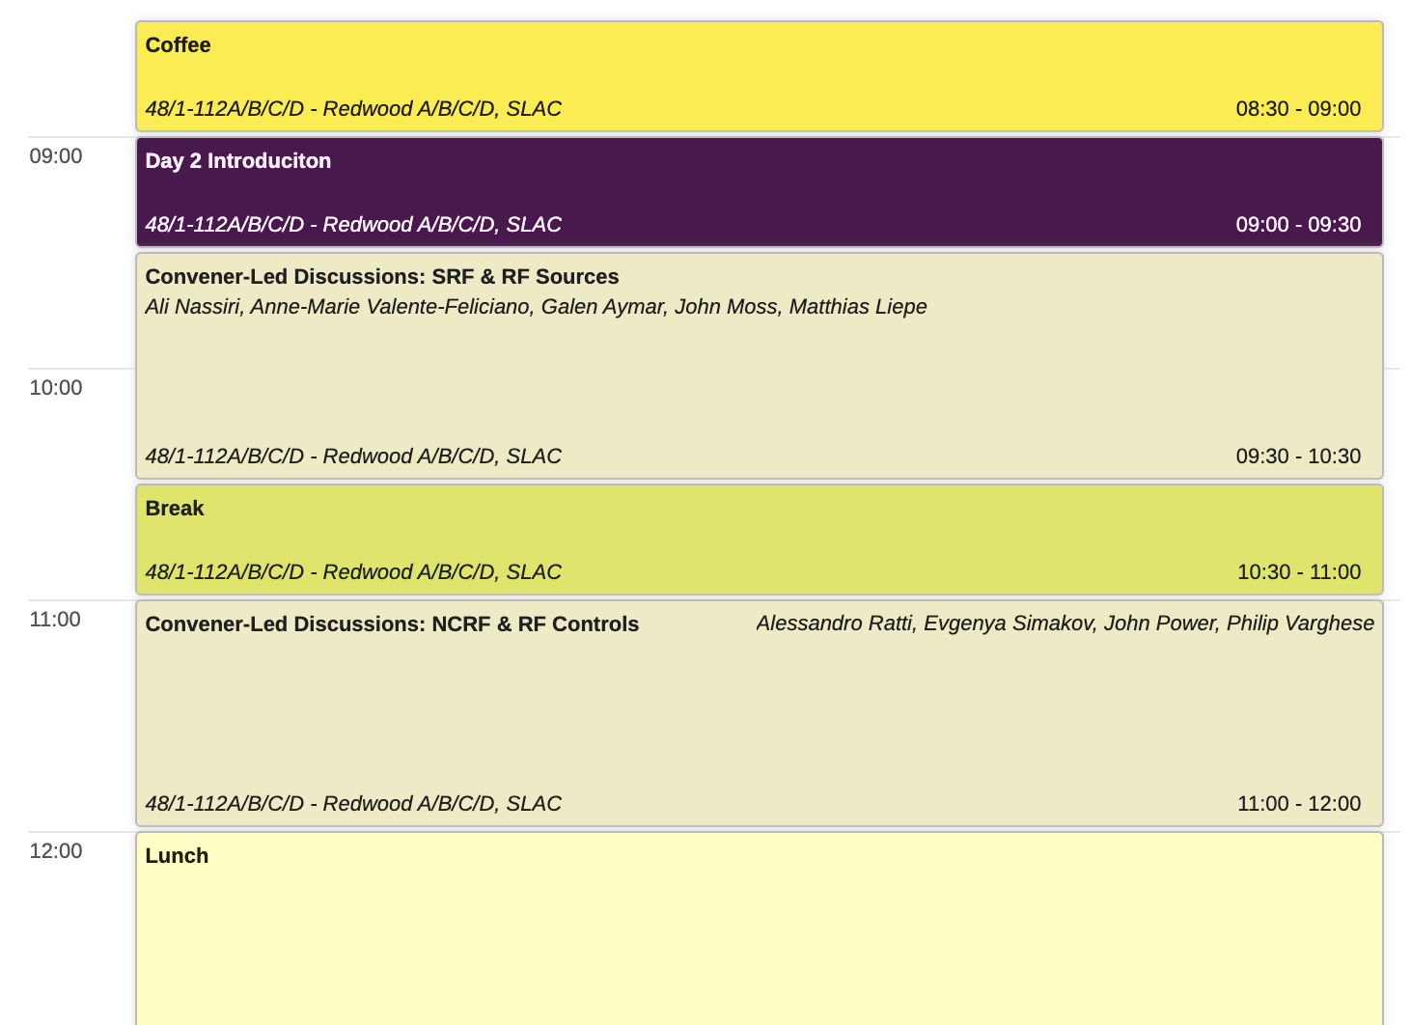
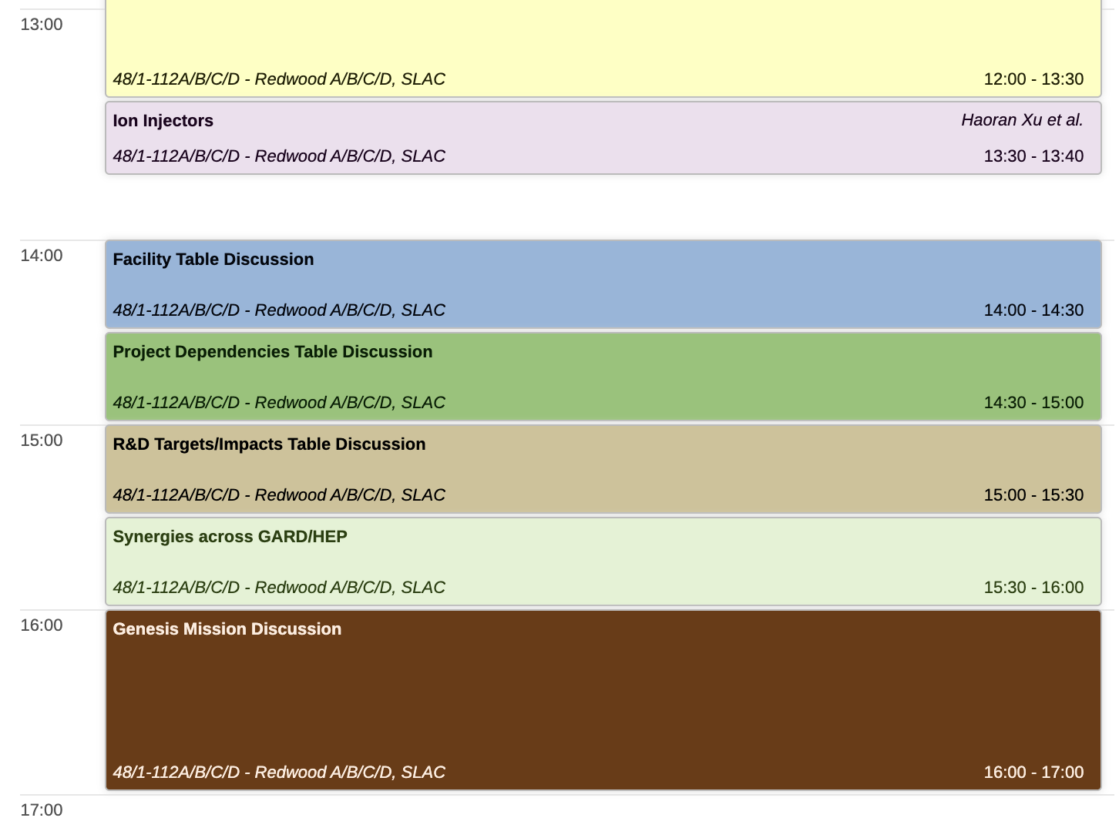
Day 2

Slide 13
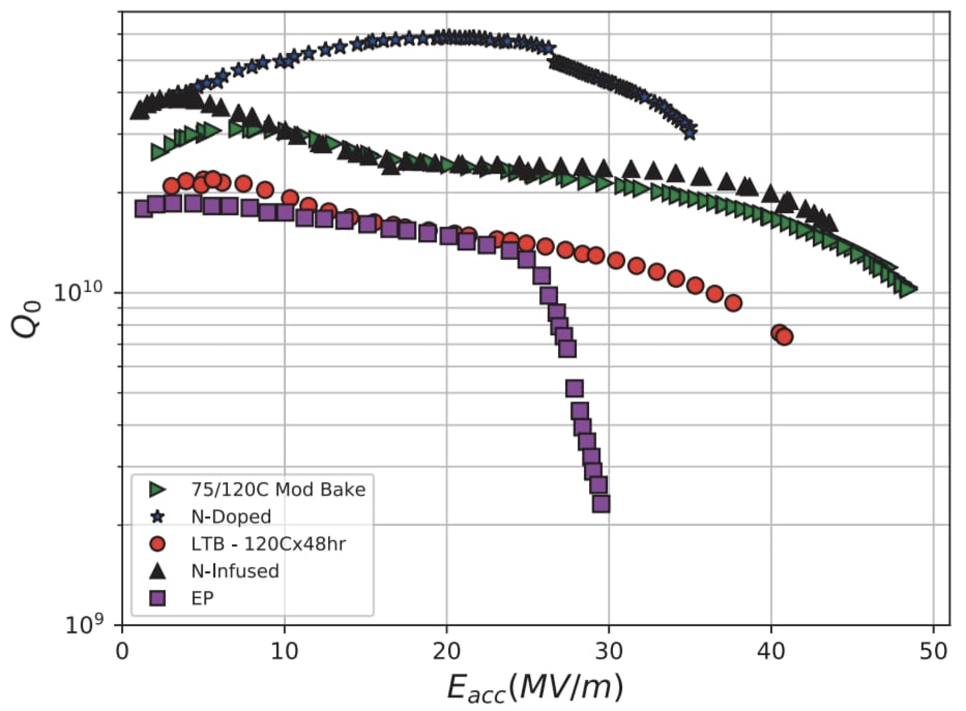
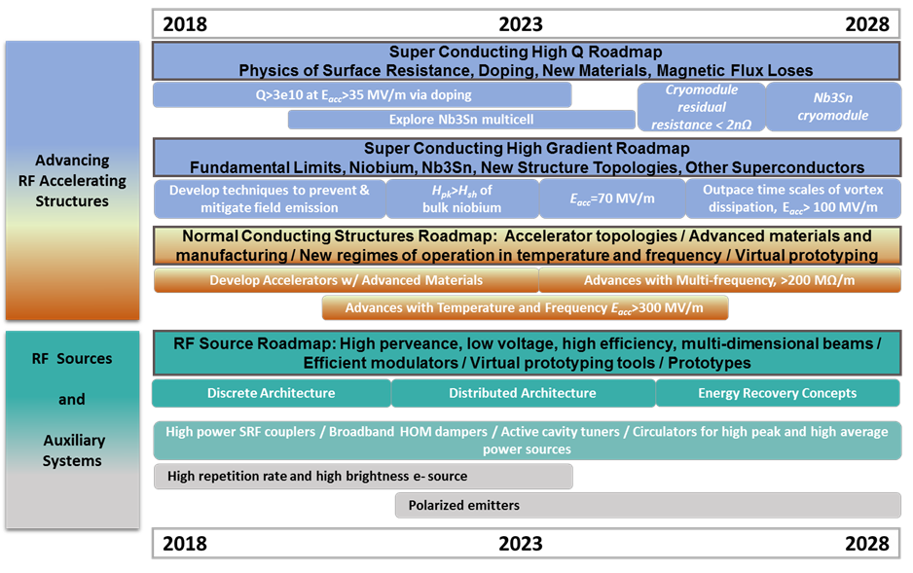
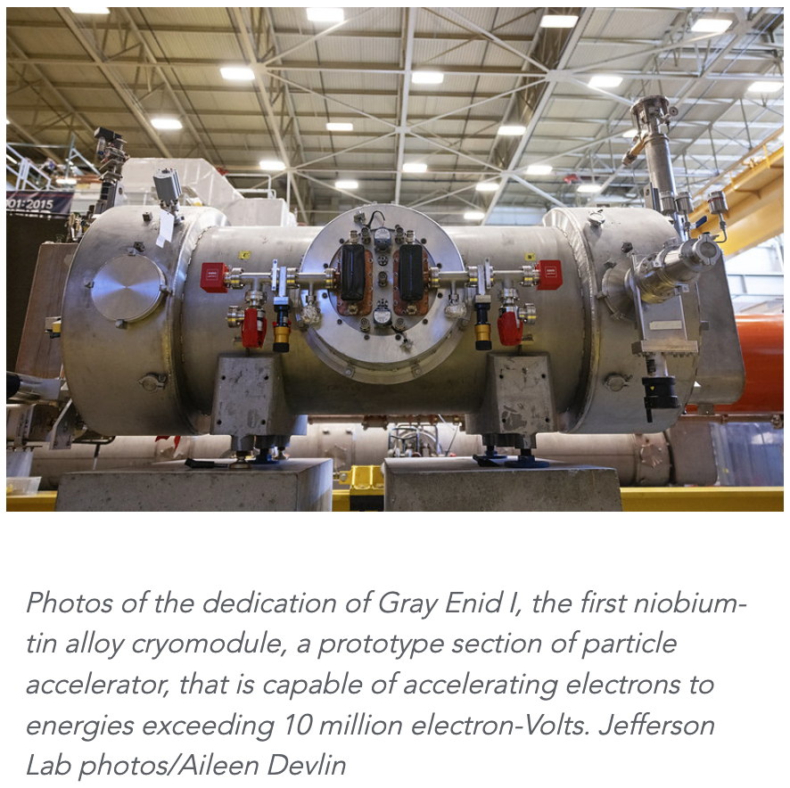
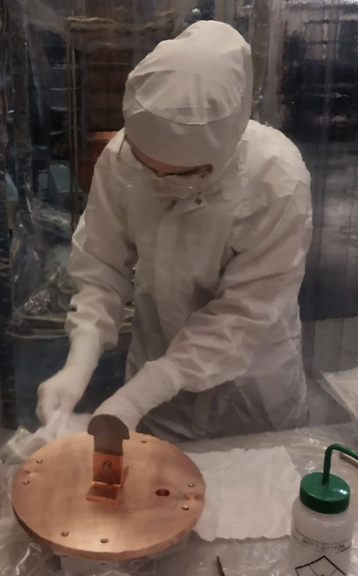
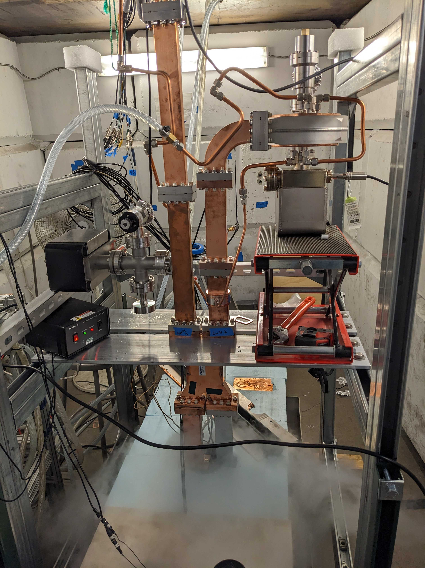
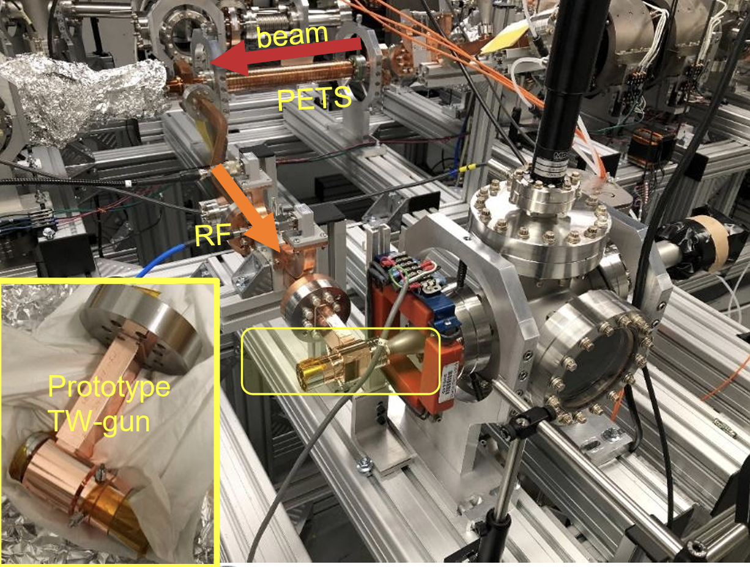
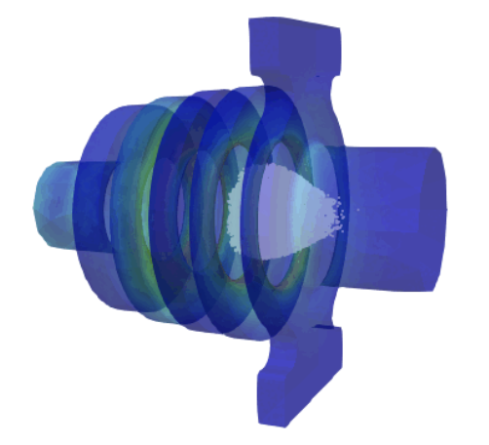
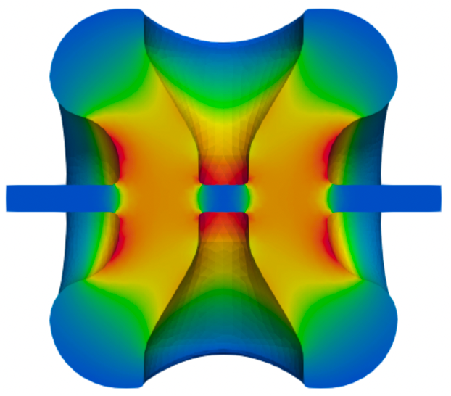
R&D Highlights from the 2017 DOE GARD RF Roadmap
*DOE RF Accelerator R&D Strategy Report, June 2017
High Q/High G
1
1
2
3
Nb₃Sn Multicell & Cryomodule
2
4
3
H_{pk}>H_{sh} of bulk niobium
5
6
Short Pulse Photoinjectors
6
5
Virtual Prototyping
Cold Copper and Distributed Coupling
4
PIP-II
Klystron Output

