Slide 1
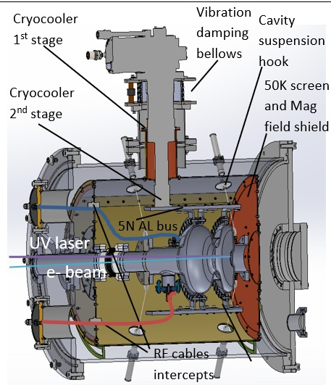
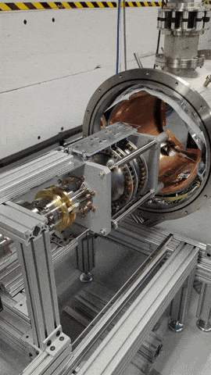
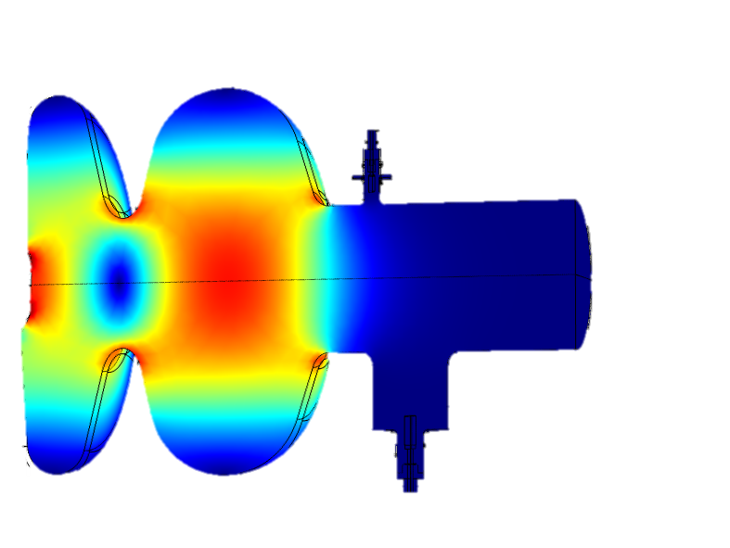
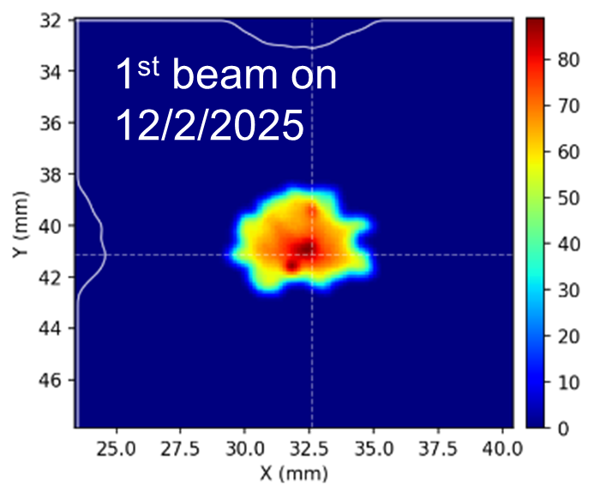
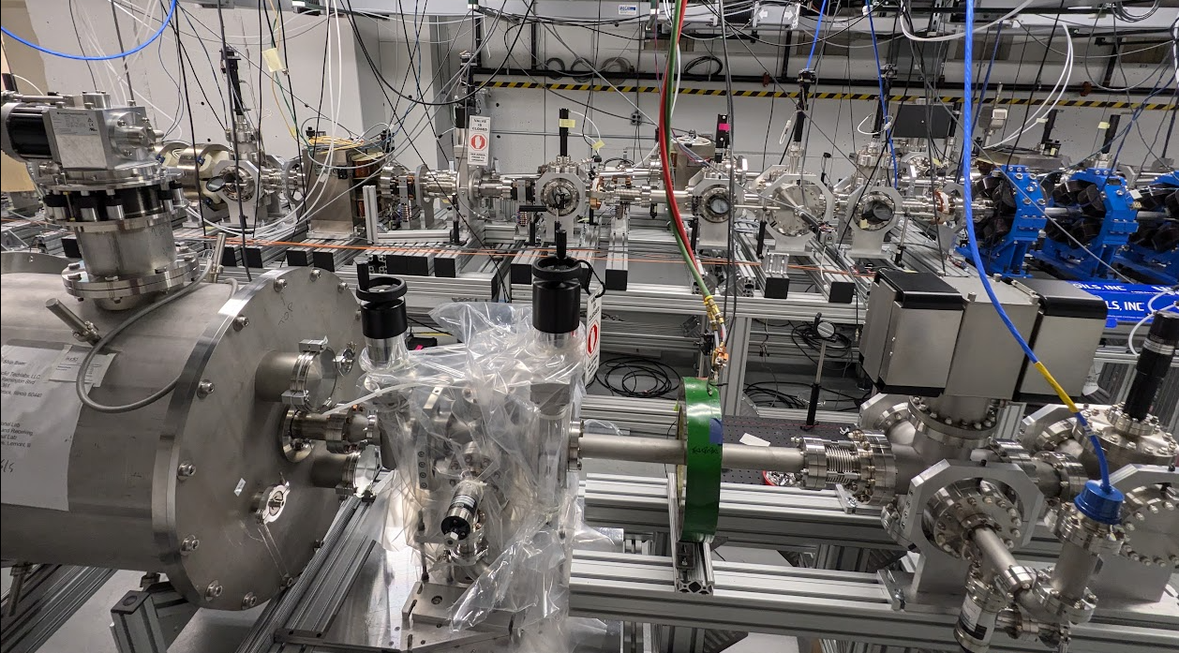
Conduction Cooled SRF Photogun for MeV Time-Resolved Electron Microscopy and Spectroscopy
Apply MeV beam to Ultrafast ED/EM/STEM/EELS can greatly reduce the challenges of the sample preparation, also suppresses the space charge effect at higher bunch charges
Stringent requirements on energy spread:
UED: dE/E~10⁻⁴, σ_{t}~10s’ fs, < 10⁶ electrons
UEM: dE/E~10⁻⁶, σ_{t} ~ps-ns, >10⁶ electrons (single shot or stroboscopic)
USTEM: 100pm level focused beam size
UEELS: <100meV level of energy spread
Current UED facilities are based on NC guns:
Large facility + high power RF needed (expensive)
Timing jitter 10~100fs
Repetition is <1000 pps
Conduction cooled Nb₃Sn SRF photo-gun:
2W cryocooler is required ($80K, affordable)
CW operation (high throughput)
Smaller footprint, 10W RF power only

Slide 2
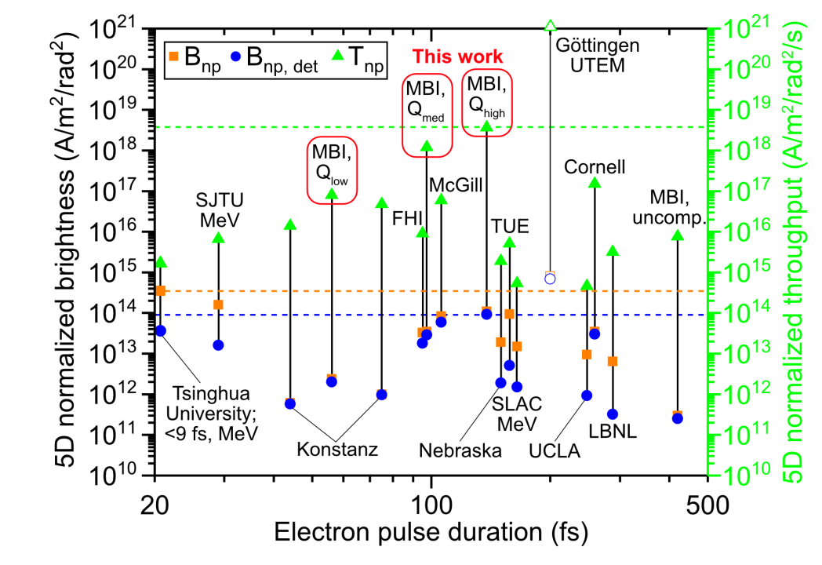
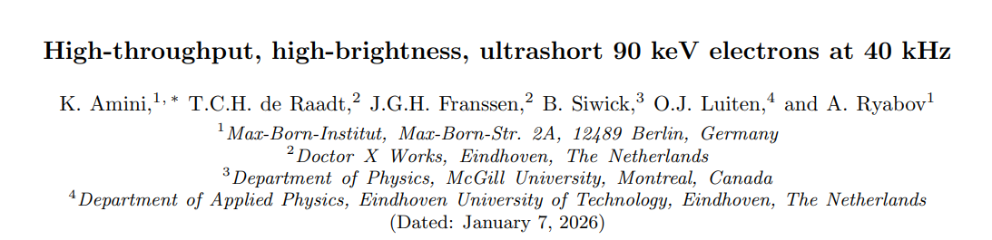


Ultimate Goal
CC-SRF enabling MeV HT-HB
https://arxiv.org/pdf/2601.02597
2

Slide 3
10 Year Roadmap
CC-SRF-MeV-UED
CC-SRF-MeV-UEM
CC-SRF-MeV-STEM
CC-SRF-MeV-EELS
CC-SRF photogun with beam parameters qualified for UED applications.
Time jitter to the 10fs level
Pulse compressor working with CW beam
User beamline demonstrator
Superconducting Objective Lens or PMQ Lens
Beamline optics with chromatic corrections.
User beamline demonstrating the beam parameters to achieve sub-nm spatial resolution and 100fs temporal resolution (STR< 10⁻²³)
Fast beam scanning
fs or sub fs Synchronization
MHz MeV Direct Electron Detector
User beamline demonstrating the beam parameters to achieve 100pm spatial resolution.
MeV energy monochromator
User beamline demonstrating the beam parameters to achieve 100meV energy resolution.
3

