Slide 1
High Temperature Superconducting RF Cavities
Ankur Dhar
GARD SRF Roadmap Update
02/05/2026

Slide 2
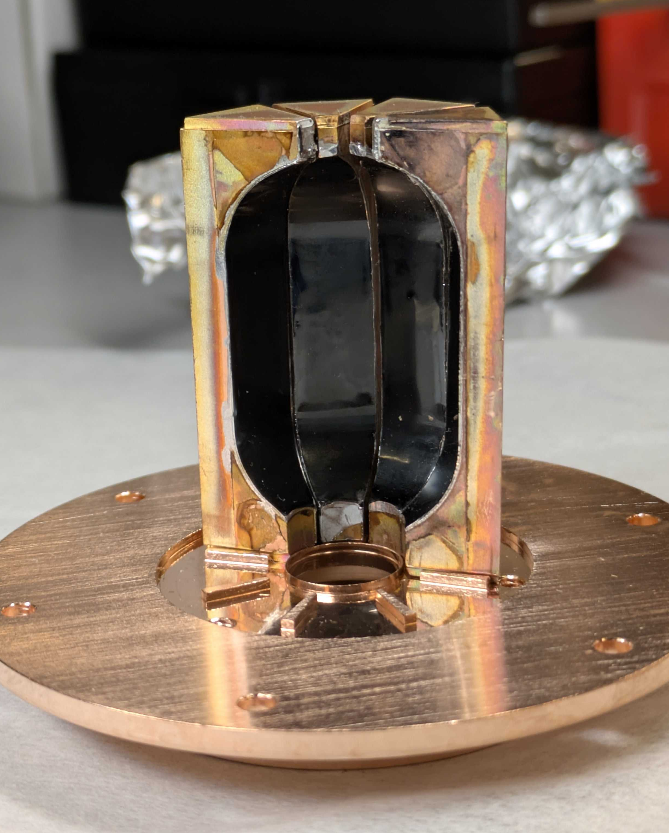
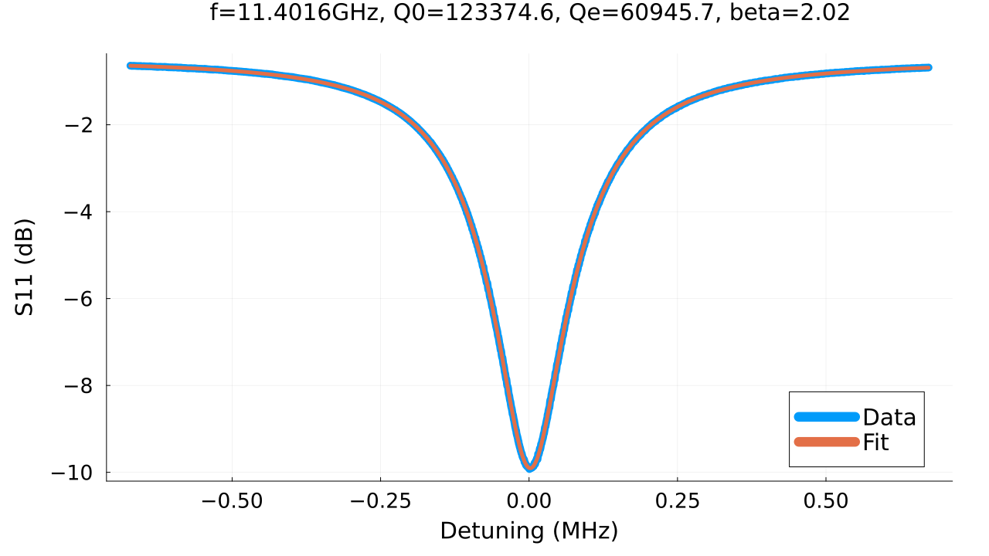
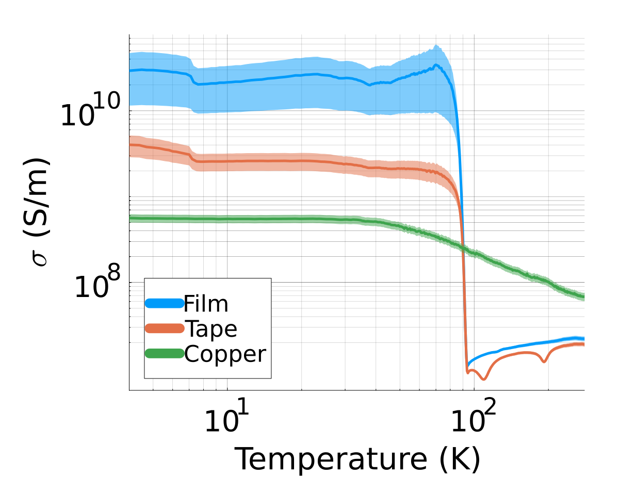
Applying High Temp Superconductors (HTS) to RF design
HTS materials present the possibility of lower loss cavities at LN temperatures
This has the potential to dramatically improve RF efficiency as compared to NCRF cavities, or improve cryogenic efficiency as compared to SRF cavities.
Measurements of planar samples and this cavity confirm substantially lower losses at 80 K.
Sample Testing
HTS Cavity
Cavity Testing
2
Upcoming tests with MW-scale power this fall

Slide 3
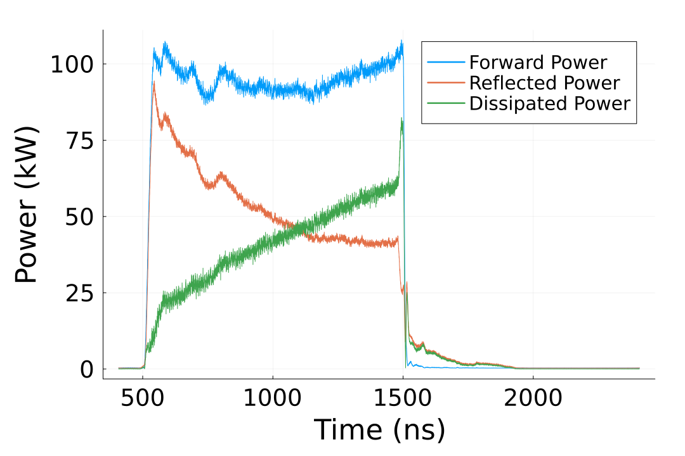
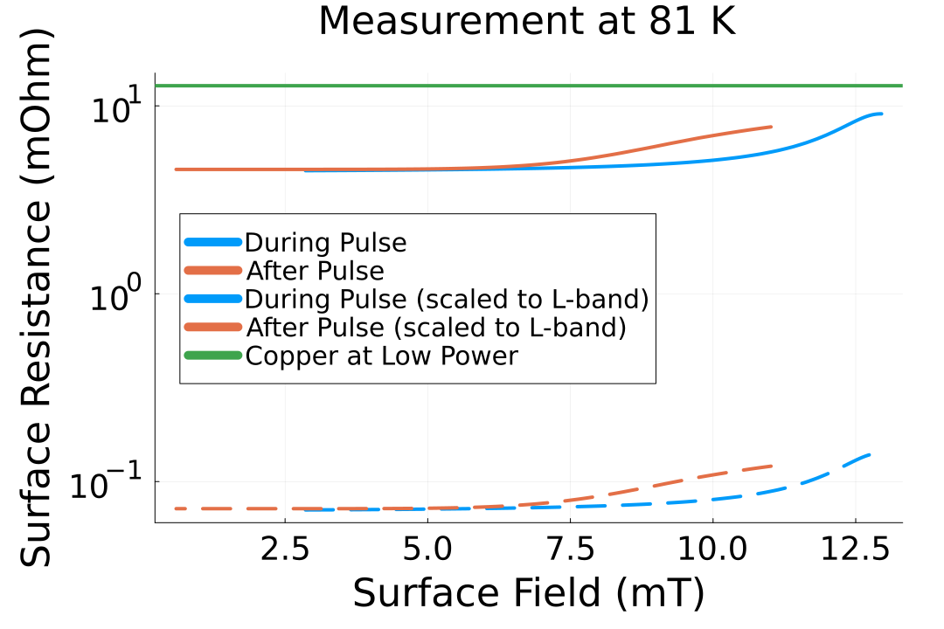
High Power Testing of HTS Samples
Initial high power tests were also conducted with 1.6 kW input power.
Shows hysteretic behavior when plotting surface resistance versus applied field
Further testing is underway up to 1 MW applied power
Reached 100 kW input at 1 us at 4 K: Dissipated power corresponds to about 21 MV/m gradient in TESLA cavity
High power testing of cavity to follow once sample testing is complete
Resistance versus Surface Field for 1.6 kW
Preliminary Data with 100 kW input power
3

Slide 4
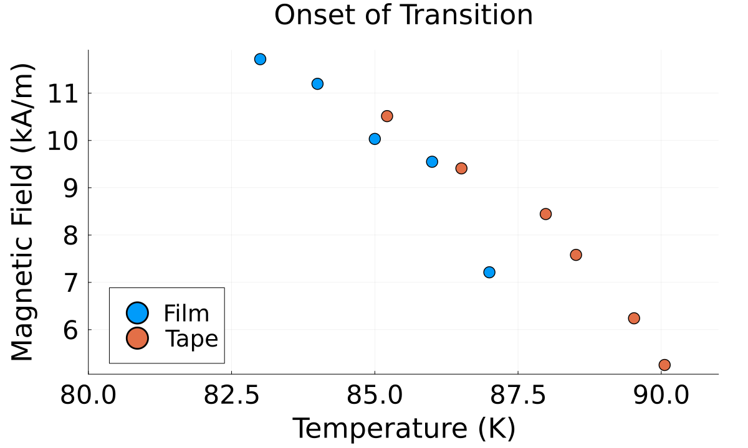
Informing Future HTS Material Design
The critical current density of these materials is tied to how the flux pinning sites are designed
Measuring the full extent of these regime could be done with high power RF testing
This would allow for direct feedback to industry on how to better design these sites for higher current handling applications for RF and even power transmission
Initial experiments started to probe this boundary, with further study now possible with MW-scale sources
Critical field limit versus temperature
A. Alimenti et al., "Proposal: a contactless microwave method to assess the critical current of superconducting films," 2024 IEEE 22nd Mediterranean Electrotechnical Conference (MELECON), Porto, Portugal, 2024, pp. 31-35, doi: 10.1109/MELECON56669.2024.10608631.
HTS materials can withstand kW-scale fields
4

Slide 5
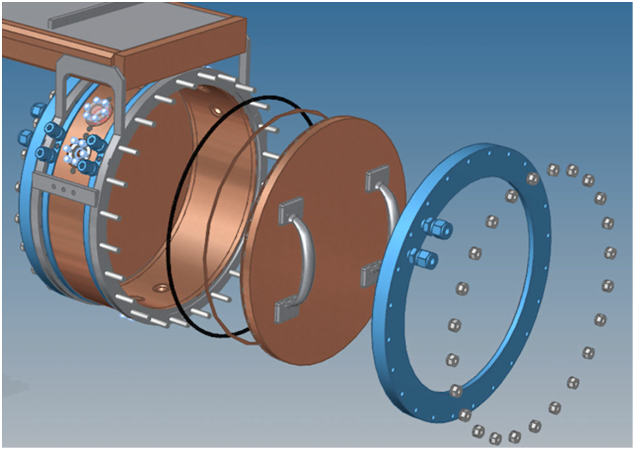
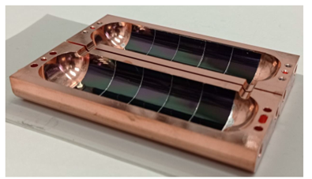
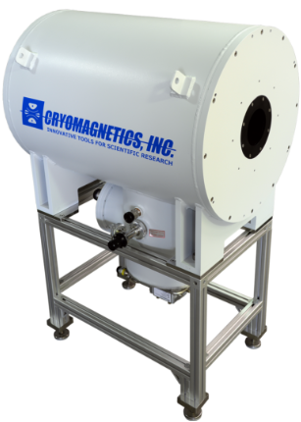
Building towards Functional Cavities for HEP Applications
Future work would ascertain the viability of HTSRF cavities for a more efficient muon cooling channel.
Broader impact on future axion search cavities, which also need high Q cavities in strong fields
Open Questions | Paths to Answers
Frequency scaling | S-band and L-band testing
Performance in strong external fields | High Field RF Test Stand at NLCTA
Film deposition on curved surfaces | Collaborate with Euro Collaborators and industry
Muon Cooling Channel Cavity
Axion Search Cavity with HTS
5
5T Solenoid at NLCTA

