Slide 1
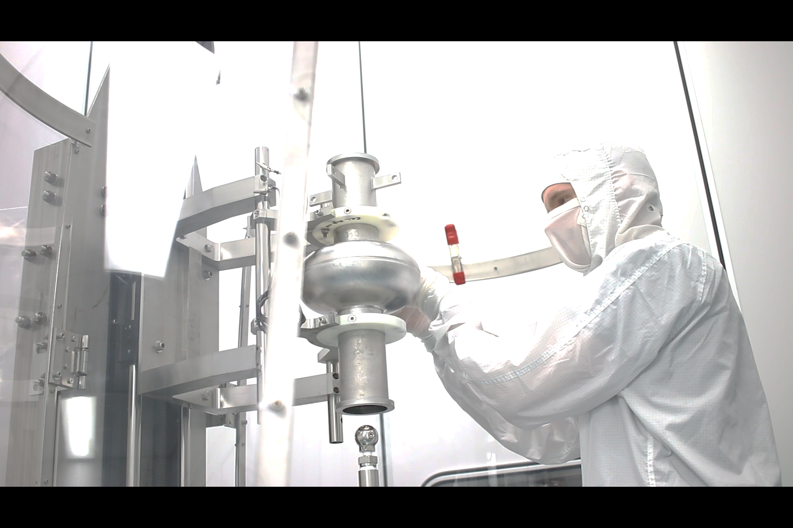
DOE RF Roadmap Update
SRF Virtual Workshop
CLOSEOUT
02/05/2026
Subgroup leaders:
Anne-Marie Valente-Feliciano (valente@jlab.org) & Matthias Liepe (MUL2@cornell.edu)
Notes:
Tip: Keep titles under 60 characters for readability
To change the photo: Right-click on photo and select change photo

Slide 2
Thanks!
21 Invited Talks + 5 Community Contribution Talks
To all the speakers and all the participants.
To the RF Roadmap organizers: Emilio Nanni & Sam Posen
Please upload your presentations to the Indico site. Email MUL2@cornell.edu if you like me to upload for you.
Notes:
Tip: Keep titles under 60 characters for readability
To change the photo: Right-click on photo and select change photo

Slide 3
Process Timeline
Spring-Fall 2025
Virtual and informal meetings during workshops/conferences
Nov 2025 – Jan 2026
Schedule meetings, develop agendas, and solicit speakers
Jan/Feb 2026
Subtopic virtual group meetings
March 3 & 4 , 2026
Large in person meeting in March with summaries of virtual meetings by subtopic leaders
Spring/early Summer 2026
Report writing
Calibration step with DOE
Notes:
Tip: Keep titles under 60 characters for readability
To change the photo: Right-click on photo and select change photo

Slide 4
Subtopic Virtual Group Meetings
SUBTOPIC | SUBTOPIC ORGANIZERS | DATE
NCRF | John Power and Evgenya Simakov | Jan. 20th, 2026
SRF | Matthias Liepe and Anne-Marie Valente | Feb. 5, 2026
RF Sources | Galen Aymar, Alireza Nassiri, and John Moss | Feb. 11th, 2026
LLRF | Philip Varghese and Alex Ratti | TBD
Notes:
Tip: Keep titles under 60 characters for readability
To change the photo: Right-click on photo and select change photo

Slide 5
March In-Person RF Roadmap Meeting
March 3rd-4th, SLAC https://indico.slac.stanford.edu/event/10359/overview
Subgroup summaries will be presented by subgroup organizers
Community discussion will focus on:
Identifying high-impact R&D opportunities
Assessing feasibility, timelines, and resource needs
Ensuring coherence across RF technology areas
Continued Community Input
Additional comments, corrections, or missing topics are welcome following today’s meeting
Notes:
Tip: Keep titles under 60 characters for readability
To change the photo: Right-click on photo and select change photo

Slide 6
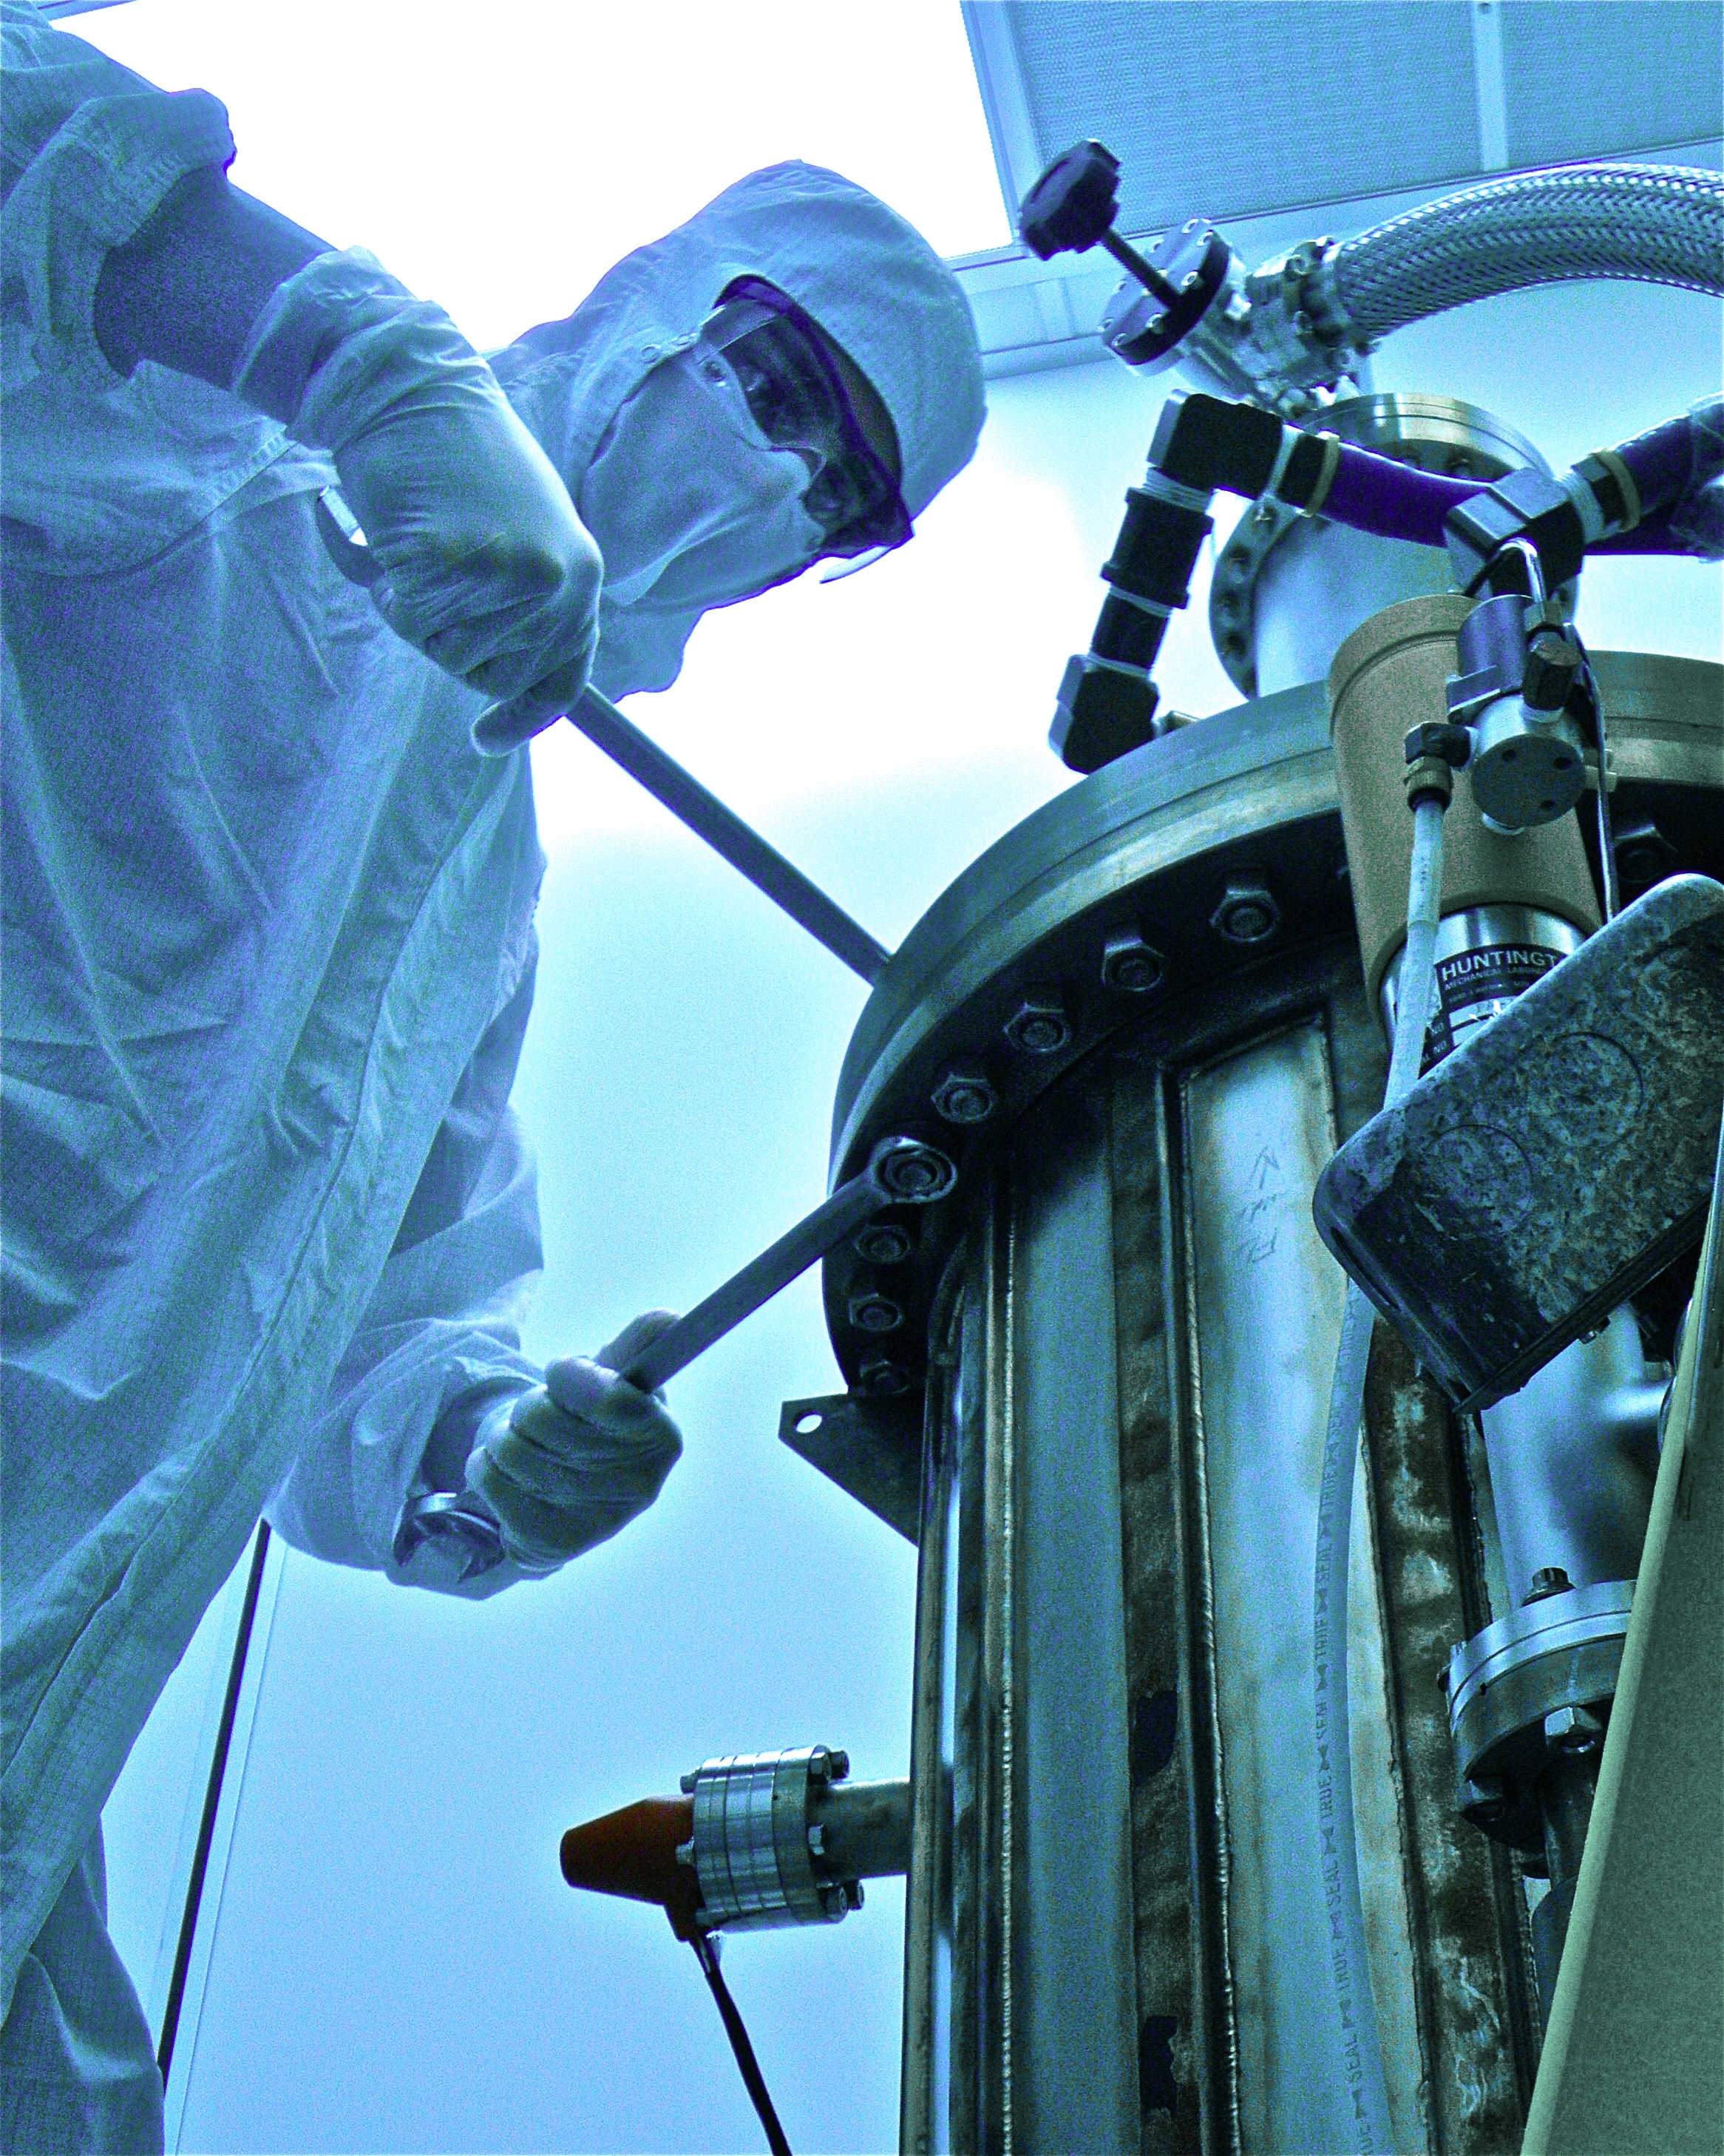
Thanks for participating!
Notes:
Tip: Keep titles under 60 characters for readability
To change the photo: Right-click on photo and select change photo

