Slide 1


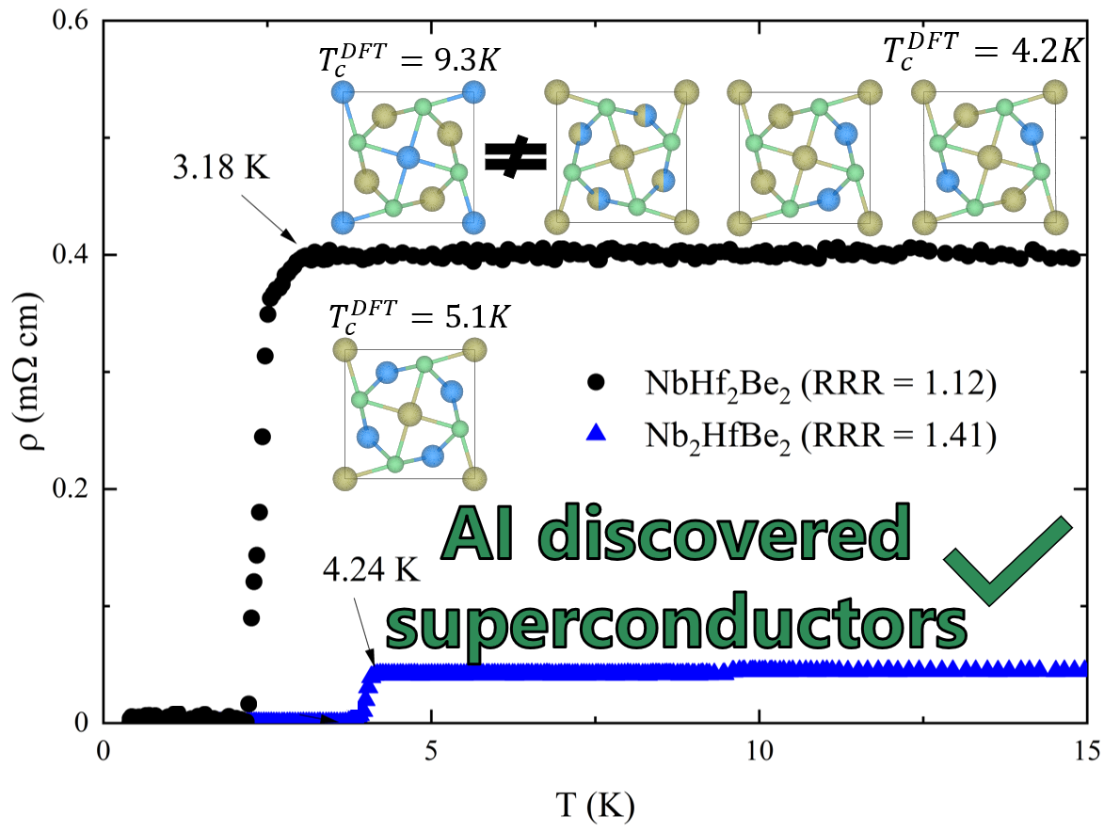
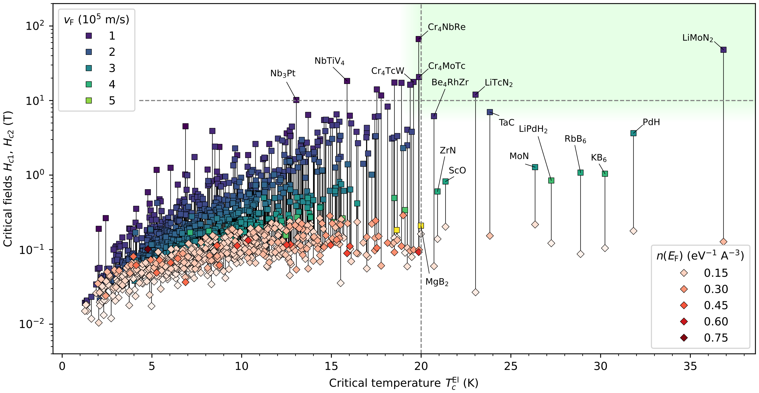
AI/ML frameworks for SRF materials
From inverse superconductor design to process maps for Nb and Nb₃Sn
Richard G. Hennig, University of Florida
How can we utilize various AI/ML methods and frameworks
to accelerate the discovery and design of materials for SRF applications?
Generative AI — new superconductors
Property ML — screening + design
ML potentials — synthesis + defects
DOE GARD RF Roadmap Update – SRF (Feb 5, 2026)
Notes:
[Sources] - Workshop description and context: https://indico.slac.stanford.edu/event/10358/ (accessed 2026-02-05). [/Sources]

Slide 2
Why AI/ML now for SRF materials?
Roadmap outcomes depend on materials and processes
SRF needs for materials
Where AI/ML can contribute
Higher gradients: push superheating-field limits and reduce quench triggers
Higher Q₀ at operating fields: mitigate field-dependent residual losses through microstructure and defect control
Reduce cryo power: Higher operating temperature through improved materials
Reproducibility + yield: Move from “recipes” to predictive materials processing
Inverse design: generate candidates under SRF constraints (T_{c}, critical fields, stability, manufacturability)
Fast property models: learn α²F(ω), critical fields, stability, surfaces, mechanical response
Scale bridging: ML potentials + surrogates to connect nanoscale defects → coating microstructure → RF performance
Closed-loop: design-of-experiments with uncertainty gating to converge quickly
University of Florida • AI/ML for SRF materials
Notes:
[Sources] - Workshop goals: SRF session description on Indico: https://indico.slac.stanford.edu/event/10358/ (accessed 2026-02-05). [/Sources]

Slide 3
Three AI/ML thrusts → one SRF impact pathway
Connect “discovery” to “deployment”: candidates → properties → process maps → validated SRF performance
Generative AI for new superconductors
Property ML for screening + design
ML potentials for synthesis + defect control
Generate stable crystals under SRF constraints
Prioritize thin-film / coating candidates
Enable inverse design beyond substitution
α²F(ω) + Tc + critical fields
Thermodynamic stability + surfaces
Down-select with uncertainty-aware screening
Defects, grain boundaries, phase transformations
Coating growth + surface evolution
Prescriptive process windows (DoE + surrogates)
SRF outcomes: higher E_{acc} • higher Q₀ • reproducibility/yield • lower cryo cost
University of Florida • AI/ML for SRF materials

Slide 4
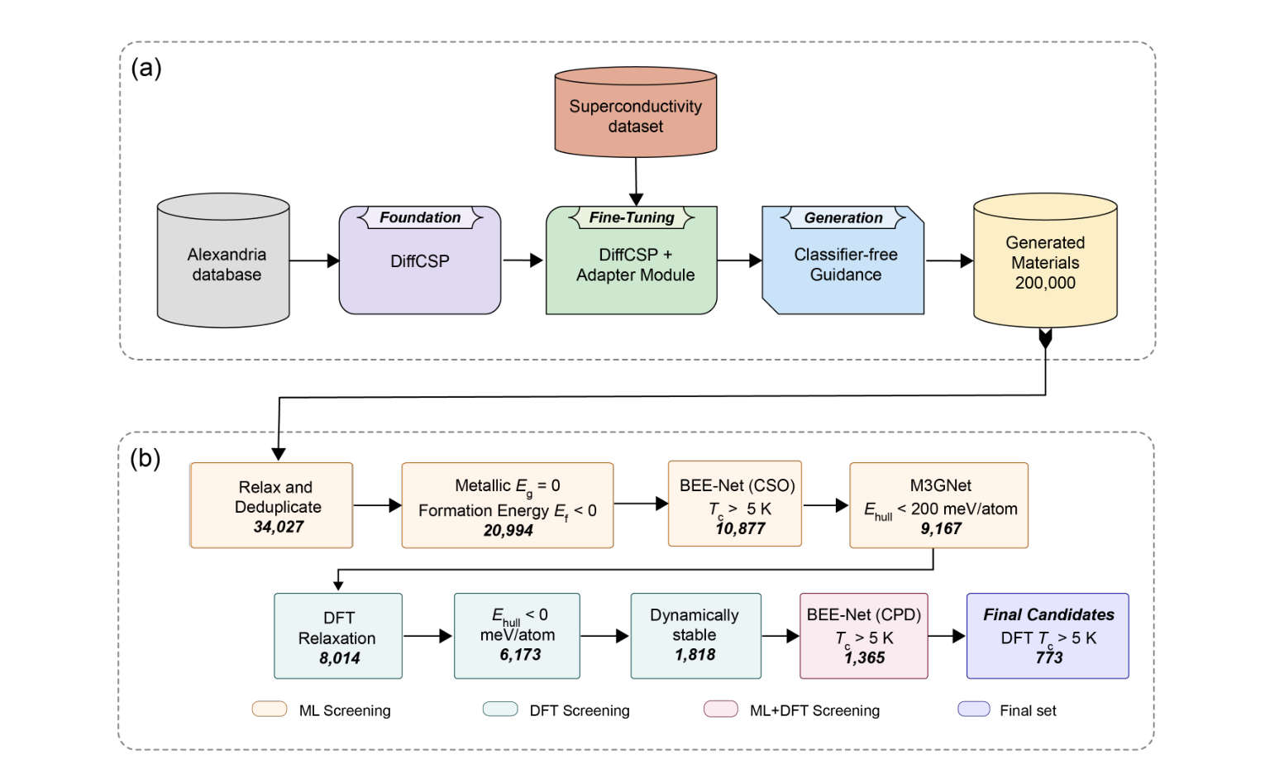
1) Generative AI: inverse discovery of superconductors (bulk + thin-film targets)
What SRF needs from generative models
Condition on SRF metrics (Tc, Hc2/Bsh, κ, stability).
Bias toward coatability: simple chemistries, low volatility, robust phases.
Integrate synthesizability & uncertainty early (avoid “paper materials”).
Tight experiment-in-the-loop: a few syntheses validate model priors.
Example outcome (guided diffusion)
200k generated → 34,027 unique materials
→ 773 DFT T_{c}>5 K candidates
Next: guide on critical fields + thin-film process constraints
University of Florida • AI/ML for SRF materials
Notes:
[Sources] - Guided diffusion workflow + counts: arXiv:2509.25186 (Prakash et al., 2025). [/Sources]

Slide 5
2) Property ML: From α²F(ω) for T_{c} to critical fields H_{c}, H_{c₁}, H_{c₂}, H_{sh}
Accelerators for screening
Learn α²F(ω) for T_{c} for generalizable models
Learn on superconductors and non-superconductors alike
Use as “forward model” inside inverse design & active learning.
SRF connection
Critical temperature informs operating temperature.
University of Florida • AI/ML for SRF materials
Notes:
[Sources] - Critical-fields dataset and workflow (7,300+ compounds): arXiv:2601.21044 (Geisler et al., 2026). [/Sources]

Slide 6
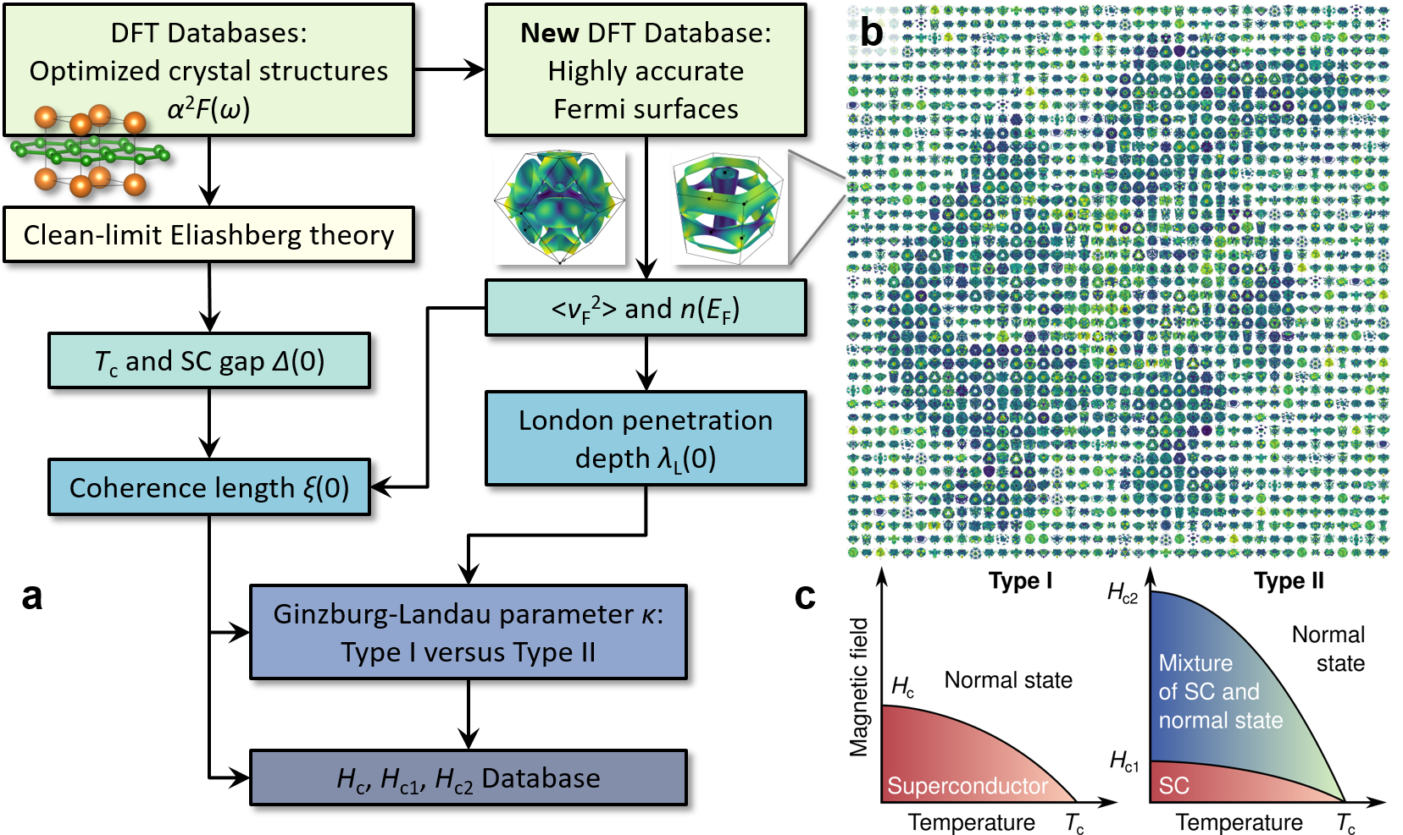
2) Property ML: From α²F(ω) for T_{c} to critical fields H_{c}, H_{c₁}, H_{c₂}, H_{sh}
Shift the target: T_{c} alone is not enough for SRF — magnetic-field response matters
Accelerators for screening
Learn α²F(ω) for critical fields.
Combine with Fermiology → ξ, λ_{L}, κ → H_{c}, H_{c₁}, H_{c₂}, H_{sh}.
Train on consistent first-principles datasets (7,300+ compounds).
Use as “forward model” inside inverse design & active learning.
SRF connection
Critical fields inform superheating-field ceilings and guide defect tolerance targets.
University of Florida • AI/ML for SRF materials
Notes:
[Sources] - Critical-fields dataset and workflow (7,300+ compounds): arXiv:2601.21044 (Geisler et al., 2026). [/Sources]

Slide 7
2) Property ML: From α²F(ω) for T_{c} to critical fields H_{c}, H_{c₁}, H_{c₂}, H_{sh}
Shift the target: T_{c} alone is not enough for SRF — magnetic-field response matters
Accelerators for screening
Learn α²F(ω) for critical fields.
Combine with Fermiology → ξ, λ_{L}, κ → H_{c}, H_{c₁}, H_{c₂}, H_{sh}.
Train on consistent first-principles datasets (7,300+ compounds).
Use as “forward model” inside inverse design & active learning.
SRF connection
Critical fields inform superheating-field ceilings and guide defect tolerance targets.
University of Florida • AI/ML for SRF materials
Notes:
[Sources] - Critical-fields dataset and workflow (7,300+ compounds): arXiv:2601.21044 (Geisler et al., 2026). [/Sources]

Slide 8
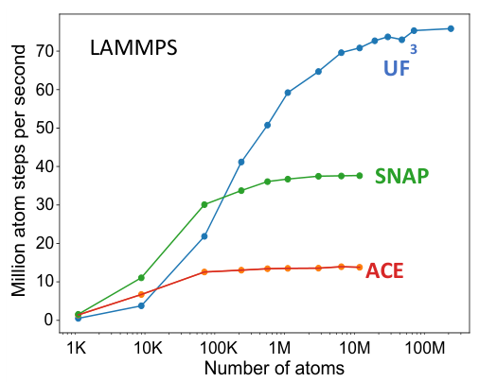
3) ML potentials: defects, grain boundaries, phase transformations, surfaces
To design synthesis, we must simulate the right physics at the right scale
SRF-relevant atomistics properties and processes
Why ML potentials?
Surface adsorption/wetting: oxide chemistry → Sn droplet nucleation density
Interface reaction front: competing phases, conversion kinetics, local stoichiometry
GB diffusion networks: anisotropic transport, segregation, roughness evolution
Defect energetics: vacancies/dislocations/GBs that seed loss or quench
Outputs → mesoscale parameters: γ(T), M(T), D(T), reaction rates, uncertainty
GPU-speed MD at growth-relevant sizes
Active learning targets hard regions (interfaces, GB cores)
Enables statistics: defect distributions, rare events
University of Florida • AI/ML for SRF materials
Notes:
[Sources] - UF3 scaling plot and rationale for Nb3Sn growth simulations: DOE_proposal_Nb3Sn_2025_082526.pdf (Fig. 4). [/Sources]

Slide 9
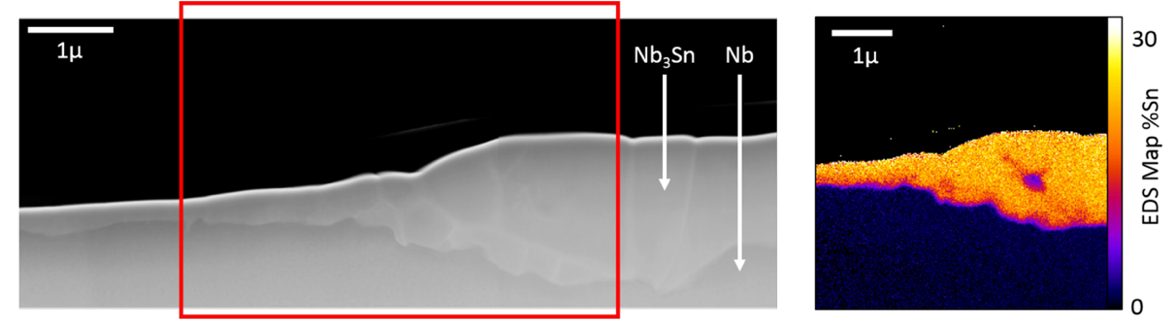
SRF metric focus: Superheating field & near-surface defect tolerance
Nb₃Sn promises >4.2 K operation, but defects near surface penetration depth dominate
Performance potential (theory)
Example issue: thin / Sn-depleted regions
 | T_{c} | B_{sh} | E_{acc,max} | Q_{ideal} at 2K | Q_{ideal} at 4.2K
Nb | 9.3 K | ~200 mT | ~50 MV/m | 2 to 5 x10¹⁰ | ~6 x10⁸
Nb₃ Sn | 18 K | ~400 mT | ~100 MV/m | >>1 x10¹¹ | ~6 x10¹⁰
Higher H_{sh} ⇒ higher reachable gradients (if defects are controlled).
Small ξ (~3–4 nm) makes stoichiometry, roughness, microstructure defects detrimental for superconducting properties
Goal: predictive knobs that minimize Sn-depleted regions and weak phases.
AI opportunity:
Learn the mapping of microstructure to RF-limiting defects and then invert it to optimized synthesis recipes.
University of Florida • AI/ML for SRF materials
Notes:
[Sources] - Nb vs Nb3Sn performance potential table and cross-section image: DOE_proposal_Nb3Sn_2025_082526.pdf (Table 1, Fig. 1). [/Sources]

Slide 10
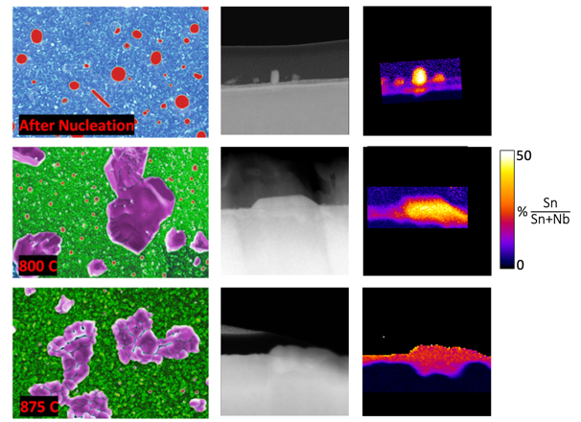
Nb₃Sn coatings: turn growth stages into process maps (with AI surrogates)
Four-stage view aligns modeling with measurable observables in the RF-relevant region
Stage-wise knobs → predicted defect outcomes
Early growth snapshots (nucleation → reaction → growth)
Stage 0 | Oxide condition: thickness + chemistry
Sets nucleation landscape and early interface stoichiometry
Stage 1 | Sn droplets: nucleation + wetting + coalescence
Seeds roughness and composition gradients that persist
Stage 2 | Reaction front: phase transformations → Nb₃Sn
Controls completion vs intermediate Sn-rich phases
Stage 3 | GB diffusion: thickening + stoichiometry uniformity
Controls thickness, Sn-poor regions, and surface topography
Deliverable: materials processing maps
Optimize (oxide, Sn activity, schedule) to minimize Sn-poor areas, residual phases, and roughness — with uncertainty bands.
Use ML surrogates to scan process space; fall back to physics models when uncertainty is high.
University of Florida • AI/ML for SRF materials
Notes:
[Sources] - Four-stage process partitioning and early-growth microstructure figure: DOE_proposal_Nb3Sn_2025_082526.pdf (Stage 0–3 description; Fig. 2). [/Sources]

Slide 11
Extending the framework: bulk Nb hydrides and field-dependent losses
Hydride nucleation is multiscale; direct observation is late-stage — modeling must bridge the gap
AI-enabled hydride modeling concept
SRF payoff
DFT: H–defect interactions: vacancies, dislocations, GBs, O/N dopants
ML potentials (UF3) + MD: Collective diffusion/aggregation at realistic sizes
Stat. mech. / mesoscale: nucleation + growth kinetics during cooldown
Invert: Design impurity profiles and heat treatments that suppress hydrides
Reduce field-dependent residual resistance → higher Q₀ at operating fields
Provide mechanistic guidance for N/O doping + cooldown protocols
Enable uncertainty-aware qualification: when is a cavity “safe” from hydrides?
Key idea
Use ML to explore the combinatorial space of microstructure × dopants × cooldown, while retaining relevant physics-based to successfully identify useful outliers.
University of Florida • AI/ML for SRF materials
Notes:
[Sources] - Hydride modeling motivation and ML-potential approach: OSP #188774 narrative_and_Appendix.docx. [/Sources]

Slide 12
What GARD can enable?
Shared benchmarks + closed-loop demonstrations
Near-term (12–24 months)
Mid-term (2–5 years)
Open SRF-relevant datasets: α²F(ω), critical fields, surfaces/oxides, defect libraries
Benchmarks with SRF metrics: H_{sh} proxies, defect tolerance, coatability filters
A “materials model card” standard: domain of validity + uncertainty reporting
Validation loop: synthesize + characterize a small, diverse test set
Inverse design conditioned on critical fields + process feasibility
Multiscale Nb₃Sn “digital twin”: UF3 → phase-field → AI surrogate → process maps
Hydride-risk predictor for bulk Nb: microstructure × dopants × cooldown
Transfer to new coatings / multilayers as SRF materials mature
Bottom line: AI/ML to make SRF materials development predictive, not empirical, and couple it to validated performance.

Slide 13
AI/ML frameworks for SRF materials
From inverse superconductor design to process maps for Nb and Nb₃Sn
Richard G. Hennig, University of Florida
How can we utilize various AI/ML methods and frameworks
to accelerate the discovery and design of materials for SRF applications?
Generative AI — new superconductors
Property ML — screening + design
ML potentials — synthesis + defects
DOE GARD RF Roadmap Update – SRF (Feb 5, 2026)
Notes:
[Sources] - Workshop description and context: https://indico.slac.stanford.edu/event/10358/ (accessed 2026-02-05). [/Sources]

