Slide 1
SRF theory for engineering an ideal surface for SRF cavities
Alex Gurevich
Old Dominion University, Norfolk VA
Supported by DOE under grant DE-SC0025560

Slide 2
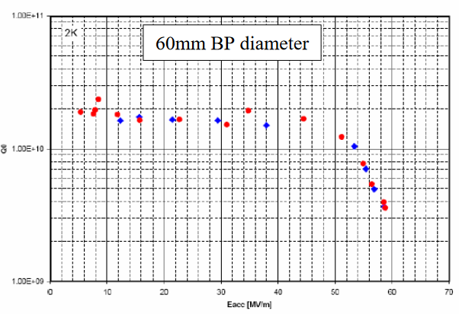
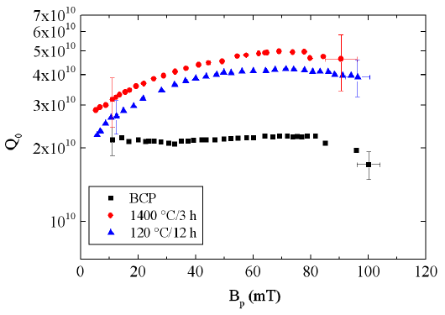
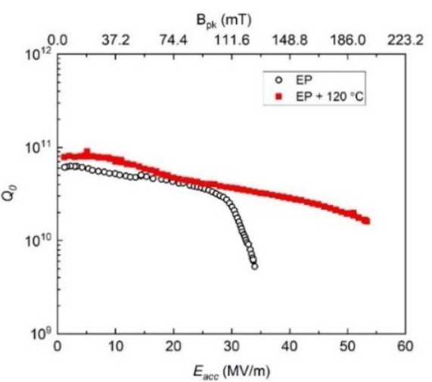
Conundrum of SRF performance limits
Positive Q slope, high Q, highest breakdown fields
Negative Q slope, high Q, reduced breakdown fields
How far can the breakdown fields and Q factors in best Nb cavities be increased?
Reentrant shape
SRF theoretical Q and H limits at T << T_{c} are unknown. Eliashberg instead of BCS is required to get reliable numbers for Nb and Nb3Sn
Dhakal, Ciovati et al.
PR STAB 16. 042001 (2013)
Single-cell: 59 MV/m (223 mT) 1.3 GHz at 2 K
Is there a magic way to simultaneously push
both Q and H limits or they are mutually
exclusive?
Grasselino et al, FNAL
Both Q and H limits can be be increased by
surface nanostructuring, even if we do not know
what the exact theoretical limits are.
53.3 MV/m in 650 MHz single-cell

Slide 3
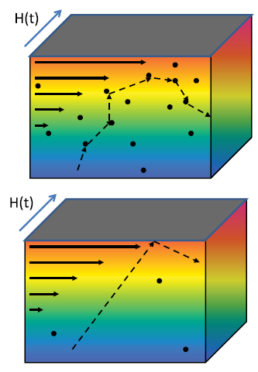
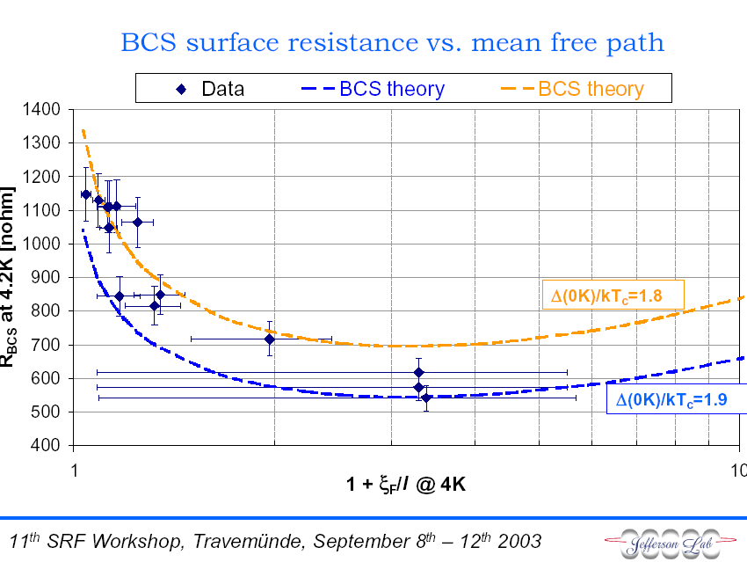
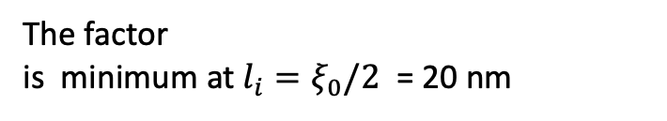
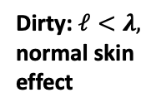
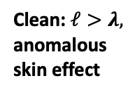
BCS surface resistance
D.C. Mattis and J. Bardeen, Phys. Rev. 111, 412 (1958)
Moderately dirty surface
is best at low RF fields
Dirty: $ℓ<λ,$
normal skin
effect
λ
Temperature-independent
residual surface resistance
The factor
is minimum at $l_{i}=ξ_{0}/2$ = 20 nm
Where is R_{i} coming from?
Clean: $ℓ>λ,$
anomalous
skin effect
λ
Is the optimal Q at GHz
frequencies and low T
limited by the idealized
BCS surface resistance?

Slide 4
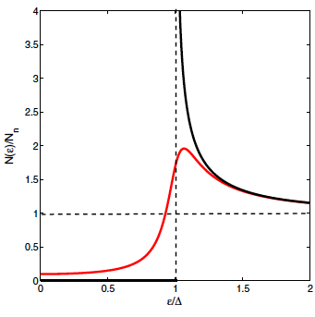
Broadening the DOS gap peaks reduces R_{s}
Low-frequency M-B surface resistance at 1-2 GHz, hf/kT ≈ 10⁻²
Broadened gap
peak and subgap
states in the
Dynes model
Idealized
BCS
Density of states with broadened gap peaks:
R_{s} can be reduced by:
electron-phonon scattering
proximity-coupled suboxides
dilute magnetic impurities
dirty layers at the surface
The log. term in R_{s} results from the singularity in the BCS DOS at ε = Δ
Broadening the gap peaks
can reduce R_{s} by 4-5 times

Slide 5
Residual surface resistance from subgap states
Generalized M-B:
AG, SUST 30, 034004 (2017)
AG and Kubo, PRB 96, 184515 (2017)
good
Residual resistance is a part of BCS surface resistance which takes into account the broadening of gap peaks in
R_{i} increases with but R_{s}(T) at higher T is decreased by moderate DOS broadening
bad
R_{i} = 10 nohm at 1.5 GHz and $λ=40$nm at

Slide 6
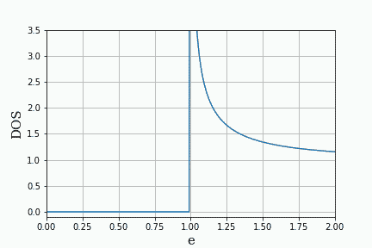
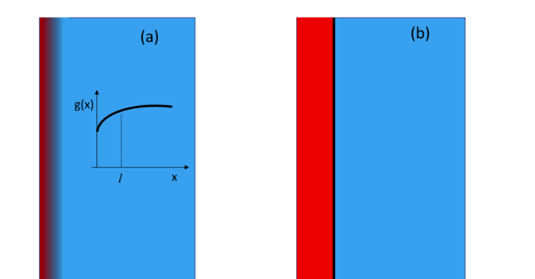
Optimizing surface resistance by pairbreaking mechanisms
Surface resistance can be reduced by RF current, surface nanostructuruing and magnetic impurities
Current-induced broadening of DOS peaks causes a negative Q(H) slope
Subgap states caused by finite quasiparticle lifetimes.
Surface layer of reduced BCS pairing constant (surface nonstoichiometry)
Proximity coupled thin normal (suboxide) layer on the surface
Small density of magnetic impurities
Gurevich, PRL 113, 087001 (2014)
Gurevich and Kubo, PRB 96, 184515 (2017)
Kubo and Gurevich, PRB 100, 064522 (2019)
Calculatioins of Rs in the dirty limit
based on the Usadel equations
DOS oscillating under RF currents
Reducing Rs by engineering an optimum DOS by surface nanostructuring and impurity management
magnetic
impurities
N
S
Current-induced DOS broadening

Slide 7
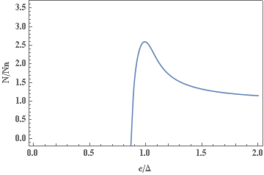
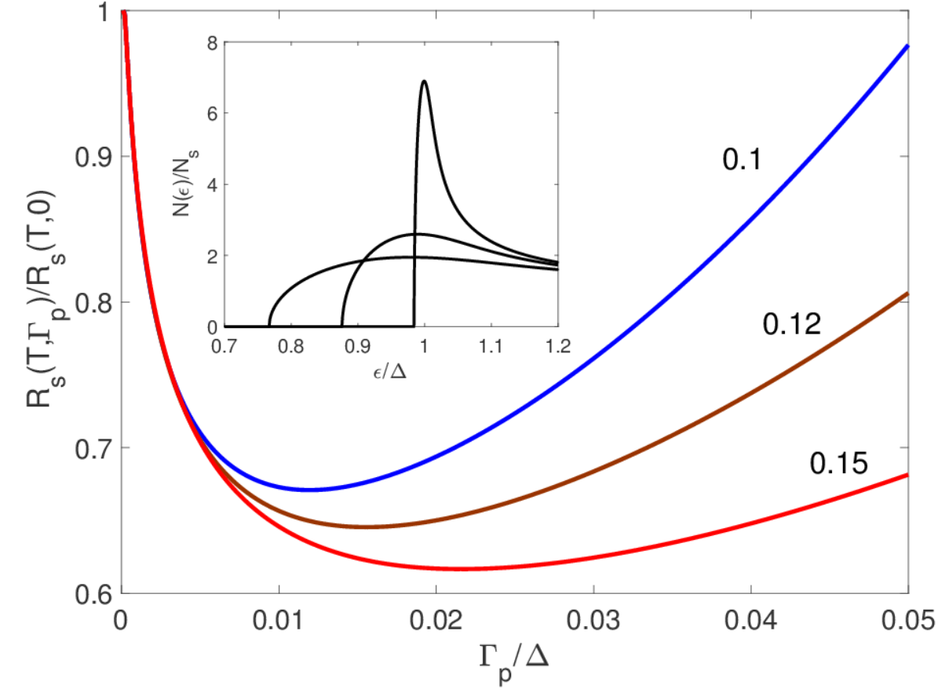

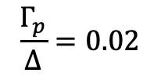



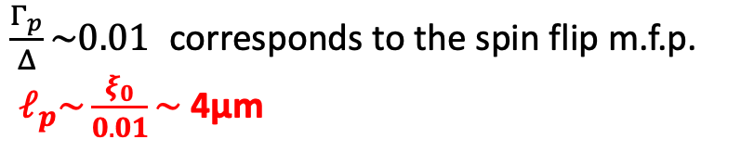
Tuning R_{s} by magnetic impurities
$$\frac{Γ_{p}}{Δ}=0.02$$
$$\left(Γ_{p}=\frac{ℏv_{F}}{2ℓ_{p}}\right)$$
magnetic
impurities
$$ℓ_{p}$$
$ℓ_{p}$ is spin flip m.f.p
$$\frac{kT}{∆}=$$
An optimum density of magnetic impurities can significantly reduce R_{s}
$\frac{Γ_{p}}{Δ}\sim 0.01$ corresponds to the spin flip m.f.p.
$ℓ_{p}\sim \frac{ξ_{0}}{0.01}\sim$ 4μm

Slide 8
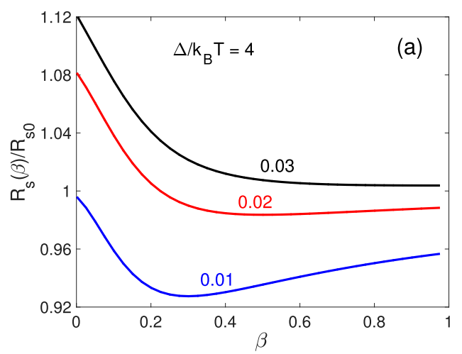
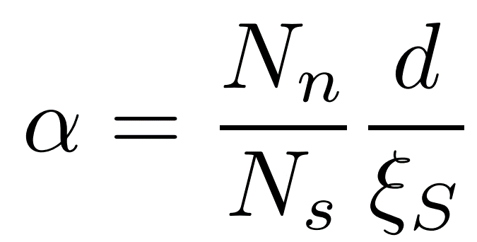
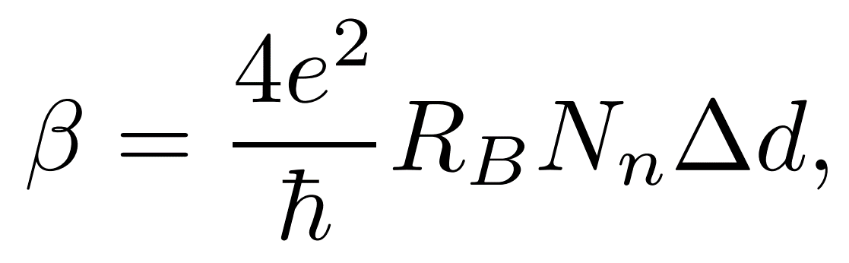

Tuning proximity-coupled NbO metallic suboxide layer
R_{s} can be optimized by tuning the N-layer parameters.
R_{s} can be smaller than the ideal surface without N layer
AG and Kubo, PRB 96, 184515 (2017)
Nb₂O₅
d
NbO
Nb
$$Γ=$$
Contact resistance R_{B} can be changed
by orders of magnitude by heat treatments

Slide 9
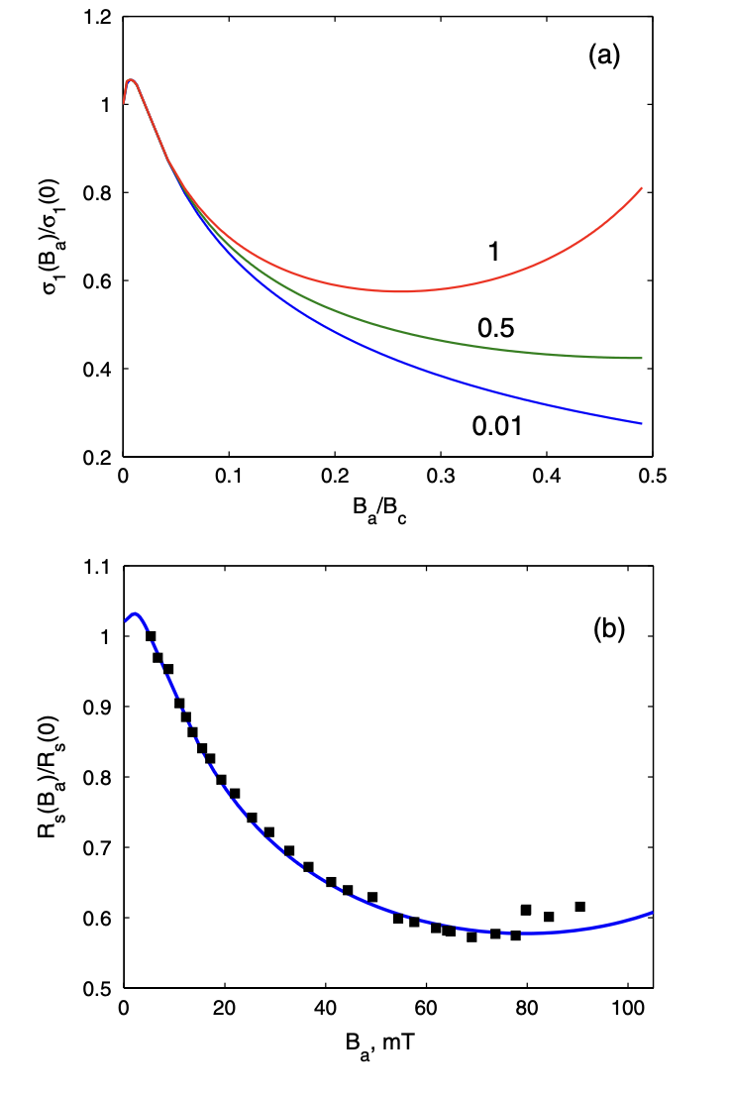
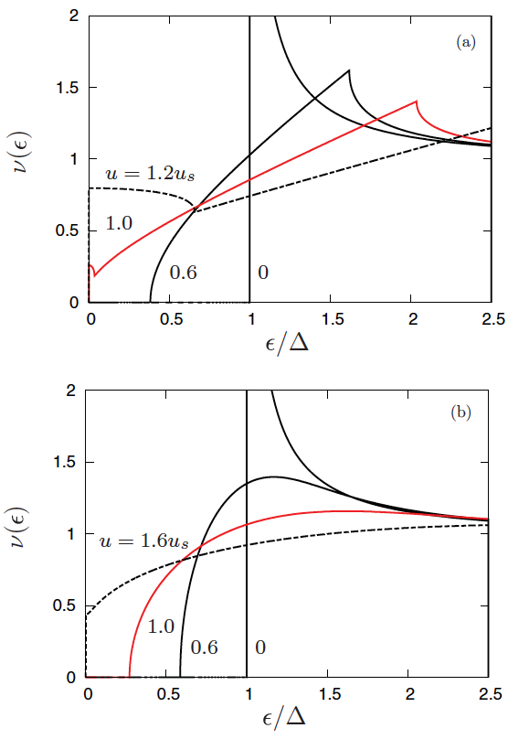
Broadening the DOS peaks by current produces negative Q slope
Maki, Prog. Theor. Phys. 29, 10; 333 (1963);
Fulde, Phys Rev. 137, A783 (1965)
Lin and Gurevich, PRB 85, 054513 (2012)
The effect of current on the DOS:
Gap singularities are smeared out
The quasiparticle gap becomes
smaller than , both and
decrease with H
In the clean limit the gap vanishes at
H < H_{s}:
In the dirty limit the gap remains
finite at H_{s}:
clean
dirty
Gurevich, PRL 113, 087001 (2014)

Slide 10
What are the SRF field limits and how could they be raised?
The GL theory of dc superheating field H_{s}(T) is applicable near T_{c} but not at T << T_{c}.
Only H_{s}(0) = 0.84H_{c} at in the clean limit Catelani and Sethna, PRB 76, 224509 (2008)
and for arbitrary impurity concentration Lin and Gurevich, PRB 85, 054513 (2012) have been calculated.
Dynamic superheating field H_{d}(T,f) can be different from the static H_{s}(T) at GHz frequencies:
Sheikhzada and Gurevich, PRB 102, 104507 (2020)
Increase of H_{s} by surface nanostructuring: dirty layers, SIS or SNS multilayers for which H_{s} has only been calculated in the limit of
GL numerical calculations of H_{s} at realistic finite GL parameters of Nb and Nb3Sn:
Pathirana and Gurevich, Front. Electr. Mat. 3, 1246016 (2023)
  Dirty surface layers
  SIS structures: dirty Nb-I-clean Nb, Nb₃Sn-I-Nb and others
A significant boost of H_{s} can be achieved by optimizing SIS parameters.

Slide 11
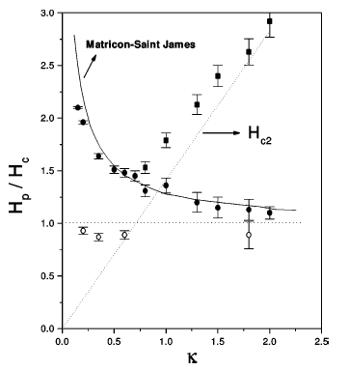
DC superheating field
GL region, T ≈ T_{c}: (Matricon and Saint-James, 1967, Chapman 1995)
B_{s} decreases as the GL parameter κ = λ/ξ increases if the
material gets dirtier:
Raising simultaneously Q and H limits appears mutually exclusive
No theory of H_{s}(T) at low T and
Clean Nb
GL extrapolation to T << T_{c} underestimates H_{s}(0) = 0.84H_{c} at κ >> 1 in the clean limit (Catelani and Sethna, 2008)
and for arbitrary concentration of nonmagnetic and magnetic impurities (Lin and Gurevich, 2012)

Slide 12
Vortices protect superconductivity at H > H_{s}
H < H_{s}
H > H_{s}
H₀
z
At H < H_{s} screening currents are not strong enough to break the Meissner state at J(0) < J_{d}
At H > H_{s} vortices reduce the current density at
the surface allowing SC at higher fields
Counterflow of vortex currents against the Meissner current reduces J(0) at the surface below J_{d} allowing
SC to survive up to high fields H_{c2} at which the vortex cores overlap
The SRF breakdown is limited by H_{s} but not H_{c2}
Vortices penetrate with supersonic velocities in
Embon et al Nat. Commun. 8, 85 (2017); Dobrovolskiy et al, Nat. Commun. 11, 3291 (2020)
Delay with penetration of vortices at H > H_{s} does not increase the SRF field limit but destroys SC

Slide 13
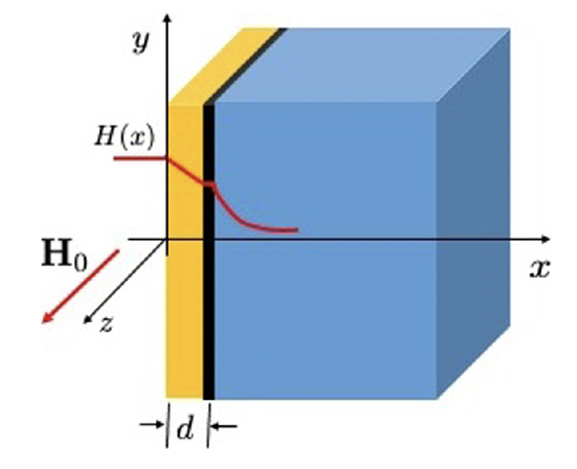
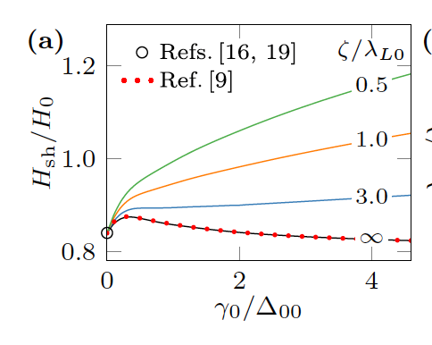
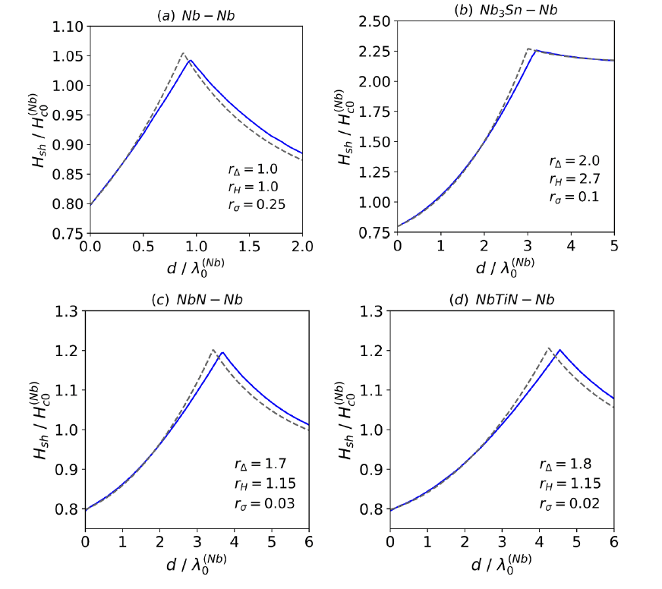
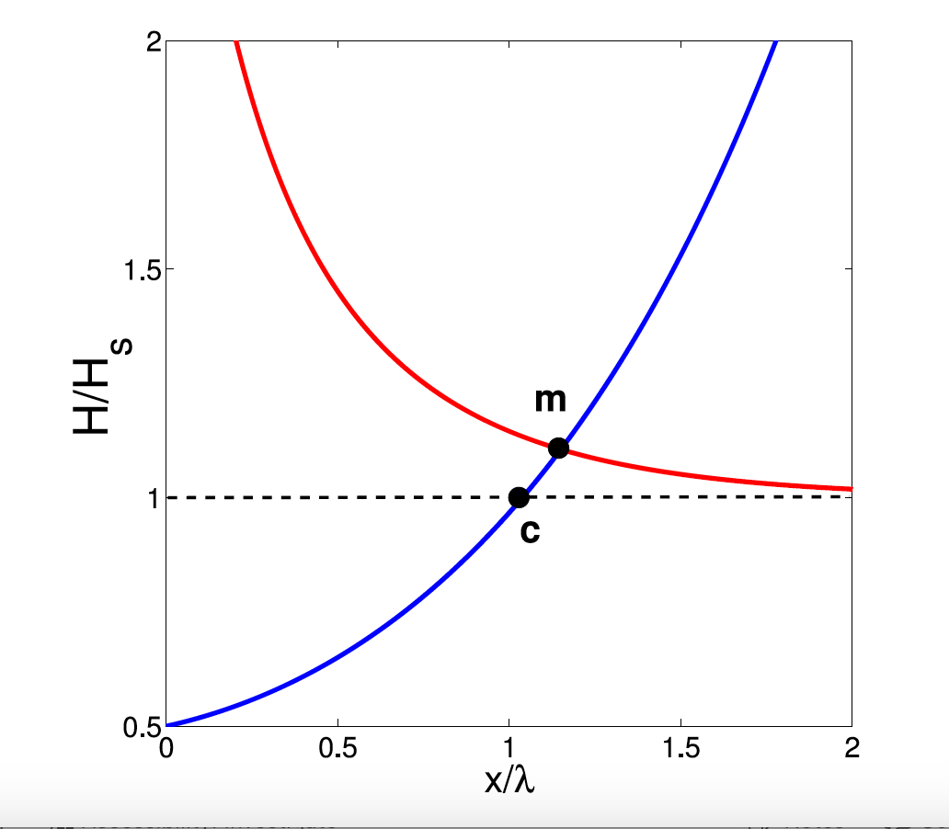
H_{s} for nanostructured surfaces in the limit of
SIS London model
Enhancement of H_{s} by current counterflow induced in the overlaayer
SIS, dirty limit, Usadel eqs
Dirty surface layer
Inhomogeneous impurity
scattering rate at the surface
Kubo, SUST 34, 045006 (2021)
Ngampruetikorn and Sauls,
Phys. Rev. Res. 1, 012015 (2019)
Gurevich, APL 88, 012511 (2006); AIP Adv. 5. 117112 (2015)
Kubo, Iwashita, Saeki, APL 104, 045006 (2014)

Slide 14
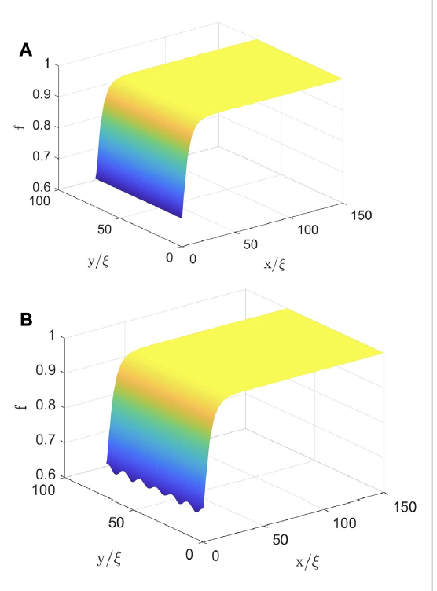
GL numerical calculations of H_{s} at finite
GL numerical simulations for Nb:
Pathirana and Gurevich, Front. Electr. Mat. 3, 1246016 (2023)
Christiansen, Solid Stat. Comm, 7, 727 (1969); Chapman
SIAM J. Appl. Math , 55, 1233 (1995); Transtrum et al, PRB
83, 094505 (2011), Liarte et al, SUST 30, 033002 (2017)
Partial suppression of
by
screening current at H < Hs
GL results for
Period along the surface
Growth of periodic perturbations
along the surface preceding
penetration of vortices at H > Hs
Decay length perpendicular to the surface

Slide 15
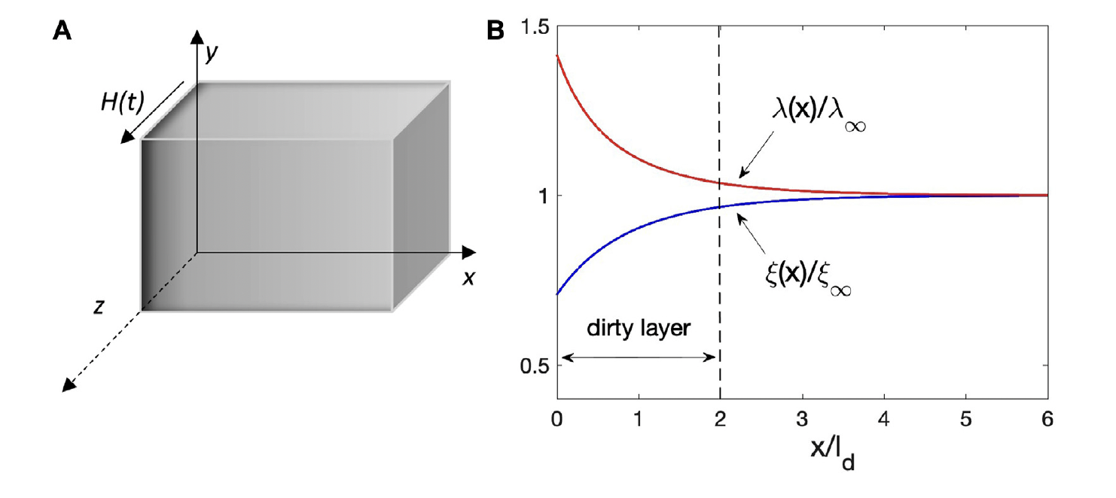
Dirty layer at the surface
Slowly ramping magnetic field:
instability

Slide 16
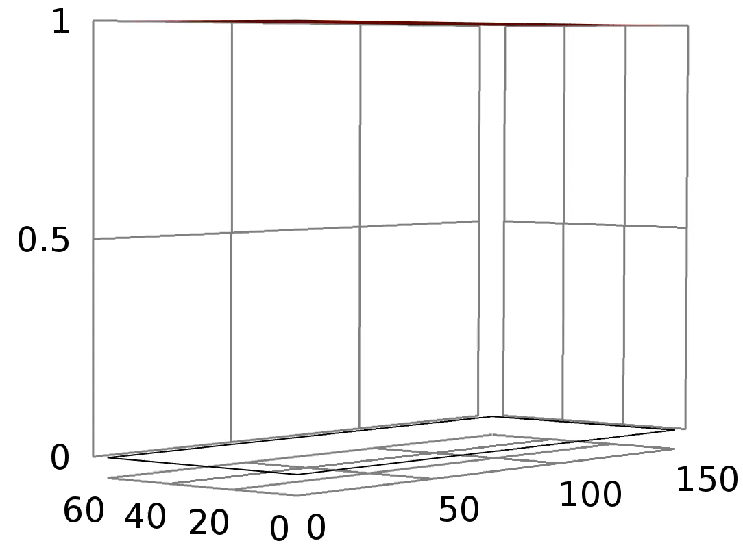
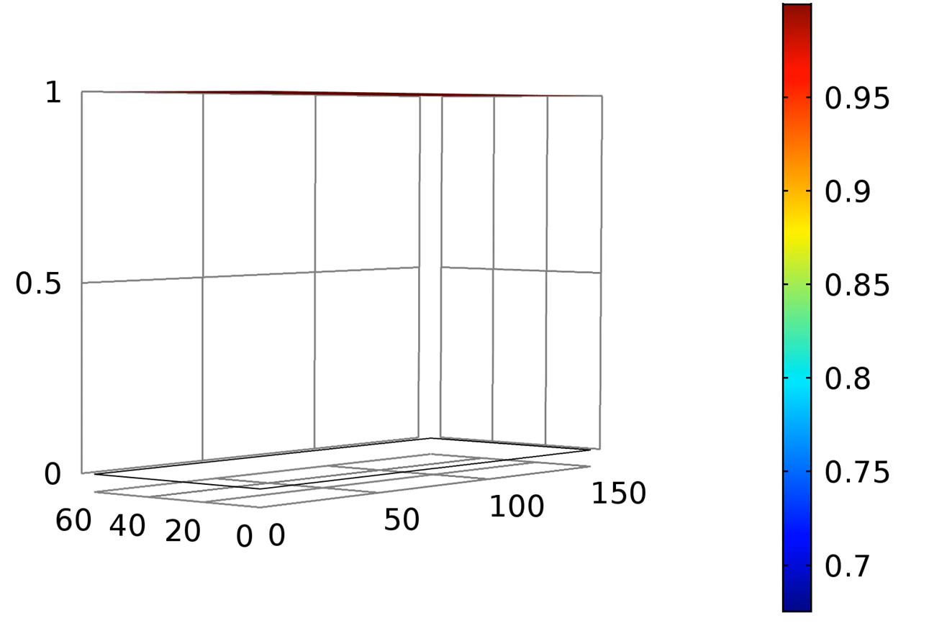
Detecting superheating field
Order Parameter (f)
x/ξ
y/ξ

Slide 17
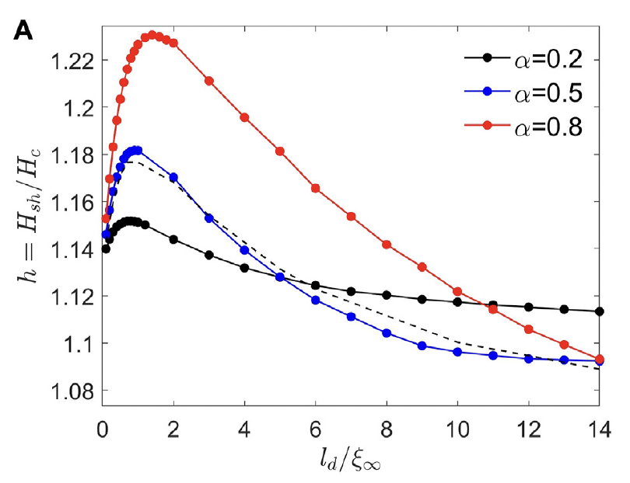
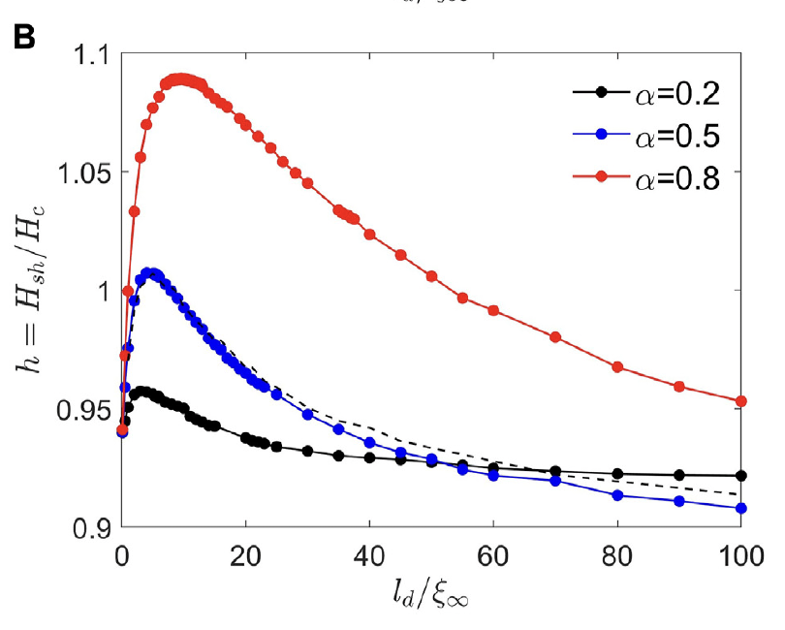
Dirty surface layer, results
Maximum in H_{s}(l_{d}) results from current counterflow induced in the dirty surface layer with larger
by the cleaner bulk with smaller , similar to that in SIS multilayers. Reduced Hs at larger ld is due to
larger GL parameter of the dirty layer,

Slide 18
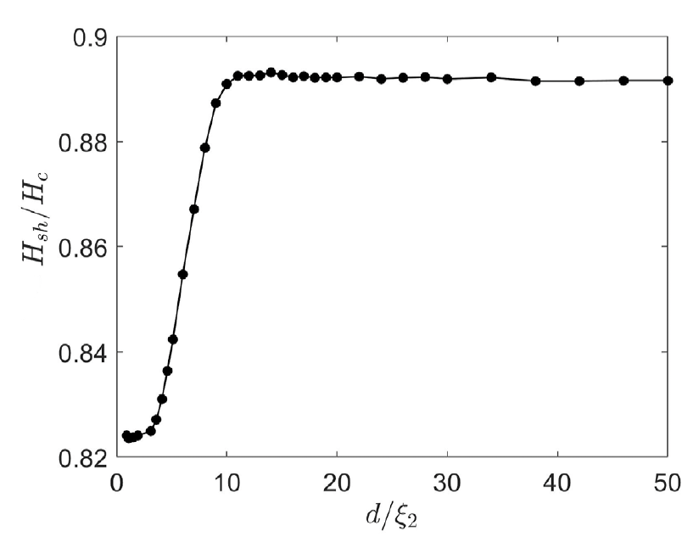
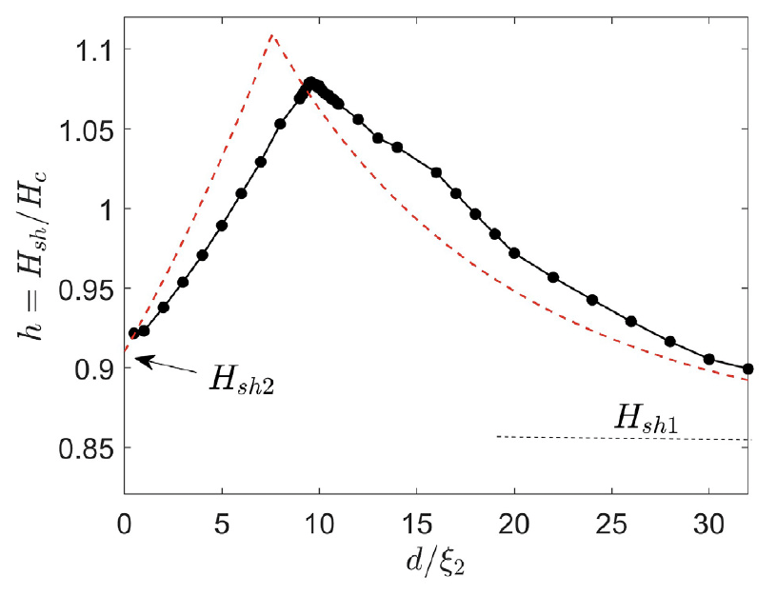
SIS with the same materials
SIS Nb₃Sn with the same
parameters of the overlayer
and the the bulk
SIS Nb₃Sn with dirtier overlayer
Dashed line: H_{s}(d) calculated in the London model
N-doped – I – clean Nb structures may outperform the best bare Nb cavities
Dip in H_{s}(d) at small d results from suppression
of vortex perturbations by I layer over
perpendicular to the surface

Slide 19
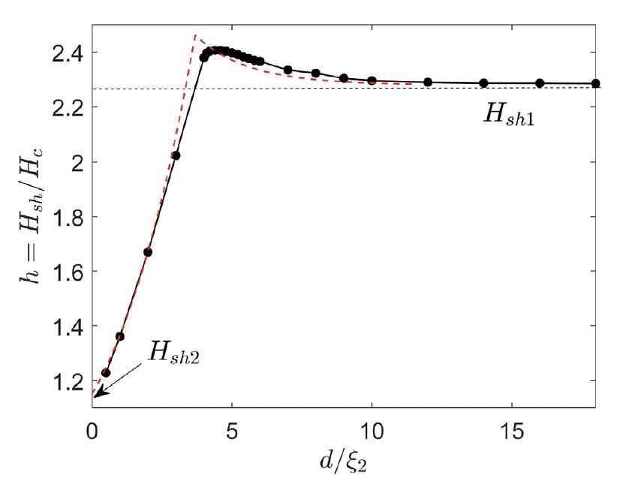
High-Tc overlayer in SIS
Thin Nb3Sn overlayer more
than doubles the dc
superheating field
London model works
surprisingly well
I interlayer is necessary to
prevent avalanche penetration
of vortices
Nb₃Sn - I - Nb

Slide 20
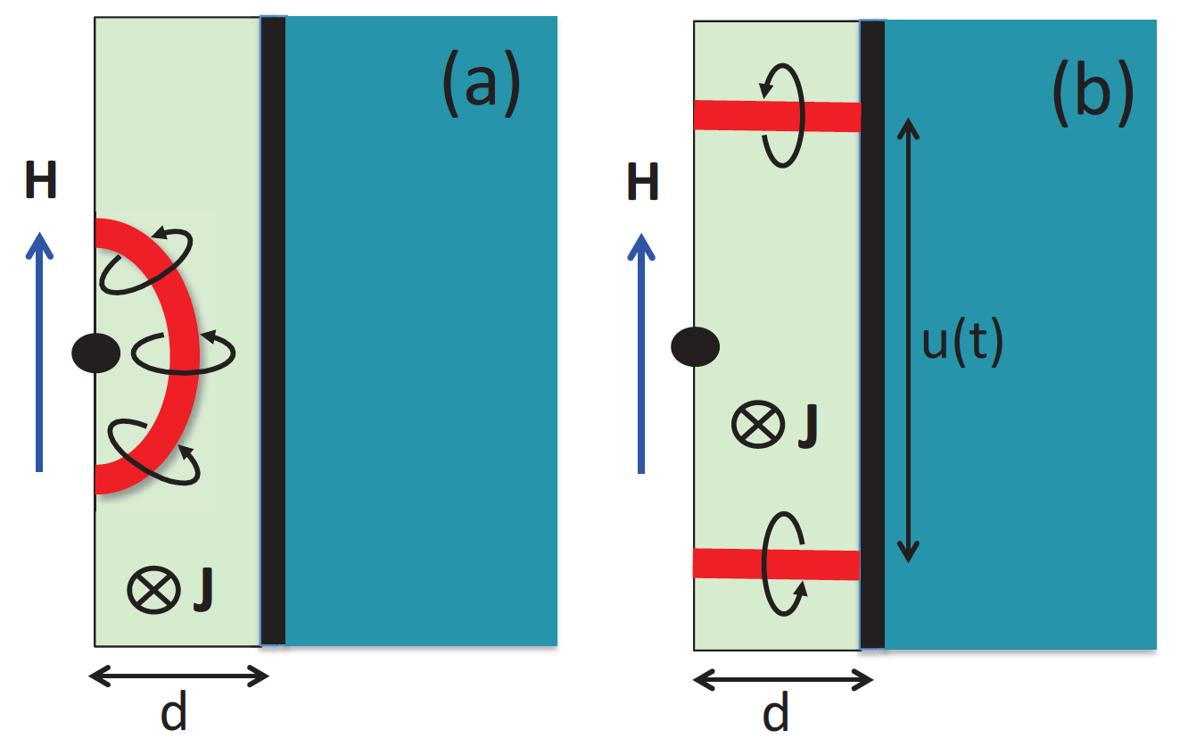
Blocking penetration of vortices by I layers
SIS multilayers (Gurevich, APL. 88, 012511 (2006))
higher-T_{c}SC: Nb₃Sn, etc, etc
Maximum breakdown
field at an optimum
layer thickness
Nb
I layer intercepts vortex loops and do not
let them propagate to the bulk
Strong decrease of vortex dissipation
dielectric layers
Gurevich, AIP Adv. 5, 017112 (2015)
Higher H_{m} due to current counterflow at
Experimental progress
H_{m} at the optimum thickness exceeds H_{s} of both Nb and the layer material. mT (dirty Nb layer),
NbN overlayer (Antoine et al, APL 102, 102603 (2013);
Roach, et al, IEEE Trans. Appl. Supercond. 23 (2013))
NbTiN/Al₂O₃/Nb thin film bilayers (Valente, SUST 29 (2016) )
Nb₃Sn multilayers (Sundahl et al.Sci. Rep. 11, 7770 (2021) )
MgB₂ coating of Nb (Tan et al, Sci. Rep. 5, 35879 (2016))
Kubo et al, APL, 104, 032603 (2014); SUST, 30, 023001 (2017); 34, 045006 (2021)
Posen, Transtrum, Catelani, Liepe, Sethna, Phys. Rev. Appl. 4, 044019 (2015)

Slide 21
Challenges for the SRF theory
Switch from the MB model to the Eliashberg theory which describes realistic superconductors with strong e-p pairing (Nb, Nb₃Sn, NbN etc)
Enigma of quasiparticle subgap states which define the ultimate Q limit at T<<Tc (SRF cavities and qubits). Many possible mechanisms (TLS, correlated impurities, strong e-p coupling, etc).
Field dependent Q(H) at high rf fields: Pandora box of nonequilibrium superconductivity and complex kinetics of superconductors under strong RF fields. e-p and e-e relaxation times and their strong dependencies on T and rf field
Extended Q(H) rise, the effect of nonequilibrium kinetics of quasiparticles or two-level states
Ultimate breakdown of superconductivity - the physics of dynamic superheating field at GHz frequencies at low T
Extreme dynamics of superfast tips of trapped vortices at the SRF depairing limit. Effect of trapped flux on the high-field Q slope

Slide 22
Conclusions
What we know: the well-established BCS electrodynamics and trapped vortex losses at low rf fields. Effect of proximity coupled metallic precipitates or suboxide layers.
What we do not know or not fully understand:
Mechanisms of residual resistance, subgap states, TLS
Theoretical Q and H limits for key SRF players (Nb and Nb₃Sn)
Theory of nonequilibrium superconductivity which describes Q(H) at high rf fields
Extreme dynamics of trapped vortices driven by rf fields in SRF cavities
The exact SRF performance limits are currently unknown. Yet the SRF performance
both at low and high RF fields can be improved by impurity management and surface nanostructuring, even if we do not know what the limits are.
Filling the knowledge gaps requires developing the Eliashberg + nonequilibrium theories of SRF limits in conjunction with advanced computational modeling.

