Slide 1
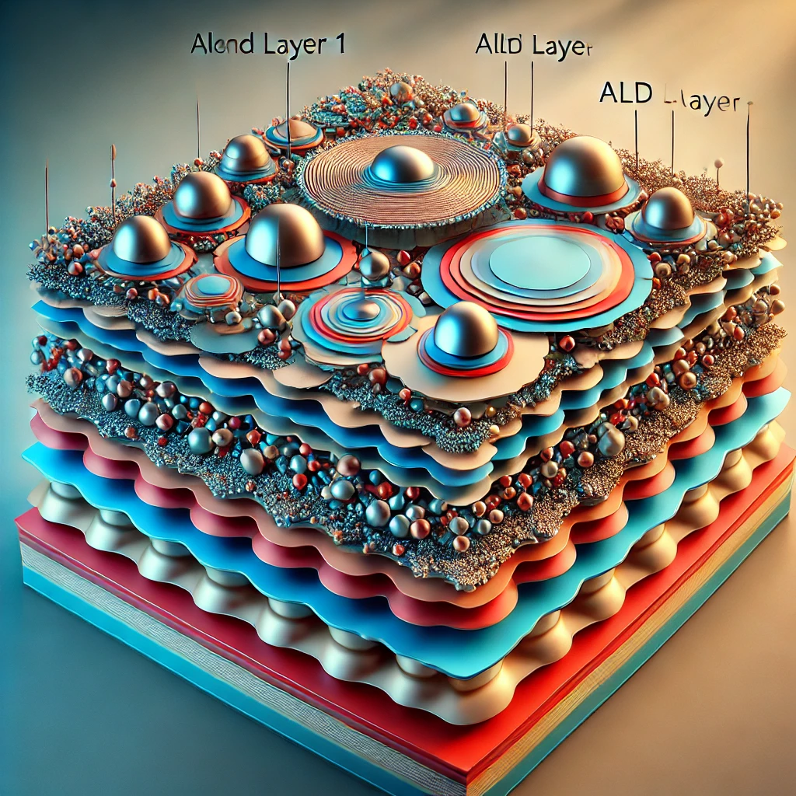
Engineered Nb surfaces
Potential and future R&D directions
Marc Wenskat (DESY)
5.2.2026 GARD RF Roadmap Update

Slide 2
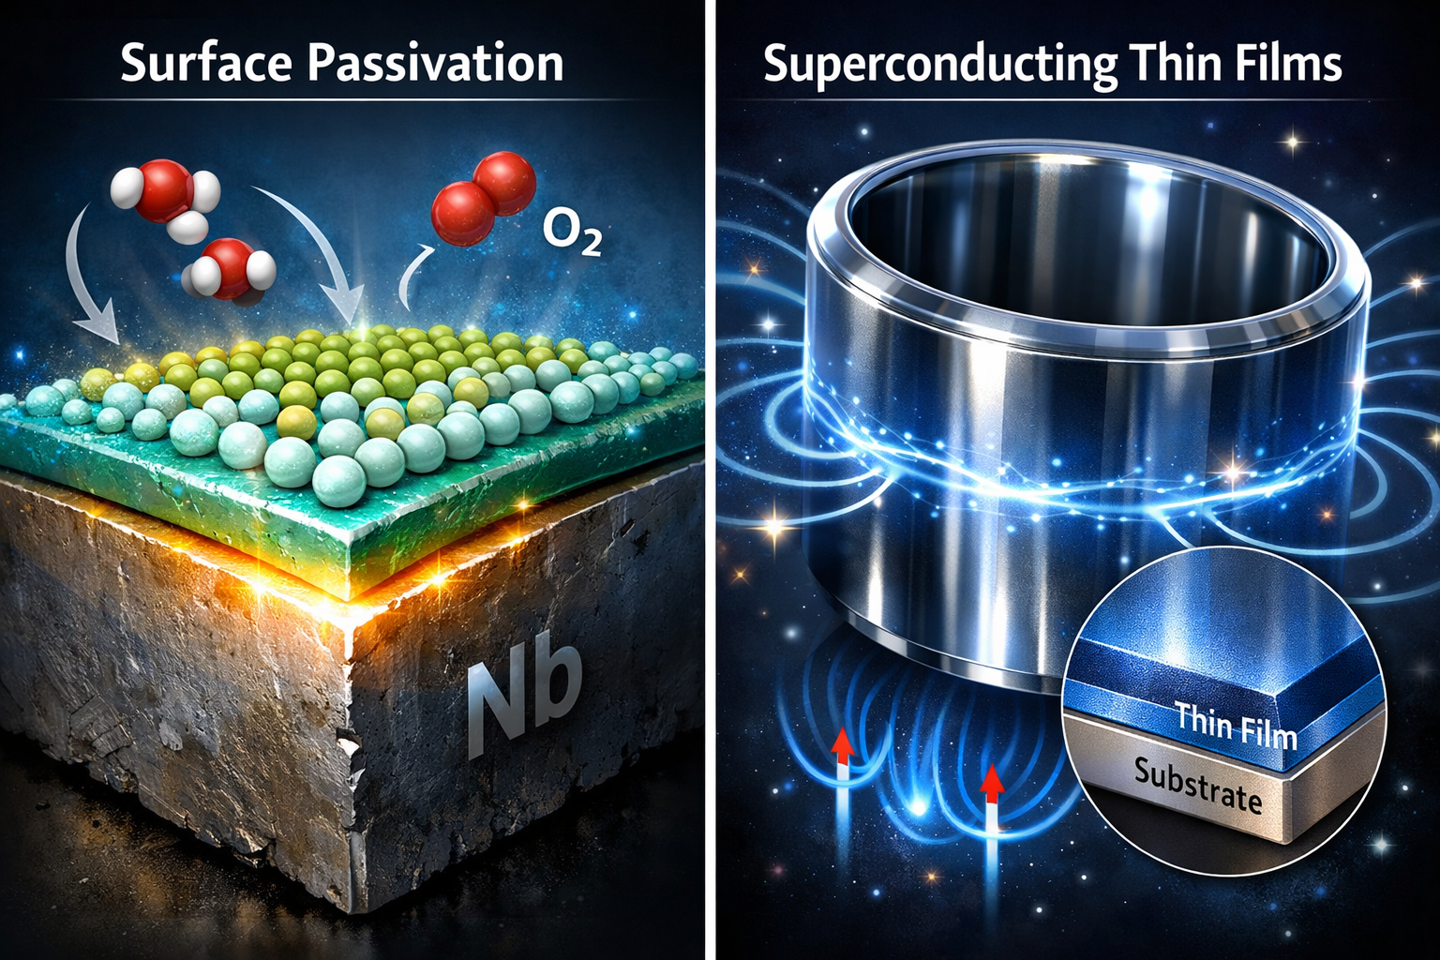
Can be split in two research topics
Surface passivation / encapsulation
Why do we care?
Various approaches & results
Outlook
Superconducting thin films
Reminder why/how it should work
Status & results
Outlook

Slide 3
Surface passivation Surface encapsulation

Slide 4
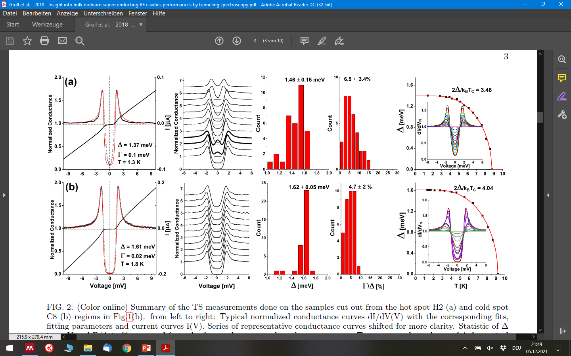
Experimental evidence: native oxide matters in itself I
and not indirect as e.g. source of oxygen
[Groll, N. R., et al. arXiv:1805.06359 (2018)]
[Proslier, T., et al. IEEE Transactions on Applied Superconductivity 21.3 (2011): 2619-2622]
[Kharitonov, M, et al. Physical Review B 86.2 (2012): 024514]
Cavity cut-outs identified by TMap
Hot Spots
Cold Spots

Slide 5
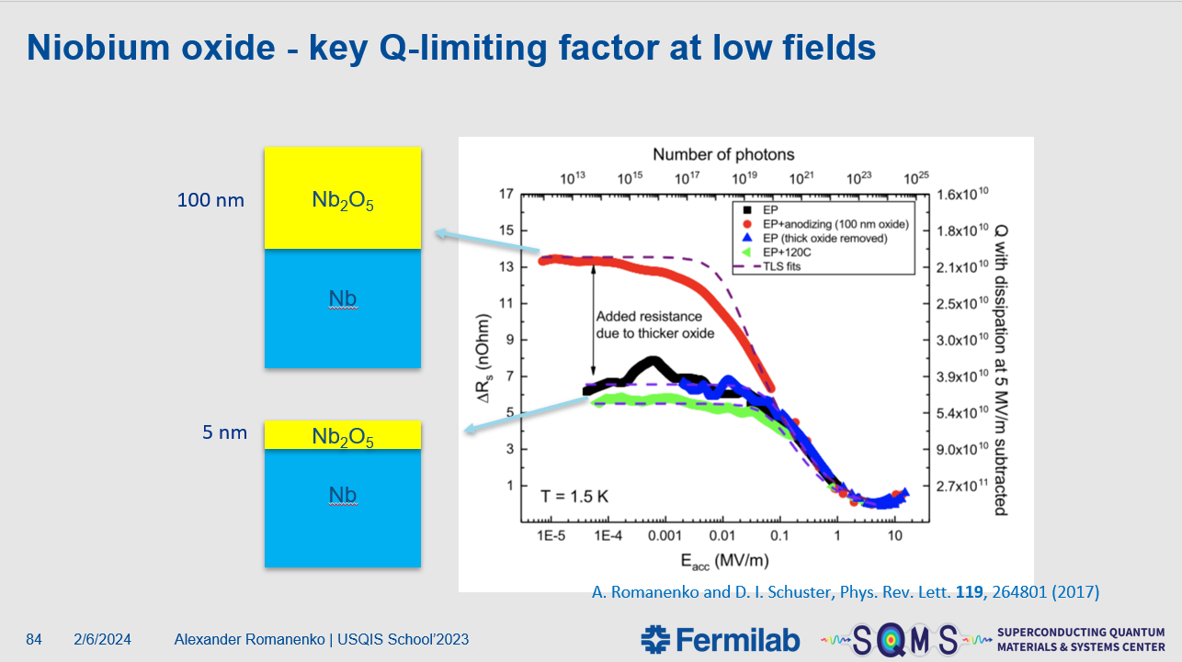
Experimental evidence: native oxide matters in itself II
and not indirect as e.g. source of oxygen

Slide 6
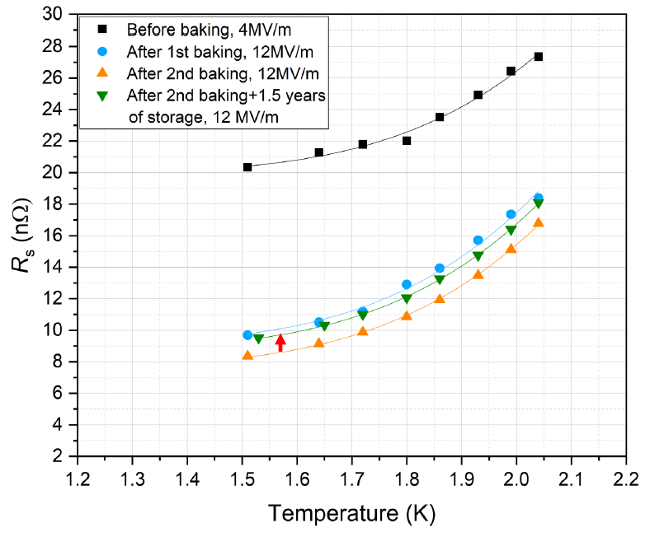
Experimental evidence: native oxide matters in itself III
and not indirect as e.g. source of oxygen
[Prudnikava, A. et al., SRF2025 TUA04]
Mid-T under vacuum twice and tested
→No/little oxide present
Stored under vacuum for 1.5 years
Leak caused pressure rise from 10⁻⁶mbar to 10⁻¹mbar
Oxide regrowth added ~1.3 nΩ

Slide 7
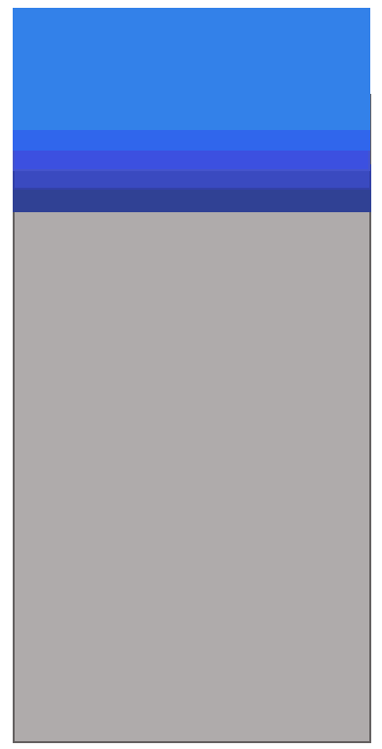
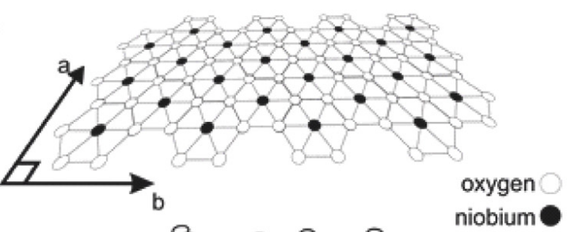
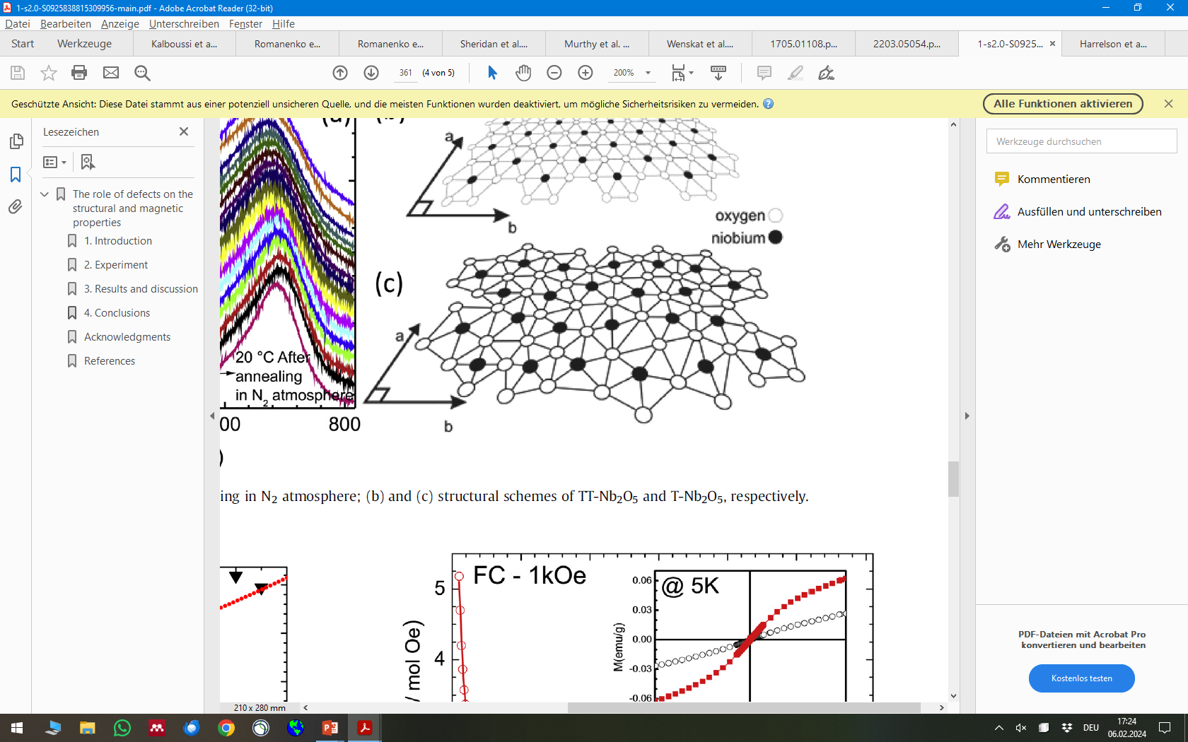
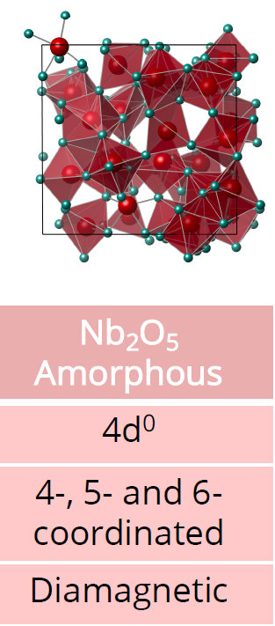
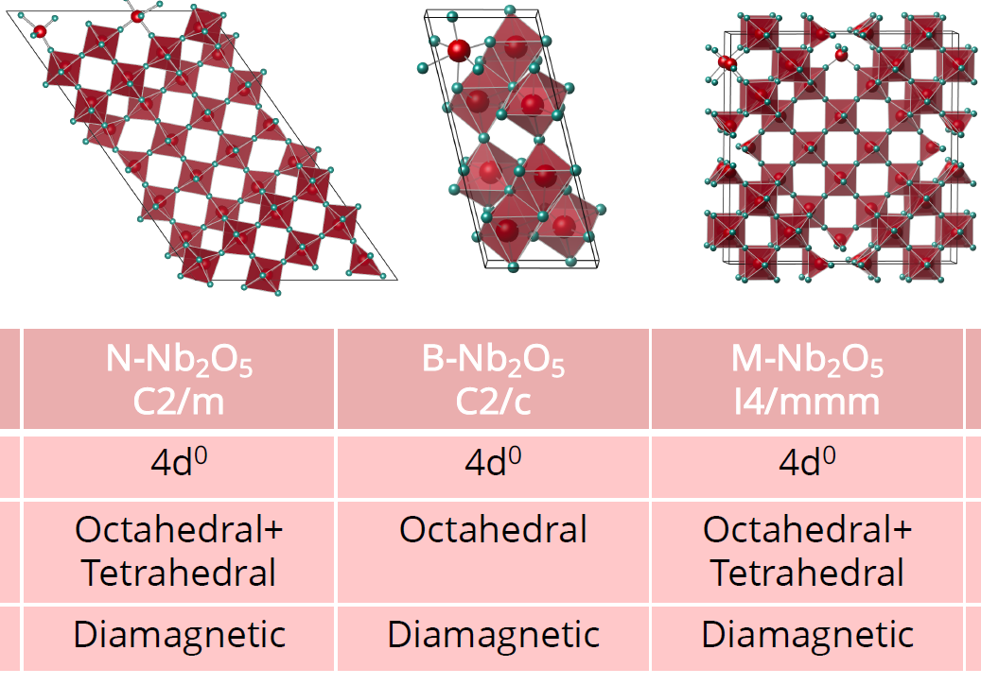



What do we know about Nb-oxides? It‘s complicated!
$${Nb}_{2}O_{5}$$
~5 nm
Periodic Lattice
$$NbO2, NbO,NbOx$$
$$Nb$$
Off-stochiometric phase
Globaly, the ratio 2 Nb : 5 O is achieved
Locally, maybe Nb₁₀O₂₃ → O-depletion
Not vacancies in a lattice, simply bad matching
„Unbound binding electrons“ of Nb
Reality:
Energetically not favored at RT, not “our” Nb₂O₅
[Sheridan, Evan, et al., arXiv preprint arXiv:2111.11684 (2021)]
[Harrelson, Thomas, et al., arXiv preprint arXiv:2111.11590 (2021)]
[Murthy, Akshay A., et al. ACS nano 16.10 (2022): 17257-17262.]
[Herval, Leonilson KS, et al. Journal of Alloys and Compounds 653 (2015): 358-362.]

Slide 8
Same same, but different
Depending on the amplitude of the RF field the same microscopic state - unbound binding electrons - is used/interpreted/labeled differently, because different effects are dominant for the RF response
As both effects are caused by the same microscopic origin: if we study one, we might learn about the other
E_{acc} (number of photons)
low
high
Electron spins alignment (dangling bond) can be in two different configuration → Two-Level System
Application: Quantum computing
Magnetic moment of spin act as magnetic scattering site, causes pair breaking → Magnetic impurities
Application: Accelerators

Slide 9
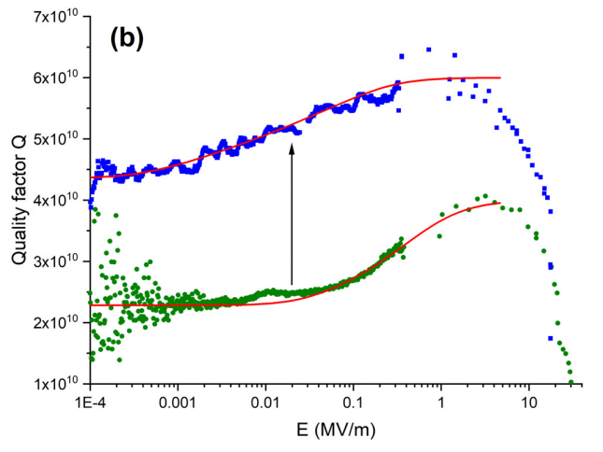
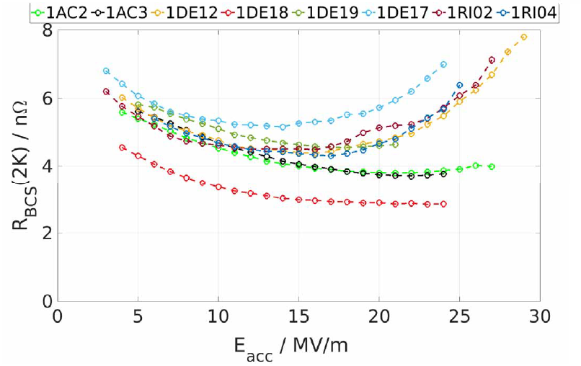
Currently four labs are conducting passivation studies
SQMS @ FNAL
See previous talk by D. Bafia
Encapsulation of cavities by CEA + subsequent annealings at FNAL
Application quantum computing
CEA
Atomic Layer Deposition of: Al₂O₃, Ta₂O₅, ZrO₂
Fundamental R&D, started with SIS studies
Funding granted with QC application
Cornell
Electroplating of Au
Fundamental R&D
Application is SRF
U Hamburg & DESY
Atomic Layer Deposition of: Al₂O₃, Ta₂O₅
Fundamental R&D, started with SIS studies
Application is SRF & a little bit QC
[Grasslino, L. et al., SRF2025 THA04]
1.5K
[Kalboussi, Y., et al. Applied Physics Letters 124.13 (2024)]
[Kalboussi, Y., et al. Physical Review Applied 23.4 (2025): 044023]
[Seddon-Stettler, S, et al. SRF2025 WEB07C]
[Méndez, Cristóbal, et al. arXiv preprint arXiv:2509.02914 (2025)]
10nm Al₂O₃ + 10h@650°C
[Wenskat, M, et al. SRF2023 TUIBA02]
[Rakshith, V. et al. SRF2025 TUP16]
18nm Al₂O₃ + 3h@300°C

Slide 10
Open questions, future & potential R&D
Two main directions: quantum computing and surface resistance tuning
Synergy between both fields
“same same, but different”
leverage to attract young brains & resources
For SRF the interplay between oxide properties and consequences of removing it should be studied
Can dissolve the native oxide only once → finite resource of interstitial oxygen
Additional variable to tune annealing process parameters & protection against C-pollution(?)
“Optimal” material for encapsulation? Oxides? Which one? Au? Other?

Slide 11
Superconducting thin films

Slide 12
Differentiation wrt other talks
More to thin films than SIS
Here: Looking at R&D where „thinness“(d ≈ λ_{L}) of films is vital and not necessarily the material
Exclude R&D which use thin films (compared to cavity wall thickness) which replace bulk Nb
with another „bulkish“ (d>>λ_{L}) higher-T_{c} material
See talks in next session for that
Uttar Pudasaini (Jlab), Nathan Sitaraman (Cornell), Cristian Pira (INFN), Grigory Eremeev
Thin-Film Roadmap – report of European IFAST project

Slide 13
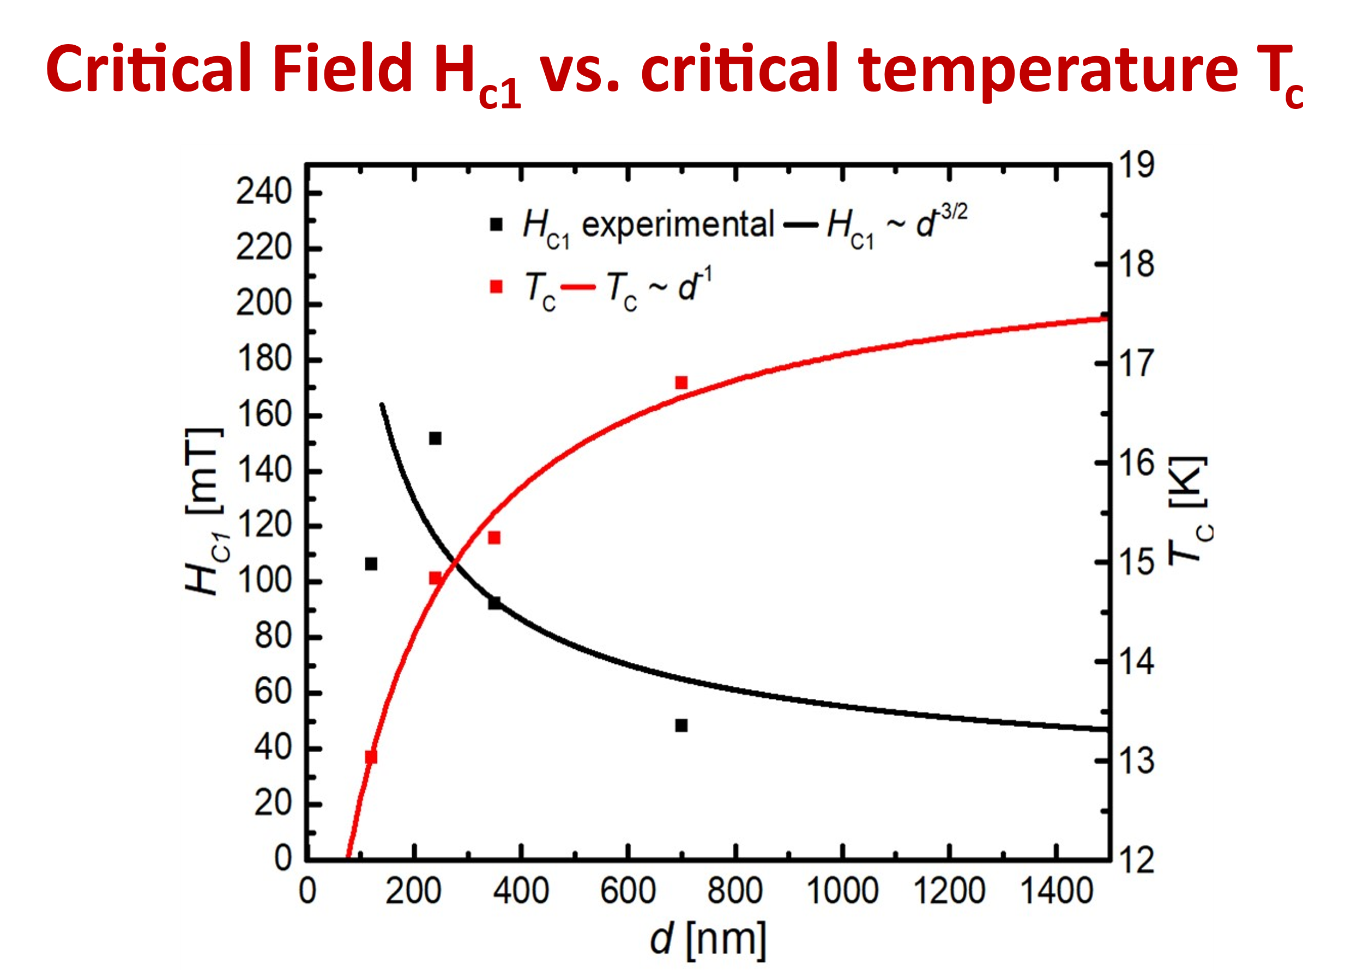
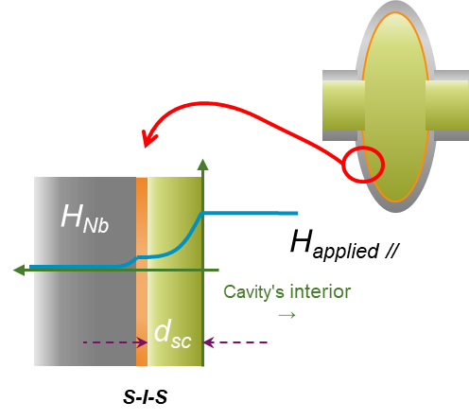
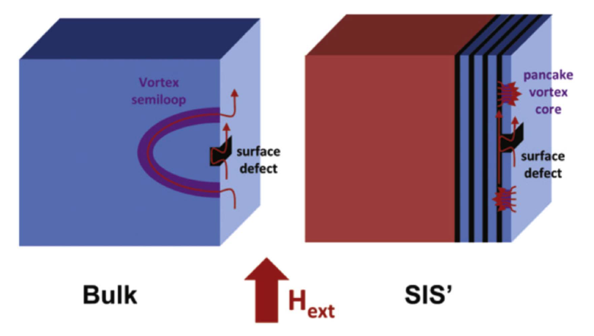
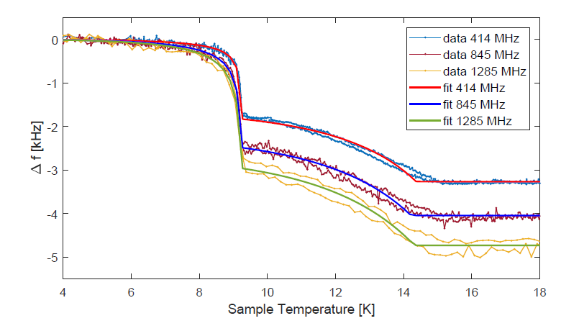
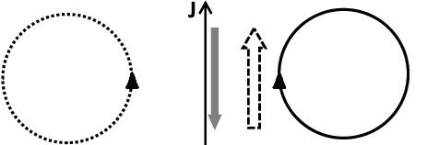
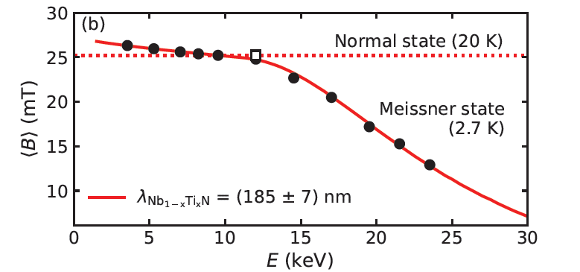
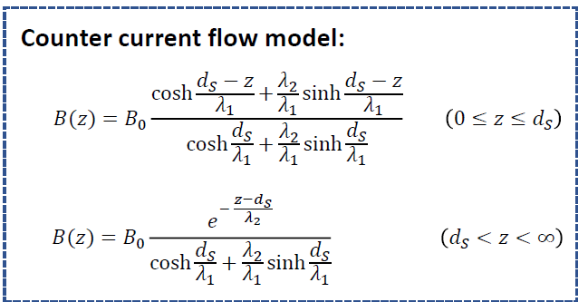

Evolution of SIS Theory
The whole is more than the sum of ist parts
Energetically suppressed vortices in thin films cause enhancement of “field of first flux entry” a.k.a. H_{c1}
Alex’ idea: Coat a cavity with a thin superconducting film with insulating layer, acting as vortex barrier
Controversy around effectiveness
Taka’s new argument: Bean-Livingston Barrier increase through “counter current”
$$µ_{0}H_{c1}= \frac{2ϕ_{0}}{πd^{2}}ln\frac{d}{ξ}$$
‘Pancake’ vortex
[G. Stejic et al., PRB 49.2 (1994)]
Co-Autor: Gurevich
[A. Gurevich, APL 88 (2006)]
[D. Liarte, SUST 30 (2017) 033002]
[T. Kubo, SUST 30 (2017)]
[N. Schäfer et al., J. Appl. Phys. 128, 133902 (2020)]
[Keckert, S. PhD Thesis, Siegen 2019]
[Asaduzzaman, arXiv: 2304.09360]
H_{c,1} of Nb₃Sn is 50mT

Slide 14
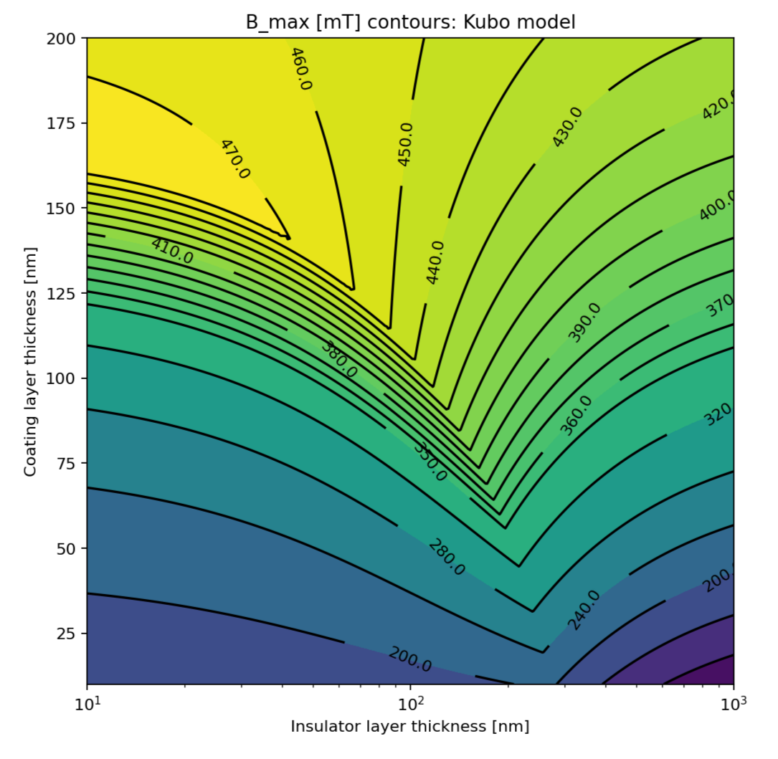
By tuning layer thickness you increase E_{acc} and reduce Q₀
[T. Kubo, SUST 30 (2017)]
Depends on H_{c,1} and λ_{L} of both SC and “defectiveness” η
Optimization: what quenches first - substrate or layer?
Thickness of insulating d_{I} and sc film d_{s} are free parameters
Shifting B-field and current density j around
Realistic material parameters give you:
E_{acc} ≈ 70-100 MV/m
Q₀ ≈ 3-5 x10¹⁰ (depends on R_{res}) @ 2K
This is all just on paper

Slide 15
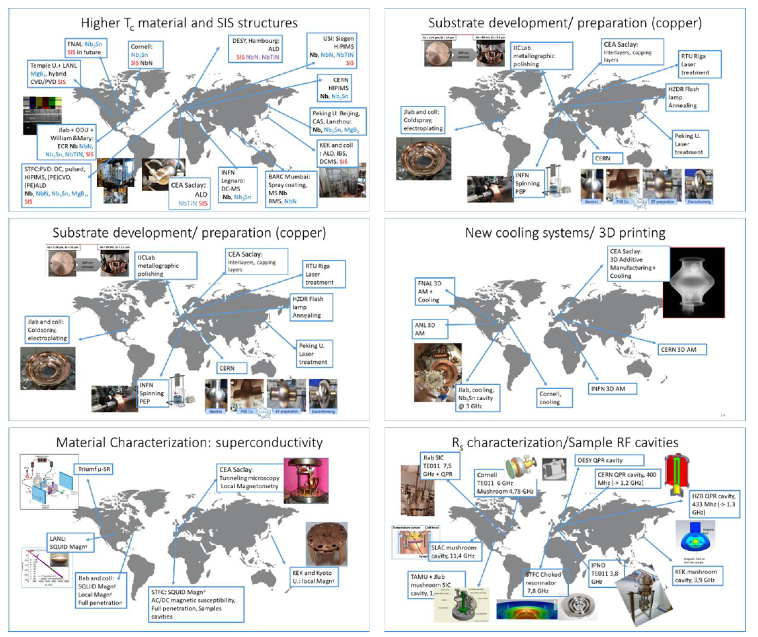
Who is conducting SIS research?
Research – not just coating
Coating:
KEK used to, FNAL expressed interest
Several labs work on planar samples (sputtering)
CEA & U Hamburg work on cavities (ALD)
…
R&D network much larger
See Thin-Film Roadmap

Slide 16
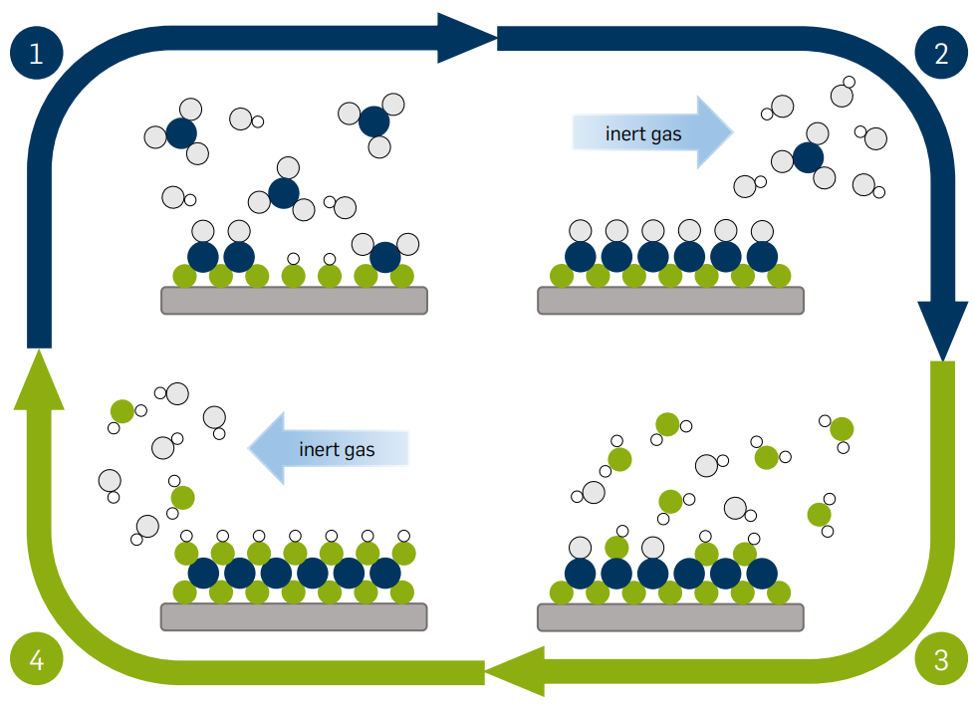
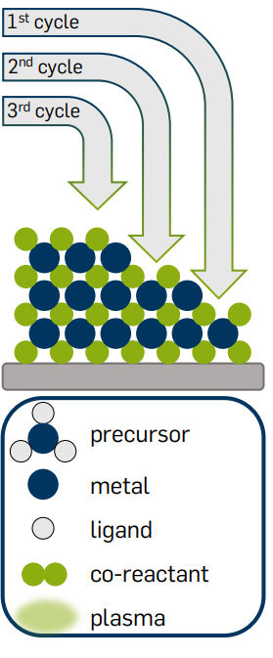
Method of choice: Atomic Layer Deposition
Achieves homogenous uniform coating on complex geometry with no shadowing effect
Taken from: L. Mai, (2020), DOI:10.13154/294-7658.

Slide 17
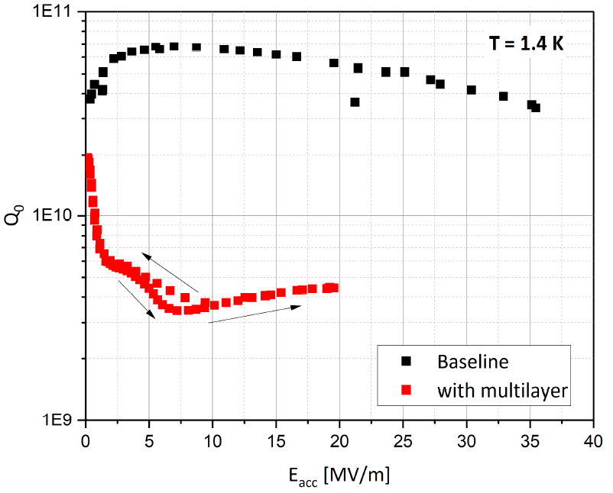
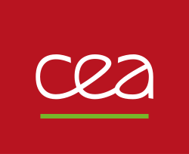
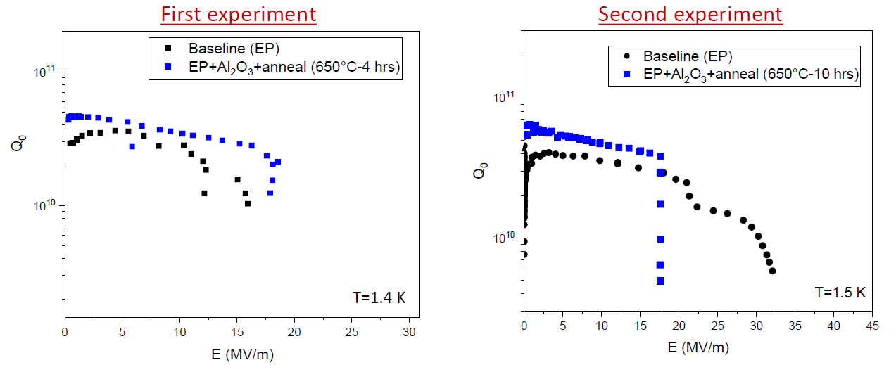
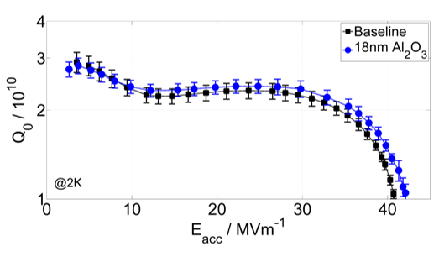

Cavity results
Only two labs conduct cavity coating
50 nm NbTiN/ 7nm AlN on Nb + 900°C annealing
10 nm Al₂O₃ on Nb + 650°C for 4/10h
[Wenskat, M. et al 2023 Supercond. Sci. Technol. 36 015010 ]
18 nm Al₂O₃ on Nb
[Kalboussi, Y. et al SRF2023 WEIBA01]
[Kalboussi, Y., et al. Applied Physics Letters 124.13 (2024)]
[Y. Kalboussi. Nano hetero-structures for improving performances of superconductors under high fields. Université Paris-Saclay, 2023.
⟨NNT : 2023UPASP029⟩ ]

Slide 18
Open questions, future & potential R&D
Theory development needed
so-far only single SIS layer, extending it to (SI)^{N} S needed
interface properties (roughness/transition) not included
Several RF/DC measurements on samples show individual pieces of the puzzle are correct
Pancake vortices & H_{c,1} enhancement
Higher Q₀ above 5K or T_{c} of Nb
Compensating individual flaws (Hysteresis, flux pinning)
…
Show that it works! Proof-of-principle with an SRF cavity still pending (or with a QPR sample)
Two labs might not be enough → more resources / shoulders needed
Same argument as above: synergy with other fields (functional materials), use this leverage

