Slide 1
FCC-ee SRF R&D needs
Frank Gerigk, 05.02.2026
DOE GARD RF R&D Roadmap

Slide 2
Critical RF challenges for FCC-ee
400 MHz 2-cell cavities & 800 MHz 6-cell cavities
RF power & HOM couplers 400 MHz + 800 MHz
400 MHz & 800 MHz prototype CM
400 & 800 MHz high-efficiency power source
400 & 800 MHz high-power infrastructure for coupler and system test

Slide 3
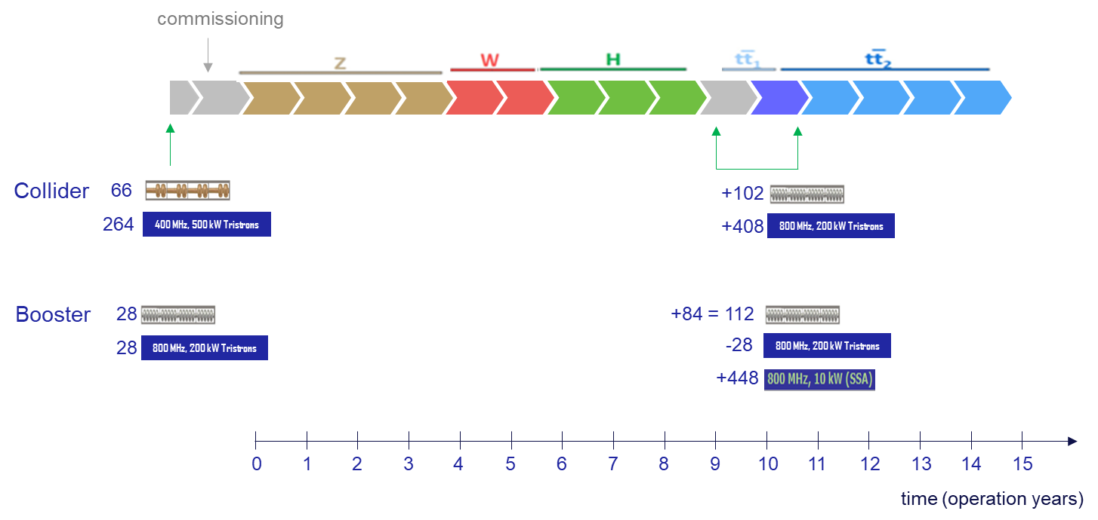
2-step approach to R&D:
Phase 1
Phase 2
All 400 MHz CMs (66) need to be available for the start of the Z.
Only 28 modules at 800 MHz for the Z, but an additional 84 modules for ttbar.
Z-power sources: ~500 kW for 400 MHz, and ~50 kW for 800 MHz.
Ttbar power sources: ~90 kW for 400 MHz, ~250 kW for 800 MHz.
For the ttbar equipment, there are 11 more years of R&D available!

Slide 4
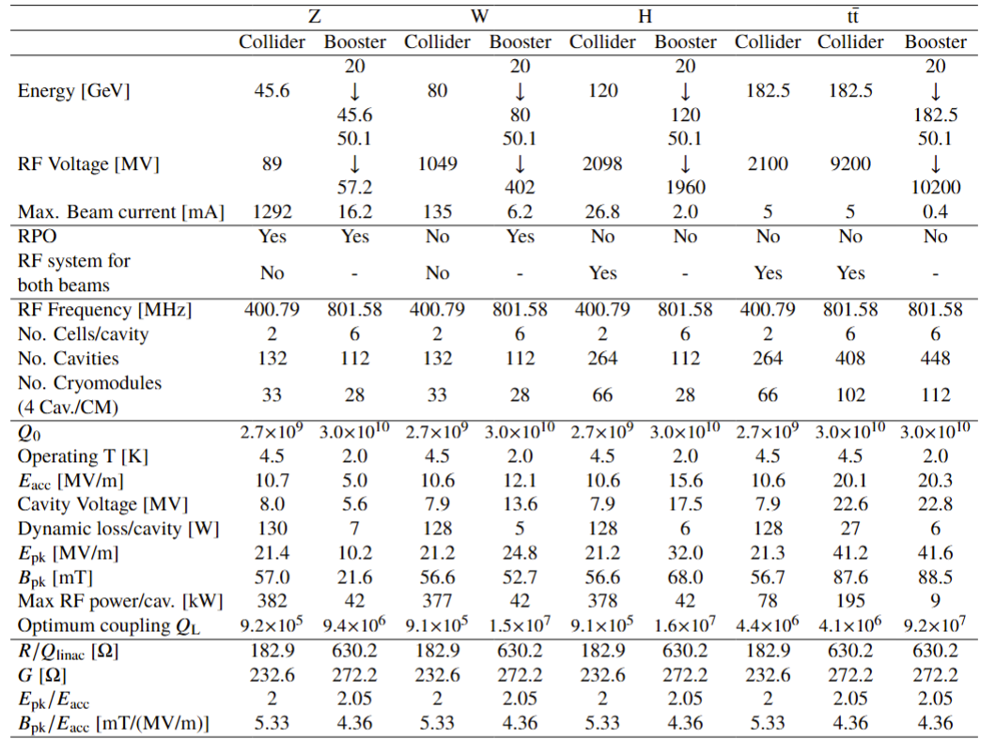
400 & 800 MHz design specifications

Slide 5
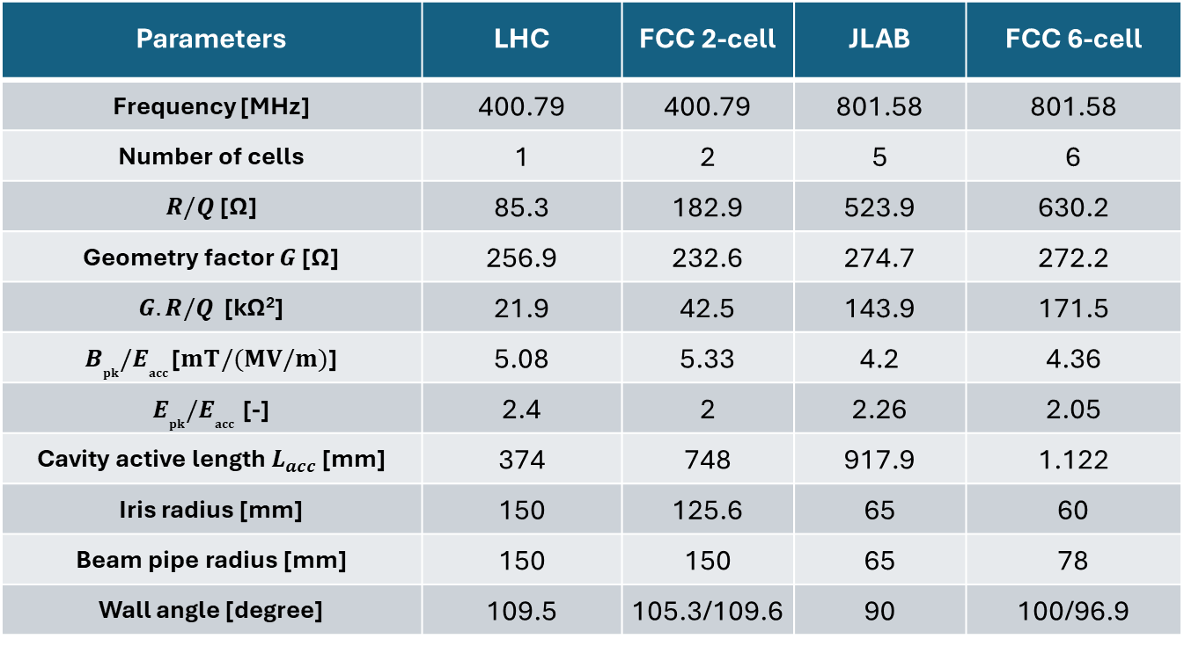
400 & 800 MHz cavity design parameters compared with existing cavities (LHC & JLAB test cavity)
Parameters | LHC | FCC 2-cell | JLAB | FCC 6-cell
Frequency [MHz] | 400.79 | 400.79 | 801.58 | 801.58
Number of cells | 1 | 2 | 5 | 6
$R/Q$ [Ω] | 85.3 | 182.9 | 523.9 | 630.2
Geometry factor $G$ [Ω] | 256.9 | 232.6 | 274.7 | 272.2
$G.R/Q$ [kΩ²] | 21.9 | 42.5 | 143.9 | 171.5
$B_{pk}{/E}_{acc}$ [$mT/(MV/m)$] | 5.08 | 5.33 | 4.2 | 4.36
$E_{pk}{/E}_{acc}$ [-] | 2.4 | 2 | 2.26 | 2.05
Cavity active length $L_{acc}$ [mm] | 374 | 748 | 917.9 | 1.122
Iris radius [mm] | 150 | 125.6 | 65 | 60
Beam pipe radius [mm] | 150 | 150 | 65 | 78
Wall angle [degree] | 109.5 | 105.3/109.6 | 90 | 100/96.9

Slide 6
TRL levels
TRL1 | Define basic properties
TRL2 | Analystical study
TRL3 | Proof of concept
TRL4 | Pre-prototype
TRL5 | Pre-prototype tested in lab
TRL6 | Prototype tested in relevant environment
TRL7 | Approved prototype
TRL8 | Pre-serial manufacturing
TRL9 | Series production (product on market)
Interpretation for cavities:
TRL3: sample test achieves specs
TRL4: a similarly shaped cavity without ports has achieved similar specs in a vertical cold test
TRL5: bare and dressed cavities with ports in vertical cold test has achieved specs
TRL6: fully dressed cavity with FPC in horizontal test achieves specs
TRL7: cavity in prototype CM achieves specs

Slide 7
1) 400 & 800 MHz cavity specifications.
Input for ESPP
Cavity configuration |  | single cell w/o ports | multi-cell w/o ports | bare with ports | dressed (He tank, HOMCs) | HTC (FPC, tuner, shielding) | CM
Test orientation |  | vertical | vertical | vertical | vertical | horizontal | horizontal
Technical readiness |  | TRL4 | TRL4 | TRL5 | TRL5 | TRL6 | TRL7
400 MHz | Cavity design | LHC |  | FCC 2-cell
 | E_{acc} (MV/m) | 8.5 @ 4.5K 10 @ 4.0 K | - | 13 | 12.4 | 11.8 | 10.6
 | Q₀ | 2.5x10⁹ @ 4.5 K 3.1x10⁹ @ 4.0 K | - | 3.3x10⁹ | 3.15x10⁹ | 3.0x10⁹ | 2.7x10⁹
800 MHz | Cavity design | FCC 1-cell | JLAB | FCC 6-cell
 | E_{acc} (MV/m) | Tests in 2026 | 30.0 | 24.8 | 23.6 | 22.5 | 20.25
 | Q₀ | Tests in 2026 | 3x10¹⁰ | 3.8x10¹⁰ | 3.65x10¹⁰ | 3.5x10¹⁰ | 3.0x10¹⁰
Achieved today
Goals

Slide 8
2) 400 & 800 MHz FPC & HOMC
 |  | High-power similar coupler | Low power test protoype | HP test (test box) | HTC (FPC, tuner, shielding) | CM with beam
TRL |  | TRL4 | TRL4 | TRL5 | TRL6 | TRL7
400 MHz | FPC P_{CW} (kW), 382 if matched, 500 to compensate failing cavities | LHC: 300 kW, tested at 500 kW (>= 500 may need full height waveguides) | S11 <-25 dB | 600 (only for Z) | 600 | 600
 | HOM P_{CW} (kW) | LHC Hook: 1 kW ? SOLEIL Hook: designed for 5 kW | S21 <-90 dB at fundamental mode, S21> -15 dB at HOMs | ⁻ | Test of fundamental mode rejection | Narrow band: 1 kW Wide band (coax, BLA): 7 kW (between cavities)
800 MHz | FPC P_{CW} (kW), 196 if matched, 250 with margin | SNS 805 MHz FPC: 550 kW pulsed, 50 kW average, ESS 704 MHz FPC: 1.2 MW pulsed, 60 kW average, SPS 800 MHz window (disk): 150 kW CW | S11 <-25 dB | 250 | 250 | 250
 | HOM P_{CW} (kW) | ? | S21 <-90 dB at fundamental mode, S21> -15 dB at HOMs |  | Test of fundamental mode rejection | Narrow band: 0.2 kW per C Wide band (BLA): 3 kW
Achieved today
Goals

Slide 9
3) TRL levels for cryomodules
TRL1 | Define basic properties
TRL2 | Analystical study
TRL3 | Proof of concept
TRL4 | Pre-prototype
TRL5 | Pre-prototype tested in lab
TRL6 | Prototype tested in relevant environment
TRL7 | Approved prototype
TRL8 | Pre-serial manufacturing
TRL9 | Series production (product on market)
Interpretation for CMs:
TRL4: CM assembled,
TRL5: low-power cold test (cryogenic performance, cavity frequencies, coupler adjustments, tuner)
TRL6: full power cold test in test stand
TRL7: test with beam (PERLE, LHC?)

Slide 10
3) 400 & 800 MHz CM: effort for (TRL5), full power cold test (TRL6) not yet funded
CM |  | Critical aspects | Manpower [FTE-y] | Material [MCHF] (excluding cavities, FPC, HOMS) | Timescale [years]
400 MHz | Collider | New key items: He tank, tuner, integration new FPCs, HOMs Complex and heavily manpower demanding, new large assembly infrastructure (SA18) Prototype (performance) in time for pre-series (costing) Transport from European labs/industry | ~ 50 FTE.y | ~ 9-10 MCHF (CERN effort) | 6-7
800 MHz | Booster/Collider (ttbar) | Depending on collaboration with labs (no commitment today) Relies on competence of labs → importance of prototyping Integration of HP FPC (CERN delivery) Engineering and QA/QC compatibility with non-EU standards and norms (pressure equipment) Overseas transportability | ~ 50 FTE.y | ~9-10 MCHF (estimated external effort) | 6-7

Slide 11
4) 400 & 800 MHz high-efficiency power sources
 |  | existing | Pre-protoype | High-power test | Tested on cavity | industrialisation
TRL |  | TRL4 | TRL4 | TRL5 | TRL6 | TRL7
400 MHz | type | LHC HE klystron | HE tristron | HE tristron | HE tristron | HE tristron
 | P_{CW} (kW) 382 in steady state, 500 to compensate for failing cavities | 350 | ? | 500 | 500 | 500
 | efficiency | 70% | 90% | 90% | 90% | 90%
800 MHz | type | IOT, (SPS) | tristron | tristron | tristron | tristron
 | P_{CW} (kW) 195 in steady state, 250 with margin | 40 kW | ? | 250 | 250 | 250
 | efficiency | ~68% | ? | 90% | 90% | 90%
Achieved today
Goals

Slide 12
5) 400 & 800 MHz cavities, couplers and cryomodules: infrastructure needed for TRL6 validation
Cavity Vertical Test Stand (2026), more or less existing at CERN
Self Excited Loop, precise RF power meters
RF amplifier: 400 MHz (700 W CW) & 800 MHz (400 W CW)
Vertical cryostats and cryogenics, instrumentation, controls, interlocks
High-Power Coupler Test Stand (2028), to be implemented
High power RF source in CW and circulator: 400 MHz - 600 kW , 800 MHz - 250 kW, either full power sources or resonant ring with LHC klystron (400 MHz, 2x multiplication) and resonant ring with IOT (800 MHz, 6-7x multiplication)
RF distribution (matched load and variable short circuit), cooling, bakeout, vacuum, LLRF & controls, interlocks
Cryomodule Test Stand (2031/32) to be implemented
Compatible with Horizontal Test Cryostat (HTC) and cryomodules
High power RF source in CW and circulator: 400 MHz - 500 kW , 800 MHz - 250 kW
RF distribution (waveguide switches), cooling, bunker, cryogenics, vacuum, LLRF & controls, interlocks

Slide 13
Technical highlights

Slide 14
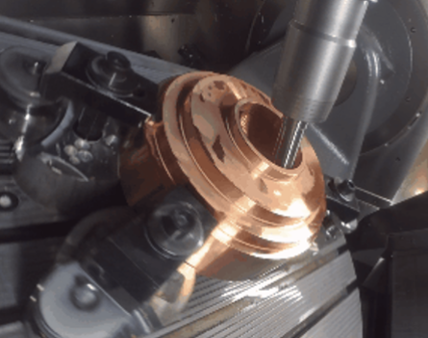
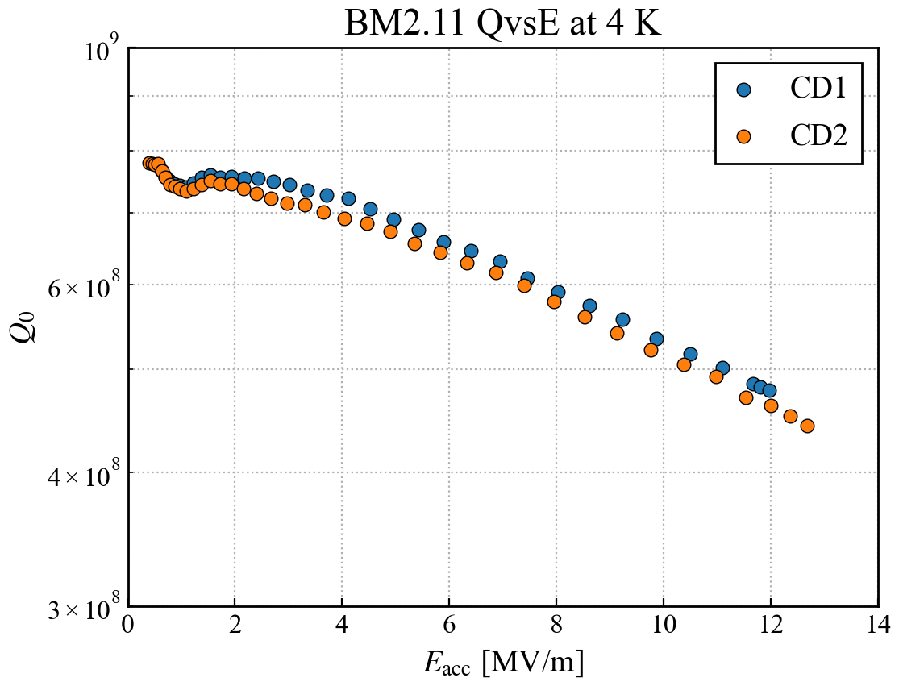
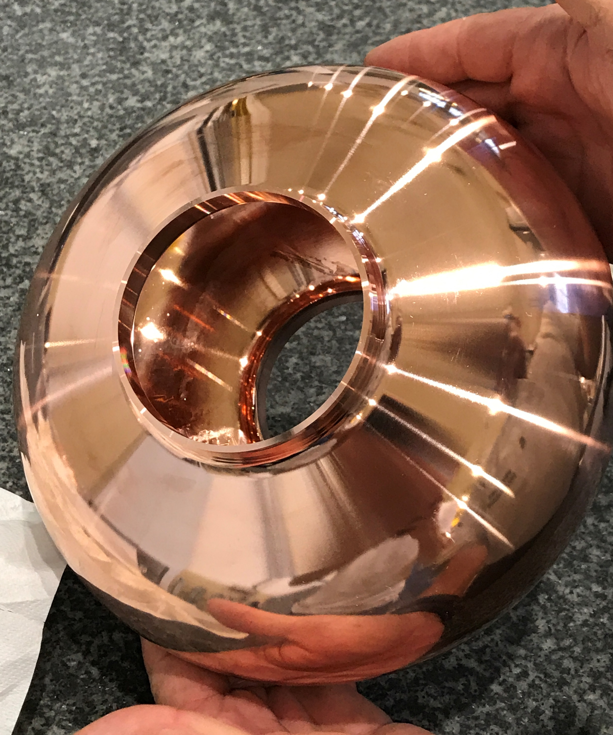
Cavity Performances – 1.3 GHz Nb/Cu
With “seamless” 1.3 GHz cavities, the chemical electropolishing and niobium coating using High Power Impulse Magnetron Sputtering (HiPIMS) has shown successful performances at cold temperature.
The scaled FCC targets for Eacc and Q0 have been reached on bulk machined cavities with a good reproducibility.
Some promising preliminary results were obtained recently on hydroformed cavities within the CERN-KEK collaboration.
BM2.11
Scaled FCC target
4.2 K
Kristof Brunner (CERN) - LCWS 2025

Slide 15
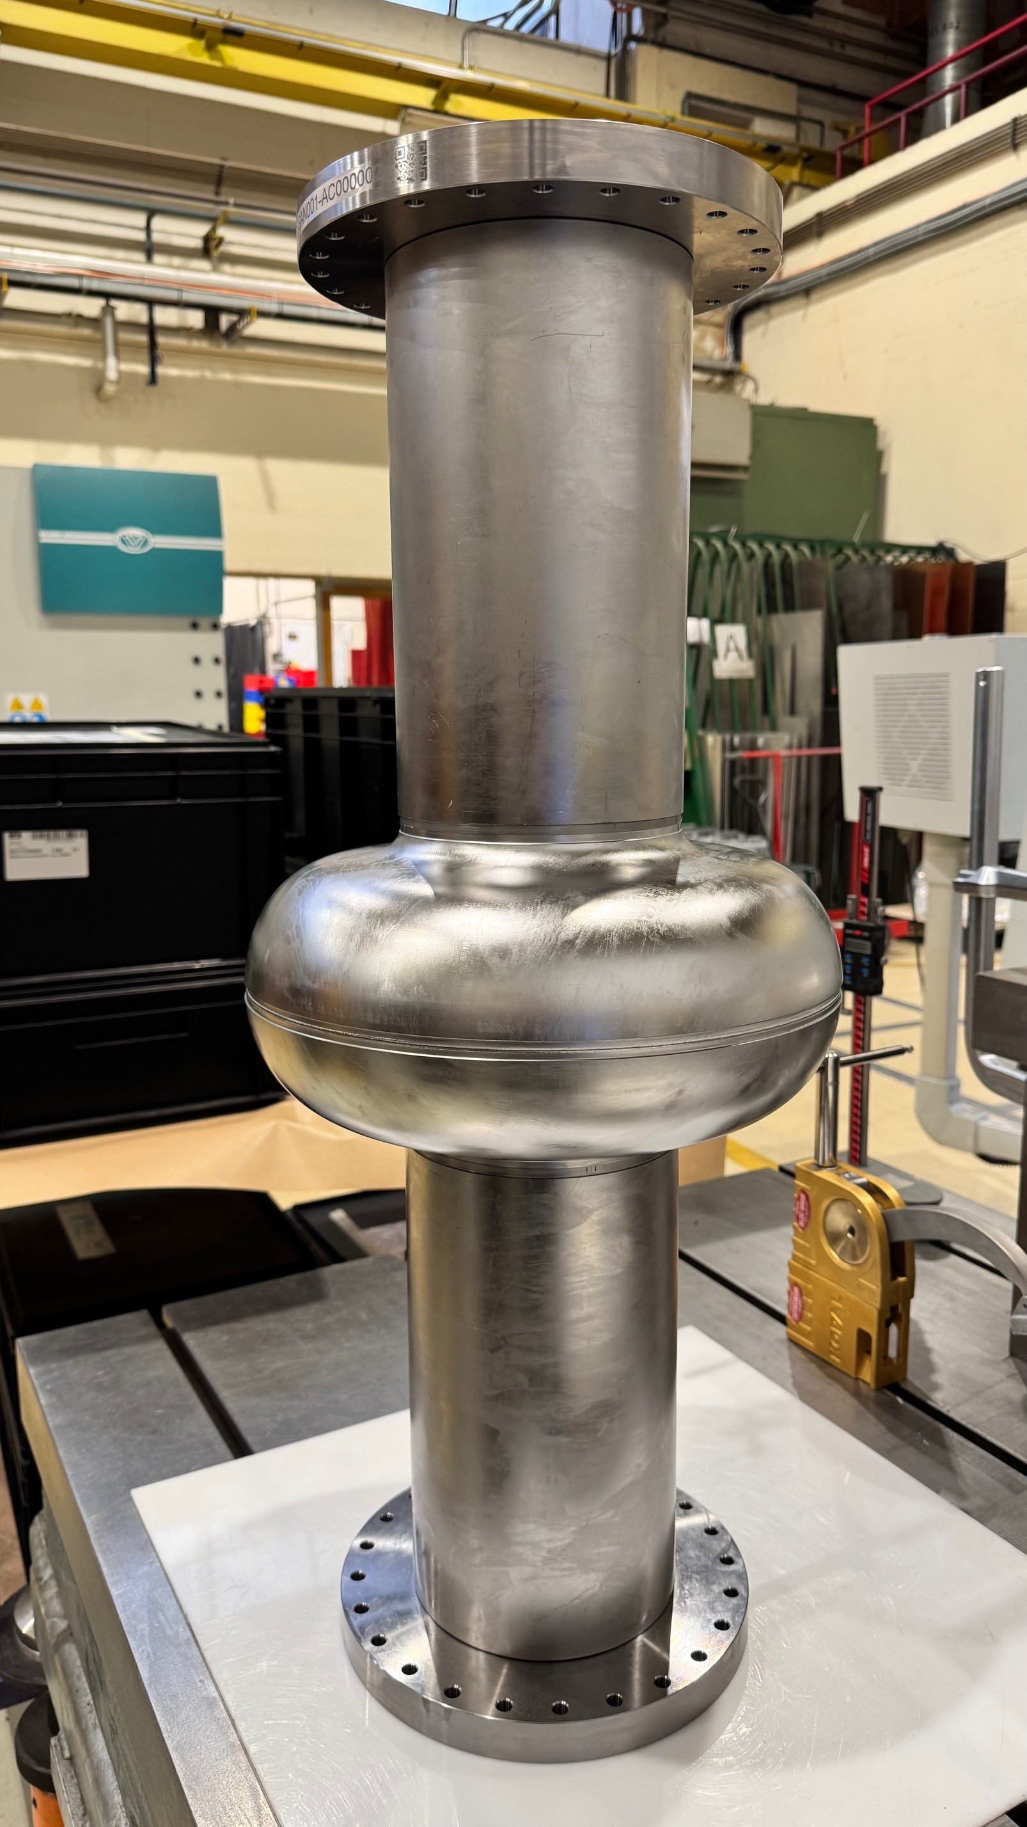
Cavity Fabrication – 800 MHz single cell
The main goal is to find the good recipe to reach ultra-high quality factor Q0 with the FCC design shape.
The mechanical design is also compatible with Nb3Sn thin film coating.
Single cell cavities are under fabrication at CERN/MME.
Knowledge of deep-drawing and electron beam welding process of niobium inherited from crab cavities manufacturing.
2 + 5 cavities will be produced in 2026.
Surface treatments will be done outside CERN :
Involvement of FNAL, IJCLab and Cornell University
3 additional cavities could be manufactured to explore both high Q0 and high gradient -> interesting for other projects
With DESY ? CEA ? KEK ?

Slide 16
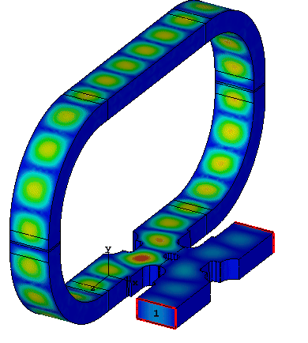
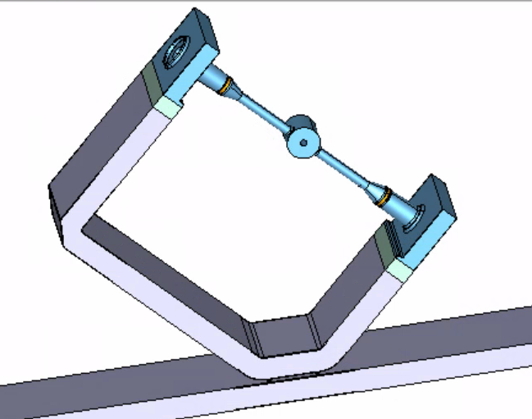
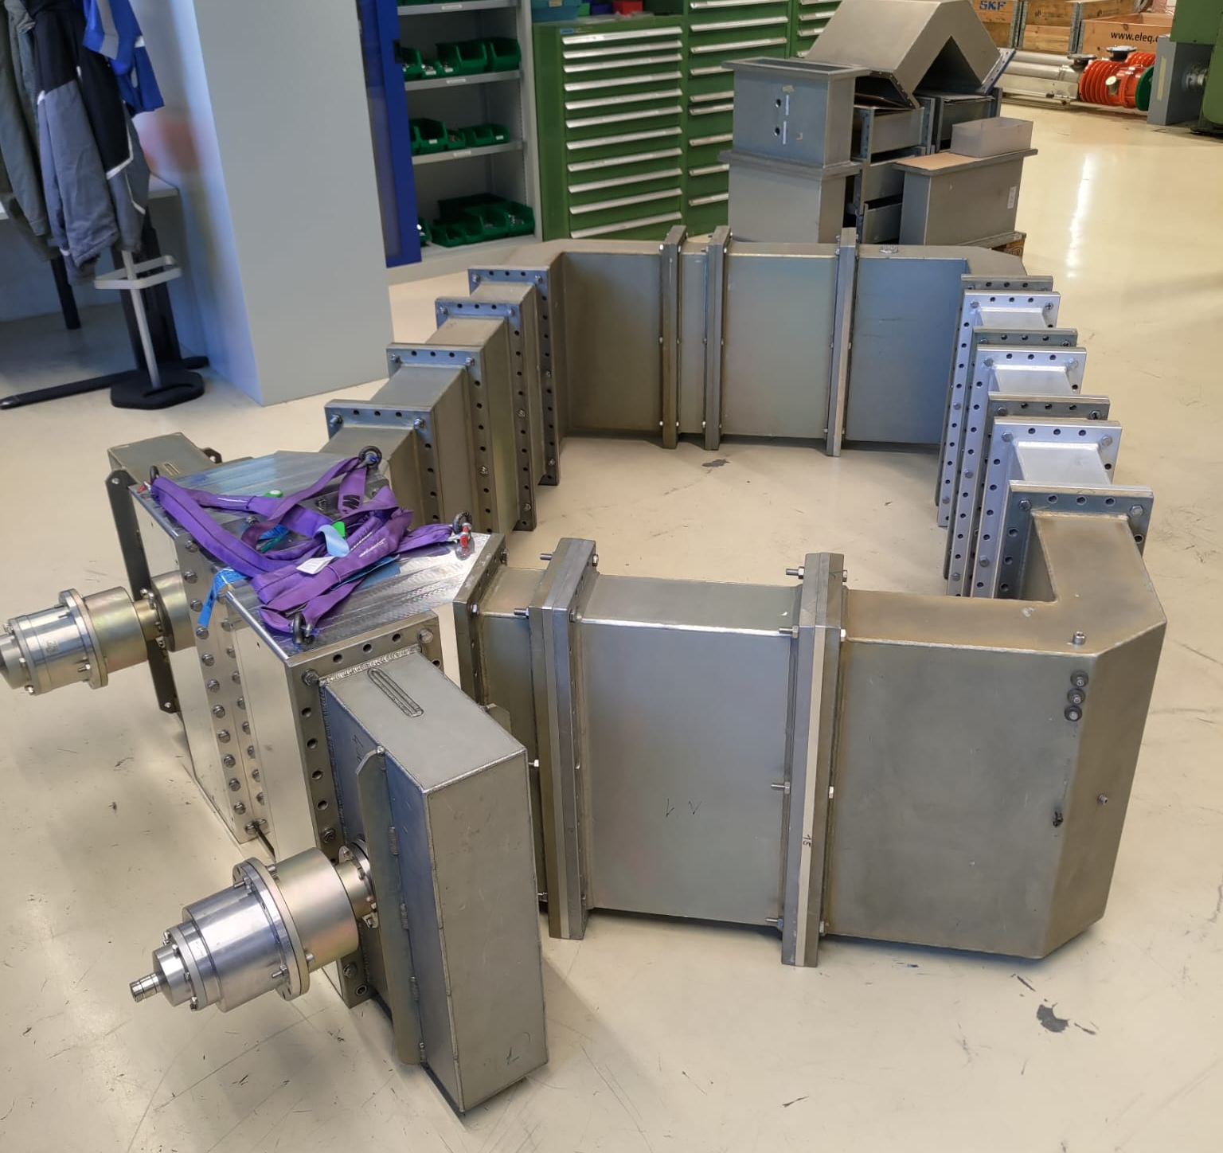
RF Resonant Ring
Prototype ring at 400 MHz in b. 864
Coupler 1
Test box
Coupler 2
A promising solution to test new Fundamental Power Couplers for FCC at nominal power with very limited investment (no need of high-power source).
Typical Gain ~ 10 dB.

Slide 17
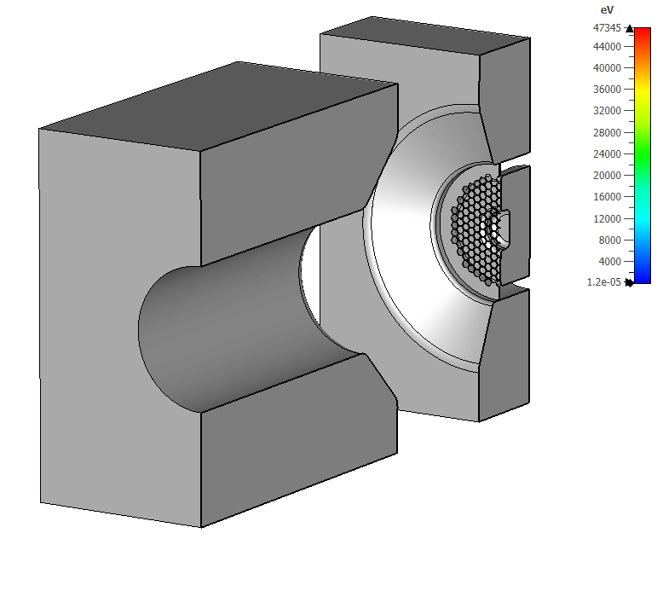
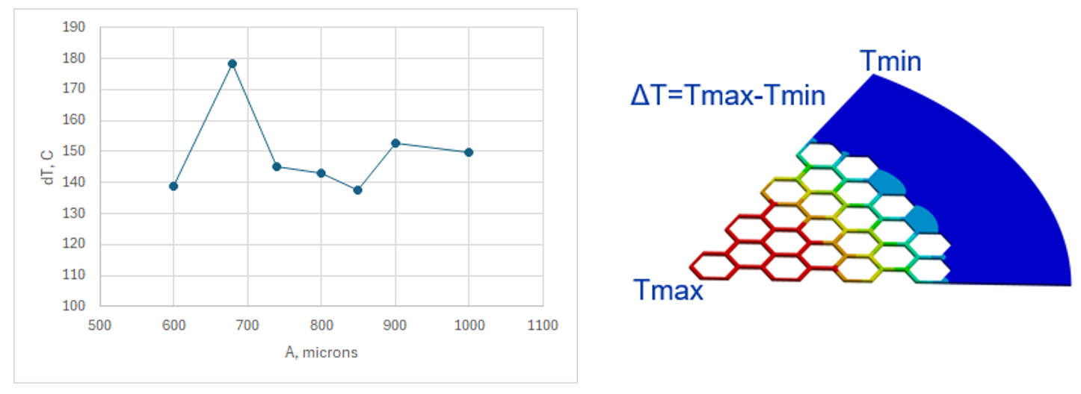
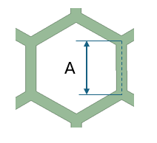
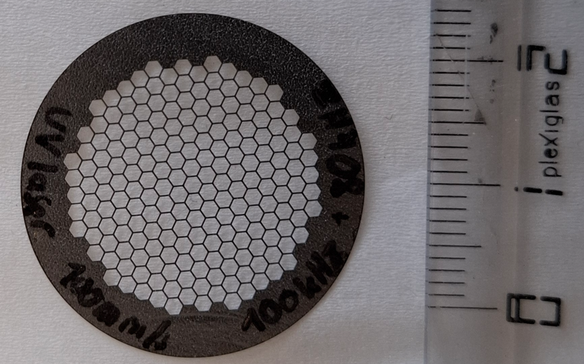
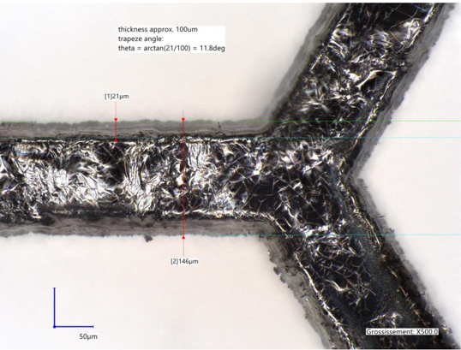
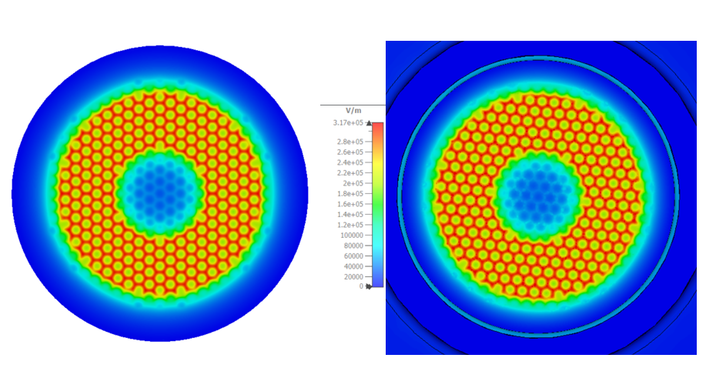
Gridded cathode is a core element of the tristron.
Tristron Gridded cathode
CST PIC simulations.
Gridded cathode development is a multi-discipline project:
Massive beam dynamics simulation and analysis.
Thermomechanical and deformation studies.
Mechanical integration with unique precision of 10μm.
Fabrication technology and reliability.
This project is on a good pace with (almost) all deliverables been following the planned schedule.
Temperature rise of the gid for the different beam opacity.
The full-scale grid was fabricated in January 2026 at CERN EN/MME using laser cutting technique on the 100 microns thick pyrolytic graphite (TPG) foil:
Electrostatic (left) and RF (right) field patterns in the middle of the cathode – grid gap.
Courtesey of Igor Syratchev and EN/MME team

Slide 18
Concluding..
All mentioned specs are phase-1 goals (Z, W, H) with phase 2 feasibility.
However, for phase-2 800 MHz cavities, we would like to see new materials like Nb3Sn to become usable.
More partners for Nb/Cu developments would be appreciated as well as a partner lab for the surface treatments of the series of 400 MHz 2-cell cavities.
For both phases, high-Q at moderate gradients is a priority.
.. Along with high-efficiency RF sources (+resonant rings), and the needed development for couplers and cryomdules towards TRL6 level.

