Slide 1
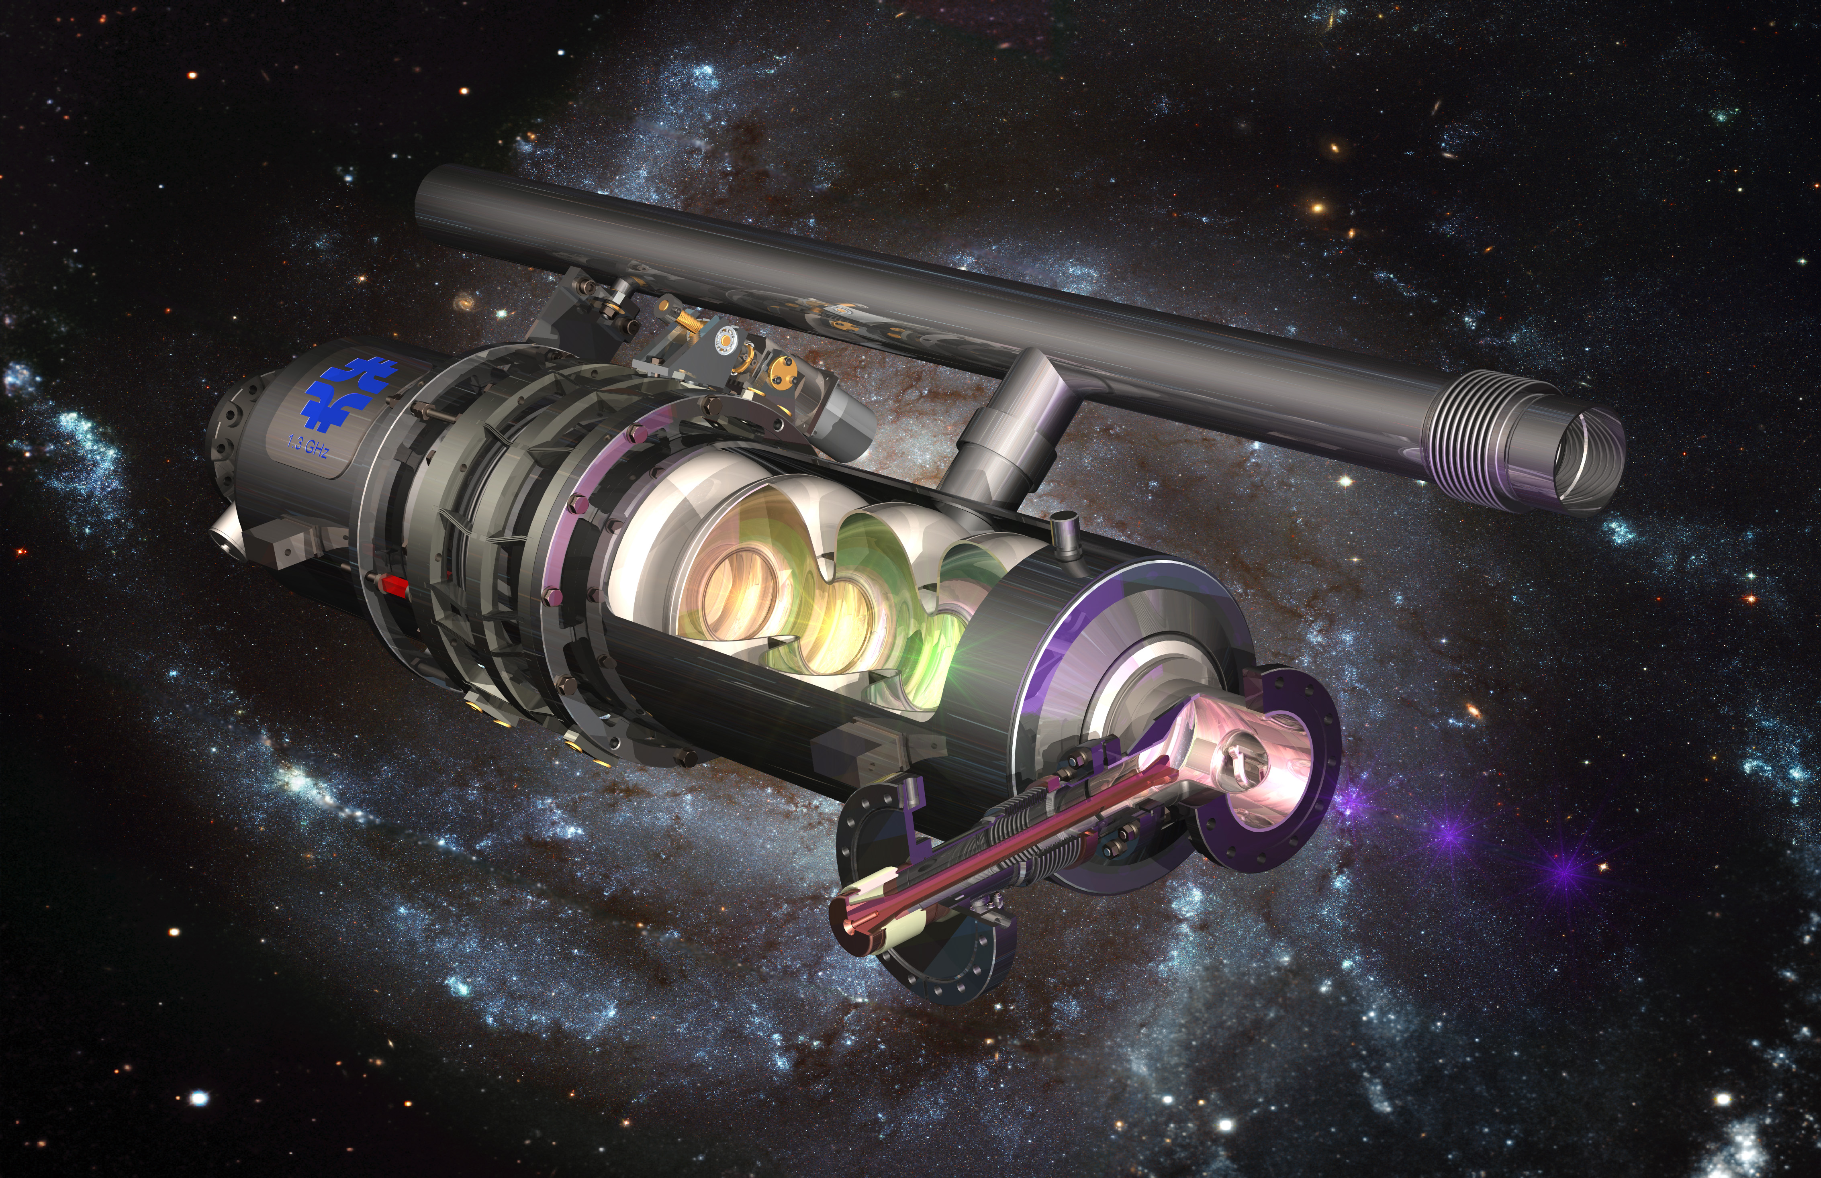
SRF R&D needs for PIP-II, the Fermilab complex, and a muon collider
February 5, 2026
Sergey Belomestnykh
Fermilab

Slide 2
Outline
PIP-II SRF R&D needs
SRF R&D for Fermilab Accelerator Complex evolution
SRF R&D for muon Collider
Summary

Slide 3
SRF R&D for PIP-II
1

Slide 4
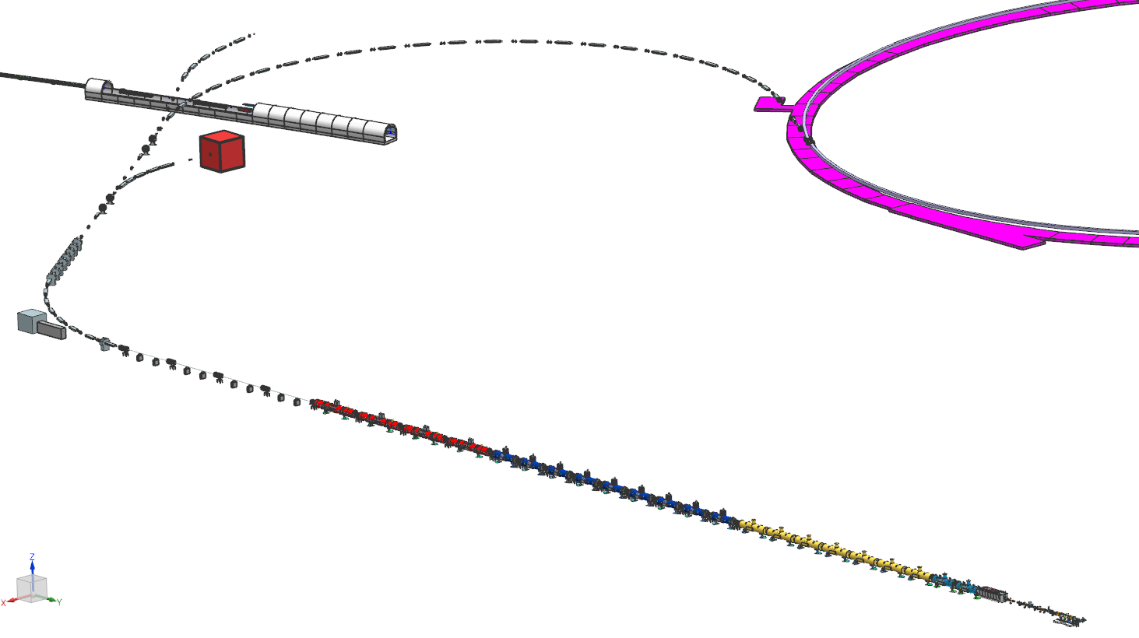
PIP-II at Fermilab
Proton Improvement Plan II (PIP-II) is an upgrade of the Fermilab accelerator complex to enable the world’s most intense beam of neutrinos to LBNF/DUNE
Space for Mu2e-II
Beam line
PIP-II Scope
800 MeV, 2mA H⁻ SRF linac
CW RF Operations
Linac-to-Booster transfer line
Accelerator Complex Upgrades
Booster
Recycler
Main Injector (MI)
Conventional Facilities
PIP-II Beam Power
1.2 MW MI proton beam on target
Upgradable to multi-MW
Beam Transfer Line
FNAL Booster
Main Ring Tunnel
25 kW Dump
Space reserved for two CMs (1 GeV)
and beam separator
Dump
800 MeV SRF Linac
CW RF Operations
HB650, 4(+2) CM x 6 Cav, 650 MHz
LB650, 9 CM x 4 Cav, 650 MHz
Front End
SSR2, 7 CM x 5 Cav, 325 MHz
SSR1, 2 CM x 8 Cav, 325 MHz
HWR, 8 Cavities, 162.5 MHz

Slide 5
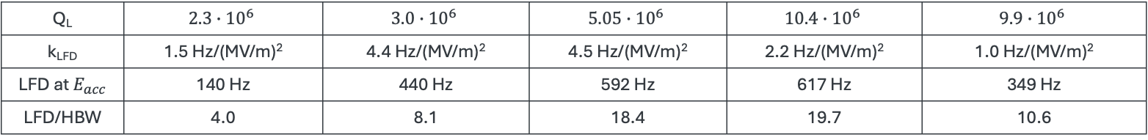
PIP-II SRF cavities
Q_{L} | $$2.3∙{10}^{6}$$ | $$3.0∙{10}^{6}$$ | $$5.05∙{10}^{6}$$ | $$10.4∙{10}^{6}$$ | $$9.9∙{10}^{6}$$
k_{LFD} | 1.5 Hz/(MV/m)² | 4.4 Hz/(MV/m)² | 4.5 Hz/(MV/m)² | 2.2 Hz/(MV/m)² | 1.0 Hz/(MV/m)²
LFD at $E_{acc}$ | 140 Hz | 440 Hz | 592 Hz | 617 Hz | 349 Hz
LFD/HBW | 4.0 | 8.1 | 18.4 | 19.7 | 10.6

Slide 6
R&D to improve SRF linac performance
PIP-II is in production mode. No on-project R&D is planned at this stage.
However, there are two important general R&D topics that can help improving the SRF linac performance (benefiting both the project and operations):
Prevention and mitigation of field emission (FE), which still rears its ugly head from time to time
Resonance control (RC)
R&D on FE prevention and mitigation includes
Careful optimization of HPR for each cavity shape
Robot-assisted cleanroom assembly of cavity strings (see Genfa Wu’s presentation)
In situ processing of FE (see Bianca Giaccone’s presentation)

Slide 7
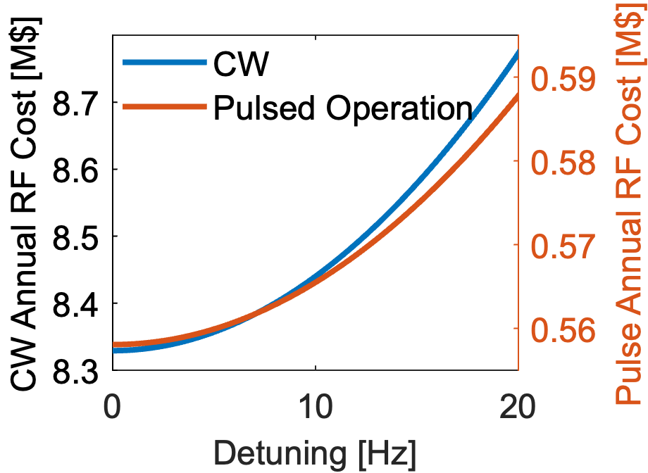
R&D on resonance control
Why resonance control?
Initial operation of PIP-II will be with pulsed beam (0.54 ms) at 20 Hz repletion rate but with CW RF operation. Pulsed RF is not in the PIP-II scope.
Operating SRF cavities in pulsed mode would reduce the annual cost of operation by a factor of ~10.
Challenge: cavities have narrow half-bandwidths (HBW in the range 30-50 Hz), while the expected detuning due to Lorentz force is up to ~20 times larger than HBW.
In addition, there will be microphonics noise on top of LFD.
Need to develop a robust AI/ML RC.
There are opportunities to experiment with RC during upcoming PIP-II cryomodule tests in the next ~3 years

Slide 8
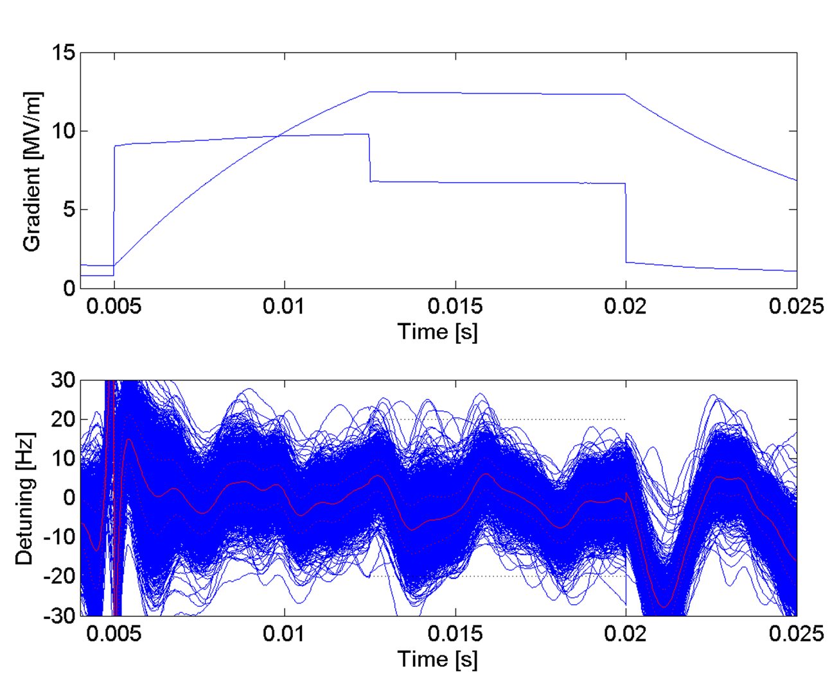
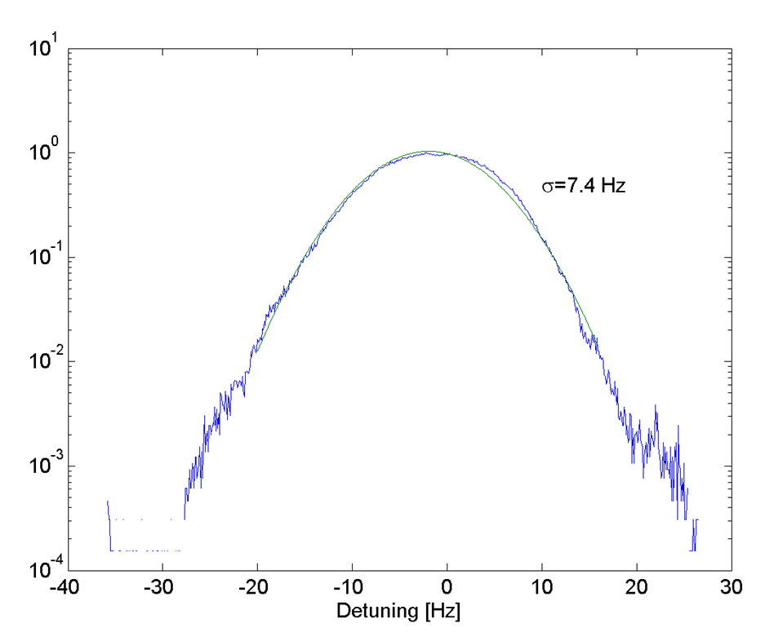
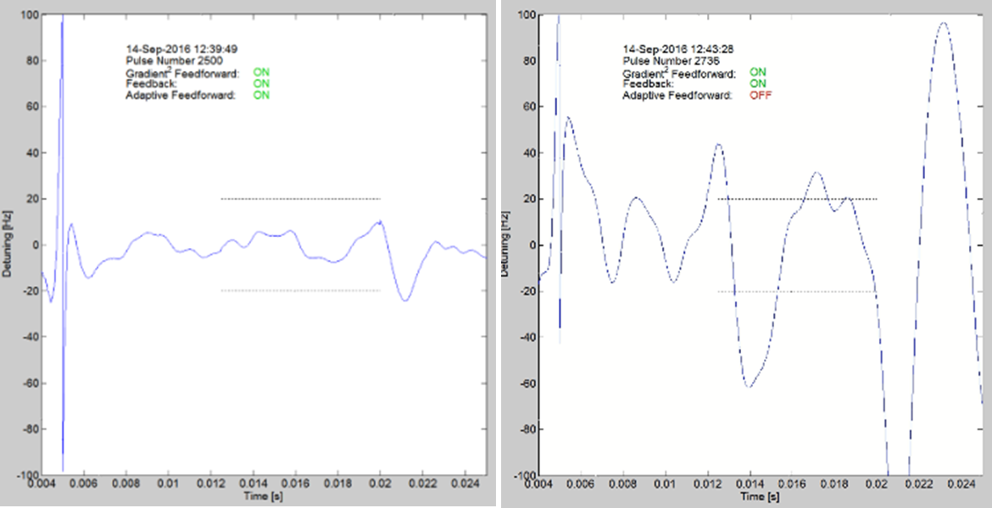
Prior results (~10 years ago)
0.55 ms PIP-II
Testing was done on SSR1 cavities (30 Hz HBW) at the STC at 2 K.
RF was driven open loop, no phase and amplitude feedback, only piezo controls for detuning. A combination of feedback loop and gradient square and adaptive feed-forward LFD compensation was studied under following conditions:
>12.5 MV/m (spec); 25 Hz rep rate (20 Hz spec); 7.5 ms fill; 7.5 ms flattop (0.54 ms spec).
Longer flattop to help diagnose performance.
Without adaptive compensation the detuning was almost an order of magnitude worse.
Without the other two compensation methods, the cavity readily fell off resonance.
Achieved ~7.4 Hz rms detuning on the flattop.
Specification for peak detuning is 20 Hz, so further improvement in rms of approximately factor of 2 is needed.
Adaptive ON
Adaptive OFF

Slide 9
SRF for Fermilab Accelerator Complex evolution
2

Slide 10
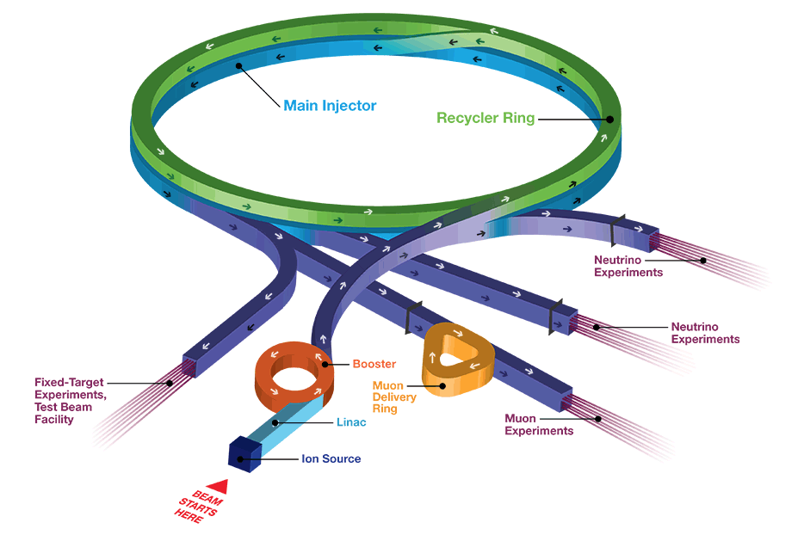
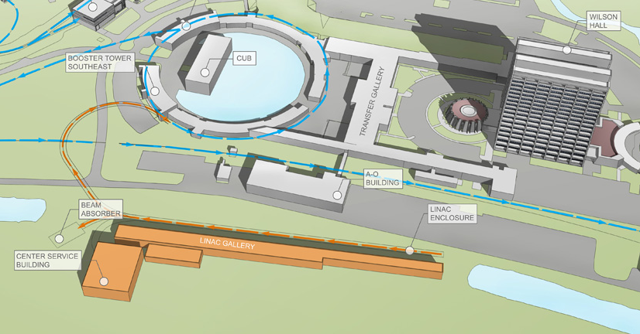
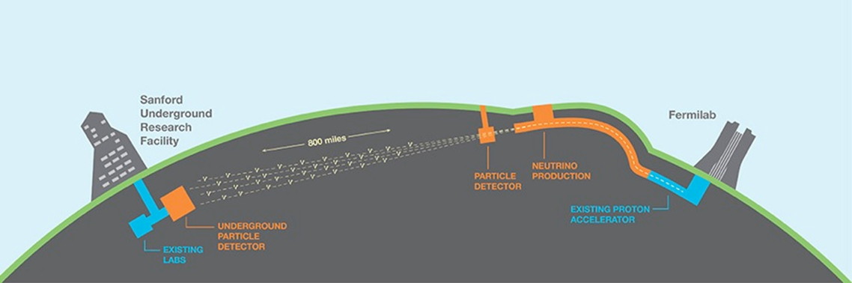
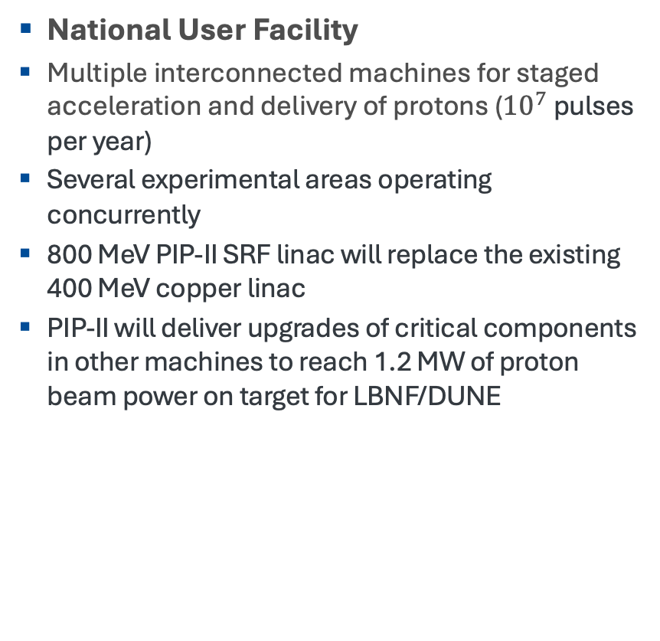
Fermilab Accelerator Complex
National User Facility
Multiple interconnected machines for staged acceleration and delivery of protons (${10}^{7}$ pulses per year)
Several experimental areas operating concurrently
800 MeV PIP-II SRF linac will replace the existing 400 MeV copper linac
PIP-II will deliver upgrades of critical components in other machines to reach 1.2 MW of proton beam power on target for LBNF/DUNE

Slide 11
ACE-MIRT – the next step
ACE-MIRT = Accelerator Complex Evolution - Main Injector Ramp and Targetry
Further beam power on target increase (at 120 GeV) can be achieved through higher beam intensity or faster cycling of MI.
The former option requires replacing Booster/Recycler with a new machine (several options are under consideration).
The latter option would utilize the excess beam from PIP-II/Boster (also a risk mitigation strategy if intensity ramp up of PIP-II/Booster is slower than expected).
Reducing the MI 120 GeV cycle time from present 1.07 s to 0.65 s would require installation of 17 normal conducting cavities in addition to 20 existing ones.
A tunable (~1%) 53 MHz SRF cavity may be an attractive option to replace 37 NC cavities with 6 SRF cavities, see Kellen McGee’s presentation.

Slide 12
ACE-BR?
ACE-BR = Accelerator Complex Evolution – Booster Replacement
Further upgrades of Fermilab Accelerator Complex are nebulous at present.
At some point we will need to replace Booster and eliminate Recycler Ring to remove intensity limitations due to these accelerators.
There are several options including an 8-GeV SRF linac, a Rapid Cycling Synchrotron (RCS) or a combination of the two. An accumulator ring may be required.
The final choice would depend on what is the next big project at Fermilab. A muon collider demonstrator perhaps? Upgrading PIP-II SRF linac energy for other applications?
In any scenario, there will be a need for SRF technology. So, any new advances in making SRF more efficient will be beneficial.

Slide 13
SRF R&D for muon collider
3

Slide 14
Muon Collider layout and RF technologies
NC RF for capture and cooling
High-gradient cavities in high magnetic field
High charge, Huge beam size, Important beam losses
Peak RF power
Little synergy with other projects
SRF for acceleration
High charge, short bunch
High efficiency at high gradient
Maintain beam quality
Longitudinal and transverse stability

Slide 15
Muon Collider layout and RF technologies
NC RF for capture and cooling
High-gradient cavities in high magnetic field
High charge, Huge beam size, Important beam losses
Peak RF power
Little synergy with other projects
SRF for acceleration
High charge, short bunch
High efficiency at high gradient
Maintain beam quality
Longitudinal and transverse stability

Slide 16
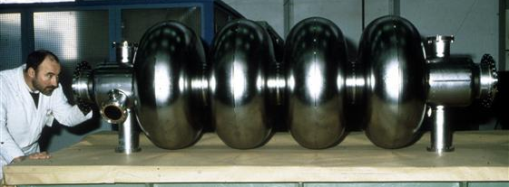
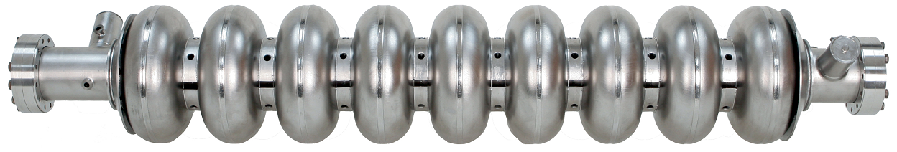
SRF for accelerators (10 TeV c.m. MC)
SC LINAC (88 MHz and 264 MHz) and RLA1 are not included, no design yet
SRF technology:
Bulk Nb or Nb/Cu for 352 MHz
Bulk Nb (TESLA cavities) for 1.3 GHz and 1.06 GHz

Slide 17
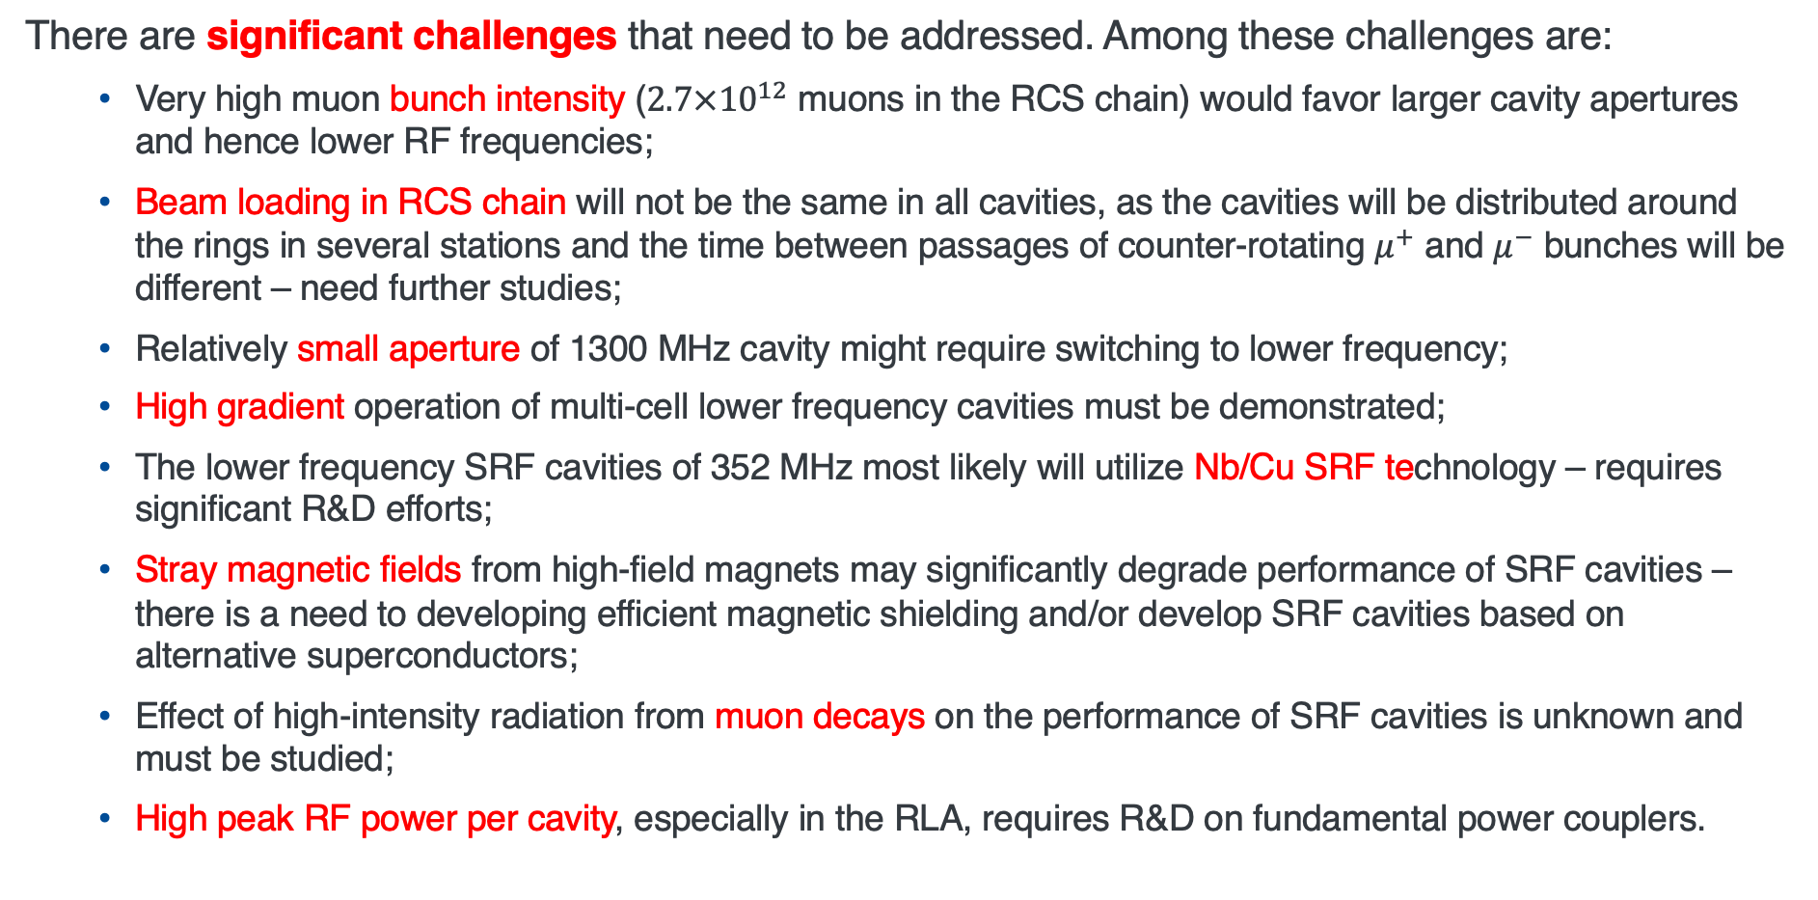
MC challenges for SRF systems
There are significant challenges that need to be addressed. Among these challenges are:
Very high muon bunch intensity ($2.7×{10}^{12}$ muons in the RCS chain) would favor larger cavity apertures and hence lower RF frequencies;
Beam loading in RCS chain will not be the same in all cavities, as the cavities will be distributed around the rings in several stations and the time between passages of counter-rotating $μ^{+}$ and $μ^{−}$ bunches will be different – need further studies;
Relatively small aperture of 1300 MHz cavity might require switching to lower frequency;
High gradient operation of multi-cell lower frequency cavities must be demonstrated;
The lower frequency SRF cavities of 352 MHz most likely will utilize Nb/Cu SRF technology – requires significant R&D efforts;
Stray magnetic fields from high-field magnets may significantly degrade performance of SRF cavities – there is a need to developing efficient magnetic shielding and/or develop SRF cavities based on alternative superconductors;
Effect of high-intensity radiation from muon decays on the performance of SRF cavities is unknown and must be studied;
High peak RF power per cavity, especially in the RLA, requires R&D on fundamental power couplers.

Slide 18
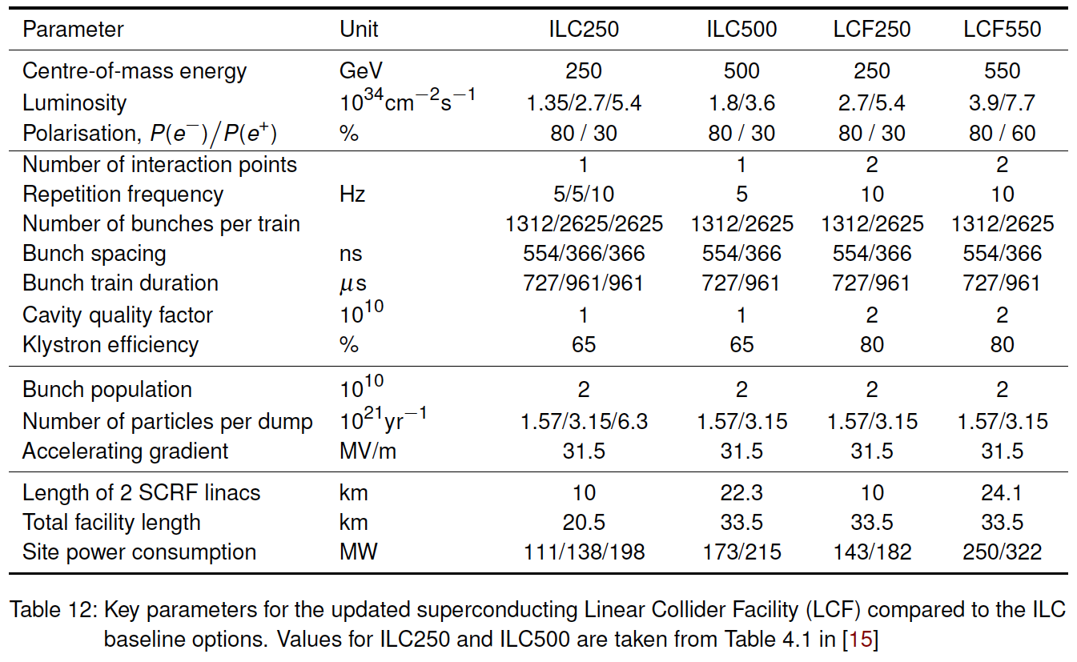
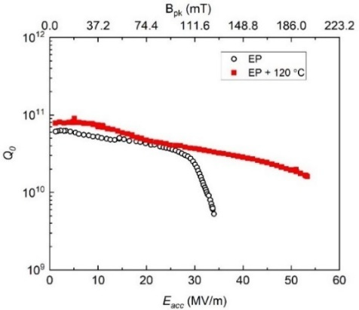
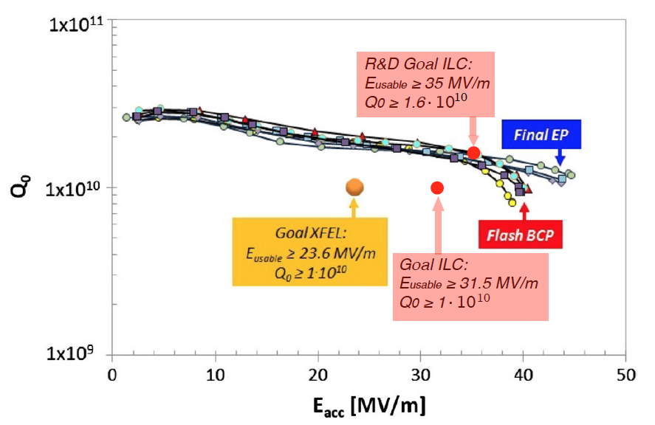
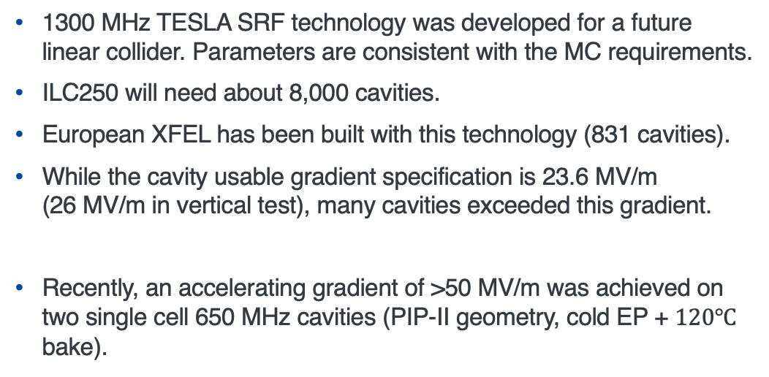
State of the art: bulk Nb
1300 MHz TESLA cavity
1300 MHz TESLA SRF technology was developed for a future linear collider. Parameters are consistent with the MC requirements.
ILC250 will need about 8,000 cavities.
European XFEL has been built with this technology (831 cavities).
While the cavity usable gradient specification is 23.6 MV/m (26 MV/m in vertical test), many cavities exceeded this gradient.
Recently, an accelerating gradient of >50 MV/m was achieved on two single cell 650 MHz cavities (PIP-II geometry, cold EP + $120℃$ bake).
Sample of best XFEL cavity results
53.3 MV/m was reached on B9AS-AES-003 650 MHz cavity at Fermilab

Slide 19
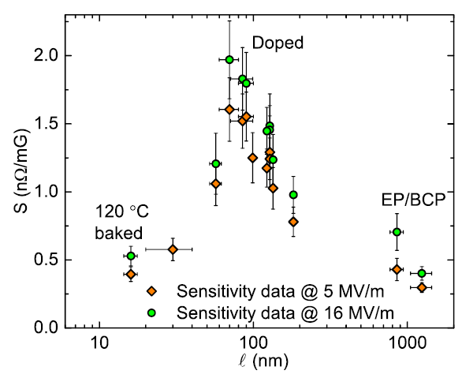
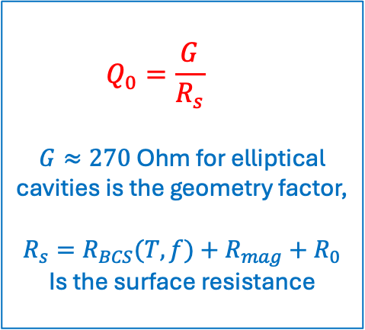
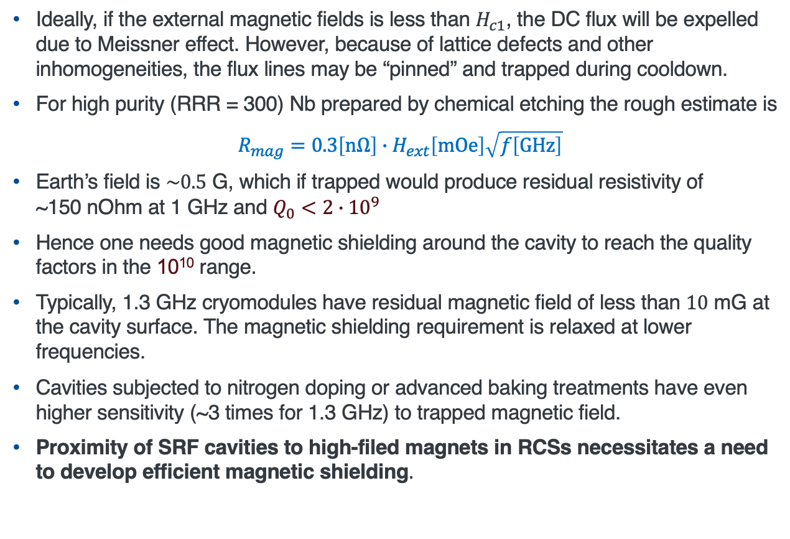
Sensitivity to residual magnetic field
$$Q_{0}=\frac{G}{R_{s}}$$
$G≈270$ Ohm for elliptical cavities is the geometry factor,
$$R_{s}=R_{BCS}(T,f)+R_{mag}+R_{0}$$
Is the surface resistance
Ideally, if the external magnetic fields is less than $H_{c1}$, the DC flux will be expelled due to Meissner effect. However, because of lattice defects and other inhomogeneities, the flux lines may be “pinned” and trapped during cooldown.
For high purity (RRR = 300) Nb prepared by chemical etching the rough estimate is
$$R_{mag}=0.3\left[\text{n}\text{Ω}\right]∙H_{ext}\left[\text{mOe}\right]\sqrt{f\left[\text{GHz}\right]}$$
Earth’s field is $\sim 0.5$ G, which if trapped would produce residual resistivity of ~150 nOhm at 1 GHz and $Q_{0}<2∙{10}^{9}$
Hence one needs good magnetic shielding around the cavity to reach the quality factors in the 10¹⁰ range.
Typically, 1.3 GHz cryomodules have residual magnetic field of less than $10$ mG at the cavity surface. The magnetic shielding requirement is relaxed at lower frequencies.
Cavities subjected to nitrogen doping or advanced baking treatments have even higher sensitivity (~3 times for 1.3 GHz) to trapped magnetic field.
Proximity of SRF cavities to high-filed magnets in RCSs necessitates a need to develop efficient magnetic shielding.

Slide 20
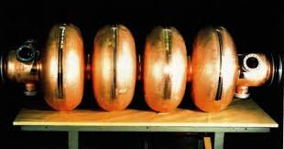
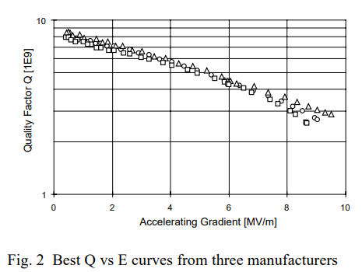
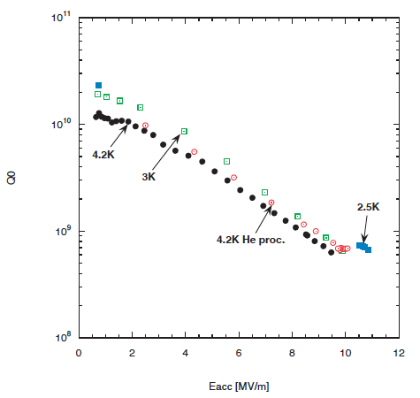
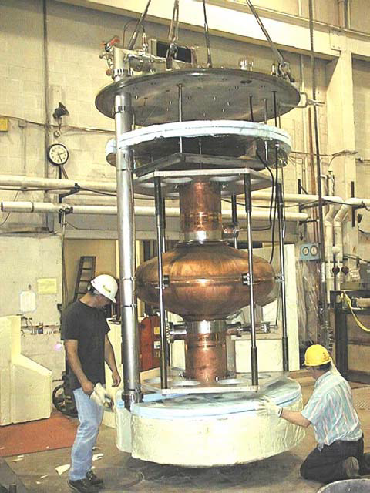
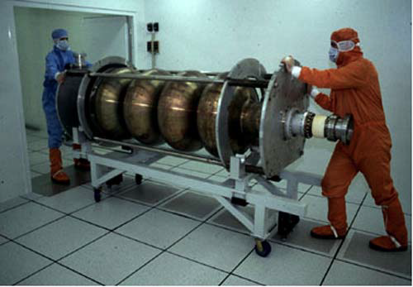
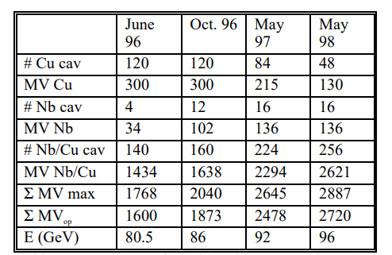

Nb/Cu SRF technology
352 MHz LEP2 cavity (Nb/Cu)
Why Nb/Cu? – Save on Nb (material cost + large sheets may be difficult to come by).
LEP2 is the only example of a large-scale deployment of Nb/Cu SRF cavities (352 MHz), operated at 4.5 K.
Used magnetron sputtering technology.
Performance does not meet Muon Collider requirements (average gradient was up to 7.5 MV/m at the end of LEP2 run), need x2 improvement in gradient.
There was a CERN-Cornell collaboration on a 200 MHz SRF cavity for an earlier version of MC. The cavity was coaled using CERN Nb/Cu technology, tested at Cornell. The cavity reached 10 MV/m with $Q$ of $\sim 0.6×{10}^{9}$ (circa 2003).
Need performance improvement!
200 MHz test results
LEP2 SRF cavity
Number of cavities in LEP and available voltage
200 MHz SRF cavity

Slide 21
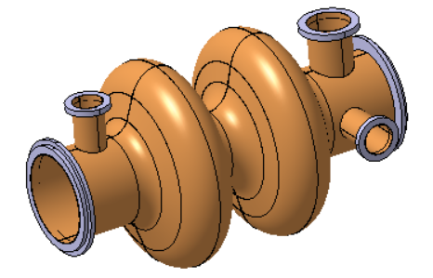
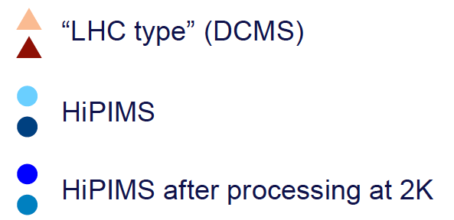
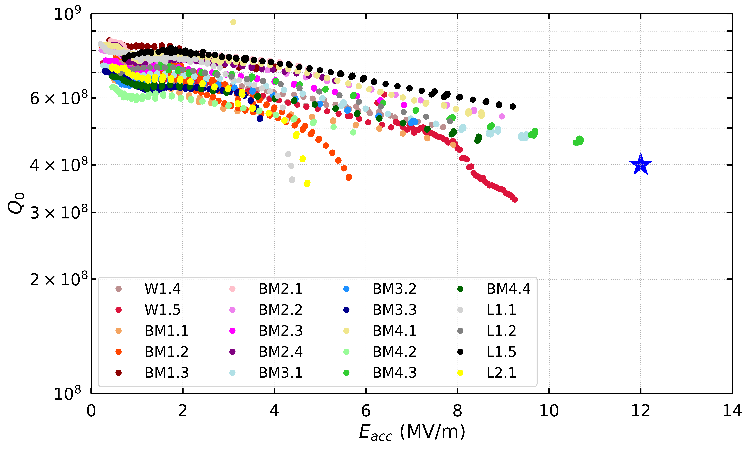
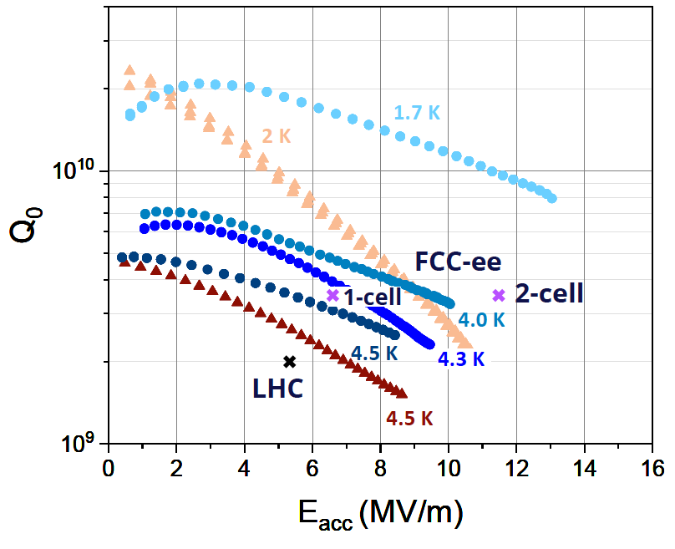
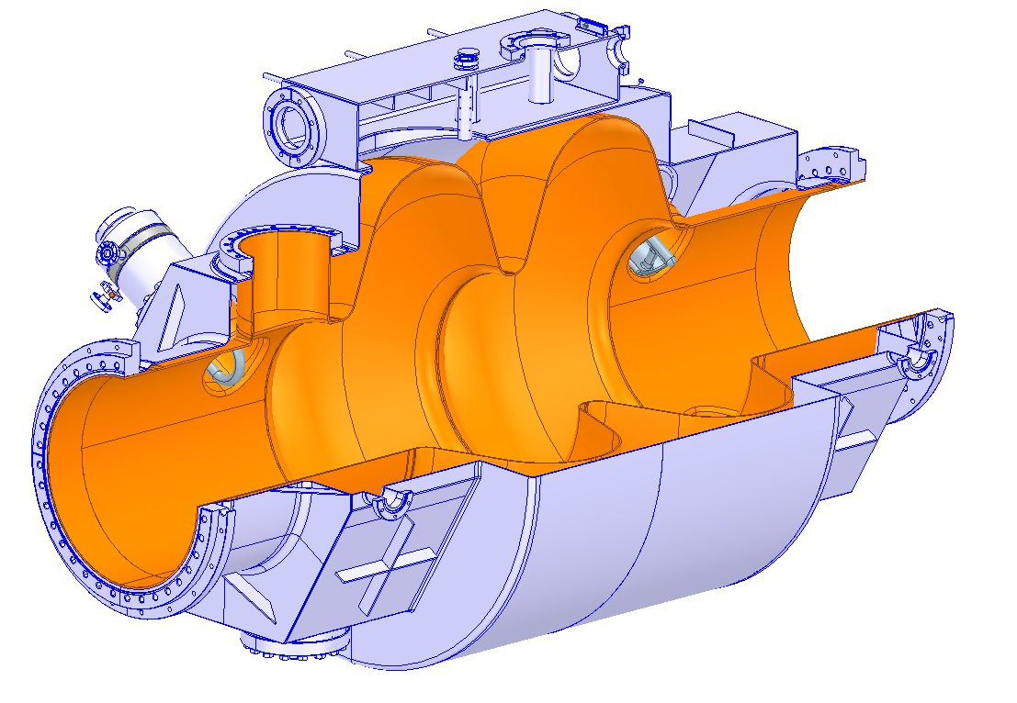
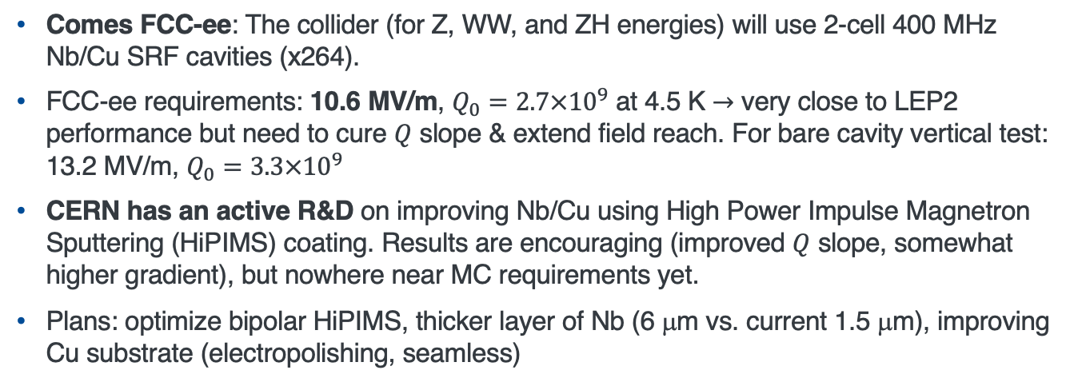

Nb/Cu state of the art
Comes FCC-ee: The collider (for Z, WW, and ZH energies) will use 2-cell 400 MHz Nb/Cu SRF cavities (x264).
FCC-ee requirements: 10.6 MV/m, $Q_{0}=2.7×{10}^{9}$ at 4.5 K $→$ very close to LEP2 performance but need to cure $Q$ slope & extend field reach. For bare cavity vertical test: 13.2 MV/m, $Q_{0}=3.3×{10}^{9}$
CERN has an active R&D on improving Nb/Cu using High Power Impulse Magnetron Sputtering (HiPIMS) coating. Results are encouraging (improved $Q$ slope, somewhat higher gradient), but nowhere near MC requirements yet.
Plans: optimize bipolar HiPIMS, thicker layer of Nb (6 μm vs. current 1.5 μm), improving Cu substrate (electropolishing, seamless)
$Q$ vs. $E$ at 4.2 K for 1.3 GHz Nb/Cu cavities. Blue star indicated FCC-ee requirements scaled from 400 MHz.
400 MHz Nb/Cu results (2023)
400 MHz 2-cell FCC-ee cavity

Slide 22
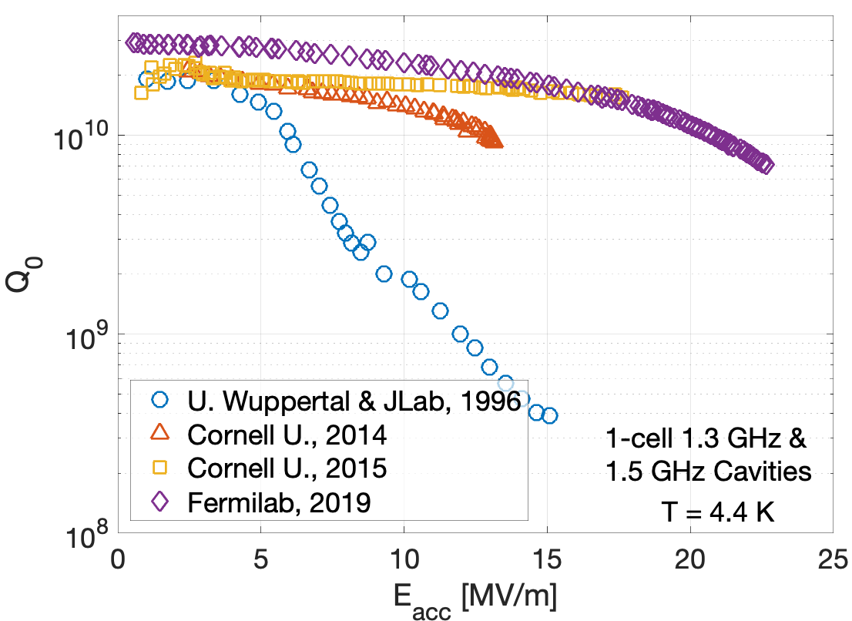
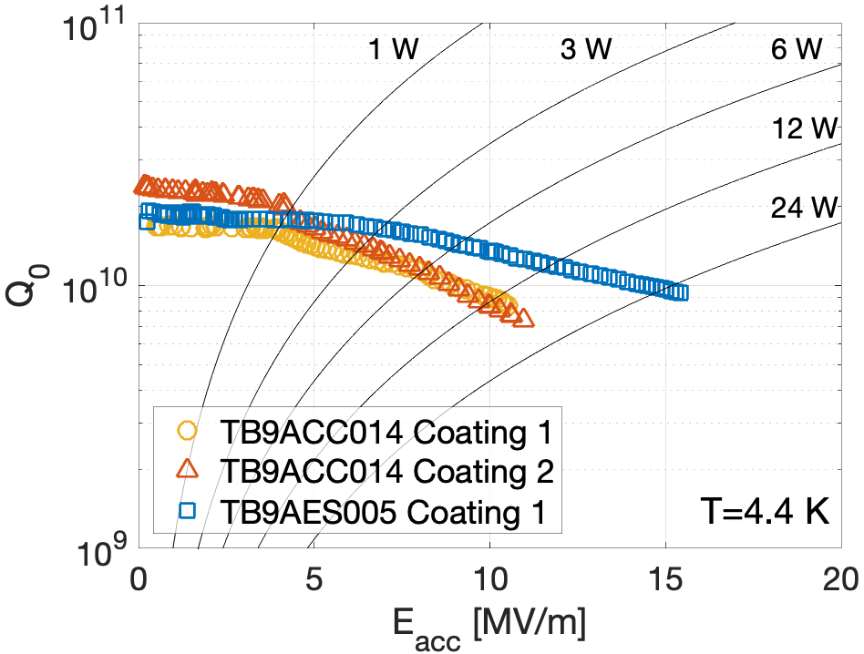

State of the art: Nb₃Sn
The most progress to date has been made with the vapor diffusion process of forming Nb₃Sn layer on Nb.
The process takes place in a high vacuum furnace, which is heated to about $1100℃$.
The tin source is heated to $1200℃$ or even higher temperature. The tin vapor coats the cavity inner surface and alloys with Nb.
There was progress over the years, but:
Accelerating gradient is still relatively low
Reproducibility from coating to coating is not good
Material is brittle (especially at room temperature), and cavities require very gentle handling
If a robust procedure is developed, Nb₃Sn cavities might be a good option as they are more tolerant to trapped magnetic flux.
More on Nb3Sn in later presentations

Slide 23
R&D plan for the next 5 years
The following plan was presented to ESPPU:
The final choice of RF frequencies, should be based on the beam dynamics requirements. However, the RF power requirements and cryomodule integration issues might play a significant role.
Based on the beam dynamics requirements, perform optimization and concept designs of SRF cavities for low energy acceleration in the SC linac and RLAs and high energy acceleration in RCSs. Select one or two most challenging designs for prototyping.
Develop an optimal cavity treatment recipe for high gradient operation and low sensitivity to residual magnetic field. Demonstrate the cavity performance in vertical testing. Utilize synergies as much as possible.
Develop HOM damping schemes as well as HOM coupler and FPC (Fundamental Power Coupler) designs per requirements based on the collective effects and beam dynamic studies.
Investigate cavity tuner technologies capable of providing the necessary tuning speeds and ranges with the required precision.
The designed cavities need to be integrated into a conceptual cryomodule design.

Slide 24
R&D plan for the second 5 years
The following plan was presented to ESPPU:
Based on the concepts develop during the first 5 years, the full conceptual design of the RF systems for the linac and RCSs will be developed at this stage. This will include
The designs of cryomodules for the cavities operating at different frequencies.
RF power and cryogenic distribution, tunnel layout, etc.
Prototypes of the cavities and possibly cryomodules will be built and tested to verify the design concepts.
While the current baseline assumes an accelerating gradient of 30 MV/m, possible improvements in the SRF technology over the previous 5 years could enhance this value significantly.
Consequently, the number of required cavities could be reduced, decreasing the complexity of the integration as well as the size of the cryogenic plant.
Additionally, the overall power consumption of the RF system could possibly be reduced.
Thus, an iteration on the overall SRF system design where appropriate might be necessary.

Slide 25
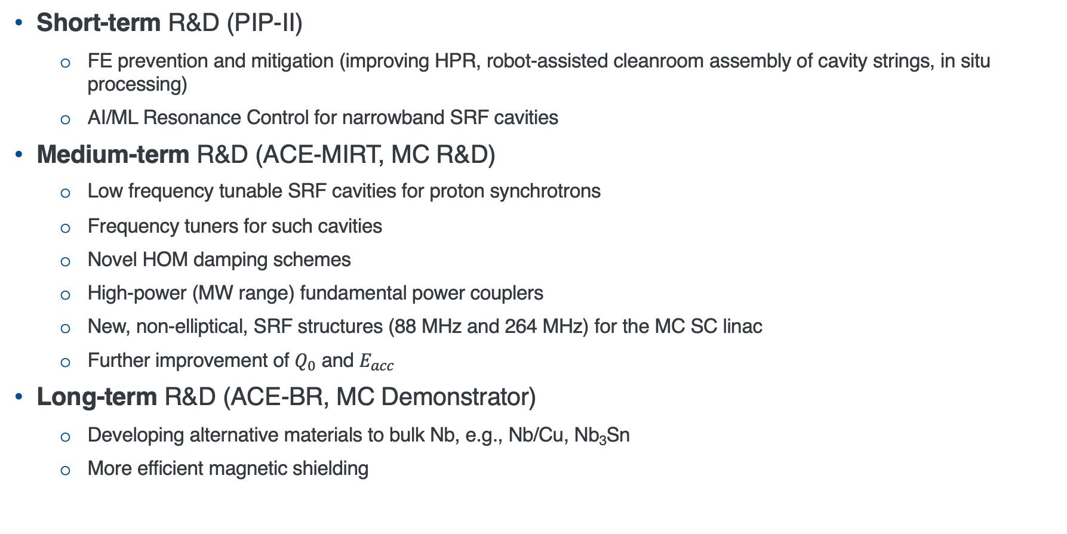
Summary: R&D needs
Short-term R&D (PIP-II)
FE prevention and mitigation (improving HPR, robot-assisted cleanroom assembly of cavity strings, in situ processing)
AI/ML Resonance Control for narrowband SRF cavities
Medium-term R&D (ACE-MIRT, MC R&D)
Low frequency tunable SRF cavities for proton synchrotrons
Frequency tuners for such cavities
Novel HOM damping schemes
High-power (MW range) fundamental power couplers
New, non-elliptical, SRF structures (88 MHz and 264 MHz) for the MC SC linac
Further improvement of $Q_{0}$ and $E_{acc}$
Long-term R&D (ACE-BR, MC Demonstrator)
Developing alternative materials to bulk Nb, e.g., Nb/Cu, Nb₃Sn
More efficient magnetic shielding

