Slide 1

Solid State RF Amplifier Development for 805 MHz Klyston Replacement at LANSCE
John T. M. Lyles, Co-PI
LANSCE Accelerator RF Engineering
AOT-RFE
February 11, 2025
LA-UR-26-20987
#20240723DI

Slide 2
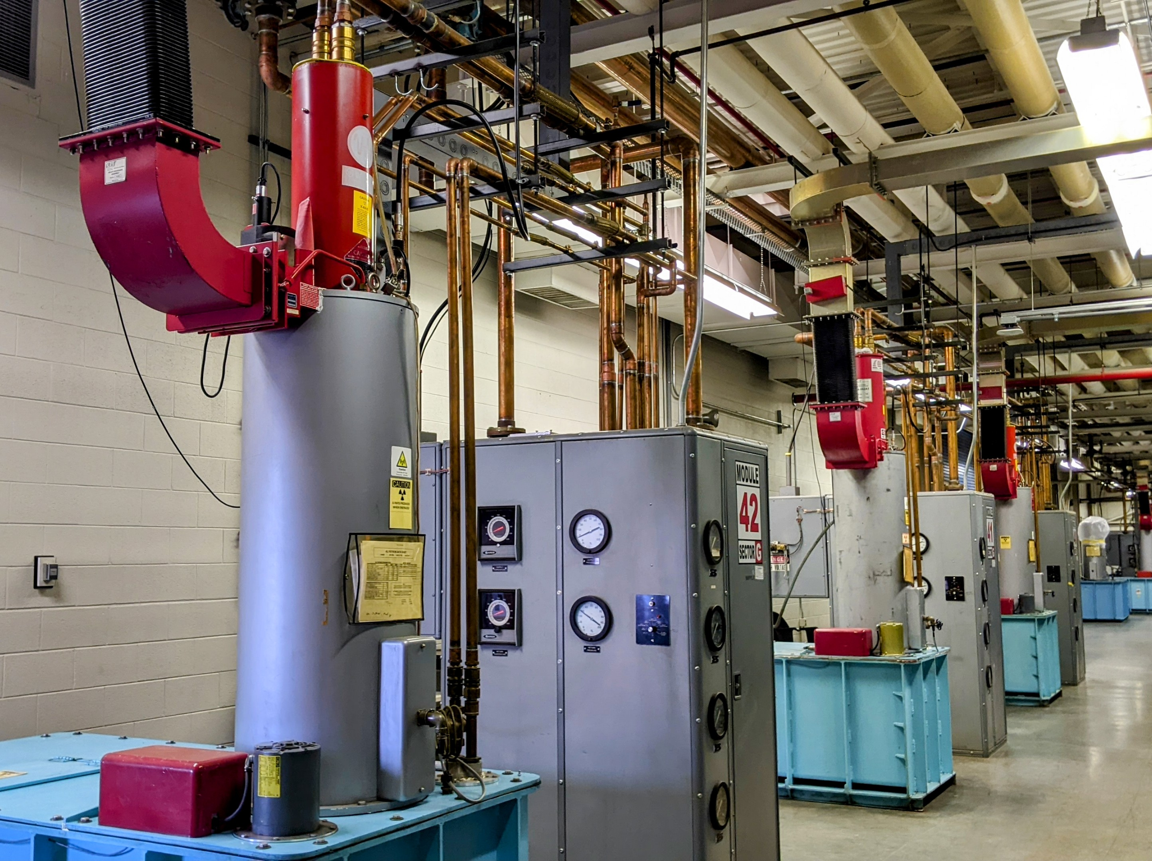
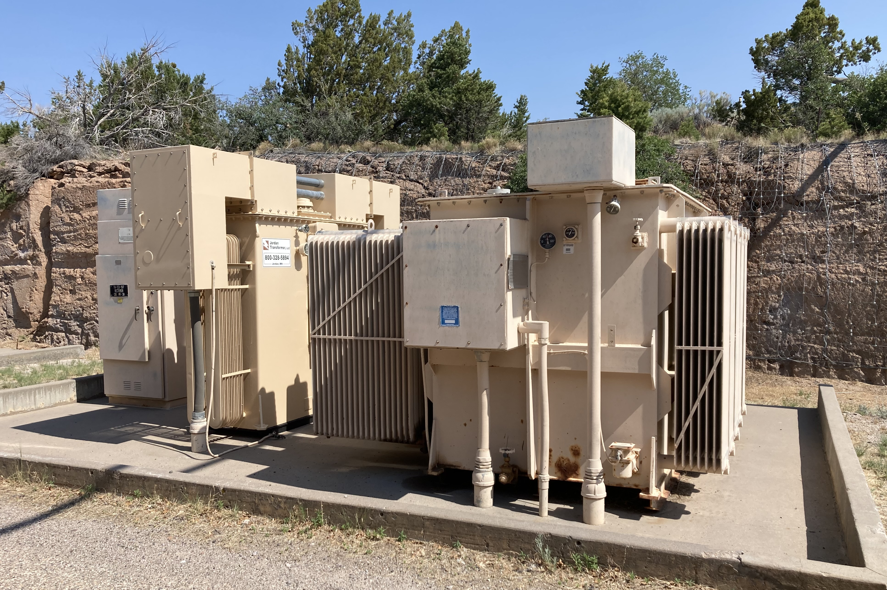
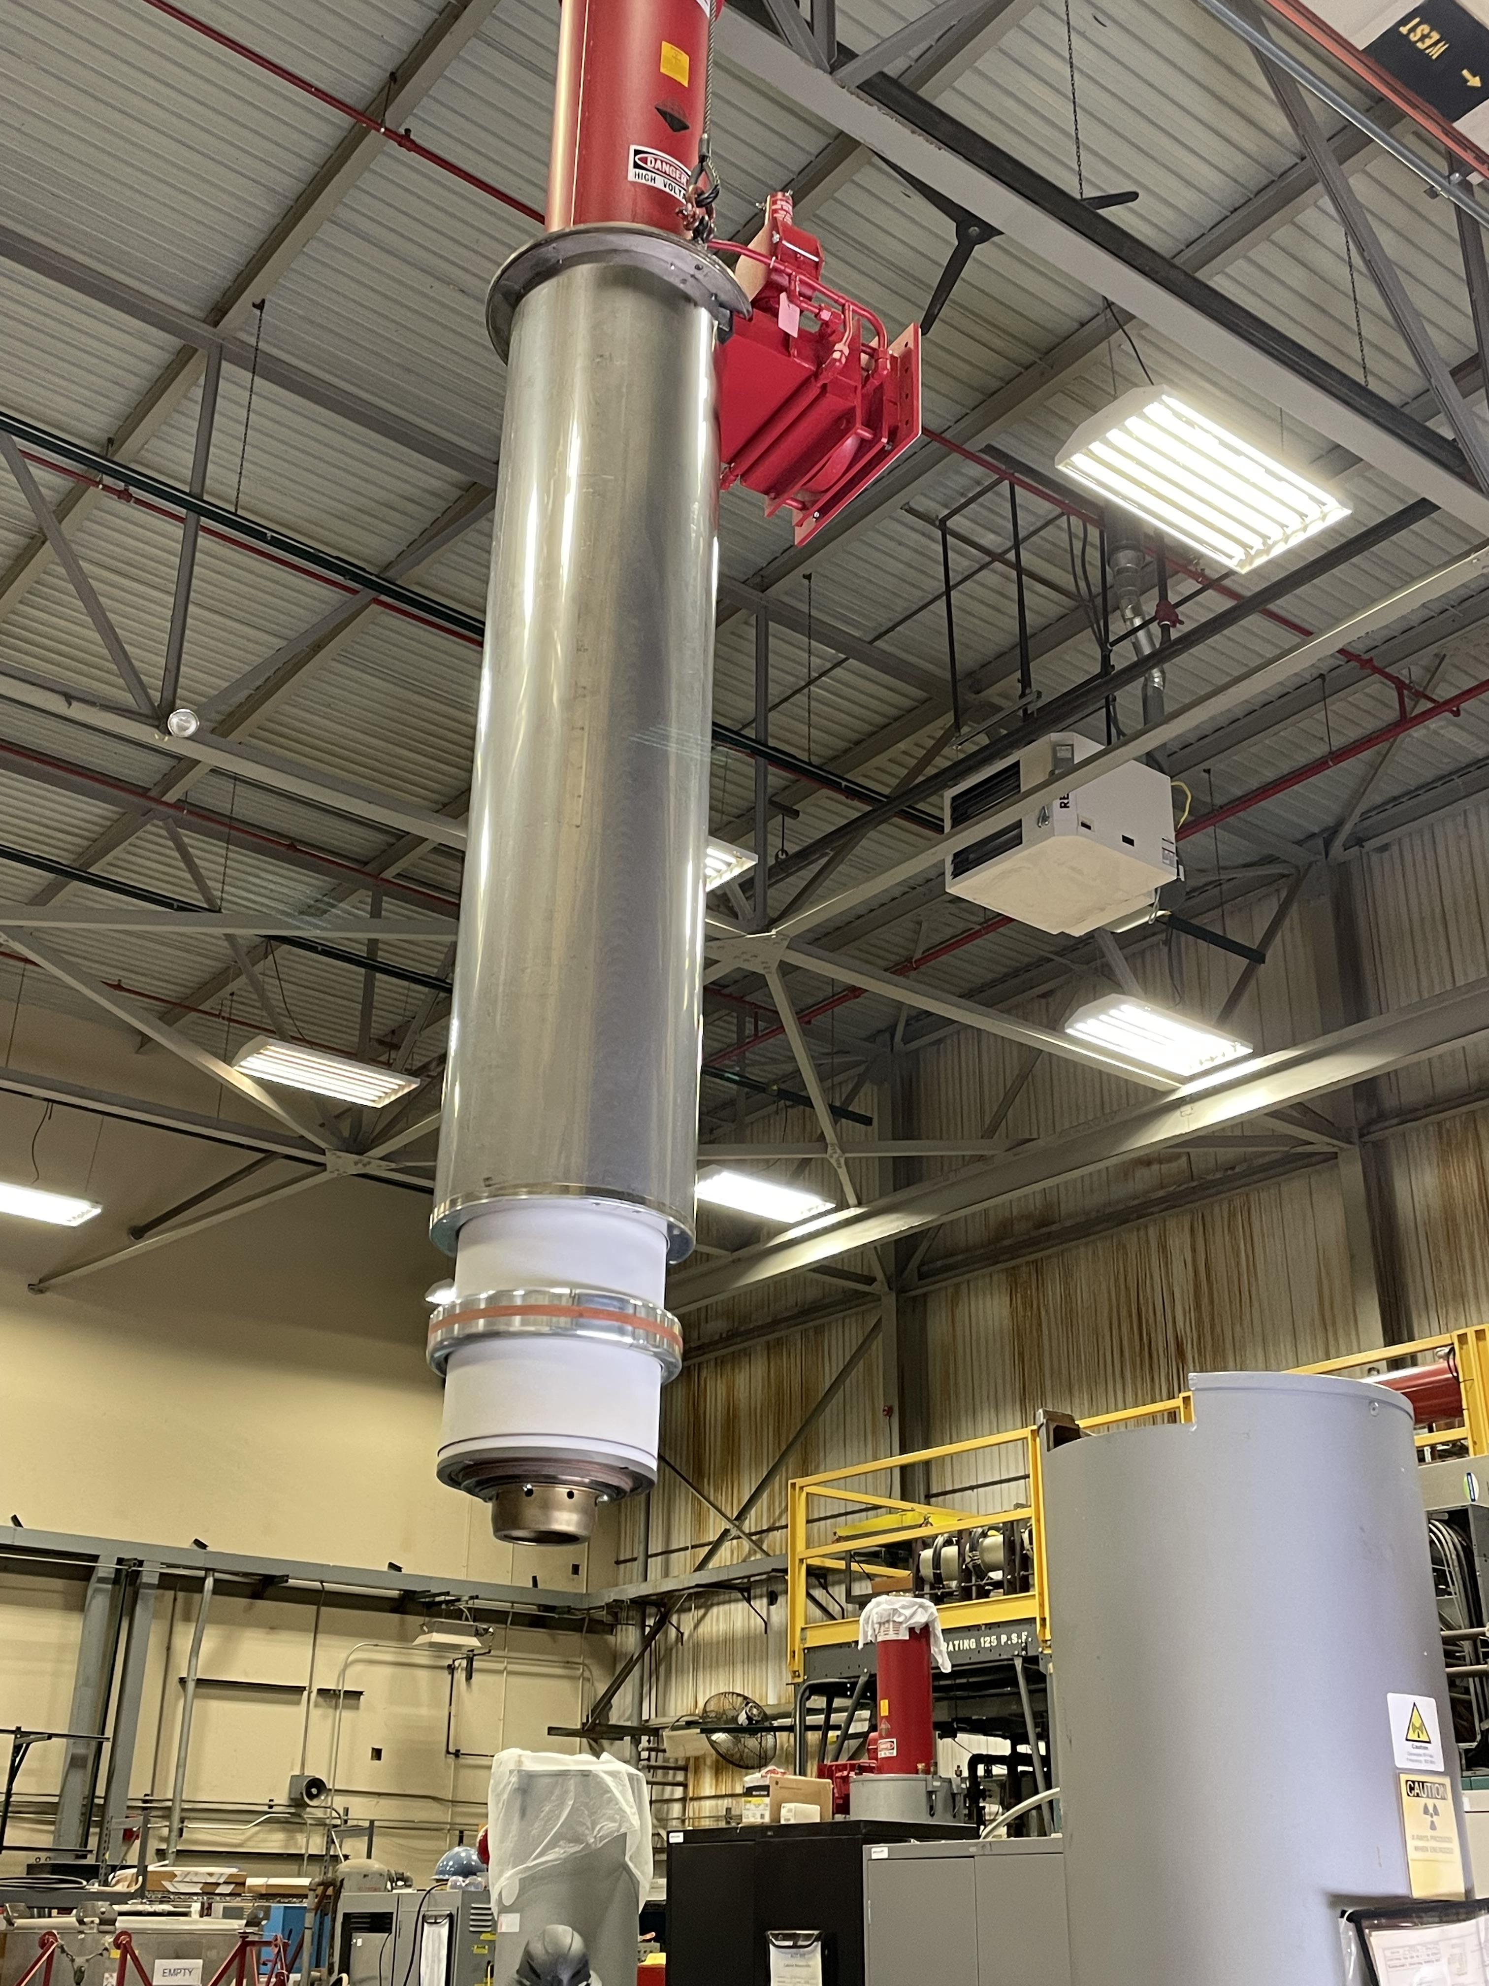
Forty-four Klystrons used for 805 MHz RF power
for LANSCE Coupled-Cavity Linac
1.25 MWp, 150 kW average power, 1960s mod anode design
Concerns of long term supply past 2050
Beam HV systems obsolete
50+ year old technology is difficult to staff with early career engineers and technologists
without lengthy training period (years)

Slide 3
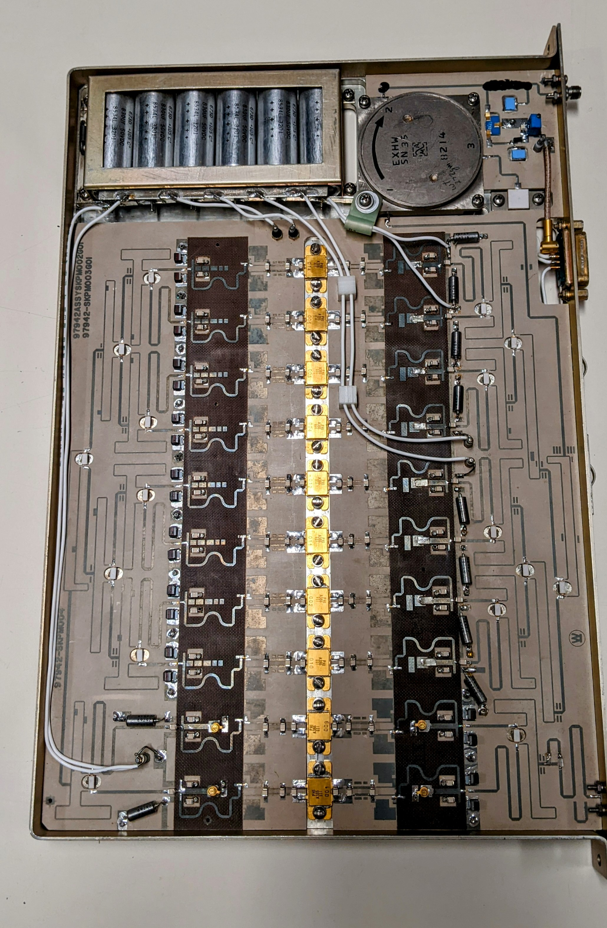
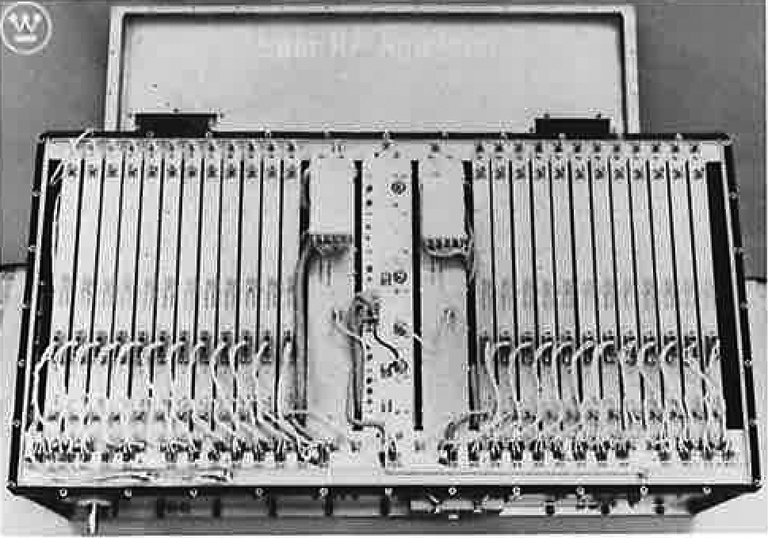
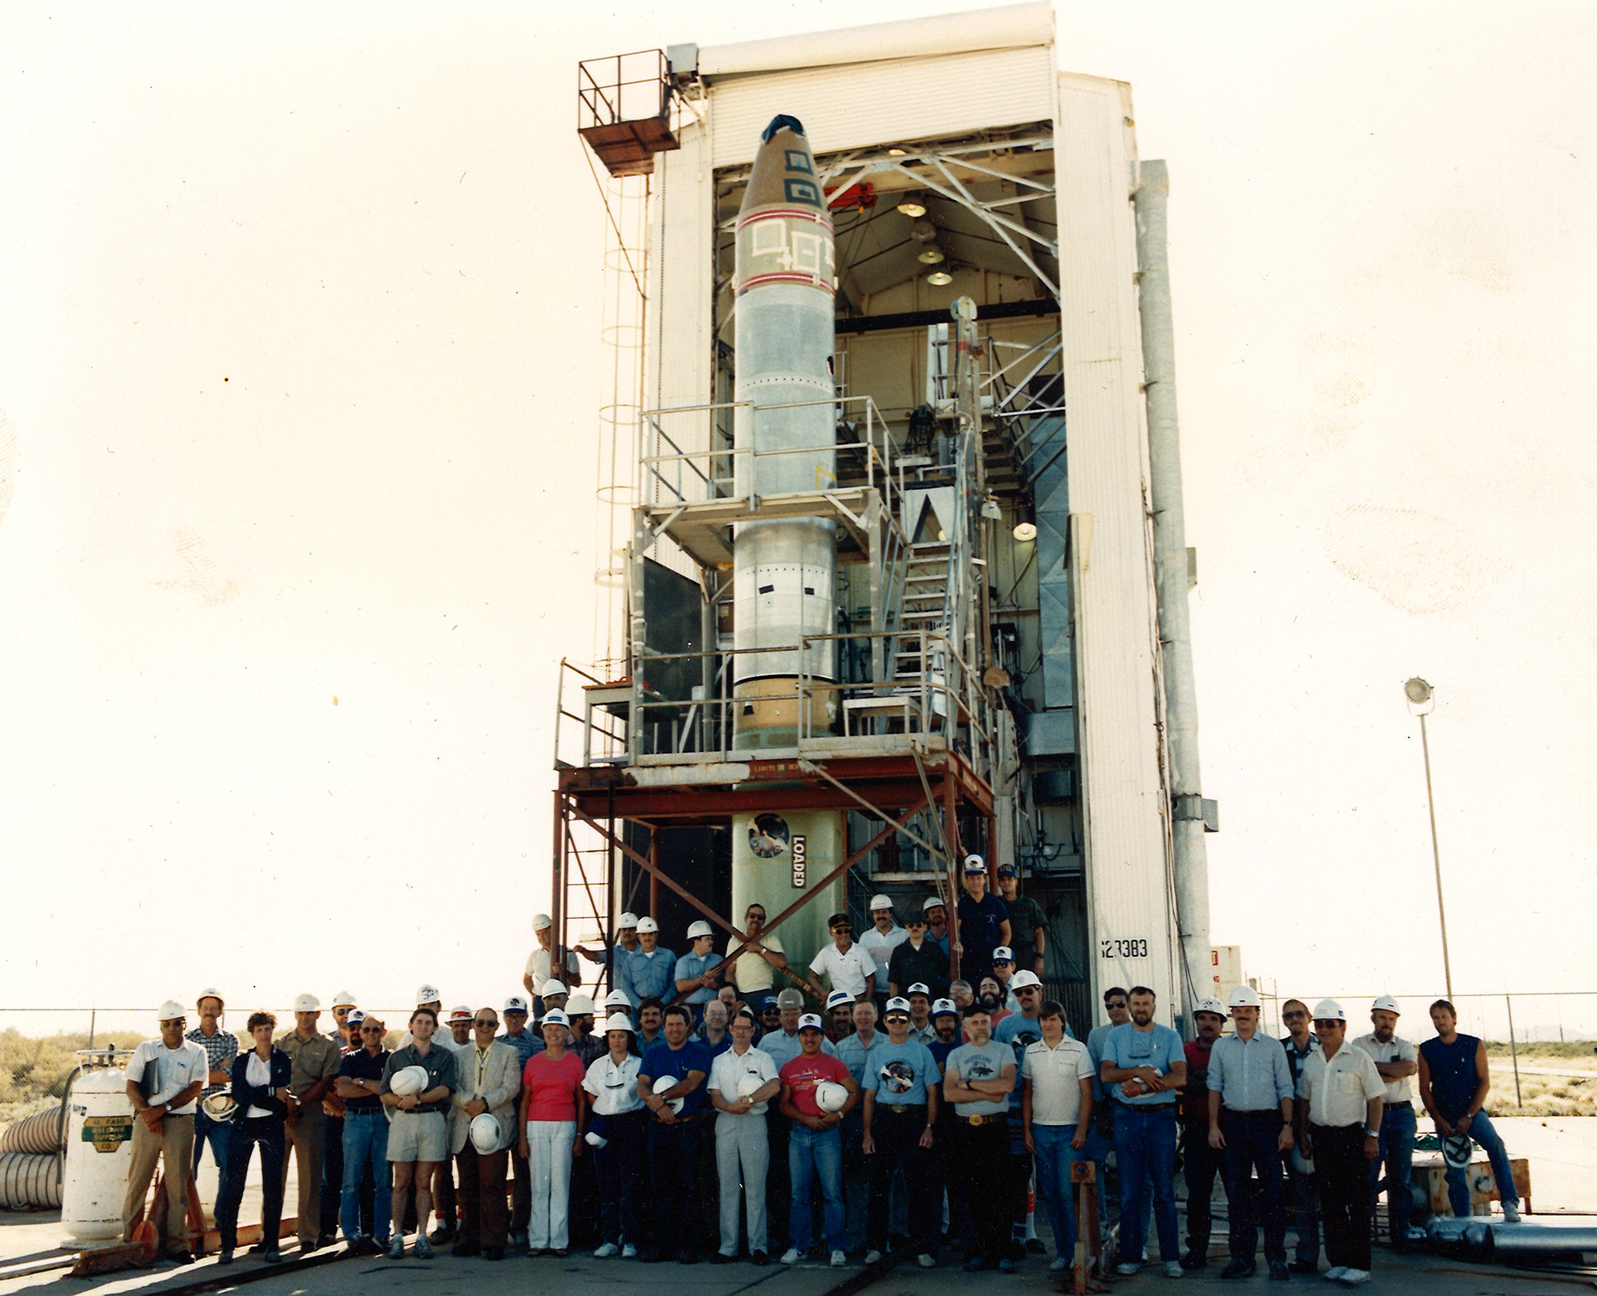
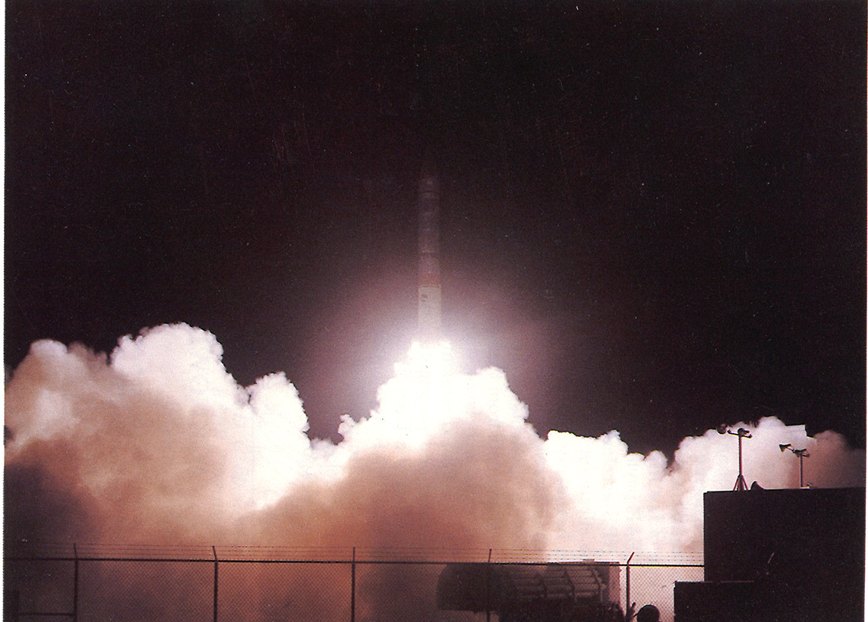
In 1980s, LANL Collaborated with Industry on
2 x 60 kW SSA for Space Accelerator BEAR
2.5 kW module using
10 x 500 Watt BJT
60 kW PA, 36 x 18 x 10 inches, 120 lbs
Launched July 1989 from White Sands Range

Slide 4
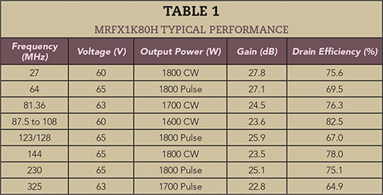
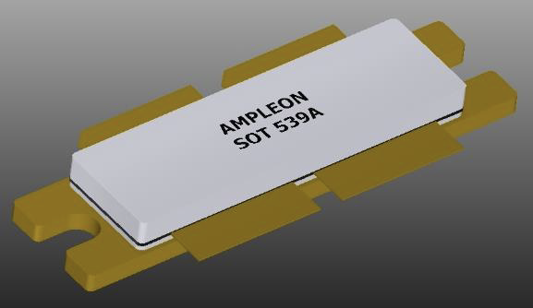
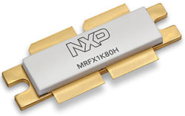
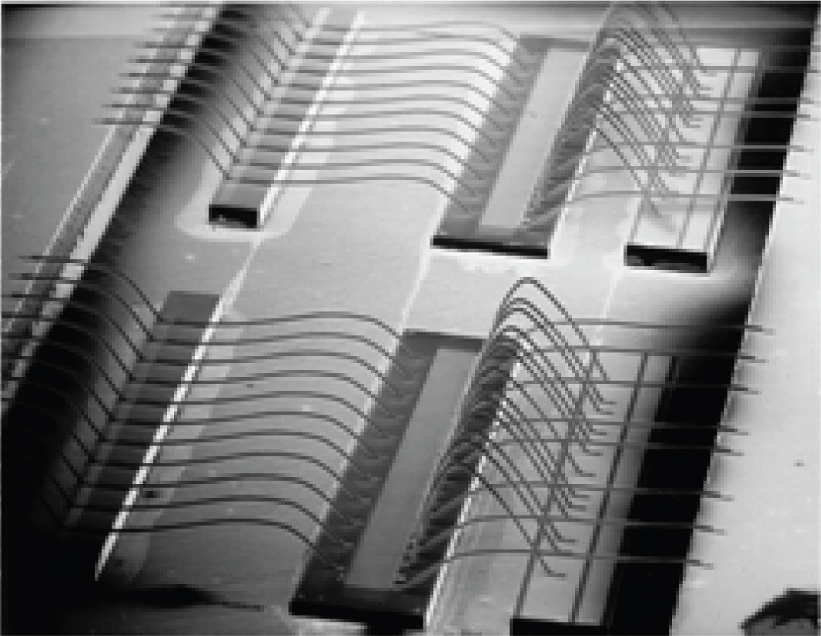
RF Power Transistors – Silicon LDMOS is Leader
Below 400 MHz LDMOS ~1.8 kW P_{sat}
Large transistor dies used for higher power have higher drain to source capacitance, reduced gain and efficiency, very low matching impedance
805 MHz power < 1 kW per transistor

Slide 5
Gallium Nitride on Silicon Carbide High Electron Mobility Transistor
Smaller structure with lower capacitance and highest power density
Capable of higher temperature operation, up to 225 deg C internally
Now able to generate 6-7 kW depending on voltage, up to L Band for avionics

Slide 6
Gallium has 3 Valence Electrons,
Nitrogen and Arsenic have 5
Material | GaN | Si | GaAs | SiC (4H)
Bandgap (eV) | 3.4 | 1.1 | 1.4 | 3.2
Breakdown Field Strength (MV/cm) | 2 | 0.3 | 0.4 | 2.2
Saturated Velocity (x10^7 cm/s) | 2.5 | 1 | 1.5 | 2
Thermal Conductivity (W/cm-K) | 1.5 | 1.3 | 0.4 | 4

Slide 7
Our SSA is using GaN on SiC Transistor Technology
805 MHz with LDMOS required excessive devices (system must fit in Klystron space)
Integra Technologies released HV GaN in 2022; long device production life is forecasted
Navy is investing in very high power and bandwidth also
They don’t sell in the wireless market, so their production runs are smaller
Collaborating with combiner company (Werlatone) for the blade design and
overall combining architecture
Third year of internal R&D, progress shown in following slides

Slide 8
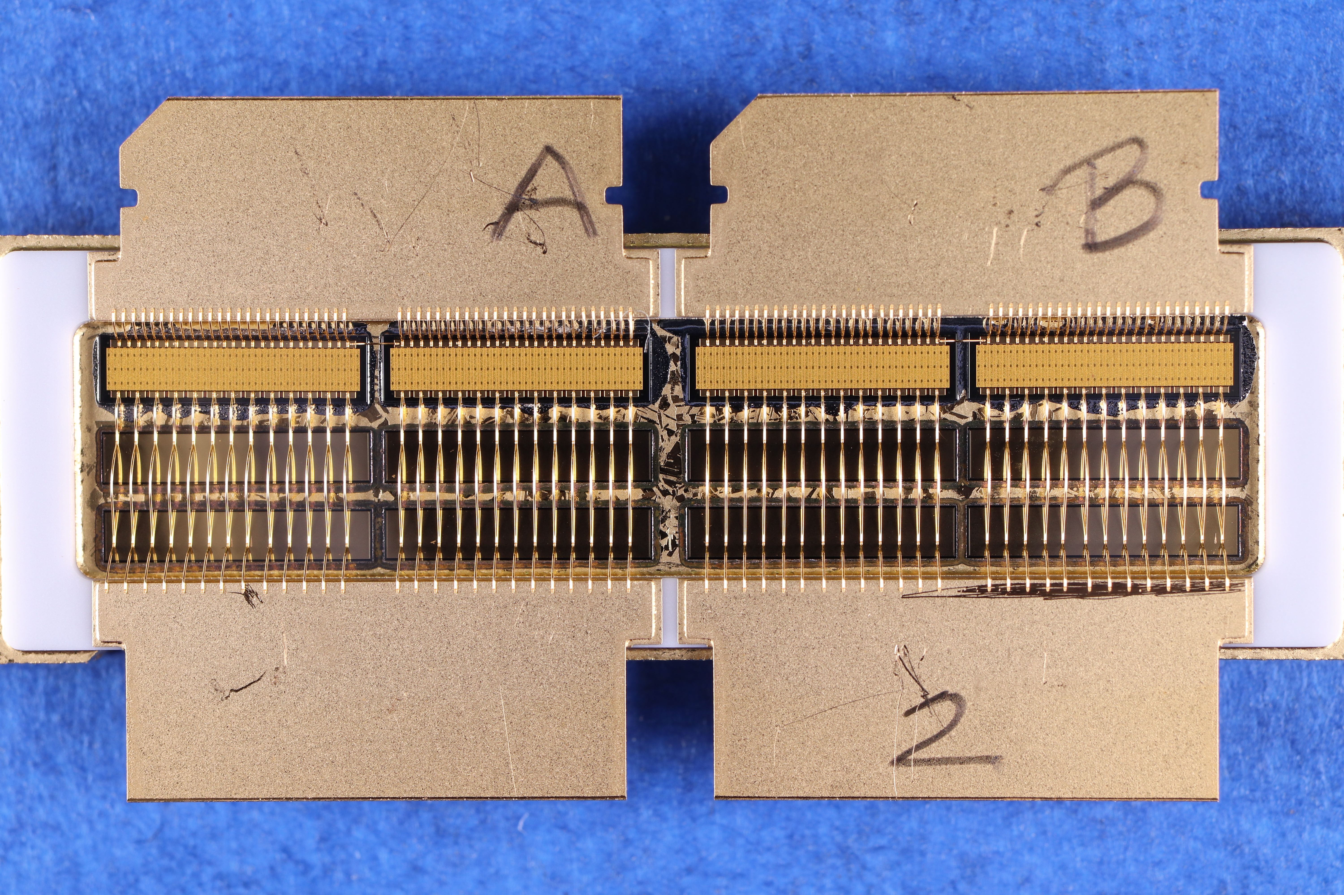
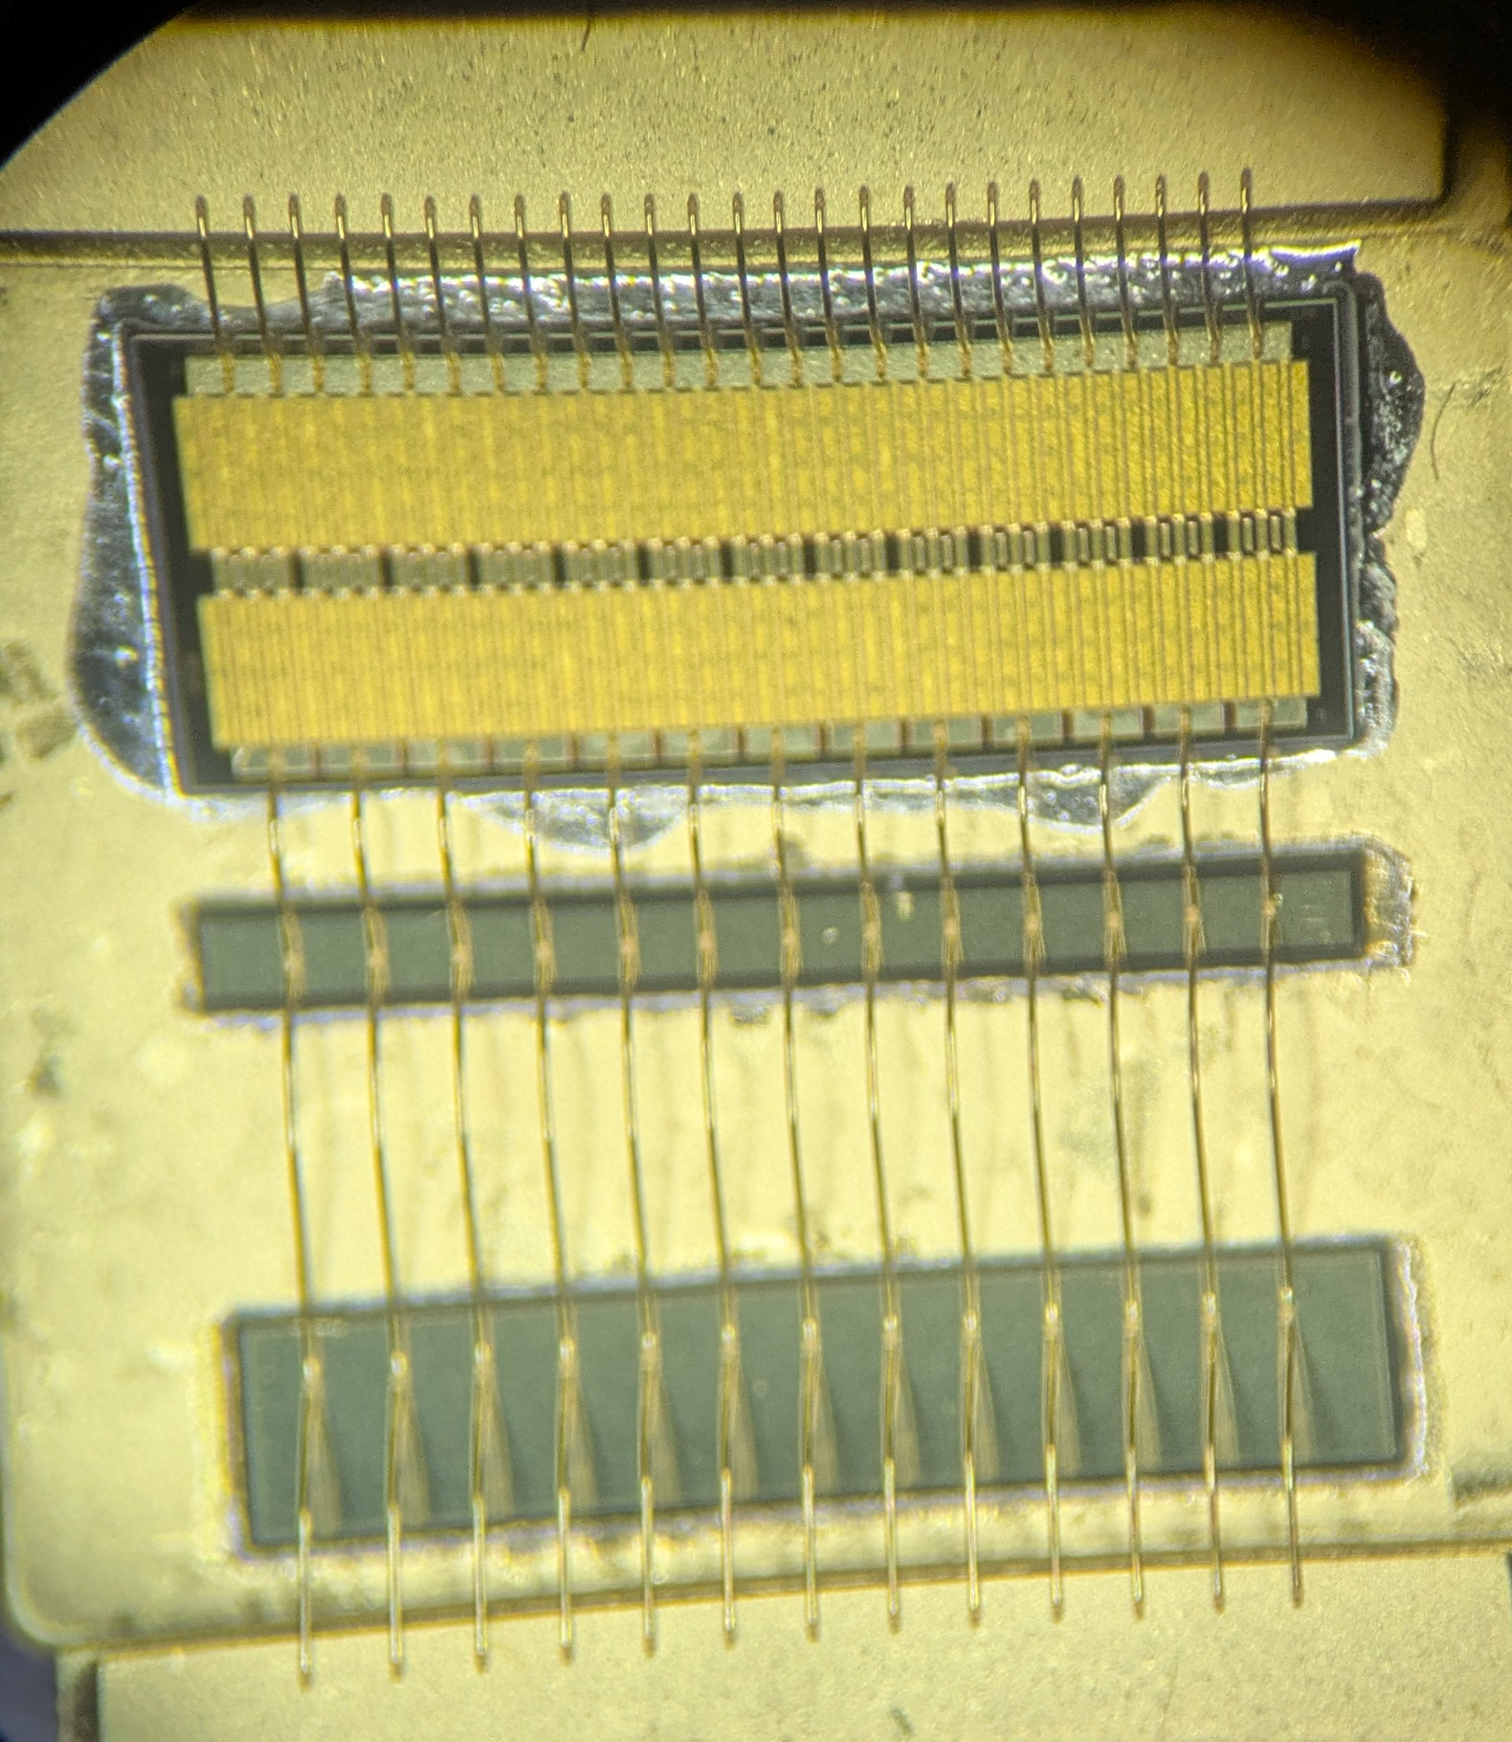
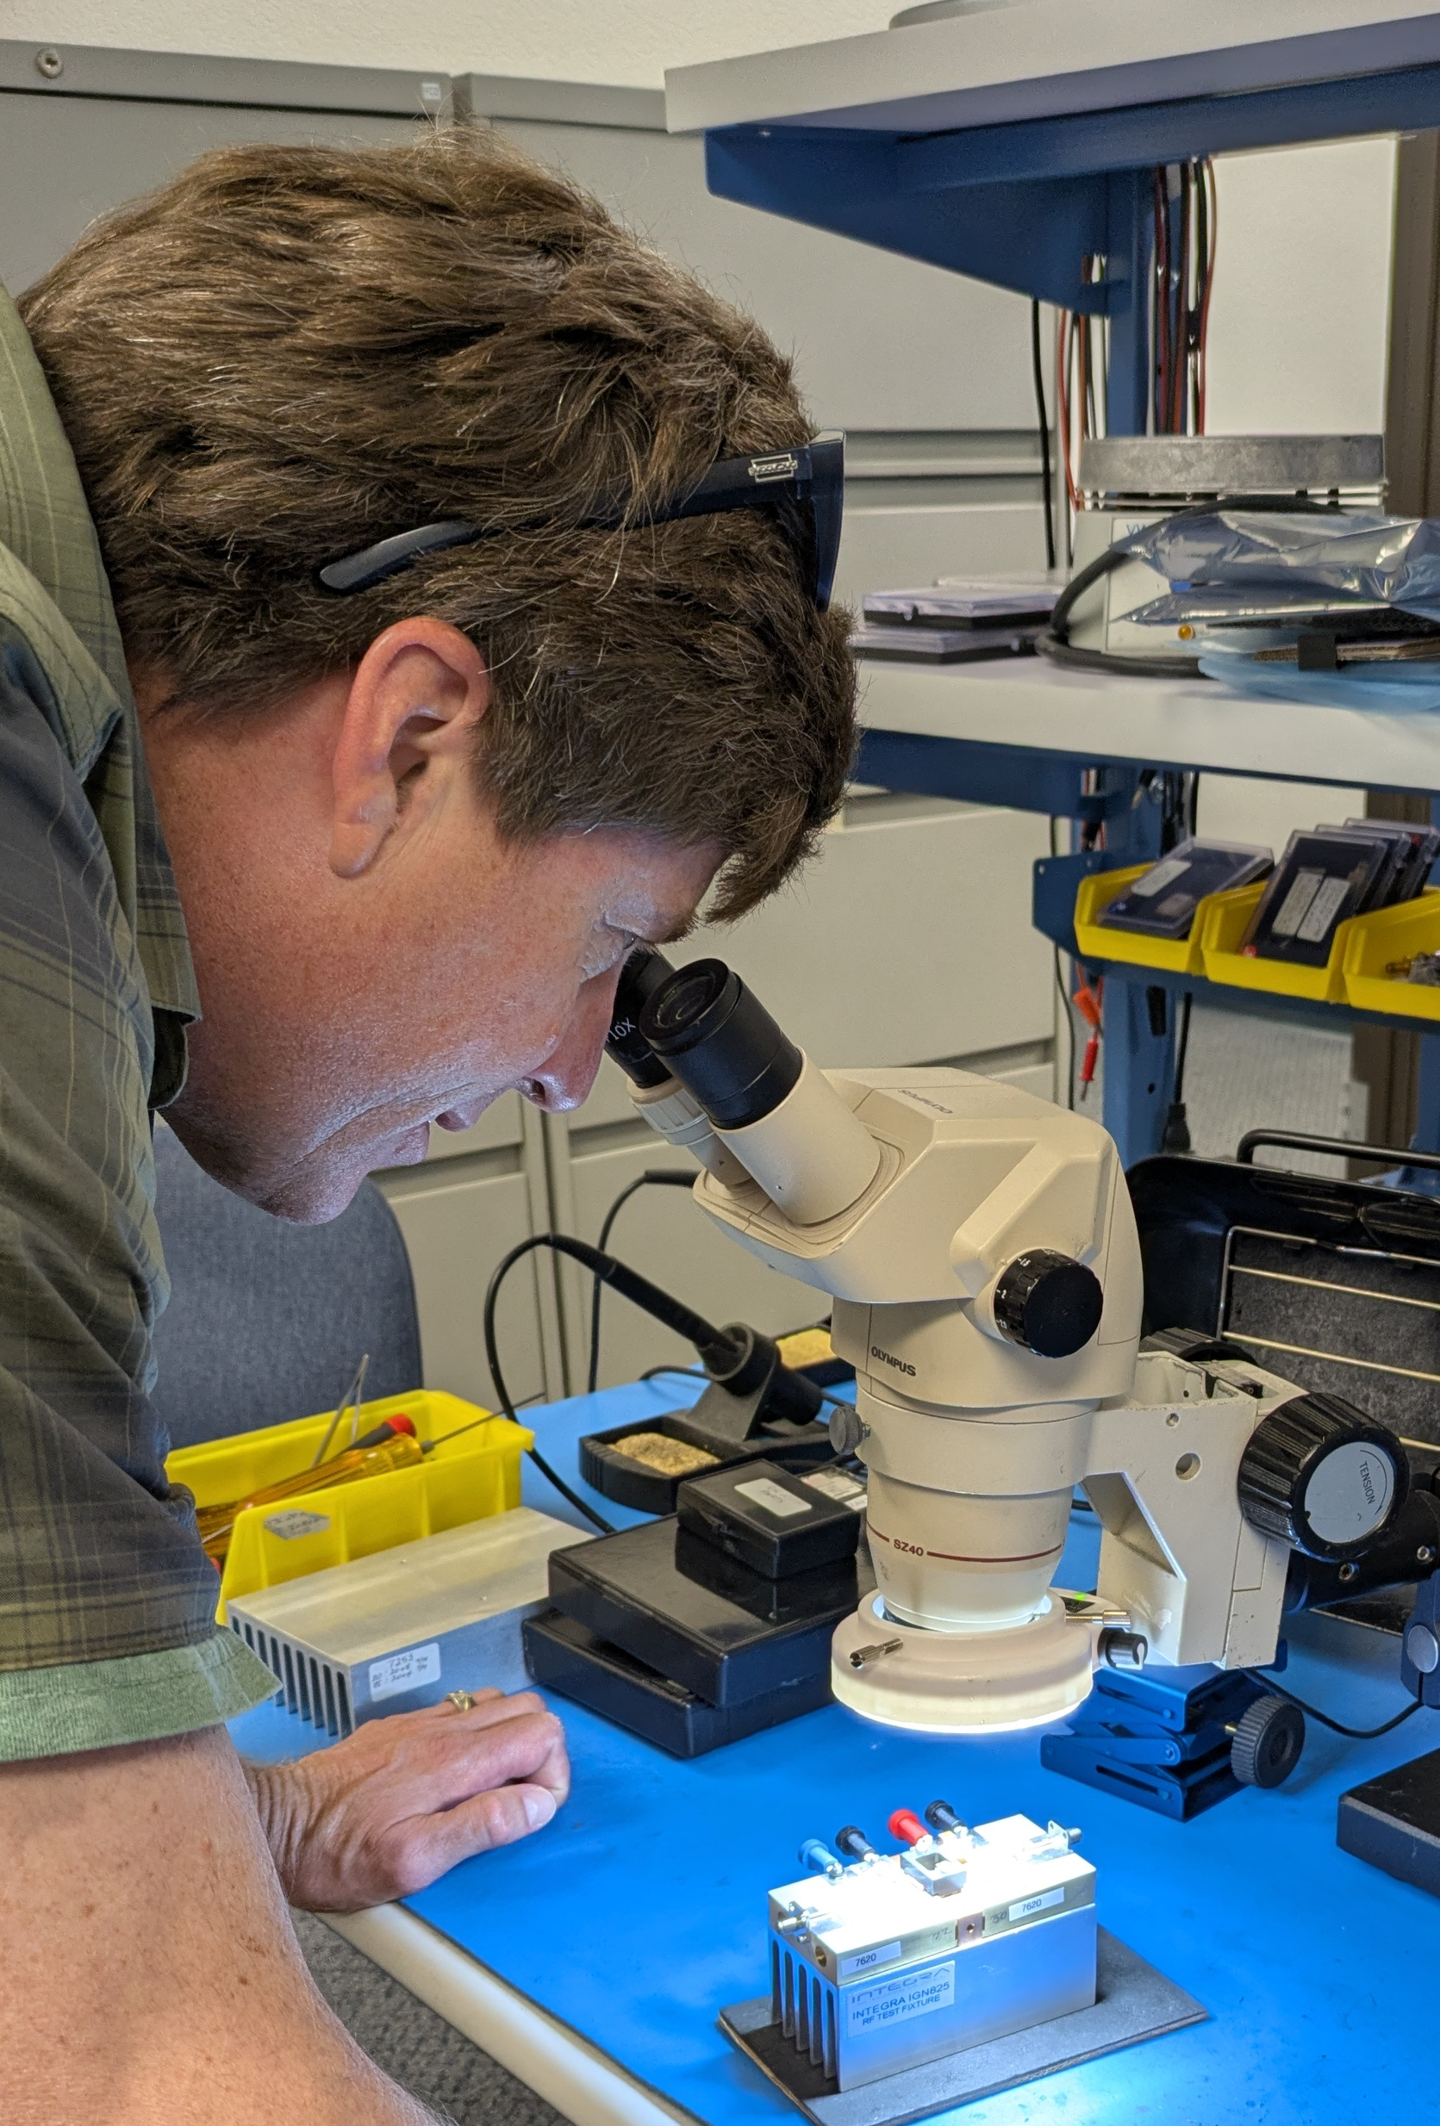
IGN815 is Gen 3 HEMT
IGN815, 3.6 kWp, 12% duty Factor
IGN825, First die is mounted, ¼ of 5 kWp, 12% duty Factor
Made from four inch GaN on SiC wafers from foundries
4 x 0.25” wide transistor dies, each having 78 x 1 μm gate length, stable design
78 mm gate periphery per die for 3.6 kWp, 117 mm for 5 kWp part
Ag bond wires, AuSn soldered die attach to CPC flange

Slide 9
IGN815 Preliminary Datasheet

Slide 10
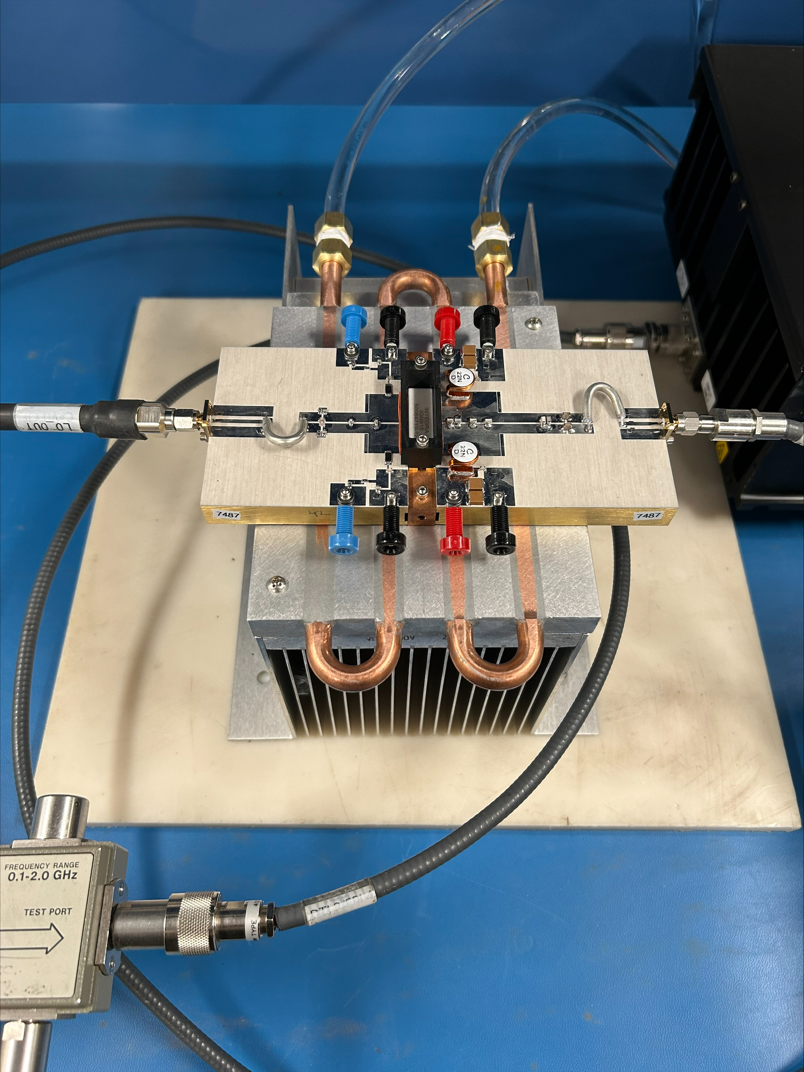
Push-Pull Test Pallet
3.6 kWp, 12% DF, 100 Volt Vds
185 deg C channel temp measured at factory

Slide 11
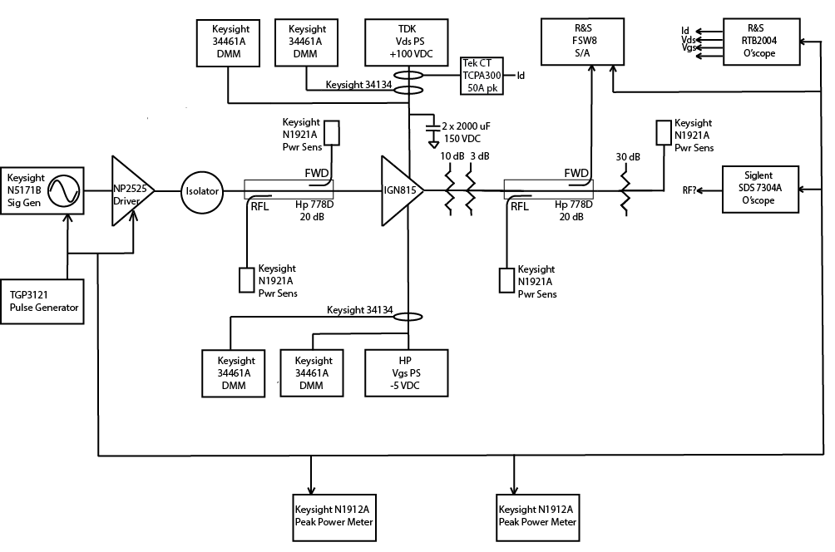
LANL Test Bench Diagram

Slide 12
5 kWp 117 mm Periphery Chips are in Test at Fab
Transistor chip development is ~ ¼ cost of tube NRE
Pizza mask from wafer lots, testing design variations
Final chip selected, RF and thermal testing
Packaged transistor development
Tuning, measurement of RF parameters
Final RF test fixture developed
Pallet design and evaluation - first item test
Takes about 1 year

Slide 13
Combining Power Modules
to get 1.25 MWp
“The rest of the story…”

Slide 14
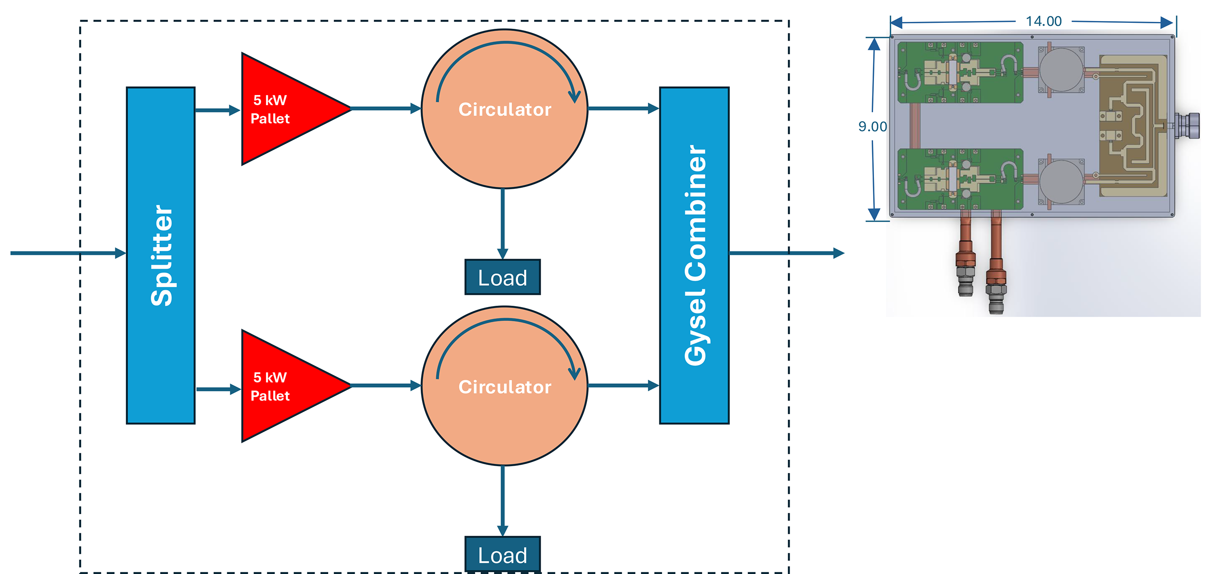
10 kWp Maximum for Blade due to Output Connector

Slide 15
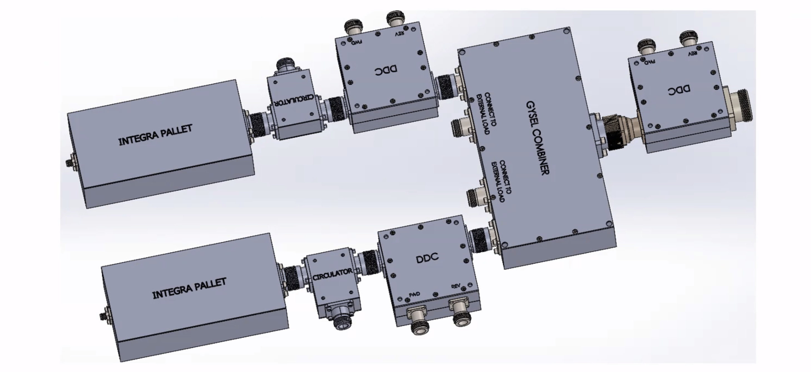
Benchtop Prototype of Components in Blade

Slide 16
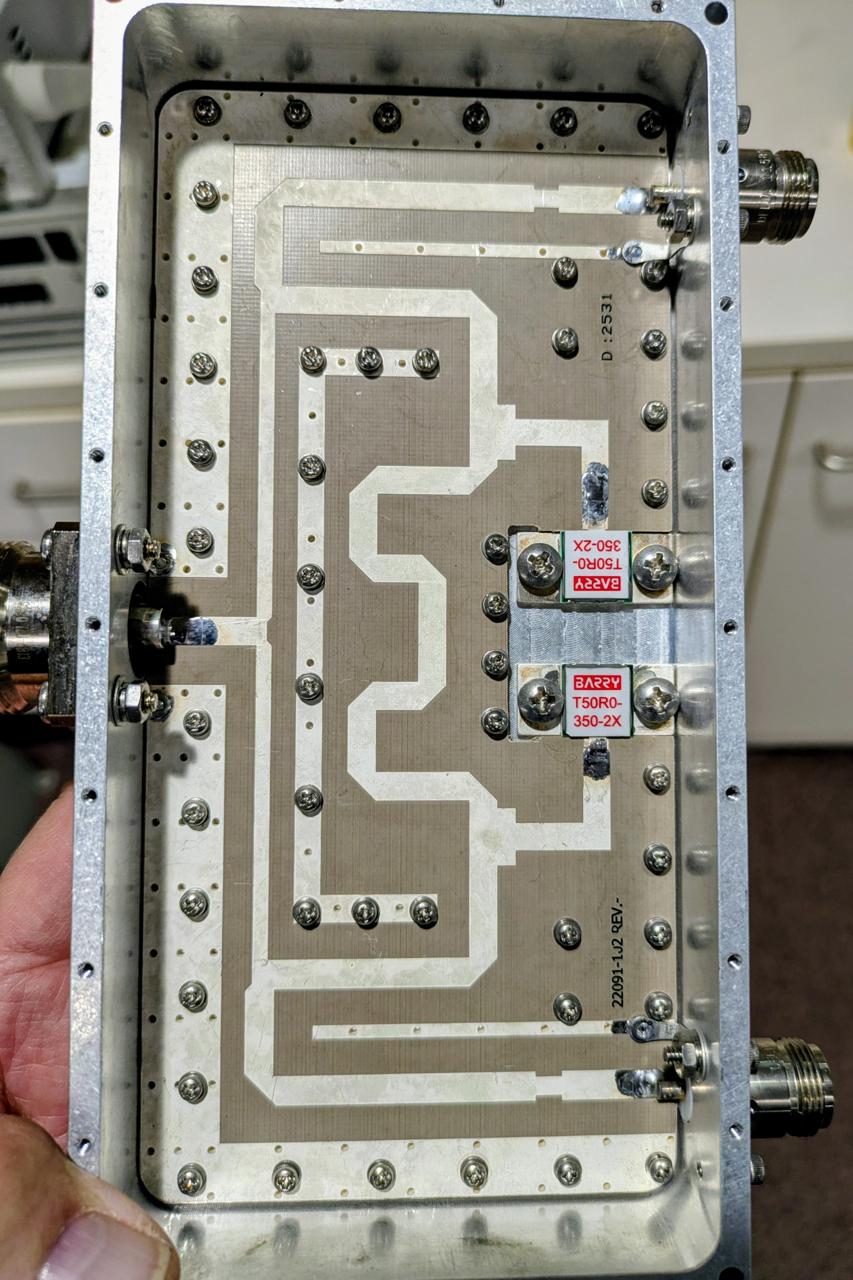
2-Way Isolated Gysel Combiner

Slide 17
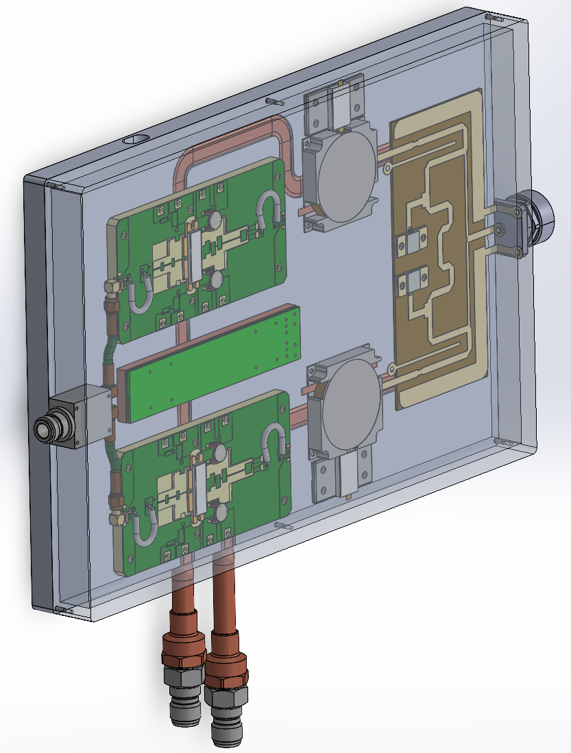
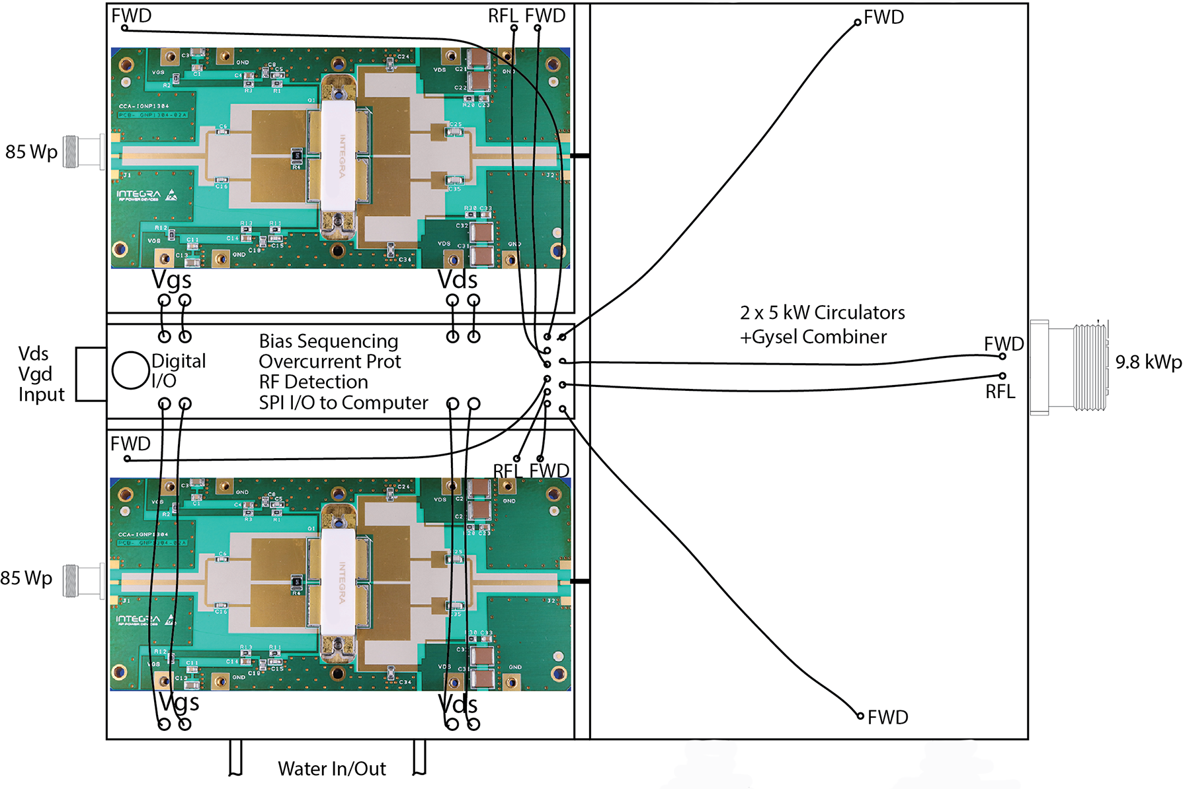
Blade Details

Slide 18
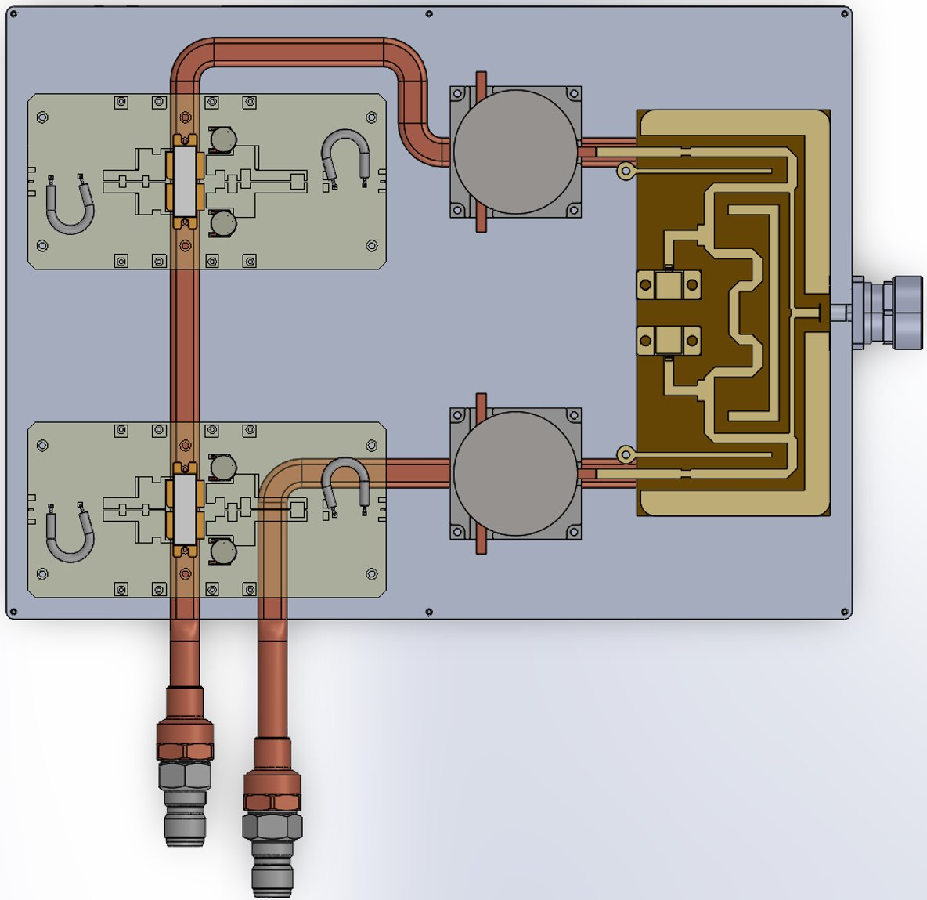
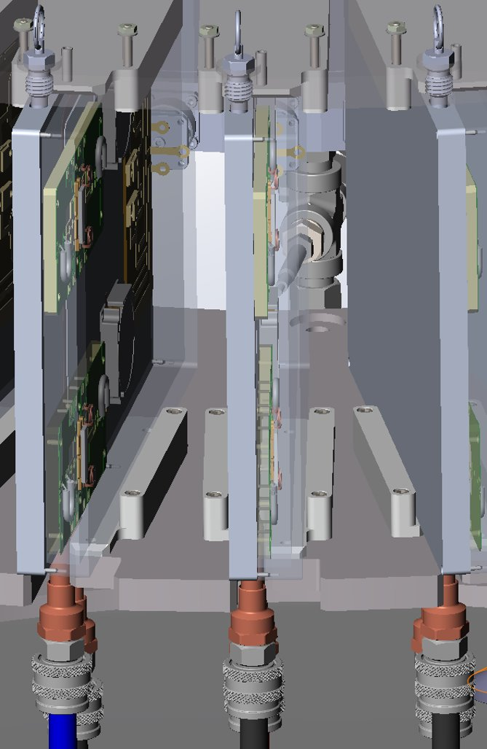
Blade Cooling Details

Slide 19
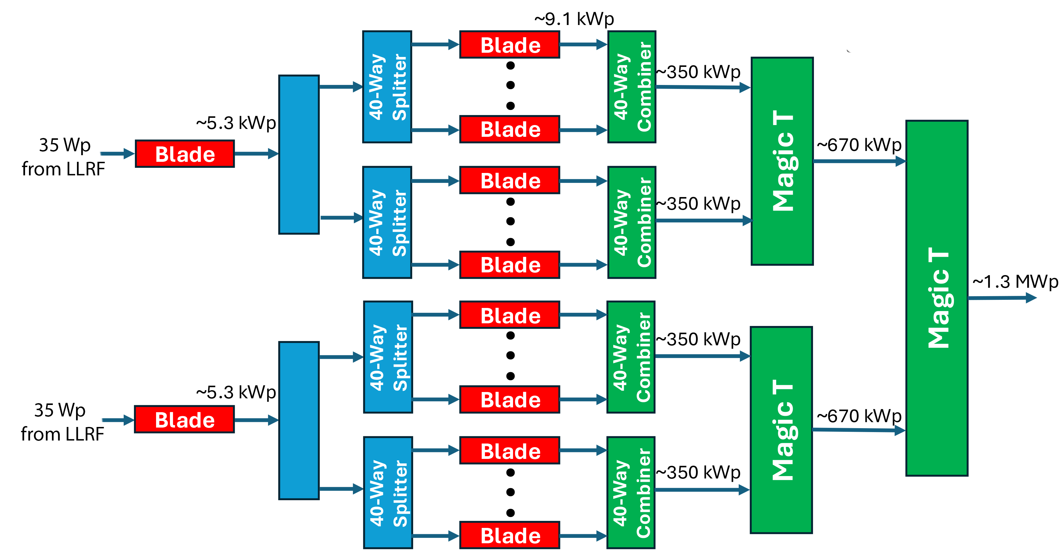
Overall Power Amplifier RF Power Flow

Slide 20
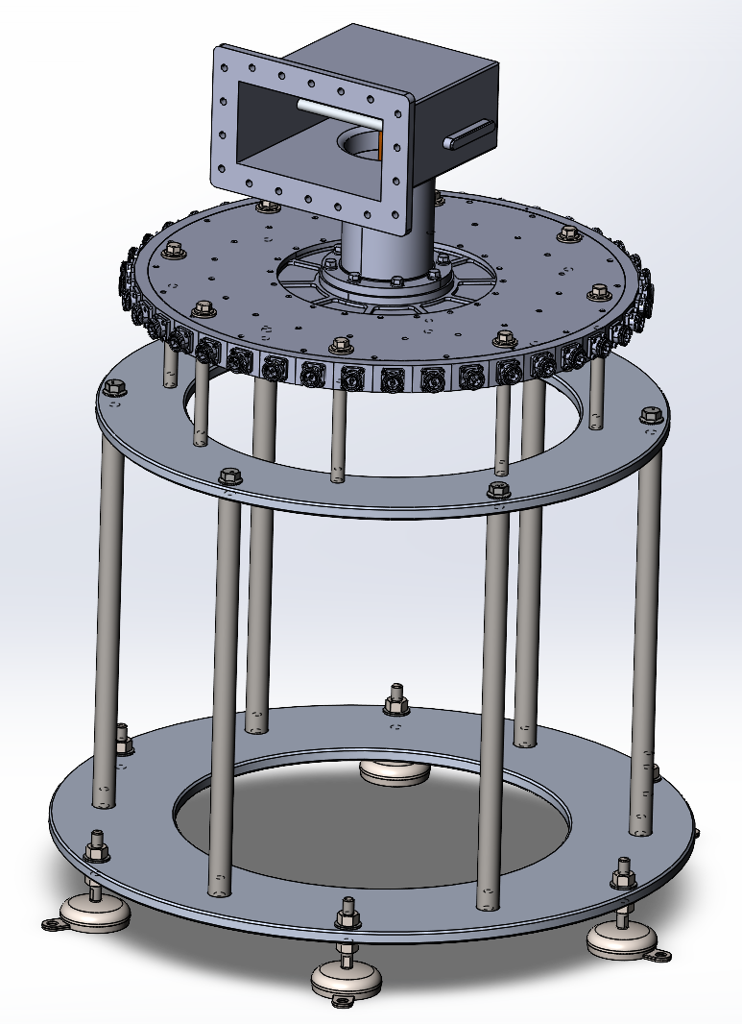
40-Way Radial Power Combiner

Slide 21
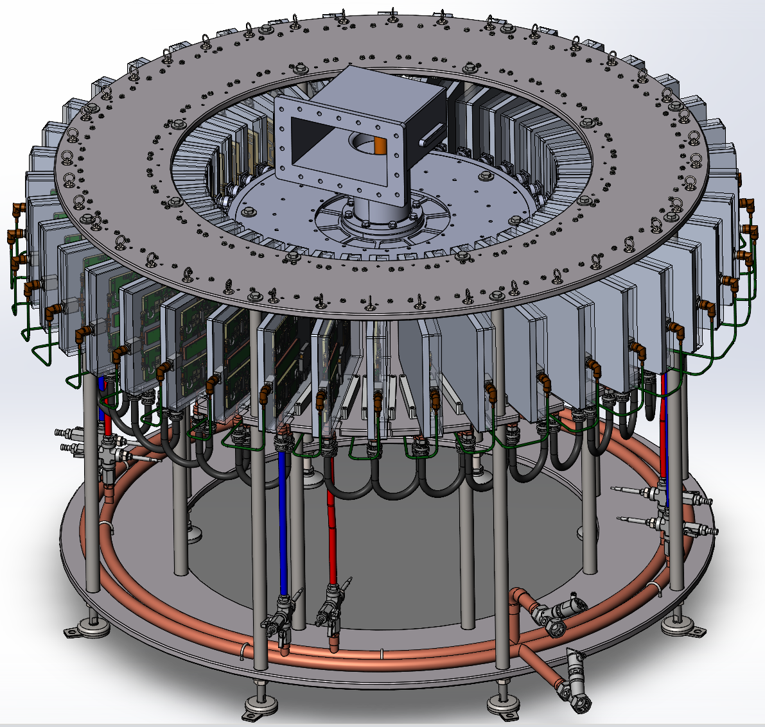
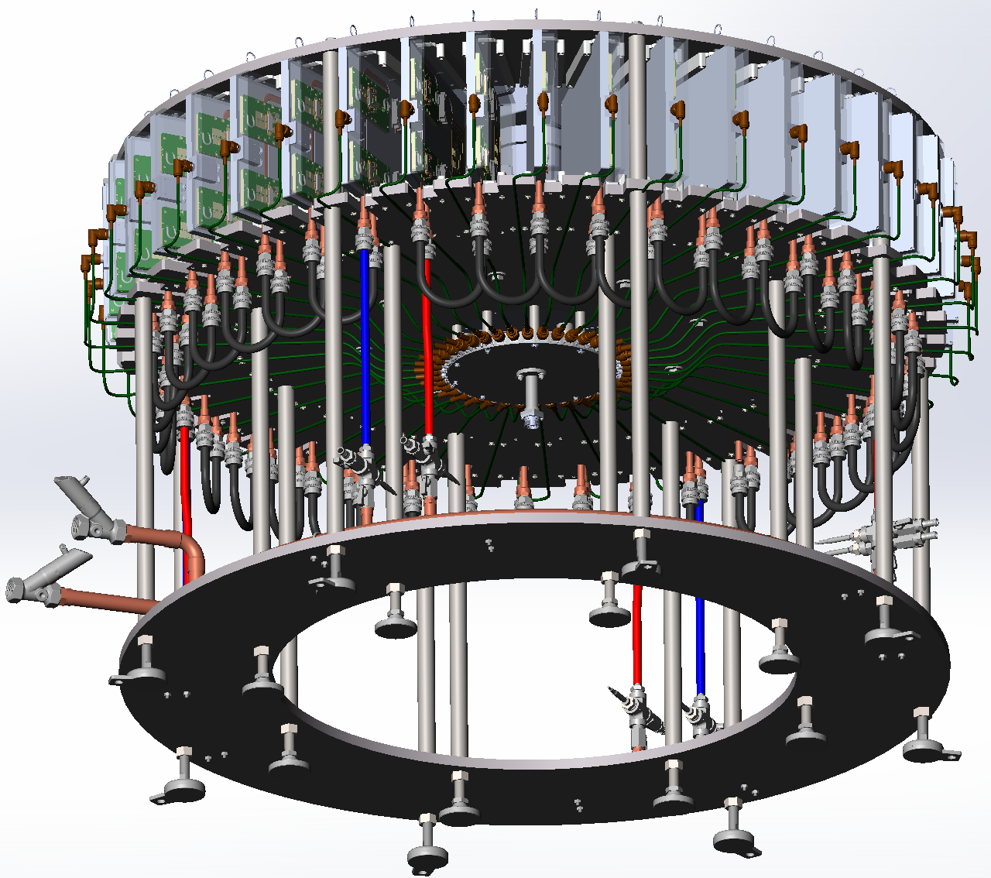
¼ Power ~ 350 kWp

Slide 22
¼ Power RF Power Flow

Slide 23
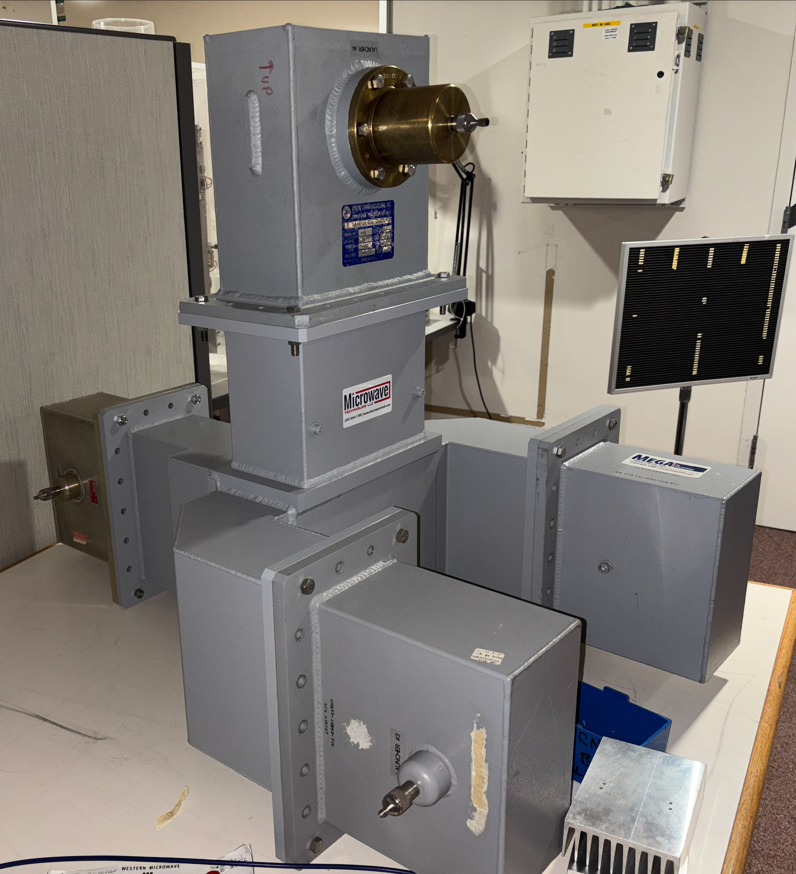
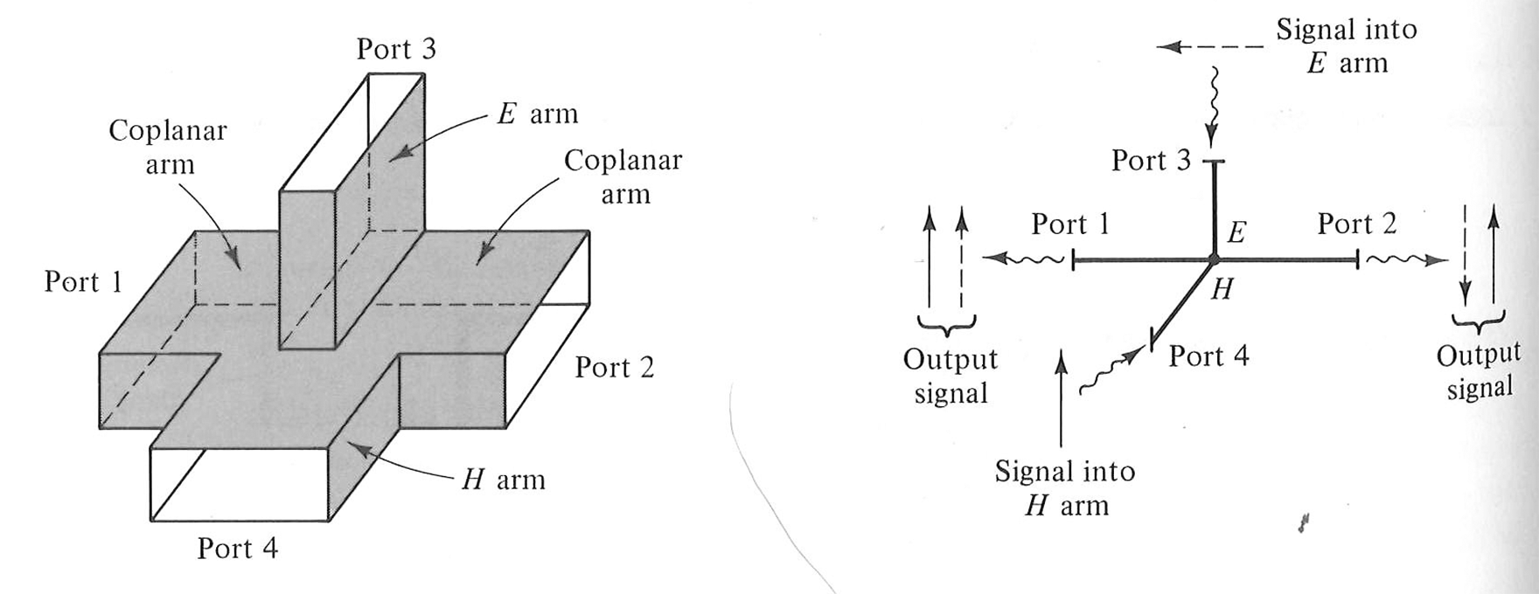
Magic Tee High Power Combiners
From Rizzi, Microwave Engineering – Passive Circuits

Slide 24
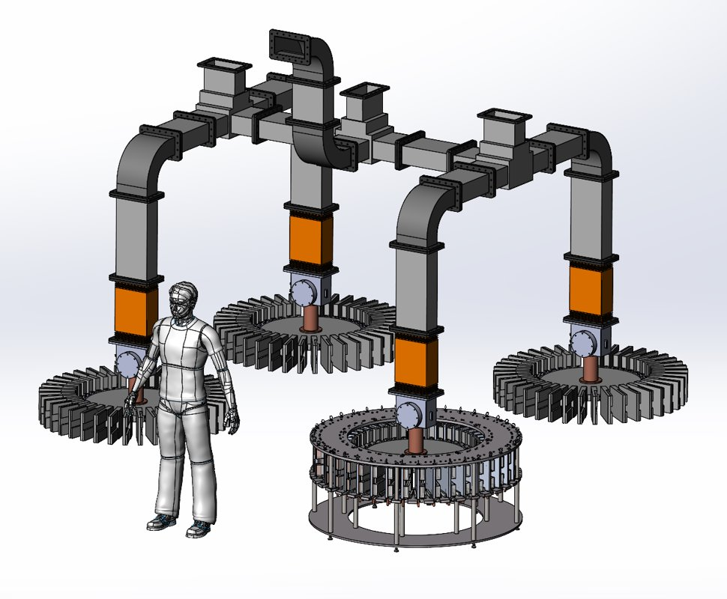
Full 1.25 MWp Amplifier
All elevated aluminum waveguide is
lightweight, including magic Tee’s
3 Water loads not shown, will be near
floor, out of way
Full power circulator is adjacent to
shielding shaft to CCL
100 VDC power supplied from area of
original HV capacitor bank, replaced
with LV capacitor bank and AC/DC
converters, four per system

Slide 25
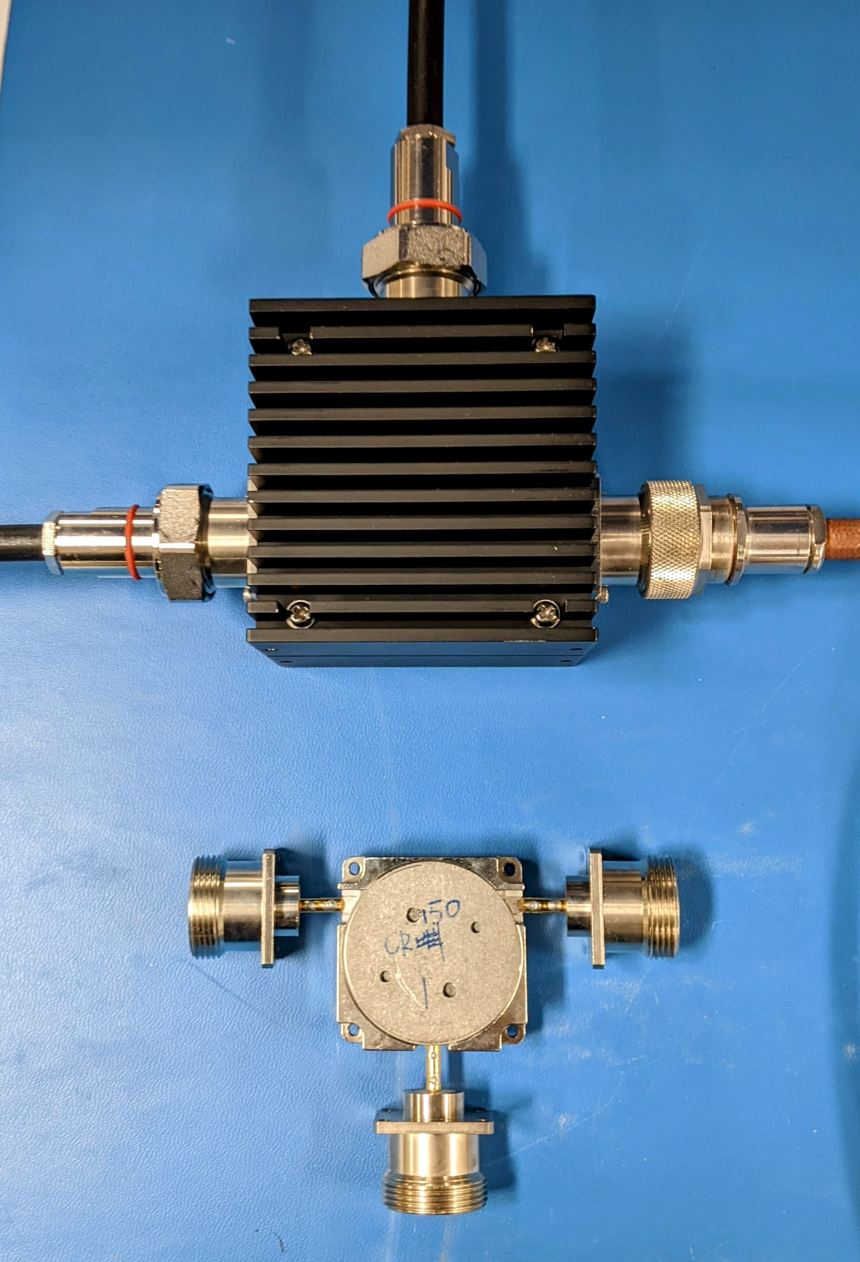
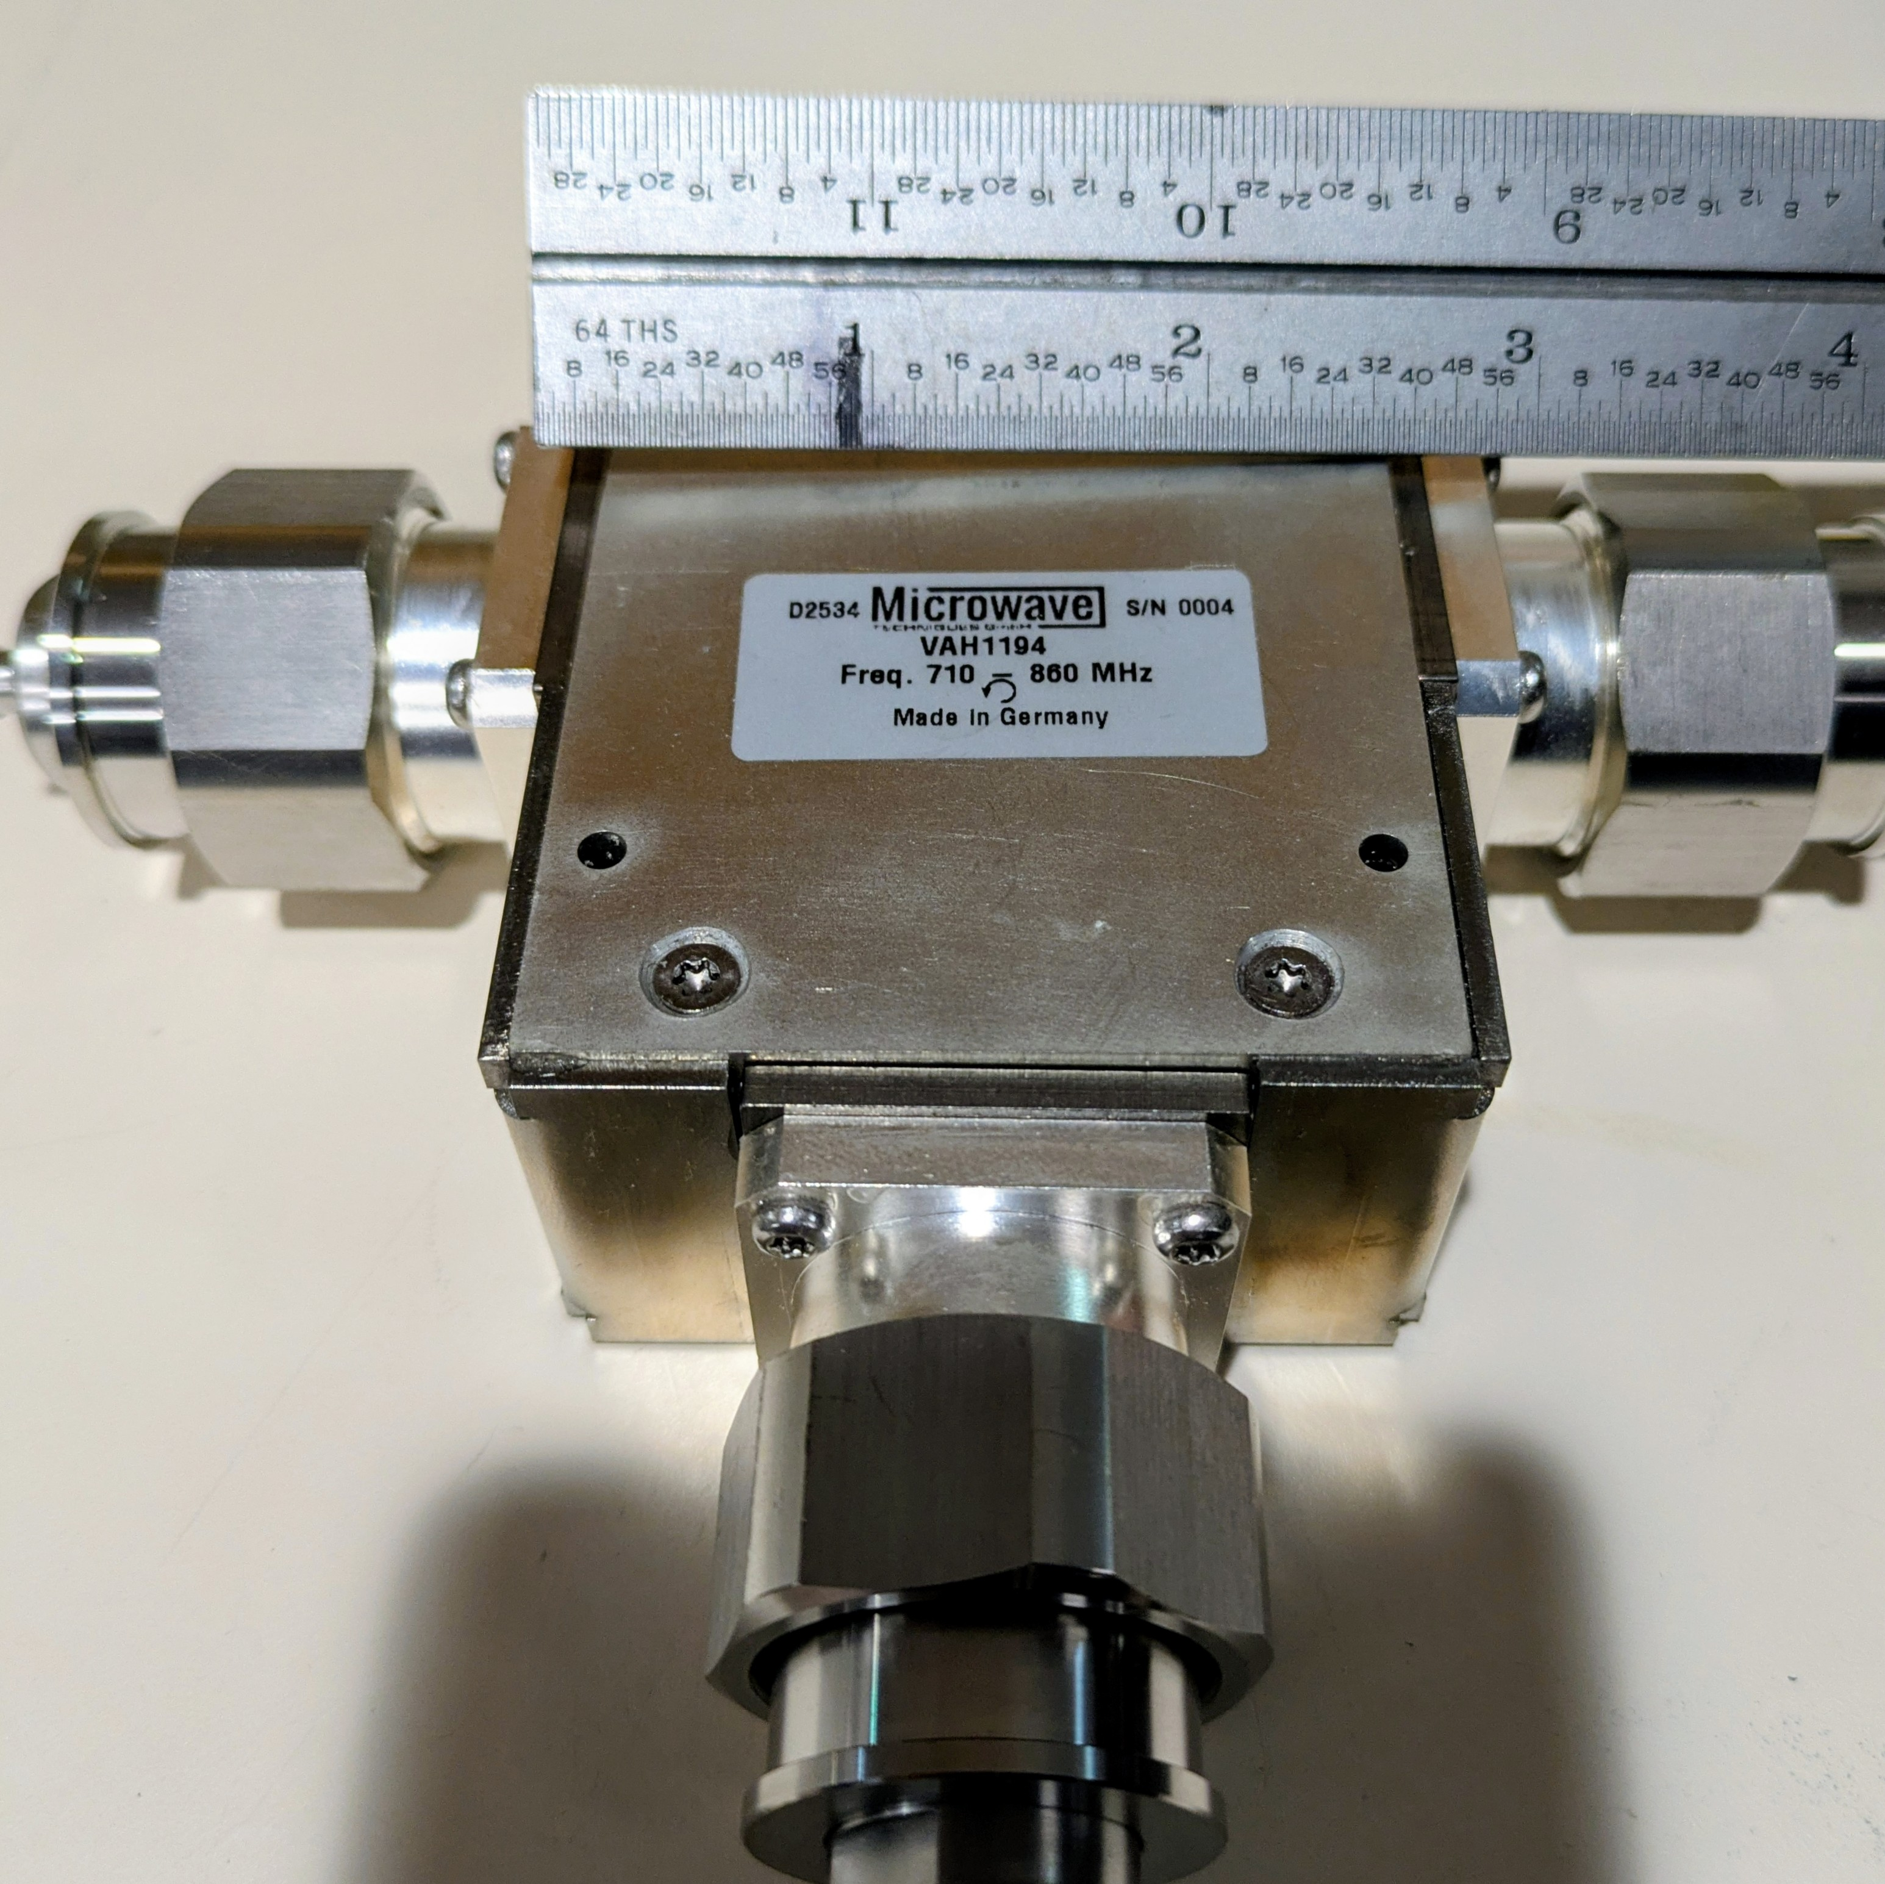
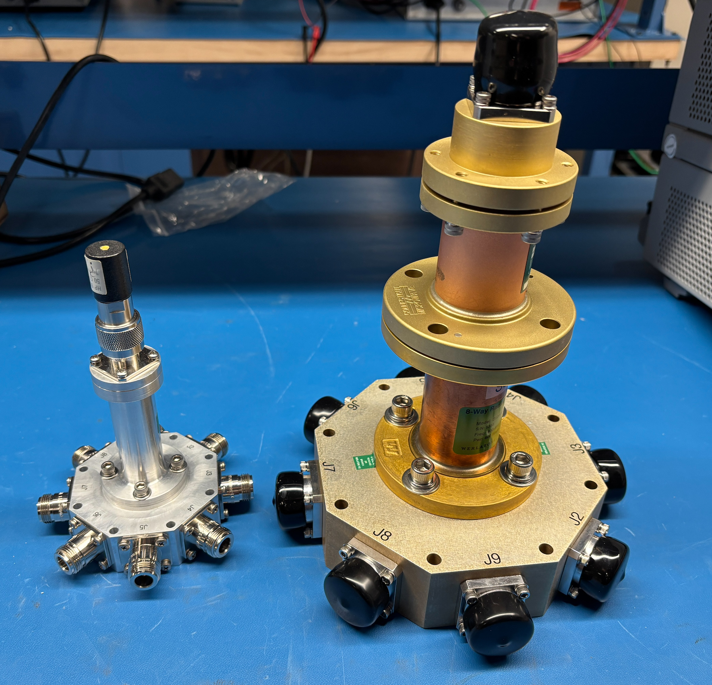
Passive RF Components in Test
5 kW circulators vary greatly, even with temperature
Measuring S-parameters in temperature chamber
8 way radial divider and combiner
for 50 kW scaled test this year

Slide 26
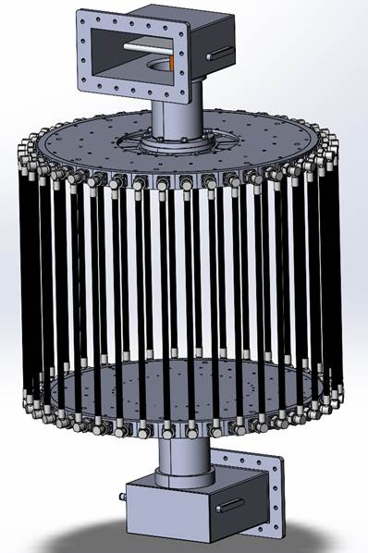
Passive RF Components – High Power Test
40-Way radial power combiner test setup, back-to-back with phase matched cables (10kWp each)
Will drive this with a klystron and use a water load, in collaboration at SNS
Thermal test for average power and peak power test for voltage
Vendor will attend testing

Slide 27
Varying CCL power requirements at different locations
Turning down drive power is a concern for Class AB devices with fixed Vd
When conditioning a CCL cavity
Ramping up power slowly
During accelerator beam tuning
Normal uneven RF power distribution along linac from physics tune
Fast power fluctuation for beam loading
Need about 14 dB of output dynamic range for these situations, 50 – 1250 kW

Slide 28
GaN Thermal Measurement at Integra Technologies
Thermal measurement performed at worst case conditions
This is for another transistor, not IGN815
Worst case power dissipation of 1.87kW
Flange temperature = 85°C
Transient infrared detector used to capture peak temperature during RF pulse
This property of Class AB amplifiers can kill transistors during power rollback

Slide 29
Techniques for Variable Power to Avoid High P_{d}
Reduction of Vds below 100 V to keep high efficiency at lower power
20% is safe but it cannot be fast with large power converters
How would it be automatic?
Below 70 V could cause K factor instability
Turning off pallets before combiner
Must account for reverse power to other pallets
Modeling is being done to understand which ones are best
Difficult to remove RF driver power from a common driver amp, but could raise gate bias via logic signal to disable output
Outphasing modulation for fast control, beam compensation

Slide 30
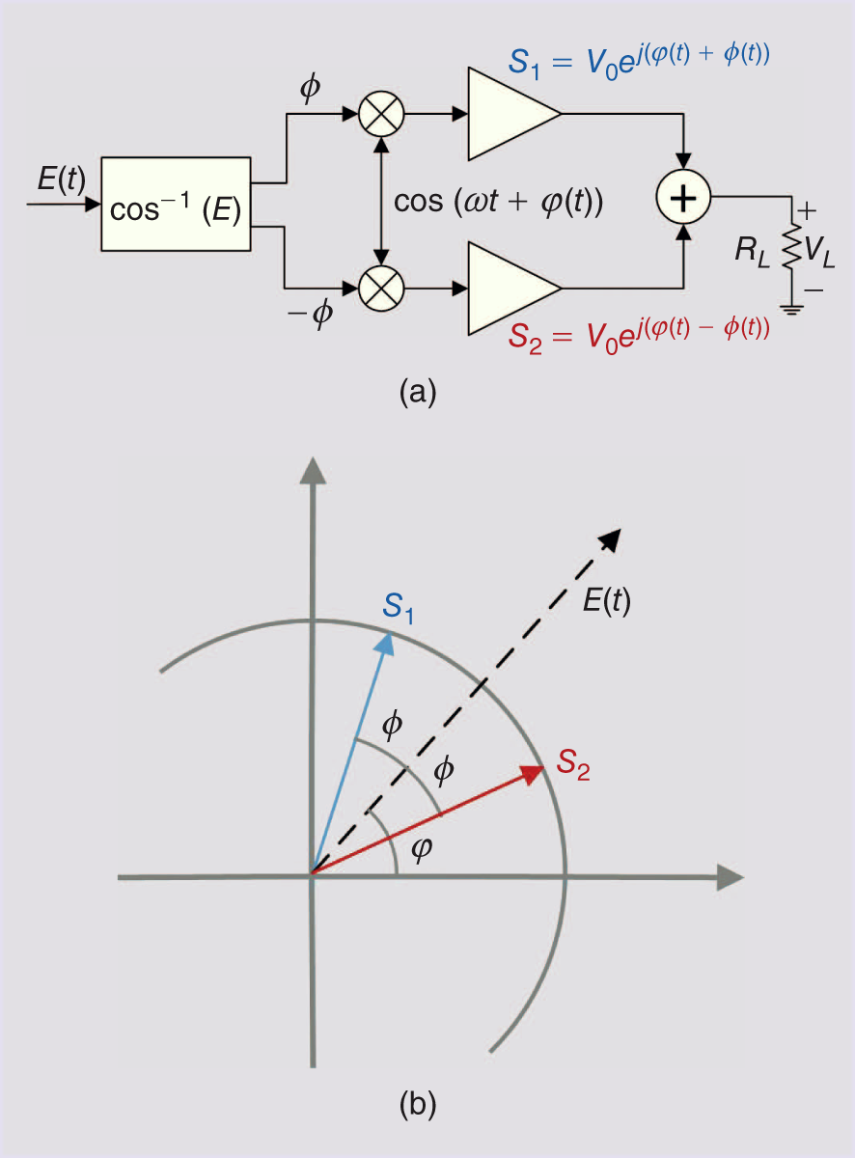
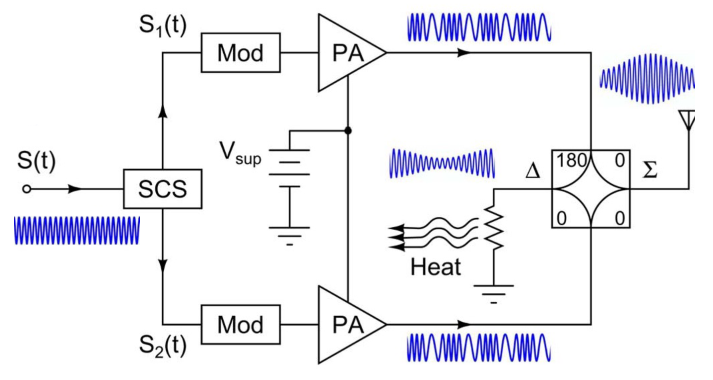
Outphasing Modulation, with Two PAs driven into Saturation
Vector representation
of outphasing transmitter
(from Barton, IEEE Microwave Magazine, Feb. 2016)
Components before PA are generated in I/Q digital LLRF,
creating two phase modulated signals of constant amplitude
(Adopted from Godoy, IEEE Trans MTT,, Dec. 2009)

Slide 31
~9.1 kWp
40-Way Splitter
Blade
40-Way Combiner
.
.
.
~350 kWp
Magic T
~5.3 kWp
Blade
LLRF Signal #1 (~35 W, ϕ Variable)
~670 kWp
Magic T
Blade
40-Way Splitter
Blade
40-Way Combiner
.
.
.
~350 kWp
Blade
40-Way Splitter
Blade
40-Way Combiner
.
.
.
~350 kWp
Magic T
LLRF Signal #2 (~35 W, ϕ Variable)
~5.3 kWp
Blade
~1.3 MWp
Blade
~670 kWp
40-Way Splitter
Blade
40-Way Combiner
.
.
.
~350 kWp
Blade

