Slide 1
High efficiency RF sources at CERN
Chiara Marrelli, N. Catalan Lasheras, I. Syratchev

Slide 2
Outline
High efficiency klystrons at CERN: 15 years of activity
Previous developments (highlights):
X-band
S-band
HL-LHC
Future needs:
HL-LHC
FCC
RF sources for FCC
The tristron
R&D over the next 5 years
Conclusions

Slide 3

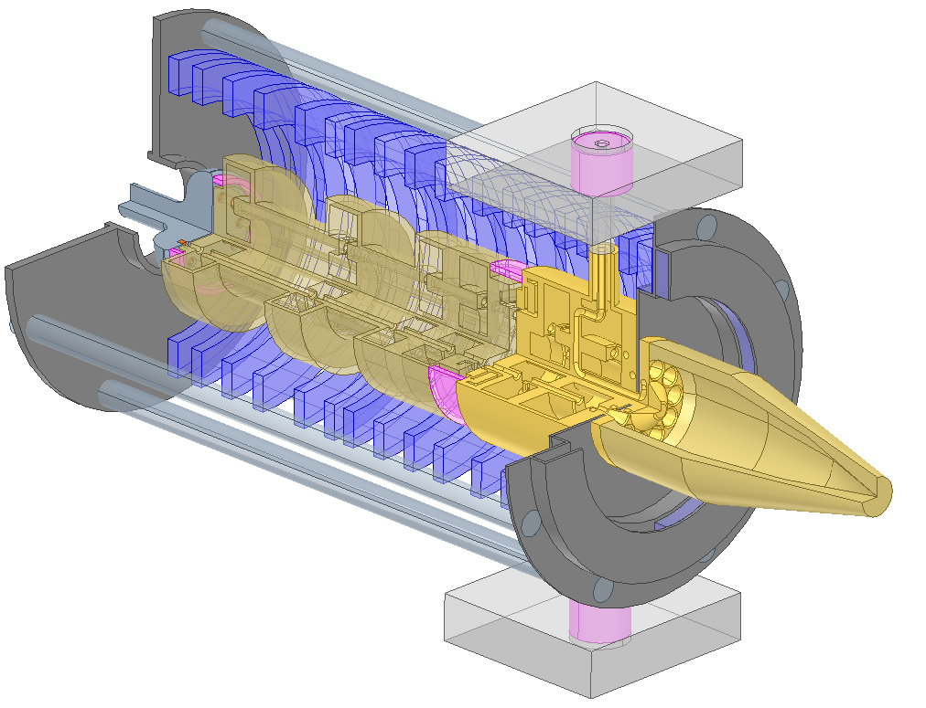
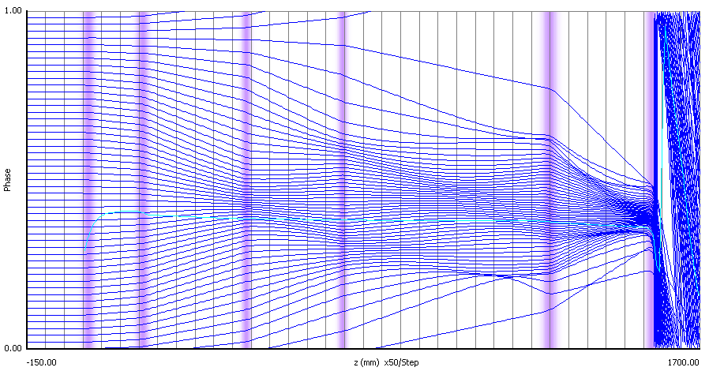
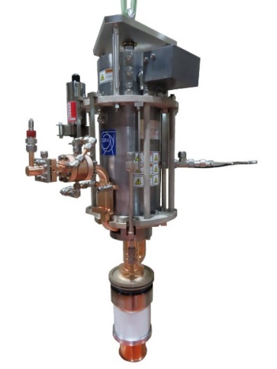
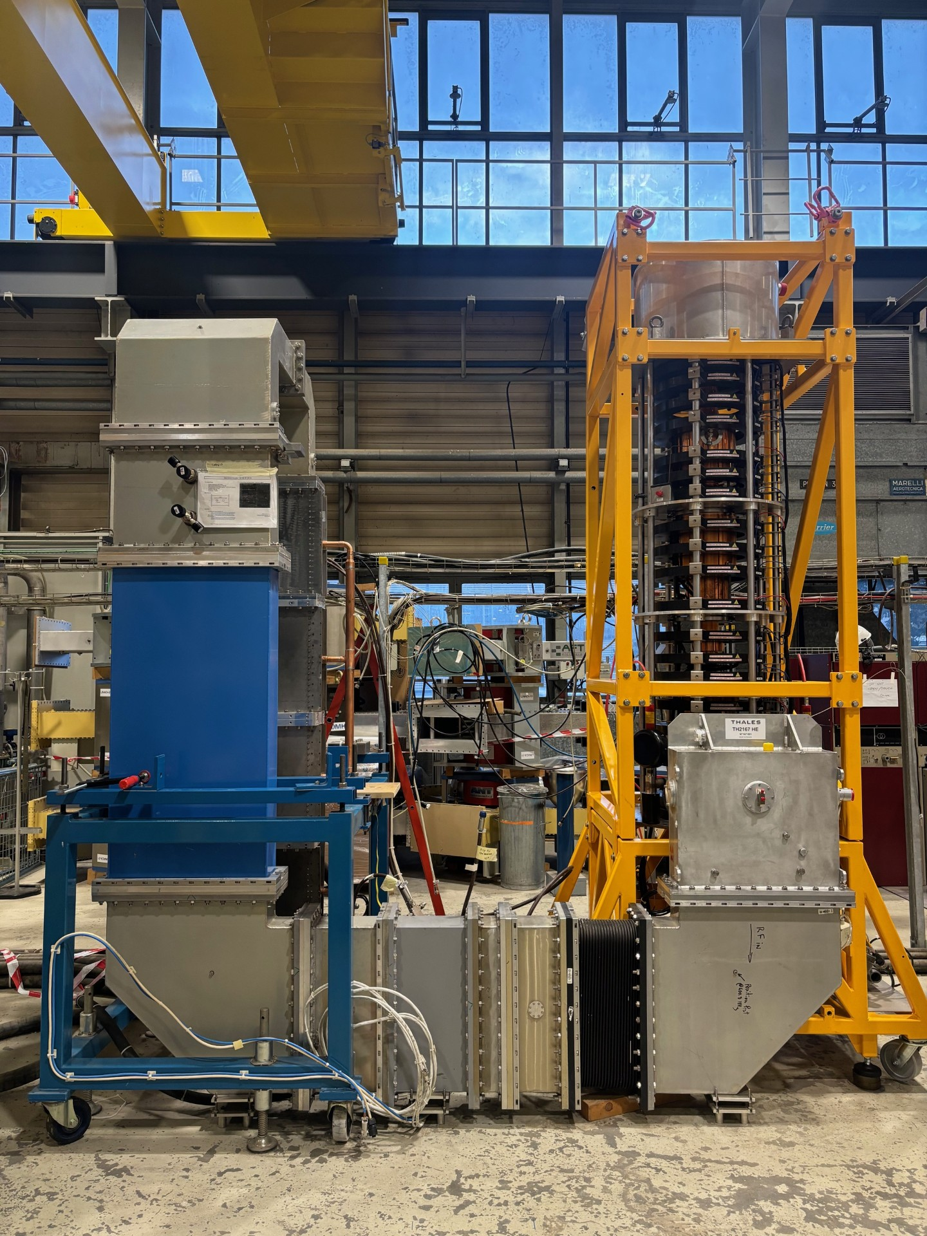
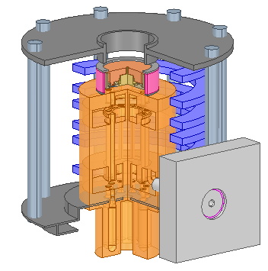
High efficiency klystrons at CERN
power sources
New bunching techniques (COM, CSM, BAC)
Studies on high efficiency limitations
KlyC simulation code
Scaling procedures
New klystron topologies
Prototyping
International collaborations (2014-2018)
Study of high efficiency klystrons for the CLIC drive beam (2010)
HEIKA started in 2014
In 2021 the HEK activity becomes a Cern project for the development, fabrication and testing of high efficiency klystrons for various particle accelerators (LHC, CLIC, FCC, ILC, etc…)
From 2024, the program expands from High Efficiency Klystrons to High Efficiency Power Sources

Slide 4

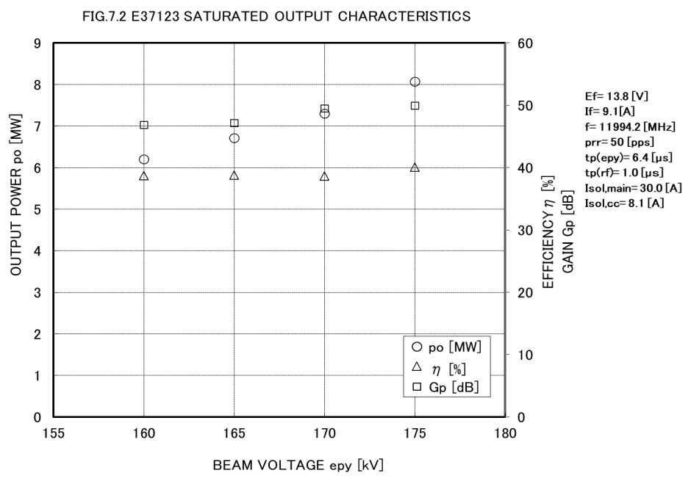
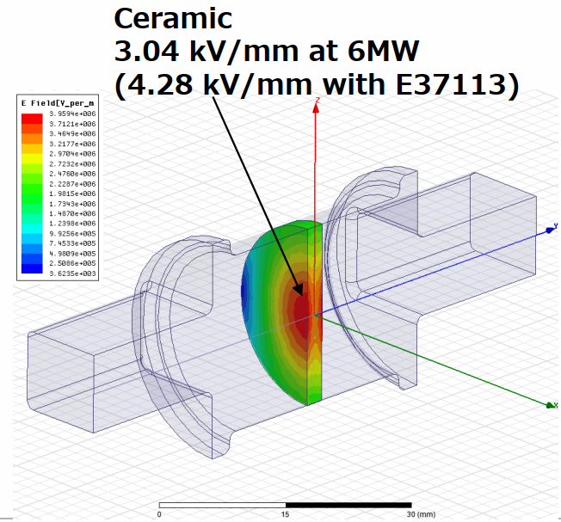
X-band
X-band klystrons used to test the CLIC accelerating structures (X-boxes)
Canon E37113 klystrons (6 MW, 12 GHz, 39% efficiency) used as baseline for HE retrofit
New window design by Cern, new gun (175 kV) to reach 8 MW, 39% efficiency (E37123)
High efficiency retrofit to reach 10 MW, 56% efficiency
Second harmonic triplet + three cells output cavity, gun and window as in E37123, original solenoid from E37113

Slide 5
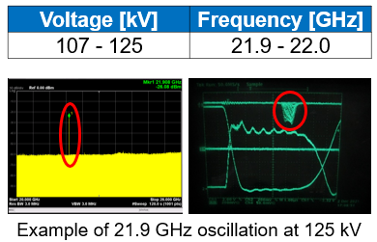
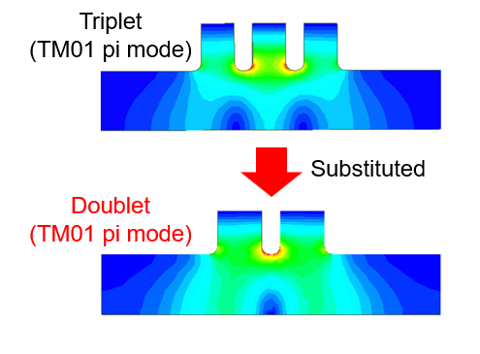
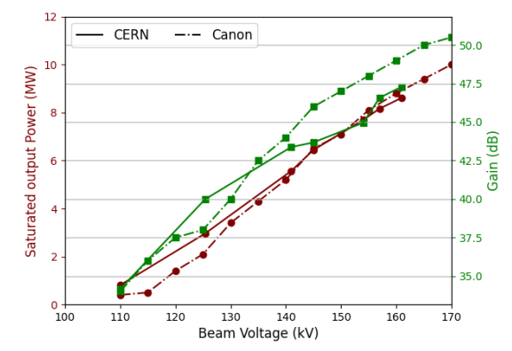
X-band
Canon/CERN HE retrofits
Two units built by Canon:
DC Oscillations observed on first prototype S/N 22M001;
Instabilities analyzed, understood and reproduced in simulations:
KlyC, monotron oscillation module
CST PIC
Instabilities addressed on the second prototype
First prototype rebuilt by Canon and successfully tested at Canon and CERN
Reached up to 10 MW, 56% efficiency, performances reproduced at CERN
2nd harmonic triplet replaced by a doublet
“decoupling” the first three bunching cavities by varying the gap lengths
Adding stainless steel in the first four drift tubes
Increase of the main coil current
[1] J.C. Cai, I. Syratchev and G. Burt, ‘Numerical Analysis of Resonant Multipolar Instabilities in High Power Klystrons’, IEEE Trans. on Electron Devices, vol.68, issue.7, pp. 3617 - 3621, June 2021.
[2] T. Anno, “X-band high efficiency klystron development”, Workshop on Efficient RF sources, July 2022.
[3] Igor Syratchev, Zaib Un Nisa, Jinchi Cai, Graeme Burt, Toshiro Anno, DC Beam Stability issues in the first commercial prototype of a High Efficiency 8MW X-Band Klystron, CLIC-Note-1176, 2022.

Slide 6
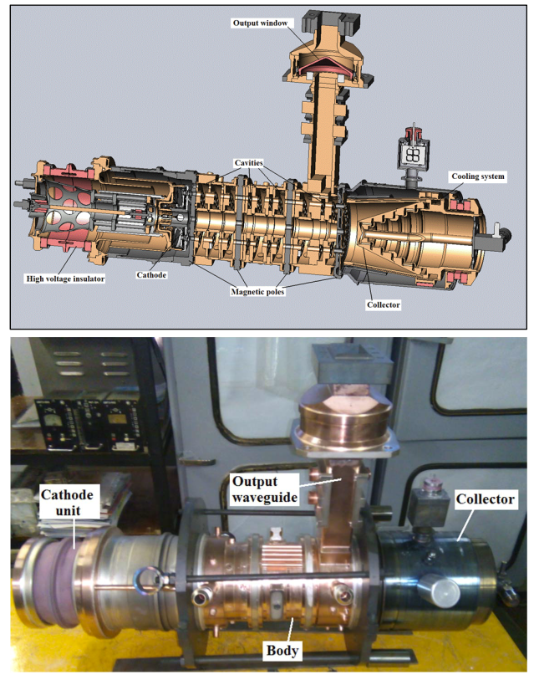
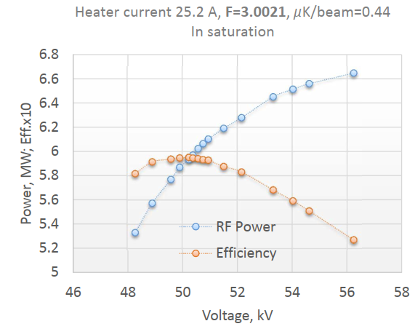
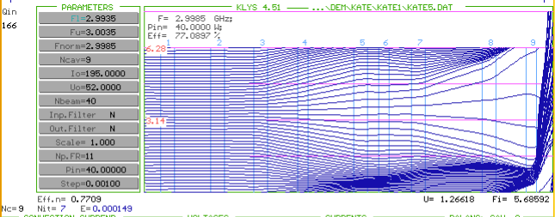
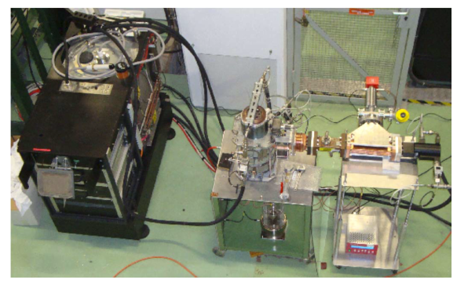
S-band MB klystron retrofit (2016)
First commercial S‐band MB tube prototype employing the new bunching technology (BAC: bunch-align-collect).
Retrofit of KIU-147 MBK klystron, from 42% to 60% by replacing the bunching circuit + PPM focusing
▪ 40 beams
▪ Permanent Magnets focusing system
▪ Voltage: <60 kV
▪ Peak power: >6.0 MW
▪ Efficiency: >60%
▪ Pulse length: 5 microsecond
▪ Repetition rate: 300 Hz
▪ Average power: 30 kW

Slide 7
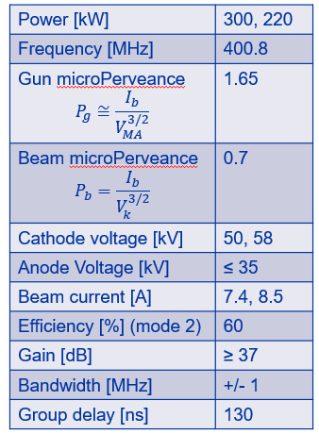
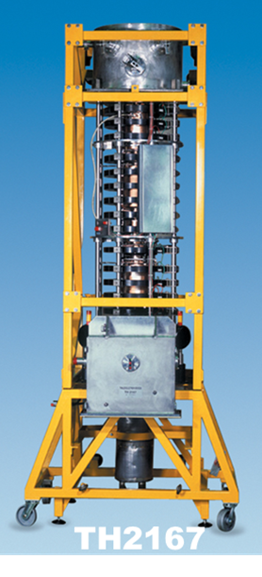
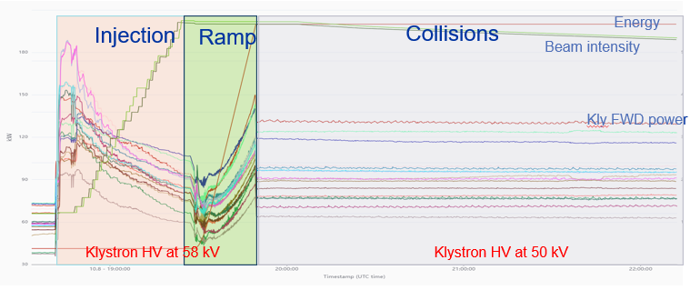
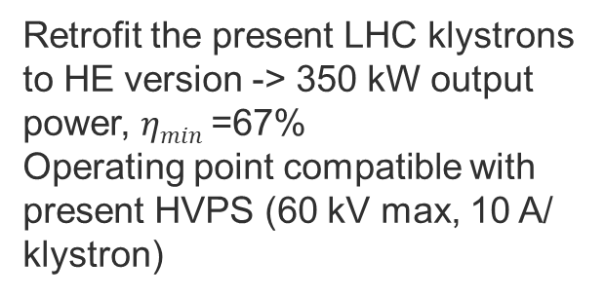
HL-LHC HE klystrons
Present LHC klystrons: Thales TH2167, 400.8 MHz, 300 kW CW
The high intensity beams of the HL-LHC will require higher voltage at injection
Power required from the klystron pushed to 350 kW (transients)
Retrofit the present LHC klystrons to HE version -> 350 kW output power, $ηmin$=67%
Operating point compatible with present HVPS (60 kV max, 10 A/ klystron)

Slide 8
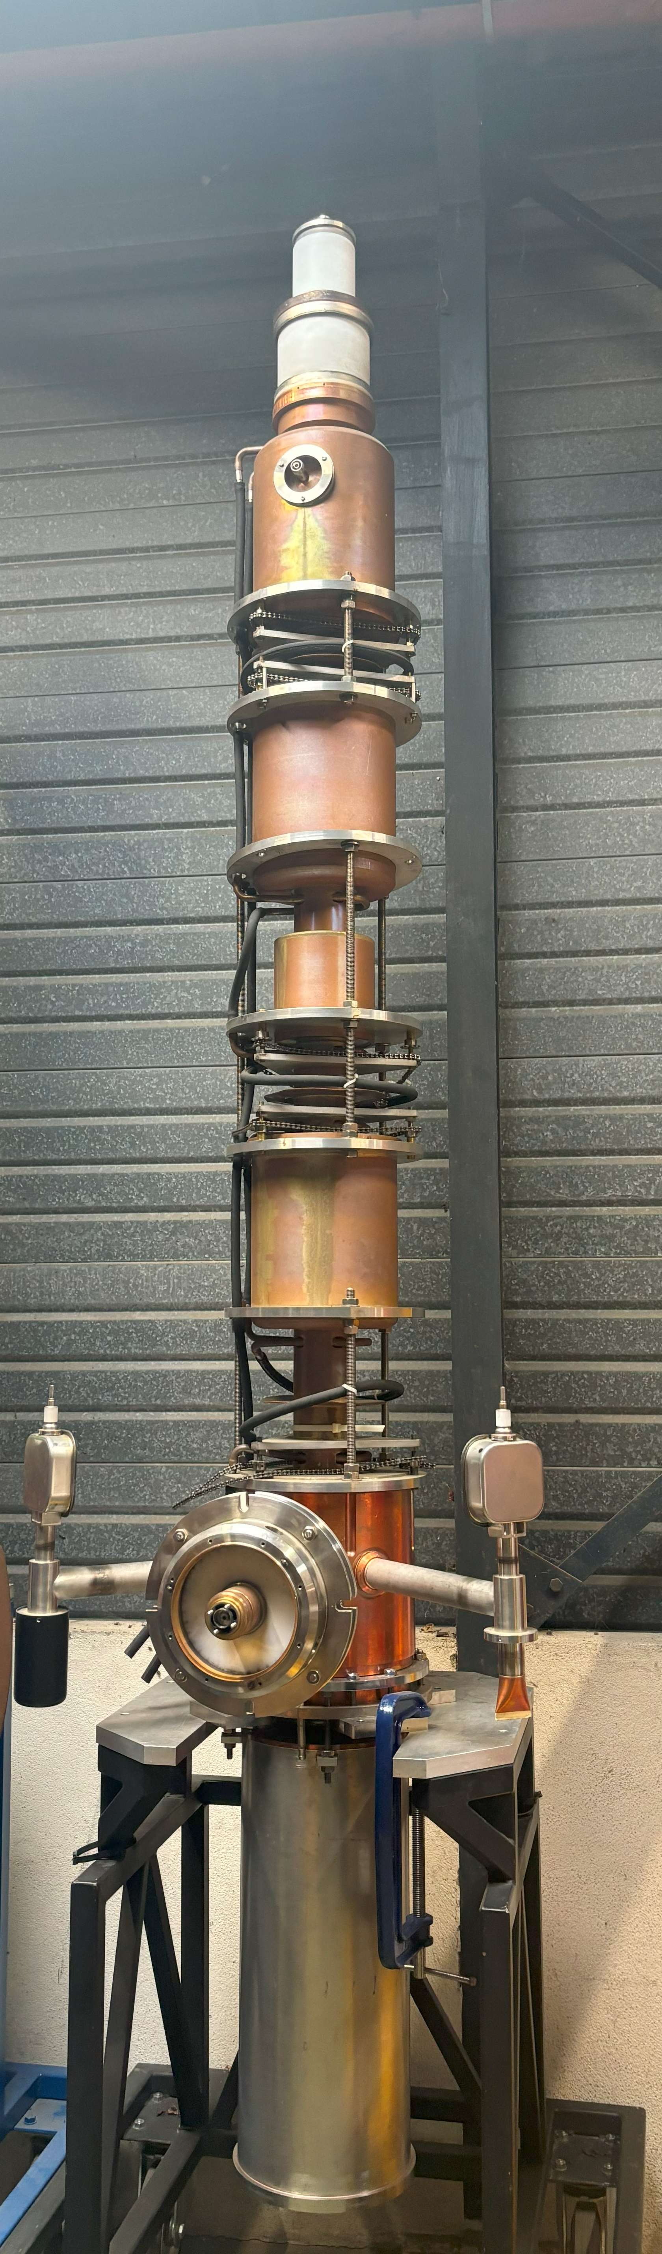
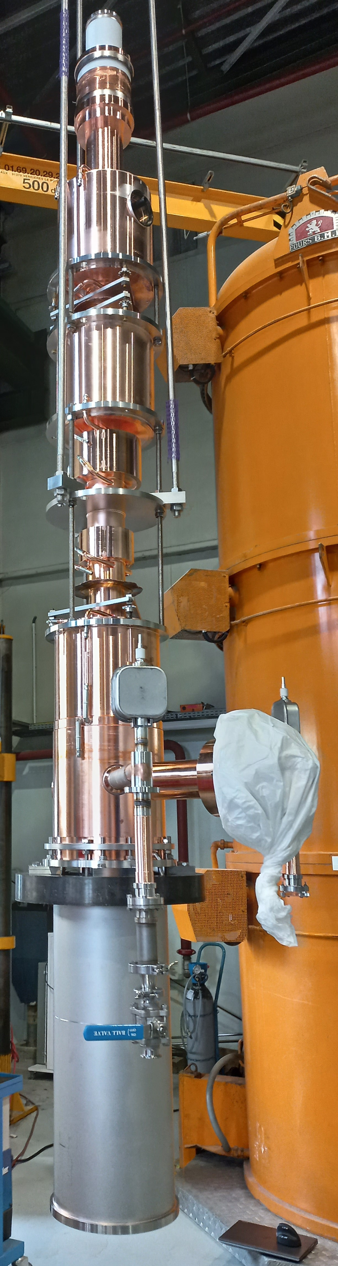
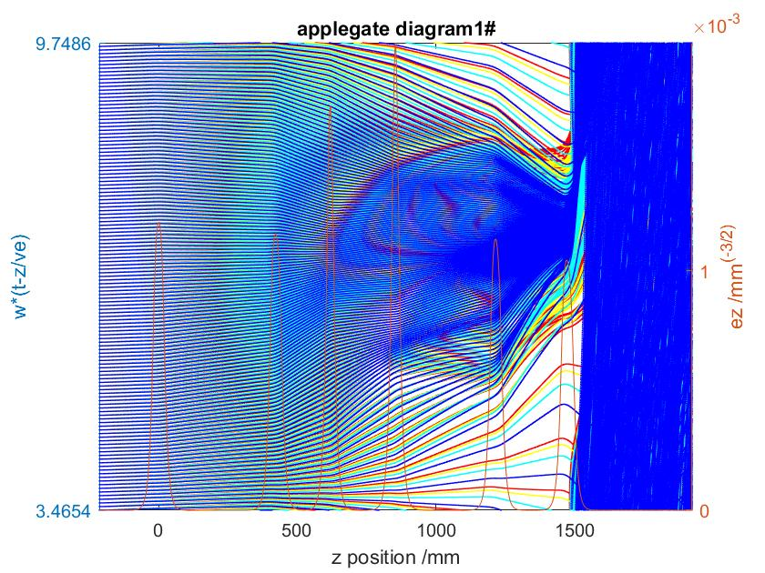
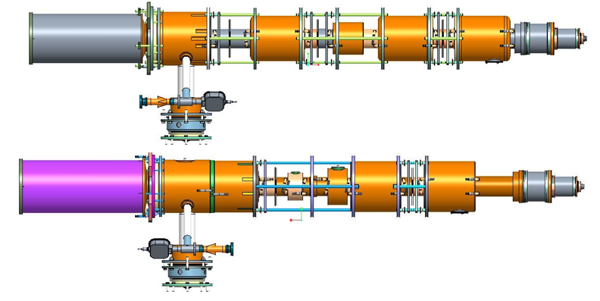
HL-LHC HE klystrons
CSM (Core Stabilization Method) interaction structure:
Second and third harmonic cavities used to stabilize the bunch core around the center, while the particles at the periphery of the bunch approach the center monotonically, increasing the bunch saturation and the efficiency.
Klystron optimized in KlyC and CST, predicted efficiency 70%
TH2167 S/N 01
“St. Paul”
TH2167HE
Prototype
Core stabilization
Manufacturing started in 2022, tube tested in summer 2024

Slide 9
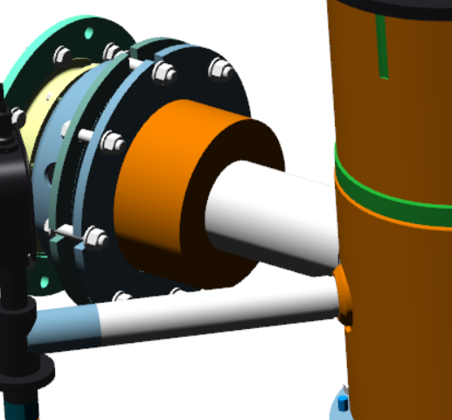
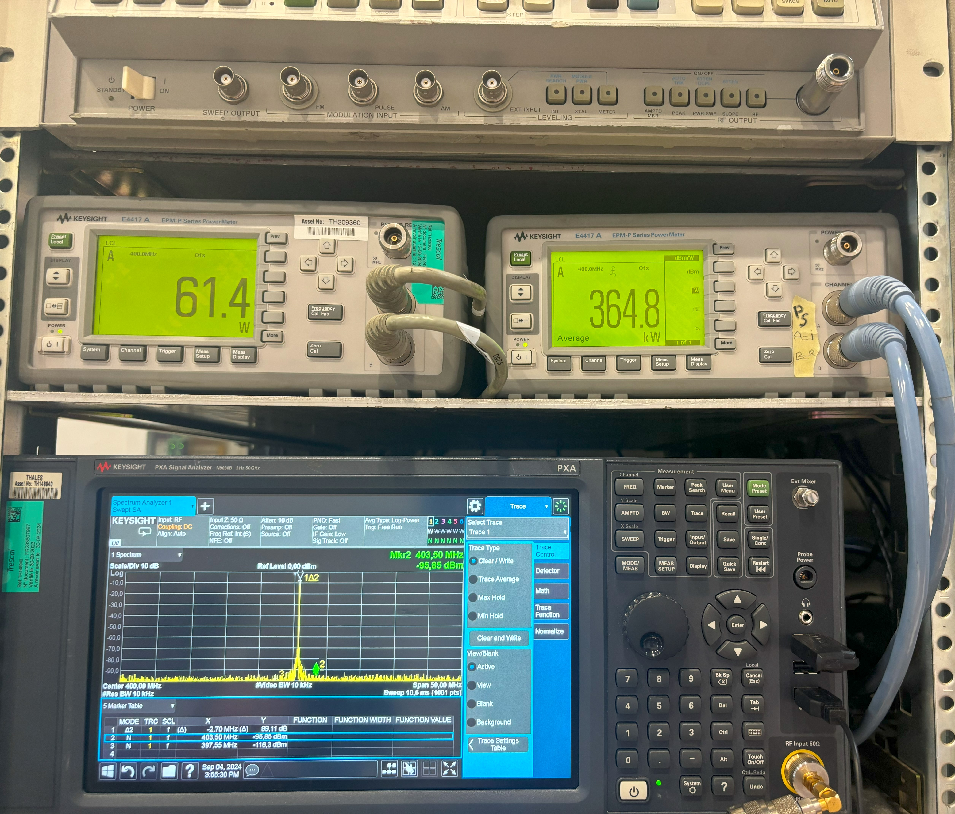
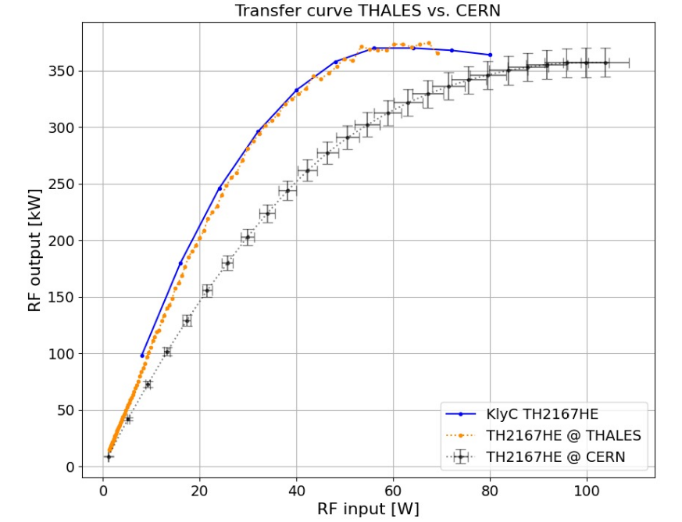
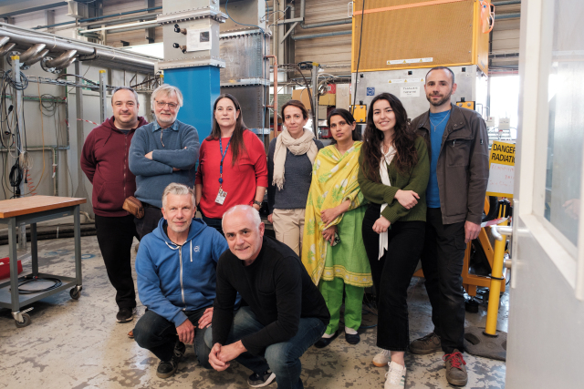
HL-LHC HE klystrons: test results
Measured efficiency 70% (calorimetric) with 365 kW output power at 57.7 kV, 9 A during FAT (Sept. 2024)
KlyC model of the klystron as “digital twin” to simulate performances and predict klystron behavior
Several issues accounted for:
Initial wrong tuning of the second harmonic cavity
Multipacting in the output coaxial
Overheating of the harmonic cavities membranes
N
Courtesy of Thales
Test at CERN confirmed 69% efficiency and all specifications met.

Slide 10
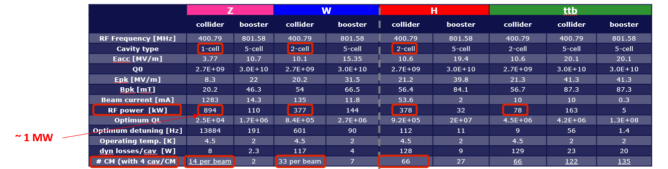
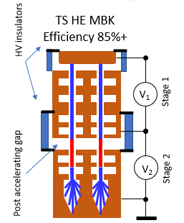
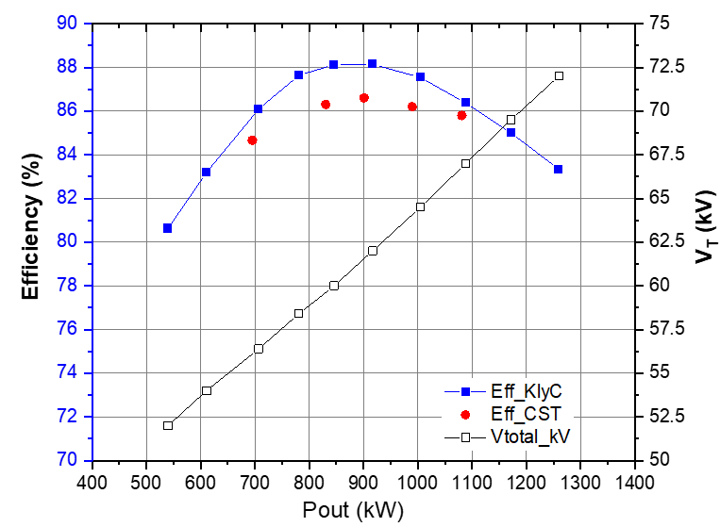
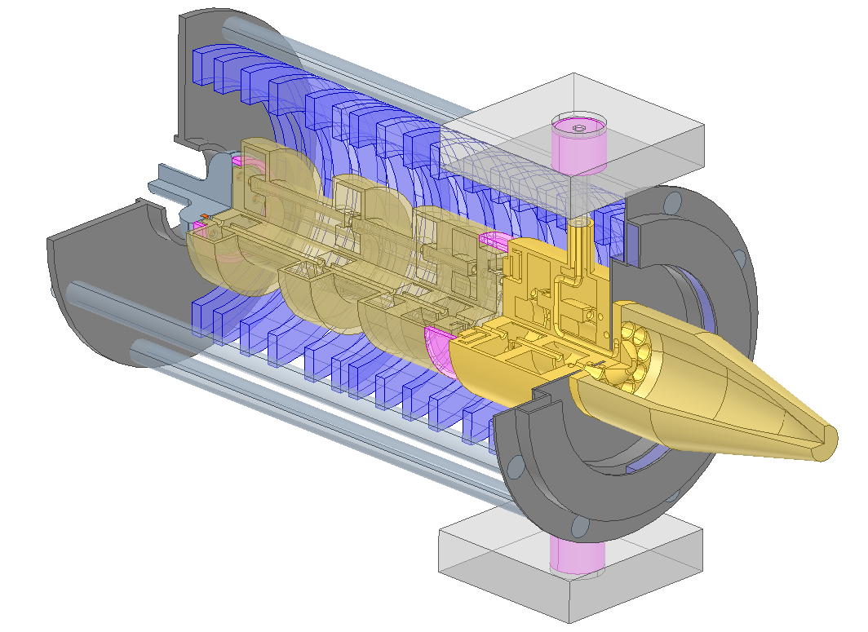
RF sources for FCC (I)
Initial layout with different cavities for Z, W, H, ttb
1 MW power source needed for Z pole
Two stages multibeam klystron
Compact and high efficiency (>80%)
bunching at low voltage (high perveance)
acceleration and cooling
Final power extraction at high voltage (low perveance)
Design completed:
KlyC simulations
PIC (CST) simulations
Beam optics and solenoid design
L < 3 m
Courtesy of U.N. Zaib, F. Peuger

Slide 11
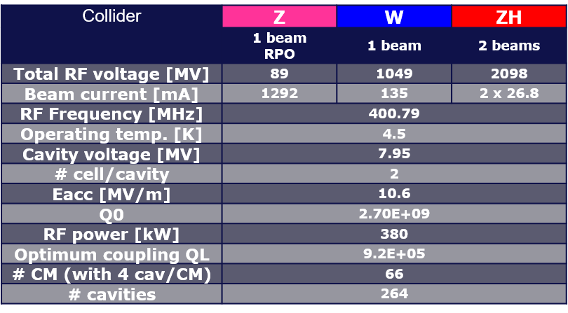
RF sources for FCC (II)
New layout with two gaps superconducting cavities for Z, W, H poles thanks to Reverse Phase Operation (RPO), allowing to use increased voltage with focusing and defocusing cavities.
One unique power source for Z,W,H
Power needed per cavity ≈ 400 kW
The ideal source:
High efficiency (>80%) across a wide range of power levels
500 kW (including overhead)
Compatible with ttb if scaled to 800 MHz
Fully compatible with HL-LHC power needs!
X 264
Multibeam Tristron
400 MHz
46 kV
500 kW, CW

Slide 12
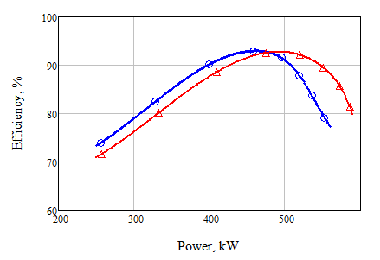
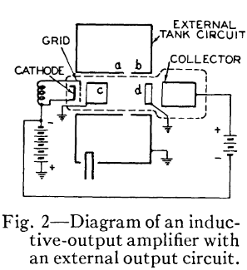
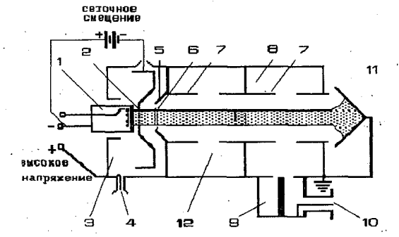
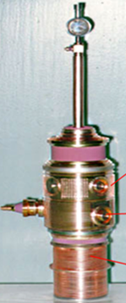
The tristron
400 MHz FCC tristron power /efficiency performance
B class
48kV
46kV
Similar to the IOT, the Tristron (a hybrid between triode and klystron) is a gridded tube with one additional penultimate cavity that boosts the RF power production efficiency from 72% (IOT) to above 90%.
Tristron concept is almost 60 years old, but it has never been fully commercialized before.
CST 3D PIC results
Increased operational efficiency (compared to klystron)
Tristron (A.D. Sushkov et. al. 1967)
MB Prototype tested in 1997, V. Tsarev:
IOT (A. Haeff, 1939)

Slide 13
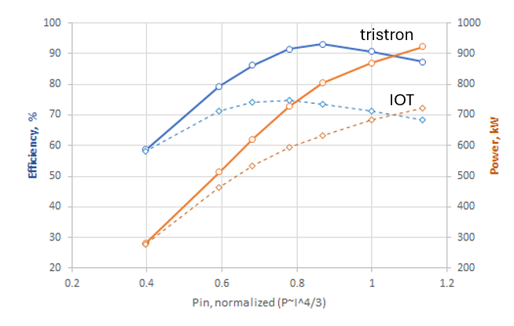
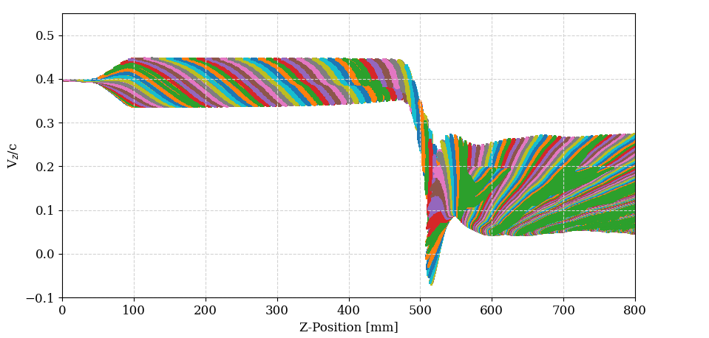
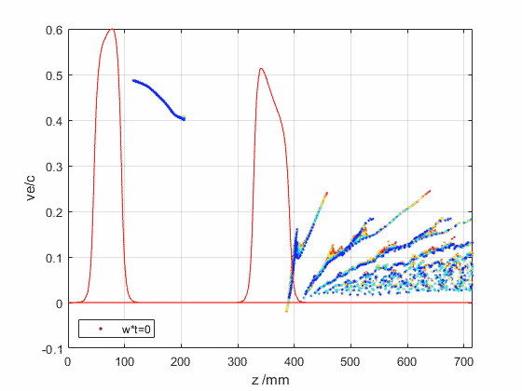
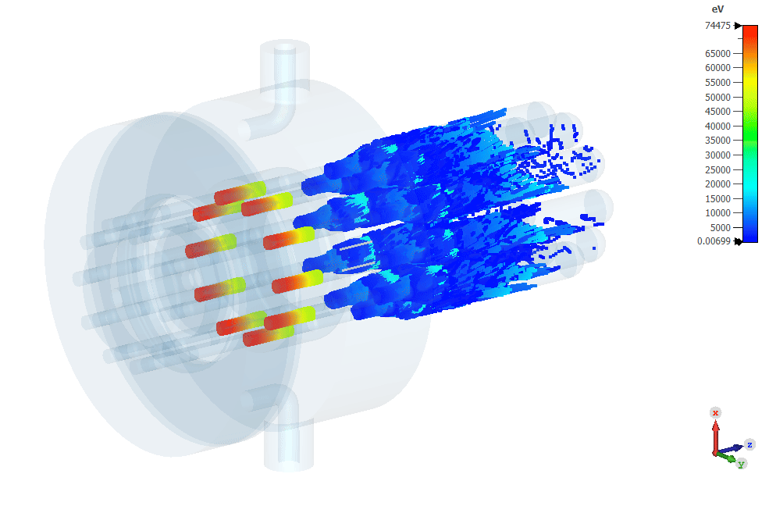
Tristron VS IOT
Taking advantage of the HE klystron studies on the optimum bunching for ultimate efficiency:
Fully saturated bunch (already in IOT)
Congregation and bunch compression provided by the penultimate cavity
Partial electron bouncing in the output cavity
Hollow beam configuration to reduce stratification
Electron bunches velocity modulation in a tristron
Output cavity
92.4%
Optimal congregation
Drift length provides optimal bunch length compression
Penultimate cavity
Bouncing electrons
KlyC
X10 individual collectors, each 30 cm long.

Slide 14
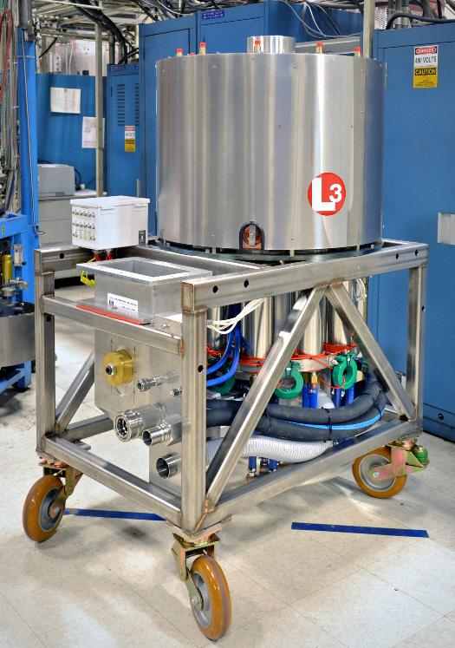
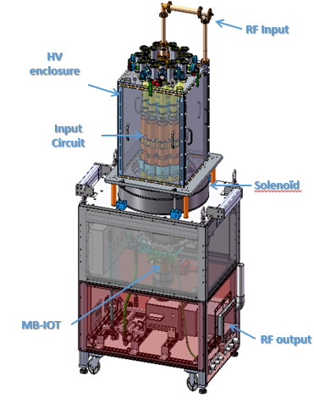
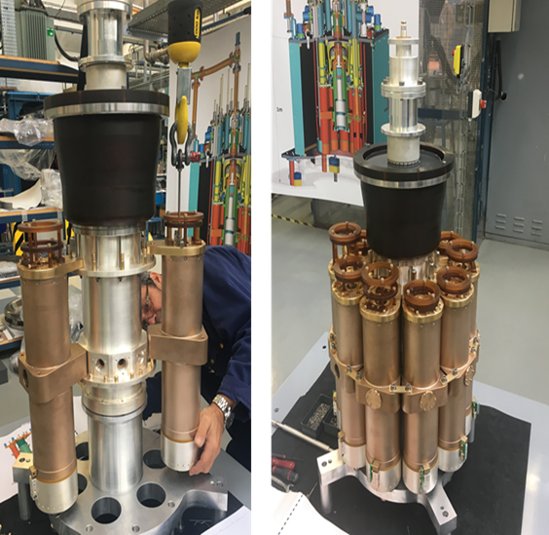
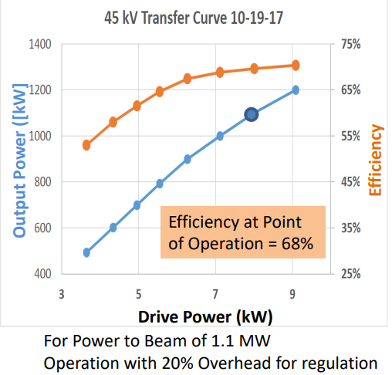
State of the art
Two MB-IOTs successfully built for ESS (Thales/CPI consortium, L3)
Prototyping successful, both MBIOTs reached specification (1.2 MW at 5% duty), with efficiency 70%.
Technology not adopted at ESS as not mature enough at the time, and too costly
10 separate input cavities are one of the cost drivers and source of complexity
Thales/CPI (presented at IVEC 2018)
L3 (presented at IVEC 2017)
M. Jensen et al., “Testing of the ESS MB-IOT prototypes”, IPAC 2018

Slide 15
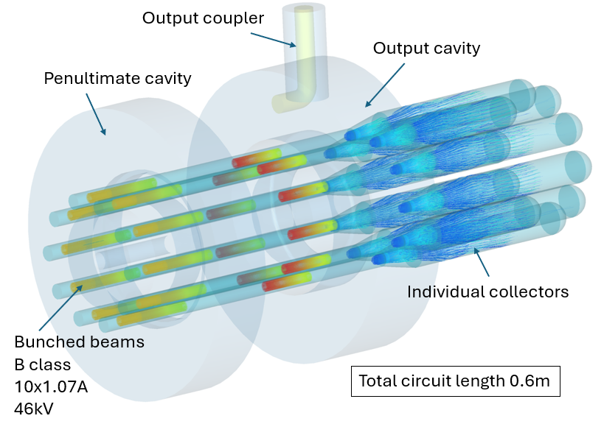
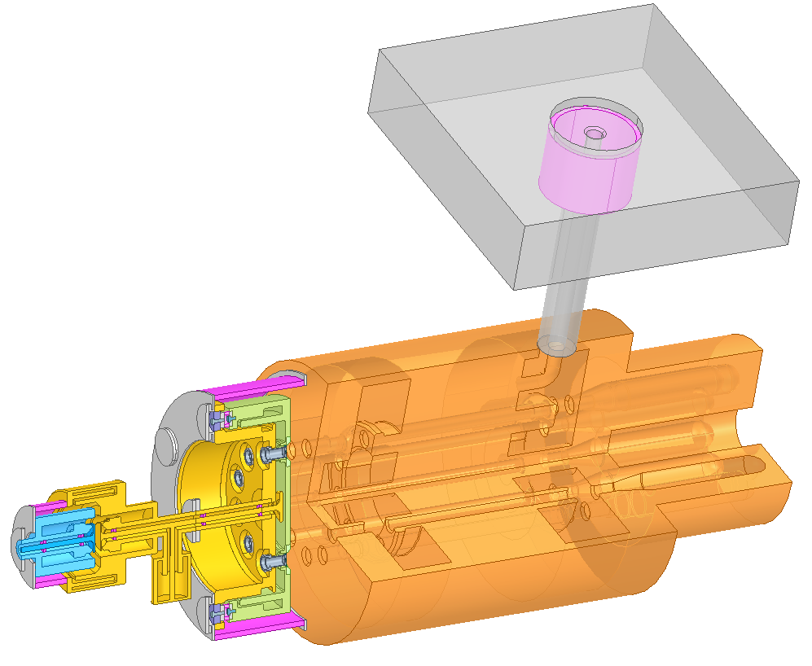
Tristron development and prototyping at CERN
FCC_{ee} 400MHz, 0.5MW MB Tristron design with a common input cavity (CERN) and flat cathodes.
High risks of development with industry:
technical risk (new input cavity, large ceramic…)
commercial risk (for CERN): single supplier
tight schedule
400MHz, 500kW, η=92%
“Artistic” view of the tristron
RF output
In-house prototyping: series production via licensing or built-to-print contracts in industry
Input cavity
Output cavity
DC/RF breaker
RF input
Total length 1.49m. External solenoid is not shown
Penultimate cavity
Individual collector x 10
Courtesy of I. Syratchev

Slide 16
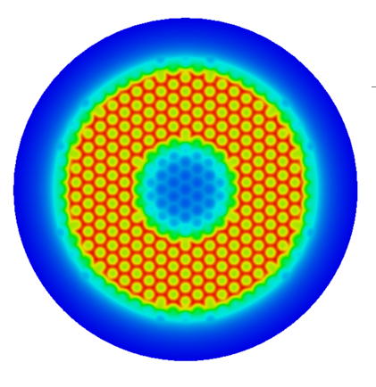
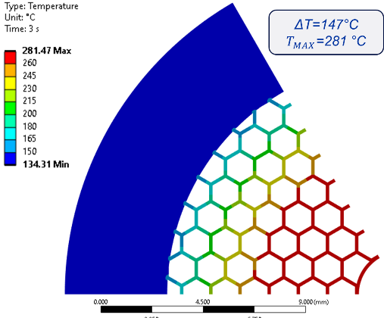
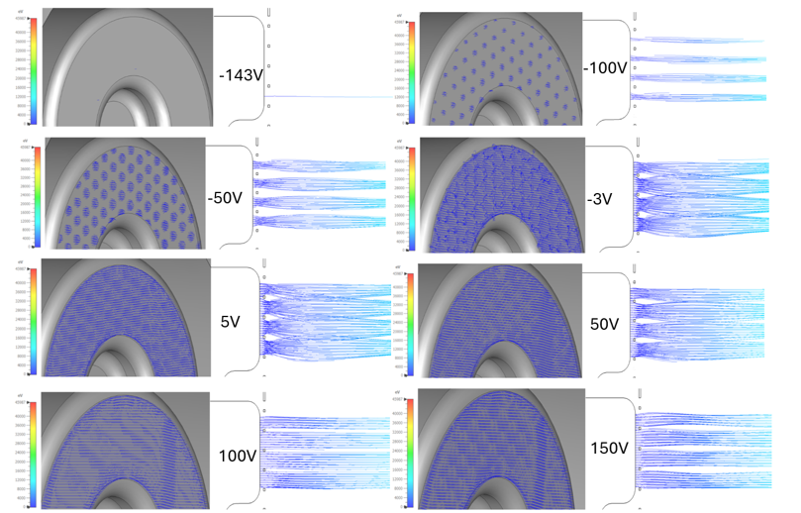
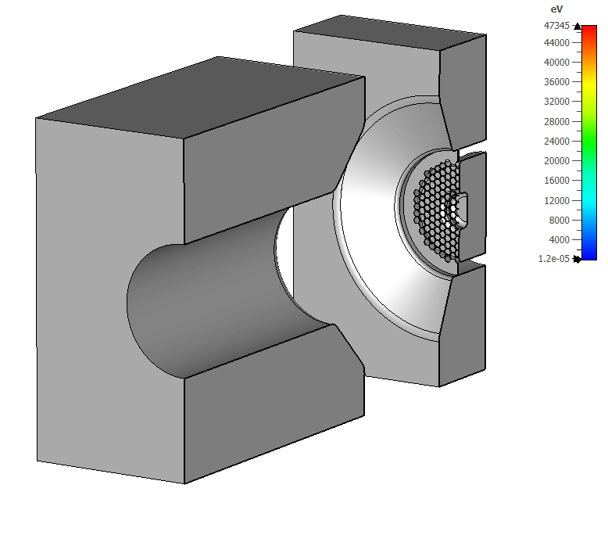
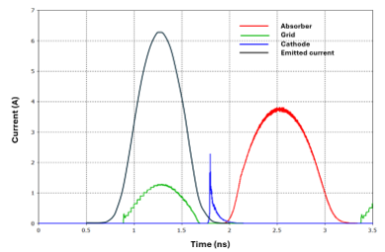
Tristron development and prototyping at CERN
RF design completed:
gridded gun, cavities, collectors, output window
Bunch generation, including sp.charge and transient effects in the cathode-grid gap
Calculation of emitted, transmitted and intercepted current/power on the grid
Optics and solenoid design
Wave/beam interaction in the RF circuit
Grid thermo-mechanical simulations, tolerance analysis
E-field in a gap center
Thermo-mechanical analysis
Beam formation vs. V bias
CST PIC
I. Syratchev, A. Thakur, U.N. Zaib

Slide 17





Tristron development and prototyping at CERN
Thermo-mechanical simulations ongoing:
Grid deformation, stresses and delta-temp
Grid fabrication (first attempts with laser cut)
Cathode design and selection
Test vehicle optics (for characterization of the gridded cathode)
L. Giezendanner, A. Piccini, K. Kissandrakis

Slide 18


Planning
Recurrent internal meetings involving several groups at Cern
Resources allocated to have a first prototype in 3 years
Collaboration with EPC for development of the HV power supply
Collaboration with Thales and SLAC to develop single beam, lower power devices
Identical gridded cathode as in 400MHz device

Slide 19
Looking at the future….
HL-LHC is the priority for CERN right now:
Delivery of the HL-LHC klystrons (+ circulators and loads) from industry
Next priority is the FCC:
First MB-tristron prototype built at CERN (3 years)
800 MHz prototypes advancing in parallel (250 kW MB and 50 kW SB)
MB-tristron fully compatible with the HL-LHC requirements
Two-stages klystron still a valid option for linear collider alternatives (ILC, CLIC)

Slide 20
Conclusions
Very successful high efficiency klystron activity
Gridded tubes have been neglected for many years (with some exceptions): they are a valid, extremely efficient in operation and compact alternative to SSA
Industry does not have the resources to invest in R&D alone! We can help with the prototype development and risk reduction
Acquiring vacuum tube manufacturing capabilities will help reducing our risk (single supplier, loss of knowledge..)

Slide 21
Bibliography (not exhaustive)
C. Marrelli, Towards more efficient klystron designs -CERN-ACC-SLIDES-2014-0055, in Tiara workshop on RF power generation for accelerators (2013).
A.Y. Baikov, C. Marrelli, and I. Syratchev, Toward High-Power Klystrons With RF Power Conversion Efficiency on the Order of 90%, IEEE Trans. Electron. Dev. 62,3406 (2015).
A. Guzilov, BAC method of increasing the efficiency in klystrons, in 2014 Tenth International Vacuum Electron Sources Conference (IVESC) (2014) pp. 1–2.
V. C. R. Hill, G. Burt, D. Constable, C. Lingwood,C. Marrelli, and I. Syratchev, Particle-in-cell simulation of second and third harmonic cavity klystron, in 18th In-ternational Vacuum Electronics Conference (2018).
I. Syratchev, Introduction to HEIKA. tentative structure and objectives, in Proceedings of the CLIC Workshop (Geneva, Switzerland, 2015) [Online].Available: https://indico.cern.ch/event/336335/contributions/789041/.
J. Cai and I. Syratchev, KlyC: 1.5-D large-signal simulation code for klystrons, IEEE Trans. Plasma Sci. 47,1734 (2019).
J. Cai, I. Syratchev and Z. Lui, "Scaling Procedures and Post-Optimization for the Design of High-Efficiency Klystrons," in IEEE Transactions on Electron Devices, vol. 66, no. 2, pp. 1075-1081, Feb. 2019, doi: 10.1109/TED.2018.2887348.
J. Cai, I. Syratchev and G. Burt, "Accurate Modeling of Monotron Oscillations in Small- and Large-Signal Regimes," in IEEE Transactions on Electron Devices, vol. 67, no. 4, pp. 1797-1803, April 2020, doi: 10.1109/TED.2020.2971279.
J. Cai and I. Syratchev, Design Study of X-band High Efficiency Klystrons for CLIC, in 21st IEEE International Vacuum Electronics Conference (2020)
J.C. Cai, I. Syratchev and G. Burt, ‘Numerical Analysis of Resonant Multipolar Instabilities in High Power Klystrons’, IEEE Trans. on Electron Devices, vol.68, issue.7, pp. 3617 - 3621, June 2021.
T. Anno, “X-band high efficiency klystron development”, Workshop on Efficient RF sources, July 2022.
Igor Syratchev, Zaib Un Nisa, Jinchi Cai, Graeme Burt, Toshiro Anno, DC Beam Stability issues in the first commercial prototype of a High Efficiency 8MW X-Band Klystron, CLIC-Note-1176, 2022.
P. Alonso Arias, A. Chauchet, C. Marrelli, I. Syratchev, M. Webber, M. Boronat, M. Jones, N. Catalan Lasheras,S. Gonzalez Anton, and Z. Un Nisa, Validation of highefficiency klystron technology, JACoW LINAC2024,THPB015 (2024).
H. Timko, T. Argyropoulos, R. Calaga,N. Catalan Lasheras, K. Iliakis, B. E. Karlsen-Bæck,I. Karpov, and M. Zampetakis, Advances on LHCRF Power Limitation Studies at Injection, JACoWHB2023, 567 (2024).
K. H. Khlifa, A. Beunas, A. Mollard, I. Syratchev, N. C.Lasheras, and C. Marelli, TH2167HE High-Efficiency Klystron for the Hi-Lumi LHC, in 26th InternationalVacuum Electronics Conference (2025).
N. Catalan-Lasheras, I. Syratchev, Z. Un Nisa,P. Alonso Arias, C. Marrelli, O. Brunner, A. Baig,G. Burt, J. Cai, T. Anno, A. Beunas, and K. Haj Khlifa,High-efficiency klystrons from a dream to a reality, JA-CoW IPAC2024, FRYD1 (2024).
T. Anno, Y. Okubo, and T. Tanaka, Development of an X-band 6 MW Pulsed Klystron, in Proceedings of the 12thAnnual Meeting of Particle Accelerator Society of Japan(2015).
V. E. Teryaev, S. V. Shchelkunov, and J. L. Hirshfield,90% efficient two-stage multibeam klystron: Modelingand design study, IEEE Transactions on Electron Devices67, 5777 (2020).
J. Cai and I. Syratchev, Modeling and technical design study of two-stage multibeam klystron for CLIC, IEEE Transactions on Electron Devices 67, 3362 (2020).
J. Cai, Z. u. Nisa, I. Syratchev and G. Burt, "Beam Optics Study on a Two-Stage Multibeam Klystron for the Future Circular Collider," in IEEE Transactions on Electron Devices, vol. 69, no. 8, pp. 4563-4571, Aug. 2022, doi: 10.1109/TED.2022.3182299.

Slide 22
Thanks to:
All colleagues in the MKS section, in particular to:
U.N. Zaib, A. Thakur, D. S. Guillen, P. A. Arias, O. Brunner
F. Peuger
L. Giezendanner, A. Piccini, K. Kissandrakis, and the other colleagues in MME and STI
J. Cai, G. Burt
K.H. Khlifa, A. Beunas (Thales), T. Anno (Canon)

