Slide 1
Large Science Projects
GARD RF Roadmap Update - RF Sources
February 11 2026
Fulvia Pilat
Director, Oak Ridge Accelerator Institute

Slide 2
Outline
Overview:
National Labs
Universities
Industry (new areas)
Large Accelerator Projects:
Electron-Ion Collider (BNL)
LBNF-Dune, PIP-II (FNAL)
NSLS-II-HE (SLAC)
…..
Fast growing:
FELs for lithography
Accelerator facilities for fusion material testing
Future large US-HEP Projects
EPP 2020 vision
The accelerators needed to support the vision
Challenges:
Supply chain
Workforce
International landscape

Slide 3
Accelerator Landscape in the US
National Labs
17 National Labs system
Large facilities at 9 Accelerator laboratories:
ANL, BNL, FRIB, FNAL, JLAB, LBL, LANL, ORNL, SLAC
Industry
Medical accelerators, radio-isotopes
Typically, small to medium size facilities
New: FELs for lithography (microchips)
Universities
Small to medium size facilities to support research

Slide 4


















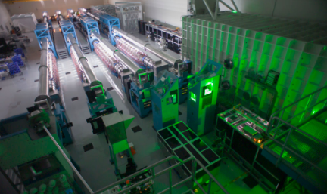














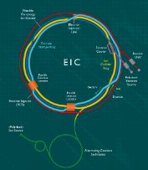


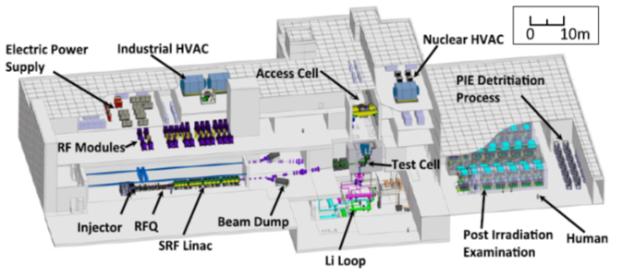



Current and planned accelerator User Facilities
OPERATING NOW
OPERATING NOW
Office of Science
BES
FES
HEP
NP
Advanced Light Source
National Synchrotron Light Source II
Stanford Synchrotron Radiation Light Source
Spallation Neutron Source
DIII-D
FACET Beam Test Facility
BELLA
BNL -ATF
ATLAS
Relativistic Heavy Ion Collider
Continuous Electron Beam Accelerator Facility
Z Machine
NIF
Omega/-EP
New or upgraded in
2-5 years
Advanced Photon Source
Linac Coherent Light Source
Fermilab Accelerator Complex
LANSCE
LCLS-II
NSTX-U
FRIB
DAHRT
JUPITER
APS-Upgrade
SNS-PPU
New or upgraded in
5-10 years
MPEX
ALS-Upgrade
Scorpius
PIP-II
BELLA-Staging
New or upgraded in >10 years
LCLS-II-HE
LANSCE UPGRADE
MEC Upgrade
HL-LHC
K-BELLA-Power
Electron Ion Collider
Terawatt XFEL
SNS-STS
FRIB 400 MeV/u Upgrade
Fusion Prototypic Neutron Source
PIP-III
FRIB 400 MeV/u Upgrade
XFEL Oscillator
FCC-ee/FCC-hh
Notes:
N.B.: This slide includes a mix of operating facilities, approved facility projects (i.e., have at least CD-0), and notional facility projects (i.e., no CD approval).
Start of operation dates (i.e., vertical position of a facility on this slide) are approximate (last unofficial update December 2025)

Slide 5
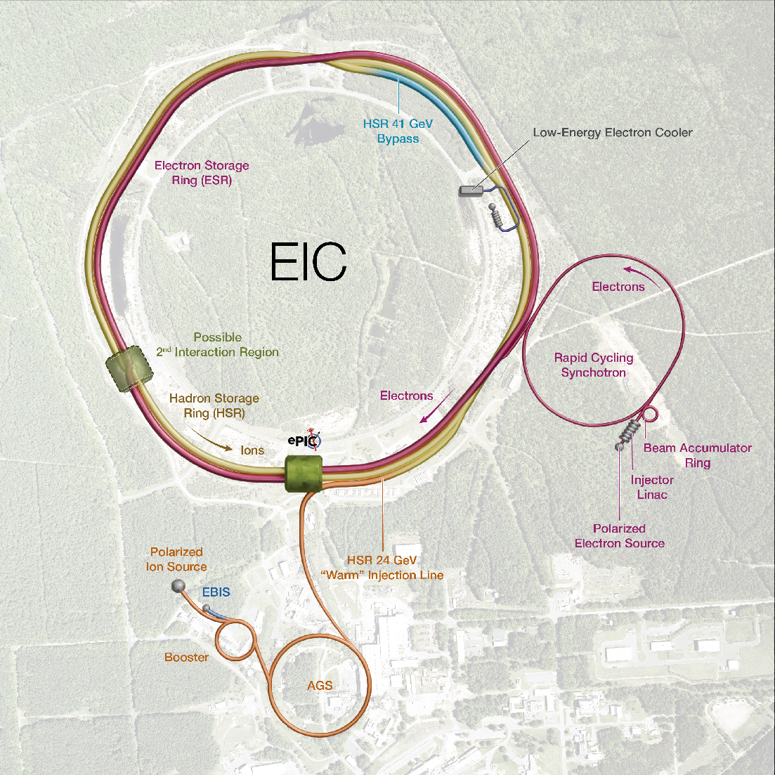
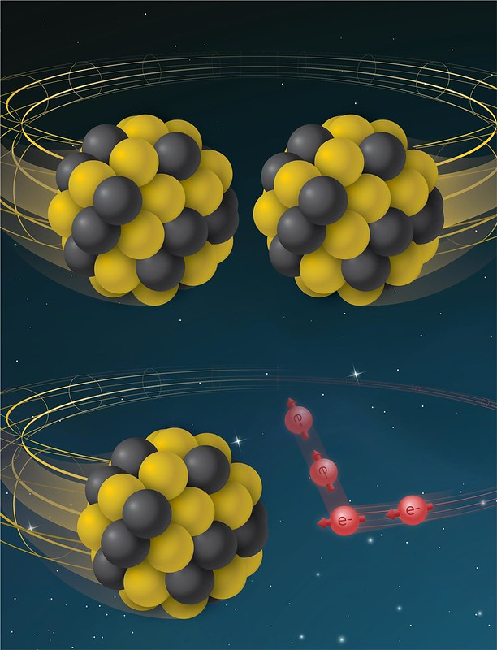
The Electron Ion-Collider
Design based on existing RHIC Complex
EIC constructed in collaboration with Jefferson Lab
Polarized Hadron storage Ring(RHIC Rings) 40-275 GeV
Polarized Electron storage ring. 2.5–18 GeV
Electron rapid cycling synchrotron. 0.4- 18 GeV (spin transparent)
High luminosity interaction region(s)
L = 10³⁴cm⁻²s⁻¹
RHIC
RHIC
EIC
Facility performance:
High luminosity
20-140 GeV COM range
Species: p to U
Large detector acceptance
Second IR

Slide 6
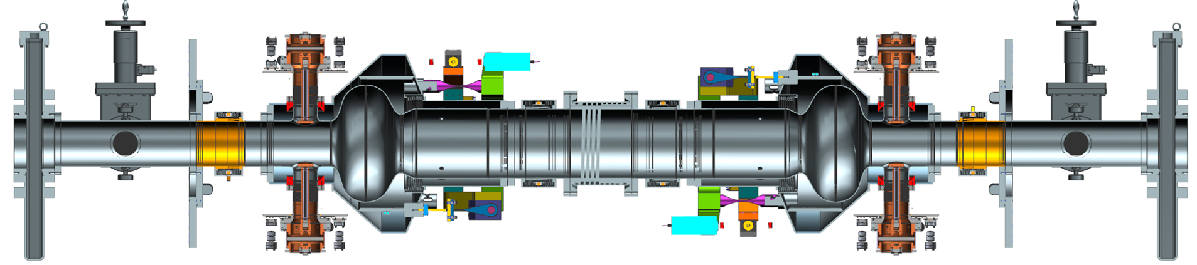
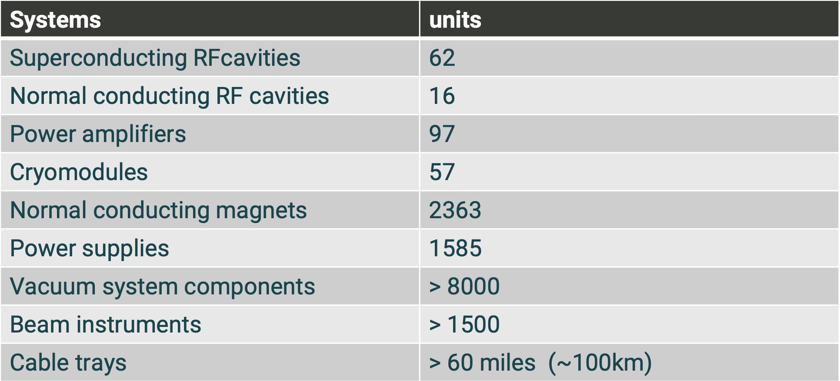
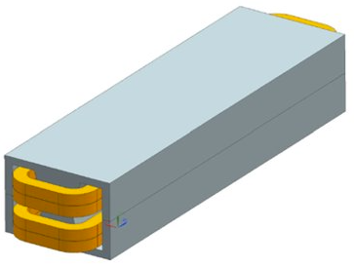
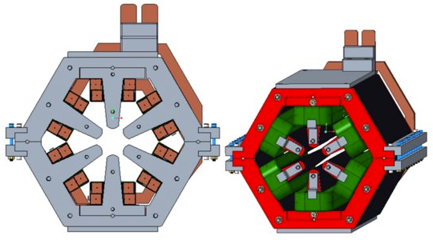
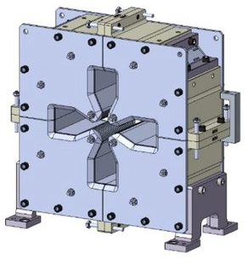
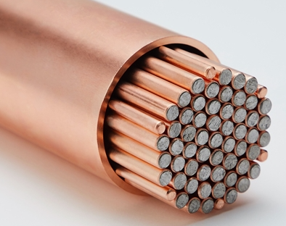
Examples of industrial needs for the EIC

Slide 7
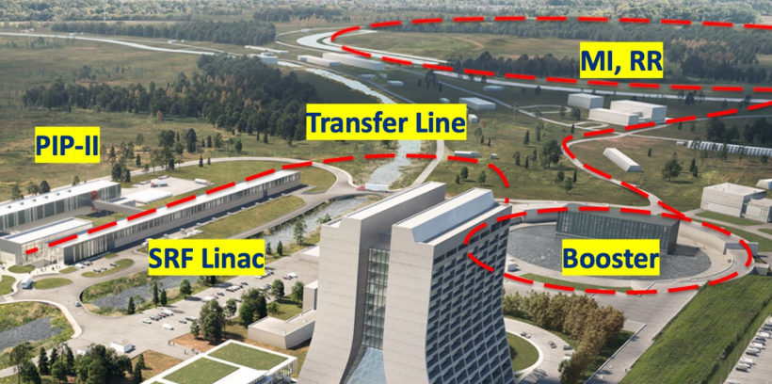
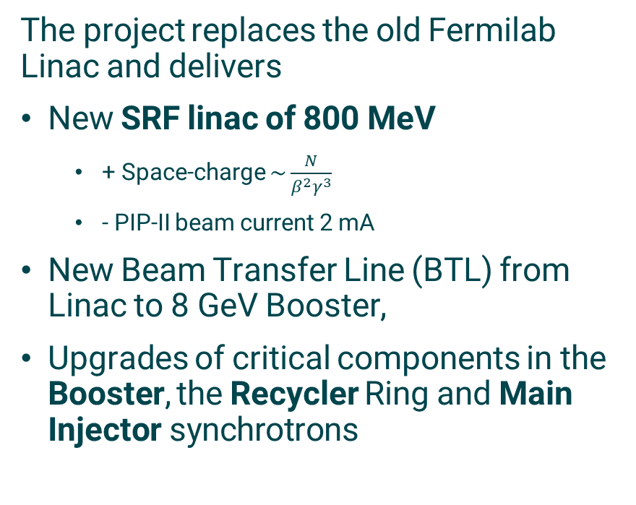
PIP-II accelerator project
PIP-II is an essential upgrade of the Fermilab accelerator complex that enables the LBNF/DUNE goal of 1.2 MW protons-on-target power, with an upgrade path to 2.4 MW.
The project replaces the old Fermilab Linac and delivers
New SRF linac of 800 MeV
+ Space-charge $\sim \frac{N}{β^{2}γ^{3}}$
- PIP-II beam current 2 mA
New Beam Transfer Line (BTL) from Linac to 8 GeV Booster,
Upgrades of critical components in the Booster, the Recycler Ring and Main Injector synchrotrons
This will result in doubling of proton flux at 8GeV and MI power of 1.2MW with a potential upgrade to above 2MW

Slide 8
PIP-II Industrialization needs for the US accelerator community
In the framework of PIP-II at Fermilab, we identified the main domestic capabilities that would benefit the US accelerator complex (most currently procured from by international sources):
Reliable Niobium suppliers capable of delivering high quality material for small and large projects
Superconducting RF cavity manufacturing and processing for piece and large production needs
Processing and assembly of SRF cavities in cleanrooms employing advanced technologies
Fabrication of beamline SRF components meeting cleanroom ISO standards and leak testing requirements such as edge welded and hydroformed bellows, gate valves, beam position monitors
High power and high efficiency RF sources for accelerator applications
Cost effective cryomodule vacuum vessels and cryogenic piping
ASME coded cryogenic piping for low to mid-pressure applications
Cryogenic environment and radiation hardened instrumentation
Accelerator control system infrastructure

Slide 9
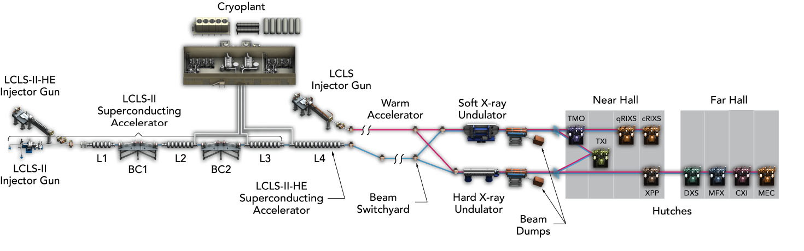
LCLS-II-HE Overview
Add 23 additional cryomodules to double the LCLS-II accelerator energy: 4 GeV to 8 GeV
Install new cryogenic distribution box and transfer line
New long period soft X-ray undulator
Upgrade the LCLS hard X-ray instruments for MHz beam and data rates
Design low-emittance injector and SRF gun for extended hard X-ray performance

Slide 10
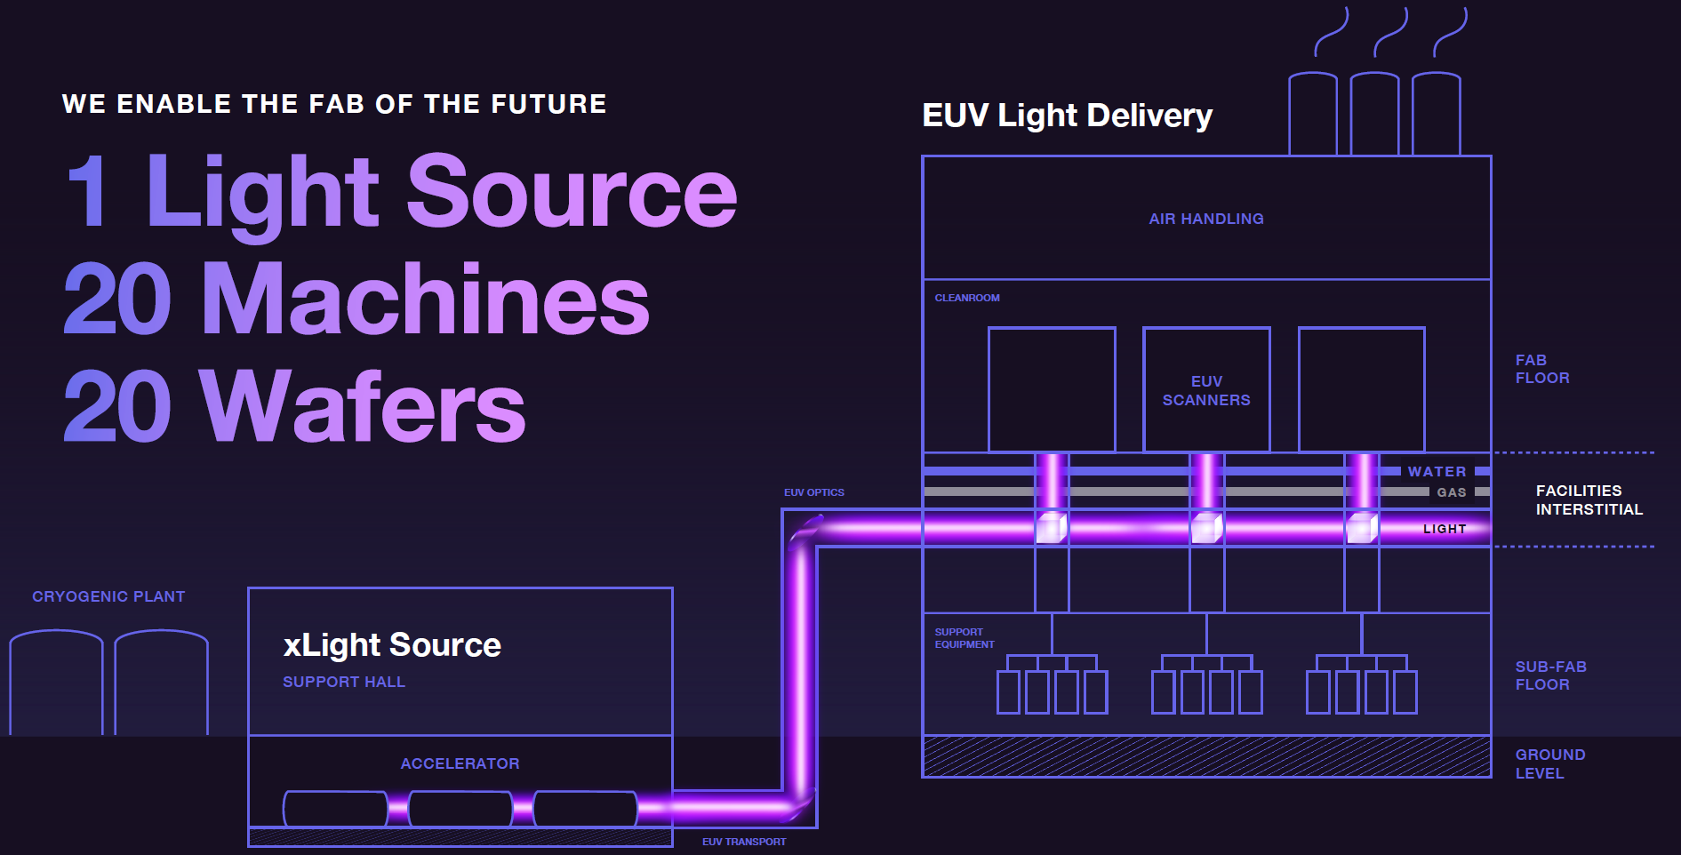
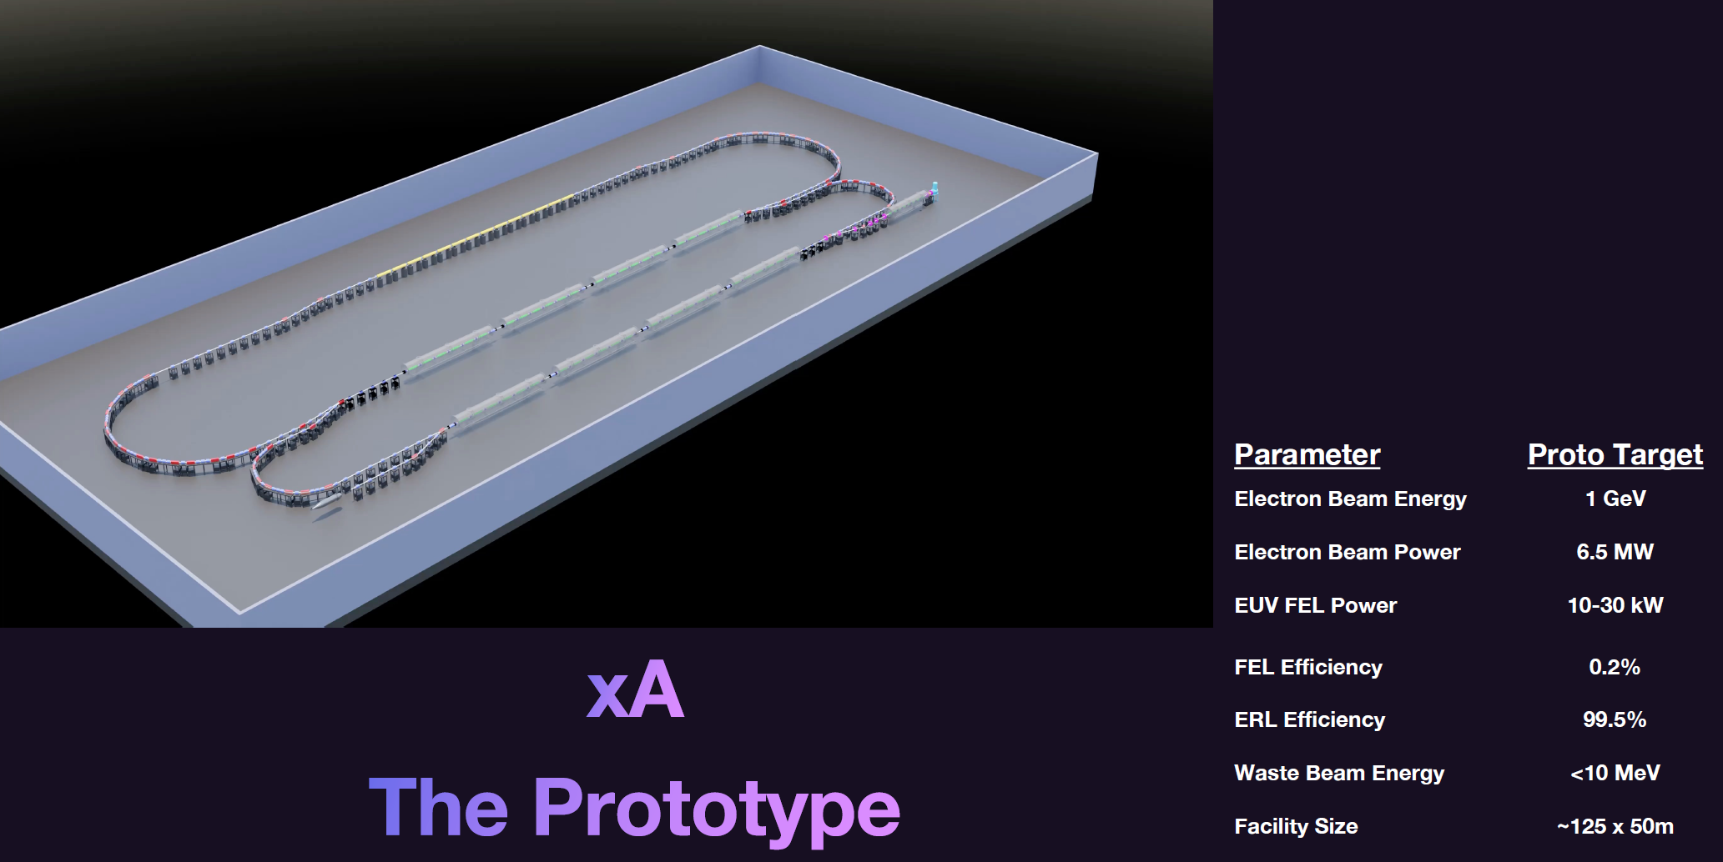
Multi-MW FELs for EUV Lithography
A leap is required to develop the new
generation of light source that will serve
the semiconductor industry indefinitely,
providing low-cost EUV as well as any
wavelength required for manufacturing or
R&D applications
xLight is building an accelerator-based light
source to drive the semiconductor industry into the next decade and beyond, providing high power, quality light to any application and delivering light as a utility.

Slide 11
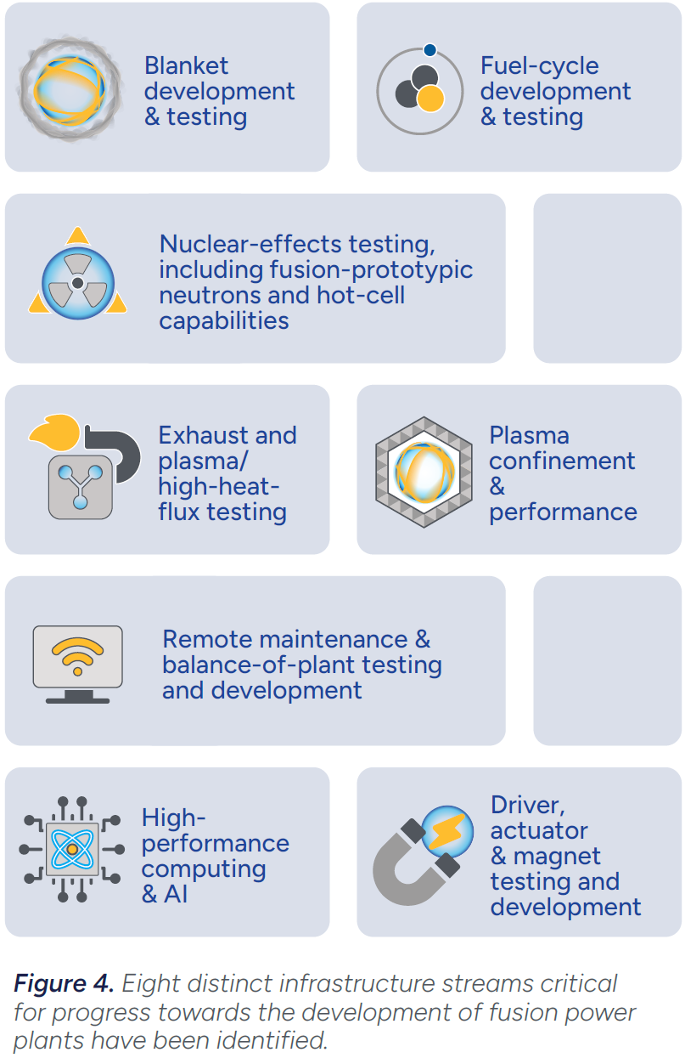
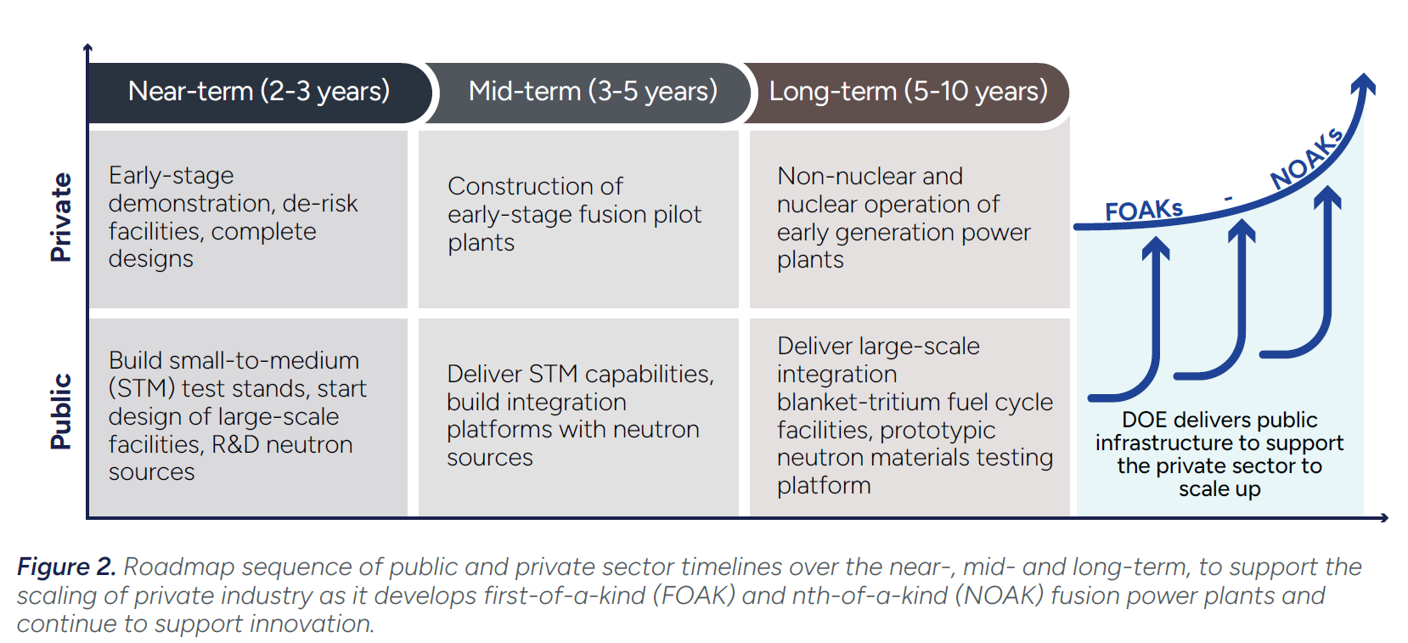
Accelerators for nuclear fusion
Fusion Science &Technology roadmap (2025)
Aggressive 10-year timeframe
Public-private partnership
Accelerator based facilities for the generation of 14.1 MeV neutrons

Slide 12


Elementary Particle Physics: The Higgs and Beyond
Committee on Elementary Particle Physics
Board on Physics and Astronomy
Dr. Maria Spiropulu and Dr. Michael Turner, EPP2024 Co-Chairs
Download the report and report resources: nationalacademies.org/epp
SLAC Town Hall 28 July 2025
Notes:
Please find training slides at the end of this template.

Slide 13
Host the World’s Highest Energy Particle Collider
Recommendation 1: The United States should host the world’s highest-energy elementary particle collider around the middle of the century. This requires the immediate creation of a national muon collider research and development program to enable the construction of a demonstrator of the key new technologies and their integration.
A collider with approximately 10 times the energy of the Large Hadron Collider is crucial to address the big questions of particle physics.
A muon collider combines the physics advantages of an electron-positron and a proton-proton collider, with a much smaller size.
Developing a US-hosted muon collider—an unprecedented machine requiring dedicated research, development, and a technology demonstrator followed by a feasibility study—would require coordinated efforts among all national labs and drive particle accelerator innovation.

Slide 14
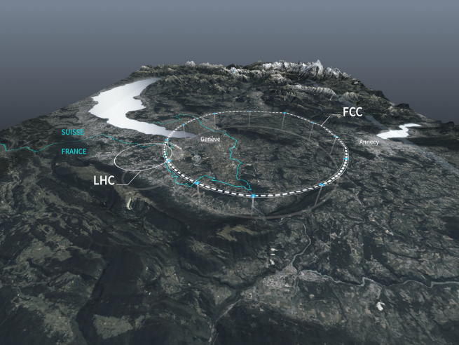
Participate in the Future Circular Collider Higgs Factory
Recommendation 2: The United States should participate in the international Future Circular Collider Higgs factory currently under study at CERN to unravel the physics of the Higgs boson.
Determining whether the Higgs is elementary or has substructure has huge ramifications for the future of particle physics.
Active participation in a Higgs factory is crucial for the U.S. particle physics community.
U.S. involvement would ensure a leading role in cutting-edge technology and provide valuable training for the next generation of physicists.

Slide 15
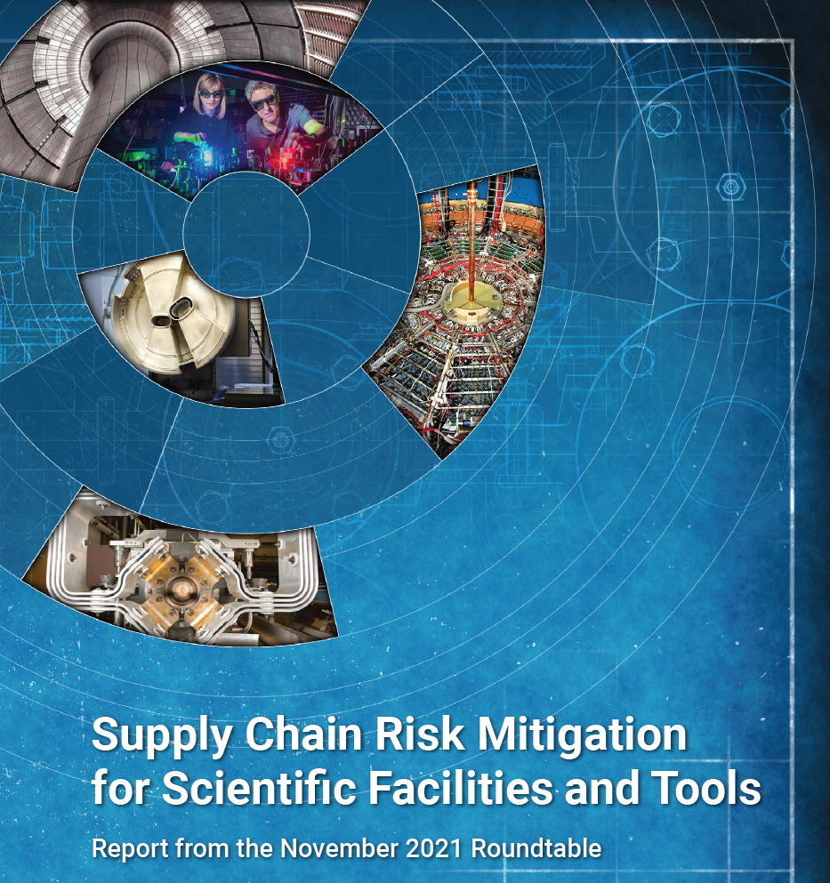
Challenges for large projects execution in the US
Supply chain and industry base
Workforce development
International trends
Adverse secular trends:
Decrease in US school-age population, international scholars, education funding, general stem preparation
Accelerator science is competing with other scientific fields for resources, and with industry for talent. (i.e. AI, quantum technologies)
Accelerator Science and Engineering Workforce Steering Group
(National Labs, Industry, Universities)
Forecast workforce needs
Recruitment and retention strategies
Growing barriers to international exchange
Limits to international students and scholars
Visa limitations
Increased National Security oversight
Increased Export Control oversight
Tariffs
Task force commissioned by DoE in 2021, report issued in 2022
https://science.osti.gov/-/media/bes/pdf/reports/2022/SC_Supply_Chain_rpt.pdf
Industry ecosystem (SRF technology)

Slide 16
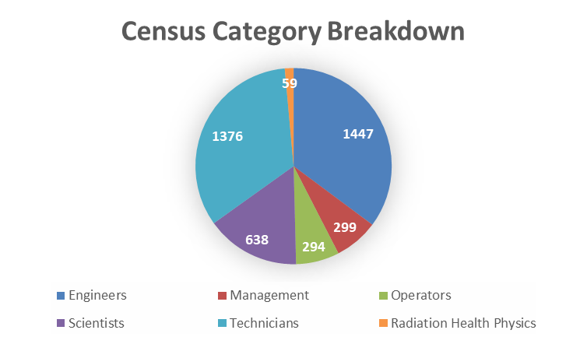
Accelerator Science and Engineering Workforce Roundtable
9 DOE Labs + 1 DOE User Facility met in January 2025 at FRIB (MSU)
Produced a census of the current Accelerator Workforce at the labs
Exchanged projections for lab future needs
Discussed best practices in
Training
Recruitment
Retention
Planned next steps
Engaging industry and universities
Engineers and Technicians combined are 69% of the accelerator workforce
Electrical engineers: 14%
Engineering Technicians: 17%
Physicists: 11%
Mechanical engineers: 9%

Slide 17
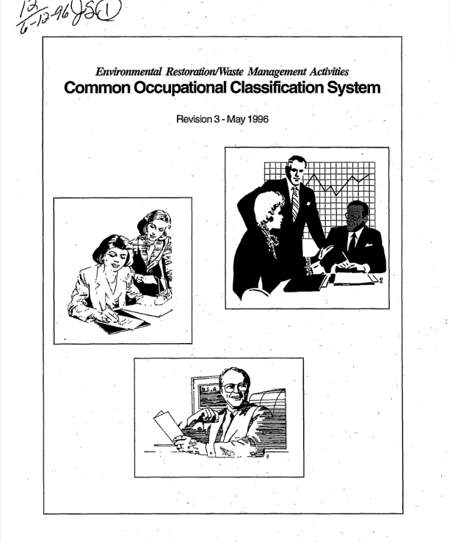
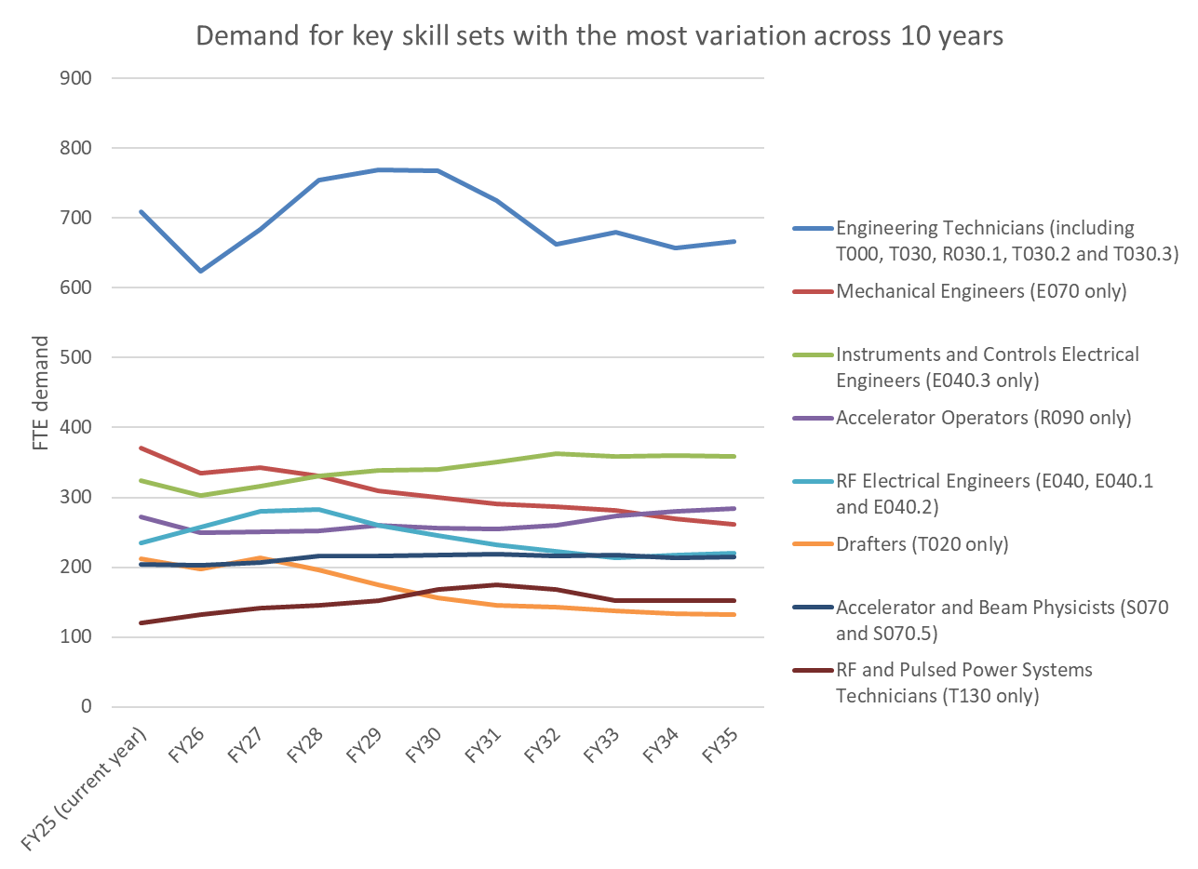
10-year projection of accelerator workforce demand
Each Lab produced a 10-year projection of the workforce demand using a common taxonomy
We modified an existing taxonomy to add accelerator-specific occupations and specialisms
Data allows plots of workforce FTEs, by Lab, occupation, and expertise
Combined data set from all 10 labs was shared with labs and DOE
“Common Occupational Classification System”1996
DOE Office of Environmental Restoration and Waste Management
https://www.osti.gov/biblio/243454

Slide 18
Next Steps
The roundtable continues now as a standing Integrated Planning Group (representation from all Accelerator Labs, co-chaired by John Schmerge, SLAC and Fulvia Pilat, ORNL)
The top priority is to maintain a sustainable organizational structure and mechanism that will enable and strengthen the sharing of resources and tools between the Labs
Goals for this year (in person Meeting on April 22-23 at ORNL):
Updates of census including future projects
Strengthen ties between university programs and National Laboratories/User Facilities to develop an accelerator workforce that is well-matched to laboratory hiring needs
Understand and help industry develop and retain capabilities for accelerator components
Predict the workforce demands of industry that has implications for laboratory workforce and university programs

Slide 19
Main takeaways Rich portfolio of large accelerator projects Challenges: supply chain, workforce, international Program coordination is critical

