Slide 1
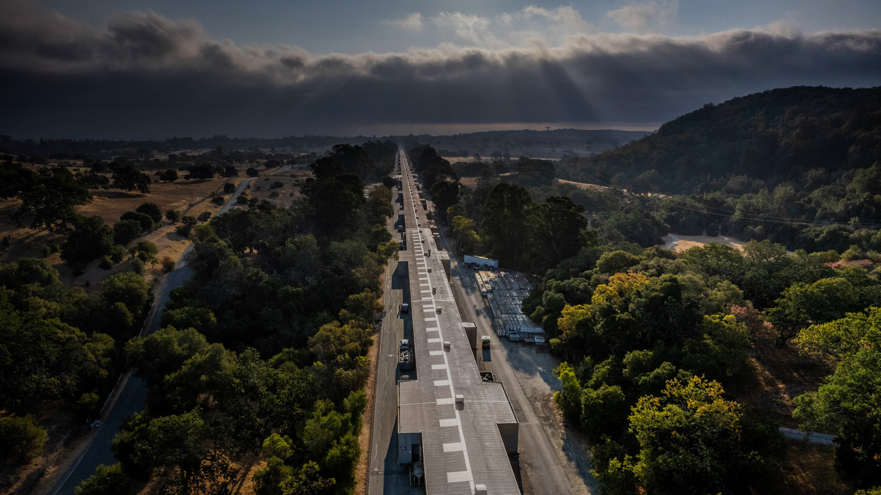

GARD HEP RF Roadmap
RF Sources Meeting
11 February 2026

Slide 2
AGENDA (all times shown as PST/EST, UTC-8/UTC-5)
8:00/11:00 (15 minutes): GARD introduction from conveners
8:15/11:15 (20 minutes): Projects - Fulvia Pilat (ORNL)
8:35/11:35 (20 minutes): High efficiency - Chiara Marelli (CERN)
8:55/11:55 (20 minutes): High efficiency - Mo Othman (SLAC)
9:15/12:15 (40 minutes): Break
9:55/12:55 (20 minutes): SSA - Doug Horan (ANL)
10:15/13:15 (20 minutes): SSA - John Lyles (LANL)
10:35/13:35 (20 minutes): Modeling - Alexander Vlasov (NRL)
10:55/13:55 (20 minutes): Modeling - Cho-Kuen Ng (SLAC)
11:15/14:15 (40 minutes): Break
11:55/14:55 (20 minutes): Manufacturing - Julian Merrick (SLAC)
12:15/15:15 (20 minutes): Manufacturing - Amy Elliot and Paul Pritchard (ORNL)
12:35/15:35 (60 minutes): Community contribution "open mic“ (Various)
Lawrence Ives, Takahiro Inagaki, Bob Rimmer, Jesus Alejandro Valladares, Pol Solans Rossell, …
13:35/16:35 (30 minutes): Discussion and closing comments
14:05/17:05: End

Slide 3
DOE HEP GARD
Department Of Energy – High Energy Physics – General Accelerator R&D
Develops the next generation of particle accelerator science and related technologies that are essential for discoveries primarily in High Energy Physics but also benefits broad accelerator-based sciences and applications. GARD supports world-leading research in the physics of particle beams, and long-range, early-stage exploratory research aimed at developing new concepts. GARD also provides graduate and postdoctoral research training, equipment for experiments and related computational efforts.
GARD Thrust Roadmaps by Year
Particle Sources and Targets (HPT) – roadmap updated in 2025​
Accelerator and Beam Physics (ABP) – 2023 roadmap​
Superconducting Magnets and Materials (HFM) – 2020 roadmap
RF Acceleration Technology (RF) – 2017 roadmap​
Advanced Accelerator Concepts (AAC) – 2016 roadmap

Slide 4
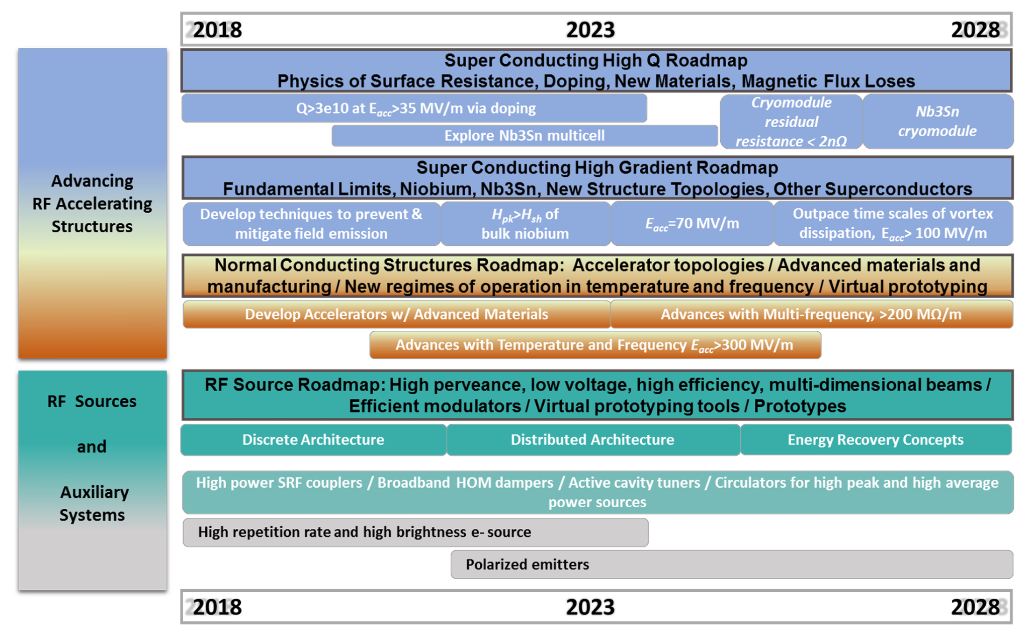
Previous GARD RF Roadmap
Encompassed four subtopics
SRF
NCRF
RF components
RF source elements
Provided quantitative targets and highlighted high impact R&D topics
There has been a lot of research progress since 2017, and the landscape of needs has continued to evolve
Updating the RF roadmap will help to incorporate progress and elevate newly relevant topics
RF Roadmap Update: Identifying high impact R&D topics; near, mid and far term goals; and ascertain the community's most urgent priorities and workforce development needs.

Slide 5
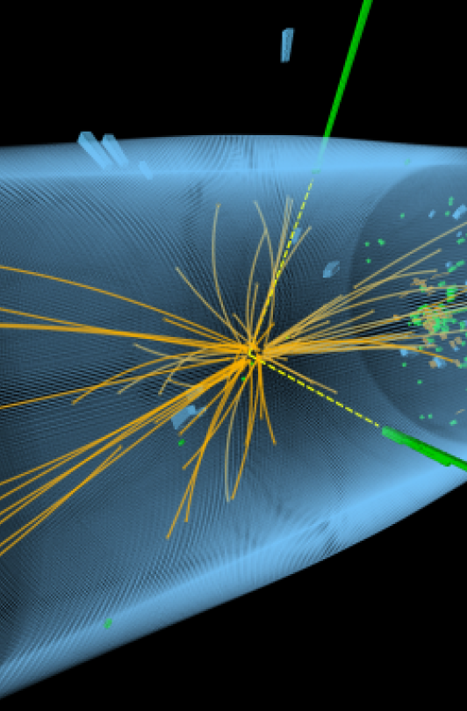
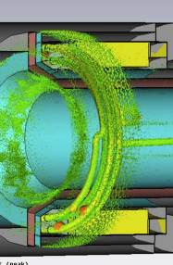
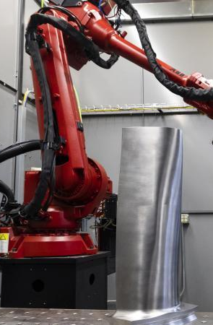
Here is a look at the framework for this decade’s update to the RF Sources subtopic roadmap.
The report subtopics will generally follow the latest advances in RF Source R&D using projected future needs as a backdrop:
High efficiency RF sources
High peak power RF sources
Solid State Amplifiers
RF component modeling
Advanced manufacturing
Other community-generated topics
Notes:
Future needs are largely project-driven and are often limited by RF sources. Some needs will be driven by operational considerations.
High-efficiency sources – large scale facilities use a lot of power and need efficient sources
High peak power – driven by the latest needs of science
Solid state amplifiers – driven by the need for reliability
RF component modeling – follows from the development of cutting edge sources
Advanced manufacturing – holds the potential to dramatically drop cost and production time
Other – will be developed as we follow the GARD update process
DOE HEP website
Lee, Sung-Woo, et. al, “Computer Simulations for RF design of a Spallation Neutron Source External Antenna H- Source”, Review of Scientific Instruments, February 26, 2010.
Duncan, Heather, “Metal Steam Turbine Blade Shows Cutting Edge Potential for Critical, Large 3D-printed Parts”, ORNL News

Slide 6
What exactly is the ”decadal update” process and where do I fit in?
It starts today, with your participation in this virtual workshop.
The speakers will give an overview – it is up to us what it means for the next 10 years.
To that end, there will be an in-person workshop March 3-4, hosted by SLAC, using this virtual workshop as a background.
It will be up to the community (all of us) to determine:
What projects are on the horizon that require new RF sources and what are their needs?
What about facility operational needs?
Higher power, higher efficiency, transistor or tube base technology?
Are there specific innovations that are the most impactful?
A few things that are helpful to remember:
Innovation starts at our level (grassroots effort)
Take what you hear today and brainstorm prior to the in-person workshop
You don’t have to wait on the workshop – feel free to contact one of us (Ali, Galen, or John) with your input individually if you need to
The final report will take everyone’s input and condense it. It will be published later this calendar year.
Notes:
The virtual workshop will cover the topics shown on the previous slide. The presenters will give an overview of each topic to stimulate audience participation.

