Slide 1


(Not Really) High Gradient NCRF for the FCC-ee injector linacs:
Alexej Grudiev on behalf of the FCC-ee injector linac design WG
S. Bettoni, I. Chaikovska, P. Craievich, S. Doebert, A. Kurtulus, A. Latina, J.-Y. Raguin, R. Zennaro, and friends
CERN + PSI
GARD RF Roadmap Update - NCRF Meeting
Tuesday 20 Jan 2026,

Slide 2
Outline: from the past to the future
Overview of the Feasibility Study Report (FSR) baseline for the FCC-ee injector complex linacs
From FSR to the TDR
Conclusion

Slide 3
FSR baseline layout of FCCee injector
4 x 3m Acc.Str./module;
Up to 4bunches@100Hz
2.8 GHz, 215m
2.0 GHz, 319m
DR @ 2.86 GeV
G
e-linac
C
e+ linac
EC
2.8 GHz, 1080m
HEC
HE-linac
BC
20 GeV
Max. Klystron Power: 80 MW, Operating Klystron Power: 64 MW i.e. 20 % Margin
Linac | RF frequency [GHz] | <a/λ> | Bunch Charge [nC] | Kly. power per structure [MW] | Loaded acc. gradients [MV/m] | Nb. modules | Linac lengths [m] | Oper. power consumptions [MW]
e-linac * | 2.8 | 0.15 | 5 | 14.2 | 19.5 | 14+1 | 215 | 2
e+ linac** | 2.0 | 0.2 | 15 | 15.4 | 13.3 | 21 | 304 | 8
HE-linac * | 2.8 | 0.12 | 5 | 14.2 | 21.1 | 72 | 1080 | 9.5
* 3 µs RF pulse length, 6 µs HV pulse length
Assumes 25 m WR284 waveguide system length for one RF module
** 5 µs RF pulse length, 8 µs HV pulse length,
Assumes 25 m WR510 waveguide system length for one RF module
Assumes 6 structures (2 modules) for Capt. Linac, 20 structures (5 modules) for S1 Linac and 260 solenoids
Future Circular Collider Feasibility Study Report | The European Physical Journal Special Topics | Springer Nature Link

Slide 4
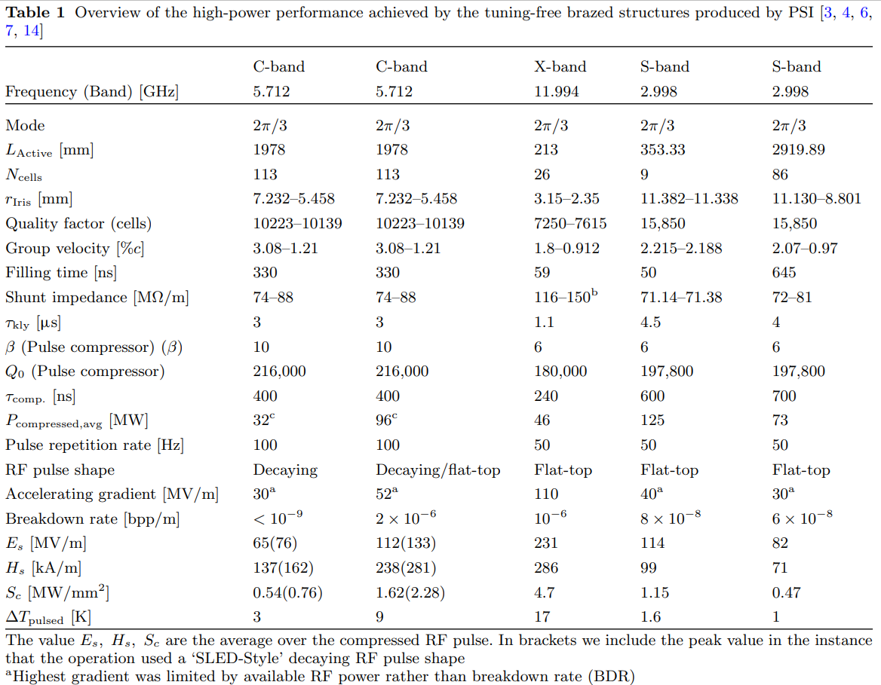
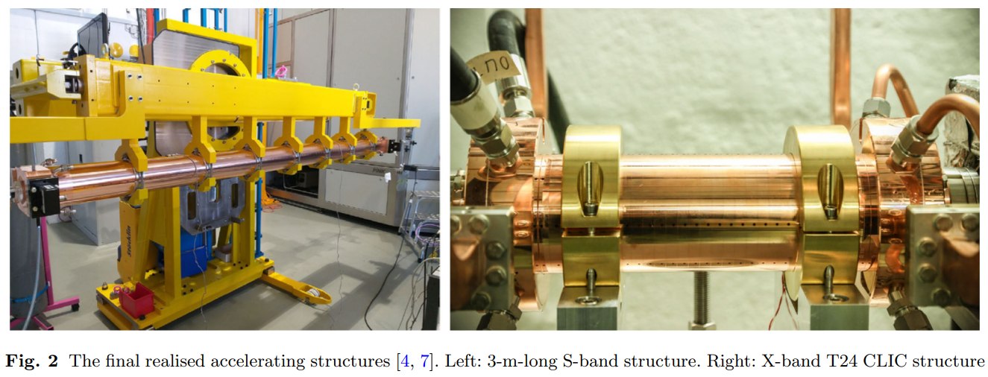
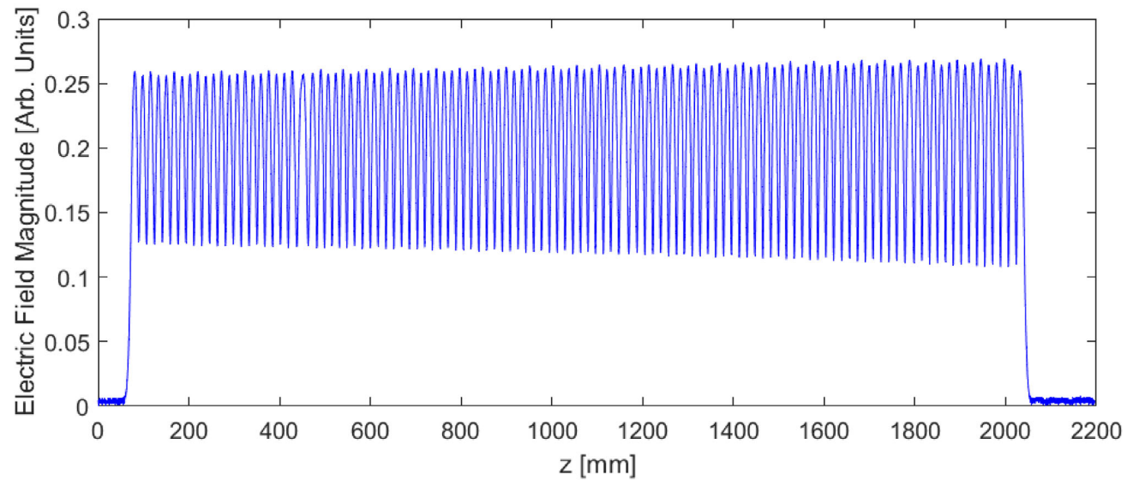
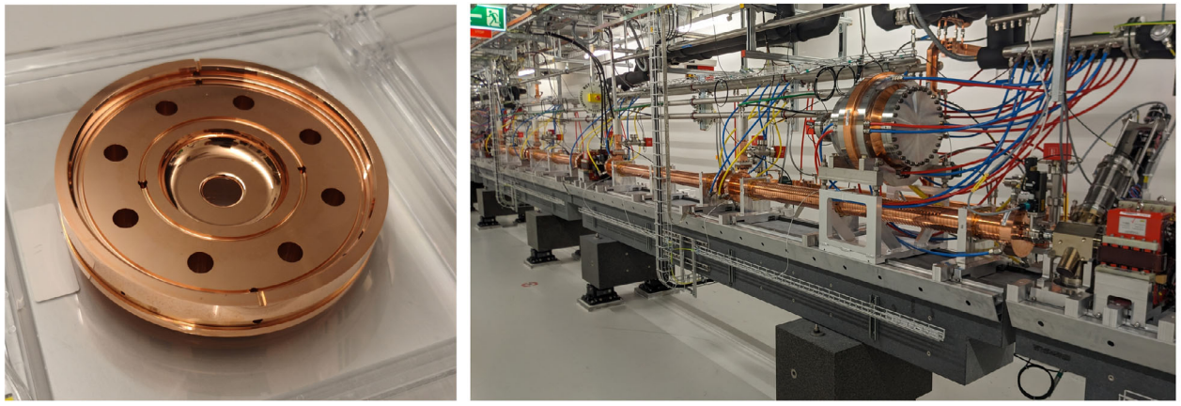
FCCee injector linacs based on SwissFEL tune-free NCRF technology
Review of the high field performance of normal-conducting, tuning-free RF technology developed at the Paul Scherrer Institute

Slide 5
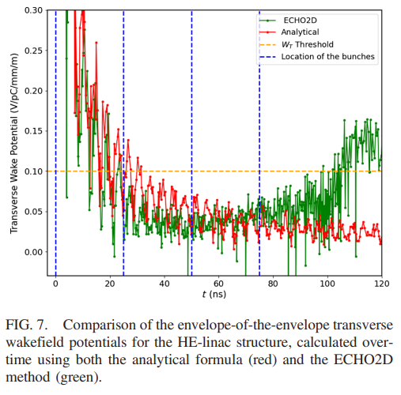
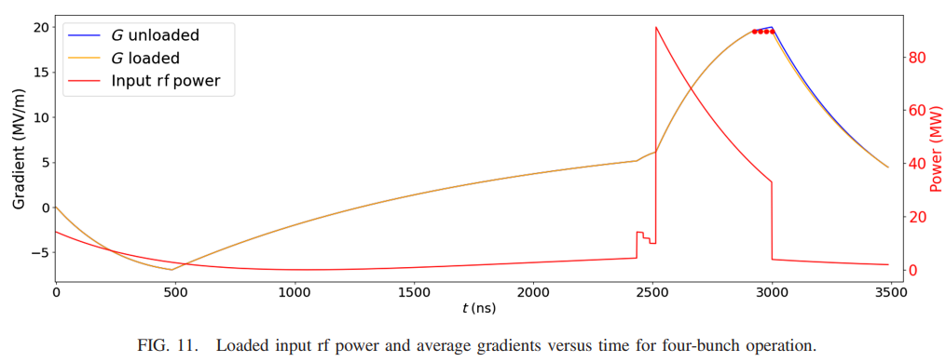
HE Linac: 4 bunch operation mode
4 Bunches case:
Unloaded Voltages | 1st Bunch | 2nd Bunch | 3rd Bunch | 4th Bunch | Rsh_eff
Single Bunch | 66 MV |  |  |  | 102.25 MΩ/m
4 Bunches | 63.81 MV | 63.84 MV | 63.86 MV | 63.82 MV | 95.65 MΩ/m
P_klys = 14.2 MW
3m structure
G = V/L
For bunch charge: 5 nC
25 ns of bunch spacing
 | 1st Bunch | 2nd Bunch | 3rd Bunch | 4th Bunch
Loaded Voltages | 63.19 MV | 63.19 MV | 63.20 MV | 63.16 MV
RF design and optimization of the high-energy linac for the FCC-ee injector complex

Slide 6
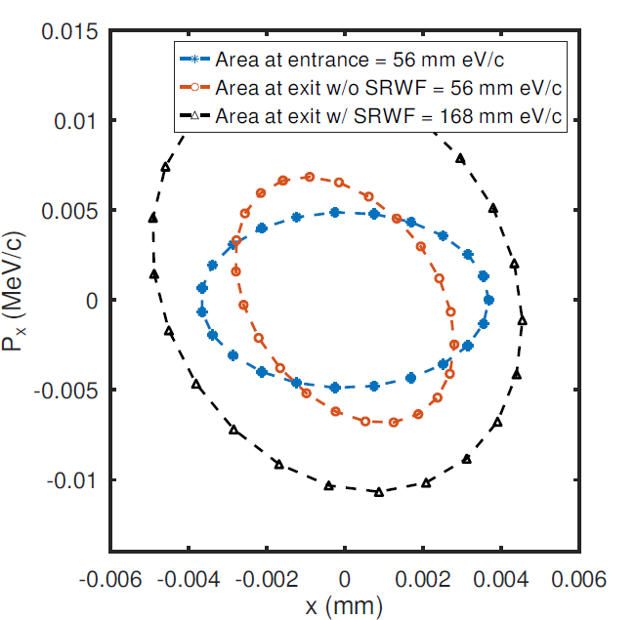

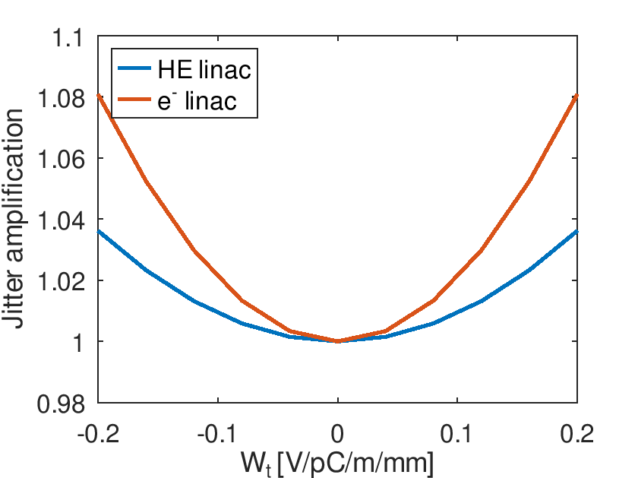
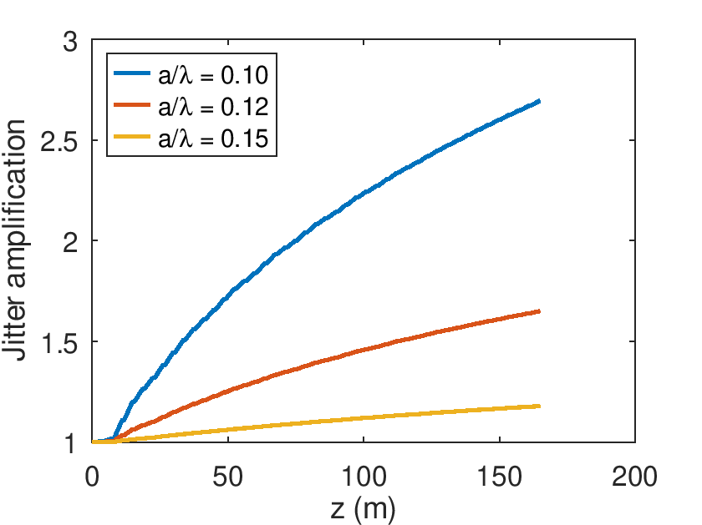
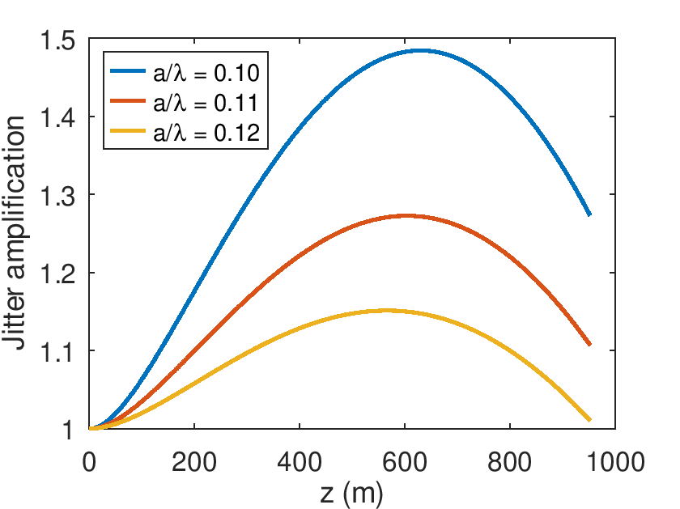
e- and HE linac: beam dynamic effects
e- linac |  | HE linac
Multi-bunch | Single bunch | Multi-bunch | Single bunch
1.03 | 1.18 | 1.02 | 1.01
Multi-bunch
Single bunch
HE linac (a/λ = 0.12)
e- linac (a/λ = 0.15)
From the previous design RF optimized for a maximum kick=0.11 V/pC/m/mm
Positron production→ok 0.15
Damping ring→ waiting for an answer
Booster→ok
Transverse beam jitter damping along the Future Circular Collider e+e− injector linacs

Slide 7
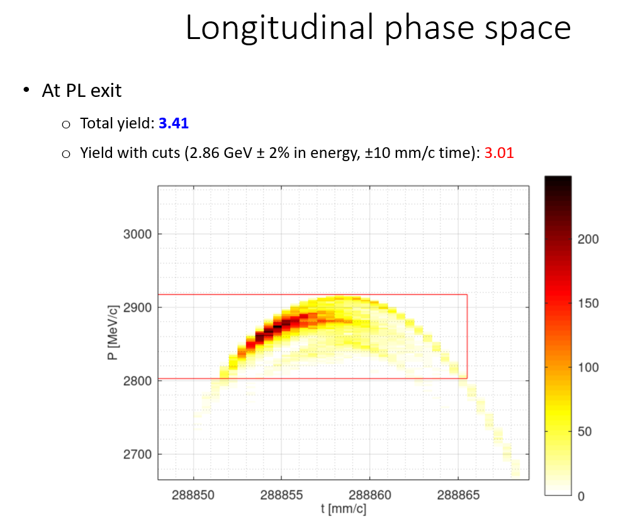
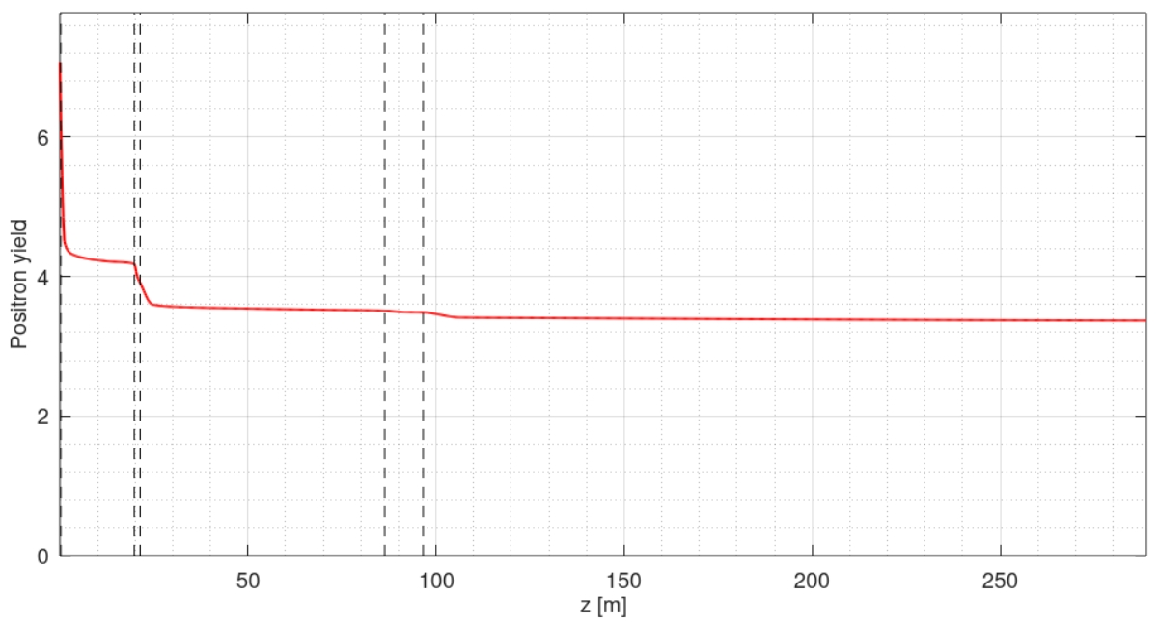
e+ linac: BD design, transmission and yield
Primary
e-bunch:
4.5 nC
2.0 GHz; a/lambda = 0.2 => D = 60mm
solenoids
quadrupoles
Collimation chicane
200 MeV
Matching section
930 MeV
2860 MeV
3.41
3.01
13.5 nC
σ_{z} = 3 mm
σ_{E} = 0.95 %
ε_{Nx,y} = 13 mm*rad

Slide 8
From FSR to TDR via CHART3(2026-2028)
The baseline schematic layout remains basically the same for the TDR.
However, the design of the linacs and associated sub-system must be adapted to accommodate the following changes:
RF frequency from 2.8 GHz to 3 GHz in e- and HE linacs. (ongoing, straightforward)
In e+ linacs, we will attempt to move from 2 GHz to 3 GHz given the acceptance of the new DR at 2.86 GeV and possibly using 1T SC solenoids. (ongoing, very difficult)
Site-related space constraints must be addressed given the final placement as well as DR and TL layout (final gradient)
Finally, engineering design will be done for the TDR
Fabrication and high power test of prototypes:
3 GHz AS for HE-linac
3 GHz AS for electron linac
2-3(?)GHz AS for positron linac
3 GHz pulse compressor for all 3 GHz linacs
3 GHz, 80 MW, 3us, 100Hz high efficiency klystron/modulator RF unit

Slide 9
FCCee linacs: the exact RF frequency
Important for 4 bunch operation
Nominal bunch spacing: 25 ns
Minimum time step to modify the bunch spacing: 5 ns => 200MHz. So that every second bucket in Collider Ring (CR) can be used potentially.
RF frequency in CR: f_CR = 400.788 MHz (FCC FSR, Table 1.2)
RF frequency in linacs (S-band): f_LI = f_CR*15/2 = 3005.91 MHz
Standard EU S-band: f_EU = 2998.5 MHz
Difference: f_LI – f_EU = 7.41 MHz
Typical klystron operating frequency specs are nominal f_RF ±1MHz. Some operational experience shows that ±2MHz is OK
What about +7.4 MHz?

Slide 10
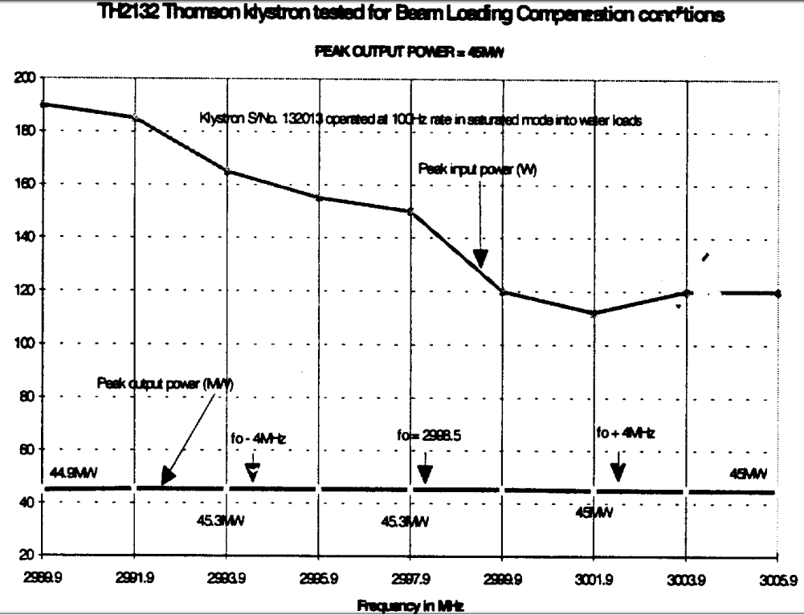
Use of EU S-band klystron at 3005.9 MHz
CTF2 TDR, CLIC note 304, 1996
S-Band frequencies
 | MHz
CLIC | 2998.55
CTF2 RF gun | 3000.50
CTF2 HCS1 | 3006.36
CTF2 HCS2 | 2990.74
Thomson TH2132 | 2998.5
Based on the measurement done for the CTF2
2998.5 klystron can be operated at nominal output RF power (45MW) at 3006 MHz.
Due to lower gain higher power might be required for the driver amplifier
This should not be a problem
More recent measurements in 2025 confirmed these results

Slide 11
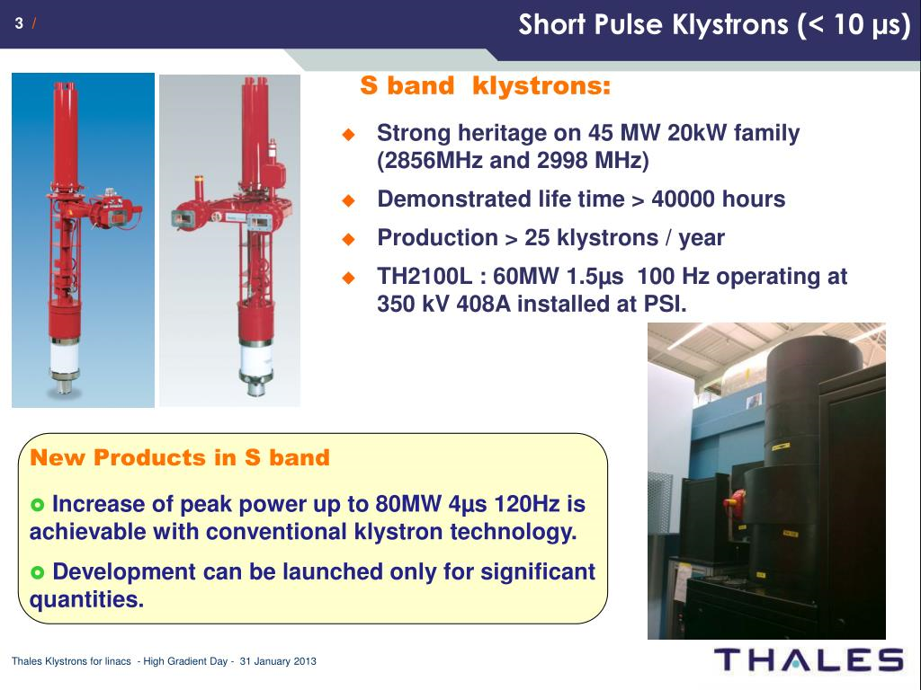
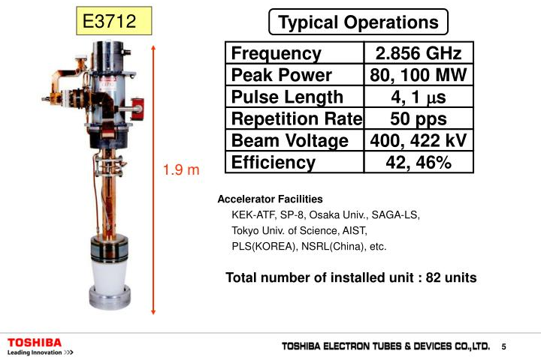
RF power for FCC Linacs: existing S-band klystrons
THALES
CANON
2998.5 MHz version exists.
E37333 build for CLARA (UK)
Nominal parameters:
70 MW, 100 Hz, 3 us
FCC-ee injector linacs 3 GHz klystron parameters: 80 MW, 3 us, 100 Hz
Several suppliers have klystrons with very close parameters, but
A new dedicated tube will be developed for the FCC injector linacs

Slide 12
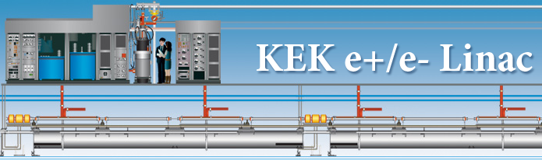
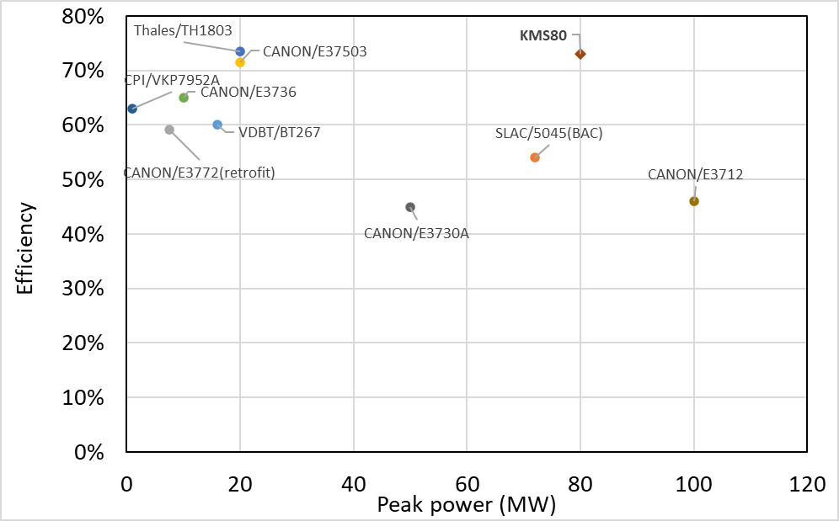
New design of high efficiency S-band Multi Beam Klystron (MBK) for KEK injector linac: KMS80
For dual records in both efficiency and output power in the field of S-band MBKs
The overall parameters of KMS80
Parameters(unit) | value
Frequency(MHz) | 2856
Gun voltage(kV) | 300
Total gun current(A) | 366.4
Beam No. | 8
Output power(MW) | 80
Expected efficiency | 73%
4us, 50Hz
(Courtesy of Takuya Natsui)
Shengchang Wang, at 2nd Workshop on efficient RF sources (23-25 September 2024): Overview · Indico

Slide 13
High efficiency RF power for FCC-ee linacs
R&D at KEK/CANON on the high efficiency MBK with 80 MW, 4 us, 50 Hz, 73% is very encouraging (1st prototype to be tested 2026)
It paves the way to high efficiency RF power source for FCC-ee injector linacs: 80 MW, 3 us, 100 Hz, >70%
Increasing klystron efficiency from 42% to 70 % is not only big reduction of the power consumption in the linacs from 19.5 MW to 13.7 MW
BUT it is also a significant reduction of the investment cost:
modulator cost which dominates with 29% the linac hardware cost
infrastructure cost: CV, EL

Slide 14
Conclusions
Robust design of the FCC-ee injector linacs has been done for the FCC Feasibility Study Report
It must be adjusted and reoptimized for the TDR to address several changes including new RF frequency, and CERN site constraints
The collider ring harmonic defines the exact RF frequency in the linacs: 3005.9 MHz, which is 7.4 MHz higher than EU S-band standard frequency 2998.5 MHz
The design for the TDR is a chance to push the sustainability of the FCC even further by developing a high efficiency (>70%) multi-beam klystron as RF power source for the injector linacs
Major RF components of the linacs will be prototyped and tested including accelerating structures, pulse compressor and klystron/modulator unit

Slide 15

Credits
Thank you for your attention
PSI | B. Auchmann, I. M. Besana, S. Bettoni, P. Craievich, M. Duda, R. Fortunati, H. Garcia-Rodrigues, D. Hauenstein, R. Ischebeck, P. Juranic, J. Kosse, F. Marcellini, U. Michlmayr, G. L. Orlandi, M. Pedrozzi, J.-Y. Raguin, S. Reiche, R. Rotundo, S. Sanfilippo, M. Schär, N. Strohmaier, N. Vallis, M. Zykova, R. Zennaro, H.H. Braun, M. Seidel all the technical groups involved in the P3 experiment
IJCLab | F. Alharthi, R. Chehab, I. Chaikovska, V. Mytrochenko, Y. Wang
CERN | W. Bartmann, H. Bartosik, M. Calviani, S. Doebert, Y. Duthell, J. L. Grenard, A. Grudiev, B. Humann, A. Kurtulus, A. Latina, A. Lechner, R. Mena Andrade, A. Perillo Marcone, K. Oide, Y. Zhao, F. Zimmermann, Z. Vostrel, M. Benedikt
INFN-LNF | C. Milardi, A. De Santis, O. Etisken, S. Spampinati
SLAC | T. Raubenheimer
KEK | Y. Enomoto, K. Furukawa
and L. Bandiera, M. Soldani, A. Sytov (INFN/Ferrara), A. Bacci, M. Rossetti Conti (INFN/Milano)
This work was done under the auspices of CHART (Swiss Accelerator Research and Technology) Collaboration, https://chart.ch - CHART Scientific Report: https://chart.ch/reports/
FCCIS: 'This project has received funding from the European Union's Horizon 2020 research and innovation programme under the European Union's Horizon 2020 research and innovation programme under grant agreement No 951754.'

