Slide 1

Dielectrics for High Gradient Normal Conducting Structures
GARD RF Roadmap - NCRF Meeting
Alexei Kanareykin
On behalf of Euclid’s/AWA ANL’s team
January 20, 2026

Slide 2
Outline
Brief history of the DWA
Materials for the DWA structures
Structures designs and novel structures
Materials with extreme low losses
DWA programs in the U.K, Japan and FACET
Exotic materials for the DWA structures (diamond, ferroelectric and conductive ceramic)
Summary
www.euclidtechlabs.com

Slide 3
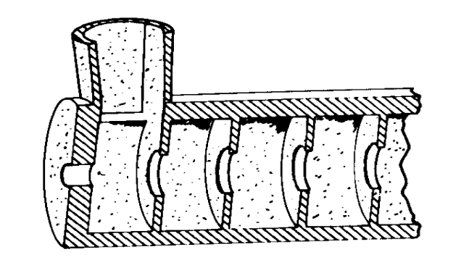
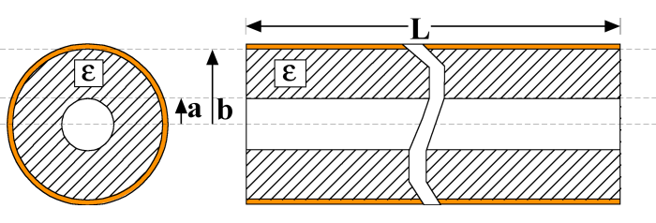
Timeline of Dielectric Accelerators
Features:
Simple geometry.
Small transverse size.
Short rf pulse, high reprate, preferred.
Electric Field Vectors
400MeV/m
~GV/m
Tunable DLA
30MV/m
theory
DWA
D. TBA
Short pulse
100MV/m
Staging
1951
1958
1963
1989
2000
2006
2007
2011
2016
2018-2025
First electron linac at Stanford
(1947)
DWA Geometry
Notes:
D

Slide 4
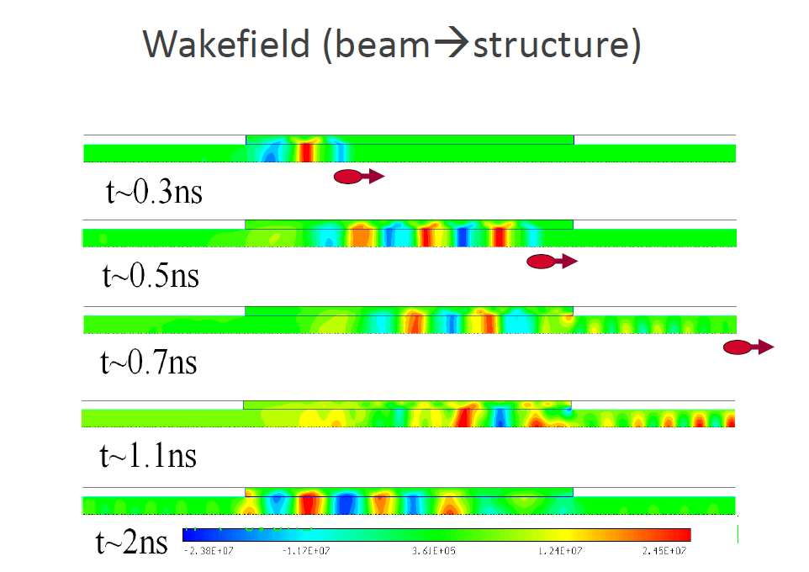
Why Dielectric Based Accelerator ?
Dielectric based accelerator advantages:
design simplicity: no tight tolerances – 2D structure
E_{z} field magnitude (γ>>1) is flat at cross-sections;
Short RF pulse X - Ka band,, high reprate
THz structures at ~ 0.5-1.0 GV/m gradient
diamond thermal conductivity
reduced BBU instability;
enables tuning;
…..

Slide 5
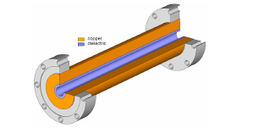
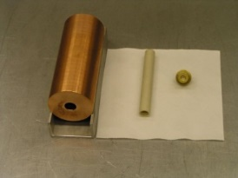
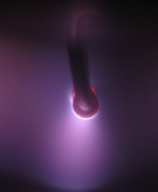
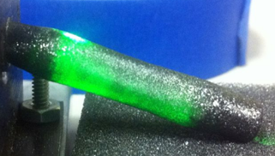
Materials for the Dielectric-Based Wakefield Accelerator
Quartz, ε~ 3.75, tanδ~10⁻⁴

Slide 6
Dielectrics Tested as DWA Loading
THz experiments at FACET and ATF

Slide 7
Loss Tangent and Dielectric Constant of Microwave Ceramic
Q × f ≈ const [GHz]
tanδ ~ f [GHz] over a wide microwave frequency range. Q×f ≈ const, [GHz], Q=1/tanδ. The product of frequency and dielectric quality is a constant. This relation is a very important characteristic of linear microwave ceramics
Best Q*f is in the range 150,000-180,000 (MgTi)
tanδ~5*10^-6 at X band (10 GHz)

Slide 8

Survey of dielectric based structures

Slide 9
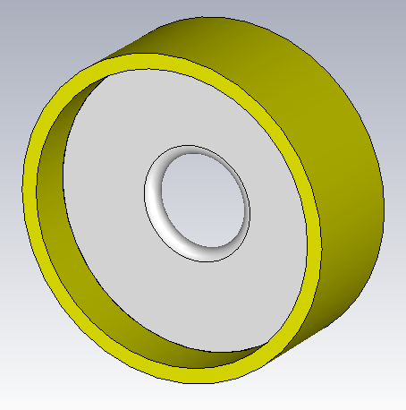
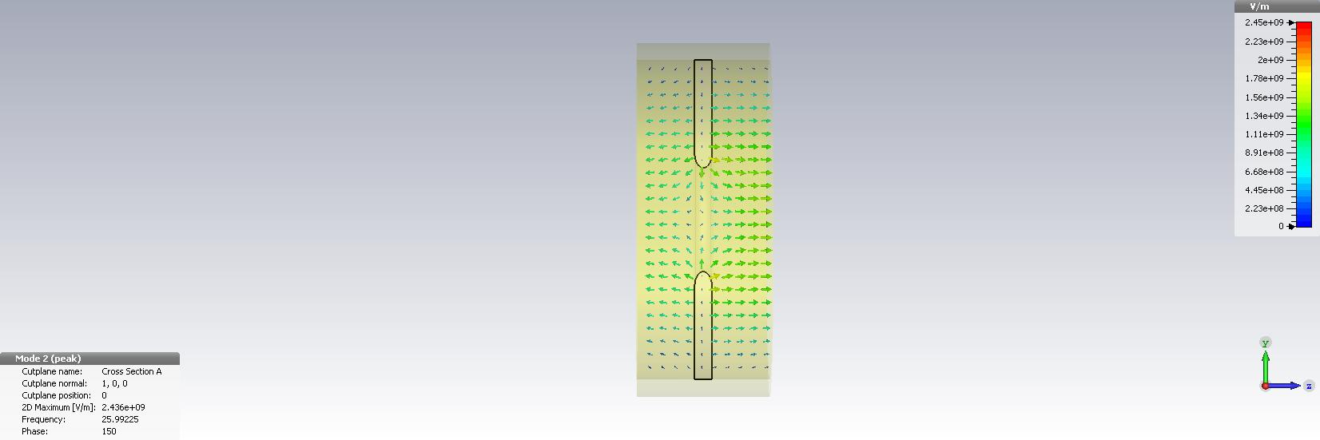
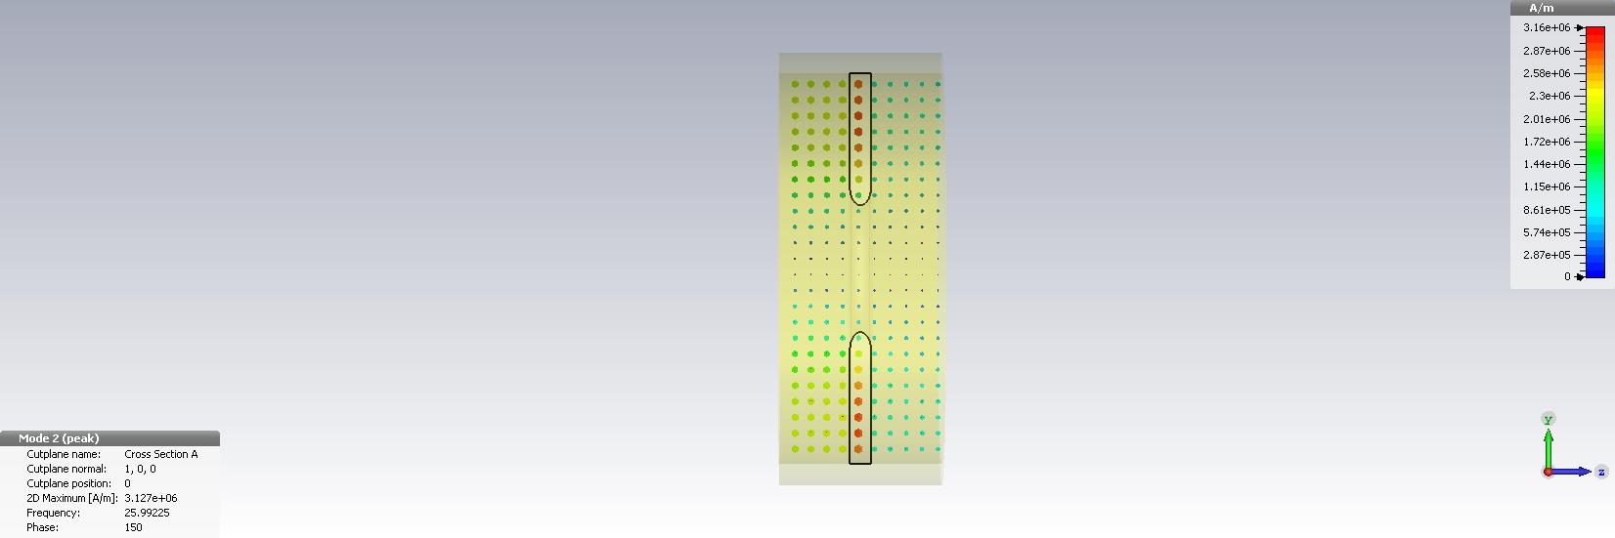
Dielectric Disk Accelerator (DDA)
A Dielectric Disk cell: a) geometry;
b) electric and
c) magnetic fields of the accelerating mode;
a
ba
c
(a) dielectric-lined circular waveguide, and (b) dielectric disk-loaded circular waveguide.
J. Shao et al. Proc. IPAC’18, p.640
.

Slide 10
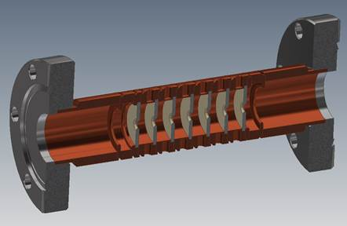
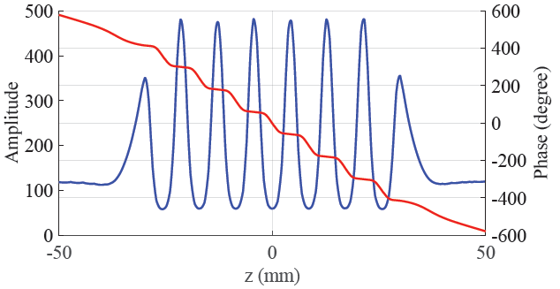
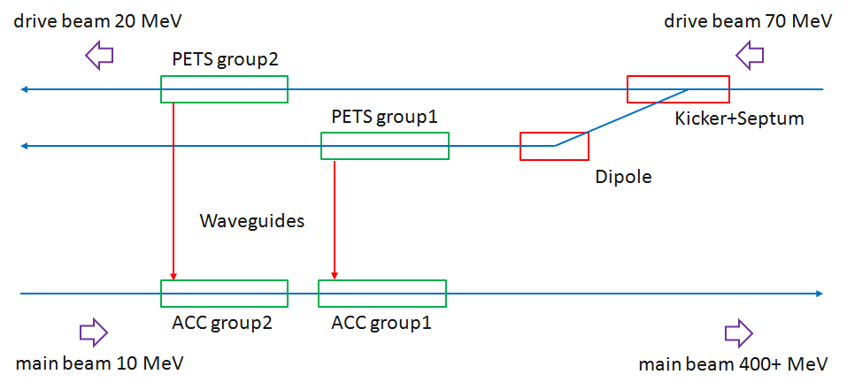
DDA structure
Dielectric-disk accelerator
J. Shao, et al, in Proceedings of IPAC2018, (2018)
Clamped structure achieved 102 MV/m accelerating gradient from 320MW
input power.

Slide 11
Dielectrics with extreme low losses vs. permittivity
D. Satoh et al. NIM B 459, 148, 2019, references there in

Slide 12
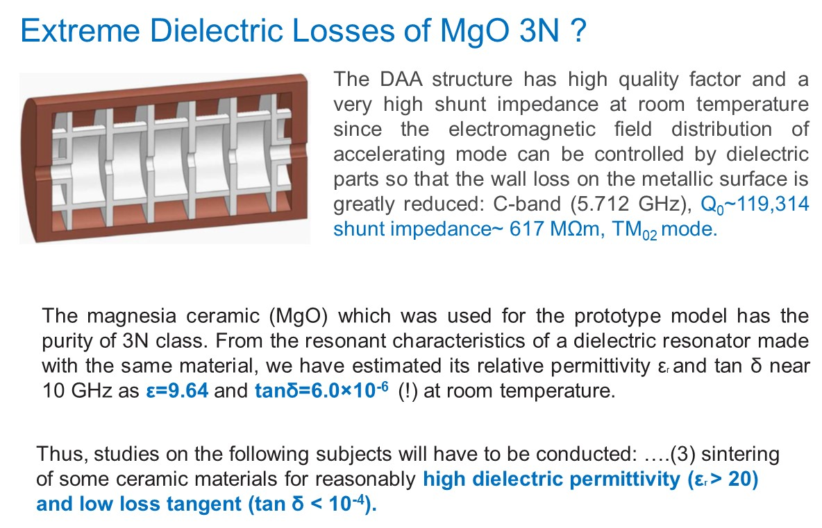
D. Satoh, M. Yoshida, and N. Hayashizaki. PRAB, 20, 091302 (2017)

Slide 13
During the high-power test, blue luminescence was detected. → caused by impurities in the sapphire due to electron impacts from multipactors.
•
D. Satoh et al. X-band dielectric assist accelerating structure. LCWS-2024

Slide 14
Dielectric Assist Accelerating (DDA) Structure at Cryogenic
D. Satoh et al. investigated the (2D) DAA structure operating at a cryogenic temperature. A simulation of a five-cell C-band (5.712 GHz) DAA structure with a BMT-BMW ceramic indicated that Q₀ of the accelerating mode was over 120,000 and Z_{sh} exceeded 850 MΩ/m at room temperature.
For the DAA structure operating at a cryogenic temperature of 27K, Q₀ and Z_{sh} of the DAA structure, high-purity MgO were to be greater than Q₀= 765,000 and Z_{sh}= 3.8 GΩ/m, respectively.
D. Satoh et al. NIM B 459, 148, 2019.

Slide 15
DWA at CLARA, Daresbury, U.K.
The energy booster for the Compact Linear Accelerator for Research and Applications (CLARA) at Daresbury Laboratory is planned to be utilizing dielectric wakefield acceleration (DWA). Research is concentrated on the transverse wakefields limitations (BBU) instability, utilizing round or planar structures and elliptical beams.
CLARA - 35 Mev, 100s fs 100 pC bunches
Quartz – preferred material. Different thicknesses down to 25 microns for single mode tunable Cherenkov radiation generation.
For a wakefield streaker to measure ultra-short bunches from LWFA, a structure with 20micron thick Mica was fabricated. Mica: eps~ 6.4 to 9.3, loss tangent 10^-4 to 5x10^-3
Compact Linear Accelerator for Research and Applications (CLARA) , Daresbury Lab, U.K., 250 MeV, 250 nC, ~ ps range.
silicate minerals, KAl₂(AlSi₃O₁₀)(OH)₂
T.J. Overton et al. NIMA, 1072, 2025, 170160

Slide 16
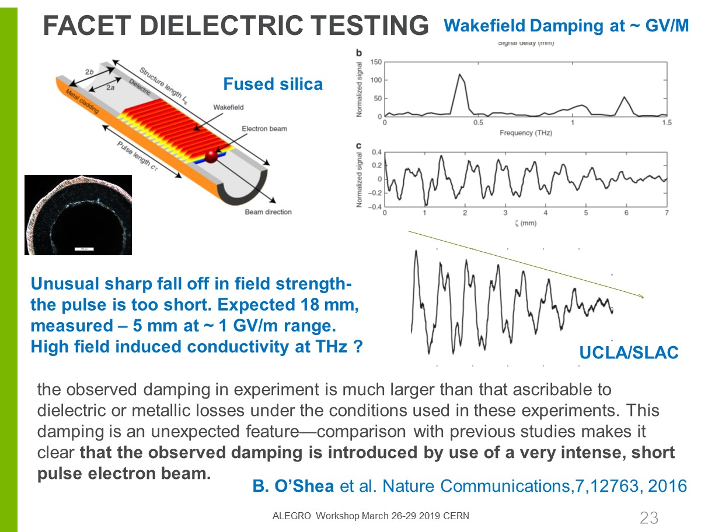

Slide 17
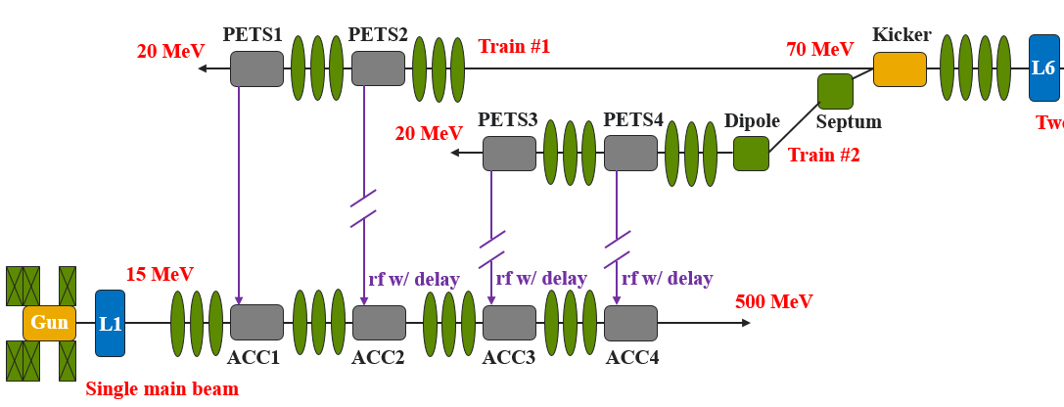
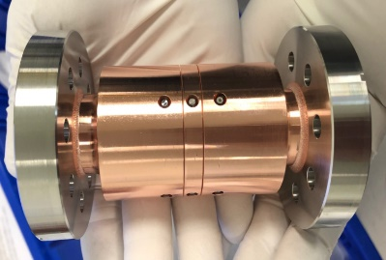
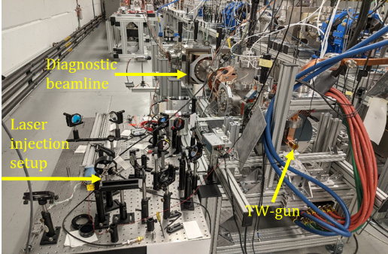
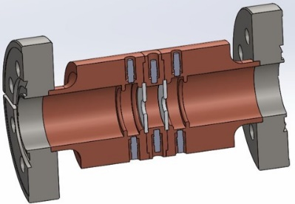
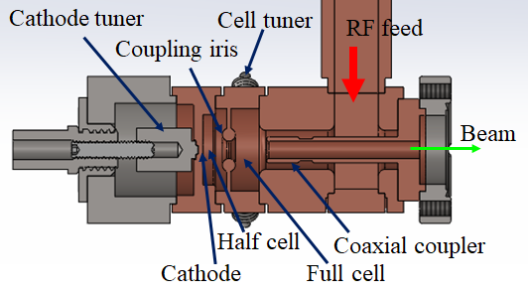
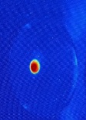
Advanced Acceleration for Future Linear Colliders
In collaboration with ANL/AWA
Relativistic, high intensity and small emittance electron bunches are the basis of linear collider and FEL projects. Using Cherenkov radiation generated by a high current bunch passing a dielectric wake-field accelerator may provide a significant cost saving and reduction of the accelerator facility size.
0.5GeV Demonstrator
Euclid is developing critical components for two SWFA milestones:
0.5GeV demonstrator at Argonne National Laboratory
Collinear wakefield accelerator energy doubler.
Novel Dielectric Disk Accelerator, first time demonstrated 100MV/m, multipactor free.
Novel short pulse traveling wave photogun, record high gradient: 400MV/m, and insignificant dark current

Slide 18
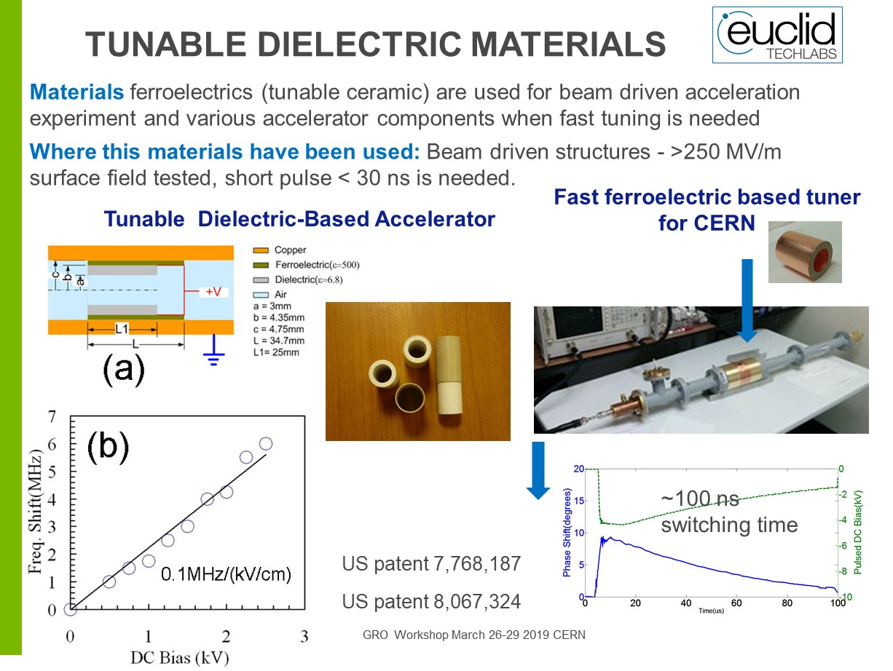

Slide 19
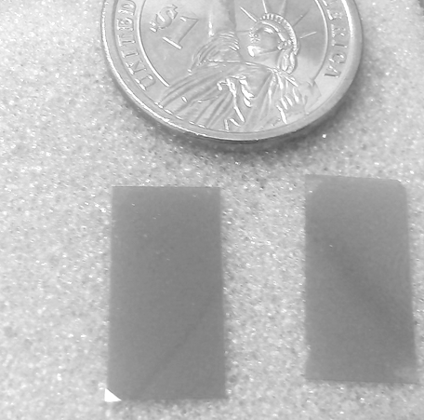
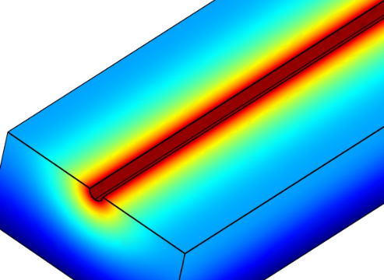
Diamond
ε = 5.7; tan δ < 5∙10⁻⁵ at 30 - 145 GHz
High breakdown threshold (DC~2GV/m)
SEE reduction by surface dehydrogenation
High thermal conductivity = 25 W∙cm⁻¹∙K⁻¹ (5xCopper)
Hardness, low coefficient of friction
Low thermal expansion
Radiation resistant
Euclid Techlabs experience:
~ 2 inch long
CVD diamond tubes ~20 GHz
Thin films for THz structures (manufacturing one unit for NIU)
Capillaries via CVD diamond (plasma capillaries for LBNL (funded by SBIR) and Oxford)

Slide 20
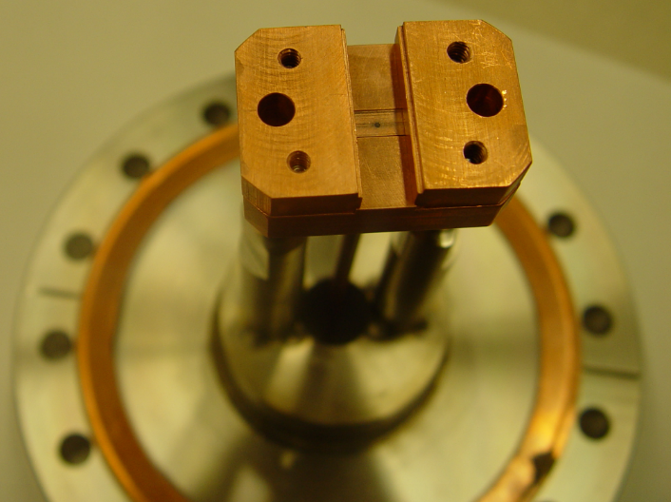
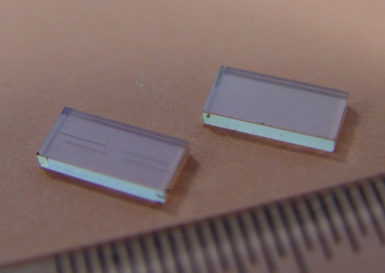
Diamond test at the AWA
Frequency | 24.81 GHz
Gradient (AWA 70 nC) | 60 MV/m
Beam gap | 4 mm
Diamond thickness | 1.2 mm
Structure width | 8 mm
Diamond length | 4 mm
Dielectric constant | 5.7; tan(δ) = 10⁻⁴
Q, quality factor | 2800, τ ~ 35ns
r/Q | 11.4 kΩ/m
Single crystal CVD diamond (E6)
Groove: 20um (wide) x 200um (deep)
Field enhancement ~ ε∙E ≈ 300 MV/m
AWA transported 72nC through the structure
Upper half of the diamond resonator
electron beam
Diamonds (E6) ...with a groove

Slide 21
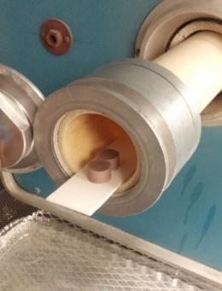
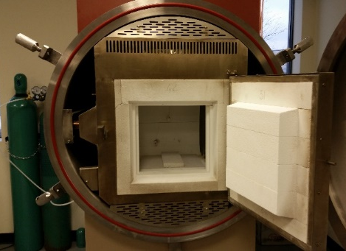
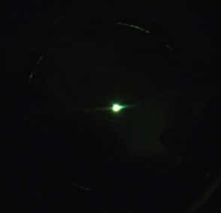
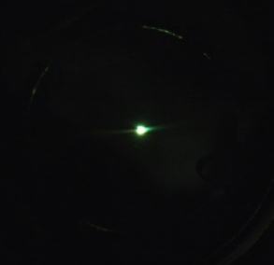
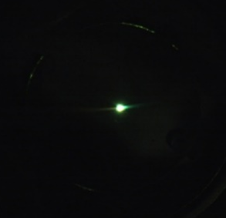
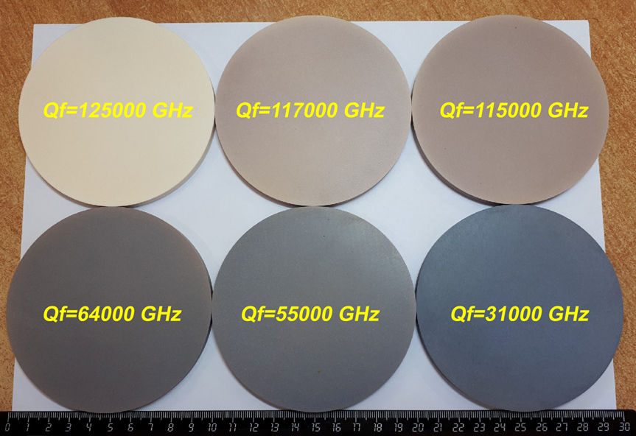
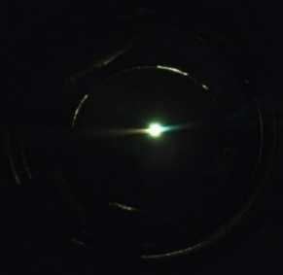
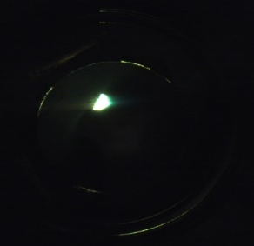
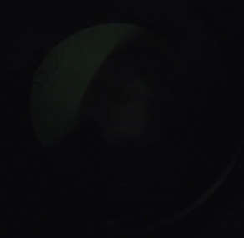
Conductive Low Loss Ceramic
Ceramics subject to DC electron beam for 2.5 hours
Conductive ceramic effectively discharges DC electron beam directly impinging on surface
Conductive ceramic
30 sec
60 sec
90 sec
DC electron beam was deflected in 90 sec
tan δ at 650 MHz
Non-conductive
21

Slide 22
SUMMARY
Simple geometry, Small transverse size, Short rf pulse/high reprate preferred
Tested for 400 MV/m at X-band and Ka-band, > 1GeV/m at THz
Various materials with dielectric constant from 4.4 up to 50
Engineered materials with required RF properties (low loss ceramic)
Extreme low losses at cryogenic temperatures
New advanced materials to be tested (diamond, ferroelectrics, conductive ceramic)

