Slide 1
THz and Millimeter Wave Structure Based Acceleration
Branko Popovic
GARD RF Roadmap: NCRF Meeting
01/20/26

Slide 2
Many Thanks to:
Mohamed Othman (SLAC)
Xueying Xu (NIU-ANL)
Gwanghui Ha (NIU)
Gerard Andonian (UCLA)

Slide 3
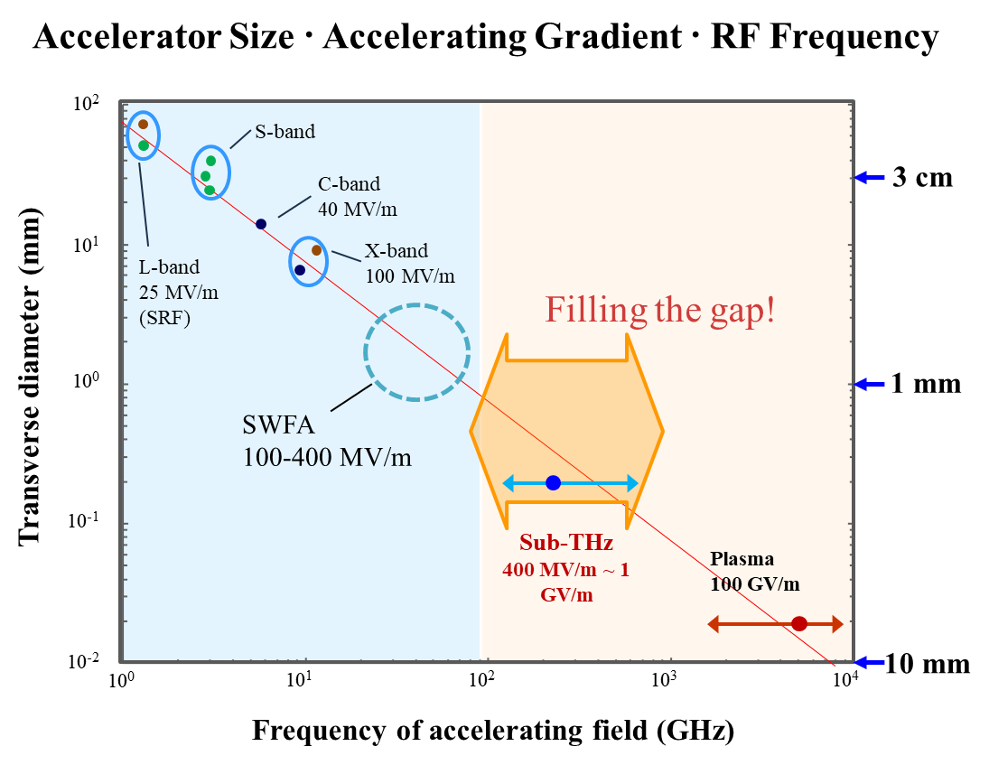
Motivation for THz –mmWave Acceleration
Could be…
High Gradient Accelerating Fields
Higher stability than plasma
Compatible with nC charges
Higher Repetition Rates
Thanks to Gwanghui Ha (NIU)
Notes:
From MO
Reduced fill times, decrease pulse heating => Higher Rep Rates
Increased shunt impedance and RF efficiency

Slide 4
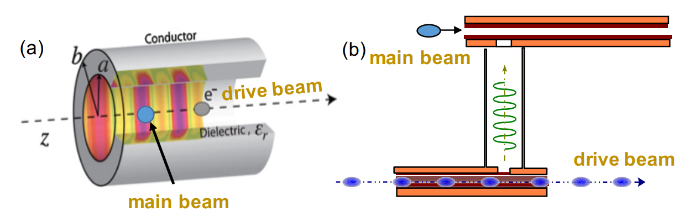
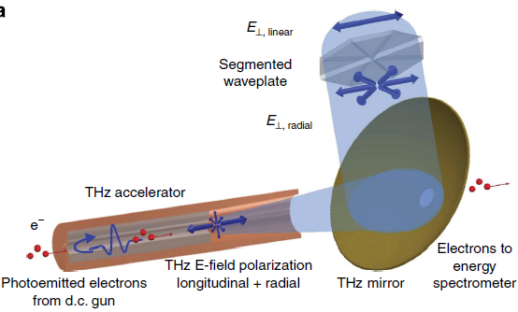
Types of Acceleration and Issues
Colinear Wakefield
Two Beam Wakefield
RF/Laser Driven
Higher Accelerating Gradients
Reduced fill times, decrease pulse heating => Higher Rep. Rates
Fabrication
Beam Instabilities
Difficulties from co-propagation
Drive beam manipulation needed
Need two beamlines
Need high-charge bunch train
Power Extraction
Sources
Coupling Schemes
Notes:
Focusing on THz in Vacuum structures
Laser driven DLA see Sophie Crisp

Slide 5
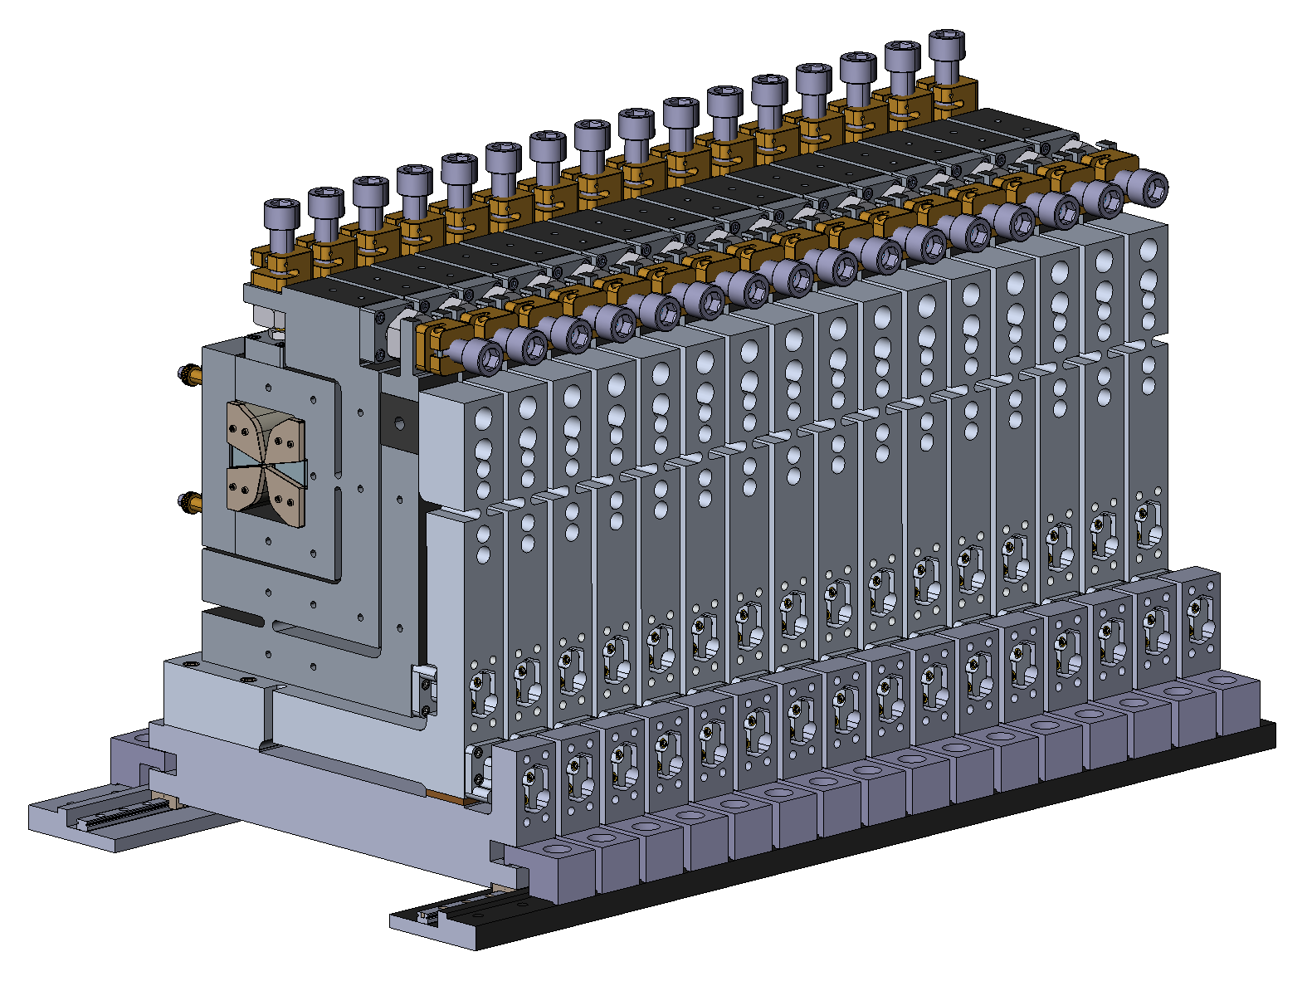
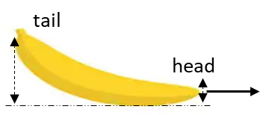
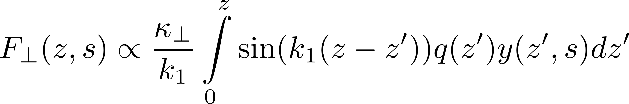
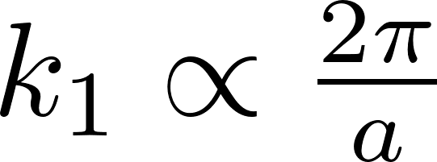
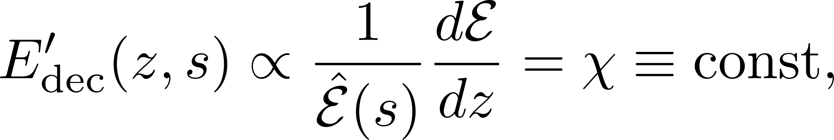
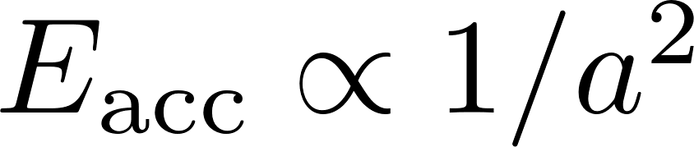
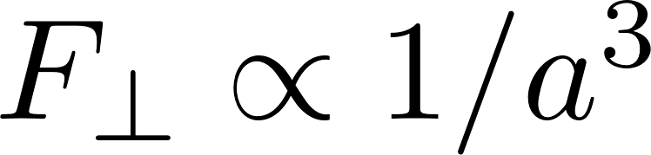
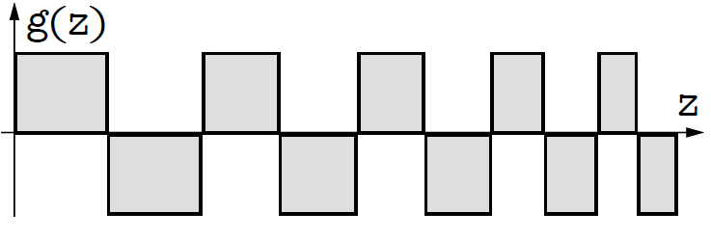
Beam Breakup (BBU) Instability
A BBU-mitigation technique consists of
Imparting an energy chirp in the drive (BNS Damping)
Embedding the CWG into the row of alternating focusing and defocusing quadrupole magnets (“quadrupole wiggler”)
Using modified “doorstep” charge distribution for dynamic adjustment of the energy chirp
Lorentz force (cause of BBU)
where
Thus
Using adaptive focusing of quadrupole wiggler
Notes:
Balakin-Novokhatsky-Smirnov (BNS) Damping:
Imparting an energy chirp to the drive bunch ensures that the betatron oscillation frequency of the bunch slices increases progressively from the head to the tail. This prevents resonant excitation of transverse wakefields by preceding slices, suppressing BBU. The energy chirp evolves dynamically as the drive bunch decelerates, maintaining stability throughout the acceleration process [6][78].

Slide 6
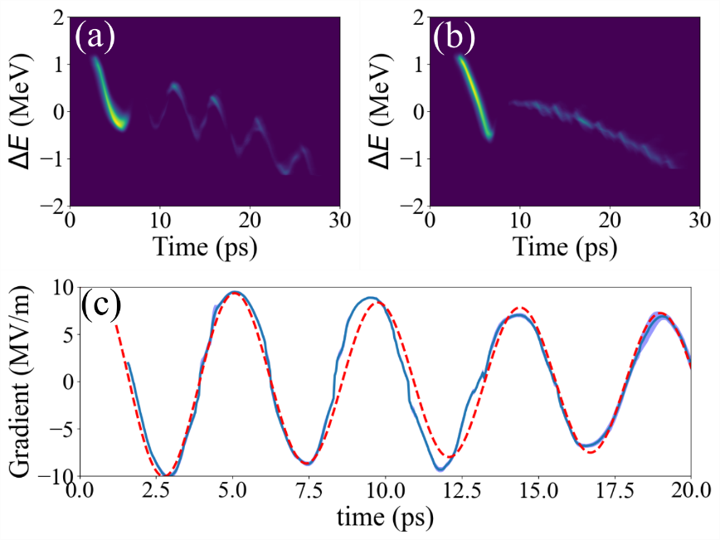
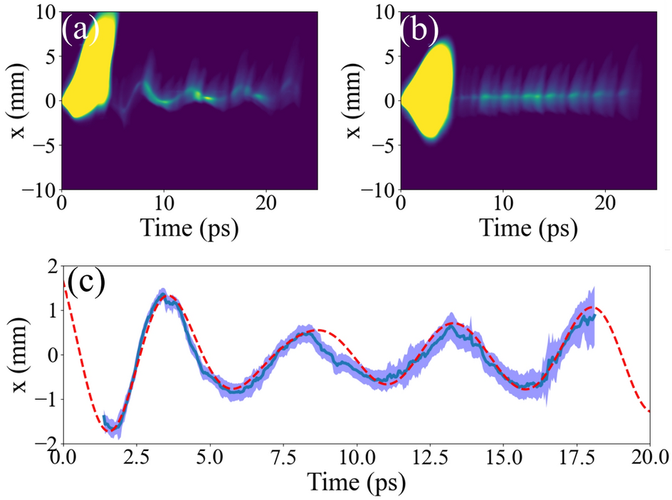
TBA 0.2 THz
Thanks to Gwanghui Ha (NIU)
Beam’s interaction with wakefield was experimentally measured by comparing longitudinal and z-x phase spaces with and without structure.
The result showed good agreement with simulation.
1 nC, 1.1 ps rms drive bunch
Longitudinal wakefield
Transverse wakefield
9.4 MV/m/nC
Several azimuthal modes excited simultaneously due to large offset

Slide 7
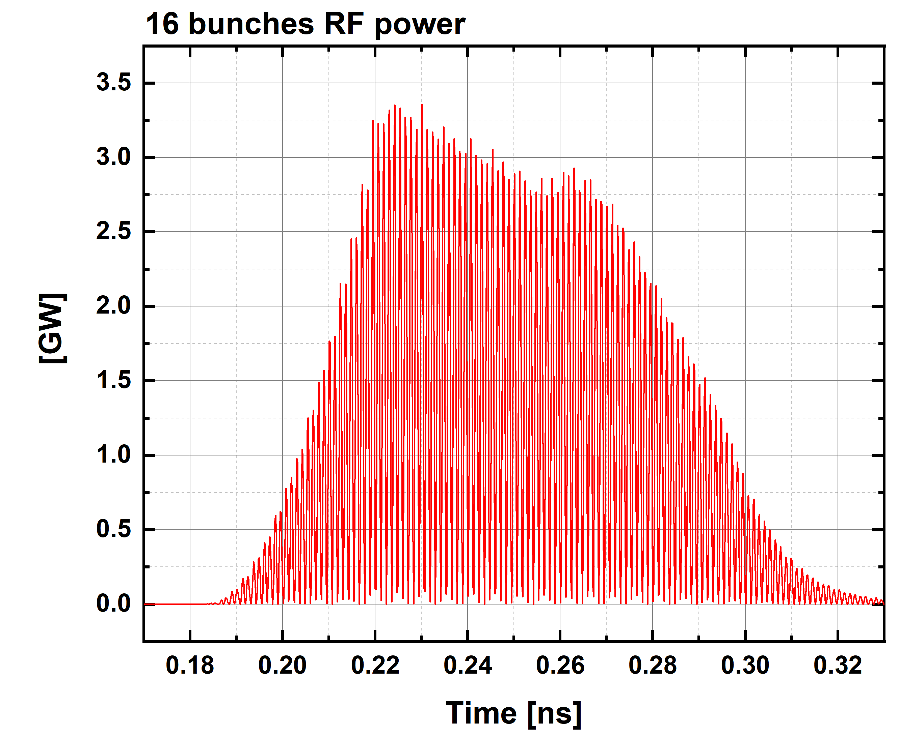
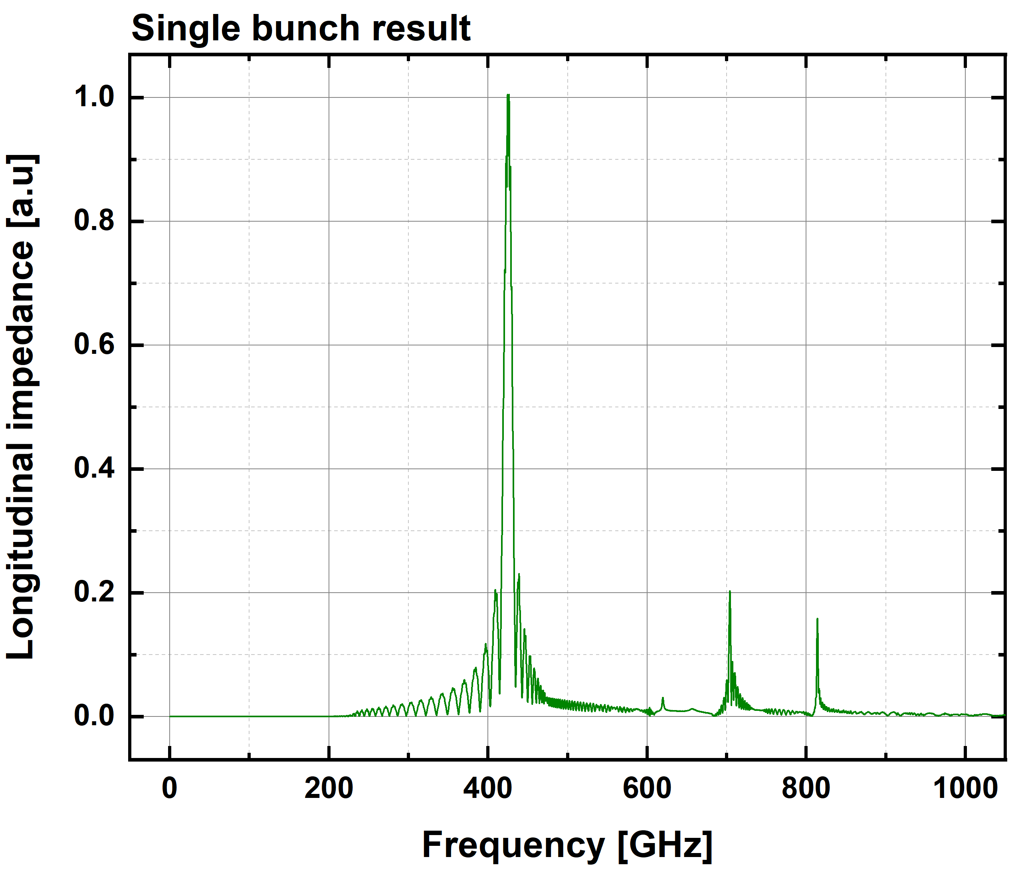
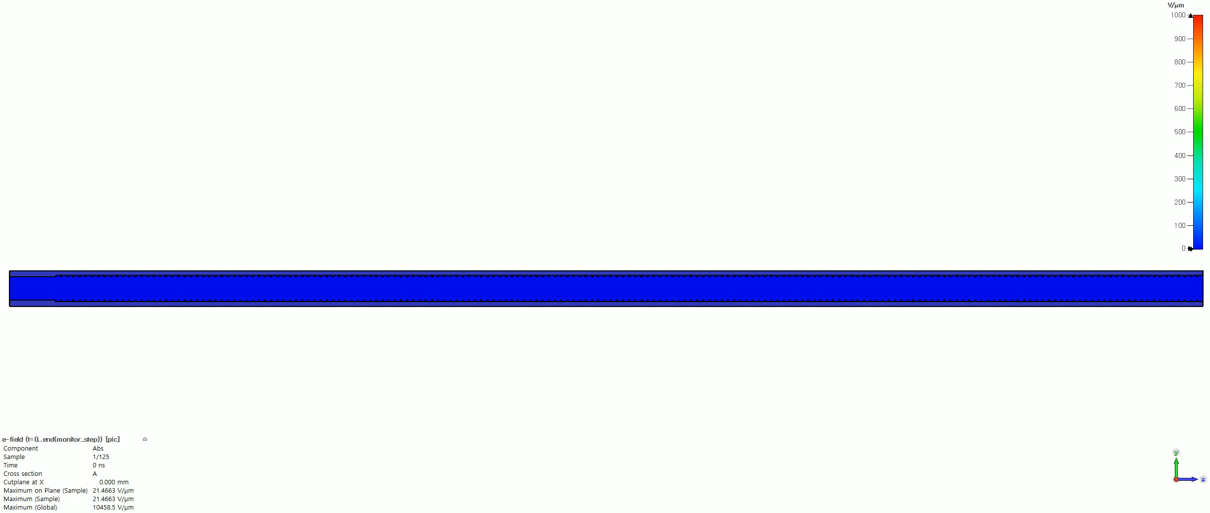
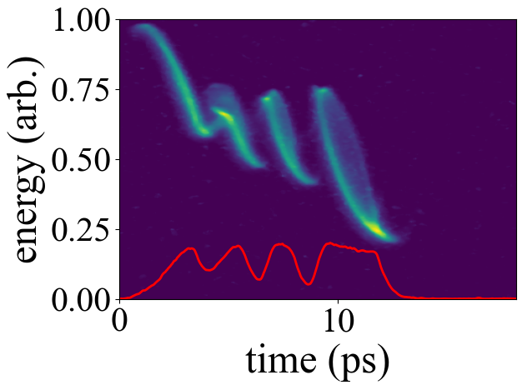
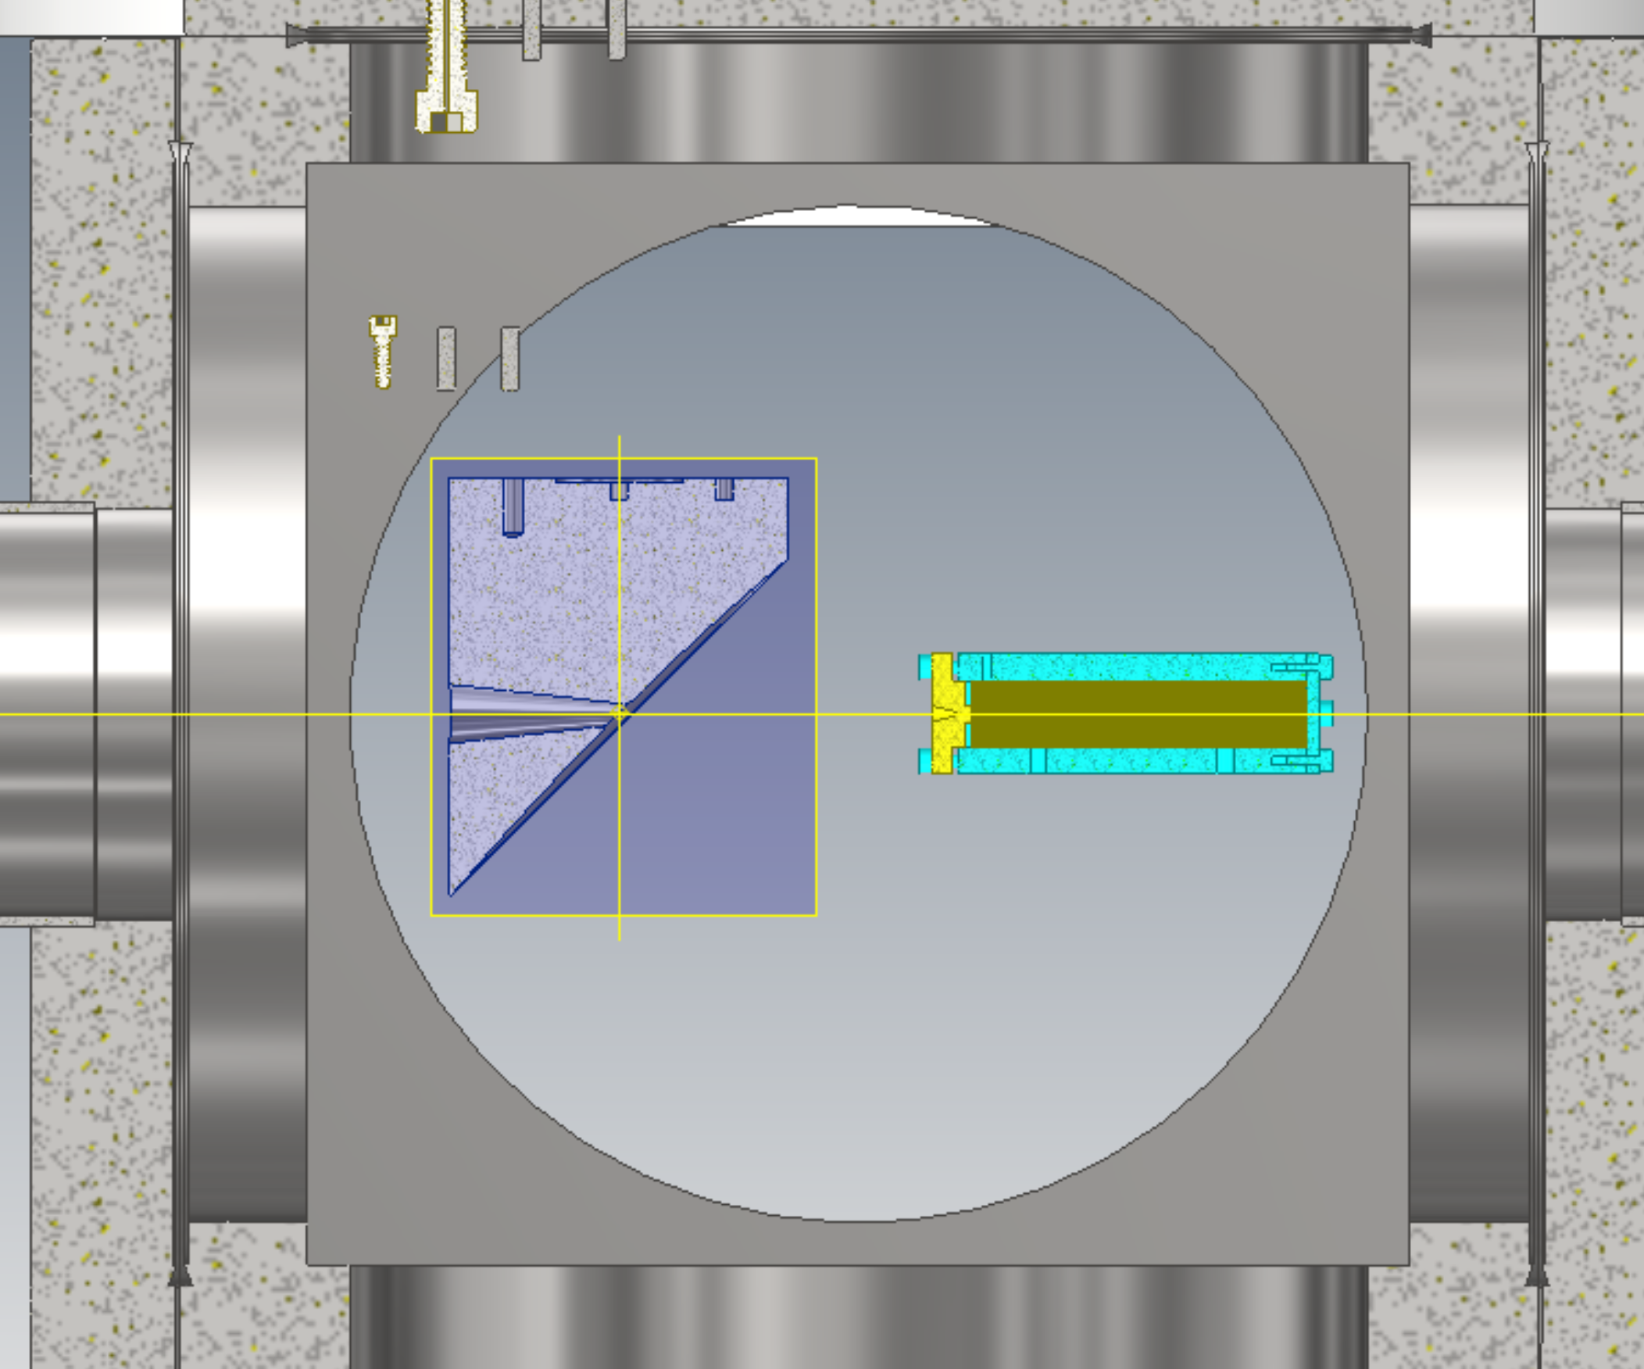
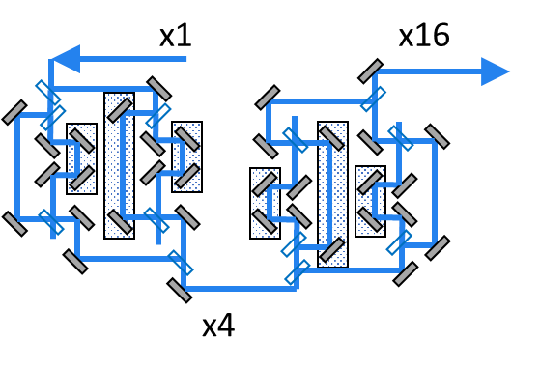
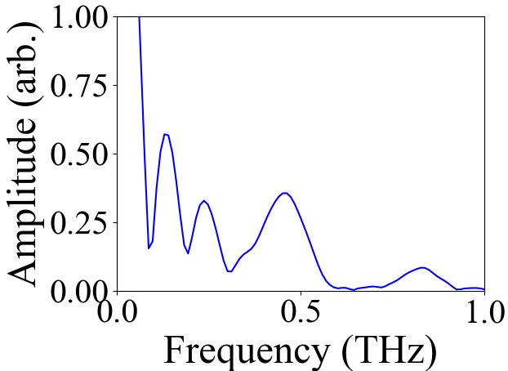
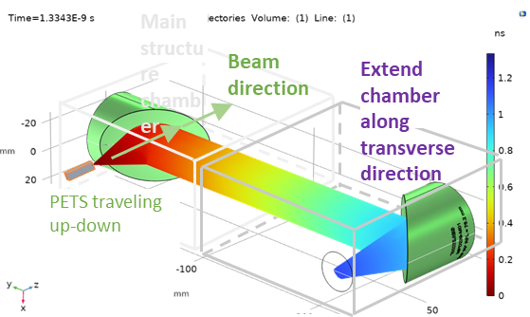
TBA 430 GHZ: GW power generation, 700 MV/m
Layout and simulations
THz Acc (700 MV/m)
0.4 THz structure
MPET
430 GHz
16 bunches, 1 nC/bunch
Longitudinal Phase space Diagnostics
Peak 3.3 GW
Avg. 1.5 GW
Drive bunch train generation
Tested concept for four bunches
Power extraction
Multi-splitter table generates a 16-bunch train (1 nC/bunch) with adj., near-arbitrary, bunch spacing.
OAP 2”OD 2”RFL
2.0, 2.0,1.6, 3.1 ps FWHM
THz PETS w/ horn
0.46 THz
Thanks to Gwanghui Ha (NIU)

Slide 8
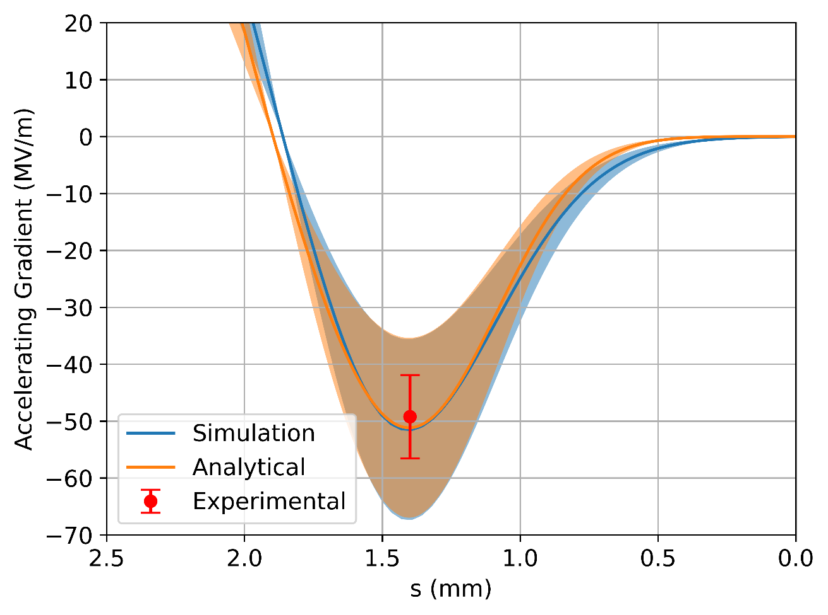
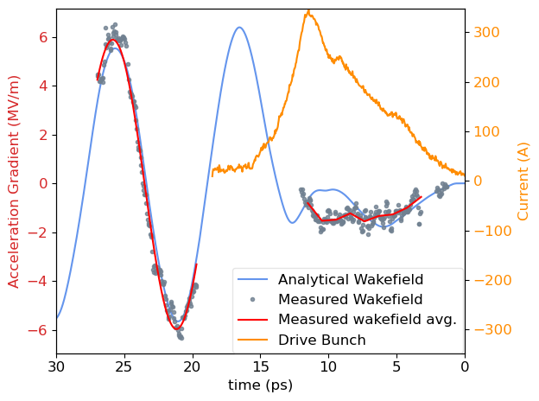
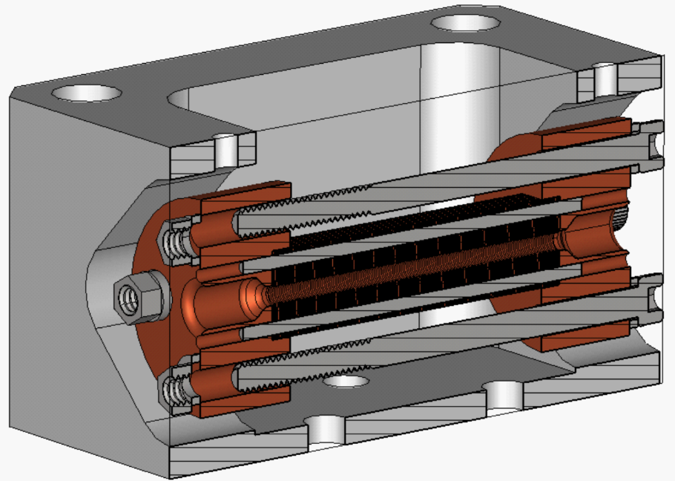
110 GHz corrugated waveguide excited by shaped electron bunches for wakefield acceleration
Single-bunch gradient meas.
Integration of sub-THz wakefield structures with shaped electron beams
Longitudinally shaped bunches using the AWA emittance exchange (EEX) beamline
110 GHz metallic corrugated waveguide by laser micromachining
Structure tested with single high-peak-current bunches and double-bunch configurations using shaped drive bunches
110 GHz structure
B. Leung et al., NIM A 1077, 170549 (2025).
PhD thesis defended by Brendan Leung (NIU)
Thanks to Xueying Lu (NIU)
Two-bunch transformer ratio meas.

Slide 9
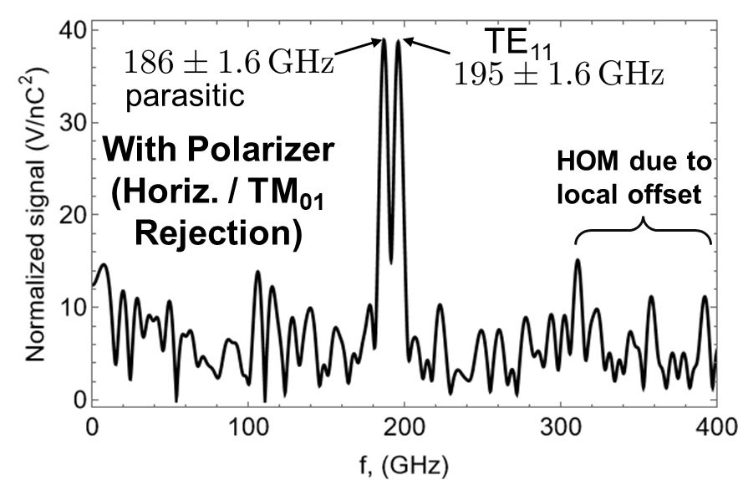
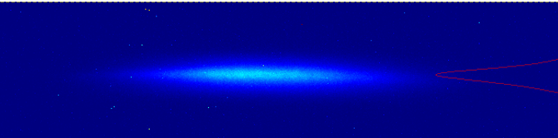
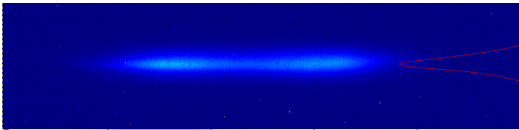
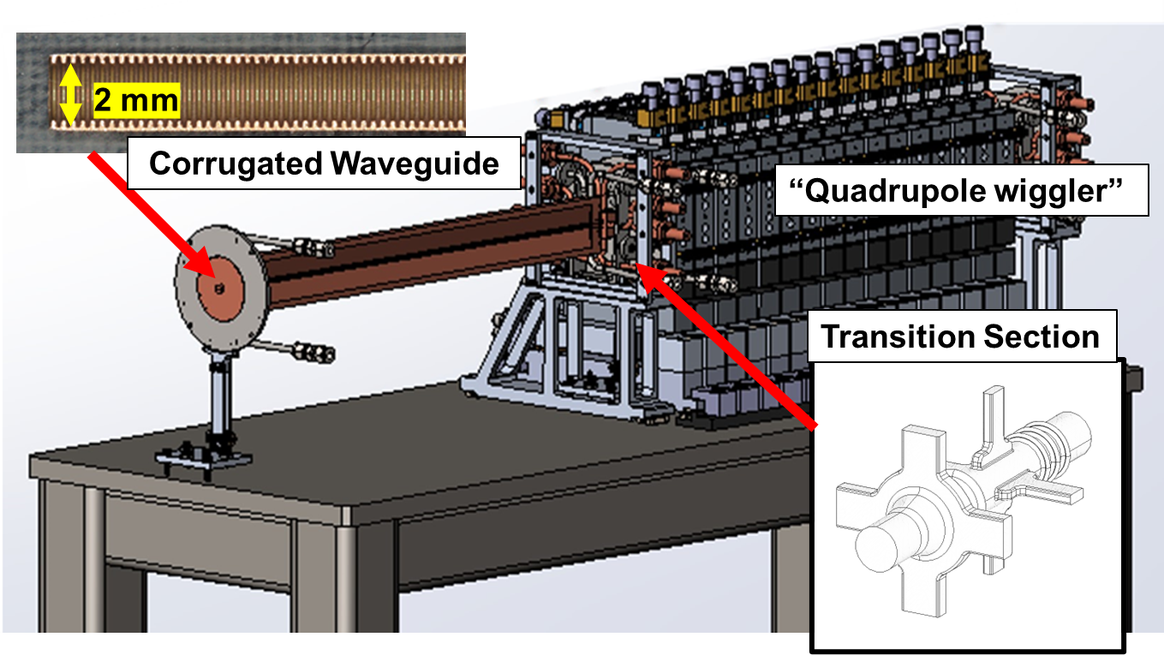
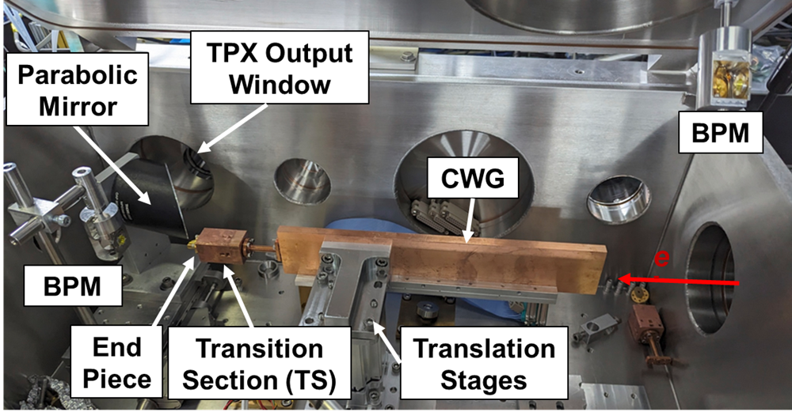
180 GHZ ANL SubTHZ Accelerator (ASTAR)
Previous Beam Testing At ATF
LINAC for a multi user XFEL
20 kHz
DOE-BES Grant
Demonstrate accelerating gradient
Utilize ANL APS Linac Extension Area
Improve/simplify transition section
Tube with a smooth wall
Corrugated Waveguide
Module

Slide 10
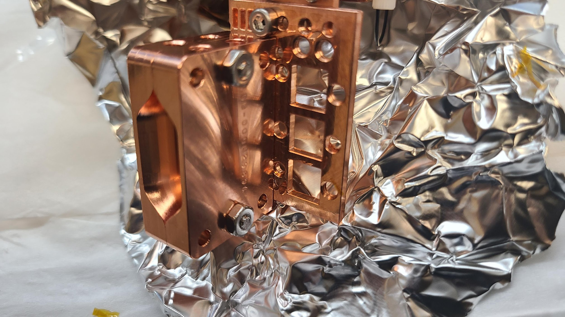

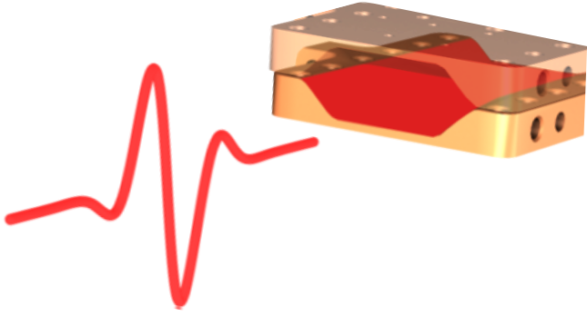
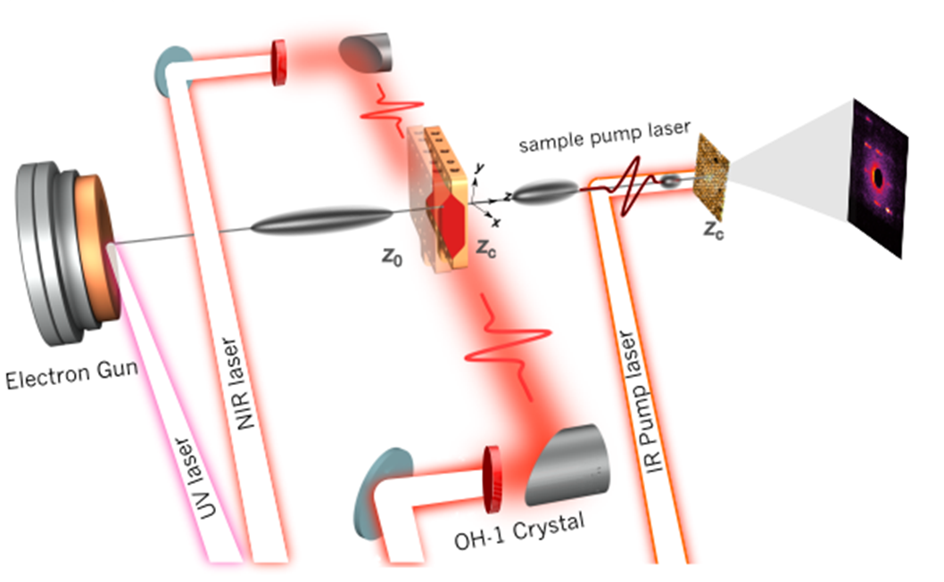
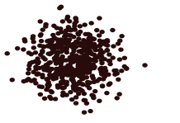
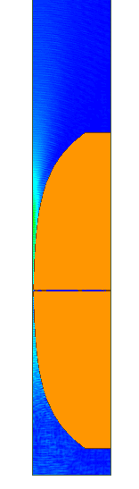
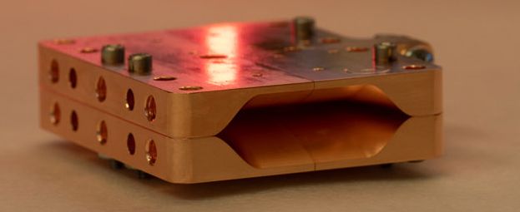
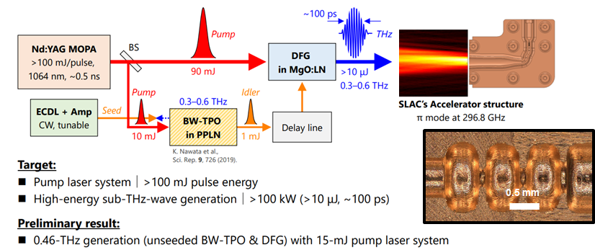
Laser Driven THz Acceleration
Time of Arrival/Streaking
THz structure
Intense THz pulses from laser driven interaction for electron acceleration
THz gradient ~100 MV/m, pulse length ~ ps
Attosecond time diagnostics of MeV-UED Probes
Need improved coupling schemes
THz structure
10 mm
streaking
Diagnostics tool
Bunch Compression
THz pulse
MeV-UED Electron
Probe
Optimized THz
Structure
70 μm
Narrowband Structures
Higher gradients
Othman et al., Opt. Express 27.17 (2019).
Li et al., Phys. Rev. Accel. Beams 22.1 (2019)
Othman, Mohamed AK, et al. "Improved temporal resolution in ultrafast electron diffraction measurements through THz compression and time-stamping." Structural Dynamics 11.2 (2024).
2020

Slide 11
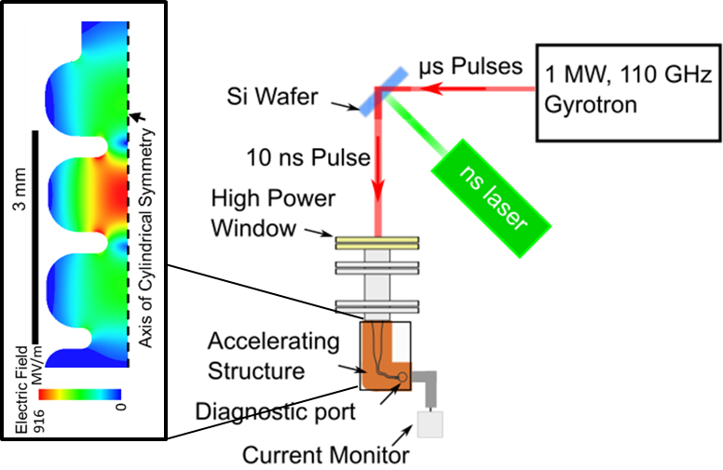
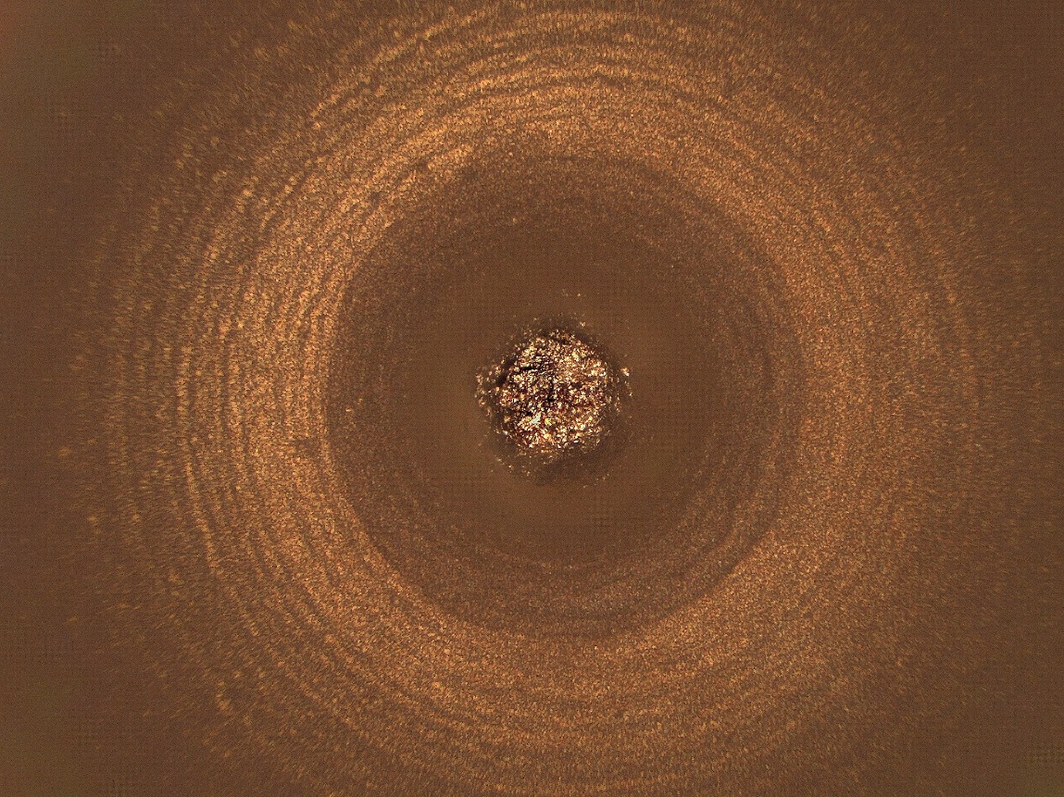
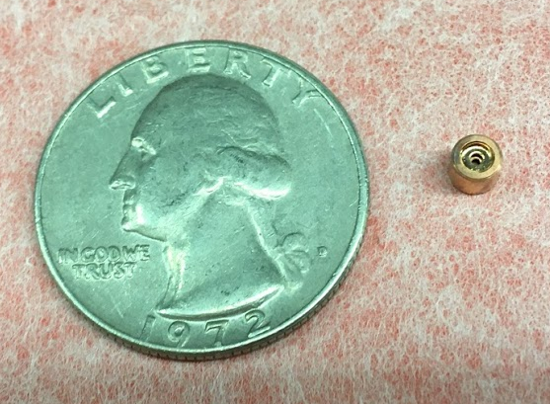
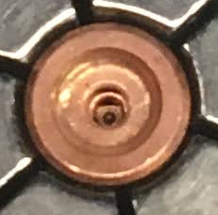
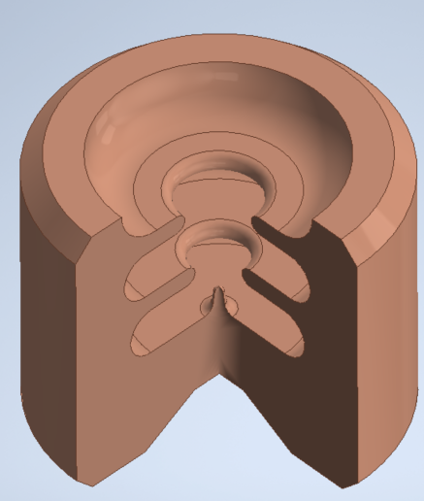
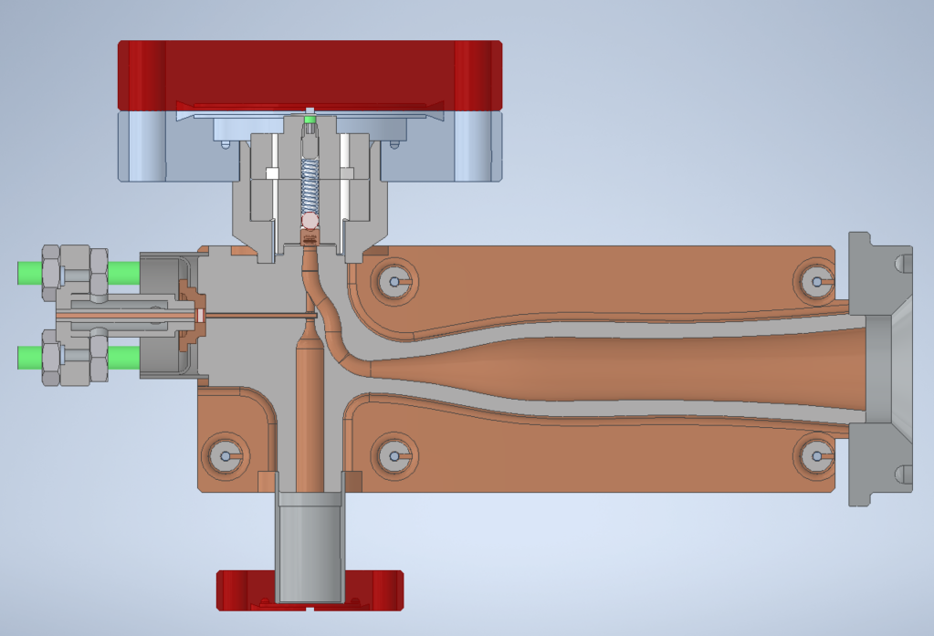
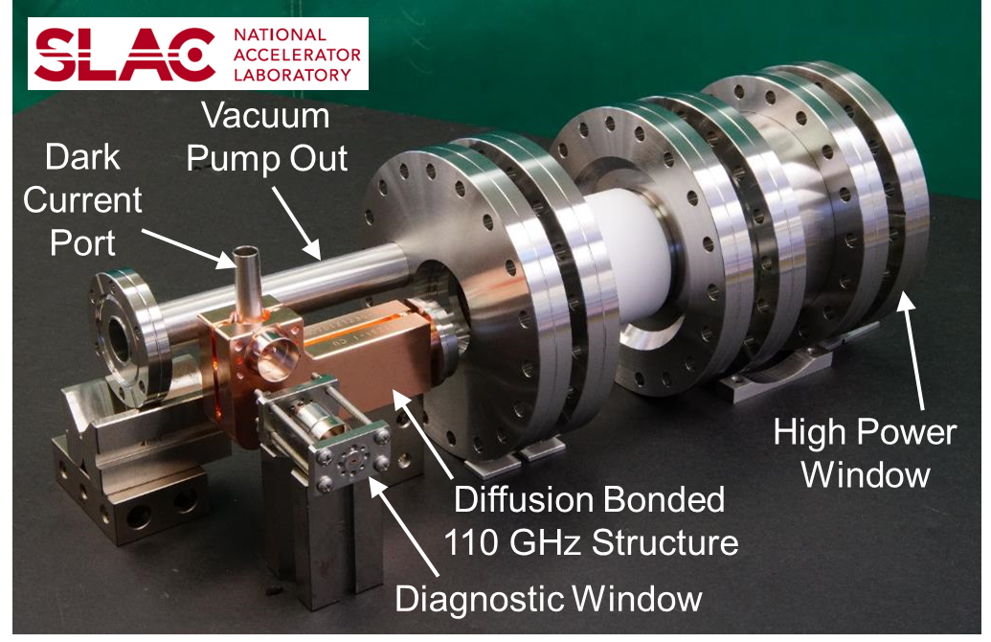
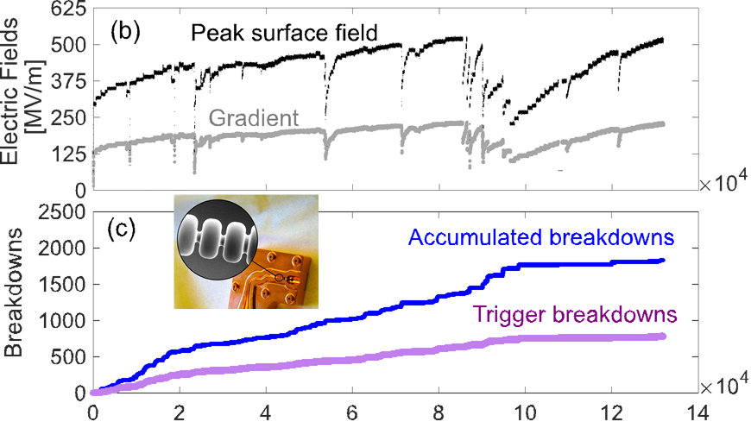
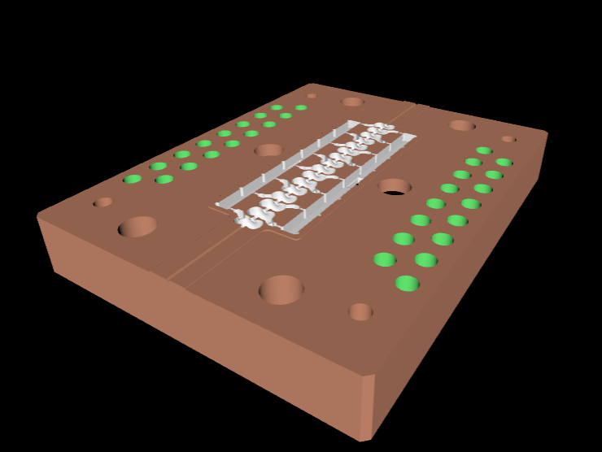
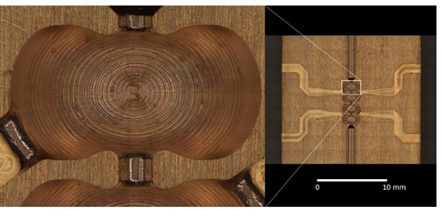
Work in RF Driven Acceleration
Thanks to Mohamed Othman (SLAC)
High Gradient Breakdown Physics
High Brightness Electron Sources
Inner iris
Coupling iris
3 mm
Copper cathode
Integration
2 cm
Gun cells
0.5 MeV energy gain
51 fC emitted per RF cycle
Normalized transverse ε_{N} = 0.88 mm-mrad
Gradient of 225 MV/m for 600 kW, 10 ns pulses
Measured breakdown statistics
Need development in power/rep. rate
WR-8 diagnostic port
THz input
e⁻
Beam tunnel
Distributed Coupling
Scaling
Distributed Coupling technology to test Sub-THz accelerators
Need gyrotron for testing
2019
2023

Slide 12
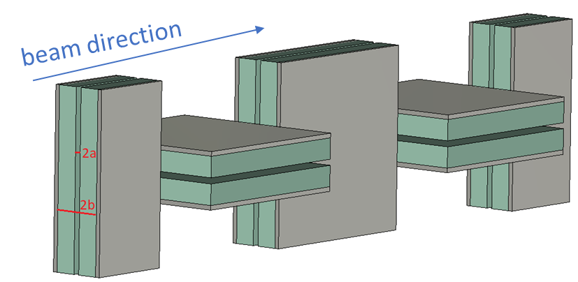
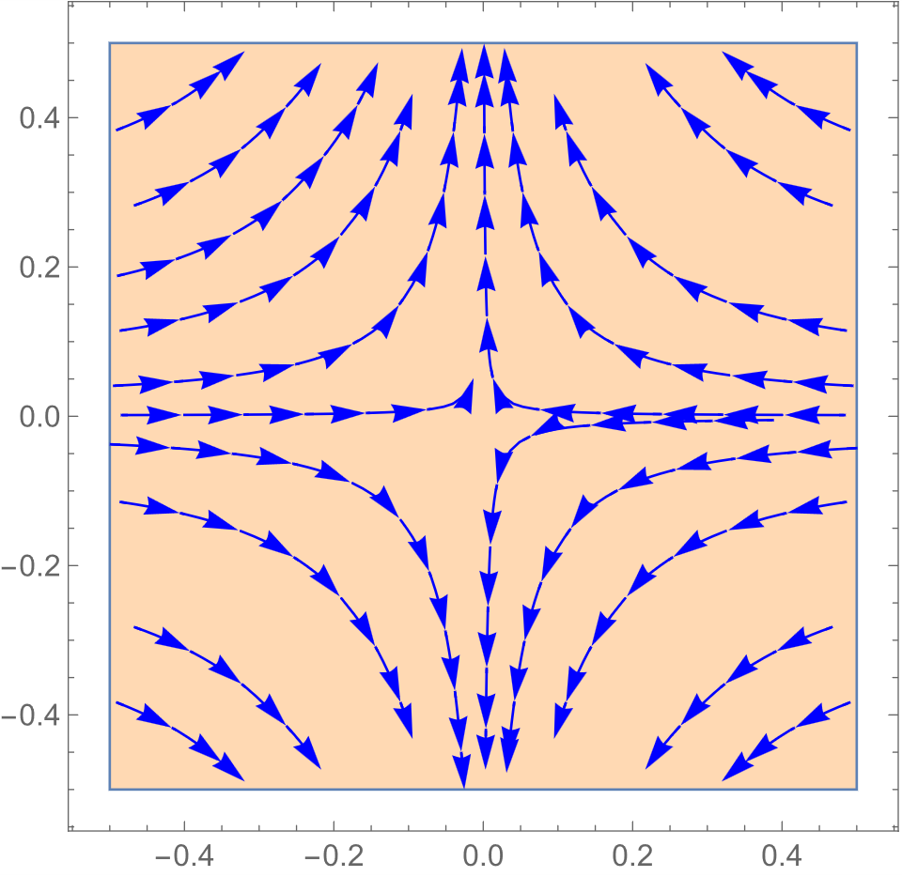
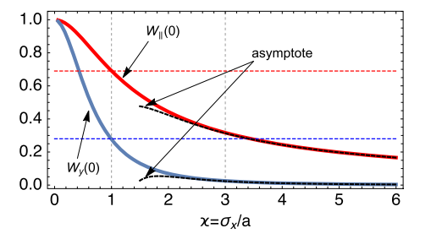
Dielectric Wakefield Acceleration (DWA)
Demonstrated:
GV/m fields in experiment
Positron-driven DWA
Limits on acceleration
Transverse fields driving instability
Alternating geometry (planar slabs) can provide gain but only delay onset
Alternating focusing Strategy
after one period
Kick map experienced by a test particle
Kick map rotates with structure
Thanks to Gerard Andonian (UCLA)
Notes:
Use alternating focusing strategy
Planar slabs will couple to “quadrupole” mode
Alternating orientation of successive structures by 90˚
Net focusing effect
Potentially stabilizing beam similar to magnetic quadrupoles superimposed on structure
Experiment conducted at AWA
Shows net transverse focusing effect when gap sizes in successive structures
Tuning can further improve transverse stability

Slide 13
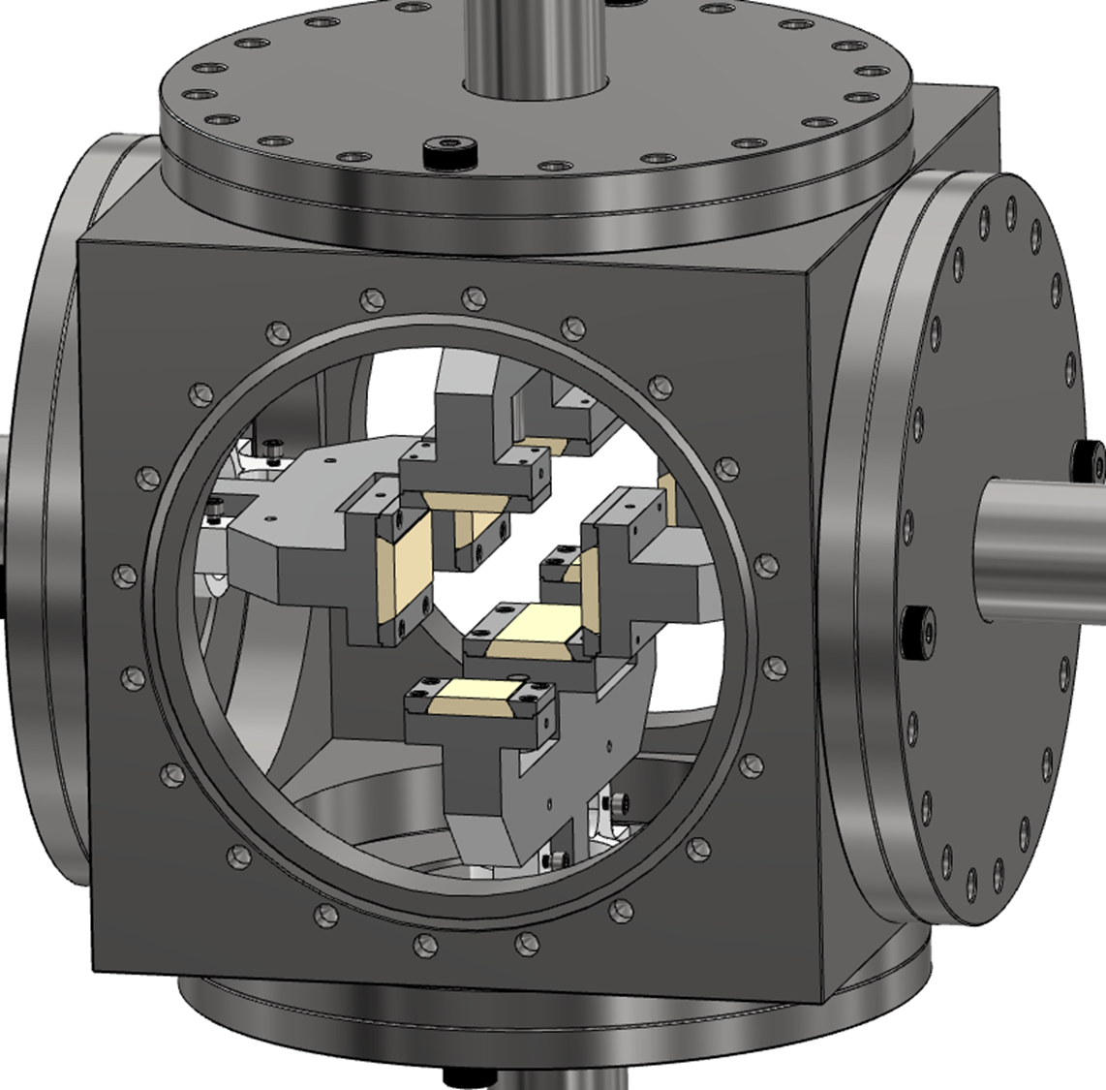




Experiment: Transverse stability at AWA
DWA with variable gaps in different dimensions to explore transverse phase space of beam through structure
Data shows transverse distribution for various gaps
When gaps are dissimilar, a ”quadrupole” like focusing effect elongates the beam
When gaps in horizontal and vertical dimensions are equal, beam is round, similar to input, due to net focusing
Thanks to Gerard Andonian (UCLA)

Slide 14






How to build these accelerators?
Colinear Wakefield
Two Beam Wakefield
RF/Laser Driven
Disc-Stacking (Laser micro-machining & UV LIGA)
Nano-CNC Machining
Electroformed Copper
Dielectric Waveguides

Slide 15









Electroformed Copper
Aluminum mandrel production
Mandrel inspection and straightening
Electroforming
High-Quality Surface Finish
100 mm
Proprietary micro-machining process
Tooth Height 252.7 μm; error 1.5 μm RMS
Tooth Width 175.9 μm; error 2.0 μm RMS
using optical comparator
reference groove
EDM of outside diameter OD
Precision cut of edges
low temperature brazing at 365 ºC
Braze alloy: 88% Au and 12% Ge
followed by second straightening
followed by aluminum etching
15
Notes:
Still need high precision machining of mandrels, cost of electroforming. Possible
High temperature braze failed
placed in a plating tank for several days where copper sulfate with proprietary additives is used for copper deposition. Afterwards, the mandrel is placed in a hot bath of NaOH to chemically dissolve the aluminum.
The CWG fabrication requires a 0.5 mm Cu deposition thickness
HOWLONG DOES THIS TAKE
What is the checmical process of leaching?
brazing alloy containing 88% Au and 12% Ge that is suitable for brazing with a maximum temperature of 365◦C

Slide 16






Disc Stacking
X-Ray LIGA (see next slide)
110 GHz Structure
0.2 THz Structure
0.4 THz Structure
Plates with alternating hole radii and alignment pin holes cut by laser micromachining
Full periodic structures clamped with alignment fixture
Brazing vs Stacking
Electro-forming
Thanks to Xueying Lu (NIU)
Fabrication method was demonstrated (Scientific Report, 13, 3207 (2023).
Thanks to Gwanghui Ha (NIU)

Slide 17







Stacking: X-Ray Lithograph
(Courtesy of J.-H. Kim & H. Kong)
PLS-II 9D beamline
Before development
Development
UV Lithography
for 40μm thickness
X-ray Lithography
for 230μm thickness
Stacking
Assembly
Expose to X-ray
Double side polishing
Electro-forming
Substrate with exposed plating area

Slide 18





Nano CNC Machining + Wire EDM
3D Printing
High-precision turning/milling used to create split-block halves: No interruption of rf current.
DMLS or high-res polymer printing followed by copper plating
Thanks to Mohamed Othman (SLAC)

Slide 19
Summary Of Fabrication
Colinear Wakefield
Two Beam Wakefield
RF/Laser Driven
Disc-Stacking (Laser micro-machining & UV LIGA)
Nano-CNC Machining
Pros:
Sub-micron tolerances
Quality Surface finishes
Cons:
Split halves limit topographies
Cons:
Alignment and fixtures
Additional fabrication steps
Pros:
Simplified elements
Electroformed Copper
Pros:
Complex geometries
Potential to modify copper’s properties
Cons:
High precision fabrication of mandrels
Cost of electroforming
Additional fabrication steps
3D Printing
Pros:
Complex geometries
Rapid Prototyping
Cons:
Surface roughness (sub-microns)

Slide 20
More work to be done…
Colinear Wakefield
Two Beam Wakefield
RF/Laser Driven
Beam Control / BBU
Fabrication
Diagnostics
Greater Understanding of breakdown (What’s the threshold?)
Drive beam manipulation
Power extraction/injection
Drive bunch train
Coupling schemes
Development in Power/Repetition Rate
mmWave Sources

Slide 21
Some Sources
RF Driven Accelerators
Othman et al, Appl. Phys. Lett. 117.7 (2020): 073502.
Lewis, Samantha M., et al. "Design, fabrication, and tuning of a THz-driven electron gun." Physical Review Accelerators and Beams 25.12 (2022): 121301.
Laser Driven Accelerators
Othman, et al. "Improved temporal resolution in ultrafast electron diffraction measurements through THz compression and time-stamping." Structural Dynamics 11.2 (2024).
Othman et al., Opt. Express 27.17 (2019).
Snively, E. C., et al. Physical review letters 124.5 (2020): 054801.
Ji, Fuhao, et al. Nature Communications 15.1 (2024): 4726
Othman, et al. Applied Physics Letters 122.14 (2023).
Li et al., Phys. Rev. Accel. Beams 22.1 (2019)
Dielectric Waveguides
C. Philipps et al., NIM A 1084, 171162 (2025).
180 GHz ASTAR
A. Zholents, S. Baturin, S. Doran, W. Jansma, et al., 18 coauthors, “A high repetition rate millimeter wavelength accelerator for an X-ray free-electron laser”, Journal of Instrumentation, JINST 20 P01023 (2025), https://doi.org/10.1088/1748-0221/20/01/P01023
S. Baturin, A. Zholents. "Upper Limit for the Acceleration Gradient in the Collinear Wake Field Accelerator as a Function of the Transformer Ratio", Phys. Rev. Acc. and Beams 20, no. 6, June 19, 061302 (2017).
A. Zholents, S. Lee, B. Popovic, M. Fedurin, K. Kusche, W. Li, A. Nassiri, A. Siy, S. Sorsher, K. Suthar, E. Trakhtenberg, and G. Waldschmidt, “Fabrication and testing of the transition section between modules of a wakefield accelerator” , Phys. Rev. Accel. Beams 27, 081303 (2024),
0.2 THz & 0.43 THz TBA
H. Kong et. al., Scientific Reports 13:3207 (2023)
110 GHz Colinear Corrugated Waveguide
B. Leung et al., NIM A 1077, 170549 (2025).

Slide 22
Roadmap Milestones
Attosecond-Scale Diagnostics & Timing Correction (laser driven)
Utilizing intrinsically synchronized laser-generated THz pulses to drive compact transverse deflecting cavities.
Enables <1 fs "Time-Stamping" and jitter correction, decoupling the experimental temporal resolution from the machine's arrival time stability.
A standard, deployable tool for UED and X-ray FELs to recover single-shot temporal fidelity in "jittery" beams.
Thanks to Mohamed Othman (SLAC)
High-Field mm-Wave Injectors (rf Driven)
Ultra-high cathode fields (>1 GV/m) overcome space-charge limits, preserving intrinsic emittance.
Enables high-luminosity collision schemes and provides a viable injection path for future structure-based (DWA) or plasma-based (PWFA) colliders which require micron-scale beam matching.
Potential to eliminate Damping Rings, drastically reducing the footprint of future lepton colliders.
Milestones (next 10 years)
1- Demonstration of facility integration (XFEL, UED) with sub 1 fs resolution
2-Demosntrating gradient >500 MV/m in high R/Q cavities
Milestones (next 10 years)
1- Demonstration of high brightness mm-wave source
2-Demonstrating gradient >500 MV/m in linac RF structure (distributed coupling etc)
Passive Phase Space Control & Collinear Acceleration
Uses the short-range wakefield of a corrugated or dielectric pipe to remove residual energy slopes (chirps) from the beam before it enters the FEL undulator.
Tunable (via variable gap), and compact.
A "Tube-in-Tube" geometry for collinear wakefield acceleration (where the drive beam and witness beam share the same pipe).
CRITICAL PROGRAM DEPENDENCIES
Milestones is contingent upon parallel advancements in High-Power RF Source (availability of MW-class W-band tubes) and Laser Efficiency (mJ-scale narrowband generation).
Milestones:
1- Demonstration of transformer ratio >5
2-Demosntrating staging and stability, suppressing BBU

Slide 23
Applications?
Two beam
0.4 THz Wakefield Accelerator: Light sources
Co-linear (corrugated waveguides, dielectric)
110 GHz Corrugated:
180 GHz Corrugated Waveguides: LINAC for an XFEL
Dielectric Waveguides
RF/ Laser Driven
User facility/ Medical Applications

Slide 24



Fabrication of dielectric-lined waveguides
Commercially available dielectric tubes
Copper deposition at Euclid Techlabs LLC
Deposited copper characterized at the ANL Center for Nanoscale Materials (right figure)
Thanks to Xueying Lu (NIU)
Notes:
Commercially available dielectric tubes (left figure)

