Slide 1
High Gradient Operation of NCRF High Brightness Photoinjectors
Jared Maxson
Cornell University High Energy Synchrotron Source (CHESS)
GARD Roadmap NCRF Meeting, Jan 20, 2026

Slide 2
Overview
The starting point of my talk:
  Photoinjector technology in general has been hugely impactful across the DOE electron accelerator infrastructure.
  In particular, the success of the 1.6 cell S-band all-Cu photoinjector is, achieving gradients ~120 MV/m, has had a an outsized/huge impact on the community.
What are the next steps the community is taking?
  New geometries/modalities
  different frequencies
  and new cathodes (new to NCRF)
Huge progress in gradient has been achieved, and huge progress in cathodes outside of guns has been achieved.
Lots to discuss here: I will focus on the intersection of all these concepts rather than focus on any individual approach.
Much international competition, very important context.
One person's view, limited time: apologies for omissions.

Slide 3
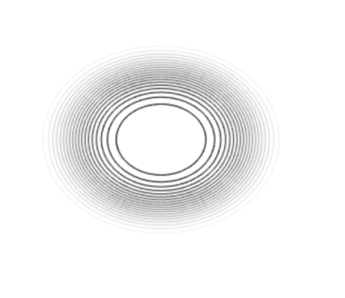

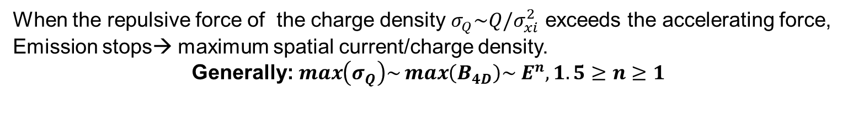


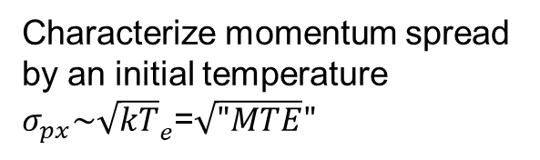








Reminder: Source Phase Space
Source phase space
Q: What determines the initial source size? A:Source/Cathode accelerating field
$$p_{x}$$
Photons $E=hν$
$$σ_{pxi}$$
$$F_{acc}$$
+
$$F_{sc}$$
-
$$x$$
$σ_{Q}$
$−σ_{Q}$
$σ_{xi}$ (source size)
Induced image charge
Emitted charge density
When the repulsive force of the charge density $σ_{Q}\sim Q/σ_{xi}^{2}$ exceeds the accelerating force,
Emission stops→ maximum spatial current/charge density.
Generally: $\max\left(σ_{Q}\right)\sim \max\left(B_{4D}\right)\sim E^{n}, 1.5≥n≥1$
Q: What determines the momentum spread?
A: Intrinsic momentum spread due to photoemission.
Characterize momentum spread by an initial temperature $σ_{px}\sim {\sqrt{kT}}_{e}$=$\sqrt{"MTE}"$
Photons $E=hν$
$$F_{acc}$$
High emittance
material
Low emittance
material

Slide 4
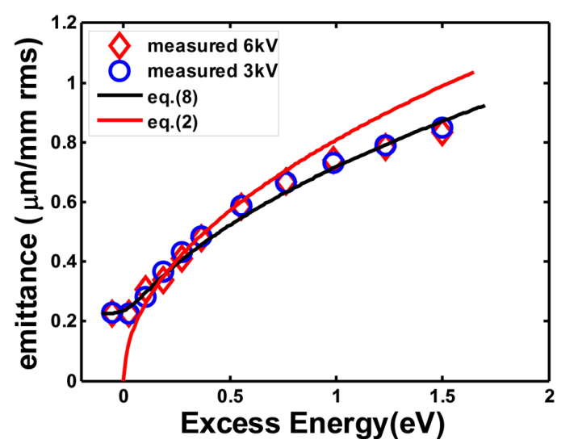
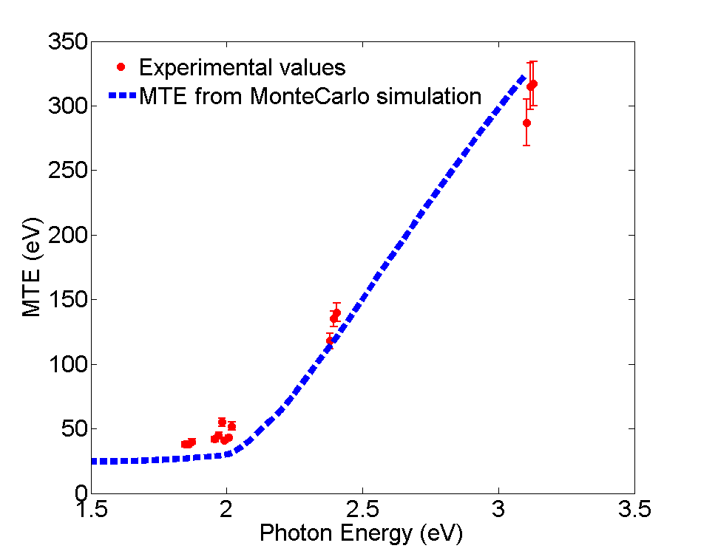

How low can you go?
By decreasing $hν→φ$, you can reduce MTE to about room temp (25 meV, or 0.2 micron/mm rms)
Why aren’t we all doing this? Laser infrastructure, QE penalty.
$QE \sim {\left(hν−φ\right)}^{2}.$
Orders of magnitude. Need to start with high QE: vacuum sensitive!
Sb
Alkali Antimonide
J. Feng, APL (2015)
L. Cultrera

Slide 5
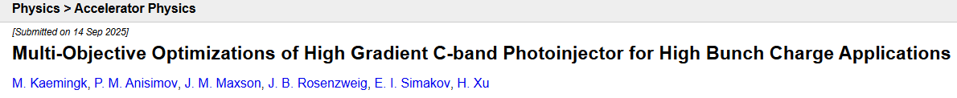
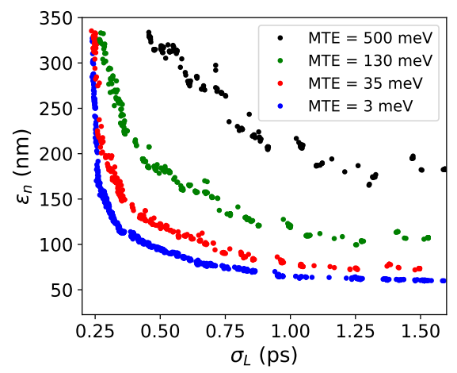
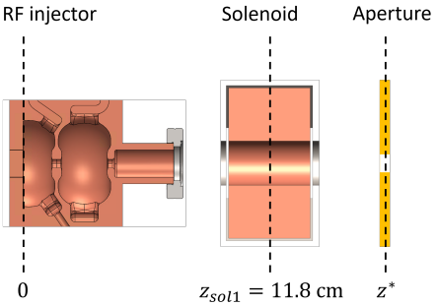
Does MTE matter?
Obviously field matters: it drives the charge density we can achieve. Does MTE matter when space charge is involved?
Many examples say yes. Recent case study: LANL, Cornell, UCLA.
https://arxiv.org/abs/2509.11014
250 pC final bunch charge with aperture
Typical Cu MTE
Strong decrease then diminishing returns
240 MV/m
Peak

Slide 6
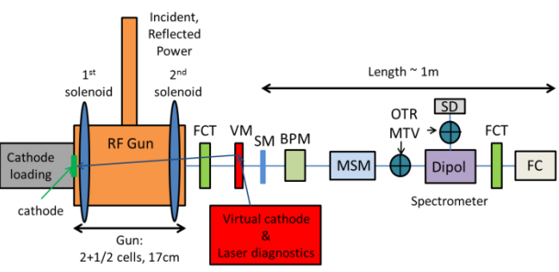
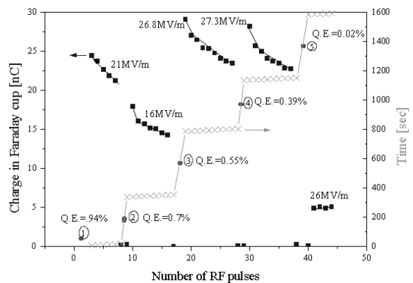
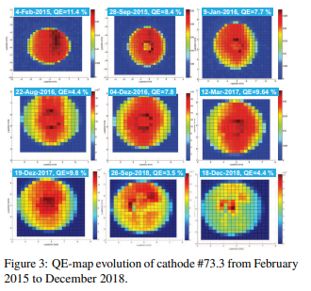
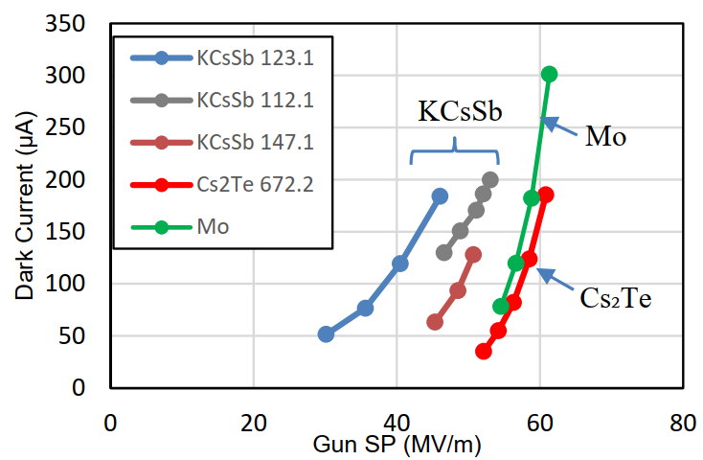
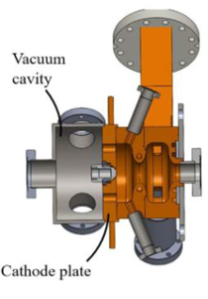
Semiconductors in NCRF
Some examples, historical and more recent (international)
Aleksandrov et al (BINP), PAC 1999
Hessler et al. (CERN) IPAC2015
PHIN photoinjector, Cs2Te/Cs3Sb
S-band, >80 MV/m
GaAs + S-band 100 MeV/m
FLASH+EuXFEL: L-band, Cs2Te
PITZ Photoinjector, L-band, Cs2Te/Alkali Antimonide, Mohanty et al, FEL 2022
Tsinghua University—more on this later.
Many
Papers!

Slide 7
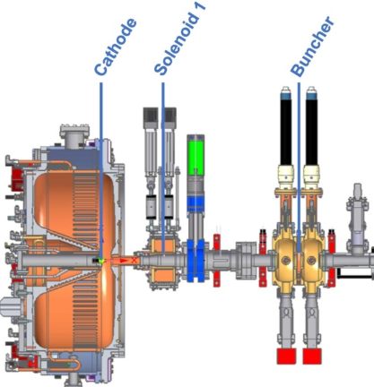
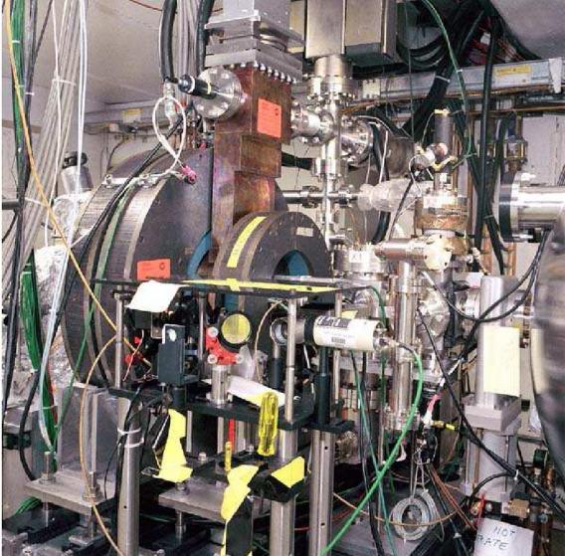
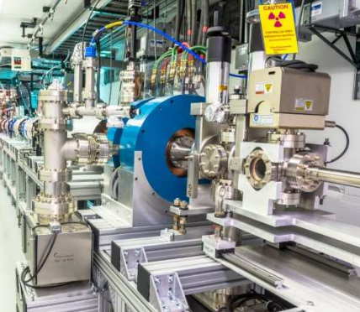
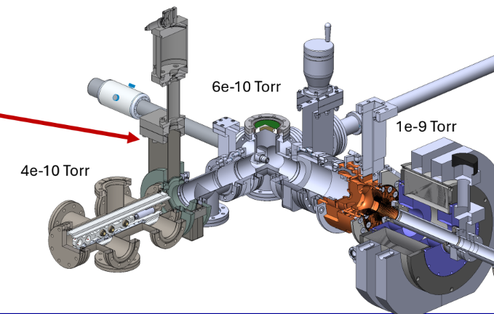
Semiconductors in NCRF
Some examples, historical and more recent (US)
A0/FAST Photoinjector: L-band, Cs2Te
Carneiro et al., PRAB 040101 (2005)
AWA photoinjector L-band, Cs2Te.
Wisniewski et al., IPAC2-15
APEX/HiRES/LCLS-II
NCRF+CW
Sannibale et al., PRAB 103501 (2012)
Cs2Te and Alkali Antimonides
UCLA Pegasus photoinjector S-band, Cs2Te and Alkali antimonides, >80 MV/m. More later!
Many more in development (this talk):
UCLA, LANL, ASU, AWA+Euclid…

Slide 8
New directions in search for high field

Slide 9
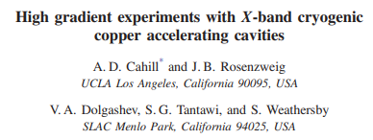
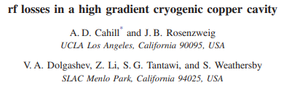
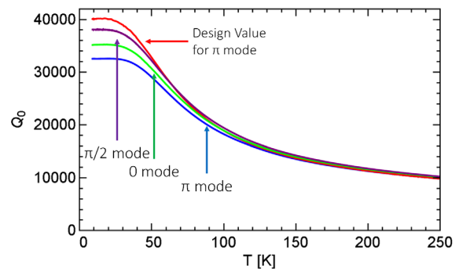
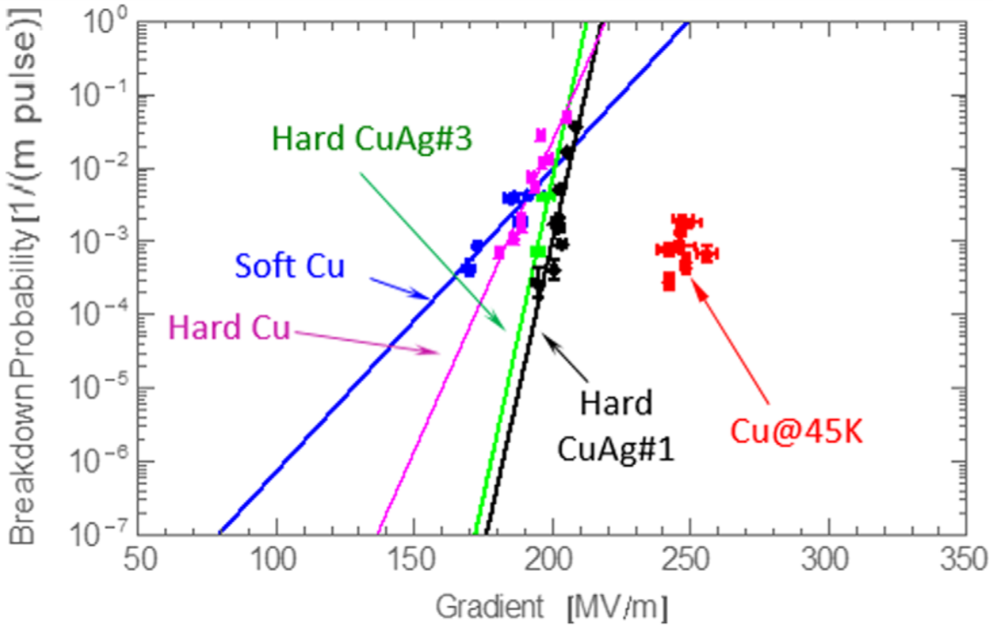
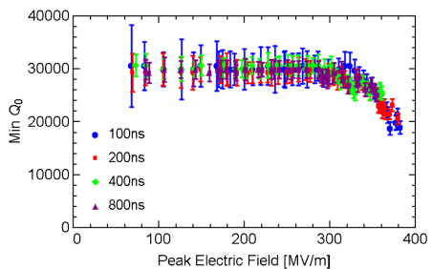
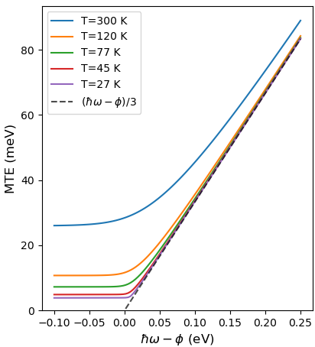
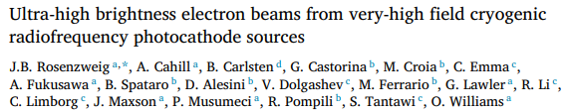
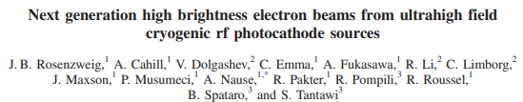
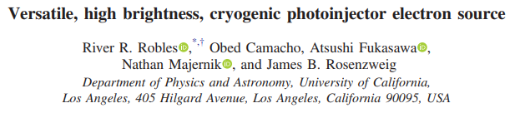

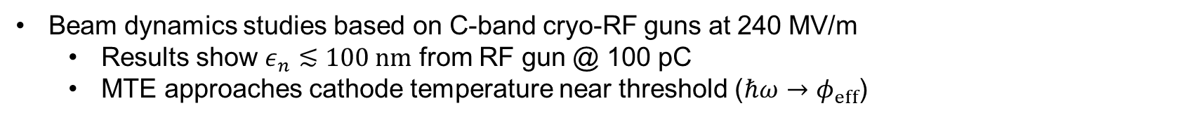
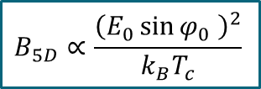
Advantages of Cryo-RF Guns
Copper at cryogenic temperature
  Increased conductivity (Q-factor & Shunt impedance) and hardness
  Reduced breakdown rate and CTE
  Tolerable dark current below 300 MV/m
Cahill et al., PRAB, 2018
Cahill et al., PRAB, 2018
Slides from Fabio Bosco
Beam dynamics studies based on C-band cryo-RF guns at 240 MV/m
  Results show $ε_{n}≲100 nm$ from RF gun @ 100 pC
  MTE approaches cathode temperature near threshold ($ℏω→φ_{eff}$)
$$∝T_{c}∝ε_{i}^{2}$$
$$B_{5D}∝\frac{{\left(E_{0}\sin{φ_{0}} \right)}^{2}}{k_{B}T_{c}}$$
J. Rosenzweig et al., NIM, 2018
J. Rosenzweig et al., PRAB, 2019
R. Robles et al., PRAB, 2021
Notes:
What’s so interesting about cryogenic copper?
Higher conductivity makes RF structures more efficient: moderate RF powers generate very high peak electric fields (good for brightness)
Increasing hardness and lower CTE mitigates breakdown phenomena as well as field emission: observed tolerable levels of dark current below 300 MV/m
Given these promising features, the same group started to imagine what type of beam would come out of a cryo-rf photoinjector of this kind with a peak field of 240 MV/m
A series of beam dynamics papers came out and simulations where showing outstanding beams with rms emittances around 100 nm at 100 pC
This is mostly due to the quadratic scaling of brightness with the launch field on top of which, depending on whether or not the laser is tunable, one could also reduce the MTE by illuminating the cathode near threshold and approach the cathode cold temperature

Slide 10
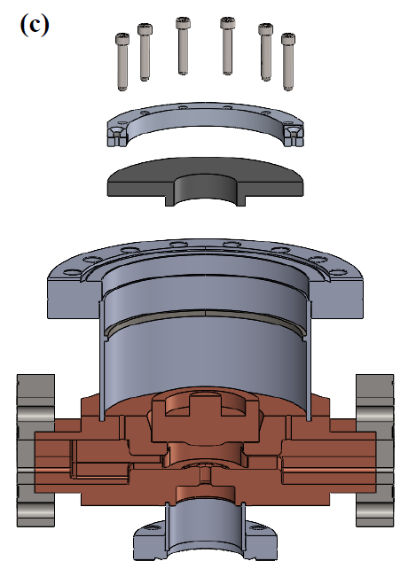
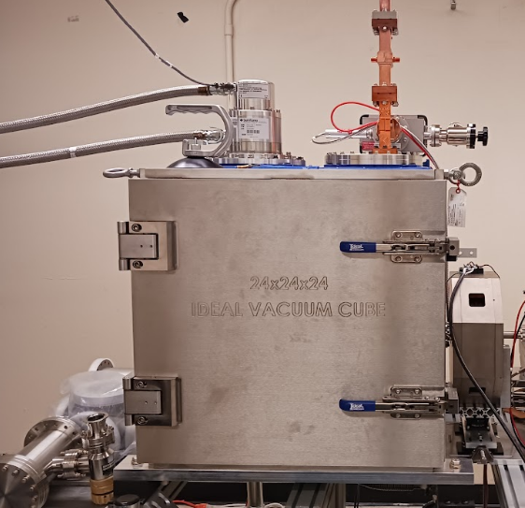
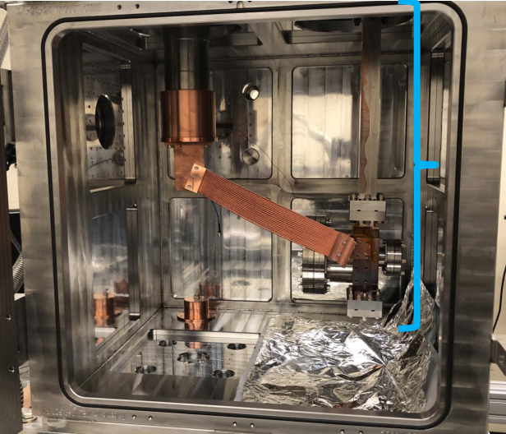
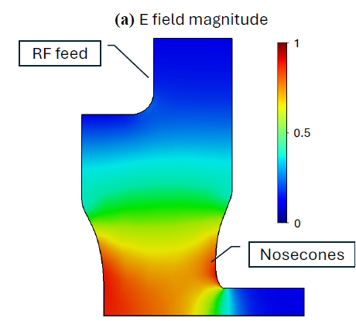
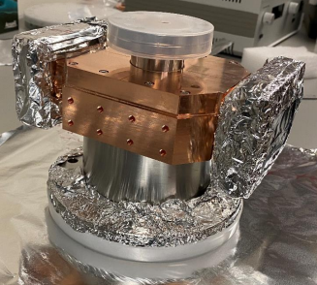
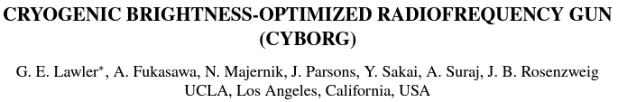
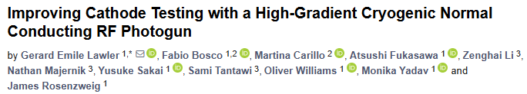
CYBORG: 1st Cryogenic NCRF Gun
CYBORG (CrYogenic Brightness-Optimized Rf Gun) beamline at MOTHRA Lab (UCLA)
Preliminary step with simplified geometry and relaxed peak field
  C-band (5.712 GHz) re-entrant half cavity with demountable back plane (upgradable to insertable cathodes)
  120 MV/m at ~80 K achievable with ~0.8 MW power
  Helium compressor cryo-coolers
CYBORG
Gun cavity
Lawler et al., IPAC 22, 2022
Lawler et al., Instruments, 2024
Notes:
Here is where our beamline at UCLA comes into place. The CYBORG beamline is a test facility intended to gain expertise on cryo-RF guns by working on a simplified version of the photoinjector and find out what’s hard about it
Simplifications:
Geometry → The CYBORG gun consists of a single cell cavity
Relaxed the nominal peak field to 120 MV/m
Start with copper cathode but the backplane is demountable so that the system can be compatible with insertable cathodes in a future phase
Here the RF gun is shown within the cryostat where it is cooled down by Helium cryocoolers

Slide 11
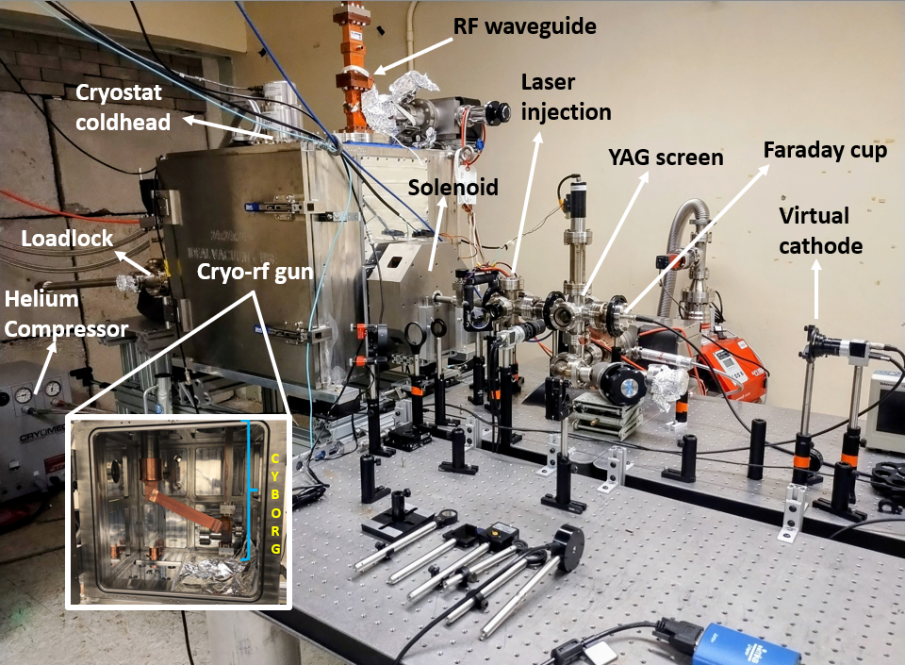
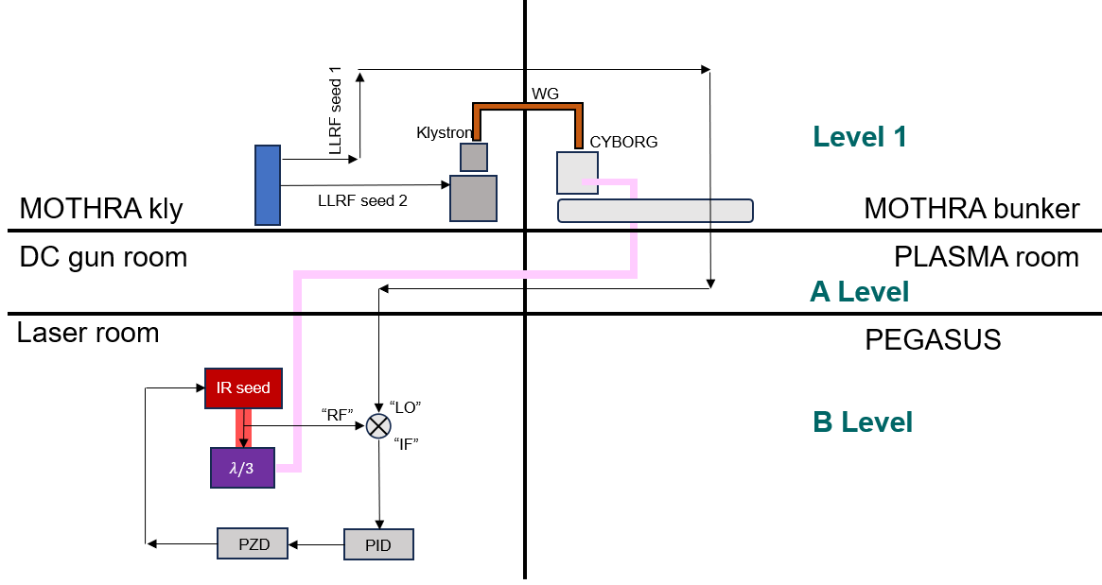
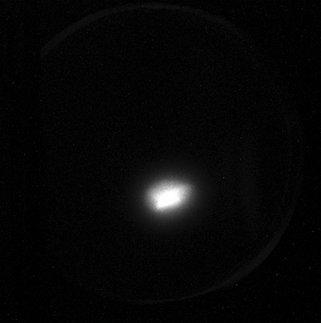
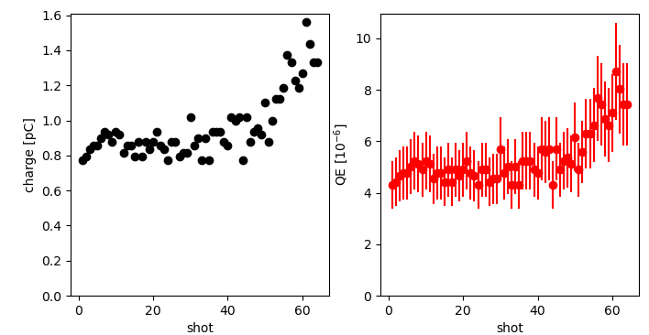
CYBORG Beamline
Slides from Fabio Bosco
e-beam from cryogenic RF-gun
(90 K, ~105 MV/m)
Charge/QE measurements
Notes:
More recent picture of the beamline and a summary of the main achievements over the last year
Optics for the injection of UV laser in the beamline illuminating the photocathode
Setting up all the optics upstream to transport such laser from the source, PEGASUS Lab
We started to make photoelectrons in our beamline at the end of April

Slide 12
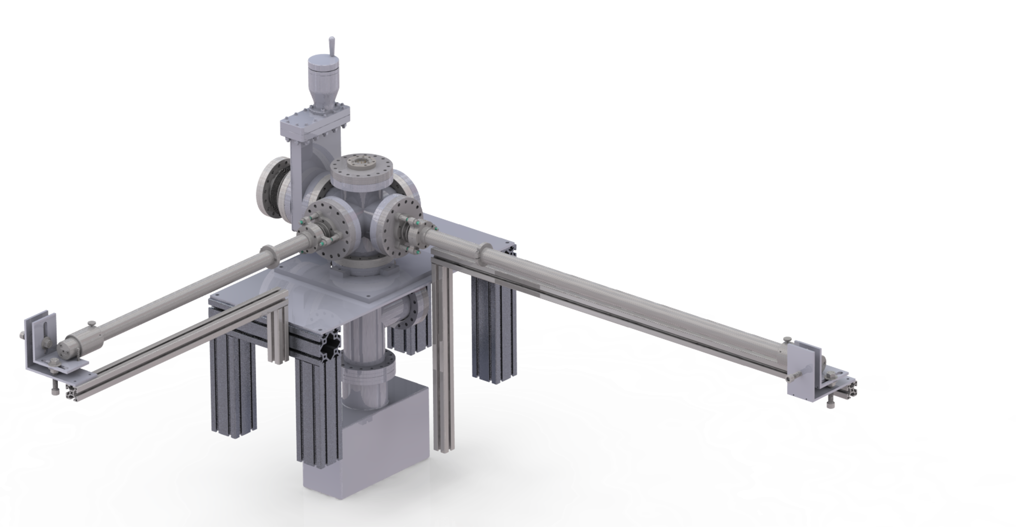
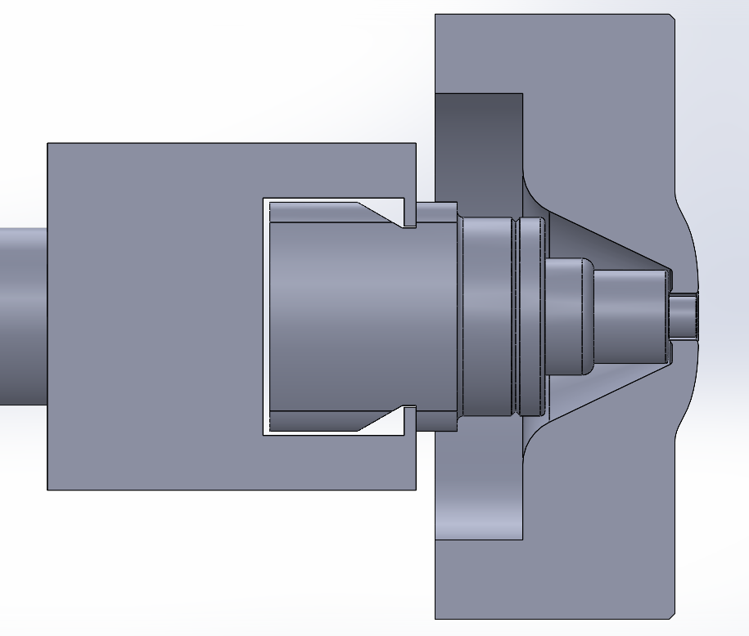
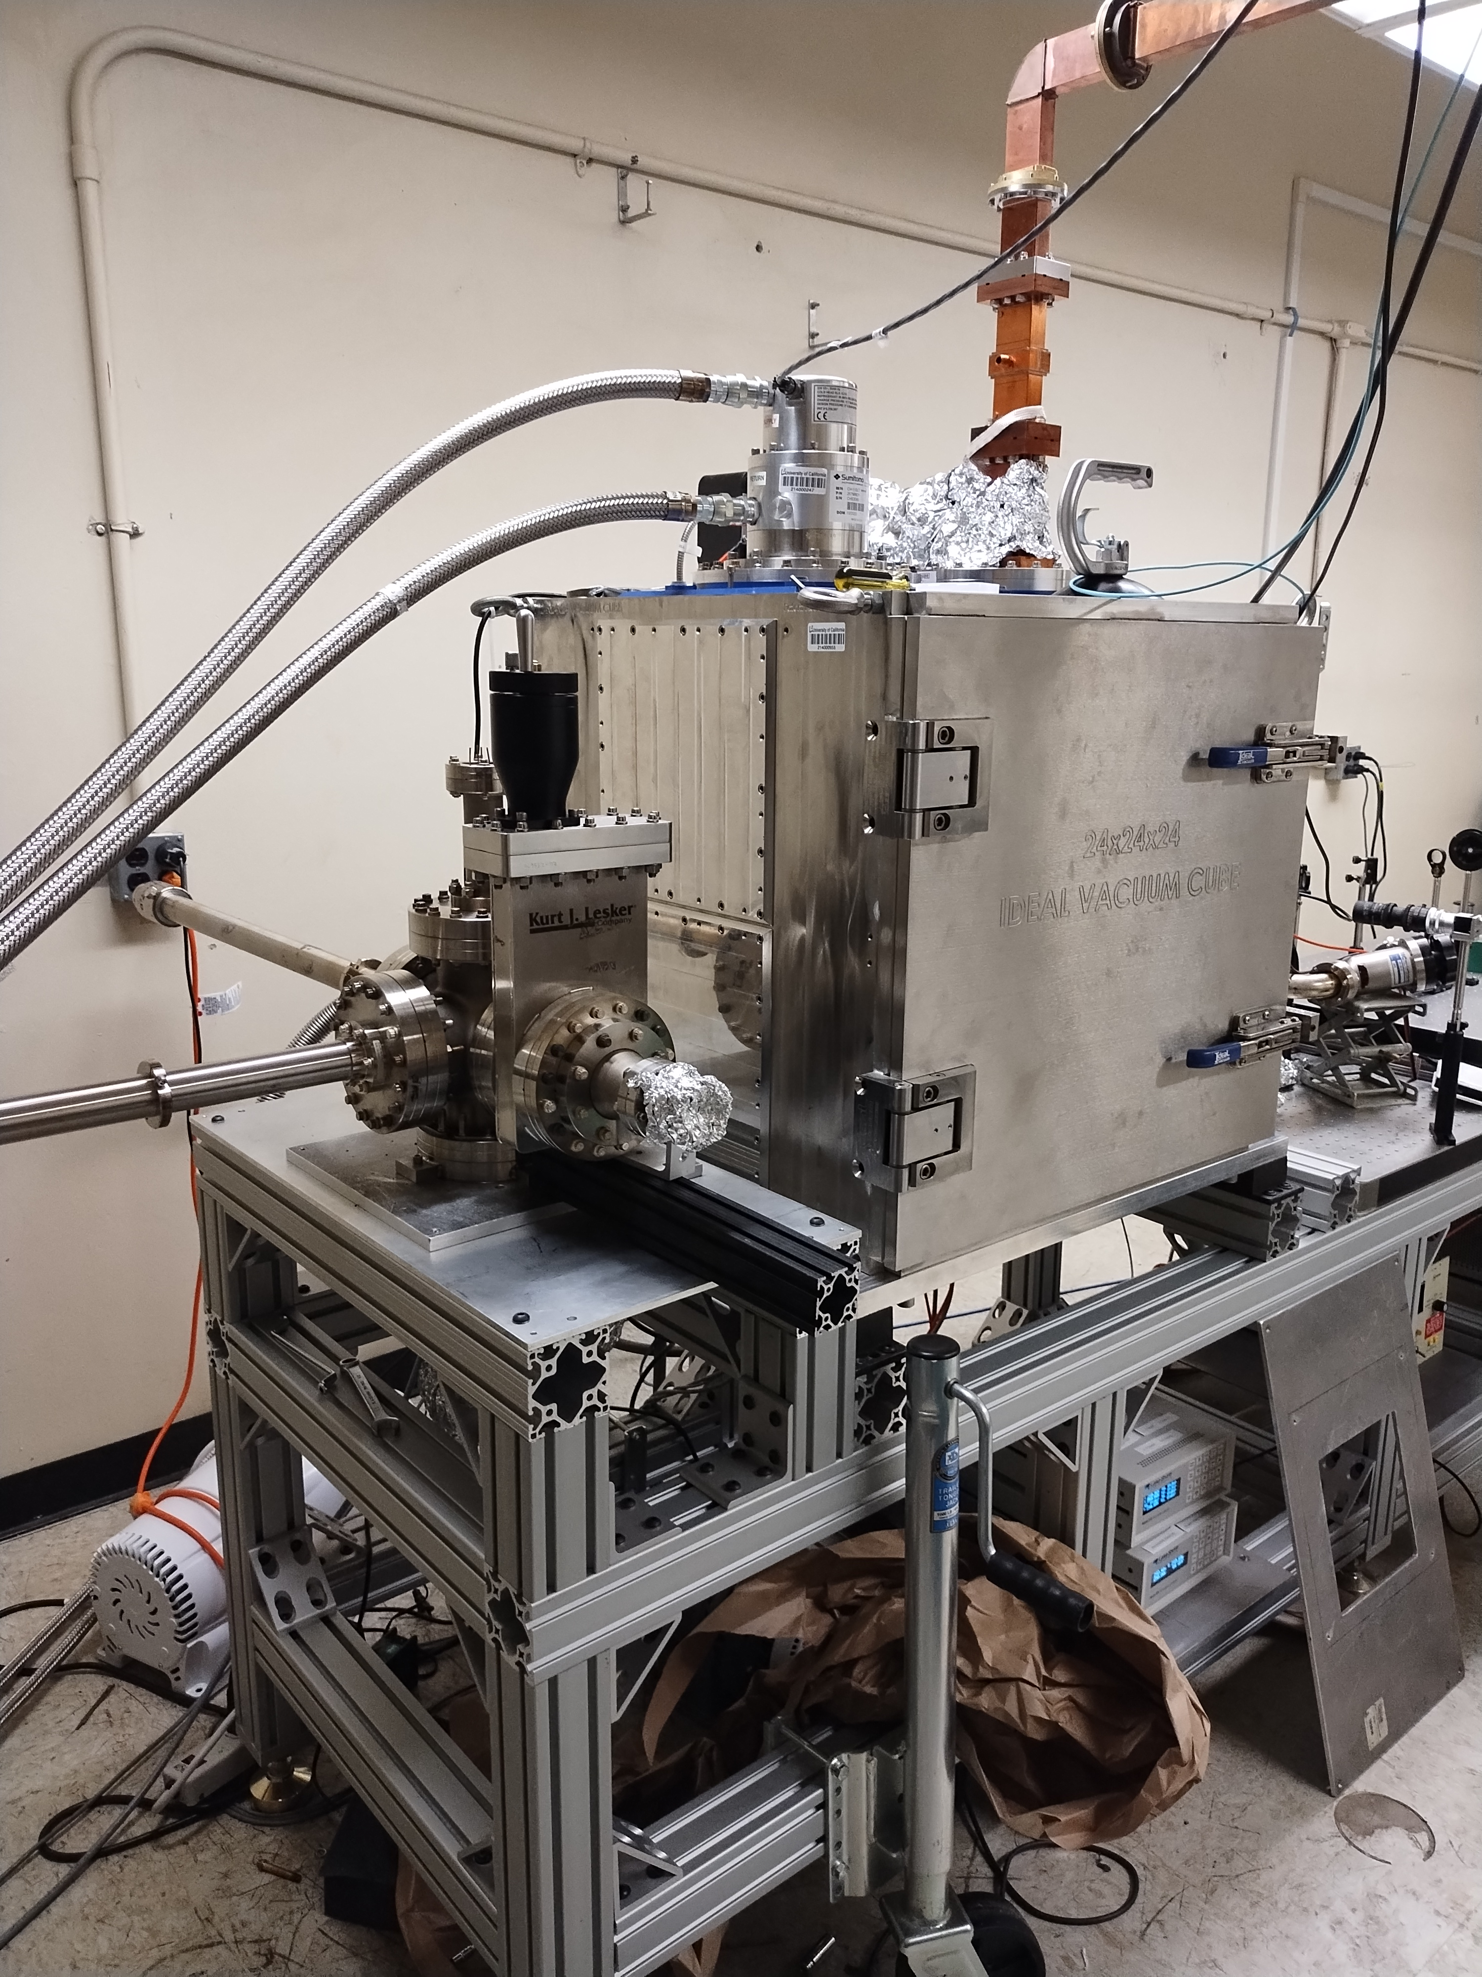
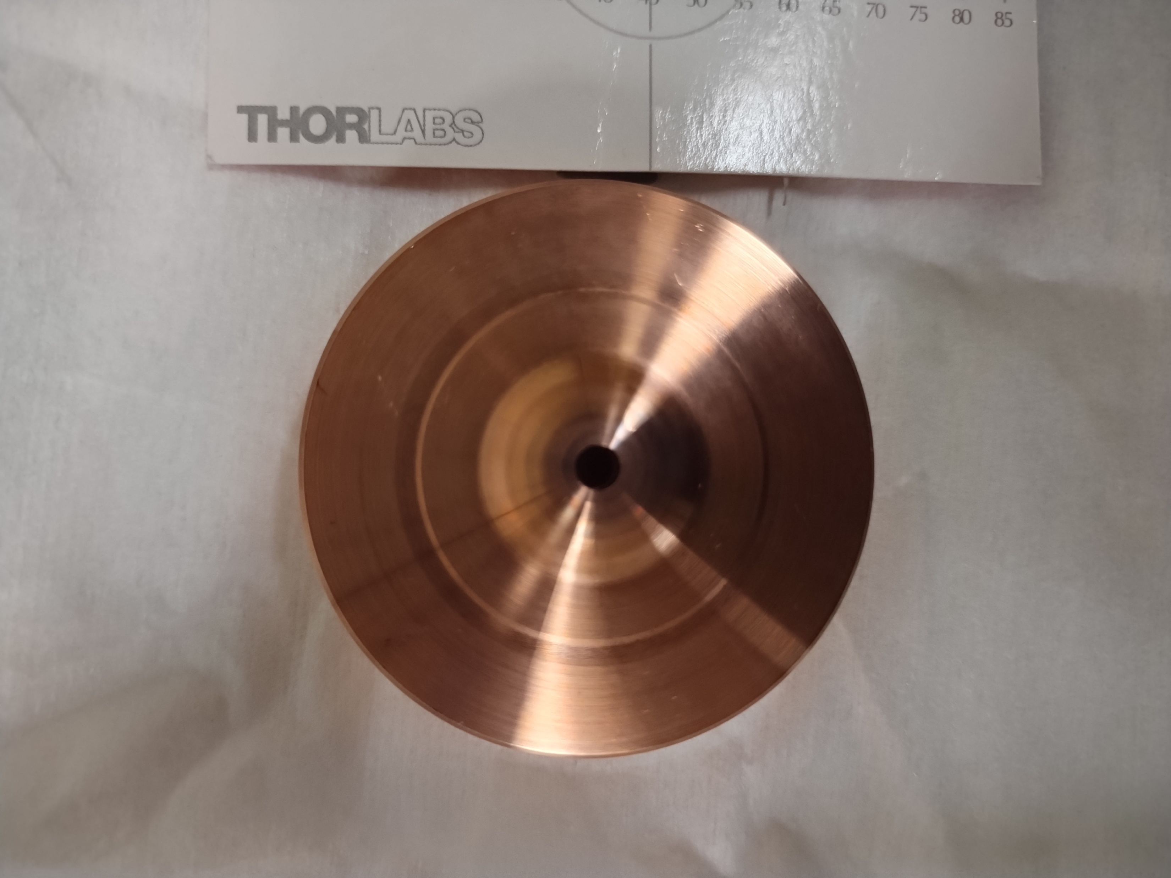
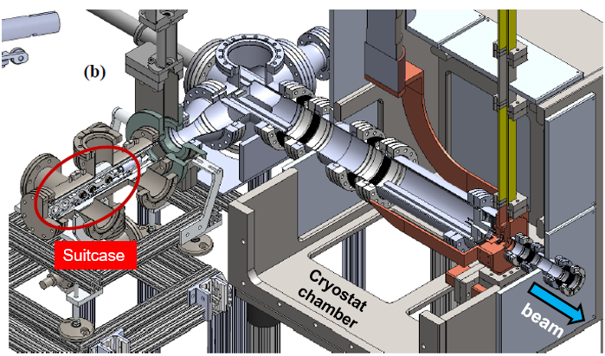
CYBORG Load Lock
Load lock at MOTHRA will enable testing of advanced cathodes (high field, low temperature environment)
Targeting Cs_{x}Te cathode tests in Spring 2026, nanostructured cathodes
INFN cathode plug modified for C-band compatible geometry
Slides from Fabio Bosco
Cathode plug
(a)
(b)
C-holder
(cathode grabber)
RF gun Backplane
Detail: inserted cathode plug and holder (a); machined backplane for insertable cathodes (b)
Load lock CAD model and integration with cryostat
Partially assembled load lock behind cryostat ready for integration
Courtesy of C. Pennington

Slide 13
UCLA/LANL 1.6-Cell Cryogenic Normal Conducting RF-Gun
January-16-2026
Slides from Jesus Jimenez-Zepeda

Slide 14
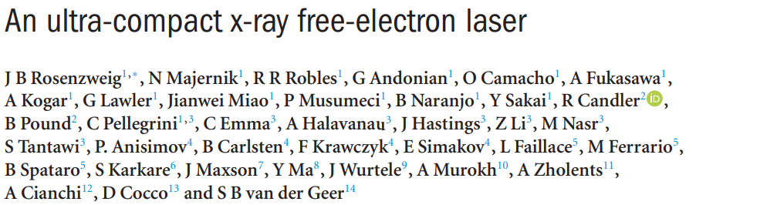
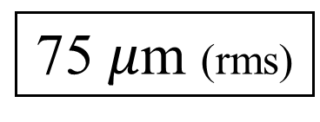
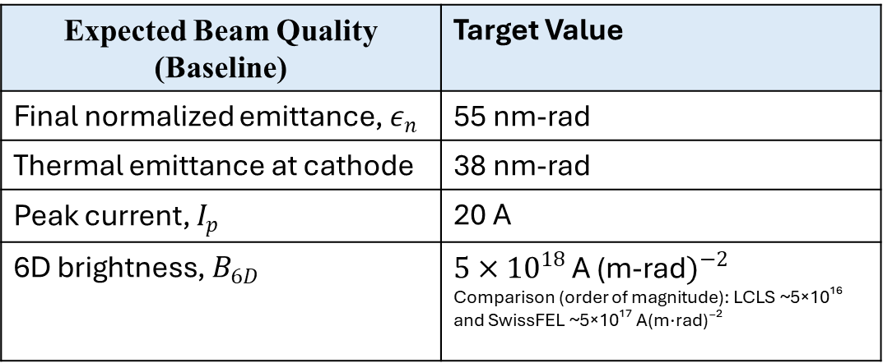
1.6 cell (C-band) cryogenic photoinjector: Design Point for UC-XFEL
Peak axial E-field
Temperature
Charge
Repetition rate
240 MV/m
Below cryogenic copper breakdown
77 K
Liquid Nitrogen
100 pC
per pulse
100 Hz
With 300 ns Rf pulse
Energy post injector
Spot at cathode
Frequency
153 MeV
75 $μ$m (rms)
5.712 GHz
Expected Beam Quality (Baseline) | Target Value
Final normalized emittance, $ε_{n}$ | 55 nm-rad
Thermal emittance at cathode | 38 nm-rad
Peak current, $I_{p}$ | 20 A
6D brightness, $B_{6D}$ | $5×{10}^{18 }$A (m-rad$)^{−2}$ Comparison (order of magnitude): LCLS ~5×10¹⁶ and SwissFEL ~5×10¹⁷ A(m·rad)⁻²
J B Rosenzweig et al 2020 New J. Phys. 22 093067

Slide 15
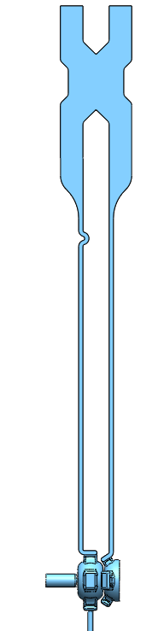





RF Coupling & Current Status
E-Hybrid
4
1
Equally split power and 90° phase difference between port 2 and 3
S-waveguide
To obtain 180° phase difference on-axis between cavities
3
2
Cryostat:
Power splitting outside
1.6 cell cavities ($π$-mode)
Re-entrant cell shape optimize for:
High shunt impedance
Minimize RF losses
Minimize peak surface fields
On-axis |E-field| (to be balance)

Slide 16




Short-pulse powered structure
X-band photogun (Xgun)—Slides from Chen Gongxiaohui
Xgun design concept
X-band structure powered by the short 9 ns rf pulse.
Need quick fill time ($t_{fill}={2Q_{L}}/ω$) → small $Q_{L}$ (a few hundreds) and large coupling (as $Q_{L}={Q_{0}}/{1+β}$).
Want high shunt impedance → small iris (lower bound limited by the laser injection angle) → however lead to weak coupling with small iris
Thus, add magnetic coupling slots, which increases the coupling and in parallel enlarges the mode separation
For Xgun: 1.5 cell | $π$-mode | strongly over-coupled SW structure | copper cathode
X-band photogun
(Xgun)
Parameter | Value
$f$ ($π$-mode) | 11.7 GHz
$Q_{load}$ | 182
$Q_{ext}$ | 191
Coupling $β$ | 22.3
Mode $∆f$ | >500 MHz
Short rf pulse

Slide 17



Selected highlights
Xgun beamline in 2025
¹ power extraction & transfer structure
² beam position monitor
³ transverse deflecting cavity
Spectrometer
dipole
Drive bunch train
($≥$240 nC)
YAG &
Pepper pot
TDC³
PETS¹
BPM²
ICT
YAG &
Multi-slit plates
X-band photogun
Quads
Xgun main beam
(~100 pC)
YAG
Quads
main solenoid
(YEAR 2020) Cold test and high power rf conditioning
(YEAR 2021) High gradient (388 MV/m) verified by beam energy measurement ^{[1]}
(YEAR 2023) Fundamental photoemission studies at different gradients (60 to 320 MV/m) ^{[2]}
(YEAR 2024-2025) Longitudinal phase space characterization and slice emittance measurement
ε measured w/ multi-slit (2025 data)
^{[1]} W. H. Tan, et al. 10.1103/PhysRevAccelBeams.25.083402 (2022)
^{[2]} G. Chen, et al. https://doi.org/10.1016/j.nima.2025.170205 (2025)

Slide 18


















New Cathode Cavity Design in $TM_{02}$ mode
Islam Shalaby, Sami Tantawi
Brazing ($TM_{01}$)
Conventional RF photoinjector with a fully-brazed cathode
Integrating semi-conductor cathodes under UHV ($TM_{02}$)
Fully-detached cathode ($TM_{02}$)
Brazed cathode
(full contact)
E-field
B-field
High RF field gradient (> 120 MV/m)
Cathode cavity
$TM_{01}$ mode
Accelerating cavities
$TM_{01}$ mode
Disposable photoinjector ($TM_{01}$)
Disposable cathode plug ($TM_{02}$)
New RF photoinjector with a detachable cathode
Micro-positioner
(soft tuning)
Cathode cavity
$TM_{02}$ mode
Accelerating cavities
$TM_{01}$ mode
On-axis positioning of the standalone cathode plug provides a soft-tuning knob for critical coupling to RF source frequency of 9.3 GHz ($TM_{02}$)
E-field
$$r_{0}$$
B-field
Mechanical gap (no contact) at B-field null { $B\left(r_{0}=18.25 mm\right)=0$ }

Slide 19
New directions in understanding cathodes in high fields

Slide 20

Note from JM:
Also see talks from Renkai Li

Slide 21


Slide 22


Slide 23


Slide 24


Slide 25

UCLA Pegasus Results
David Garcia, et al.,
P3 Workshop 2025

Slide 26


Slide 27


Slide 28



Slide 29
Wrap-up
There has been huge subsystem progress in NCRF photoinjectors and cathodes recently.
Cathode progress would need another talk.
We are near the stage of "full scale" beam demonstrations with new class of guns:
  By full scale, I mean cathode->gun->laser preparation-> beam dynamics correction->emittance compensation-> post accel/application.
Application space has not been a focus of this talk. It spans nearly all aspects of DOE electron accelerator infrastructure.
We need continued general R+D support to push this technology over the next hill to the application point.

