Slide 1
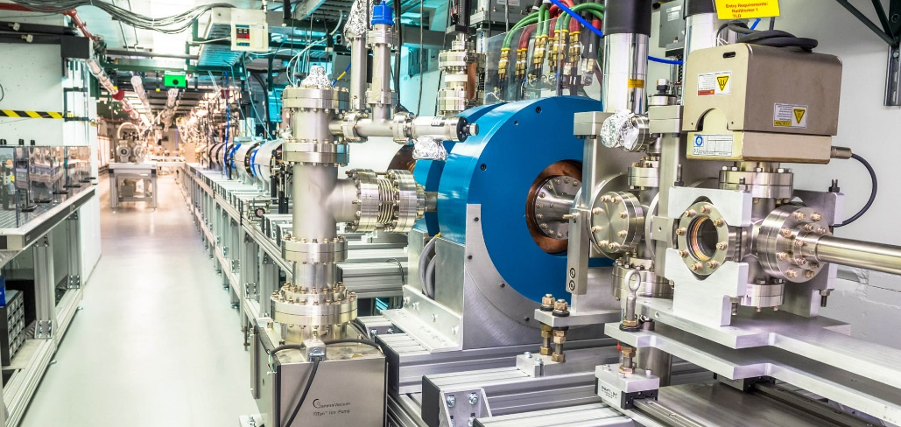
GARD RF Roadmap Update – NCRF Meeting closeout
January 20, 2026
NCRF subgroup leaders
John Power
Evgenya Simakov
Argonne National Laboratory
<jp@anl.gov>
Los Alamos National Laboratory
<smirnova@lanl.gov>

Slide 2
summary of NCRF subtopic meeting
DOE GARD RF Roadmap Update effort
Thanks!
To all the speakers and all the participants.
The RF Roadmap organizers: Emilio Nanni & Sam Posen
Special thanks to Evgenya Simakov my subgroup organizer

Slide 3
summary of NCRF subtopic meeting
DOE GARD RF Roadmap Update effort
Today’s Purpose: Collecting community input for the NCRF subtopic (we are not setting conclusions or priorities today
The first of 4 community input meetings
SUBTOPIC | SUBTOPIC ORGANIZERS | DATE
NCRF | John Power and Evgenya Simakov | Jan. 20th, 2026
SRF | Matthias Liepe and Anne-Marie Valente | Jan. 29th, 2026
RF Sources | Galen Aymar, Alireza Nassiri, and John Moss | Feb. 11th, 2026
LLRF | Philip Varghese and Alex Ratti | TBD
In-Person: RF Roadmap Location: TBD (SLAC or Fermilab) | Sam Posen and Emilio Nanni | March 3rd and 4th, 2026

Slide 4
NEXT STEPS IN THE RF ROADMAP PROCESS
DOE GARD RF Roadmap Update effort
NCRF after Today
We, the NCRF organizers (Jenya and John) will prepare a summary of today’s discussion to be presented in March.
The summary will:
Reflect community input as presented
Identify open questions and areas needing further discussion
Avoid ranking or prioritization
The other subgroups of RF Roadmap
The remaining RF subtopic meeting (SRF, RF Sources, LLRF) will take place
Each subgroup will prepare a comparable summary
March In-Person RF Roadmap Meeting
Subgroup summaries will be presented
Community discussion will focus on:
Identifying high-impact R&D opportunities
Assessing feasibility, timelines, and resource needs
Ensuring coherence across RF technology areas
Continued Community Input
Additional comments, corrections, or missing topics are welcome following today’s meeting

Slide 5
Thanks for coming!

