Slide 1
  An Overview of the Simulation Tools and Needs for Simulating High Gradient NCRF Structures
Zenghai Li
GARD RF Roadmap Update – NCRF Meeting
January 20, 2026

Slide 2
Advancement of Numerical Modeling
Has significantly advanced research and development of modern accelerators and light sources
Advances with high fidelity capabilities provided
powerful tools for the design and optimization of RF components
comprehensive tools for analyzing system performances under realistic operating conditions and tolerances
achieving virtual prototyping of accelerator structure and accelerator systems
  high fidelity geometry representation
  higher accuracy (p and h refinement)
  fast speed (high performance computing)

Slide 3
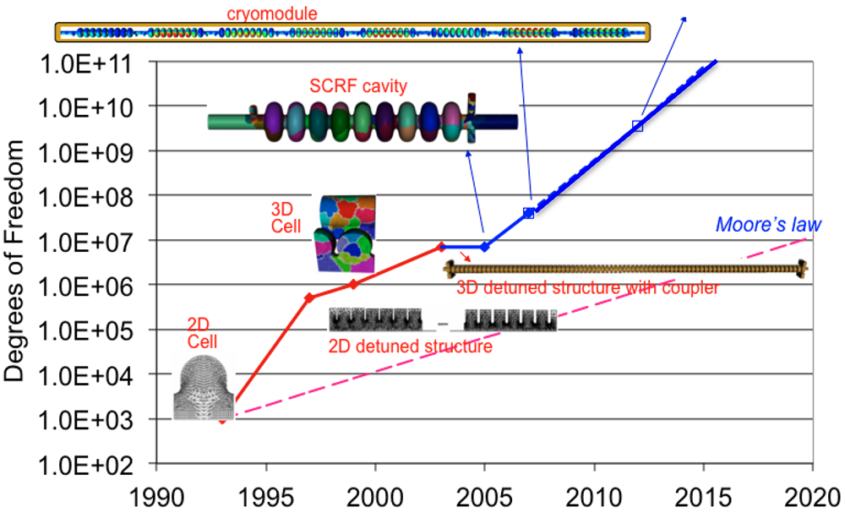
Evolution of Capabilities
Multi-physics
Large RF system
Design
Numerical prototyping

Slide 4
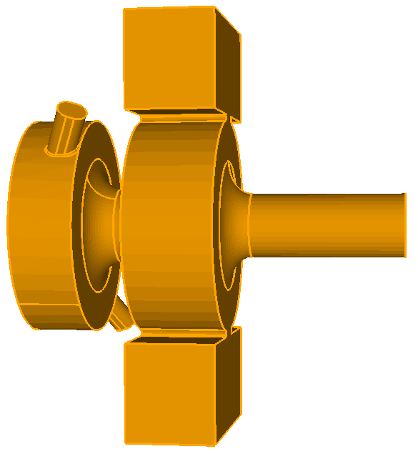
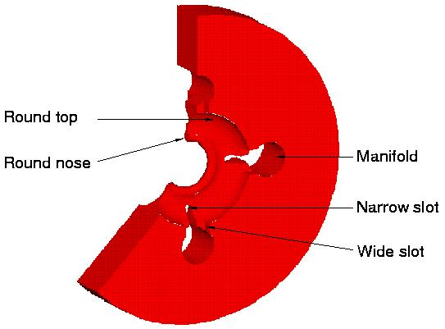
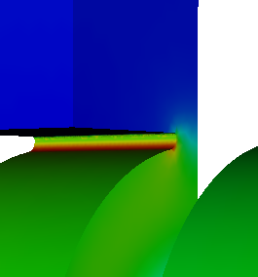
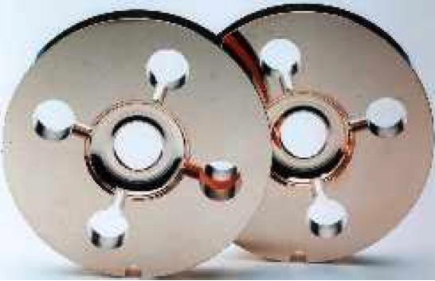
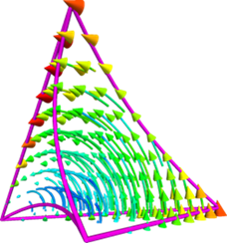
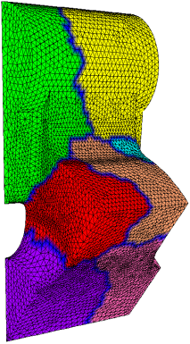
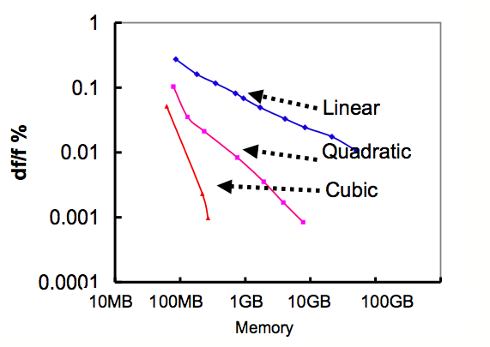
Virtual Prototyping – Modeling Accurate Within Machining Tolerance
Geometry Fidelity
High Field Accuracy
Possible through advanced algorithm and parallel computing
Quad Δ(γβr)/mm
(Omega3P 1998)
– parallel modeling for 3D
NLC RDDS Accelerator structure
1/8 RDDS finite element mesh
Calculated on NERSC supercomputer
~ 1 million DOF
Accuracy in frequency: <10⁻⁴
RF Gun:
minimized dipole and quadrupole fields to meet beam requirement
High fidelity geometry
High order elements
Curved element
Higher order base function
HPC computing
Produce accurate dimension for engineering design

Slide 5
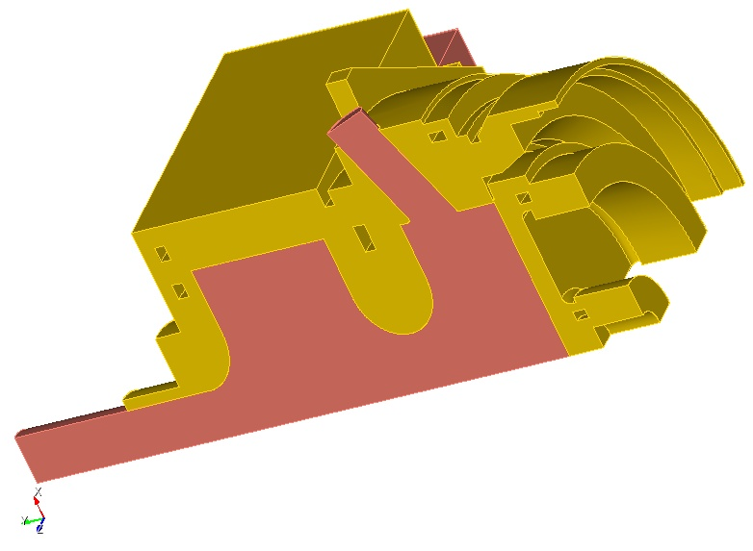
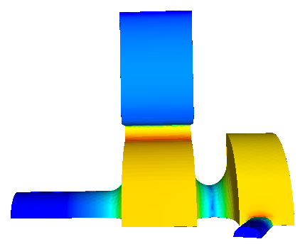
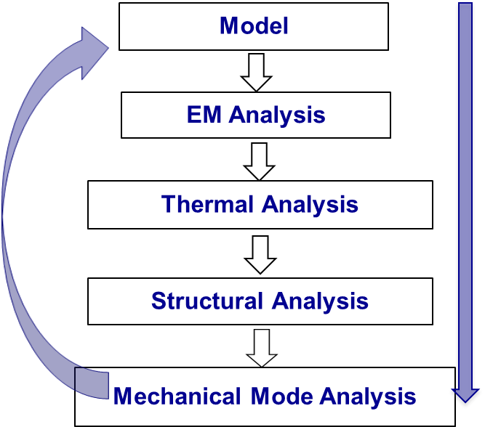
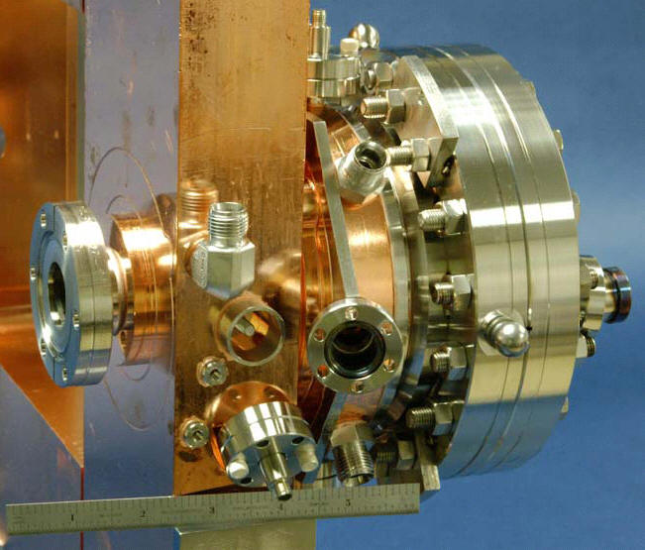
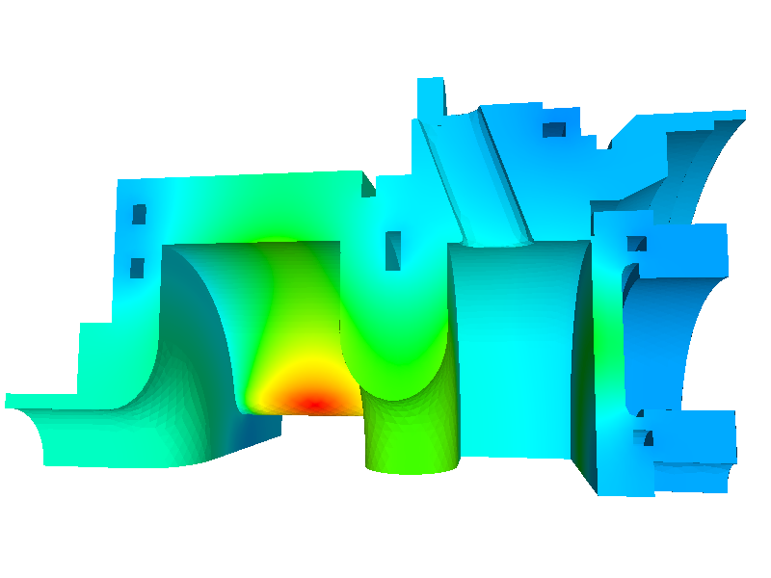
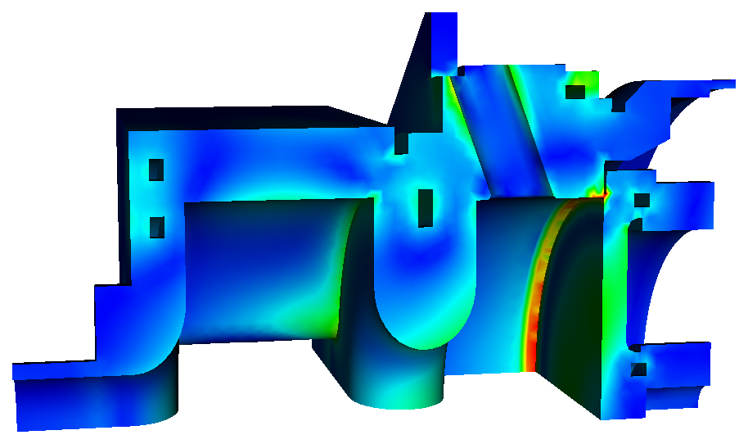
Multi-physics Simulation – EM, Thermal, Mechanical
CAD model
Electromagnetics
Metal
Vacuum
Fabrication
Mechanical
Thermal
Enable fast, optimal design of component

Slide 6
State of Art Modeling Tools and Capabilities

Slide 7
Tools – an incomplete list
Commercial codes:
Focus on broad applications
Multiphysics
Variety of functionalities
Parallel (desktop and clusters)
Not easily accessible to super computers
Some obsolete
  CST MWS
  HFSS
  GdfidL
  COMSOL
  MAGIC (no longer supported) …
  Echo, ABCI, MultiPack
  Superfish
  SLANS/CLANS…
  Fast Optimization (2d, Sami)
  ACE3P
  …
Mixed user experience
Solution reliability
Speed
etc
ACE3P:
Focus on accelerator applications
Multiphysics
New functionalities being added
Accessible to super computers (e.g. NERSC)
Readily adaptable to new HPC architectures
Open to community new capability request

Slide 8
Capabilities - (ACE3P Example)
Frequency domain (Omega3P)
Time domain (T3P)
Particle tracking (Track3P)
  Real eigenmodes in lossless or periodic cavities
  Complex eigenmodes in lossy or externally loaded cavities
  Linear, quadratic and nonlinear eigensolvers
  Port and PML boundary conditions
  Transient and wakefield from source excitation
  Absorbing and PML, impedance boundary conditions
  Particle tracking code in external rf and static fields
  Multipacting
  Dark current with external B field
Time domain （Pic3P）
Multi physics (TEM3P)
  Self consistent particle-in-cell (PIC) modeling of beam-cavity interactions in space-charge dominated devices
  User-specified particle emission model
  Integrated EM, thermal and mechanical effects
  Mechanical eigensolver and harmonic solver
  Transient thermal analysis
Frequency domain (S3P)
  S-parameters of rf components and open structures
Optimization – 2D and 3D
Integration of RF and Beam
Beam-material interaction – Radiation physics
Parallel implementation desired

Slide 9
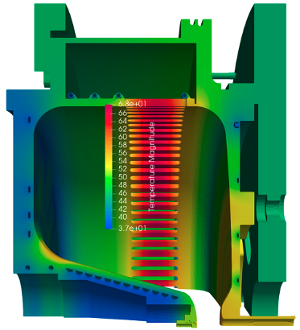

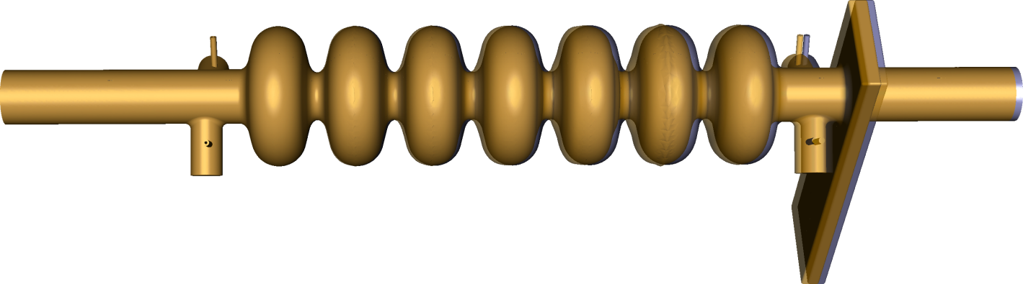
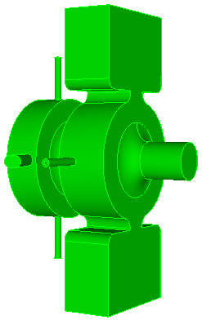
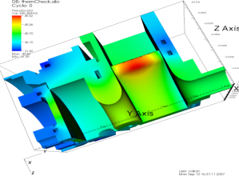
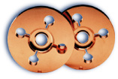
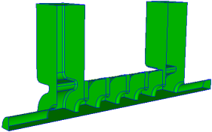
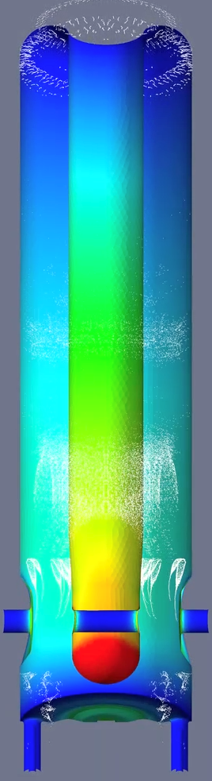
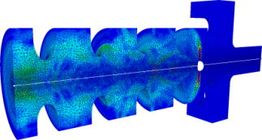

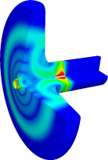
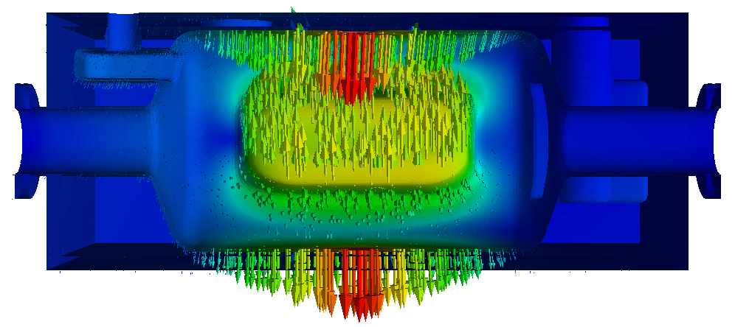

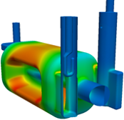
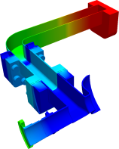
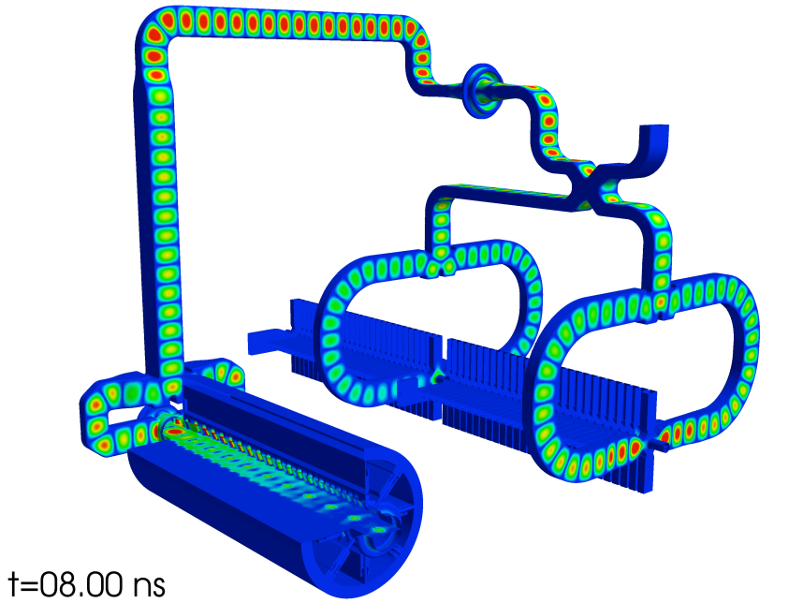
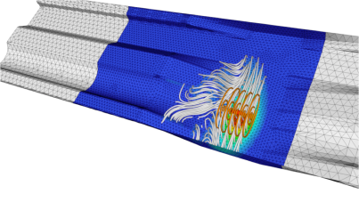
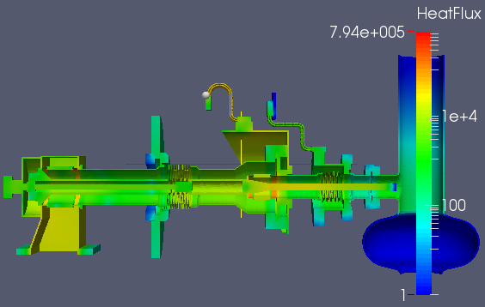

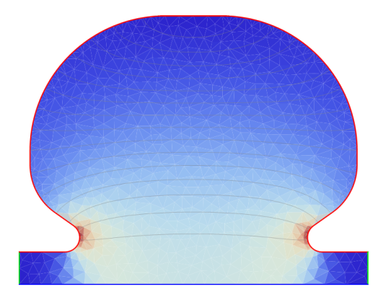
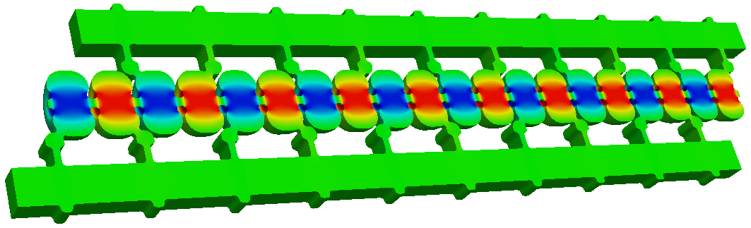
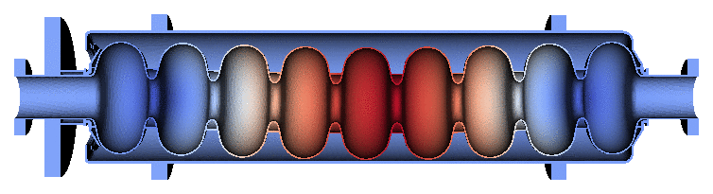
Computational Capabilities Making Significant Impacts in Accelerator Technologies
LCLS
LCLS2
ILC/LCLS-II
CEBAF
NLC
ERL
LHC
CLIC
FRIB
LCLS-II
Distributed Coupling
PIP-II
Design – optimization, novel structure, system validation
Performance analysis – multi-physics, dark current, multipacting

Slide 10
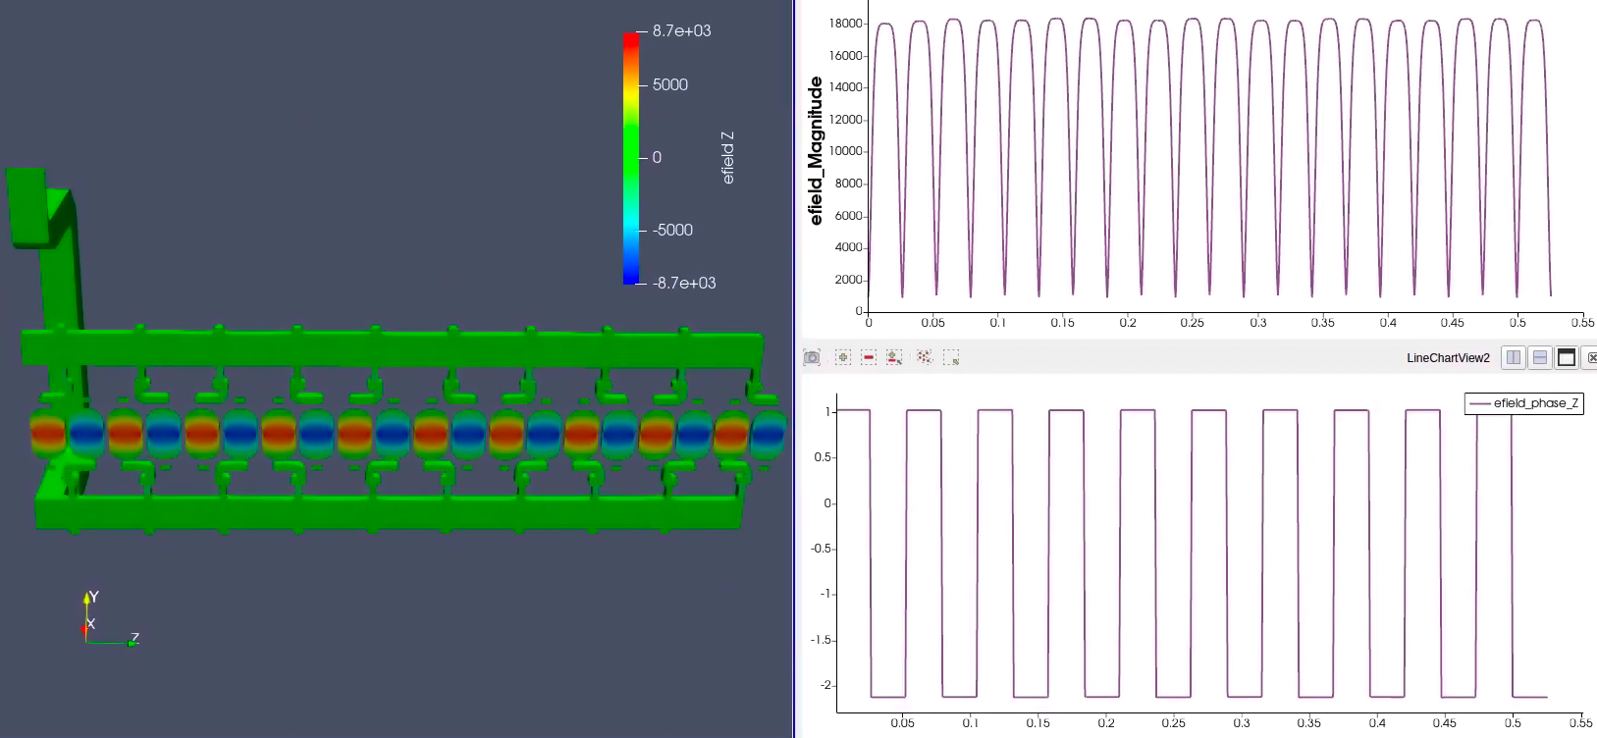
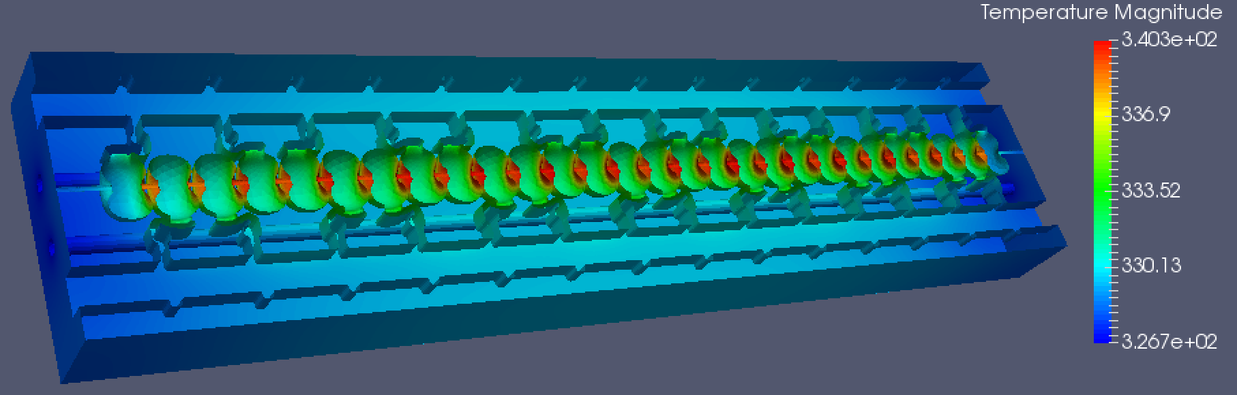
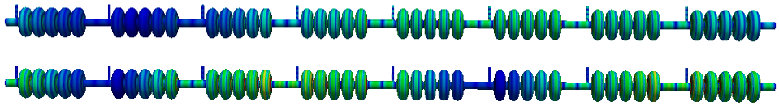
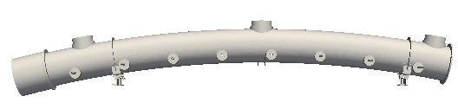
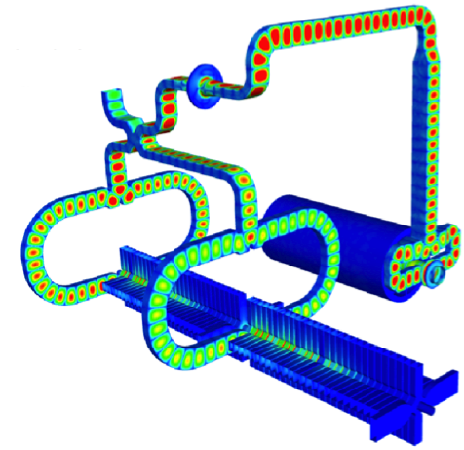
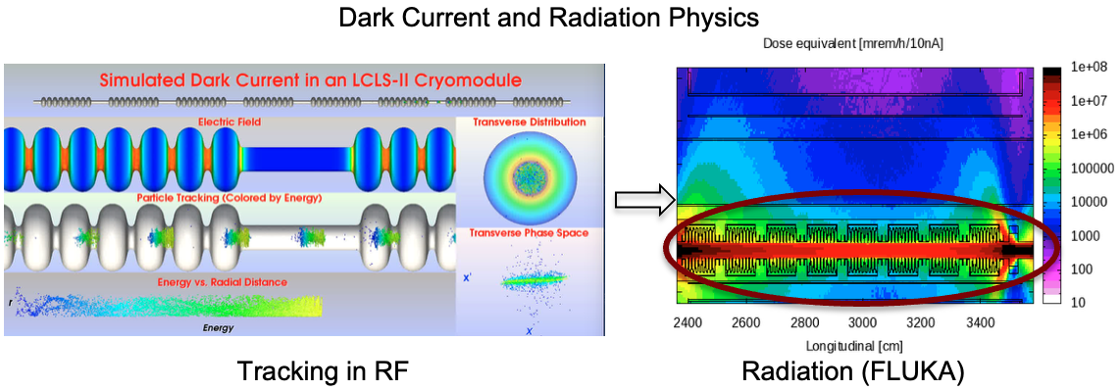
Large Scale System Analysis – Through HP Computing
RF
Thermal
Distribute coupling structure
Multi-physics
HOM of PIP-II Cryomodule
Tunnel Thermal effect
Coupled RF systems
Increased scalability enhanced by improved solver and upgrade of HP computing facilities
Integrated multi-physics

Slide 11
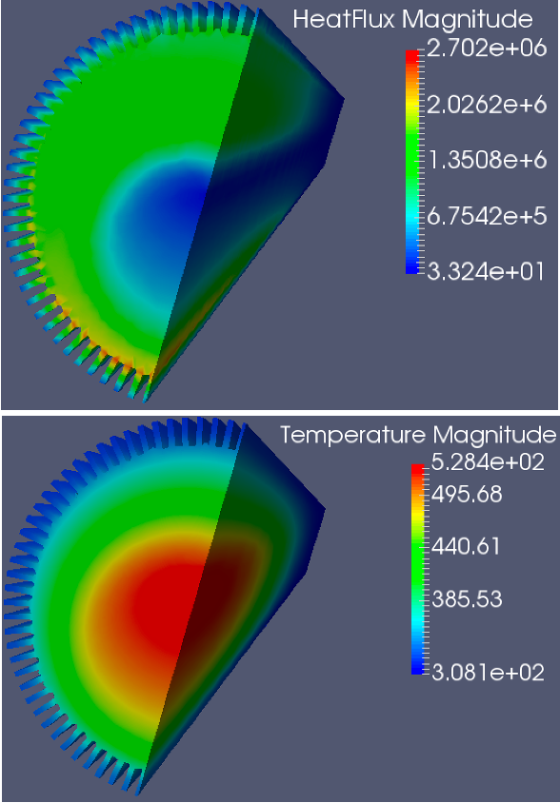
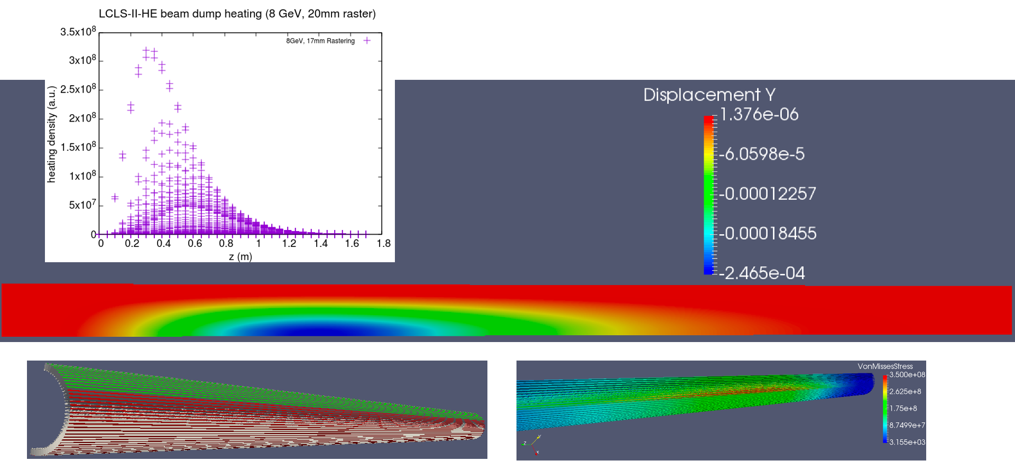
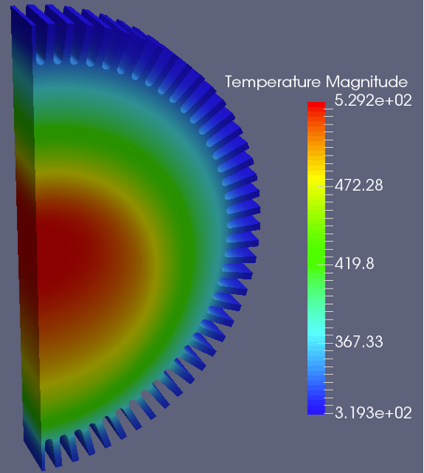
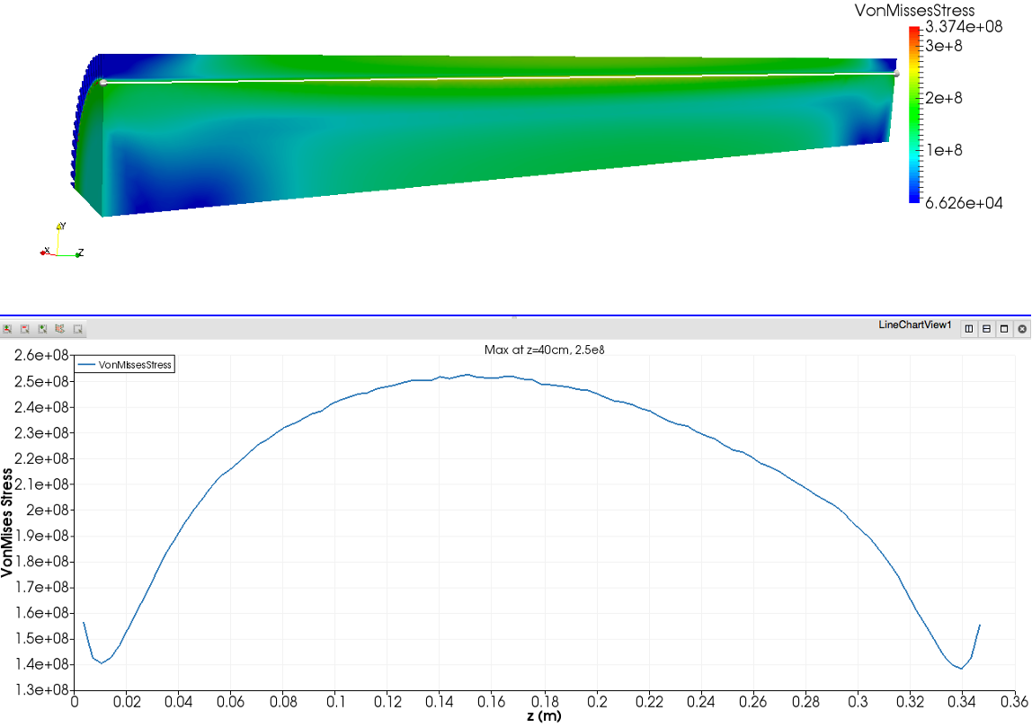
Large Scale Thermal Analysis - Beam Dump
Temperature distribution
slice modeling suitable for desktop tools
T and stress (with beam off center)
Stress distribution
Large size with small features, local stress modeling requires accurate mesh
Desktop tools can only model a slice
ACE3P thermal calculation
Parallel modeling capable to model the whole beam damp with details

Slide 12
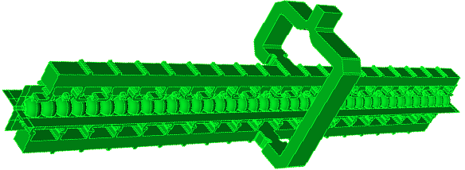
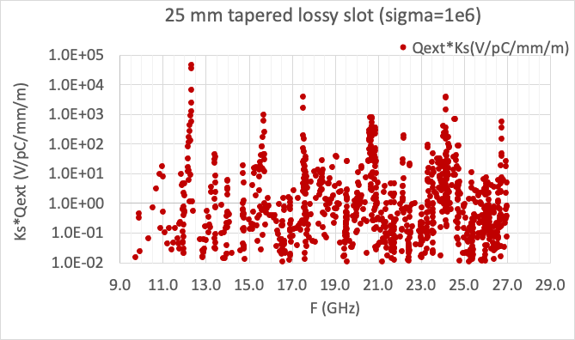

HOM Wakefield Damping of Distributed Coupling Structure
– Full system, Large Scale
C3 damped structure
Reduced
model for
HOM analysis
Modes coupled through out, full length geometry needed
Large geometry with small features

Slide 13
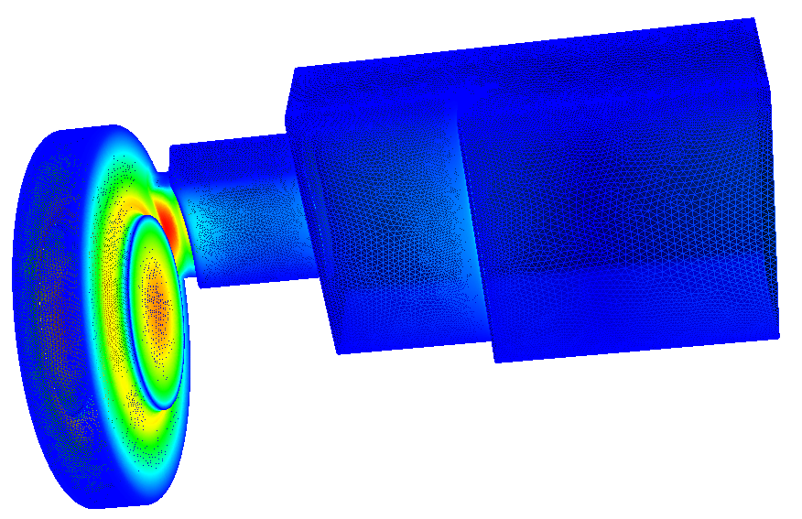
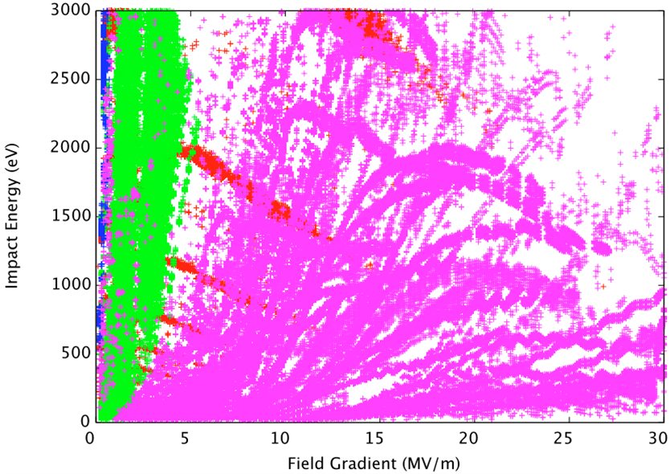
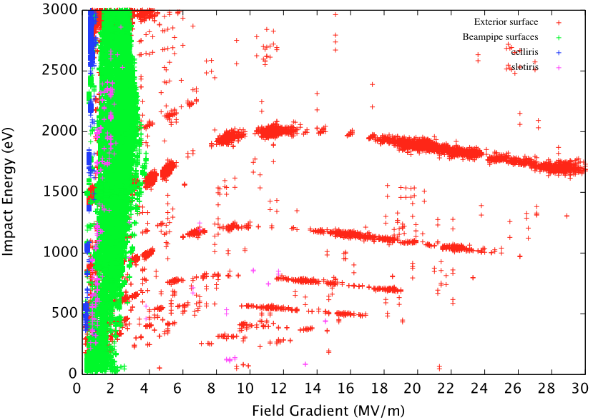
Multipacting and DC – Cavity Under Strong Magnetic Field
Field level scan: 0.1MV/m – 30MV/m, interval 0.1MV/m
Initial Particles distributed on all exterior surface
Each field level ran 50 RF cycles
B field
Original Design
New Design
Window
Disk rounding
Coupling iris
Other
B and RF field level scan, large emission area

Slide 14
Can, get around with tools available
almost
BUT
More Enhanced Computing Can Make Even Greater Impact

Slide 15
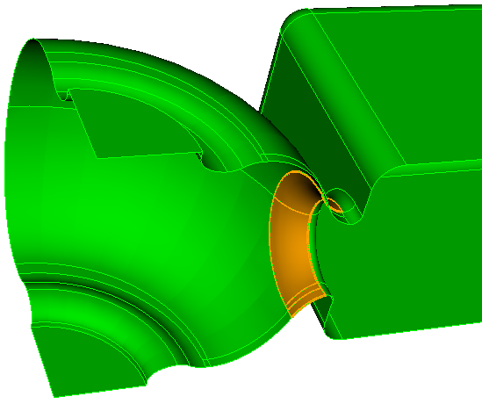
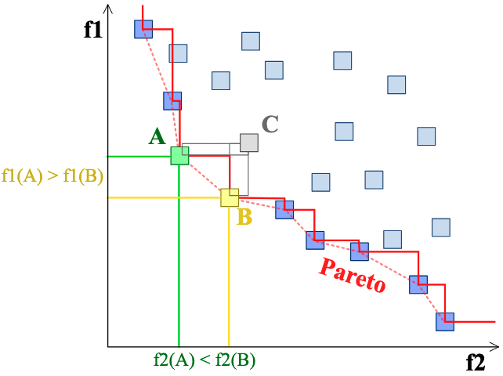

Fast Solver Required
Optimization
  Multi-parameter, multi-objective
  Hundreds or thousands solves required
Parallel computing
AI enhanced optimization (Lume-ACE3P)
Effective user interface
Reliable 3D model manipulation
dcenter
Pareto front In multi-objective optimization
Example: single cav with coupler
  Peak fields
  Coupling
  Multipole

Slide 16
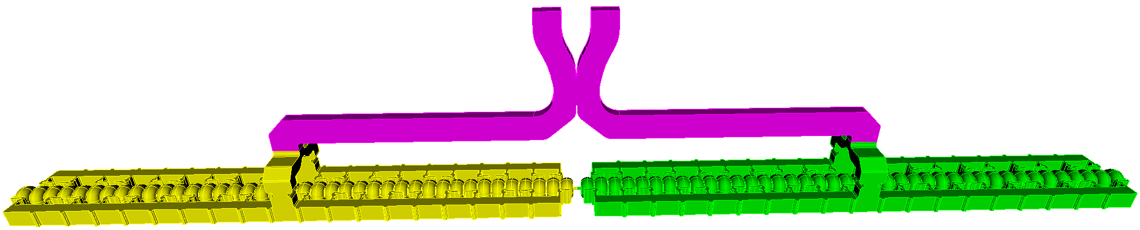


Enhanced Scalability Required for Multi-physics at Large Scale
Current capability - simulate a portion of the structure with desired accuracy
Large system
High fidelity and accuracy
Imperfection analysis
Complex and multi-scale geometry
System validation
Accuracy and impefection
HOM of PIP-II Cryomodule
LCLS-II (BES) RF gun multi-physics
High power structure (Accelerator Stewardship, Shumail)
Full system wakefield
  GPU, CPU capability
  Improved scalable solvers

Slide 17



New Physics Models and New Solvers Needed
High gradient issues
  Surface physics (breakdown) and modeling
  Multi-scale geometry
  Multi-scale computing domain
PIC simulation – high fidelity, reliable
  Injector and RF source modeling
  Speed
  Accuracy – formulation and noise control
  (Large signal modeling for power source)
New materials
  RF components with non-linear materials
  New RF applications (e.g. QIS)

Slide 18




Model New Physics and Applications - Non-linear materials
Simulation Tool Development
- to Support R&D in Quantum Information Science (QIS)
  - simulate transient response of an optical device to external photon pulses
Enhanced capabilities can be integrated with quantum simulation tools in a QIS subsystem
[Mohamed Othman]
Researcher Accessible to Source Code Essential

Slide 19


Workflow for Seamless Model Translation Desired
RF model – Mechanical mode
  Straight forward
Mechanical design model to RF vacuum model
  to check consistence of mechanical design
  additional features, model cleaning required
  sometimes requires re-build part of the model
  time consuming
Machined parts to RF vacuum model
  validate parts before proceeding to brazing/assembly
  re-construct solid model from CMM scan measurement
Re-construct RF model from mechanical model
Model manipulation, model heeling, model correction (AI enhanced)

Slide 20
Advance RF Technology Through HP Computing
    Virtual prototyping - cost saving, performance improvement
Implement capabilities to address community R&D needs
Test new materials for advanced R&D and application
Test new physics models to advance understanding and mitigate high field related challenges
Scale to state-of-art high performance computers, e.g. NERSC e.t.c, for reliable solutions
Optimize for CPU+GPU architecture for speed and problem size
Incorporate AI enhanced capabilities
A Comprehensive Community HP Modeling Tool is Essential

Slide 21
Acknowledgements
Lixin Ge
Cho Ng
Chris Nantista
Mohamed Othman
Muhammad Shumail
Liling Xiao
Valery Dogshev

