Slide 1
Geometry Optimization and Distributed Coupling for High Gradient NCRF Structures
Sami Tantawi

Slide 2
Outline
Physics of breakdown
in high gradient normal conducting structures
The distributed-coupling technology
New geometric optimization capabilities
Cryogenic-copper structures
New accelerating frontiers for high-gradient operation
Next-Generation Distributed-Coupling Linacs
Making full benefit of the optimization capability of this novel technology

Slide 3
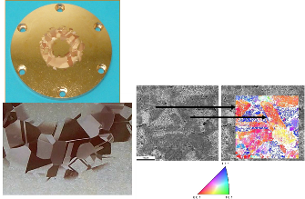
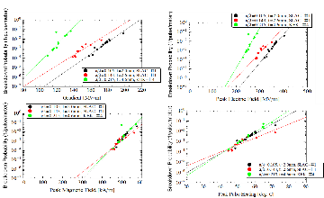
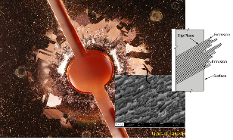
New Discovery of Magnetic Fields Role in Breakdown Triggered a Change in Research Direction
Geometrical Studies: Standing-wave structures with different iris diameters and shapes a/λ=0.215, a/λ=0.143, and a/λ=0.105
Pulsed heating and crystal orientation: Annealed Copper with large grain shows crystal pattern because damage is different for each crystal orientation
New research initiated
Geometry optimizations for accelerator structures based on reduction of the magnetic surface field
Studies of surface magnetic fields and materials
Basic Physics studies with mixed E&H dual-mode cavities
Low temperature experiments with very high gradient structures
Applications of new information
A new methodology for designing Photonic Band Gap (PBG) structures
New understanding of MUON cooling cavity results in operation under strong magnetic fields
Improved design of high peak power rf sources
3
Valery Dolgashev et al., “Geometric dependence of radio-frequency breakdown in normal conducting accelerating structures,” Applied Physics Letters, Volume 97, Issue 17, pp 171501 - 171501-3, October 2010.
Alex Cahill et al., "High gradient experiments with X-band cryogenic copper accelerating cavities" Phys. Rev. Accel. Beams 21, 102002 – Published 23 October 2018.
Evidence of pulsed heating due to magnetic field triggers crystal plane slippage that caused breakdown due to electric filed

Slide 4
Optimized Geometries
using
Distributed-Coupling Topology

Slide 5
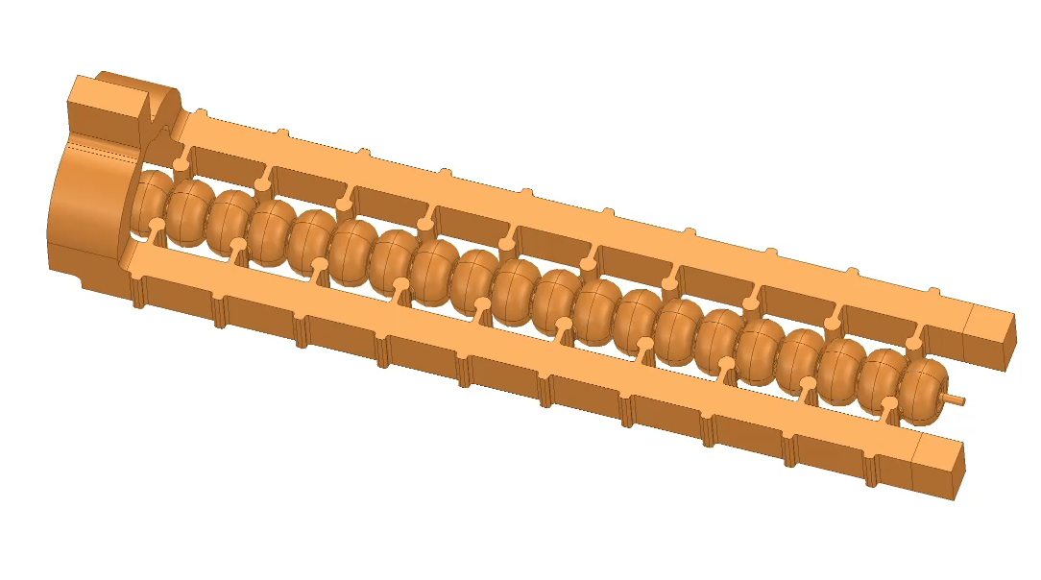
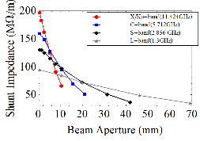
Distributed coupling Linacs provides a new technology that enables much flexible cell-design optimization
The existing linac designs requires careful consideration of the coupling between cells
which limits the ability of designers to optimize the cell shape.
The distributed coupling linac overcomes these limitations by providing a new topology
that allows feeding each accelerator cell independently using a periodic feeding network.
Distributed-coupling linac
New Scaling Laws Determine the Best Performance for Accelerating Structures
Tantawi et al. “Distributed coupling and multi-frequency microwave accelerators,” Jul. 5 2016, US Patent 9,386,682.
S. Tantawi, M. Nasr et. al. "Design and demonstration of a distributed-coupling linear accelerator structure." Physical Review Accelerators and Beams 23.9 (2020): 092001.

Slide 6
Novel Manufacturing Techniques

Slide 7
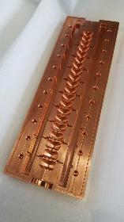
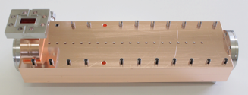
Novel fabrication methods are compatible with hard metals and reduced cost
Milling structure out of two halves instead of machining and then brazing single cells
No RF currents through the joint
Consistent with manufacturing structures out of hard copper alloys
Demonstrated with Standing and Traveling Wave Structure
S. Tantawi, P. Borchard, Z. Li
V. Dolgashev
Developing new manufacturing techniques to implement advanced materials in practical accelerating structures and reduce costs
Notes:
This technique have proved efficient operation in practical accelerators at high-gradient operation

Slide 8
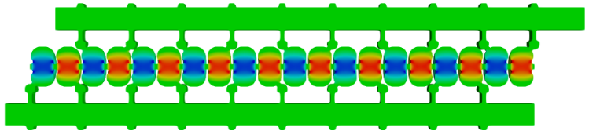
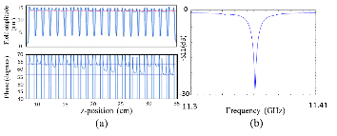
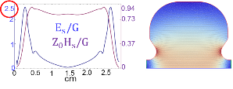



Distributed coupling Linacs provides a new technology that enables much flexible cell-design optimization
$$λ_{g}/2\sim λ$$
Designed to minimize surface magnetic field
Easy tuning and single frequency rather than 20
$π$-mode, X-band, 20 cells Linac
$$R_{shunt}=155 MΩ/m$$
Tantawi et al. “Distributed coupling and multi-frequency microwave accelerators,” Jul. 5 2016, US Patent 9,386,682.
S. Tantawi, M. Nasr et. al. "Design and demonstration of a distributed-coupling linear accelerator structure." Physical Review Accelerators and Beams 23.9 (2020): 092001.

Slide 9
Cryogenic Operation
of
Normal Conducting Structures

Slide 10
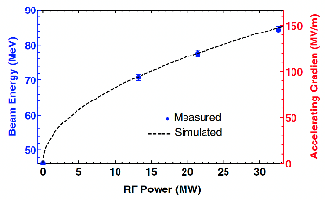
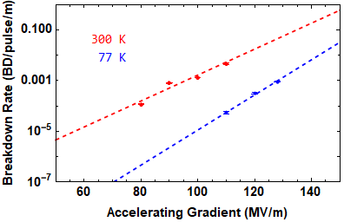
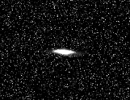

High-power test of the distributed-coupling structure (Xband, 20 cells) at LN cryogenic temperature (77k)
Modeled structure gradient confirmed with electron beam
Reduced breakdown rates compared to 300k operation
$$×100$$
Measured
Simulated
Room Temp (300k)
Cryogenic Temp (77k)
Stepped pulse with flat gradient of 200ns
Gradient=145 MV/m
Pixels
84MeV
Beam Energy
M. Nasr et al. "Experimental demonstration of particle acceleration with normal conducting accelerating structure at cryogenic temperature." Physical Review Accelerators and Beams 24.9 (2021): 093201.

Slide 11
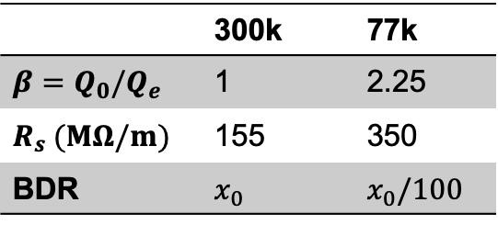
High-power test of the distributed-coupling structure (Xband, 20 cells) at LN cryogenic temperature (77k)
Modeled structure gradient confirmed with electron beam
Reduced breakdown rates compared to 300k operation
$$×100$$
Measured
Simulated
Room Temp (300k)
Cryogenic Temp (77k)
Stepped pulse with flat gradient of 200ns
 | 300k | 77k
$$β=Q_{0}/Q_{e}$$ | 1 | 2.25
$$R_{s} (MΩ/m)$$ | 155 | 350
BDR | $$x_{0}$$ | $$x_{0}/100$$
Heavy beam loading
Reduced breakdown rates
High RF-to-beam efficiency
Cost-efficient solution with LN
M. Nasr et al. "Experimental demonstration of particle acceleration with normal conducting accelerating structure at cryogenic temperature." Physical Review Accelerators and Beams 24.9 (2021): 093201.

Slide 12
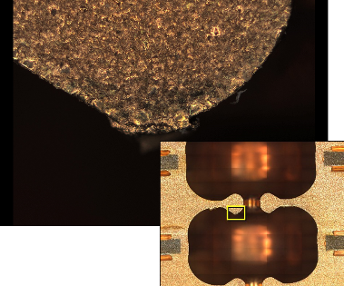
Distributed coupling structures are indestructible.
Old distributed coupling structure, Suface deformation happened at 300 MV/m
structure had a field enhancement factor of 2.6.

Slide 13
Next-Generation
Distributed-Coupling Linac

Slide 14
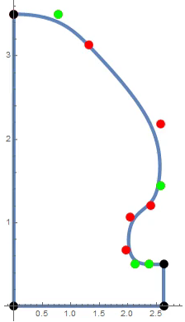


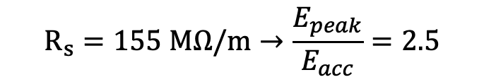
Next-generation distributed coupling linac: New geometric-optimization approaches and optimized ports
New geometric-optimization approaches
The cavity curvature is defined with a set of control points with variable positions to control splines which describes the cavity shape.
$$r$$
The first design with circular shapes
$$R_{s}=155 MΩ/m→\frac{E_{peak}}{E_{acc}}=2.5$$
Can we do better?
$$z$$
Beam Axis
M. Nasr et al. New Geometrical-Optimization Approach using Splines for Enhanced Accelerator Cavities’ Performance, IPAC’18
M. Nasr, and S. Tantawi
Notes:
Successfully verifying the operation of the first distributed-coupling linac
We started developing the next generation of distributed-coupling linacs
Benifiting from the design flexibility of the distributed-coupling topology and overcoming the limitations of the first design

Slide 15
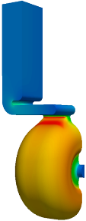
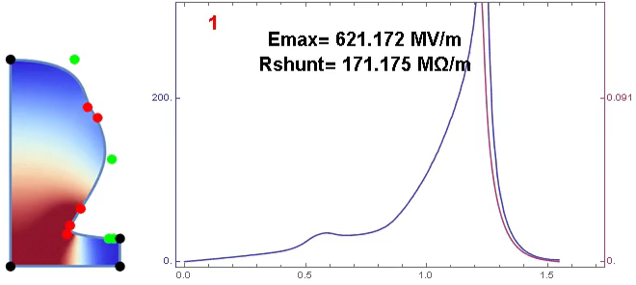




Next-generation distributed coupling linac: New geometric-optimization approaches and optimized ports
New geometric-optimization approaches
Optimized coupling ports
X-band, 11.424 GHz, iris diameter $0.1λ$
Optimized shape
$E_{surf}$ (MV/m)
$H_{surf}$ (MA/m)
Starting shape
a.u.
Gradient=100MV/m
H Field
Distance along the surface (cm)
Target: Maximize shunt impedance with peak surface E-field to gradient ratio of 2
Peak surface E-field to gradient reduction from 2.5 to 2
with even higher shunt impedance
Reducing magnetic field enhancement to from $×$2.3 to $×$1.17
M. Nasr et al. New Geometrical-Optimization Approach using Splines for Enhanced Accelerator Cavities’ Performance, IPAC’18
M. Nasr, Z. Li, and S. Tantawi

Slide 16
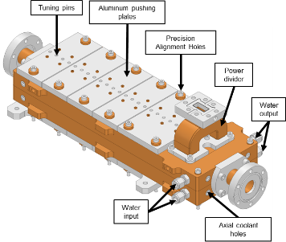
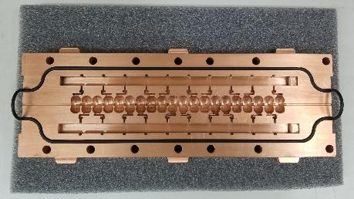
Next-generation distributed coupling linac: New geometric-optimization approaches and optimized ports
New geometric-optimization approaches
Optimized coupling ports
Peak surface E-field to gradient reduction from 2.5 to 2
with even higher shunt impedance
Reducing magnetic field enhancement to from $×$2.3 to $×$1.17
M. Nasr et al. New Geometrical-Optimization Approach using Splines for Enhanced Accelerator Cavities’ Performance, IPAC’18
M. Nasr, Z. Li, G. Bowden, and S. Tantawi
Notes:
We finalized the full structure design along with the mechanical design
, and we tested the manufacturing of our structure using a set of prototypes, and it is currently being built

Slide 17
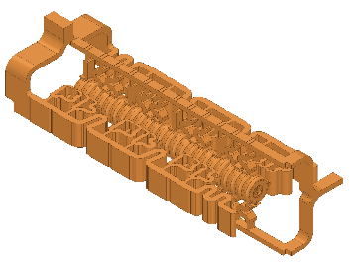
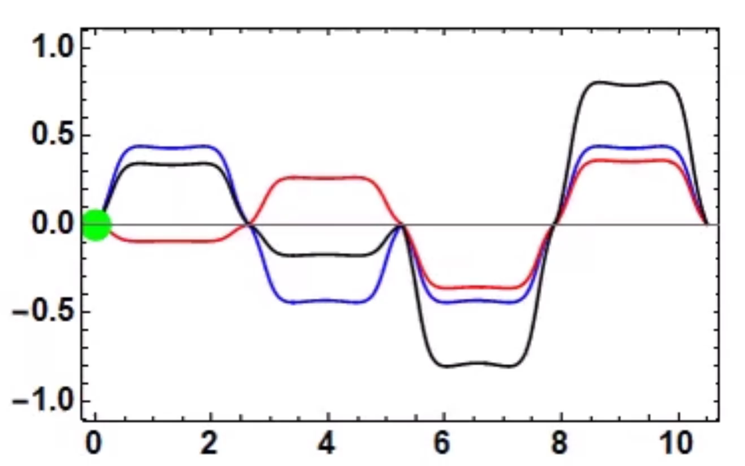
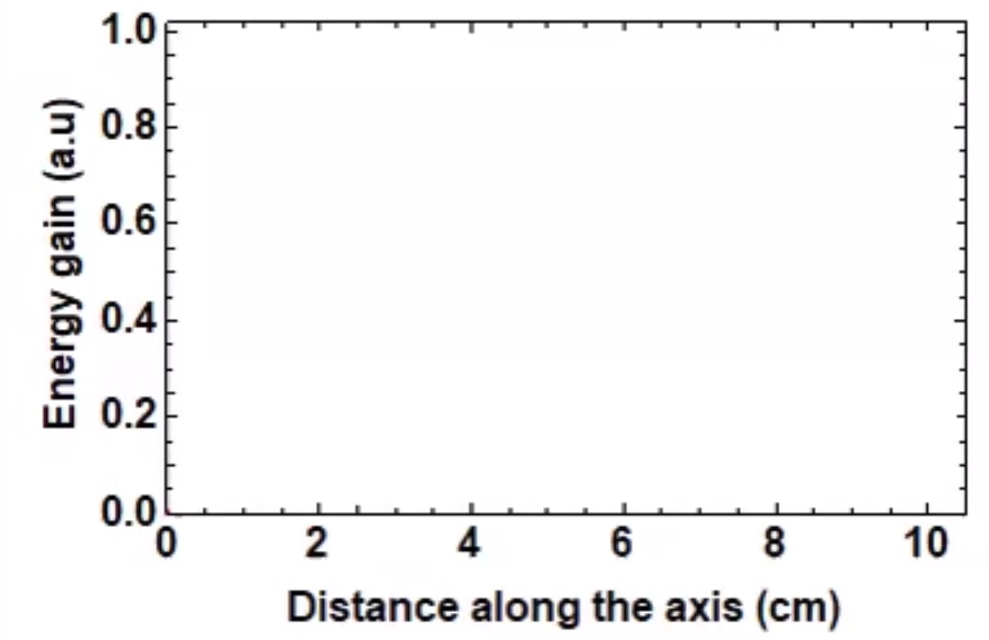

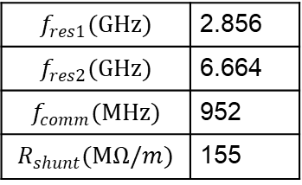
Having every cell fed individually by a manifold naturally inspires the use of another manifold with another mode feeding the same cell
S-band
$$f_{res1}(GHz)$$ | 2.856
$$f_{res2}(GHz)$$ | 6.664
$$f_{comm}(MHz)$$ | 952
$$R_{shunt}(MΩ/m)$$ | 155
Power $∝$ (gradient)²
Performance of cavity improves when powered with two different RF modes
Efficiency: Linear superposition of fields by adding power in the two modes.
Gradient: doubling the accelerating gradient without doubling surface fields
C-band
M. Nasr, and S. Tantawi
Optimum designs require non-harmonic operation; instead, we design for frequencies that are not necessarily harmonically related, but rather have a common sub-harmonic.
Mode01
Mode02
Total
$E_{z}$ (a.u)
Energy gain(a.u)
M. Nasr et al. “A Novel Dual-Mode Dual-Frequency Linac Design”, IPAC’17
M. Nasr et al. “The Design and Construction of a Novel Dual-Mode Dual-Frequency Linac Design”, IPAC’18
Distance along the surface (cm)
Distance along the surface (cm)
Notes:
Increasing the gradient for single-mode operation comes at the cost of a larger increase in the input power with a square relation
On the other hand, dual-mode operation increases the system efficiency by boosting the accelerating gradient with a linear superposition of the power from the two modes; which increases the system efficiency
Also, Generally, the peak fields for the two modes doesn’t add up simultaneously on the surface
We found that our optimum designs require….
Thus, our designs still support multi-bunch operation separated by multiples of the common sub-harmonic period of the operating frequencies.
Our dual-mode design operating at S and C bands achieves a shunt impedance that is compatible with the one for our X-band design, but with double the iris diameter
And as we can see, an electron beam traveling on-axis experience the acceleration from both modes

Slide 18

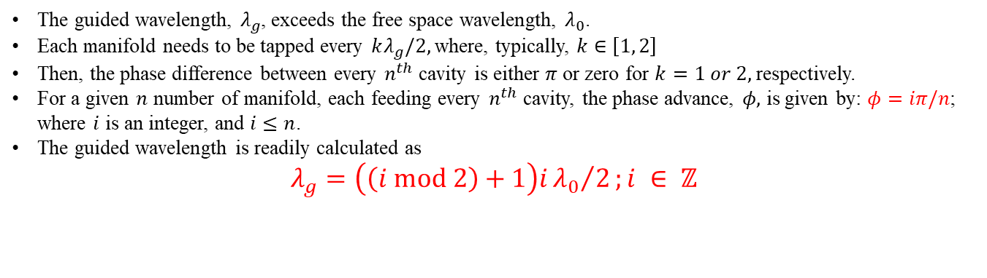



Distributed coupling with smooth-wall waveguide distribution manifolds
The guided wavelength, $λ_{g}$, exceeds the free space wavelength, $λ_{0}$.
Each manifold needs to be tapped every $kλ_{g}/2,$ where, typically, $k∈\left[1, 2\right]$
Then, the phase difference between every $n^{th}$ cavity is either $π$ or zero for $k=1 or 2,$ respectively.
For a given $n$ number of manifold, each feeding every $n^{th}$ cavity, the phase advance, $φ,$ is given by: $φ=iπ/n$; where $i$ is an integer, and $i≤n$.
The guided wavelength is readily calculated as
$λ_{g}=\left(\left(i mod 2\right)+1\right)i{λ_{0}}/2;i ∈ ℤ$
This expression for the guided wavelength does not yield a $λ_{g}>λ_{0}$ until $i≥3$; consequently, the natural minimum for the number of manifolds required is three.
$$\frac{λ_{g}}{2}=\frac{{3λ}_{0}}{2}$$
0
$$π$$
0
$$π$$
0
$$π$$

Slide 19
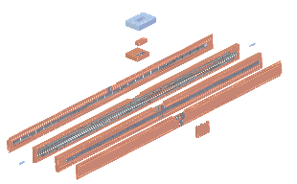
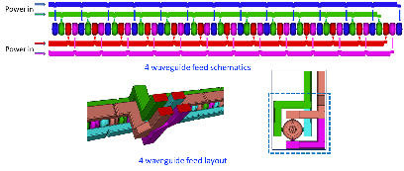
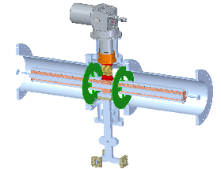
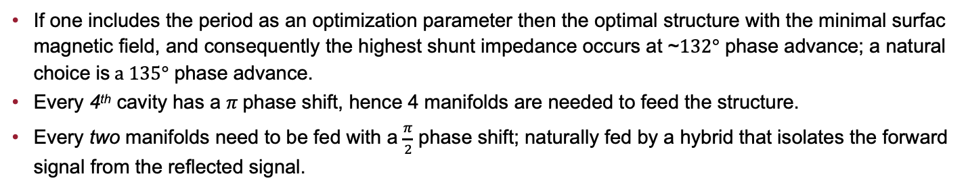
135 degree phase advanced distributed coupling structure
If one includes the period as an optimization parameter then the optimal structure with the minimal surfac magnetic field, and consequently the highest shunt impedance occurs at ~$132°$ phase advance; a natural choice is$a 135°$ phase advance.
Every 4th cavity has a $π$phase shift, hence 4 manifolds are needed to feed the structure.
Every two manifolds need to be fed with a $\frac{π}{2}$ phase shift; naturally fed by a hybrid that isolates the forward signal from the reflected signal.
Marco Oriunno, J. Merrick, G. Bowden, Z. Li, C. Nantista, E. Snively, M Shumail, S. Tantawi

Slide 20
135 degree phase advanced distributed coupling structure
If one includes the period as an optimization parameter then the optimal structure with the minimal surfac magnetic field, and consequently the highest shunt impedance occurs at ~$132°$ phase advance; a natural choice is$a 135°$ phase advance.
Every 4th cavity has a $π$phase shift, hence 4 manifolds are needed to feed the structure.
Every two manifolds need to be fed with a $\frac{π}{2}$ phase shift; naturally fed by a hybrid that isolates the forward signal from the reflected signal.
Marco Oriunno, J. Merrick, G. Bowden, Z. Li, C. Nantista, E. Snively, M Shumail, S. Tantawi

Slide 21
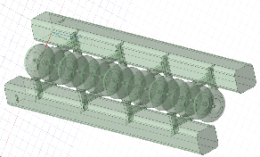
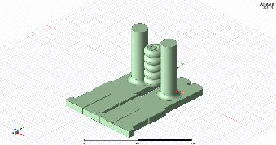
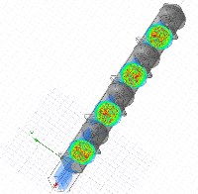
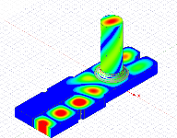
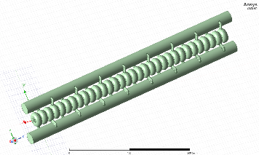
Dual Moded Distributed Coupling 3$π/4$ Linac
Ultimate shunt impedance, bigger apertures without loss of efficiency.
The elimination of the spigot length compacted the structure horizontally. Hence, operation at low frequency would still yield a reasonably sized device, which would allow us to think about a superconducting implementation.
Electrically it is a standing wave accelerator. For the point view of the source it acts as travelling-wave accelerator.
The manifold provide damping for both dipole polarizations.

Slide 22
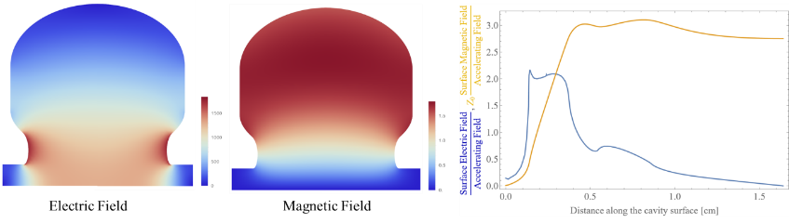
Optimized Cavity for the 3π/4 phase advance linac

Slide 23
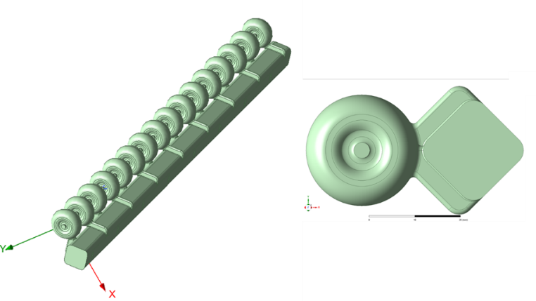
Dual moded Manifold feeding a set of 16 cavities. Each mode feeds 8 cavities

Slide 24
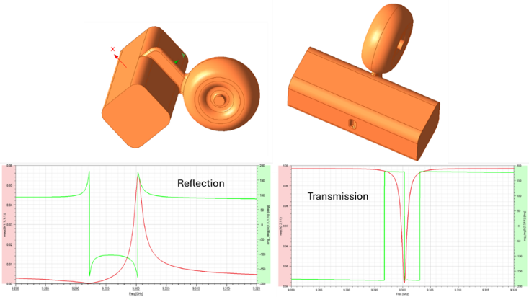
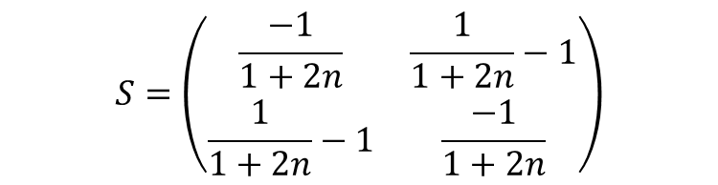
Single cavity-Manifold design optimized for a chain of 8 cavities (32 cavities total in the linac)
$$S=\left(\begin{matrix}\frac{−1}{1+2n} & \frac{1}{1+2n}−1 \\ \frac{1}{1+2n}−1 & \frac{−1}{1+2n}\end{matrix}\right)$$

Slide 25
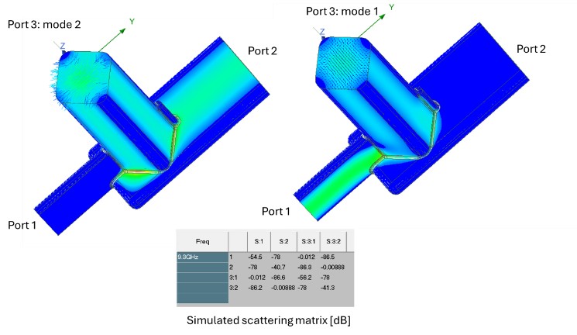
dual-mode launcher

Slide 26
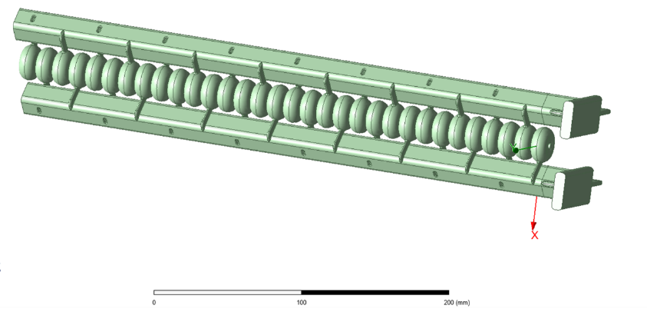
Integrated Linac that comprise the cavities, manifolds and the mode launchers Structure termination

Slide 27
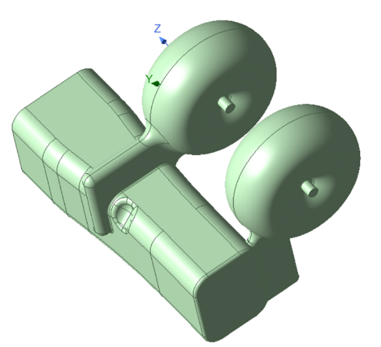
Manifold termination topology
The last two cavities within a manifold are fed differently from the rest of the linac cavities.
The reflection coefficient for each mode within the manifold is synthesized to achieve a particular scattering matrix needed for the manifold termination.

Slide 28
Conclusion
Understanding the physics of breakdowns triggered new research directions for high-gradient operation
Distributed-coupling technology enables much flexible cell-design optimization and pushes the limitation of Linacs performance.
Cryogenic-copper accelerating structures have the promise for a new frontier for beam brightness, efficiency and cost-capability

Slide 29
Thanks!
Questions?

