Slide 1
Cold Copper Technology
Ankur Dhar
January 20th, 2026
GARD RF Roadmap Update: NCRF Meeting

Slide 2
Agenda
Introduction
Quarter Cryo-Module
Motivation to improve maturity of cold copper technology
R&D Goals for Quarter Cryo-Module
Upcoming Tests with QCM
Near-term implementation for ESRF
High Power Testing of Cold Copper
Initial developments since 2018
Single cell tests for maximum gradient and shunt impedance
Meter-scale cryogenic linac tests
Looking to Future Development
Synergies with other NCRF Developments
Synergies with Future Colliders
New Regime at 80 K: High Temperature Superconductors
Operational Feasibility of Cryogenic Structures
Cryogenic vibrational measurements
Integrating damping slits

Slide 3
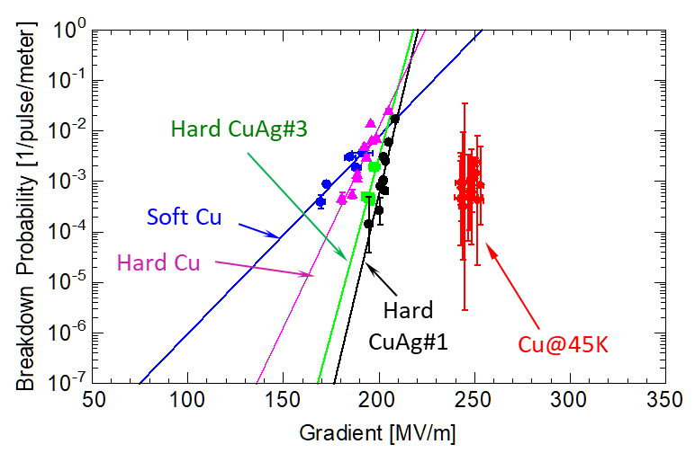
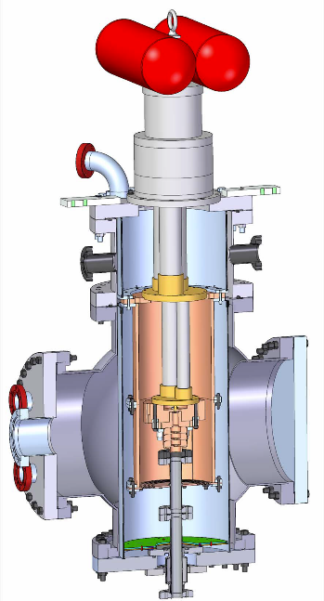
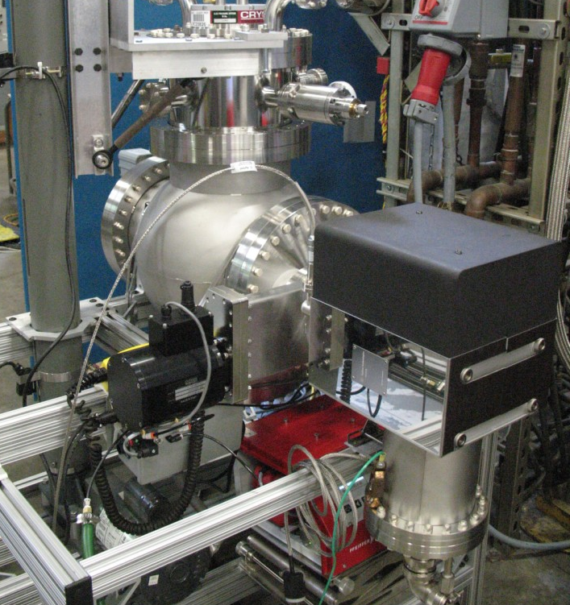
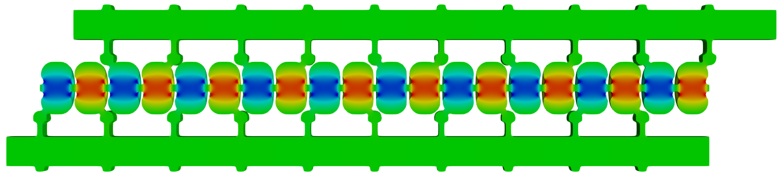
Motivation for Developing Cold Copper RF Accelerators
Cold-copper established as a pathway for achieving high gradients in single cavities (2015)
Distributed-coupling established a novel topology for achieving higher efficiency (2018)
Cold-copper program has focused on understanding fundamental limits
What gradients can we achieve?
How efficient can we make these structures?
How do we achieve and maintain precision alignment?
Can we preserve beam quality with damping and detuning?
Can we operate at higher beam powers?
Is this concept scalable?
High Gradient Workshop (2015) PRAB 21, 102002 (2018)
arXiv:1811.09925 (2018) PRAB 23, 092001 (2020)

Slide 4
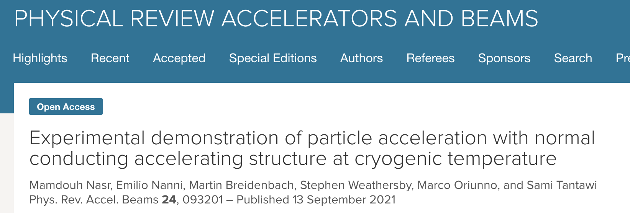
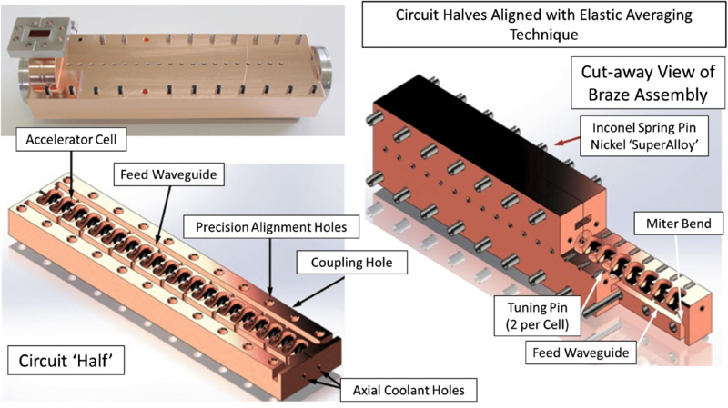
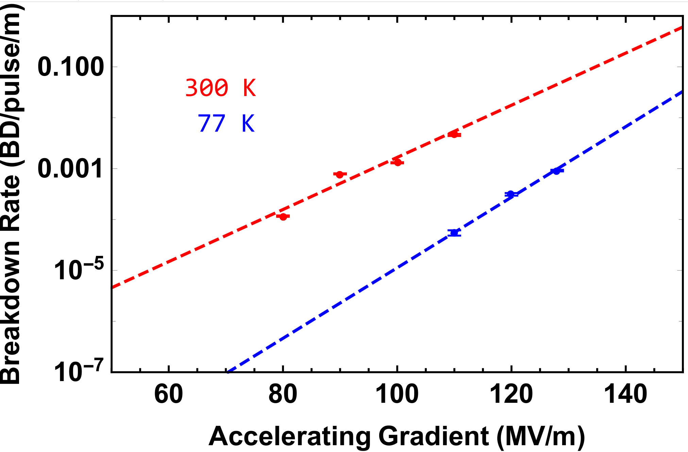
First Demonstration of Cold Copper Accelerating Structure
Ernest Courant Outstanding Paper Recognition
140 MeV/m measured with beam tests at NLCTA
Breakdown rate (BDR) reduction by 50x from room temperature operation
Breakdown limits primarily driven by high H-field regions within cell coupler
PRAB 23, 092001 (2020)
PRAB 24, 093201 (2021)
Cold copper can dramatically reduce breakdown rates at high gradient

Slide 5
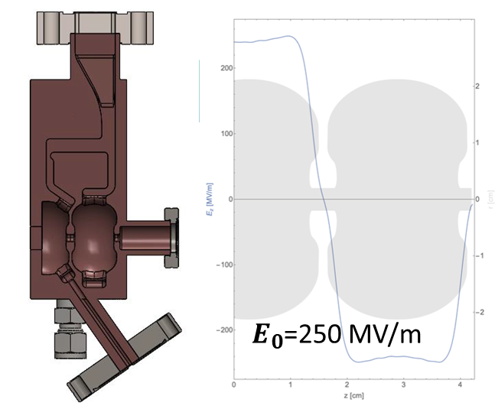
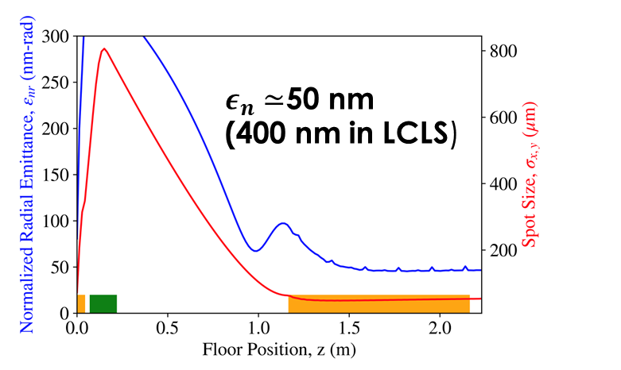
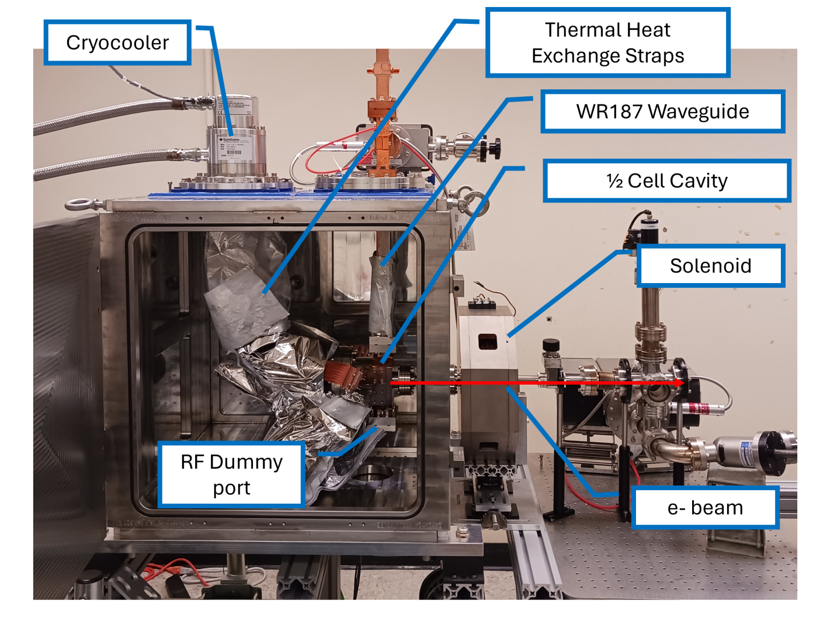
Ongoing Development for Cryogenic RF Photo-Injectors
Ongoing work at UCLA is looking to achieve higher photo-injector gradients for brighter beams
C-band gun uses a mechanical chiller instead of liquid nitrogen to achieve this
Higher gradient would allow for lower emittance beams, benefiting current and future light sources
Rosenzweig et al., PRAB 22, 2019
Robles, et al., PRAB 24, 2021
Cahill et al., PRAB 21, 2018.
Lawler et al., Proc. IPAC’24
HEP GARD RF Roadmap Update

Slide 6
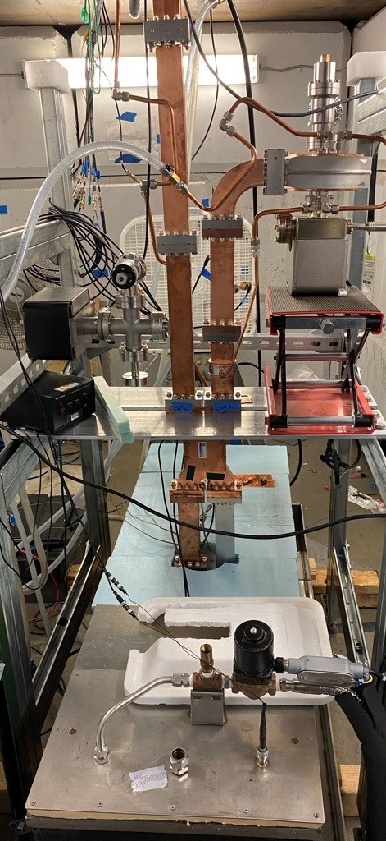
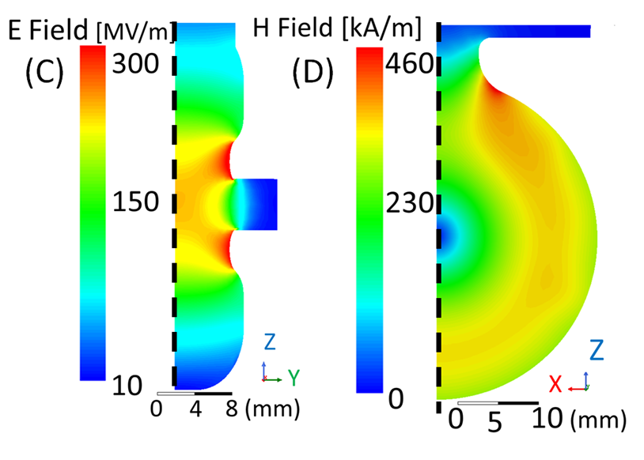
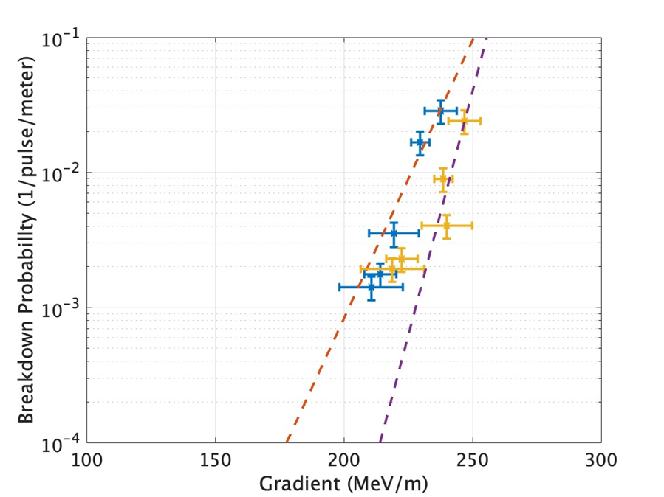
Single Cell High Gradient Tests with Cu and CuAg Cavities
High power tests at LANL (room temp) and Radiabeam (cryo) with up to 5 MW per cavity
Improved coupler design significantly reduced breakdown probability
C-band cavities were able to reach gradients over 250 MeV/m in cryogenic tests
C-band is a sweet spot for driving high power beams with high efficiency
Test at Radiabeam
Previous Cryo
X-band Results
Cu
CuAg
Copper at 44 K
with
on-axis
coupling
APL 121, 254101 (2022) IPAC2024 p. MOPR29
Improved RF design further enhances the achievable gradient
HEP GARD RF Roadmap Update

Slide 7
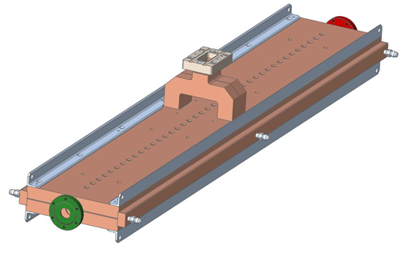
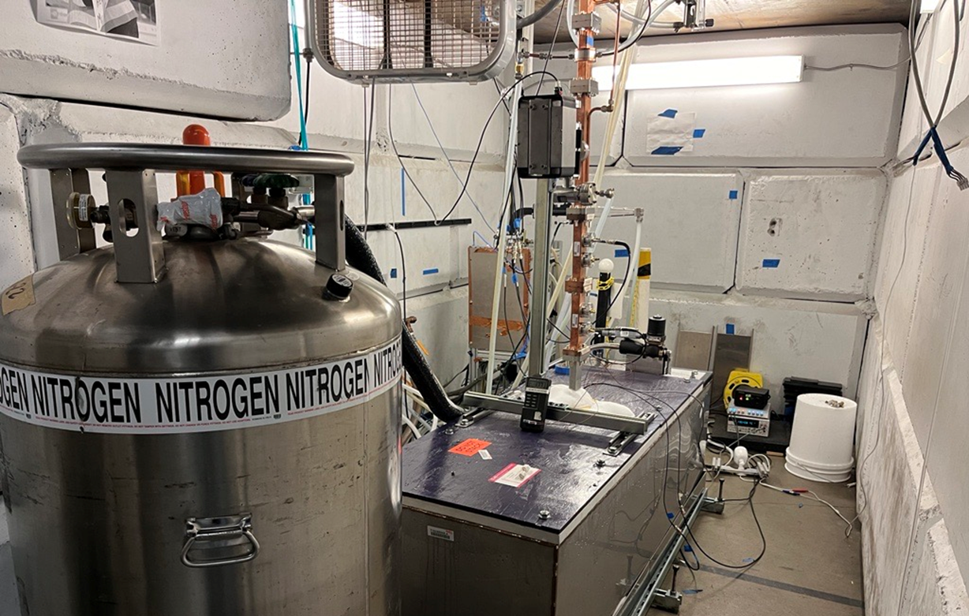
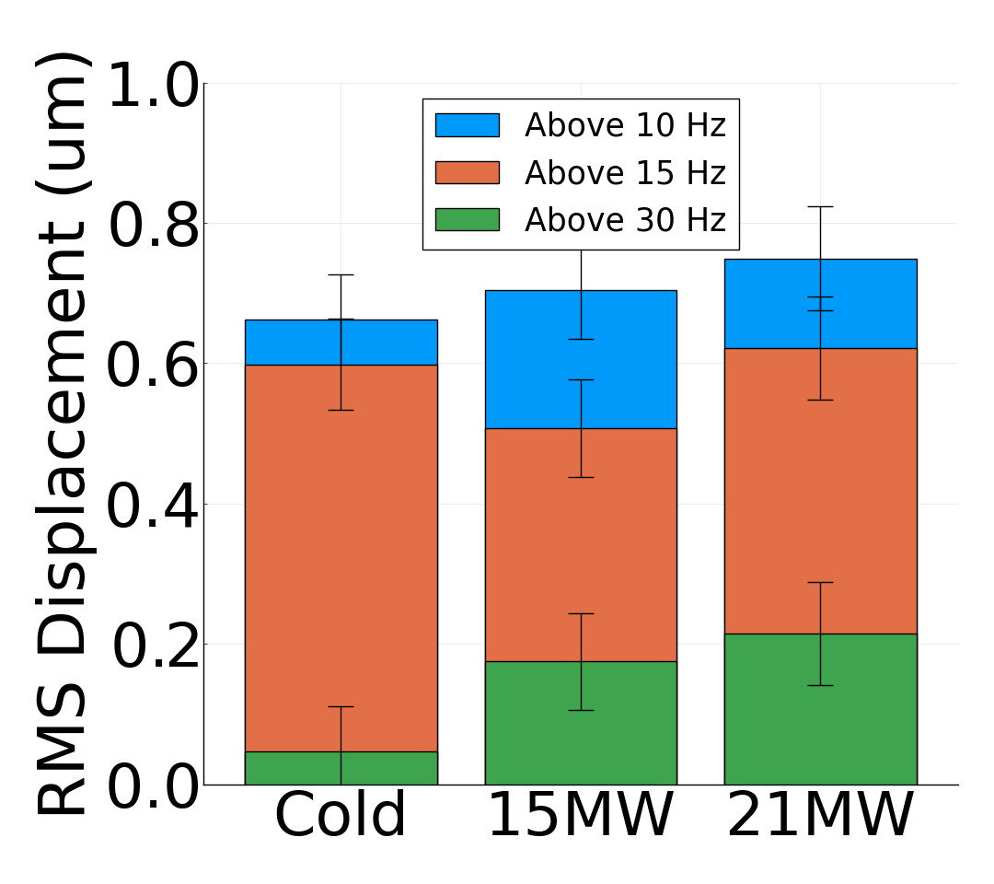
Meter-long Linac Cryogenic High Gradient Tests
Conditioned at Radiabeam up to 21 MW (source limit), 60 MeV/m, 60 Hz, and 1 μs
Meter-long linac leverages two slab design for lower fabrication cost
Cryogenic operation and distributed coupling result in 6X reduction in required RF power
At 50 MeV/m BDR was O(10-6) /pulse/m after 2M pulses
Breakdown events remained localized within structure
Vibration measurements showed displacement on structure were within 1 μm
Meter-long Linac
Test at Radiabeam
Vibration measurement
Meter-scale structures with low cost and high RF efficiency can be fabricated
LCWS 2024
HEP GARD RF Roadmap Update

Slide 8
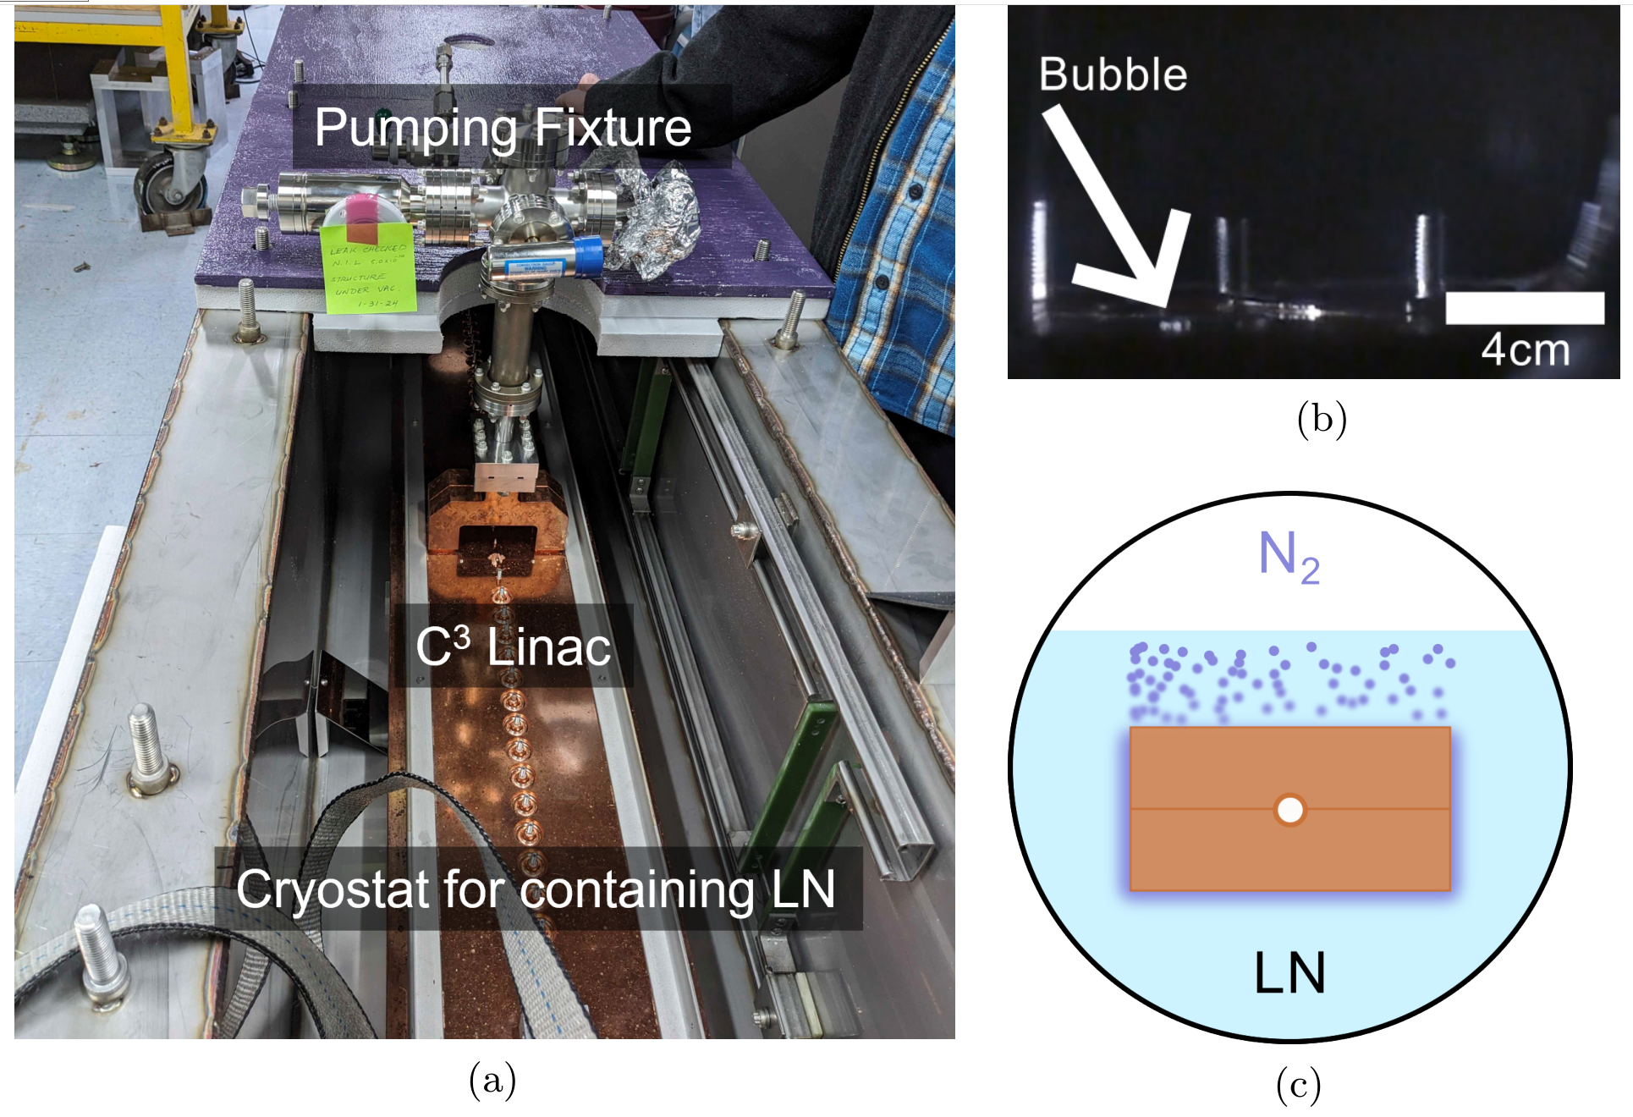
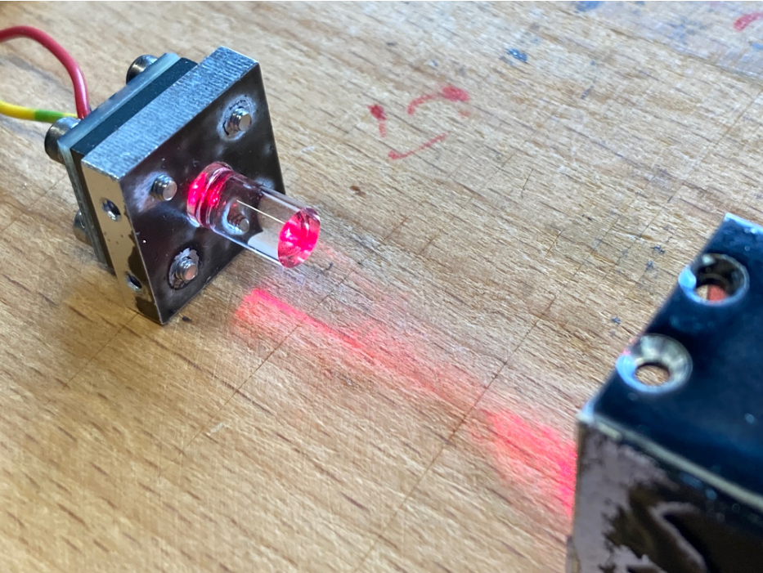
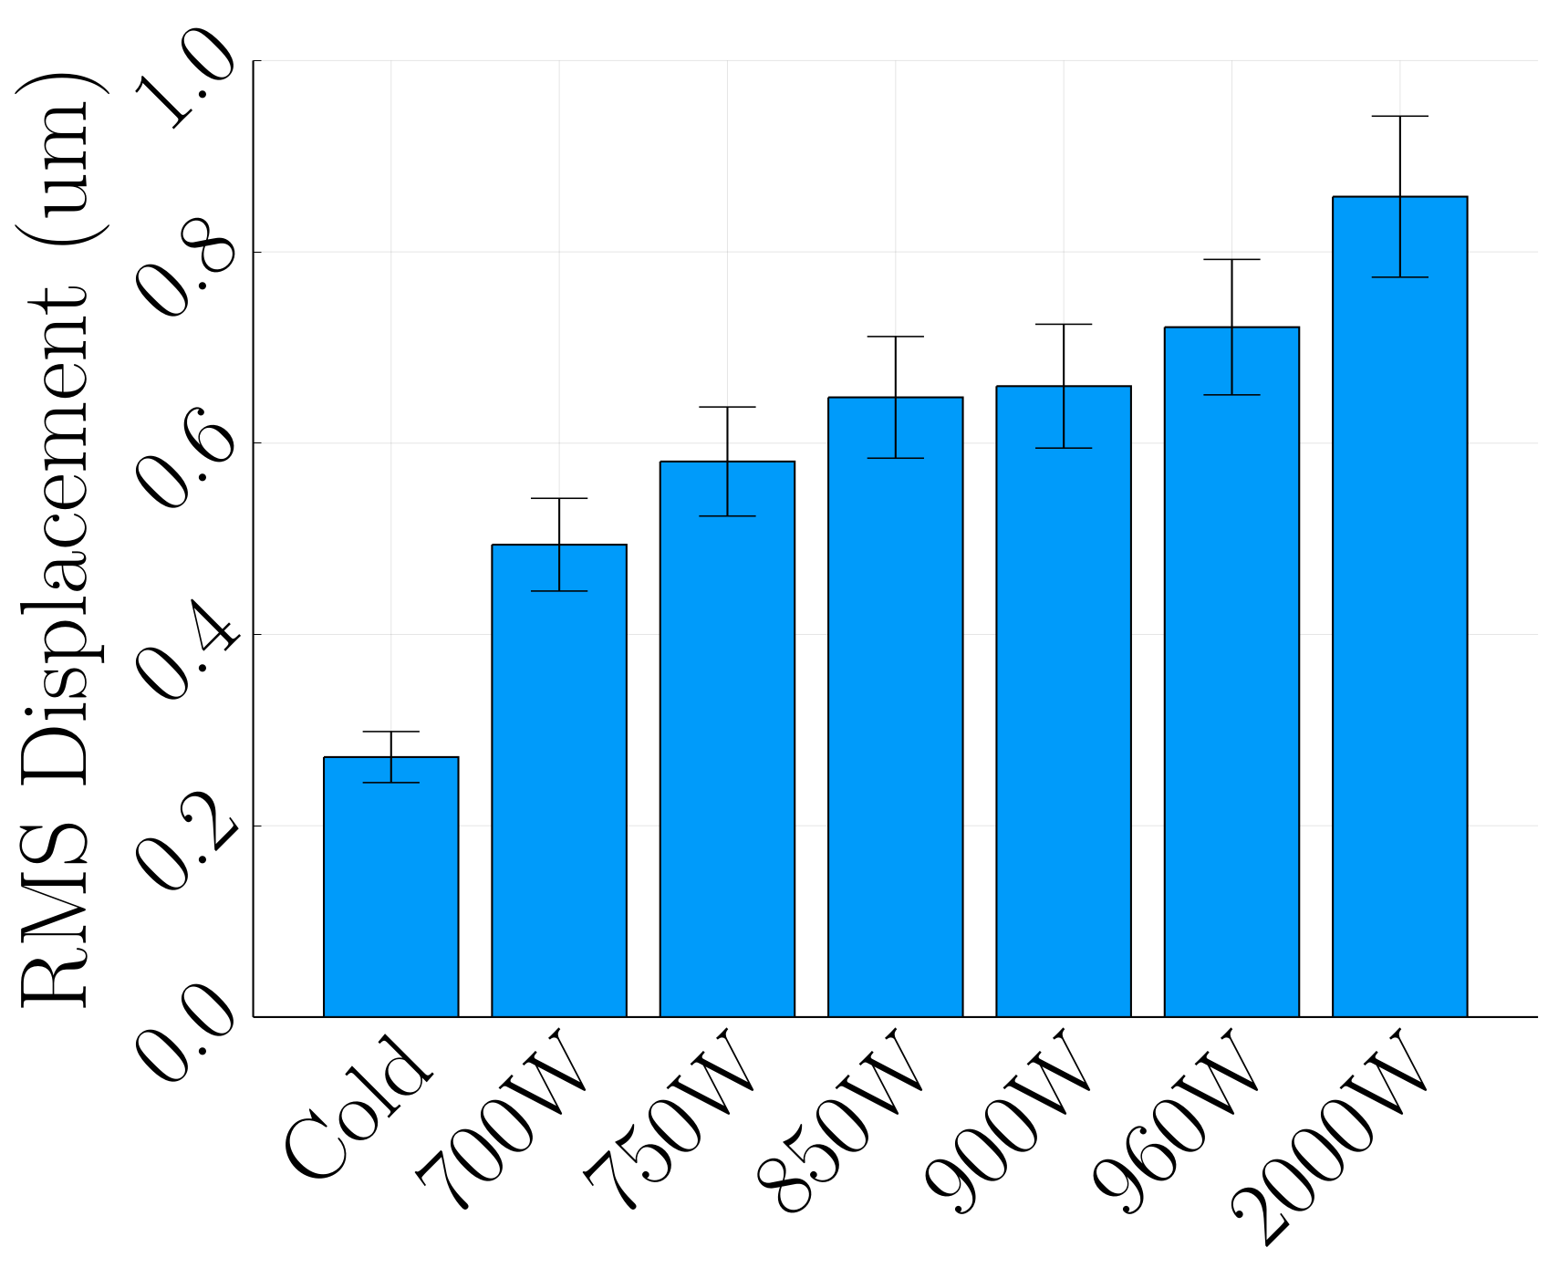
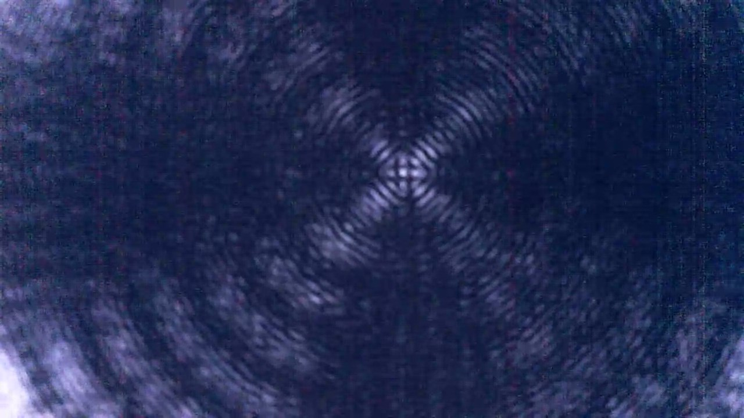
Alignment Stability during Liquid Nitrogen (LN) Operation
Linac heated via a resistive wire to characterize impact of LN boiling on precision alignment
Maximum displacement from nitrogen bubbling was micron-scale for up to 2 kW average heating
Rasnik laser alignment system is currently tested in liquid nitrogen with roughly 2.5 micron displacement resolution
Experimental Setup
Vibration Measurement
Rasnik Alignment System
SLAC-PUB-17776 (2024) arXiv:2307.07981 (2024)
EPJ Web Conf., 315 (2024) 02018
Displacements from liquid nitrogen operation can be maintained to within tolerances required for HEP facilities
HEP GARD RF Roadmap Update

Slide 9
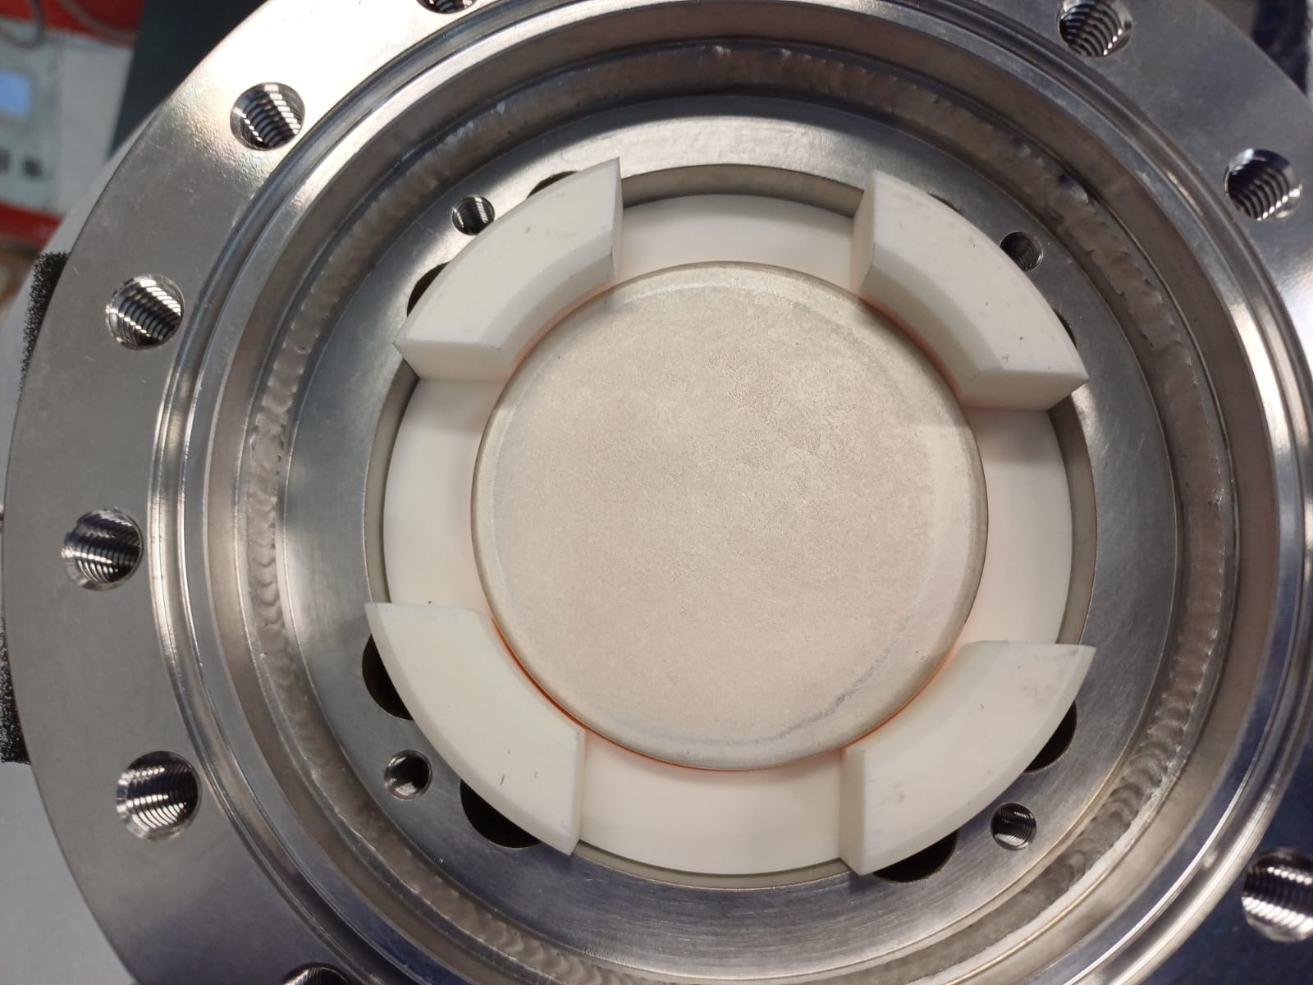
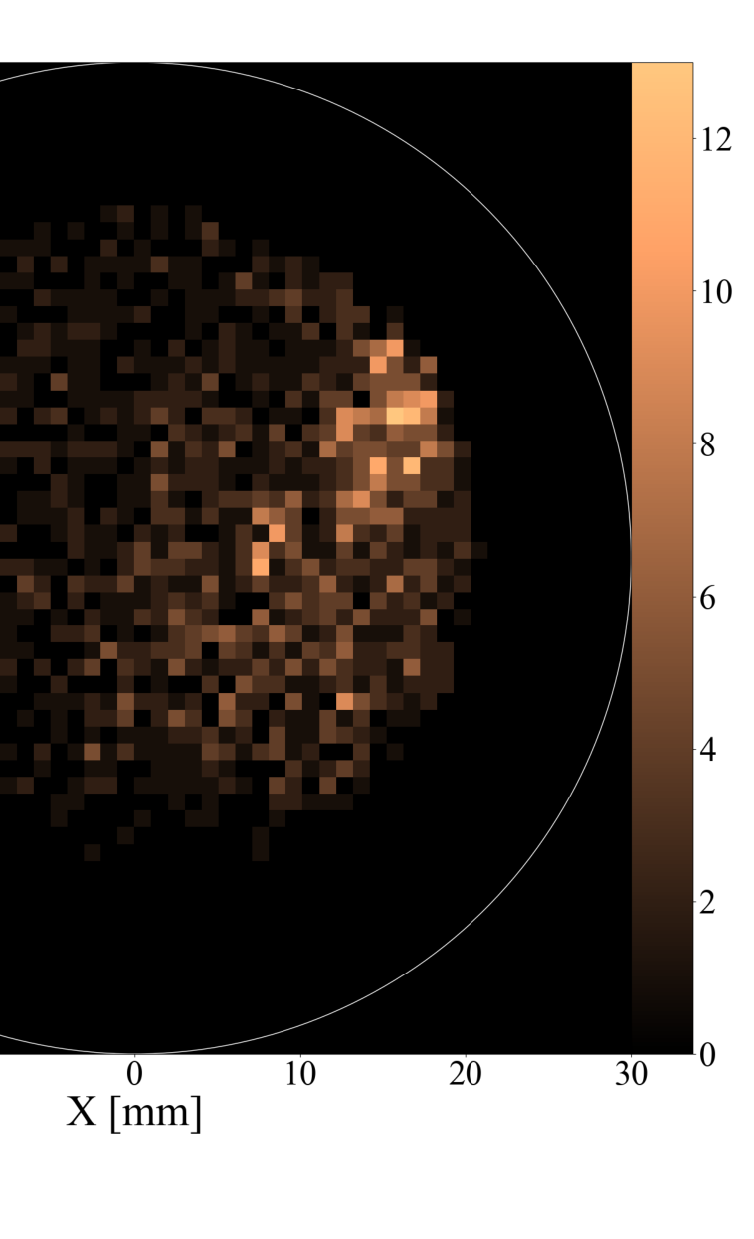
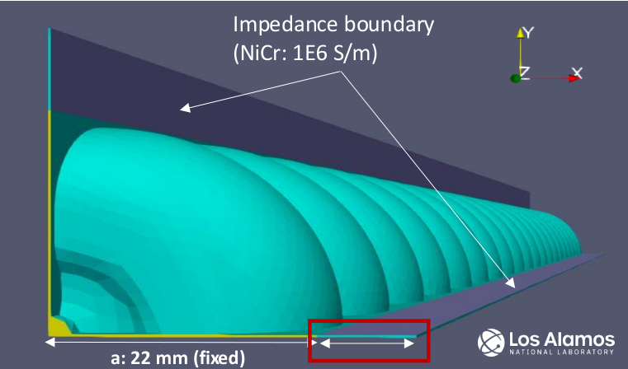
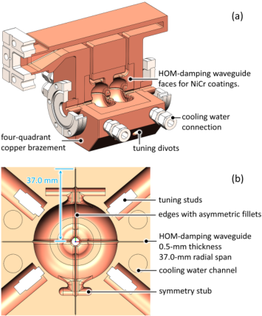
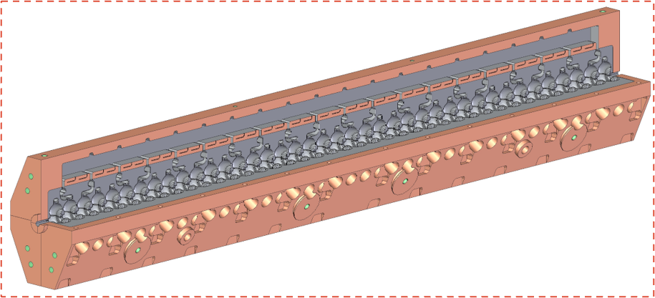
Integrated Higher Order Mode Damping Slits
Longitudinal slits can damp higher order modes and improve emittance preservation
Field Emission Sites
Need for a lossy material that can withstand brazing and breakdowns while preserving UHV
NiChrome has been identified as a potential material
Recent tests at CERN applied DC fields at 1 kHz with 1 us pulses
Field emission sites uniformly distributed over sample
Fabrication of cavity with damping slits underway at LANL
Design of a meter-long C-band structure using these slits is also complete
Damping Slot Design
Damped Cavity Design
Linac Design
LCWS 2025
Damping can be accomplished with UHV compatible materials and split-cell fabrication technique developed at SLAC
HEP GARD RF Roadmap Update

Slide 10
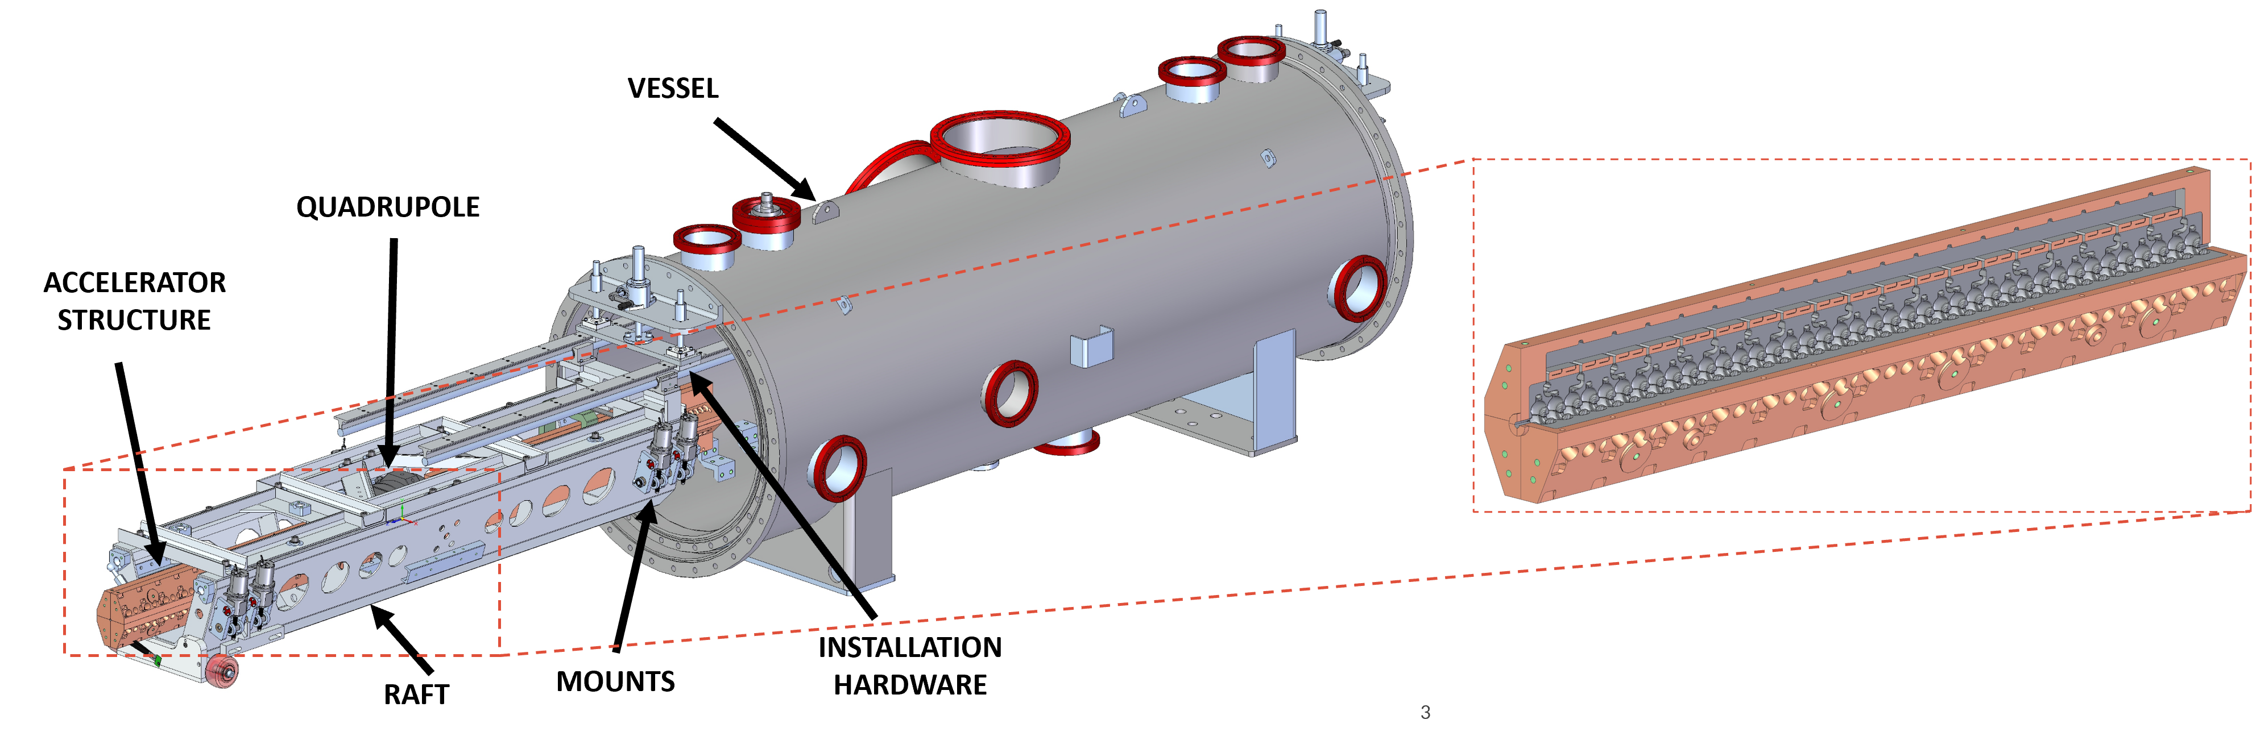
Cold Copper R&D in the Quarter Cryo-module (QCM)
Cold-Copper and Distributed Coupling → demonstrated record gradients and record efficiency
30% increase in gradient at the BDR needed for HEP applications
6X reduction in RF Power → >50% higher than RF Roadmap Goal
Key Scientific and Technical Questions to be Answered in QCM
Gradient – Understand impact of multiple structures
Vibrations / Alignment – Maintain sub-micron alignment between structures
Damping/Detuning – Deploy test structure with damping slots
Beam Loading and Stability – Conduct beam tests with collaborators
Scalability – Raft designs and integration part of QCM design
LCWS 2025

Slide 11
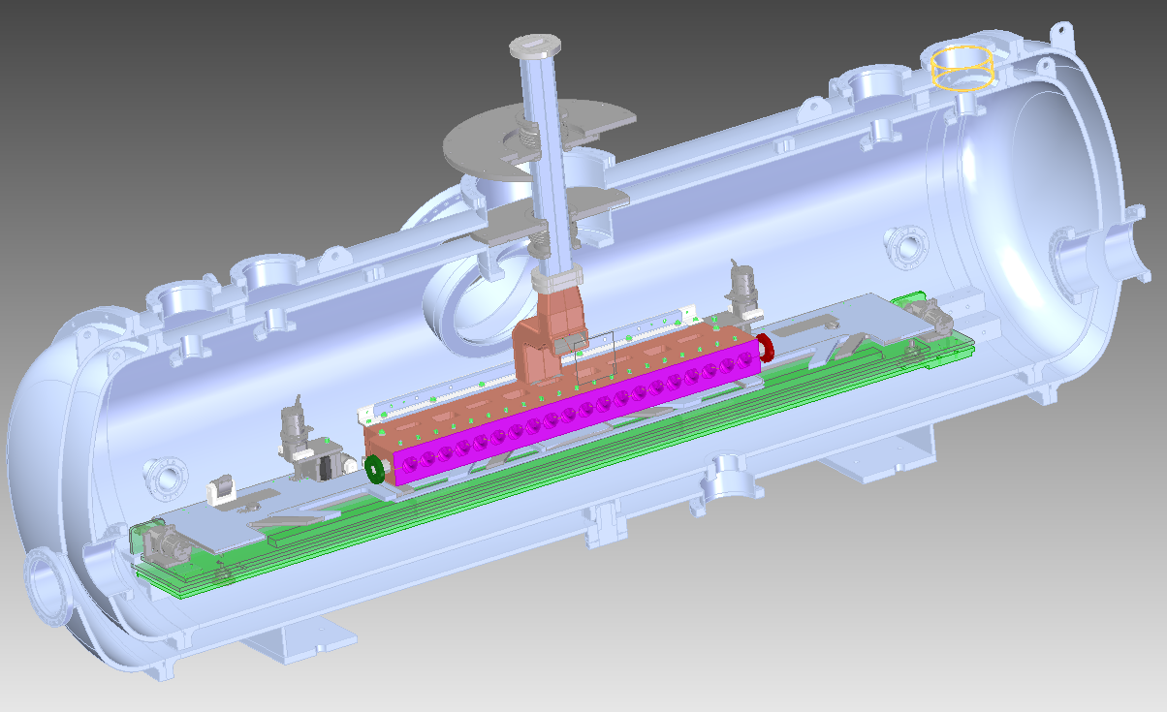
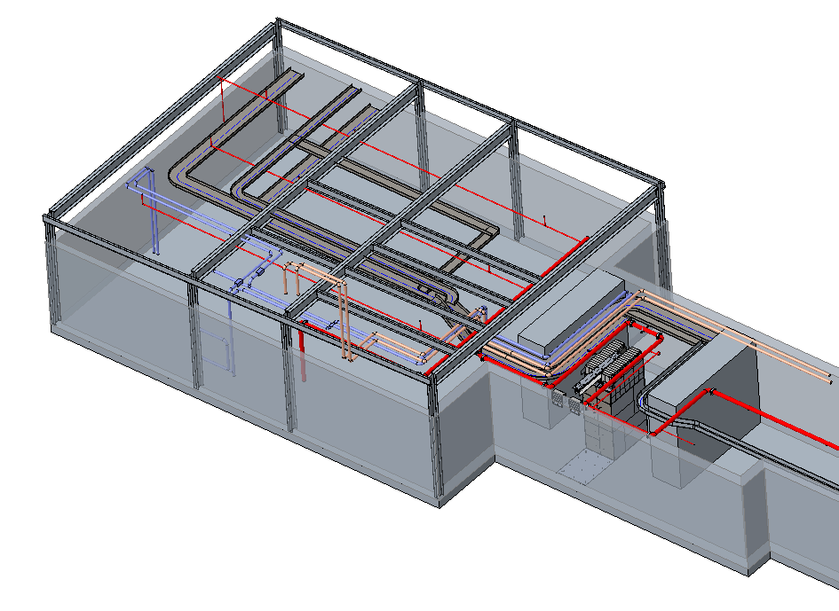
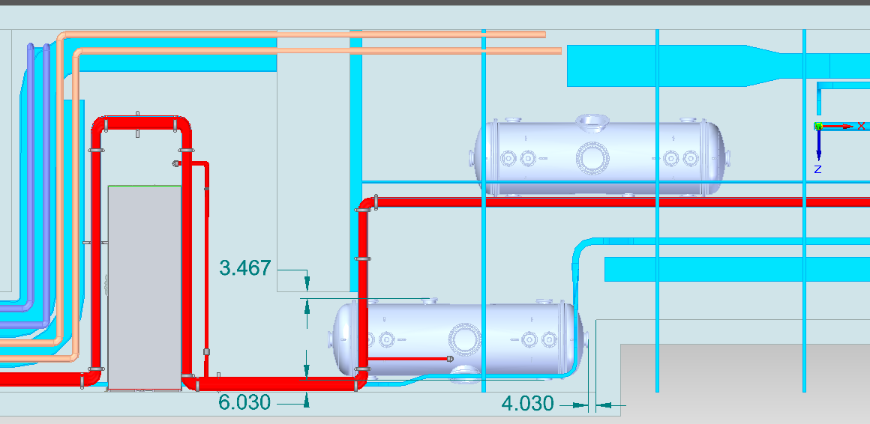
Initial High Power Test Plans
Preparations are underway for high power tests of an S-band cold copper structure at Argonne National Laboratory (ANL), Advanced Photon Source (APS) using the Linac High-Power RF Test stand and the Linac Extension Area (LEA). Tests are expected this summer.
High power test measuring breakdown rate with 30 MW klystron
Second phase with two structures and 60 MW klystron
One structure will be housed within quarter cryo-module
END STATION
MAZE AREA
TUNNEL
Linac Extension Area at Argonne
11
Plan to maneuver QCM through the maze

Slide 12
COOL COPPER OPERATION LINAC DEMONSTRATOR (COLD) AT ESRF
INFN: could be S-band
OBJECTIVES:
Test C-band 77K high gradient technology:
Acc. Gradient
Breakdowns
Dark currents
Reliability
Maintainability
Gain experience:
C-band structures / modulators
Laser
Cryogenics
Evaluate potential to extend to 6GeV
35 MW
4-6μs
4Hz
S-band (--> C-band)
50 MW
0.5-10 μs
4-10Hz
C-band
load
load
pen
Independent test of modulators
pen
valve
WG switch
valve
WG switch
pen
WALL
valve
load
pen
Directional Coupler
Directional Coupler
IP
Window
Isolator (critical in C-band)
pen
valve
Directional Coupler
load
pulse compressor?
pen
Window
IP
valve
Window
50MW
Directional Coupler
valve
pen
pen
Window
25MW
Planar hybrid
Collaborators:
SLAC
CORNELL
INFN
CERN
GUN
valve
Phase shifter
attenuator
valve
pen
attenuator
valve
C3 1m struct
C3 1m struct
C3 1m struct
LCWS 2025

Slide 13
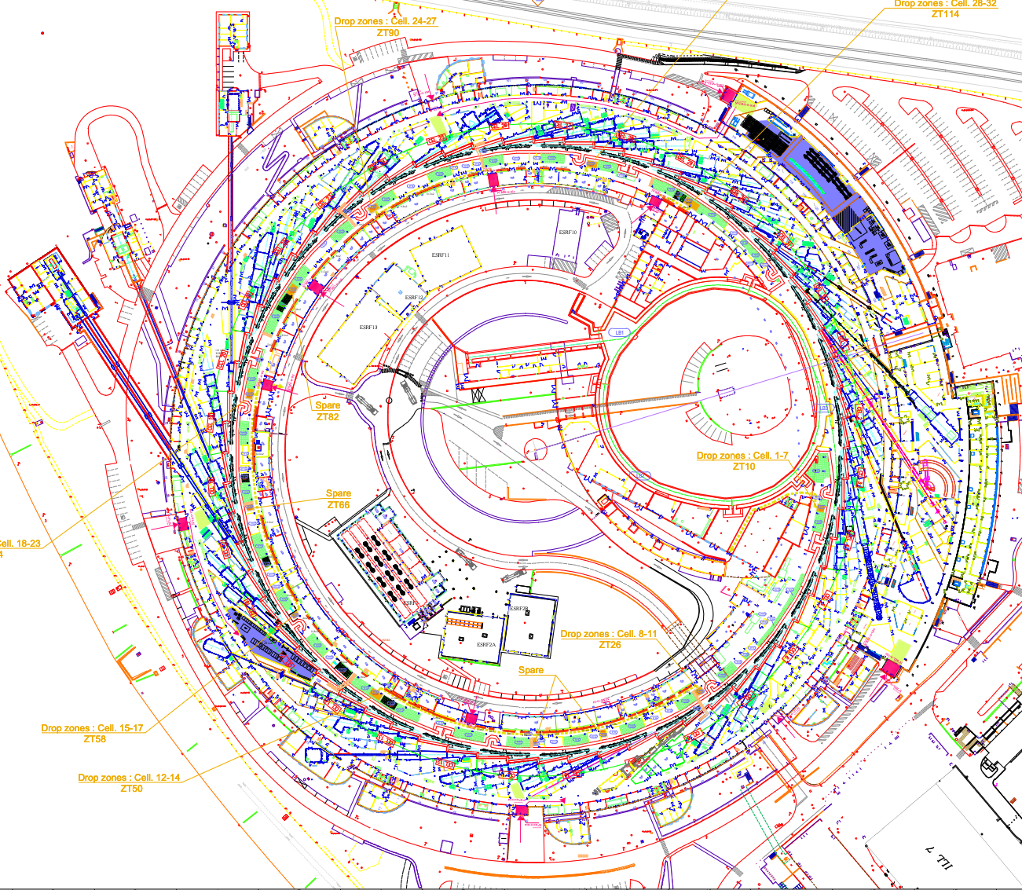
COLD Project Phases and Scope
2025 S-band RF-unit for photo-gun (usable for present linac)
2026 2x C-band RF-unit for Cryomodules
diagnostics for Linac refurbishment
2027 RF test of 77K C-band acc.struc. +dark currents +laser
2028 photogun, diagnostics
2029 beam measurements
2030 + 2xC-band accelerating structures for: pulse compression, phasing studies, EU cryomodule development and/or: install undulators
2031 COLD as ~300-350MeV alternate operation injector for ESRF. (Two injector linacs will be operational)
2032: new 12x100 m tunnel construction
2033: install and commission 6GeV Linac
2034: decommission booster, installation of transfer line 6GeV linac to SR (~2 months dark time)
Phase 1
6GeV Linac
Phase 2
Beyond
S. Liuzzo, et al.,Proc. IPAC'25,TUPM107

Slide 14
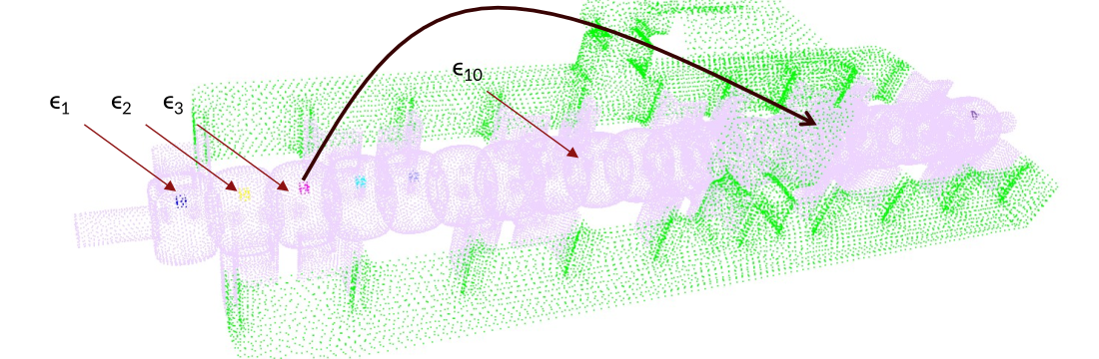
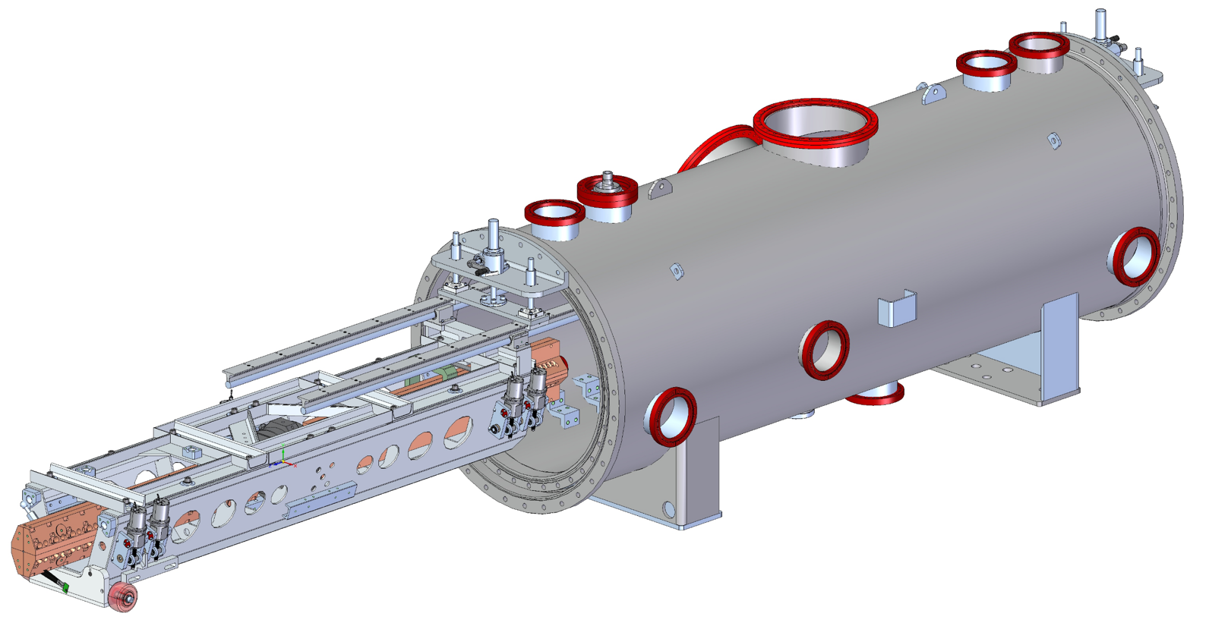
Synergies with NCRF Developments
Cold Copper technology benefits from collaboration with several other NCRF Developments
Distributed Coupling: Directly benefits and motivated further development in high gradient RF design for NCRF structures
ACE3P: Allows for rapid iteration on new designs and accurate benchmarking of fabricated structures
Future BES accelerators: Cold copper can provide high energy electron beams for hard X-ray FELs or synchrotrons which operate at 6 GeV
Industrial linacs: Cryo-cooled medical accelerators can provide high energy beams with a compact form factor
Short pulse: Both cold copper and short pulse RF can reach higher gradients, combining the two could provide even better peak power handling
6GeV Linac
HEP GARD RF Roadmap Update

Slide 15
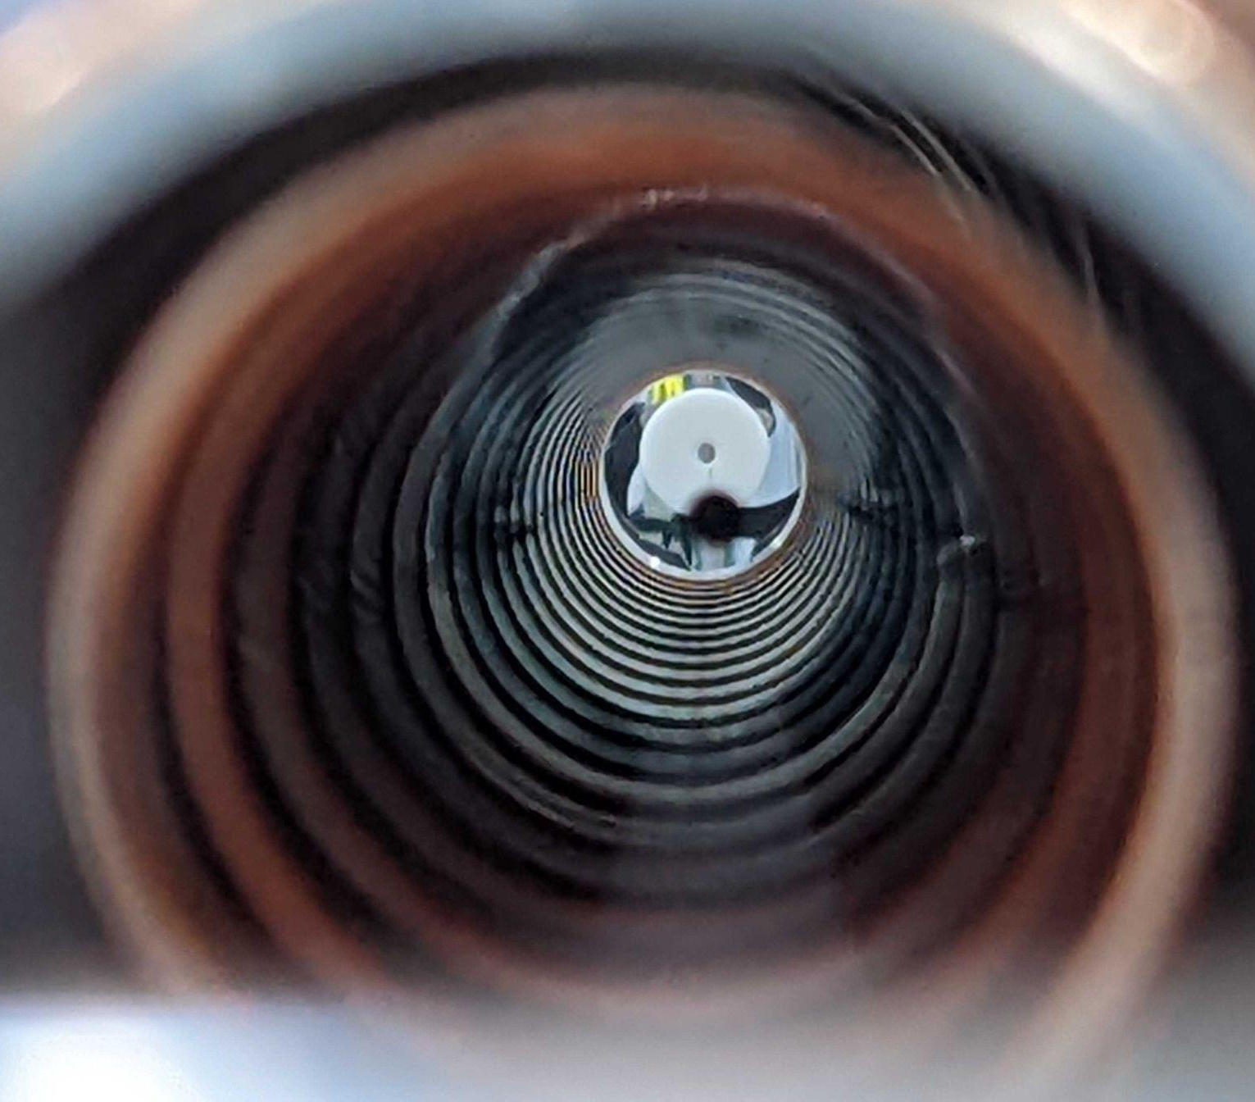
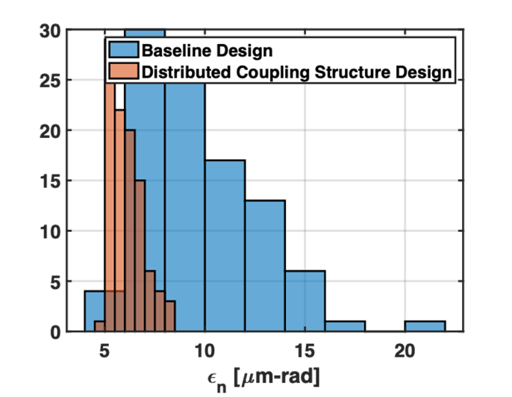
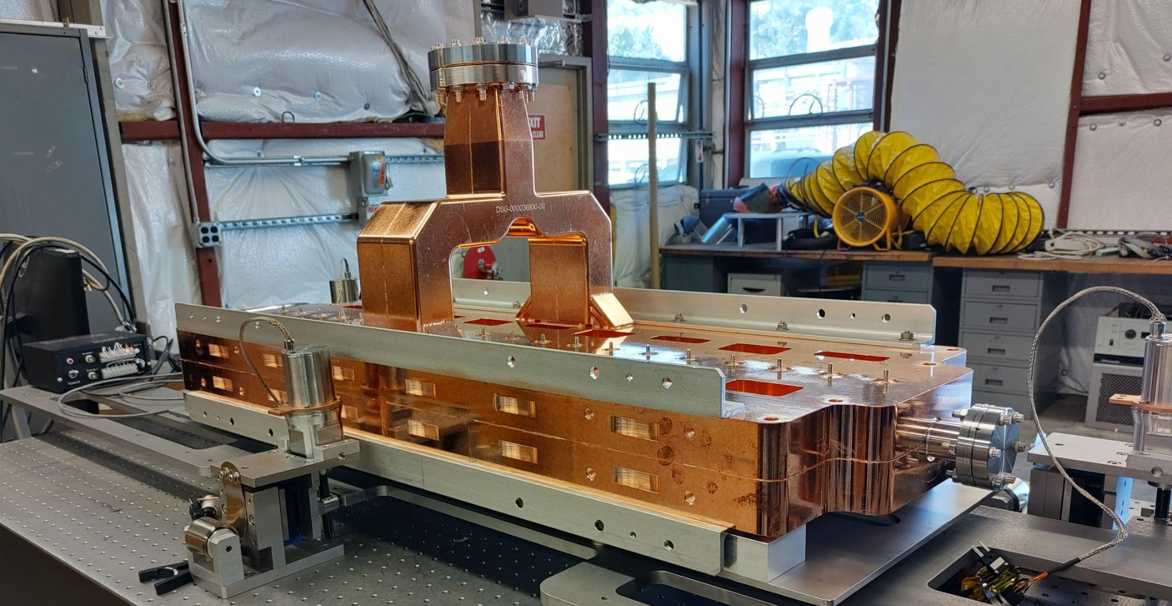
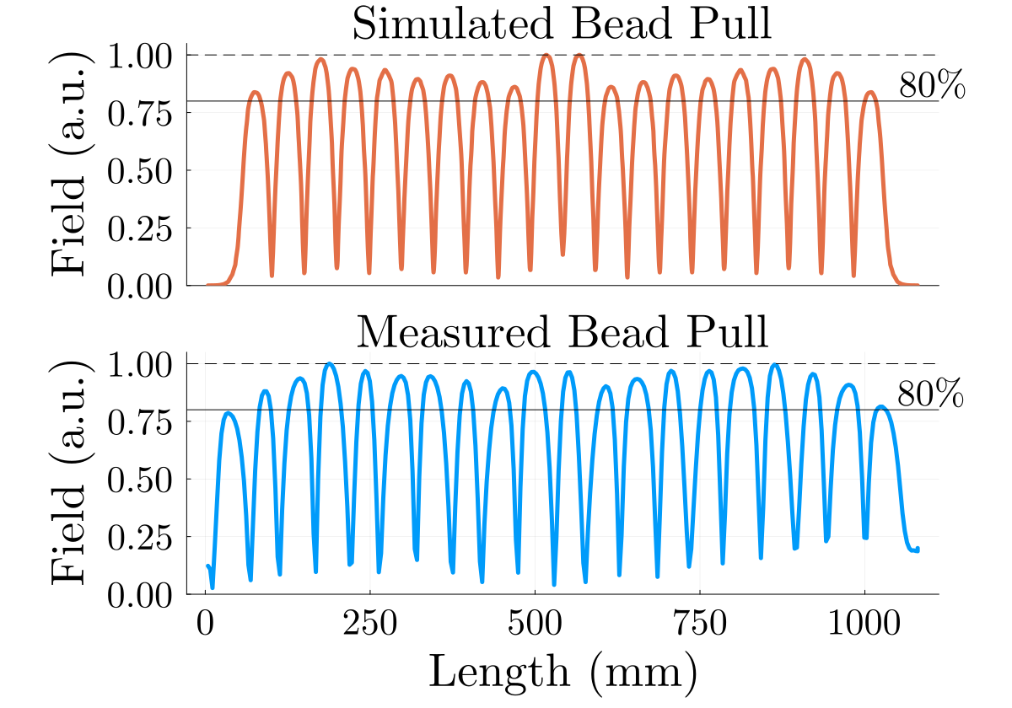
Distributed-Coupling based Large Aperture Injector Linac
S-Band linac developed for efficient acceleration of high charge bunches
Prototype structure tuning utilized iterative measurements and simulation in ACE3P
Current design would preserve emittance for up to 14 nC bunches with 18 MV/m gradient
Power draw would only be 5 MW for a meter-long 20 cavity linac
Large aperture design (14.12 mm) for reduced wakefields
Designed based on requirements for Electron Ion Collider (EIC)
Operating cold enables even higher gradients/RF efficiency
Up to 80 MV/m with 35 MW per structure
Alternatively, 1.8 MW/m for the EIC target gradient
Emittance Comparison
Simulated tuning in ACE3P
Prototype Linac
IPAC2024 p. TUPR14
Distributed coupling and cold copper technology can be applied to injector linacs and other high beam power applications
HEP GARD RF Roadmap Update

Slide 16
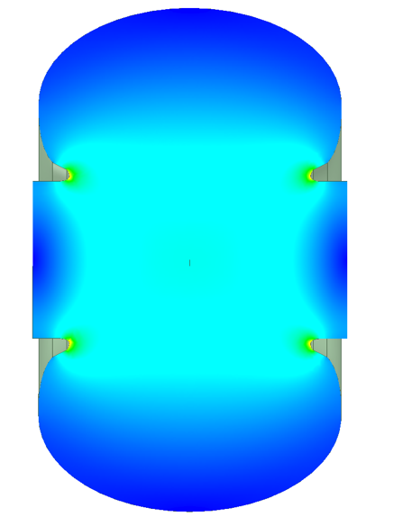
Synergies with Future Colliders
NCRF Accelerator Technology Required for all Near-Term Collider Concepts
Cold copper technology is positioned to contribute synergistically or directly to all near-term collider concepts
FCC-ee - common electron and positron High Energy linac from 6 to 20 GeV
Muon Collider - high gradient cryogenic copper cavities in muon cooling channel
AAC - SLAC Beam Test facility proposal utilized for staging, multi-TeV energy upgrade reutilizing tunnel, 𝛾𝛾 colliders
Single Cavity
Design Study: FCC HE-Linac
HE-Linac Requirements
Charge (nC) | 0-5.5 nC
Number Bunches | min. 4
Bunch Spacing | 25 ns spacing
Initial Energy | 6 GeV
Final Energy | 20 GeV
Goal is high RF efficiency for a set gradient
Shunt impedance at 300 K: 58.5 MΩ/m
At 77 K: 152 MΩ/m
Gradient: 22.5 MeV/m
Baseline design: 3.5 MW/m, 3 μs
Pulse compressed version should be even more efficient in terms of RF power
HEP GARD RF Roadmap Update

Slide 17
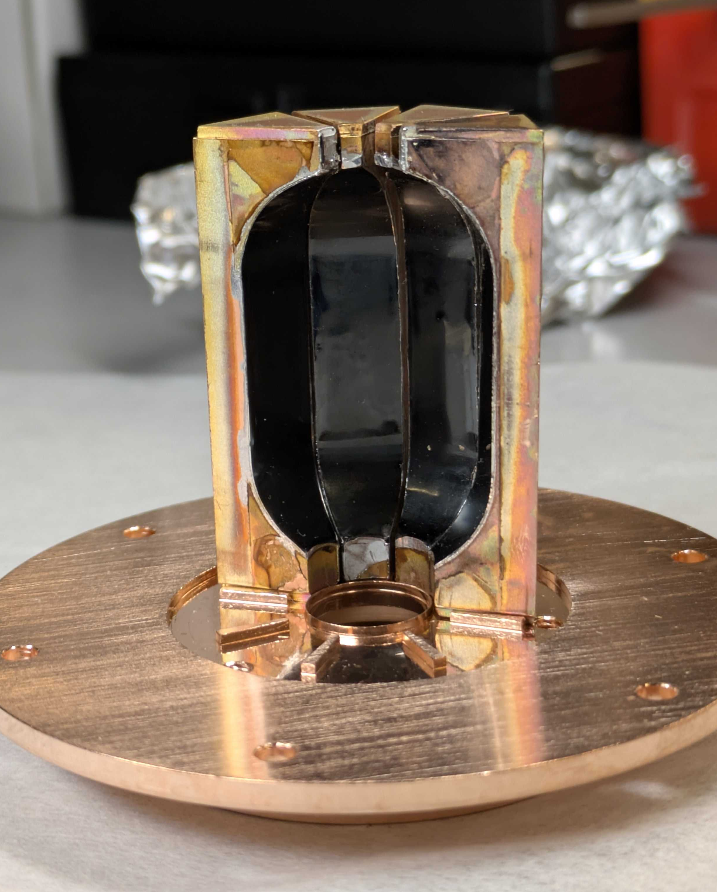
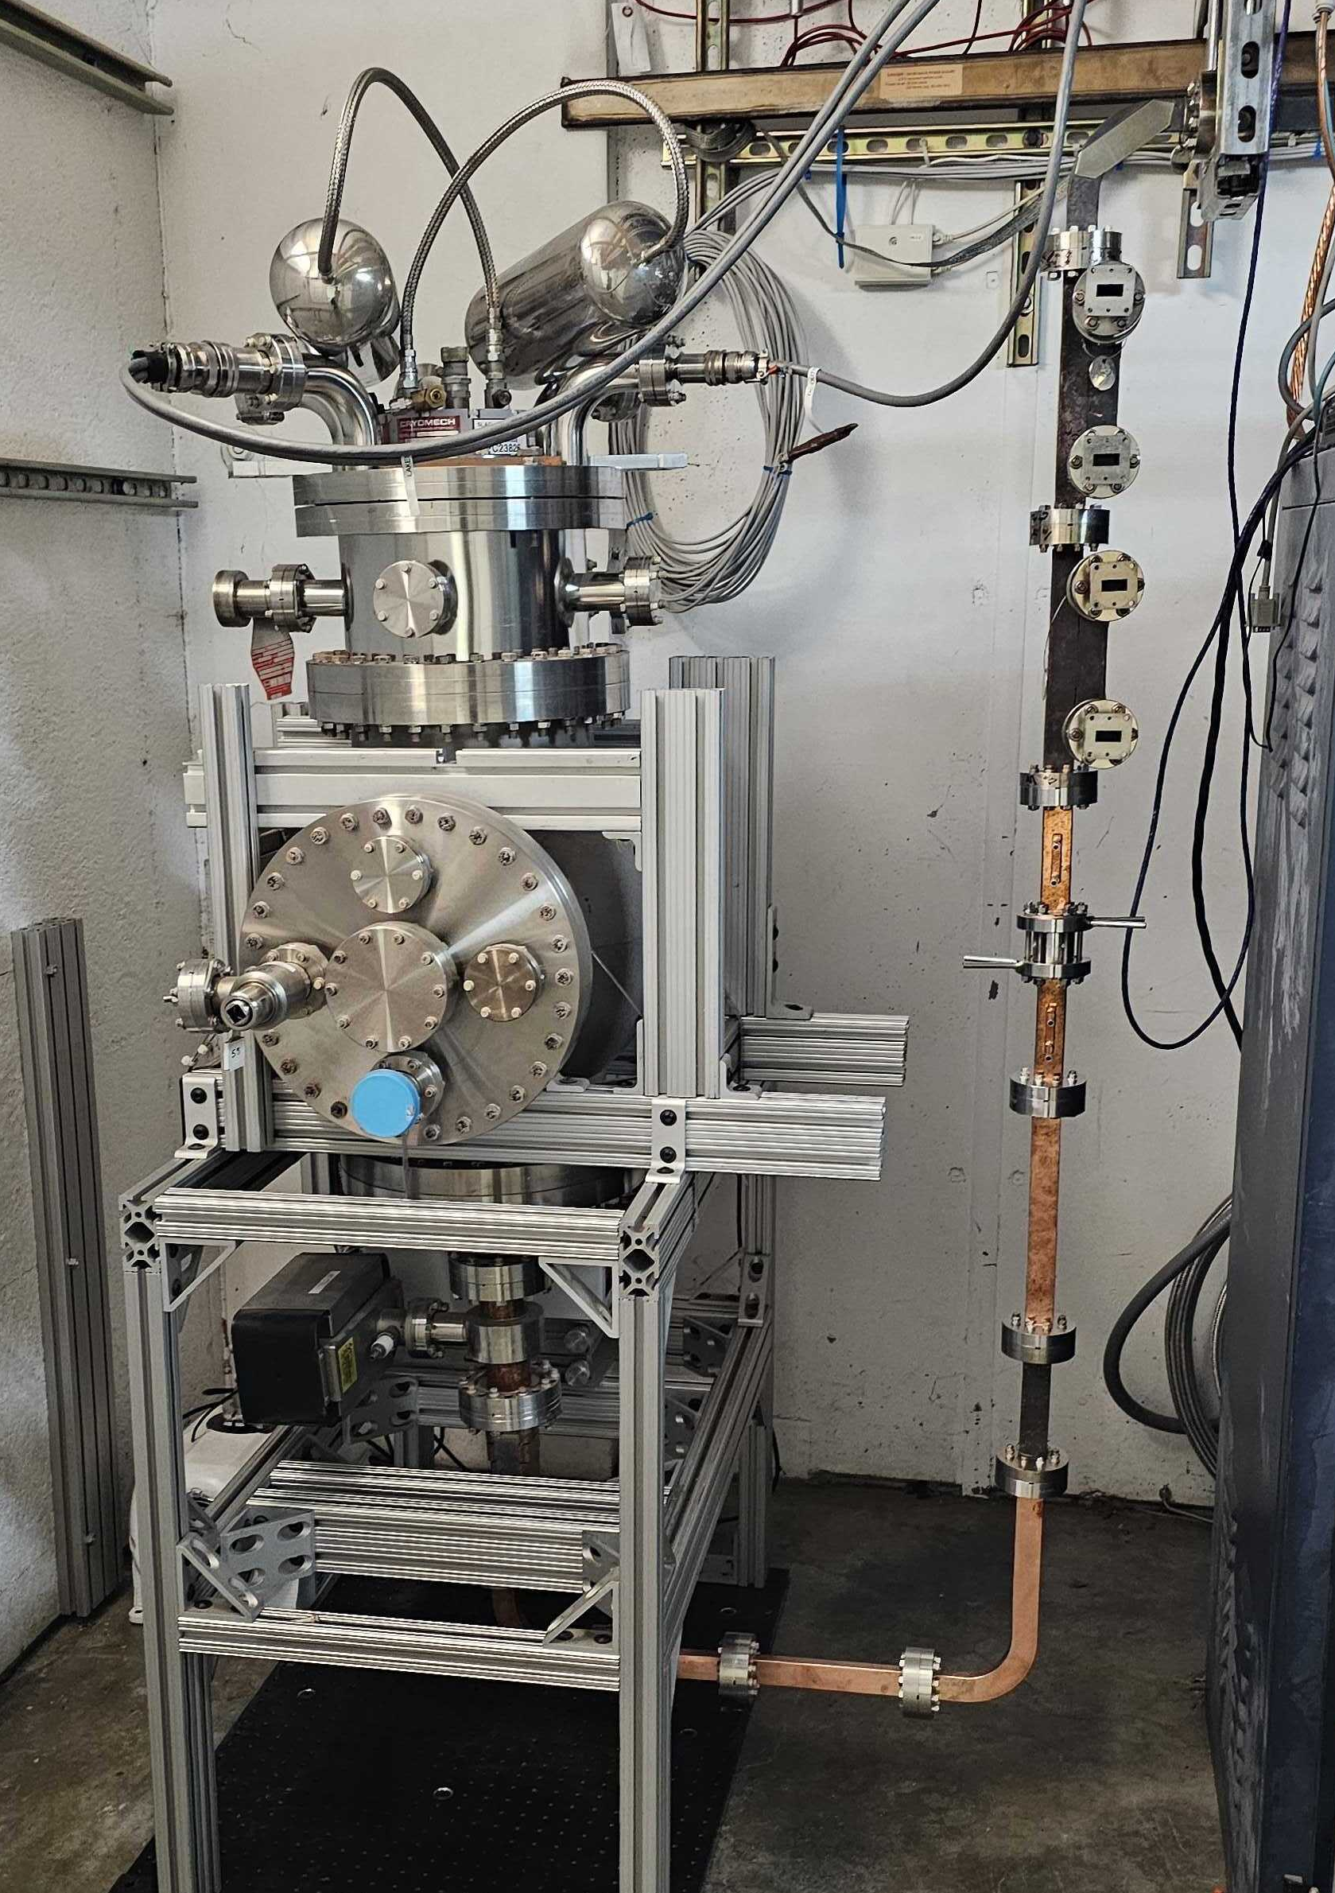
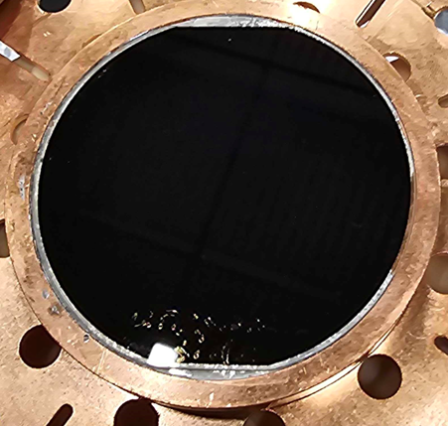
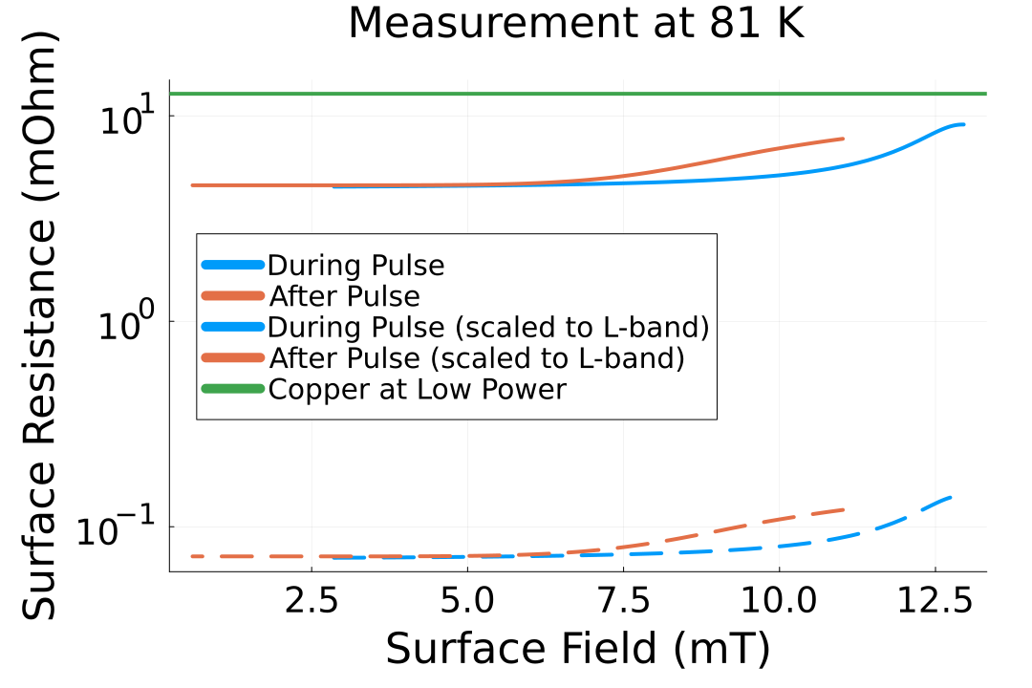
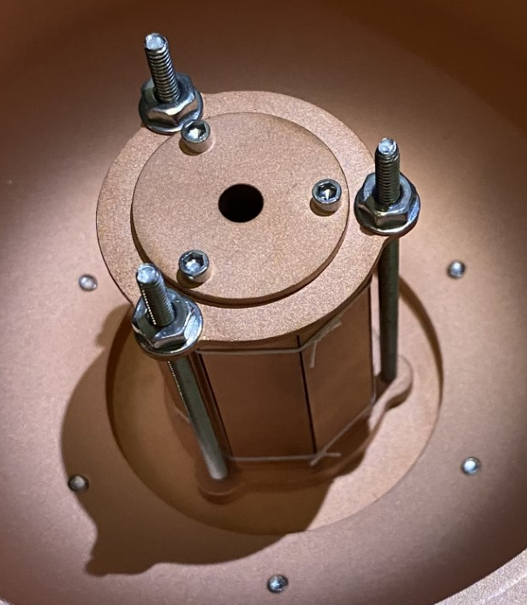
RF Testing of High Temp Superconductors (HTS)
Exploratory research to develop the basis for a HTS based RF cavity for pulse compression
Using the same cryostat that kicked off cold copper work, high power RF testing of HTS samples is underway
Samples are deposited on copper and MgO as well as HTS tapes or compressed pucks
HTS coated samples can function in strong magnetic fields, potential candidate for muon cooling cavities
Estimated Q₀ for HTS cavity using the TM010 mode at 77 K is 150,000 (versus 22,500 for copper)
Cryostat
HTS Sample
Surface Resistance with 1 kW
Prototype
HTS Cavity
2509.13668
HTS materials represent a new regime of SRF applications
HEP GARD RF Roadmap Update

Slide 18
Future R&D Directions for Cryogenic NCRF
Technological advances for cryogenic operation of accelerators benefits both Cu and HTS
Cryogenic operation should be further explored for high gradient and high efficiency applications, some examples:
Short pulse structures for high gradient
Linacs with damping slits for high efficiency
Injector linacs with wide apertures for high bunch charges and low wakefields
Cavities with embedded absorbers for muon cooling
Targets for the next ten years:
High power testing of accelerating structures with >300 MV/m operational accelerating gradient
Goal of reaching 6 GeV to replace booster rings in synchrotrons in more compact footprints
Operation of an injector linac for >10 nC bunches with shunt impedance >200 MΩ/m
Goal of improving efficiency for large bunch charges needed for future colliders
Cryogenic operation of cavities with >50 MV/m gradient in magnetic fields up to 5 T
Goal of reaching record breaking performance for muon cooling cavities
Stable operation of cryo-cooled photo-injector with cathode gradient of 300 MV/m
Goal of reaching <100 nm emittance for future light sources and hard X-ray FELs
All this development should build towards the larger use of cryomodules, as well as operation in a demo facility. This could be done in an analogous model to ESRF or in a dedicated facility.
HEP GARD RF Roadmap Update

Slide 19
Future R&D Directions for HTS RF
HTS RF structures could provide tremendous efficiency gains for cryogenic applications
HTS technology should be developed to improve technical readiness:
Could be used for Pulse compressors, Accelerating structures, and resonant structures for QIS applications
Ideal temperature range needs to determined to balance conductivity gains with cryogenic power consumption
At lower frequencies these conductivities greatly exceed that of copper, making efficiency operation more likely
Pulsed operation may still favor copper, but CW operation or high average power would favor HTS
Improvements to cavity formation, such as film deposition on curved surfaces, 3D printing of HTS surfaces
Targets for the next ten years:
High power testing of structures with surfaces equivalent to 50 MV/m gradient in a TESLA cavity
Milestone metric for SRF structures and opens direct benefits to Muon cooling channel
Operation of a 1 MW beam power accelerating structure above 50 K
Game-changer for efficiency high beam power applications like waste treatment
Cryocooled operation of an HTS structure for wall-plug efficiency of 30%
Opens up broader adoption of accelerators in power constrained environments
Integration of HTS input couplers into SRF systems to boost wall-plug efficiency
Benefit to HEP missions like Muon collider, FCC cavities, TESLA cavities as well as other SRF facilities
HEP GARD RF Roadmap Update

Slide 20
Case Study: CW Linac with 1 MW Beam Power
HTS RF Accelerator could provide high Q performance with higher cryogenic efficiency
MW-scale accelerators could provide game-changing improvements to intensity frontier facilities, as well as smaller accelerator driven systems like waste treatment, isotope production, and energy production.
As a comparison of the current state of the art, consider a 1 MW beam from L-band 20 MV/m accelerating cavity:
 | Niobium | HTS | Cold Copper | Copper
Temperature | 4 K | 80 K | 80 K | 300 K
Quality Factor | 10¹⁰ | 10⁷* | 10⁵ | 10⁴
Wall Loss | 15 W | 10 kW* | 700 kW | 18 MW
RF Power | 1 MW | 1.01 MW* | 1.7 MW | 11 MW
Cryogenic Load | 30 W | 10 kW* | 700 kW | N/A
Cryogenic Power | 30 kW | 100 kW* | 7 MW | N/A
Total Power | 1.03 MW | 1.11 MW* | 8.7 MW | 19 MW
* Targets for future development, further improvement would drive these savings even higher
HEP GARD RF Roadmap Update

Slide 21
Acknowledgements
Emilio Nanni
Mei Bai
Zenghai Li
Mohamed Othman
Wei-Hou Tan
Sami Tantawi
Glen White
Emma Snively
Andy Haase
Matt Boyce
Valery Borzenets
Dennis Palmer
FCC-ee
Bettoni Simona
Alexej Grudiev
Raguin Jean-Yves
Craievich Paolo
Zennaro Riccardo
Argonne National Lab
Ali Nassiri
William Berg
ESRF
Simone Liuzzo
Simon White
21

Slide 22
Questions?

Slide 23
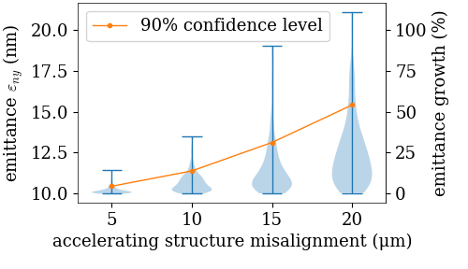
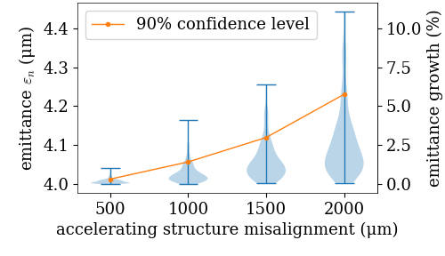
Beam Dynamics Studies for HEP Linac Applications
Studies needed to guide accelerator design and alignment tolerances with novel structures
Test Case: C³ main linac for tightest tolerances
Single bunch studies used for studying alignment tolerances
Similar studies were done for FCC HE-Linac design study to determine applicability
Large aperture and lower frequency make this design extremely robust
C³ Main Linac
FCC High Energy Linac
Cool Copper Collider Workshop (2024)
FCC Week 2024
Distributed coupling structures can maintain emittance to strictest tolerances required for HEP facilities
HEP GARD RF Roadmap Update

