Slide 1

GARD RF Roadmap for NCRF structures: current status and the update initiative
Evgenya Simakov
Los Alamos National Laboratory
January 20, 2026
Managed by Triad National Security, LLC., for the U.S. Department of Energy’s NNSA.

Slide 2
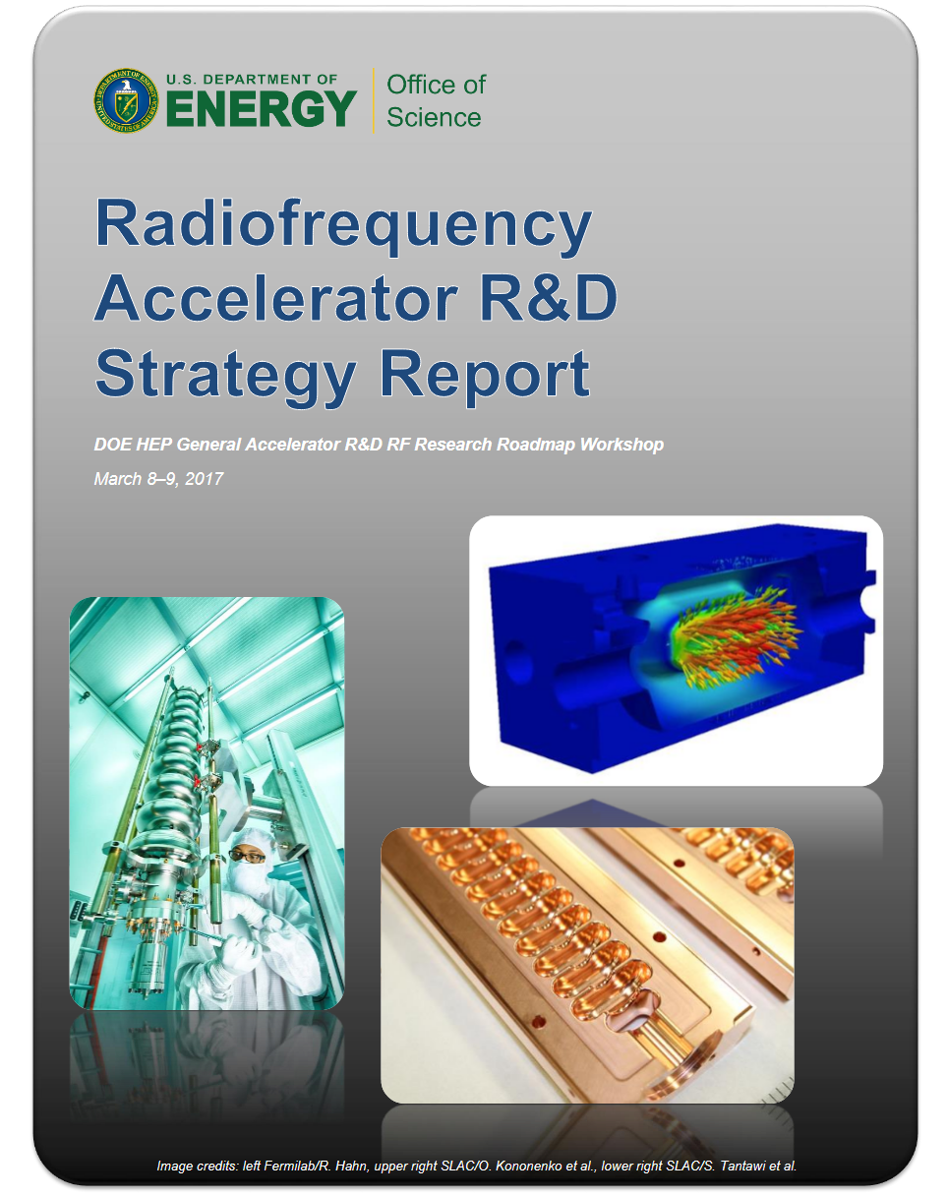
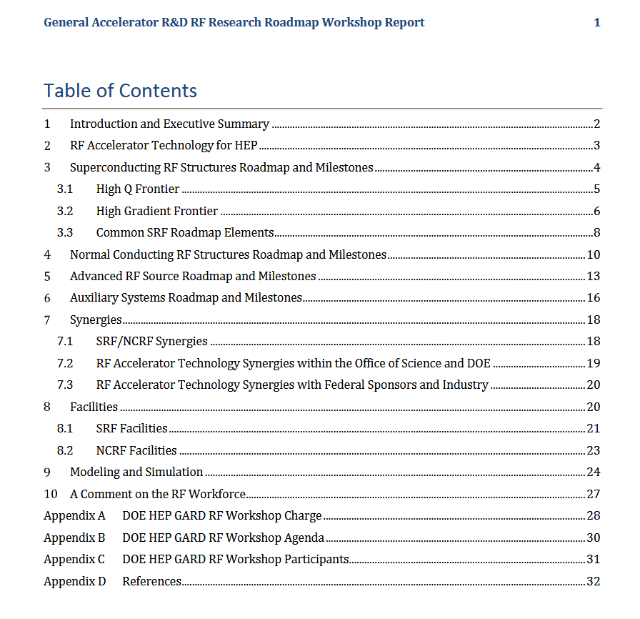
The last decadal GARD RF Roadmap was published in 2017

Slide 3
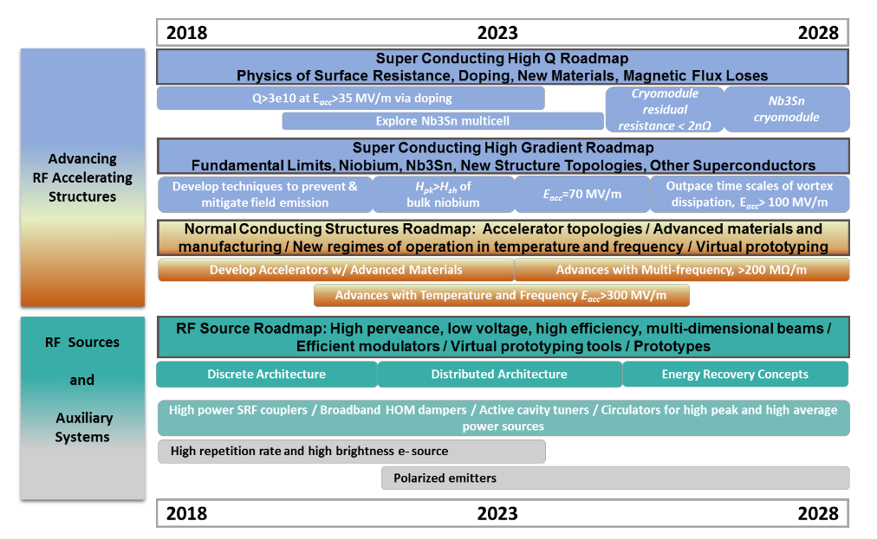
General accelerator R&D RF research roadmap
Focus on improving accelerator structures, RF sources, and auxiliary systems

Slide 4
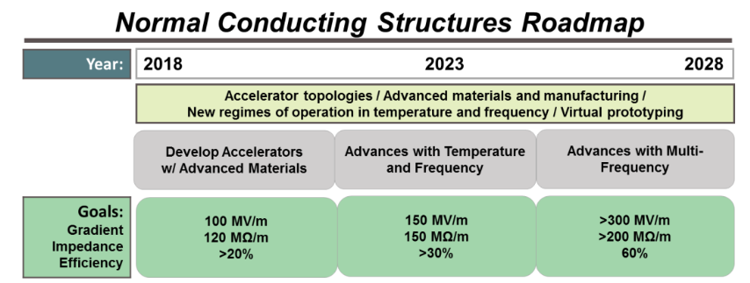
Decadal roadmap for the normal conducting structures
Focus on pushing the gradient and acceleration efficiency. Reducing production cost was also mentioned.

Slide 5
Decadal roadmap for the normal conducting structures
Focus on pushing the gradient and acceleration efficiency. Reducing production cost was also mentioned.

Slide 6
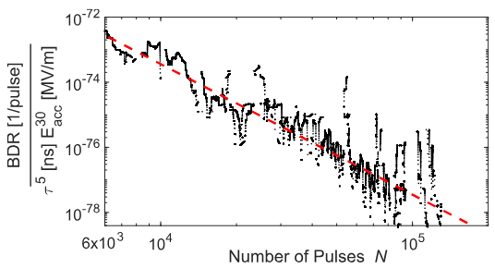
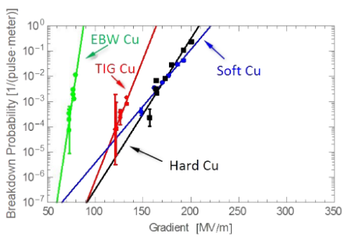
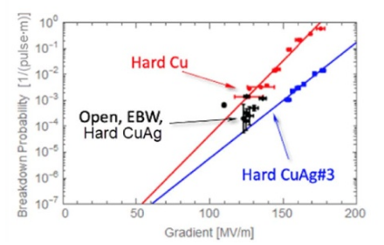
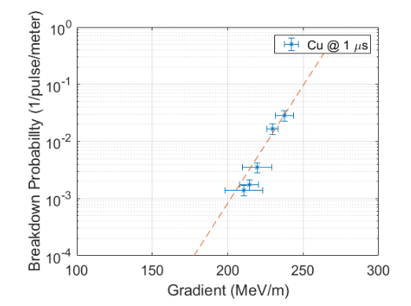
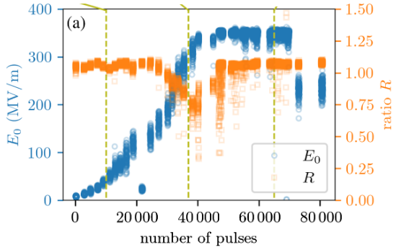
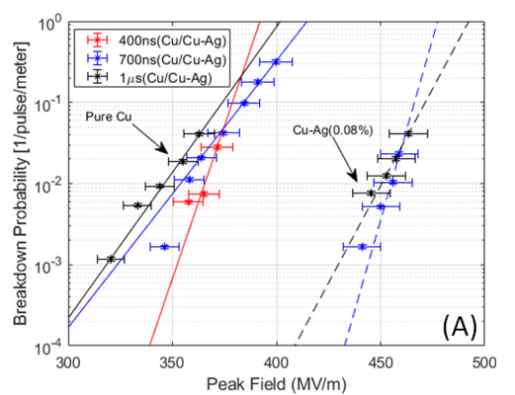
Notable results from the last decade – short structures
Three-cell, 110 GHz, 10 ns pulse, 230 MV/m gradient
Three cell, 11.424 GHz, EBW and TIG hard Cu
Three cell, 11.424 GHz, EBW hard Cu
R. Agustsson et al., J. Phys. D: Appl. Phys. 55, 145001 (2022).
M.A. K. Othman et al., Appl. Phys. Lett. 117, 073502 (2020).
V. Dolgashev et al., Phys. Rev. AB 24, 081002 (2021).
Single-cell, 5.712 GHz, Cu and CuAg
Single-cell, 5.712 GHz, cryo-cooled.
1.5 cell RF injector, 11.7 GHz, 9 ns pulse
M. Schneider et al., doi: 10.18429/JACoW-IPAC2024-MOPR29
W. H. Tan et al., Phys. Rev. AB 25, 083402 (2022).
M. Schneider et al., Appl. Phys. Lett. 121, 254101 (2022).

Slide 7
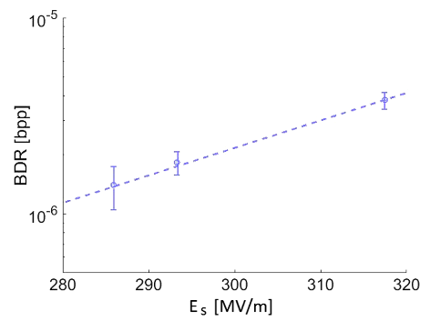
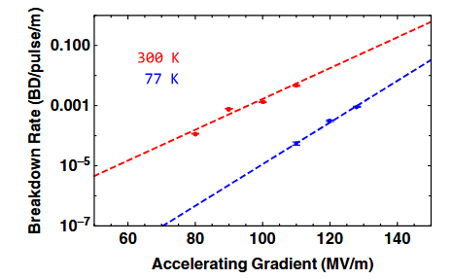
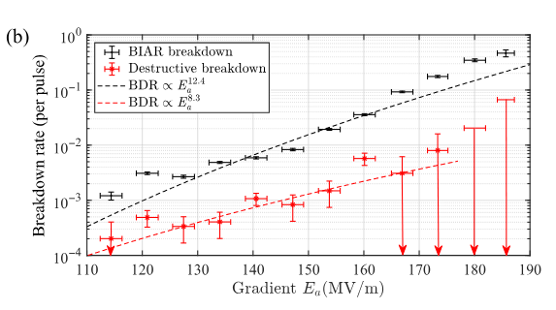
Notable results from the last decade – multicell structures
“Breakdown insensitive acceleration regime”, 11.7 GHz metamaterial structures, 6 ns pulses
12 cells, 2.9985 GHz, 2.5 µs pulse width, proton structure
20 cells, 11.424 GHz, room temperature and cryo-cooled
A. Vnuchenko et al., Phys. Rev. AB 23, 084801 (2020).
M. Nasr et al., Phys. Rev. AB 24, 093201 (2021).
D. Merenich et al., Phys. Rev. AB 27, 041301 (2024).

Slide 8
Goals of the GARD RF Roadmap Refresh initiative
The landscape has evolved considerably since 2017, notably with the recent release of a new P5 report in 2023 and budgetary constraints. The GARD program manager Derun Li launched an initiative to update the GARD RF Roadmap with specific goals to:
Identify high impact R&D topics.
Define near, mid, and far term goals.
Ascertain the community’s most urgent priorities.
Evaluate workforce development needs.
At all stages we welcome your input and feedback.

