Slide 1

GrapPA Shower Optimization Experiments
(January 7, 2026)
Z. Djurcic, M. Bilal Azam et. al.

Slide 2
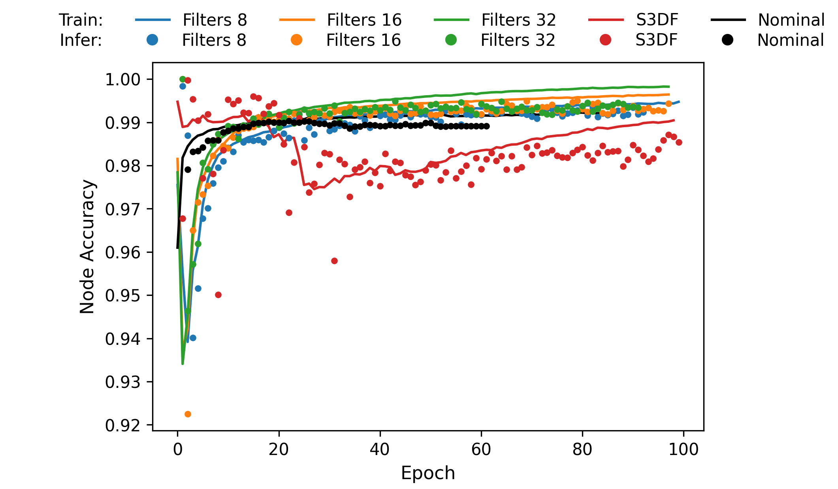
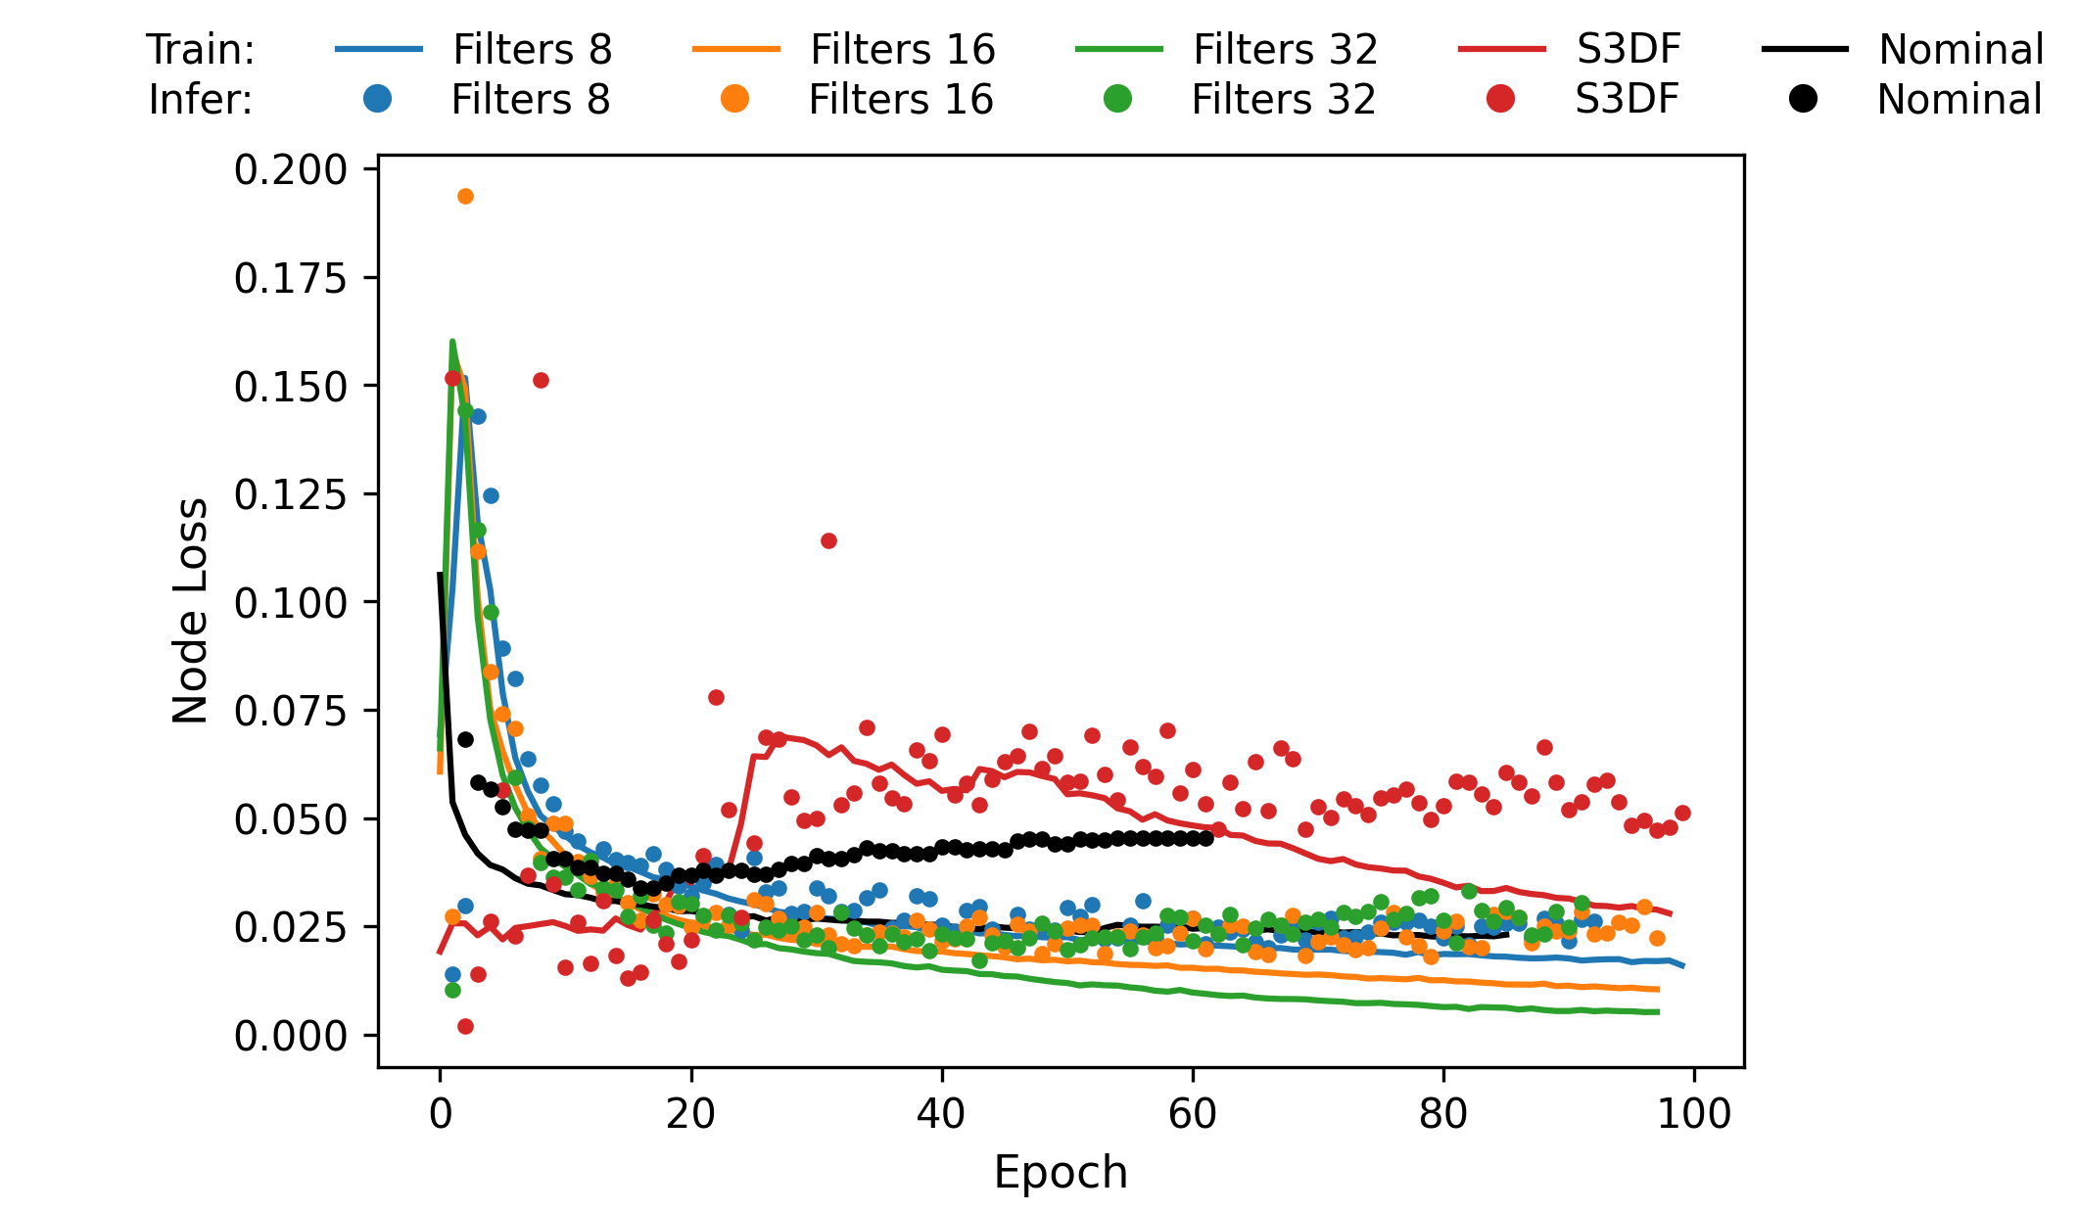
Phase 5 - Filters: Node Accuracy and Node Loss
Configuration: CNN Node Encoder only (Edge Encoder removed)
Hyperparameters: Reps 3; Depths 3; Filters 8/16/32; Coord_Conv True.

Slide 3
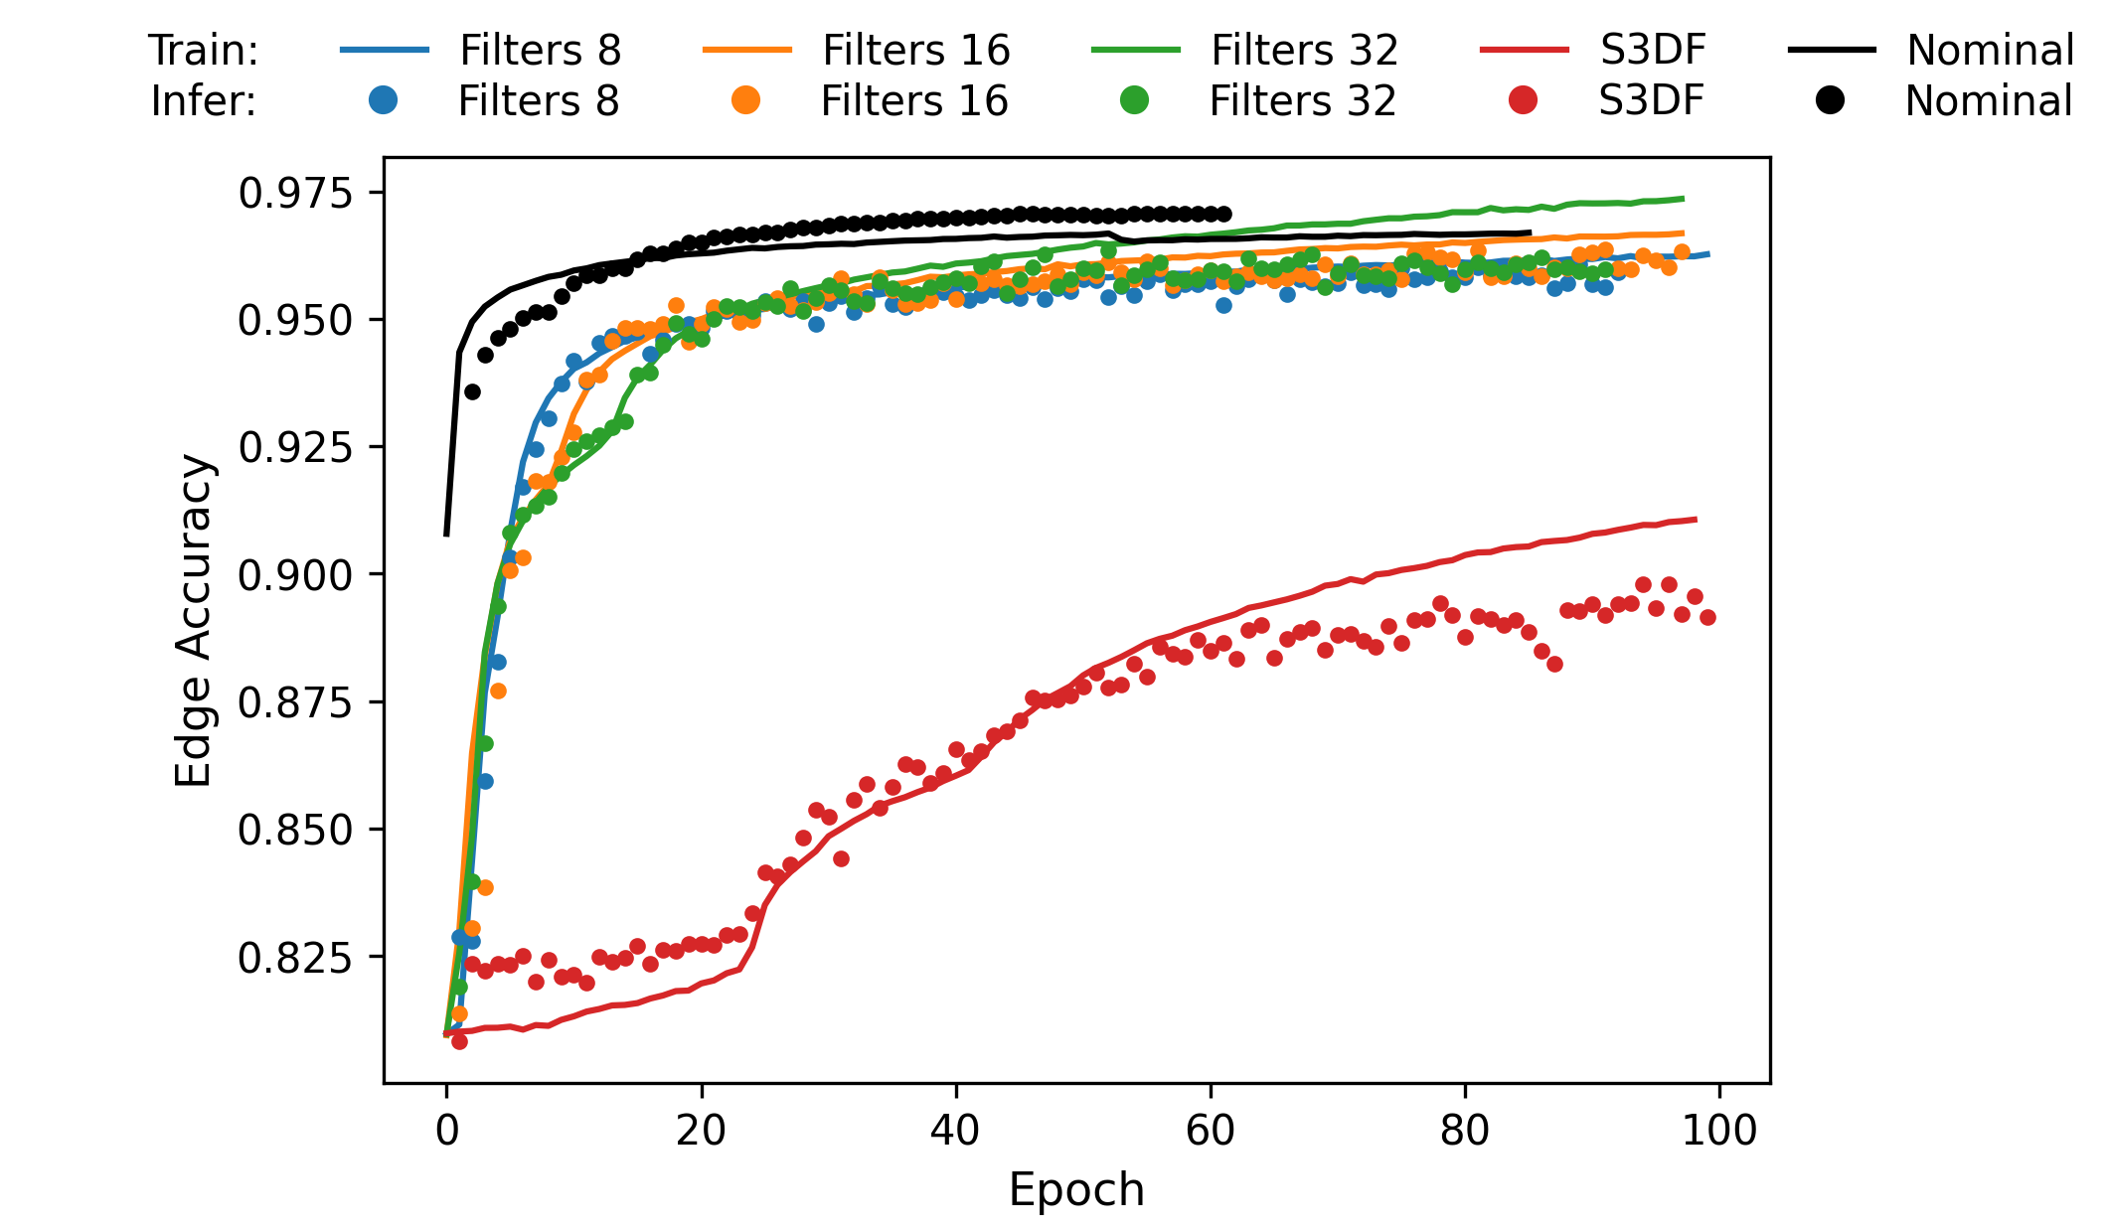
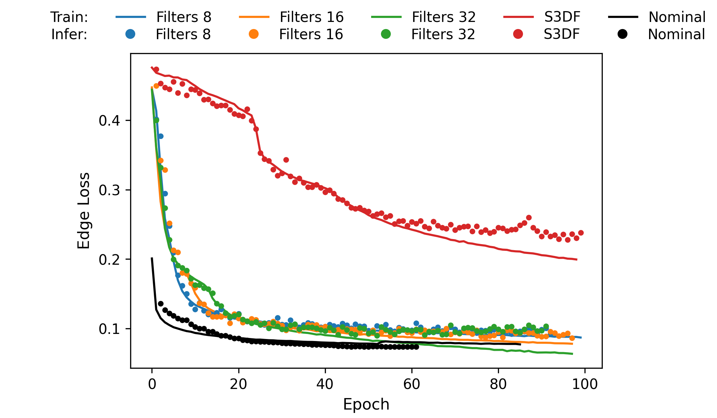
Phase 5 - Filters: Edge Accuracy and Edge Loss

Slide 4
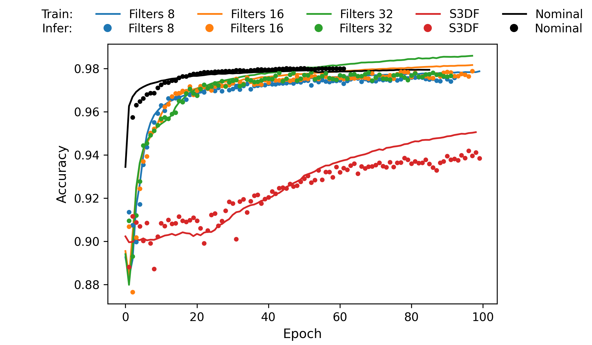
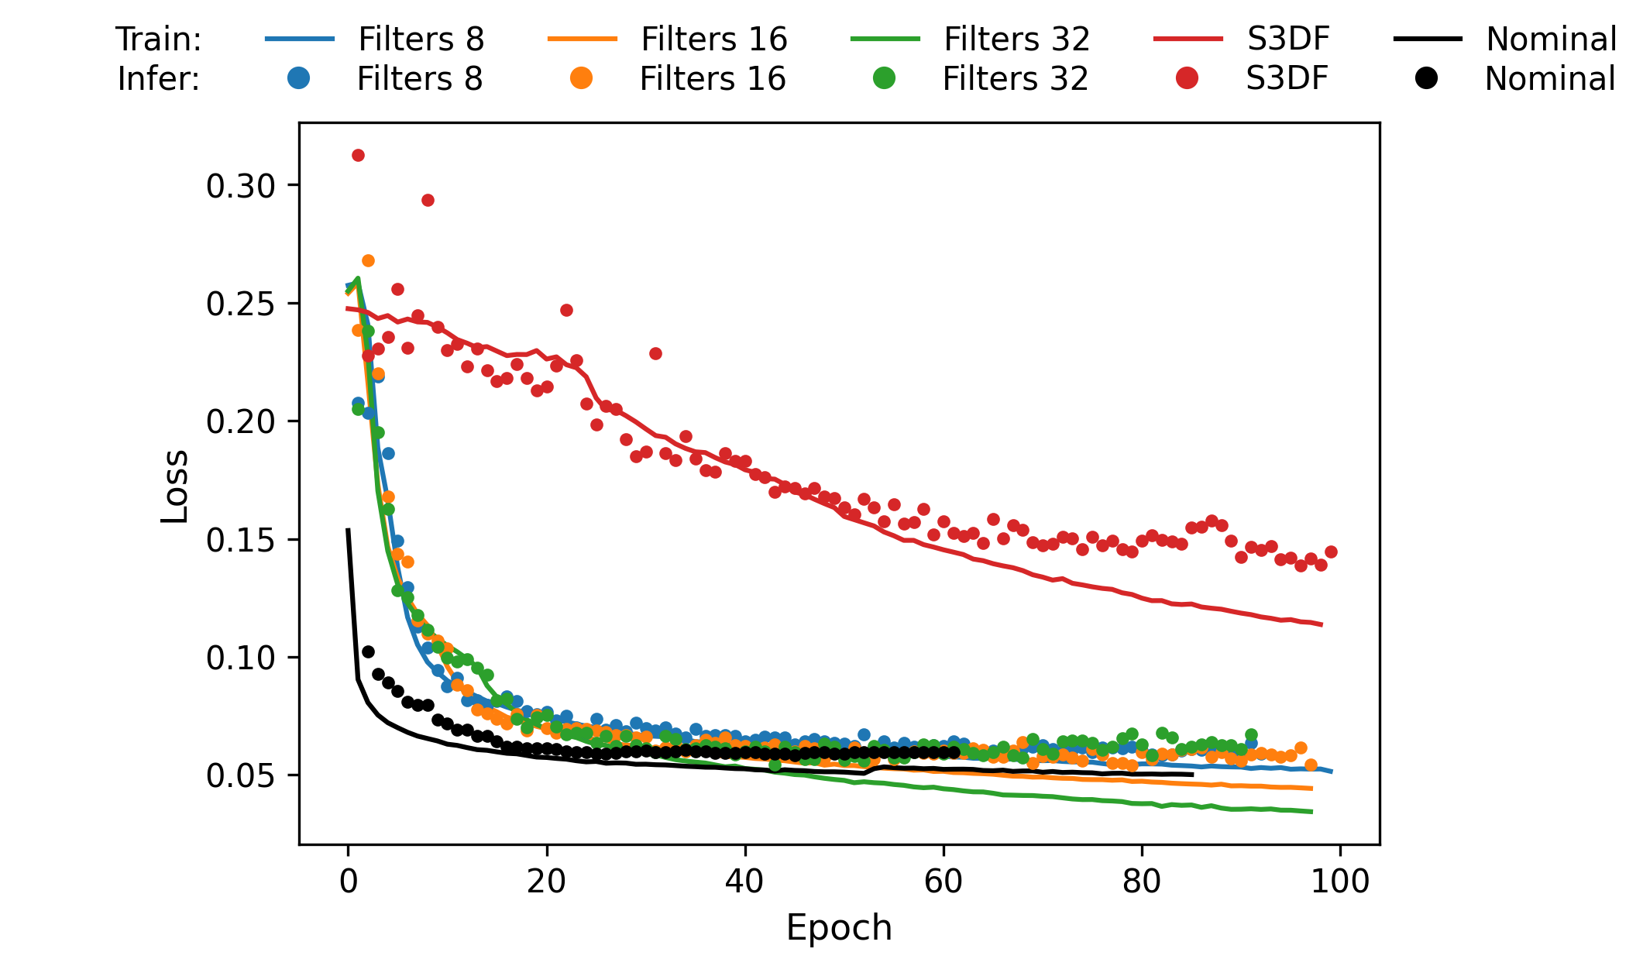
Phase 5 - Filters: Total Accuracy and Total Loss

Slide 5
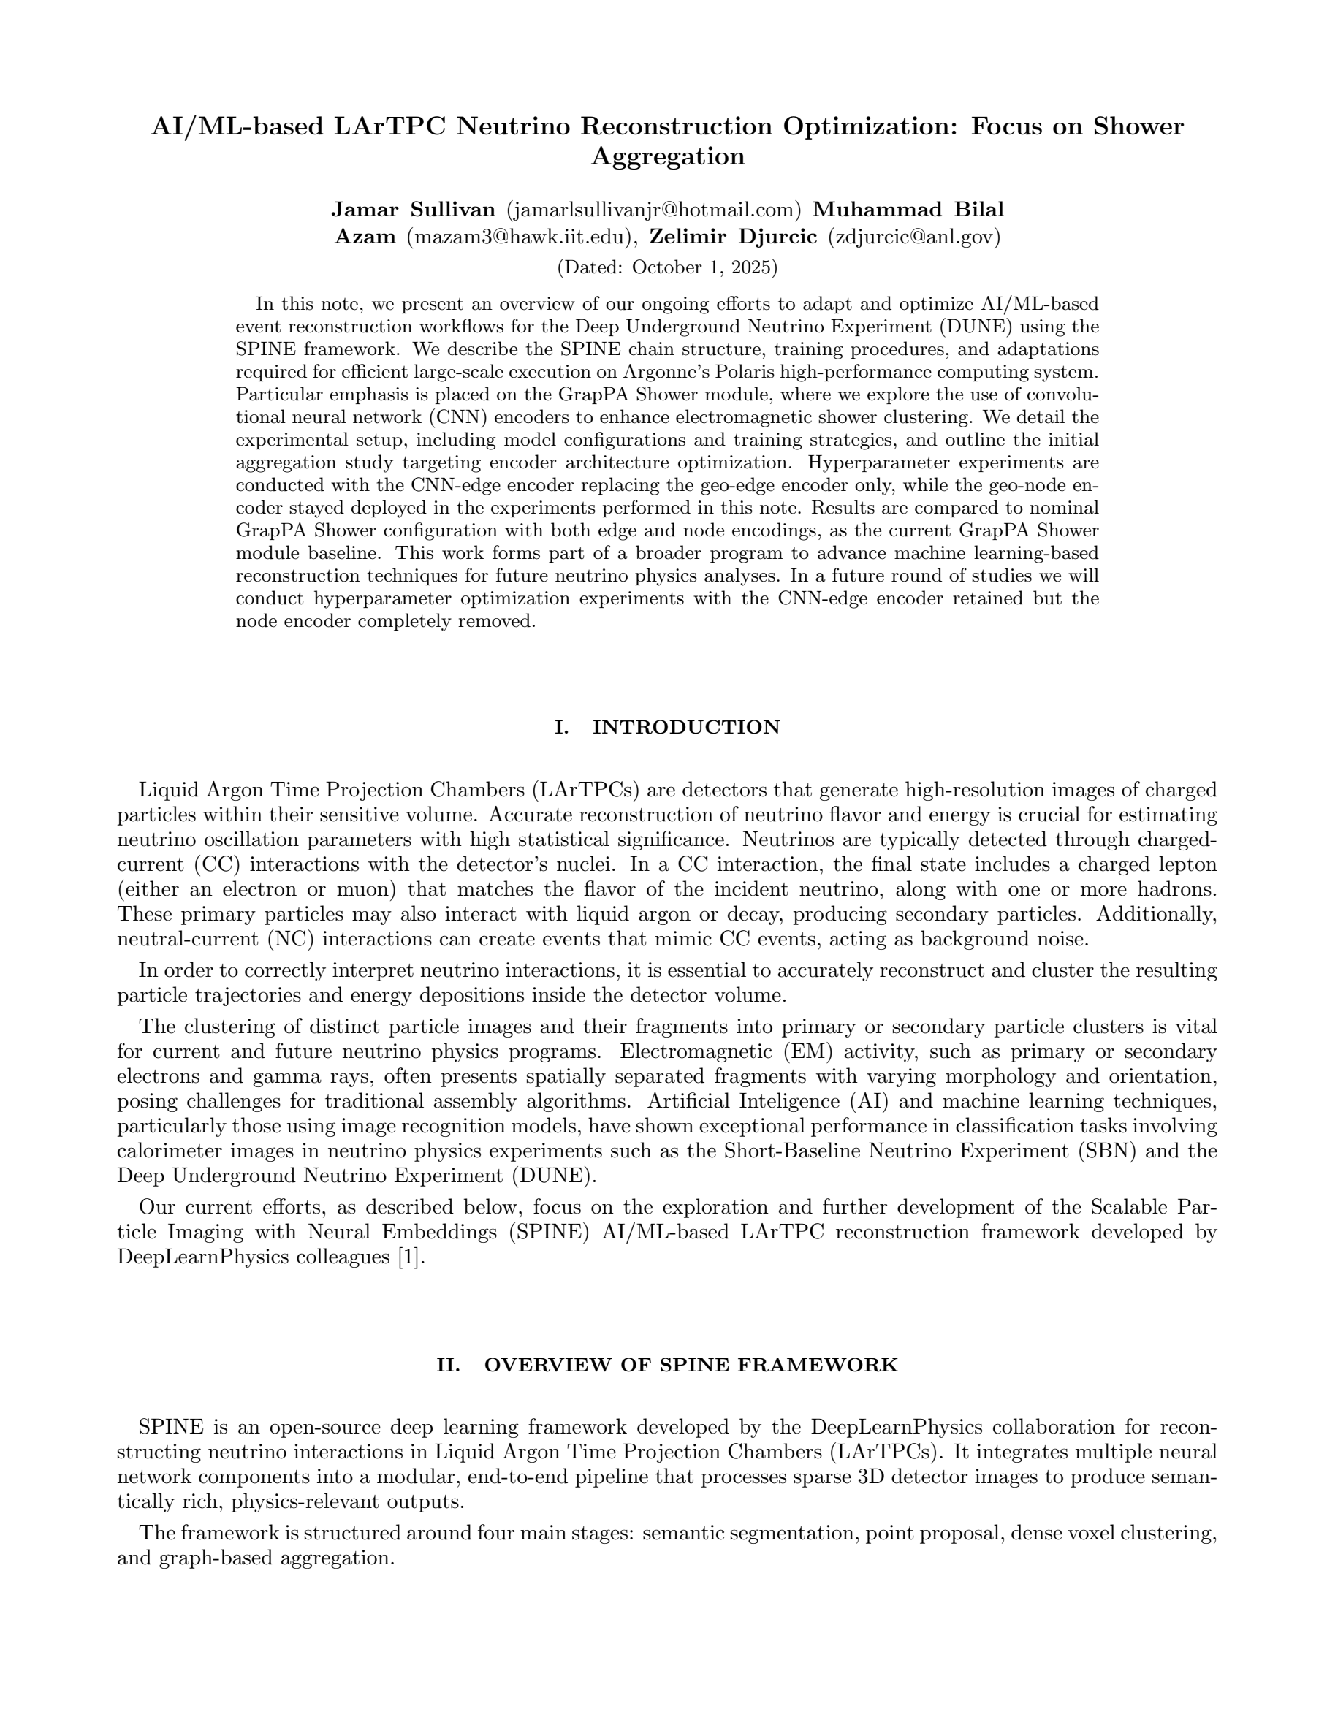
Tech Note and Ongoing Optimization Studies
Round 1: Completed Optimization Phase
  Configuration: CNN Edge Encoder + Geometric Node Encoder
  Technote is submitted on DocDB (DUNE-doc-34923-v1)
Round 2: Completed Optimization Campaign
  Configuration: CNN Edge Encoder only (Node Encoder removed)
  Maintaining identical hyperparameter settings as in Round 1
Round 3: Current Optimization Campaign
  Configuration: CNN Edge Encoder + CNN Node Encoder
  Maintaining identical hyperparameter settings across both encoders as Round 1
Round 5: Current Optimization Campaign
  Configuration: CNN Node Encoder only (Edge Encoder removed)
  Maintaining identical hyperparameter settings as of Rounds 1 with an addition of coord_conv: true parameter
  Run another configuration with Francois’ Hyperparameter Settings (shown on Slide 6)

Slide 6
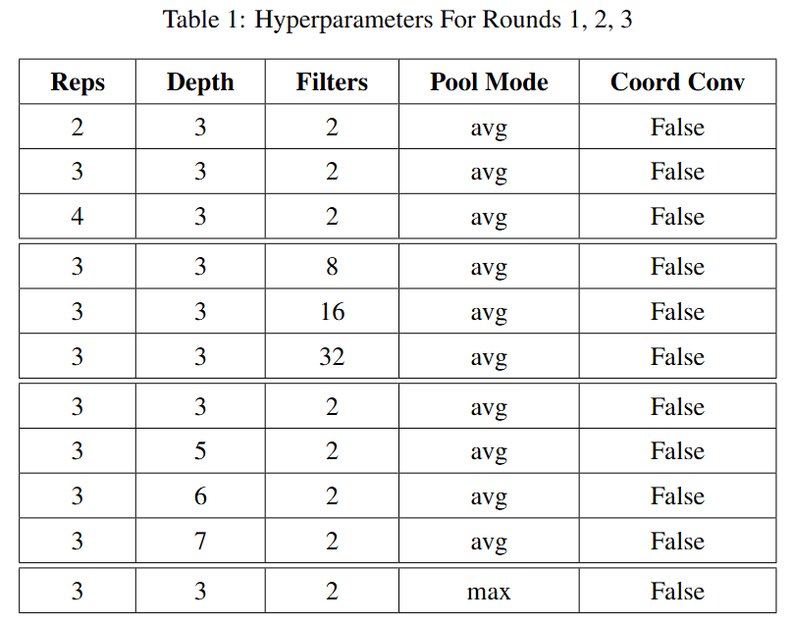
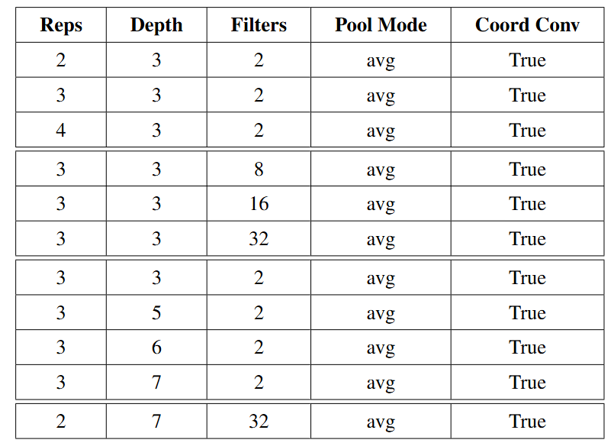
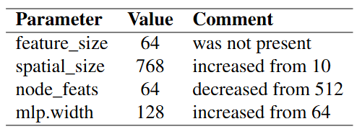
Tech Note and Ongoing Optimization Studies
Parameter setting for Rounds 1, 2, 3
Parameter setting for Round 5
S3DF (Francois’ Settings)
Apart from these settings, several additional parameters were introduced for the CNN block in Round 5.

