Slide 1
Modeling of Radiation Impact Physics and Phonon Dynamics at PNNL
Jake Inman
June 15, 2026

Slide 2
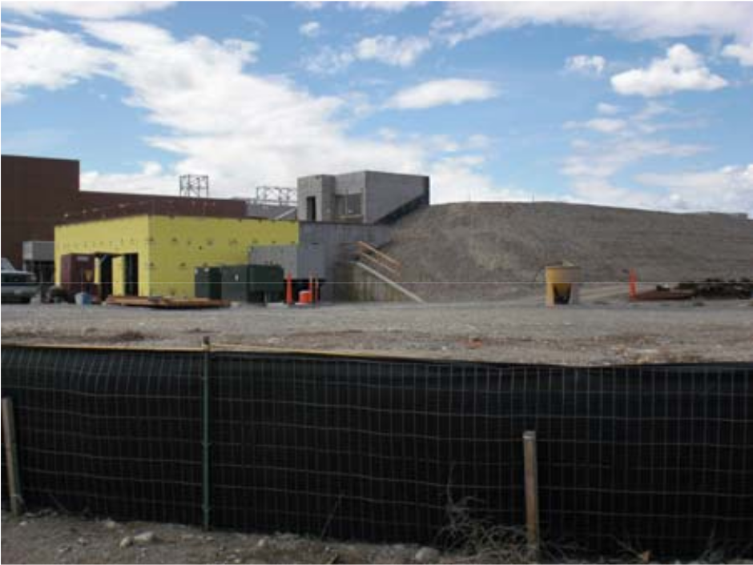
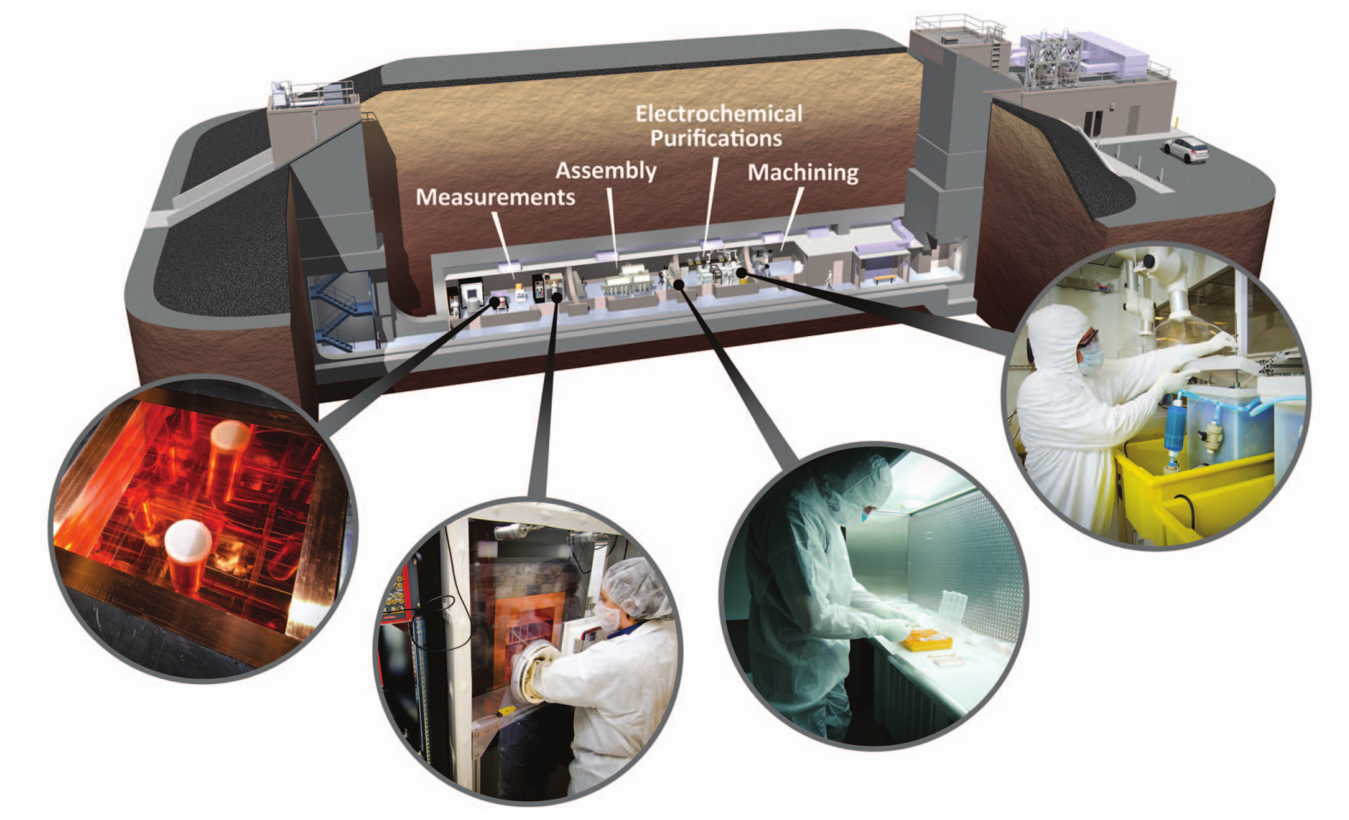
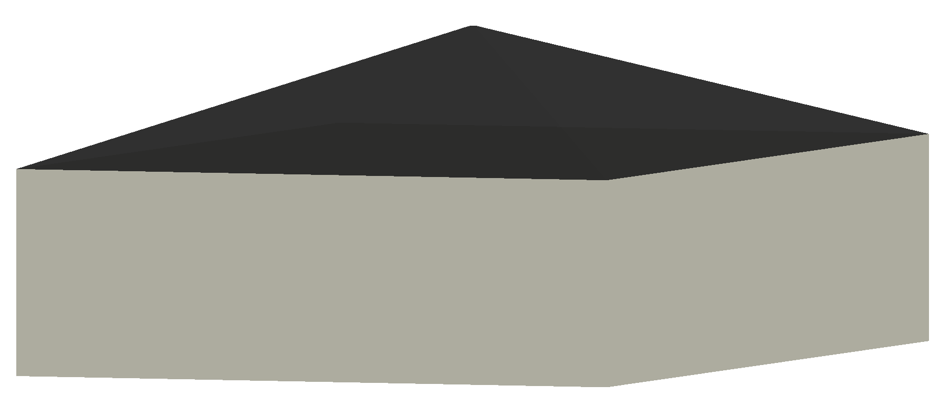
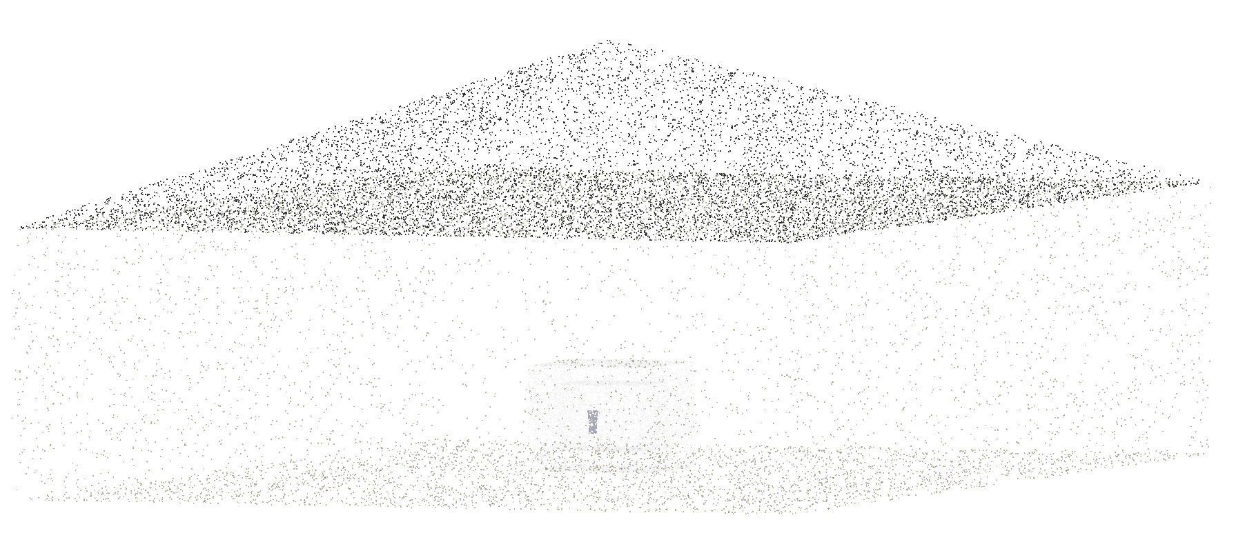
Low Background Cryogenic Facility (LBCF) Experiments
SUL: 9.1 m overburden + 10 m earthen bunker = ~35 mwe

Slide 3
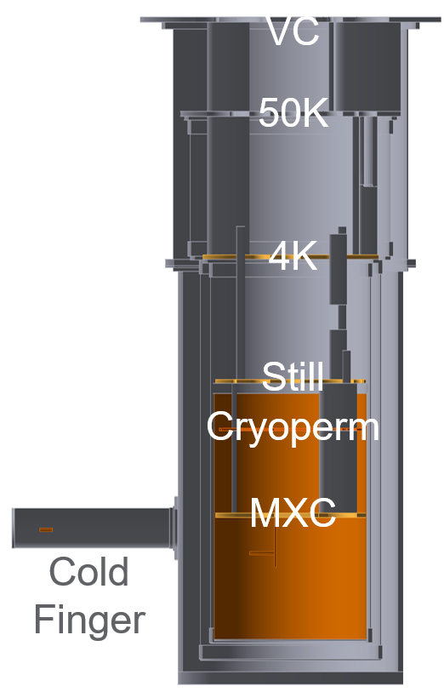
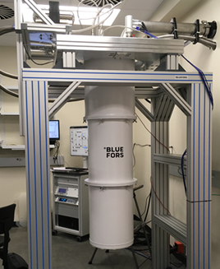
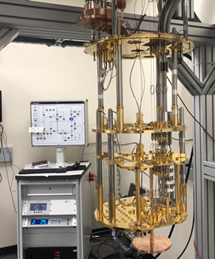
Low Background Cryogenic Facility (LBCF) Experiments
SUL: 9.1 m overburden + 10 m earthen bunker = ~35 mwe
LBCF fridge: BlueFors LD400

Slide 4
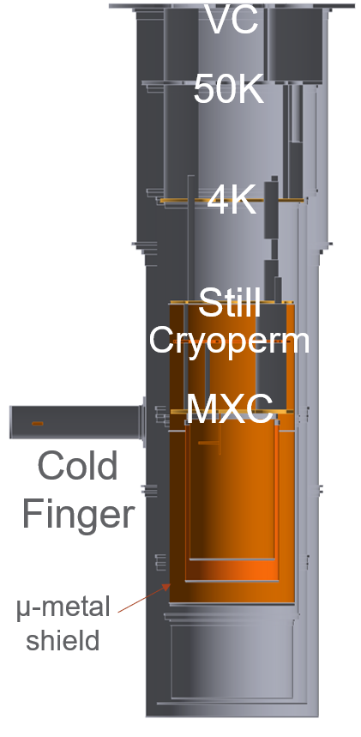
Low Background Cryogenic Facility (LBCF) Experiments
GPCL/STV configuration
LBCF configuration
SUL: 9.1 m overburden + 10 m earthen bunker = ~35 mwe
LBCF fridge: BlueFors LD400

Slide 5

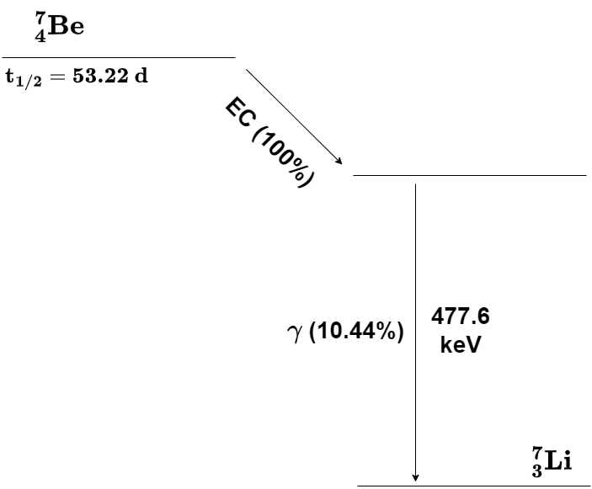
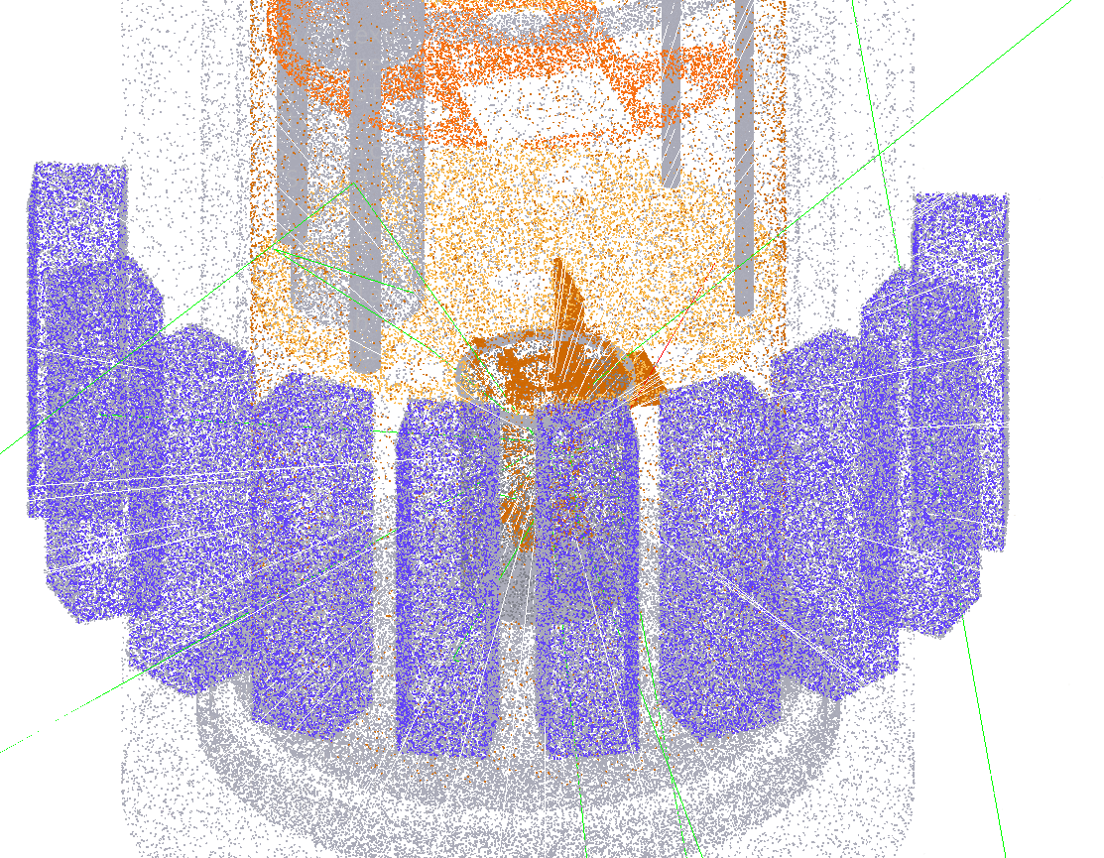
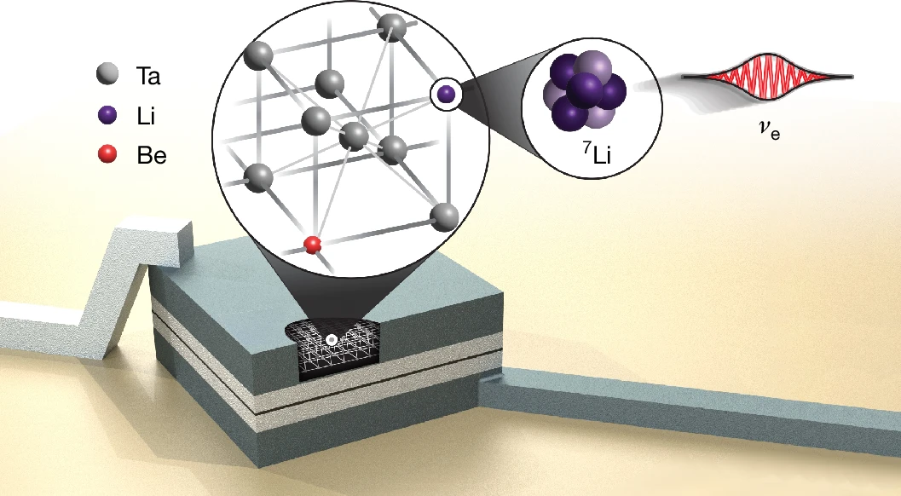
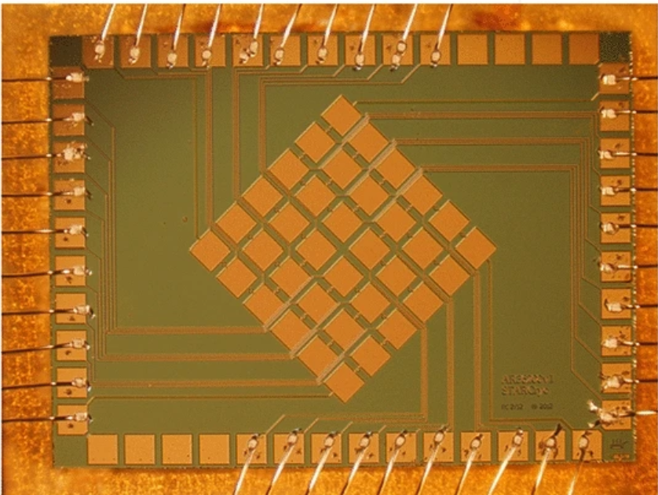
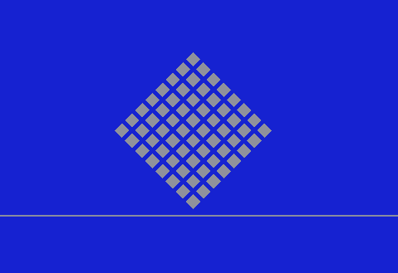
Low Background Cryogenic Facility (LBCF) Experiments
BeEST collaboration
  Radiation background environment
  Coincidence counting
  Readout simulation
doi:10.1038/s41586-024-08479-6
doi:10.1007/s10909-022-02759-z
Notes:
The BeEST experiment searches for sterile neutrinos in the keV mass range using the nuclear electron capture decay of 7Be implanted into STJs
Based on momentum reconstruction of the eV-scale 7Li nuclear recoil energy spectrum following neutrino emission

Slide 6
BeEST Collaboration Simulations
Background sources
  STJ ⁷Be decay gamma-rays
doi:10.1038/s41586-024-08479-6
doi:10.1007/s10909-022-02759-z
Notes:
The BeEST experiment searches for sterile neutrinos in the keV mass range using the nuclear electron capture decay of 7Be implanted into STJs
Based on momentum reconstruction of the eV-scale 7Li nuclear recoil energy spectrum following neutrino emission

Slide 7
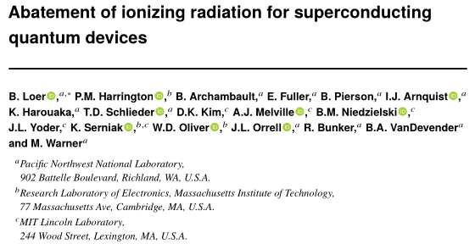
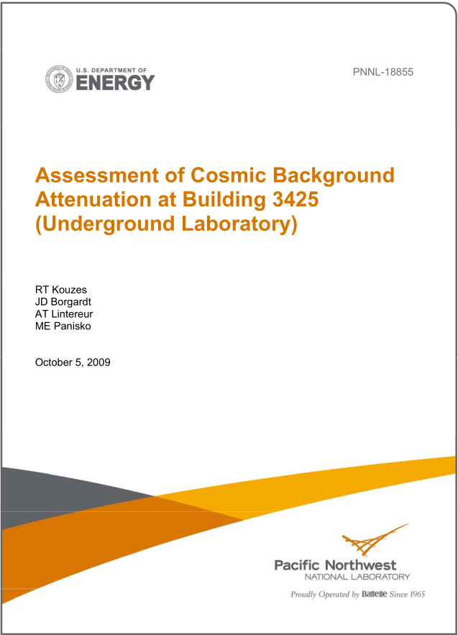
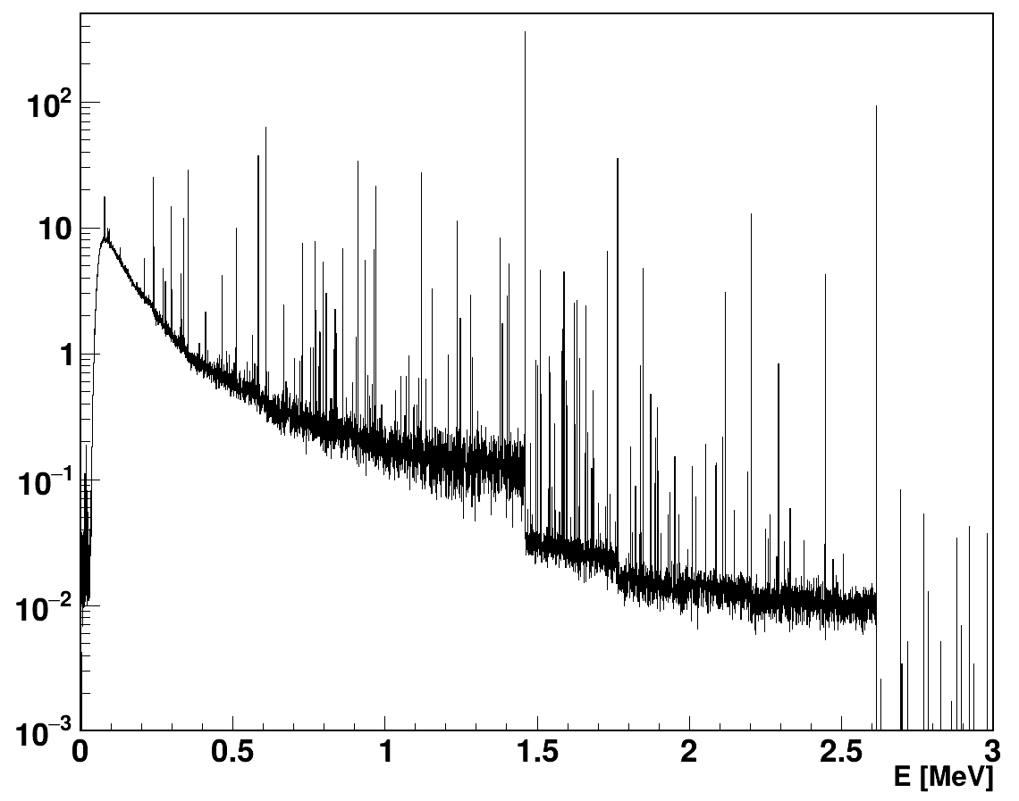
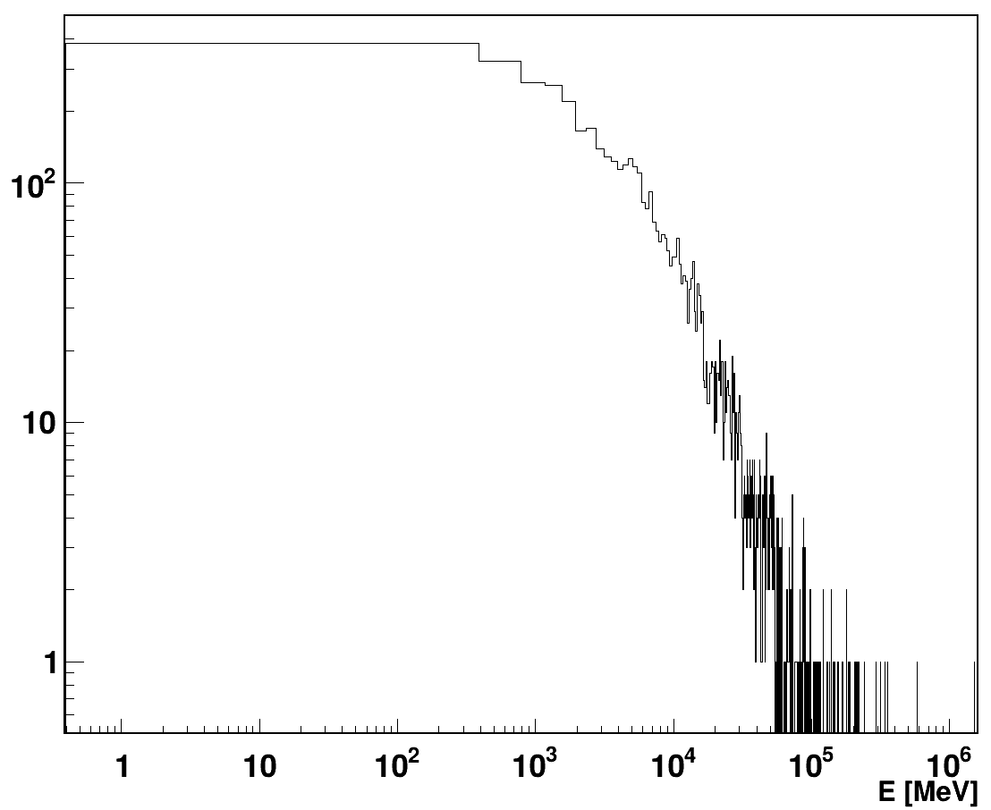
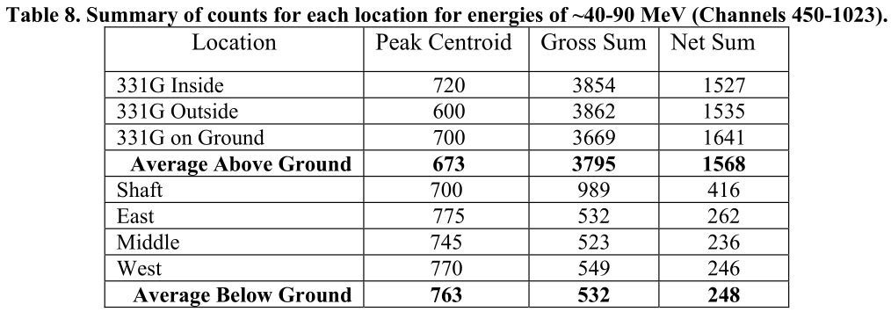
BeEST Collaboration Simulations
Background sources
  STJ ⁷Be decay gamma-rays
  Terrestrial gamma-rays
  Cosmic rays
arXiv:2403.01032
doi:10.2172/967232
Notes:
The BeEST experiment searches for sterile neutrinos in the keV mass range using the nuclear electron capture decay of 7Be implanted into STJs
Based on momentum reconstruction of the eV-scale 7Li nuclear recoil energy spectrum following neutrino emission

Slide 8
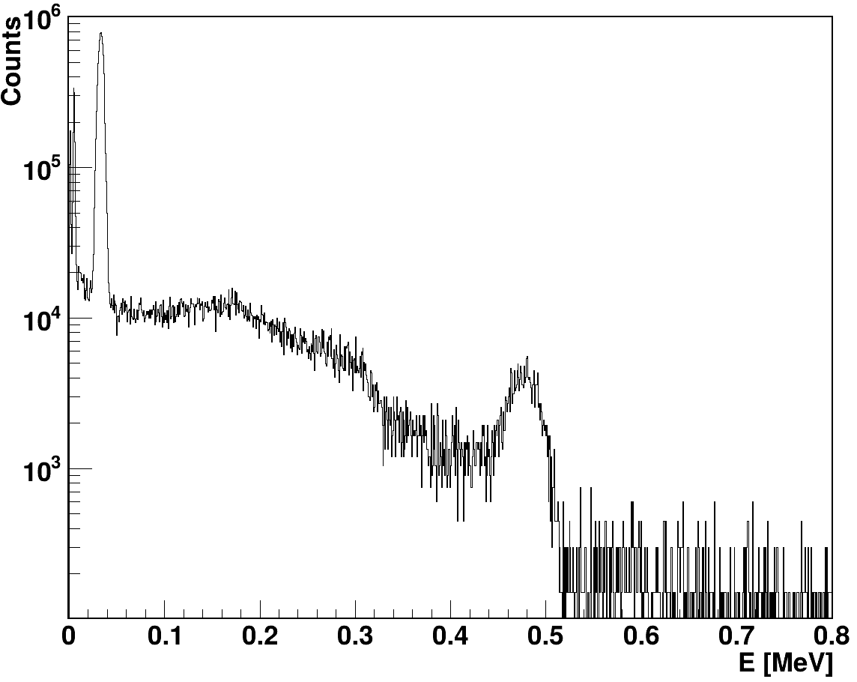
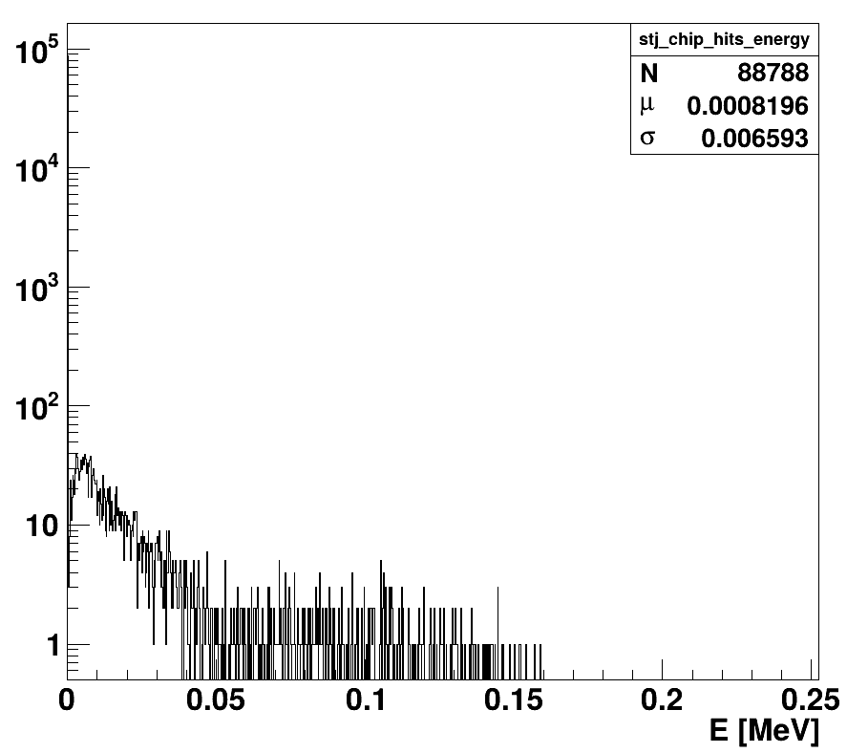
BeEST Collaboration Simulations
Background sources
  STJ ⁷Be decay gamma-rays
  Terrestrial gamma-rays
  Cosmic rays
NaI
Iodine Kα
arXiv:2403.01032
STJ
doi:10.2172/967232
Notes:
The BeEST experiment searches for sterile neutrinos in the keV mass range using the nuclear electron capture decay of 7Be implanted into STJs
Based on momentum reconstruction of the eV-scale 7Li nuclear recoil energy spectrum following neutrino emission

Slide 9
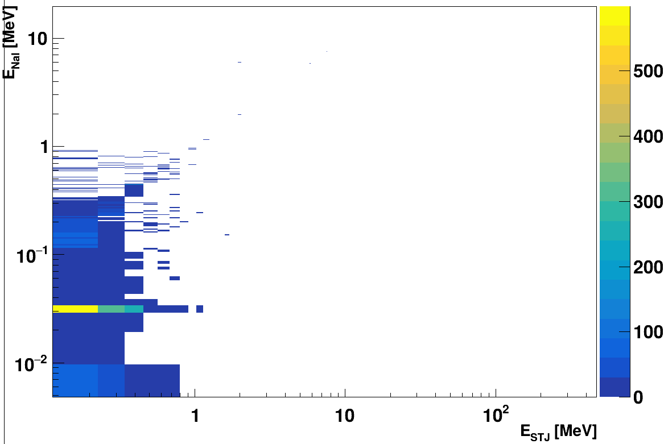
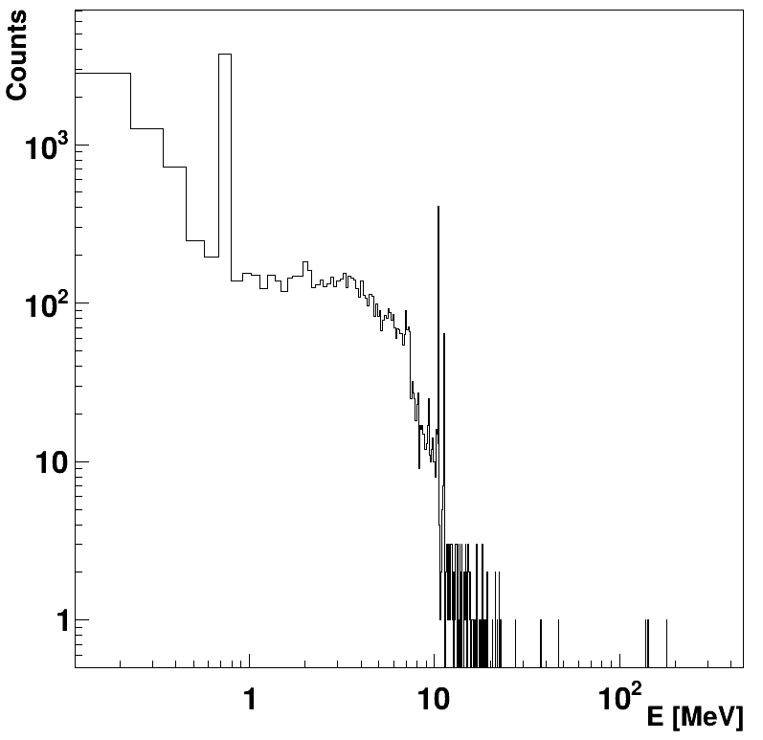
BeEST Collaboration Simulations
Coincidence counting
  Custom ROOT class
  Online or post-processing
  Cross-compatible with numerous data streams:
    HEP+CMP digitizer output (CAEN, Mirion, Ortec, XIA)
    Geant4 simulation ntuples
Notes:
The BeEST experiment searches for sterile neutrinos in the keV mass range using the nuclear electron capture decay of 7Be implanted into STJs
Based on momentum reconstruction of the eV-scale 7Li nuclear recoil energy spectrum following neutrino emission

Slide 10
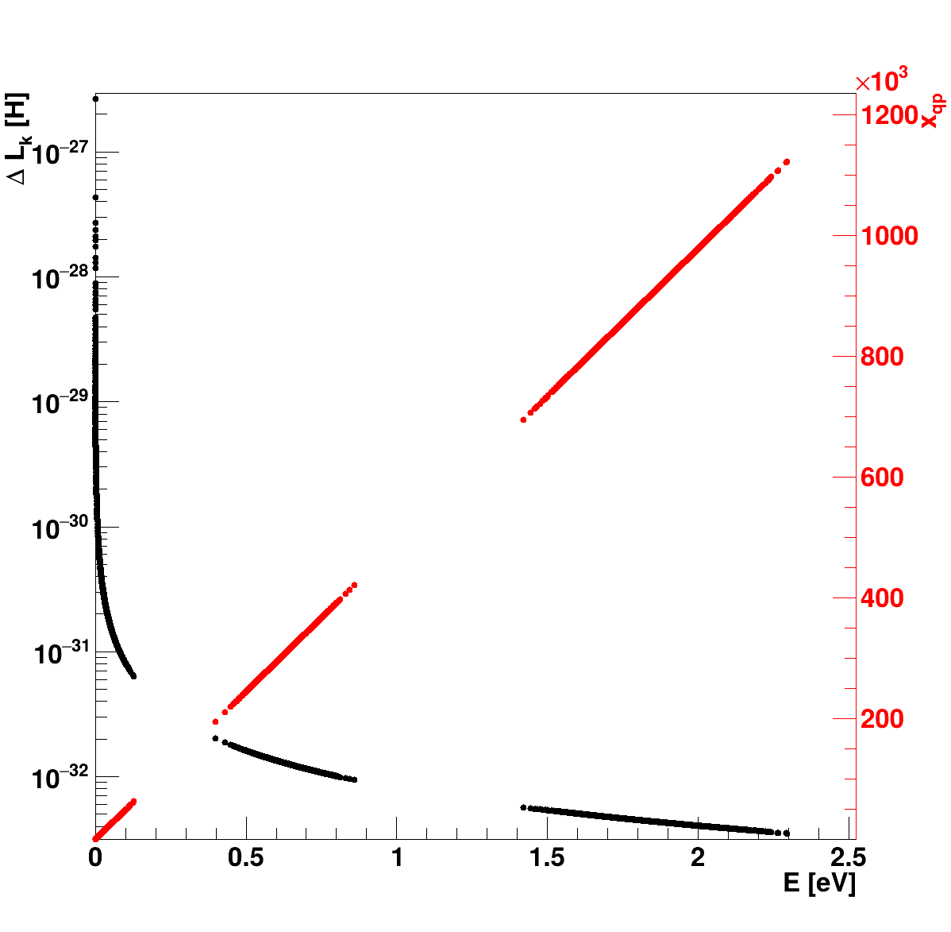
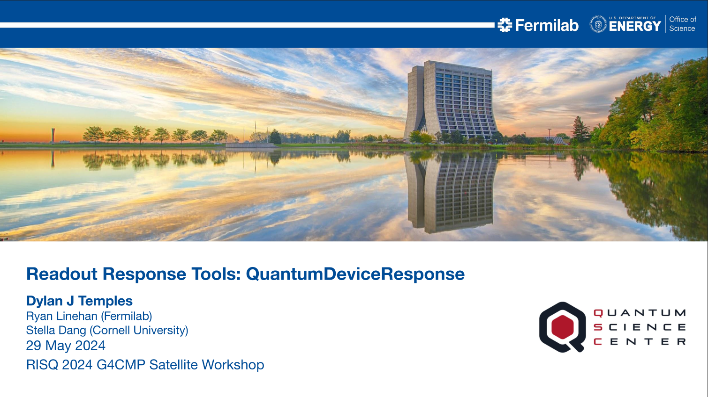
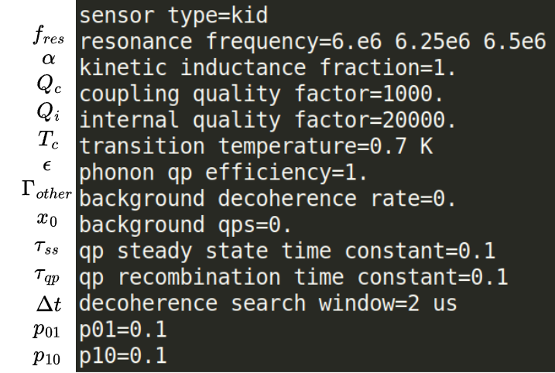
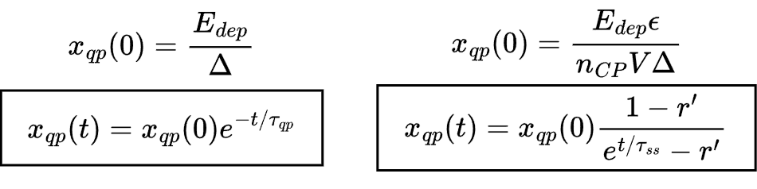
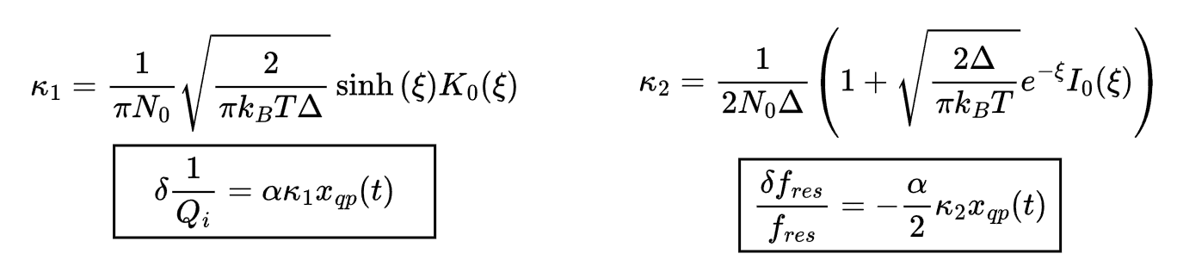
BeEST Collaboration Simulations
Coincidence counting
Readout simulation
Work in progress
Notes:
The BeEST experiment searches for sterile neutrinos in the keV mass range using the nuclear electron capture decay of 7Be implanted into STJs
Based on momentum reconstruction of the eV-scale 7Li nuclear recoil energy spectrum following neutrino emission

Slide 11

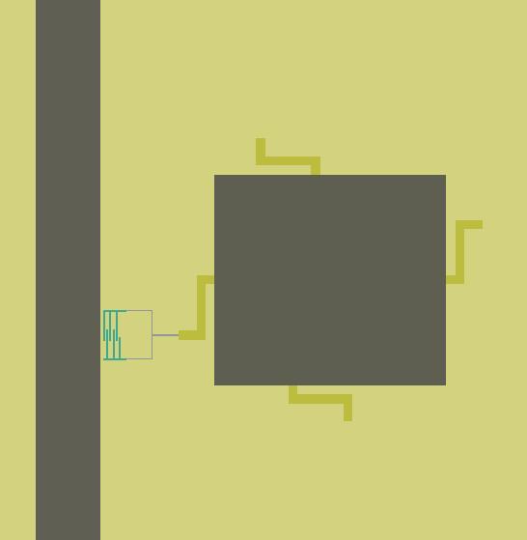
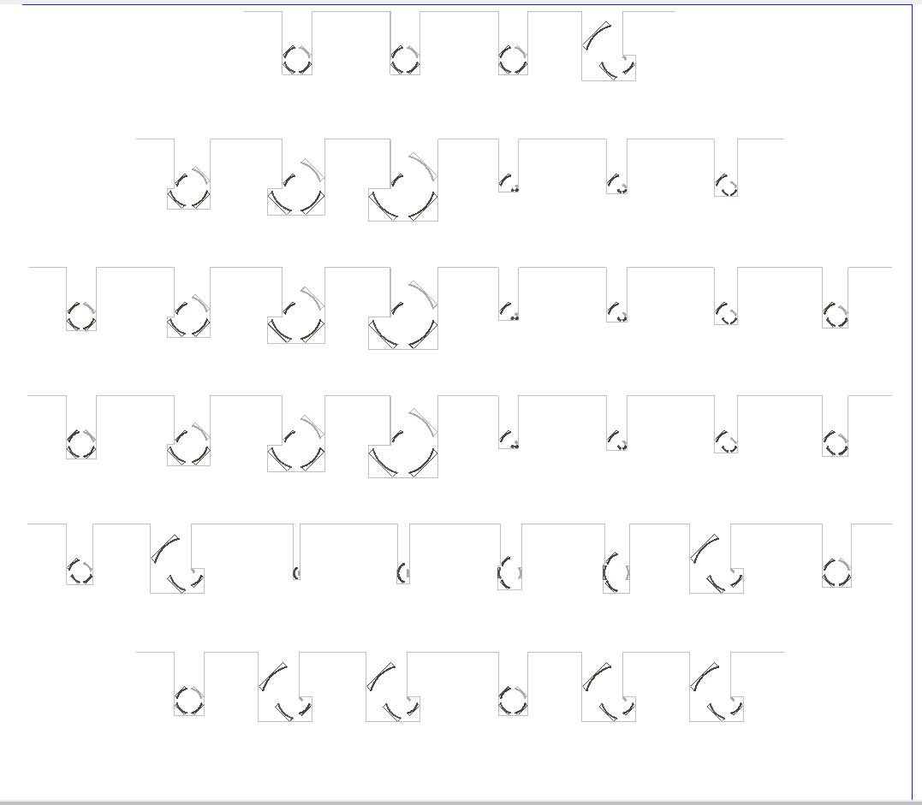
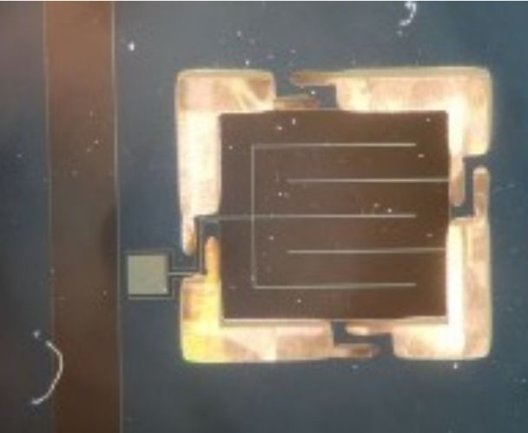
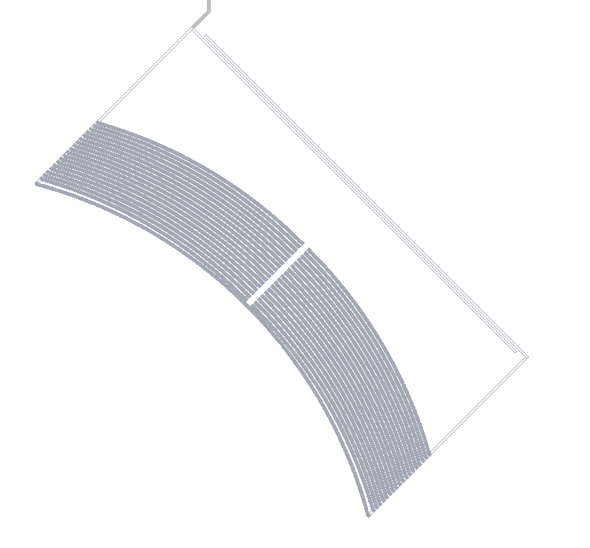
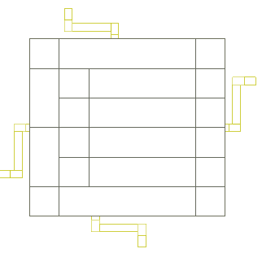
Low Background Cryogenic Facility (LBCF) Experiments
BeEST collaboration
NIST collaboration
  TKID phonon dynamics
  Phonon spectrometer development
Notes:
The BeEST experiment searches for sterile neutrinos in the keV mass range using the nuclear electron capture decay of 7Be implanted into STJs
Based on momentum reconstruction of the eV-scale 7Li nuclear recoil energy spectrum following neutrino emission

Slide 12
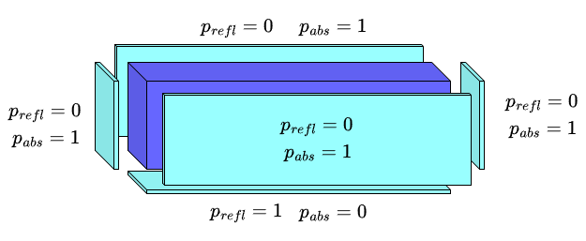
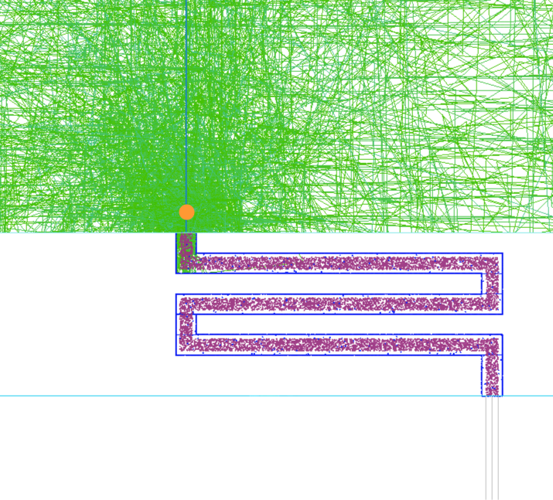
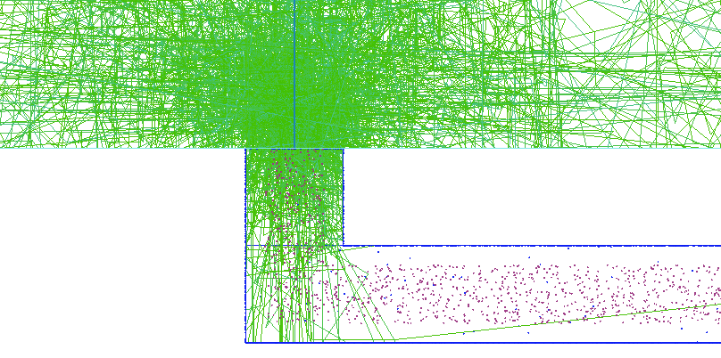
NIST Collaboration Simulations
Lattice surface implementation
Boundary process overriding (for like materials)
Notes:
The BeEST experiment searches for sterile neutrinos in the keV mass range using the nuclear electron capture decay of 7Be implanted into STJs
Based on momentum reconstruction of the eV-scale 7Li nuclear recoil energy spectrum following neutrino emission

Slide 13
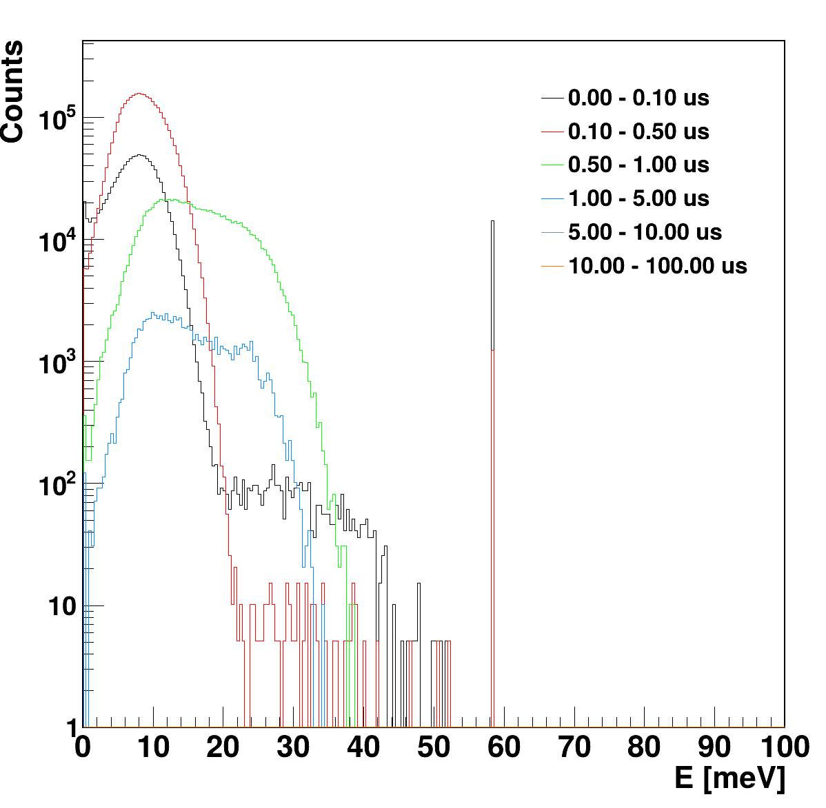
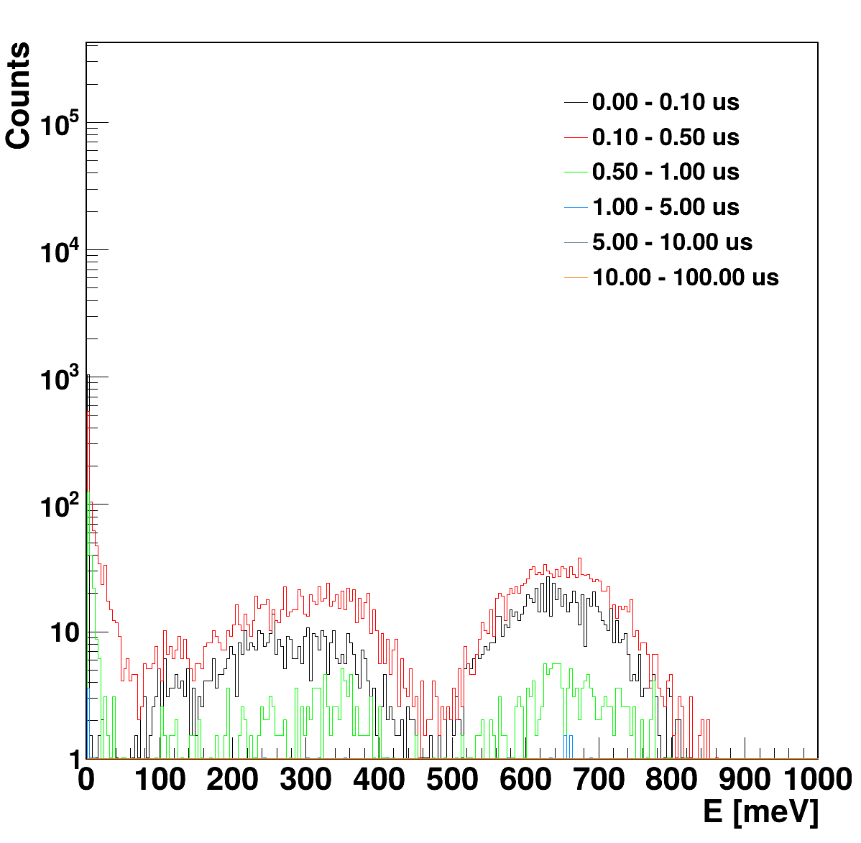
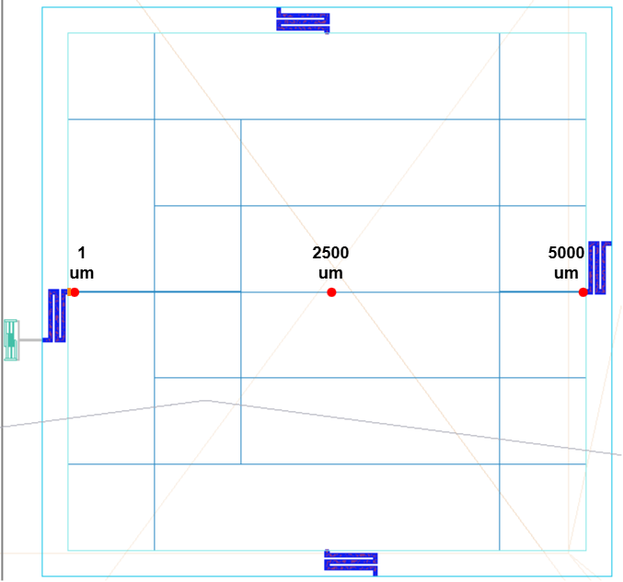
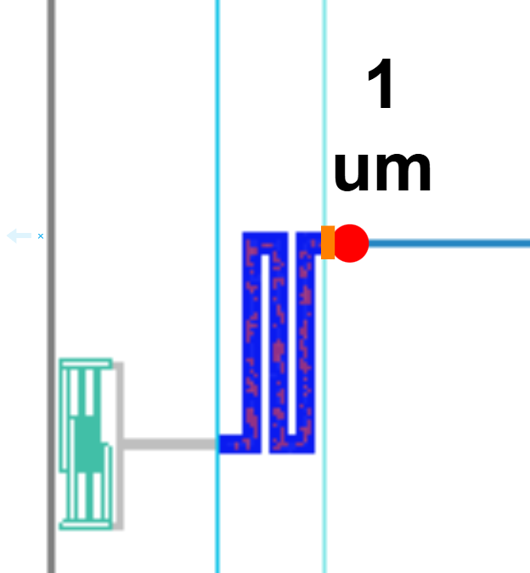
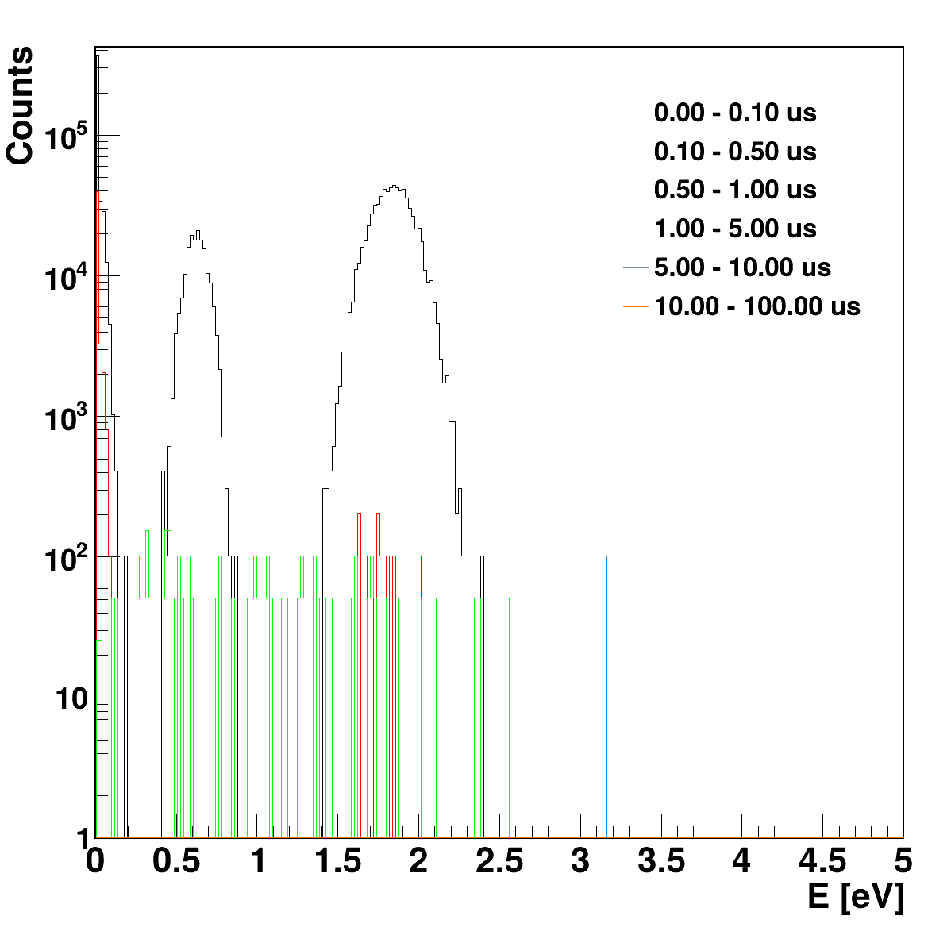
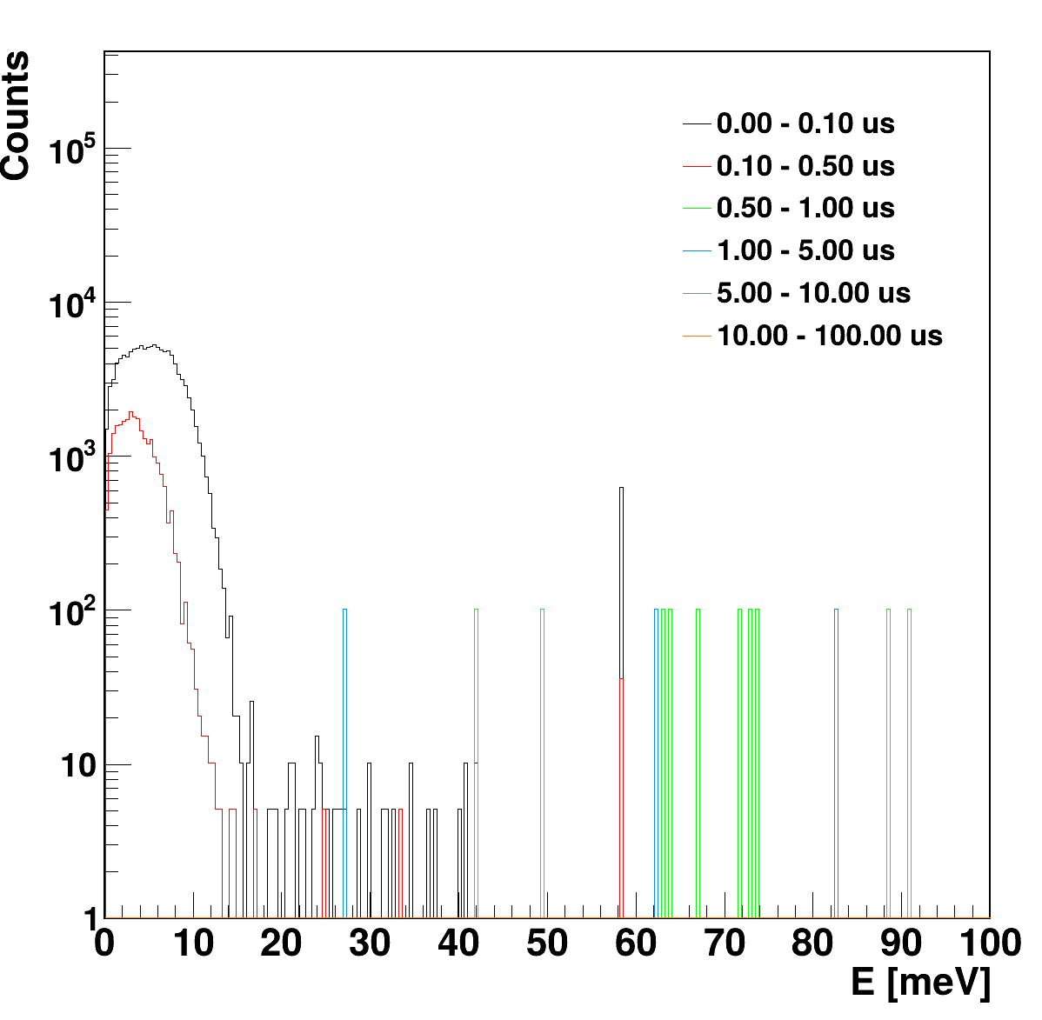
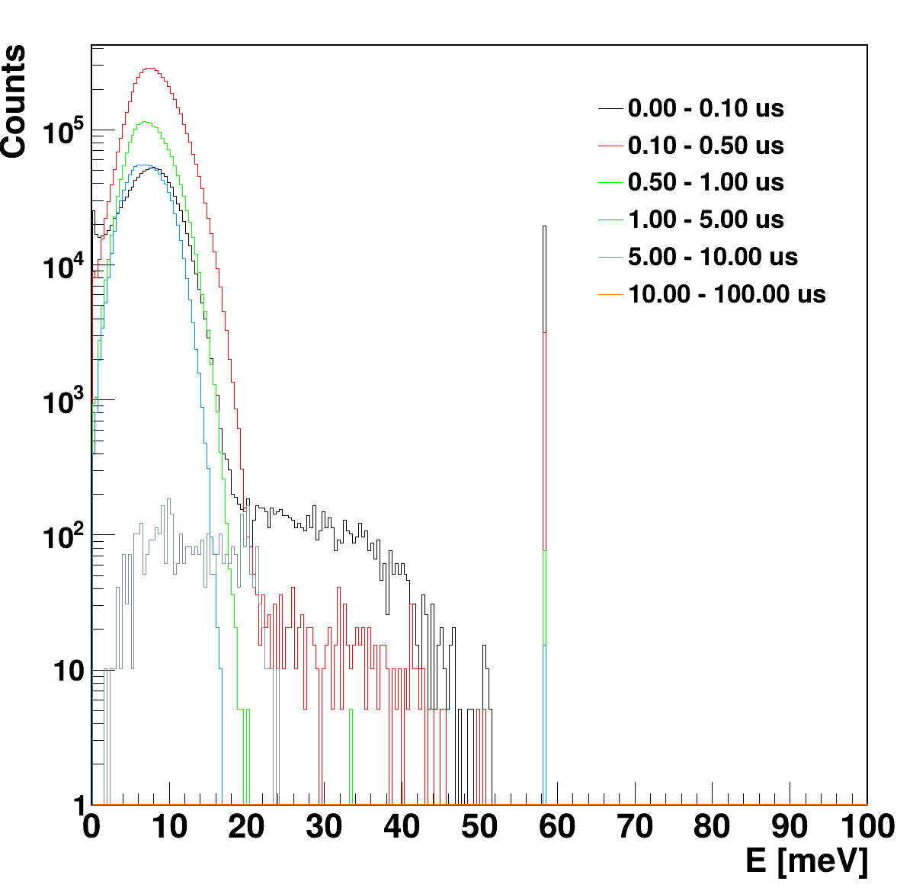
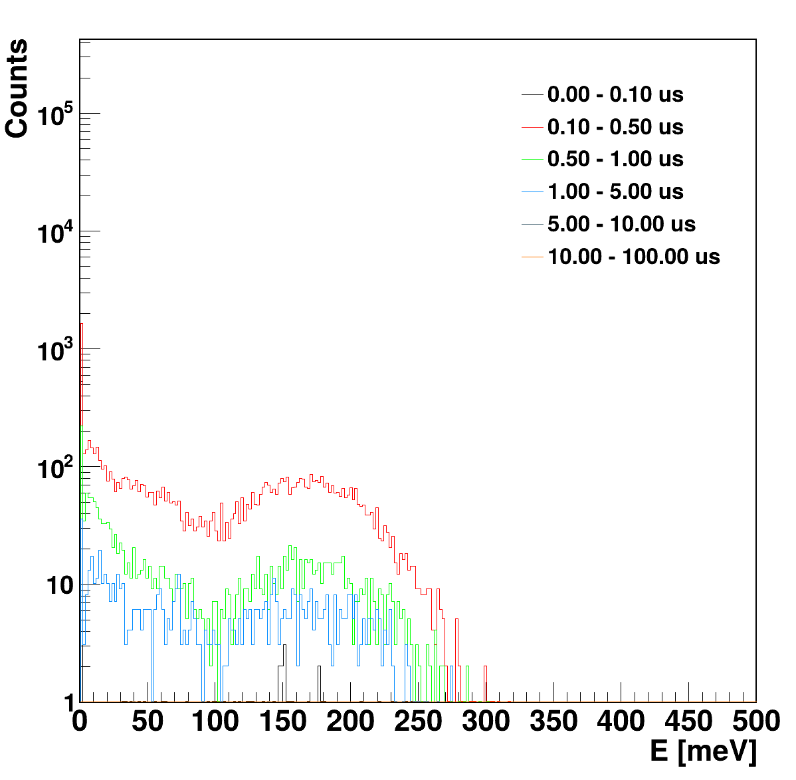
NIST Collaboration Simulations
Surface
Film
500 um
500 um
Radiation impact position sensitivity
Surface
Film
Surface
Film
32 um
32 um
1500 um
1500 um
Notes:
The BeEST experiment searches for sterile neutrinos in the keV mass range using the nuclear electron capture decay of 7Be implanted into STJs
Based on momentum reconstruction of the eV-scale 7Li nuclear recoil energy spectrum following neutrino emission

Slide 14
NIST Collaboration Simulations
Surface
Film
500 um
500 um
Radiation impact position sensitivity
Surface
Film
Surface
Film
32 um
32 um
1500 um
1500 um
Notes:
The BeEST experiment searches for sterile neutrinos in the keV mass range using the nuclear electron capture decay of 7Be implanted into STJs
Based on momentum reconstruction of the eV-scale 7Li nuclear recoil energy spectrum following neutrino emission

Slide 15
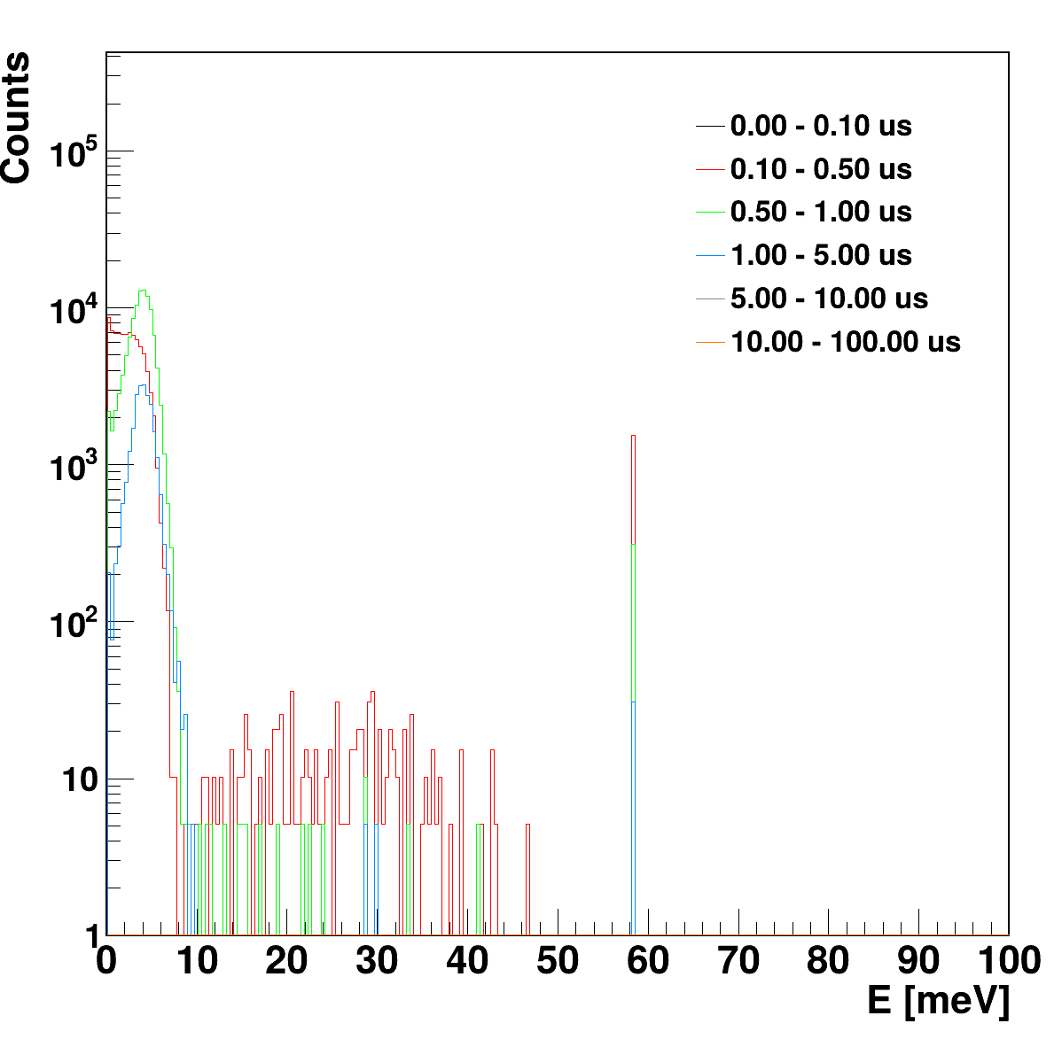
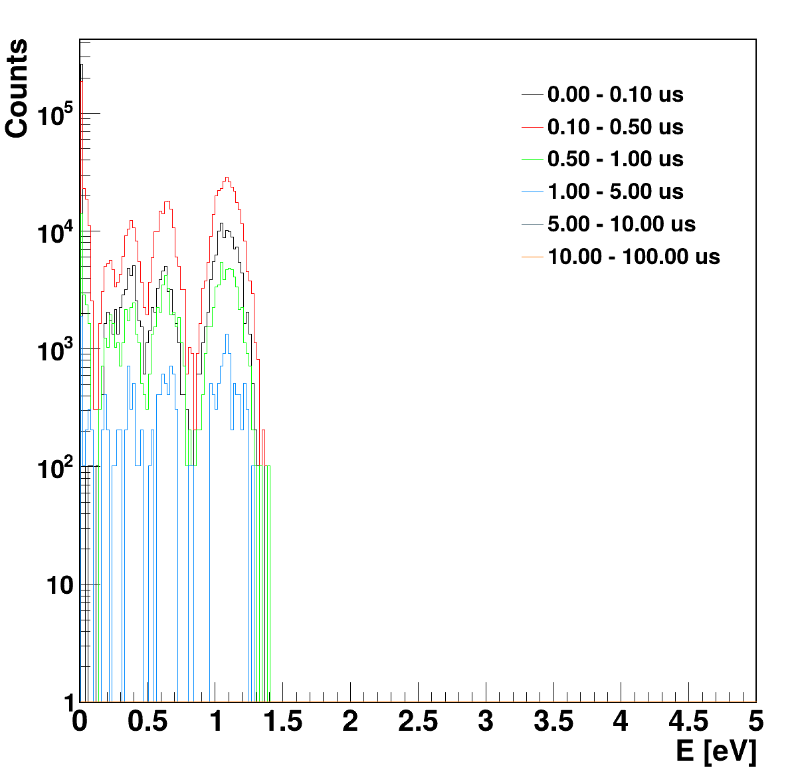
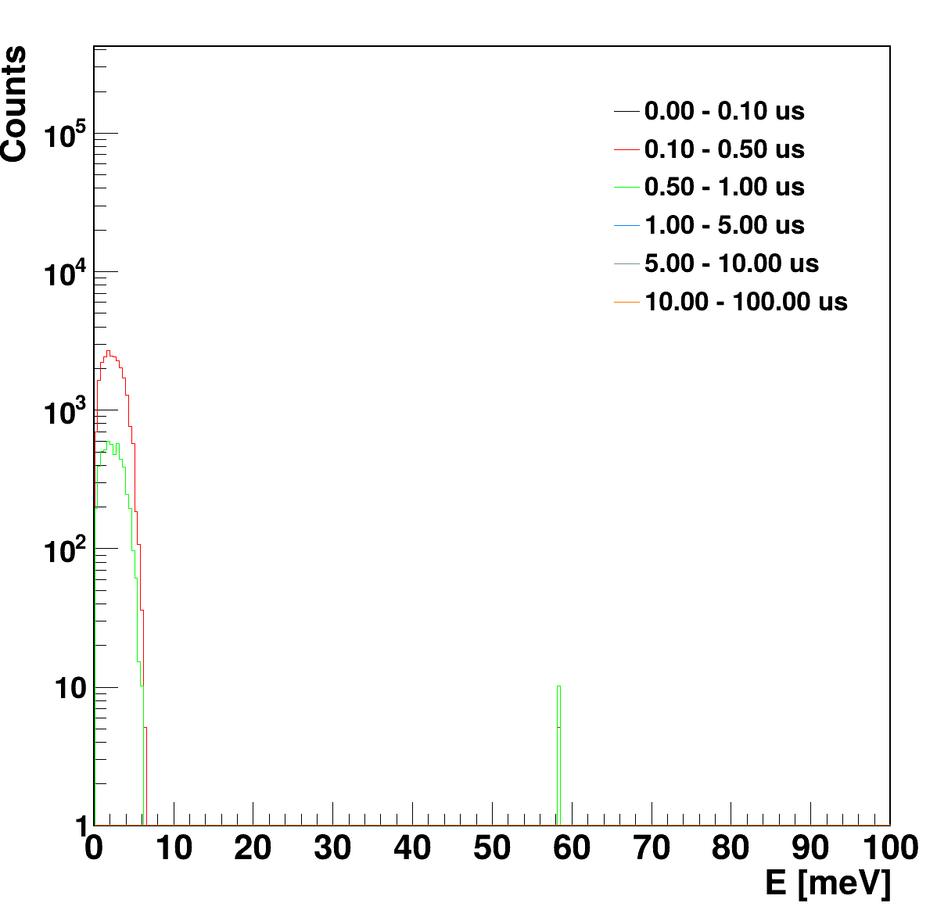
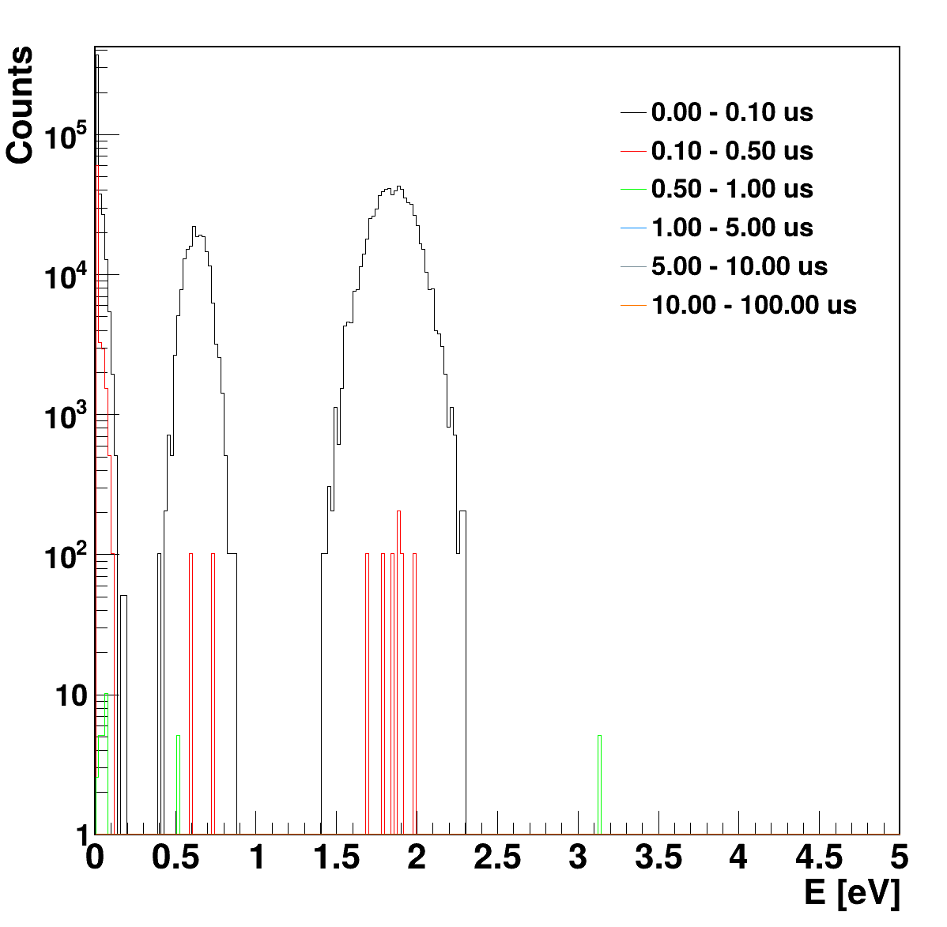
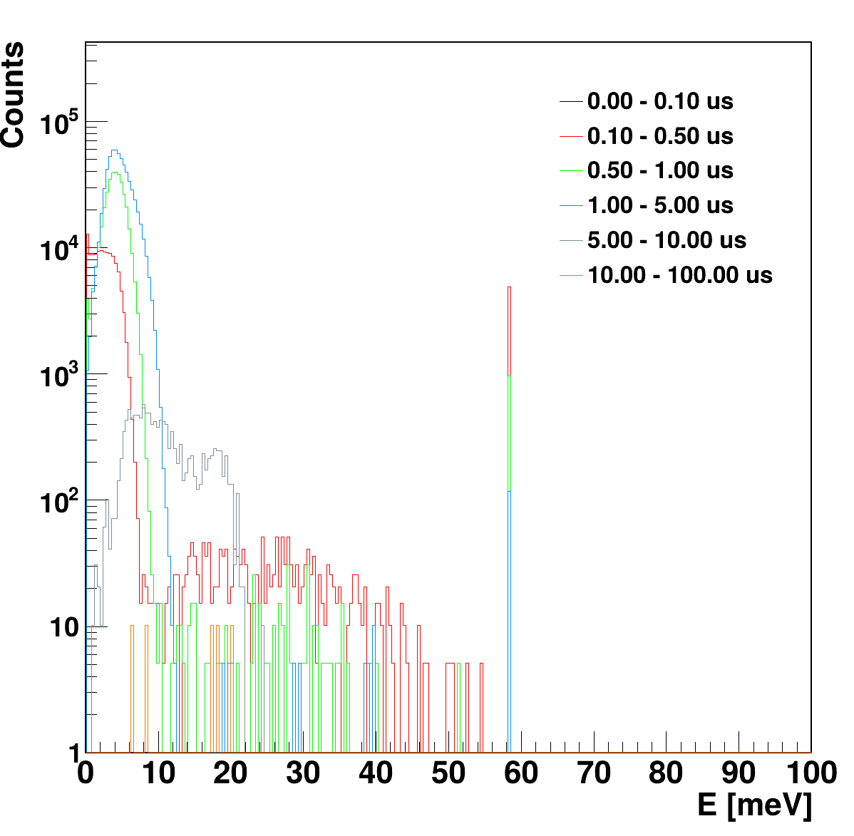
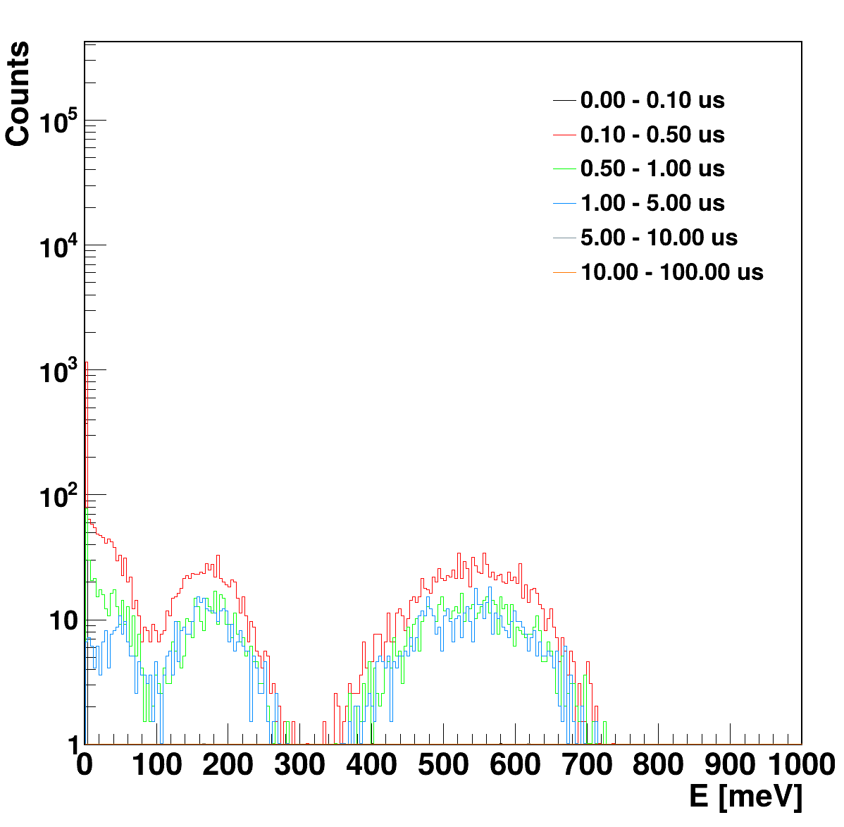
NIST Collaboration Simulations
Surface
Film
500 um
500 um
Radiation impact position sensitivity
Surface
Film
Surface
Film
32 um
32 um
1500 um
1500 um
Notes:
The BeEST experiment searches for sterile neutrinos in the keV mass range using the nuclear electron capture decay of 7Be implanted into STJs
Based on momentum reconstruction of the eV-scale 7Li nuclear recoil energy spectrum following neutrino emission

Slide 16
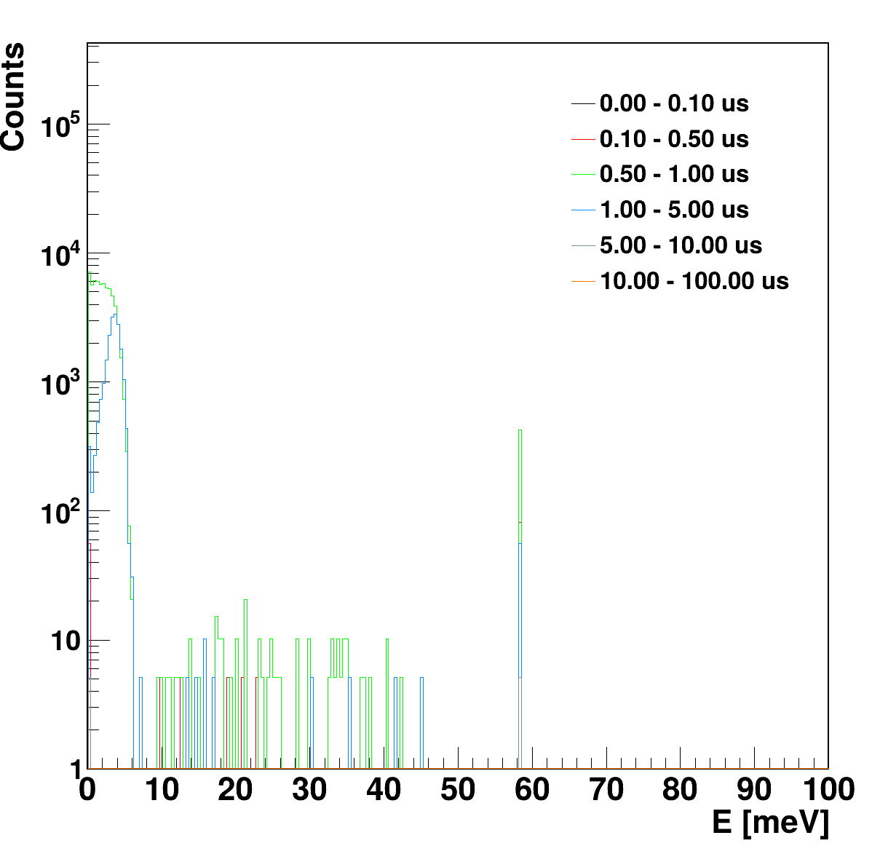





NIST Collaboration Simulations
Surface
Film
500 um
500 um
Radiation impact position sensitivity
Surface
Film
Surface
Film
32 um
32 um
1500 um
1500 um
Notes:
The BeEST experiment searches for sterile neutrinos in the keV mass range using the nuclear electron capture decay of 7Be implanted into STJs
Based on momentum reconstruction of the eV-scale 7Li nuclear recoil energy spectrum following neutrino emission

Slide 17
















Low Background Cryogenic Facility (LBCF) Experiments
BeEST collaboration
NIST collaboration
LPS + LLNL collaboration
  Qubits sandwiched by muon rejection detectors (MKIDs)
Notes:
The BeEST experiment searches for sterile neutrinos in the keV mass range using the nuclear electron capture decay of 7Be implanted into STJs
Based on momentum reconstruction of the eV-scale 7Li nuclear recoil energy spectrum following neutrino emission

Slide 18





LPS + LLNL Collaboration Simulations
Mixed-field radiation impact study: ²¹⁰Po + ¹³⁷Cs
  See Sam Watkins’s talk during the main workshop!
¹³⁷Cs gammas
²¹⁰Po alphas
Notes:
The BeEST experiment searches for sterile neutrinos in the keV mass range using the nuclear electron capture decay of 7Be implanted into STJs
Based on momentum reconstruction of the eV-scale 7Li nuclear recoil energy spectrum following neutrino emission

