Slide 1


Phonon Collection Modeling in G4CMP
with Finite Surface Losses
Toward Direct Absorber Phonon Sensor Design
Selby Q Dang / SLAC + Stanford
June 15, 2026 | RISQ 2026 G4CMP Workshop
Notes:
I will be presenting on studies of phonon loss and its effects on phonon collection modeling and implications toward sensor design.

Slide 2
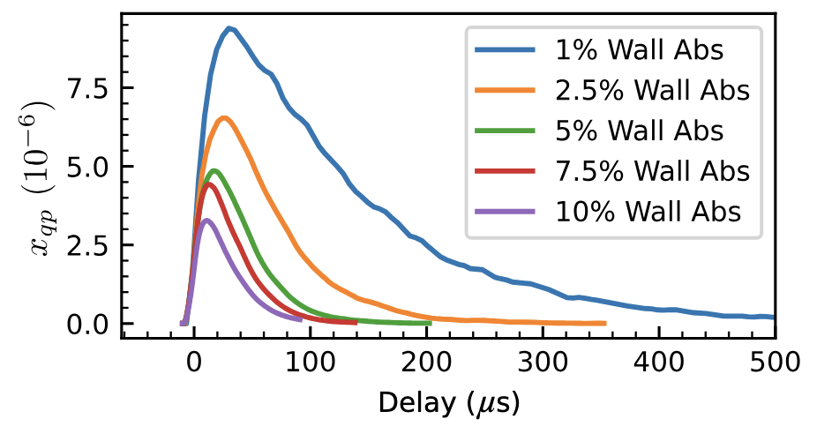
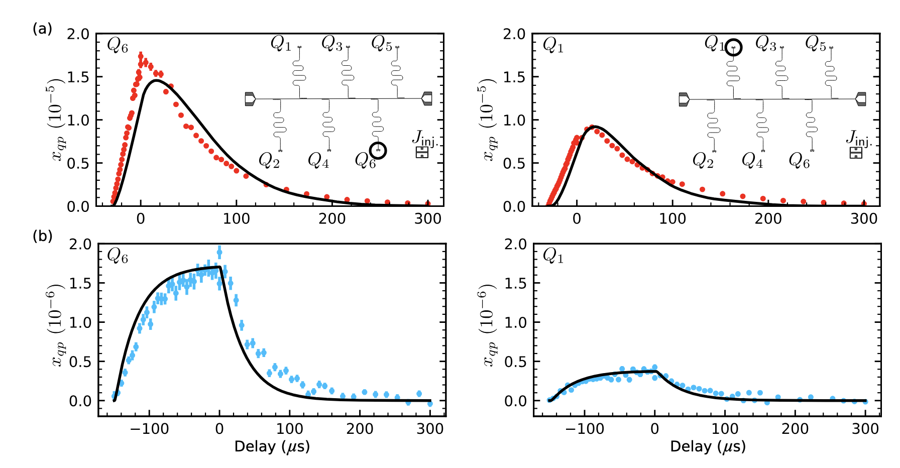

Overview
Benchmarking effects of phonon loss is relevant for modeling diverse phonon sensors in G4CMP.
Position-dependent phonon responsivity gives insight into loss mechanisms
I. Benchmarking phonon loss
Evidence for phonon thermalization in cryogenic crystals is not fully modeled by anharmonic decay or loss to device clamps
Using one possible loss model, we can optimize sensor layout for efficiency
sensor
"dead metal"
II. Impact of phonon loss on forward modeling
?
mounts
incident particle
https://journals.aps.org/prb/pdf/10.1103/PhysRevB.110.024519
Selby Q Dang | RISQ 2026
Notes:
The takeaway from this talk is that phonon loss is a relevant consideration for modeling various kinds of phonon sensors. What do we mean by loss? There has been experimental evidence for phonons thermalizing in cryogenic crystal volumes, which are not fully explained by models of anharmonic decay or loss to device clamps. The plots on the right from Eric’s 2024 paper shows that phonon loss to the side walls in his qubit chips were necessary in reconstructing the QP response. Today we will talk about benchmarking possible models of phonon loss with a MEMS study and how we can use this insight into optimizing sensor layout.

Slide 3
Part I
Benchmarking Phonon Loss

Slide 4
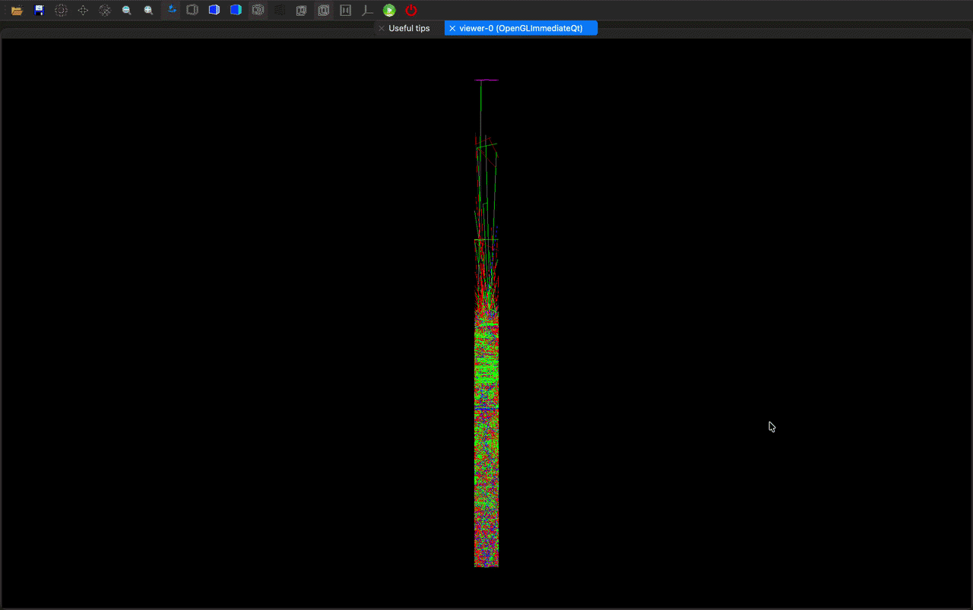
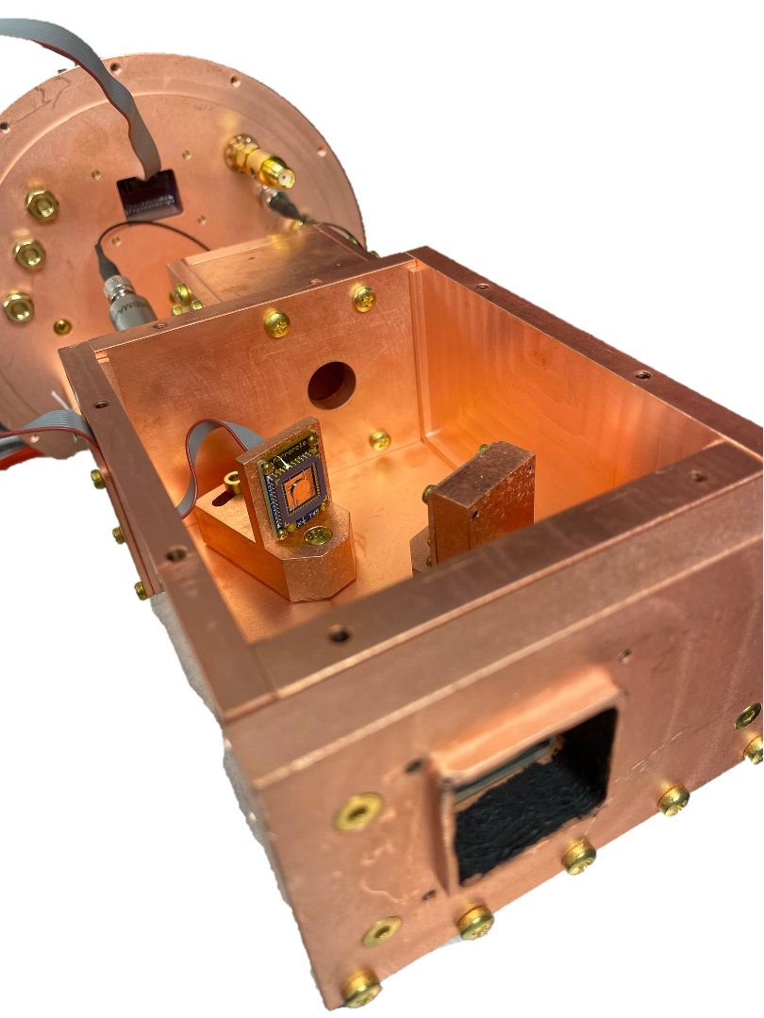
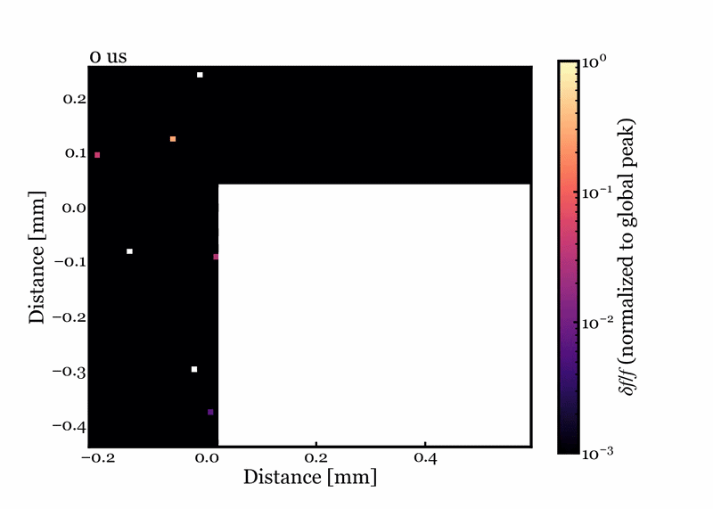
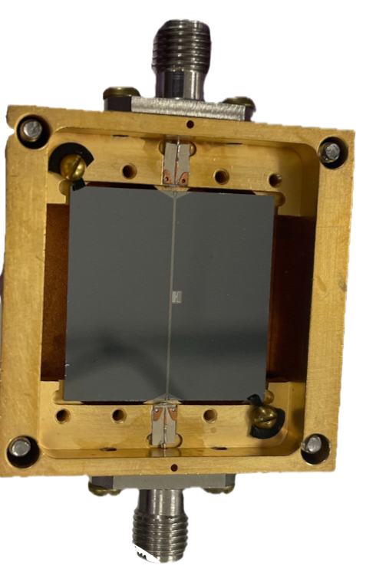
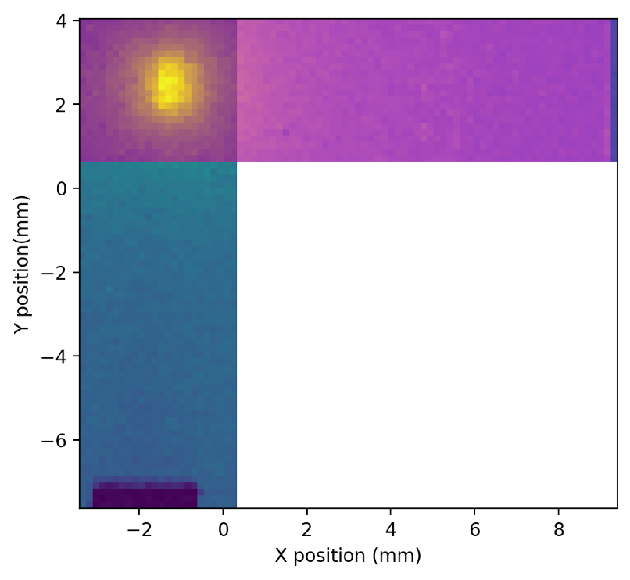
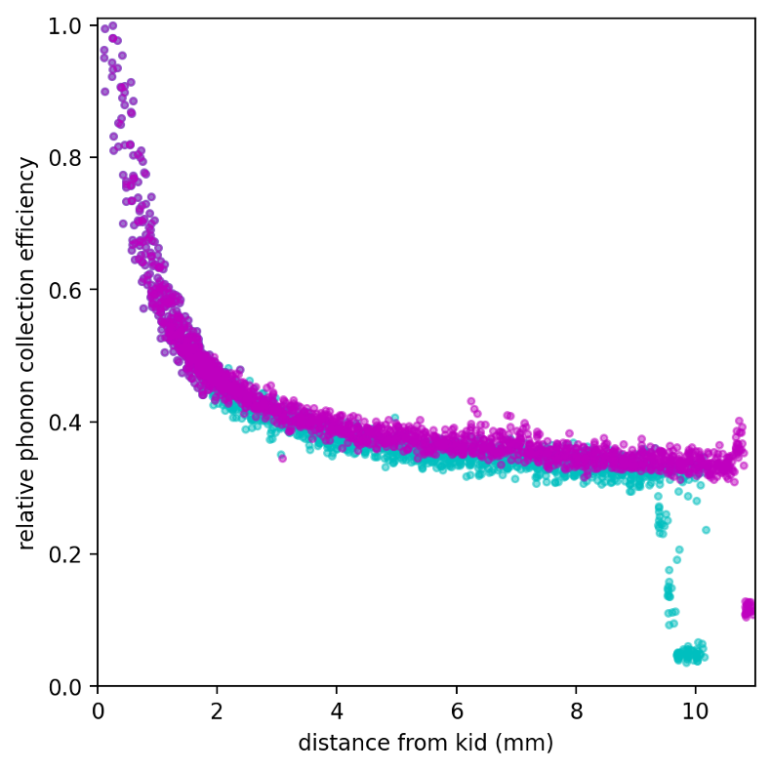

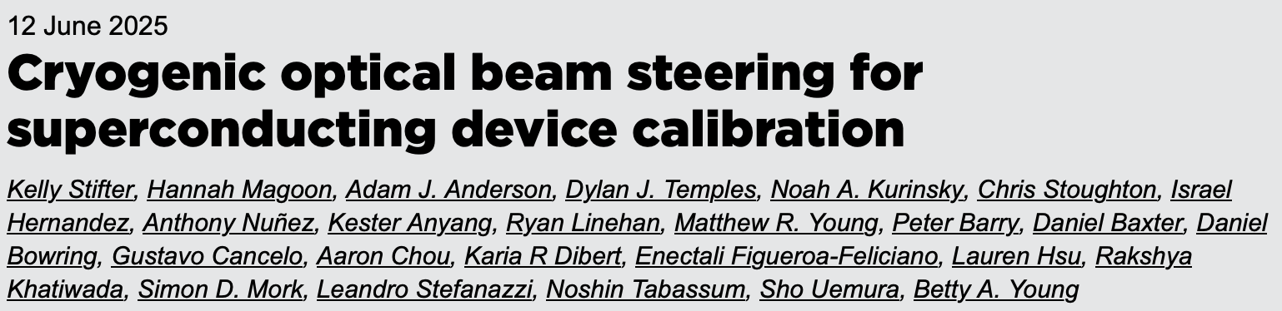
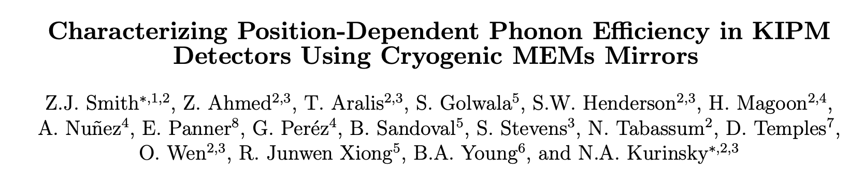
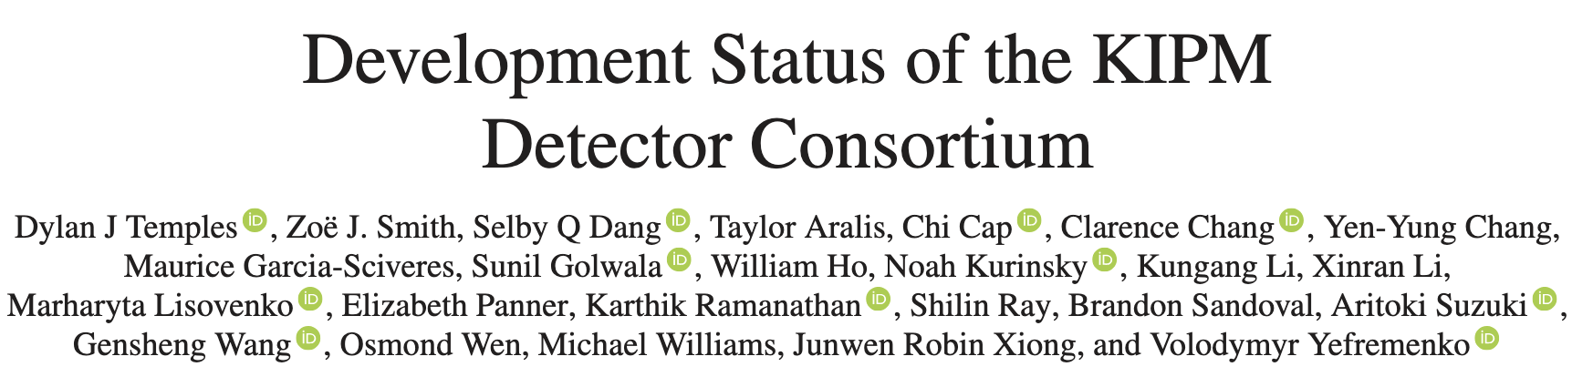
MEMS Measurement
We probed our detector response to LED pulses at different XY positions using the MEMS.
Image credit: Leonid Sajkov
I. Benchmarking phonon loss
Our KIPM detector:
MKID as phonon sensor
Direct absorber: no trapping
Small sensor (<0.1% coverage on Si substrate)
Thin film (30 nm Al)
Single resonator
Al resonator
polished faces
Nb feedline
side walls
Cu housing
https://custom.cvent.com/B6DBF01384AB4E1CB4B0C6F97B77BDB2/files/event/22930724c2e84b3b93f62c7170746141/47687c07935646a0acea1924d0112ab4.pdf
Image credit: Zoë Smith
Selby Q Dang | RISQ 2026
MEMS + KIPM paper in prep!
Notes:
We performed an optical calibration of a KIPM detector using the MEMS, which gives us a proxy to the peak-normalized phonon collection efficiency. We won’t have time to talk about how a KIPM detector works, but please ask me after this talk if you’re interested. What you do need to know about our KIPM detector is that it uses MKIDs as phonon sensors, and it is a direct absorber, which means it can tell us when and where phonon energy arrives but doesn’t do quasiparticle trapping. The sensor is small, the film is thin, and there is only one sensor on this chip. We have some exciting data of peak-normalized signal amplitude as a function of position and time, which we will be comparing our sims to.

Slide 5
Direct Absorber Architecture
In our detector, phonons are directly absorbed into the MKID inductor, which generates the signal.
Direct absorber (e.g. KIPM):
I. Benchmarking phonon loss
Incident Particle
Cooper Pair
Quasiparticle
Athermal Phonon
Crystalline Substrate
Sensitive Volume
Collector Volume
Quasiparticle trapping (e.g. QET, SQUAT):
Analysis of Event Position Dependence in HVeV Detectors with G4CMP and MEMS
Caitlyn Stone-Whitehead
6/15, 10:20 am
SQUATs: Qubit-Based Sensors for Dark Matter
Hannah Magoon
6/18, 10:00 am
Selby Q Dang | RISQ 2026
Notes:
Just to hammer in this point: our sensor is a direct absorber, meaning that phonons go straight into the sensor that generates the signal. We don’t have a collection volume that traps quasiparticles like in QETs or SQUATs, but my colleagues have very interesting talks about these other detectors.

Slide 6
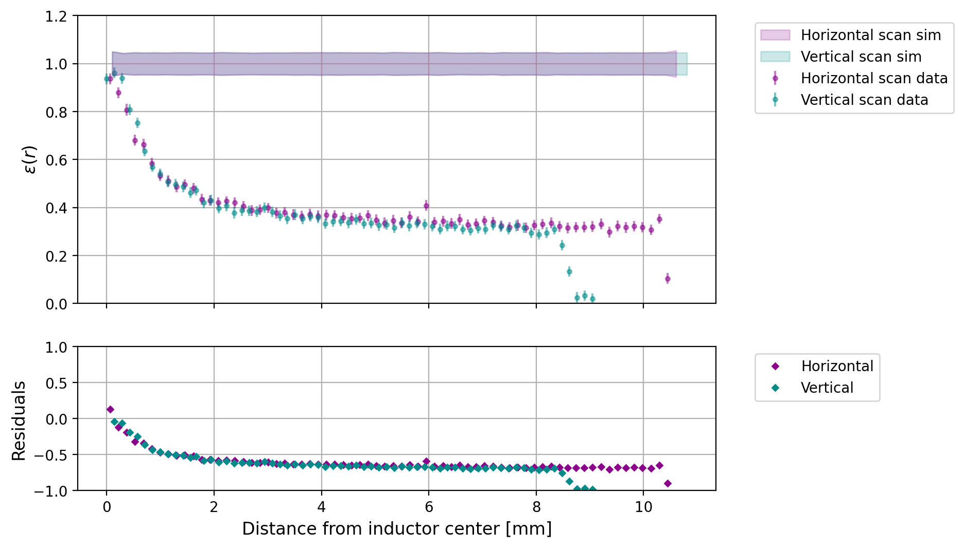
From Phonon Loss to Position Dependence
Loss mechanisms differently affect position dependence in phonon collection efficiency.
I. Benchmarking phonon loss
Al resonator
polished faces
Nb feedline
side walls
Cu housing
p_{abs, inductor} | 0.103
p_{abs, capacitor} | 0
p_{abs, Nb} | 0
p_{abs, Cu} | 0
p_{abs, polished surfaces} | 0
p_{abs, side walls} | 0
η: absolute phonon energy collection efficiency
ε: relative phonon energy collection efficiency; ε(x,y) = η(x,y) / η_{max}
Selby Q Dang | RISQ 2026
Notes:
So we have this data on our detector’s relative phonon collection efficiency, epsilon, which displays a particular position dependence. In particular, we notice that epsilon drops off steeply when we’re close to the sensor, and then it levels out when we’re farther away. We implemented a few models of phonon loss to study their effects on this position dependence. First, if we just have a sensor and a chunk of silicon without any loss, there isn’t any position dependence.

Slide 7
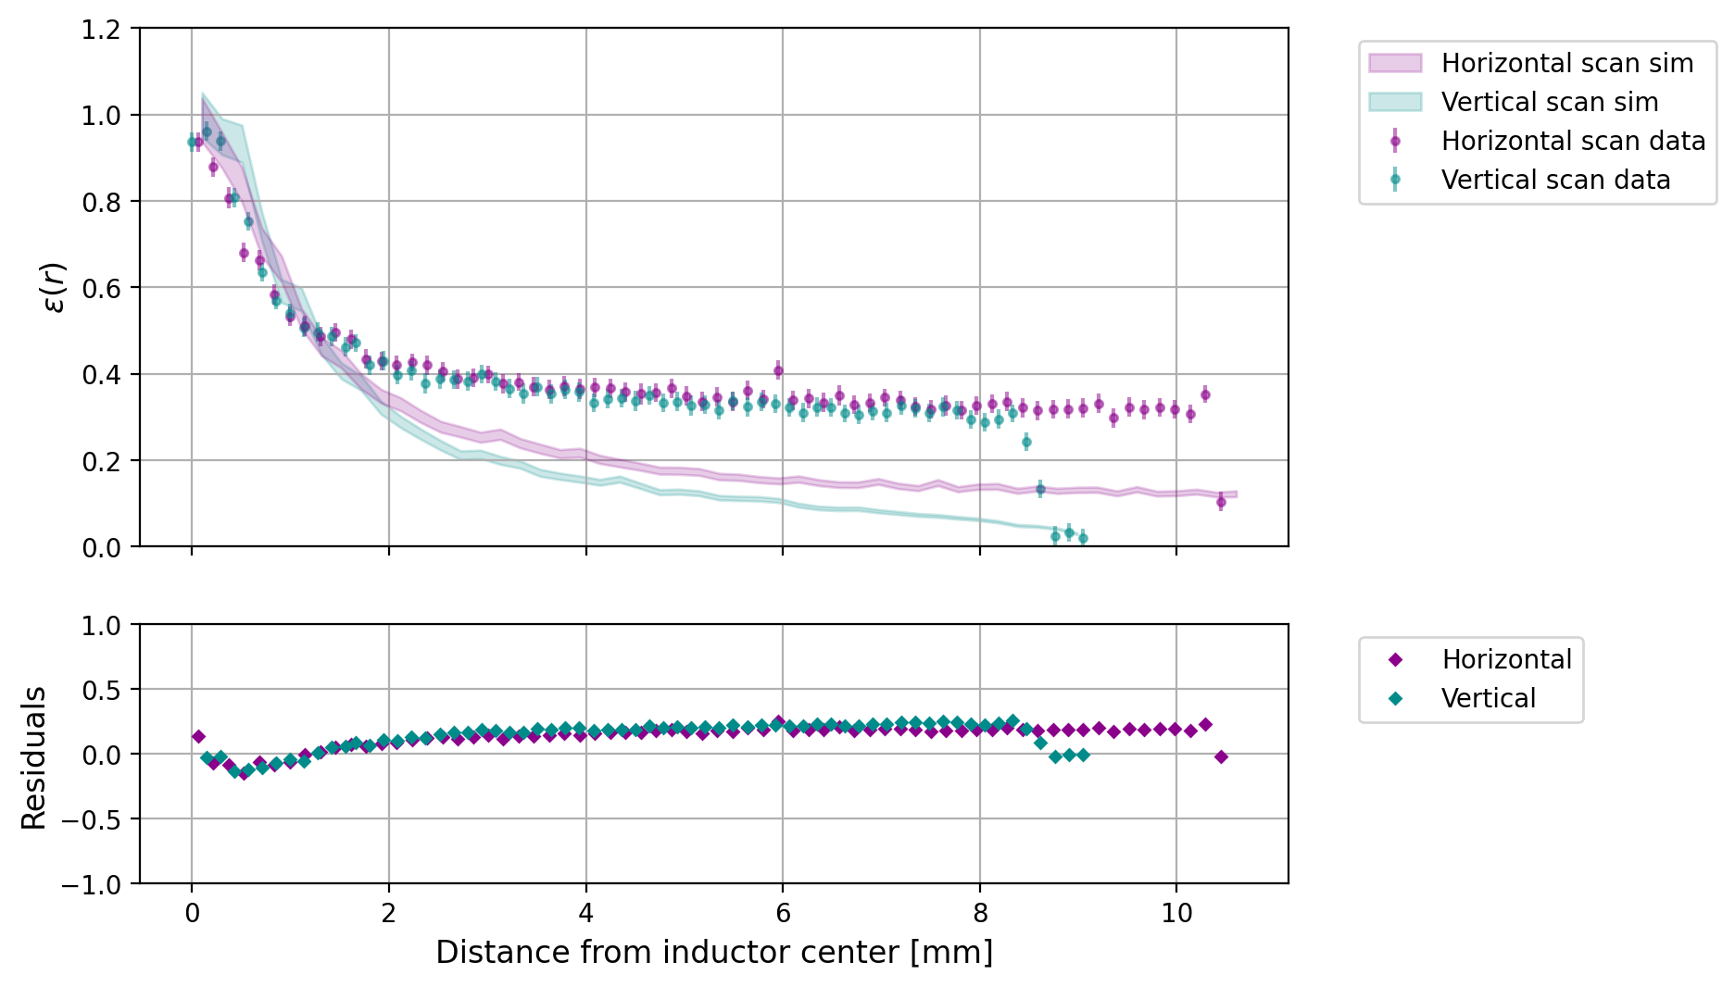
From Phonon Loss to Position Dependence
Loss mechanisms differently affect position dependence in phonon collection efficiency.
I. Benchmarking phonon loss
Al resonator
polished faces
Nb feedline
side walls
Cu housing
p_{abs, inductor} | 0.103
p_{abs, capacitor} | 0
p_{abs, Nb} | 0.745
p_{abs, Cu} | 0.736
p_{abs, polished surfaces} | 0
p_{abs, side walls} | 0
η: absolute phonon energy collection efficiency
ε: relative phonon energy collection efficiency; ε(x,y) = η(x,y) / η_{max}
Selby Q Dang | RISQ 2026
Notes:
And then if we add in all the metal and superconducting volumes at nominal values of loss, we overshoot this position dependence metric.

Slide 8
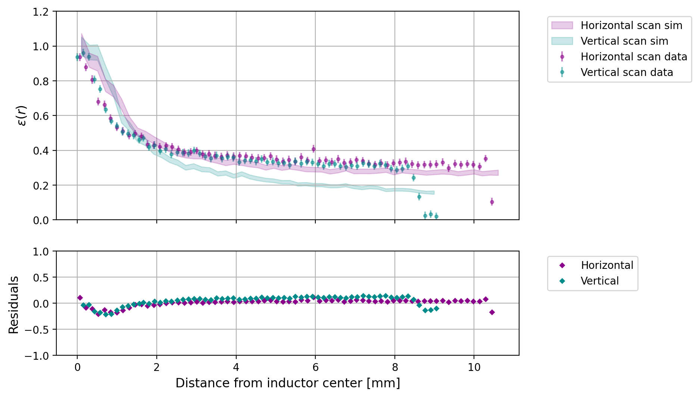
From Phonon Loss to Position Dependence
Loss mechanisms differently affect position dependence in phonon collection efficiency.
I. Benchmarking phonon loss
Al resonator
polished faces
Nb feedline
side walls
Cu housing
p_{abs, inductor} | 0.103
p_{abs, capacitor} | 0
p_{abs, Nb} | 0.745
p_{abs, Cu} | 0
p_{abs, polished surfaces} | 0
p_{abs, side walls} | 0
η: absolute phonon energy collection efficiency
ε: relative phonon energy collection efficiency; ε(x,y) = η(x,y) / η_{max}
Selby Q Dang | RISQ 2026
Notes:
Adding just the dead metal at a nominal value was still too much, and it shows a bigger discrepancy between the horizontal and vertical regions.

Slide 9
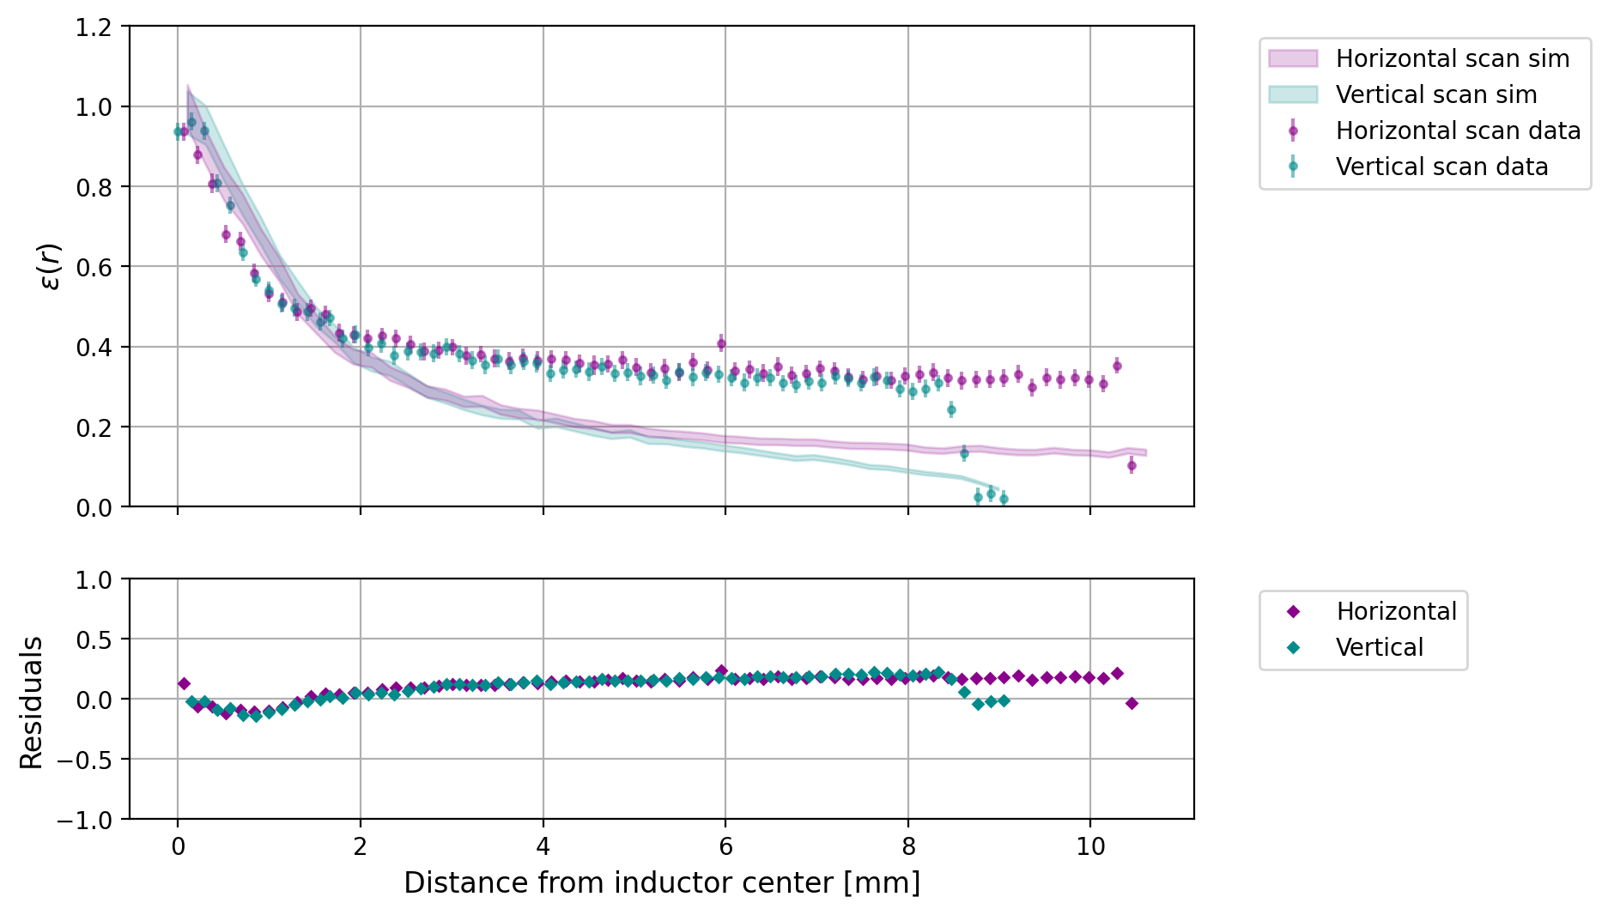
From Phonon Loss to Position Dependence
Loss mechanisms differently affect position dependence in phonon collection efficiency.
I. Benchmarking phonon loss
Al resonator
polished faces
Nb feedline
side walls
Cu housing
p_{abs, inductor} | 0.103
p_{abs, capacitor} | 0
p_{abs, Nb} | 0
p_{abs, Cu} | 0.736
p_{abs, polished surfaces} | 0
p_{abs, side walls} | 0
η: absolute phonon energy collection efficiency
ε: relative phonon energy collection efficiency; ε(x,y) = η(x,y) / η_{max}
Selby Q Dang | RISQ 2026
Notes:
Adding just the mounts was even worse.

Slide 10
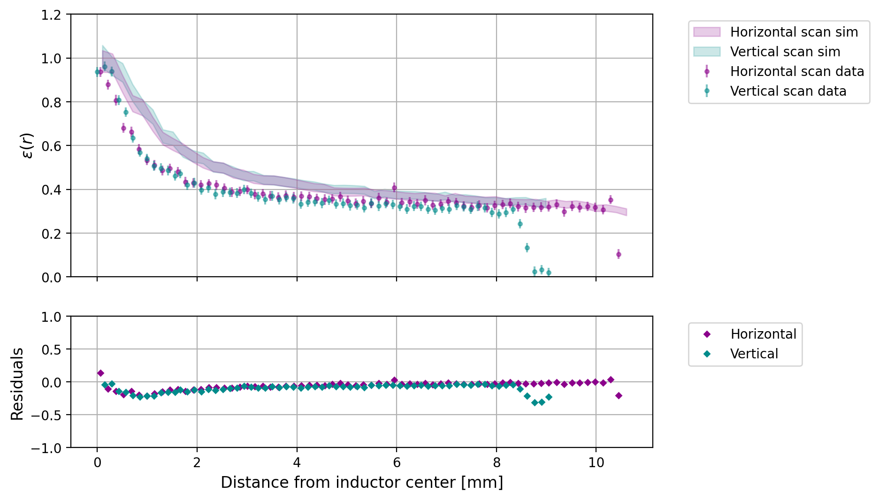
From Phonon Loss to Position Dependence
Loss mechanisms differently affect position dependence in phonon collection efficiency.
I. Benchmarking phonon loss
Al resonator
polished faces
Nb feedline
side walls
Cu housing
p_{abs, inductor} | 0.103
p_{abs, capacitor} | 0
p_{abs, Nb} | 0
p_{abs, Cu} | 0
p_{abs, polished surfaces} | 0
p_{abs, side walls} | 0.025
η: absolute phonon energy collection efficiency
ε: relative phonon energy collection efficiency; ε(x,y) = η(x,y) / η_{max}
Selby Q Dang | RISQ 2026
Notes:
Things start to get better when we use Eric’s model of the side walls.

Slide 11
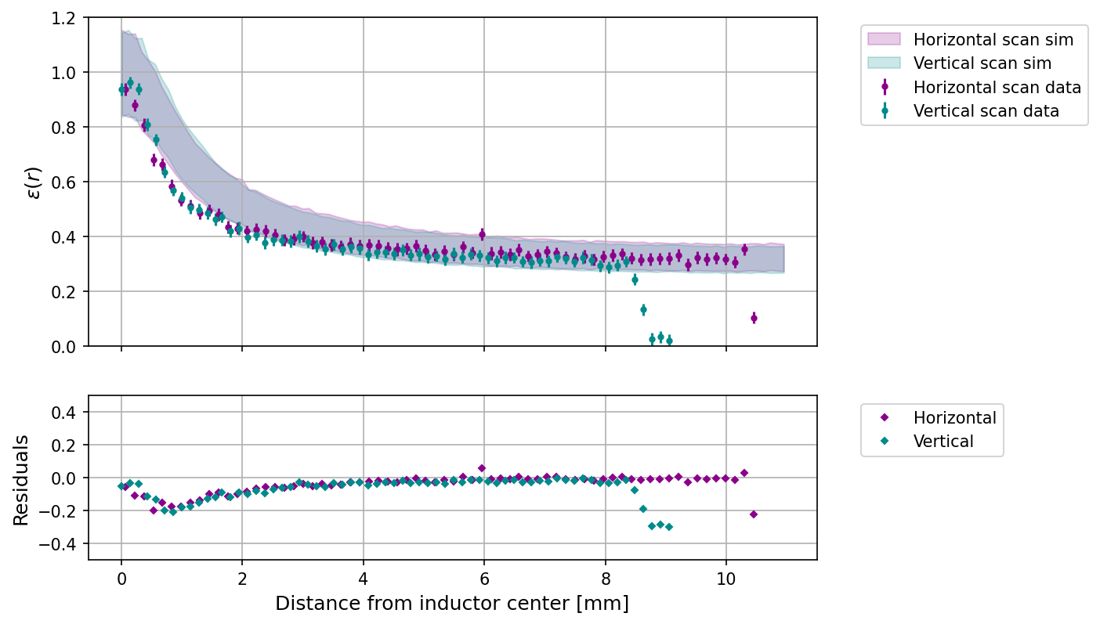
From Phonon Loss to Position Dependence
Loss mechanisms differently affect position dependence in phonon collection efficiency.
I. Benchmarking phonon loss
Al resonator
polished faces
Nb feedline
side walls
Cu housing
p_{abs, inductor} | 0.103
p_{abs, capacitor} | 0
p_{abs, Nb} | 0
p_{abs, Cu} | 0
p_{abs, polished surfaces} | 0.0025
p_{abs, side walls} | 0
η: absolute phonon energy collection efficiency
ε: relative phonon energy collection efficiency; ε(x,y) = η(x,y) / η_{max}
Selby Q Dang | RISQ 2026
Notes:
They still look nice when we consider loss to the polished surfaces, and there’s a flat position dependence away from the sensor, which we like.

Slide 12
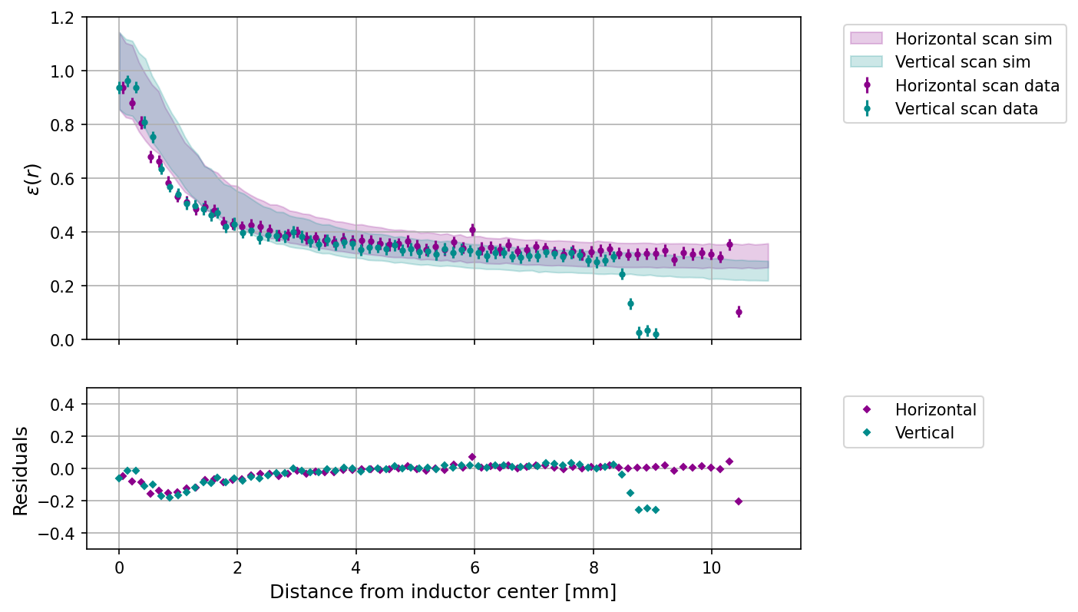
From Phonon Loss to Position Dependence
Loss mechanisms differently affect position dependence in phonon collection efficiency.
I. Benchmarking phonon loss
Al resonator
polished faces
Nb feedline
side walls
Cu housing
p_{abs, inductor} | 0.103
p_{abs, capacitor} | 0
p_{abs, Nb} | 0.1
p_{abs, Cu} | 0
p_{abs, polished surfaces} | 0.002
p_{abs, side walls} | 0
η: absolute phonon energy collection efficiency
ε: relative phonon energy collection efficiency; ε(x,y) = η(x,y) / η_{max}
Selby Q Dang | RISQ 2026
Notes:
If we add back in a little bit of loss to the dead metal, we can even recreate the slight discrepancy between the horizontal and vertical regions.
So are we saying surfaces are THE loss model? No. But we are saying that the loss mechanism we’re seeing seems fairly isotropic and not localized to any detector feature.

Slide 13
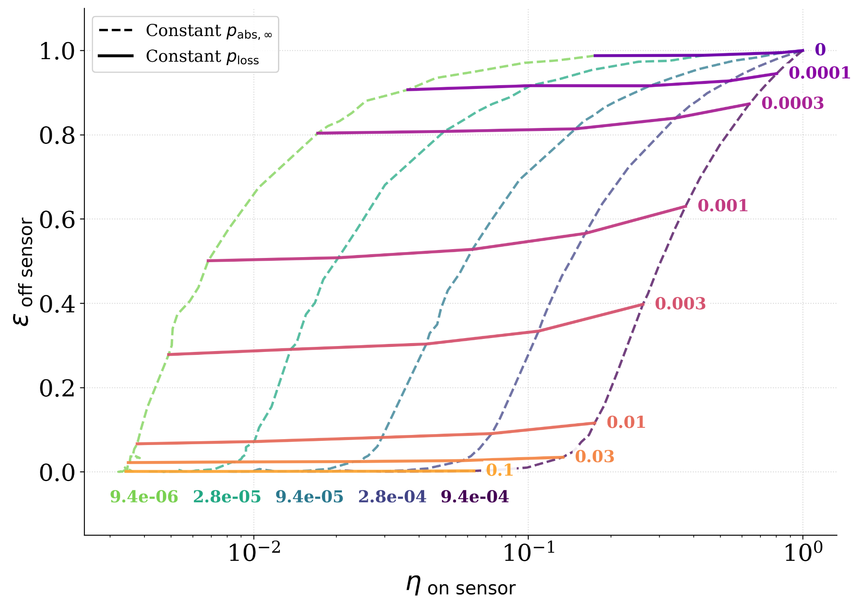
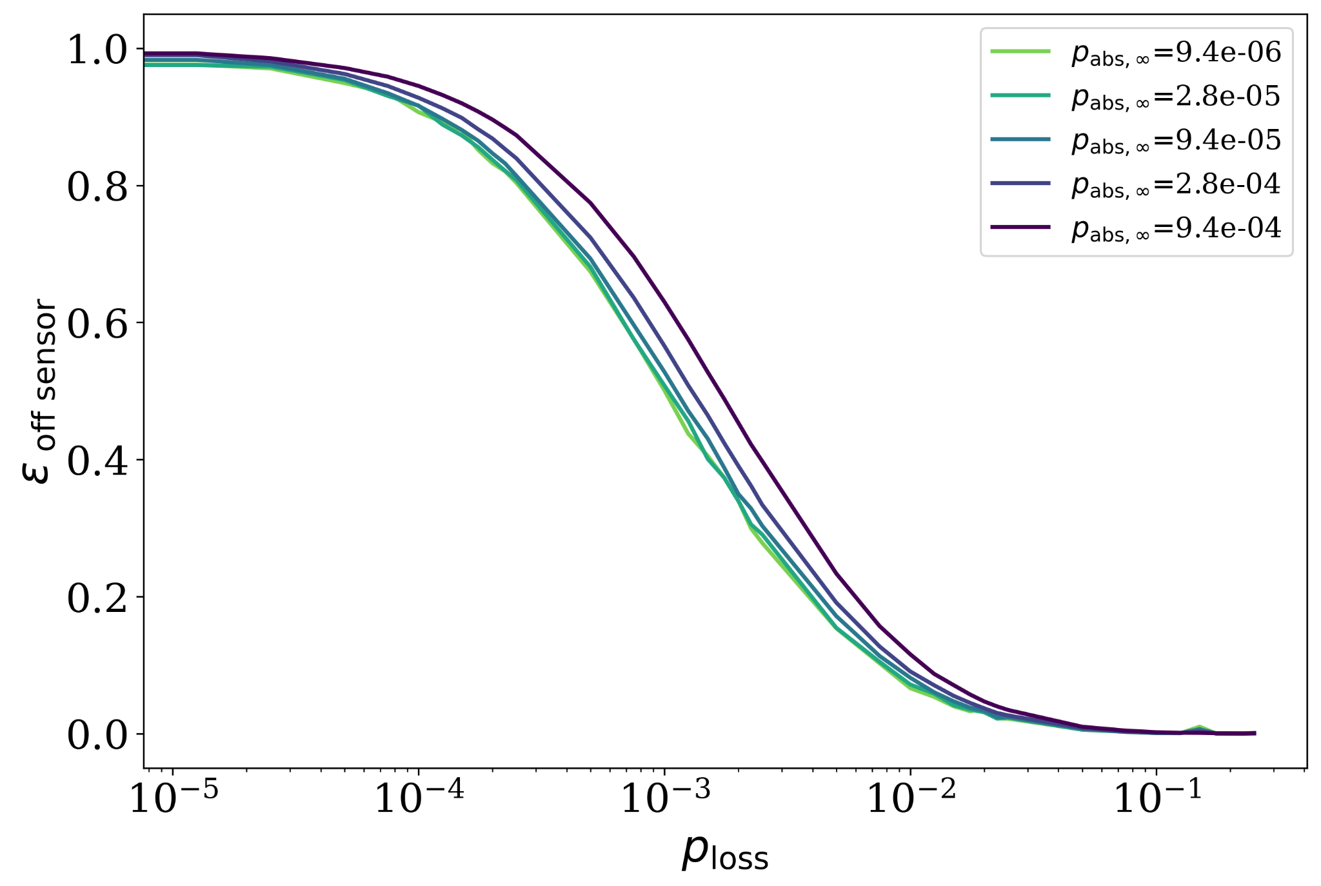
Parameter Space for Low Coverage
Assuming isotropic phonon loss, position dependence is a good indicator for loss probability.
I. Benchmarking phonon loss
Increased surface loss
Faster absorption
η: absolute phonon energy collection efficiency
ε: relative phonon energy collection efficiency; ε(x,y) = η(x,y) / η_{max}
p_{abs,∞}: absorption probability at interface × area coverage fraction
Al resonator
polished faces
Nb feedline
side walls
Cu housing
Selby Q Dang | RISQ 2026
Notes:
Now if we assume an isotropic loss to surfaces, we can zoom out a bit into the parameter space for this thin film, low-coverage single sensor. And we find these trends in their collection efficiency and position dependence. We notice that changing the loss probability changes both metrics dramatically, whereas changing absorption probability only changes the absolute collection efficiency. So we can use position dependence to pinpoint a loss probability. We think our KIPM detector lives around the lower left corner on this grid, corresponding to about a 0.2% surface loss probability.

Slide 14
Part II
Impact of Phonon Loss on Forward Modeling

Slide 15
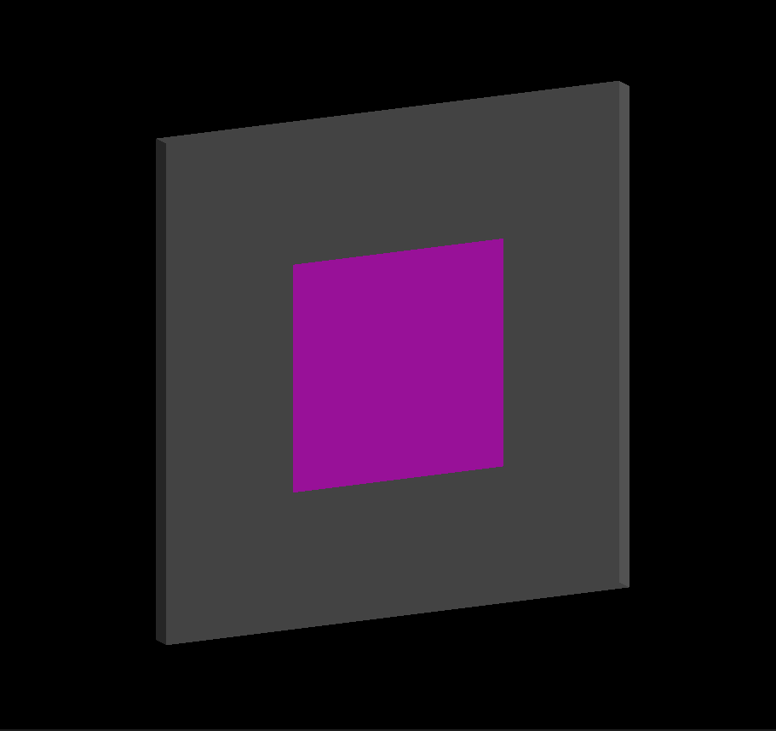
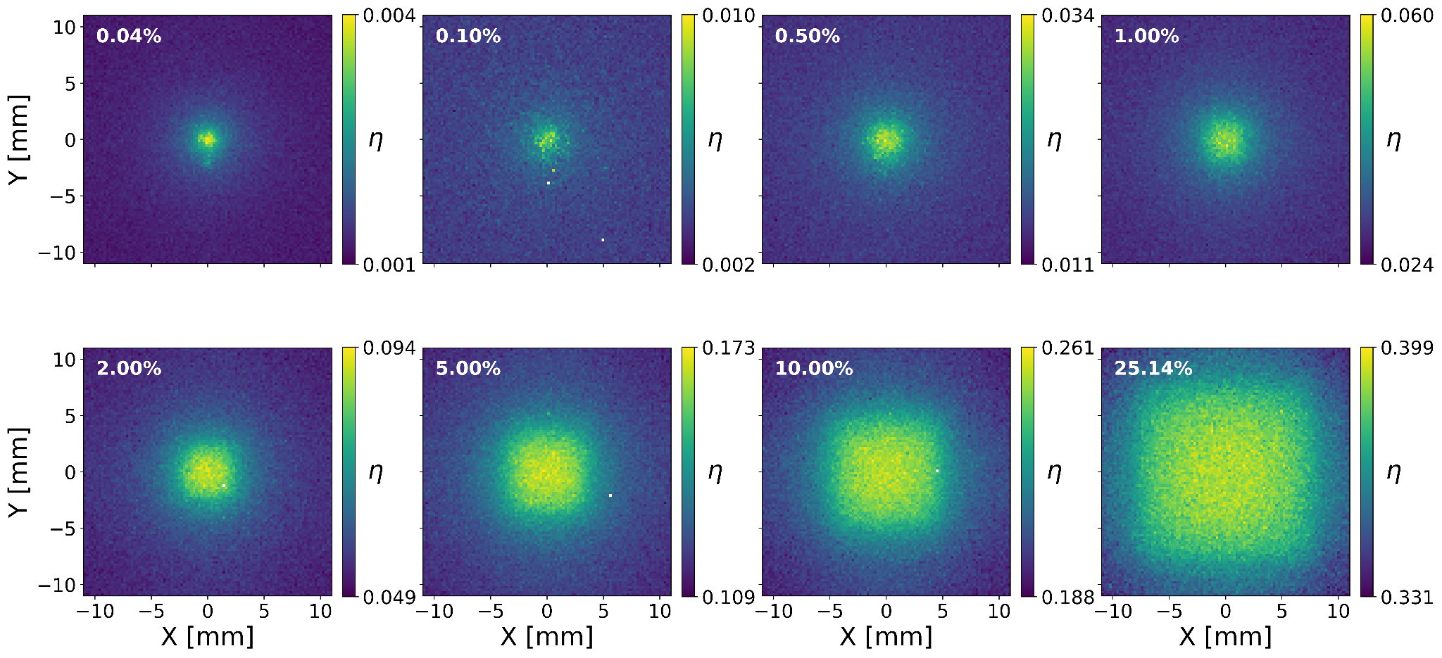
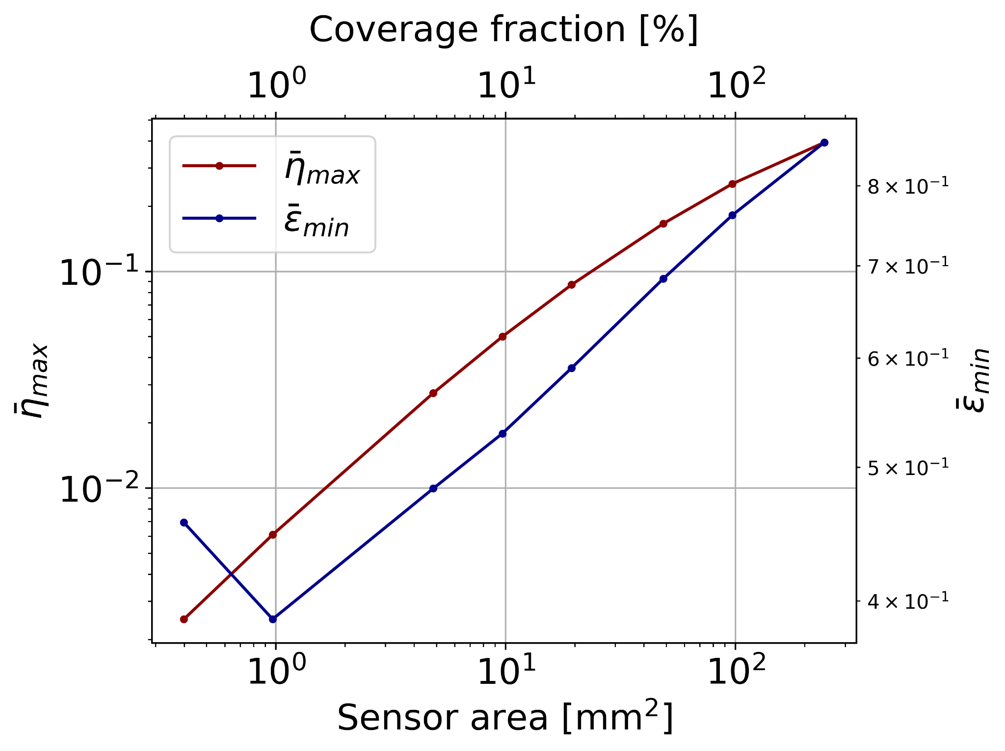
Varying Sensor Area
Assuming isotropic phonon loss, we can map out how different phonon sensor layouts perform.
I. Benchmarking phonon loss
η: average η(x,y) above 2σ
ε:
II. Impact of phonon loss on forward modeling
η: absolute phonon energy collection efficiency
ε: relative phonon energy collection efficiency; ε(x,y) = η(x,y) / η_{max}
average η(x,y) below 2σ
average η(x,y) above 2σ
Selby Q Dang | RISQ 2026

Slide 16
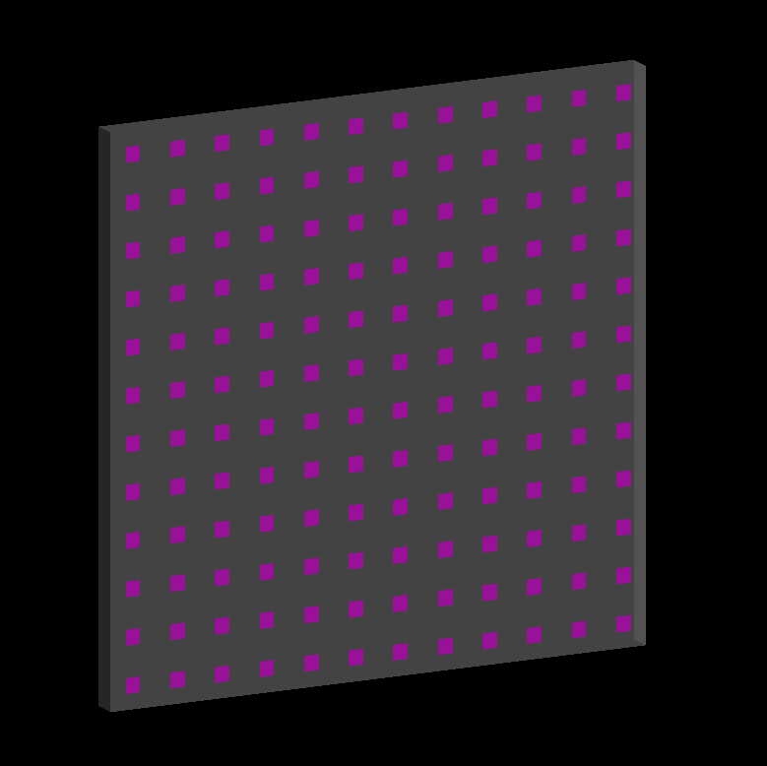
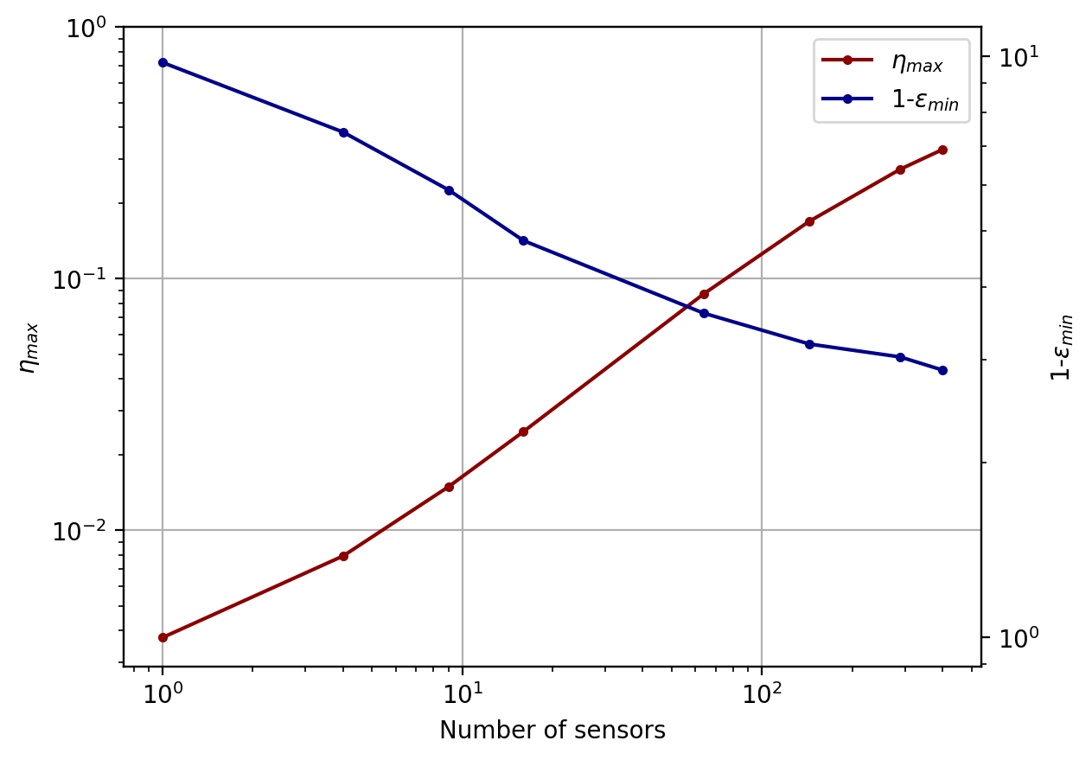
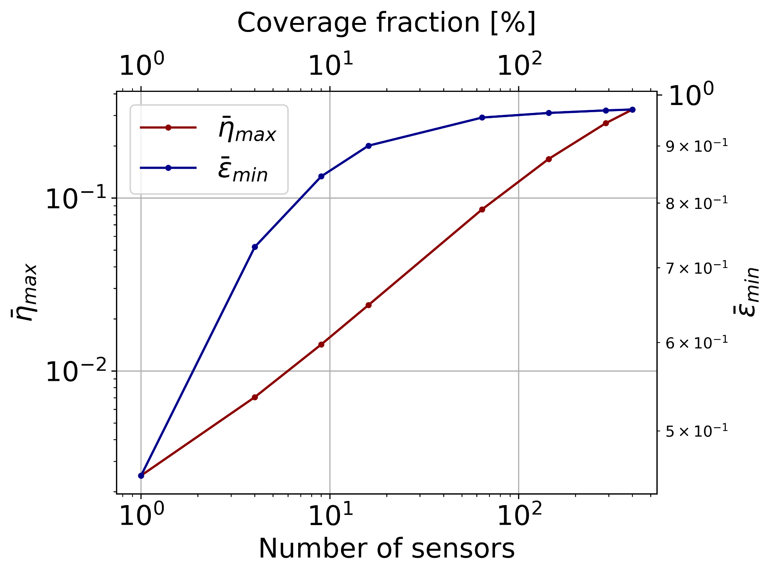
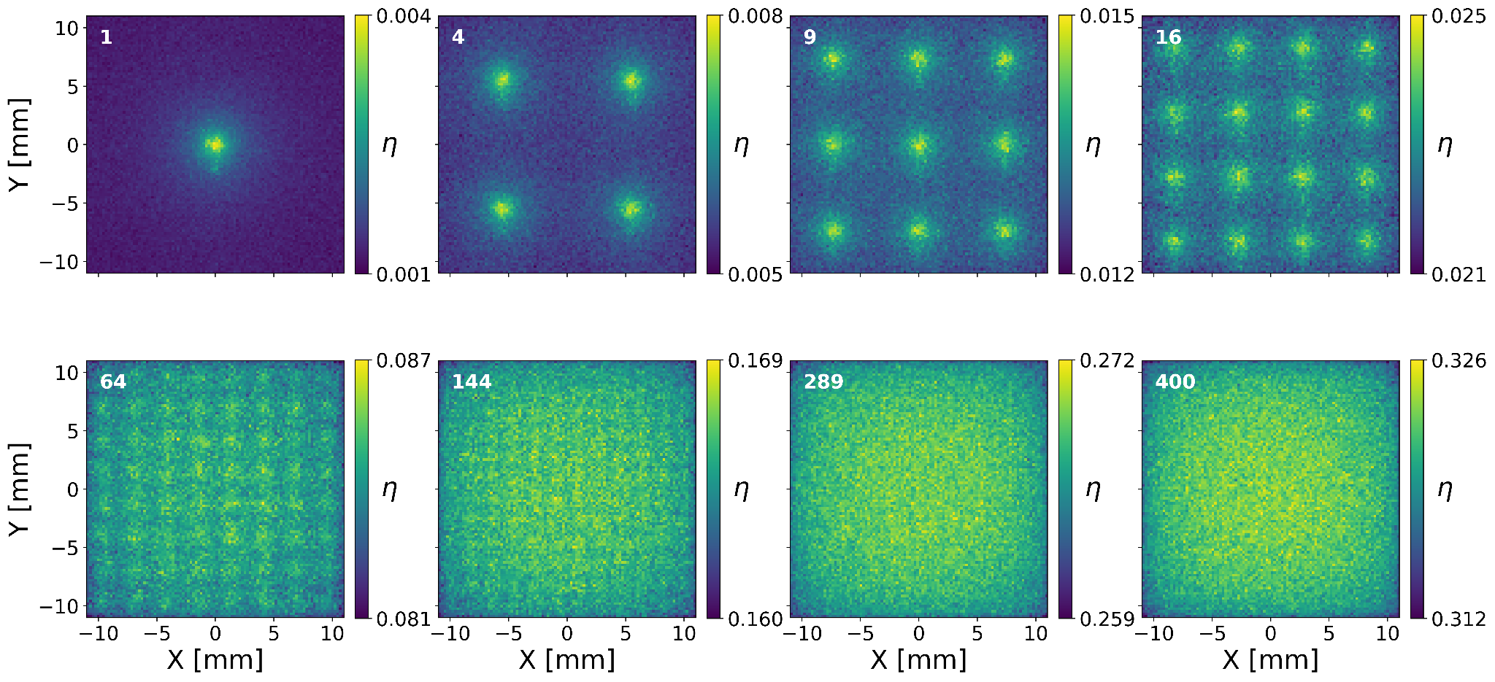
Varying Number of Sensors
Assuming isotropic phonon loss, we can map out how different phonon sensor layouts perform.
I. Benchmarking phonon loss
η: average η(x,y) above 2σ
ε:
II. Impact of phonon loss on forward modeling
η: absolute phonon energy collection efficiency
ε: relative phonon energy collection efficiency; ε(x,y) = η(x,y) / η_{max}
average η(x,y) below 2σ
average η(x,y) above 2σ
Selby Q Dang | RISQ 2026
Notes:
log scale all the x axes
log log
good efficiency, low position dependence, overall area high
thickness vs number of sensors
look at this space! it's super nonlinear!
for qubits thickness affects delta Delta

Slide 17
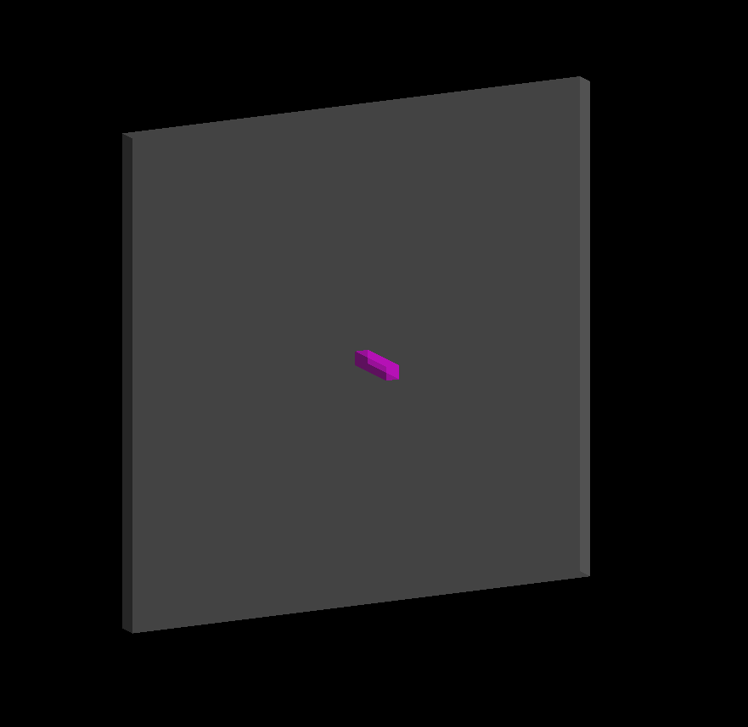
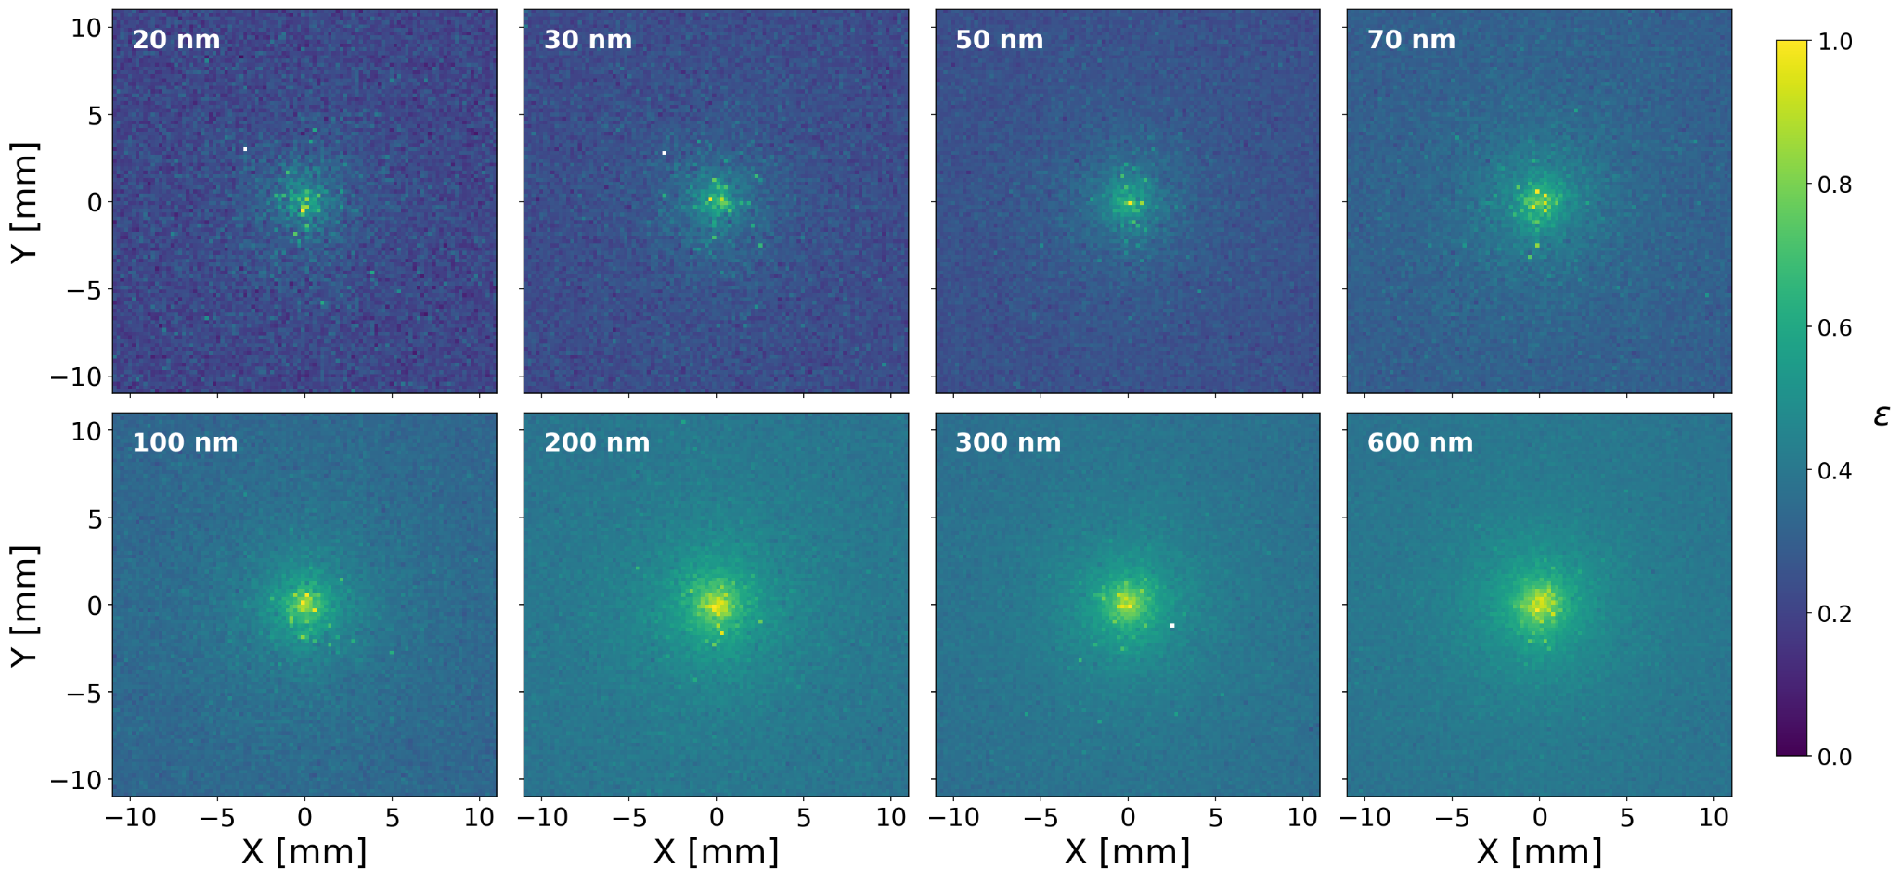
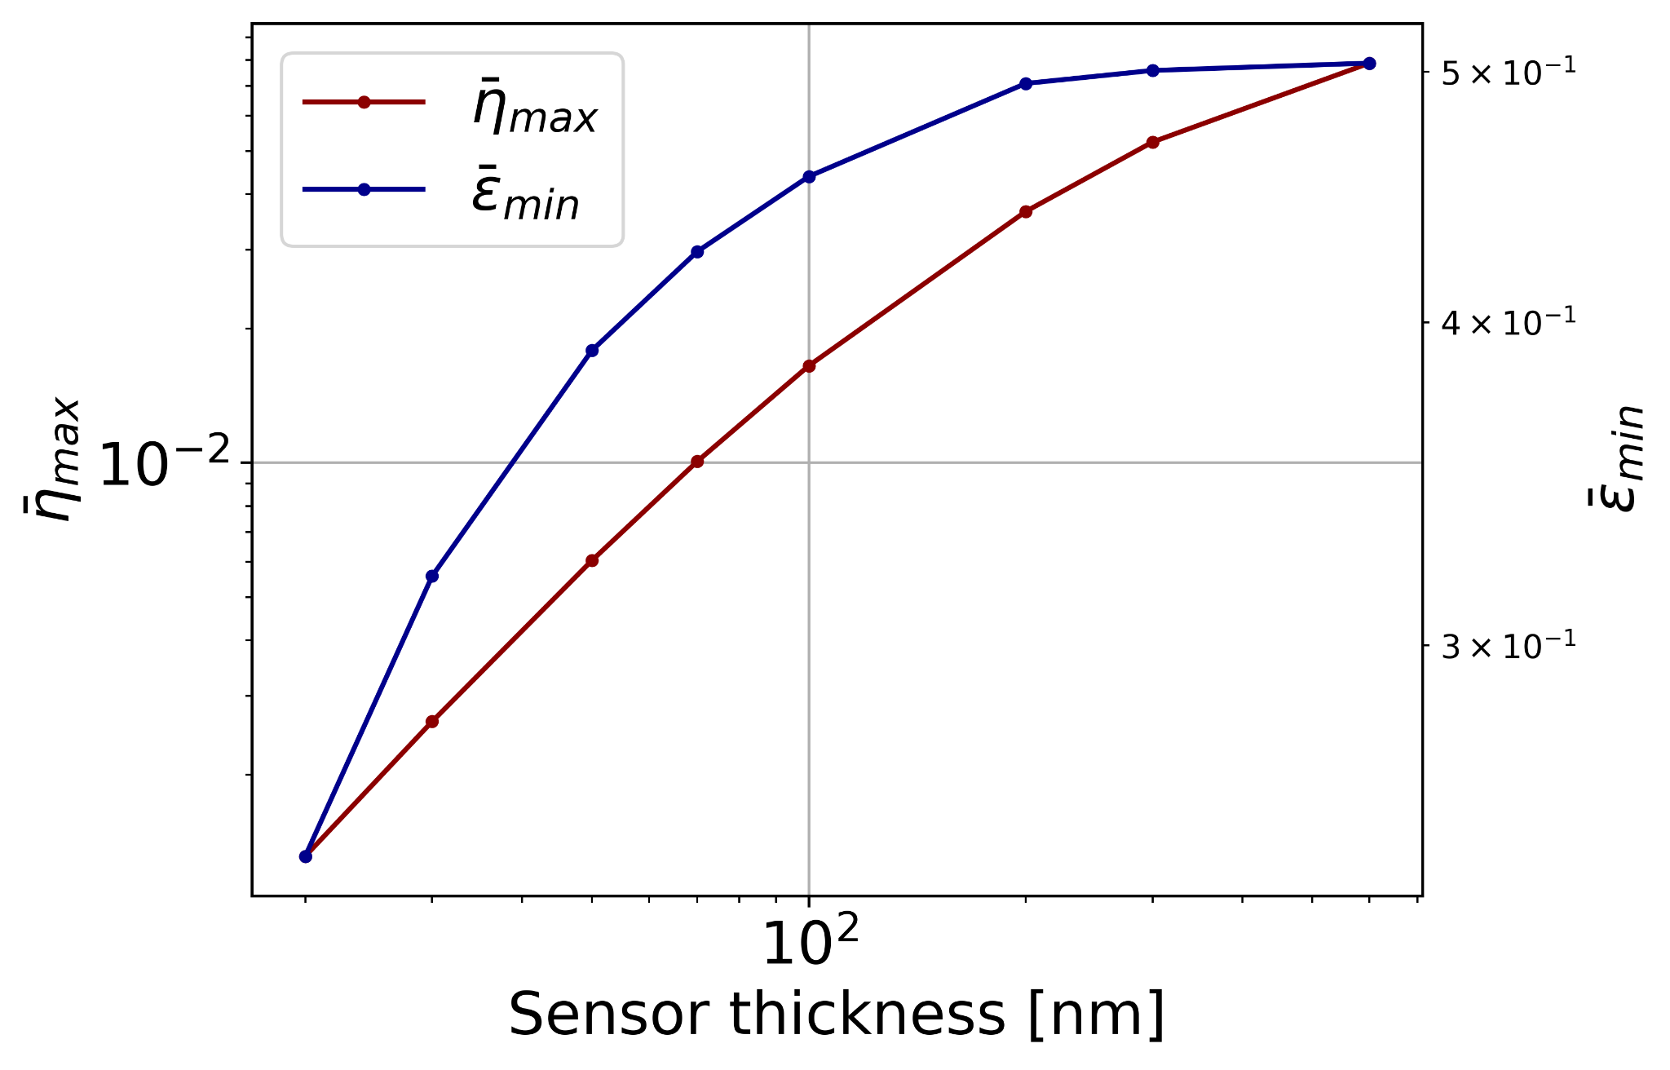
Varying Sensor Film Thickness
Assuming isotropic phonon loss, we can map out how different phonon sensor layouts perform.
I. Benchmarking phonon loss
η: average η(x,y) above 2σ
ε:
II. Impact of phonon loss on forward modeling
η: absolute phonon energy collection efficiency
ε: relative phonon energy collection efficiency; ε(x,y) = η(x,y) / η_{max}
average η(x,y) below 2σ
average η(x,y) above 2σ
Selby Q Dang | RISQ 2026

Slide 18
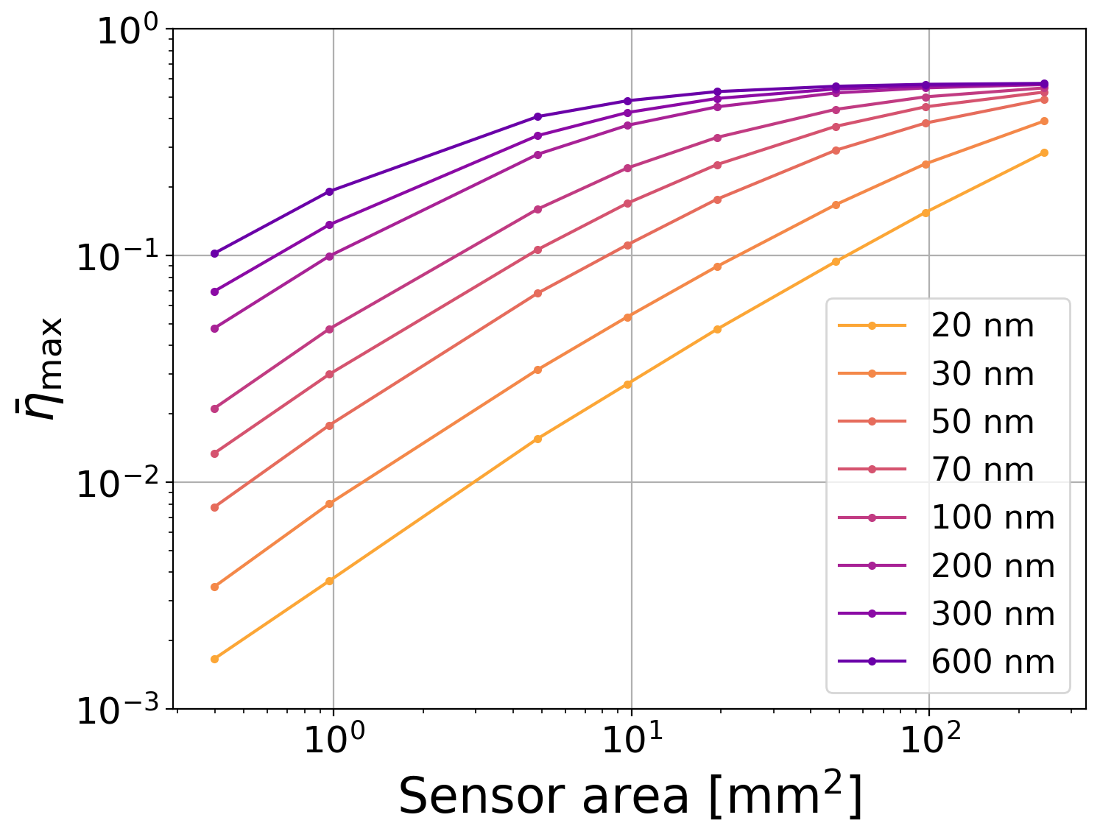
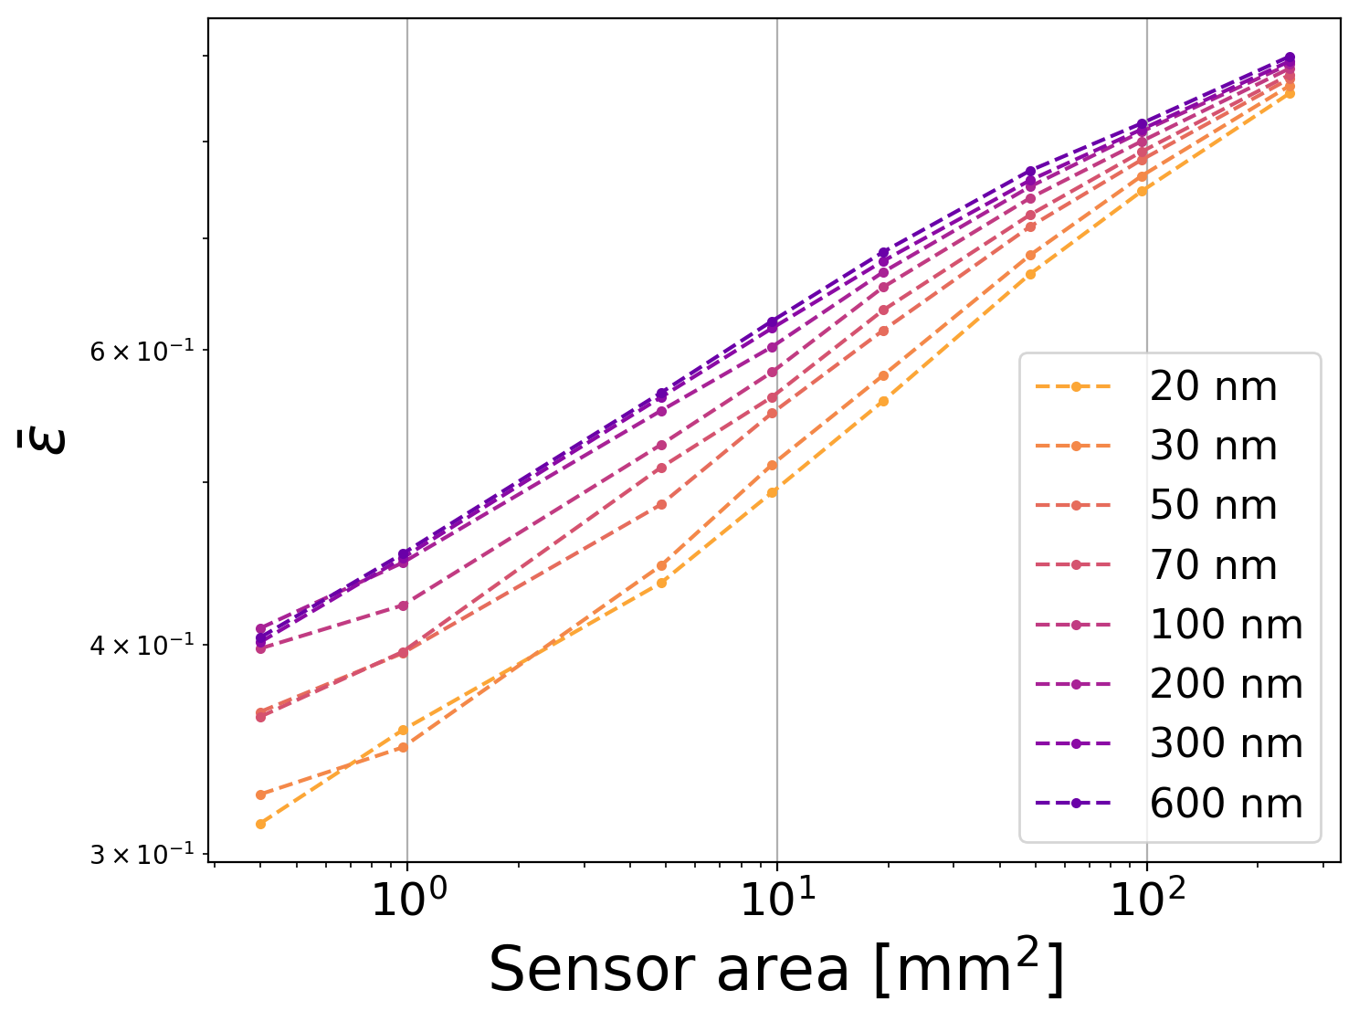
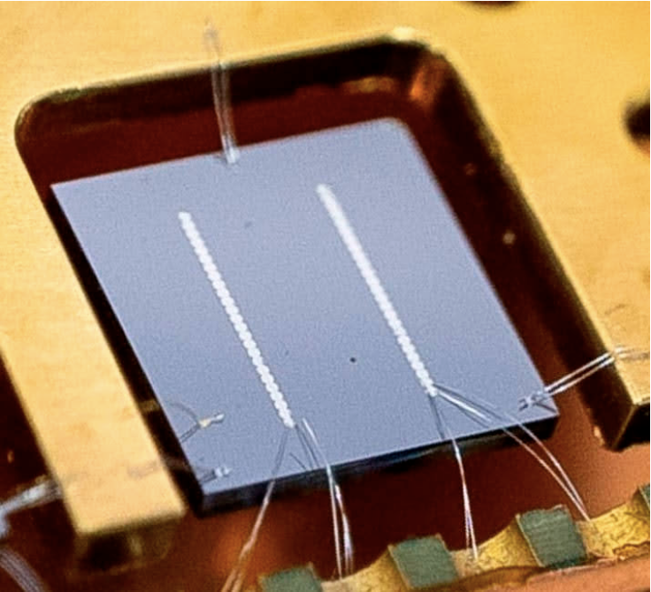
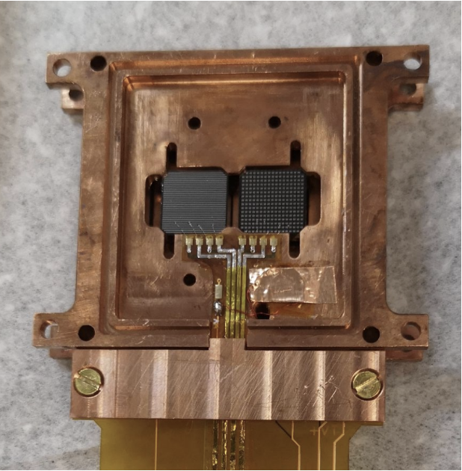
Parameter Space Beyond Low Coverage
From our assumptions of phonon loss, we can create a "lookup table" for the optimization space relevant to different sensor layouts.
high-coverage QET (HVeV)
I. Benchmarking phonon loss
arxiv.org/2505.16092v1
low-coverage QET (Berkeley)
arxiv.org/2601.16307
KIPM
II. Impact of phonon loss on forward modeling
η: average η(x,y) above 2σ
ε:
η: absolute phonon energy collection efficiency
ε: relative phonon energy collection efficiency; ε(x,y) = η(x,y) / η_{max}
average η(x,y) below 2σ
average η(x,y) above 2σ
Selby Q Dang | RISQ 2026

Slide 19
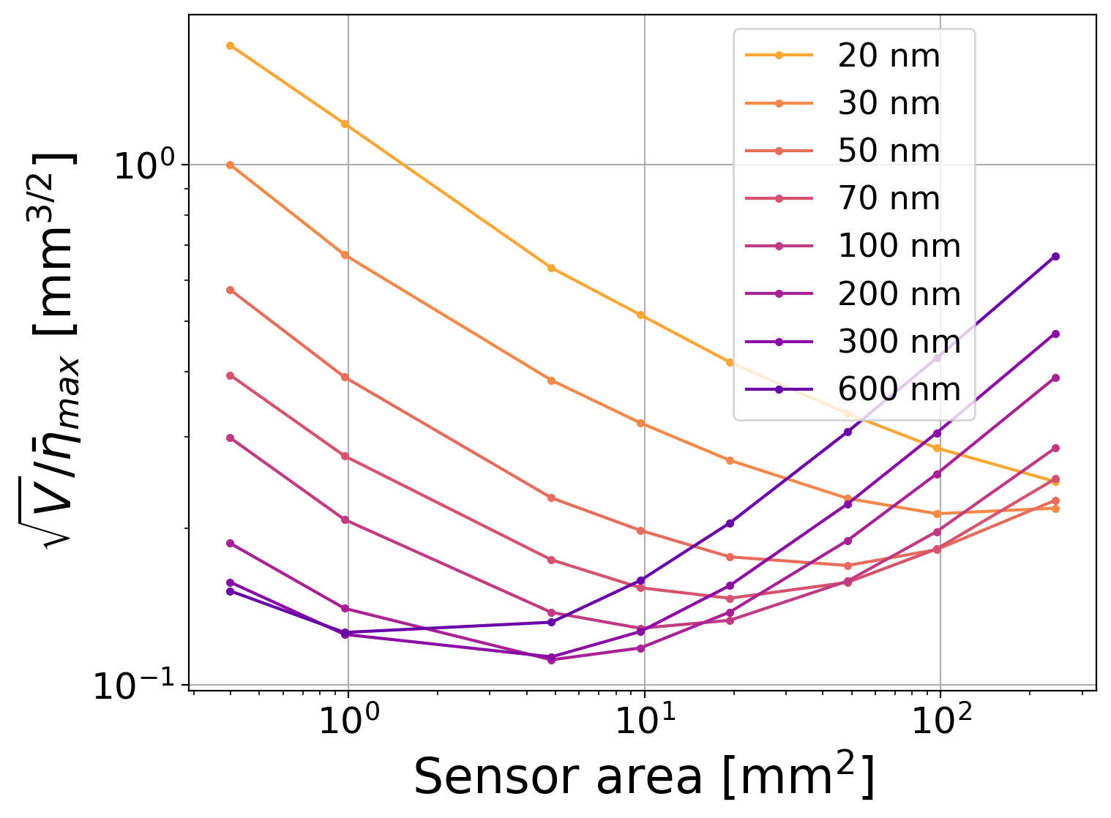
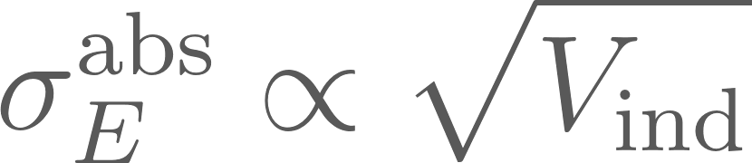
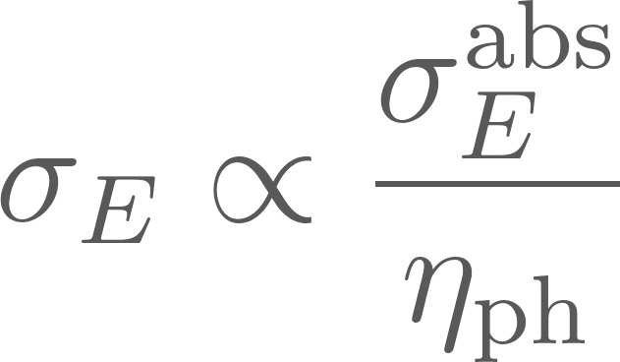
Direct Absorber Volume Optimization
We explore the volume optimization for direct absorber phonon sensors as a trade off between collection efficiency and sensor resolution.
I. Benchmarking phonon loss
our KIPM
The ideal calorimeter, without any trapping enhancement, will have resolution scale as the square root of absorber volume.
II. Impact of phonon loss on forward modeling
η: absolute phonon energy collection efficiency
η: average η(x,y) above 2σ
Selby Q Dang | RISQ 2026

Slide 20
Conclusion
Benchmarking effects of phonon loss is relevant for modeling diverse phonon sensors in G4CMP.
Our MEMS measurement of position-dependent phonon responsivity provides a benchmark for phonon loss, which we think is isotropic & potentially at crystal surfaces
Assuming this isotropic loss, we can project efficiency for different sensor layouts
Next steps: given models of sensor resolution, we can make sensitivity projections for different sensor layouts and architectures
I. Benchmarking phonon loss
II. Impact of phonon loss on forward modeling
Selby Q Dang | RISQ 2026

Slide 21
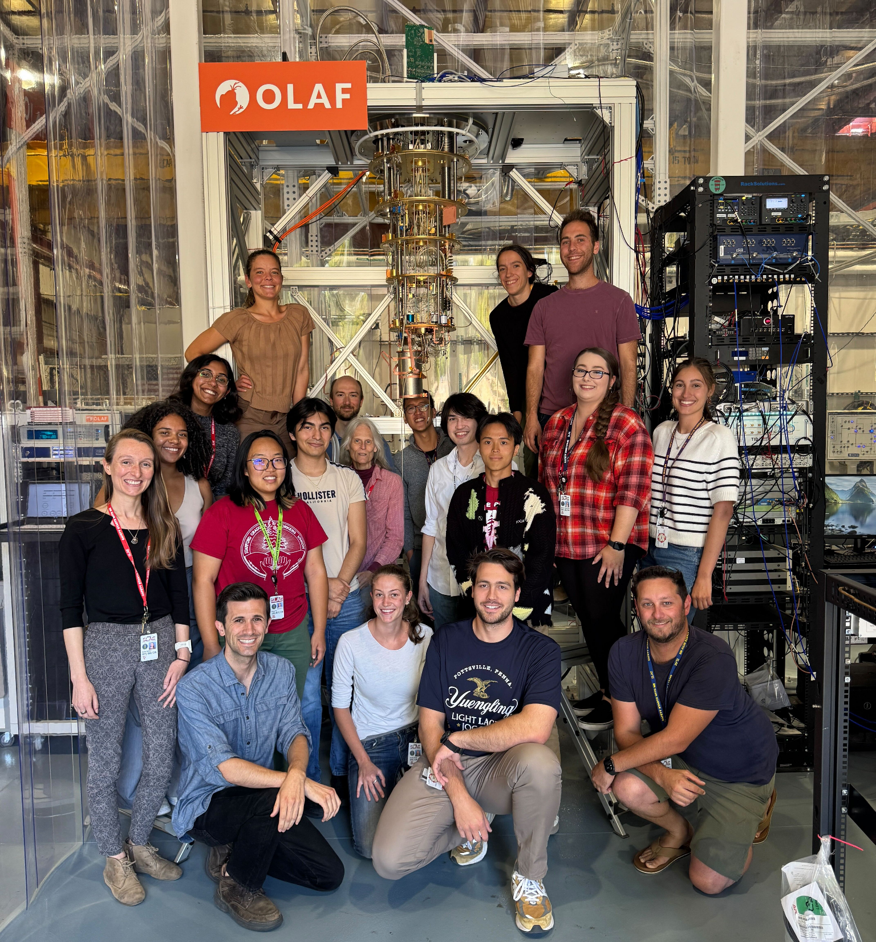
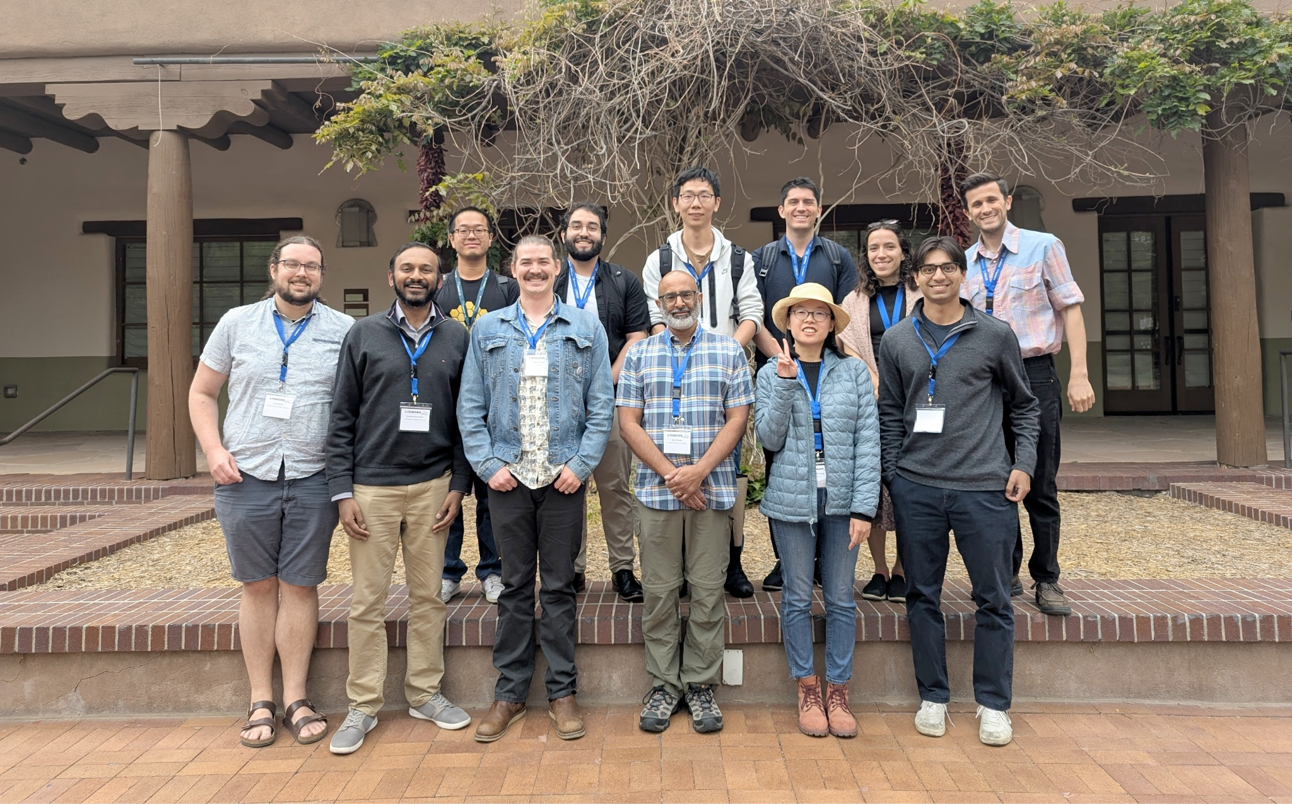

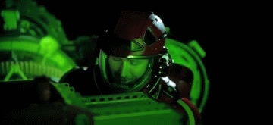
Thank you!

Slide 22
Backup

Slide 23
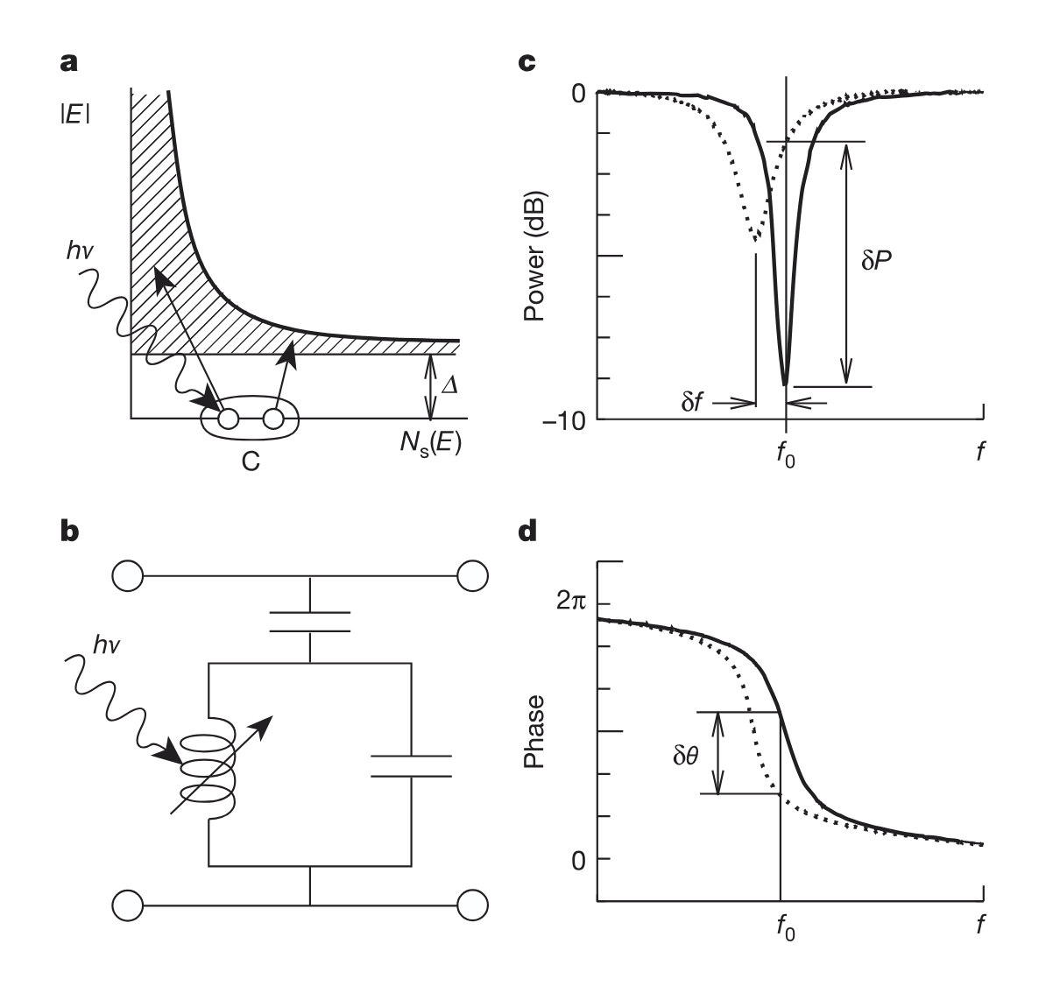
Microwave Kinetic Inductance Detectors
Quasiparticles from broken Cooper pairs shift kinetic inductance in a superconducting resonator.
I. Benchmarking phonon loss
https://doi.org/10.7907/GZ72-V784
Selby Q Dang | RISQ 2026

Slide 24
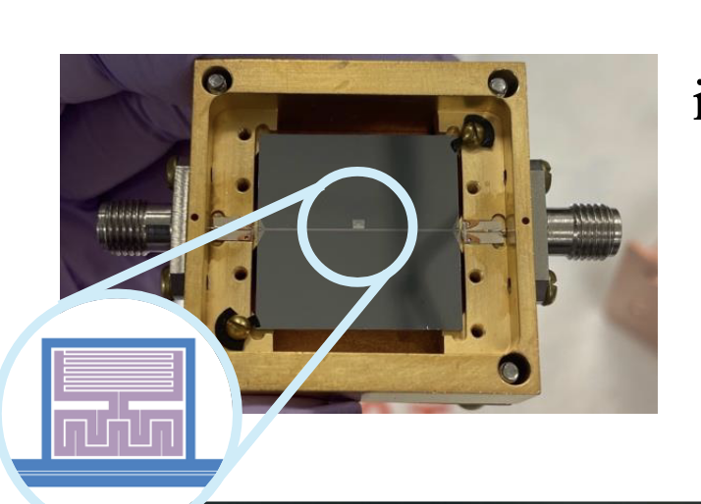
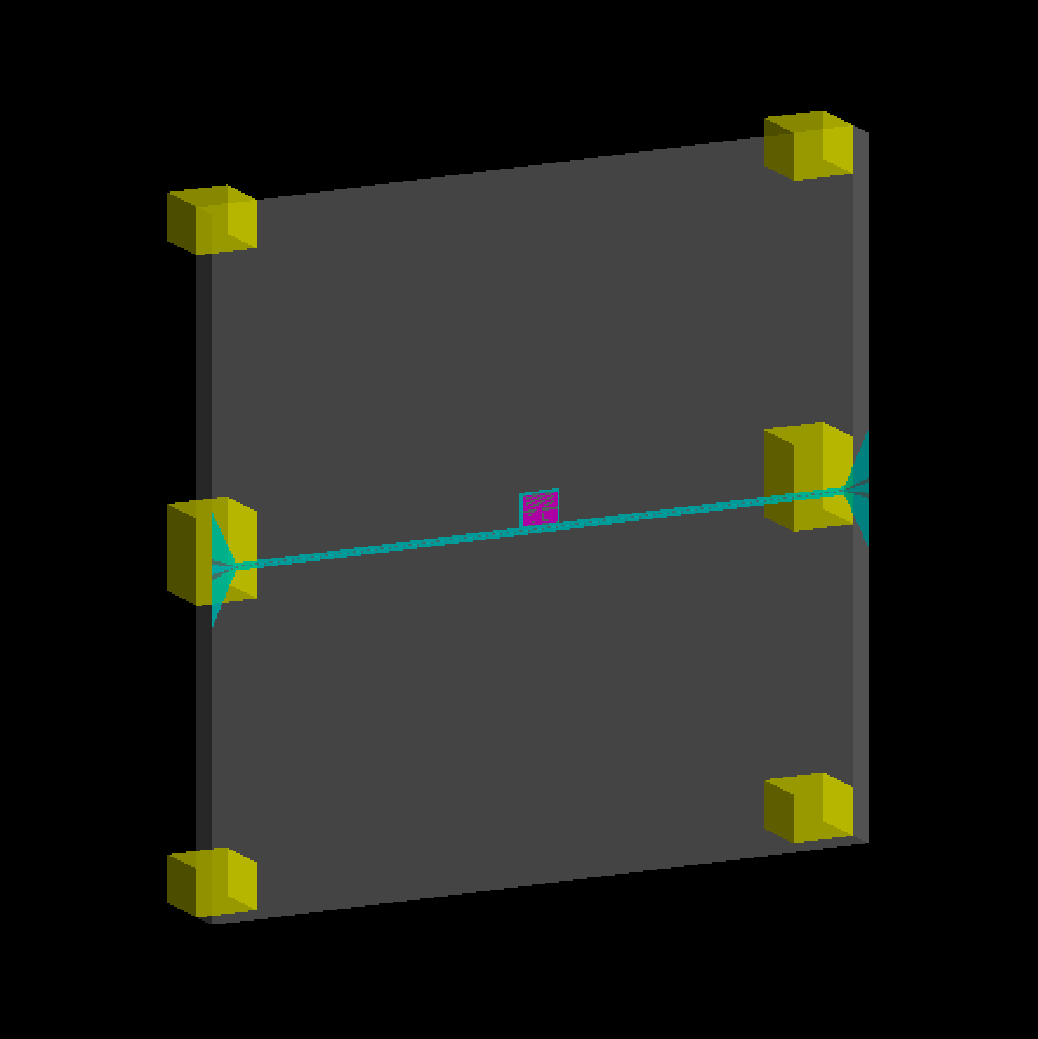
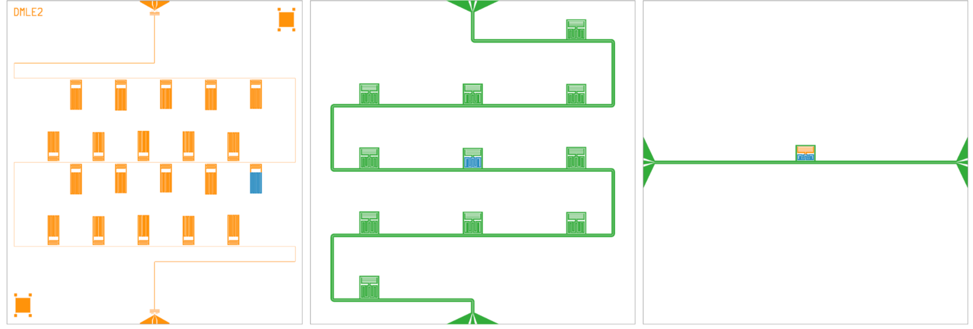
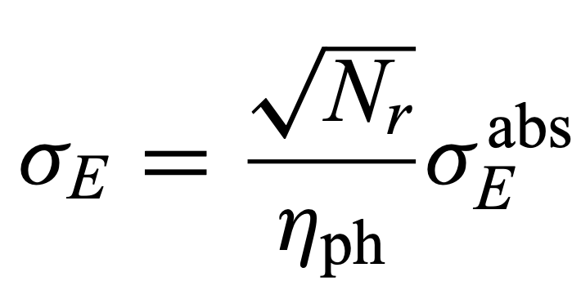
Kinetic Inductance Phonon-Mediated Detectors
Our KIPM (OW230427)
1mm x 2cm x 2cm Si chip
30 nm Al resonator, 70 nm Nb feedline
0.09% sensor surface area coverage
<13,695.6 μm³ active inductor volume
Fabricated at JPL by Osmond Wen and Bruce Bumble
I. Benchmarking phonon loss
capacitor
inductor
feedline
Use cases: low-threshold rare event searches, co-sensors for qubits
Overall detector resolution is limited by low phonon collection efficiency
number of resonators
resolution on energy deposited in the substrate
(hundreds of eV)
resolution on energy absorbed by the sensor
(few eV)
σ_{Edep} [eV] | 380 | 320 | 850
σ_{Eabs} [eV] | 5.9 ± 0.9 | 2.1 ± 0.1 | 23
η [%] | 7.0 ± 1.1 | 0.78 ± 0.07 | 1.1 ± 0.2
phonon collection efficiency (<1%)
Selby Q Dang | RISQ 2026

Slide 25
Note on Parameters for Part I
Studies in Part I do not model quasiparticles using either KaplanQP or TrackedFilmResponse
  Any above-gap phonons that are absorbed according to the phonon absorption probability are counted toward energy depositions
Other relevant parameters:
  For slides 6-12, electron-hole pairs are generated in a uniform (x,y) distribution across the L-scan region & an exponential z distribution consistent with the attenuation of a 625-nm optical photon in Si
  For slide 13, electron-hole pairs are generated at the center of the inductor for the "on-sensor" (x,y) position and (-9.3 mm, 8.52 mm) for the "off-sensor" (x,y) position; the z position is still sampled from the exponential distribution
  Electron-hole pairs each have a 0.814-eV kinetic energy partitioned in an "all-to-one" scheme to electron or hole
  Charge trapping is off
  Maximum phonon bounces = 100000
I. Benchmarking phonon loss
Selby Q Dang | RISQ 2026

Slide 26
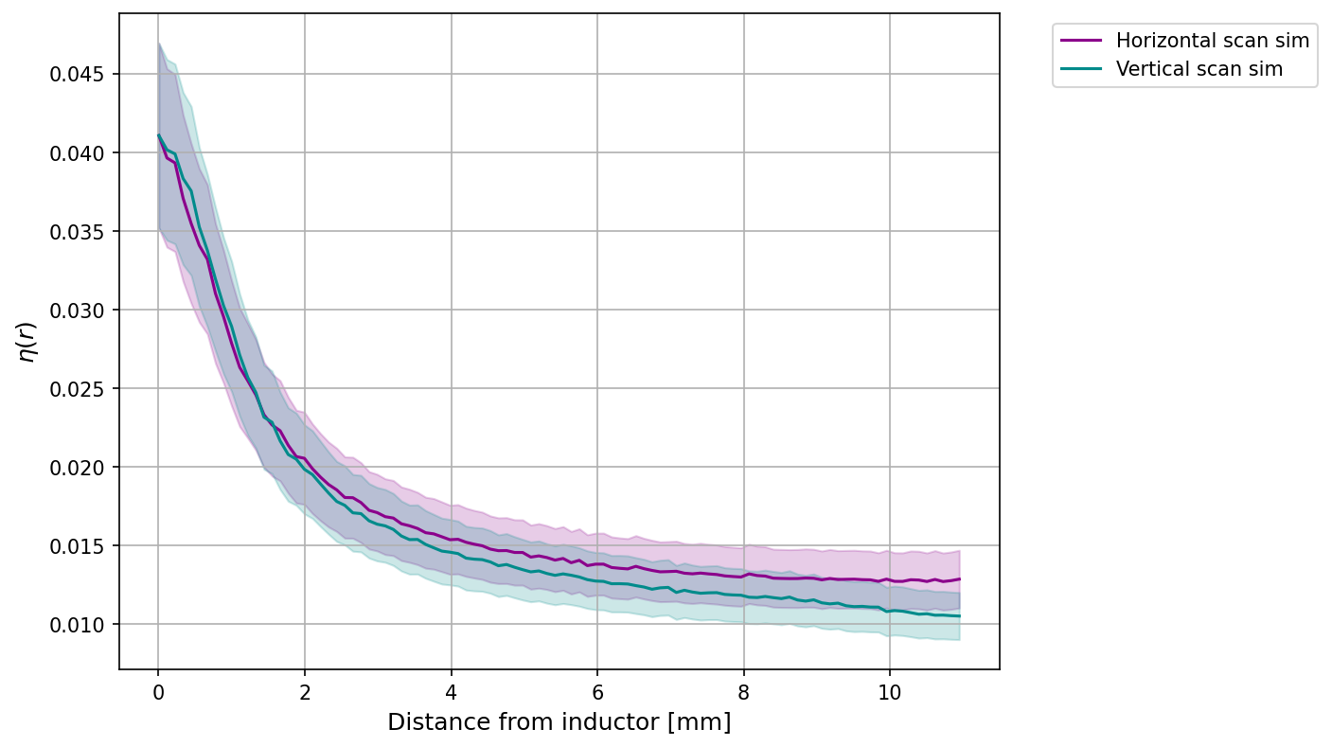
η(r) in Part I
Al resonator
I. Benchmarking phonon loss
polished faces
Nb feedline
side walls
Cu housing
p_{abs, inductor} | 0.103
p_{abs, capacitor} | 0
p_{abs, Nb} | 0.1
p_{abs, Cu} | 0
p_{abs, polished surfaces} | 0.002
p_{abs, side walls} | 0
η: absolute phonon energy collection efficiency
ε: relative phonon energy collection efficiency; ε(x,y) = η(x,y) / η_{max}
Selby Q Dang | RISQ 2026

Slide 27
Note on Parameters for Part II
Studies in Part II model quasiparticles in 0D using KaplanQP
  Phonon transmission probability: p_{trans, Si → Al} = 0.795*
  Pairbreaking probability: p_{break} = 1 - exp(-4d/λ_{pb})
    d = sensor film thickness, λ_{pb}= pairbreaking length ≈ 866 nm*
  filmAbsorption: p_{abs} = p_{trans} × p_{break}
Other relevant parameters:
  For slides 15-17, electron-hole pairs are generated in a uniform (x,y) distribution and an exponential z distribution consistent with the attenuation of a 625-nm optical photon in Si
  For slides 18-19, electron-hole pairs are generated in a diagonal (x,y) distribution from (0 mm, 0 mm) to (11 mm, 11 mm) and an exponential z distribution
  Electron-hole pairs each have a 0.814-eV kinetic energy partitioned in an "all-to-one" scheme to electron or hole
  Charge trapping is off
  Maximum phonon bounces = 100000
I. Benchmarking phonon loss
II. Impact of phonon loss on forward modeling
*https://journals.aps.org/prb/pdf/10.1103/PhysRevB.110.024519
Selby Q Dang | RISQ 2026

Slide 28
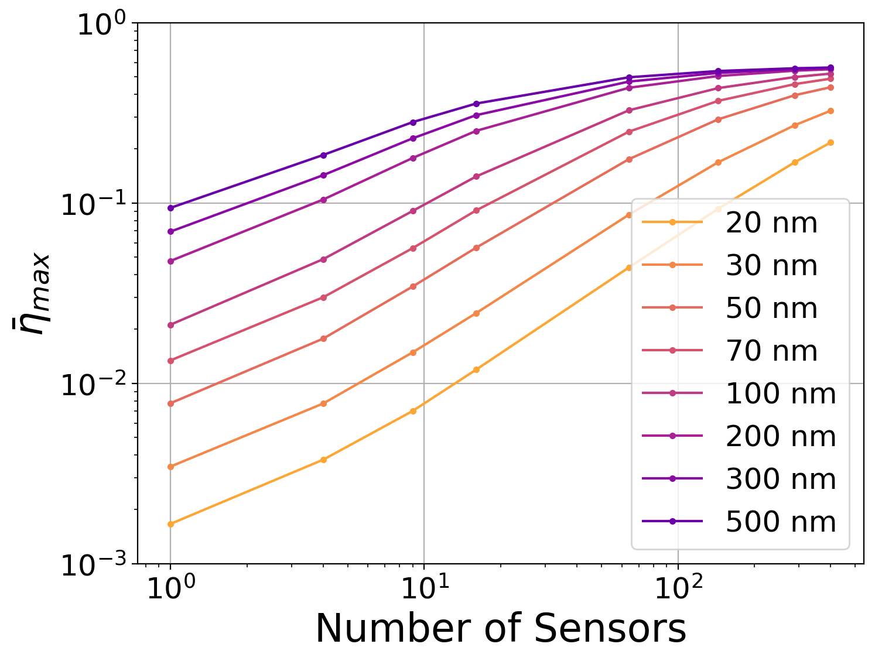
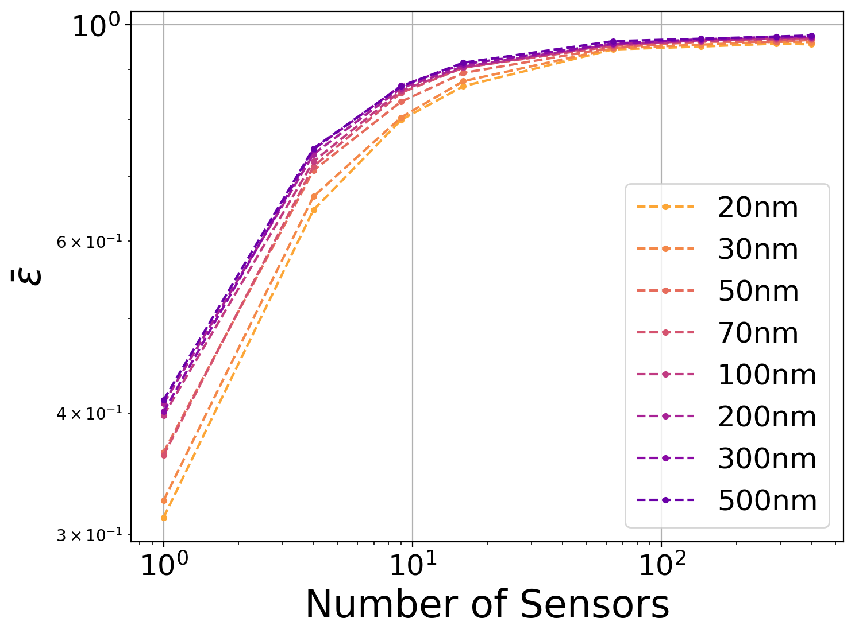
More Sensor Layout Studies
I. Benchmarking phonon loss
II. Impact of phonon loss on forward modeling
η: average η(x,y) above 2σ
ε:
η: absolute phonon energy collection efficiency
ε: relative phonon energy collection efficiency; ε(x,y) = η(x,y) / η_{max}
average η(x,y) below 2σ
average η(x,y) above 2σ
Selby Q Dang | RISQ 2026

Slide 29
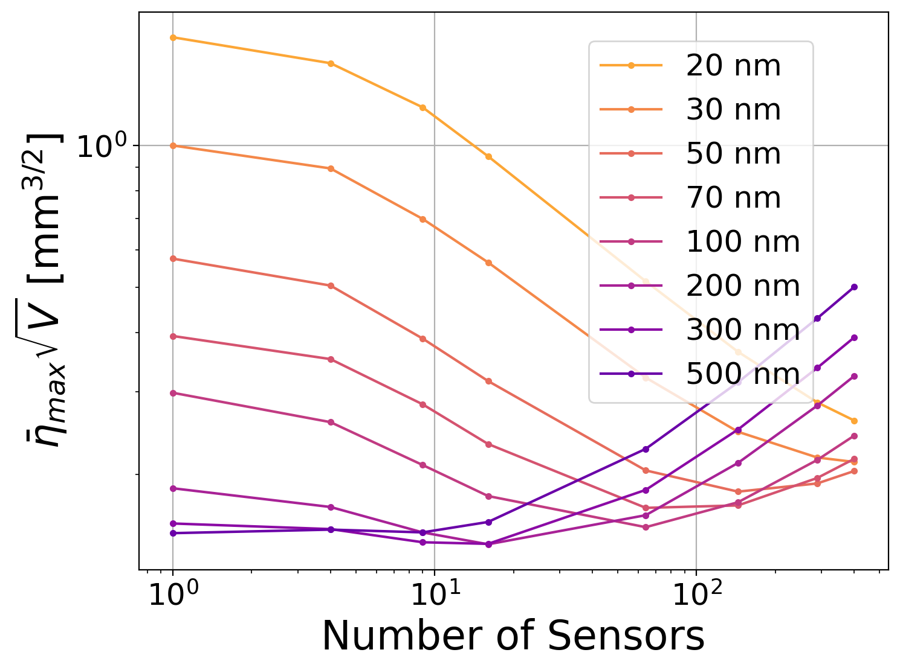
More Sensor Layout Studies
I. Benchmarking phonon loss
II. Impact of phonon loss on forward modeling
η: absolute phonon energy collection efficiency
η: average η(x,y) above 2σ
Selby Q Dang | RISQ 2026

Slide 30





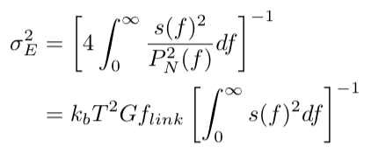



Volume Scaling of an Ideal Calorimeter
Temperature evolution, in the limit of mapping sensor response to equilibrium temperature state:
I. Benchmarking phonon loss
Linearize first term & assume film thermalizes in steady state, we get
Solution with initial ΔT=E/C:
→ pulse amplitude ∝ energy deposited
Power signal from fluctuation-dissipation theorem:
Noise in Fourier space:
Energy resolution:
In the limit that , where C_{VT} is the volumetric specific heat:
II. Impact of phonon loss on forward modeling
Selby Q Dang | RISQ 2026

