Slide 1
Analysis of Event Position Dependence in HVeV Detectors with G4CMP and MEMS
Caitlyn Stone-Whitehead, Hope Fu

Slide 2
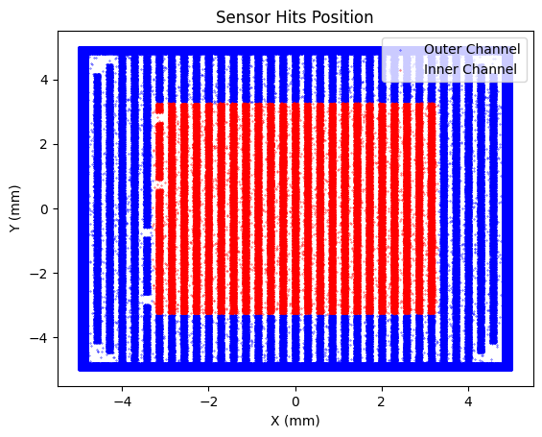
HVeV Detectors
Outer Channel
Channels consist of QETs wired in parallel
Inner Channel
Quasiparticle-assisted Electrothermal feedback TESs (QETs)
Cu Holder
Cu Holder
Al Collection Fin
α-W TES
Phonons
Silicon Substrate
Aluminum Grid
[1] Kyle Kennard et al., arXiv:2601.16307 [physics.ins-det] (2026). https://doi.org/10.48550/arXiv.2601.16307

Slide 3
HVeV Detectors
Outer Channel
High Voltage with eV-sensitivity
Cu Holder
Cu Holder
Inner Channel
Incoming Particle
An incoming particle deposits energy in the Si​
X
ΔV
Silicon Substrate
Aluminum Grid

Slide 4
HVeV Detectors
Outer Channel
High Voltage with eV-sensitivity
Cu Holder
Cu Holder
Inner Channel
Incoming Particle
An incoming particle deposits energy in the Si​
Prompt phonon and charge excitation​
2)
e-
X
ΔV
h+
Silicon Substrate
Aluminum Grid

Slide 5
HVeV Detectors
Outer Channel
High Voltage with eV-sensitivity
Cu Holder
Cu Holder
Inner Channel
Incoming Particle
An incoming particle deposits energy in the Si​
Prompt phonon and charge excitation​
Charges produce NTL phonons when being accelerated due to the applied voltage
3)
e-
2)
X
ΔV
h+
3)
Silicon Substrate
Aluminum Grid

Slide 6
HVeV Detectors
Outer Channel
High Voltage with eV-sensitivity
4)
Cu Holder
Cu Holder
Inner Channel
4)
Incoming Particle
An incoming particle deposits energy in the Si​
Prompt phonon and charge excitation​
Charges produce NTL phonon when being accelerated due to applied voltage
The phonons are either absorbed in the QET or lost to the Al Grid or Cu Holder
3)
2)
ΔV
Silicon Substrate
Aluminum Grid
4)

Slide 7
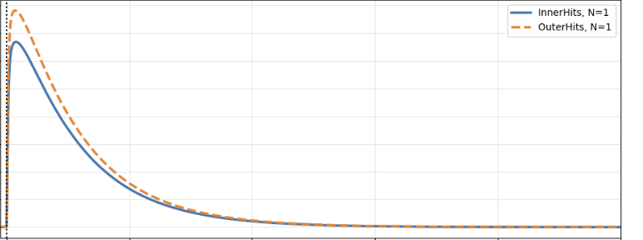
Micro-electro-mechanical-system (MEMS)
How does event position affect HVeV response?
Backside of HVeV device
Inner Channel vs Outer Channel Pulse
Amplitude
2eV Photons
Time
Mirror

Slide 8
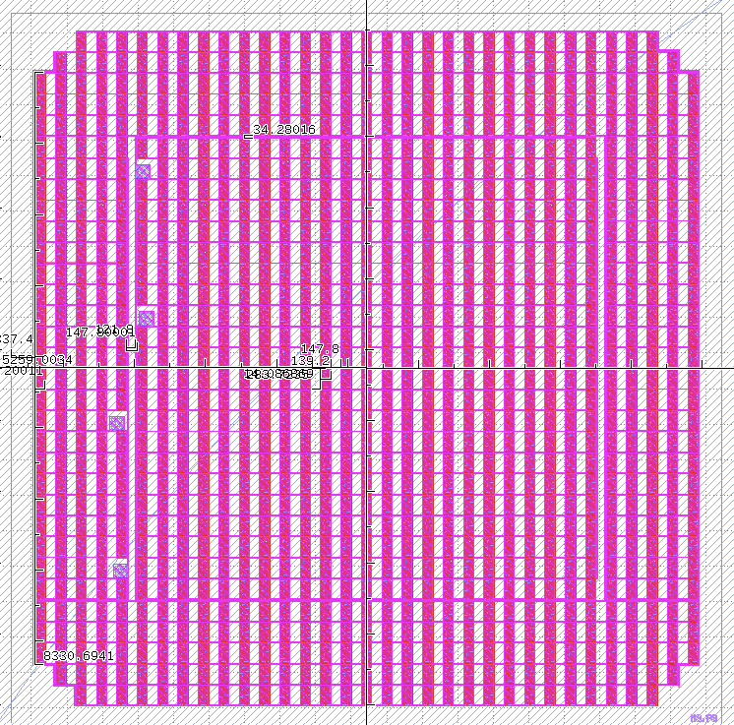
G4CMP Implementation
Outer Channel
GDS
G4CMP
Inner Channel
Cu Holder
Cu Holder
3.4 mm
Phonon absorption at boundaries specified using the Kaplan model for AMM and phonon lifetime / MFP [2,3]
KaplanQP implemented on QETs and Al grid
4 mm
Silicon Substrate
Aluminum Grid
1 cm ​
[2] S. B. Kaplan, “Acoustic matching of superconducting films to substrates,” J. Low Temp. Phys. 37, 343–365 (1979)
[3] S. B. Kaplan, C. C. Chi, D. N. Langenberg, J. J. Chang, S. Jafarey, and D. J. Scalapino, “Quasiparticle and phonon lifetimes in superconductors,” Phys. Rev. B 14, 4854–4873 (1976).

Slide 9
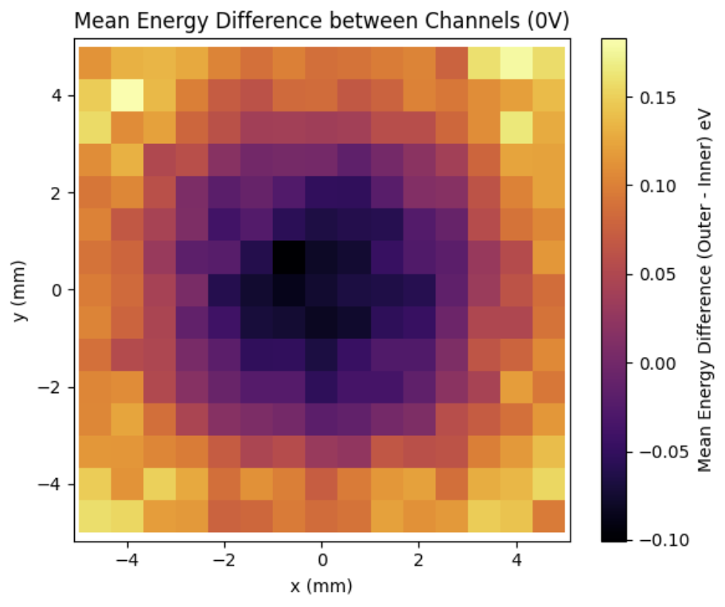
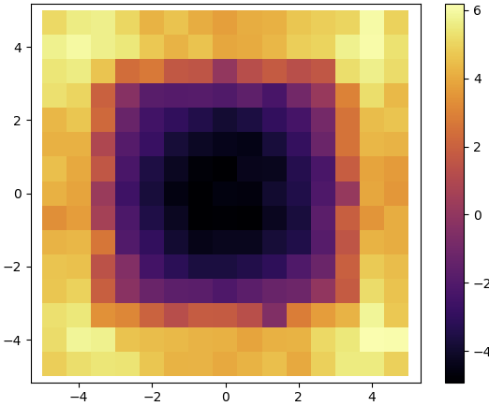
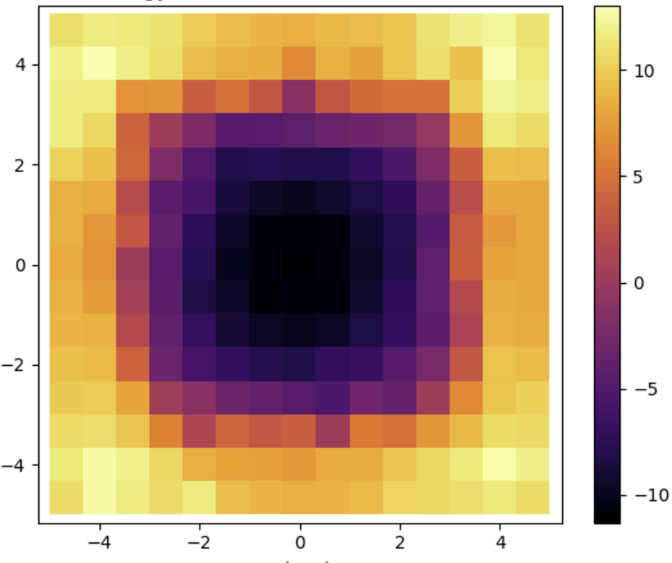
Difference in Energy Collection between Channels in G4CMP
0V
50V​
100V​
Y (mm)
Y (mm)
Y (mm)
Energy (eV)
Energy (eV)
Energy (eV)
X (mm)
X (mm)
X (mm)
e-
h+
e-
h+

Slide 10
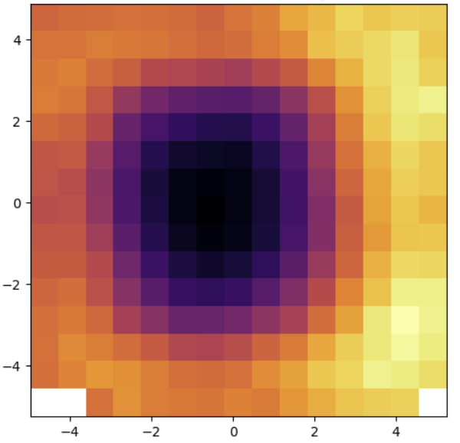
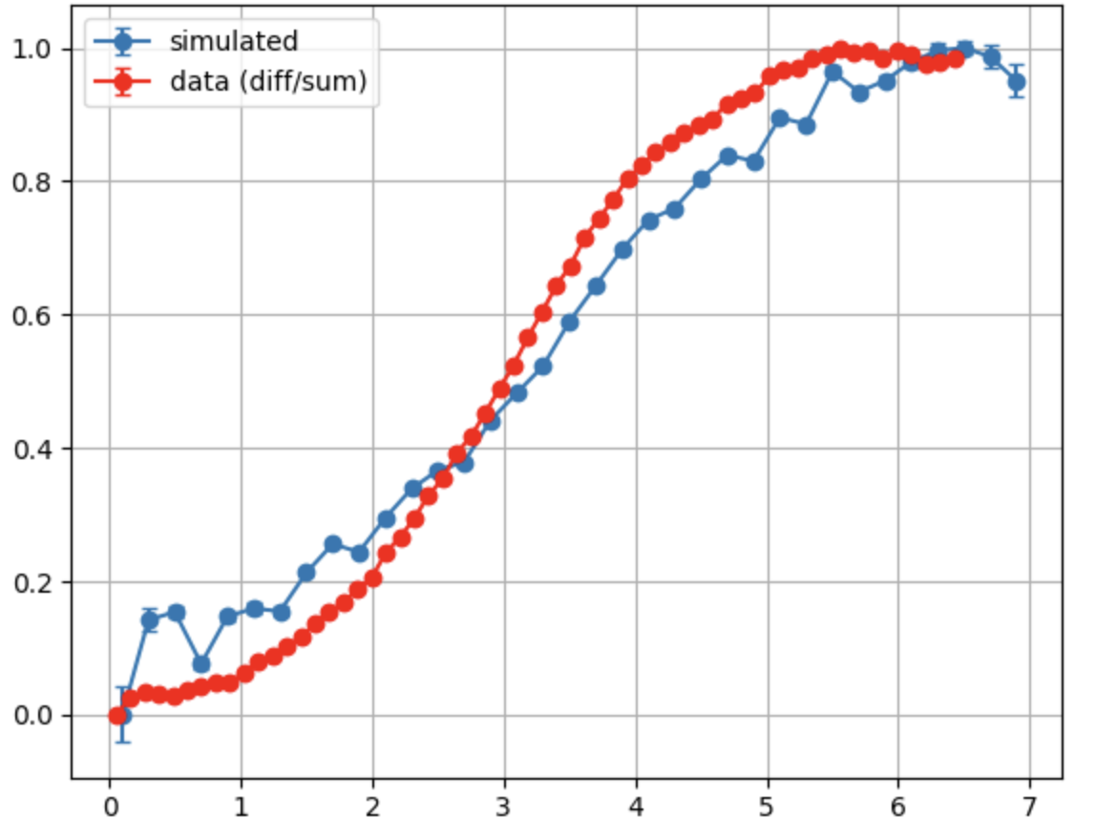
Comparison to Data: 0V
Simulation
Data
Normalized ΔE between Channels
Y (mm)
Y (mm)
ΔE (Outer – Inner)
P R E L I M I N A R Y
R (mm)
X (mm)
X (mm)

Slide 11
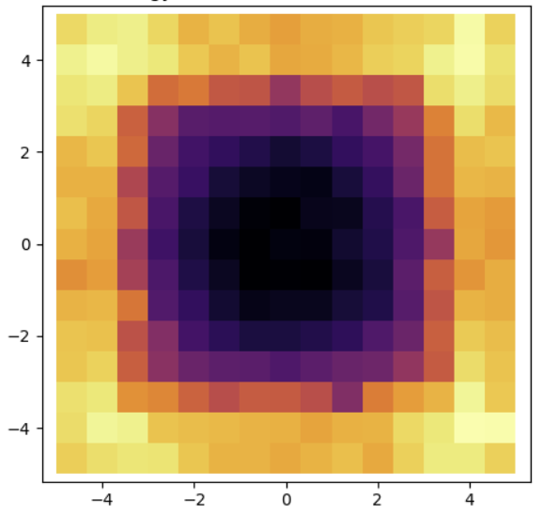
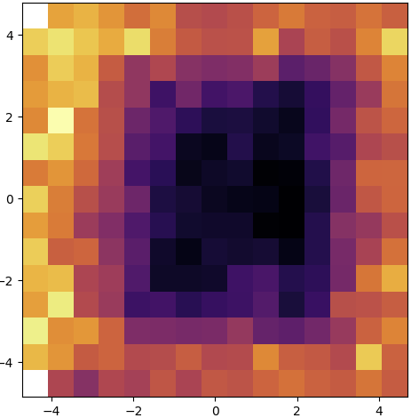
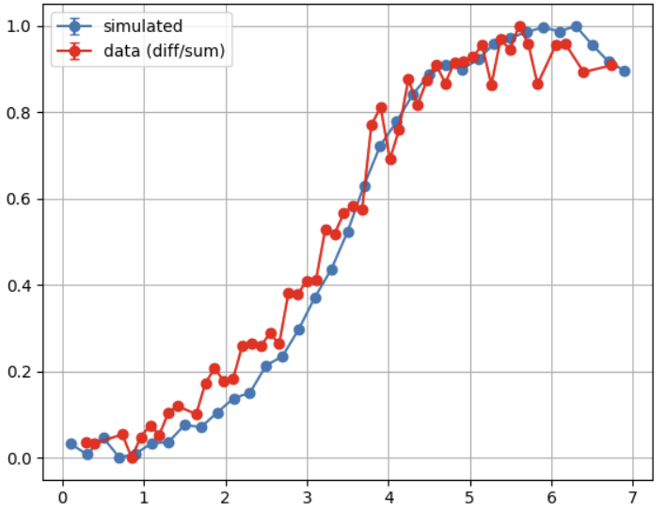
Comparison to Data: 50V
Simulation
Data
Normalized ΔE between Channels
Y (mm)
Y (mm)
ΔE (Outer – Inner)
P R E L I M I N A R Y
R (mm)
X (mm)
X (mm)

Slide 12
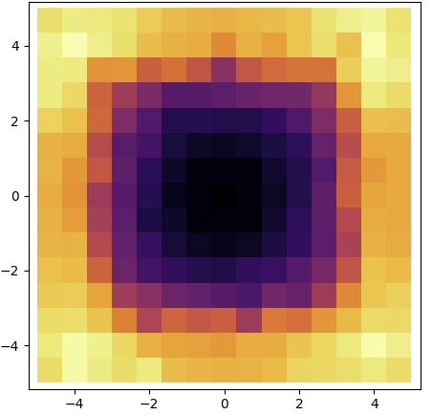
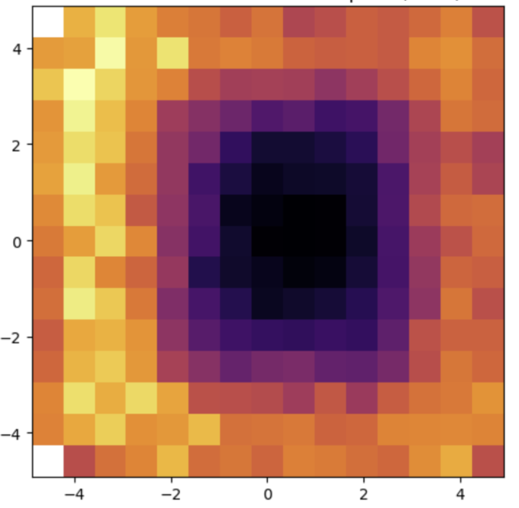
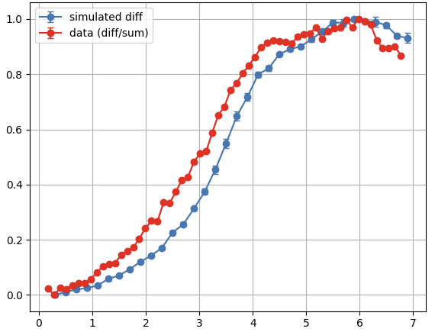
Comparison to Data: 100V
Simulation
Data
Normalized ΔE between Channels
Y (mm)
Y (mm)
ΔE (Outer – Inner)
P R E L I M I N A R Y
R (mm)
X (mm)
X (mm)

Slide 13
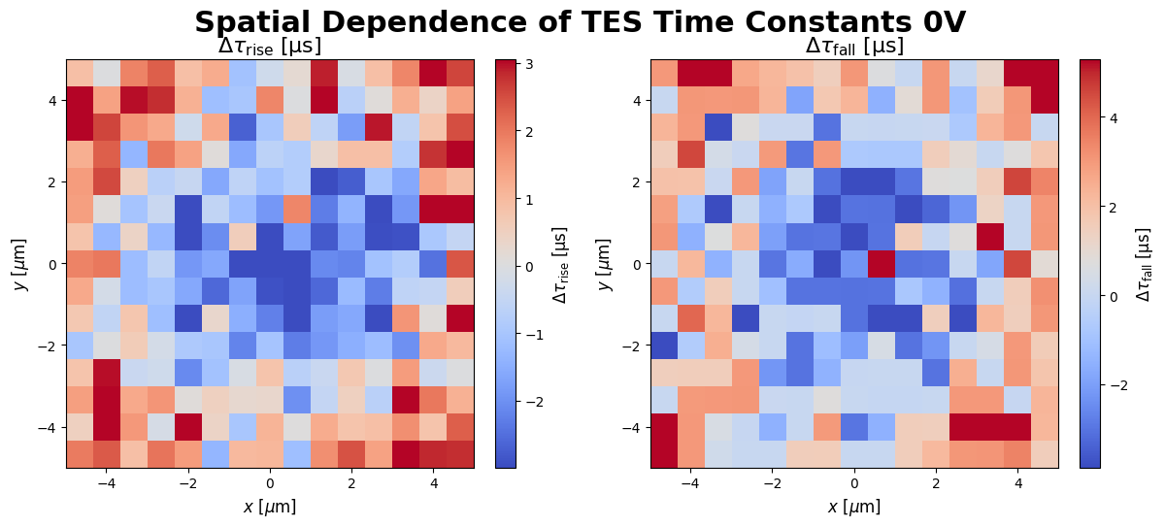
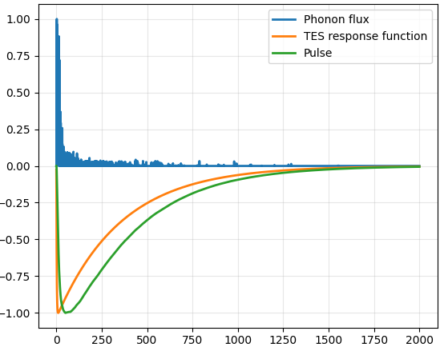
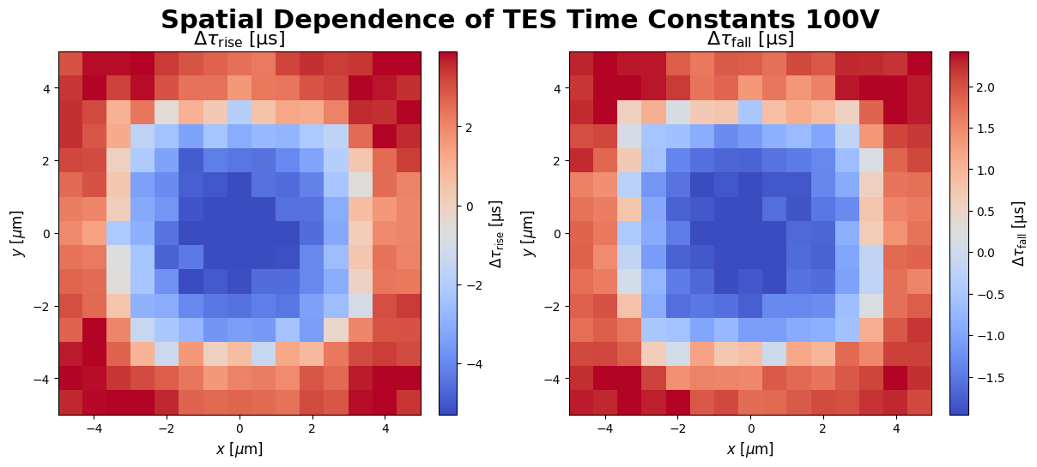
Pulse Simulation Results
Ideal Pulse
Normalized Amplitude
Time (us)
[4] N. A. Kurinsky, “The low-mass limit: dark matter detectors with eV-scale energy resolution,” Ph.D. thesis, Stanford University, 2018.

Slide 14
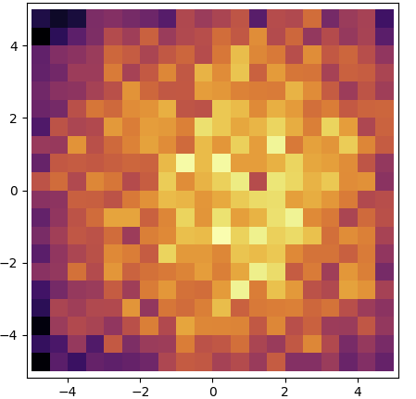








Investigating Asymmetry in Data
Why is the data asymmetric?
What if loss to the holder is asymmetric?
Left = 20%, Right = 30%
Let each corner have its own loss probability...

Slide 15
Conclusions and Future Work
G4CMP can reproduce position dependence seen in the MEMS+HVeV data...
G4CMP is a powerful tool for detector fiducialization
  and investigating detector loss!
Stay tuned for the upcoming HVeV-MEMS paper

Slide 16


Acknowledgments
This work was supported by the U.S. Department of Energy Office of Science Graduate Student Research (SCGSR) program through contract number DE-SC0014664
This work was done by the Dark Matter/Quantum Information Science (DMQIS) Group at SLAC
Thank you!

Slide 17
Questions?

Slide 18
Additional Slides

Slide 19
Quasiparticle-assisted Electrothermal feedback Transition Edge Sensors (QETs)
Al Collection Fin
α-W TES
Phonons propagate to the Al collection fin
Phonons break Cooper pairs in the film
Liberated quasiparticles in the Al propagate to the α-W TES
Quasiparticles relax and emit phonons directly in the TES
Phonons

