Slide 1
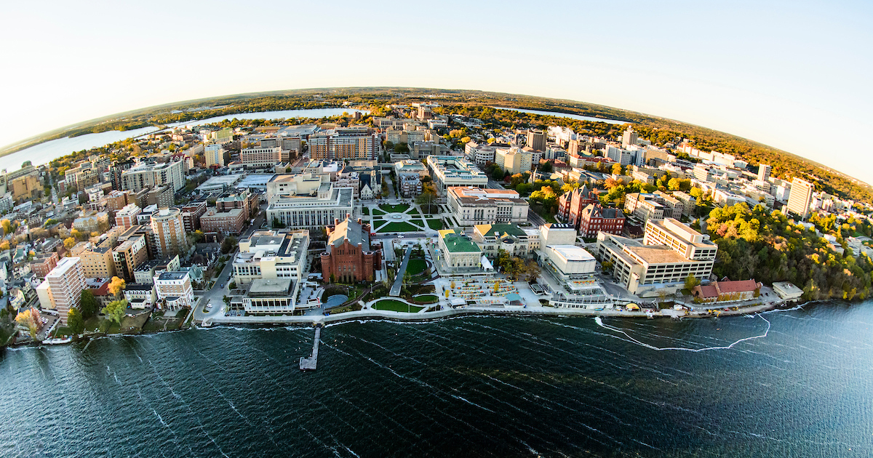


Welcome to the G4CMP
Workshop
Jared Yamaoka LPS
RISQ26
June 15, 2026
Lightning talk presenters send slides to
linehan3@fnal.gov
and dbaxter9@fnal.gov

Slide 2
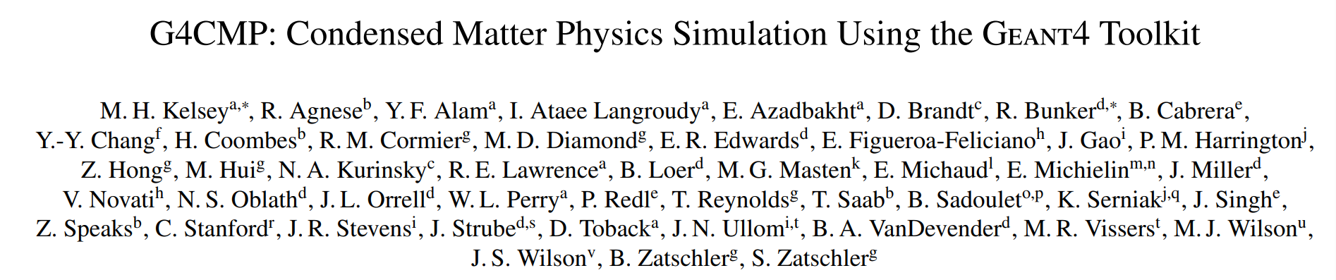
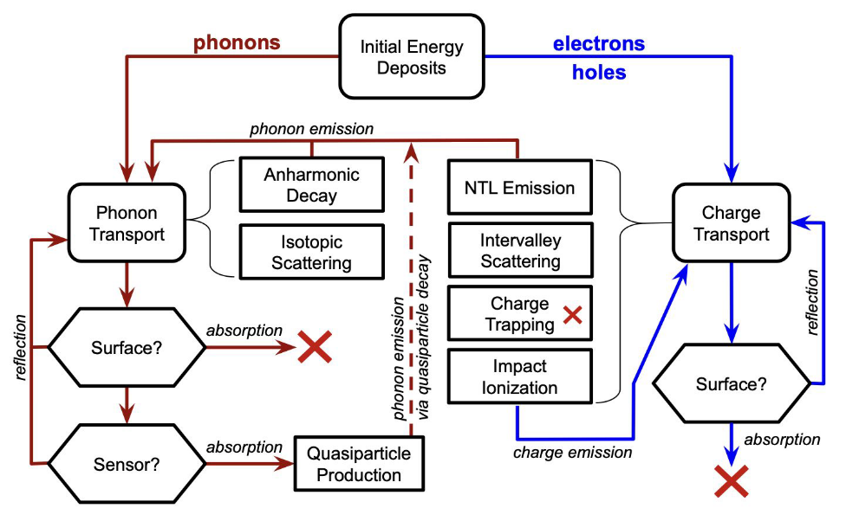
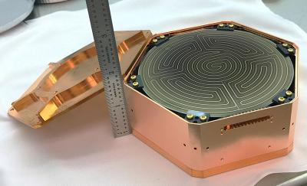
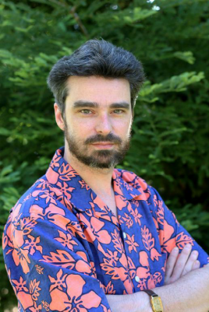

Brief History: G4CMP
GEANT4 Condensed Matter Physics (G4CMP) package was initially developed by Mike Kelsey to simulate phonon and charge transport for the SuperCDMS cryogenic dark matter search experiment (c.2012).
Mike Kelsey
Over the last few years the developer community has grown and garnered strong interest from the QIS community.
arxiv:2302.05998

Slide 3
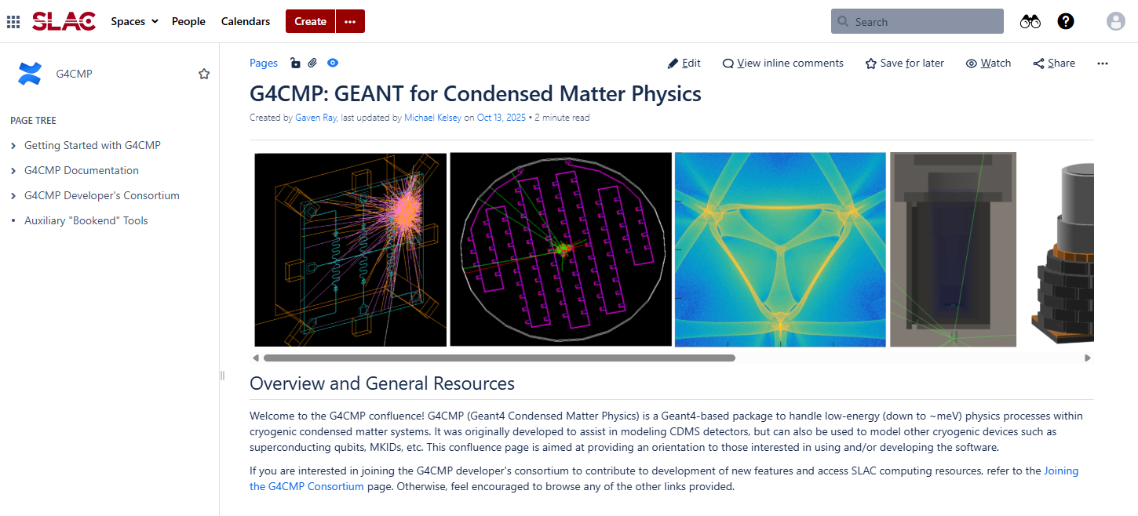


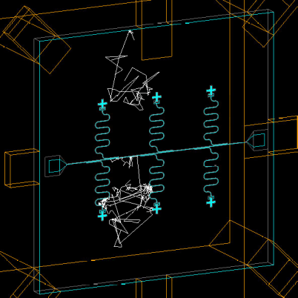
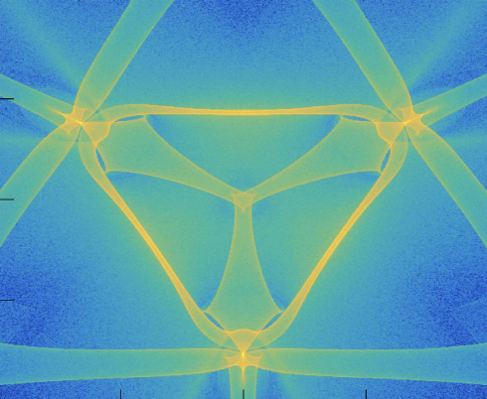
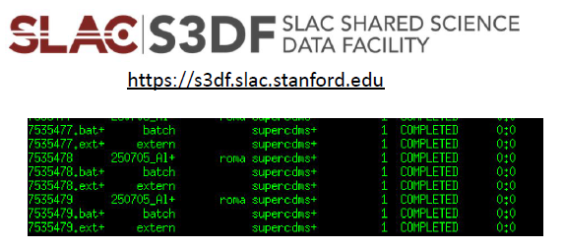
Brief History: Consortium
Documentation/Community Engagement/Planning (Morning: Birgit Z.)
G4CMP Consortium was started in 2024, with important discussion taking place at RISQ 2024.
  Continue development of G4CMP outside of SuperCDMS
  Support the User Community particularly QIS
https://confluence.slac.stanford.edu/spaces/G4CMP/overview
New Functionality (Morning: Ryan L.)
Shared Computing (Afternoon II: Stefan Z.)

Slide 4
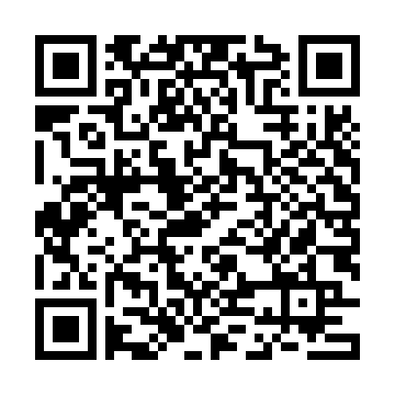
JOIN NOW!
All Are Welcome!
30+ Institutions
90+ Member
Students, Post-docs, and Seniors interesting in joining us for help with their projects or interested in participating in developing G4CMP please sign up.
Attend biweekly meetings
Find out what others are doing.
Find out about new features.
Help desk time.
Join Here:
Contact Info
Ryan L.: linehan3@fnal.gov
Mike K.: kelsey@slac.stanford.edu
UW-Madison
UMD LPS
University of Waterloo
INFN
HRL Labs
PNNL
SNOLAB
Caltech
LLNL
Colorado School of Mines
University of Florida
IN2P3
Sandia National Labs
Fermilab
University of Montreal
Syracuse University
Google
Northeastern University
IIT
Northwestern University
Brookhaven National Lab
Texas A&M University
MIT
SLAC
WashU St. Louis
…and more!

Slide 5
Goals
Provide an overview of the current state of G4CMP, highlighting new features and capabilities.
Share how users are leveraging G4CMP to provide inspiration on how the SW could contribute to your scientific work.
Provide tutorials as a jumping off point to make G4CMP more accessible to beginners and introduce advanced functions to more experienced users.
Discuss what we learn and use the day’s sessions to ground thoughts about how G4CMP can be used and what resources and features will further drive its usefulness.

Slide 6
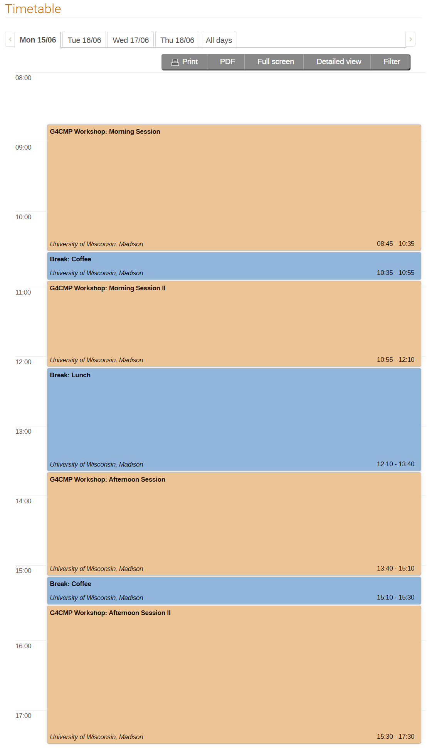
Schedule
Indico Link
Morning: Current tate of G4CMP
  Code and Features
  Consortium News and Plans
  Lightning Talks: Community use cases
Lunch: Tutorial Help Desk (12:40-1:40)
Afternoon I: Tutorials Parallel Sessions
  Getting Started
  Advanced Features
Afternoon II:
  Demo: SLAC Shared Computing
  Discussions

Slide 7
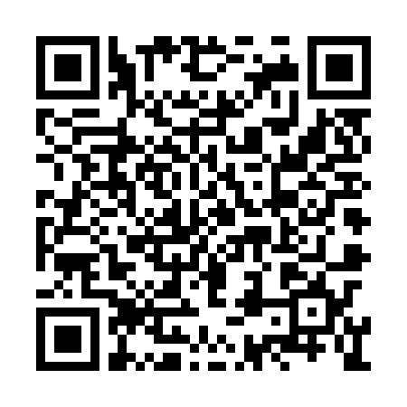

Tutorial Information
There will be two parallel session: Introductory and Advanced please ask the organizers if you need help deciding which to attend.
To get the most out of the tutorials you need to have the software installed and tested prior to the start of the session. (See Email)
There will be a “help desk” toward the end of lunch if you have problems. However, depending on you system it can take more than hour to install the SW so please consider starting this now if you haven’t.
Install Help
  Tutorial: https://confluence.slac.stanford.edu/spaces/G4CMP/pages/711111279/RISQ+2026+G4CMP+Workshop
  Install Video: https://youtu.be/D1ZfUewM8-E
Source
  G4CMP: https://github.com/G4CMP
  GEANT4: https://github.com/Geant4
Other Documentation
  G4CMP: https://confluence.slac.stanford.edu/spaces/G4CMP/overview
  SLAC|S3DF: https://s3df.slac.stanford.edu/

Slide 8

ENGAGE
ASK QUESTIONS
HAVE FUN
Lightning talk presenters send slides to
linehan3@fnal.gov
and dbaxter9@fnal.gov

