Slide 1


Detection of Spatiotemporally Correlated Errors in OCS Transmons
Felipe Contipelli¹, Jeffrey M. Gertler¹, Serra Erdamar¹,
Kate Azar^{1,2}, Renée DePencier Piñero¹, Michael Gingras¹, Patrick M. Harrington²,
Max Hays², David K. Kim¹, Bethany M. Niedzielski¹, H. Douglas Pinckney^{2,3}, H.P. Binney^{2,3},
Mallika T. Randeria¹, Hannah Stickler¹, Jeffrey A. Grover², Joseph A. Formaggio³,
Mollie E. Schwartz¹, William D. Oliver³, Kyle Serniak^{1,2}
¹MIT Lincoln Laboratory, Lexington MA
²MIT Research Laboratory of Electronics, Cambridge MA
³MIT Laboratory for Nuclear Science, Cambridge MA

Slide 2
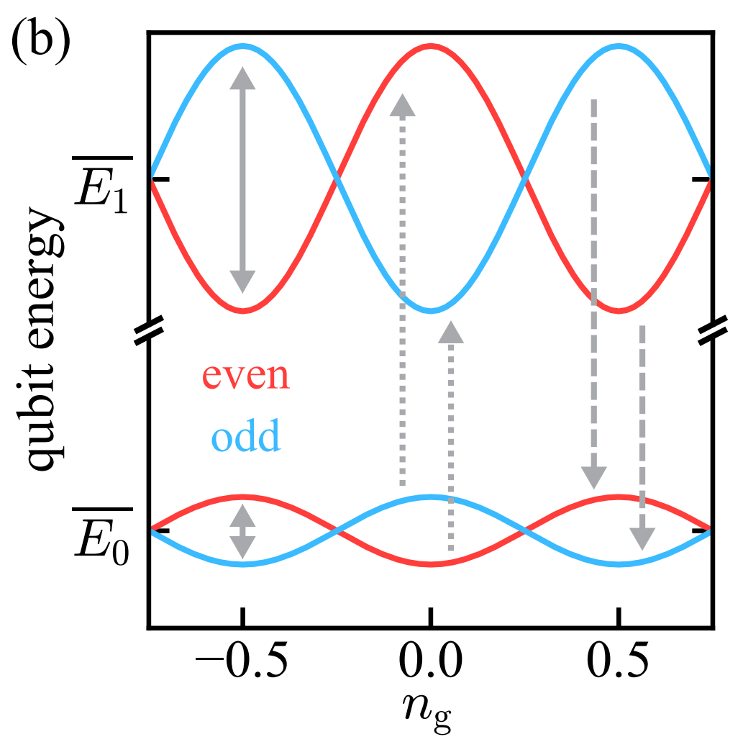
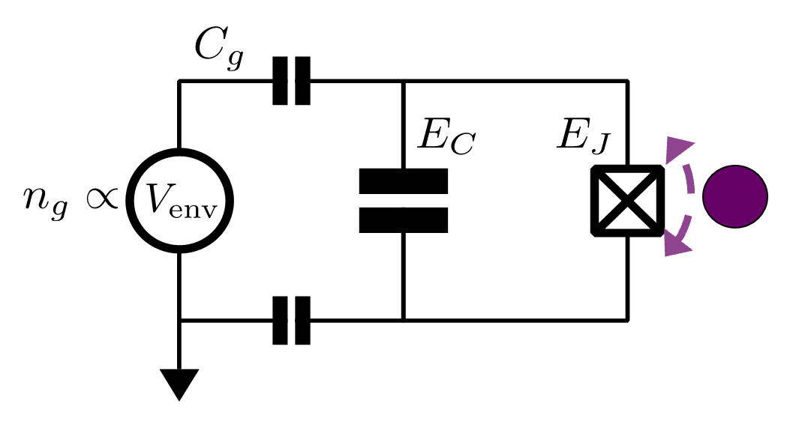
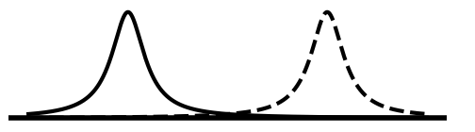
Offset Charge Sensitive Transmons
charge-parity-dependent
qubit frequency
even
~MHz
odd
f₀₁ ~ 4 GHz
f
E_{J} / E_{C} ~ 20
Serniak et al., PRL (2018)

Slide 3
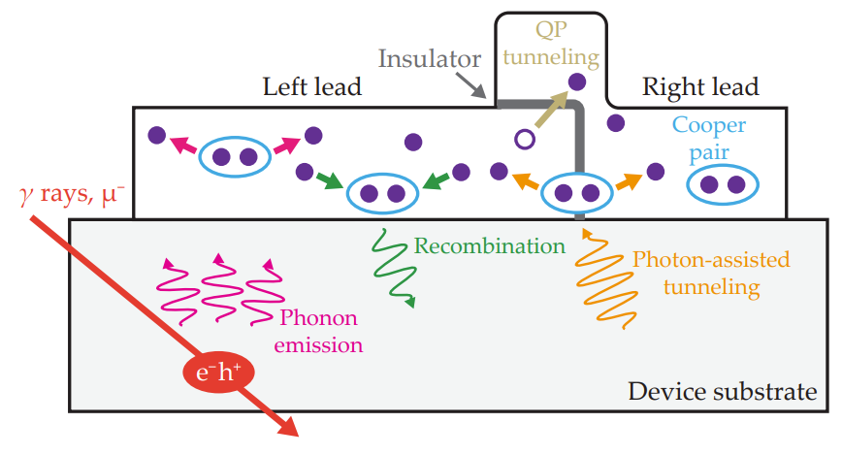
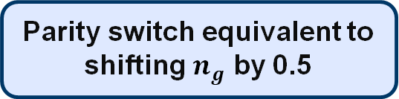
OCS Transmons
charge-parity-dependent
qubit frequency
even
~MHz
odd
f₀₁ ~ 4 GHz
f
E_{J} / E_{C} ~ 20
QP tunneling across JJ switches charge-parity
Parity switch equivalent to shifting $n_{g}$ by 0.5
Aumentado, Catelani, Serniak, Physics Today (2023)
Serniak et al., PRL (2018)

Slide 4
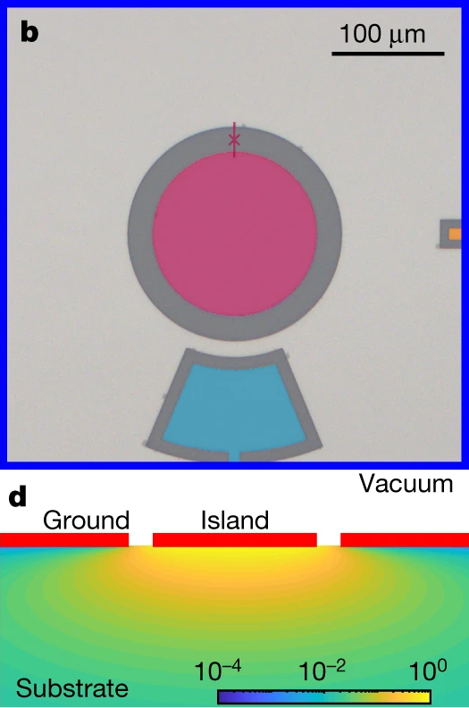
Charge Sensing
charge-parity-dependent
qubit frequency
even
~MHz
odd
f₀₁ ~ 4 GHz
f
E_{J} / E_{C} ~ 20
Wilen et al., Nature (2021)
Aumentado, Catelani, Serniak, Physics Today (2023)
Ristè et al., Nat. Comm. (2013)
Serniak et al., PRL (2018)

Slide 5
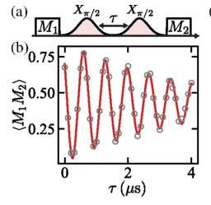
n_{g} Detection Methods
charge-parity-dependent
qubit frequency
even
~MHz
odd
f₀₁ ~ 4 GHz
f
E_{J} / E_{C} ~ 20
Ramsey offset charge measurement
Slow technique to measure offset charge fluctuations
Ignores parity transitions (essential to its function)
Ristè et al., Nat. Comm. (2013)
Serniak et al., PRL (2018)

Slide 6
n_{g} Detection Methods
charge-parity-dependent
qubit frequency
even
~MHz
odd
f₀₁ ~ 4 GHz
f
E_{J} / E_{C} ~ 20
Ramsey offset charge measurement
Single shot parity measurement
wait
1/4𝛿f(n_{g})
odd
even
Fast technique to measure parity transitions
Needs retuning after offset charge jumps
Slow technique to measure offset charge fluctuations
Ignores parity transitions (essential to its function)
Ristè et al., Nat. Comm. (2013)
Serniak et al., PRL (2018)

Slide 7
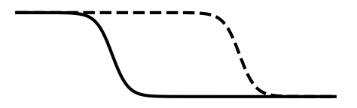
n_{g} Detection Improvements
charge-parity-dependent
qubit frequency
charge-parity-dependent
readout frequency
even
odd
Arg(S₁₁)
~MHz
odd
~MHz
even
E_{J} / E_{C} ~ 20
f₀₁ ~ 4 GHz
f_{r} ~ 9 GHz
f
Single shot parity measurement improvements
Direct dispersive readout: use ng shift of resonator, leave qubit in ground state.
Manucharyan, Thesis, Yale (2012)
Serniak et al., PR Applied (2019)

Slide 8
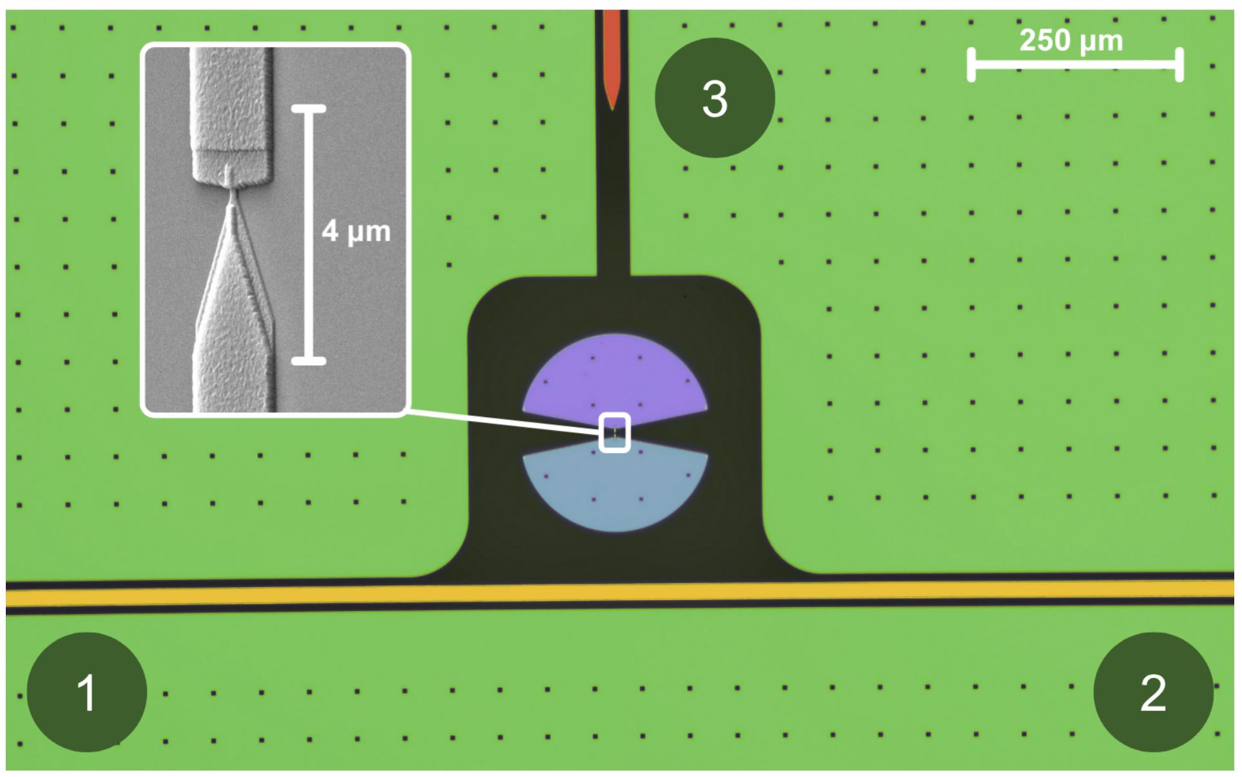
n_{g} Detection Improvements
charge-parity-dependent
qubit frequency
charge-parity-dependent
readout frequency
even
odd
Arg(S₁₁)
~MHz
odd
~MHz
even
E_{J} / E_{C} ~ 20
f₀₁ ~ 4 GHz
f_{r} ~ 9 GHz
f
Single shot parity measurement improvements
Direct dispersive readout: use ng shift of resonator, leave qubit in ground state.
SQUAT: remove the resonator, directly probe transmission of qubit. Use gap engineering for quasiparticle amplification.
Fink et al., PR Applied (2024)
Magoon et al., arXiv (2026)

Slide 9
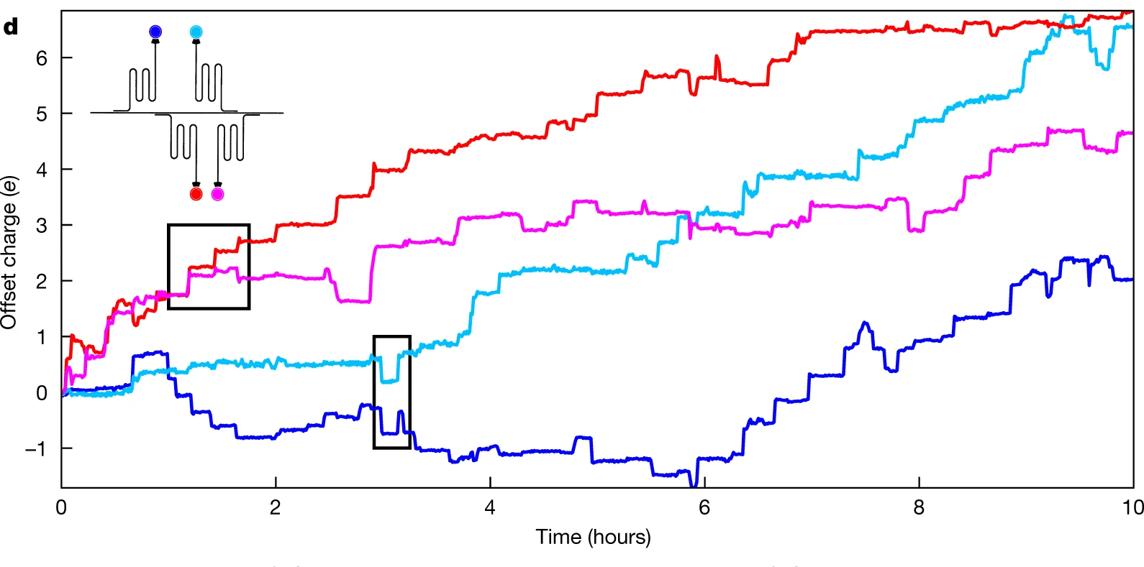
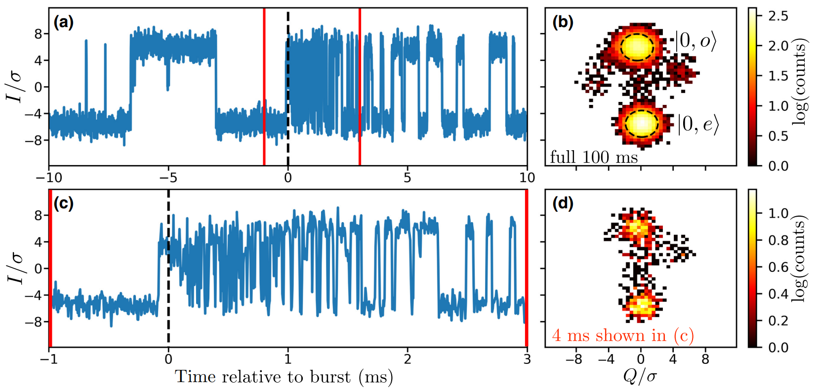
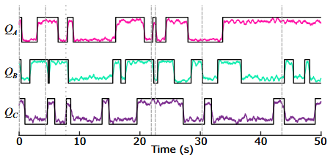
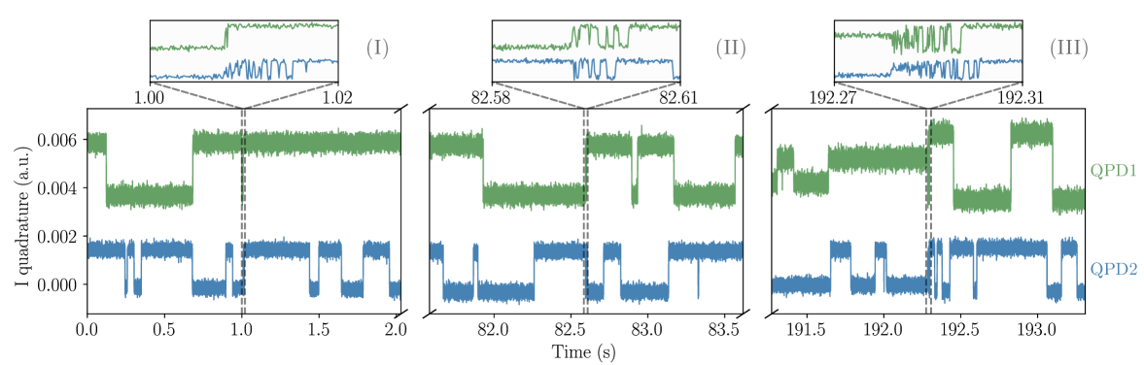
Correlated Events and Bursts
Correlated offset charge changes
Single Parity Switching from Bursts
Wilen et al., Nature (2021)
Diamond et al., PRX Quantum (2022)
Correlated charge parity changes
Correlated Parity Switching from Bursts
Iaia et al., Nat. Comm (2022)
Sundelin et al., arXiv (2026)

Slide 10
Recalibration Issues
Frequent calibration of individual offset-charge
Correlated offset jumps can ruin parity sensitivity exactly when you need it
~35%
~65%
Calibration Overhead
Parity
Monitoring
Sundelin et al., arXiv (2026)
Post-select traces with high state discrimination fidelity
~ 63% of data discarded w/o recalibration
Ideally, we want to monitor and retain 100% of our duty cycle

Slide 11
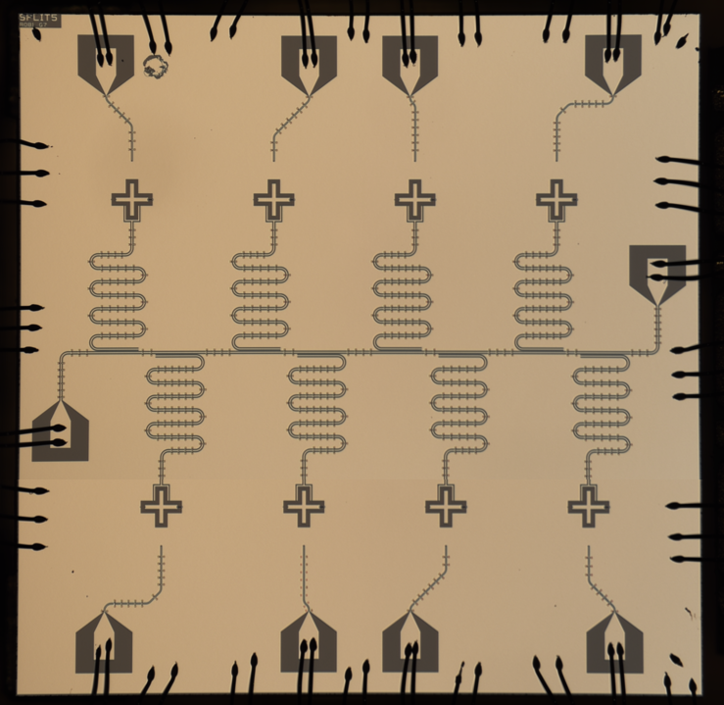
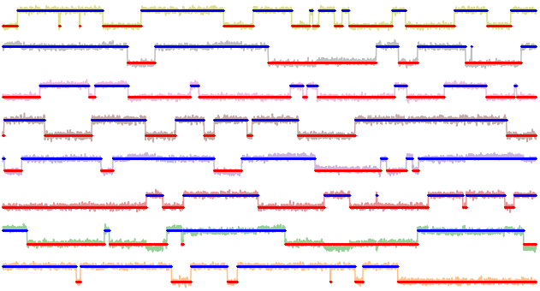
Detection of Charge-Parity Jumps
Simultaneous charge-parity monitoring
on 8 OCS transmons
Our OCS Transmon Device
~1kHz bandwidth
Q8
Q7
Q6
Q8
Q5
Q1
Q4
Q5
ADC voltage (A.U.)
Q4
Q3
Q2
Q3
Q2
Q7
Q6
Q1
0 5 10 15 20 25 30
Time (s)
1 mm
Long charge-parity lifetimes (> 1s)

Slide 12
Detection of Charge-Parity Jumps
Simultaneous charge-parity monitoring
on 8 OCS transmons
Our OCS Transmon Device
~1kHz bandwidth
Q8
Q7
Q6
Q8
Q5
Q1
Q4
Q5
ADC voltage (A.U.)
Q4
Q3
Q2
Q3
Q2
Q7
Q6
Q1
0 5 10 15 20 25 30
Time (s)
1 mm
Long charge-parity lifetimes (> 1s)

Slide 13
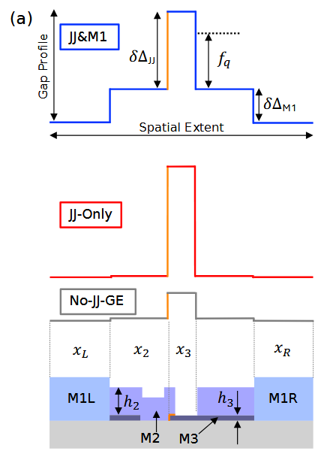
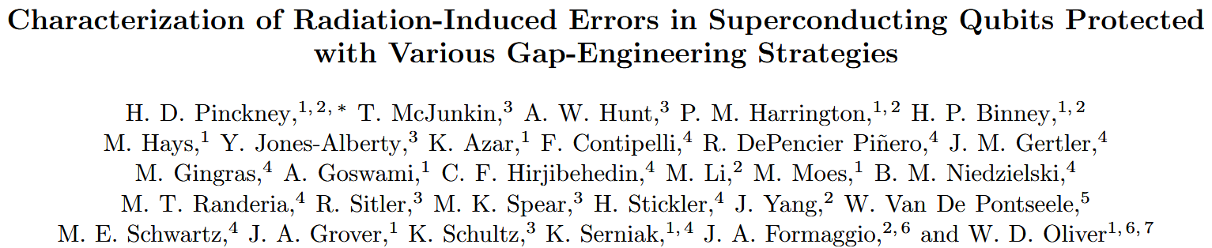
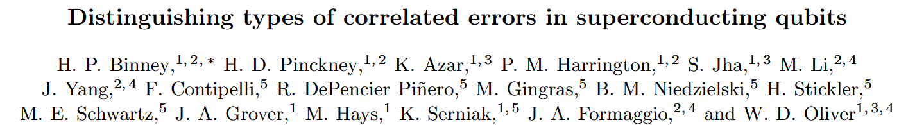
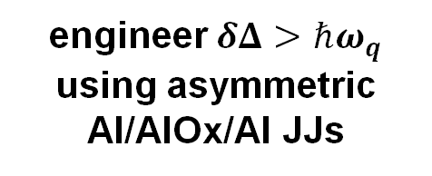
A Brief Aside: Gap Engineered Transmons
Fabricated at Lincoln Lab, Collaboration with MIT
engineer$δΔ>ℏω_{q}$
using asymmetric Al/AlOx/Al JJs
Measuring and modeling the impact of radiation on superconducting qubits protected through gap engineering
Doug Pinckney on Wednesday @ 2:30pm
Marchegiani et al., PRX Quantum (2022)

Slide 14
Calibration Free n_{g} Measurement
1. Detection scheme robust to offset-charge jumps
2. Sample much faster than charge-parity switching rate
3. High-fidelity simultaneous readout on multiple qubits
Charge-Ramp Modulation

Slide 15
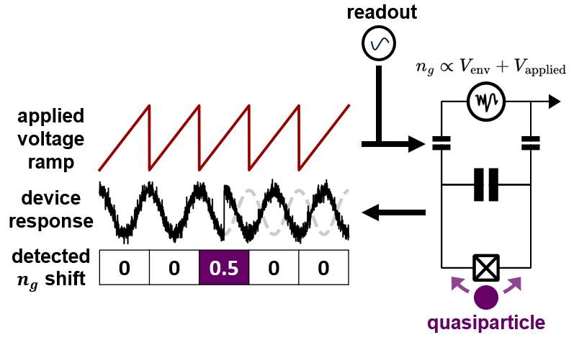
Calibration Free n_{g} Measurement
1. Detection scheme robust to offset-charge jumps
2. Sample much faster than charge-parity switching rate
3. High-fidelity simultaneous readout on multiple qubits
Charge-Ramp Modulation

Slide 16
Calibration Free n_{g} Measurement
1. Detection scheme robust to offset-charge jumps
2. Sample much faster than charge-parity switching rate
3. High-fidelity simultaneous readout on multiple qubits
Charge-Ramp Modulation

Slide 17
Calibration Free n_{g} Measurement
1. Detection scheme robust to offset-charge jumps
2. Sample much faster than charge-parity switching rate
3. High-fidelity simultaneous readout on multiple qubits
Charge-Ramp Modulation
Extended application of flux-ramp modulation technique used for SQUID/TES multiplexing
Mates et al., J Low Temp Phys (2012)

Slide 18
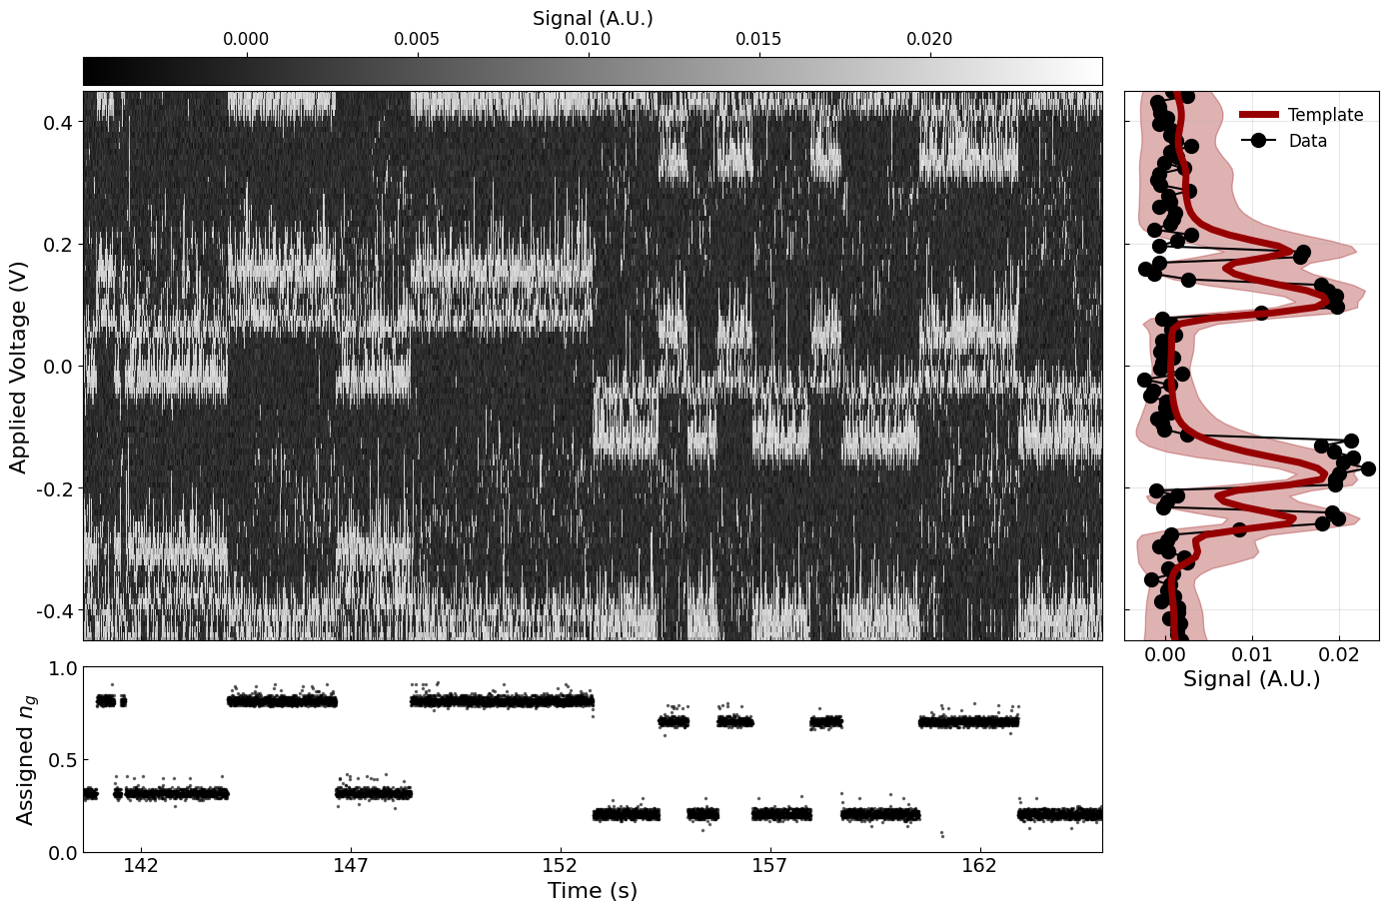
Raw Acquisition
20μs per point, 100 points per modulation, ~500Hz modulation

Slide 19
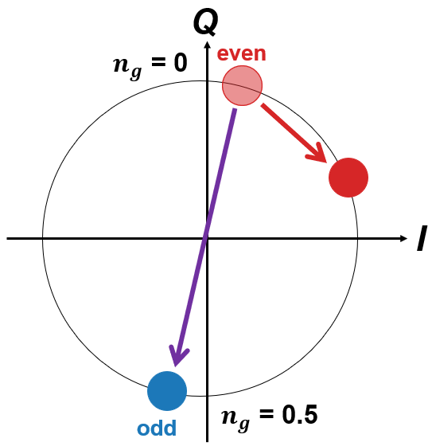

Raw Acquisition
20μs per point, 100 points per modulation, ~500Hz modulation
Offset-Charge
Phase Shift
Charge-Parity
Phase Flip
Parity switch equivalent to shifting $n_{g}$ by 0.5

Slide 20
Template Generation
20μs per point, 100 points per modulation, ~500Hz modulation
$n_{g}$ assignment through template convolution
TODO: Move slowly here

Slide 21
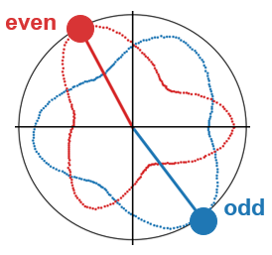

Signal Convolution
20μs per point, 100 points per modulation, ~500Hz modulation
$n_{g}$ assignment through template convolution
TODO: Move slowly here

Slide 22
n_{g} Assignment
20μs per point, 100 points per modulation, ~500Hz modulation
$n_{g}$ assignment through template convolution

Slide 23
Charge-Parity State Assignment
20μs per point, 100 points per modulation, ~500Hz modulation
Offset-Charge
Phase Shift
Charge-Parity
Phase Flip
Charge-Parity Jump: every ~1s Offset-Charge Jump: every ~100s

Slide 24
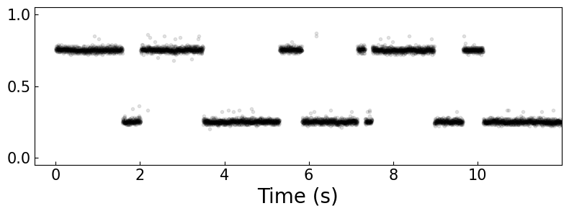
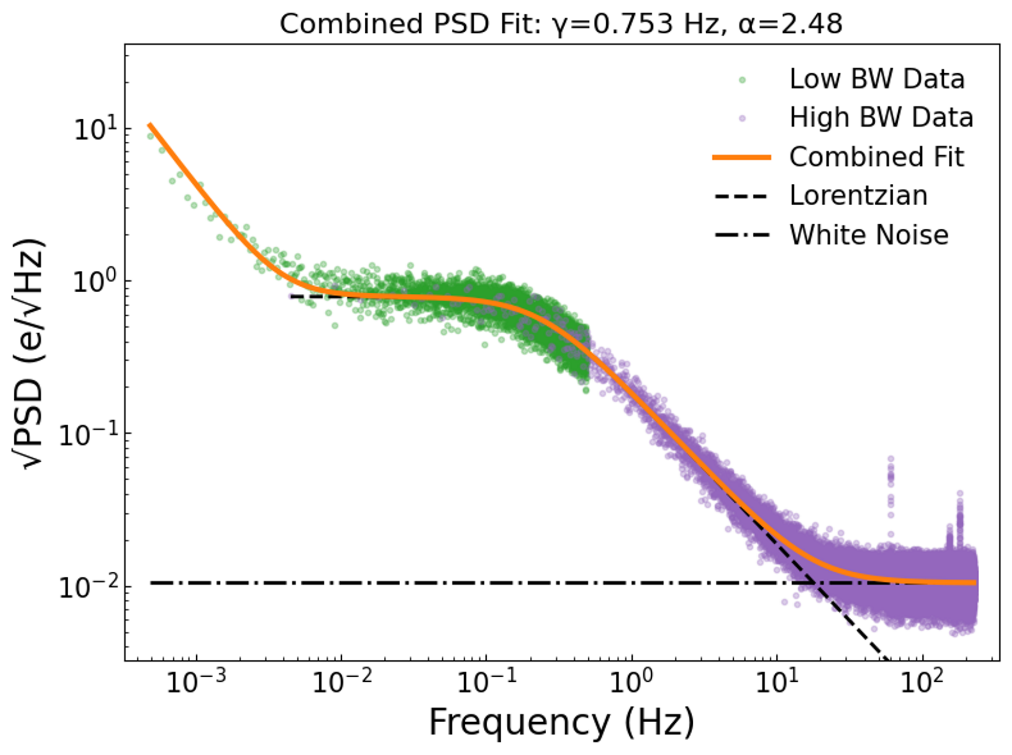
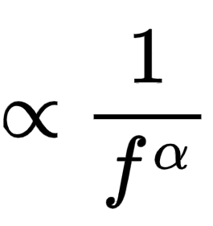
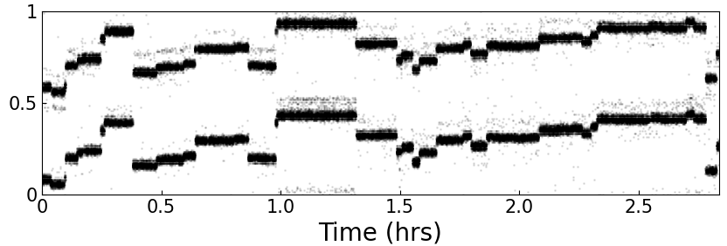

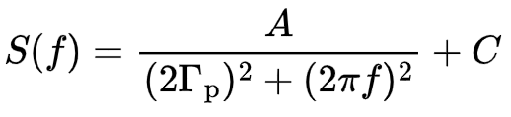
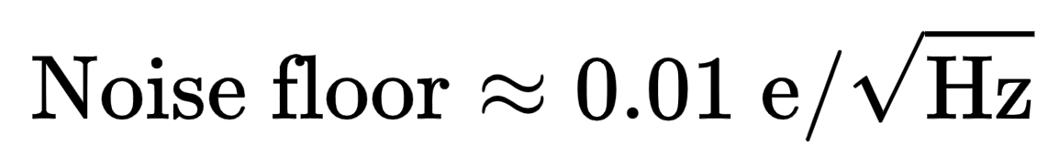

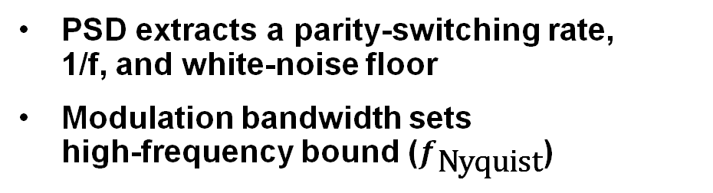
Characterization of Charge Noise/QP Dynamics
PSD extracts a parity-switching rate, 1/f, and white-noise floor
Modulation bandwidth sets high-frequency bound ($f_{\text{Nyquist}}$)
~500Hz bandwidth
$n_{g}$ assigned
Charge-Parity Jumps
~10Hz bandwidth
$n_{g}$ assigned
Offset-Charge Jumps

Slide 25
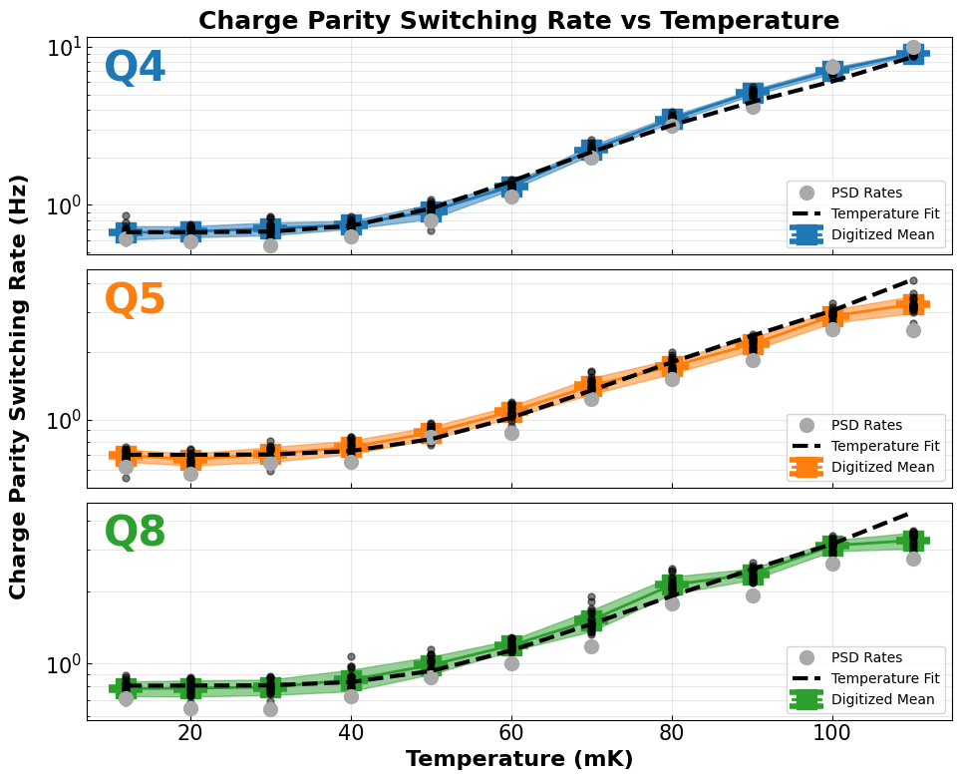
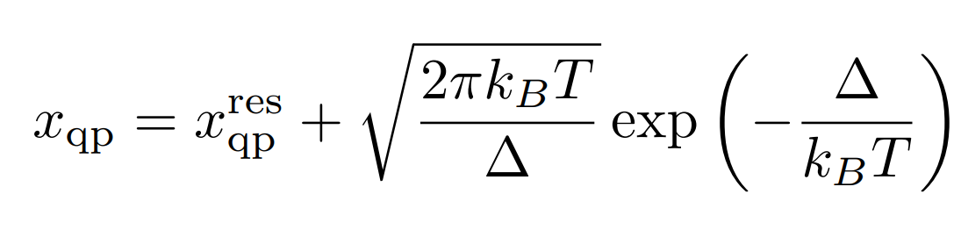
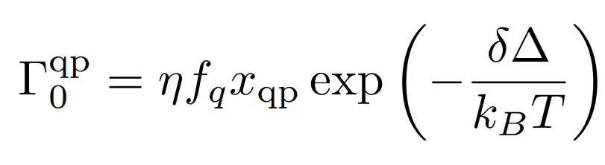
Parity vs Temperature
1.2 hours of data per temperature
Connolly et al., PRL (2024)

Slide 26
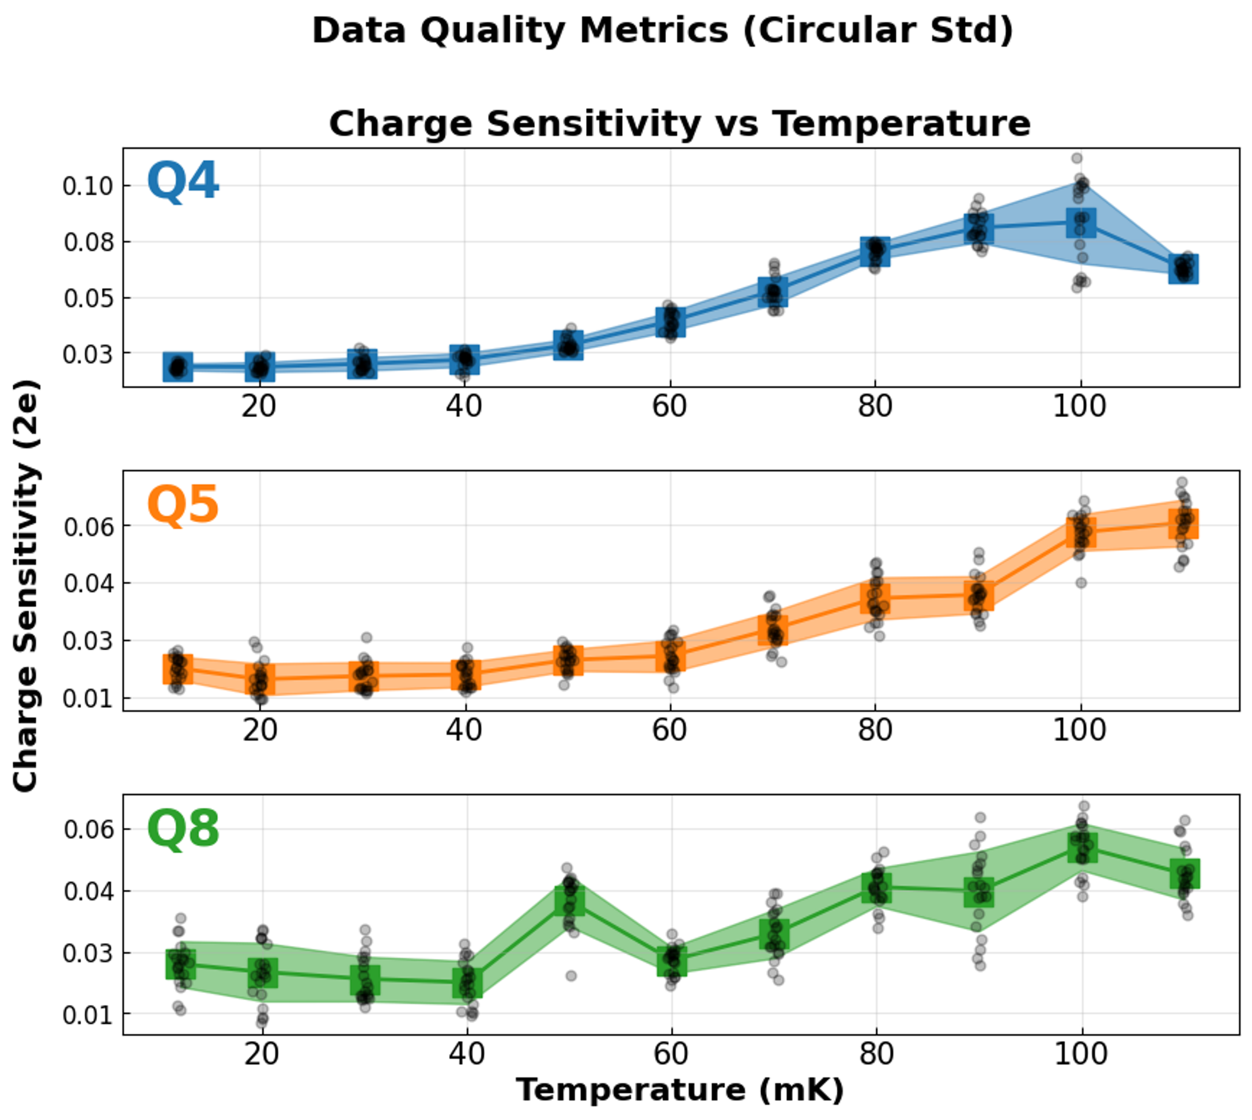
Detector Statistics
1.2 hours of data per temperature

Slide 27
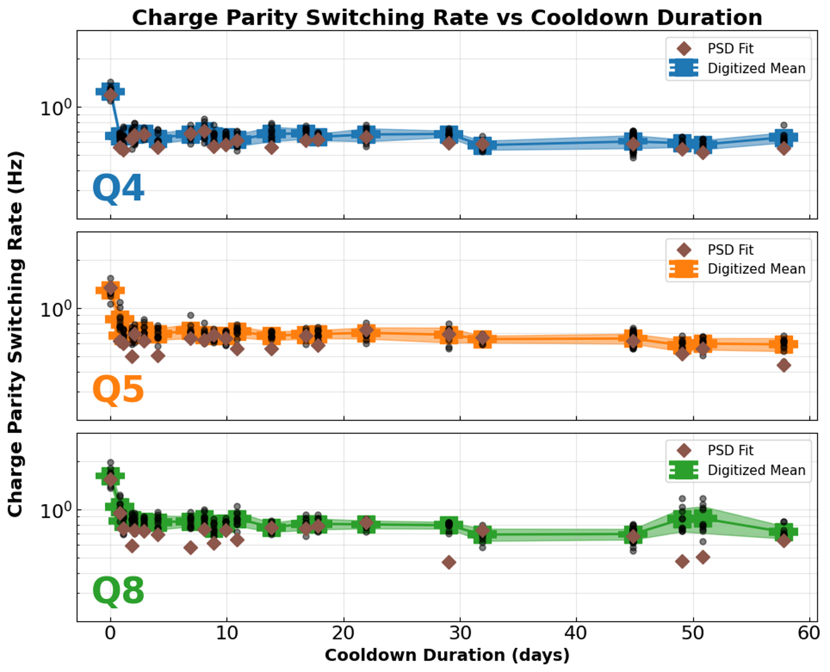
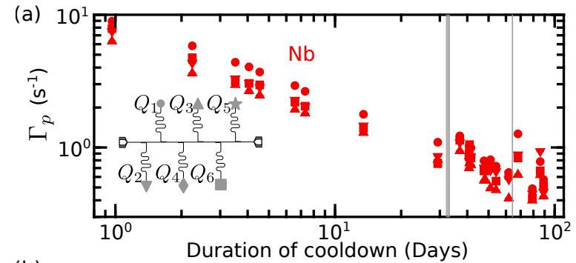
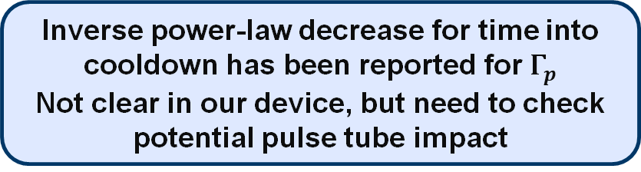
Parity Switching Rate during Cooldown
Yelton et al., PRL (2025)
Inverse power-law decrease for time into cooldown has been reported for $Γ_{p}$
Not clear in our device, but need to check potential pulse tube impact
Time 0 corresponds to cryostat hitting 20mK after condensing
40 min of data per time index

Slide 28
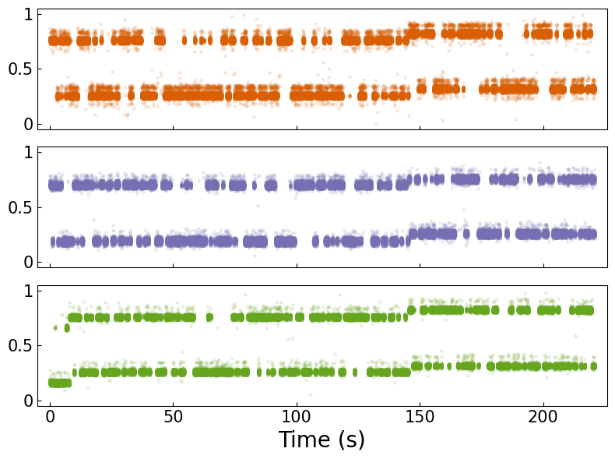
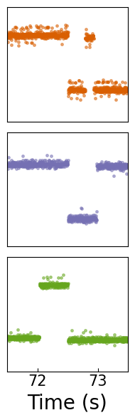

Detection of Spatiotemporal Correlated Errors
Coincident
Offset-Charge Jump
Coincident
Charge-Parity Jump
Use coincident jumps on multiple qubits as a proxy
~500Hz modulation
Q4
Q8
Q5
Q1
Q4
$n_{g}$ assigned
Q5
Q3
Q2
Q7
Q6
1 mm
Q8
Limitation (for now)
Need ~10kHz modulation to temporally resolve QP bursts
Lab Time (s)
Lab Time (s)

Slide 29

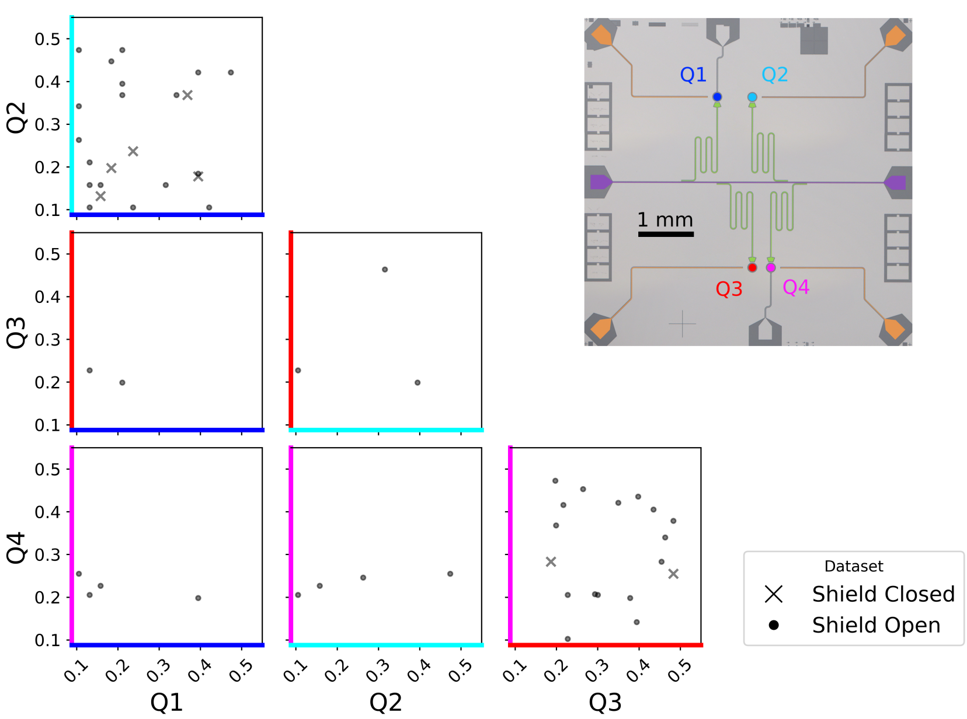

Detection of Spatiotemporal Correlated Errors
Threshold
0.5
0
0.5
Threshold
Bratrud et al., Nature Comms (2025)

Slide 30
Detection of Spatiotemporal Correlated Errors
2 qubit correlated parity jumps
0.5
Correlated offset and parity jump
Single qubit offset jumps
2 qubit correlated offset jumps
0
0.5
Non-events
Single qubit parity jumps

Slide 31

Detection of Spatiotemporal Correlated Errors
2 qubit correlated parity jumps
0.5
Correlated offset and parity jump
Single qubit offset jumps
2 qubit correlated offset jumps
0
0.5
Non-events
Single qubit parity jumps

Slide 32
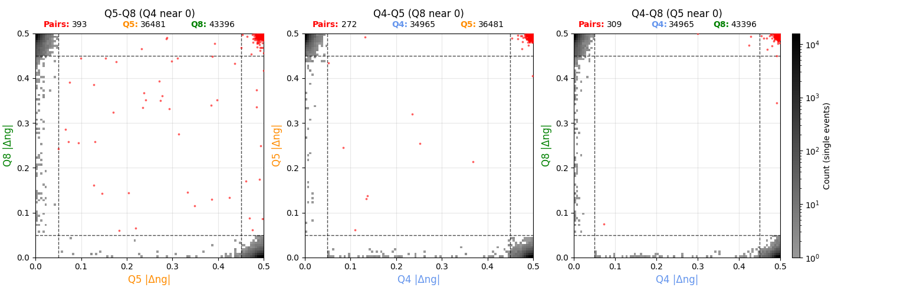
Single Qubit Jumps and Pair Events
Closest qubits
Farthest qubits
Q8
Q5
Q4
15.35 hours of acquisition
Q3
Q2
Q7
Q6
1 mm

Slide 33
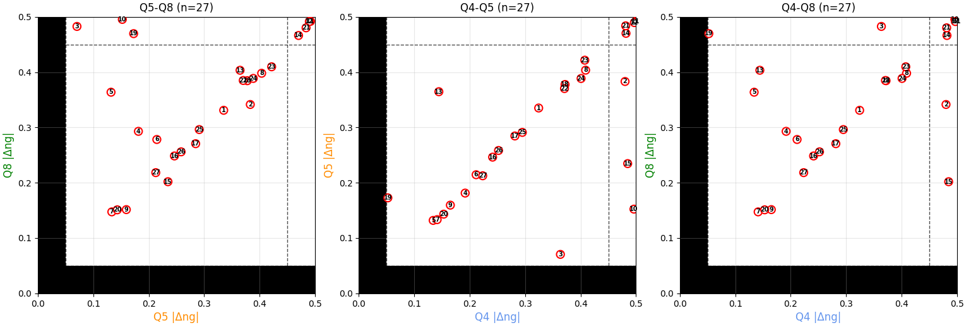
Three Qubit Events
15.35 hours of acquisition

Slide 34


Conclusions and Next Steps
Conclusions:
Continuous n_{g} measurement scheme robust to offset-charge jumps
Complementary rates from PSD and discrete jump analysis
Correlated event detection
$n_{g}$ assigned
Charge-Parity Jumps
Offset-Charge Jumps
$n_{g}$ assigned
Next Steps:
Directly measure OCS transmons coupled to feedline like SQUATS
Ensure fast enough readout to measure bursts
Model correlated event statistics
Probe superconducting backplane devices
superconducting backplane
Al
Al
Si substrate
Al/Ti/Al

Slide 35

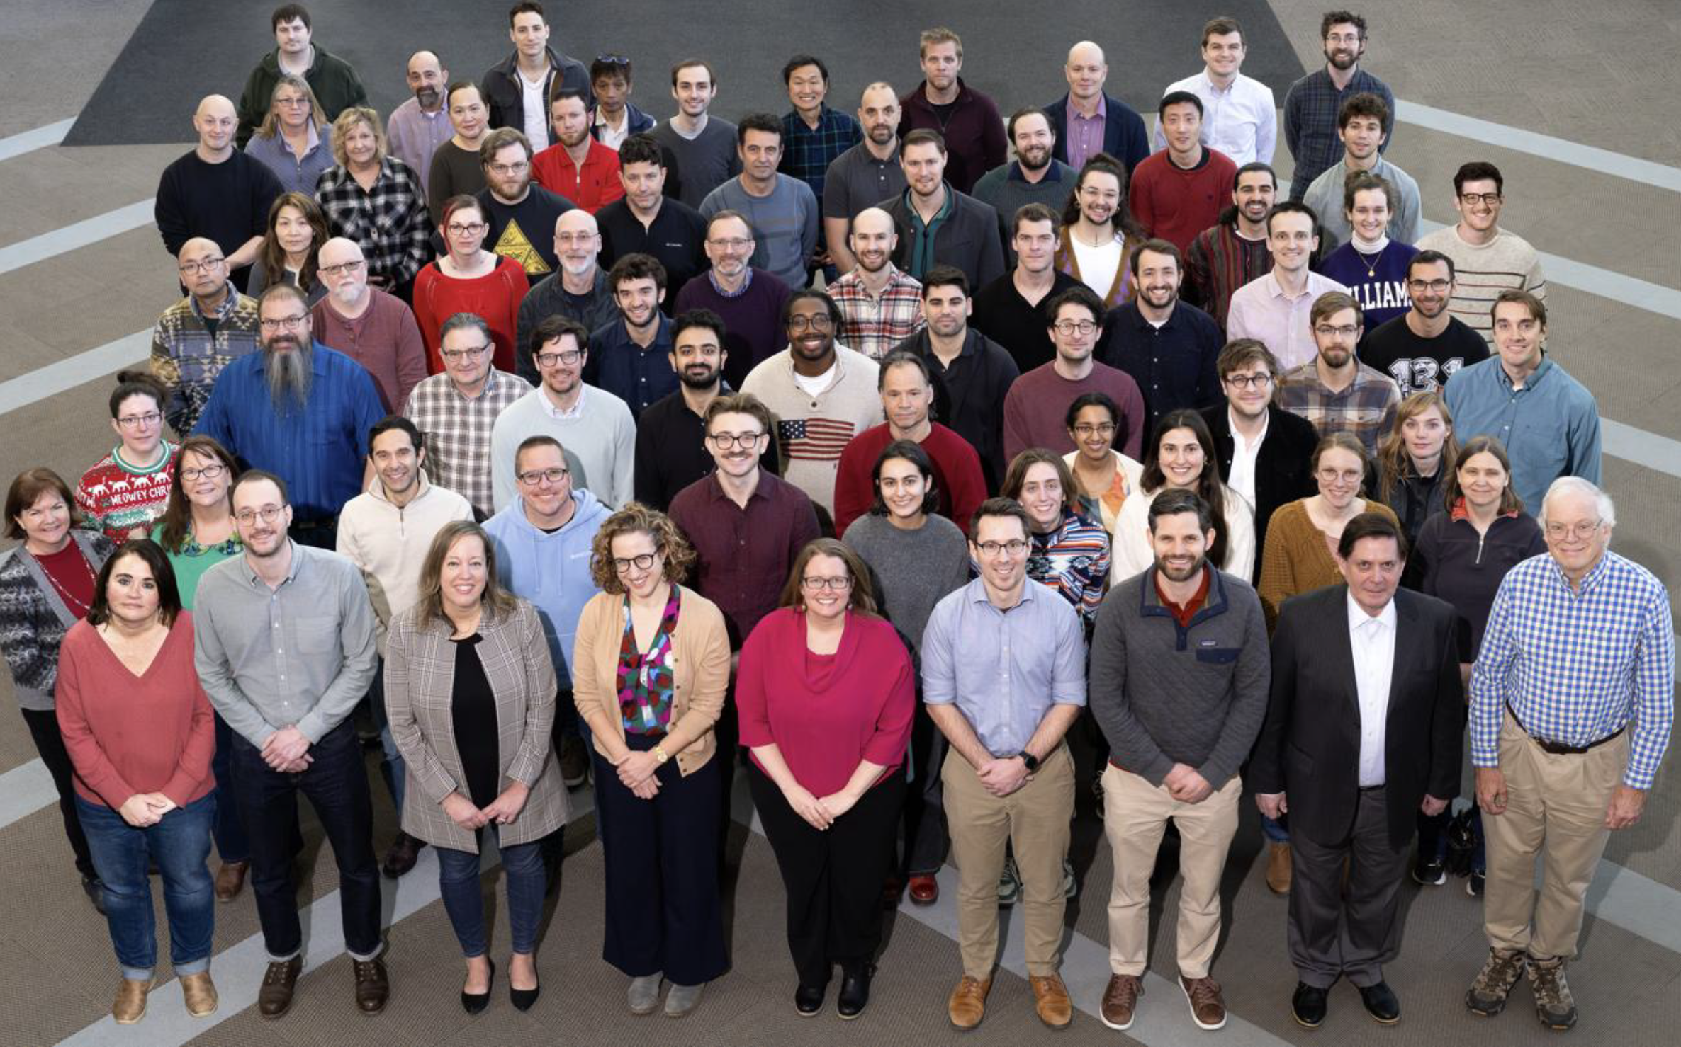
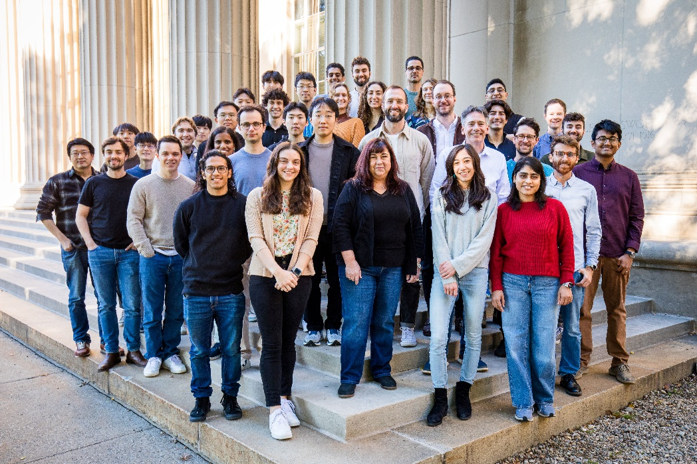







Acknowledgements
Quantum-Enabled Computation Group, MIT-LL
MIT Engineering Quantum Systems (EQuS)
Formaggio Group:
H.P. Binney,
Joseph A. Formaggio,
Superconducting Qubits Team:
Group Leaders: Mollie Schwartz, Kyle Serniak, Steven Weber, Jonilyn Yoder
Team: Mike Augeri, Kate Azar, Peter Baldo, Jeffrey Birenbaum, Tristan Brown, Luke Burkhart, Gregory Calusine, Glenn Carl, Joe Ciampi, Felipe Contipelli, John Cummings, David Danza, Rabindra Das, Dan Davis,
Renée DePencier Piñero, Steven Disseler, Justin Elenewski, Alec Emser, Serra Erdamar, Ben Freiman,
Jeffrey Gertler, Michael Gingras, Kevin Grossklaus, Karen Harmon, Thomas Hazard, Mike Hellstrom,
Cyrus Hirjibehedin, Gerry Holland, Sokharom Huon, Jennifer Hritz, Lenny Johnson, A. Jamie Kerman, David Kim, Jeff Knecht, Arthur Kurlej, Colleen Lilly-Dunkum, Justin Mallek, Duncan Miller, Nathan Miller, Jovi Miloshi,
Maddie Morocco, Ray Moya, Rylee Neumann, Bethany Niedzielski Huffman, Kevin Obenland,
Christopher O’Connell, Luis Ortega, Mallika Randeria, Ravi Rastogi, Matt Ricci, Lila Rodgers, Robert Rood, Gabriel Samach, Meghan Schuldt, Arjan Sevi, Marcus Sherwin, Gary Smith, Basil Smitham, Katrina Sliwa,
Chris Thoummaraj, Kunal Tiwari, David Volfson, Terry Weir, Donna-Ruth Yost, Doug Young
William D. Oliver, Jeff Grover, Max Hays, Patrick Strohbeen, Joel Wang, Terry Orlando, Kyle Serniak,
Chihiro Watanabe, Lenore Buck
Postdocs: Aziza Almanakly, Réouven Assouly, Fabrizio Berritta, Farid Hassani Bijarbooneh, Jorge Marques,
Doug Pinckney, Holly Stemp, Helin Zhang
PhD students: Vaishnavi Addala, Junyoung An, Lamia Ateshian, Kate Azar, William Banner, Cora Barrett, Frederike Brockmeyer, Shoumik Chowdhury, Gabriel Cutter, Andy Ding, Ben Helman, Kotaro Hida,
Shantanu Jha, Om Joshi, Harry Kang, Gyunghun Kim, Junghyun Kim, Jonathan Knoll, Maggie Marte,
Chris McNally, Miguel Moreira, Sarah Muschinske, David Pahl, Lukas Pahl, David Rower, Chia-Chin Tsai, Hung-Yu Tsao, Beatriz Yankelevich, Sameia Zaman
Undergraduates: Oswin Cervantes, Justin Chen, Catherine Lowe, Mati Yablon
Visiting Members: Mathis Moes, Sein Park, Daniel Rocha, Gabriele Rolleri, Alexander Rommens

