Slide 1
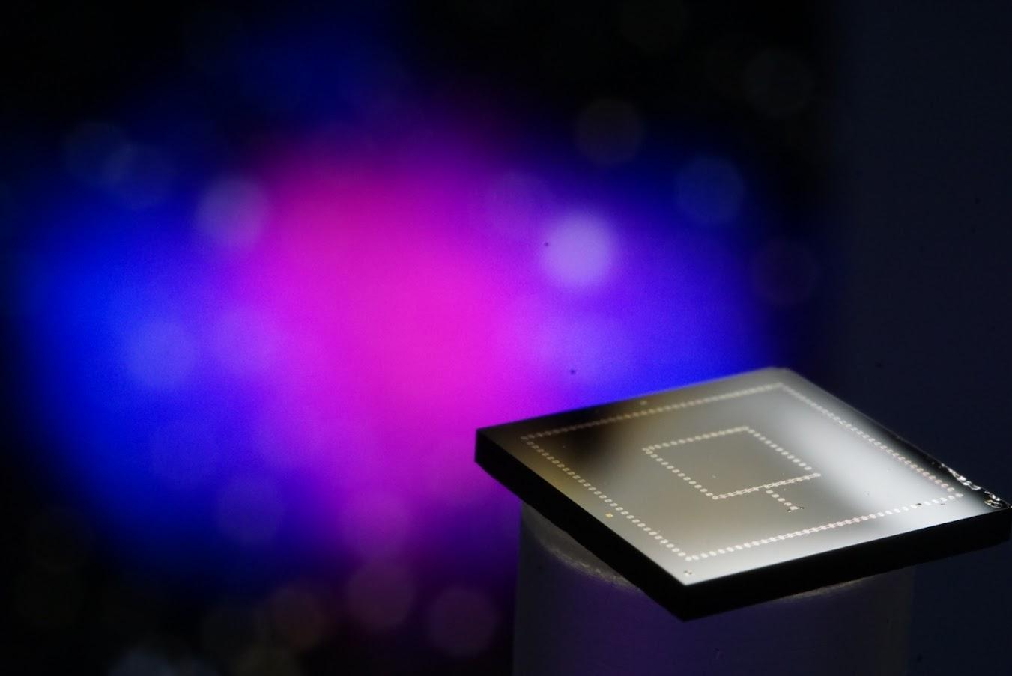

Using Classical Superconducting Athermal Phonon Sensors to Understand Non-ionizing Backgrounds in Superconducting Qubits
Matt Pyle
UC Berkeley
RISQ 2026 @UW

Slide 2
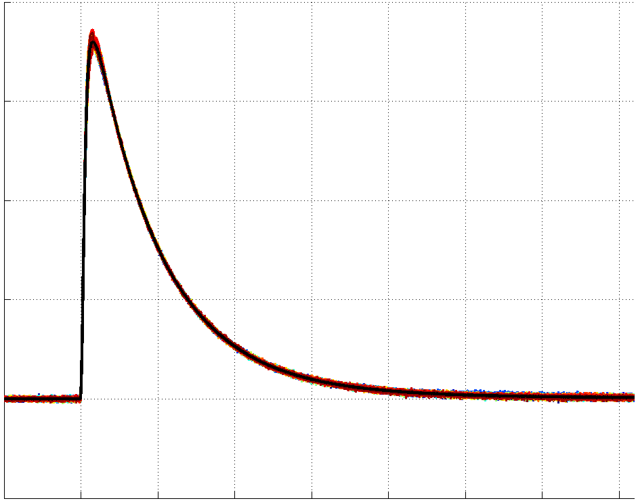
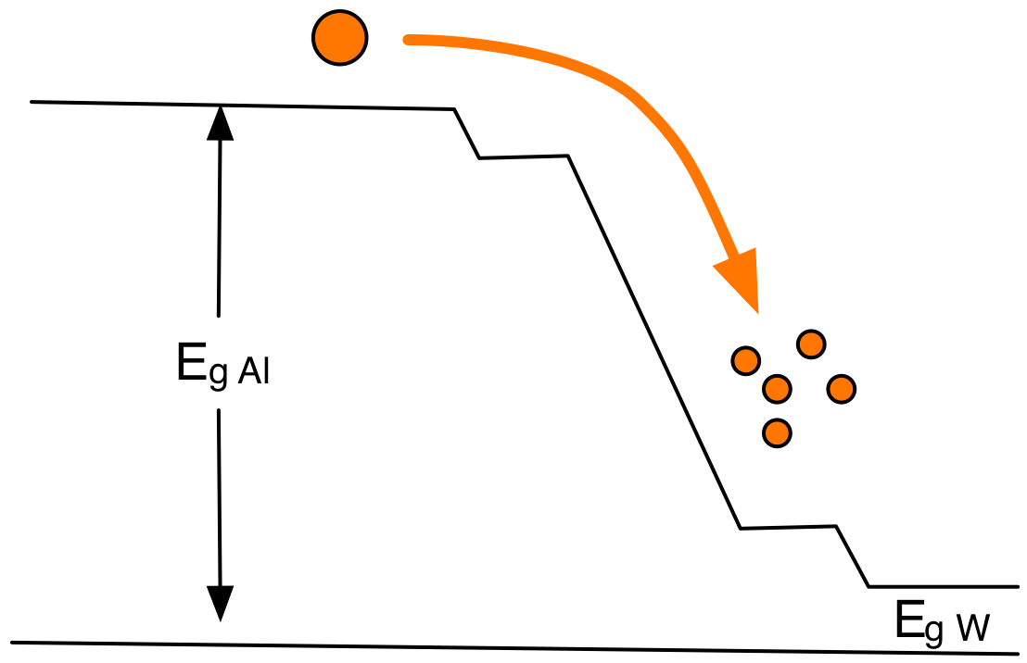
TES based Athermal Phonon Detectors
TES (W)
Athermal Phonon
Collection Fins (Al)
Substrate (Si, Al₂O₃)
R
T
1 cm
1 cm
Bandgap engineering is used to collect and concentrate QP to maximize sensing efficiency rather than to minimize sensitivity as in computational qubits

Slide 3
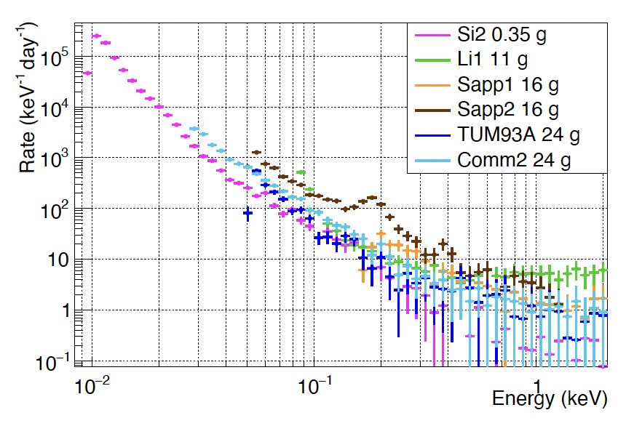
Mysterious Phonon Burst Background (LEE)
CRESSTIII Background Studies
CRESST III
2207.09375
Si 0.35g
LiAlO₂ 11g
Al₂O₃ 16g
Al₂O₃ 16g
CaWO₄ 24g
CaWO₄ 24g
?
Expected Radiogenic Backgrounds
1. What’s the source of this background?
2. How can we minimize it?

Slide 4
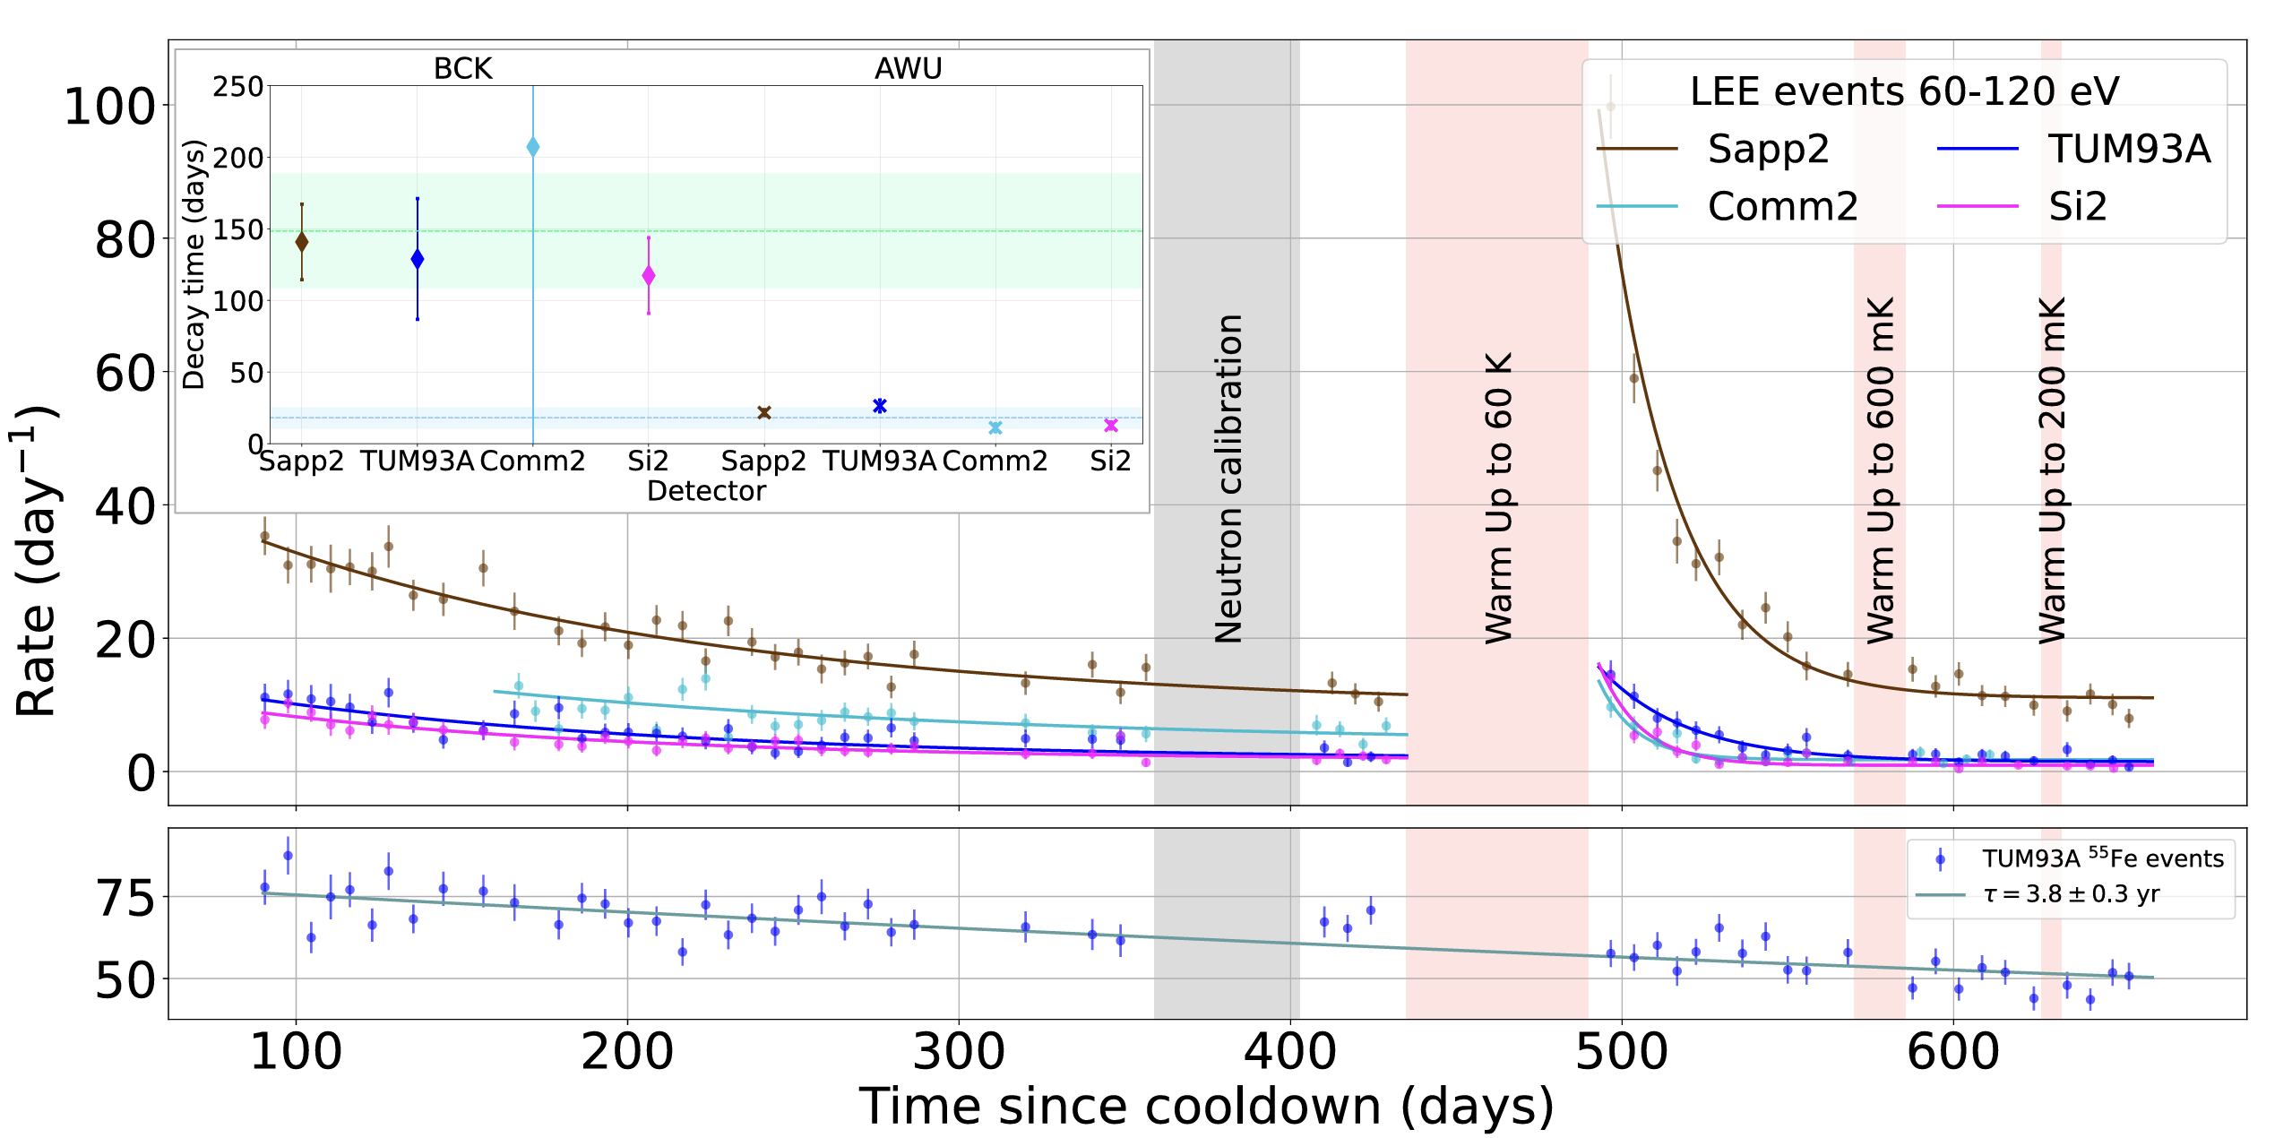
Phonon Burst Rate variation with time and Thermal Cycling
CRESST III
2207.09375
1. Phonon Burst rate monotonically decreases with time since cooldown
2.Partial reset with thermal cycling
Seen in all calorimeters to various extent

Slide 5
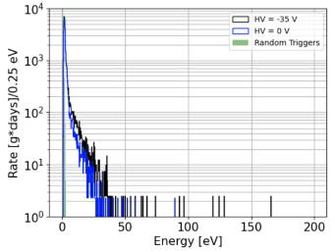
3) Phonon Burst Excess is Non-Ionizing
K. Kennard EXCESS 26
SuperCDMS
20eV recoil,1e/h Er @0V = 20eV
Luke Phonons
ΔV
Recoil Phonons
@35V: 20eV+35eV=55eV
Drifting of e/h pairs converts electrostatic potential energy into additional athermal phonon energy. A 20eV recoil with 1eh event would have a 20eV+35eV=55eV total phonon energy.
Also seen in EDELWEISS

Slide 6
Not Just In Athermal Phonon Detectors …

Slide 7
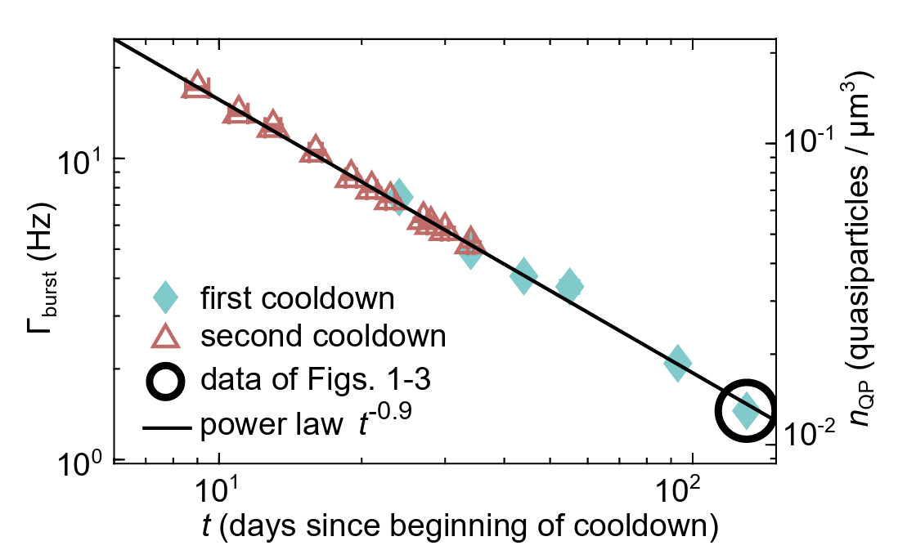
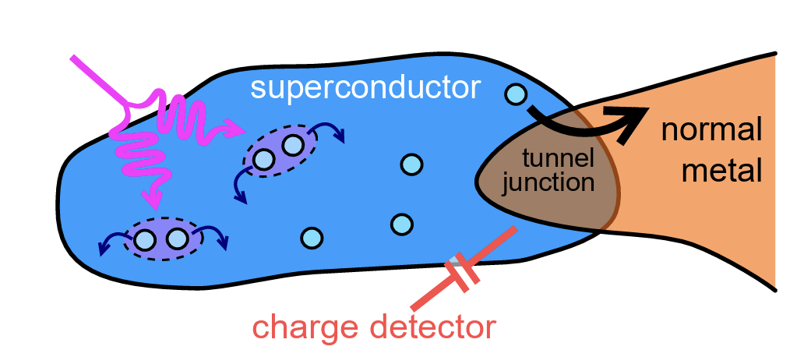
QP burst relaxation background in single e- qubits
RF single e⁻ transistor show QP burst rate that relaxes with time
Manilla et al (2102.00484)
Chip held with vacuum grease?

Slide 8
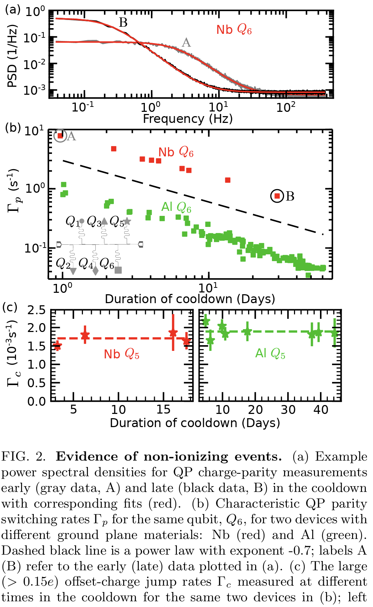
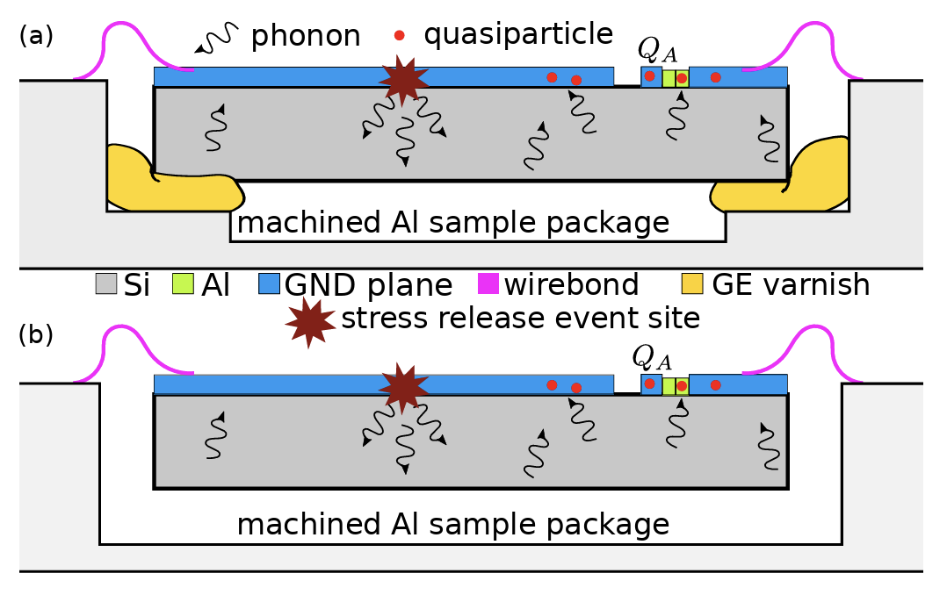
Non-Ionizing Phonon Relaxation Backgrounds in Computational Qubits too
Charge parity flip rate background limited by phonon burst relaxation processes in Yelton et al (2503.09554v1)
Al ground plane rate much lower than Nb ground plane rate -> phonon bursts
Charge rates constants -> non-ionizing
Charge rates don’t see relaxation
Non-ionizing phonon relaxation bursts seen in all superconducting technologies … this is a shared problem!

Slide 9
Fact Summary
 | Phonon Calorimeters | Qubits
1) Variation with time since cooldown (and/or time since fabrication) | Yes | Yes
2) rate resetting with thermal cycling | Yes | Yes
3) Non-Ionizing | Yes | Yes
These facts are incredibly restrictive!
Athermal Phonon Detectors and Qubits are sensitive to the same underlying phonon burst background sources

Slide 10
Hypothesis: Stress Relaxation?
Detector
Detector
Detector under stress due to thermal contraction,manufacturing, etc.
Detector relaxes releasing phonon energy
Potential Source Hypotheses:
metals/insulating substrate
detector substrate/support structure interface
Surface states
Bulk defects
?
arXiv:physics/0504151

Slide 11
Recap of Previous Results from TESSERACT (with commentary)

Slide 12
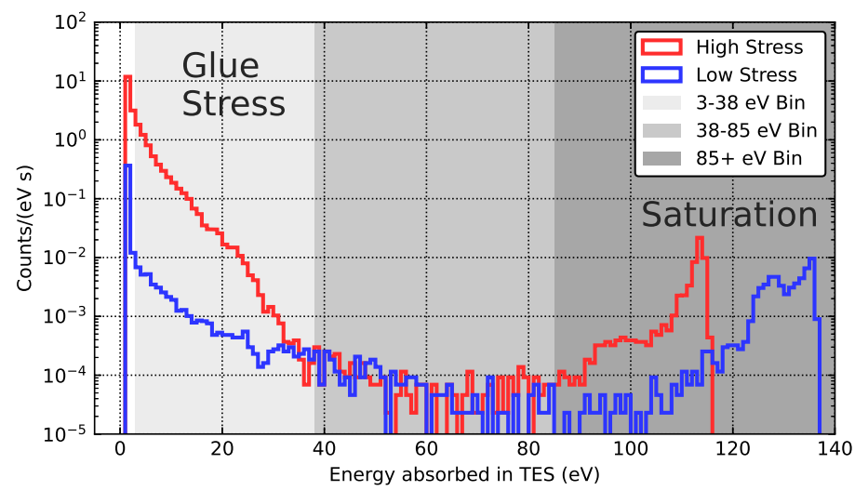
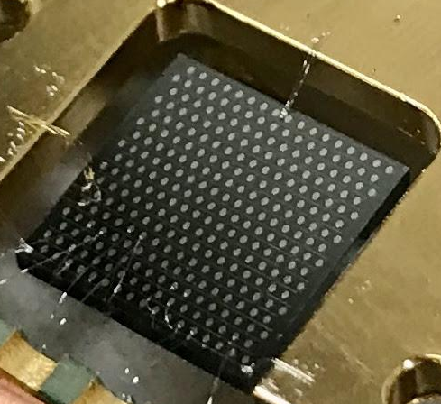
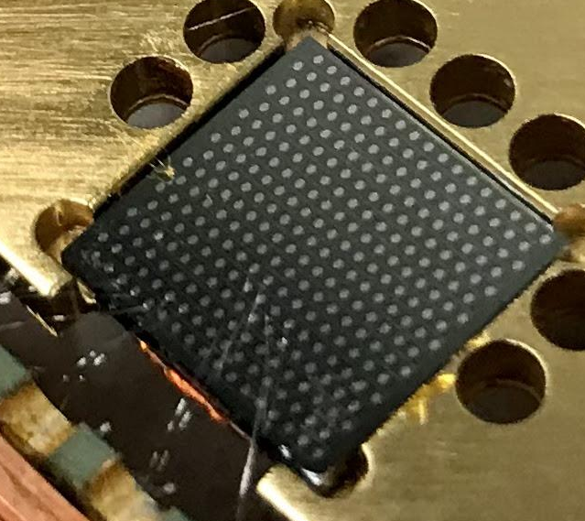
Phonon Bursts from GE varnish
2208.02790
Hanging (low stress)
2 orders of magnitude difference in rate between high stress (glued) and low stress (hanging) device
Glued Down with GE varnish
(High Stress)
GE varnish (and rubber cement) significantly increase <38eV backgrounds

Slide 13
LEE from Glued Detector/Support Interface … Completely Robust
Also seen with rubber cement (qualitatively worse) -> unpublished
We do TES T_{c} runs to confirm fabrication quality pretty regularly that we just glue down, all have this qualitative effect -> unpublished
But ….

Slide 14
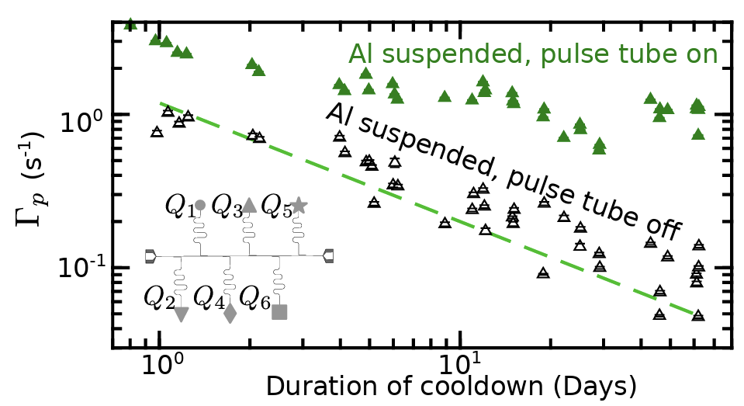
QP poisoning from Glue LEE Not Measureable in Qubits
2503.09554v1
GE varnish Glue Support
In Yelton et al (2503.09554v1), QP tunneling from GE varnish glued and wirebond supported (PT off ) are identical! Glue QP poisoning is subdominant to other LEE like QP poisoning mechanisms
2503.09554v1
Wirebond Supported

Slide 15
How do we reconcile these somewhat conflicting observations?
LEE/non-ionizing phonon burst rate incredibly susceptible to gluing SOP:
  How much GE varnish over how much area?
    UW Plourde: 4 mm² squares in the corner
    UCB Pyle: 100% coverage
  Curing SOP: vacuum?, heat?, etc?
QP poisoning flip rate not dominated by phonon bursts in the 1-10eV range
Retest following Britton’s gluing SOP?

Slide 16
PT Environmental Vibration Causes QP bursts In Wirebond Supported devices
Wirebond Supported
2503.09554v1
In Yelton et al (2503.09554v1), QP tunneling rates asymptote in devices held by wirebonds
If you turn the PT off, relaxation is visible … PT vibrations are making QP. Definitely not what we saw in the published result. Why not? Well …

Slide 17
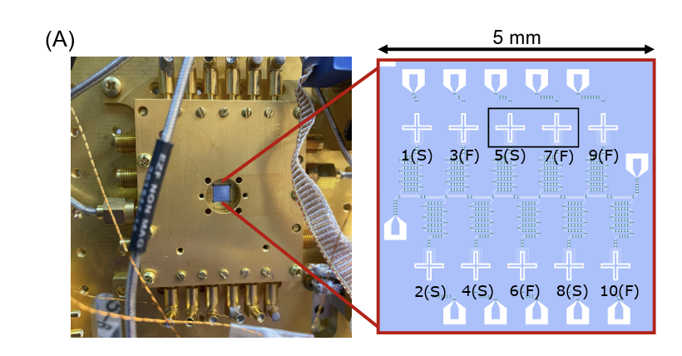
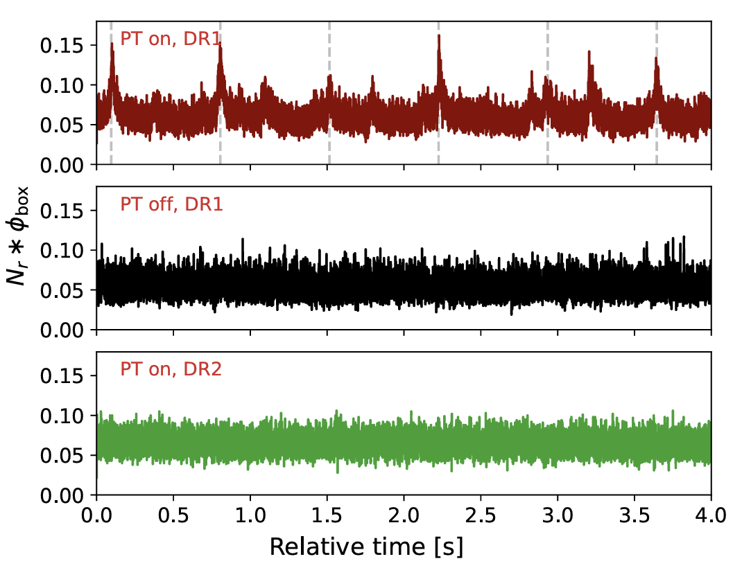
Complex Environmental Vibration Dependence: Correlated T1 Errors from PT Vibrations
MIT (2603.16494) measured the correlated QUBIT decoherence rate for a hanging qubit array with no bandgap engineering and found PT vibrations caused QP poisoning in one fridge but not the other.
Leiden PT415
Leiden PT415
Blufors XLD PT425

Slide 18
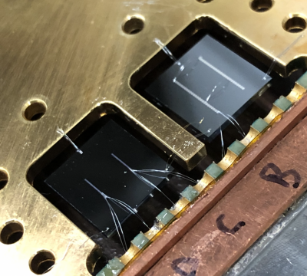
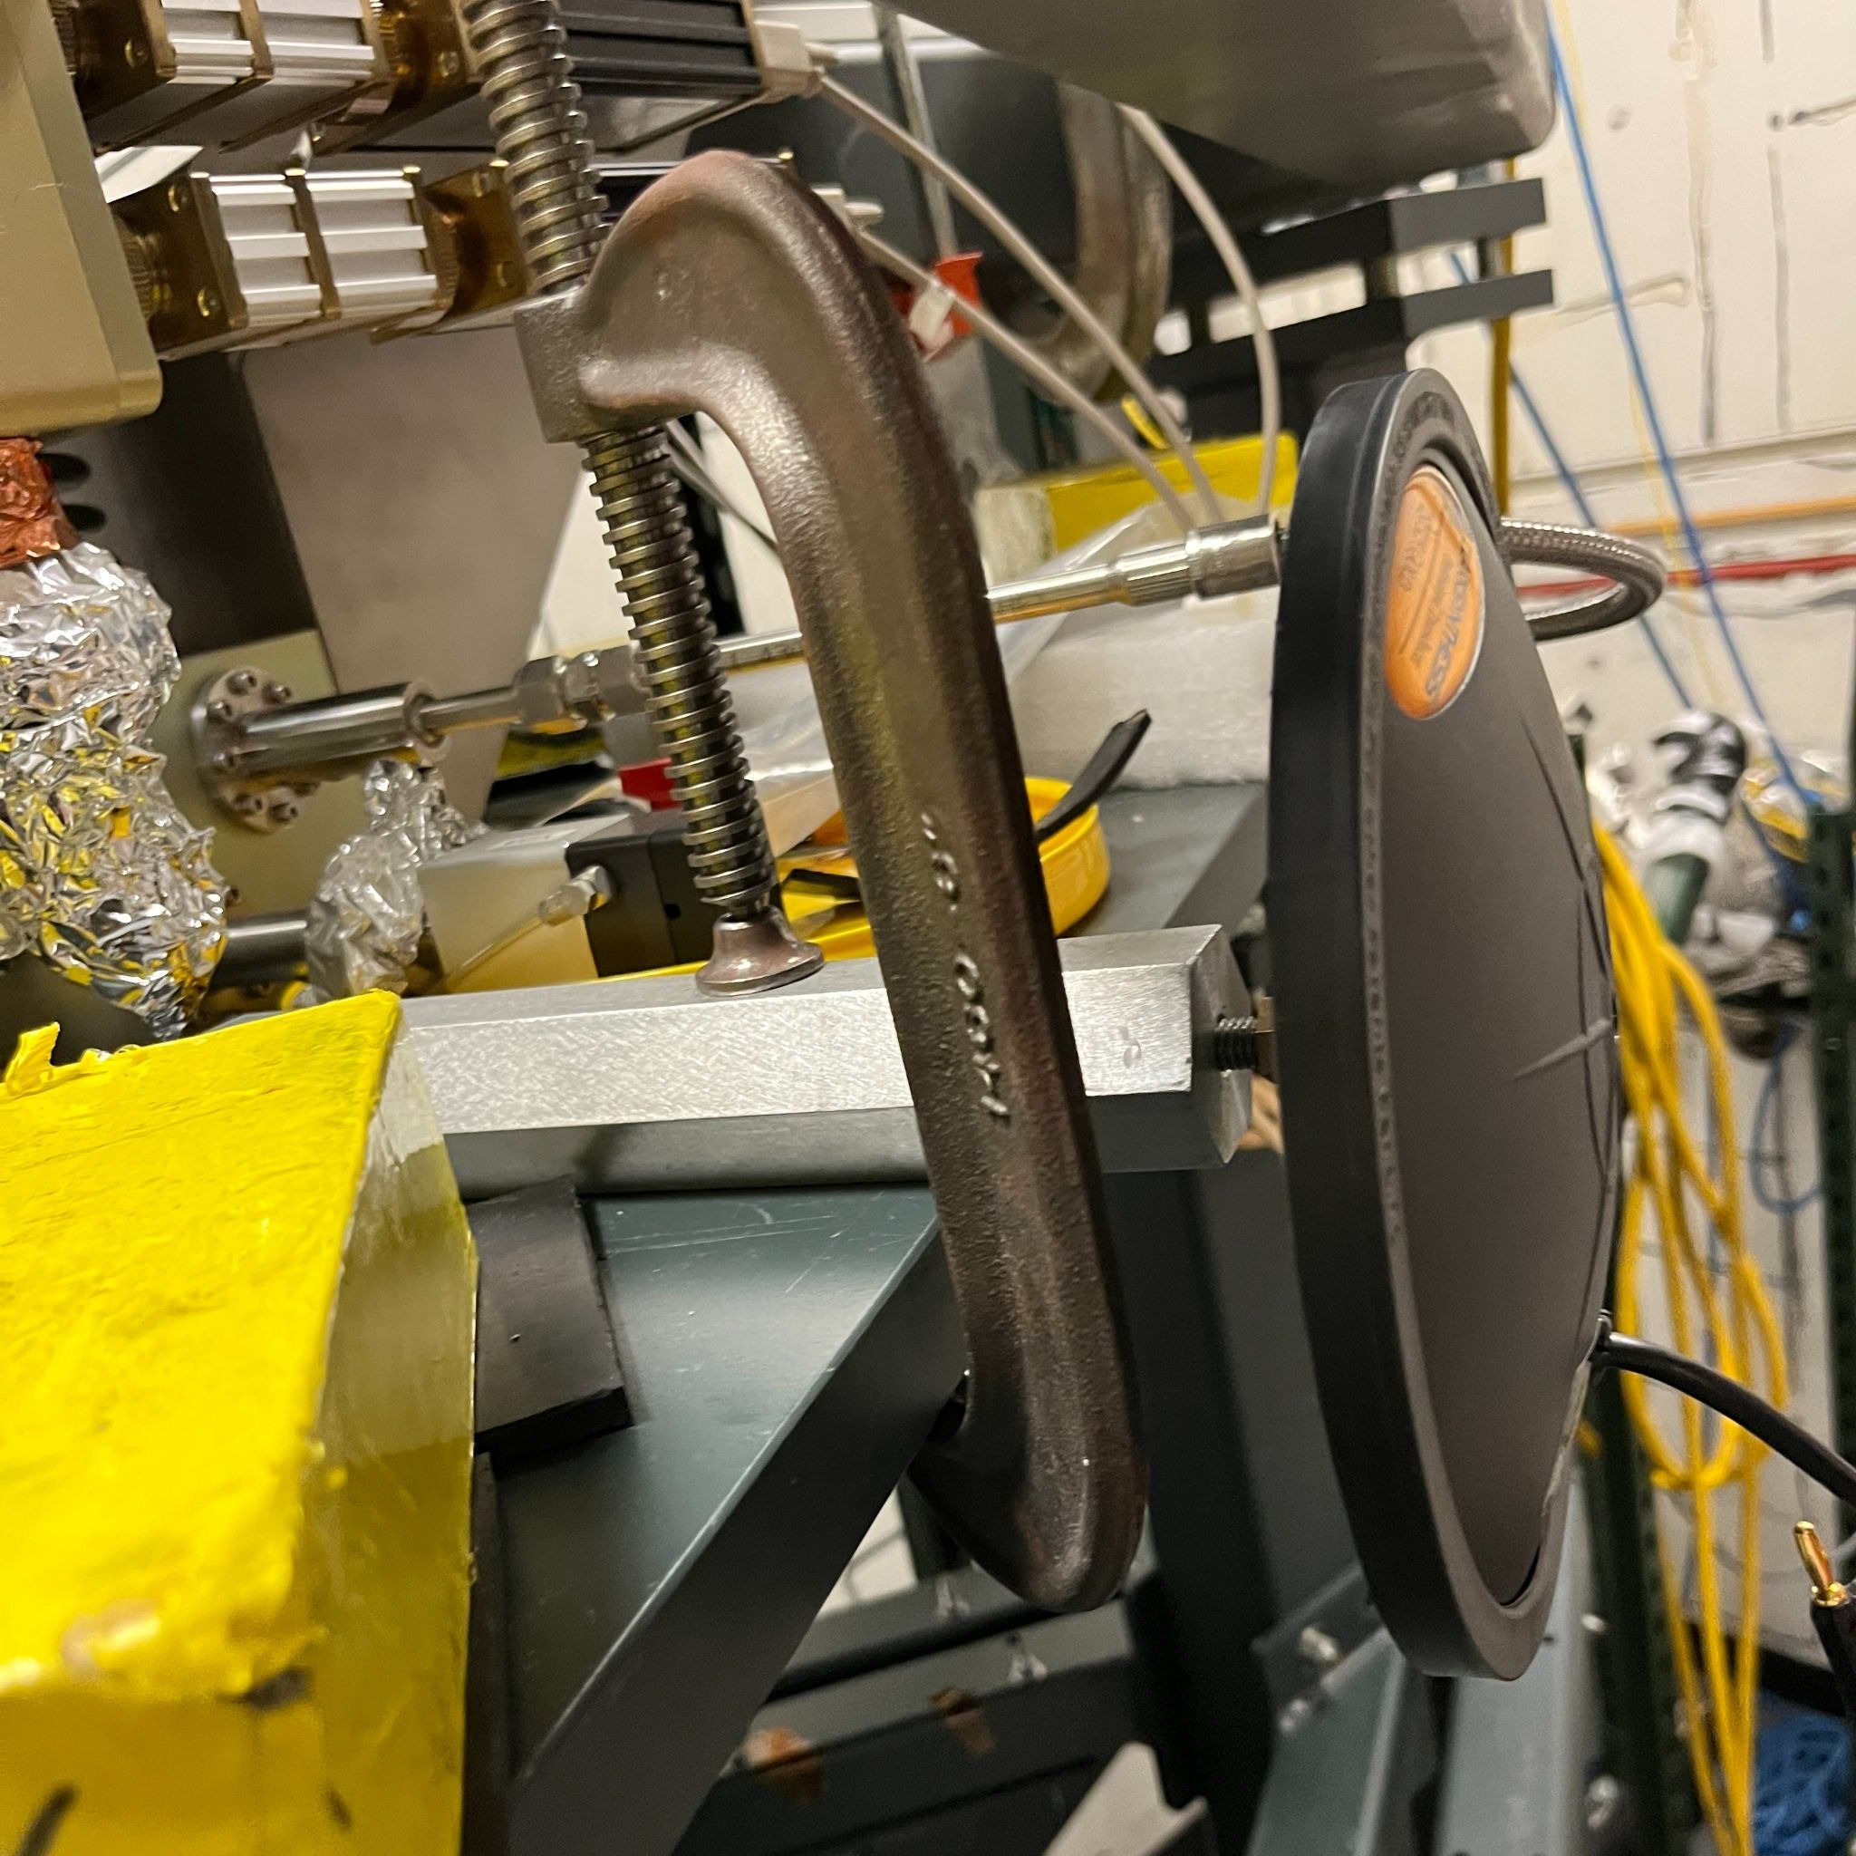
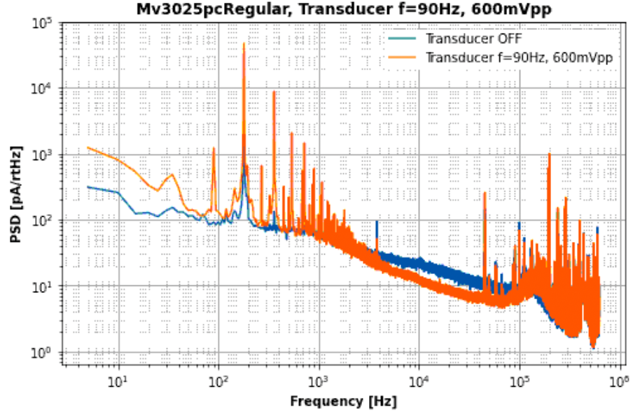
Wirebond Holding has Significant Environmental Vibration Susceptibility
2603.17964
In Pyle lab (Cryoconcepts PT415) @ UCB, hanging devices have:
  ~50% of the time no measureable vibration power.
  ~50%: some-to-significant vibrational noise
Vibration excitation studies confirm that we are exciting vibrational modes in the wirebond/detector mechanical system:
If loss mechanisms are linear:
Due to the dominance of 2nd vibrational harmonic, we have a primarily linear system
really high quality factor: Q ~ 10⁴
Sometimes your environmental vibrations overlap with the resonance sometimes they don’t

Slide 19
Phonon Bursts from Vibrations
2603.17964
In most recent paper (2603.17964), the control device had very large transient coupling.
When vibrations are worst:
  Standard athermal phonon losses in foot
  eV (10¹⁴Hz) scale phonon bursts seen when vibrational power is highest!
For this run, a hard cut on DC parasitic power (baseline cut) removes all background rate – vibration phase correlation with 80% livetime.
Vibration PB subdominant above 5eV and the ROI was 15-30eV
even so, we likely wouldn’t have published if vibration LEE was on fast neutron exposed detector
2603.17964

Slide 20
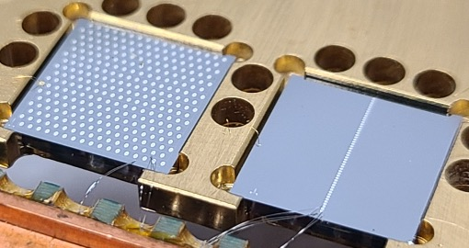
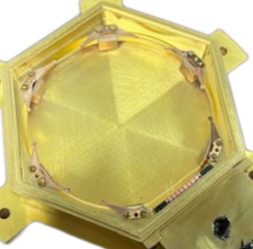
Best Structural Support?
Glue
Clamp
Hanging (low stress)
Resting
We’re many orders of magnitude away from where we want to be in Phonon Bursts. Thus, every source that is localized needs to be suppressed by many orders of magnitude.
Every DM experiment (and superconducting quantum computer?) needs a good vibration decoupler (as the CRESST/CUORE ecosystem knows)

Slide 21
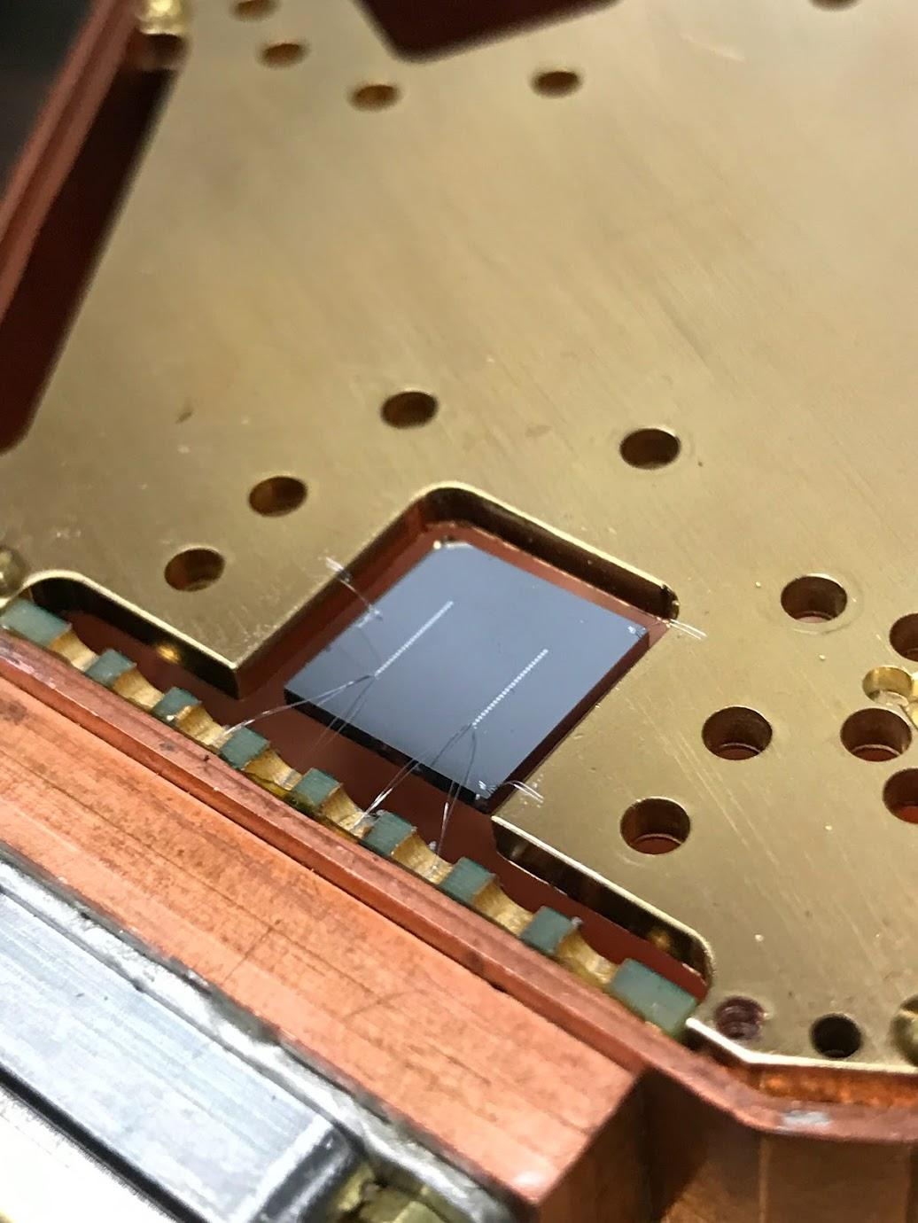
Phonon Burst Source: Substrate or Metal ?
1% 2 Channel Device
R Romani
We (and CRESST 2404.02607) see both shared and single channel relaxation events
Singles: Al metal film relaxation
Shared: Substrate Phonons
2410.16510

Slide 22
Not Just In Athermal Phonon Detectors …

Slide 23
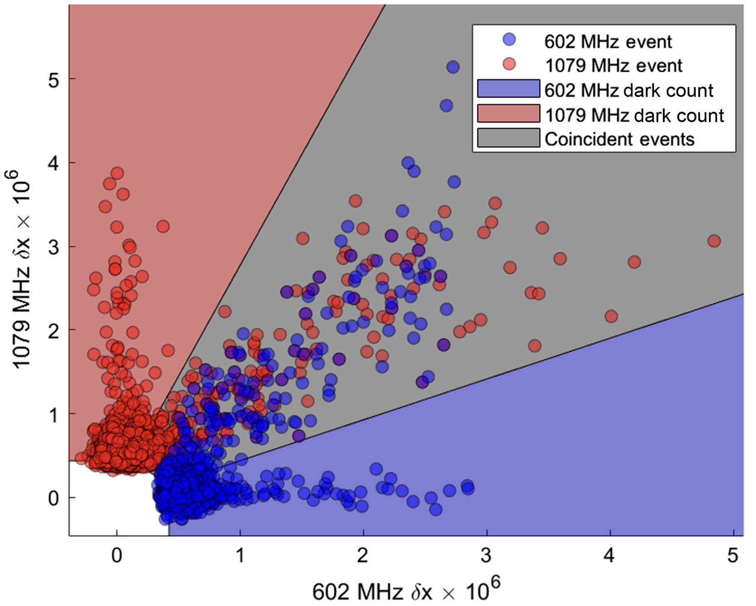
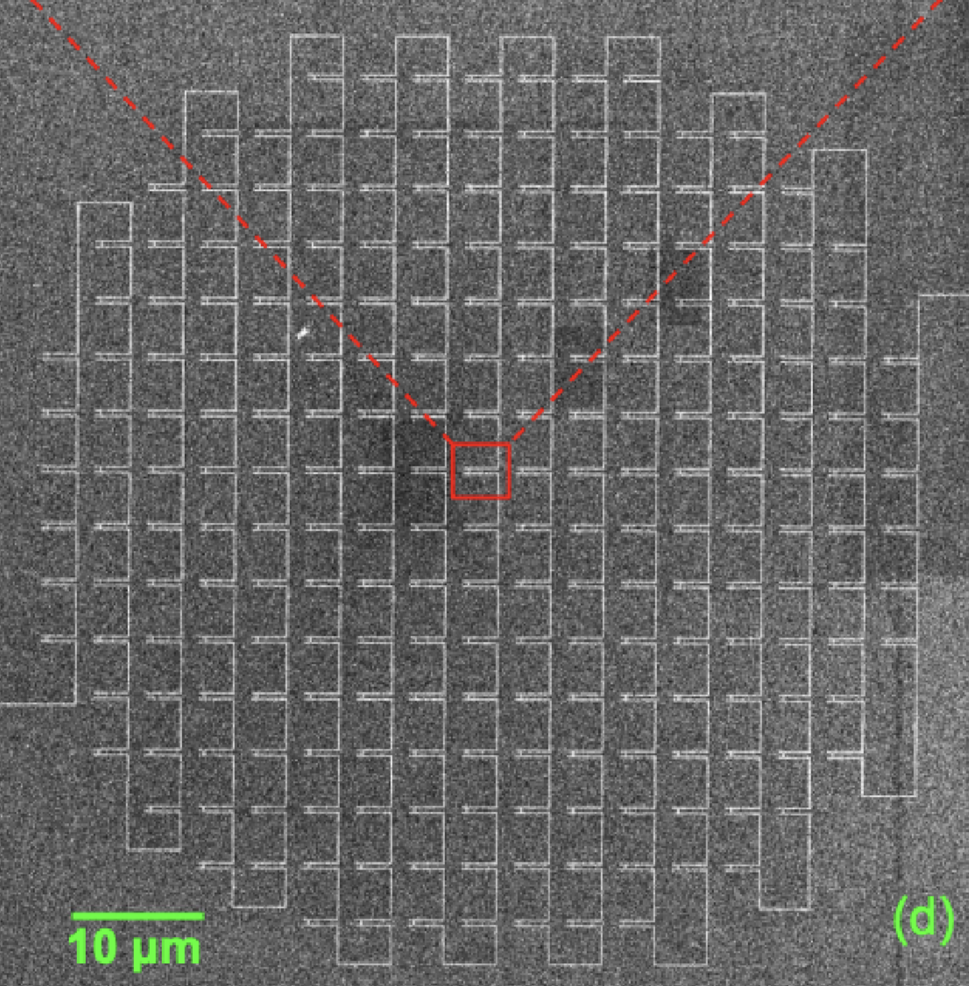
Phonon Bursts in Far IR Resonator (MKID) Sensor Arrays
JPL (Day et al 2404.10246)
Standard single/shared topology of dark count rate in Far IR resonator sensor arrays
MKID Inductor Geometry

Slide 24
Source of Shared Phonon Bursts ?
Test hypotheses with different substrate geometries
 | Scale with thickness | Independent of thickness
Scale with Aspect ratio | Substrate side wall
Independent of Aspect ratio | Wirebond support (likely some weird power) Substrate volume | Substrate top/bottom face

Slide 25
Shared Phonon Burst Rate
2505.16092
Shared LEE scales with thickness

Slide 26
Source of shared Phonon Bursts not the top/bottom polished face
 | Scale with thickness | Independent of thickness
Scale with Aspect ratio A tinge sketchy | Substrate side wall
Independent of Aspect ratio | Wirebond support (likely some weird power) Substrate volume | Substrate top/bottom face

Slide 27
Comparing PB rate in CPDs and 1cm²
76mm diameter x1mm thick
2505.16092
CPDs and 1cm² have pretty much the same background rate/mass above 10eV
Different support: clamp vs wirebonds
Different sidewall/volume ratio

Slide 28
Source of shared PB in the substrate volume? warning: not a clean A/B test
 | Scale with thickness | Independent of thickness
Scale with Aspect ratio A tinge sketchy | Substrate side wall
Independent of Aspect ratio | Wirebond support (likely some weird power) Substrate volume | Substrate top/bottom face

Slide 29
Could Bulk PB be Lattice Defect Complexes from fast neutron interactions?

Slide 30
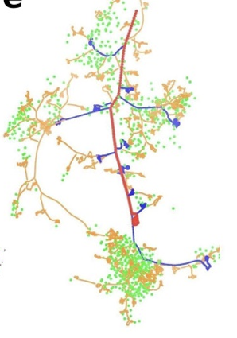
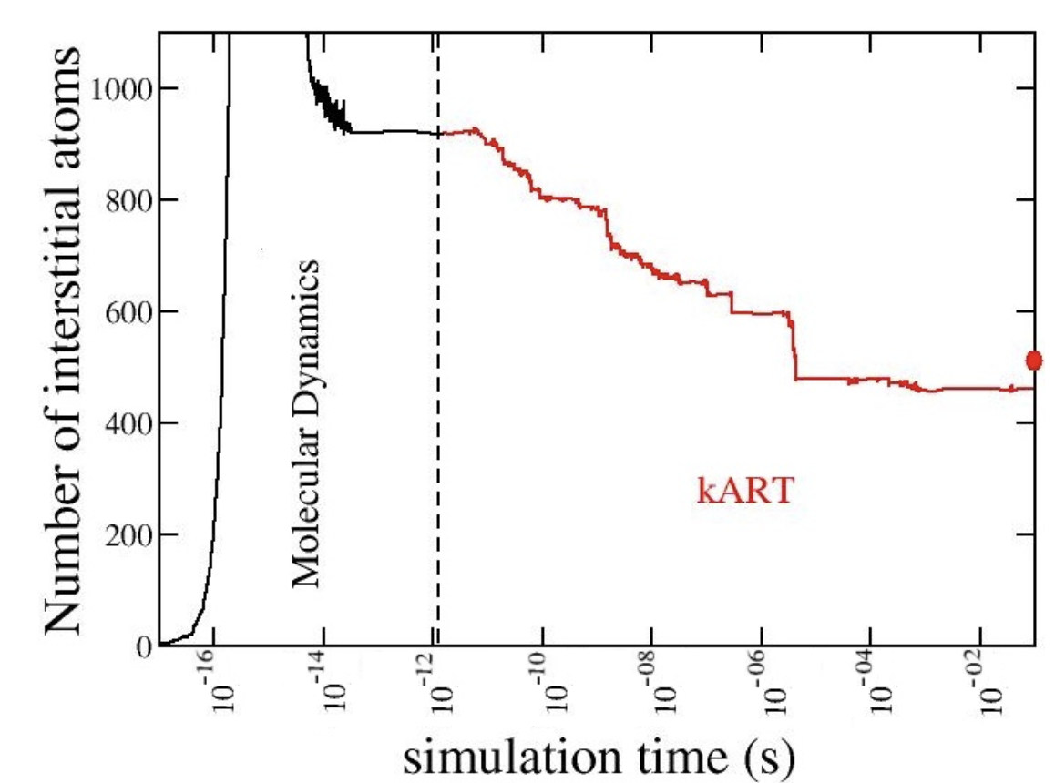
Physics of Lattice Defect Generation
Lots of computational/theoretical effort has gone into modeling defect generation due to nuclear recoils
  Nordlund 2408.07518
  Jay 10.1109/TNS.2016.2628089
  And many others …
By ~0.3ps, the nuclear recoil (PKA) has hard scattered with secondary atoms (SKA) and generated lots of defects.
Jay
Jay 10.1109/TNS.2016.2628089
Jay 10.1109/TNS.2016.2628089
After this defects begin to interact
  I and V recombine and anneal away
  I and I, V and V combine to make more complex defects configurations
Since 1I, 1V and 2I can diffuse at 300K, these annealing process can continue to occur at long time scales
Is LEE just the tail of this process ?
SRIM
Jay 10.1109/TNS.2016.2628089

Slide 31
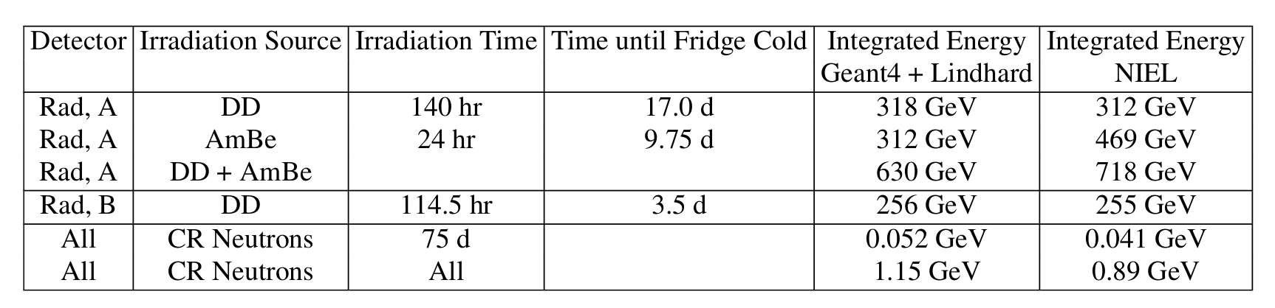
A/B Test for Fast Neutron Defect PB
Irradiate one detector of a near identical pair with a fast neutron source at 300K
We tried to really irradiate the detectors ... 2 orders of magnitude more total non-ionizing recoil energy than expected from cosmic rays …
Warning: AmBe/DD much softer spectrum than Cosmic Ray Neutrons

Slide 32
Background in Irradiated Device vs Control
Definitely see excess background in irradiated device
Spectral differences from our usual LEE background … higher energy
Not enough to be the dominate source of LEE. We see a ~x10 increase in 15-30eV background where we would expect ~x100
Weird: the excess background shape wasn’t the same

Slide 33
Time dependence of Background
Irradiated device background decays away with time since cool down just like the control does (and all of our devices) … SEEMS REALLY LEE LIKE

Slide 34
Response to 50K Partial Warmup
After cycling the detectors to 50K ,the excess background in the irradiated device largely disappeared (if only all PB behaved like this). Fast Neutron generated backgrounds is like/not like real PB

Slide 35
Remeasure 2 months later
Background is still a bit elevated, but nothing like before. Suggests that fast neutron defects continue to anneal at 300K on month time scales?

Slide 36
Summary
Non-ionizing Phonon Burst now seen in all superconducting devices (qubits, resonators, phonon sensors)
Enormous progress in understanding the source:
  Structural support / Environmental Vibration
  Differential contraction between substrate/superconducting films (singles)
  Some source in the substrate volume
Fast neutron lattice irradiation @300K produces long time scale lattice defect relaxation events @10mK
  Tantalizingly similar to standard non-ionizing LEE
  Naively, rate too small to be a dominant component of our background LEE ?
  More studies needed

Slide 37
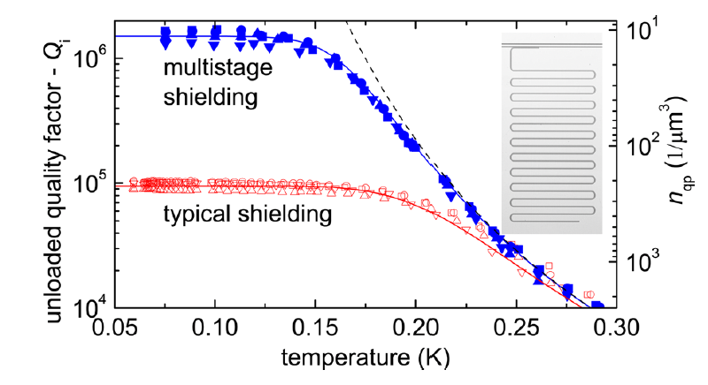
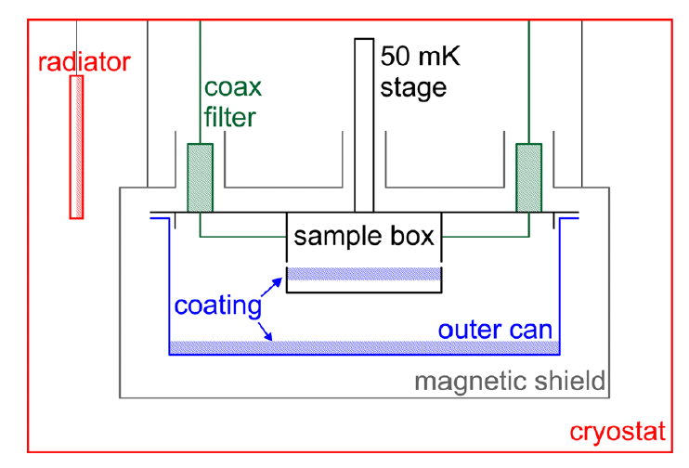
Resonators as a Tool to Understand Qubit Backgrounds
Quasiparticle poisoning due to mm blackbody leakage first understood with resonators in 1105.4642.
Every qubit setup uses something like the box-in-box architecture proposed here today.

Slide 38
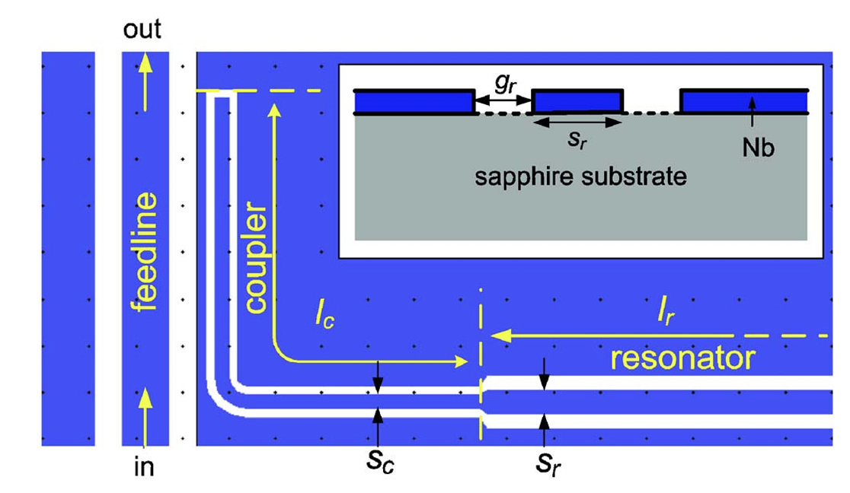
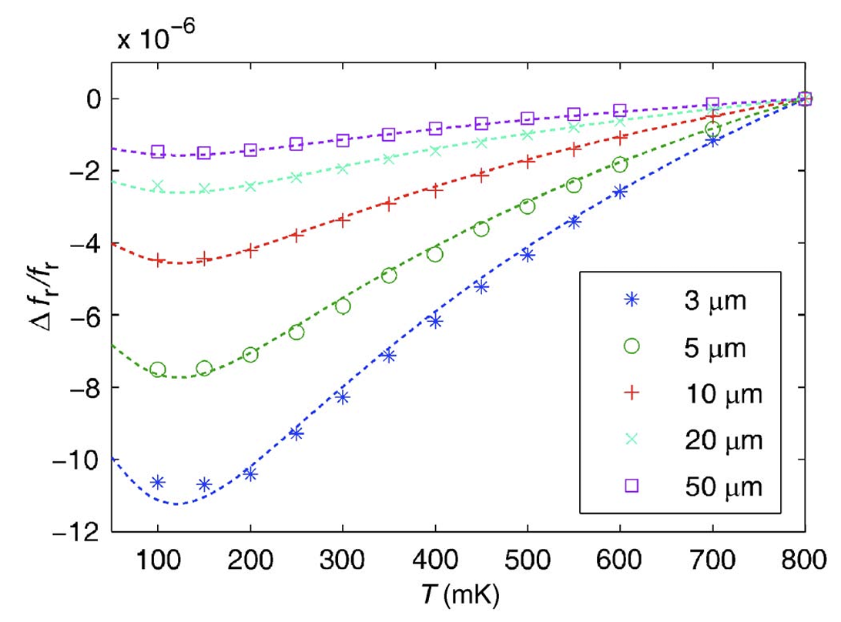
Resonators as a Tool to Understand Qubit Backgrounds II
0802.4457 mapped out the frequency shift of resonators due to TLS as a function of CPW geometry (participation ratio) and found that the majority of the TLS seemed to be on the sapphire surface and not in the bulk
Classical superconducting resonators are an extremely powerful tool to understand sources of decoherence in superconducting qubits

Slide 39
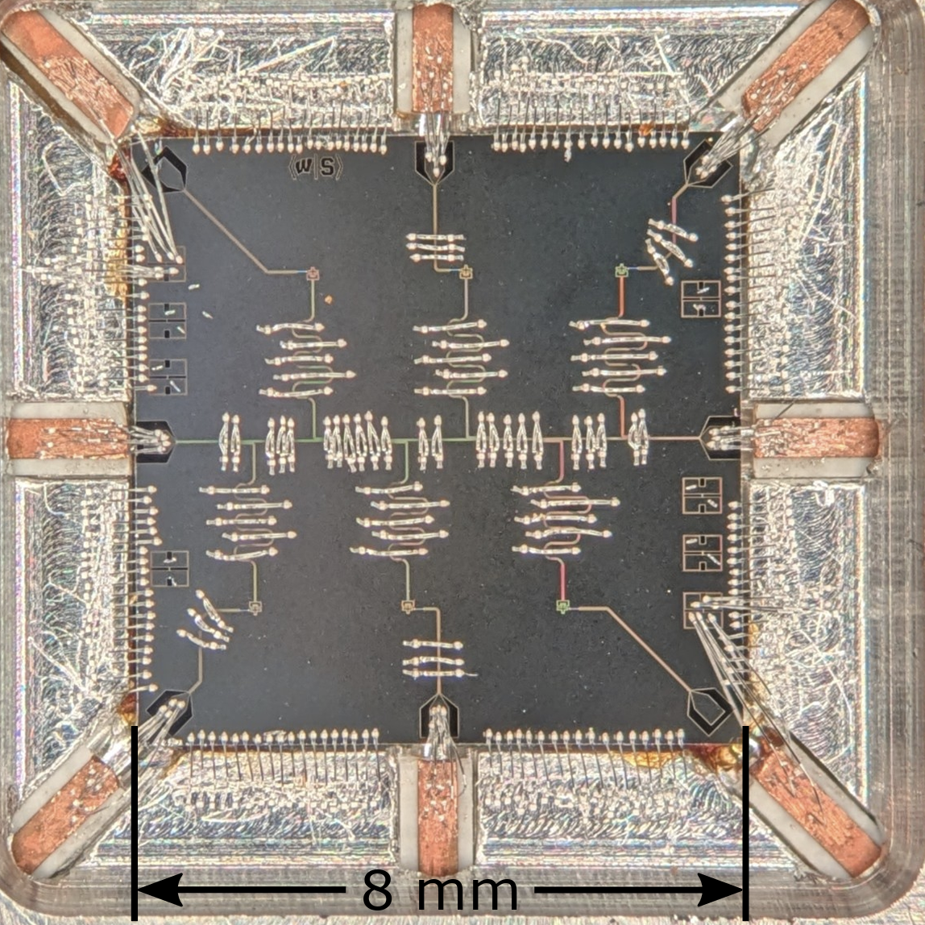
Phonon Sensors as a Tool to Understand Qubit Backgrounds?
Phonon Sensors are a powerful tool to understand non-ionizing qubit backgrounds because they are:
designed to be maximally collect and measure athermal phonons
Easily provide phonon burst energy information

Slide 40
Backup

Slide 41
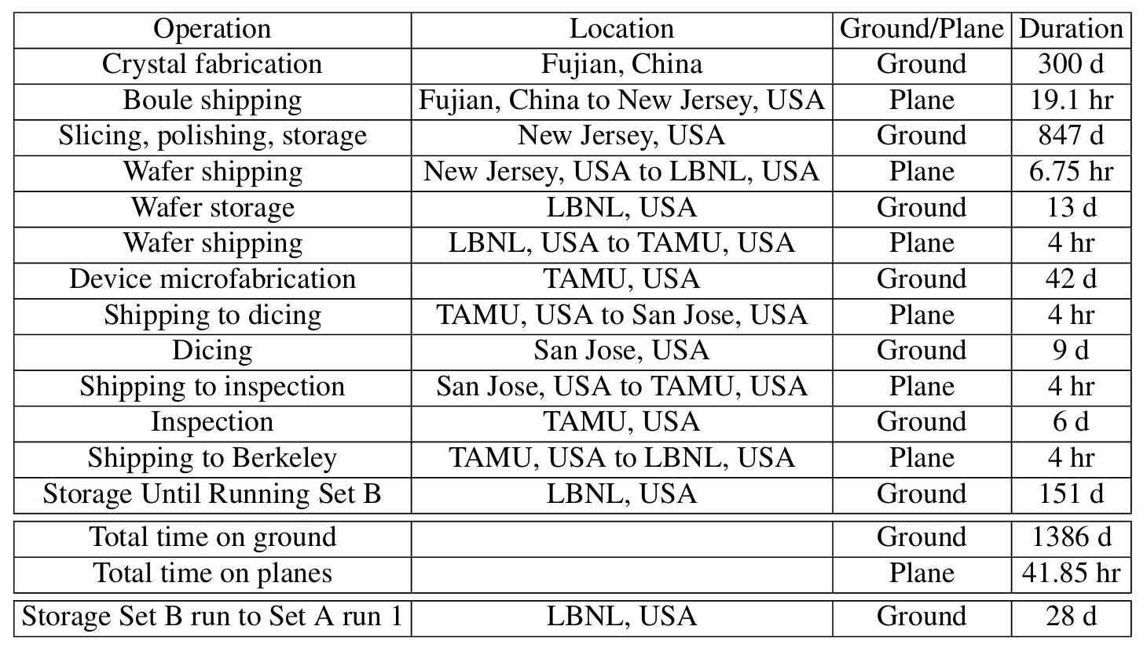
Substrate History

Slide 42
Single Events in Photon Calibration too
Calibration photons have single and shared events too!
Shared = substrate absorption
Singles = Al fin absorption
1 Al fin photon + 1 substrate photon

Slide 43
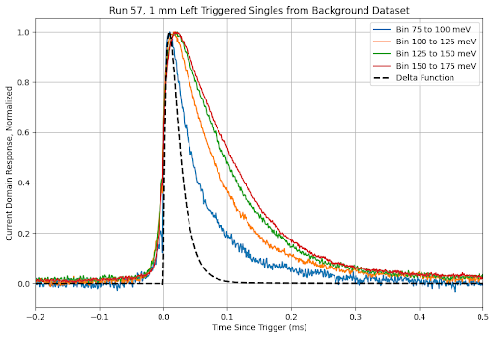
Single Relaxation Event Pulse Shape
LEE single pulse shapes and Al fin calibrations photons have pulse shapes consistent with a dirac delta energy pulse that saturates a single phonon sensor in the channel
As LEE energy drops, pulse shape looks more like a dirac-delta energy deposition (known from dIdV)
Single LEE background source is Al film relaxation!

Slide 44
Perfect A/B Test?
For a systematically clean measurement of LEE dependence on thickness, we must keep all other variables identical
 | Same | Differences
Design | identical
Substrates | >20kOhm cm Intrinsic Si double side DSP | Different Boules Baking times slightly different
Fabrication | Same SOP Texas A&M fabrication facility | Consecutive fabrication runs separated by 1 week
Dicing | Same vendor | Different blade thickness
Storage, Shipping | Identical
Measurement | Same run/cooldown, nominally same electronics chain | Different vibration susceptibility

