Slide 1



Phonon-Only Events and Correlated Quasiparticle Poisoning
Britton Plourde
University of Wisconsin-Madison
RISQ 2026
University of Wisconsin-Madison
June 16, 2026

Slide 2
Phonon-mediated quasiparticle poisoning from radiation impacts
γ-ray, muon impact deposits ~100 keV – 1 MeV
rate ~ 1/(10 s) for (8 mm)² chip
Generation of electron-hole pairs in Si, offset charge jumps
e-h recombination and radiation of high-energy phonons
Pair-breaking phonons travel throughout chip
Phonons impacting superconductor break pairs, quasiparticles recombine and emit 2Δ phonons back into Sirrelated
Vepsäläinen et al., Nature 584, 551 (2020)
McEwen et al., Nature Physics 18, 107 (2021)
Wilen et al., Nature 594, 7863 (2021)
Martinis, npj Quantum 7, 1 (2021)
Cardani et al., Nature Comm. 12, 1 (2021)
Iaia, Ku et al., Nature Comm. 13, 6425 (2022)
Thorbeck et al., PRX Quantum 4, 020356 (2023)
→ Correlated pair-breaking & quasiparticle
generation across the chip
Notes:
~10 orders of mag. larger than qubit transition energy; ~8-9 orders of magnitude larger than SC gap
EY/BP stress relaxation: 0.03 s^{-1} over (8 mm)^2 chip
UWM: 0.02 s^{-1} over (6.25 mm)^2 chip
Google: 0.1 s^{-1} over (10 mm)^2 chip (+20 mm x 24 mm carrier chip)
Background gamma emitters: ^40K (potassium), ^208Tl (thallium), ^232Th (thorium), ^238U

Slide 3
Signatures of phonon-mediated QP poisoning from particle impacts
Impact produces many electron-hole pairs that spread before trapping
Shifts in local charge environment for qubits near impact site
Motion and recombination of e- and h+ radiates high-energy phonons; enhanced pair-breaking
Enhanced relaxation rates for qubits
Elevated QP charge-parity switching rates on qubits
Notes:
27,777 e-h pairs following 100 keV gamma impact
Si bandgap = 1.12 eV
--e/h pair needs energy a few times the bandgap to avoid immediate recombination
Si Debye energy ~ 450 K (= .038 eV)

Slide 4
Mitigating phonon-mediated QP poisoning
Possible mitigation strategies:
SC gap-engineering to suppress tunneling of excess QPs
Phonon downconversion…
Normal metal structures on back side of chip:
Inelastic electron-phonon scattering
Low e-ph interaction rate at low temperatures
Need large metallic volume
Martinis, npj Quantum 7, 1 (2021)
Alternatively, could use low-gap superconductor…
Henriques et al., APL 115, 212601 (2019)
Karatsu et al., APL 114, 032601 (2019)
Notes:
Henriques et al. – gr-Al resonators with clean Al traps on sapphire
Karatsu et al. – Al-NbTiN MKIDs on SiN membranes with low-Tc (0.6 K) Ta on back side

Slide 5
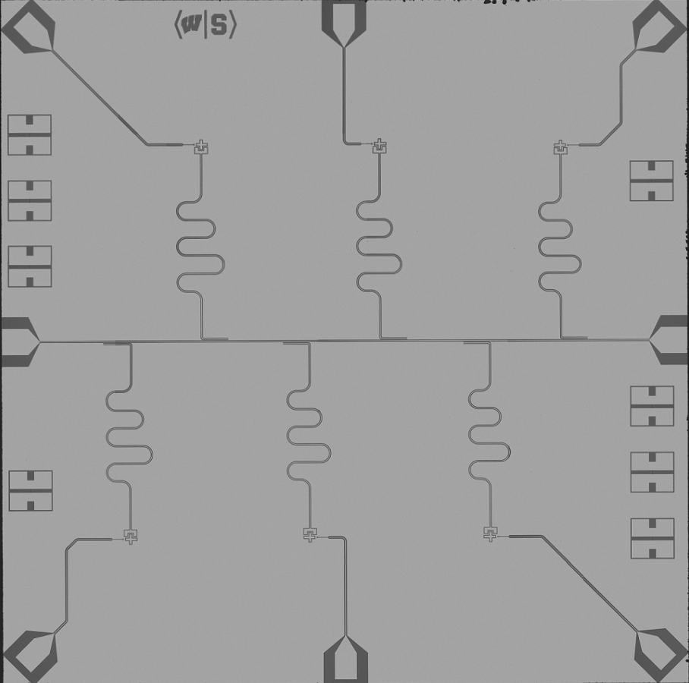
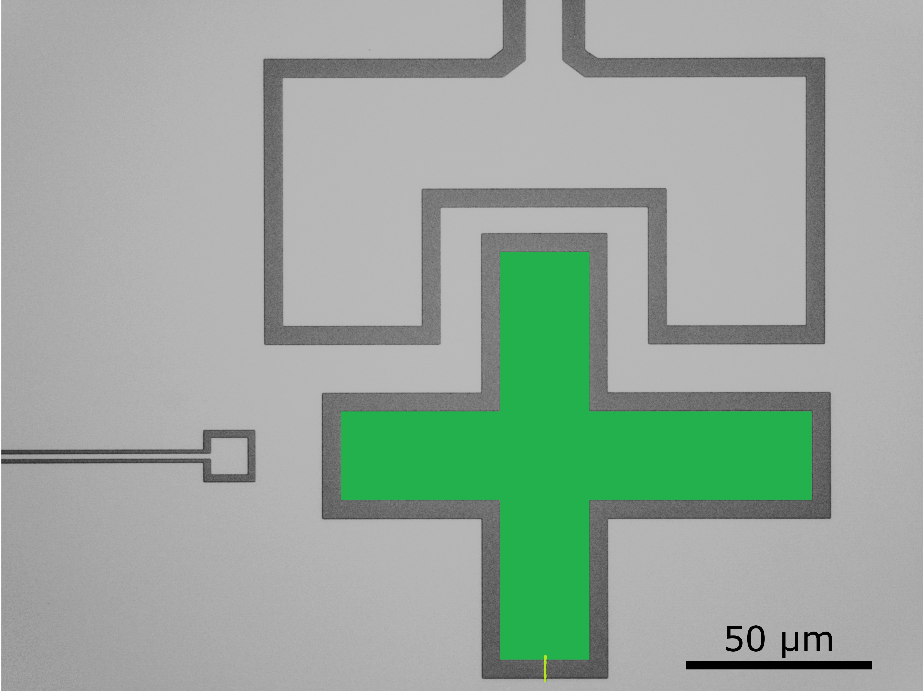
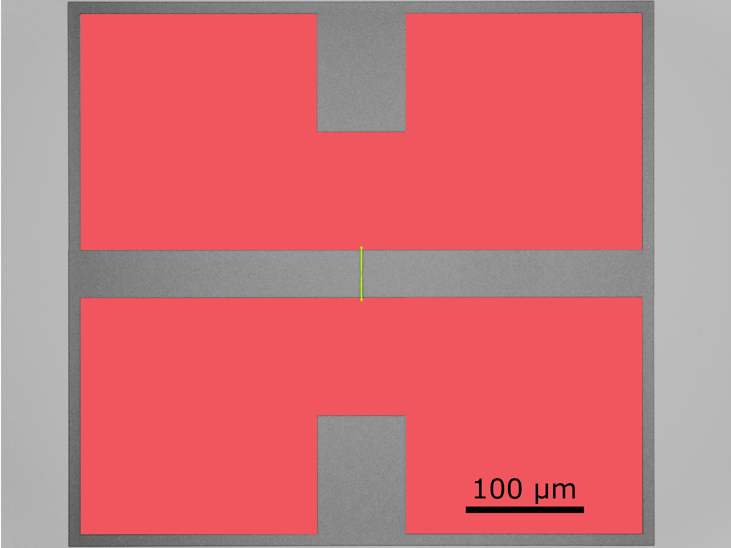

Device layout for studying phonon-mediated QP poisoning
Nb groundplane (or Al)
Al/AlOx/Al junctions
Charge-sensitive transmons
Electroplated Cu
Thickness: 1 μm, 10 μm
Notes:
EJ/EC ~ 25-30
RRR ~ 42

Slide 6
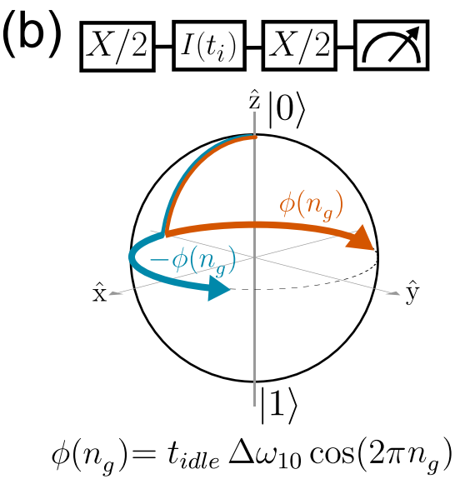
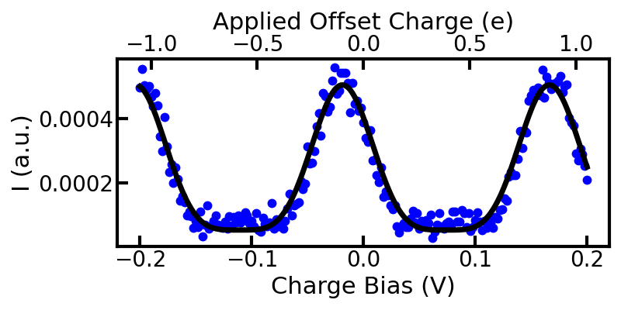



Using qubits as sensors of charge environment
environmental
Christensen et al., Phys. Rev. B 100, 14 (2019)
Notes:
Degeneracy at +/-0.5e
Max charge separation at integer e

Slide 7
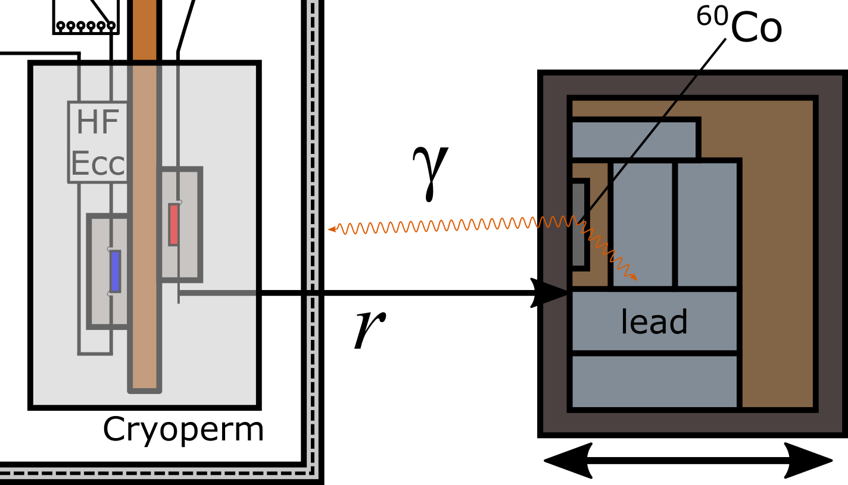
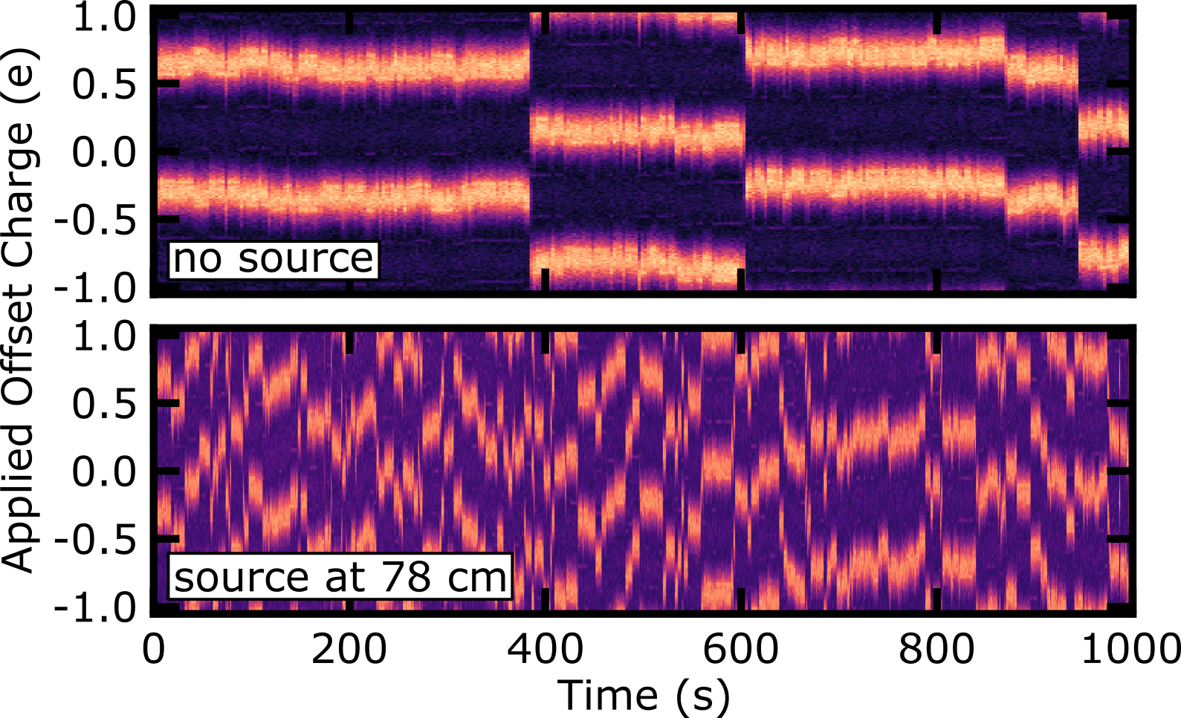
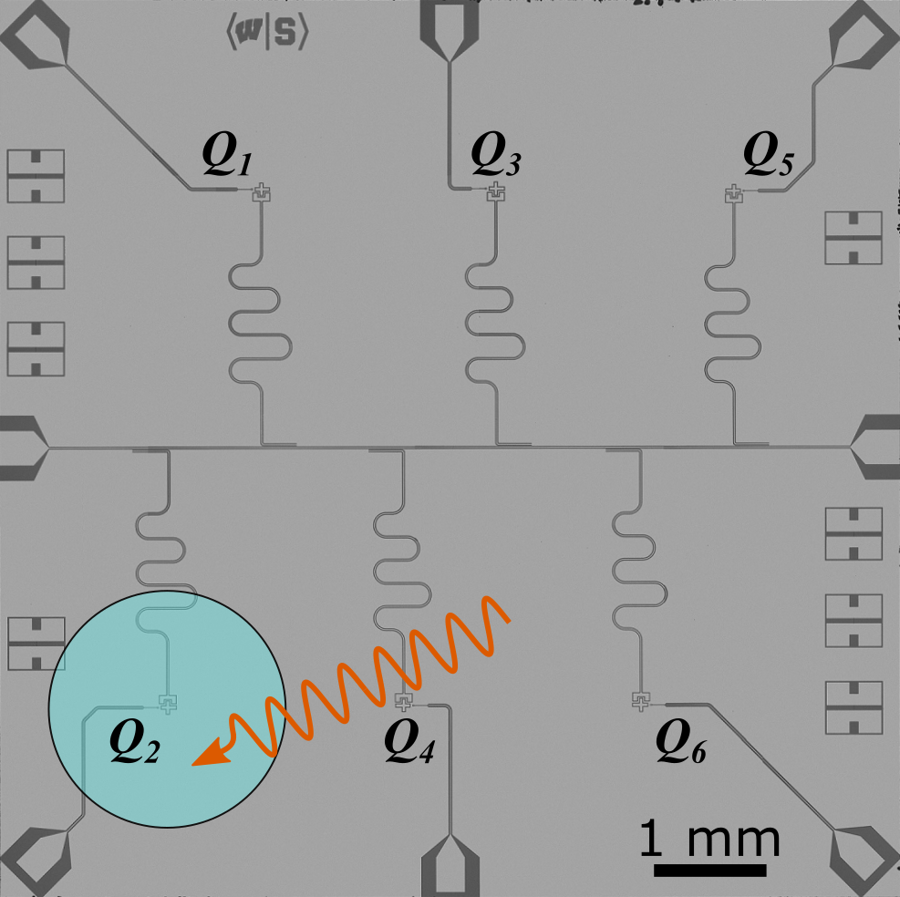
Dependence of offset-charge jump rate on γ dose
Larson et al., PRX Quantum 6, 030339 (2025)

Slide 8
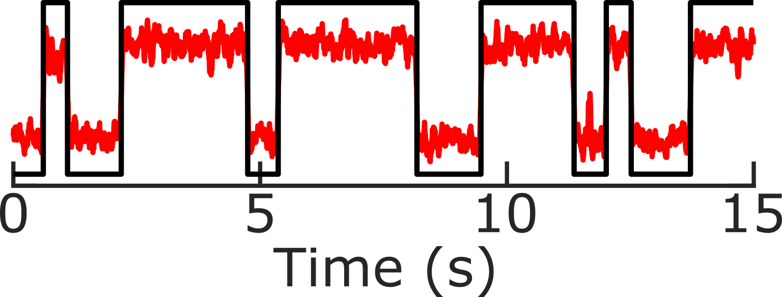
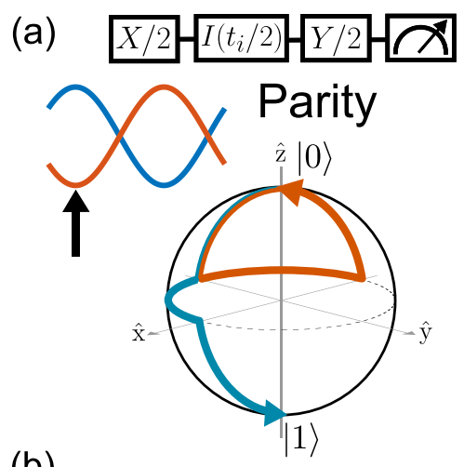
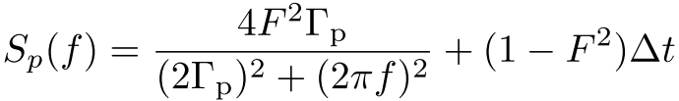
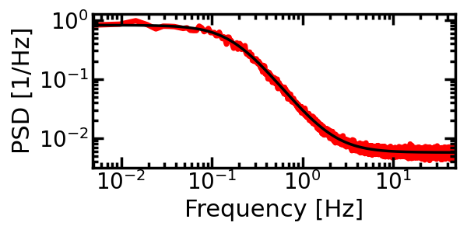
Sensing QP poisoning with charge-parity switching
0000111111111111001111100000000…
Christensen et al., Phys. Rev. B 100, 14 (2019)
Riste et al., Nature Comm. 4, 1913 (2013)

Slide 9
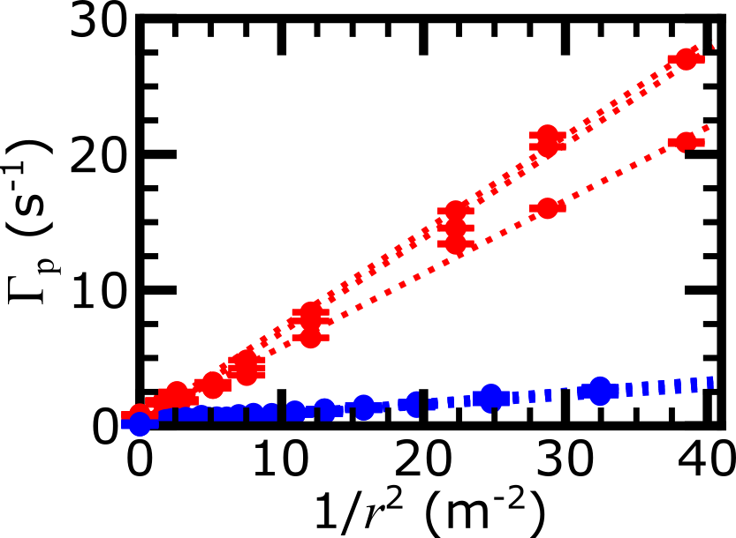
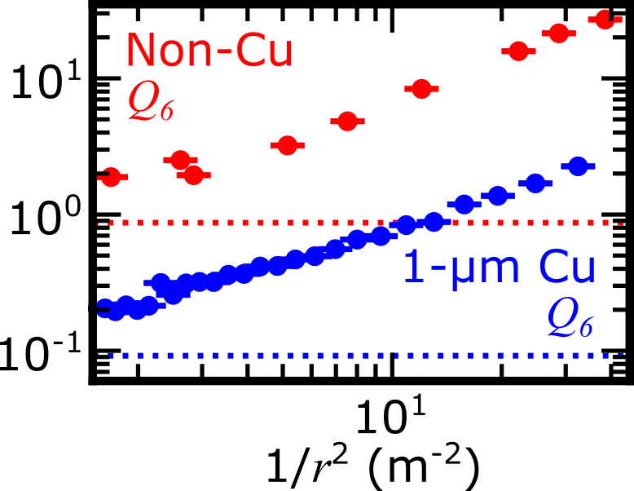
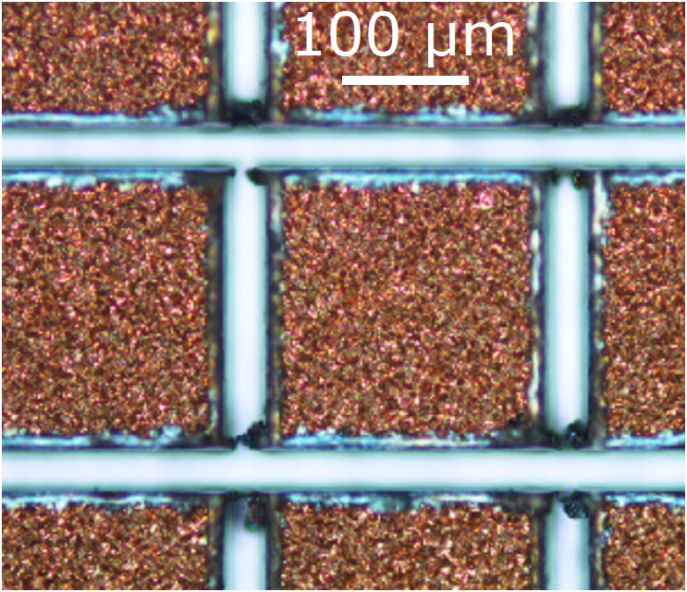
Dependence of QP charge-parity switching rate on γ dose
QP charge-parity switching rates proportional to 1/r²
Rates suppressed by ~10x with 1-μm Cu islands
Larson et al., PRX Quantum 6, 030339 (2025)

Slide 10
Generation of nonequilibrium QP in qubits
E
Deposition of pair-breaking energy generates QPs near qubit junction
Quasiparticles
Impact of phonons near junction electrodes, e.g., following radiation impact
Absorption of pair-breaking photons
Photon
absorption
Mechanism for photon absorption and coupling to qubit junction…?
0
DOS
Phonon
absorption
Cooper pair

Slide 11
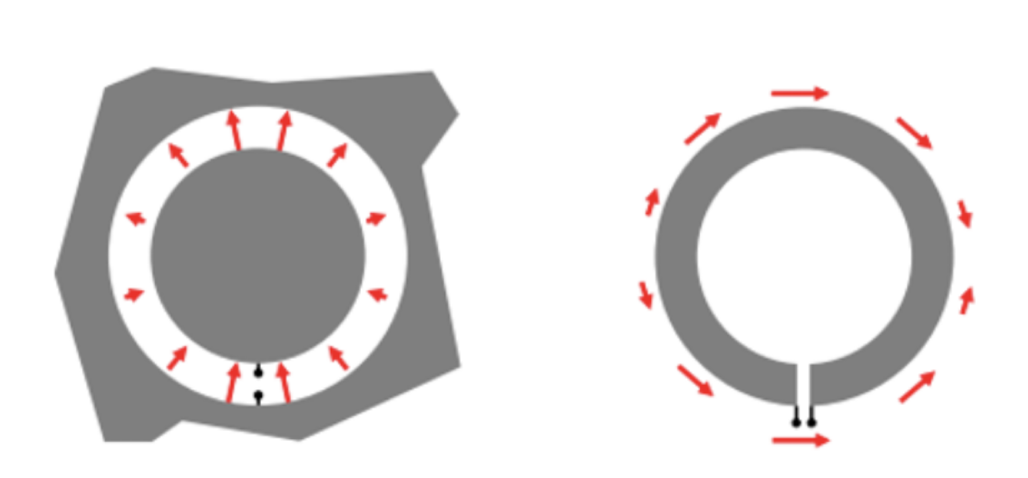
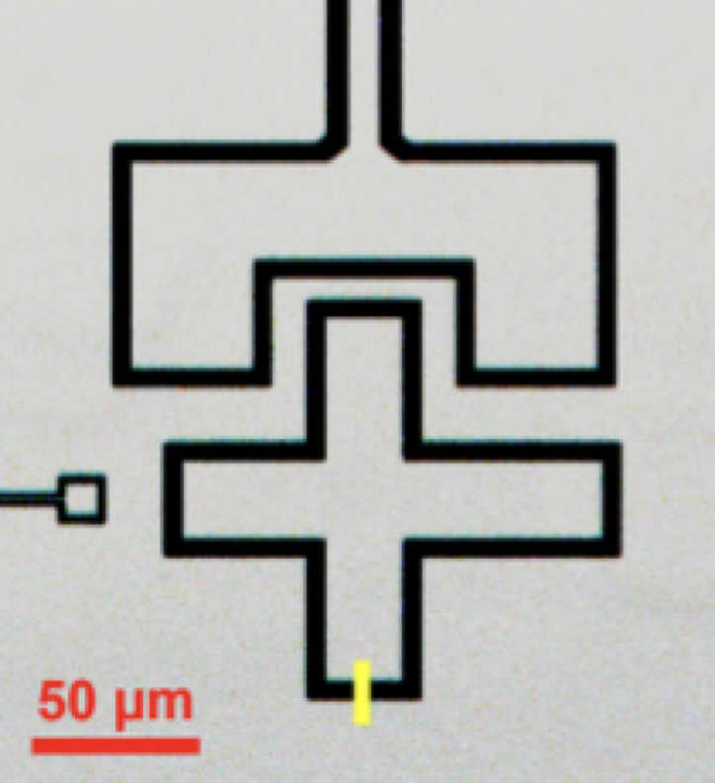
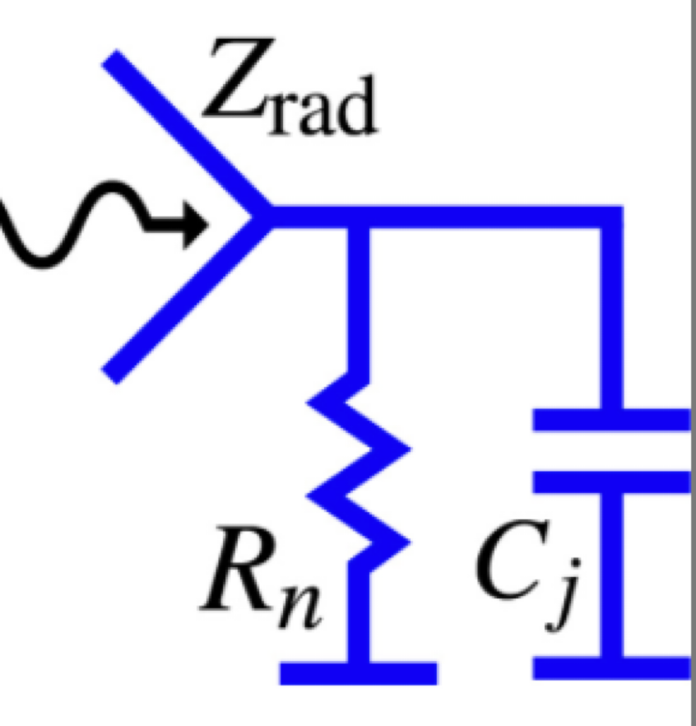
Spurious Antenna Modes of Superconducting Qubits
Babinet’s Principle
Coupling efficiency:
Rafferty et al., arXiv:2103.06803
Houzet et al., Phys. Rev. Lett. 2019
Notes:
This preprint from last year from our collaborators in the McDermott group described the realization that typical qubit structures host high-f antenna modes, hundreds of GHz
--Typical transmon structure has C shunt from large SC island embedded in opening in ground plane
From Babinet’s Principle, such a structure driven by a voltage is the aperture dual of a wire-loop antenna that radiates or absorbs with currents driven around the loop
Wavelength set by the perimeter around this loop, corresponding then to frequencies in the 100s of GHz
For typical qubit parameters, this configuration turns out to be a rather efficient match for coupling high-frequency radiation (mm-wave, above SC gap) to the junction, thus driving high-f currents through junction and generating QPs locally
Z_{rad} is radiation impedance of antenna structure → numerically calculate based on physical qubit structure
--CST microwave
(Optimal power transfer from antenna to junction when Z_{rad} = Z_j*)

Slide 12
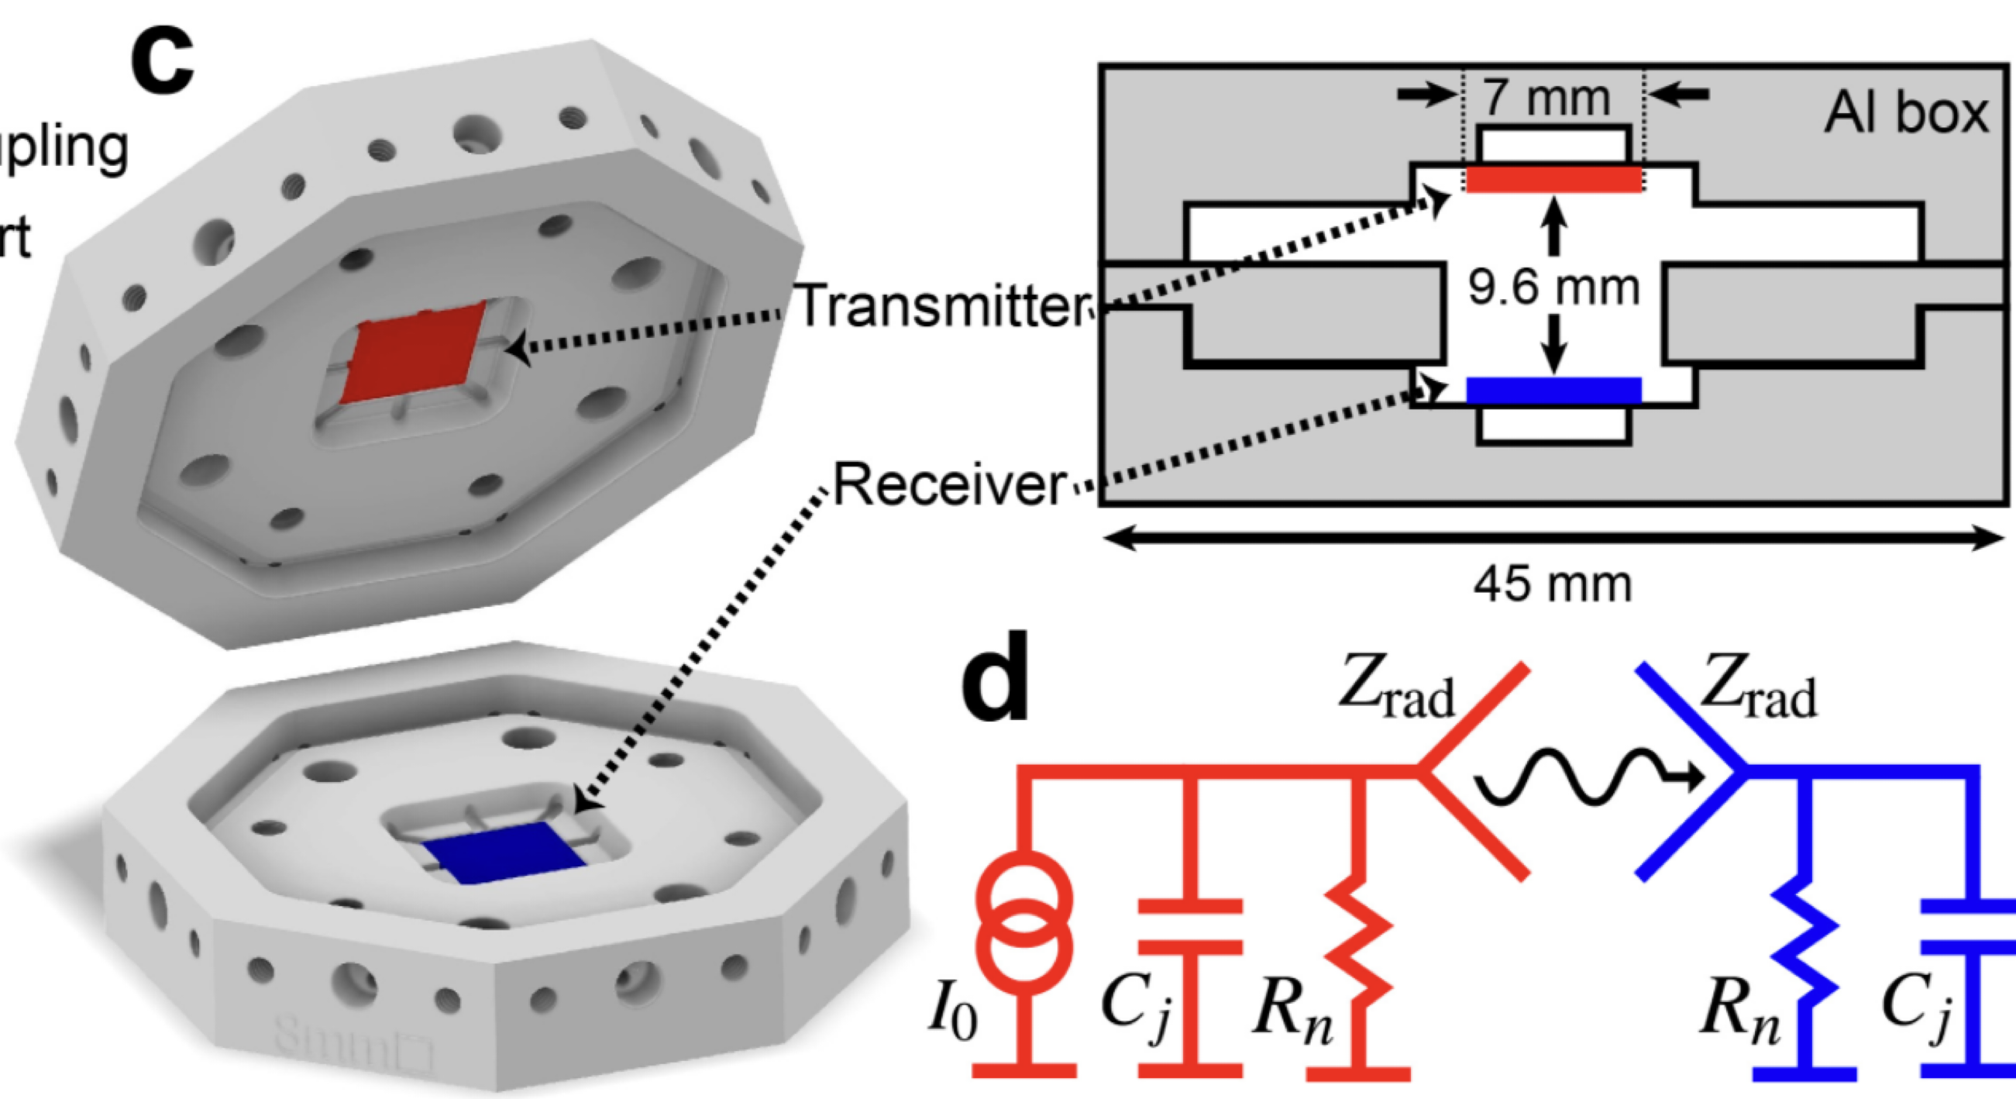
Measuring Photon-mediated Quasiparticle Poisoning
Liu et al., Phys. Rev. Lett. 132, 017001 (2024)
Notes:
Recent experiments in Robert McDermott’s lab using devices from my lab, in close collaboration with my research group at Syracuse…
*use Josephson radiation from voltage-biased Josephson junctions on transmitter chip to broadcast narrowband photons into the space between this chip and a qubit chip that acts as the receiver of this EM radiation down below

Slide 13
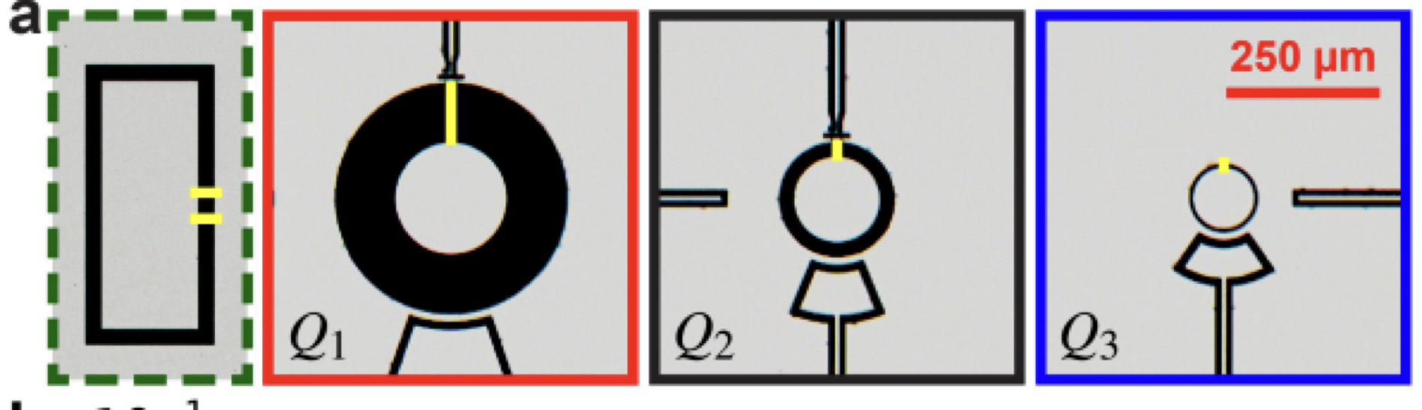
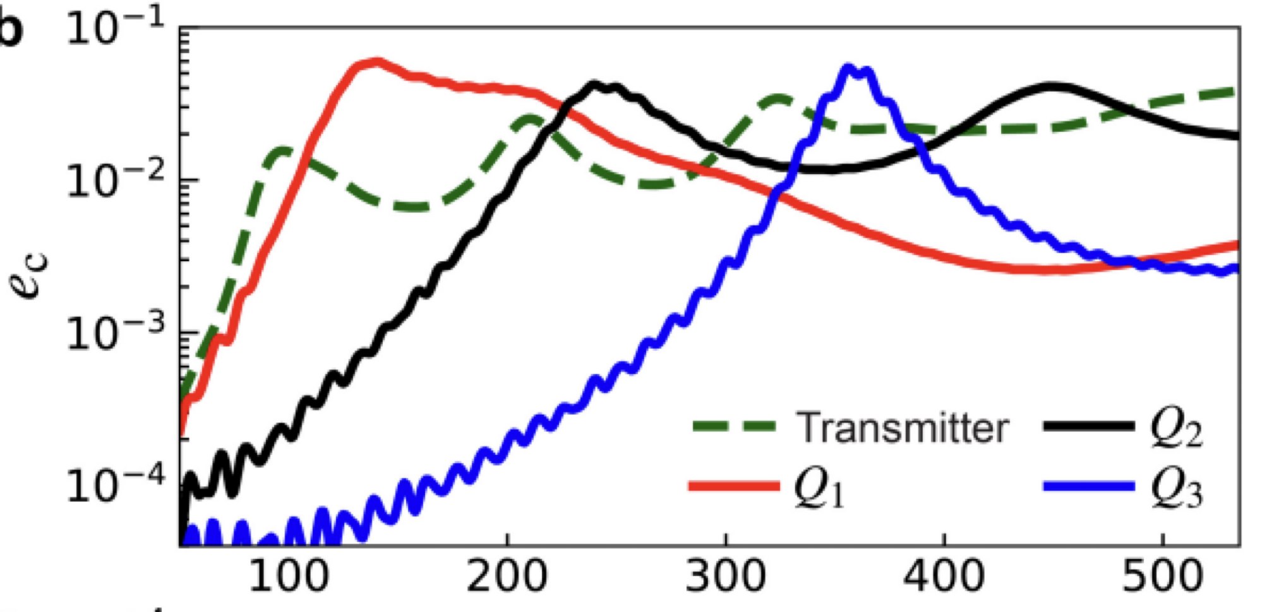
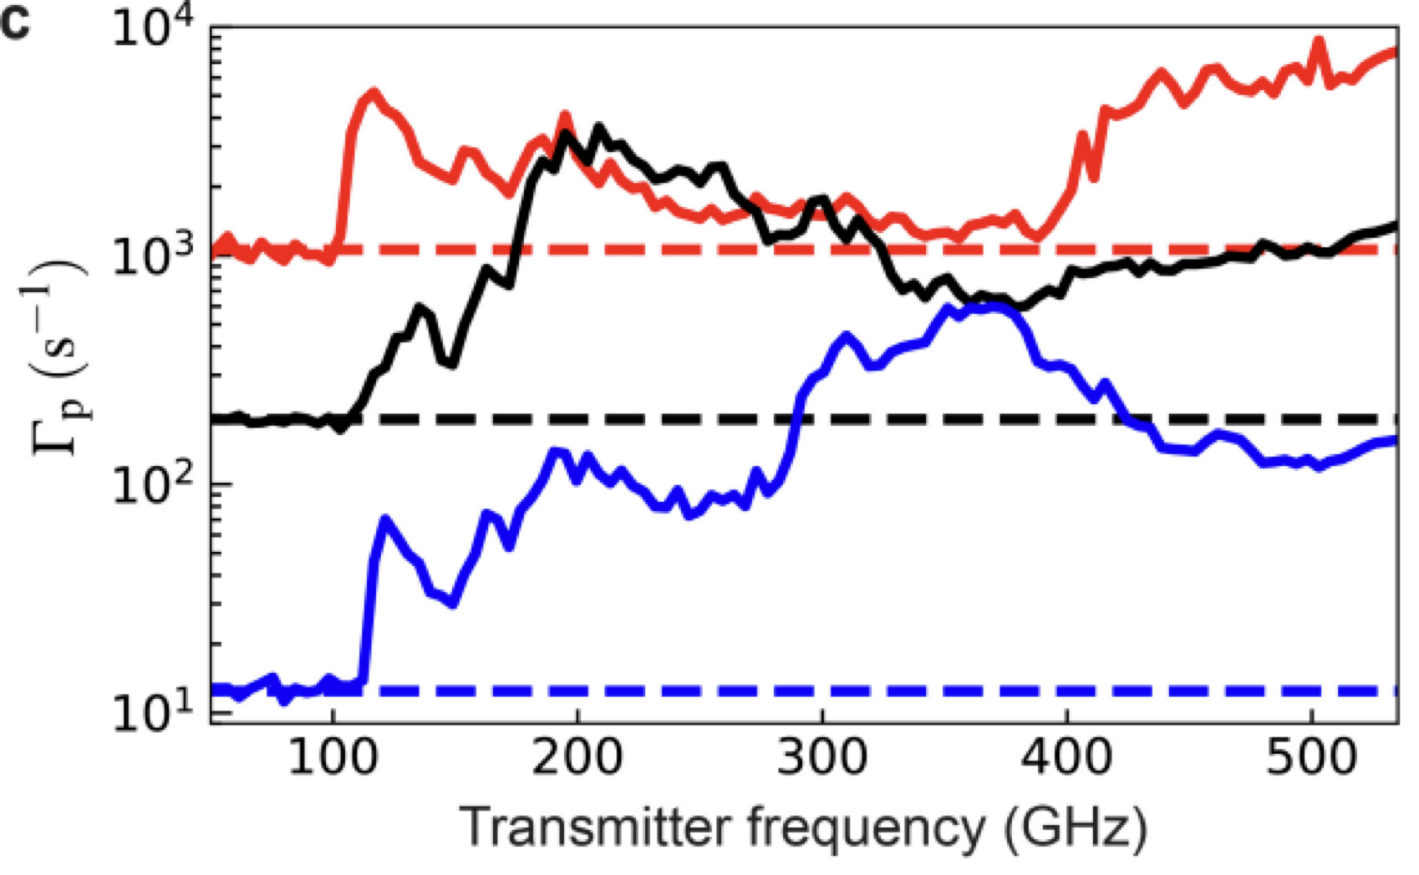
Photon-mediated Quasiparticle Poisoning
Liu et al., Phys. Rev. Lett. 132, 017001 (2024)
frequency (GHz)
Mitigating photon-mediated QP poisoning:
More compact shunt capacitor designs for higher frequency antenna modes
Further improvements to filtering, shielding, thermalization to reduce effective blackbody temperature of photons in qubit environment
Notes:
Similar measurements on a different qubit chip fabricated in Madison with different sizes of qubit islands and apertures, so different antenna resonances
Smaller qubit shifts antenna resonance to higher frequencies – this is roughly captured in the experimental measured QP parity switching rates as a function of the Josephson radiation frequency from the photon-poisoning source junction
But, also notice that the baseline parity switching rate increases as the antenna frequency shifts to lower frequencies for the larger qubit designs
For these low photon injection frequencies, the parity switching will be dominated by background mm-wave photons, likely from hotter elements in the qubit environment or measurement chain that aren’t sufficiently filtered or shielded from the qubit. This suggests a dual strategy for mitigating this QP poisoning mechanism in qubits…
Mitigating photon-mediated QP poisoning:
*More compact shunt capacitor designs for higher frequency antenna modes
*Further improvements to filtering, shielding, thermalization to reduce effective blackbody temperature of photons in qubit environment
(blackbody T ~ 400-500 mK)
(at high bias, incoherent emission of pair-breaking photons from scattering and recomibation of QPs dominates over coherent Josephson radiation)

Slide 14
Correlated QP poisoning from phonon-only events
Slow decrease in QP poisoning rates & low-energy excess events observed in TES detectors and mesoscopic SC devices
Mannila et al., Nature Phys 18, 145 (2022)
Anthony-Petersen et al., Nature Comm 15, 6444 (2024)
Notes:
Prior recent work on QP poisoning rates that exhibit a slow decay in time after the start of the device cooldown
—from Pekola group
—TES from dark matter detection group, LEE = dominant background currently in dark matter searches in certain energy range

Slide 15
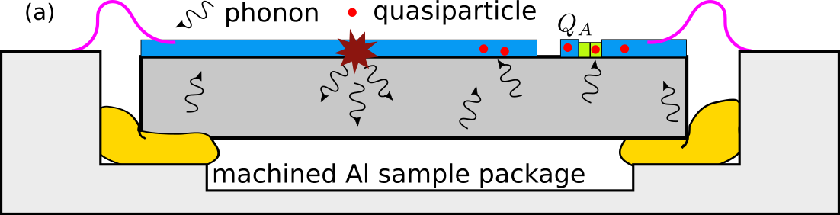
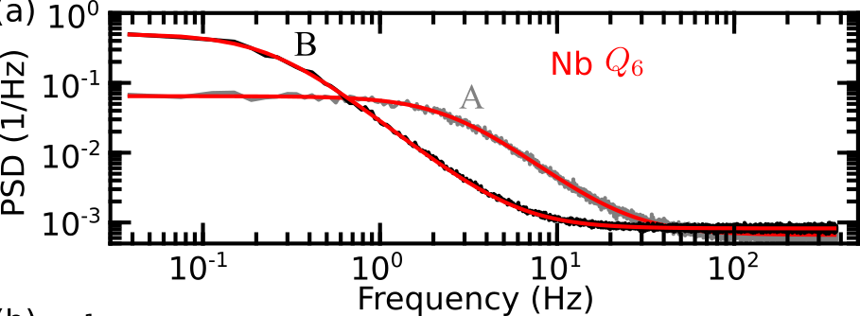
Correlated QP poisoning from phonon-only events
Yelton et al., Phys. Rev. Lett. 135, 123601 (2025)
Notes:
—QP parity switching rate significantly higher at start of cooldown compared to a month later

Slide 16
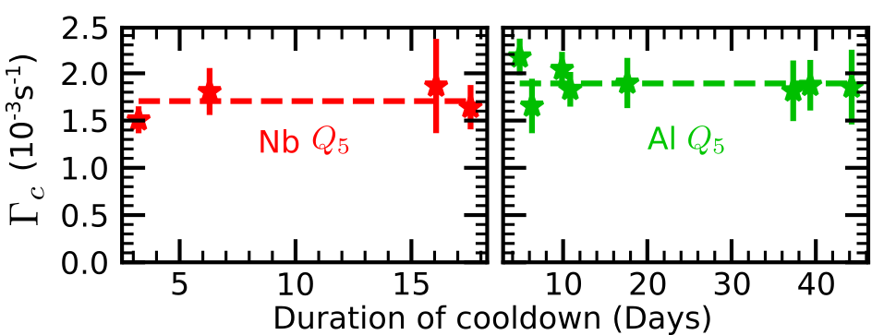
Reduction in charge-parity switching rates over time
Lower poisoning rates for Al vs. Nb compatible with phonon-mediated mechanism
*Offset-charge jump rate constant over course of cooldown

Slide 17
Reduction in charge-parity switching rates over time
Lower poisoning rates with mitigation of pair-breaking phonons, but all configurations exhibit decreasing poisoning rates with time after start of cooldown

Slide 18
Reduction in correlated charge-parity switching rates over time
Yelton et al., Phys. Rev. Lett. 135, 123601 (2025)
Correlations suggest phonon- rather than photon-mediated poisoning
*Expected rate of 4-fold correlated poisoning due to γ impacts with no phonon mitigation = 2 x 10⁻³ s⁻¹
Notes:
Estimate rate of ionizing impacts on chip ~3 x 10^-2 s^-1
Q1, Q2, Q3, Q6

Slide 19
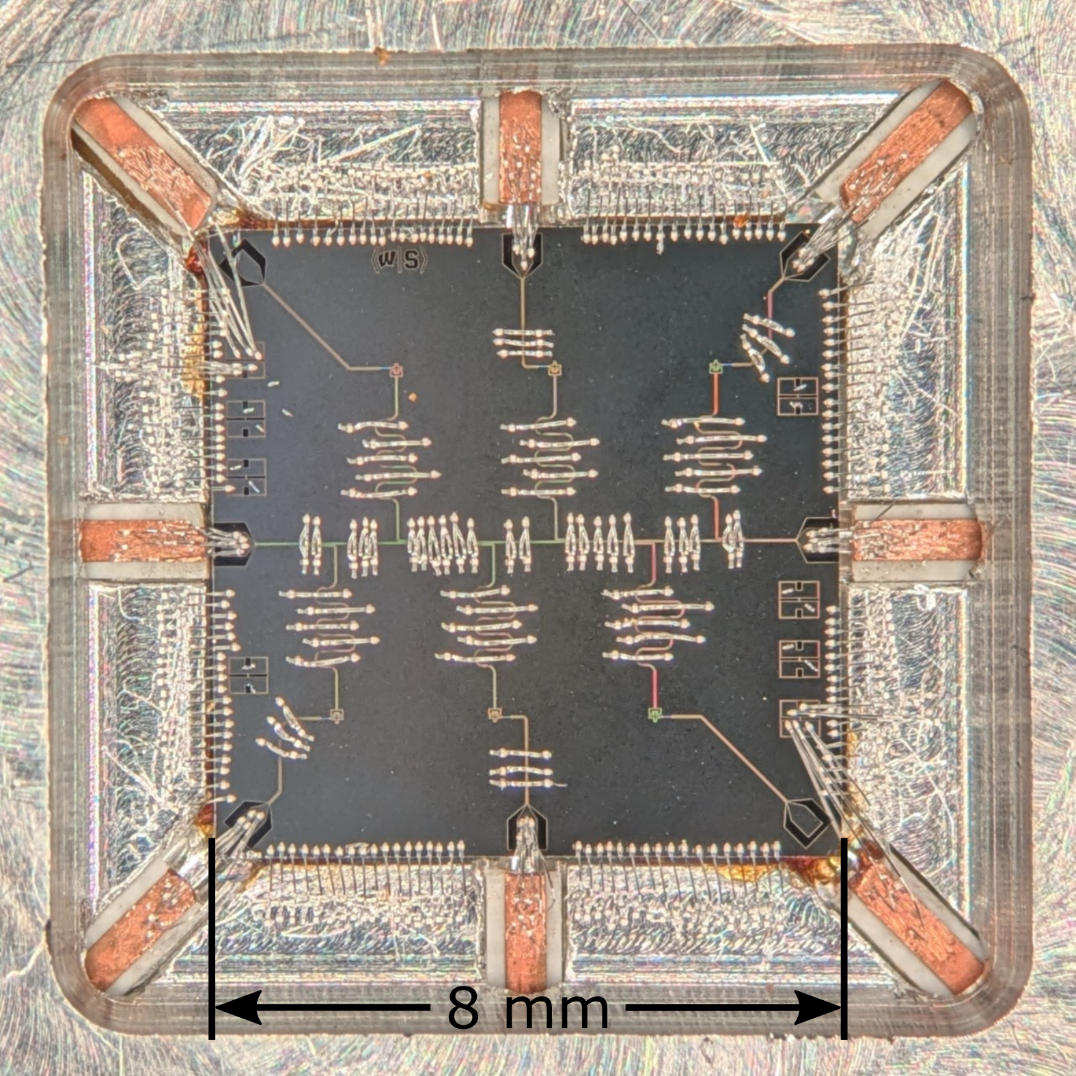
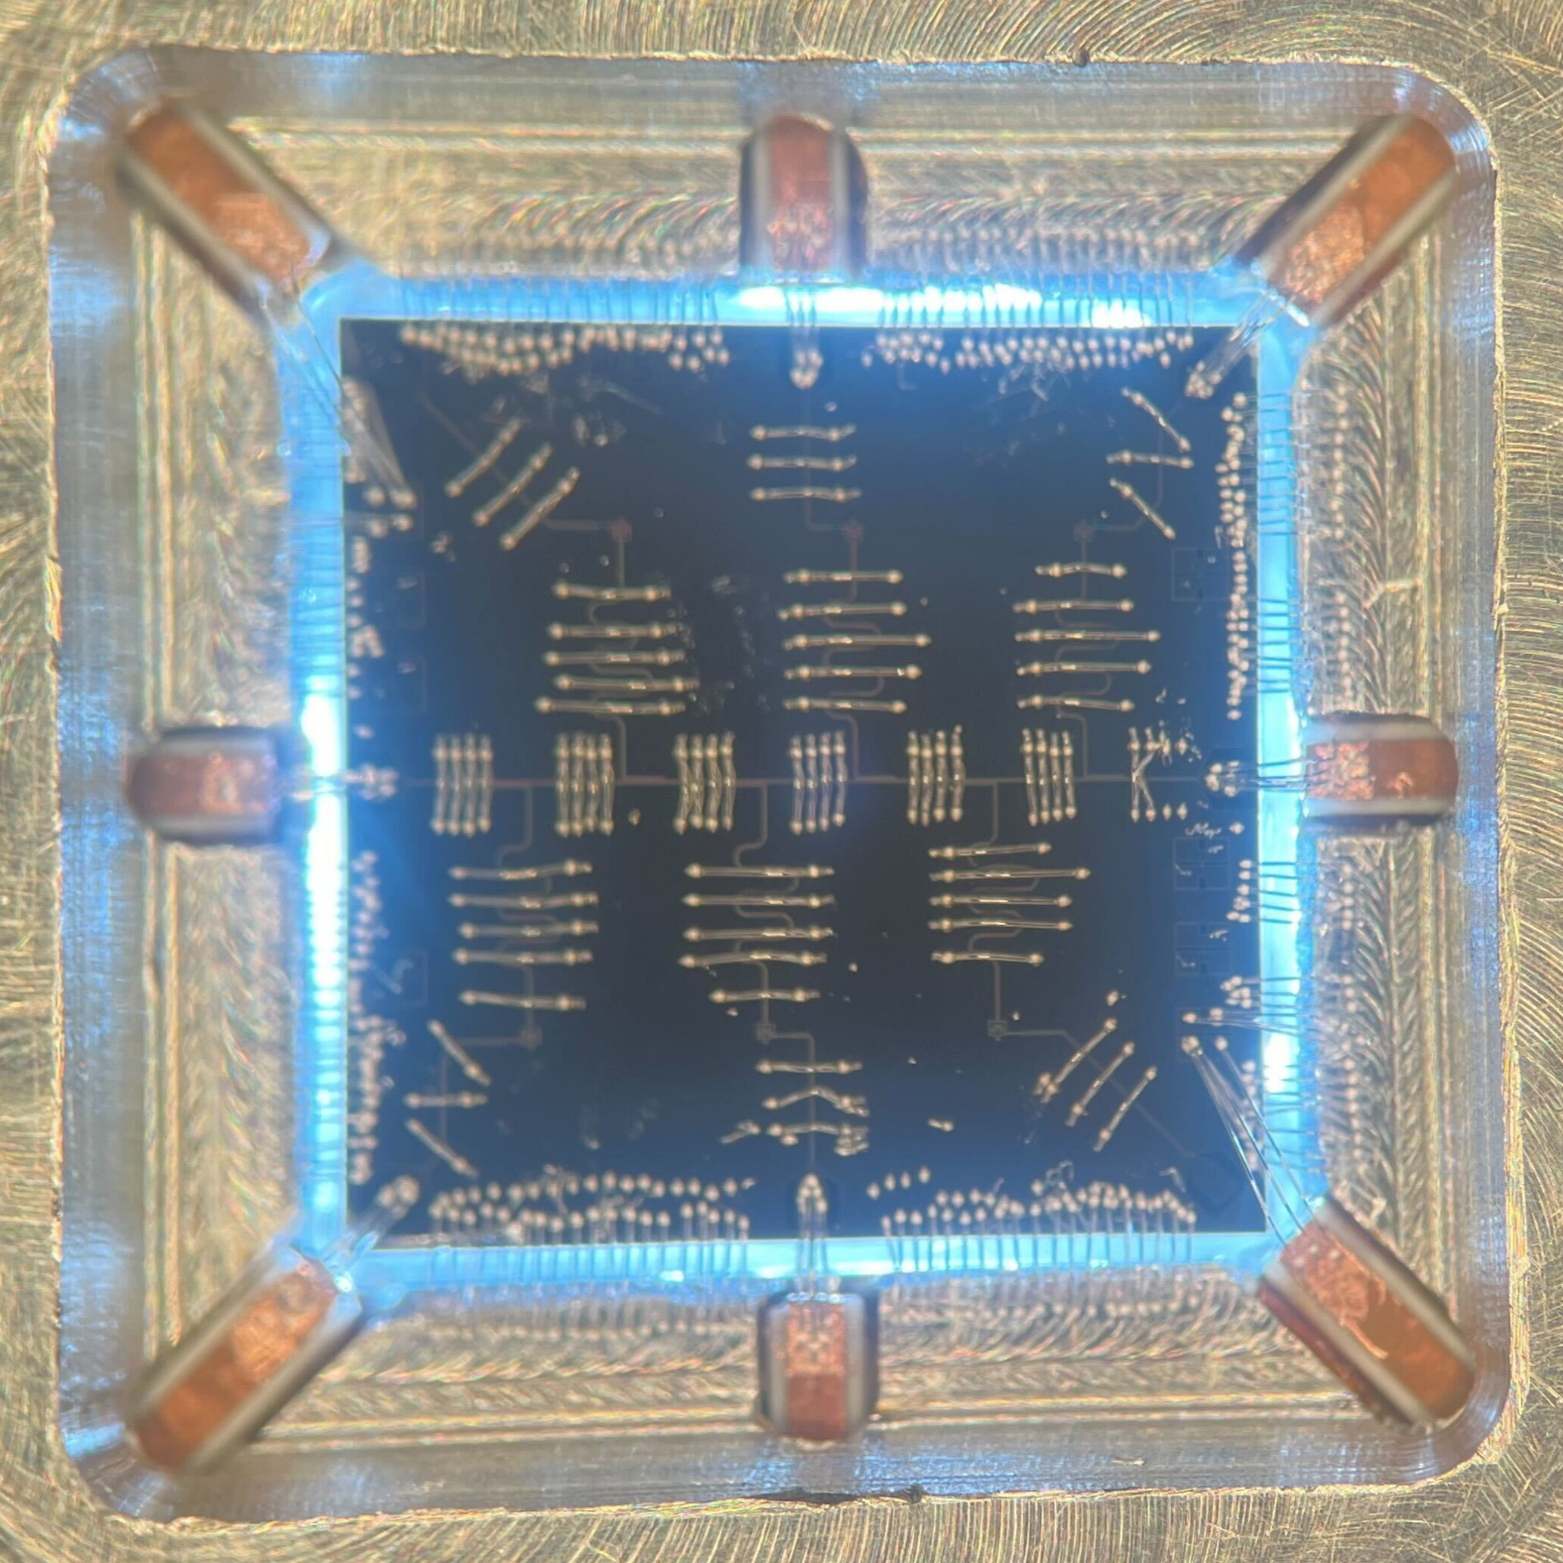
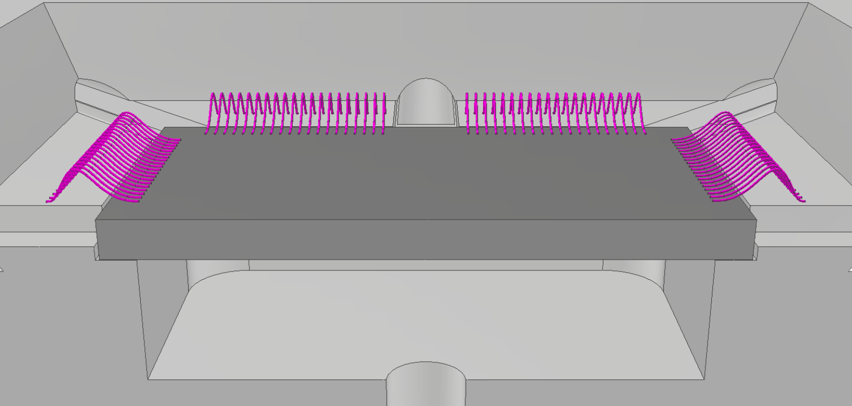
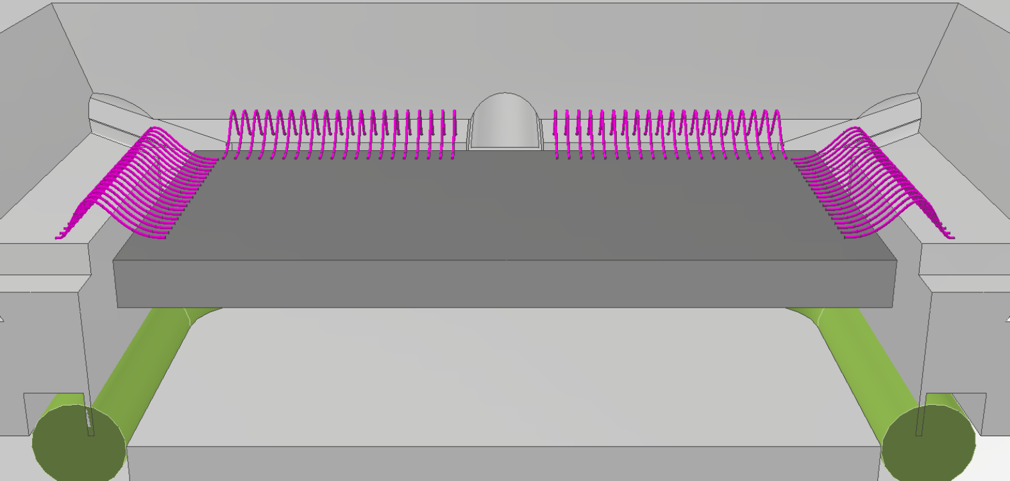
Sample package with wirebond-suspension of chip

Slide 20
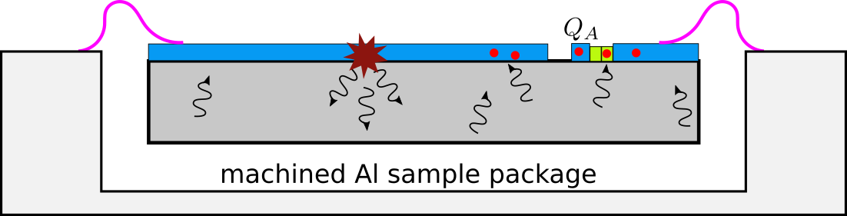
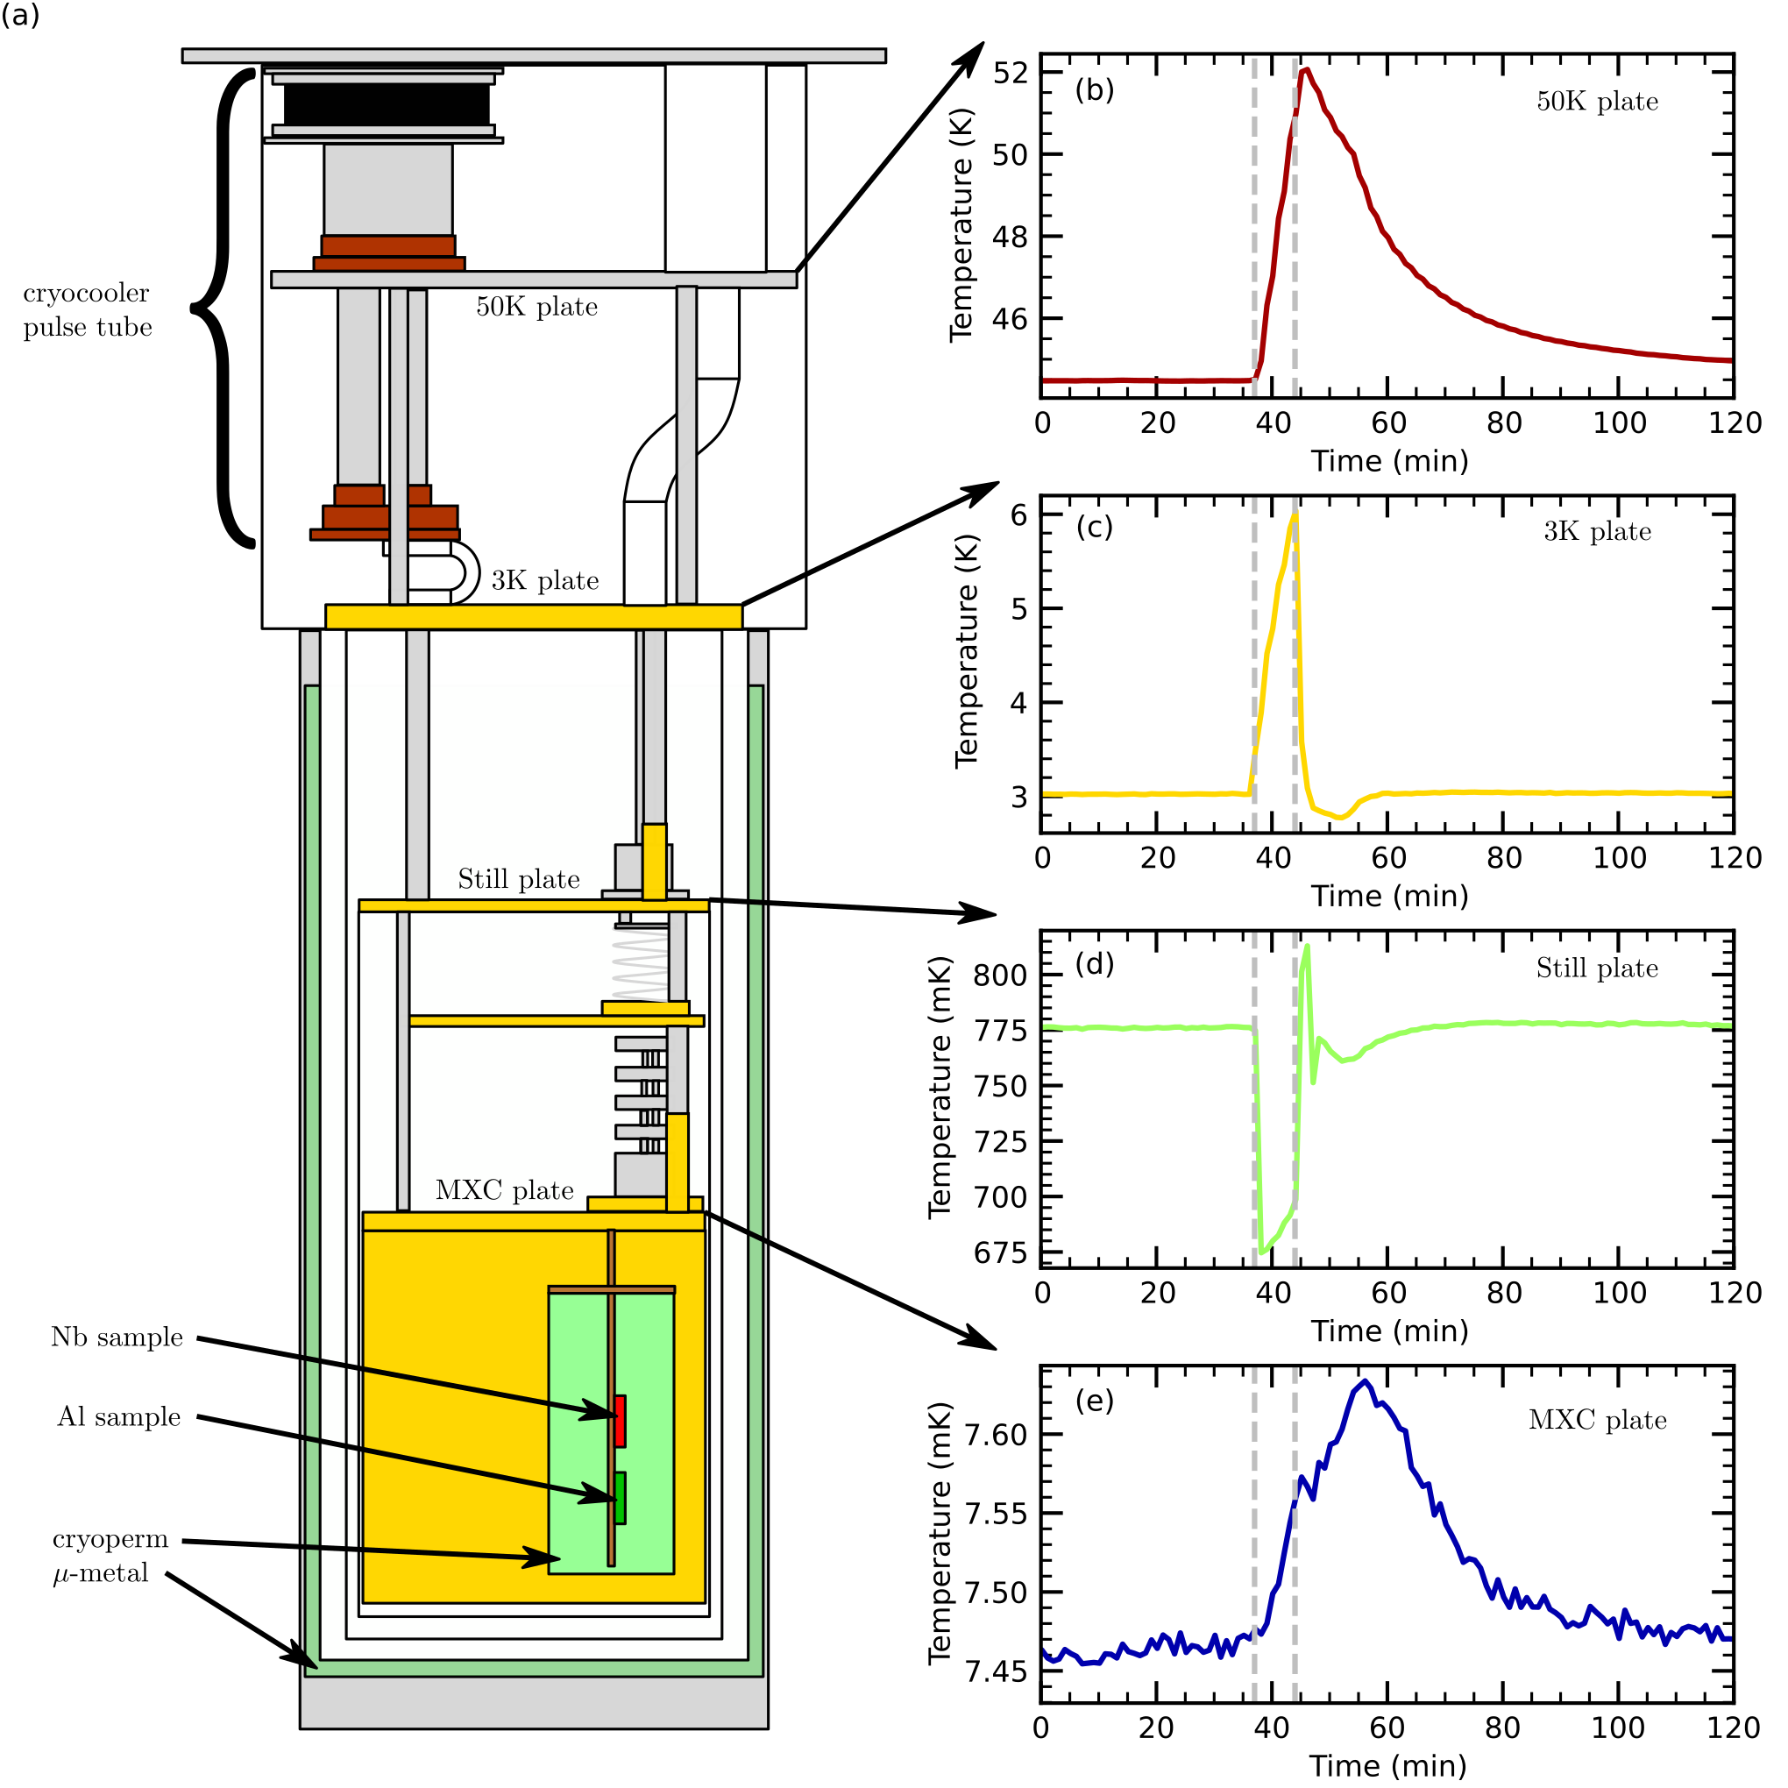
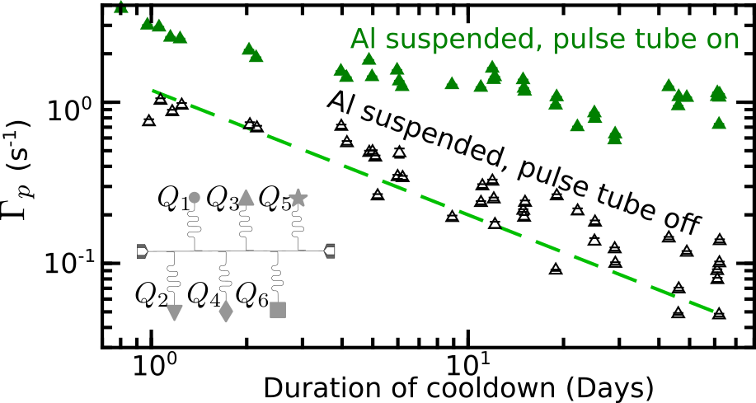
QP charge-parity switching rates with wirebond-suspension of chip
Yelton et al., Phys. Rev. Lett. 135, 123601 (2025)

Slide 21
Potential sources of phonon-only events
Stick-slip relaxation of built-up stresses
Releases burst of pair-breaking phonons
Defects in substrate metal
Defects in JJ metal
Flexing of wirebonds
Bulk defects in substrate
Defects at edge of substrate

Slide 22
Conclusions & Ongoing Work
Compact qubit designs plus extensive IR shielding and filtering can suppress photon-mediated QP poisoning
Phonon-only events produce QP poisoning without accompanying charge signal
Releases of built-up mechanical stresses in device produce bursts of pair-breaking phonons
Rate of phonon bursts decreases gradually with time after start of cooldown
Larson et al., PRX Quantum 6, 030339 (2025)
Iaia, Ku et al., Nature Comm. 13, 6425 (2022)
Yelton et al., Phys. Rev. B 110, 024519 (2024)
Yelton et al., Phys. Rev. Lett. 135, 123601 (2025)

Slide 23




Acknowledgments
E. Yelton, C. P. Larson, K. Dodge, V. Iaia, J. Ku, A. Ballard
Syracuse University
K. Okubo, Manabputra, J. Batarekh, A. Huynh, R. McDermott
University of Wisconsin-Madison
G. Catelani
Jülich Research Center
N. Kurinsky
SLAC

