Slide 1

Introductory Overview
Daniel Baxter (on behalf of the RISQ 2026 Organizers)
Radiation Impact on Superconducting Qubits
16 June 2026

Slide 2
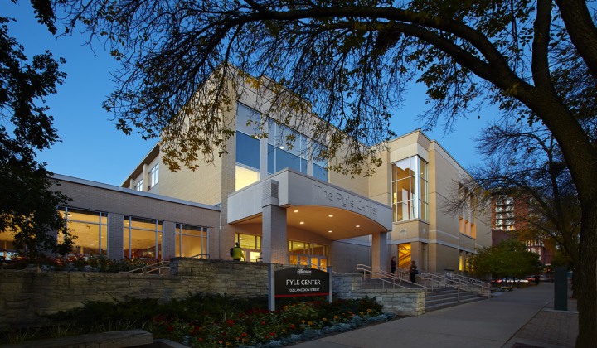


Outline
Some historical context
Review of RISQ 2024
Snapshot “where are we now”

Slide 3
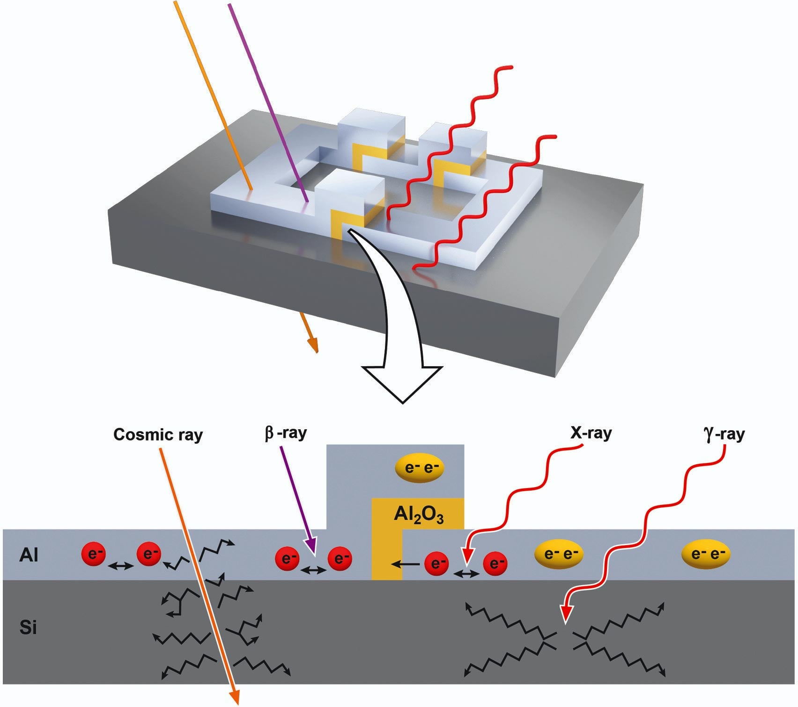
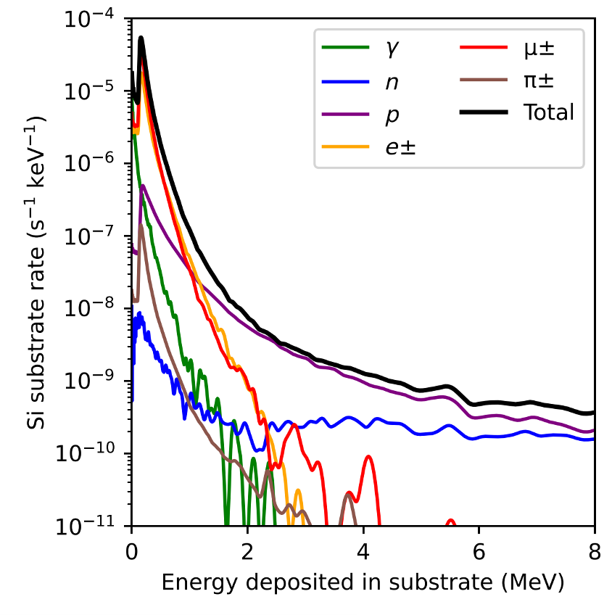
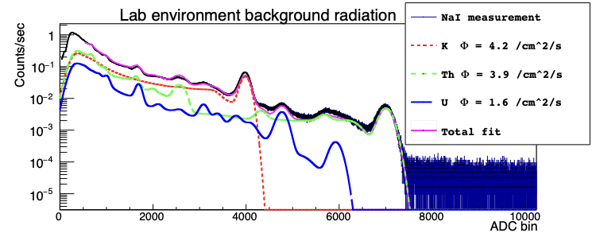
Radiation Impact on Superconducting Qubits
We often simplify the problem of radiation impact on devices, but the reality is far more complex.
  - How each type of radiation impacts quantum chips is an area of active study
Image credit: SciTechDaily
Typical, measured (NaI) laboratory radiation environment: gammas + cosmics ≲ 8000 ch., cosmics ≳ 8000 ch.
Modeled spectrum of E-deposits in 5x5x0.5 mm³ silicon substrate
images from Brent VanDevender

Slide 4
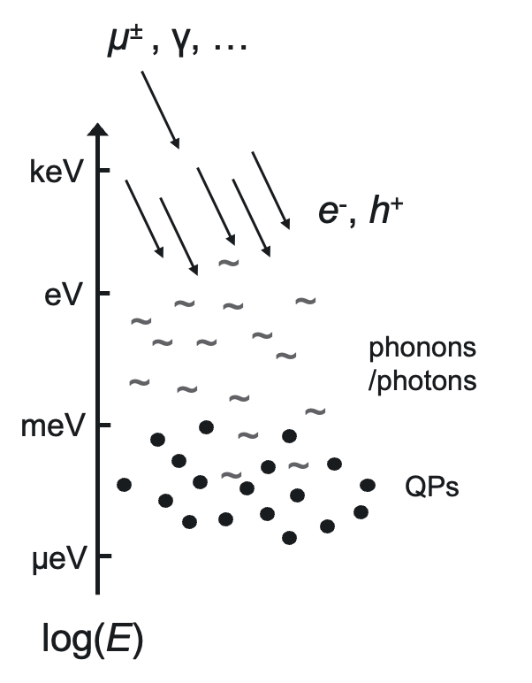
Radiation Impact on Superconducting Qubits
cosmic rays (mostly μ±, but also, e±, γ, p, n… at surface)
β, x-ray, and α from intrinsic radioactivity
μ±
Image credit: SciTechDaily

Slide 5
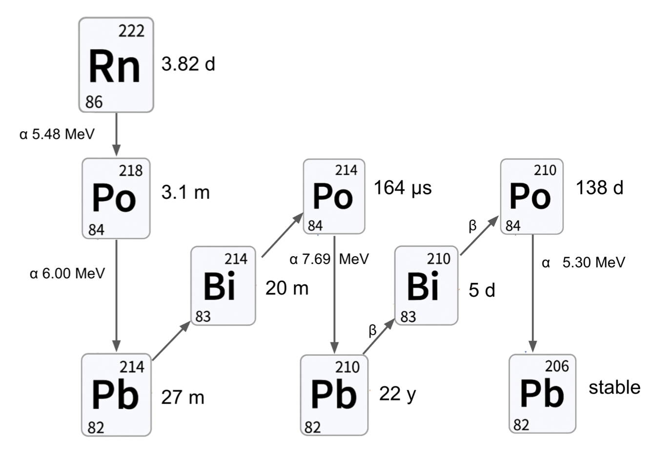
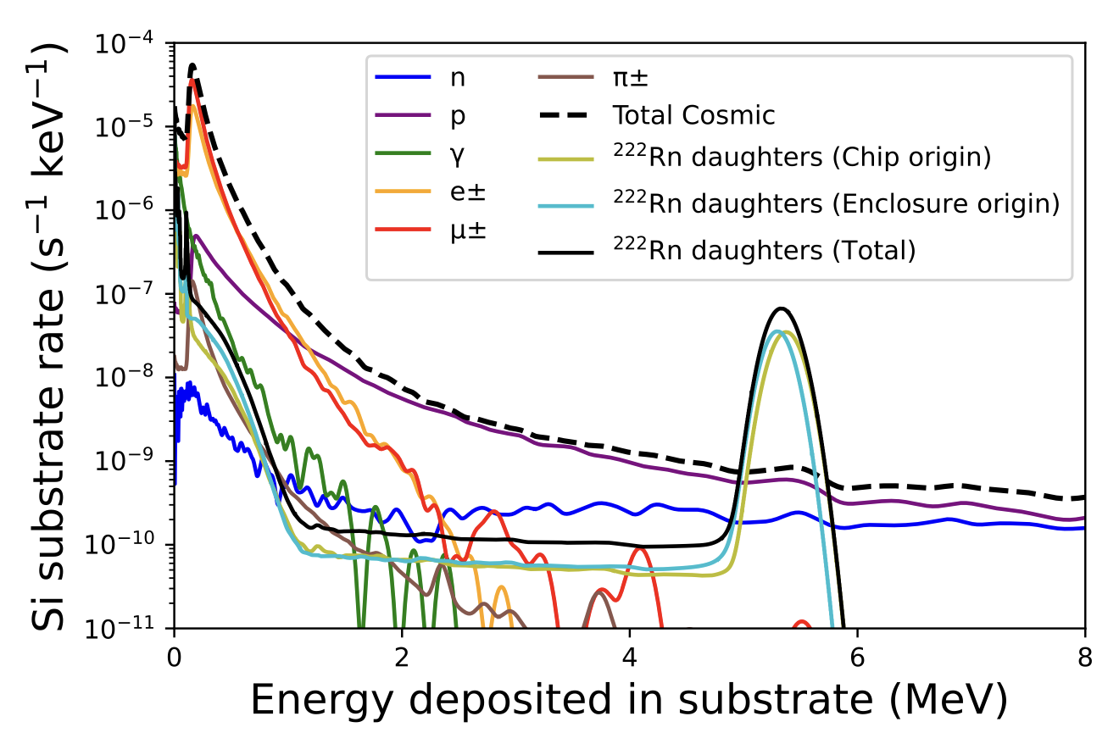
Radiation Impact on Superconducting Qubits
Poudel et al, preprint (2026) [arXiv:2606.00473]
Alpha decays!
See talks from Isaac Arnquist and Sam Watkins (PNNL)

Slide 6
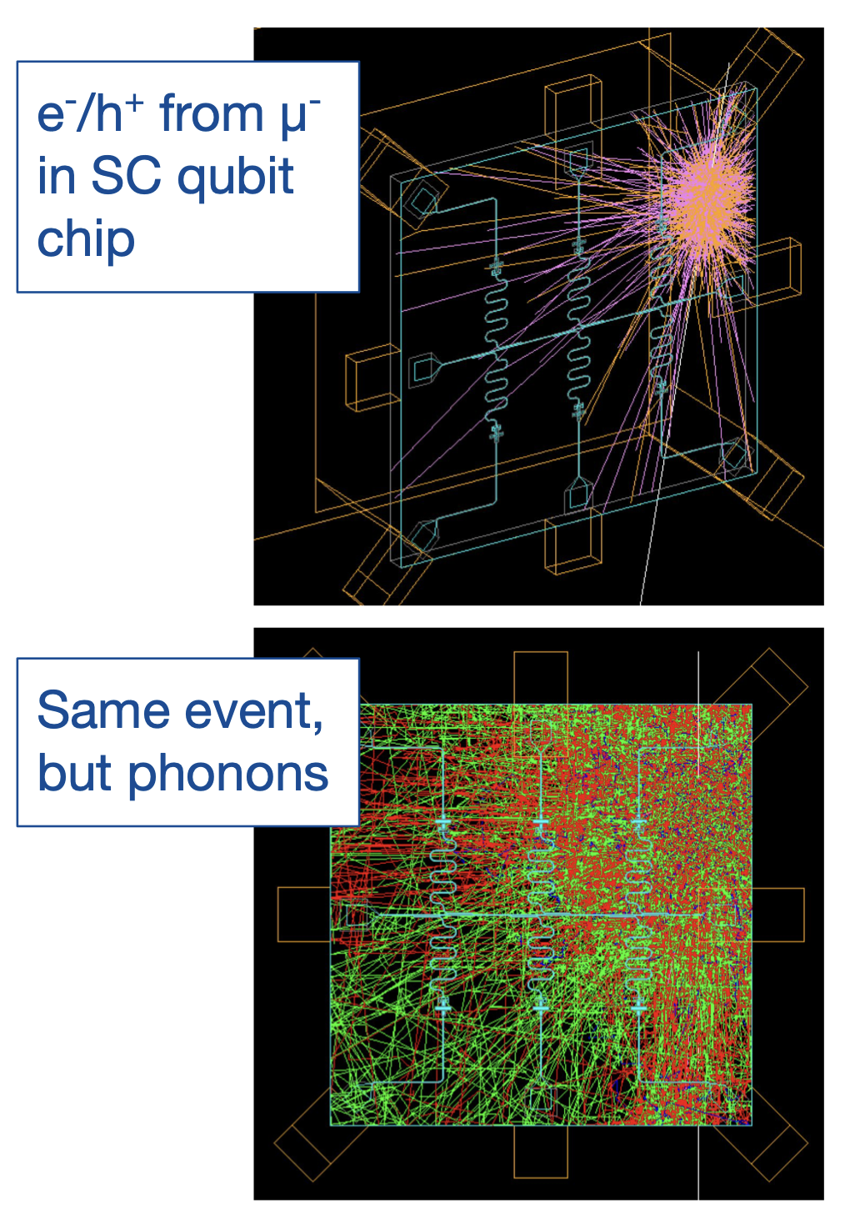
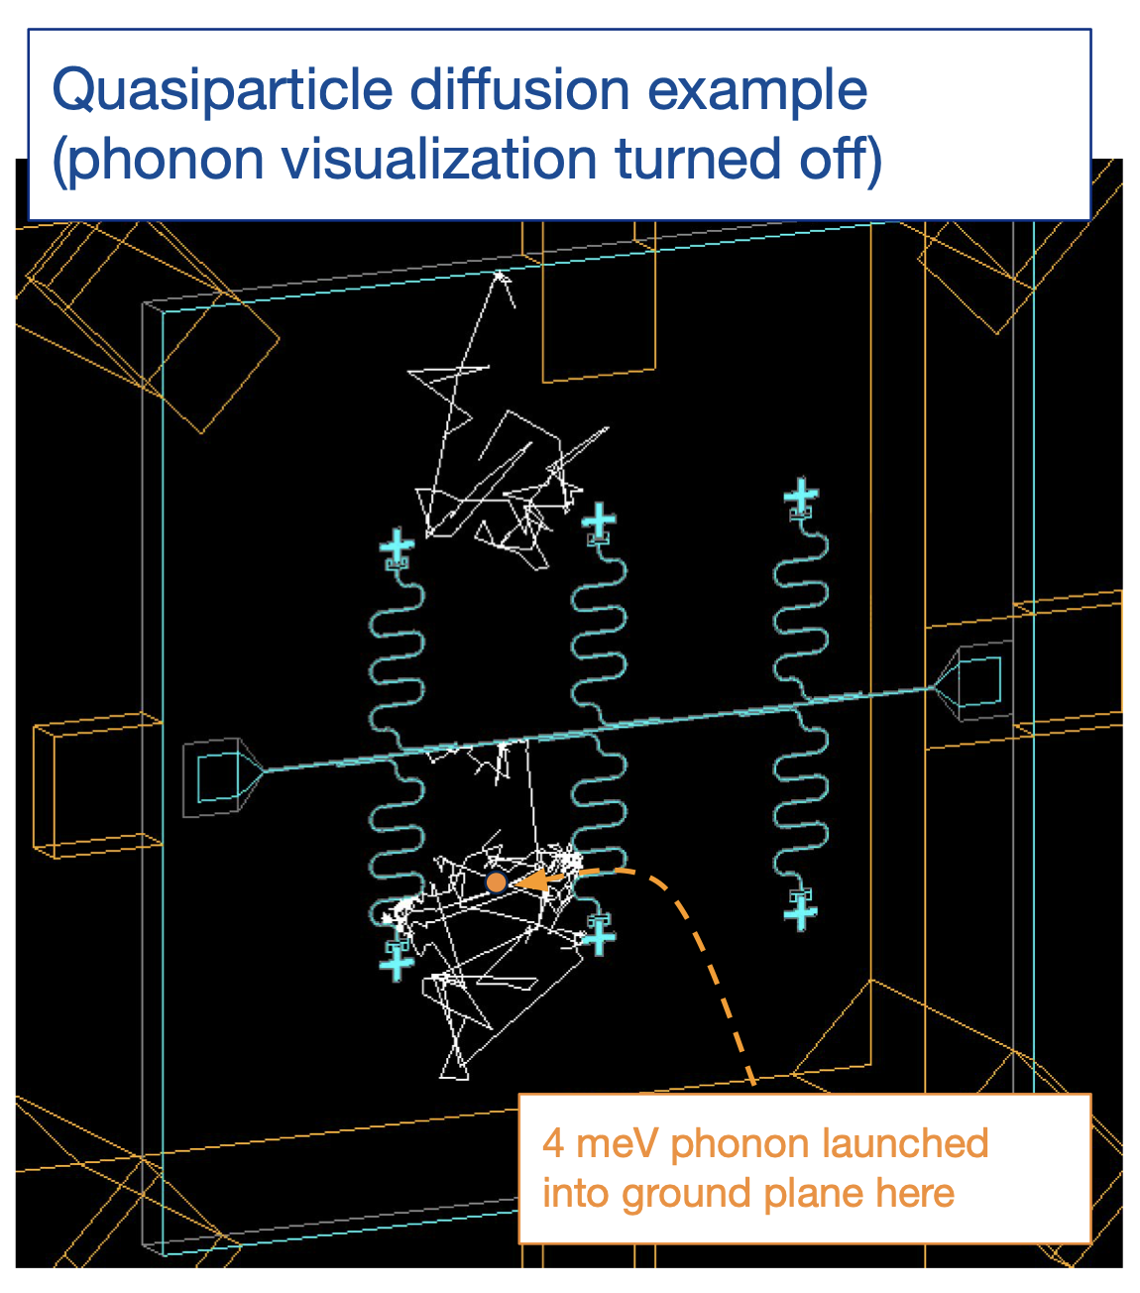
Radiation Impact on Superconducting Qubits
The Geant4 Condensed Matter Physics (G4CMP) Package is a powerful Monte Carlo simulation tool for understanding the dynamics of energy depositions
images from Ryan Linehan

Slide 7
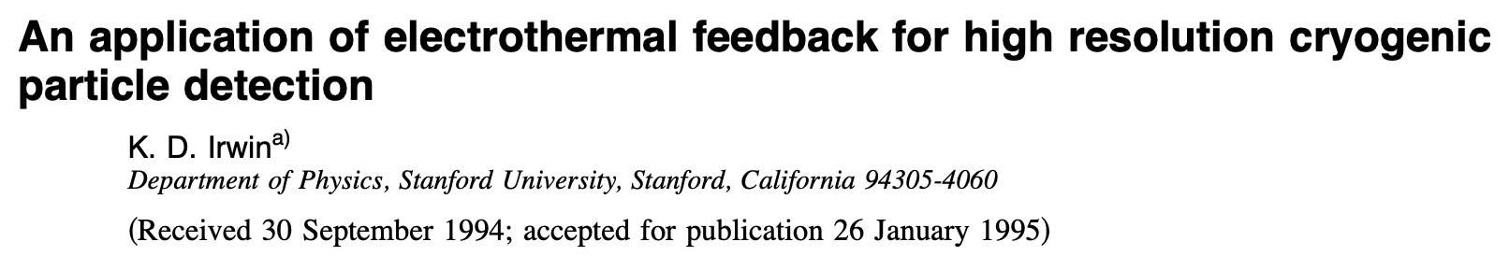
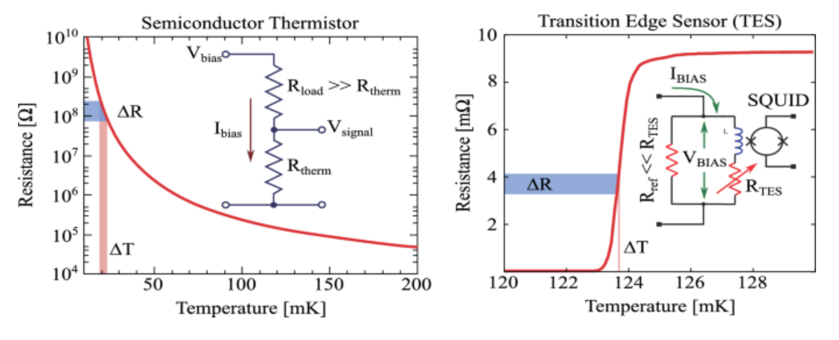
Radiation Impact on Superconducting Qubits

Slide 8
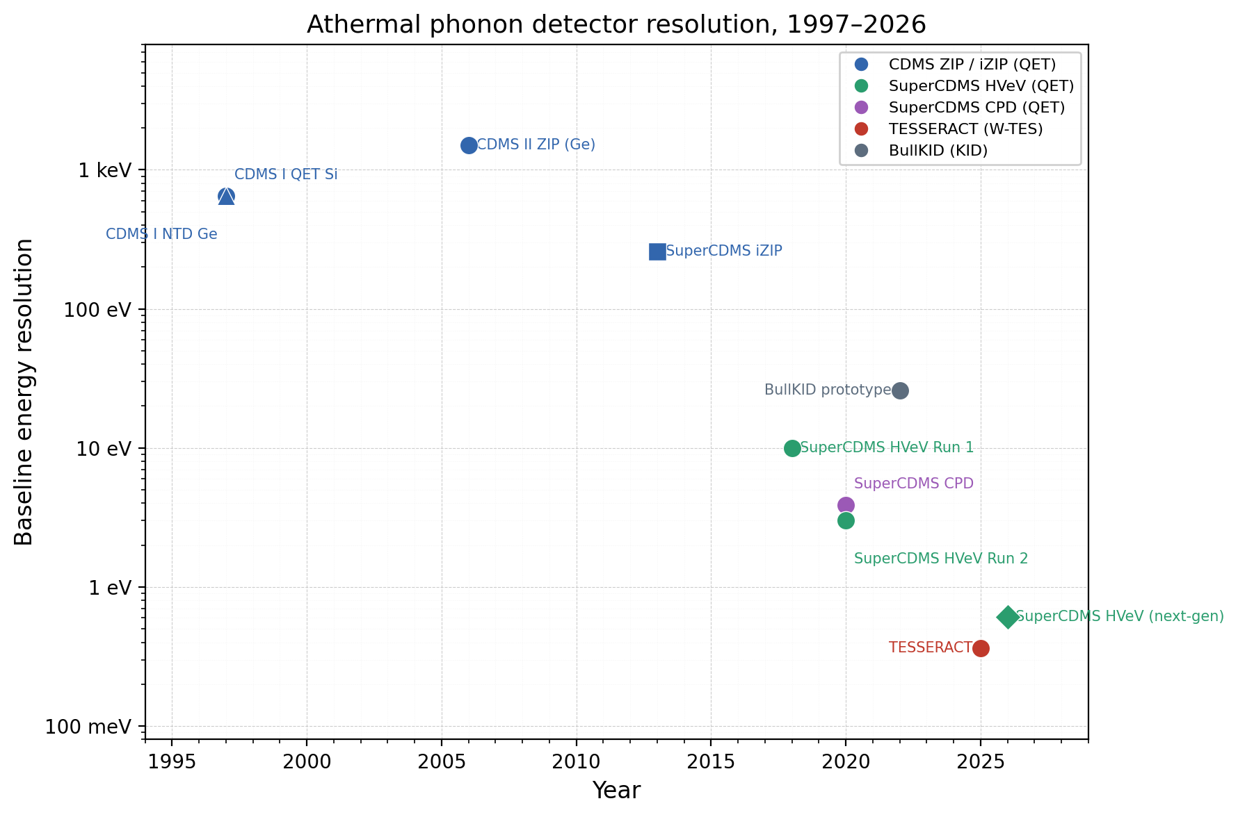
Radiation Impact on Superconducting Qubits
QET = Quasiparticle-trapping-assisted Electrothermal-feedback Transition-edge sensor
Since the QET was first developed, we’ve enabled resolution improvements by:
improving phonon collection
making smaller sensing volumes
moving to lower sensing volume and smaller superconducting gaps
The major improvement was a much more complete understanding of QET efficiency and implementing systematic optimization
QET Invented
Improved QET
Smaller Volume
Lower Tc
Credit Claude + Arxiv
slide from Noah Kurinsky

Slide 9
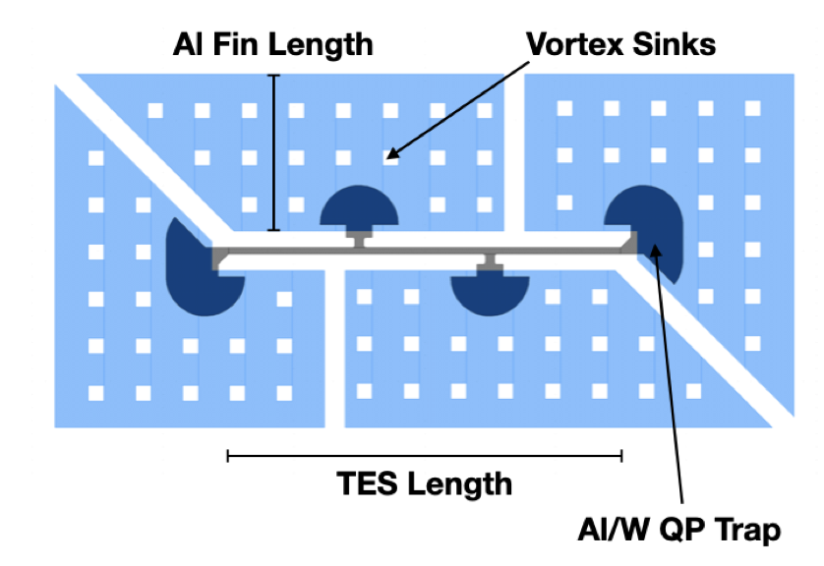
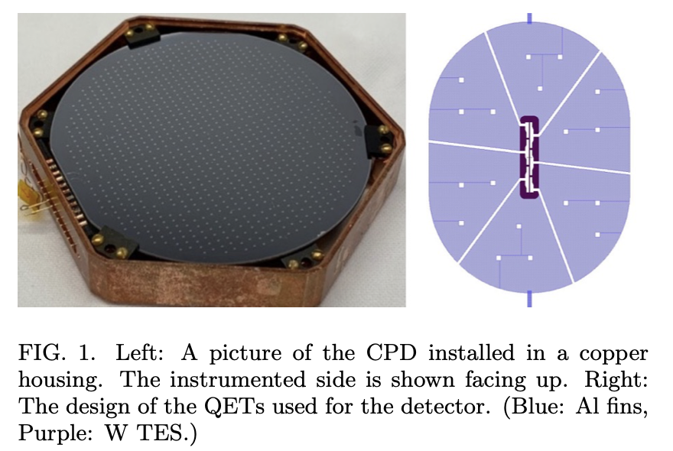
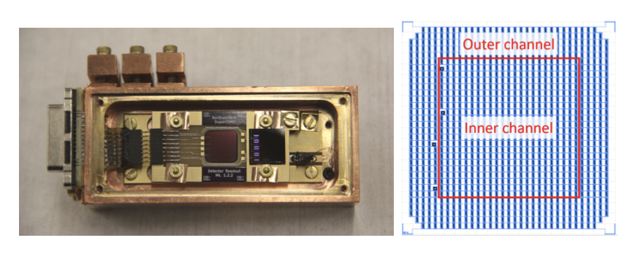
Radiation Impact on Superconducting Qubits
https://arxiv.org/pdf/2009.14302
https://arxiv.org/pdf/2012.12430
We’ve optimized the phonon reflector to the point that its internal quantum efficiency is near 100% - the remaining advances come from improvements in unit cell resolution and loss matching to the substrate.
slide from Noah Kurinsky

Slide 10
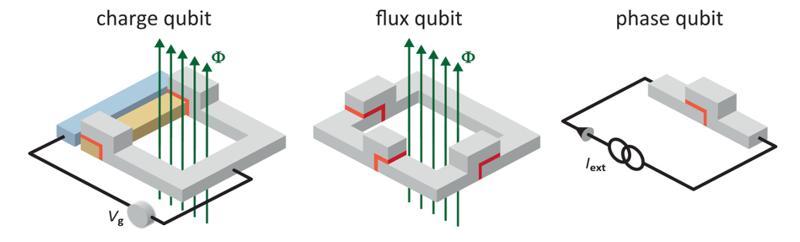
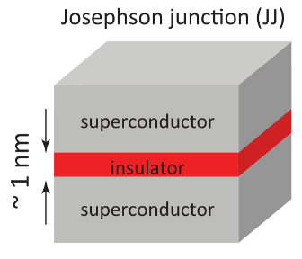
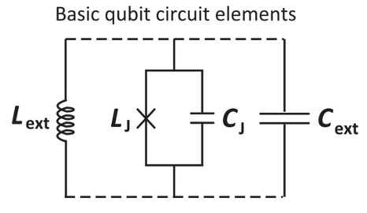
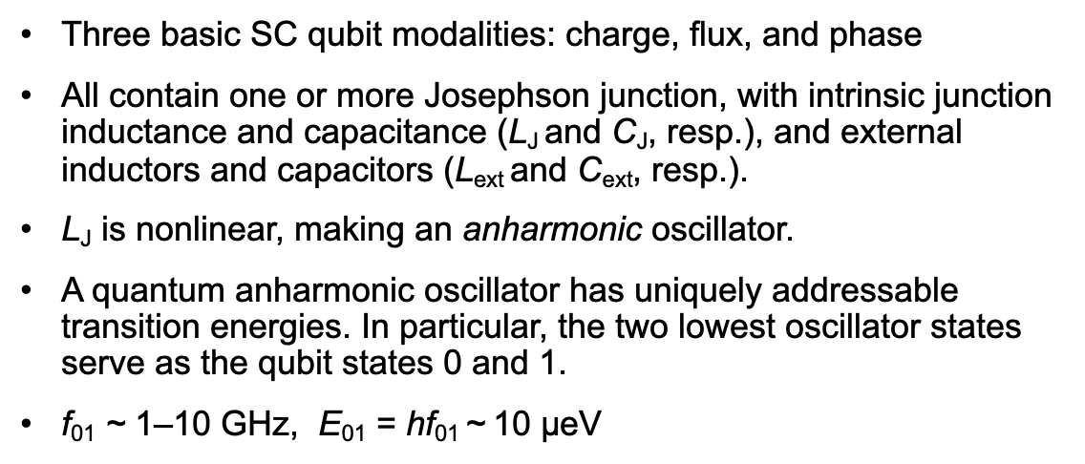
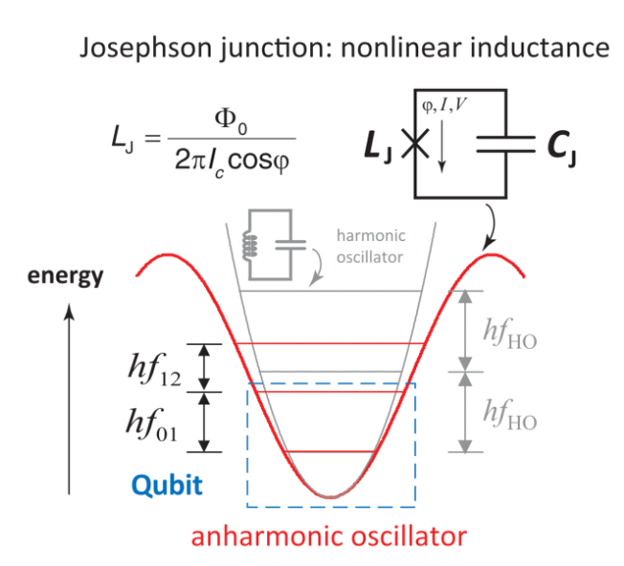
Radiation Impact on Superconducting Qubits
[Oliver and Welander, MRS Bulletin 38, 816—825 (2013)]

Slide 11
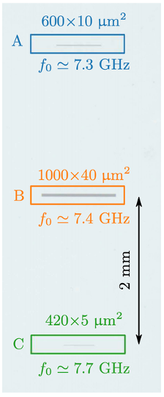
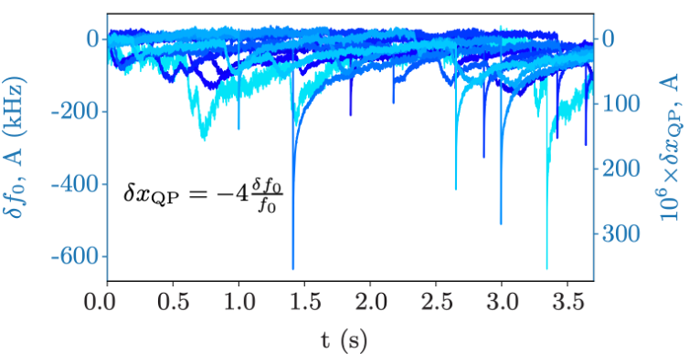
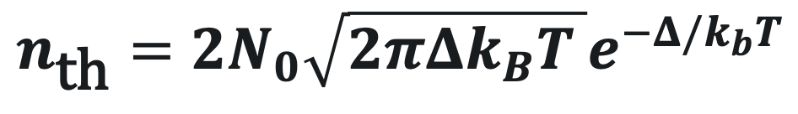
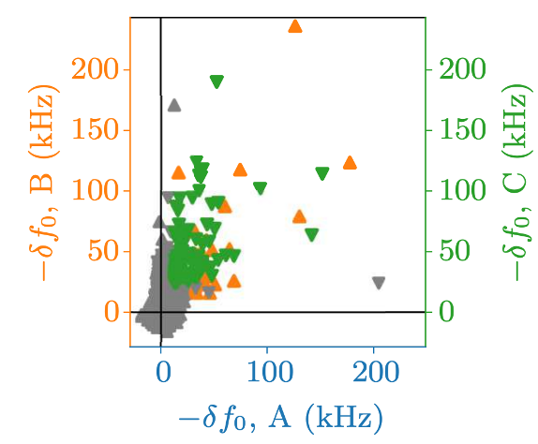
Radiation Impact on Superconducting Qubits
TWO PROBLEMS
QP density vs. thermal expectation (uncorrelated)
QP bursts (correlated)
Add to that radiation-induced, correlated bursts:
Far more quasiparticles than termal expectation n_{th}:
➝ n_{th} = 1.0×10⁻⁴⁰ μm⁻³ in aluminum at 20 mK.
Observations of actual QP densities range from 10⁻²–10² μm⁻³
Thermal density ~10 μm⁻³ occurs for T = 165 mK
[Cardani et al., Nature Comm. 12 2733 (2021).]

Slide 12
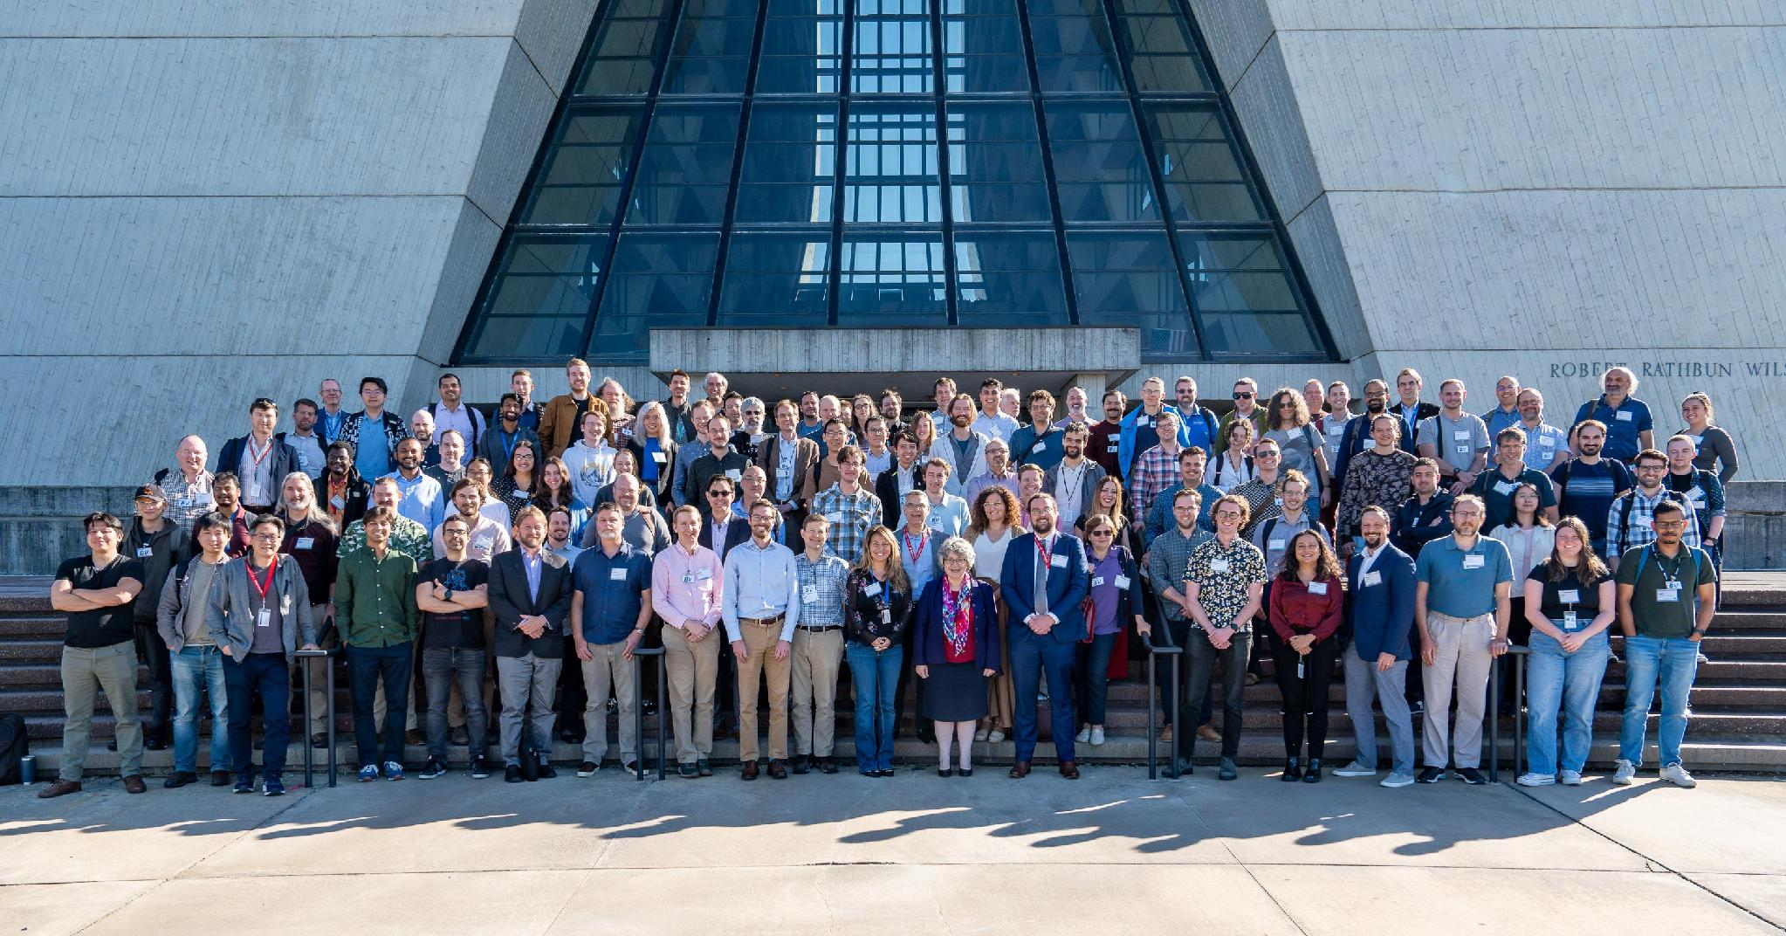



Radiation Impact on Superconducting Qubits (RISQ)
Scientific Organizing Committee:
Daniel Baxter, FNAL/NU (SOC chair, QSC)
Travis Humble, ORNL/UTK (director, QSC)
Farah Fahim, FNAL (QSC)
Enectali Figueroa-Feliciano, NU/FNAL (QSC)
Anna Grassellino, FNAL/NU (director, SQMS)
Laura Cardani, INFN/LNGS (SQMS)
Tanay Roy, FNAL (SQMS)
Andrew Houck, Princeton (director, C2QA)
Brent VanDevender, PNNL/UW (C2QA)
Jon Cripe, LPS
Jonathan DuBois, LPS
Andrew Kubik, SNOLAB
May 29-31, 2024
Photo credit: Dan Savoboda, Fermilab
https://indico.fnal.gov/event/63132/

Slide 13
Radiation Impact on Superconducting Qubits (RISQ)
Scientific Organizing Committee:
Daniel Baxter, FNAL/NU (SOC chair, QSC)
Travis Humble, ORNL/UTK (director, QSC)
Farah Fahim, FNAL (QSC)
Enectali Figueroa-Feliciano, NU/FNAL (QSC)
Anna Grassellino, FNAL/NU (director, SQMS)
Laura Cardani, INFN/LNGS (SQMS)
Tanay Roy, FNAL (SQMS)
Andrew Houck, Princeton (director, C2QA)
Brent VanDevender, PNNL/UW (C2QA)
Jon Cripe, LPS
Jonathan DuBois, LPS
Andrew Kubik, SNOLAB
Conference Photo today at 5:30pm (start of poster session!)
May 29-31, 2024
Photo credit: Dan Savoboda, Fermilab
https://indico.fnal.gov/event/63132/

Slide 14
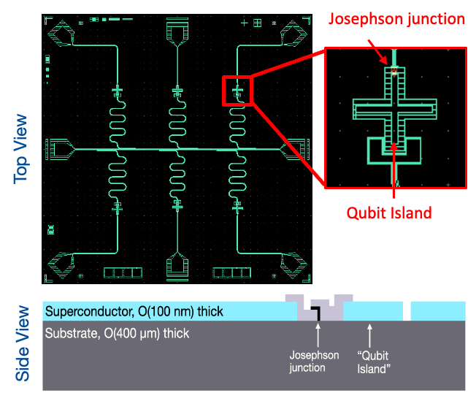
Superconducting Qubit Circuit Design
Out of the box, qubits are NOT efficient particle detectors because there is so much “dead” metal on the chip (ground plane, etc)
In many ways, this is the opposite of a QET, which efficiently collects the energy in the phonon system and brings it into the superconductor as broken Cooper pairs
The result is a much higher energy threshold than the Cooper pair binding energy

Slide 15
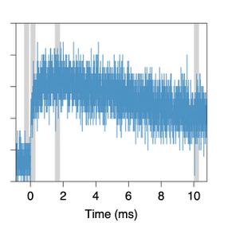

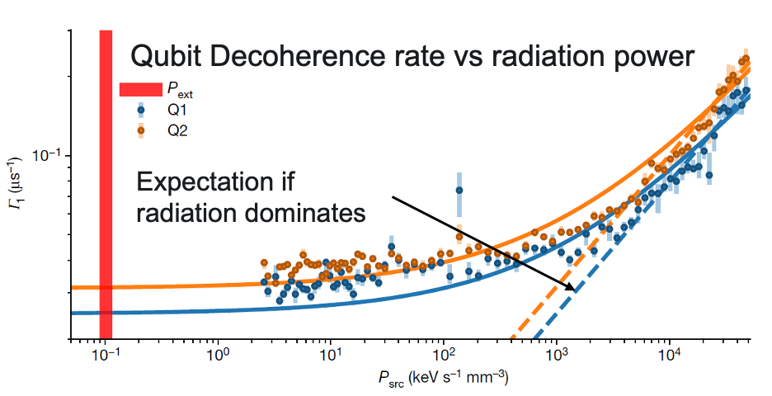
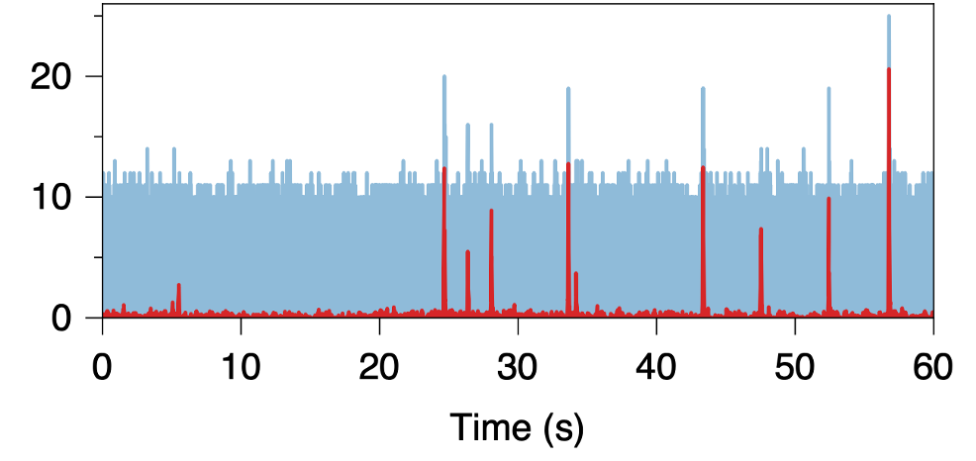
Qubits as Radiation Sensors
Google Sycamore
Coherence times reduced and ultimately limited to a few ms by extrapolating the performance of irradiated qubits.
[Vepsäläinen et al., Nature 584 551–556 (2020)]
Radiation-induced bursts of errors: ~10 ms every few seconds
[Wilen et al, Nature 594 369 (2021)] (not pictured)
[McEwen et al., Nature Communications 18 107 (2022)]

Slide 16
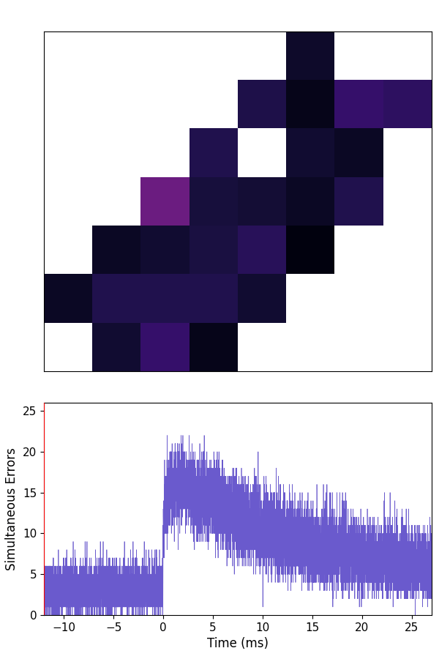
Qubits as Radiation Sensors
Google Sycamore
Graphics presented by Matt McEwen (Google) at previous RISQ Workshop
[McEwen et al., Nature Communications 18 107 (2022)]

Slide 17
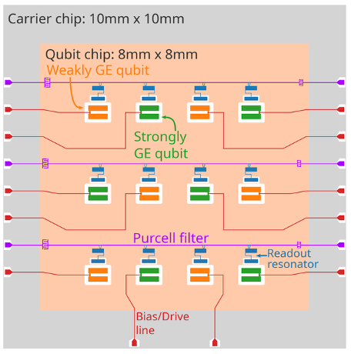
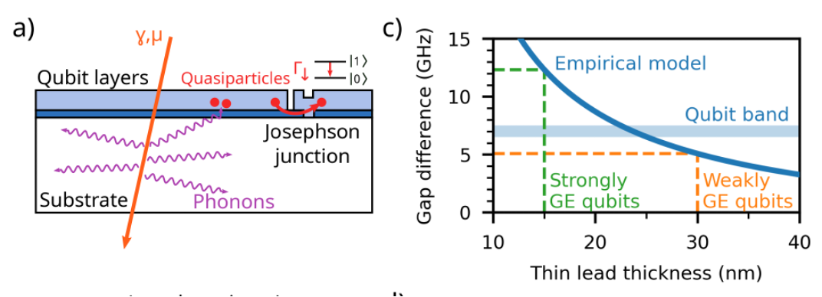
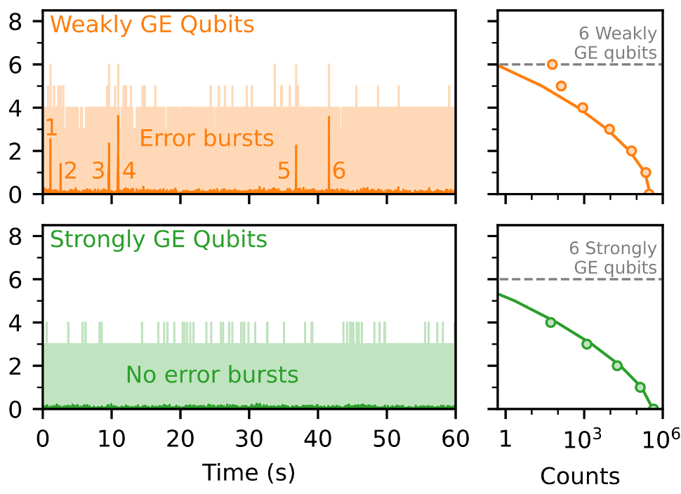
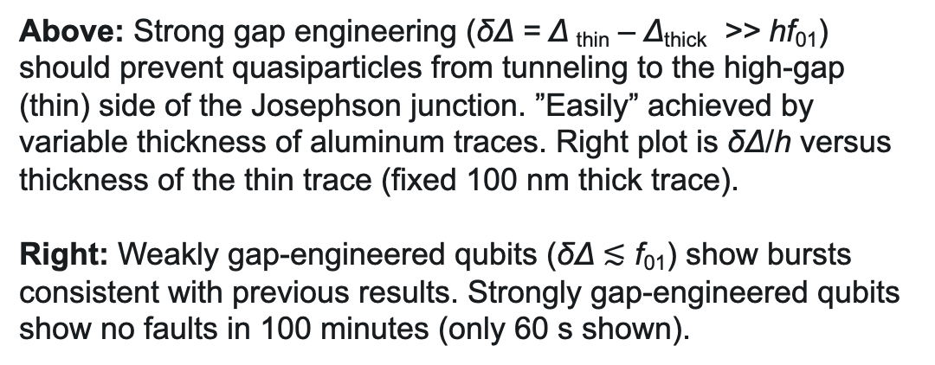
Partial Solution - Gap Engineering
[McEwen et al., Phys. Rev. Lett. 133 240601 (2024).]

Slide 18
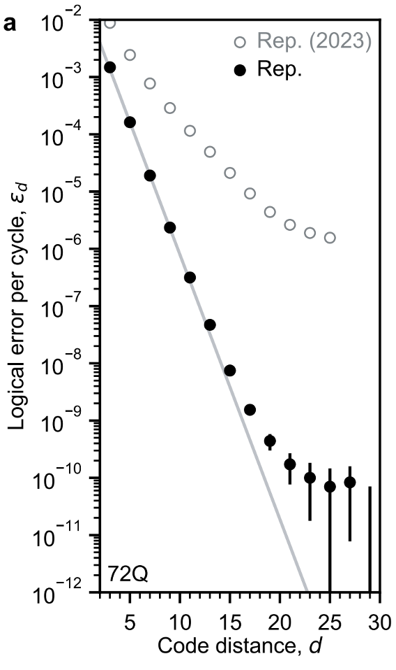
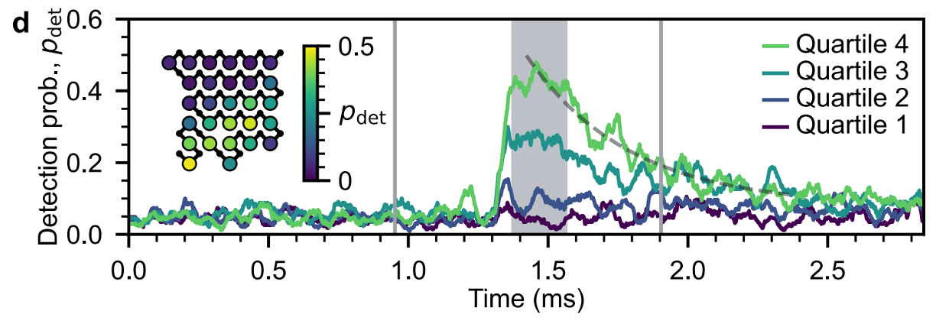
Limits of Gap Engineering - Uncorrected Faults
Gap engr. scaling expectations fail for high-distance codes (right)
Attributed to ~1/hour correlated events in regions of about 30 qubits (below). Different from prior McEwen et al. results, in that:
  Events are more rare: ~1/(10 s) ➝ ~1/hour*
  Relaxation is faster: ~10 ms ➝ ~100 μs
“We do not yet understand the cause of these events, but mitigating them remains vital to building a fault-tolerant quantum computer.”
[Acharya et al. (Google Quantum AI), Nature 638 920 (2025)]

Slide 19
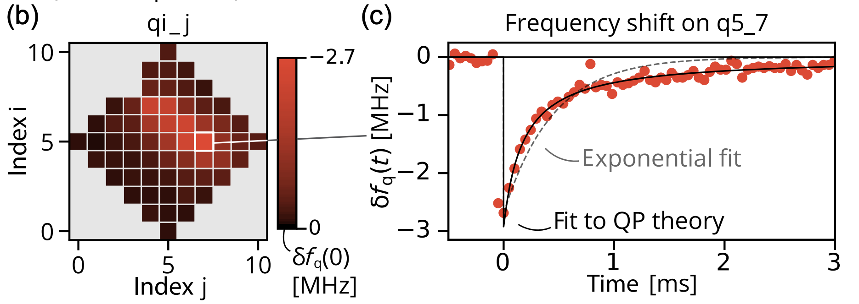
Limits of Gap Engineering - Phase Errors
[Kurilovich, Roberts et al., Phys. Rev. X 16 012025 (2026)]
“We observe that impacts shift the frequencies of the affected qubits, and thus lead to correlated phase errors… We provide evidence that the shifts originate from QP-qubit interactions in the JJ region. Further, we demonstrate that the shift-induced phase errors can be detrimental to the performance of quantum error correction protocols.”
A heat map of the peak value of δf_{q} during an impact.across the 60-qubit grid during an impact.
Dynamics of δf_{q} for a single qubit, during the impact.

Slide 20
RISQ 2024
Scientific Organizing Committee:
Daniel Baxter, FNAL/NU (SOC chair, QSC)
Travis Humble, ORNL/UTK (director, QSC)
Farah Fahim, FNAL (QSC)
Enectali Figueroa-Feliciano, NU/FNAL (QSC)
Anna Grassellino, FNAL/NU (director, SQMS)
Laura Cardani, INFN/LNGS (SQMS)
Tanay Roy, FNAL (SQMS)
Andrew Houck, Princeton (director, C2QA)
Brent VanDevender, PNNL/UW (C2QA)
Jon Cripe, LPS
Jonathan DuBois, LPS
Andrew Kubik, SNOLAB
May 29-31, 2024
Photo credit: Dan Savoboda, Fermilab
https://indico.fnal.gov/event/63132/

Slide 21

RISQ 2024 Review
QSC focused largely on the modeling of radiation-dependence through comparison of surface and underground qubit operation at Fermilab

Slide 22

RISQ 2024 Review
QSC focused largely on the modeling of radiation-dependence through comparison of surface and underground qubit operation at Fermilab
SQMS also explored surface-to-underground comparison through facilities in LNGS, Italy, in addition to novel studies of material dependence on device response

Slide 23

RISQ 2024 Review
QSC focused largely on the modeling of radiation-dependence through comparison of surface and underground qubit operation at Fermilab
SQMS also explored surface-to-underground comparison through facilities in LNGS, Italy, in addition to novel studies of material dependence on device response
C2QA studied device response in shallow-underground site at PNNL and focused on two-level-system (TLS) dynamics in tantalum

Slide 24

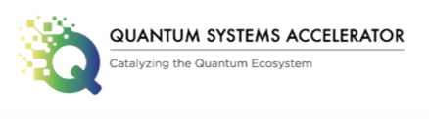
RISQ 2024 Review
QSC focused largely on the modeling of radiation-dependence through comparison of surface and underground qubit operation at Fermilab
SQMS also explored surface-to-underground comparison through facilities in LNGS, Italy, in addition to novel studies of material dependence on device response
C2QA studied device response in shallow-underground site at PNNL and focused on two-level-system (TLS) dynamics in tantalum

Slide 25
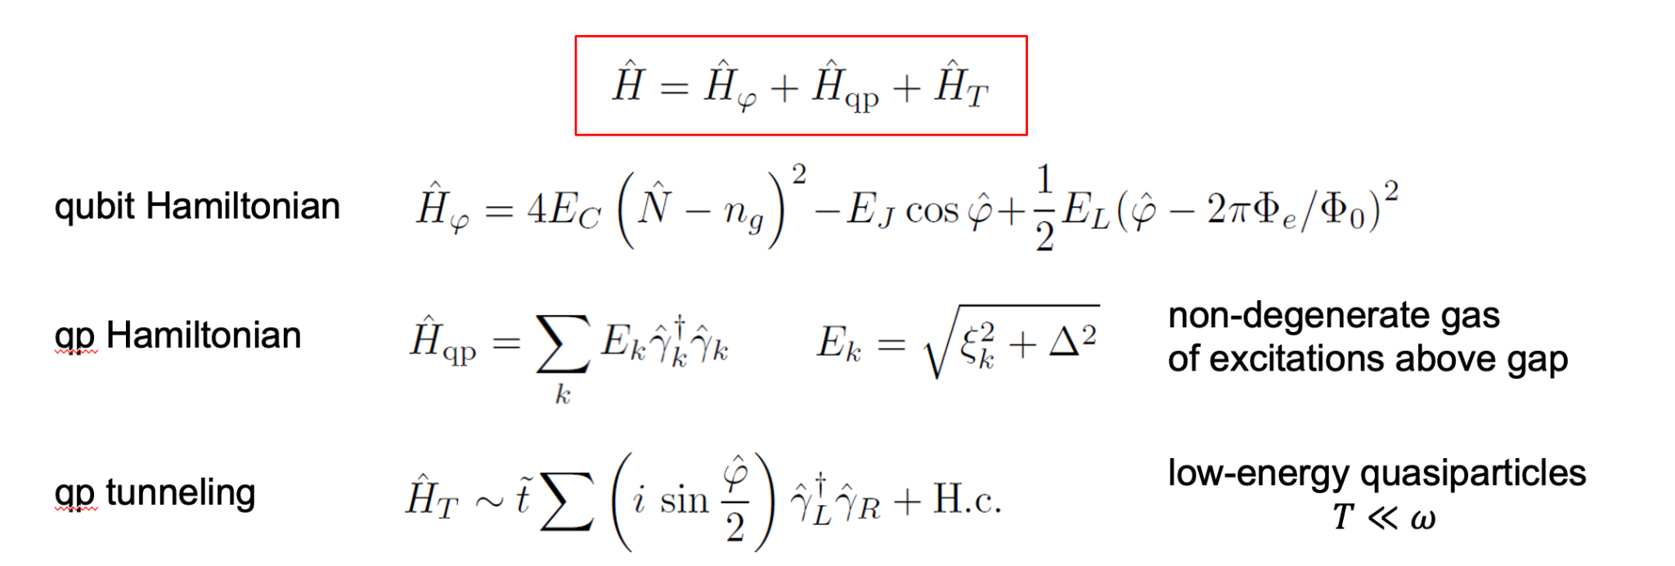
RISQ 2024 Review
We had a very nice theory talk from Gianluigi Catelani
Reviewed the full Hamiltonian for a single-junction qubit with QPs
screenshot from Gianluigi’s talk at RISQ 2024

Slide 26
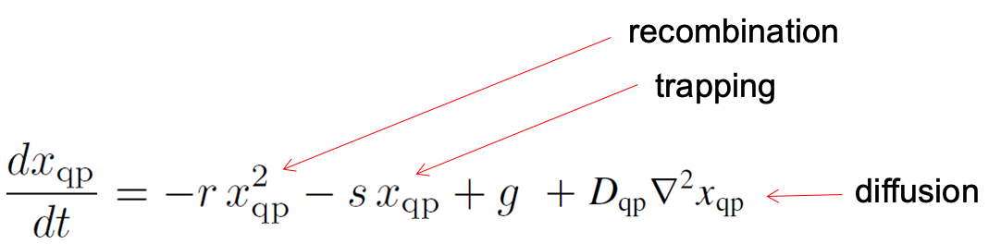
RISQ 2024 Review
We had a very nice theory talk from Gianluigi Catelani
Reviewed the full Hamiltonian for a single-junction qubit with QPs
Highlighted the analytical form of qubit dynamics
screenshot from Gianluigi’s talk at RISQ 2024
Nice talk fitting this model to data from Emanuela Celi (Northwestern)
Updates from parallel efforts by Alberto Ressa (INFN)
Two separate theory overview talks this year from Leonid Glazman (Yale) and Gabrielle Roberts (Google)

Slide 27
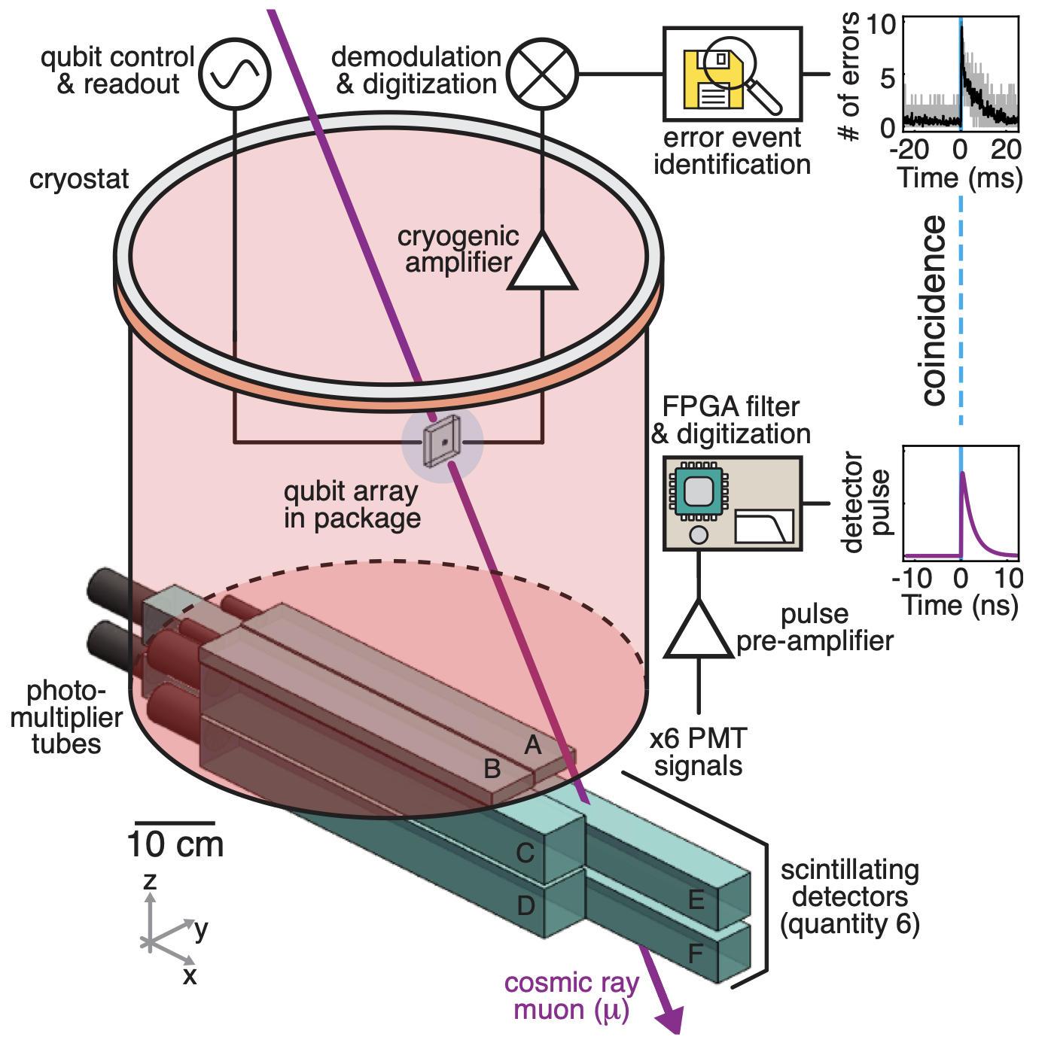
RISQ 2024 Review
One classic trick to reject particle impacts from cosmic rays is to “tag” muons as they pass through the chip
This is a very tried-and-true technique
Pro: can be highly effective at rejecting poisoned livetime
Con: does not actually reduce the rate of poisoning events
See talk from Patrick Harrington on this subject from previous RISQ
Harrington et al, Nature Commun. 16, 6428 (2025)

Slide 28
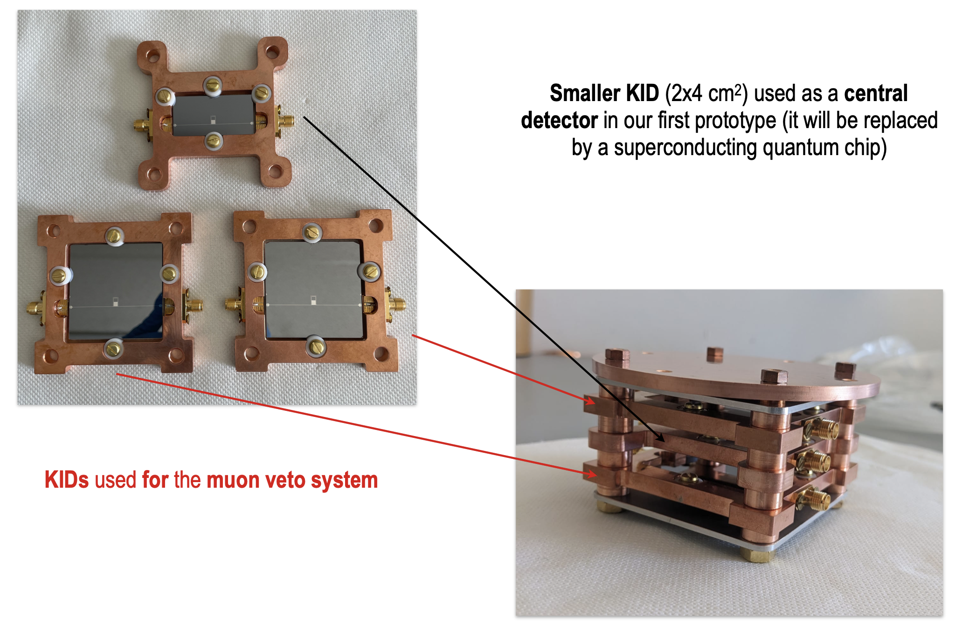
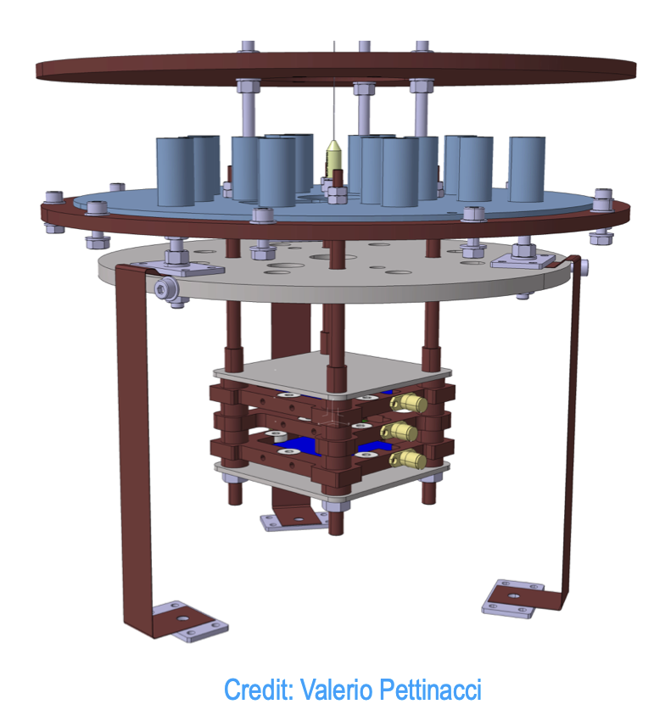
RISQ 2024 Review
Alternatively, can sandwich muon detector chips inside the fridge around the payload chip
See talk from Ambra Mariani last RISQ
Separate talks this time from Yaniv Rosen (LLNL), Tanay Roy (FNAL), and Joel Ullom (NIST)
screenshots from Ambra’s talk at RISQ 2024

Slide 29
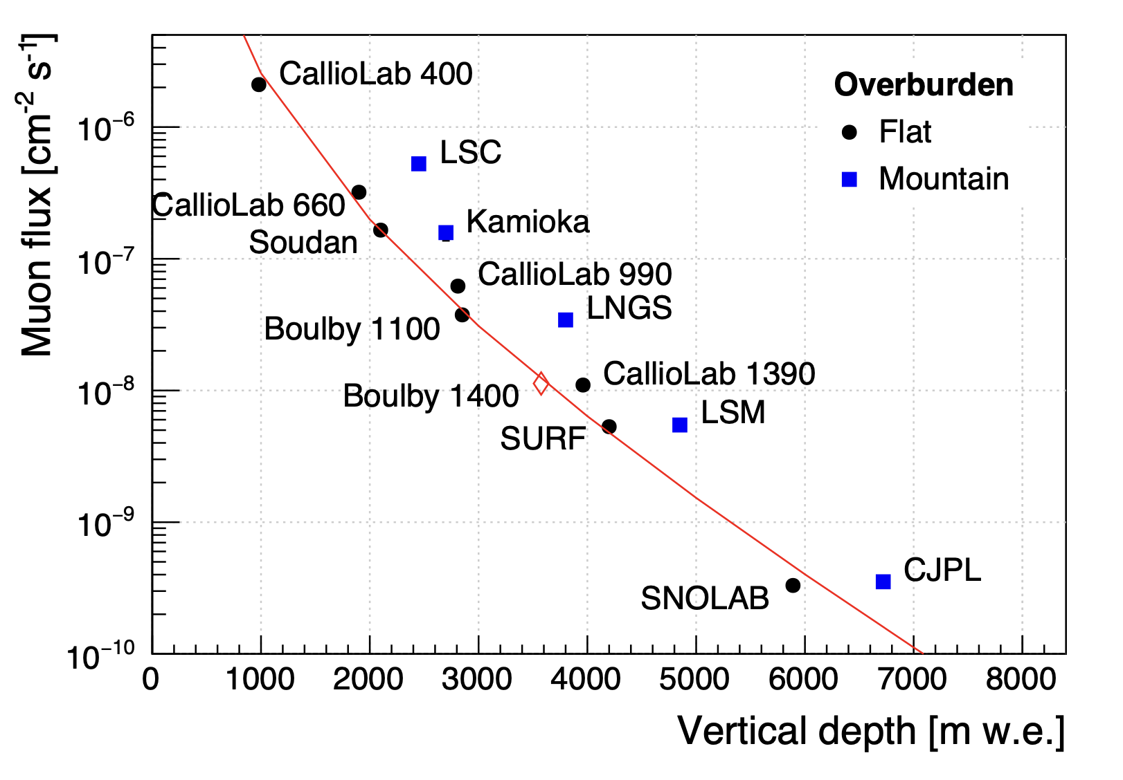
RISQ 2024 Review
Imperfect solution: Go underground!
  Con: Not scalable for industrial applications
  Pro: … but incredibly useful for understanding microphysics
Presentations from different facilities!
  LBCF@PNNL (30 mwe)
  QUIET/NEXUS@Fermilab (225 mwe)
  CURIE@Mines (415 mwe)
  LSC (2450 mwe)
  QUP@Kamioka (2700 mwe)
  Boulby (2800 mwe)
  CELLAR@SUPL (2900 mwe)
  Ieti@LNGS (3800 mwe)
  SURF (4300 mwe)
  LSM (4800 mwe)
  CUTE@SNOLAB (6010 mwe)
  Jinping (6720 mwe)
Pec et al, Eur. Phys. J. C 84, 481 (2024)

Slide 30
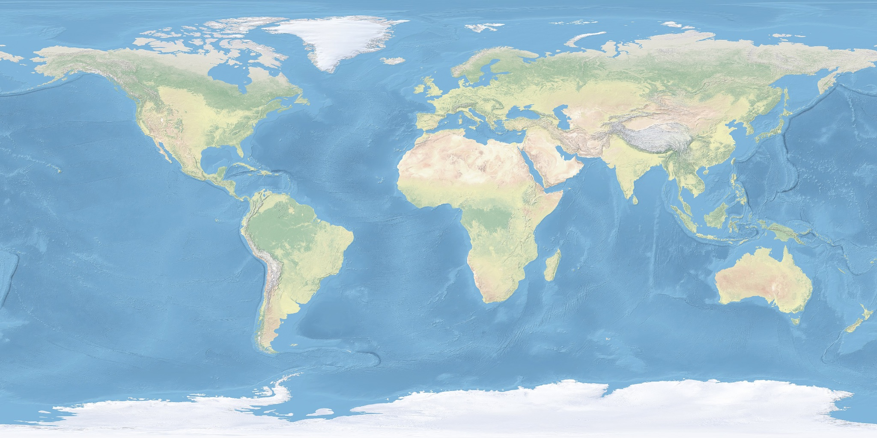
Ieti
at LNGS
LBCF
at PNNL
CUTE
at SNOLAB
Boulby
LSM
Kamioka
SURF
QUIET/NEXUS
at Fermilab
LSC
CURIE
Jinping (?)
CELLAR
at SUPL

Slide 31
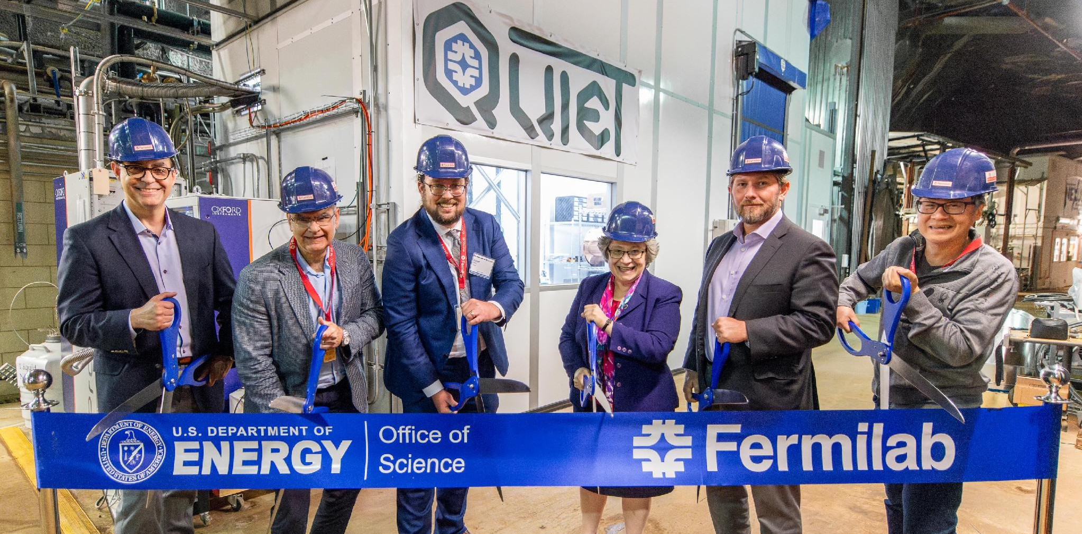
QUIET
Quantum Underground Instrumentation Experimental Testbed
May 30, 2024
NEXUS
Photo credit: Dan Savoboda, Fermilab

Slide 32
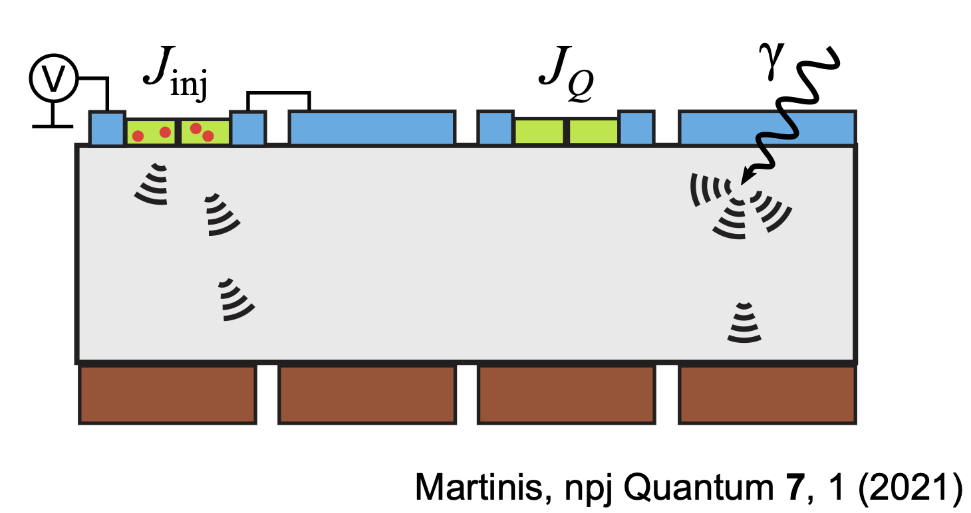
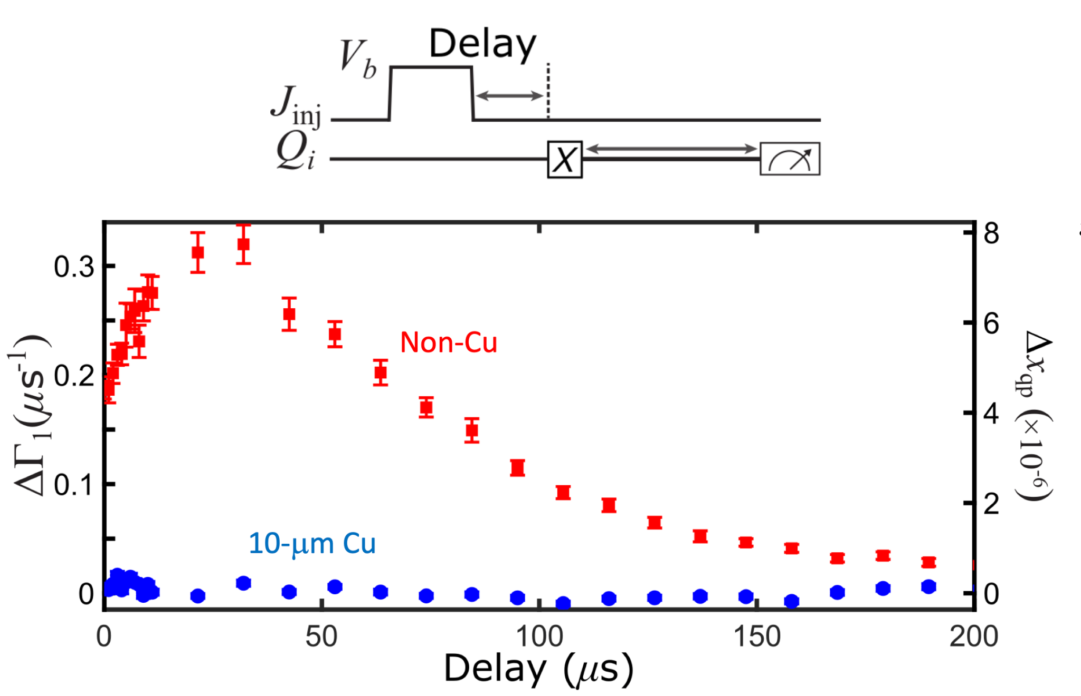
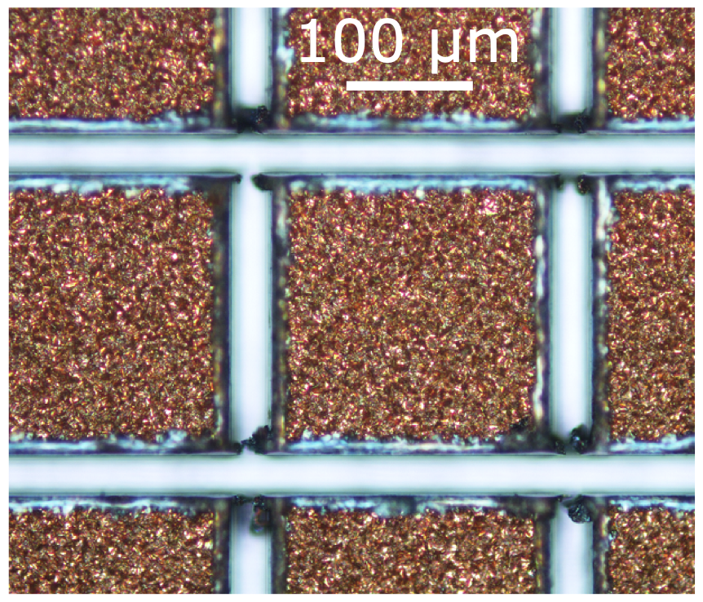
RISQ 2024 Review
Phonon Trapping: can you pull the energy even more efficiently away from the qubit?
See talk from Britton Plourde at RISQ 2024
Iaia et al., Nature Comm. 13, 6425 (2022)

Slide 33
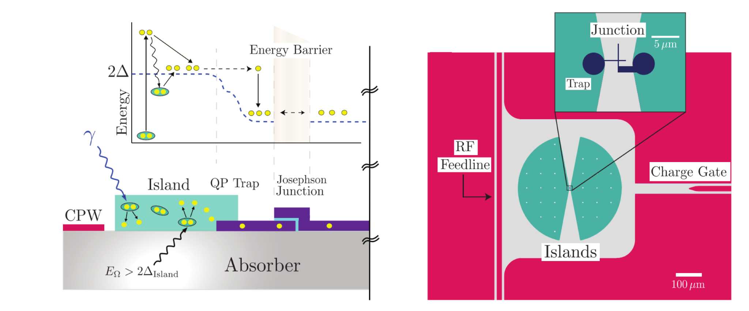
RISQ 2024 Review
Phonon Funneling: can you pull the energy even more efficiently towards the qubit?
Potential high-impact for quantum sensing of particle impacts (dark matter or neutrinos)
See talk from Noah Kurinsky at last RISQ
Fink et al., Phys. Rev. Applied 22, 054009 (2024)
Progress update on these sensors from Hannah Magoon (Stanford/SLAC)

Slide 34


Aside: Quantum Sensing of Neutrinos (QuSeN)
DARPA program investing on increasing the sensitivity of qubit systems to radiation impacts for the purpose of reaction monitoring through neutrino detection.
  Phase I: FY26-28; 4-5 project ideas funded to proceed
  Phase II: expected downselection, scaling, and deployment at ORNL test reactor
  Phase III: profit?
Chu et al, Science 358, 199 (2017)
Linehan et al, PRD 112, 115005 (2025) [arXiv:2410.17308]
Omahen et al, preprint [arXiv:2507.02653]

Slide 35


RISQ 2024 Review
Tom McJunkin (JHU) gave a great talk on using electron linear accelerator for calibration
Progress update on this work tomorrow!
See also talk by Doug Pinckney (MIT)

Slide 36


RISQ 2024 Review
Yen-Yung Chang (Berkeley/LBNL) presented on work engineering IR filtering into flange design = “stub filter”
Matt Pyle (Berkeley) will provide update on this work (and others)

Slide 37




RISQ 2024 Review
Spin Qubits
(Mark Eriksson, Madison)
Topological Qubits
(Torsten Karzig, Microsoft)
Lessons from CMOS
(Farah Fahim, Fermilab)
QP Poisoning in nanowires
[arXiv:2606.00446]

Slide 38
RISQ 2024 Review
Spin Qubits
(Mark Eriksson, Madison)
Topological Qubits
(Torsten Karzig, Microsoft)
Lessons from CMOS
(Farah Fahim, Fermilab)
QP Poisoning in nanowires
Dedicated session on spin qubits with presentation from Joshua Lou (LPS) and update from Mark Eriksson (Madison)
[arXiv:2606.00446]

Slide 39

RISQ 2024 Review - The Panel
Enectali Figueroa-Feliciano (Northwestern)
John Martinis (Qolab)
Laura Cardani (INFN)
Lara Faoro (Google)
Ted Thorbeck (IBM)

Slide 40

Where are we now?
Phonon-mediated correlated errors from QP Bursts:
Gap-engineering + Phonon trapping offer a pretty sound solution to this problem
BUT we still need to understand these processes and fully model them
This is made clear by the ms-long T2 Ramsay errors in Google’s Willow chip
Talks from Alex Opremcak (Google), Heekun Nho (Yale), and Jeffery Gertler (MIT-LL)
Kurilovich et al., Phys. Rev. X 16 012025 (2026)

Slide 41

Where are we now?
Charge jumps from ionizing radiation:
Repeated Wilen measurement underground at Fermilab
Despite significant reduction in charge jump rate, there is an excess source of charge jumps NOT coming from external ionizing radiation
No talks this year?
But definitely some posters!
Bratrud et al, Nature Comm. 16, 9906 (2025) [arXiv:2405.04642]

Slide 42

Where are we now?
Two-level system (TLS) scrambling:
Old measurement from IBM demonstrating TLS scrambling following radiation impact
Fascinating talk from Eric Mascot (Google) yesterday during G4CMP workshop indicating possible solutions
Talk from Bradley Christensen (Northrop Grumman)
Thorbeck et al, PRX Quantum 4, 020356 (2023) [arXiv:2210.04780]

Slide 43

Where are we now?
Low-Energy Excess (LEE) backgrounds:
Every cryogenic particle physics detector with ~eV energy threshold measures a steeply rising background of events at low-energies
Multiple studies now point to this as possible origin for BOTH a population of correlated burst events and the excess QP population
Talks from Britton Plourde (Madison), Matt Pyle (Berkeley), Marios Samiotis (Delft), and Lanqing Yuan (WashU-StL)
Baxter et al, Ann. Rev. Nucl. Part. Sci. 75, 301 (2025)

Slide 44
Enjoy the workshop!

