Slide 1


Measuring and Modeling the Impact of Radiation on
Gap-Engineered Superconducting Qubits
H.D. Pinckney^{1,2}, P.M. Harrington¹, K. Azar¹, H.P. Binney^{1,2}, A. Goswami¹, M. Hays¹, M. Moes⁷, J. Yang², W. Van De Pontseele²,
F. Contipelli³, R. DePencier Piñero³, H. Stickler³, M. Randeria³, T. McJunkin⁴, A.W. Hunt⁴, Y. Jones-Alberty⁴, K. Schultz⁴,
B.M. Niedzielski³, M. Gingras³, M.E. Schwartz³, J.L. Yoder³, J.A. Grover¹, K. Serniak^{1,3}, J.A. Formaggio^{2,5}, W.D. Oliver^{1,5,6}
¹Research Laboratory of Electronics, MIT
²Laboratory for Nuclear Science, MIT
³MIT Lincoln Laboratory
⁴Johns Hopkins Applied Physics Laboratory
⁵Department of Physics, MIT
⁶Department of Electrical Engineering and Computer Science, MIT
⁷Swiss Federal Institute of Technology ETH Zurich
http://arxiv.org/abs/2603.13460
Radiation Impacts on Superconducting Qubits 2026
June 16th, 2026

Slide 2


Radiation Mitigation: Gap Engineering
Vepsäläinen et al. (2020)
Wilen et al. (2021)
McEwen et al. (2022)
Harrington et al. (2024)
Bratrud et al. (2024)
Larson et al. (2025)
Ionizing radiation $→$ correlated errors
Cooper
Pairs
Quasiparticles
(QP)
Superconductor
Ballistic Phonons
Substrate
$α, γ, μ,$ …

Slide 3
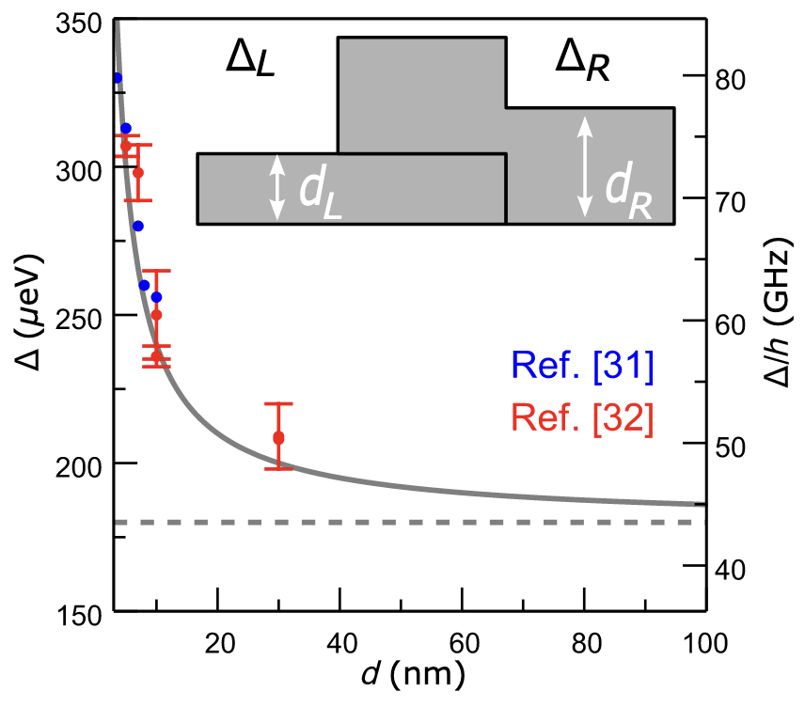

Radiation Mitigation: Gap Engineering
Vepsäläinen et al. (2020)
Wilen et al. (2021)
McEwen et al. (2022)
Harrington et al. (2024)
Bratrud et al. (2024)
Larson et al. (2025)
Marchegiani et al. (2022)
Ionizing radiation $→$ correlated errors
Josephson junction gap engineering (JJ-GE) can suppress these errors
Aumentado et al. (2004)
Kamenov et al. (2023)
McEwen et al. (2024)
Nho et al. (2025)

Slide 4




Radiation Mitigation: Gap Engineering
Vepsäläinen et al. (2020)
Wilen et al. (2021)
McEwen et al. (2022)
Harrington et al. (2024)
Bratrud et al. (2024)
Larson et al. (2025)
Marchegiani et al. (2022)
Ionizing radiation $→$ correlated errors
Josephson junction gap engineering (JJ-GE) can suppress these errors
Aumentado et al. (2004)
Kamenov et al. (2023)
McEwen et al. (2024)
Nho et al. (2025)
1
$$γ$$
0
$δΔ$_{JJ}
$hf$_{qb}

Slide 5



Radiation Mitigation: Gap Engineering
Vepsäläinen et al. (2020)
Wilen et al. (2021)
McEwen et al. (2022)
Harrington et al. (2024)
Bratrud et al. (2024)
Larson et al. (2025)
Marchegiani et al. (2022)
Ionizing radiation $→$ correlated errors
Josephson junction gap engineering (JJ-GE) can suppress these errors
  Engineer such that $δΔ$_{JJ} > $f_{q}$
Aumentado et al. (2004)
Kamenov et al. (2023)
McEwen et al. (2024)
Nho et al. (2025)
1
X
0
$δΔ$_{JJ}
X
$hf$_{qb}

Slide 6
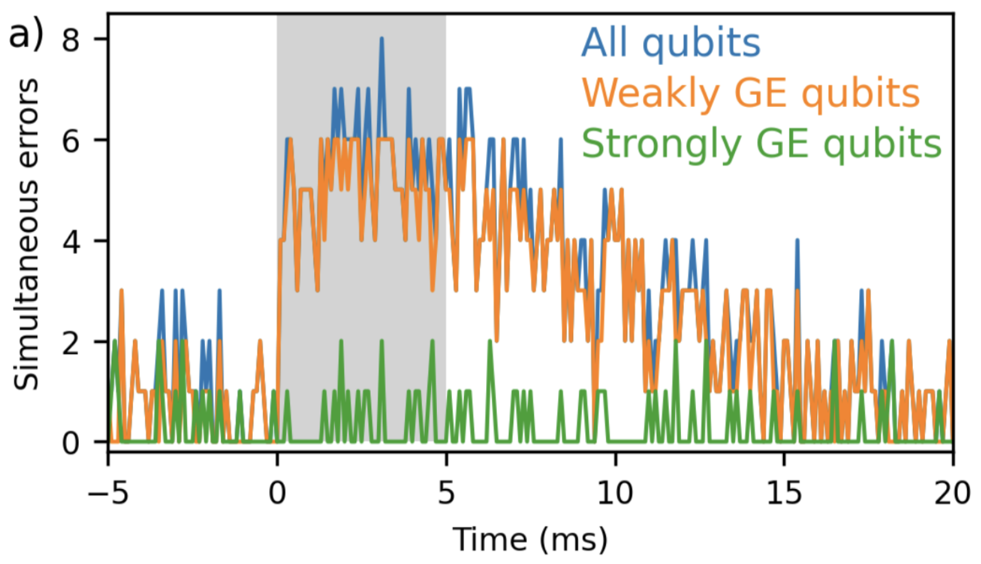

Radiation Mitigation: Gap Engineering
Vepsäläinen et al. (2020)
Wilen et al. (2021)
McEwen et al. (2022)
Harrington et al. (2024)
Bratrud et al. (2024)
Larson et al. (2025)
Marchegiani et al. (2022)
Ionizing radiation $→$ correlated errors
Josephson junction gap engineering (JJ-GE) can suppress these errors
  Engineer such that $δΔ$_{JJ} > $f_{q}$
  Protects against “cold” QP on the low-gap side of the JJ
Aumentado et al. (2004)
Kamenov et al. (2023)
McEwen et al. (2024)
Nho et al. (2025)
1
X
0
McEwen et al. (2024)
$δΔ$_{JJ}
X
$hf$_{qb}

Slide 7
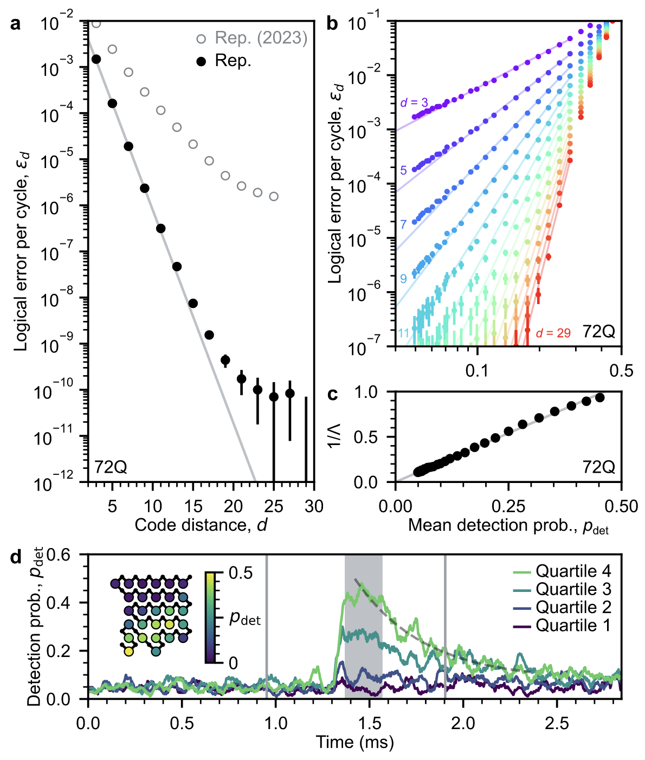
Radiation Affects Superconducting Qubits
Google Quantum AI and Collaborators (2024)
Low rate of correlated errors remains
Google Quantum AI and Collaborators (2024)

Slide 8
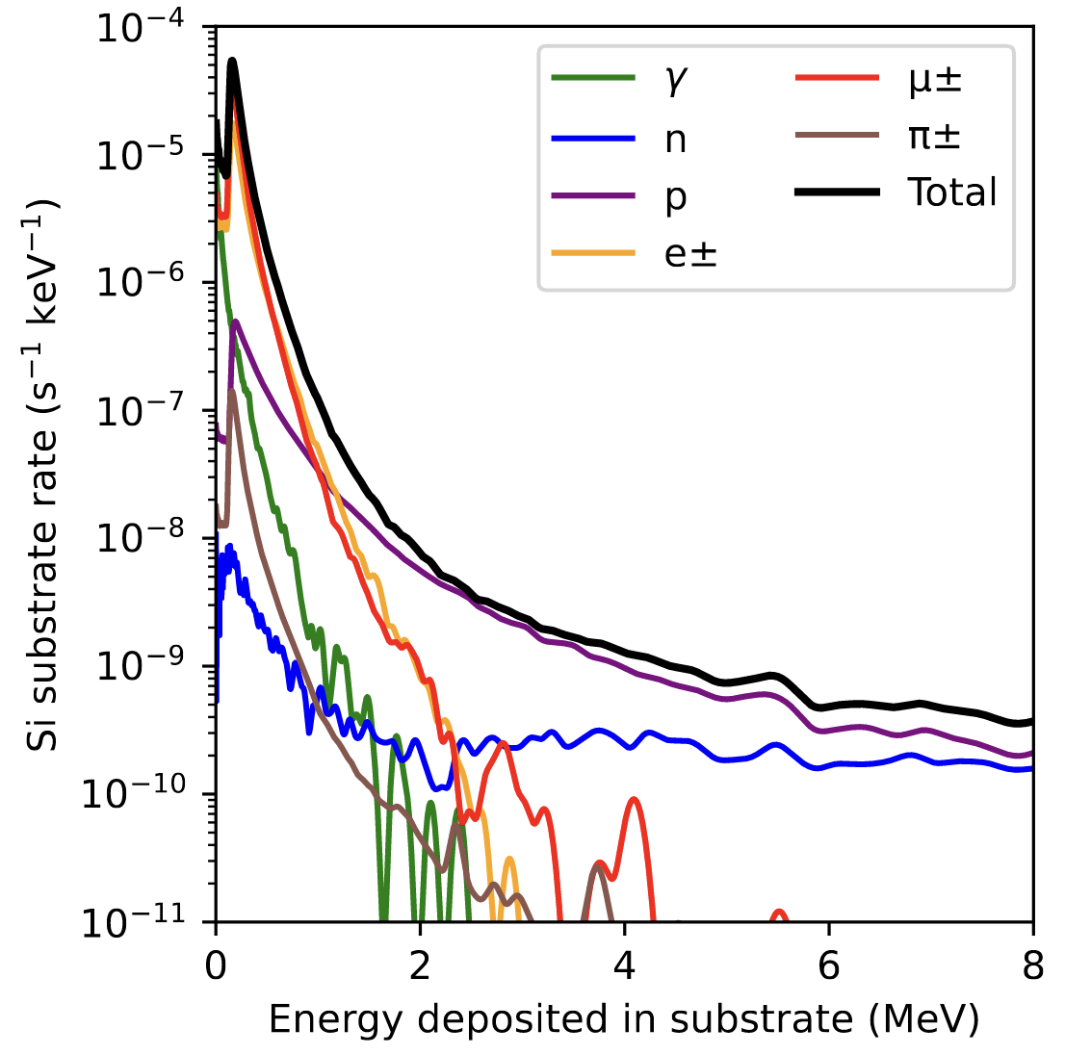
Radiation Affects Superconducting Qubits
Fowler et al. (2024)
Low rate of correlated errors remains
  Consistent with cosmic ray protons and neutrons
~ 1 impact/hour above 1 MeV
Google Quantum AI and Collaborators (2024)

Slide 9
Radiation Affects Superconducting Qubits
Fowler et al. (2024)
Low rate of correlated errors remains
  Consistent with cosmic ray protons and neutrons
Questions: to what degree does JJ-GE protect SC qubits? What about other GE strategies?
~ 1 impact/hour above 1 MeV
Google Quantum AI and Collaborators (2024)

Slide 10


Radiation Affects Superconducting Qubits
Low rate of correlated errors remains
  Consistent with cosmic ray protons and neutrons
Questions: to what degree does JJ-GE protect SC qubits? What about other GE strategies?
Measurements:
  At MIT with ²⁴¹Am
JJ-GE Qubit
Collimator, ~100 $μ$m $∅$
$$α$$
²⁴¹Am

Slide 11
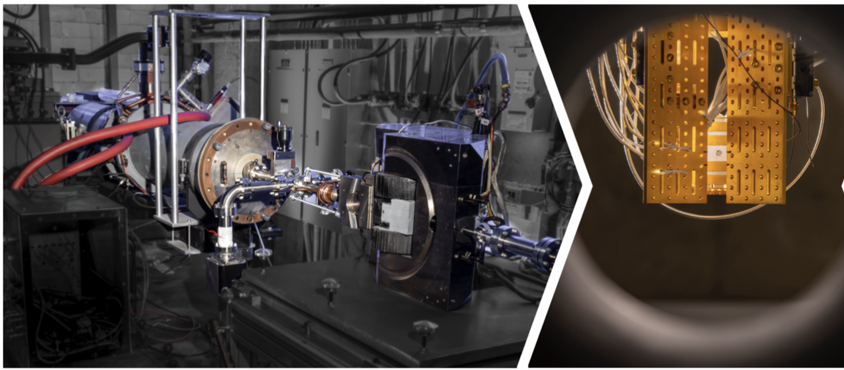
Radiation Affects Superconducting Qubits
Low rate of correlated errors remains
  Consistent with cosmic ray protons and neutrons
Questions: to what degree does JJ-GE protect SC qubits? What about other GE strategies?
Measurements:
  At MIT with ²⁴¹Am
  At APL with CLIQUE, a linear accelerator

Slide 12




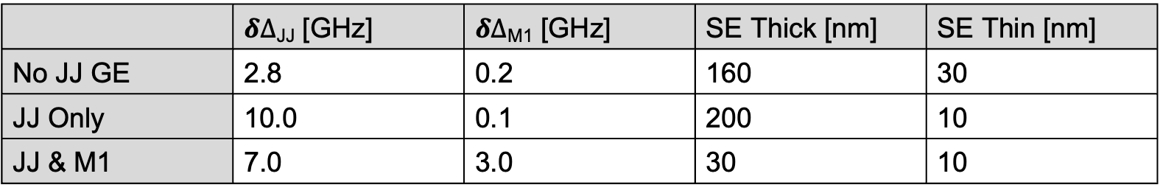






Three Devices Under Test
 | $δΔ$_{JJ} [GHz] | $δΔ$_{M1} [GHz] | SE Thick [nm] | SE Thin [nm]
No JJ GE | 2.8 | 0.2 | 160 | 30
JJ Only | 10.0 | 0.1 | 200 | 10
JJ & M1 | 7.0 | 3.0 | 30 | 10
Junction barrier
$$f_{q}$$
$$f_{q}$$
$$f_{q}$$
Profile of $δΔ$
$δΔ$_{JJ}
$δΔ$_{gnd}
$δΔ$_{JJ}
$δΔ$_{gnd}
$δΔ$_{gnd}
$δΔ$_{JJ}
No JJ blocking
Junction Blocking Only
Junction Blocking and Ground Trapping

Slide 13


Three Devices Under Test
 | $δΔ$_{JJ} [GHz] | $δΔ$_{M1} [GHz] | SE Thick [nm] | SE Thin [nm]
No JJ GE | 2.8 | 0.2 | 160 | 30
JJ Only | 10.0 | 0.1 | 200 | 10
JJ & M1 | 7.0 | 3.0 | 30 | 10
Junction barrier
$$f_{q}$$
$$f_{q}$$
$$f_{q}$$
Profile of $δΔ$
$δΔ$_{JJ}
$δΔ$_{gnd}
$δΔ$_{JJ}
$δΔ$_{M1}
$δΔ$_{gnd}
$δΔ$_{JJ}
No JJ GE
Junction Blocking Only
Junction Blocking and Ground Trapping

Slide 14

Three Devices Under Test
 | $δΔ$_{JJ} [GHz] | $δΔ$_{M1} [GHz] | SE Thick [nm] | SE Thin [nm]
No JJ GE | 2.8 | 0.2 | 160 | 30
JJ Only | 10.0 | 0.1 | 200 | 10
JJ & M1 | 7.0 | 3.0 | 30 | 10
Junction barrier
$$f_{q}$$
$$f_{q}$$
$$f_{q}$$
Profile of $δΔ$
$δΔ$_{JJ}
$δΔ$_{gnd}
$δΔ$_{JJ}
$δΔ$_{M1}
$δΔ$_{M1}
$δΔ$_{JJ}
No JJ GE
JJ Only
Junction Blocking and Ground Trapping

Slide 15
Three Devices Under Test
 | $δΔ$_{JJ} [GHz] | $δΔ$_{M1} [GHz] | SE Thick [nm] | SE Thin [nm]
No JJ GE | 2.8 | 0.2 | 160 | 30
JJ Only | 10.0 | 0.1 | 200 | 10
JJ & M1 | 7.0 | 3.0 | 30 | 10
Junction barrier
$$f_{q}$$
$$f_{q}$$
$$f_{q}$$
Profile of $δΔ$
$δΔ$_{JJ}
$δΔ$_{JJ}
$δΔ$_{M1}
$δΔ$_{M1}
$δΔ$_{JJ}
No JJ GE
JJ Only
JJ & M1
JJ & M1

Slide 16

Three Devices Under Test
 | $δΔ$_{JJ} [GHz] | $δΔ$_{M1} [GHz] | SE Thick [nm] | SE Thin [nm]
No JJ GE | 2.8 | 0.2 | 160 | 30
JJ Only | 10.0 | 0.1 | 200 | 10
JJ & M1 | 7.0 | 3.0 | 30 | 10
Junction barrier
$$f_{q}$$
$$f_{q}$$
$$f_{q}$$
Profile of $δΔ$
$δΔ$_{JJ}
$δΔ$_{M1}
$δΔ$_{JJ}
$δΔ$_{M1}
$δΔ$_{M1}
$δΔ$_{JJ}
No JJ GE
JJ Only
JJ & M1

Slide 17
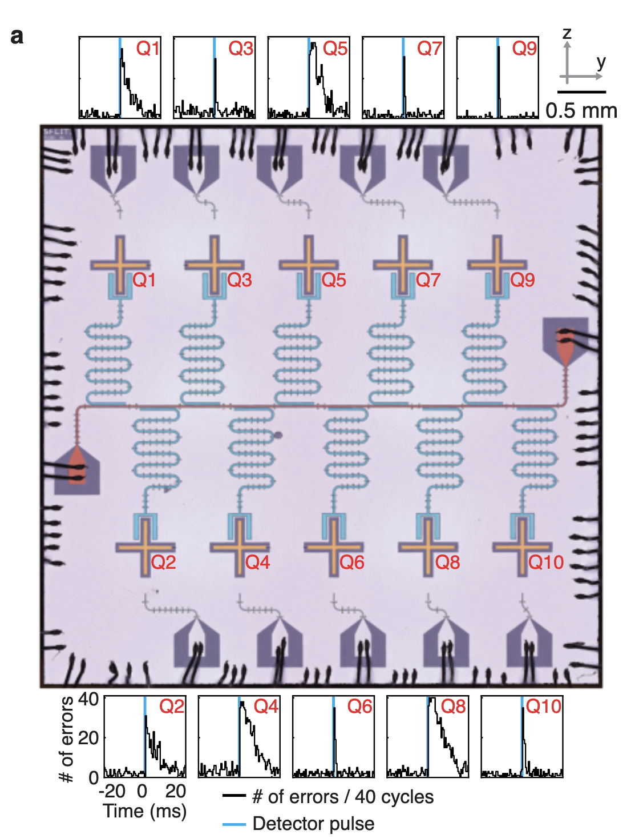
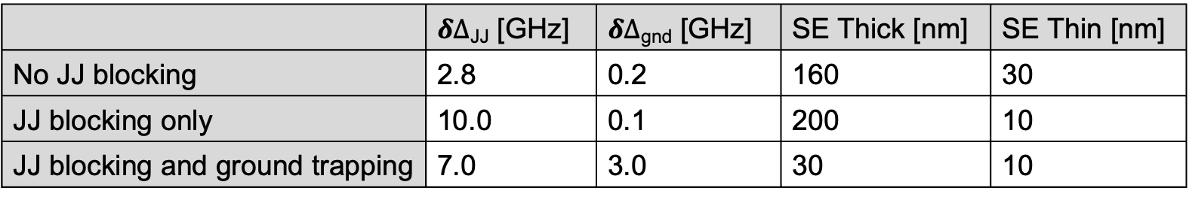

Three Devices Under Test
 | $δΔ$_{JJ} [GHz] | $δΔ$_{gnd} [GHz] | SE Thick [nm] | SE Thin [nm]
No JJ blocking | 2.8 | 0.2 | 160 | 30
JJ blocking only | 10.0 | 0.1 | 200 | 10
JJ blocking and ground trapping | 7.0 | 3.0 | 30 | 10
Same mask design as Harrington et al. (2024):
  Qubit frequencies: 4-5 GHz
  T₁’s ~ 20-50 $μ$s, readout fidelities ~90%

Slide 18
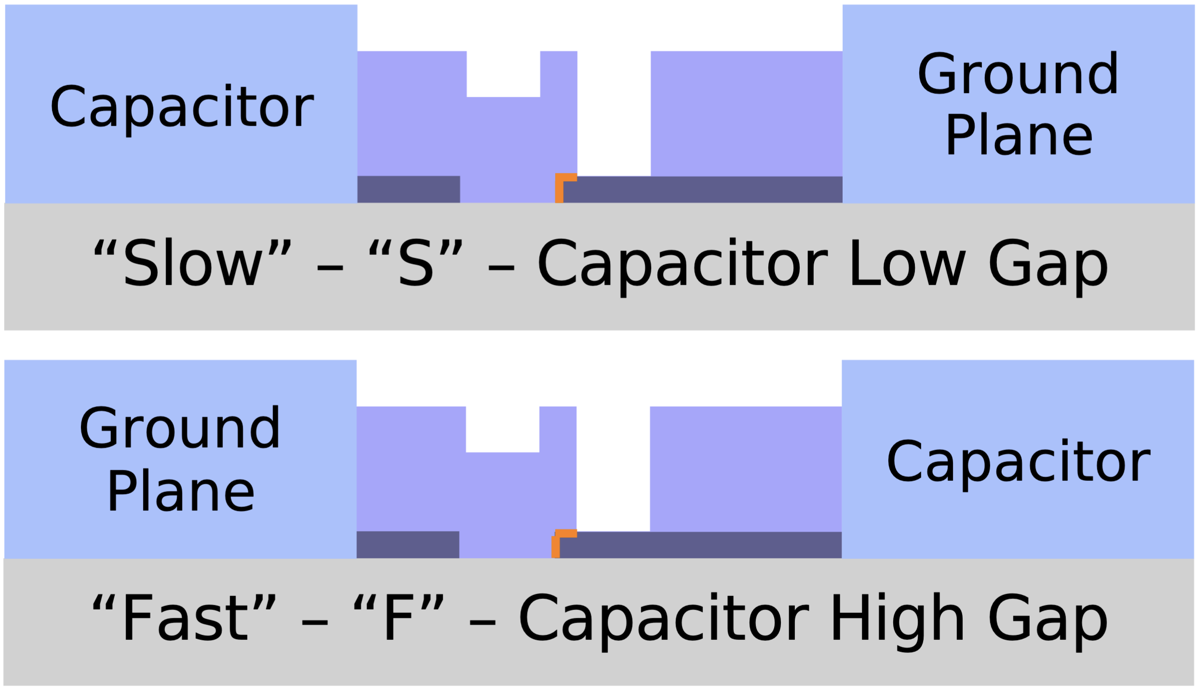

Three Devices Under Test
 | $δΔ$_{JJ} [GHz] | $δΔ$_{gnd} [GHz] | SE Thick [nm] | SE Thin [nm]
No JJ blocking | 2.8 | 0.2 | 160 | 30
JJ blocking only | 10.0 | 0.1 | 200 | 10
JJ blocking and ground trapping | 7.0 | 3.0 | 30 | 10
S
S
F
S
F
Same mask design as Harrington et al. (2024):
  Qubit frequencies: 4-5 GHz
  T₁’s ~ 20-50 $μ$s, readout fidelities ~90%
  Junction orientation dependence

Slide 19
Tests with ²⁴¹Am
Fowler et al. (2024)
A test source: ²⁴¹Am
  5.5 MeV alpha (and 59 keV gamma)
~ 1 impact/hour above 1 MeV

Slide 20
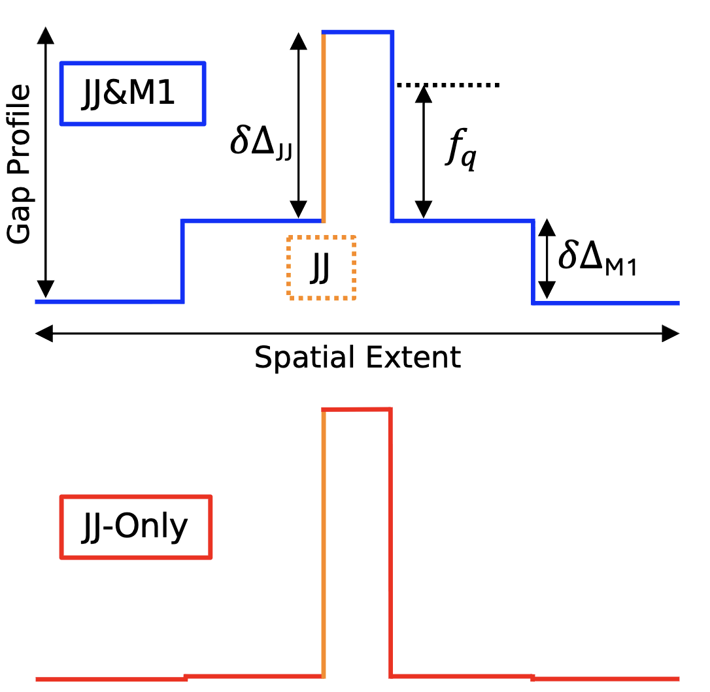
Tests with ²⁴¹Am
A test source: ²⁴¹Am
  5.5 MeV alpha (and 59 keV gamma)
  Expect 1 event per 13 seconds
  Measured on “JJ Only” and “JJ & M1”
Qubit error rate increased by alphas
  Observed rate matches expectation
Conclusions: While JJ-GE substantially reduces errors, JJ-GE qubits remain sensitive to rare, high E_{dep} cosmic rays
  Motivates investigating additional mitigation strategies
JJ-GE Qubit
Collimator, ~100 $μ$m $∅$
$$α$$
²⁴¹Am

Slide 21


Hypothesis: Hot QP Mediate These Errors
QPs have extra energy which can facilitate tunneling
1
X
0
$δΔ$_{JJ}
X
$hf$_{qb}

Slide 22
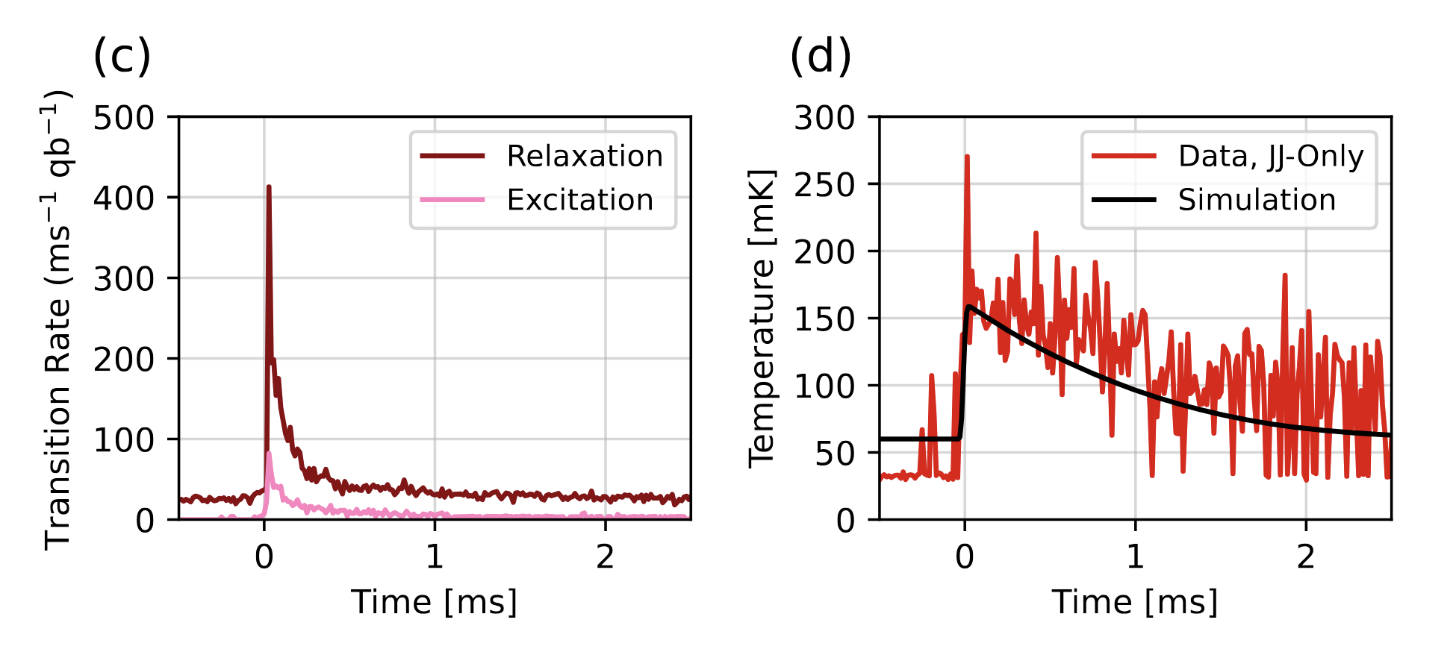


Hypothesis: Hot QP Mediate These Errors
QPs have extra energy which can facilitate tunneling
Excitation/relaxation error rate $→T_{qb}$
$T_{qb}$ increases during an “event”
Nho et al. (2025)
1
$$γ$$
0
$δΔ$_{JJ}
X
$hf$_{qb}
$E$_{QP}

Slide 23
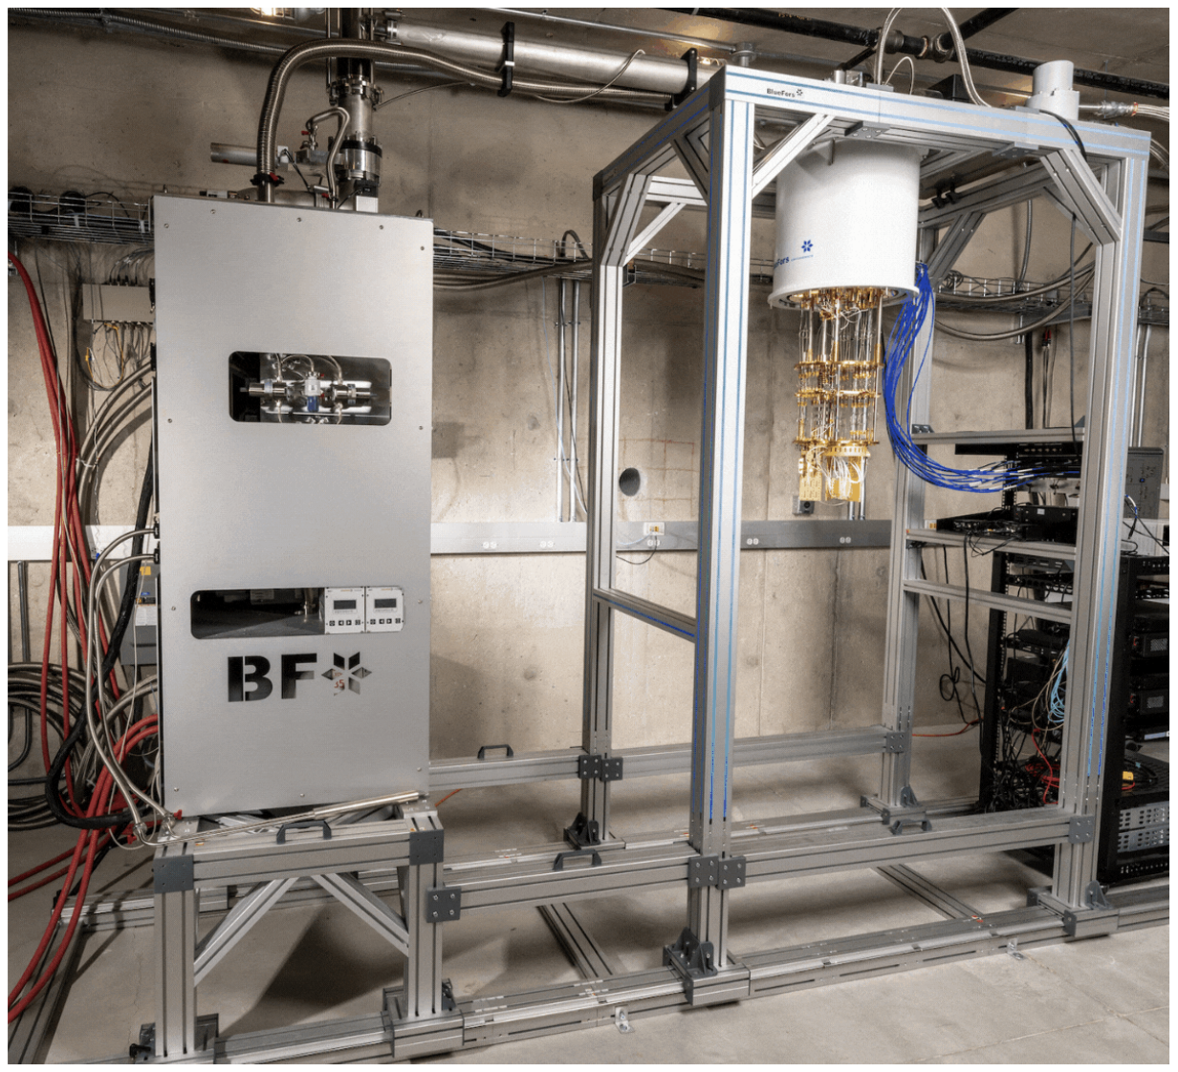
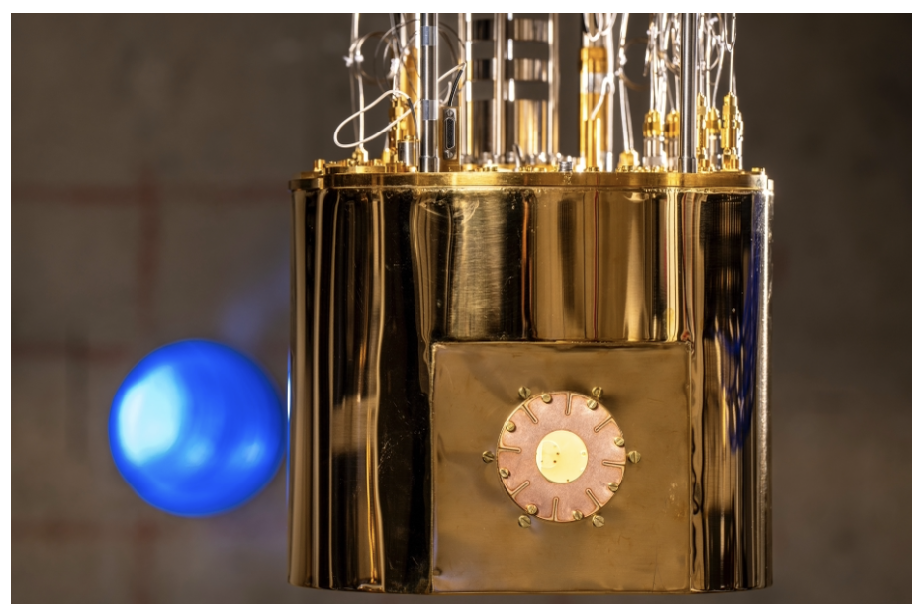
Tests at JHU APL
McJunkin et al. (2026)
arXiv:2603.13124
Cryostat in linear accelerator beamline
  Thinned vacuum can and thermal shields

Slide 24
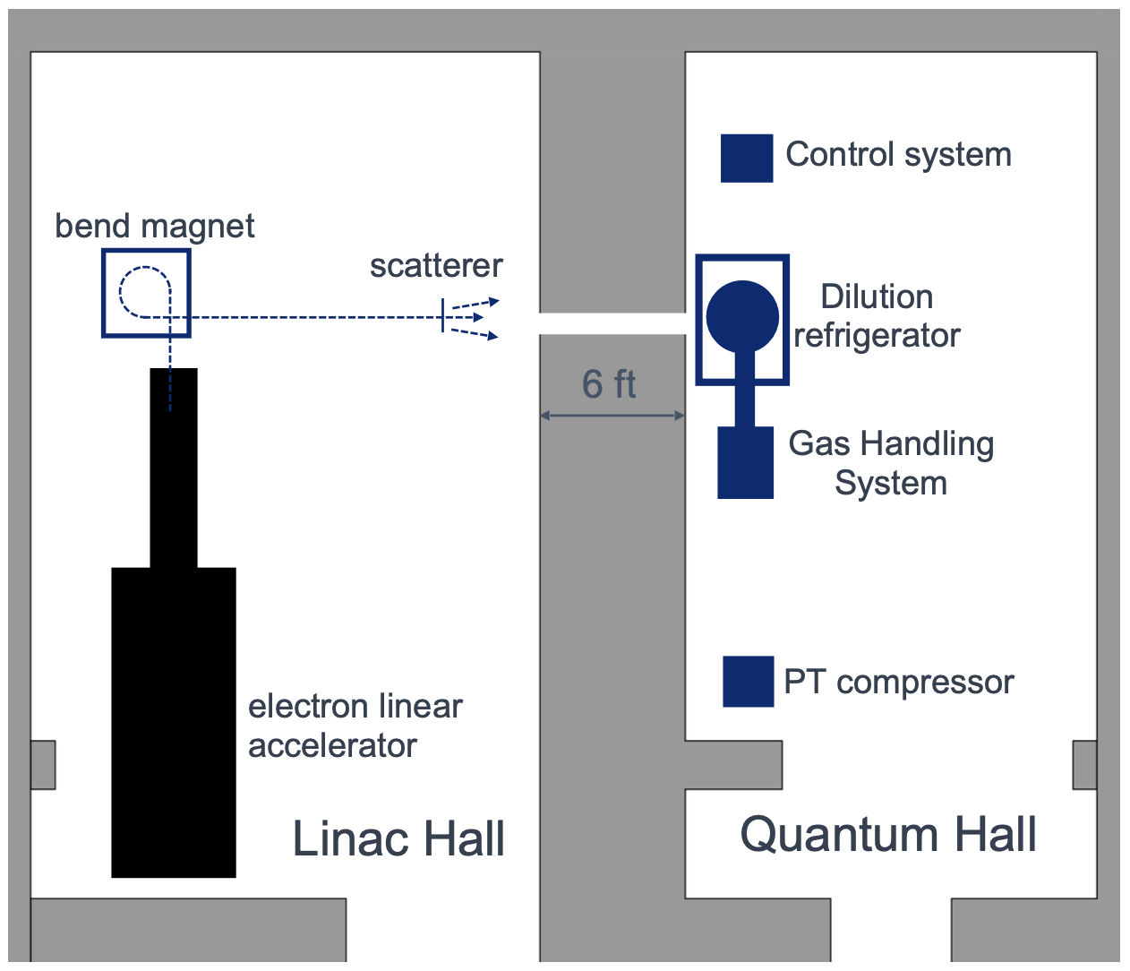
Tests at JHU APL
McJunkin et al. (2026)
arXiv:2603.13124
Cryostat in linear accelerator beamline
  Thinned vacuum can and thermal shields
e⁻

Slide 25

Tests at JHU APL
McJunkin et al. (2026)
arXiv:2603.13124
Cryostat in linear accelerator beamline
  Thinned vacuum can and thermal shields
Pulse width ~4 $μ$s
Accelerated electrons are minimum ionizing (5-25 MeV)
  Mean electron number: 0 $→$ 6.5 e⁻
  Mean energies: 0 $→$ 942 keV
e⁻

Slide 26
Energy Dependence
Linac averaging reveals errors at the lowest measured energy (0.3 e⁻ ~ 100 keV)
Conclusion: low-energy radiation still affects JJ-GE qubits
  As other error mechanisms are reduced, qubit sensitivity to lower energy radiation may become apparent

Slide 27
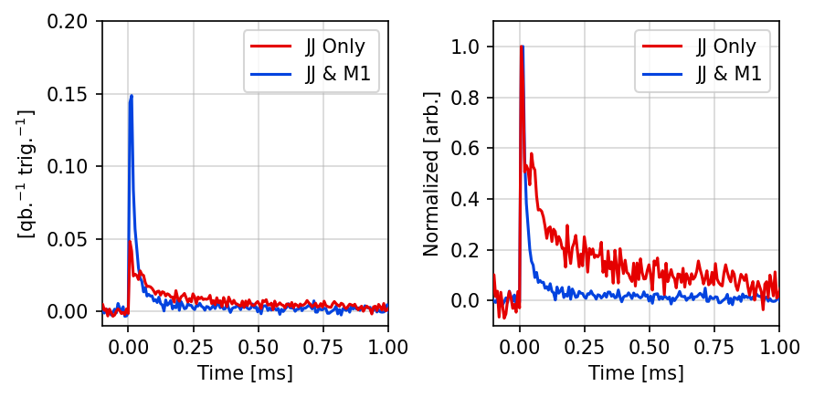
Differences Between Devices – Severity
Errors on JJ&M1 are more severe initially
145 to 435 keV

Slide 28

Differences Between Devices – Severity
Errors on JJ & M1 are more severe initially
Conclusion: The “magnitude” of gap-engineering at the JJ ($\frac{δΔJJ}{f_{q}}$) matters
145 to 435 keV
145 to 435 keV

Slide 29

Differences Between Devices – Recovery Time
Errors on JJ & M1 recover faster
Hypothesis: Gap-engineering at the M1 interface ($δΔ$_{M1}) traps QP away from the JJ
145 to 435 keV
145 to 435 keV

Slide 30
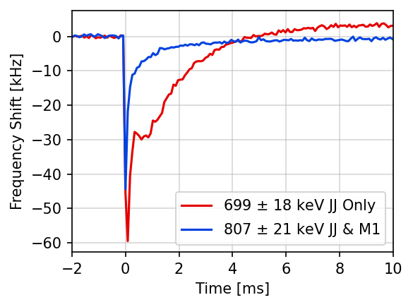

Qubit Frequency Shifts
Increased QP density $→$ decreased qubit frequency
Estimated with Ramsey interferometry
QP density recovers faster for JJ & M1
Conclusion: Gap-engineering at the M1 interface ($δΔ$_{M1}) traps QP away from the JJ
Catelani et al. (2011)
Kurilovich et al. (2025)
Antonenko et al. (2026)

Slide 31

Differences Between Devices
Conclusion: Gap-engineering at the M1 interface ($δΔ$_{M1}) traps QP away from the JJ
Average of
1-3 electrons

Slide 32
QP Modeling Goal
Re-create key features of our data:
  Event severity
  Recovery timescale
  JJ Orientation dependence
  Qubit frequency shift
Not a fit

Slide 33







The QP model
A modified, time-dynamic implementation of the model from Marchegiani and Catelani (2025)
$$x_{3}$$
$δΔ$_{JJ}
$$x_{2}$$
$$f_{q}$$
$$x_{L}$$
$δΔ$_{M1}
$$x_{R}$$
M1L
M1R
M2
M3
Notes:
Outline slide

Slide 34



The QP model
A modified, time-dynamic implementation of the model from Marchegiani and Catelani (2025)
Account for gap engineering by splitting QP density on low-gap side of JJ into two energy bins: greater than and less than $δΔ$
$$x_{2>}$$
$$x_{3}$$
$δΔ$_{JJ}
$$x_{2<}$$
$$f_{q}$$
$$x_{L}$$
$δΔ$_{M1}
$$x_{R}$$
M1L
M1R
M2
M3
Notes:
Outline slide

Slide 35
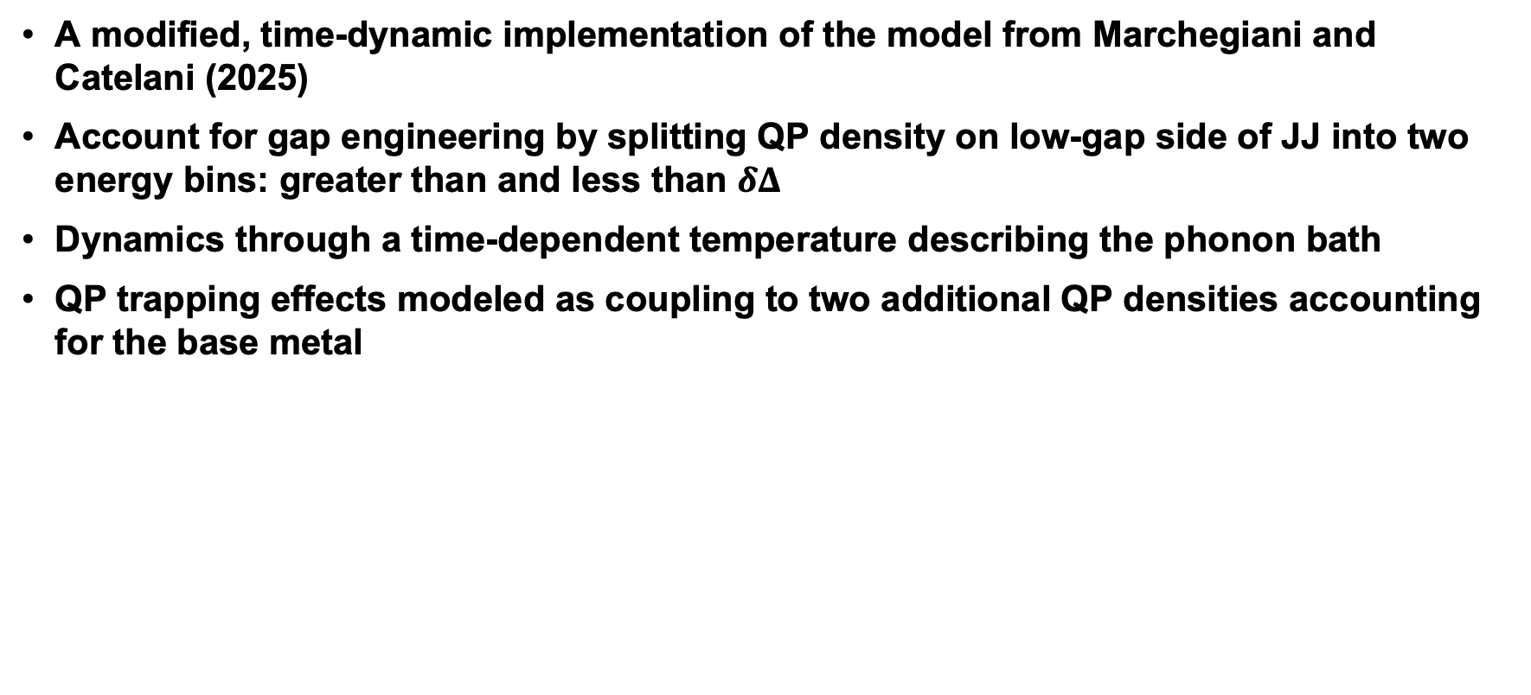
The QP model
A modified, time-dynamic implementation of the model from Marchegiani and Catelani (2025)
Account for gap engineering by splitting QP density on low-gap side of JJ into two energy bins: greater than and less than $δΔ$
Dynamics through a time-dependent temperature describing the phonon bath
QP trapping effects modeled as coupling to two additional QP densities accounting for the base metal
$$x_{2>}$$
$$x_{3}$$
$δΔ$_{JJ}
$$x_{2<}$$
$$f_{q}$$
$$x_{L}$$
$δΔ$_{M1}
$$x_{R}$$
M1L
M1R
M2
M3
Notes:
Outline slide

Slide 36
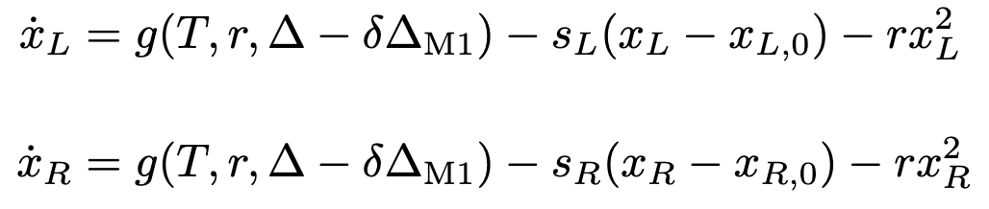
The Model Itself
Coupled equations for change in reduced QP density
Thermal Generation
Trapping
Recombination
$$x_{2>}$$
$$x_{3}$$
$δΔ$_{JJ}
Time-dependent temperature
$$x_{2<}$$
$$f_{q}$$
$$x_{L}$$
$δΔ$_{M1}
$$x_{R}$$
M1L
M1R
M2
M3

Slide 37
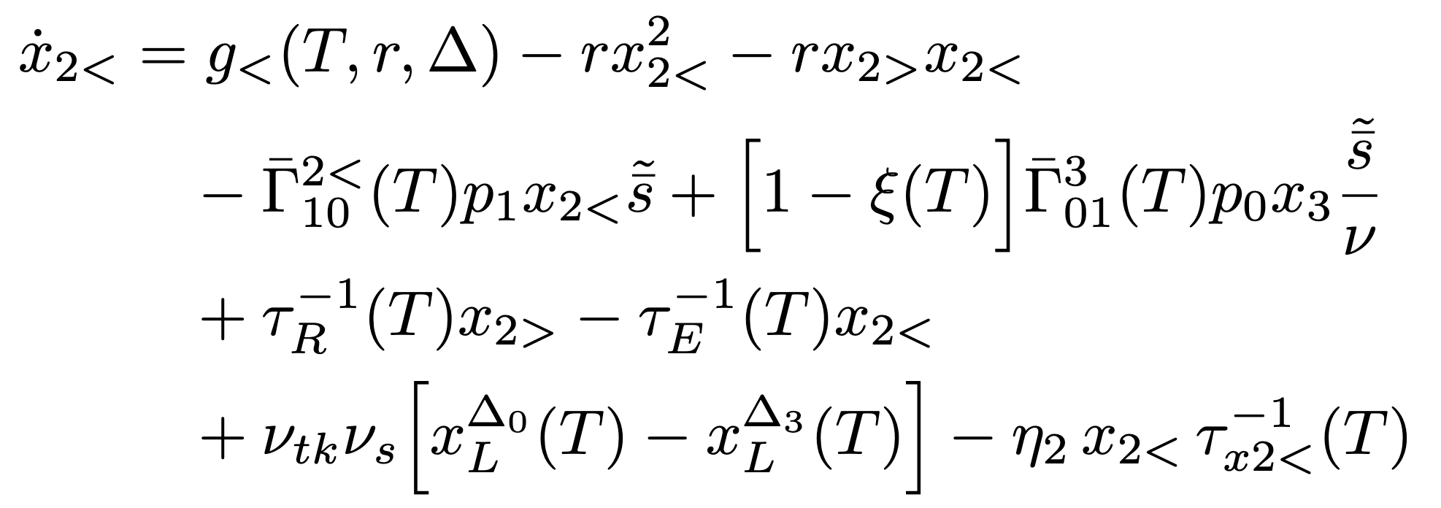
The Model Itself
Coupled equations for change in reduced QP density
For JJ-adjacent densities: add qubit transitions, QP relaxation and excitation
  Trapping assumed subdominant in leads
Scale factors for qubit variation
$$x_{2>}$$
$$x_{3}$$
$δΔ$_{JJ}
$$x_{2<}$$
$$f_{q}$$
$$x_{L}$$
$δΔ$_{M1}
$$x_{R}$$
M1L
M1R
M2
M3

Slide 38
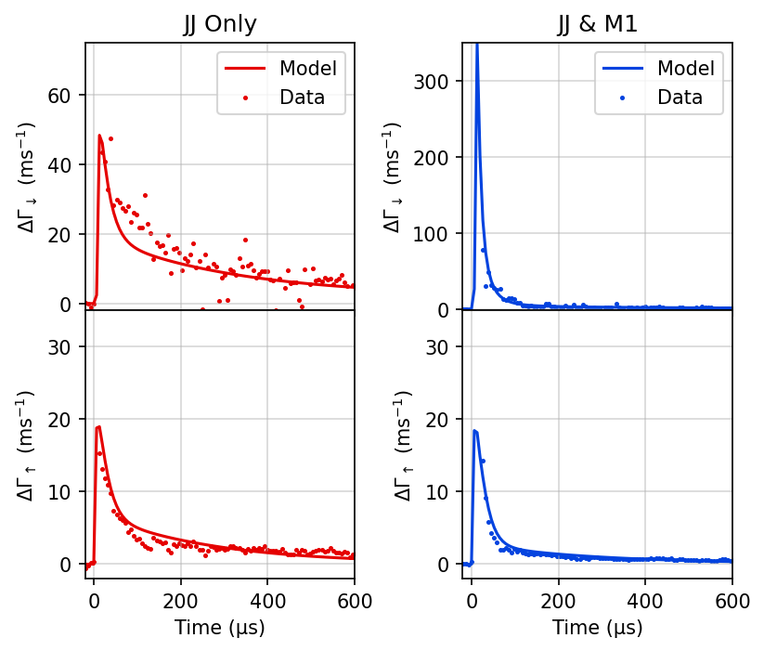
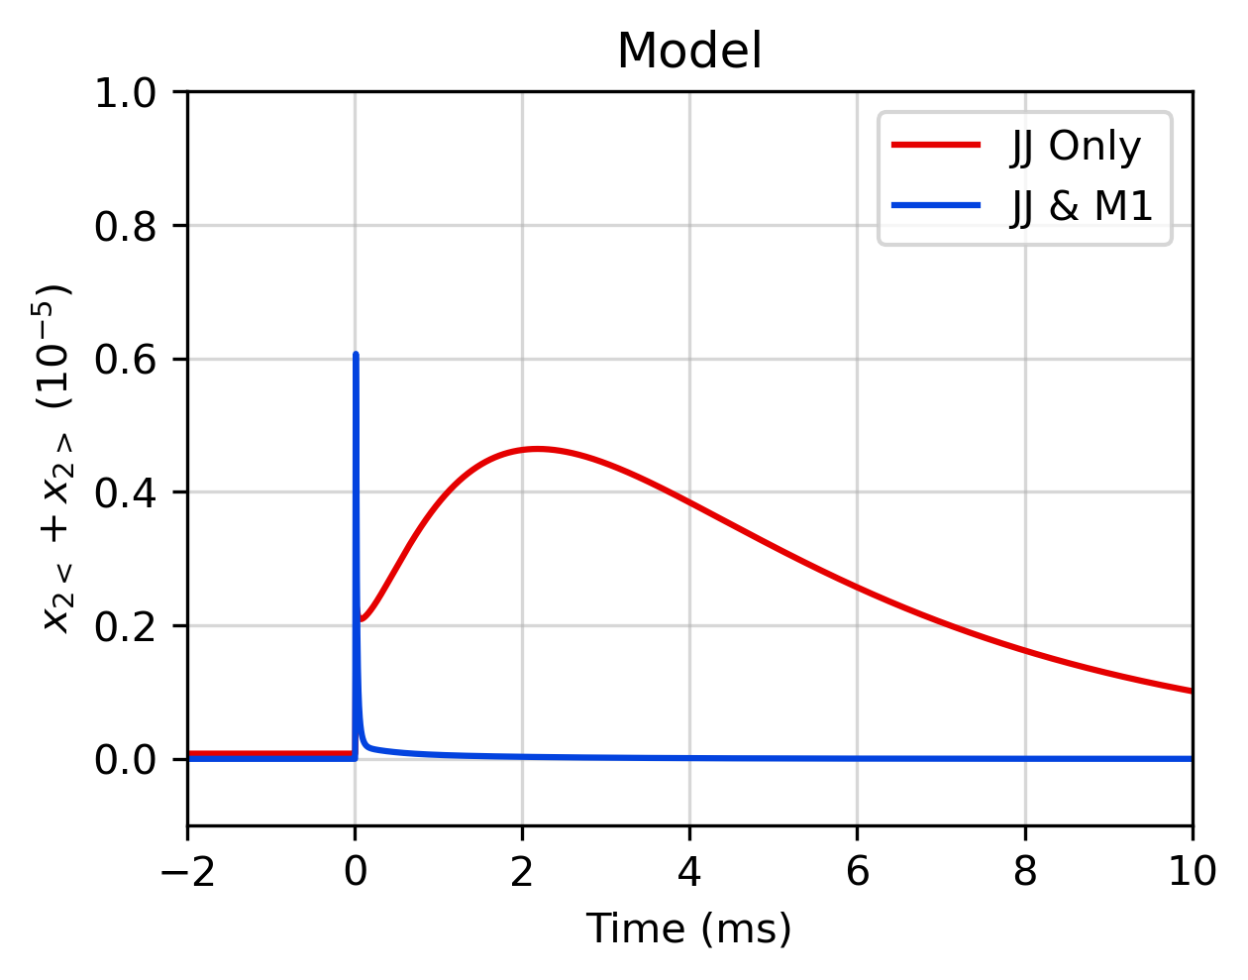
Qualitative Agreement with Data
Qualitatively re-creates gap profile influence on:
  Event severity
  Recovery timescale
  Qubit frequency shift
Notes:
Outline slide

Slide 39
Qualitative Agreement with Data
For qubits across the array, in excitation and relaxation, simultaneously
Notes:
Outline slide

Slide 40
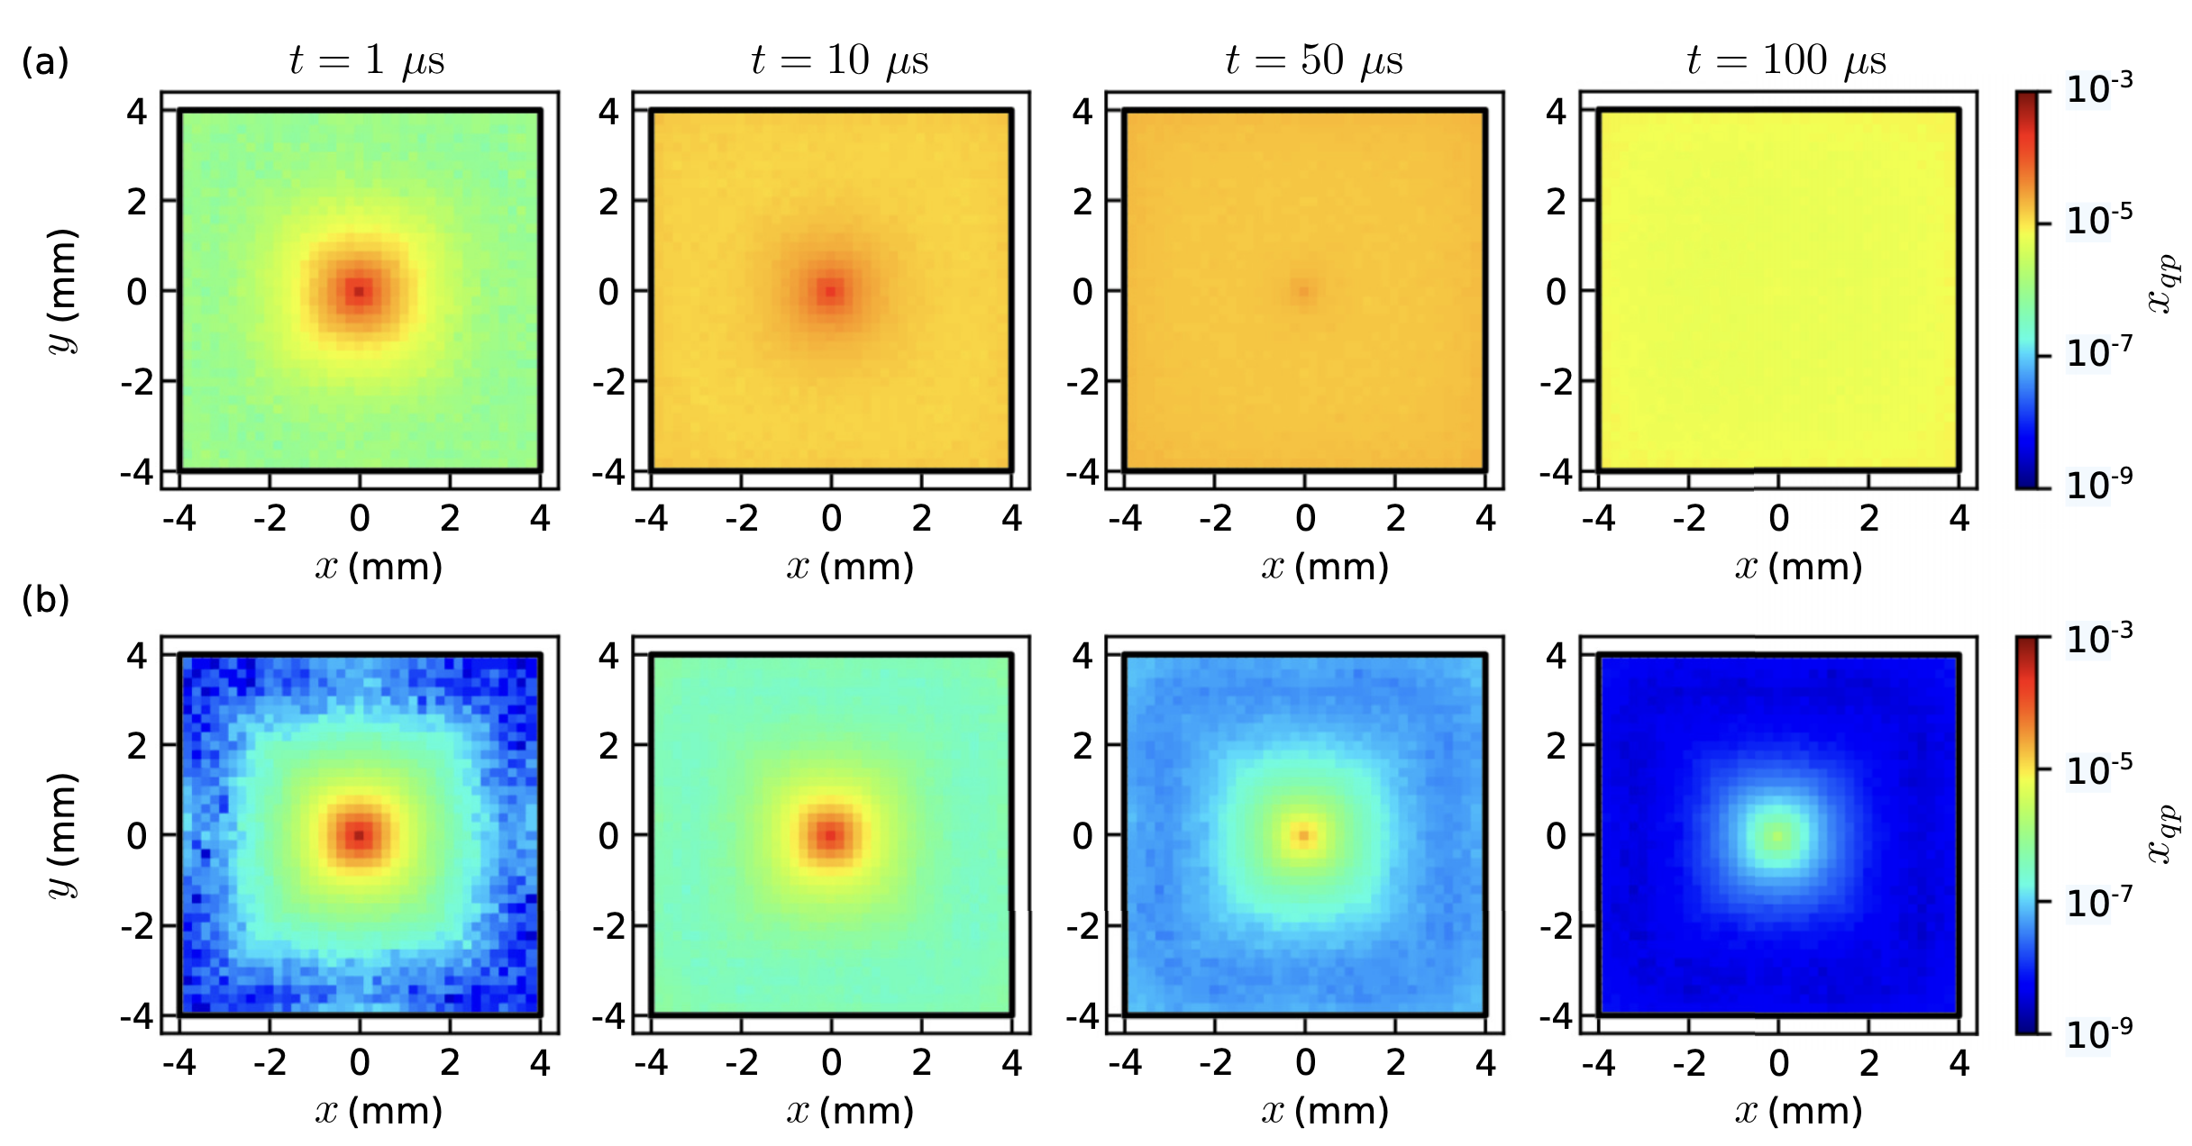
Limitations
Qubit response averaged across impacts over whole chip
0D model, so no diffusion
Transition rates and model only assume 2-states
Yelton et al. (2024)

Slide 41
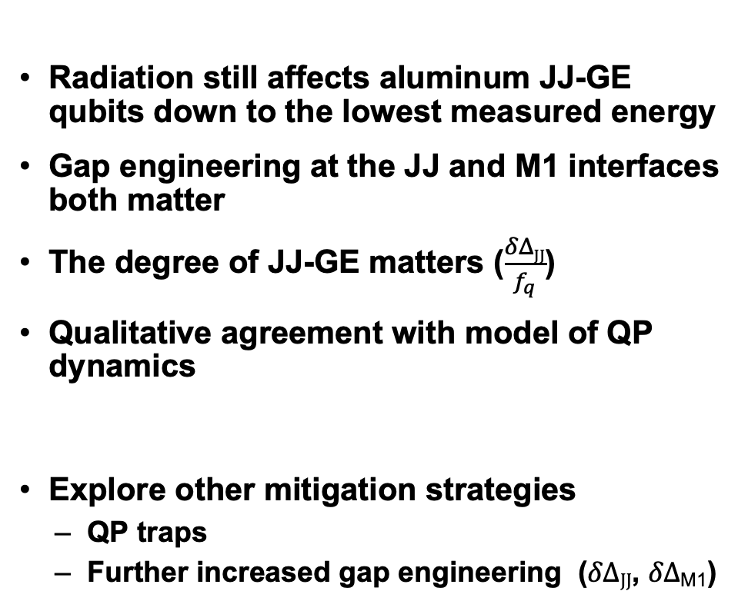
Summary and Future
Summary
Radiation still affects aluminum JJ-GE qubits down to the lowest measured energy
Gap engineering at the JJ and M1 interfaces both matter
The degree of JJ-GE matters ($\frac{δΔJJ}{f_{q}}$)
Qualitative agreement with model of QP dynamics
Explore other mitigation strategies
  QP traps
  Further increased gap engineering ($δΔJJ$, $δΔ$_{M1})
Future

Slide 42
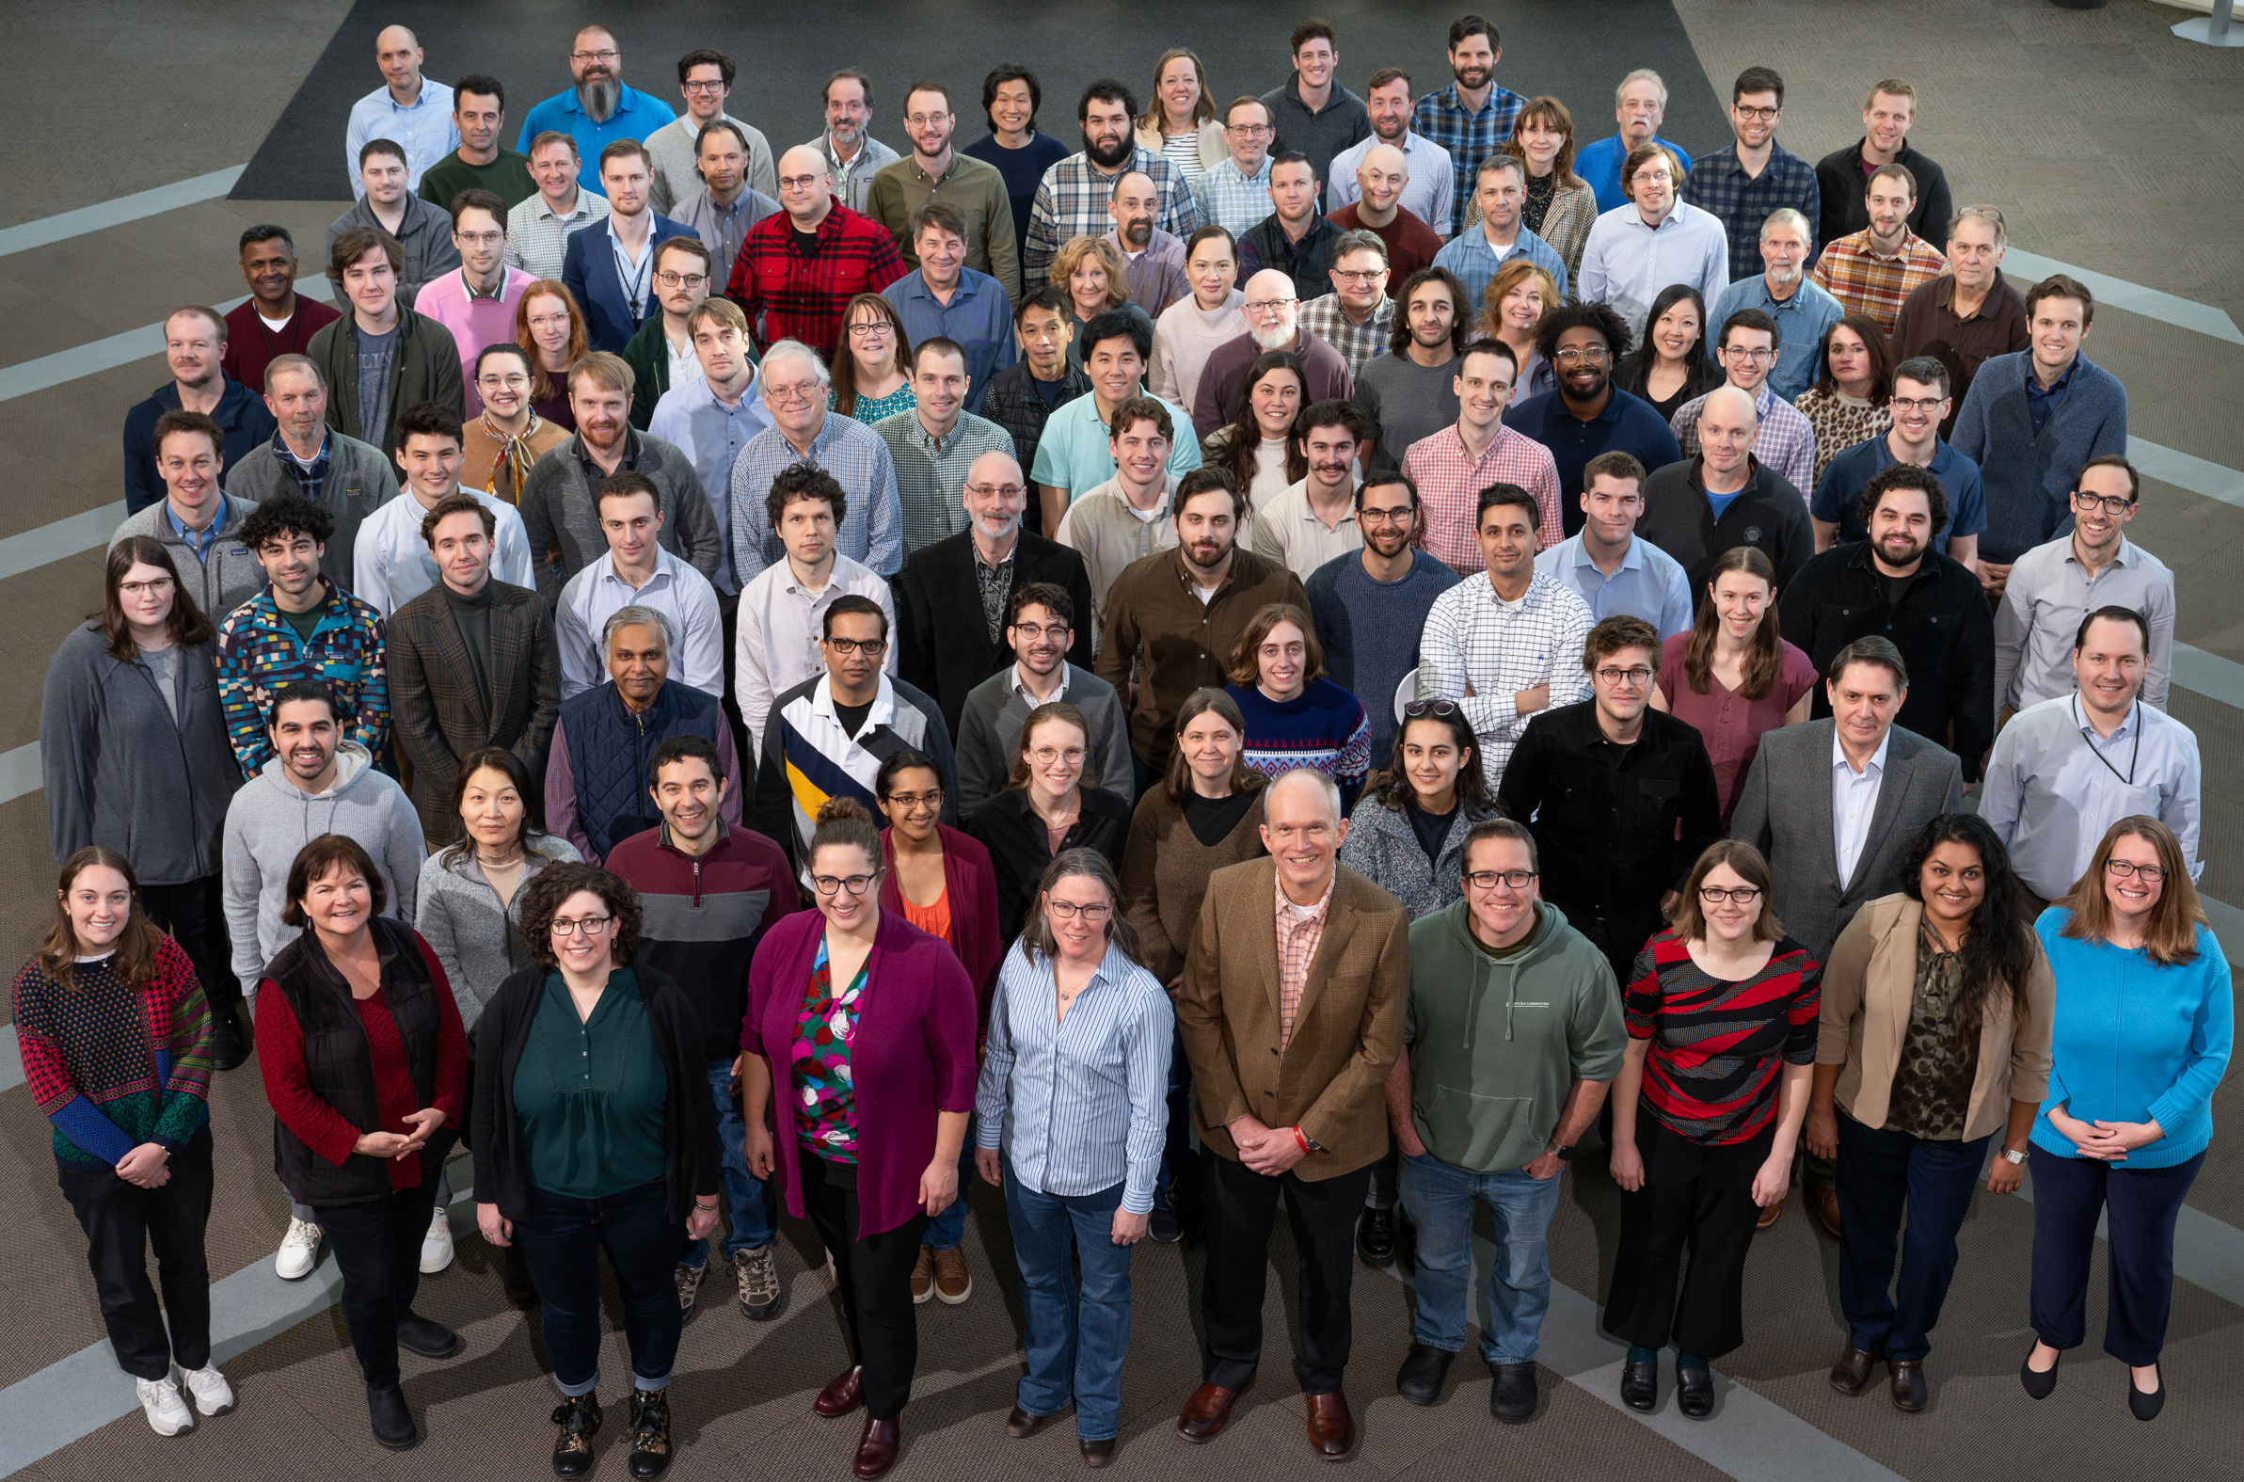
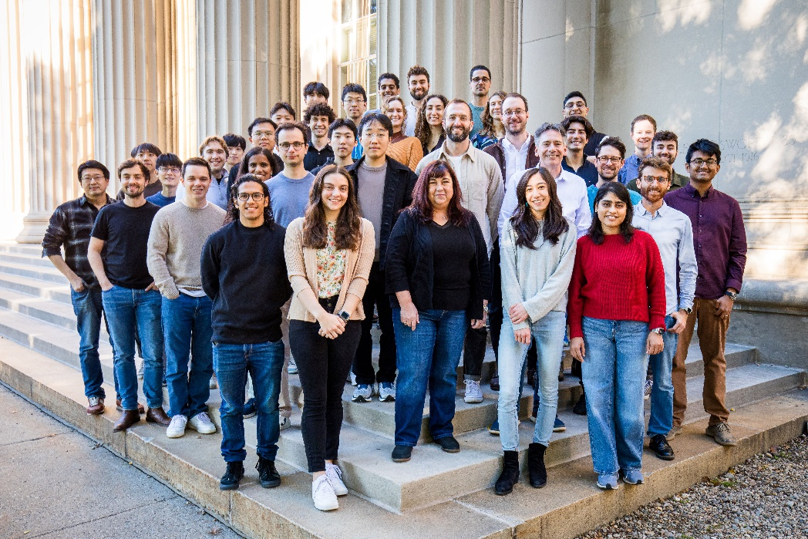
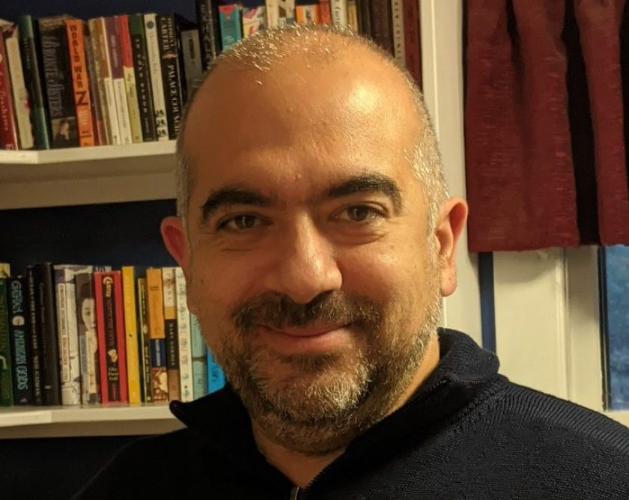
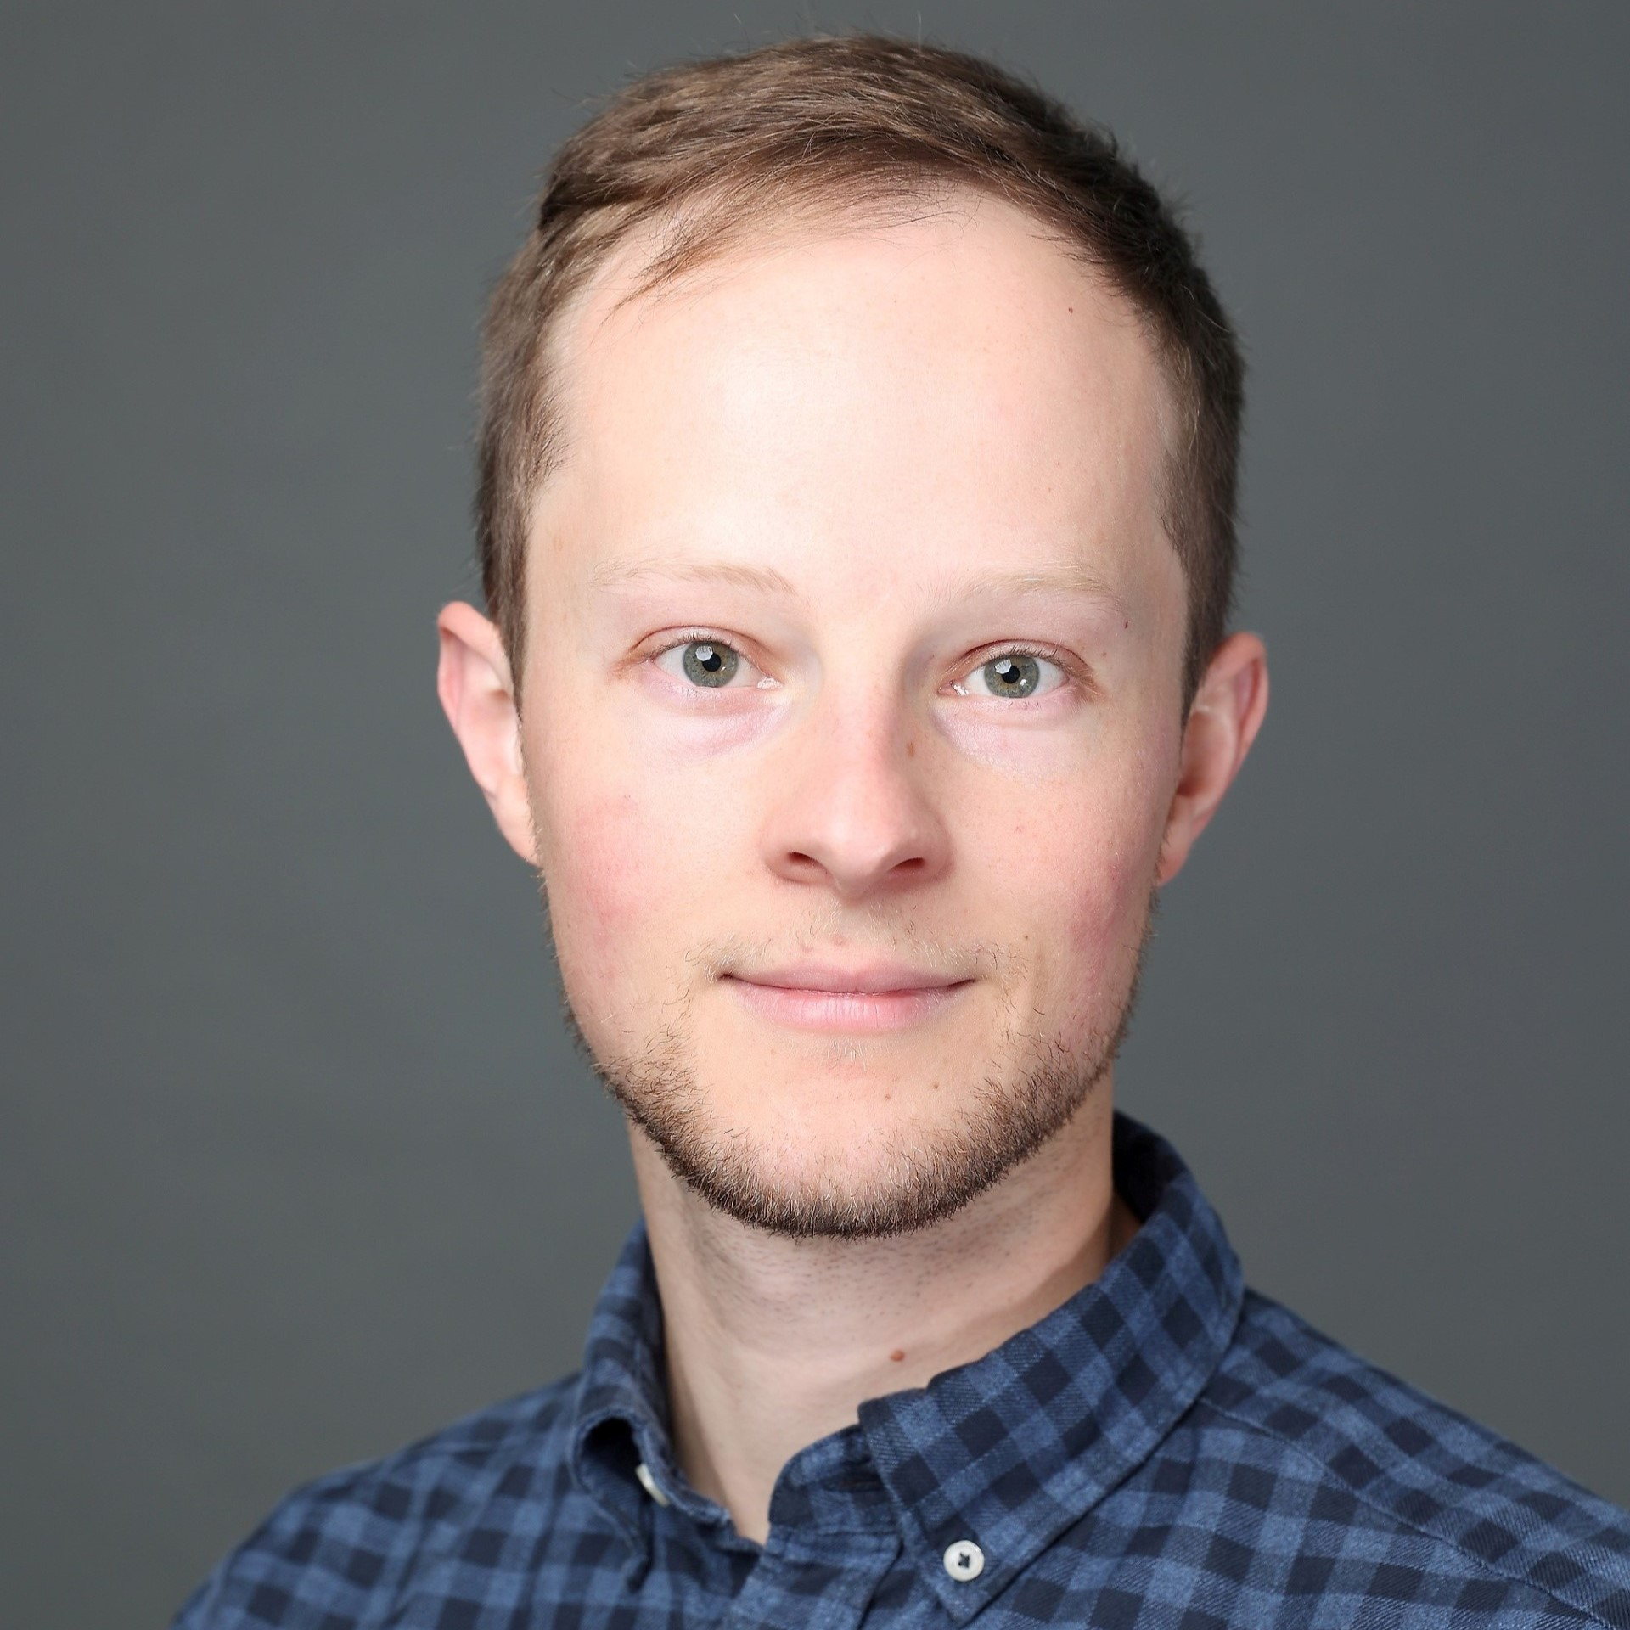
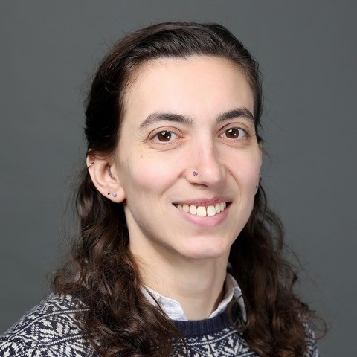
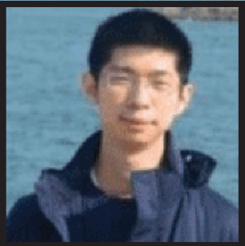
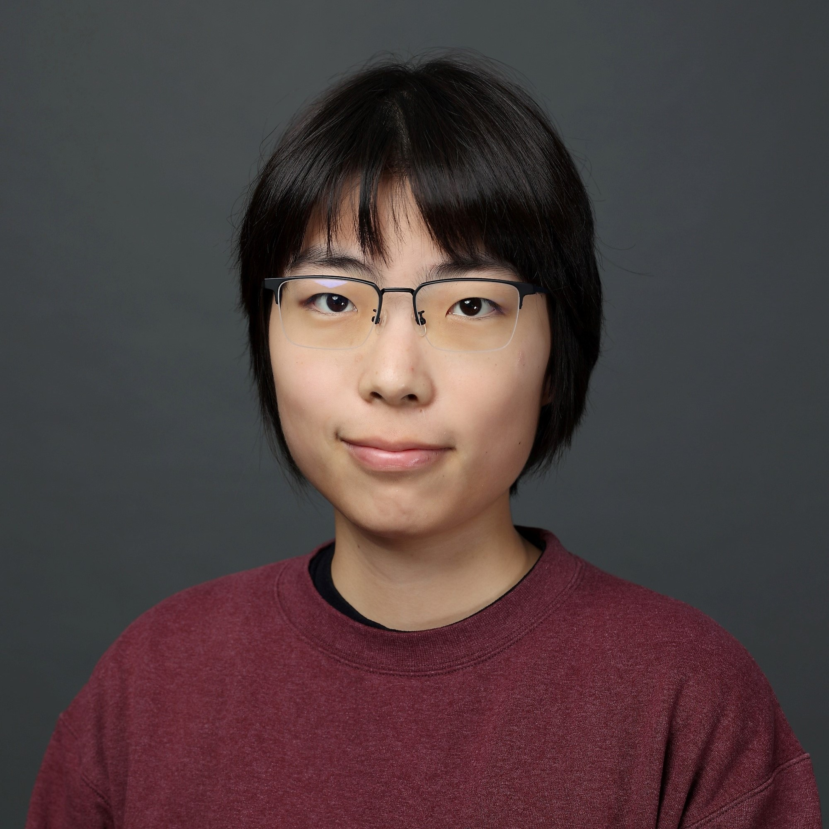





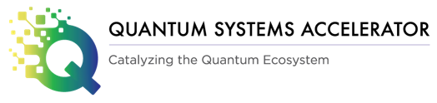



Acknowledgements
Quantum-Enabled Computation Group, MIT-LL
MIT Engineering Quantum Systems (EQuS)
Johns Hopkins Applied Physics Lab
Alan Hunt
Yenuel Jones-Alberty
Tom McJunkin
Kevin Schultz
Formaggio Radqb Group
Joe Formaggio, Doug Pinckney, Hannah Binney, Mingyu Li, Jiatong Yang
Superconducting Qubits Team:
Group Leaders: Mollie Schwartz, Kyle Serniak, Steven Weber, Jonilyn Yoder
Team Leads: Luke Burkhart, Rabindra Das, Michael Gingras, Thomas Hazard, Cyrus Hirjibehedin, Bethany Niedzielski Huffman, Katrina Sliwa, Donna-Ruth Yost
Team: Mike Augeri, Kate Azar, Peter Baldo, Jeffrey Birenbaum, Logan Bishop Van Horn, Tristan Brown, Gregory Calusine, Glenn Carl, Felipe Contipelli, John Cummings, David Danza, Dan Davis, Renée DePencier Piñero, Steven Disseler, Bryce Fisher, Ben Freiman, Jeffrey Gertler, Kevin Grossklaus, Karen Harmon, Mike Hellstrom, Gerry Holland, Jennifer Hritz, Sokharom Huon, Andrew J. Kerman, David Kim, Jeff Knecht, Arthur Kurlej, Duncan Miller, Nathan Miller, Jovi Miloshi, Maddie Morocco, Kevin Obenland, Christopher O’Connell, Mallika Randeria, Matt Ricci, Lila Rodgers, Robert Rood, Gabriel Samach, Meghan Schuldt, Arjan Sevi, Marcus Sherwin, Hannah Stickler, Chris Thoummaraj, Kunal Tiwari, David Volfson, Terry Weir, Zally Yun
Visiting Member: Serra Erdamar
William D. Oliver, Jeff Grover, Max Hays, Patrick Strohbeen, Joel Wang, Terry Orlando, Kyle Serniak, Chihiro Watanabe, Lenore Buck,
Simon Gustavsson (now at Google Quantum AI)
Postdocs: Aziza Almanakly, Réouven Assouly, Fabrizio Berritta, Farid Hassani Bijarbooneh, Jorge Marques, Doug Pinckney, Holly Stemp, Helin Zhang
PhD students: Vaishnavi Addala, Junyoung An, Lamia Ateshian, Kate Azar, William Banner, Cora Barrett, Frederike Brockmeyer, Shoumik Chowdhury, Gabriel Cutter, Andy Ding, Ben Helman, Kotaro Hida, Shantanu Jha, Om Joshi, Harry Kang, Gyunghun Kim, Junghyun Kim, Jonathan Knoll, Maggie Marte, Chris McNally, Miguel Moreira, Sarah Muschinske, David Pahl, Lukas Pahl, David Rower, Chia-Chin Tsai, Hung-Yu Tsao, Beatriz Yankelevich, Sameia Zaman
Undergraduates: Oswin Cervantes, Justin Chen, Catherine Lowe, Mati Yablon
Visiting Member: Mathis Moes, Sein Park, Daniel Rocha, Gabriele Rolleri, Alexander Rommens
Collaborators: Joe Formaggio, Kevin O’Brien (MIT); Ben Loer (PNNL)

