Slide 1
Radioassay of Materials in Superconducting Qubit Systems
Development of α-Decay Calibration Sources for Radiation Upset Studies
Isaac J. Arnquist
Amanda D. French
Lawrence K. S. Horkley
Ben M. Loer
Tyler D. Schlieder
Evan J. Warzecha
Brent A. Vandevender

Slide 2
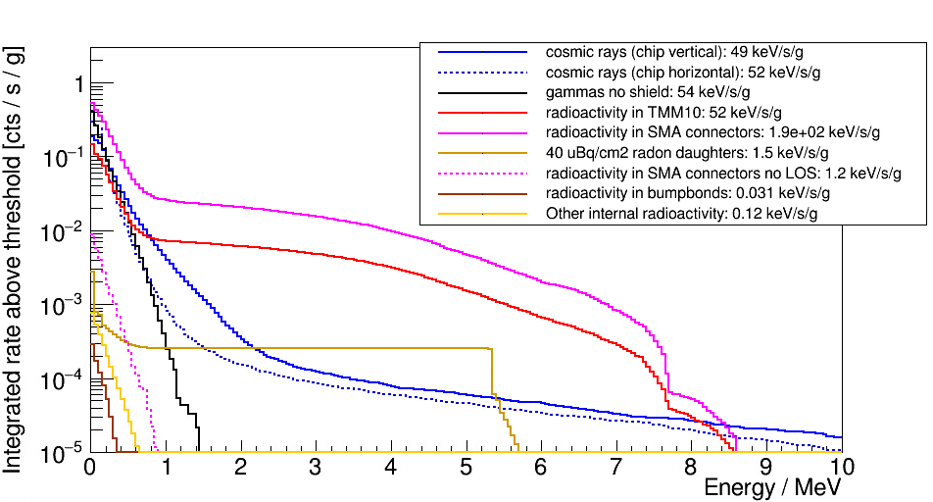
Potential Problematic Radiation Sources
Loer et. al. [1] identified some internal components that can dominate the total radiation budget, especially at higher energies.
Count rate above threshold
External gammas subdominant if insensitive to sub-MeV impacts
Rogers PCB Board
SMA Connector
Typical radon levels
Surface Rn-daughters
Mostly protons and neutrons
Are there other high radioactivity components?
What about cleaner alternatives?
[1] Loer et al., JINST 19 P09001 (2024)
w/ additions stimulated from Poudel, Temples et al. arXiv:2606.00473v1

Slide 3
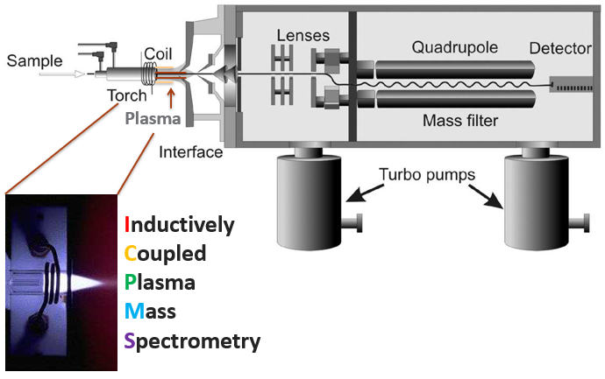
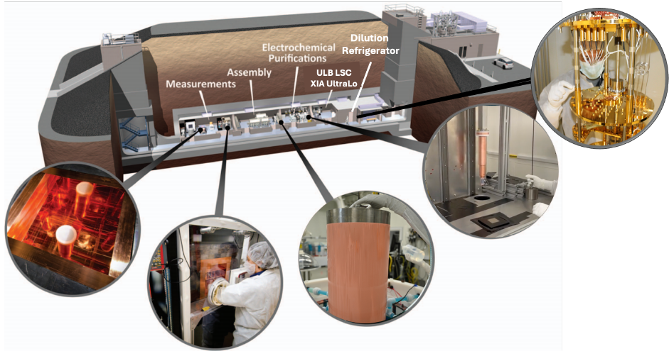
Materials and Assay Capability

Slide 4
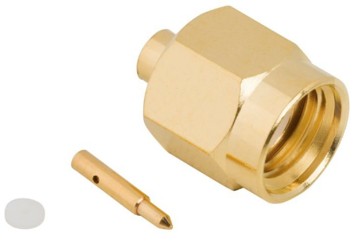
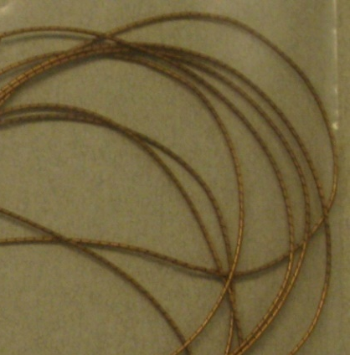
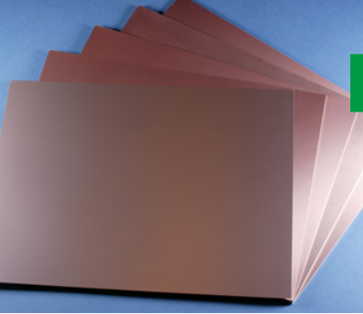
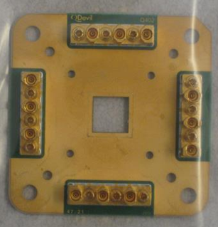
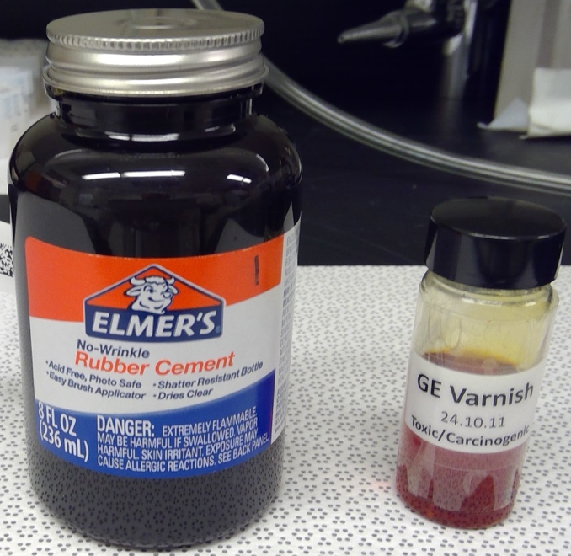
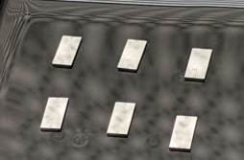
Assessing Material Backgrounds
Component materials have been assayed to understand potential background sources from potential materials near superconducting qubits
 | Activity (Bq/kg)
Material | ²³⁸U | ²³²Th | ⁴⁰K
Spira Gasket (uses CuBe) | 60 | 2 | 0.02
GPPO Connector (has CuBe) | 31 | 1 | 0.2
Rogers TMM10 PCB [1] | 29 | 6 | 17
SMA Connector [1] | 25 | 2.2 | -
Gold PCB | 5 | 8 | 1
Q-Devil PCB | 1 | 1 | 1
NbTi Nut Connector | 1.5 | 0.06 | 0.1
GE Varnish | 0.04 | 0.001 | 0.24
Brass Fastener/Washer | 0.0005 | 0.0002 | 0.0012
Elmer’s Rubber Cement | 0.0004 | 0.0001 | 0.5
Phosphor Bronze Washer | 0.0003 | 0.0002 | 0.0008
OFHC Copper | 0.00005 | 0.00001 | -
Qubits (MIT) | 0.000014 | 0.000007 | -
Silicon | 0.000005 | 0.000001 | -
rogers.com
Any other materials you are curious about? Reach out.
Notes:
Mention clean alternatives

Slide 5
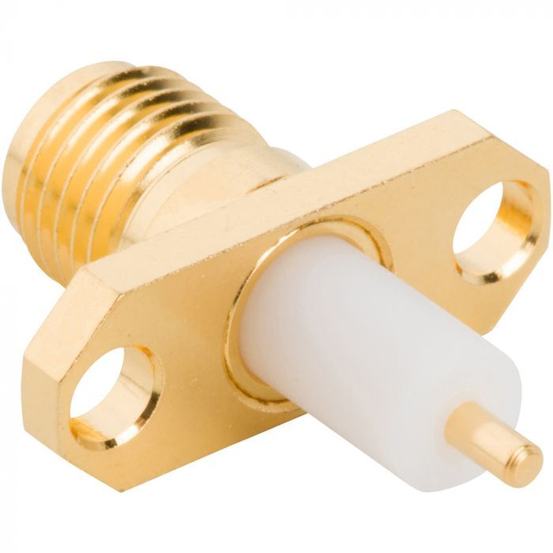
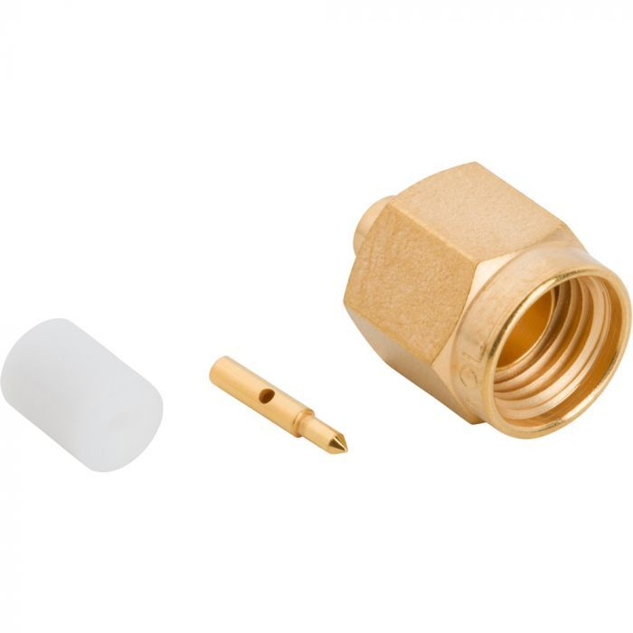
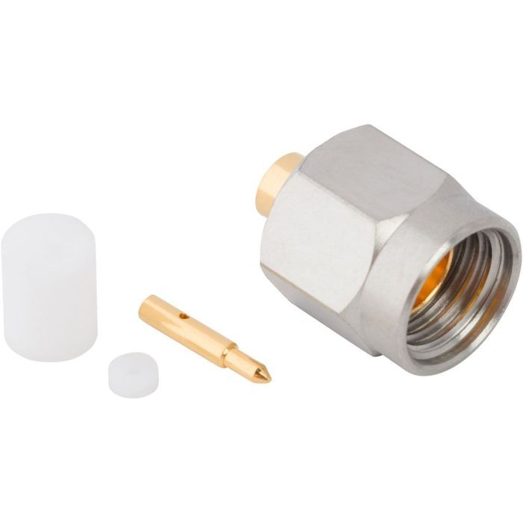
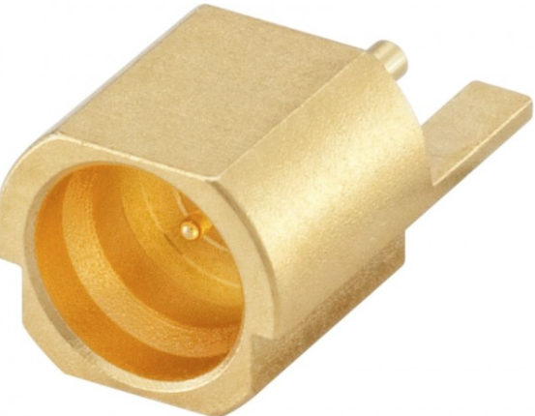
SMA Connectors
Product No. | Tested Material | ²³⁸U (Bq/kg) | ²³²Th (Bq/kg)
132147-29 | All (w/ Cu Be pin) | 0.30 | 0.01
901-9201-2A | Nut Portion w/CuBe | 0.20 | 0.06
901-9201-2A | CuBe Pin | 31 | 1.1
132101 | Brass Nut Portion | 0.0006 | 0.00005
132101 | Brass Pin | 0.00006 | 0.00011
132248 | Steel Nut Portion | 0.004 | 0.002
132248 | CuBe Pin | 0.003 | 0.0002
19S202-40ML5 | All (no CuBe) | 0.00004 | 0.00002
Take Home Message: When in doubt choose non-CuBe options
Caution: Copper beryllium is used in more than just connectors

Slide 6
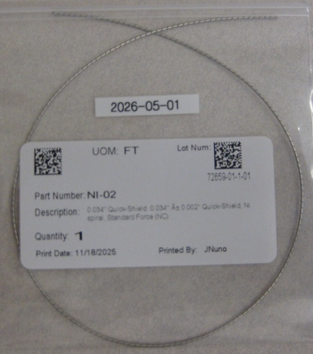
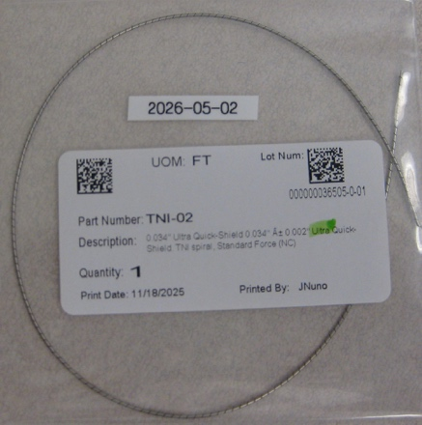
Potential Alternative Spira Shields
 | Activity (Bq/kg)
 | ²³⁸U | ²³²Th | ⁴⁰K
SS Spira Shield | 0.014 | 0.004 | 0.3
Sn-Pb Coated SS Spira Shield | 0.04 | 0.02 | 3
Cu-Be Spira Shield | 60 | 2 | 0.02

Slide 7
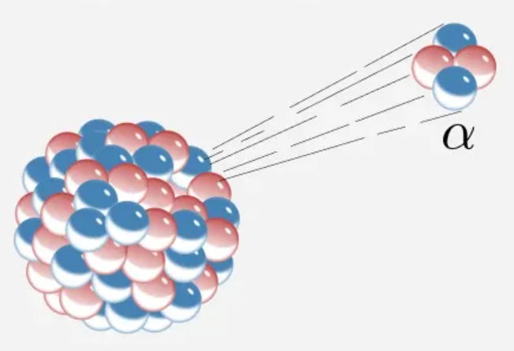

Slide 8
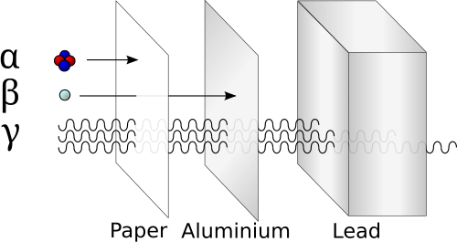
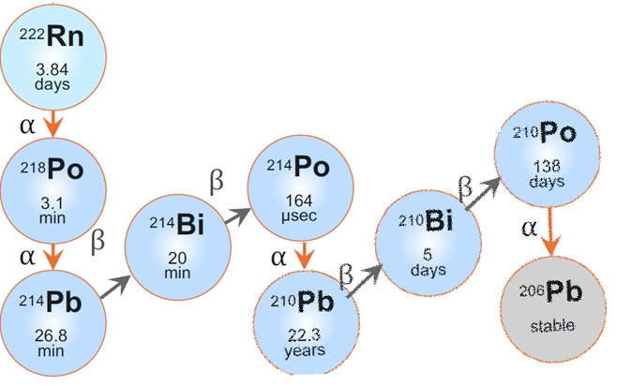
Considerations for Testing α-decay in Quantum
Balancing Line of Sight vs Contamination Risk
Which alpha-emitter to employ?
  “Goldilocks” half-life…not too short, not too long
  Controlled Experiment: α-decay → stable nuclide
5.3 MeV pure alpha emitter
“Let it Rnain” vs Wet Chemistry Methods for source creation

Slide 9
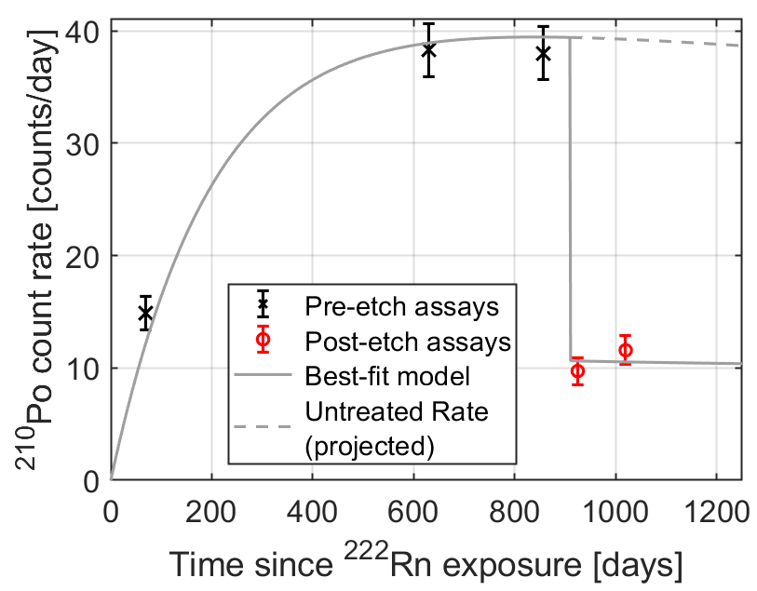
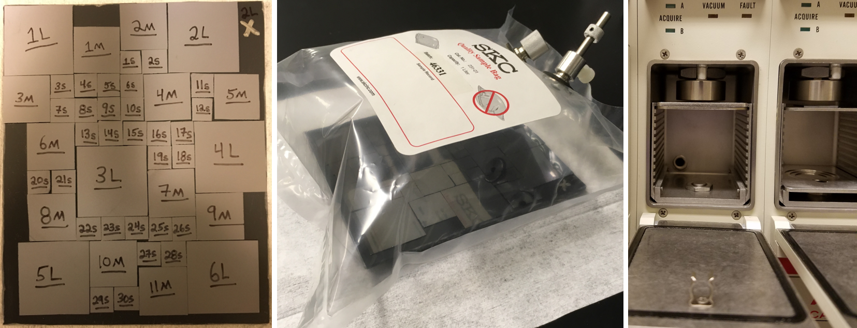
²¹⁰Po α-source: Rn Daughter In-Growth Approach
²²²Rn
Direct (Amplified) Replication for Studying Rn-daughter concerns
Takes Time. Less control. Potential Long-lived Contamination (²¹⁰Pb ejecta)
Exploration of methods to remove implanted ²¹⁰Pb and ²¹⁰Po contamination from silicon surfaces Arnquist, Bunker, et al. NIMA 2024
Accelerating Surface Radiation Content to Investigate the Impact of Radon Progeny on Superconducting Qubits Poudel, Temples et al. arXiv:2606.00473v1

Slide 10
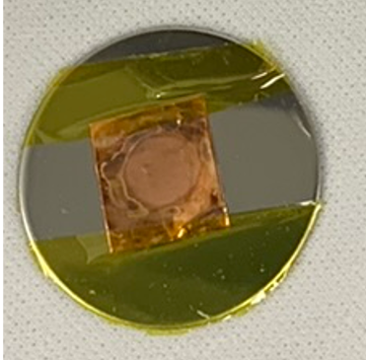
²¹⁰Po alpha source: Wet Chemistry Approach
Smooth the copper surface through polishing
Rinse/Dry Cu Coupon
Mask Opposite Side
Add Cu to Solution
Validate ²¹⁰Po activity using PIPS Detector
Heat at ~80 ºC for 4 hr
Dilution of ²¹⁰Po
Standard
Multiple copper coupons with deposited ²¹⁰Po can be made in a batch.
Various shapes/sizes can be accommodated. Interested? Let us know.
PNNL Max target activity to be at releasable levels is 20 dpm.

Slide 11
Key Takeaways
To be safe, stay away from…
…CuBe components, particularly with line-of-sight to qubit substrate
…ceramics
Low background options have been identified and are available
Reach out if you have materials you are worried about
An easy-to-employ alpha source using ²¹⁰Po was developed for R&D into understanding impacts from alpha radiation.
  See Sam’s talk next showcasing α effects
  Let us know if you would like one for study (e.g., in gap-engineered systems)
We are open to collaborating on material background challenges and/or the creation of novel sources using our rad-chemistry expertise

