Slide 1




Investigating Effects of Gamma Radiation on Spin Qubits in HRL SLEDGE Devices
J. J. Lou^{1,2}*, A. R. Mills¹, R. Oszwaldowski¹, J. J. Lutz³, S. Misra³, P. A. Sharma³, R. M. Jock³, E. Acuna⁴, M. D. Reed⁴, S. G. Carter¹
¹Laboratory for Physical Sciences, College Park, MD 20740
²Quantum Collaborative Research Corps, Dept of Physics, University of Maryland, College Park, MD 20740
³Sandia National Lab, Albuquerque, NM 87123
⁴HRL Laboratories, LLC, Malibu, CA 90265
Notes:
Break down authors into institutions

Slide 2
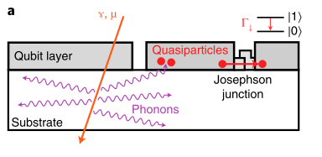
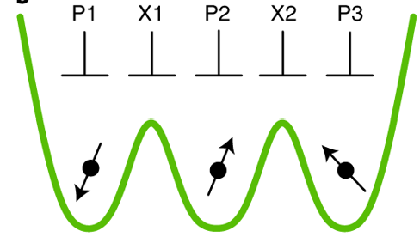
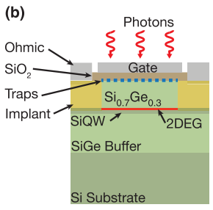






Radiation effects: Motivation
High energy particles (cosmic rays, gamma rays) are difficult to shield against
For superconducting qubits, radiation can cause errors for many qubits at once
Problem for error correction
gates and “other stuff” $1μm$
$HfO_{2}$ , 4.8 nm
$${Si}_{0.7}{Ge}_{0.3} , 60nm$$
${Al}_{2}O_{3}$, 2.4nm
$${Si}_{0.7}{Ge}_{0.3} , 170nm$$
$$QW, 3nm$$
CMP interface
$${Si}_{x}{Ge}_{1−x} graded buffer, 4μm$$
Compton e-
e-h pairs
$$Si$$
$ρ=3−5kΩ⋅cm at T_{R}$, n-type
$$γ$$
M. McEwen et al,” Nature Physics 18, 107-111 (2022)
NIR laser illumination of SiGe quantum dot
Not as much is known about radiation effects on spin qubits
Obvious effect is that electrons and holes produced by particles can affect device
Carriers can fill charge traps, shifting the potential of the dots
Potential shifts can mess up readout, calibration of gate pulses
May produce correlated effects across many dots
Observed for low energy photons
M. A. Wolfe et al, PR Applied 22, 034044 (2024)

Slide 3
Outline
Radiation induced charge sensor offset shift
Correlated charge sensor jumps
Preliminary Exchange-Only Qubit results

Slide 4
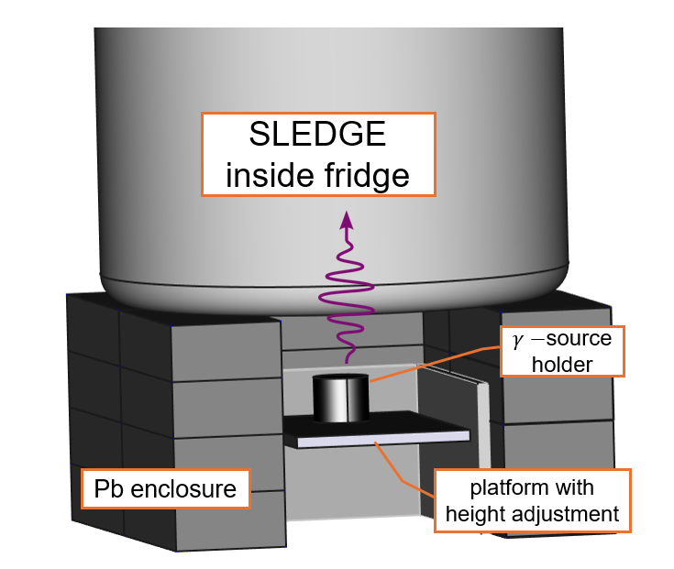
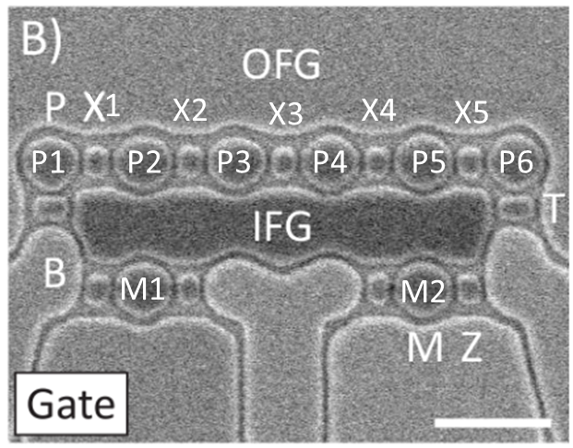
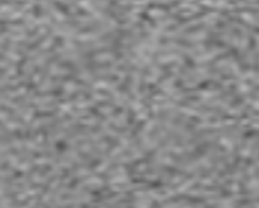

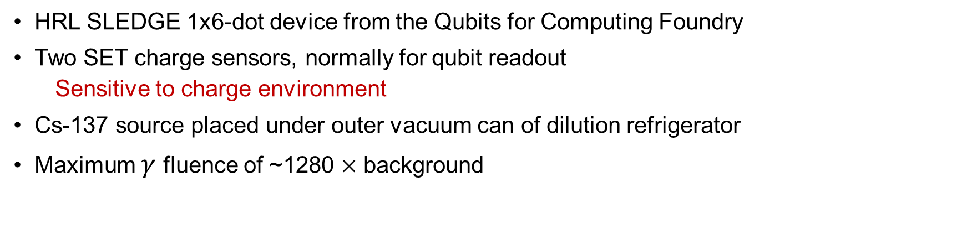
Device and Setup
HRL SLEDGE 1x6-dot device from the Qubits for Computing Foundry
Two SET charge sensors, normally for qubit readout
  Sensitive to charge environment
Cs-137 source placed under outer vacuum can of dilution refrigerator
Maximum $γ$ fluence of ~1280 $×$ background
Qubits
$$γ$$
B1
M1
M2
B3
Baths
B2
charge sensors
Notes:
Interleaved measurements
Scanning one sensor then the other within 50ms of each other

Slide 5
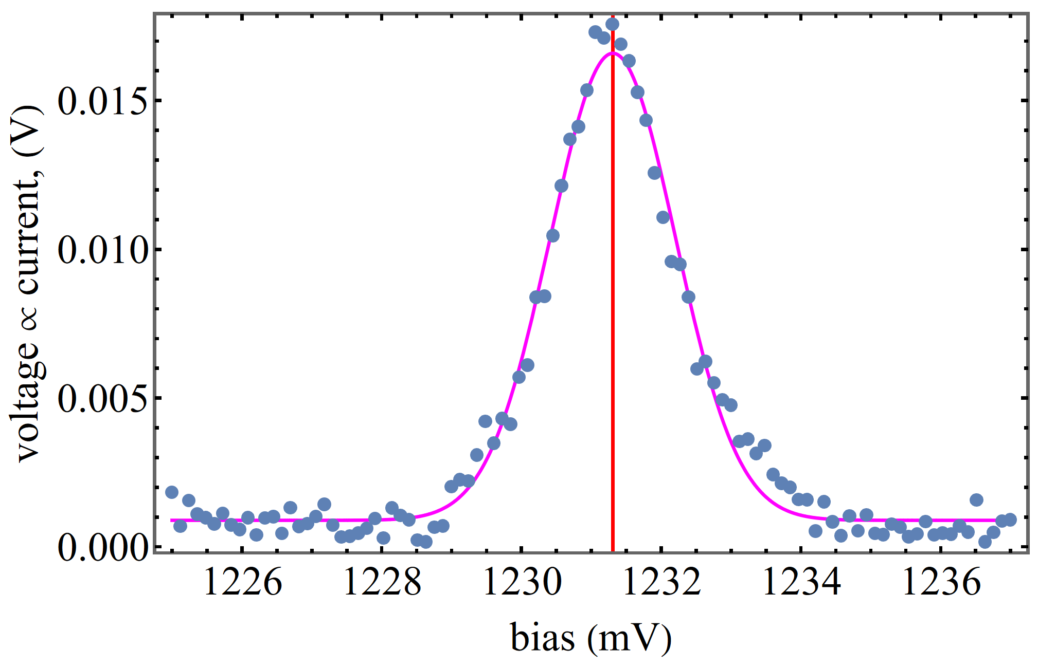
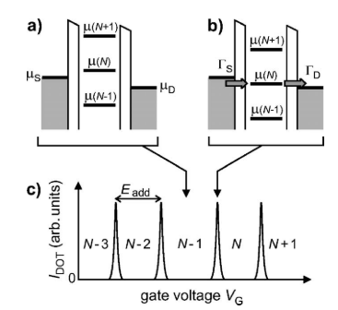
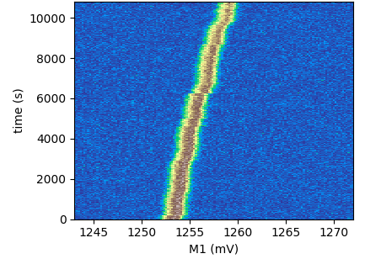


SET Charge Sensor Measurement
B1
M1
M2
B3
$$μ_{D}$$
B2
$$μ_{S}$$
R. Hanson et al, RMP 79, 1217-1265 (2007).

Slide 6
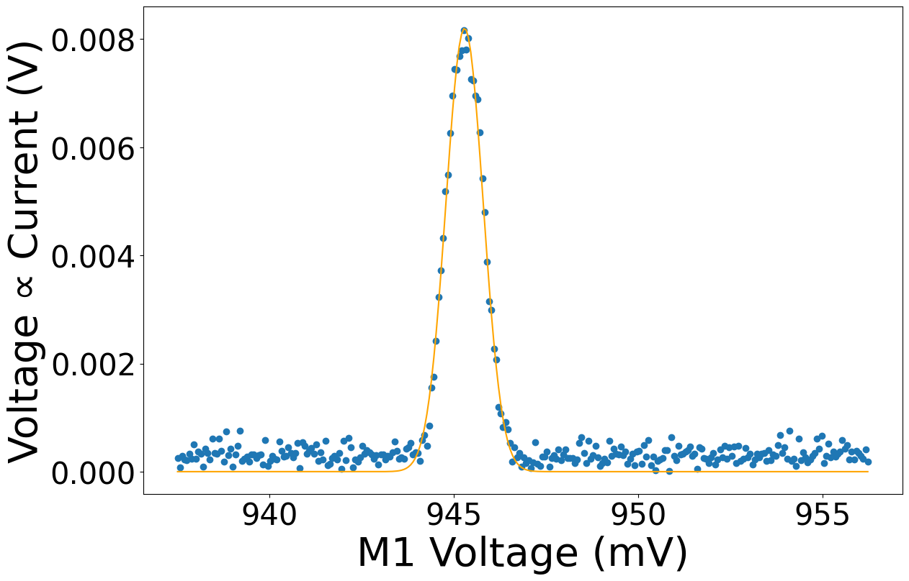
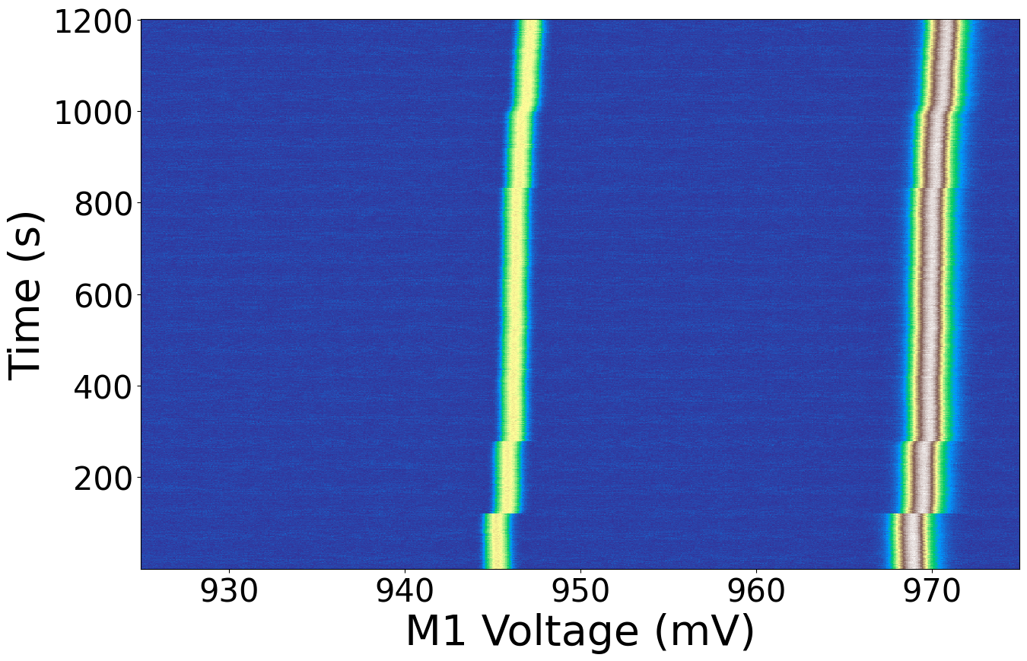
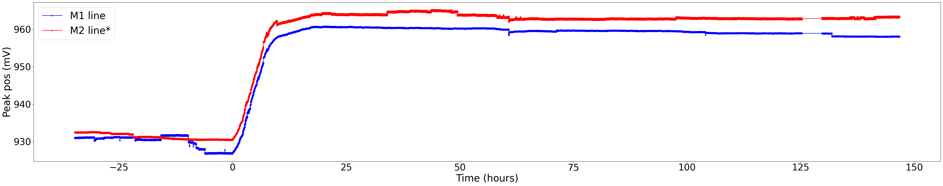
Overall Drift
M1
M2
*added offset for clearer comparison
No radiation
Full γ
No radiation
Sensor sweeps are interleaved
Scanning one sensor then the other within 50ms of each other
Simultaneously track peak positions of both SETs
Initial shift up → plateau/saturates
Both sensors show same behavior
No further shifts after removing source
Notes:
Data shows filling and saturation of charge traps
Shift upwards suggests electron trapping causing shift
No shift after removing source → deep trap (relative to 10mK)
Fairly flat/stable b4 rad
M1 jumping around bc of other measurements taken before
Sudden shift when source introduced
Plateaus
Talk about Compton scattering + secondary electrons and holes → fills traps
Shifts energy of dots
Eventually fill all traps

Slide 7







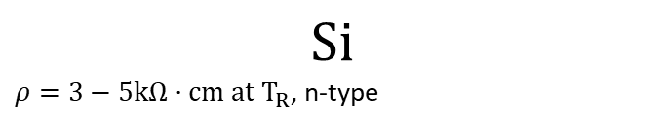

Model for threshold shift based on trapped charge
gates and “other stuff” $1μm$
$HfO_{2}$ , 4.8 nm
${Al}_{2}O_{3}$, 2.4nm
$${Si}_{0.7}{Ge}_{0.3} , 60nm$$
$$QW, 3nm$$
$${Si}_{0.7}{Ge}_{0.3} , 170nm$$
Gamma irradiation produced a quasistatic voltage shift.
Implies e-h pairs are liberated and trapped in the Si/SiGe device stack.
  Looked at oxide, chemical mechanical polishing (cmp), and graded buffer layers as potential trapping layers
Goal is to simulate the microphysics for prediction of the threshold shift.
CMP interface
$${Si}_{x}{Ge}_{1−x} graded buffer, 4μm$$
Compton e-
e-h pairs
$$γ$$
$$Si$$
$ρ=3−5kΩ⋅cm at T_{R}$, n-type

Slide 8
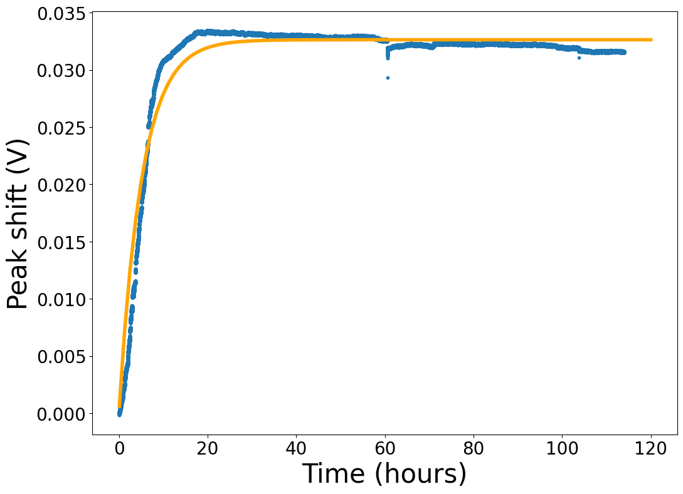
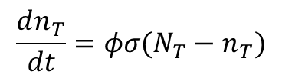
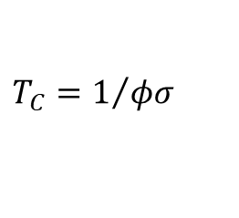
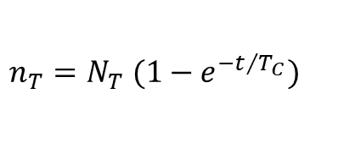
Fit to threshold shift data and materials parameters
Model with trapping at the CMP layer is shown, other trap locations can be considered
Model for CMP trapping
Trapped charge sheet
Fit data to rate equation
${n_{T}=N}_{T} (1−e^{−t/{T_{C}}})$
$$\frac{dn_{T}}{dt}=φσ(N_{T}−n_{T})$$
Potential
$$T_{C}=1/{φσ}$$
60 nm
Charge flux
From G4CMP
Trap xsection
# available traps
# filled traps
oxide
well
Vertical stack profile
Electrostatic modeling used to calculate voltage shift from trapped charges
A fitting procedure was developed to estimate materials parameters given a trapping model.
  Trap density
  Trap cross section
Shape of curve due to filling and saturation of charge traps in device

Slide 9
Outline
Radiation induced charge sensor offset shift
Correlated charge sensor jumps
Preliminary Exchange-Only Qubit results

Slide 10
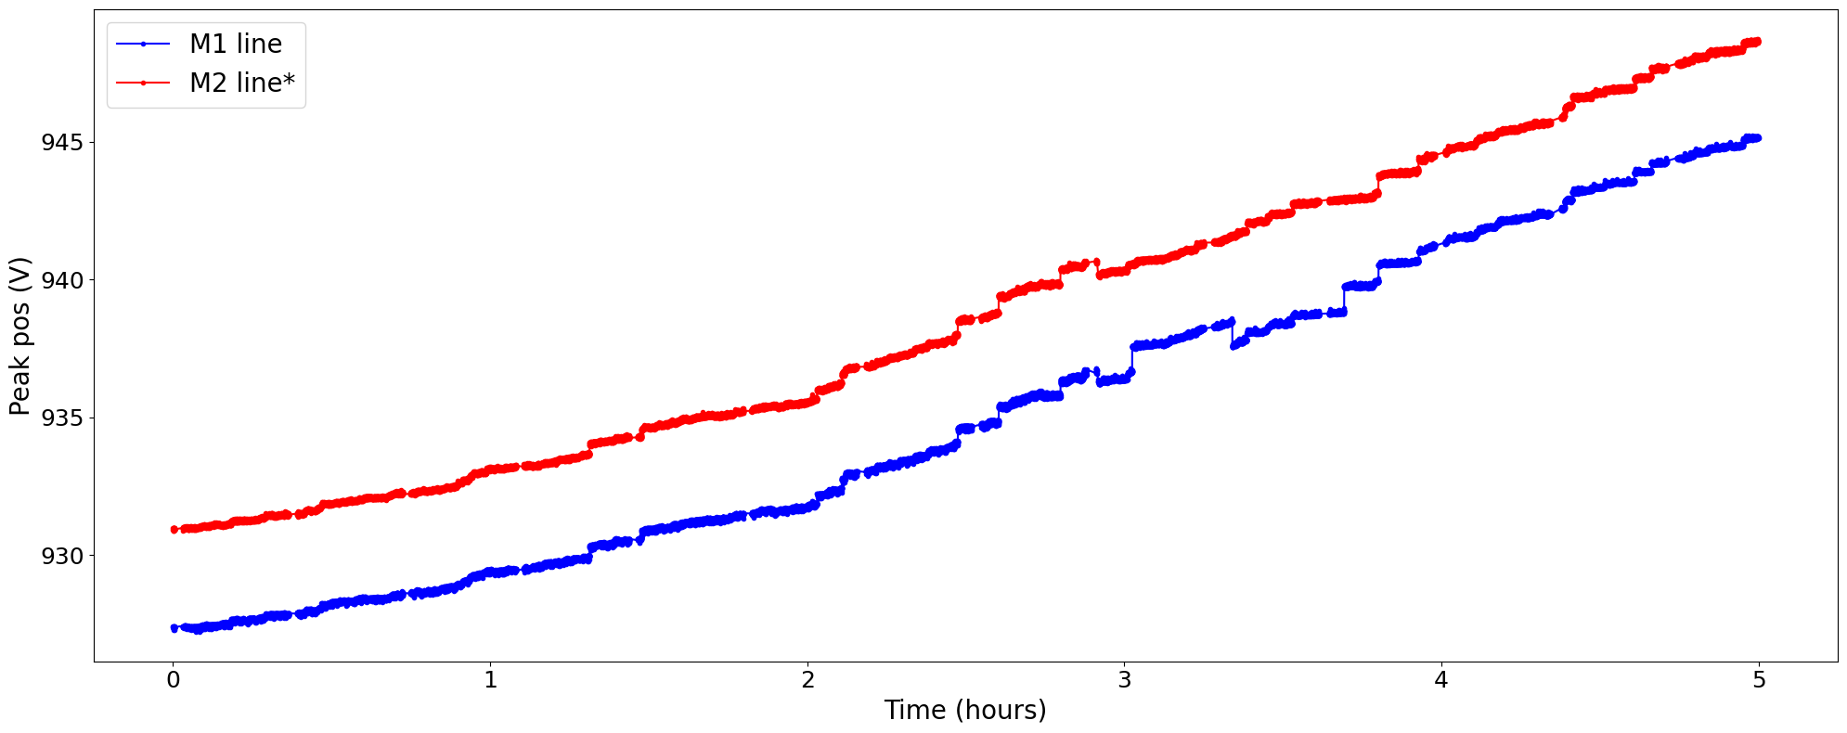
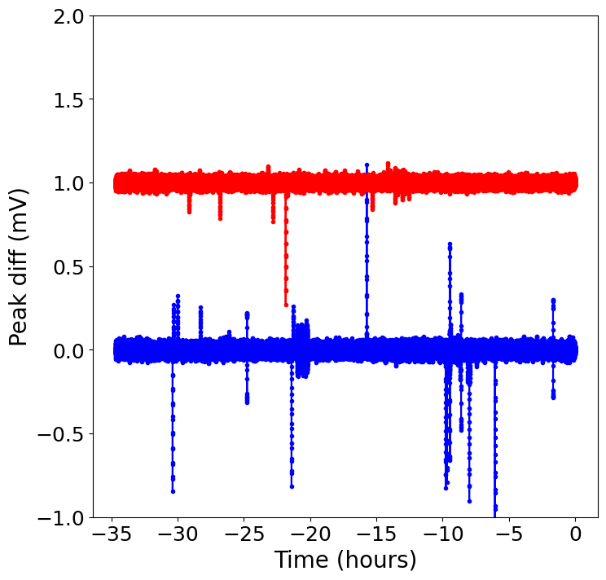
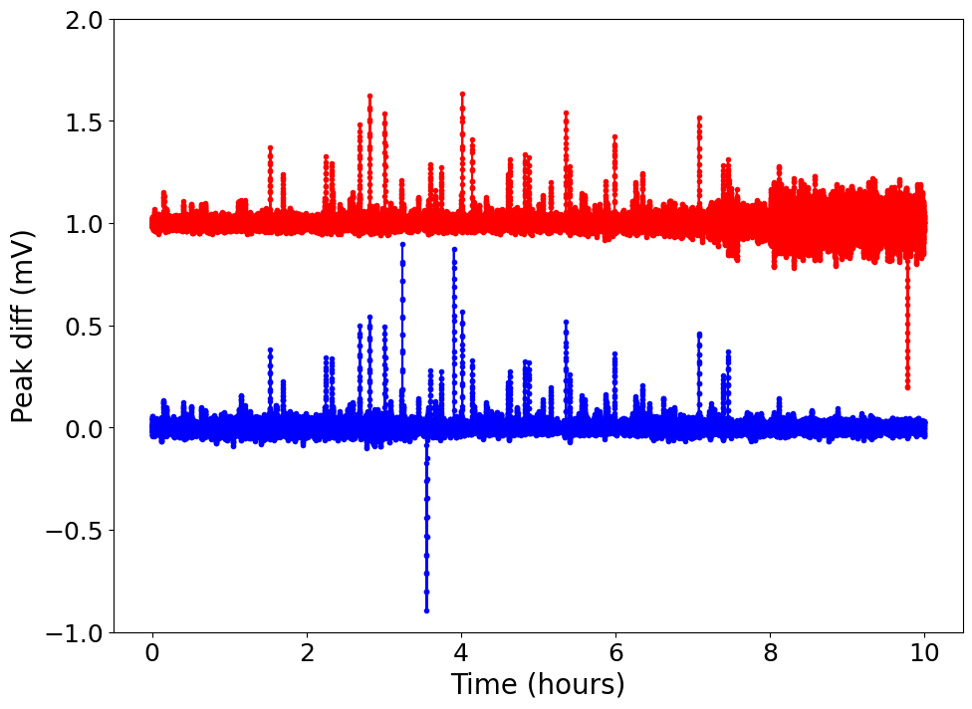
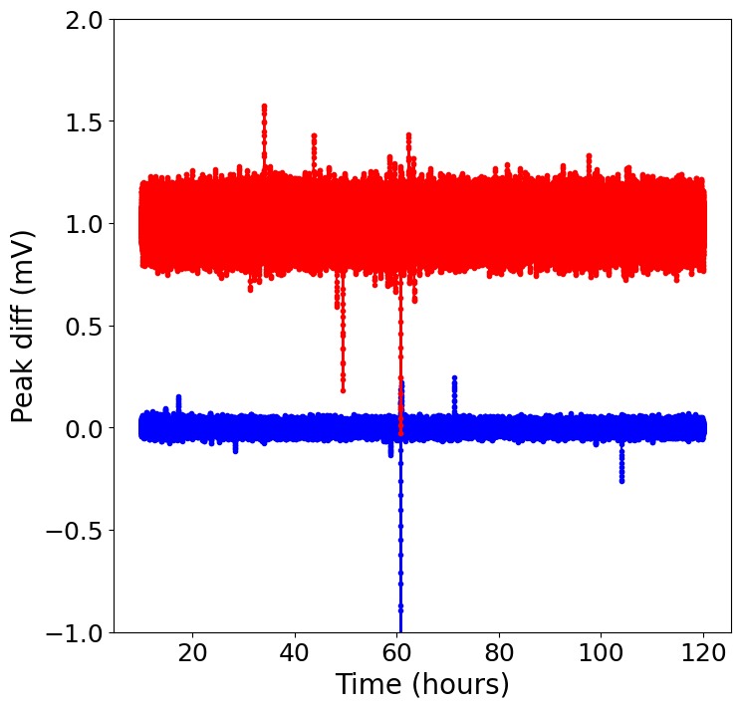
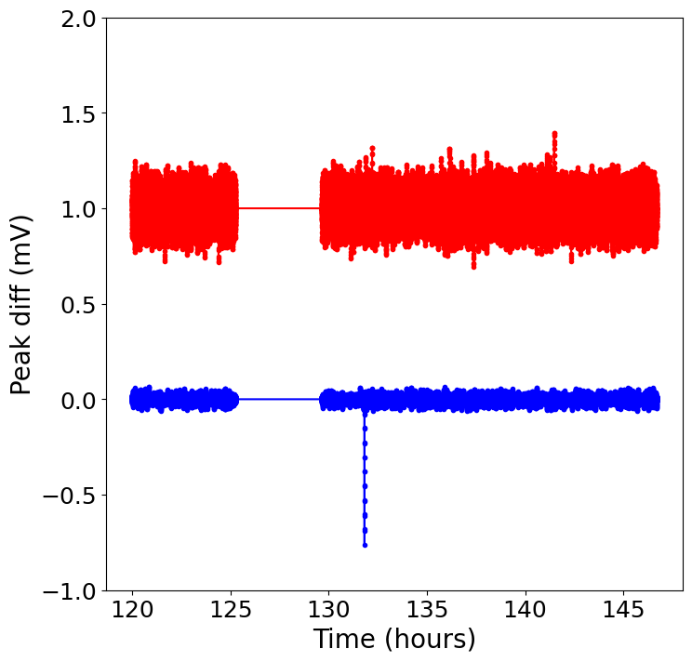
Jumps
No radiation
Radiation
No radiation
Radiation, shifting
Full γ, plateau
No radiation
No radiation
Notes:
Noise in plateau due to sensor peak amplitude decreasing → fitting noisier

Slide 11
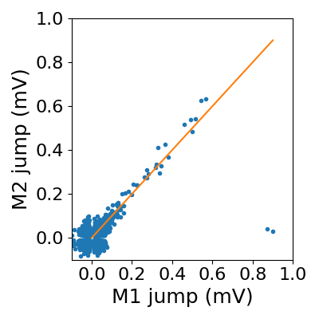
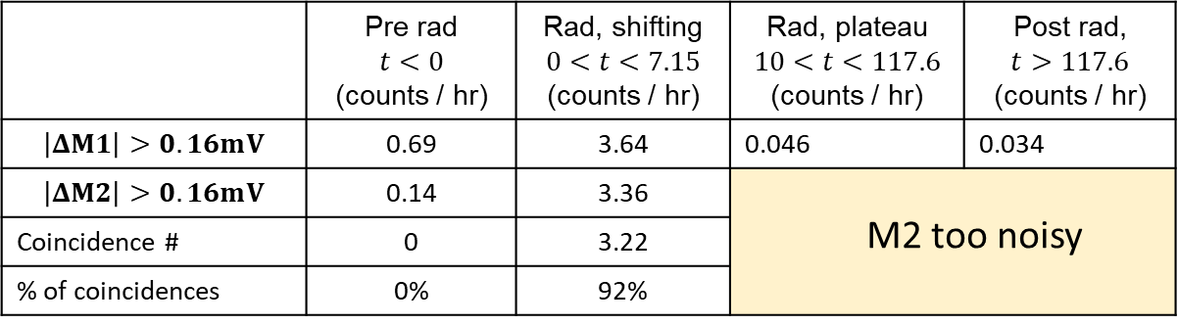
Jumps: Correlations
Jump threshold = 0.16 mV
 | Pre rad $$t<0$$ (counts / hr) | Rad, shifting $$0<t<7.15$$ (counts / hr) | Rad, plateau $$10<t<117.6$$ (counts / hr) | Post rad, $$t>117.6$$ (counts / hr)
$$\left|ΔM1\right|>0.16mV$$ | 0.69 | 3.64 | 0.046 | 0.034
$$\left|ΔM2\right|>0.16mV$$ | 0.14 | 3.36 | M2 too noisy
Coincidence # | 0 | 3.22
% of coincidences | 0% | 92%
Interleaved measurements → detect correlations
No coincidences before source is put under fridge
Jumps are highly correlated!
Very few jumps during plateau with or without source
Notes:
M2 noisy bc signal gets too small while shifting
If asked, coincidence are jumps within a ~1s of each other (based on scan rate)

Slide 12
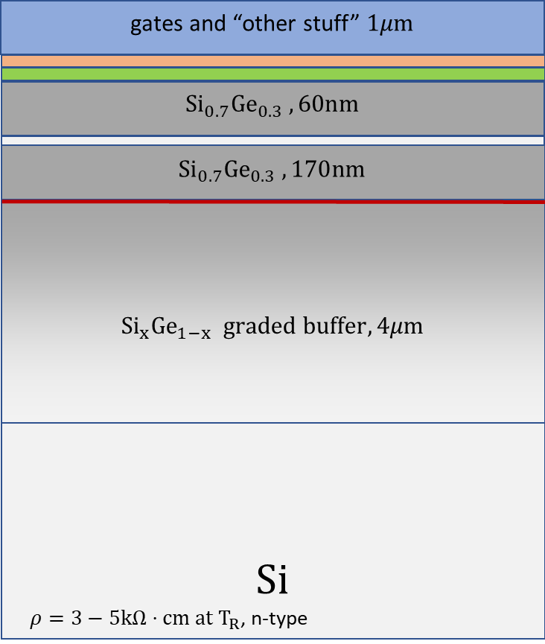
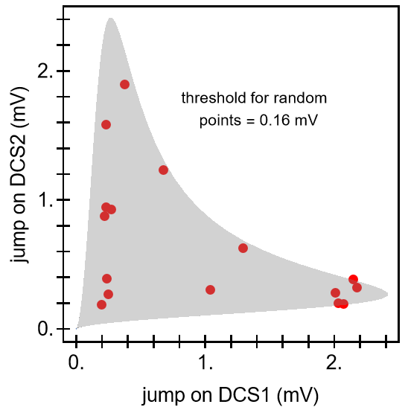
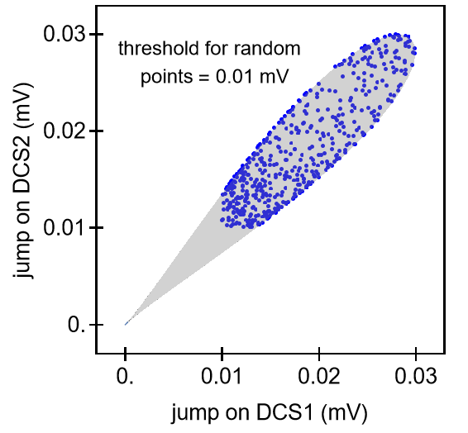
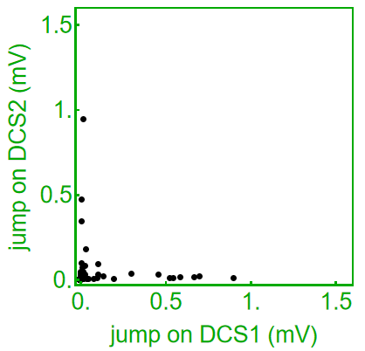
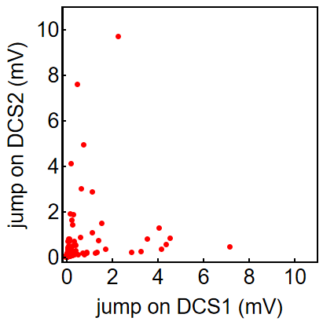
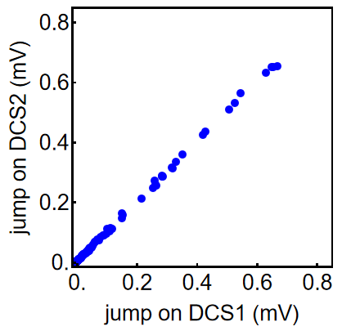
Picture for correlated jumps
Rafal Oszwaldowski
Consider simple analytical model for jumps:
Place electron at different locations, along with image charge
Calculate change in potential energy at each charge sensor
Convert to gate voltage from lever arm
Consider jumps from one electron and multiple electrons
M1
M2
Gate oxide (60 nm)
CMP layer (170 nm)
Graded buffer (@ 2 μm)
Single electron
Experiment
Multiple electrons
Notes:
Gate oxide -

Slide 13
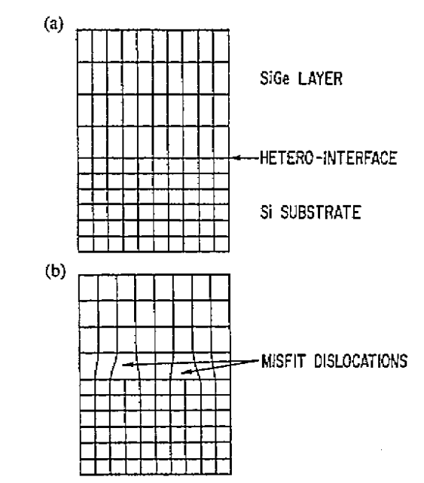
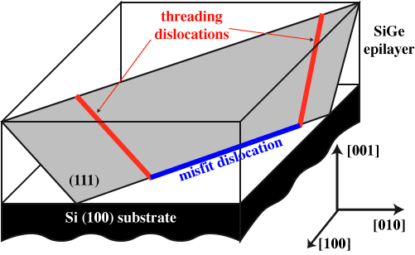


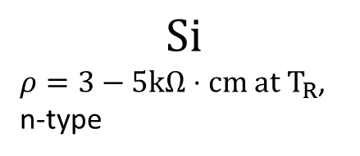







Traps in the graded buffer
$HfO_{2}$ , 4.8 nm
gates and “other stuff” $1μm$
${Al}_{2}O_{3}$, 2.4nm
$${Si}_{0.7}{Ge}_{0.3} , 60nm$$
$$QW, 3nm$$
$${Si}_{0.7}{Ge}_{0.3} , 170nm$$
CMP interface
https://userweb.eng.gla.ac.uk/douglas.paul/SiGe/misfit.html
$${Si}_{x}{Ge}_{1−x} graded buffer, 4μm$$
$\text{(}\text{0}\text{0}\text{1}\text{)}\text{, }\text{stack} =760μm$
P.M. Mooney, Materials Science and Engineering, R17 (1996) 105-146
$$Si$$
$ρ=3−5kΩ⋅cm at T_{R}$,
n-type
Graded buffer grown because of lattice mismatch between $Si_{0.7}Ge_{0.3}$ and $Si$
The graded buffer has many misfit dislocations
Dislocations act as charge traps
Each jump observed corresponds to multiple traps filling
Notes:
Usually care about threading dislocations bc appear on surface
Misfit dislocations can’t be ignored when thinking about radiation effects in Si/SiGe devices
4e13 cm-3

Slide 14
Outline
Radiation induced charge sensor offset shift
Correlated charge sensor jumps
Preliminary Exchange-Only Qubit results

Slide 15
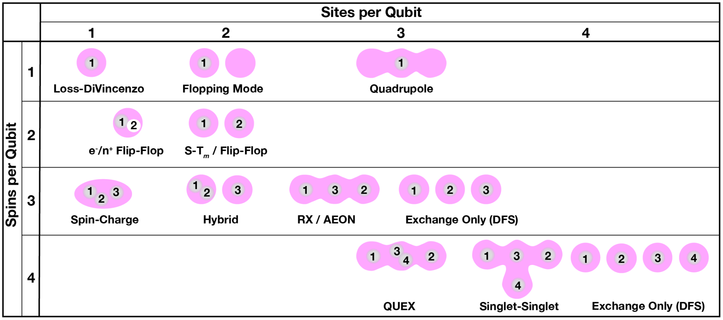
Spin Qubit Encodings
Loss-DiVincenzo
1-spin
AC mag field driving
Micromagnet needed
Sensitive to mag and charge noise
Exchange-only
3-spins
Full electrical baseband control
No micromagnet needed
Insensitive to global magnetic field noise
Burkard et al, Rev. Mod. Phys. 95, 025003 (2023)

Slide 16
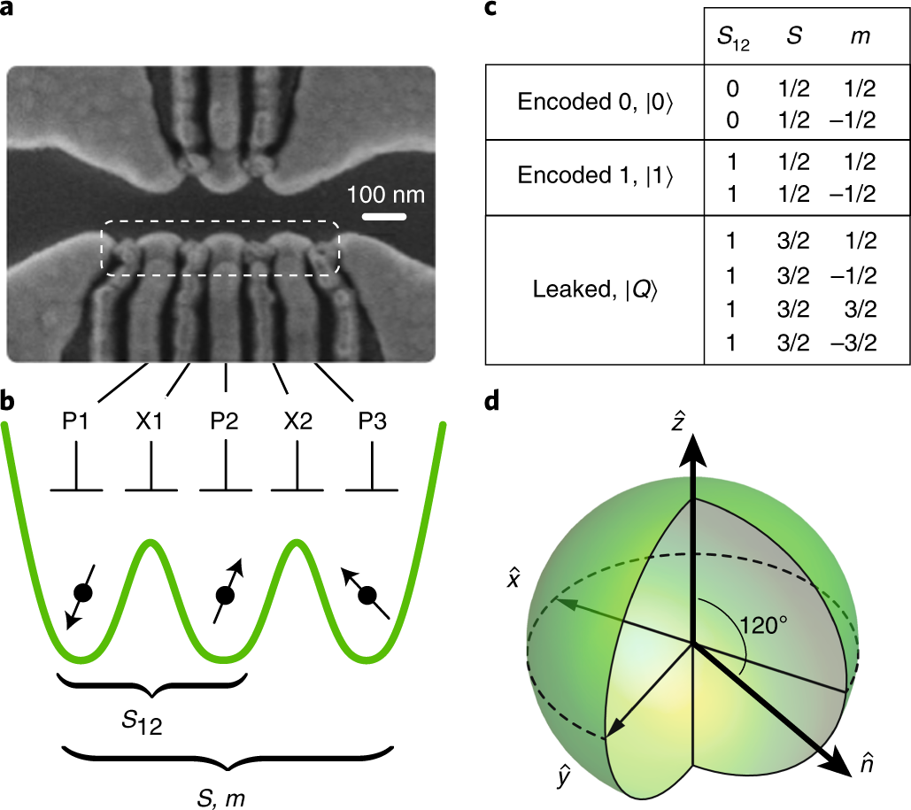
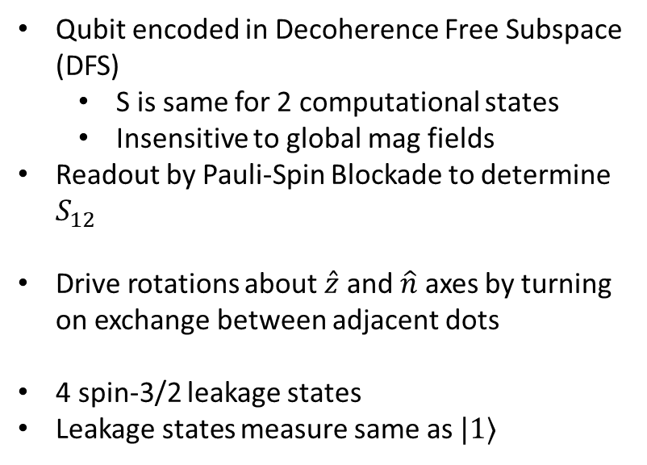
Exchange-Only Qubit Encoding
Qubit encoded in Decoherence Free Subspace (DFS)
  S is same for 2 computational states
  Insensitive to global mag fields
Readout by Pauli-Spin Blockade to determine $S_{12}$
Drive rotations about $\hat{z}$ and $\hat{n}$ axes by turning on exchange between adjacent dots
4 spin-3/2 leakage states
Leakage states measure same as $|1⟩$
Andrews, R.W., Jones, C., Reed, M.D. et al., Nat. Nanotechnol. 14, 747–750 (2019).
Notes:
Qubit performance dependent on fine tuning and calibration of triple-dot potential

Slide 17
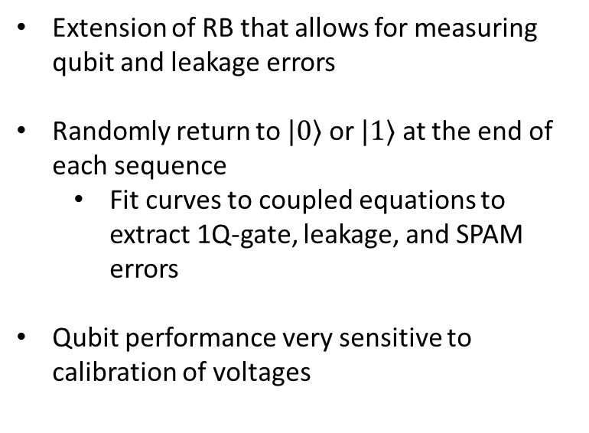


Blind Randomized Benchmarking
Init $|0⟩$
X
H
Z
…
Y
Return $|0⟩$ or$|1⟩$
Readout
Extension of RB that allows for measuring qubit and leakage errors
Randomly return to $|0⟩$ or $|1⟩$ at the end of each sequence
  Fit curves to coupled equations to extract 1Q-gate, leakage, and SPAM errors
Qubit performance very sensitive to calibration of voltages

Slide 18
RB results
Measure 3 RB curves every ~10min
Compensate for sensor peak drift
Not much effect observed for 30% fluence
Device drifts rapidly for 100% fluence
  Qubit calibration changing quickly
  Cannot readout qubit past 110min
No change in leakage

Slide 19
Conclusion
Gamma radiation induces systematic drift in charge sensors that plateaus
  Saturated peak position remains after source removed
  Effect attributed to filling of traps near sensors as bursts of carriers are generated by Compton scattering
Jumps in SETs are highly correlated in time and amplitude
  Modeling indicates traps inducing jumps are likely in the buffer, with multiple traps filled per jump
Gamma radiation has clear impacts on qubit gate and SPAM fidelities
  Device irradiated at ~1280x background, drifts in qubit fidelities can be corrected with periodic retuning
  harder to deal with effects of radiation-induced jumps
Notes:
Drifting effects can be fixed by periodic retuning (will prob need anyway)
Want to focus specifically on what the effects of jumps are

Slide 20



Future/Ongoing work
High $ρ$
Low $ρ$
Qubit
B1
M1
M2
B3
B2
Sensor
$$γ$$
Measure charge jump effects on qubit
Use sensor as trigger for jump event
Simultaneously measure qubit
Spin qubits don’t need high 𝜌 substrates
Explore effects of substrate resistivity
Simultaneously measure 2 devices with different substrates
Acknowledgements
LPS: Michael Wolfe
UPenn: Anthony Sigillito

Slide 21
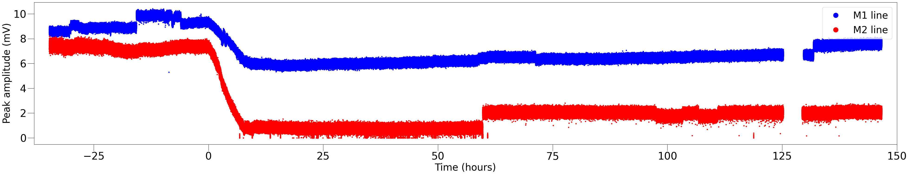
Overall Drift: Sensor peak amplitude

Slide 22
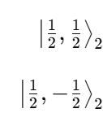
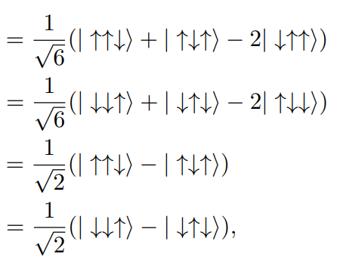
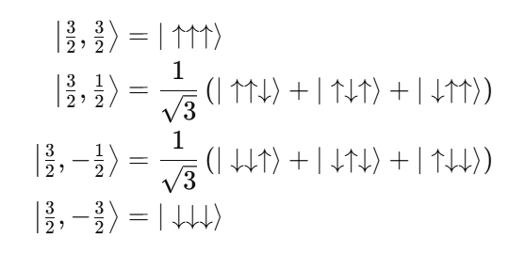
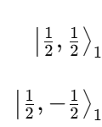
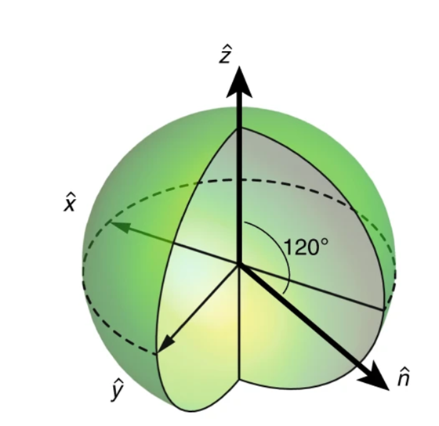


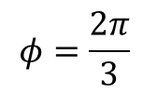
Exchange-Only Qubit encoding
$m_{z}=\frac{1}{2}$ doublet
Spin-3/2 Leakage states
$m_{z}=−\frac{1}{2}$ doublet
$$φ=\frac{2π}{3}$$
Andrews, R.W., Jones, C., Reed, M.D. et al., Nat. Nanotechnol. 14, 747–750 (2019).

Slide 23
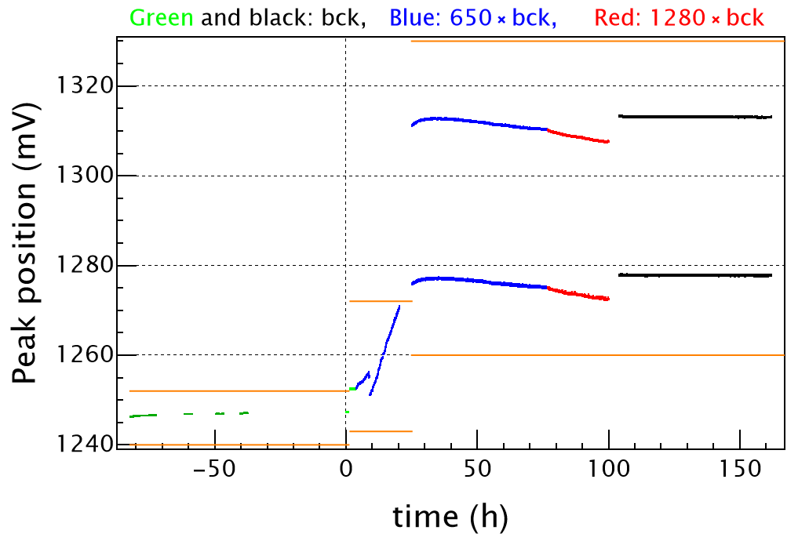
Overall Drift: February Data
1. Device is (mostly) stable with no radiation (green)
2. Introduce γ source with 1/2 of maximum
flux (blue), drift up starts
3. Big jump down at 8 h, then increase in
slope
4. Start recording two peaks at 25 h
5. Saturation @ 30 h, sensor peak starts
slow drift down
6. Increase flux of γ (red) @ 77 h, drift down
speeds up
7. Jump after noise measurements; red to
black
8. Source removed (black), sensor stable at
new offset (no relaxation for days)
7
4
5
6
8
1
2
3

Slide 24
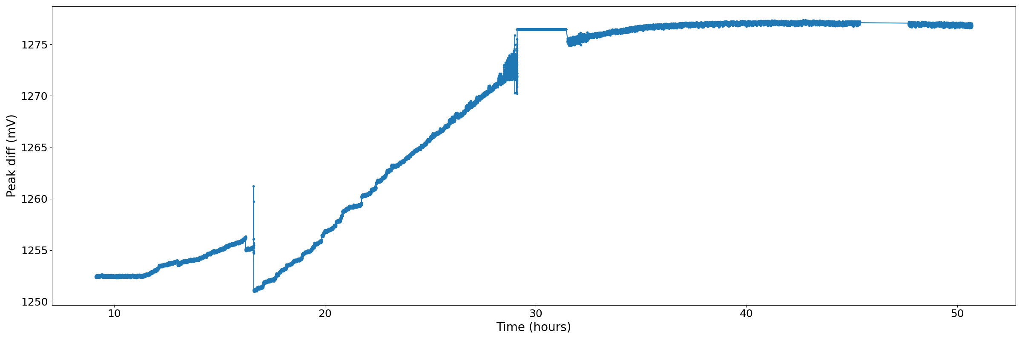



Jumps: February Data
Half γ
No radiation
No rad
Half γ, shifting
Half γ, plateau

Slide 25

Experiment with a gate pulse

Slide 26







Correlations, thresholds
$$coincidences= \sum_{i,j}{f_{c}[t_{i}^{\left(M1\right)}−\left(t_{j}^{\left(M2\right)}−Δt\right)]}$$
$$f_{c}\left(t\right)=\left\{\begin{aligned}1 \text{if} \left|t\right|<δt \\ 0 \text{if} \left|t\right|≥δt\end{aligned}\right.$$
$t_{i}^{\left(M1\right)}$ are the times of jumps on M1.
$Δt$ is in multiples of the time step
For 140-146 hr, 11/7
Threshold | 0.2 | 0.16 | 0.14 | 0.12 | 0.1 | 0.08
$M1$ jumps | 1.67 | 2.33 | 2.83 | 4.67 | 15.83 | 60.6
$M2$ jumps | 1.33 | 2.5 | 4.33 | 8 | 19 | 49
Coinc., $Δt=0,δt=1.05$ s | 1.17 | 2 | 2.33 | 2.5 | 2.83 | 5.83
% coinc | 78% | 83% | 65% | 39.5% | 16% | 10.6%
0.16
0.14
0.12
0.1
0.08
$δt=0.1$ s
$δt=0.1$ s
$δt=0.1$ s
$δt=0.1$ s
$δt=0.1$ s

Slide 27


3D calculations.
Spherical burst originating at any depth in the substrate (only). Electrons emanate from the randomly-chosen center along straight lines. They are trapped at random positions within the 3 nm buffer. Electrons not reaching the buffer are neglected in the calculation.
3nm buffer
one randomization.
Blue/green: below/above 0.16mV threshold
Example of distribution of ca. 2E4 electrons from one burst, trapped in the buffer. We assume no electrons go through the buffer.

Slide 28



More randomizations
total shifts on DCS during the jumpy period
total density accumulated in the buffer
biggest jump on M2

Slide 29
Threshold shifts
QDS1
QDS2
Green – bef. rad
Red/magenta - after
OFG
OFG

