Slide 1

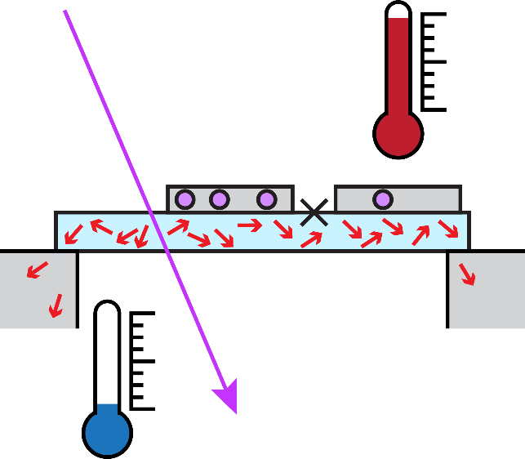







Recovery dynamics of a gap-engineered
3D aluminum transmon after a quasiparticle burst
Heekun Nho
Department of Applied Physics, Yale University
Charlotte Bøttcher ⁴
Luigi Frunzio
Leonid Glazman
Michel Devoret ^{1,5}
Tom Connolly ¹
Pavel Kurilovich ²
Spencer Diamond ³
current affiliations:
1. Google Quantum AI
2. Department of Physics, Harvard University
3. Northrop Grumman
4. Department of Applied Physics, Stanford University
5. Department of Physics, U.C. Santa Barbara
Acknowledgements:
Notes:
Going to tell you about how we can use the tools of single photon gen and detection
Presented by shyam in previous talk to realize concurrent remote entanglement
This is an essential primitive in quantum information, especially for modular architectures

Slide 2





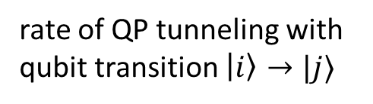

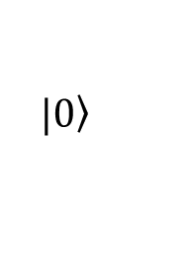


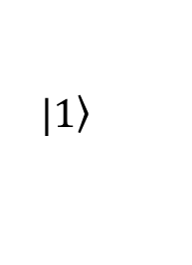




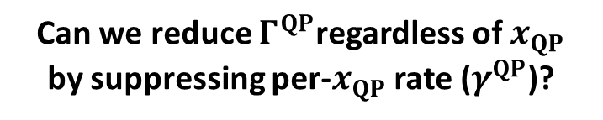
Nonequilibrium quasiparticles in superconducting qubits
observed “non-equilibrium” QP density
$$x_{QP}^{ne}≔\frac{N_{QP}}{N_{CP}}\sim {10}^{−10}−{10}^{−7}$$
qubit state
tunneling QP can relax or excite the qubit
$$S$$
$$I$$
$$S$$
$$|\left.1\right\rangle$$
$$\frac{1}{T_{1}}>Γ_{10}^{QP}+Γ_{01}^{QP}$$
$$E$$
$$Γ_{10}^{QP}$$
$$|\left.0\right\rangle$$
$Γ_{ij}^{QP}$:
rate of QP tunneling with
qubit transition $\left|i\right\rangle →|j⟩$
$$Γ_{01}^{QP}$$
$$Δ$$
$$Γ^{QP}=x_{QP}γ^{QP}$$
Can we reduce $Γ^{QP}$regardless of $x_{QP}$
by suppressing per-$x_{QP}$ rate ($γ^{QP}$)?
$$0$$
DOS
high energy phonons/photons
past attempts of gap engineering with heterostructure:
Joyez et al. (1994), Lang et al. (2003), Sun et al. (2012), Riwar et al. (2016)

Slide 3
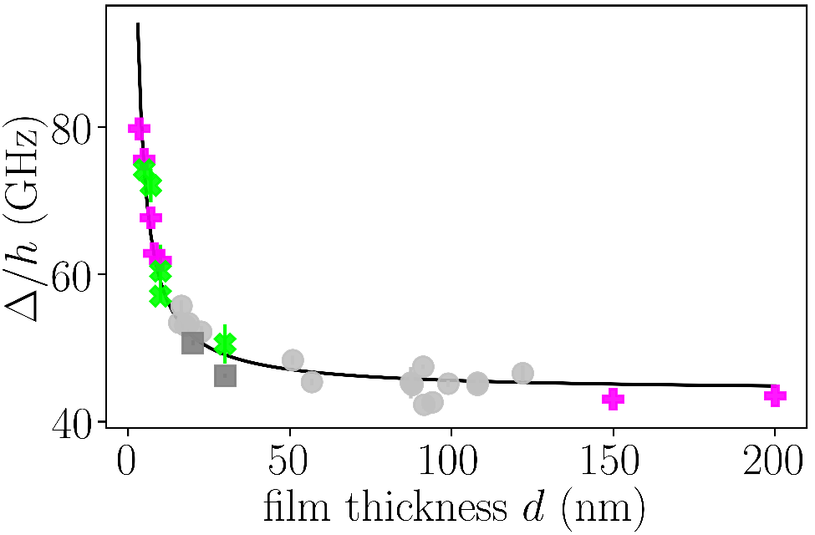
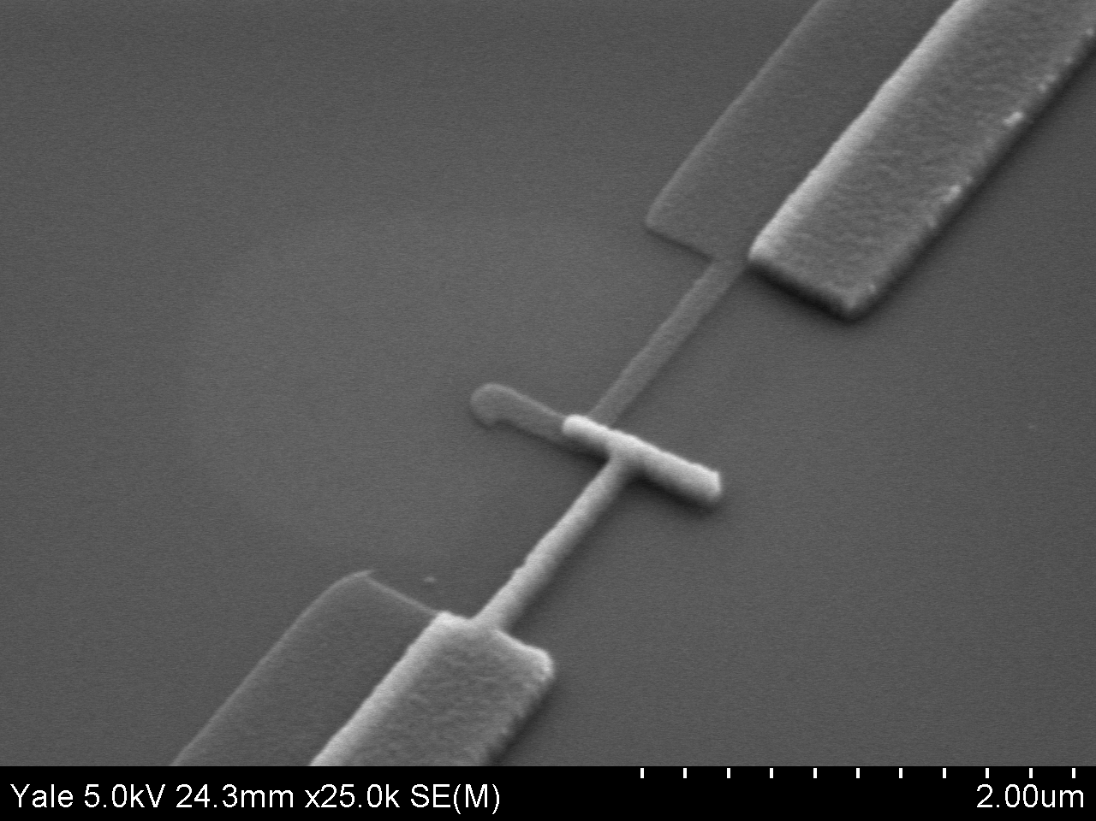
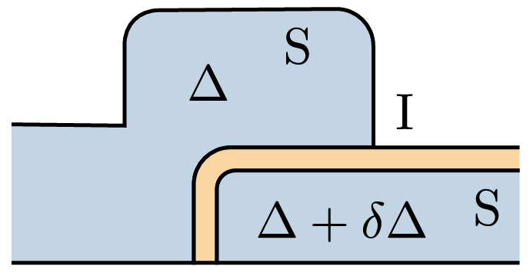




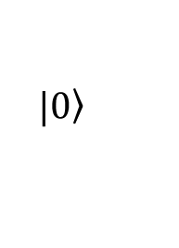
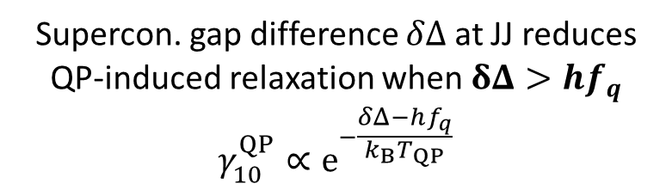

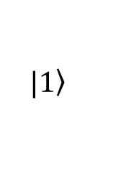






Reducing QP-induced relaxation rate
using superconducting gap asymmetry near JJ
gap engineering with aluminum film thicknesses
$$S$$
$$I$$
$$S$$
10 $μm$
$$E$$
qubit state
$$|\left.1\right\rangle$$
$$|\left.0\right\rangle$$
$$δΔ$$
$$Δ$$
$$0$$
DOS
Supercon. gap difference $δΔ$ at JJ reduces QP-induced relaxation when $δΔ>hf_{q}$
$$γ_{10}^{QP}∝e^{−\frac{δΔ−hf_{q}}{k_{B}T_{QP}}}$$
Cherney et al. (1969)
Court et al. (2007)
Connolly&Kurilovich et al. (2024)
Diamond et al. (2022),
Pan et al. (2022)
Marchegiani et al. (2022),
Harrington et al. (2024),
see also:
McEwen & Miao et al. (2024)

Slide 4
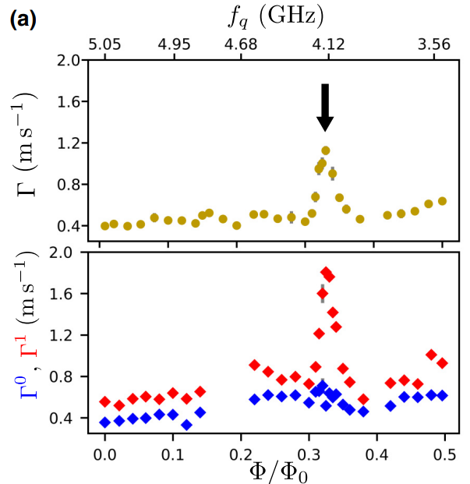
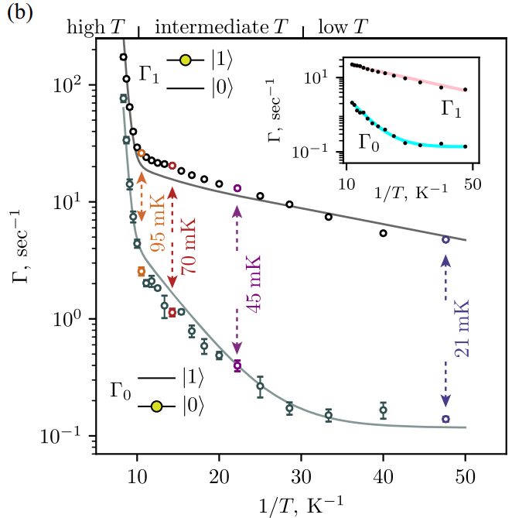
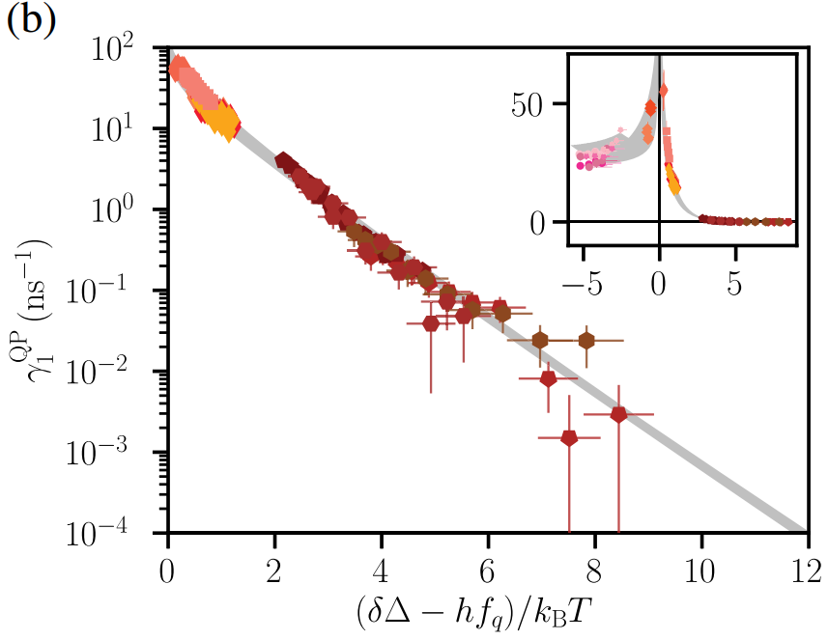

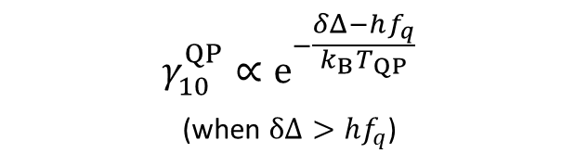
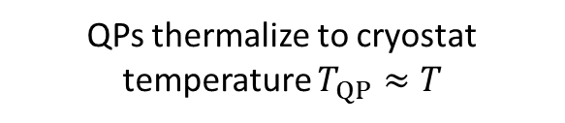
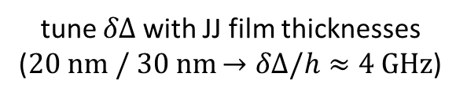
Reducing QP-induced relaxation rate
using superconducting gap asymmetry near JJ
Here: steady-state $x_{QP}^{ne}$
gap engineering with aluminum film thicknesses
Diamond et al. (2022)
Connolly & Kurilovich et al. (2024)
$$γ_{10}^{QP}∝e^{−\frac{δΔ−hf_{q}}{k_{B}T_{QP}}}$$
(when $δΔ>hf_{q}$)
tune $δΔ$ with JJ film thicknesses
($20 nm / 30 nm$ $→δΔ/h≈4 GHz$)
QPs thermalize to cryostat temperature $T_{QP}≈T$
Can gap engineering suppress the qubit decoherence due to high-energy impacts?

Slide 5
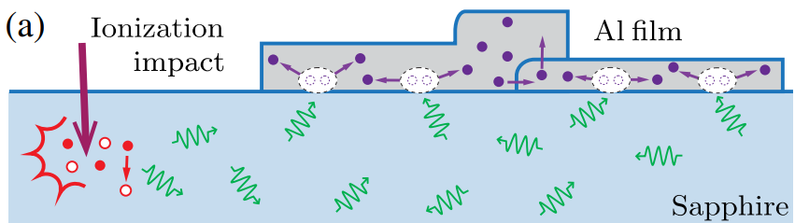
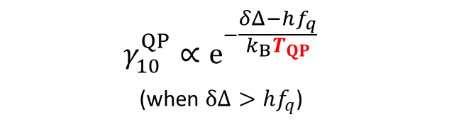


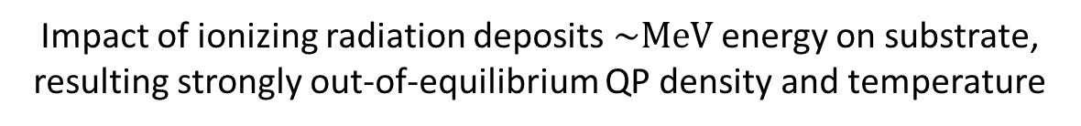
Reducing QP-induced relaxation rate
using superconducting gap asymmetry near JJ
gap engineering with aluminum film thicknesses
Impact of ionizing radiation deposits $\sim MeV$ energy on substrate, resulting strongly out-of-equilibrium QP density and temperature
$$T_{QP}↑$$
Can gap engineering suppress QP tunneling even after high-energy impacts?
$$γ_{10}^{QP}∝e^{−\frac{δΔ−hf_{q}}{k_{B}T_{QP}}}$$
(when $δΔ>hf_{q}$)
How fast do qubit/QPs/phonon bath recover?
$$(Γ_{10}, x_{QP}, T_{q} …)$$
Fowler et al. (2024)

Slide 6

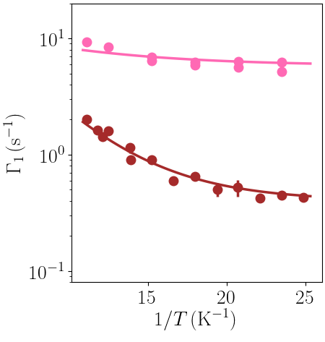


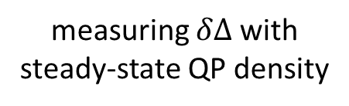
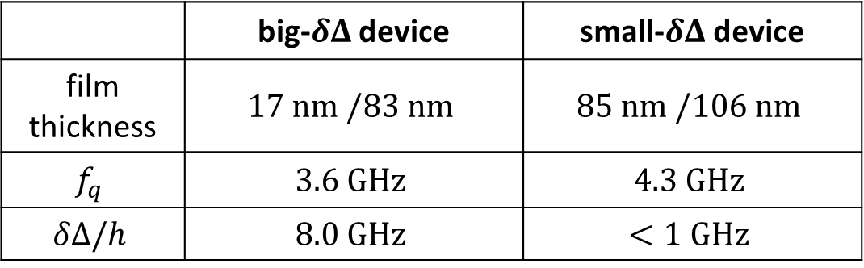




Controlling gap difference with film thickness
Al covers only 2% of chip area
measuring $δΔ$ with steady-state QP density
sapphire
“big” $δΔ$ device
“small” $δΔ$ device
JJ
Al
JJ
Al
 | big-$δΔ$ device | small-$δΔ$ device
film thickness | $$17 nm /83 nm$$ | $$85 nm /106 nm$$
$$f_{q}$$ | $$3.6 GHz$$ | $$4.3 GHz$$
$$δΔ/h$$ | $$8.0 GHz$$ | $$<1 GHz$$
$$Γ_{10}^{QP}∝e^{−\frac{δΔ−hf_{q}}{k_{B}T}}$$
$$δΔ>hf_{q}$$
$$δΔ<hf_{q}$$

Slide 7
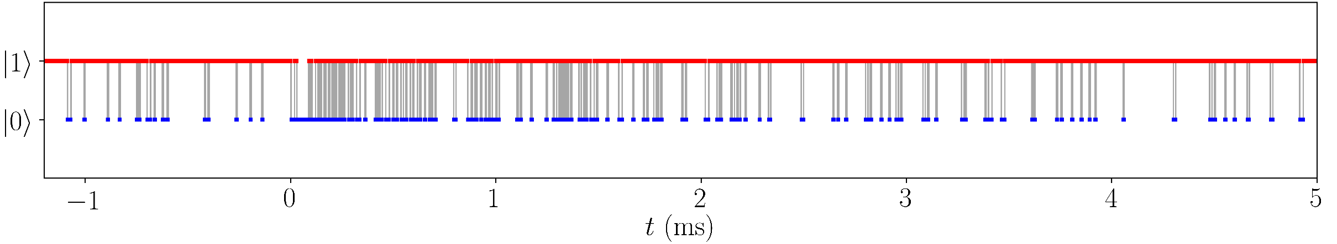





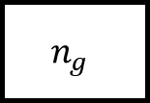


Detecting QP burst events in transmons
$$90 s×500$$
reset to $|1⟩$
reset to $|1⟩$
reset to $|1⟩$
pulse sequence for
burst detection:
$$n_{g}$$
$$n_{g}$$
$$Δt_{msmt}=5.7 μs$$
big-$δΔ$ device
no burst
burst
burst starts
$$00…00$$
QP burst observed in gap engineered device $(δΔ≈2⋅hf_{q})$

Slide 8

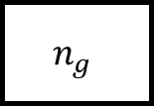
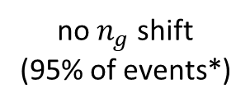
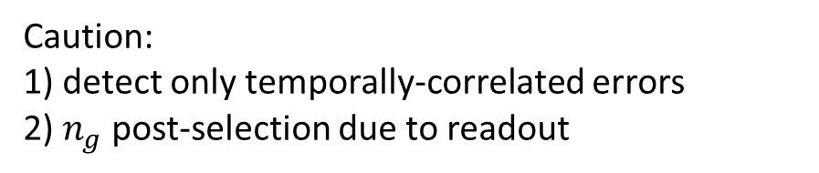

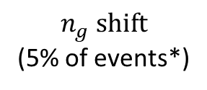
Detecting QP burst events in transmons
$$90 s×500$$
reset to $|1⟩$
reset to $|1⟩$
reset to $|1⟩$
pulse sequence for
burst detection:
$$n_{g}$$
$$n_{g}$$
$$Δt_{msmt}=5.7 μs$$
Caution:
1) detect only temporally-correlated errors
2) $n_{g}$ post-selection due to readout
$$n_{g} shift$$
(5% of events*)
sapphire
no $n_{g}$ shift
(95% of events*)
*measured in 3rd device (Suppl. III.D)

Slide 9
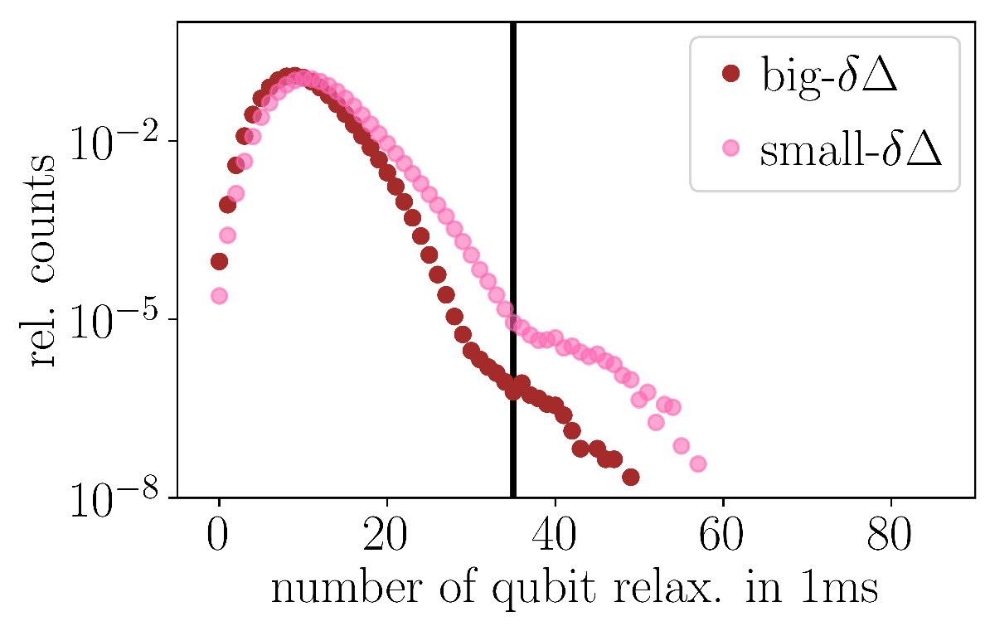
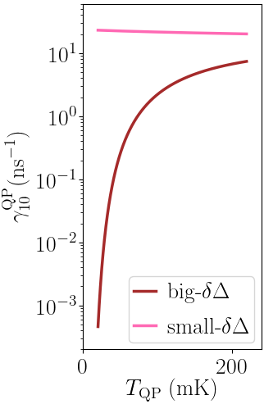
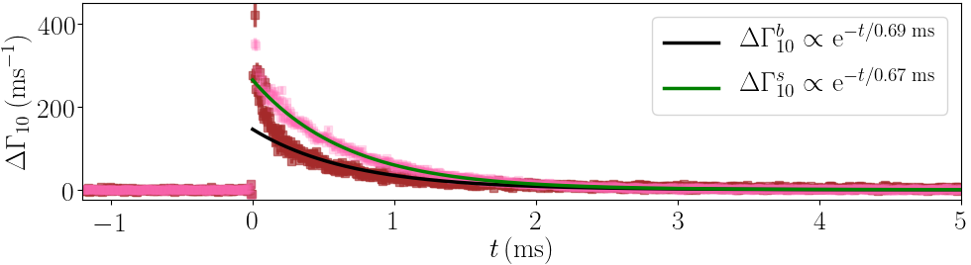


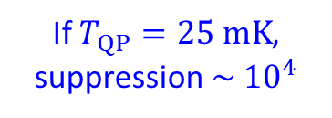
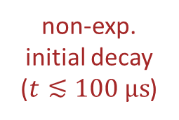
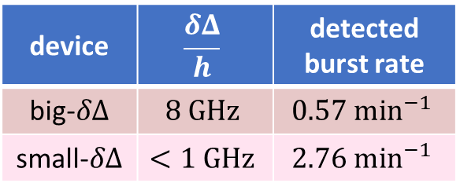
Large $δΔ$ modestly reduces burst occurrence
device | $$\frac{δΔ}{h}$$ | detected burst rate
big-$δΔ$ | $$8 GHz$$ | $$0.57 \min^{−1}$$
small-$δΔ$ | $$<1 GHz$$ | $$2.76 \min^{−1}$$
calculated $γ_{10}^{QP}≔Γ_{10}^{QP}/x_{QP}$
burst threshold
5x suppression
in detected event rate
If $T_{QP}=25 mK$, suppression$\sim {10}^{4}$
steady-state $T_{1}$
burst
averaged over all detected events
non-exp.
initial decay
($t≲100 μs$)
QPs are hot during bursts?

Slide 10
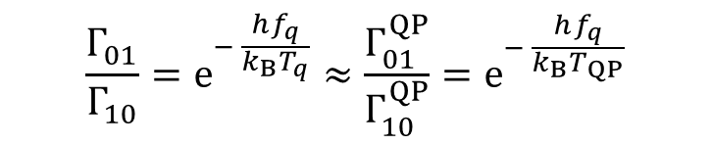


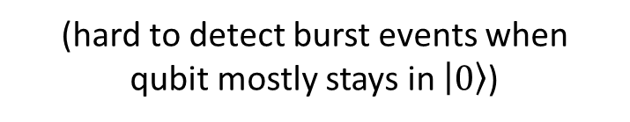



Qubit temperature as a proxy for $T_{QP}$
$$\frac{Γ_{01}}{Γ_{10}}=e^{− \frac{hf_{q}}{k_{B}T_{q}}}≈\frac{Γ_{01}^{QP}}{Γ_{10}^{QP}}=e^{− \frac{hf_{q}}{k_{B}T_{QP}}}$$
during QP bursts, $T_{q}≈T_{QP}$
reset to $|1⟩$
reset to $|1⟩$
reset to $|1⟩$
feedback measurement → extract only $Γ_{10}$
repeated readout → extract $Γ_{10}\& Γ_{01}$
(hard to detect burst events when
qubit mostly stays in $\left|0\right\rangle$)

Slide 11
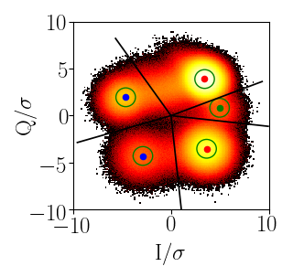
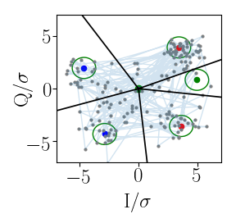
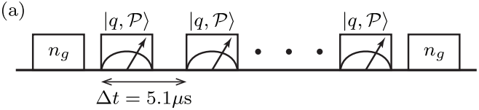
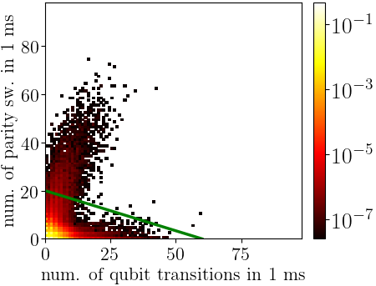








Parity-switching burst detection in big-$δΔ$ device
Here: big-$δΔ$ device
single-shot joint parity-qubit state readout $|q,𝒫⟩$
e.g. during burst event (1 ms)
$$|1,o⟩$$
$$|0,o⟩$$
spike in both
qubit decoherence & parity-switching rate
$$|≥2,o⟩$$
$$|0,e⟩$$
$$|1,e⟩$$
device | qubit relax. burst rate | parity sw. burst rate
big-$δΔ$ | $$0.57 \min^{−1}$$ | $$2.63 \min^{−1}$$
small-$δΔ$ | $$2.76 \min^{−1}$$ | $$−$$
parity sw. burst
$$≈$$
collect more (weaker) burst events than thresholding on qubit relaxation events
cannot threshold on number of qubit transitions
→ only changes scaling (Suppl. III.E)

Slide 12
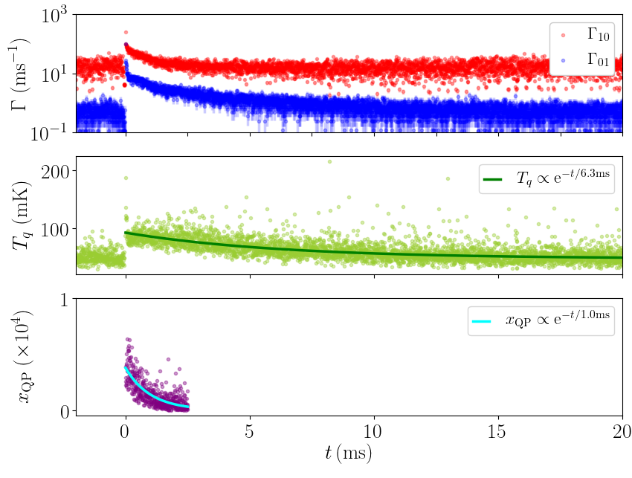
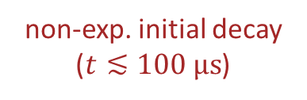
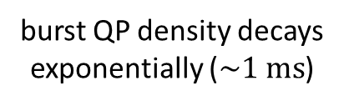

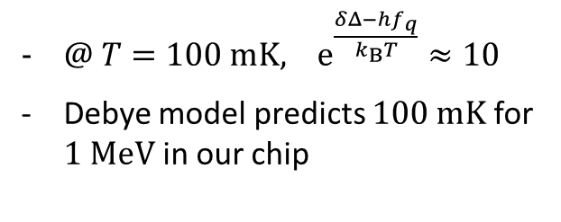
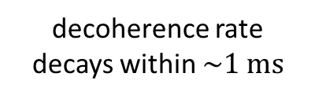
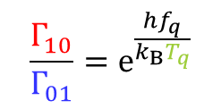
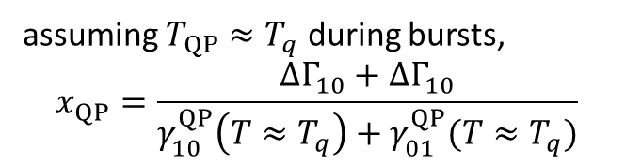
Recovery dynamics after QP bursts
Here: big-$δΔ$ device
decoherence rate decays within $\sim 1 ms$
$$\frac{Γ_{10}}{Γ_{01}}=e^{\frac{hf_{q}}{k_{B}T_{q}}}$$
non-exp. initial decay
($t≲100 μs$)
$@ T=100 mK,$ $e^{\frac{δΔ−hf_{q}}{k_{B}T}}≈10$
Debye model predicts $100 mK$ for $1 MeV$ in our chip
burst QP density decays exponentially ($\sim 1 ms$)
assuming $T_{QP}≈T_{q}$ during bursts,
$$x_{QP}=\frac{ΔΓ_{10}+ΔΓ_{10}}{γ_{10}^{QP}\left(T≈T_{q}\right)+γ_{01}^{QP}(T≈T_{q})}$$
(decoherence dominated by dielectric loss)
see also:
Kurilovich & Roberts et al. (2026)

Slide 13





Recovery dynamics after QP bursts
Here: big-$δΔ$ device
decoherence rate decays within $\sim 1 ms$
$$\frac{Γ_{10}}{Γ_{01}}=e^{\frac{hf_{q}}{k_{B}T_{q}}}$$
non-exp. initial decay
($t≲100 μs$)
$@ T=100 mK,$ $e^{\frac{δΔ−hf_{q}}{k_{B}T}}≈10$
Debye model predicts $100 mK$ for $1 MeV$ in our chip
$$μ, γ$$
burst QP density decays exponentially ($\sim 1 ms$)
Phonons with $hf_{ph}<2Δ$ can only escape through two clamps
sapphire
e-h pairs
(decoherence dominated by dielectric loss)
$\sim GHz$ phonons stuck in the chip and heat up the qubit/QPs
$$40 mm$$

Slide 14


Recovery dynamics after QP bursts
Here: big-$δΔ$ device
decoherence rate decays within $\sim 1 ms$
$$\frac{Γ_{10}}{Γ_{01}}=e^{\frac{hf_{q}}{k_{B}T_{q}}}$$
non-exp. initial decay
($t≲100 μs$)
$@ T=100 mK,$ $e^{\frac{δΔ−hf_{q}}{k_{B}T}}≈10$
Debye model predicts $100 mK$ for $1 MeV$ in our chip
burst QP density decays exponentially ($\sim 1 ms$)
Small patch of Cu film ($10{mm}^{2} x 1μm$)
can absorb $\sim 1MeV$ at $20 mK$
(decoherence dominated by dielectric loss)
Cu phonon trap experiment:
Henriques et al. (2019), Iaia et al. (2022), Larson et al. (2025)

Slide 15


Summary
Gap engineering is useful for mitigating QP bursts,
but its effectiveness is limited by temperature
How to suppress QP bursts further:
1. Increase gap difference above $\sim K$ (e.g. gr-Al film)
2. Enhance phonon escape:
better thermalization/normal metal traps

Slide 16


Slide 17


Slide 18


Slide 19


Slide 20

Debye model
  $C_{V}^{ph}\left(T\right)=9nR{\left(\frac{T}{T_{D}}\right)}^{3}\int_{0}^{T_{D}/T}{\frac{x^{4}e^{x}}{{\left(e^{x}−1\right)}^{2}}dx}≈234\left[\frac{J}{mol⋅K}\right] n{\left(\frac{T}{T_{D}}\right)}^{3}$
  $U\left(T\right)=6.5\left[\frac{J}{mol⋅K}\right] nT{\left(\frac{T}{T_{D}}\right)}^{3}$
  For our sapphire chip $\left(n≈3 mmol, T_{D}≈1000 K\right)$, $U\left(100 mK\right)=1 MeV$
Cu
  $C_{V}\left(T\right)=C_{V}^{ph}\left(T\right)+C_{V}^{el}\left(T\right)≈234\left[\frac{J}{mol⋅K}\right] n{\left(\frac{T}{343 K}\right)}^{3}+0.695\left[\frac{mJ}{mol⋅K}\right]nT$
  For $10{mm}^{2}×1μm$ patch, $U\left(20 mK\right)≈1 MeV$

