Slide 1
FCC Project Office
System engineering and integration – SEI
Olga Beltramello
FCC US week – September 2026

Slide 2
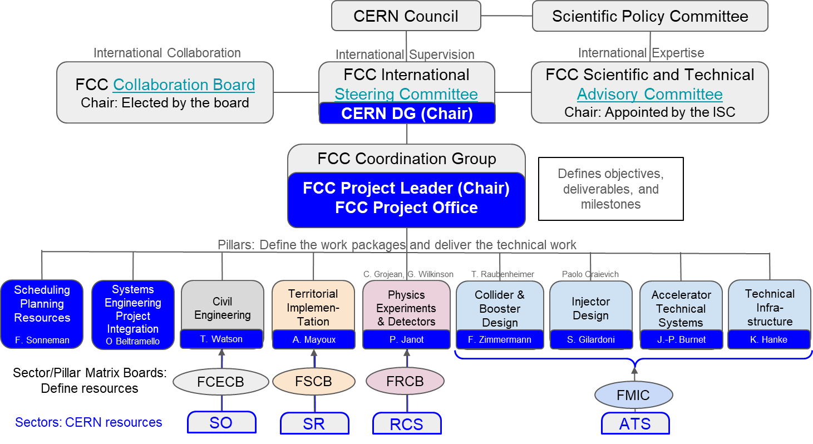
FCC Organisation for the Reference Design Phase
Project Governance
Project
Execution

Slide 3
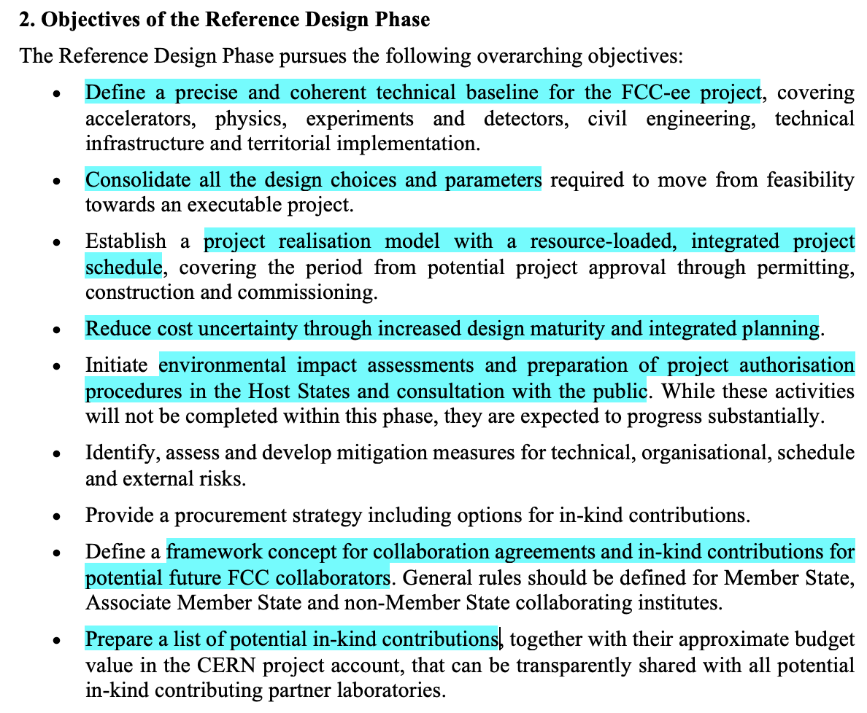
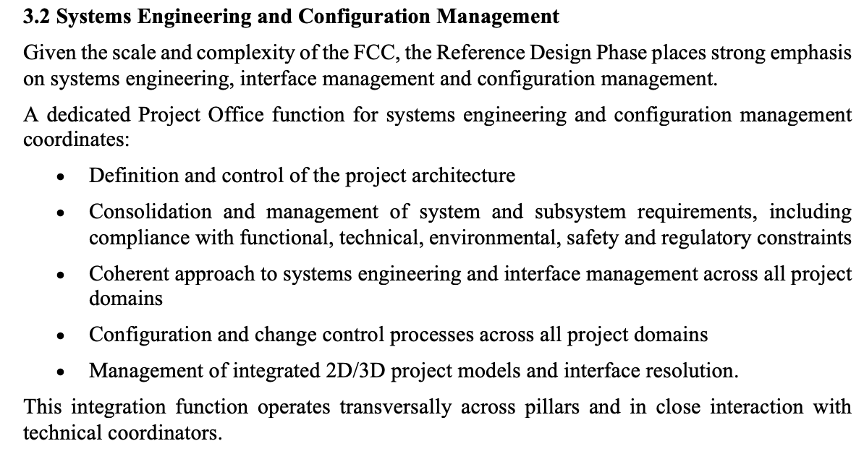
Objectives, Scope an Deliverables for the RDP
The objectives, scope and deliverables of the RDP were approved by Council in June 2026.

Slide 4
SEI Objectives for the RDP
The main objectives of the Systems Engineering and Integration (SEI) are:
Propose and maintain a project-wide Systems Engineering framework to ensure consistency across all FCC pillars.
Define a project work breakdown structure (WBS), any activity including international contribution should be part of it
Manage project baselines: high level performance and parameters, layouts, and functional and technical specifications for PED, Accelerators, technical infrastructure, injectors, civil engineering and MDI.
Develop the global Integrated CAD model of the project (undergrounds and surfaces) including definition of interfaces between systems. Priority is given to the consolidation of the Civil engineering layout and surface implementation (fall 2026) and MDI Interaction Region.
Ensure Configuration and Changes control throughout the project lifecycle.
Define Compliance Control strategy and ensure its implementation. Demonstrate project safety compliance with Host States rules and regulations and technical compliance with the project high level performances.
The priority of studies should be related to the risk of impacting the schedule or the cost or the capability to reach the high level performance and requirements expected.
Civil Engineering, Territorial Implementation and MDI is the current focus of studies.

Slide 5
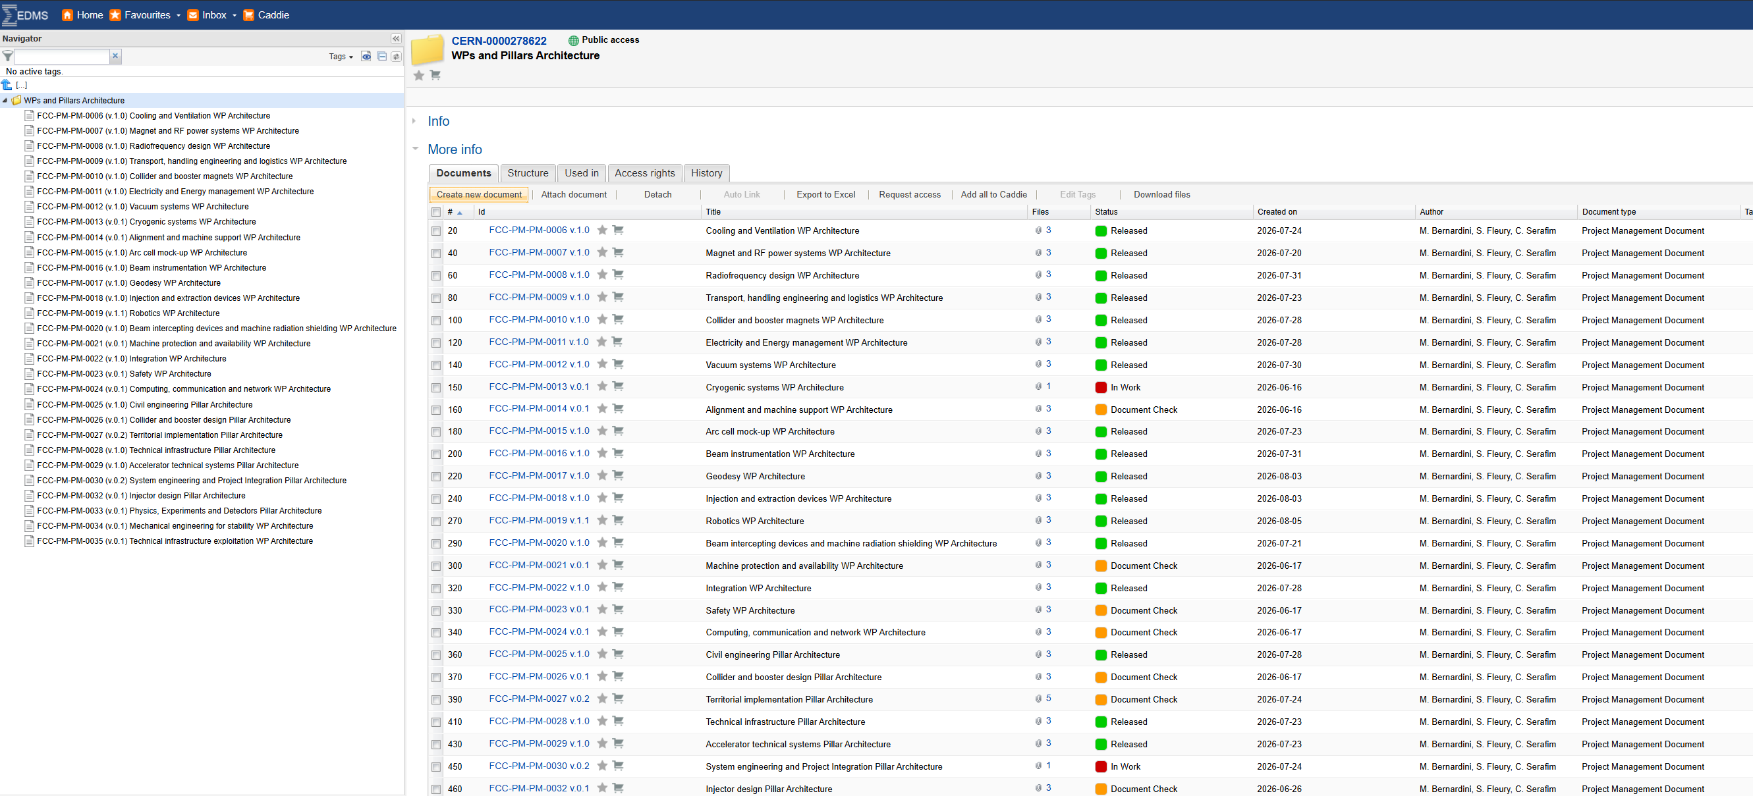
Project Systems Architectures
Starting from systems architectures
All the systems architectures can be found in EDMS in this node CERN-0000278622
Courtesy M. Bernardini

Slide 6
Work package Architecture for reference for WBS
Architecture for System Engineering and Integration Pillar EDMS 3480027
Systems Engineering and Project Integration
Systems engineering methodology and tools
Change management, coordination of impact assessment & configuration control
Compliance control
Compliance control methodology
Compliance with systems interfaces and technical specifications
Global integration
SEI for
MDI - WP5
Experimental cavern Detector and MDI integration
(envelopes and interfaces)
Global static and dynamic integration control of the project
(interfaces)
Civil Engineering
Machine (accelerator and booster)
Surface buildings for machine and experiments
Coordination
Rules and regulations requirements
Safety requirements
Engineering safety regulations
Transversal engineering specifications (seismic, vibrations, …)
Compliance with project parameters and requirements
Injectors
High level performance and technical requirements
Civil Engineering
Machine (accelerator and booster)
Surface buildings for machine and experiments
Injectors
MDI and PED
Hardware baseline & layout
Booster and collider
Injectors
PED - MDI
SEI for
MDI - WP4 Metrology, alignment and adjustment strategy*
Alignment Strategy*
Mechanical Engineering for stability *
+ SEI for calculation
Structural analysis and performance assessment
(already in SEI – Compliance control methodology)
Compliance with rules and regulations
Design of support structure for FFQ
Demonstration of compliance with project parameters and requirements
MDI systems static and dynamic envelopes
Global experimental cavern integration
MDI and detector assembly/disassembly scenario
Assessment of removal/installation of cavern vacuum chambers
Proof of concepts of MDI Far End vacuum supporting structures *
* Not in this Pillar but strong interaction with it
Courtesy M. Bernardini

Slide 7
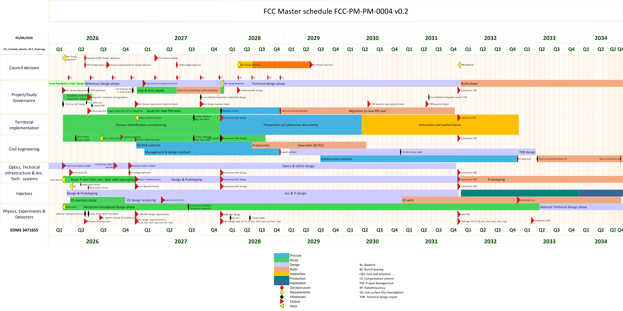
FCC Master Schedule
Courtesy M. Bernardini

Slide 8
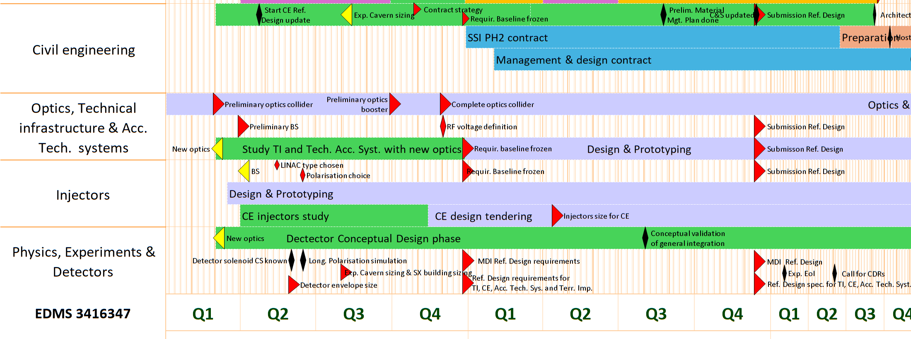
FCC Schedule Interdependency
Strong Inter Project Links among Civil Engineering, Optics and PED
Courtesy M. Bernardini

Slide 9
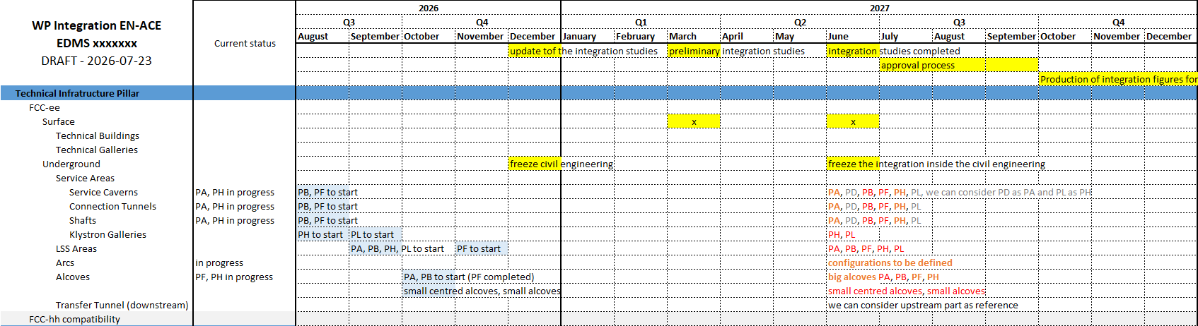
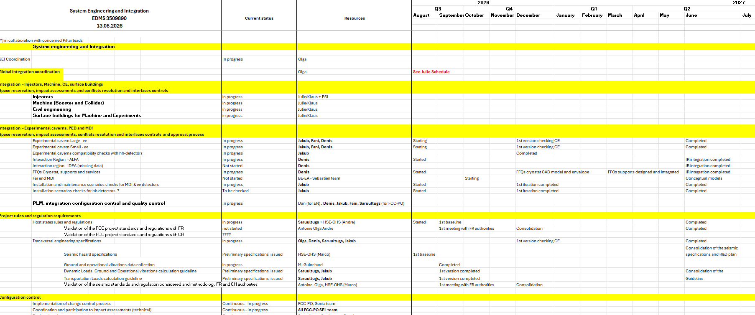
SEI Schedule and Milestones – Draft
A detailed schedule and milestones of the System Engineering and Integration Pilar is being developed.
The priorities of the SEI are directly linked to the RDP main deliverables captured in the FCC Master schedule and in particular to the territorial implementation and civil engineering deadlines.
The schedule inter-connections and compatibility are currently being scrutinized by Schedule Planning and Resources experts.
Confirmation of the MDI deliverables for RDP and associated planning is expected soon from the WPs, to be validated by the Pillar Leads.

Slide 10
Project performances and requirements and Compliance Control
SEI is currently coordinating the collection and baselining of the Project high level performance specifications and systems functional and technical requirements
  A list of priorities is currently being set up, MDI is obviously part of it.
  Coherent high-level performance baselines are expected by this fall (at least a first version).
SEI is in charge to coordinate the demonstration that the systems technical designs comply with :
  High levels performance parameters (luminosity, static/dynamic stability of the beams pipes, detector structures,..)
  The systems functional and technical requirements (for agreed priority systems)
  Transversal engineering specifications (dynamics from seismic, ground motion and operations)
  Host States rules and regulations, environmental, safety and regulatory constraints.
  Definition of standards and regulation for Host States – FCC-PO/HSE – Done (required for design of systems) -
  FCC-INTEGR-SPC-0001- applicable codes and standards for FCC activities
  Guidelines for dynamic loads for FCC equipment, structures and detector (for structural design and performance assessment) - FCC-PIL_SEI-EN-0002 - guidelines for dynamic loads for FCC equipment, structures, and detectors
Related to safety rules and regulations, nonconformity or derogations can be assessed by SEI as well as standards equivalencies for In-Kind contributions.

Slide 11
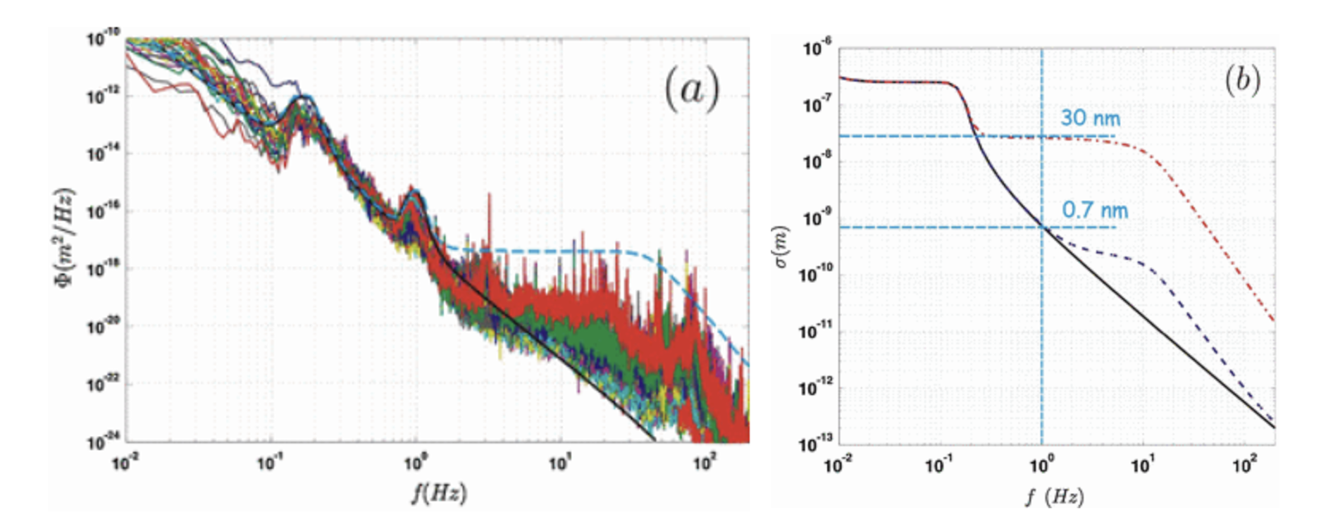
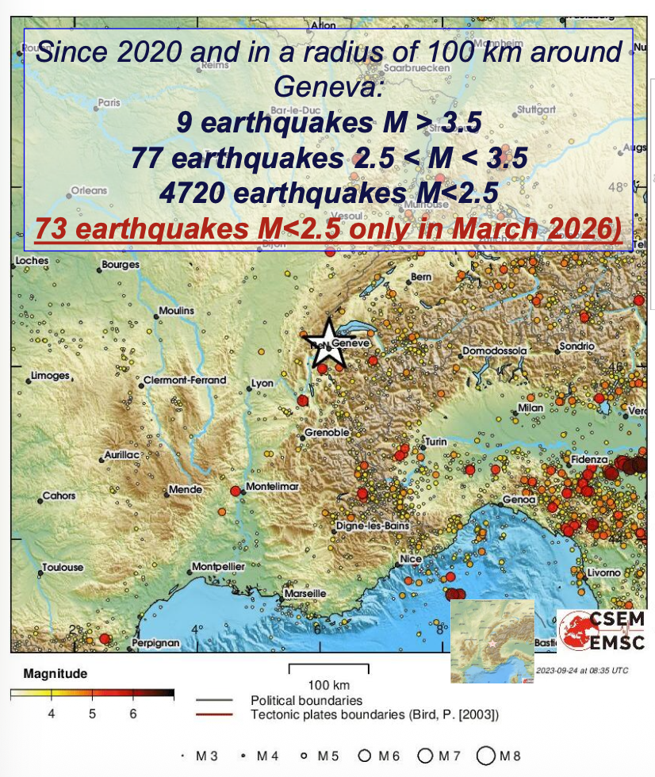
Compliance Control
Measured PSD in LHC tunnel
RMS value – FCC Beam lines in the arcs
The Compliance control process for mechanical and structural equipment is defined in:
FCC-INTEGR-SPC-0004 – EDMS 3466339 - FCC structures and mechanical components - Compliance Control - RDP
This document describes the expected documentation inside the structural engineering file as well as the approbation process by FCC-PO to demonstrate that the equipment and/or structure has been designed compliant.
SEI will coordinate the justification of compliance to stability requirements by the end of the RDP or a detail plan to achieve these requirements.
If case of non-compliance, a R&D plan of resolution is expected by end RDP.

Slide 12
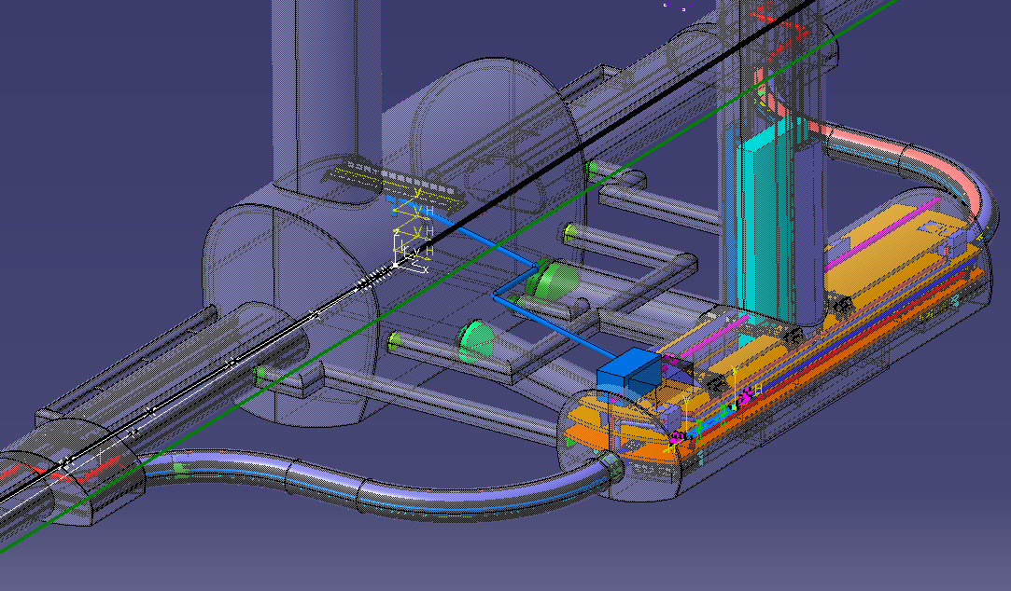
Project – Wide Integration
SEI is responsible of the Project global integration, i.e. :
  Coordination of the 2D-3D systems envelopes models creation (static, global and dynamic)
  3D space reservation and clearances definition
  systems interfaces definition and documentation
  Inter systems conflict resolution
  creation and implementation of the systems naming convention
  integration approbation processes and configuration control
CAD models and associated documentation are stored under CERN PLM system
This is under revision as a collaboration between Technical Infrastructure and SEI pillars and the CERN EN-ACE group.
By the end of RDP, all Points, arcs, straight sections, surface buildings, services and technical caverns, alcoves, experimental caverns and MDI, and Civil Engineering infrastructures should have the same level of maturity.
Impact of FCC-hh on territorial implementation and civil engineering is taken into account.
The SEI Pillar is ultimately in charge to validate the systems envelopes and interfaces, agree on the clearances and resolve conflicts between Pillars or systems if any.

Slide 13
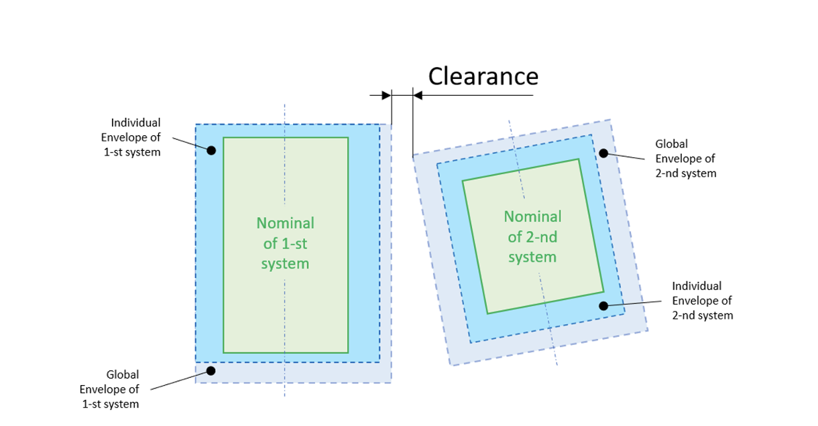
Reminder - Envelope Definitions
  General Definitions
3D envelopes and 2D associated drawings are generated for systems, sub-systems or components, to identify clashes/interferences, verify clearances, and establish allowable design volumes for each system
The 3D physical envelopes
Individual envelope
Global envelope
Dynamic envelope
Individual Envelope = Nominal Dimension + Mechanical Tolerances + Deformation
Dynamic Envelope = Global Envelope + Dynamic deviation during movement (roll in and out) / transport during the installation or maintenance phase.
Mechanical tolerances are permissible geometric deviations and can be split:
- Manufacturing Tolerance
- Assembly Tolerances
Global Envelope = Individual Envelope + Positioning Tolerances in operational position
EDMS 3446976 v.0.1 – FCC-INTEGR-SPC-0002 v.0.1 – FCC systems envelopes definition
Notes:
.

Slide 14
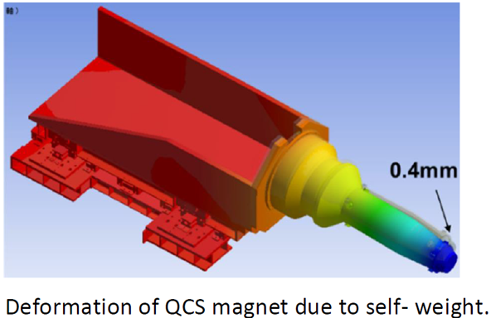
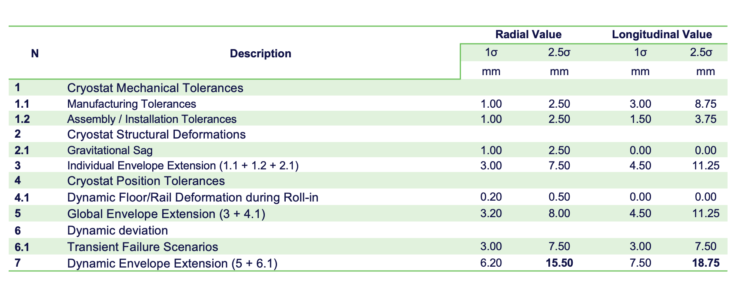
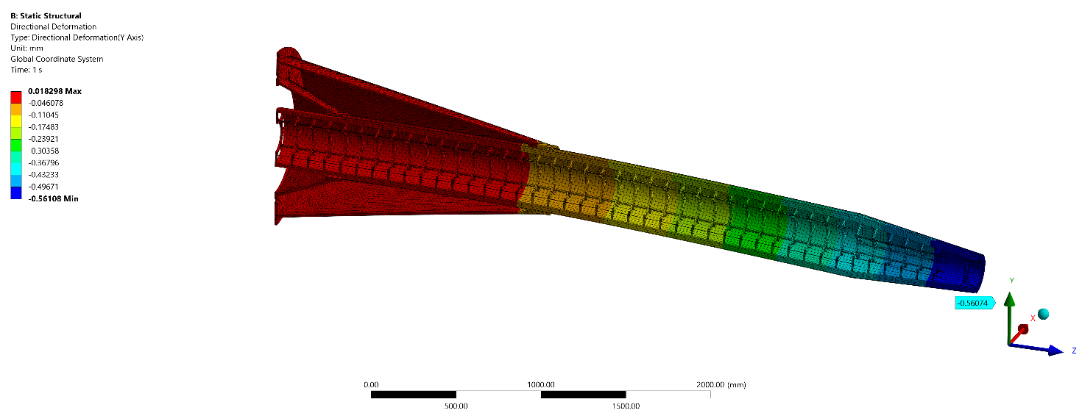
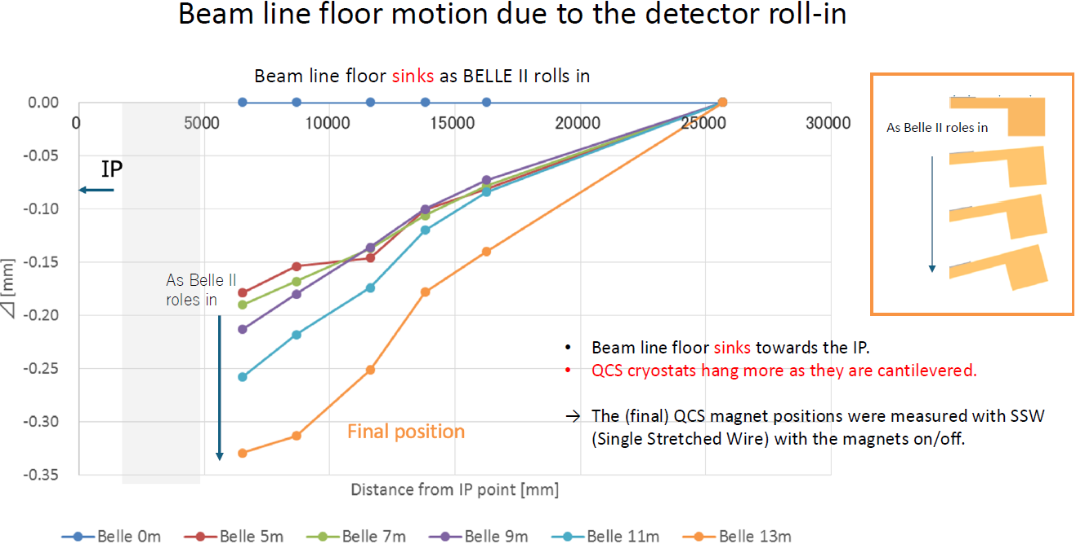
An example – envelope of the FFQs cryostat
  Cryostat Envelope is being defined based on our current understanding of the cryostat structure (M. Koratzinos design, but we would to implement B. Parker design)
  We also need to assess all load cases ..
  The values below are not final but give a good order of magnitude
Visualization of SuperKEKB Belle II self-weight sagging
Deformation Results
All detailed information regarding the Cryostat Envelopes definition is presented in the EDMS 3484308 v.0.1 document.
The floor deformation during the SuperKEKB Belle II detector roll-in

Slide 15
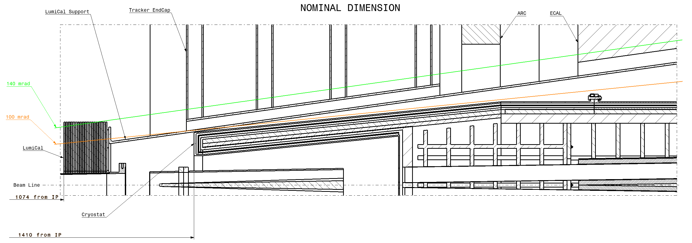
MDI Interaction Region for ALFA
2400 from IP
We need to progress on resolving the space conflicts in this region
In discussion currently with IDEA detector to receive their CAD models

Slide 16
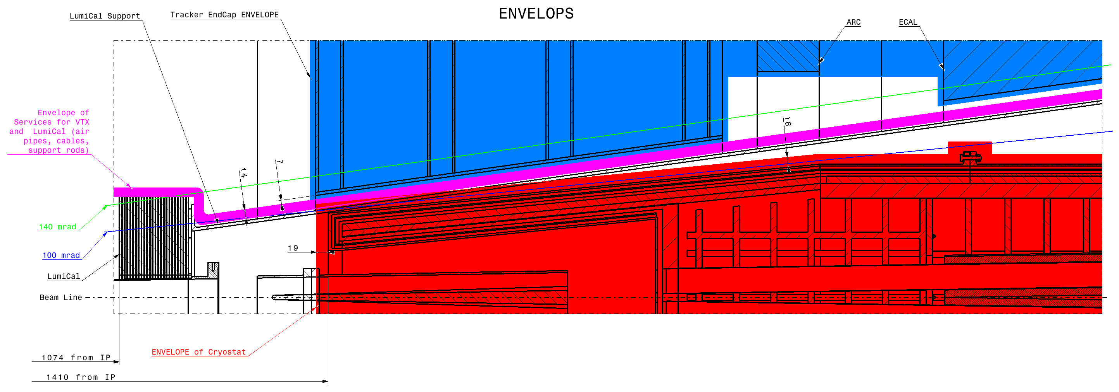
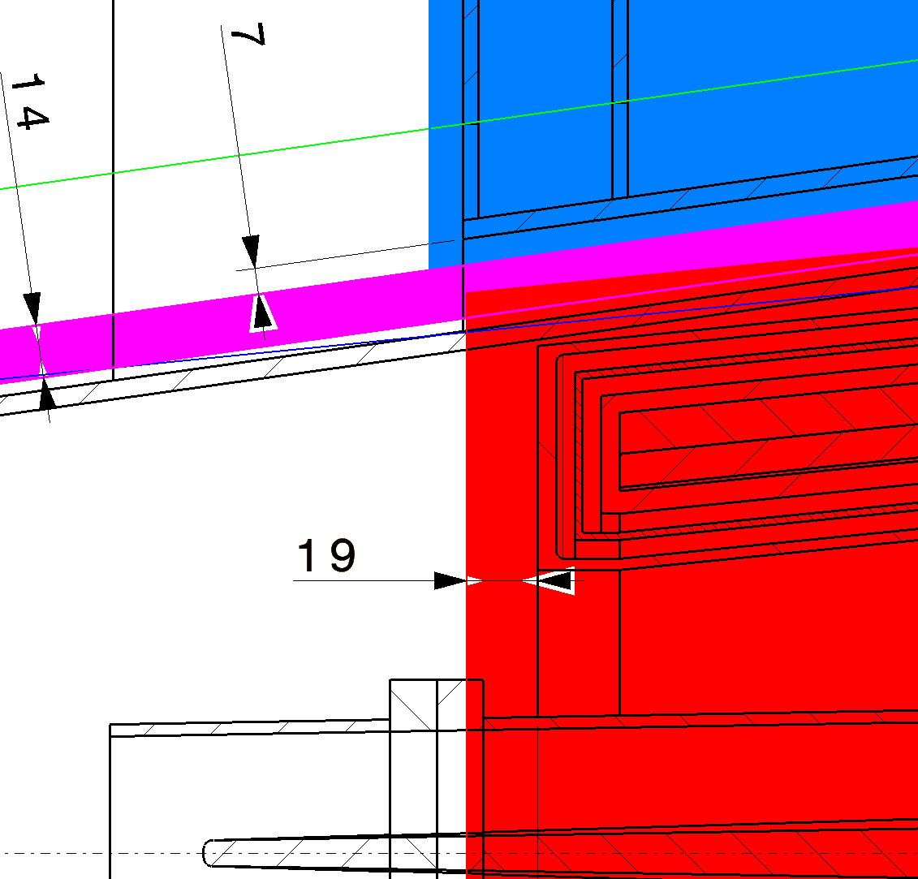
Envelopes without LumiCal Envelope
16
Clash between:
-Cryostat envelope and Services for VTX and LumiCal
-Cryostat envelope and Nominal of LumiCal support
LumiCal Support

Slide 17
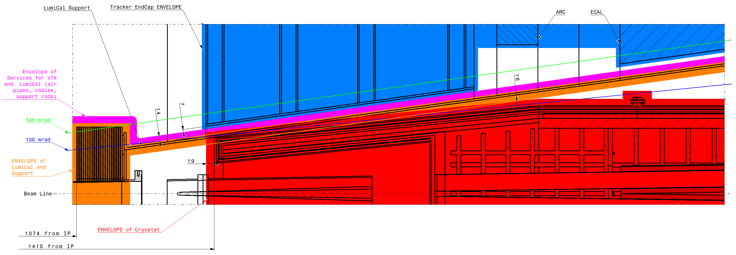
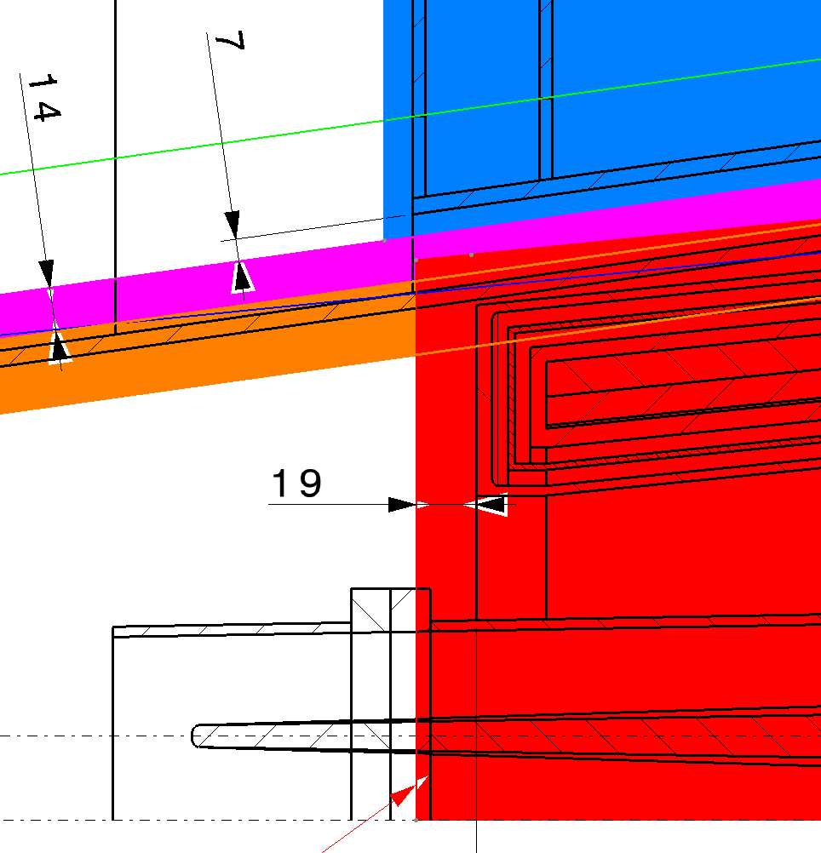
Envelopes with LumiCal Envelope
16
23
Clash between:
-Cryostat envelope and Services for VTX and LumiCal
-Cryostat envelope and Envelope of LumiCal support

Slide 18
Configuration and Change Control
A 1st baseline has been issued in March 2026 based on the feasibility study (for MDI based on IDEA and nor clear on which cryostat .. )
FCC-PM-MG-0001 v.0.2 "FCC global integration model - Feasibility Study configuration"
It includes 2D and 3D CAD models and associated documentation, project parameters and layout based on the feasibility study report.
Proposals of changes should be submitted with documented justification documents (stored on EDMS).
It goes through impacts assessments and change control process. This is coordinated at Project Office level or at Pillar level depending on the impact of changes.
Typically, any change impacting transversally Pillars, project high level performances, risks, costs and schedule is dealt at PO level.
The Project Office assess transversally the possible impacts with the Groups and record of decision documentation are prepared for approbation or rejection of the proposal.
In case of approbation, Engineering Change requests are documented and followed up by the Project Office SEI and SPR Pillars.
FCC-INTEGR-TMP-0001 – Template for FCC Engineering Change Requests (ECR)
FCC-PM-TMP-0007 v.1.0 - Template for FCC Record of Decision (RoD)
FCC-PM-SPC-0001 – FCC- PO ECR policy for the Reference Design phase

Slide 19
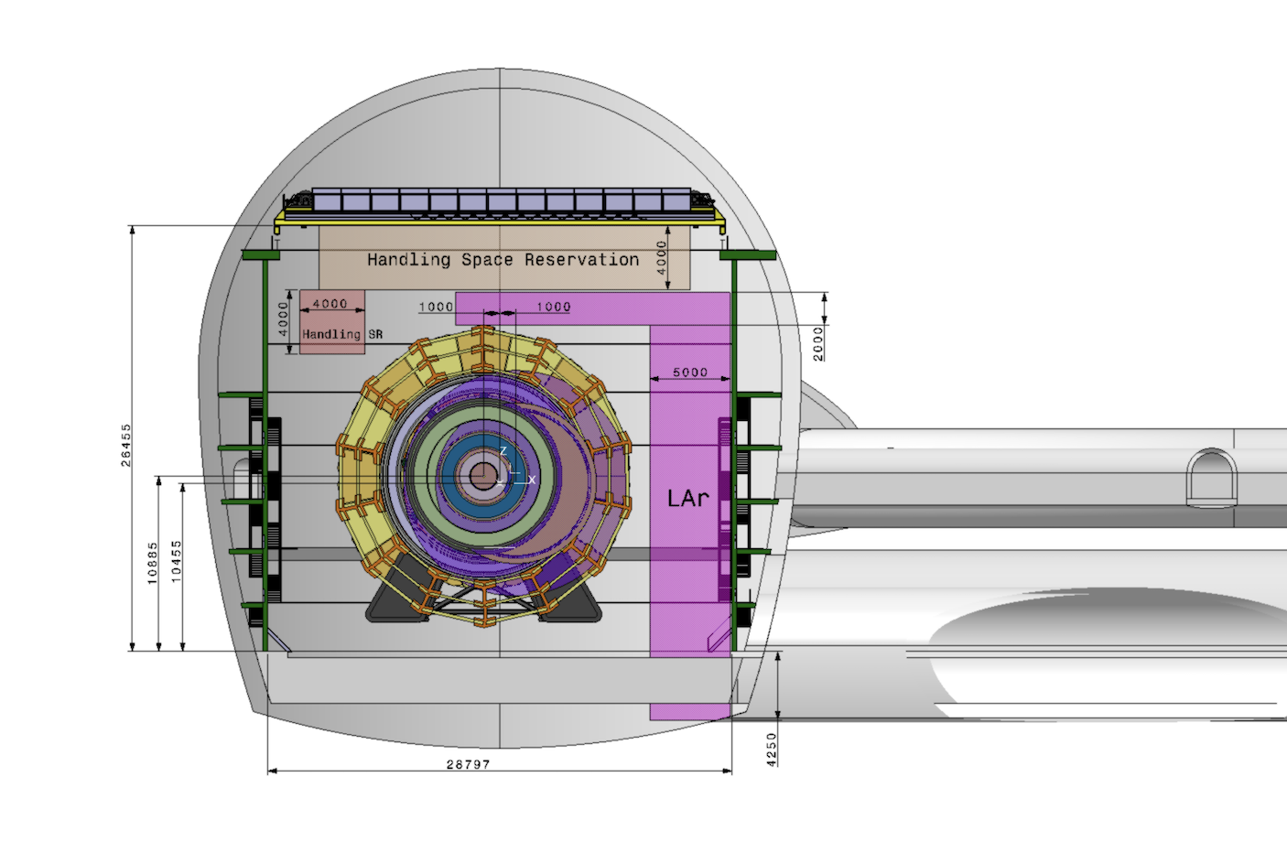
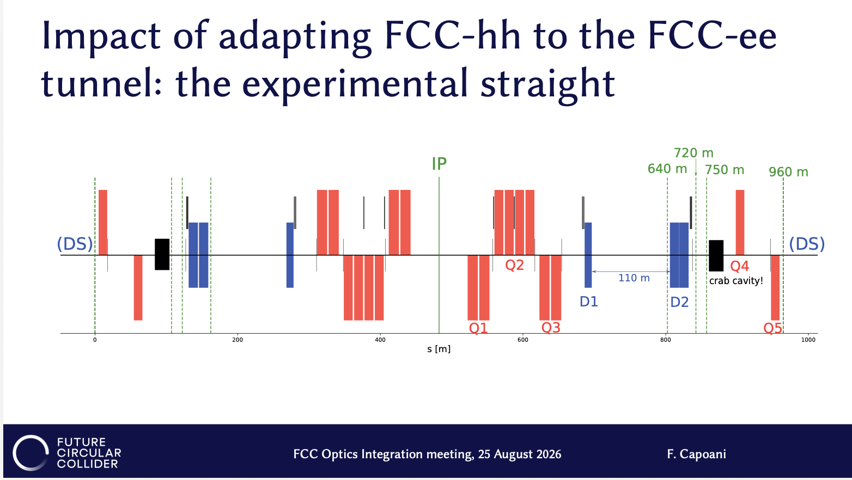
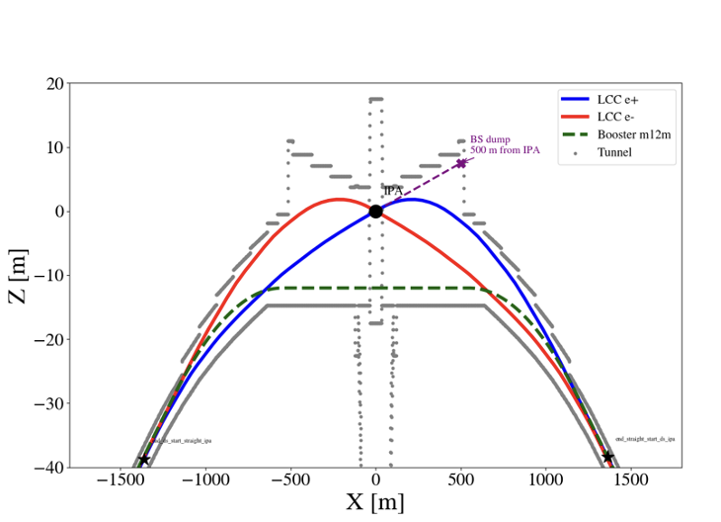
Some current baselining and integration studies
We are currently freezing the ee-IPs versus shaft surface locations, baseline is expected within 2 weeks.
The hh versus ee IPs locations are being assessed (2m lateral offset) in order to facilitate the hh lattice integration in the long straight sections.
Some major integration studies are associated to changes impacting CE:
  - Space required by the groups on surface buildings (new requests from detector concepts)
  - LCC optics impact on civil engineering (expecting data from booster layout)
  - modifications or addition of CE infrastructures (alcoves) to cope with radiations on electronics
  - Experimental area integration associated with the verification of transport, maintenance and installation scenarios for ee and hh detectors (scenarios as ATLAS and CMS)

