Slide 1
Solid State Tracking and Timing Technologies within CPAD
Tony Affolder
Santa Cruz Institute for Particle Physics
University of California, Santa Cruz
On behalf of the RDC3
Fourth US FCC Meeting
SLAC, September 8-11, 2026

Slide 2
Overview
CPAD RDC3 coordinates US “blue sky” R&D for Solid State Tracking and Devices (https://cpad-dpf.org/?page_id=1702)
  Work towards a particular experiment is outside of scope
5 main topic areas:
  RDC3-WP1: Developing and adapting non-silicon and novel configuration tracking sensors
  RDC3-WP2: Developing scalable, low mass tracking systems
  RDC3-WP3: Extending the performance reach of sensors toward fluences of 10^18 n_{eq}/cm², timing of 1 ps, and characteristic dimensions of 5 microns
  RDC3-WP4: Developing advanced models of existing and new technologies
  RDC3-WP5: Adding more intelligence to tracking systems
Inputs to this presentation is from the 2025 CPAD Workshop in Penn: https://indico.global/event/14966/timetable/#20251007

Slide 3
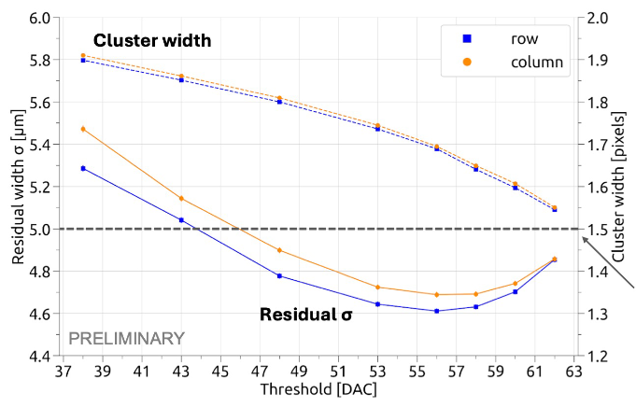
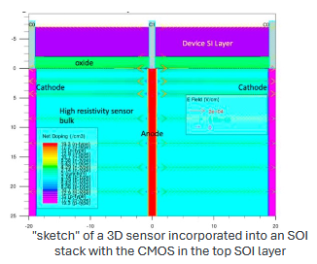
MAPS (Design & Characterization)
Evaluation of Arcadia MAPS (Fermilab)
  512x512 arrays of 25x25 mm2 pixels using LF 110 nm process designed by INFN
  Laser and beta-source tested at HEERD facility
  Evaluated at FNAL 120 GeV proton test beam
Development of MAPS sensors at US commercial process (SkyWater) with fast timing (10 ps) and high precision (LBNL, Fermilab, BNL, UCSC, KEK, UTsuk)
  SBIR with Caporus technology to investigate feasibility of 3D sensors/Deep Trench Electrode
  Goal of integration with directly coupled CMOS electronics in an SOI stack
See presentation for details

Slide 4
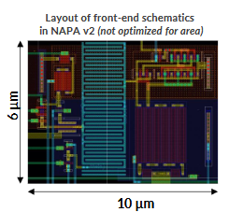
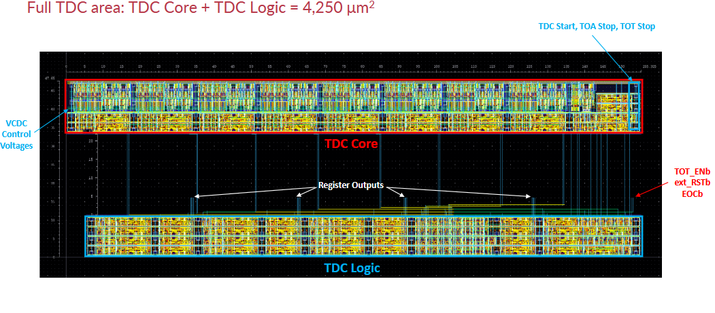
MAPS (Design)
Design of MAPS with improved timing performance for low-duty cycle accelerators in Tower 65 nm technology: (SLAC/Stanford in collaboration with CERN)-slides
  Chiplet prototype was submitted in CERN ER2 run (NAPA v2):
    Designed for ~ns timing performance, but should achieve O(100) ps jitter
    Includes pixels matrix & test structure for TDC (delay cells) for characterization
      Multiple pixel analogue cells connected to one TDC

Slide 5
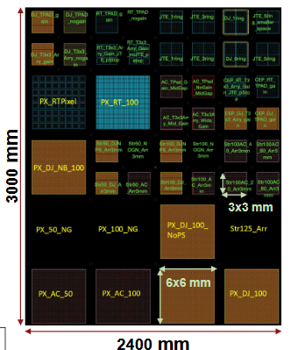
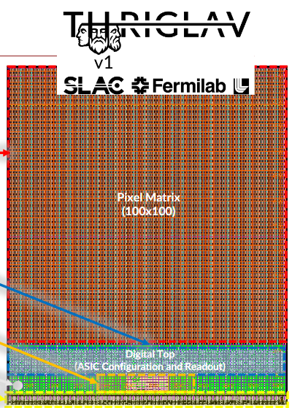
MAPS with 3d Integration
Designing and characterization of 28nm readout ASICs for 3D-integrated LGAD sensors (SLAC, Fermilab, LLNL, Stanford)-slides
  LGADs produced using Tower 65 nm with 12” full wafer run
  28 nm CMOS readout with 10 ps ToA jitter, 100x100 50 μm pixel array and 10 Gbps serializer

Slide 6
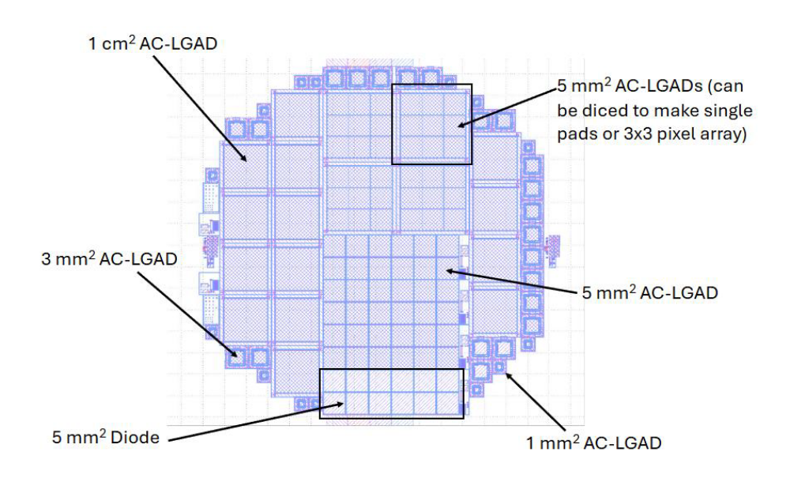
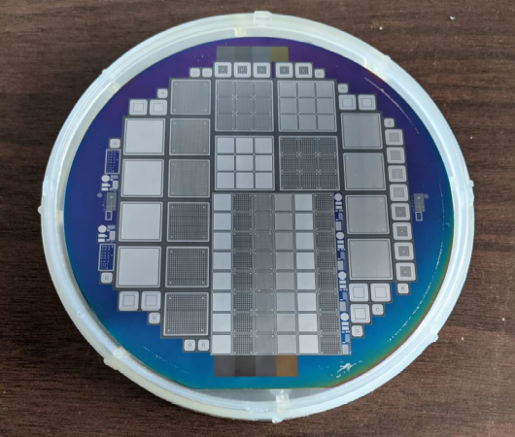
Silicon LGADs (Design)
Optimization of geometry and gain balancing spatial/timing resolutions (Syracuse, Nalu, BNL)-slides
  Pad size, thickness, gain implantation energies, metallization
    Design minimizes sensor capacitance
  Feedback between Synopsys simulation and BNL-produced samples (IV, CV, TCT)
1st set of wafers produced by BNL understudy

Slide 7
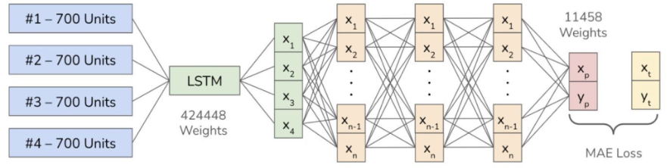
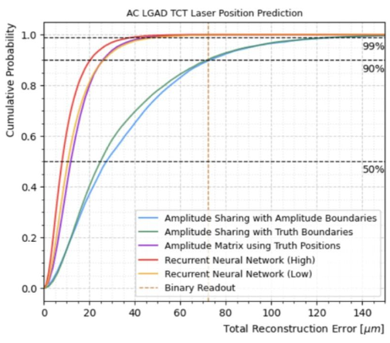
Silicon LGADs Signal Processing
Evaluating the impacts of ML processing and data compression of signal sharing (Brown, BNL, Northwestern Zurich)- slides
  Recurrent Neural Network with four waveforms as input per event
    Allows the network to learn from small variations to enhance amplitude and timing information
  Improves spatial resolution of AC-LGADs with lower computational costs and compression of data to predicted hit positions.

Slide 8
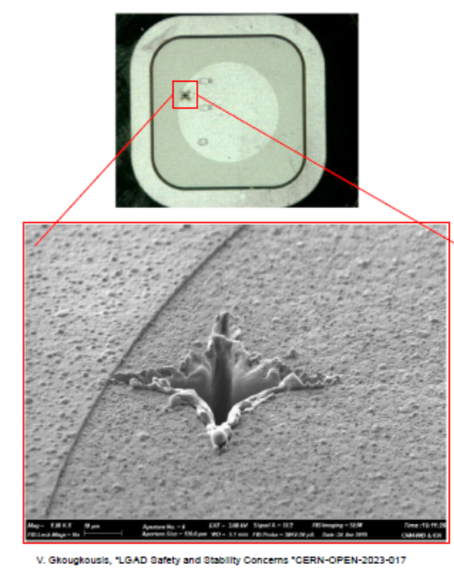
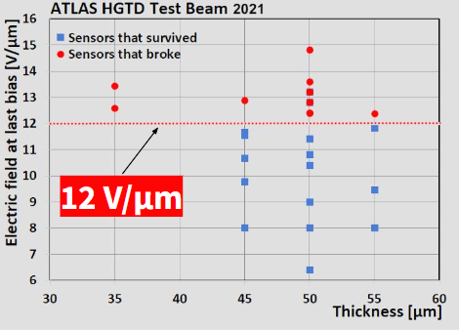
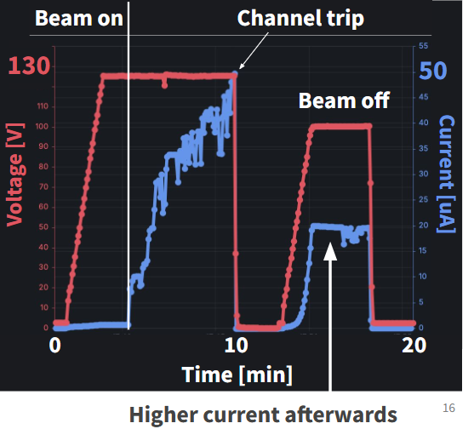
Silicon LGADs (Evaluation)
Evaluating the mortality of ultra-thin LGADs from high energy deposition (UNM, Brown, BNL) at BNL Tandem Van De Graff- slides
  Single event burnout confirmed at 12 V/μm field threshold same for heavy ions
  Additional increased current damage observed with only heaviest ions (gold/iron)
    Mechanisms not understood

Slide 9
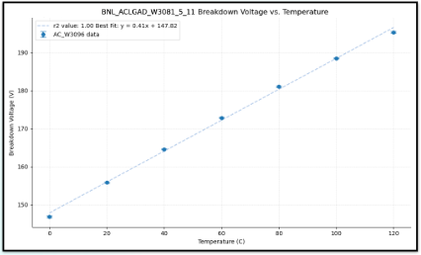
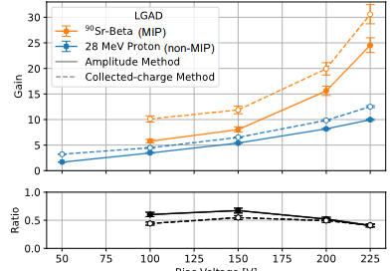
Silicon LGADs (Evaluation)
Evaluating the impacts of environmental stress on (AC-coupled) Low Gain Avalanche Diodes (Brown, BNL, UNM)- slides
  Using LGADs produced at BNL
  Temperature/RH%
Evaluating LGADs (DC/AC) response after (Non)Ionizing radiation (UNM, BNL, )- slides
  Produced by BNL
  Gammas to 10 MGy, 400 MeV protons to 2x10¹⁵ n_{eq} cm⁻²
Charactierizing LGADs using different particle beams (BNL, UNM)- slides
  28 MeV protons and ⁹⁰Sr90 beta source
    Gain suppression seen in proton beam (screening effect may be source)
Correlation of breakdown voltage and temperature

Slide 10
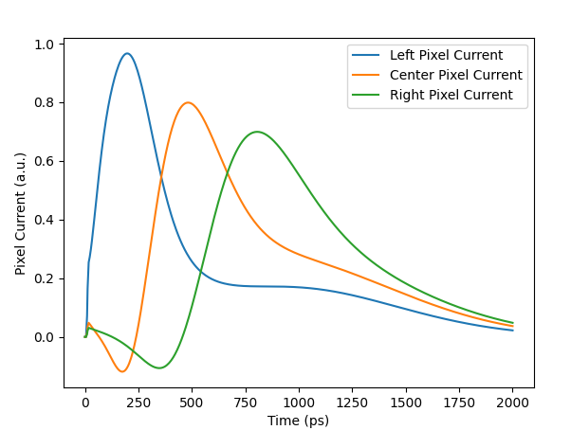
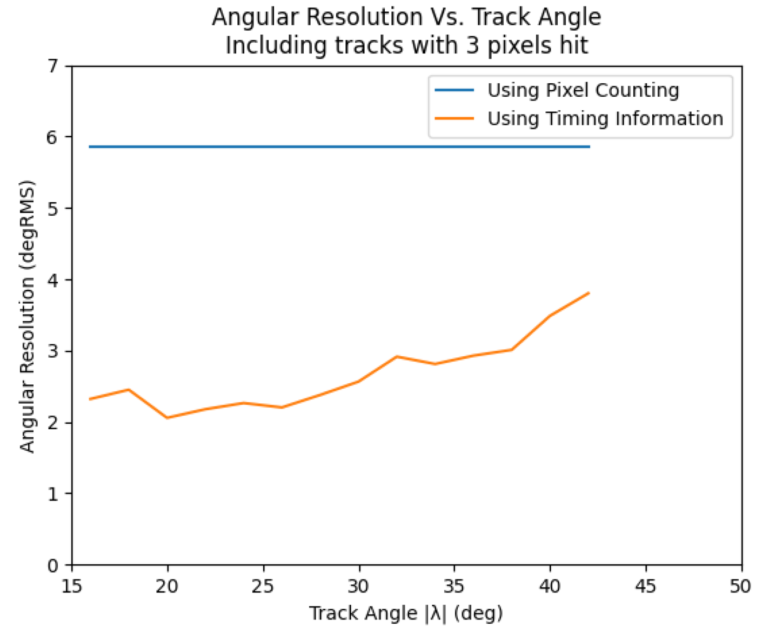
6D Tracking
Using fast-timing to determine track position, time, and angles (SLAC/Staford EE)-slides
  A 45-degree track has a ~500 ps variation between peak times of the 3 hit cells on a 25 μm pitch, 75 μm thick sensor
  At least 3 pixels need to be hit to determine angle
    Can improve angular resolution by 2-3x

Slide 11
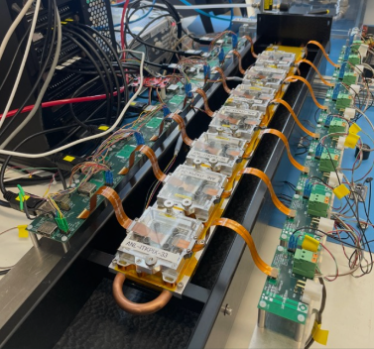
4D Pixel Detector Demonstrator Project
Developing a 4D tracking demonstrator with steps to larger and larger scale to explore and understand systems aspects (LBNL/SLAC/UCSC)-slides
  Integrated timing in classical 3d tracker
    1st stage is test beam telescope with high spacial (<15 μm) and timing resolution (<30 ps) tracking
    2nd stage is R&D thrusts (eFPGA, AI/ML, radiation hardening,..)
    3rd stage is targeting toward collider environment (muon, FCC-hh,..)
  Hope to coalesce multiple national R&D projects

Slide 12
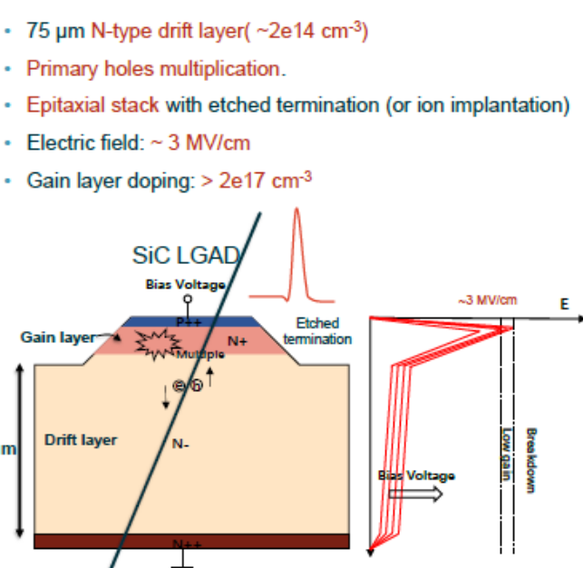
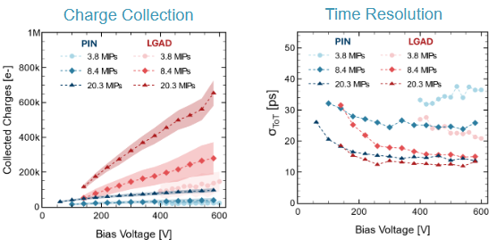
4H-SiC LGADs for timing
Developing 4H-SiC LGADs for fast timing applications (LBNL, NCSU, BNL)-slides
  Higher electron and hole saturation velocity than silicon (2-3x)
  Demonstrated time resolution better than 60 ps with 2-3x gain
    Limited by charge generation currently

Slide 13
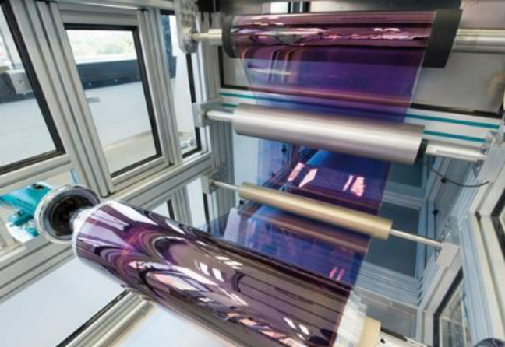
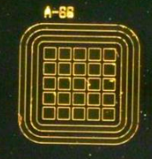
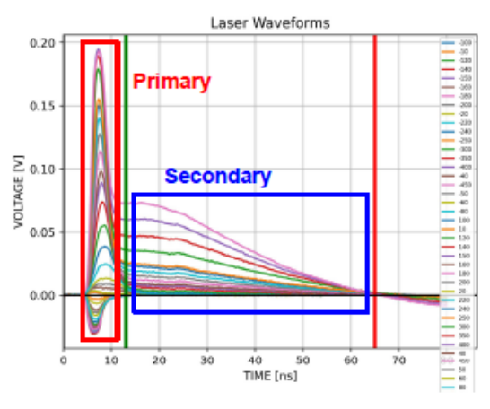
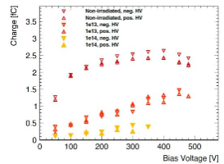
Thin-Film Tracking
Development and evaluations of thin film detectors (ANL, SCIPP)- slides 1 and 2
  Goal to produce cheap, large area thin film detectors in roll-to-roll process
  InP most promising
    First devices made from InP:Fe crystalline wafer fabricated at ANL
    250 ps rise time, 20-40 ps timing resolution, good S/N
    Relative strong degradation with neutron irradiation
Large scale “roll-to-roll” deposition/fabrication

Slide 14
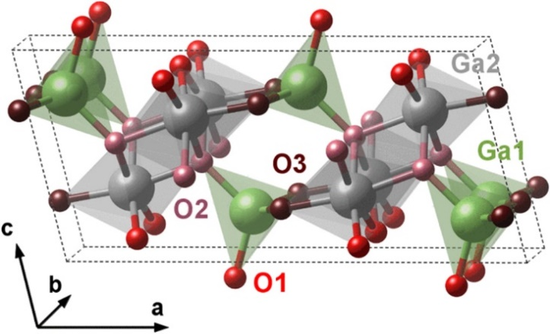
Ga₂O₃ Solid-State Detectors
Beginning detector fabrication, testing and irradiation to demonstrate the potential of Ga₂O₃ for next generation radiation hard HEP detectors (NCSU)
  β-Ga2O3 has many material advantages
    Thermal stability (M. P. > 1800 C)
    Very high breakdown electric field (8 MV/m)
    High-quality bulk single crystals from melt
    Cost-effective, large-scale manufacturability

Slide 15
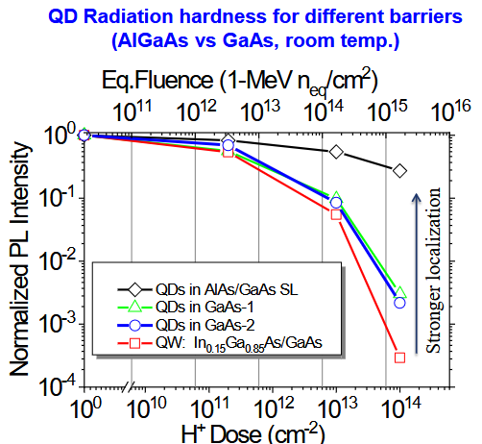
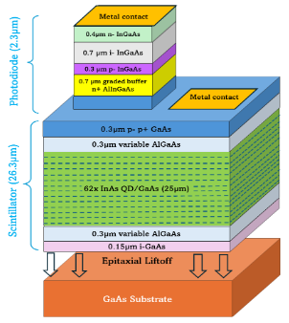
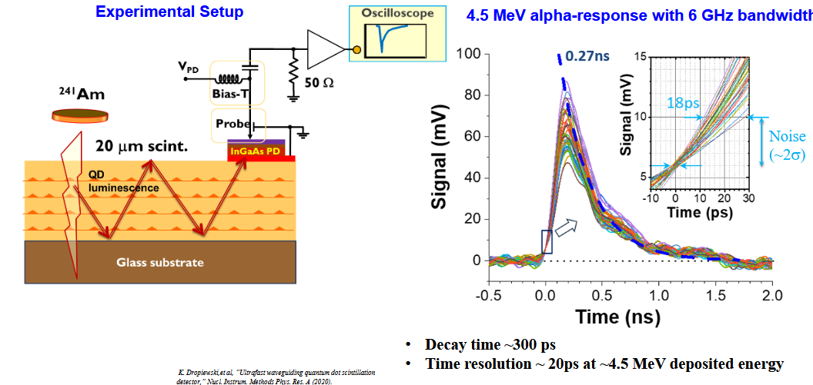
InAs/GaAs Semiconductor Quantum Dot Scintillation Detector
Development of InAs/GaAs Quantum Dot 4D Scintillation Tracker (Albany/Fermilab)-slides
  Ionizing bulk semiconductor (GaAs) and then capture electrons with p-type quantum dots (InAs)
    Overall efficiency 30-40 el./keV, ~15% of the theoretical efficiency limit
    Extremely fast scintillation (< 0.3 ns)
    Time resolution of 18-40 ps for α-particles
    Thickness (25 μm) limited by epitaxial growth technology
      Breakeven thickness with Si LGAD is 40-70 μm

Slide 16
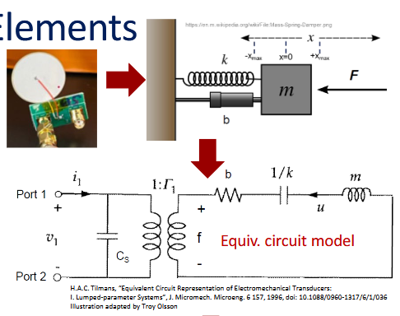
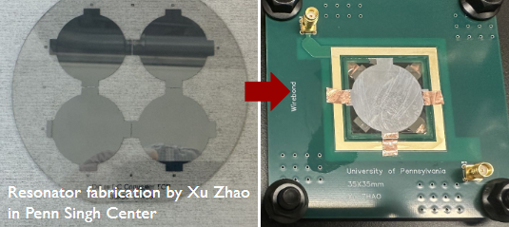
Powering Options
Miniaturizing DC-DC convertors for trackers by replacing large inductors with custom piezoelectric elements
  Energy storage is mechanical, not magnetic/electric field
    Low EMI
    Potentially radiation tolerant
  Lithium Niobate is a potential material for miniaturization:
    high Q
    In shear mode: higher K2 (electromechanical coupling), no thermoelastic heating (no tension and compression forces)
See presentation for details

