Slide 1
Integrating Stitched & Coffea into the Key4Hep Ecosystem
September 10, 2026
Lindsey Gray, on behalf of the CODE4HEP team
Scientist

Slide 2
CODE4HEP
An LDRD Initiative at FNAL for Future Collider Software
Collider Optimization Development Environment 4 HEP
Primary goal: understand the applicability of CMSSW’s architecture within key4hep ecosystem
Foci:
  Support FCC and Muon Collider physics objectives (PI - Kevin Pedro, LG)
  Exercise scaling of simulation and event mixing
  Framework considerations (Chris Jones, Matti Kortelainen, Elizabeth Sexton-Kennedy, W. David Dagenhart)
    Governance once extracted outside CMSSW, EDM4HEP compatibility, heterogenous computing
  Improve GEANT multithreading model (GEANT expertise at FNAL: Daniel Elvira, Soon Yung Jun)
  Support EDM4HEP in columnar analysis codes (LG, Viraj Nain)
Funding period finishes at end of year – we have largely accomplished our goals at this point.
We invite discussion on making this work impactful in the long run, there are accumulated decades of experience in a framework lifted out of an operational experiment.

Slide 3
Major Focus Areas
01

Slide 4
Stitched
The Extracted Framework Core from CMSSW
https://github.com/code4hep/stitched-alpha2
Contains only:
  the necessary data formats: wrappers, dictionary basics
  the framework core itself: modules, concurrency model, conditions, configuration
Concurrency possible across: Runs, Luminosity, Events, within Events
  Varying threading properties available through: edm::one::, edm::stream::, edm::global::
  Conditions also concurrent – thread-shared memory access at all levels
Note this is not the same thing as Gaudi, which is a framework for building frameworks
Rather, it is an in-state event processing framework striped away from experiment needs
  Isolates the computing fundamentals from the science requirements
  Provides opportunity for studying/evaluating scheduling opinions and a clean slate for comparison
Governance: currently CODE4HEP contributors, but under Apache v2 License
  Governance needs to be determined as LDRD ends

Slide 5
GEANT
Multithreading Consolidation
G4MTRunManagerKernel
OscarMTProducer
32
Threads = [0, … n]
RunManagerMT
OscarMTMasterThread
InitializeGlobalCache
32
state loop: wait
12
initG4
beginRun
globalBeginRun
00
initializeTLS
OscarMTProducer(…)
32
RunManagerMTWorker
callConsumers
beginRun
beginRun
std::thread
tbb::thread_group
InitializeG4
produce
produce
terminateRun
endRun
terminateRun
stopG4
endRun
globalEndRun
stopThread
globalEndJob
Threads = [0, … n]
GEANT has its own threading model and its organization is difficult to cleanly match to modern paradigms like TBB

Slide 6

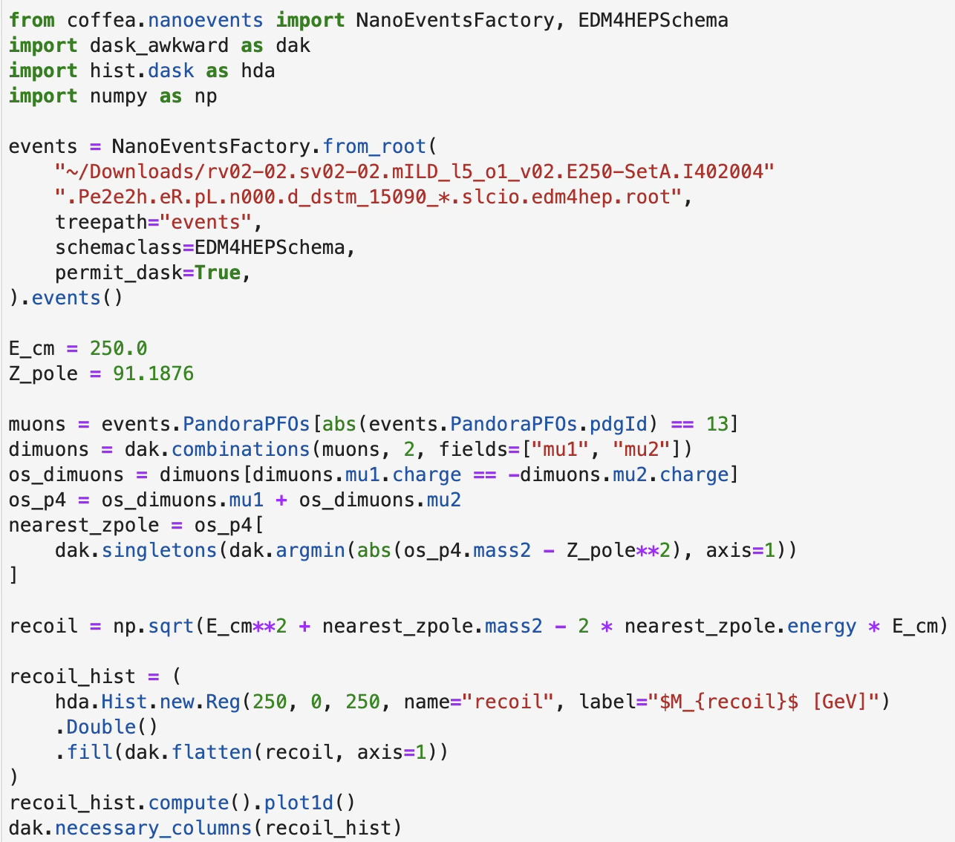
:
Columnar Analysis
https://github.com/scikit-hep/coffea
Uses awkward array, uproot to achieve physics analysis in the idioms of python-based data science tools (e.g. numpy)
Full histogramming capabilities
Delivers the bulk of US CMS analyses
e+ e- “hello world” (higgs recoil) is ~10 lines
  Investigating detailed/easy/scaling systematics handling and bookkeeping
  EDM4HEP evolves rapidly staying in line with it requires automation

Slide 7
Results
02

Slide 8
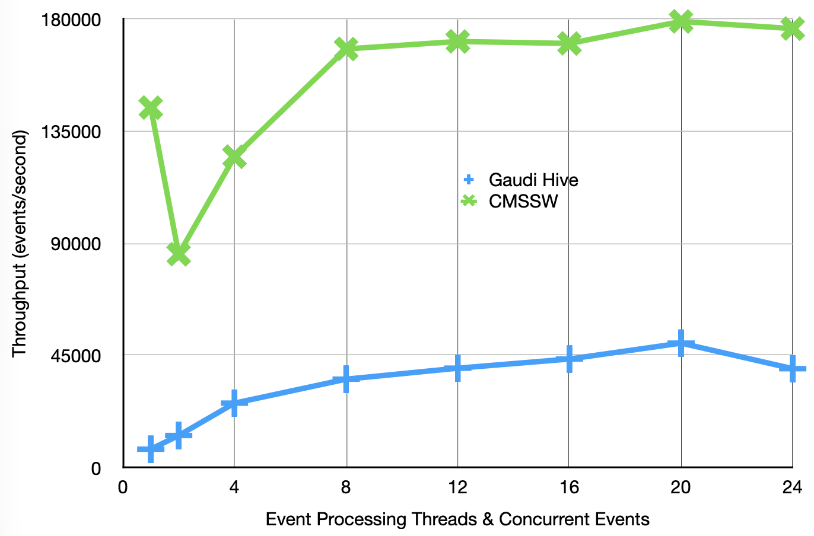
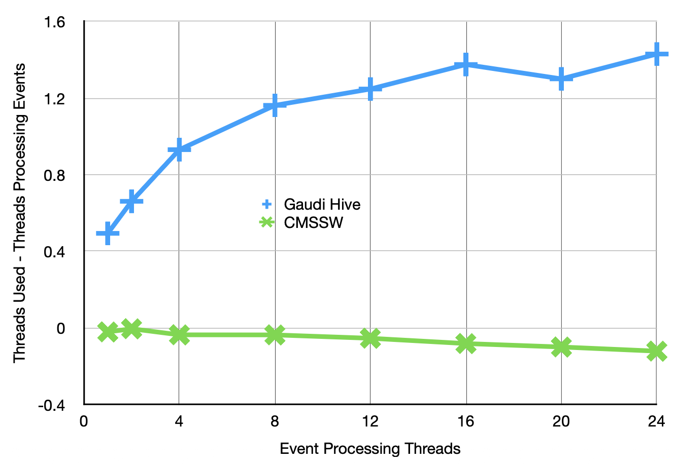
Stitched
Thread Dispatch Scaling (I)
Run a pure test of thread scheduling
  This is adding two numbers and saving the result
  Asks the question “how fast can we dispatch work”
Demonstrates different resource utilization patterns between
  unscheduled execution (stitched)
  master-thread dispatch (Gaude Hive)
Not a “true” measure of framework performance (i.e. real event throughput)
  However, clearly identifies the overhead of the master thread in Gaudi Hive

Slide 9
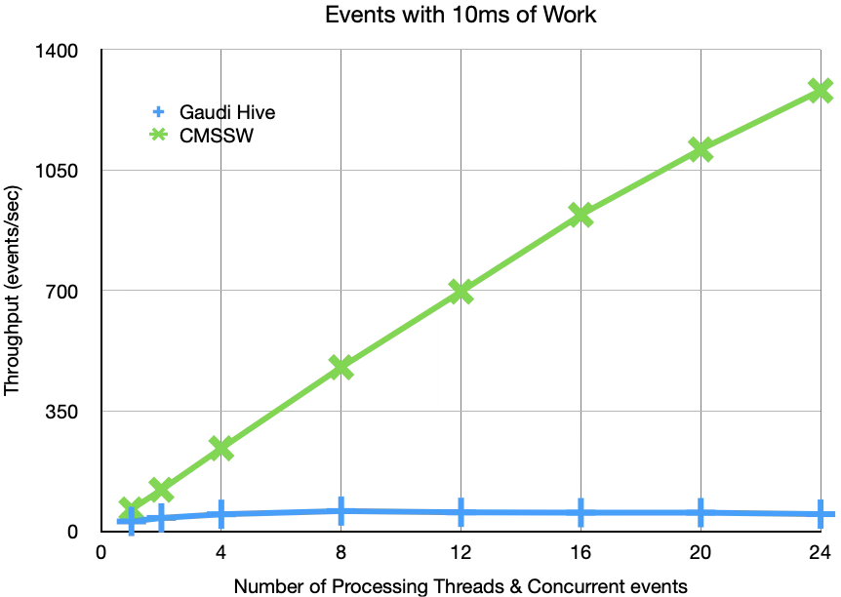
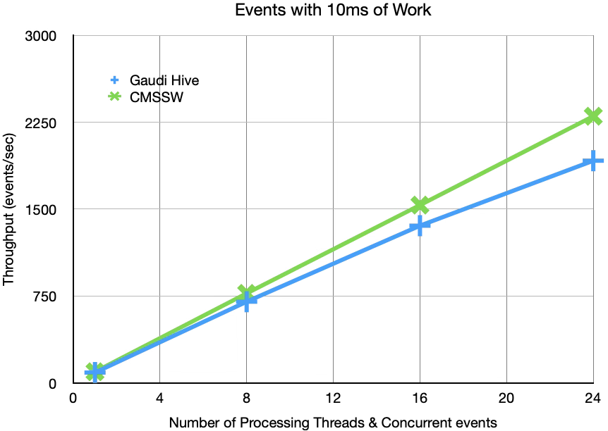
Stitched
Thread Dispatch Scaling (II)
Number-of-modules vs. time-spent in model parameter space has interestingly rich performance structure
Stitched and Gaudi converge at large per-module times, up to 24 cores (see backup)
At large module multiplicity when modules execute very quickly the thread-dispatch appears to throttle Gaudi Hive
  This is not a common situation presently but if running on many core machines with fast modules – possibly a consideration?
Not meant as claim of superiority, but rather a useful 2D probe of design impacts towards building future software
1000 modules, 10 μs each
100 modules, 100 μs each

Slide 10
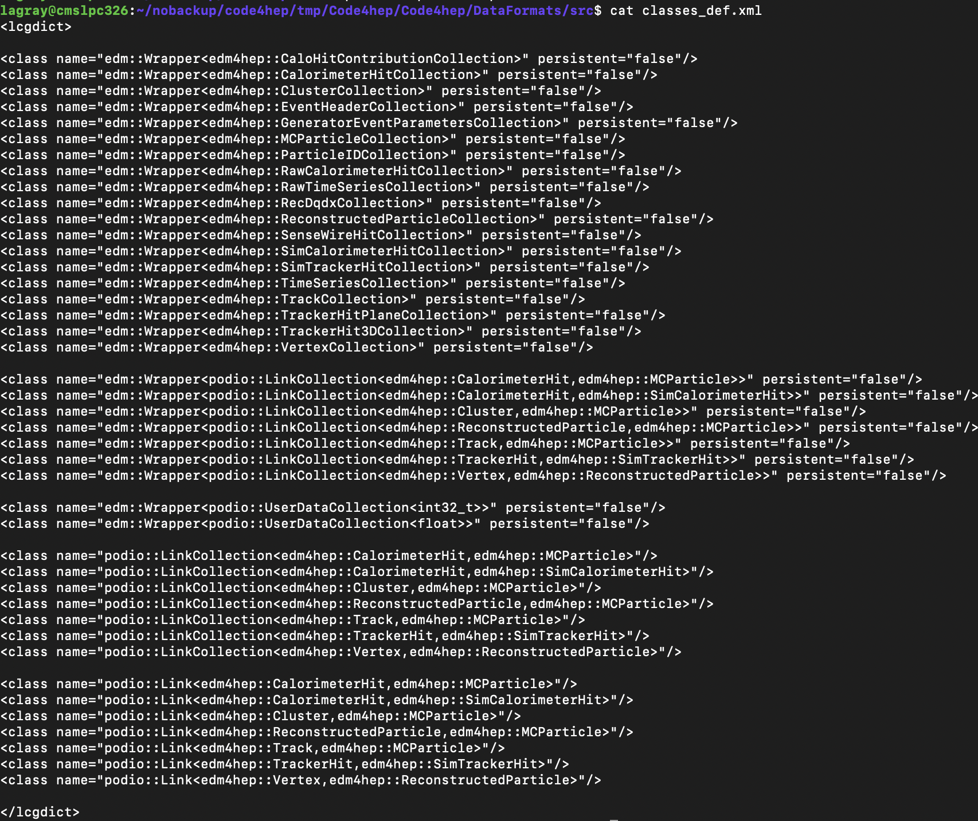
Stitched
EDM4HEP Integration
Implemented podio reading and writing modules as stitched plugins
  In code4hep repository next to stitched
Along the way: numerous mismatches between edm4hep and stitched default data model
  CMS idioms and provenance needs
  Compiling impl. notes into useful artifacts
  Able to eventually pipe-fit our way to stitched-compliant data reflection
Stitched uses edm4hep classes exactly
  No internal translation between dialects
Hijacked edm4hep metadata to satisfy framework provenance requirements
TL;DR stitched reads and writes modern edm4hep

Slide 11
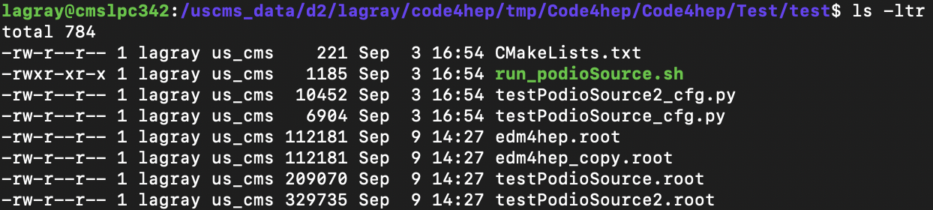
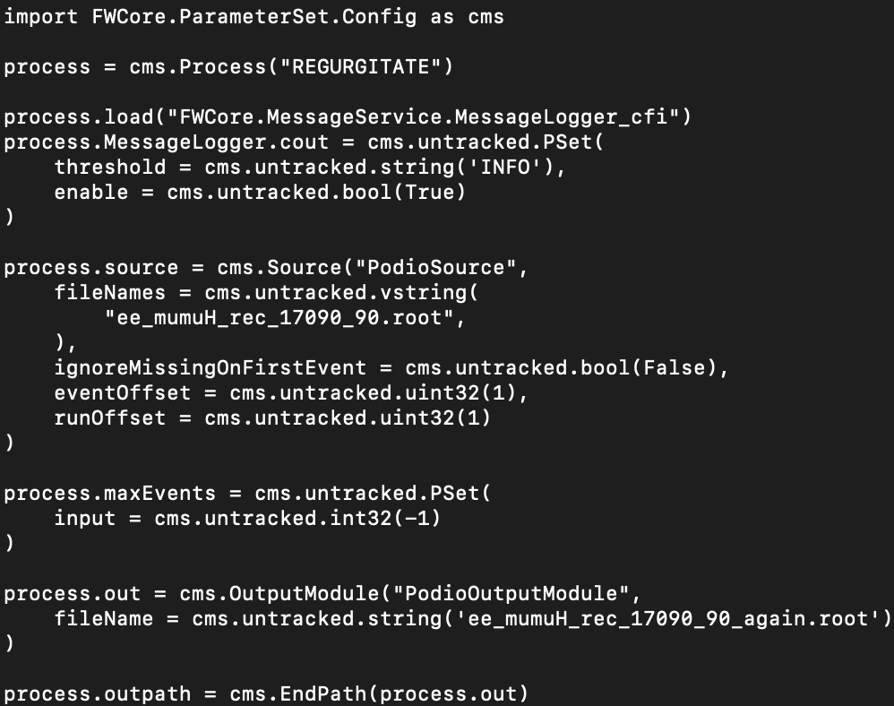
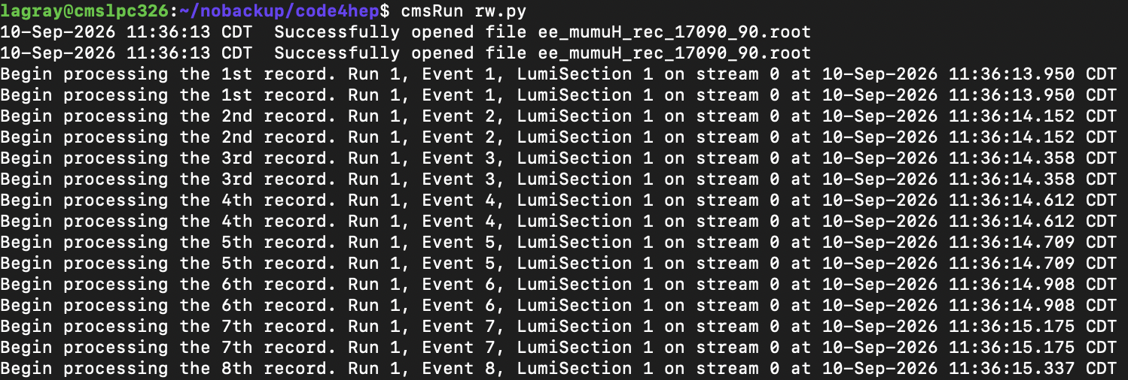
Stitched
The Read/Write Test
Read/write unit test output
Read/write central production file:

Slide 12
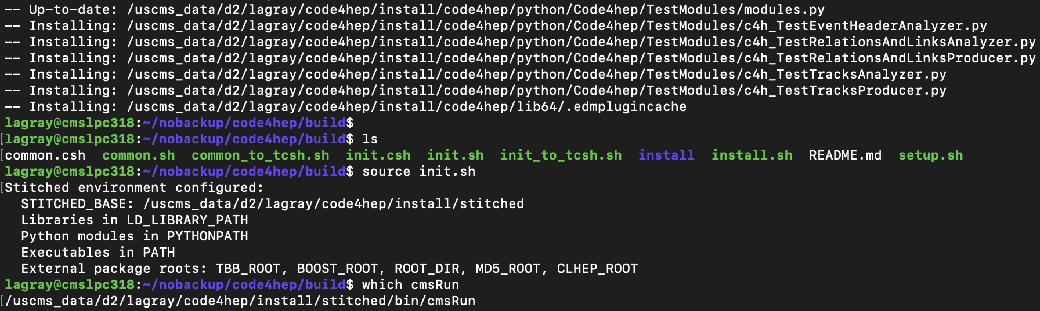
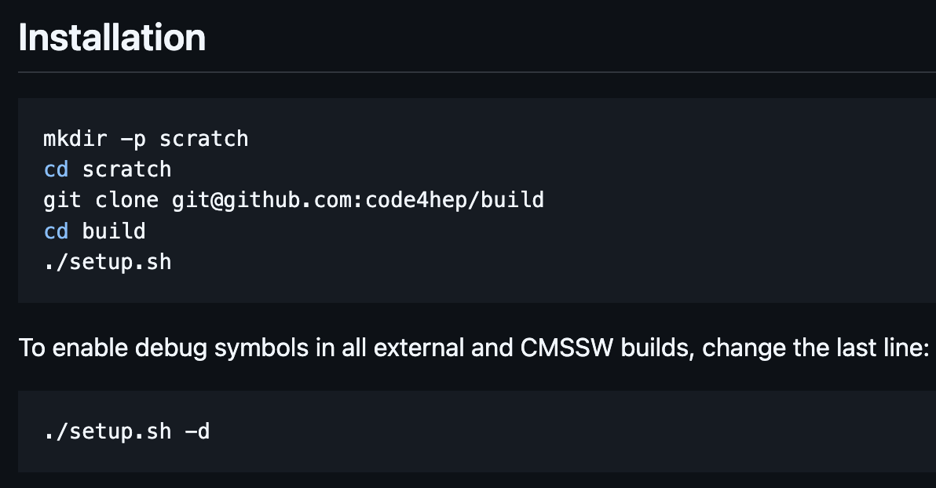
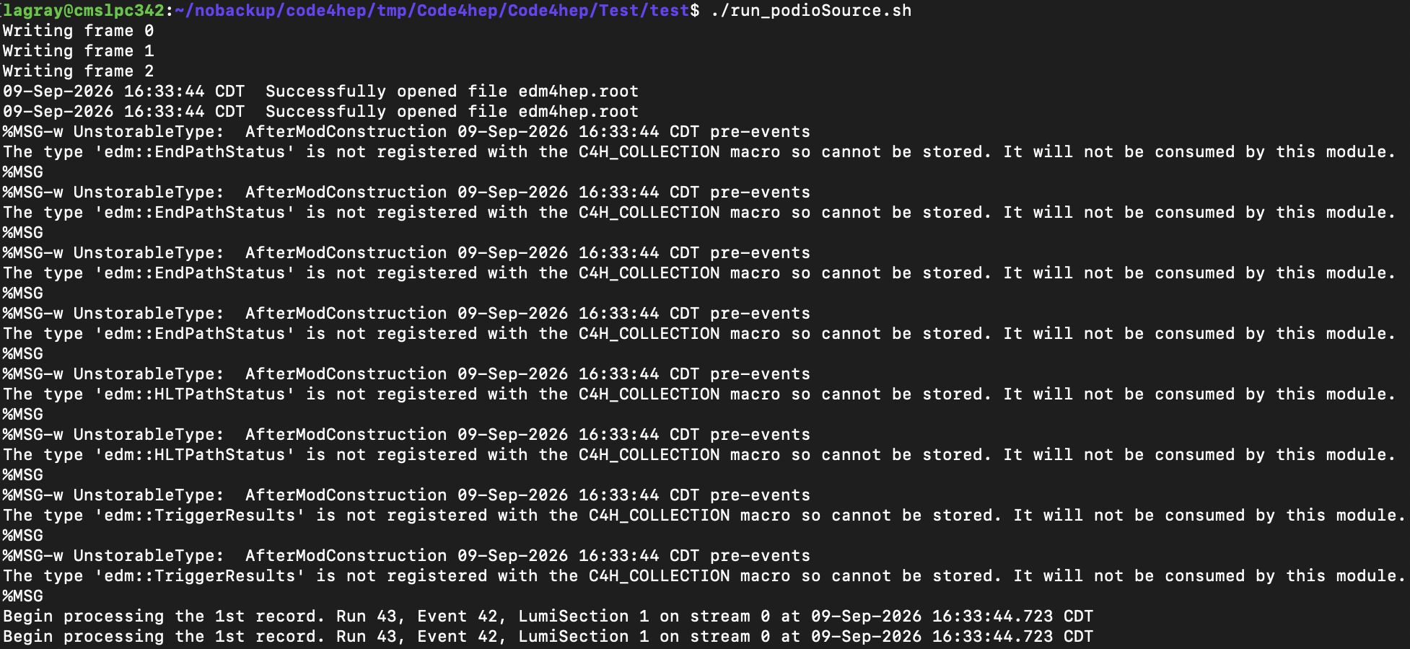
Stitched
Building It Yourself
Unofficial reproducer available at: https://github.com/code4hep/build
Then go make a coffee…
At the end ->
SPACK installation being finalized, supersedes this installer

Slide 13
GEANT
Multithreading Consolidation – event processing framework agnostic
EDProducer
Worker Threads Id = [0, … n]
G4MTRunManager
G4MasterInterface
InitializeGlobalCache
G4WorkerRunManager
state loop: wait
G4SimProducer
G4WorkerInterface
Initialize
beginRun
globalBeginRun
phys
det
UAs
callConsumers
beginRun
InitializeG4
Field
SDs
tbb::thread_group
TLS (SD, Field, UAs)
std::thread
produce
produce
endRun
endRun
ThreadState::EndRun
endRun
globalEndRun
kernel→RunTerminate()
Cleanup
stopThread
globalEndJob
Various configurations now made thread local so that GEANT threading model can be adapted to modern threading models

Slide 14
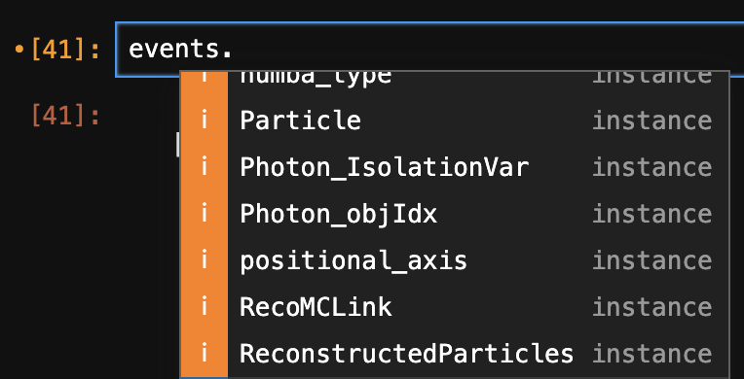
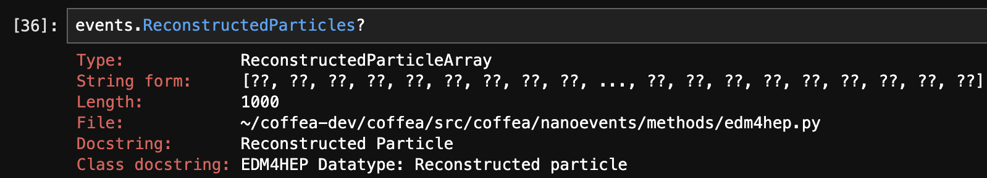
Coffea
EDM4HEP Analysis (I)
EDM4HEP is a natively columnar dataformat (for the most part)
Easy to adapt to awkward-array idioms for data analysis
Have made a “NanoEvents” schema for EDM4HEP
Full integration with EDM4HEP (including ~nearly all past revisions)
  Now a CI run automatically checks for new EDM4HEP releases and opens a PR in coffea
  Nearly zero maintenance burden
Python notebook creature-comfort integrations:

Slide 15
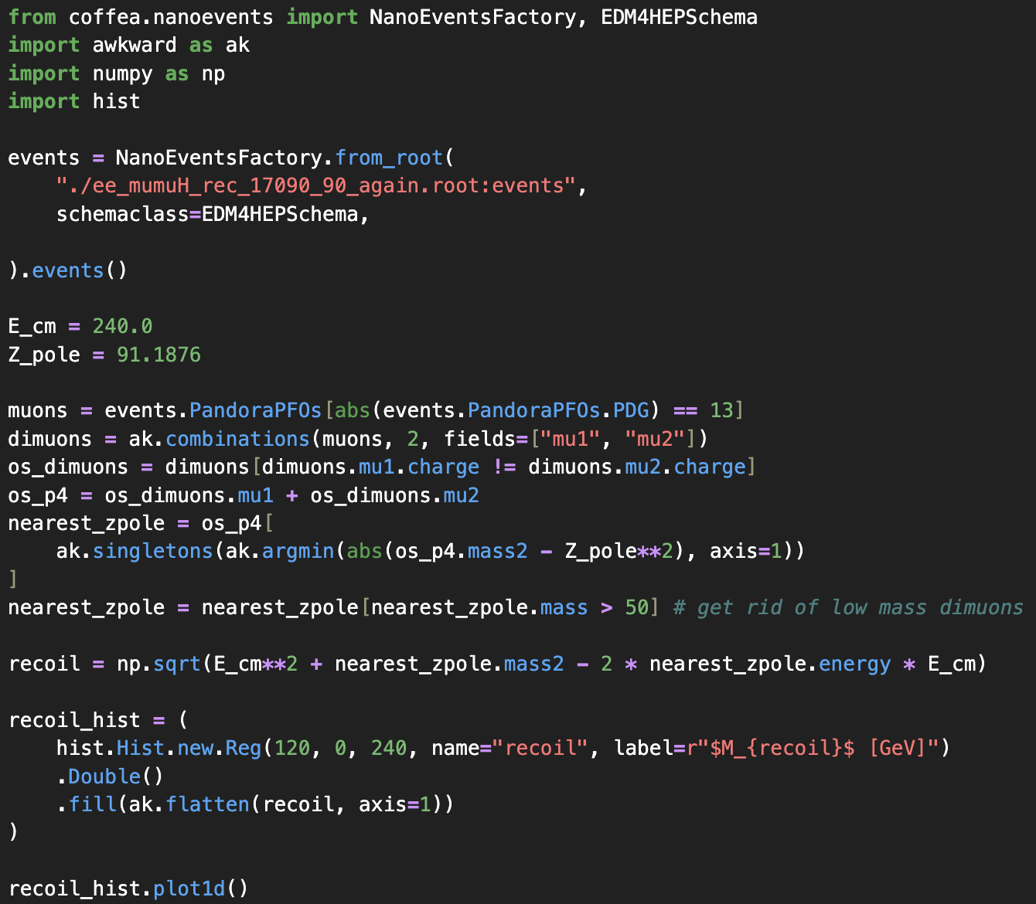
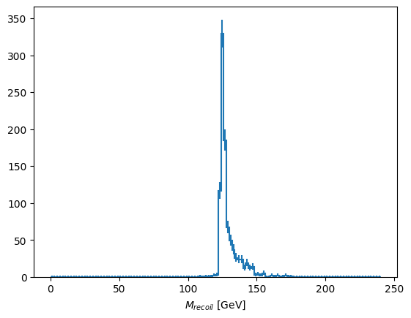
Coffea
EDM4HEP Analysis (II)
This file was made by stitched!

Slide 16
Remarks & Conclusions
We have successfully integrated EDM4HEP (01.00) into CMSSW
We have GEANT building in within code4hep, running as a stitched module
  Improved threading architectures – as part of GEANT itself
  Can scale multithreaded GEANT jobs based on years of experience within CMS
  k4Geo based simulation is coming soon, expect before end of year
We could theoretically start interoperating now in terms of passing around files
  Framework module definitions are rather fundamentally different between Gaudi and Stitched
  However – could envision presenting surfaces of reconstruction algorithms such that implementing modules between the two is easy
  Honestly, depends on level of interest from community what/how many RECO algorithms get implemented
Coffea can easily read edm4hep files and make plots
Coming Soon:
  CrossStitched – the extracted heterogenous core (SONIC, ALPAKA, raw CUDA) from CMSSW

Slide 18
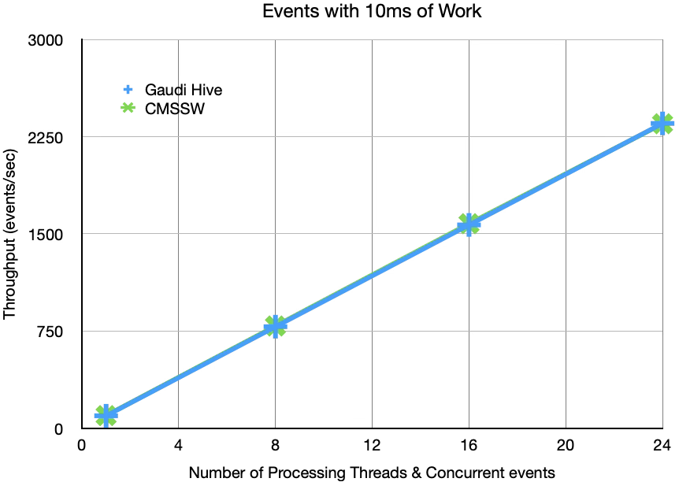
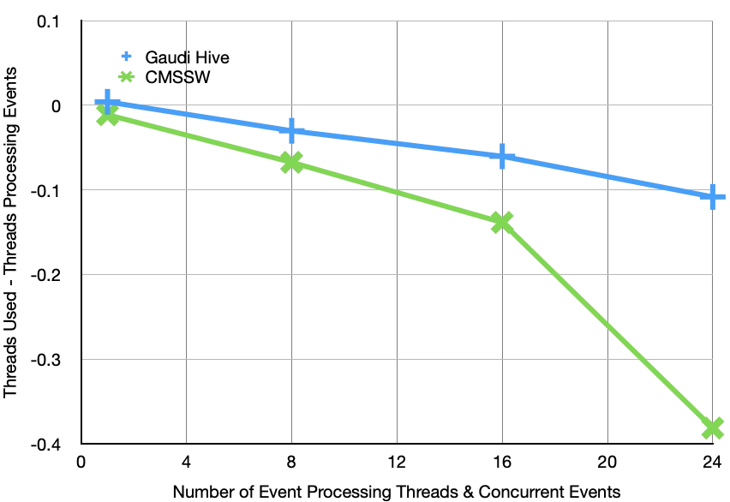
Stitch / Gaudi Performance for heavy modules
Impact of master thread, not actual per-thread efficiency.
Impact of OS scheduling on threads

