Slide 1
4th US FCC Collaboration Meeting
US FCC Accelerator Summary
September 11, 2026
Tor Raubenheimer

Slide 2
US FCC Collaboration Meeting Accelerator Program
Tuesday afternoon: review of on-going HFCC R&D programs
Wednesday afternoon: US Accelerator R&D and FCC-ee R&D opportunities
Thursday: New R&D opportunities for the US
HFCC-ACC is just a portion of the contributions from the US to FCC.
Individuals contributing to FCC
On-going collaboration between EIC and FCC and on-going
efforts at BNL, SLAC, and FNAL
DOE General Accelerator R&D (GARD) funding for synergistic R&D
New LDRD’s at LBNL & SLAC and potentially at ANL and FNAL

Slide 3
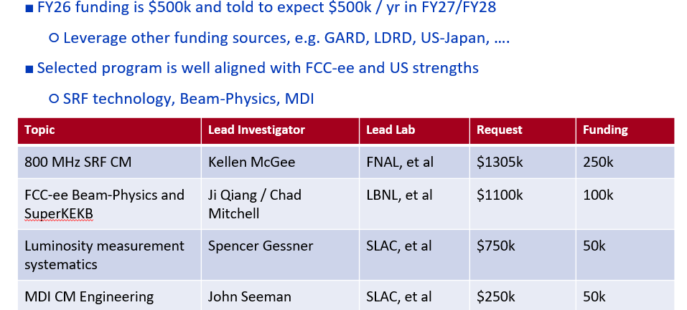
US HFCC-ACC Program
Worked with contacts supplied by FCC leadership
to develop and prioritize program
Building collaborations and establishing relationships

Slide 4
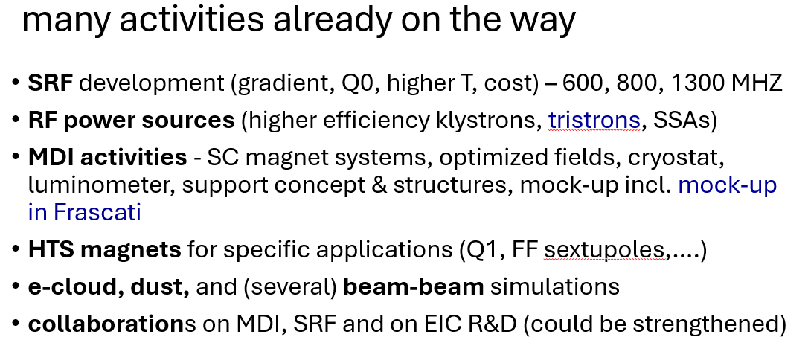
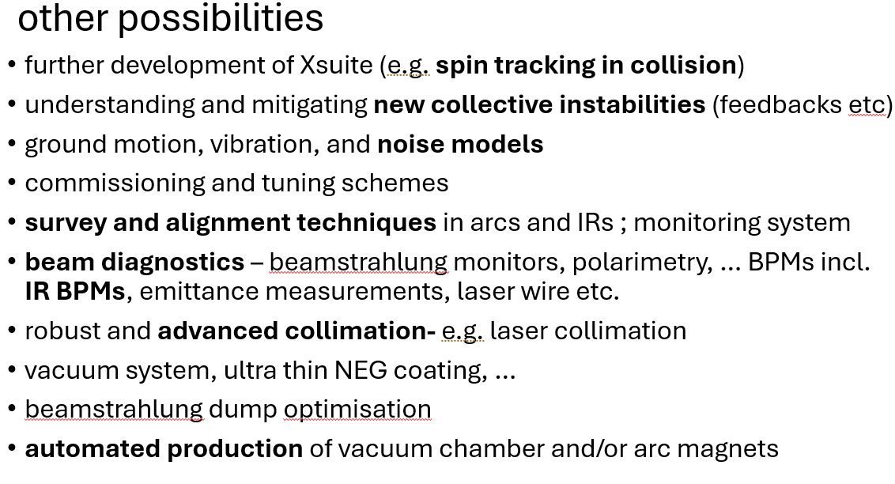
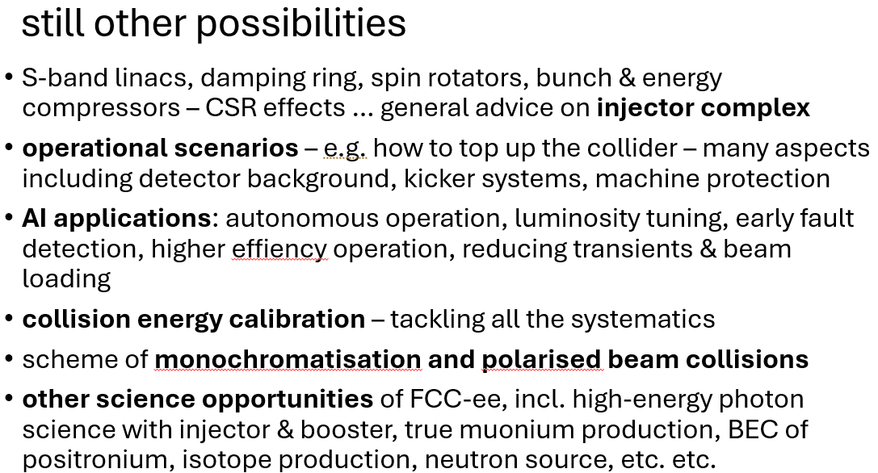
FCC-ee Accelerator Needs (Zimmermann)

Slide 5
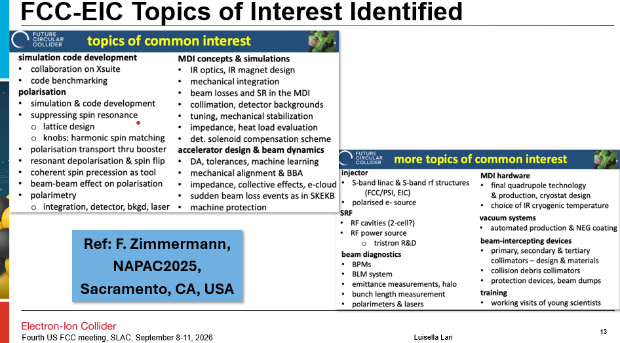
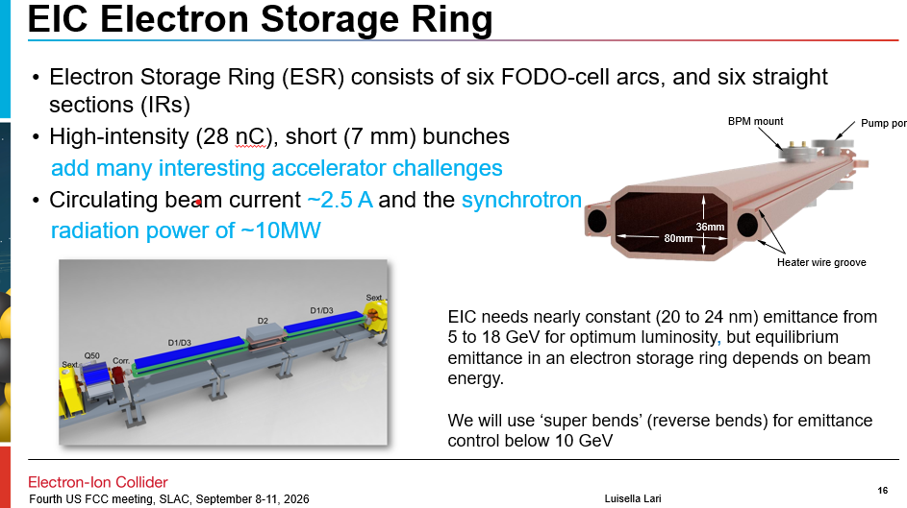
Synergies with EIC (Lari)

Slide 6
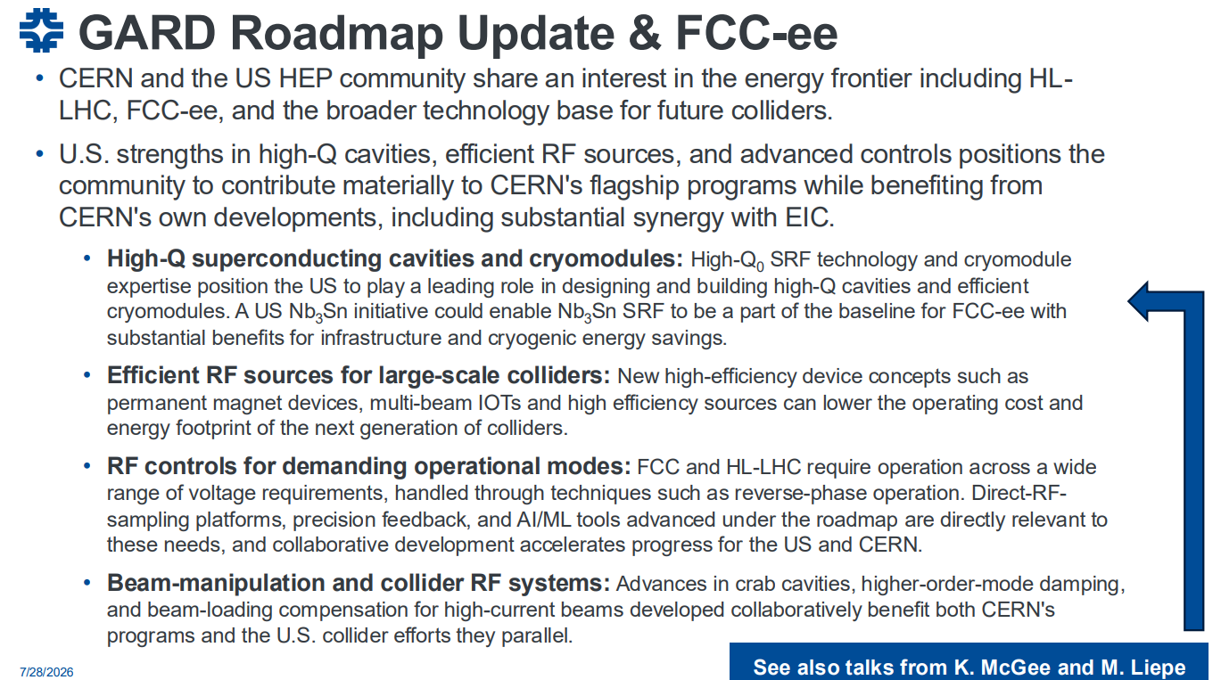
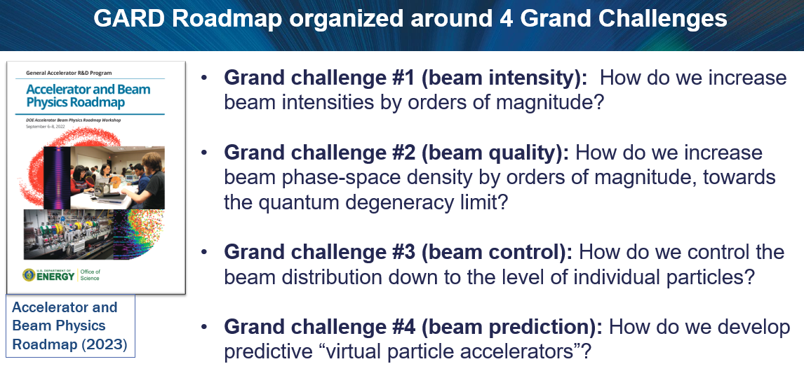
US General Accelerator R&D (GARD) Roadmap
Sam Posen
RF technology development that will
impact FCC-ee as well as other new
accelerators
Beam physics simulations with very
high fidelity that are needed to fully
model FCC-ee
Jean-Luc Vay

Slide 7
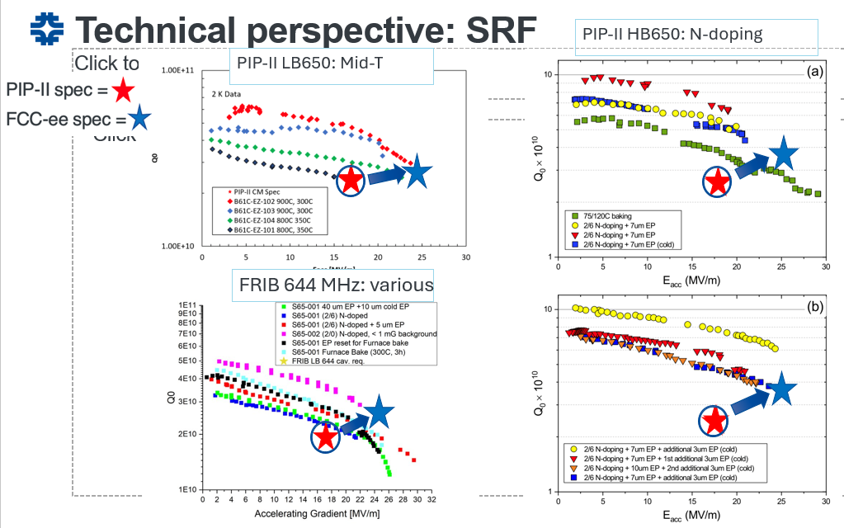
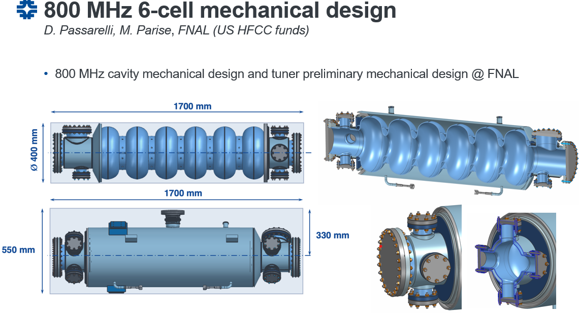
800 MHz SRF R&D
The US has built 6 large SRF linacs over
last two decades: LCLS-II, LCLS-II-HE, Jlab
12 GeV Upgrade, SNS Power upgrade, FRIB,
and PIP-II and has developed high-yield
processes to achieve gradients and Q’s
approaching the FCC-ee goals.
Kellen McGee
Collaborative effort started in Feb 2024
and ‘launched’ at FCC Week 24 but 1st
formal funding was 2026.

Slide 8
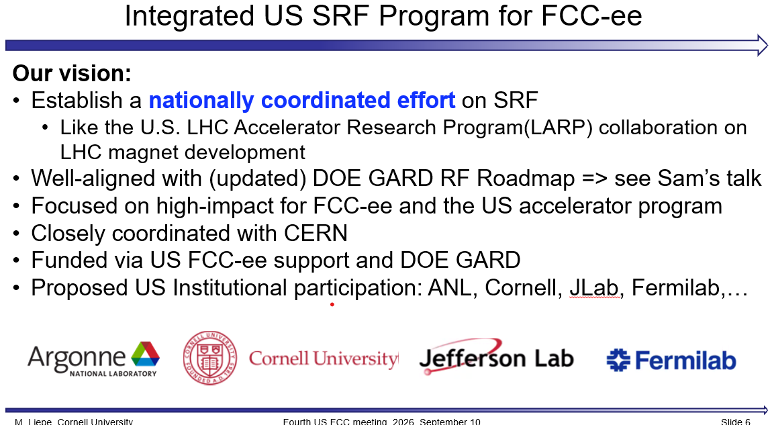
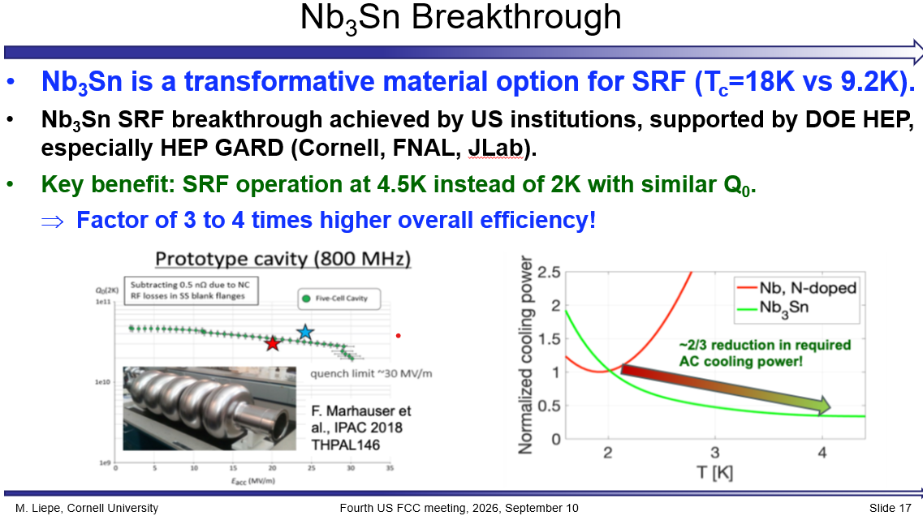
A Nationally Coordinated SRF R&D Program
The US has many SRF accelerators and R&D facilities across the complex: Cornell, Fermilab, Jlab, SNS, ANL, BNL, MSU, ….
We are a leader in development of high Q, high gradient bulk-Nb SRF cavities and we’re also a leader in Nb3Sn coated cavities which would have application for almost all new accelerators across DOE as well as medicine/industry

Slide 9
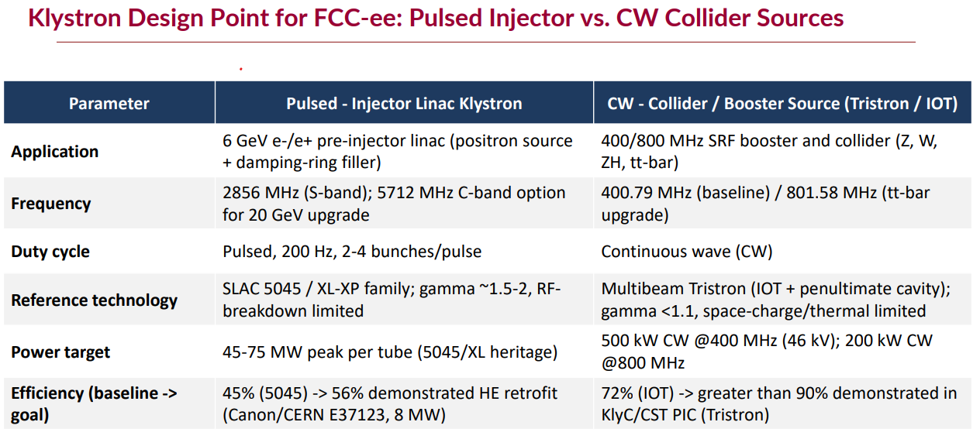
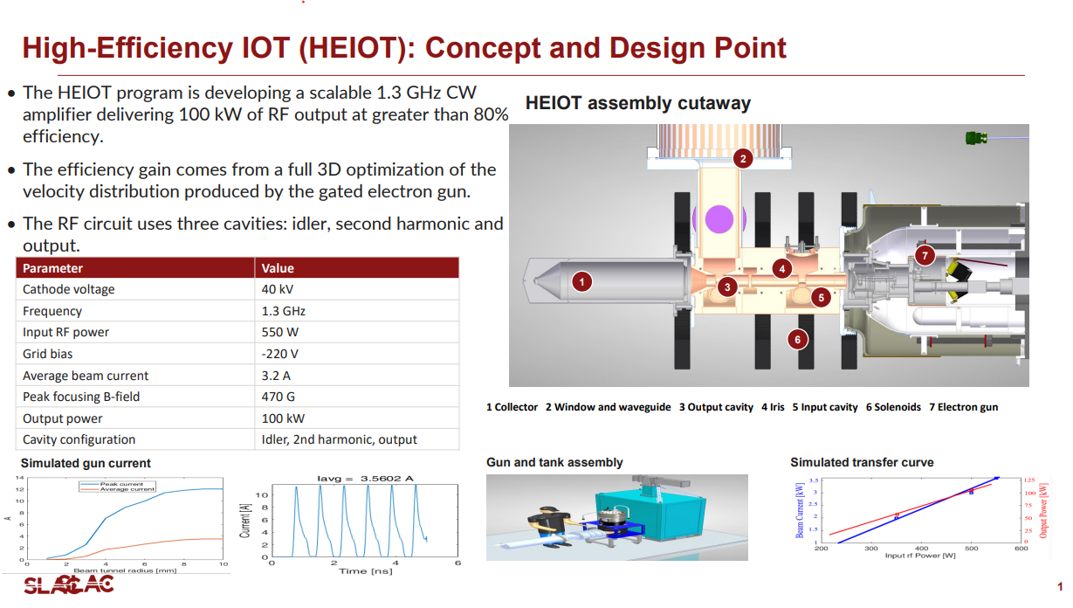
RF Power Opportunities
FCC-ee is looking to develop a new type
of high power RF source that operates with
high efficiency across a broad operating range.
Mohamed Othman and Emilio Nanni
Few manufacturers are interested in producing
much less engineering RF sources (problem
high power accelerators across DOE) however
design of sources completely changed with
modern 3D tools → work with manufacturers
and develop prototypes

Slide 10
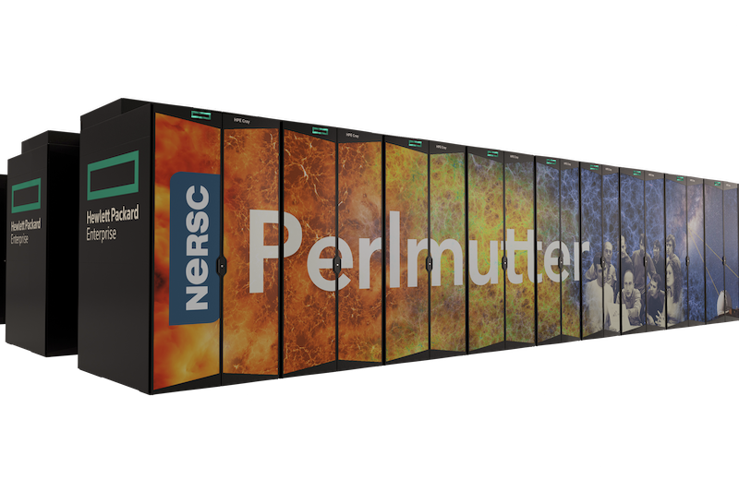
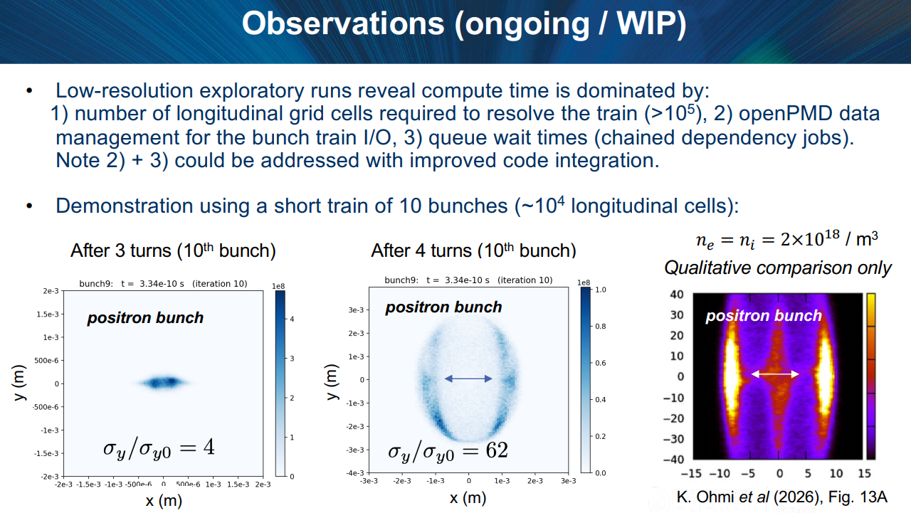
Beam Dynamics Simulations
SuperKEKB has exhibited some poorly understood
phenomena that could impact FCC-ee. One example
is the Sudden Beam Loss where a large amount of
charge is lost over a few turns. It is expected to be
due to ‘dust’ getting trapped in the beam. Cleaning
one source in e+ ring has reduced frequency but
still effects seen the e- ring. Very complex problem
to model with evolution the dust to form a plasma and
then the multi-bunch interaction with the plasma
Jean-Luc Vay
DOE has developed computers and
computational tools for Exascale computing.
This very large-scale computing complements
capabilities that exist at CERN with the Xsuite
simulation package. Collaborations with CERN
and KEK to understand critical beam dynamics.
Chad Mitchell

Slide 11
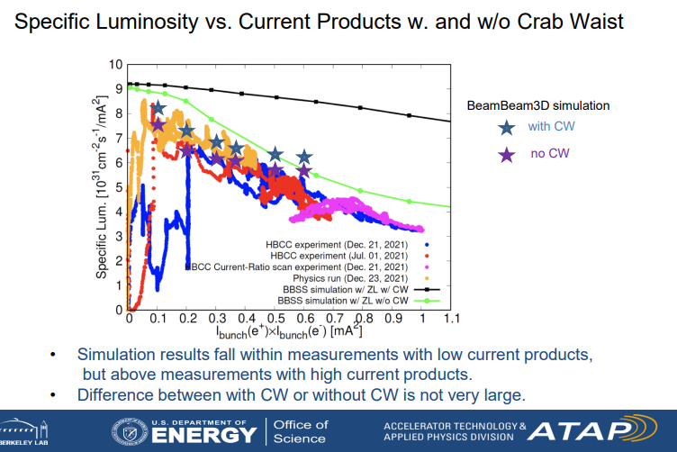
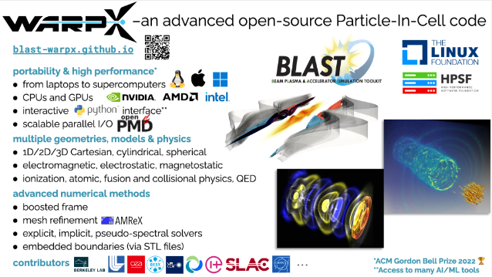
Beam Dynamics Simulations
SuperKEKB luminosity is lower than expected.
Many possible reasons. Some are ‘understood’
and some not. Lots of simulations but results
are not clear.
The US has two tools with different levels of fidelity:
BeamBeam3D, used for EIC and …, and WarpX,
being designed to fully model interactions with
beam-beam including beamstrahlung, pairs, ….
Ji Qiang
Arianna Formenti and Peter Kicsiny

Slide 12
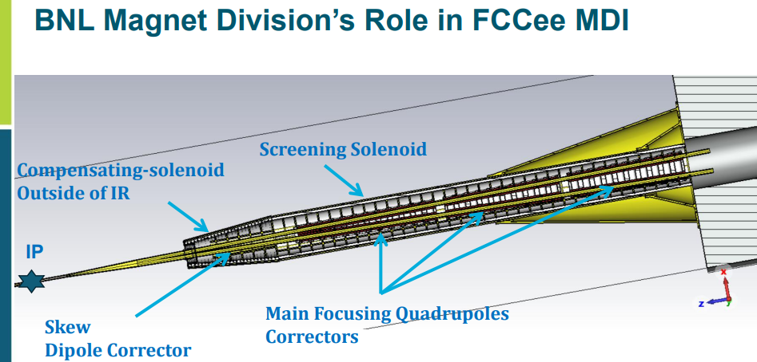
Interaction Region Magnet
IR Magnet is challenging due to space
constraints and harmonic requirements
while the fields are relatively modest
(very different from High Lum LHC)
Vikas Teotia
BNL has been collaborating
with the FCC-ee MDI group
for 3 years (supported on
LDRD) to help develop
concepts for the IR magnets
Direct-wind is one possible
technical solution. Used in
RHIC, HERA-II, BEPC-II,
JPARK, ILC/ATF2, and
SuperKEKB and planned for
EIC

Slide 13
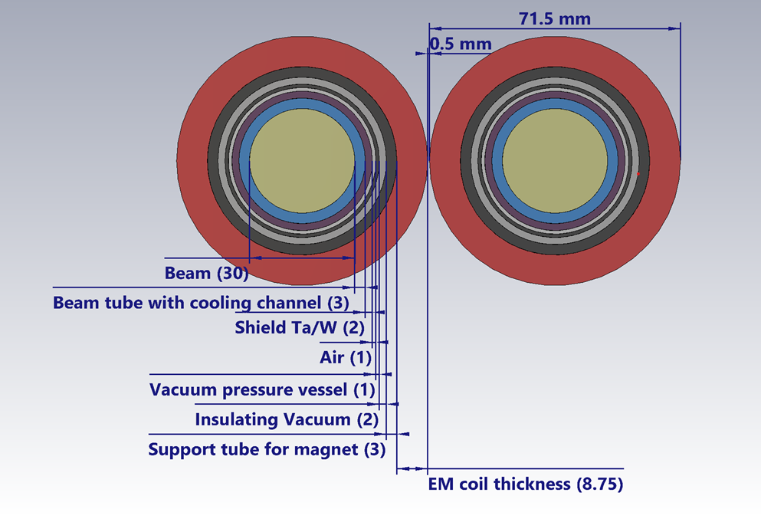
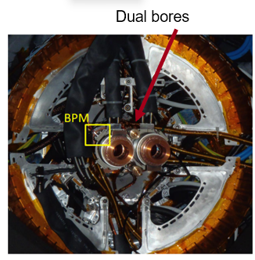
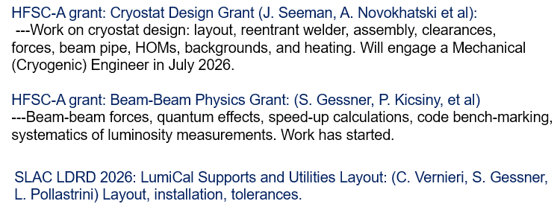
IR Magnet Cryostat and Layout
John Seeman
US experts from SLAC and BNL have been
collaborating with FCC-ee MDI group to
develop concepts for the IR magnets and
associated components. Bring experience
from e+/e- colliders PEP-II and SuperKEKB
SuperKEKB

Slide 14
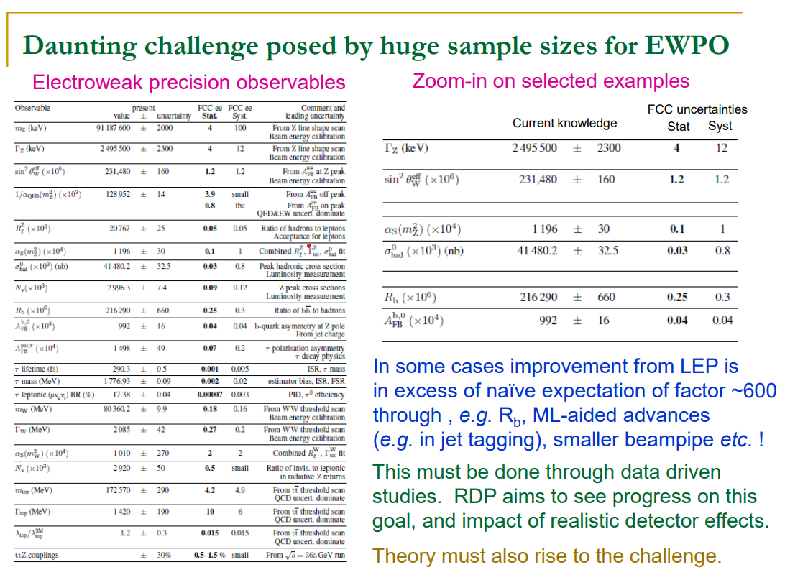
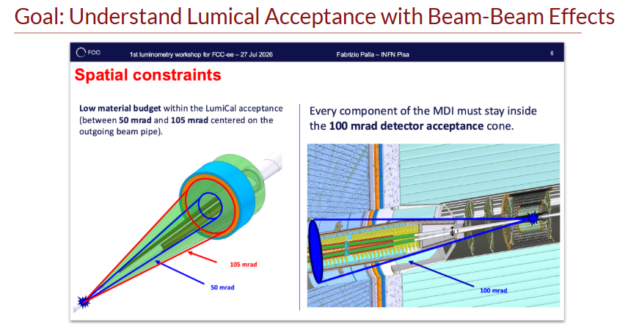
FCC-ee MDI Challenges & Luminosity Systematics
Guy Wilkinson
Limits on systematics from accelerator
  Energy
  Polarization
  Luminosity
Spencer Gessner

Slide 15
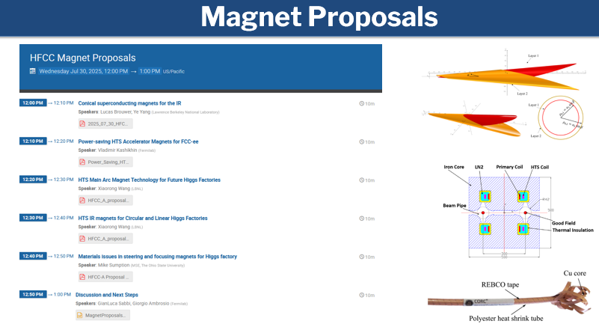
SC Magnet Technologies for FCC-ee
Working to understand opportunities for magnet technologies
FCC-ee baseline use few SC
magnets however there are
discussions of using HTS in
arcs and possibly the FFS
and IR.
As optics and requirements
clarify, plan to hold a workshop
to clarify needs and opportunities
GianLuca Sabbi

Slide 16
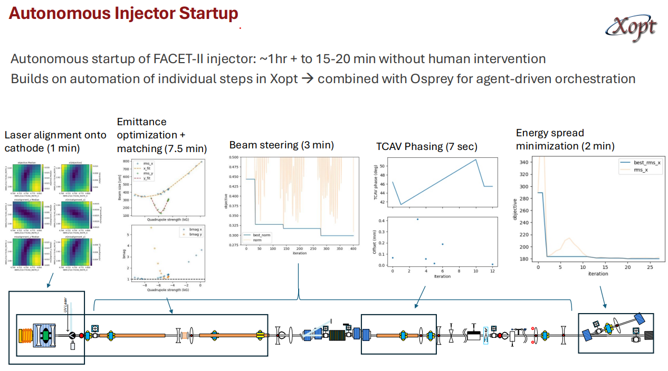
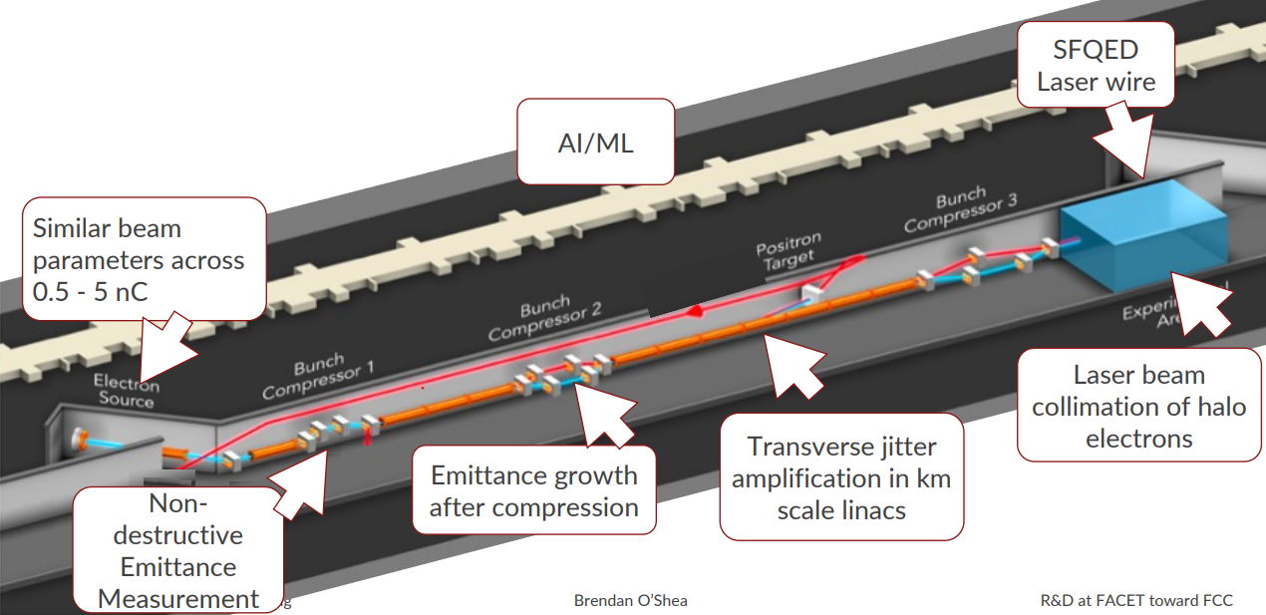
AI and BD Studies using FACET-II
Agentic AI is starting to have a real impact in accelerator operation and will certainly have an impact on design as well. We need to figure out how to benefit from co-design and add hooks for the future
FACET-II has been used to study BD aspects
relevant for FCC-ee injector linacs and
diagnostics and other concepts working closely
with PSI groups that have been doing injector
design
Auralee Edelen
Brendan O’Shea

Slide 17
Summary
Many good talks, great discussions, and wonderful posters!
US has opportunities to important contributions to FCC-ee
National labs and DOE are supporting program through LDRD and the GARD program which supports foundational R&D
Proposed a few new opportunities that would have broad impact beyond FCC-ee
Thank you all!

