Slide 1
FCC-ee
Interaction region developments
Fabrizio Palla
INFN Sezione di Pisa, Italy
4th US FCC meeting
SLAC – 9 September 2026
Acknoledgments to Manuela Boscolo (INFN Frascati)

Slide 2
Introduction
Latest developments on IR studies on the assemblies and their mechanical integration
Work ongoing from the detector and collider side. Cryostat technical considerations have been reported by John.
Backgrounds, optics etc. have been exhaustively reported by Jan and Manuela during this meeting.

Slide 3
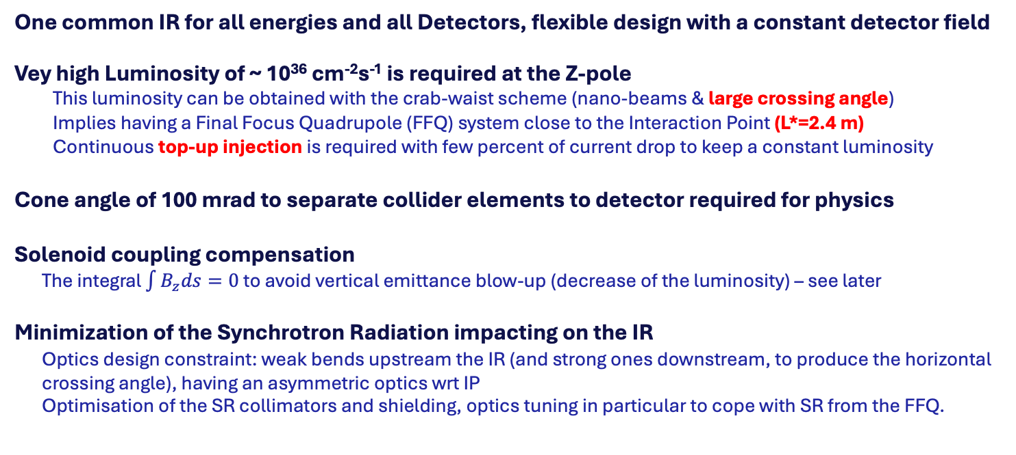
High-level Requirements for the IR and MDI region
One common IR for all energies and all Detectors, flexible design with a constant detector field
  Vey high Luminosity of ~ 10³⁶ cm⁻²s⁻¹ is required at the Z-pole
    This luminosity can be obtained with the crab-waist scheme (nano-beams & large crossing angle)
    Implies having a Final Focus Quadrupole (FFQ) system close to the Interaction Point (L*=2.4 m)
    Continuous top-up injection is required with few percent of current drop to keep a constant luminosity
Cone angle of 100 mrad to separate collider elements to detector required for physics
Solenoid coupling compensation
  The integral $\int{B_{z}ds=0}$ to avoid vertical emittance blow-up (decrease of the luminosity) – see later
Minimization of the Synchrotron Radiation impacting on the IR
  Optics design constraint: weak bends upstream the IR (and strong ones downstream, to produce the horizontal crossing angle), having an asymmetric optics wrt IP
  Optimisation of the SR collimators and shielding, optics tuning in particular to cope with SR from the FFQ.

Slide 4
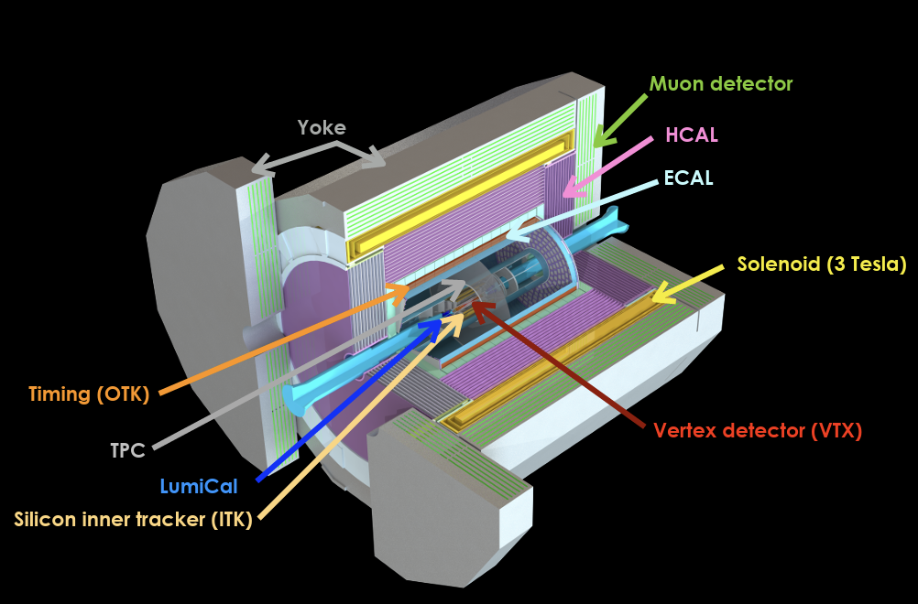
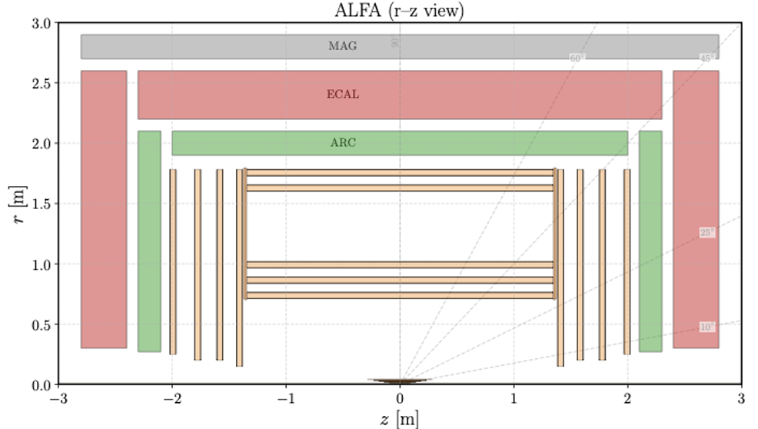
Detector concepts
 | AGORA | ALFA | ALLEGRO | CLD | IDEA | ILD
Vertex | MAPS | MAPS | MAPS | MAPS | MAPS | MAPS
Tracker | Si+TPC | MAPS | DCH/Straw/SciFi | Silicon | DCH | Si+TPC
ECAL | Crystals | Grainita | LAr | Si+W | DR-Crystals | Si+W
HCAL | Fe+Scint | DR Fibre | Fe+Scint | Fe+Scint | DR Fibre+Fe | Fe+Scint
Muon | Scint | TBD | RPC | RPC | µRWell | Scint

Slide 5
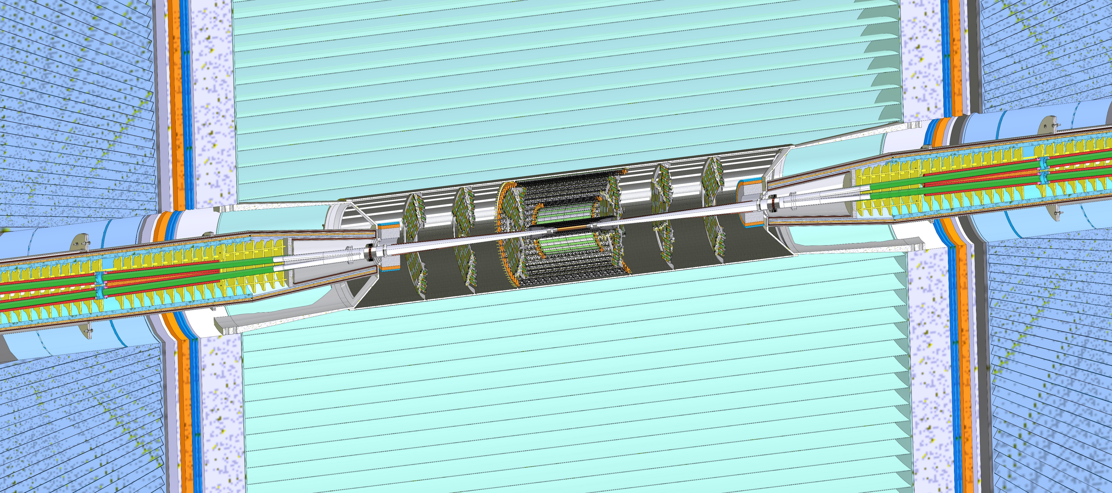
IDEA/ALLEGRO MDI mechanical model
3 m
Cooling
Inner vertex
Bellows
Cryomagnet
IP
LumiCal
Disks
Ellipto-Conical chamber
Remote vacuum connection
Support tube
Outer and middle vertex
L* = 2.4 m
Central chamber

Slide 6
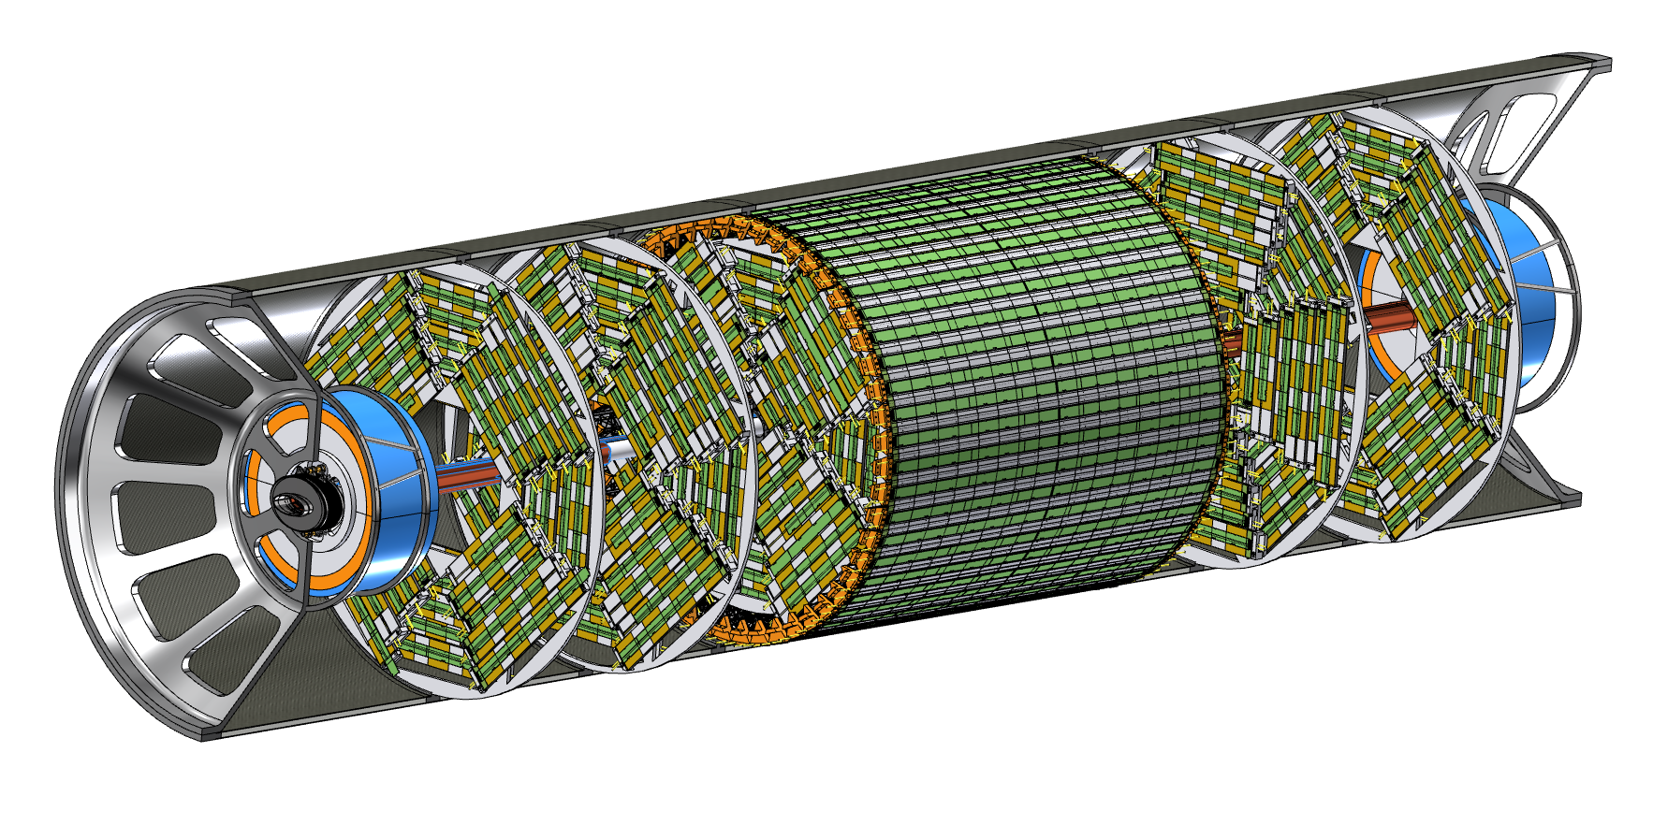
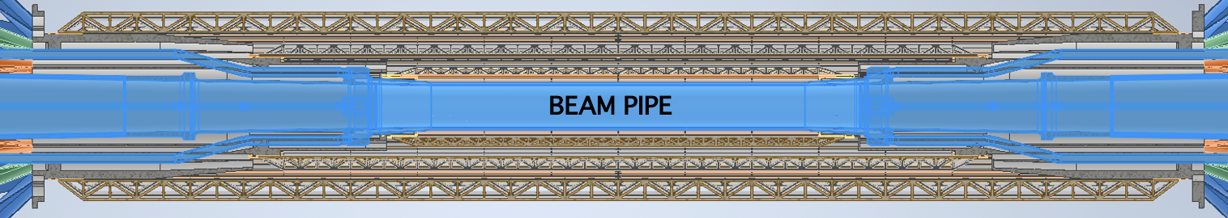
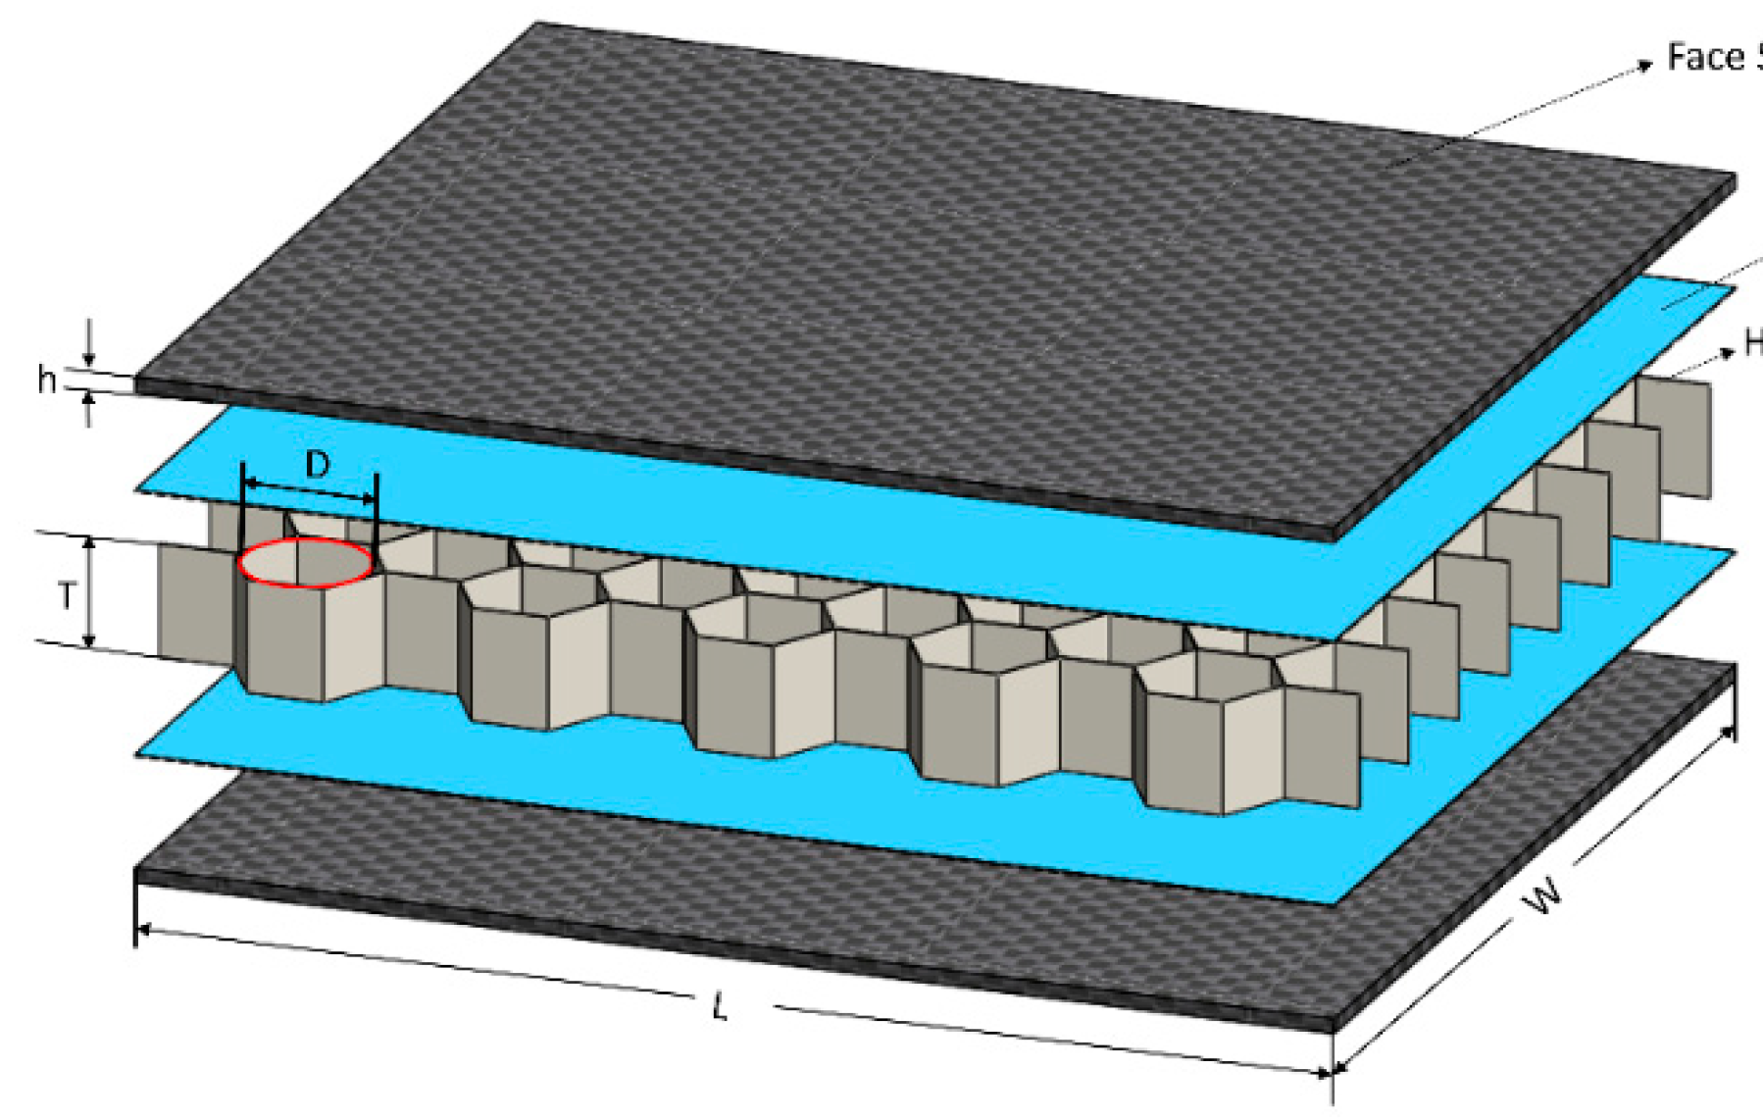
FCC-ee IR: beam pipes and vertex detector
Support tube provides a rigid structure for the integration of the beam pipes, vertex, and LumiCal detectors
Support tube material
1mm CF + 8mm HC + 1mm CF

Slide 7
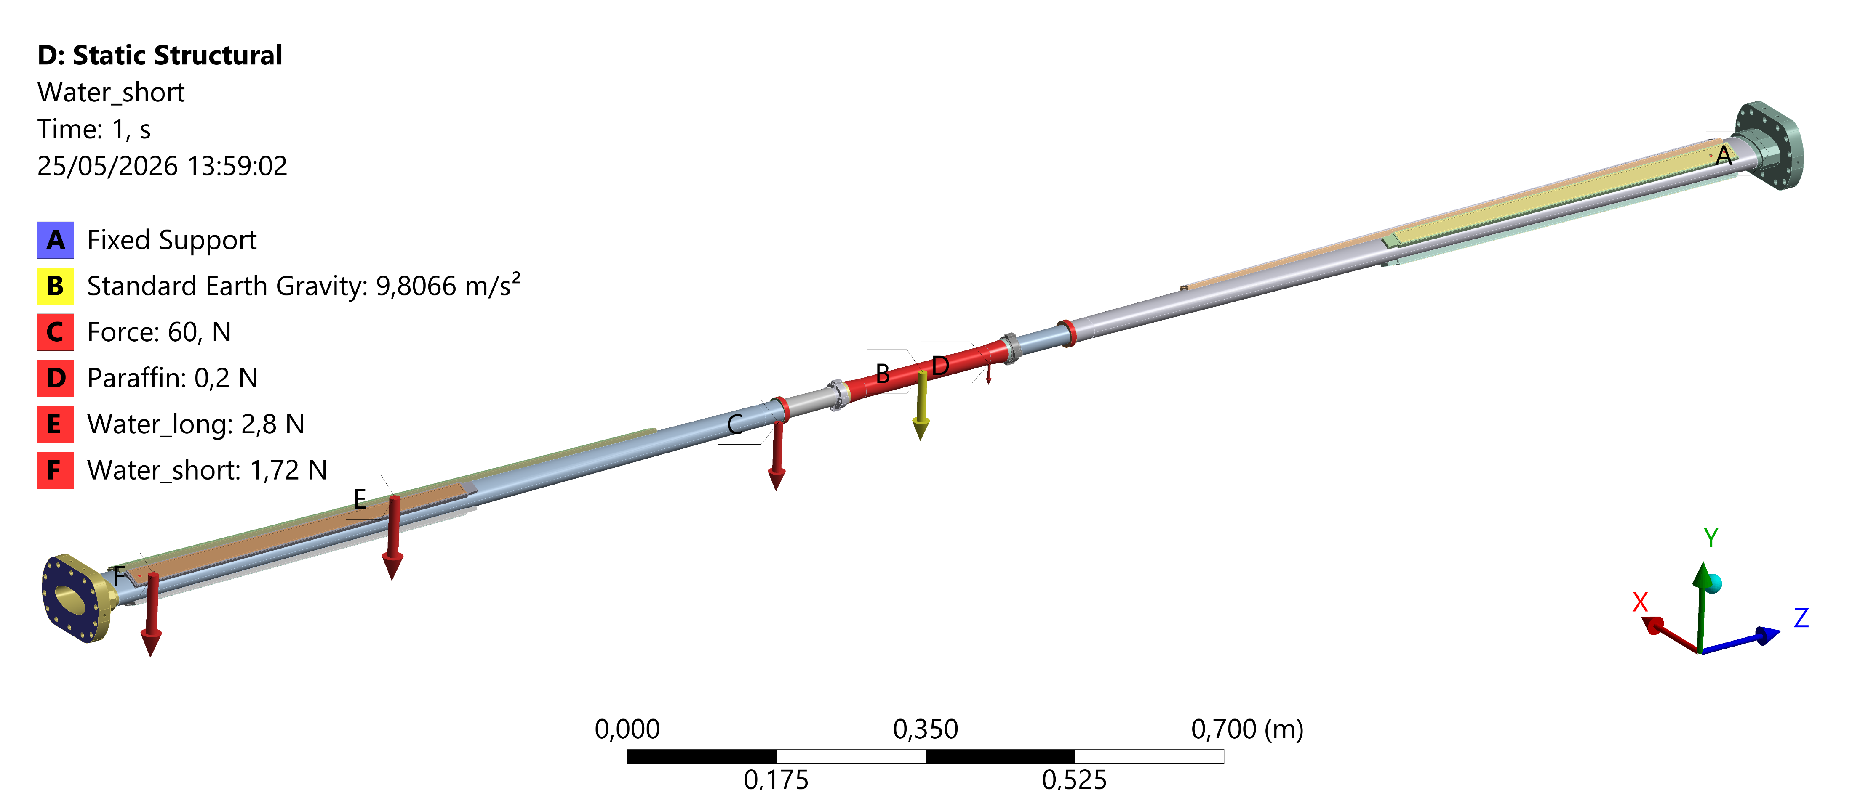
Engineered chambers simulation – static structural and thermal
A static structural analysis has been performed to study the chambers’ behavior during operation, considering the thermal map calculated from the steady-state thermal analysis, using the wakefield calculation made by Alexander Novokhatski.
Paraffin flow (central chamber)
Flow rate: 0,015 kg/s
Section:68,17 mm²
Velocity: 0,3 m/s
Inlet temperature: 18°C
Convective coefficient: 900 W/m²K
Water flow (Ellipto-Conical chamber)
Flow rate: 0,01 kg/s (4 channels per side)
Total flow rate per side: 0,04 kg/s
Section: 12,25 mm²
Velocity: 1 m/s
Inlet temperature: 16°C
Convective coefficient: 1200 W/m²K
Vertex detector
130 W
26 W
130 W
Constraint
Fixed ends configuration
Heat load
26 W central
130 W AlBeMet162 for each part
Weight
Vacuum chamber
Inner Vertex
Coolant
Courtesy F. Fransesini

Slide 8
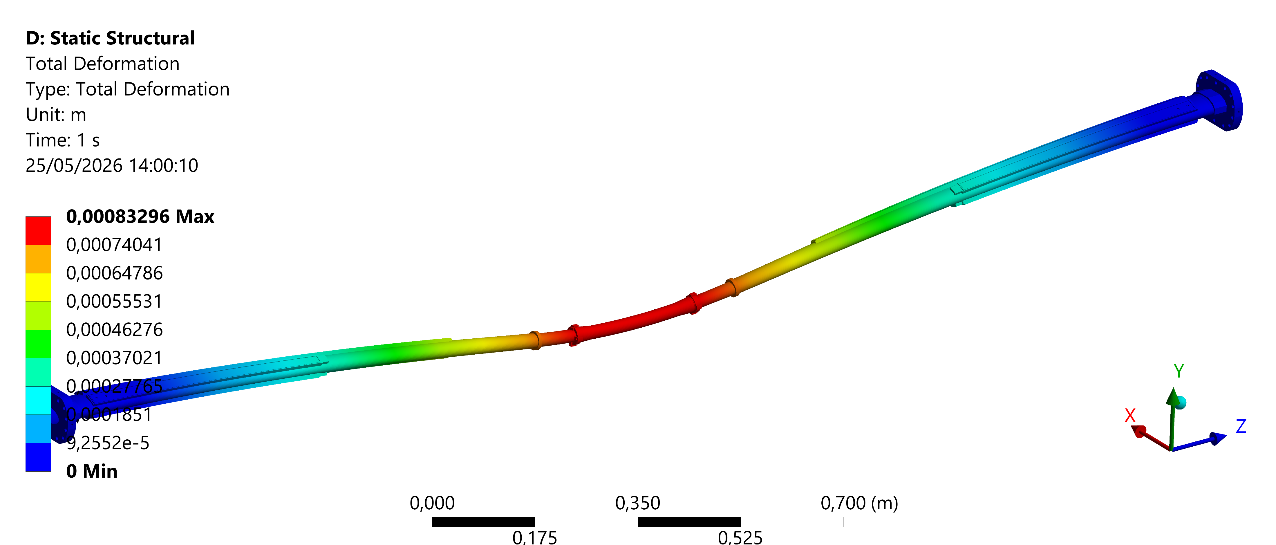
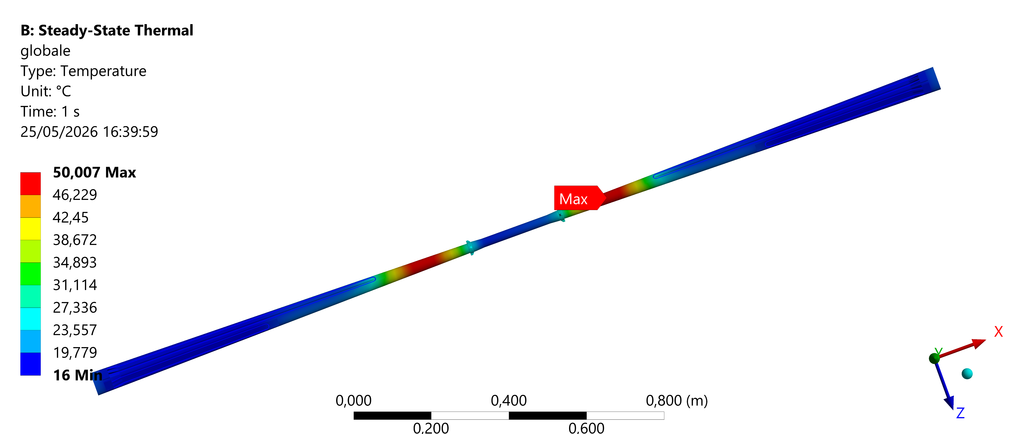
 | Conical chamber | Central chamber
Coolant | Water | Paraffin
Maximum chamber temperature [°C] | 50 | 29
T_out coolant [°C] | 18 | 20.5
Max total deformation: 0.8 mm
 | Conical chamber | Central chamber
Maximum Von Mises stress | 60 MPa | 52 MPa
Maximum displacement | 0.7 mm | 0.8 mm
Max temperature: 50 °C
Additional structural analysis will be performed to consider the assembly procedure.
Courtesy F. Fransesini

Slide 9
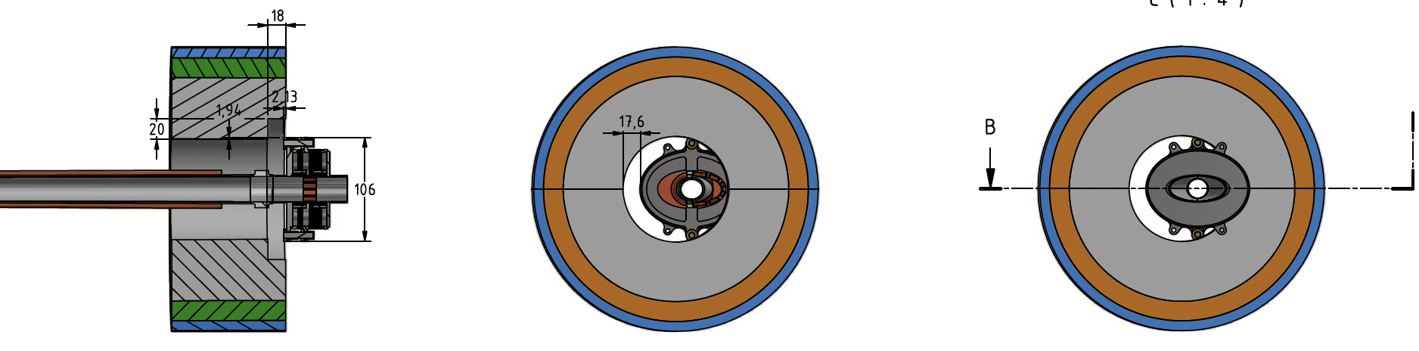
Bellows designed to allow LumiCal to be mounted as a single piece:
  Minimise the constant term in energy resolution
  Allows to use single 12” wafers for silicon sensors
Needs special mechanical tools to insert it and then center around outgoing beampipe
Techn Instrum 10, 16 (2023). https://doi.org/10.1140/epjti/s40485-023-00103-7

Slide 10
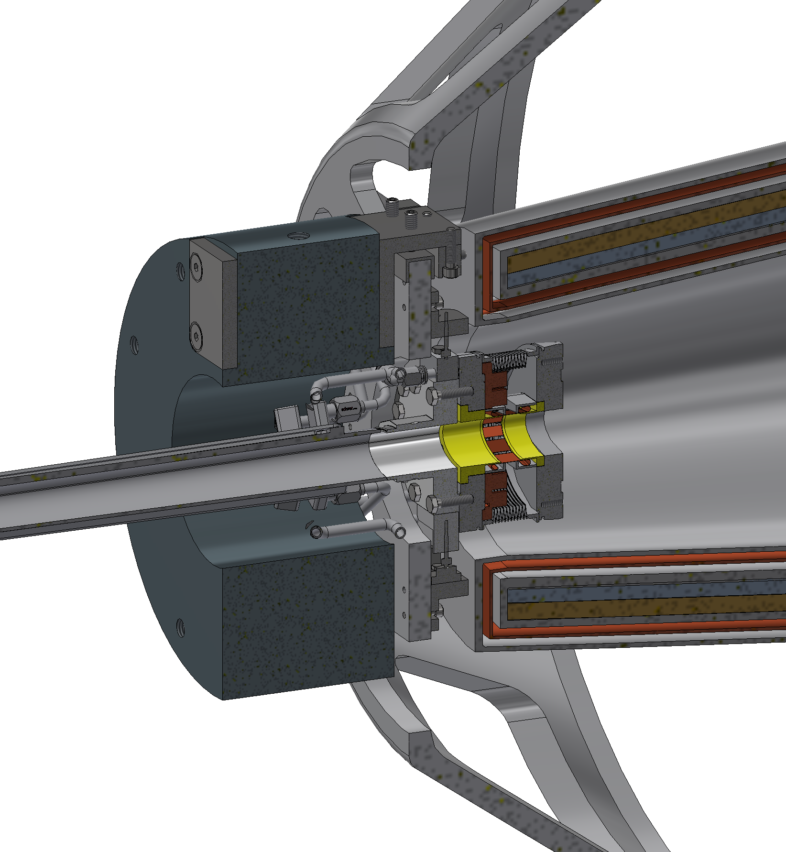
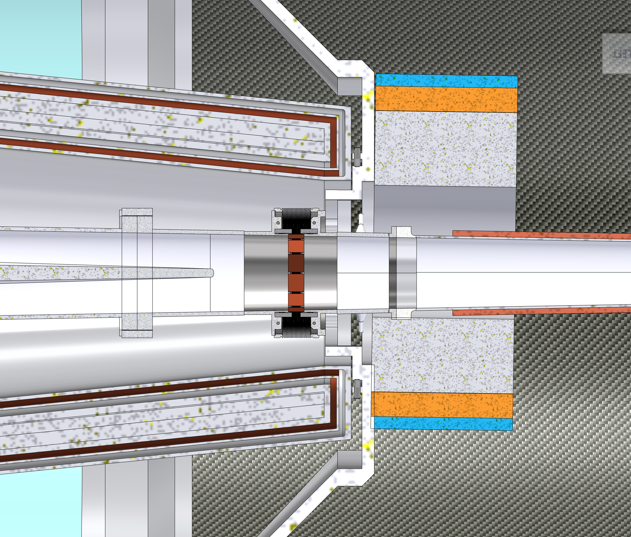
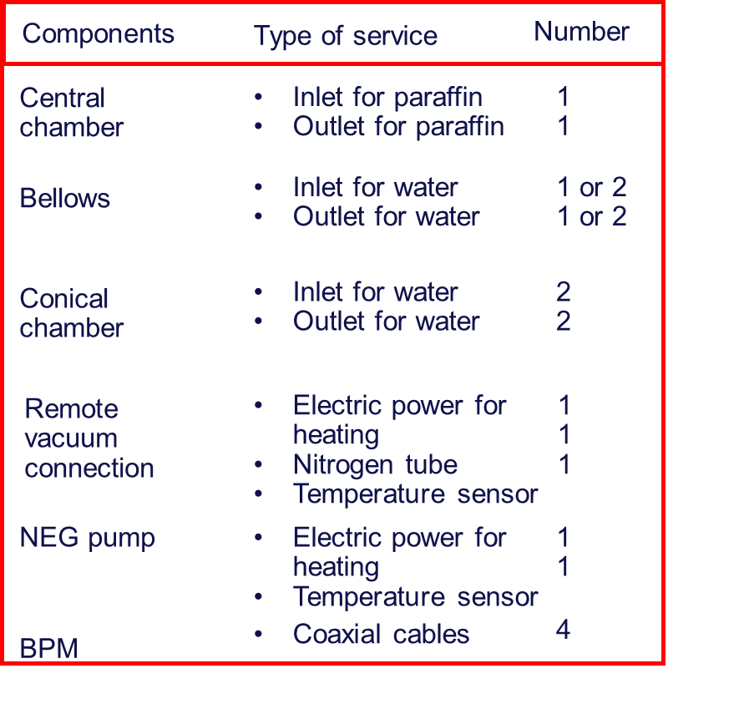
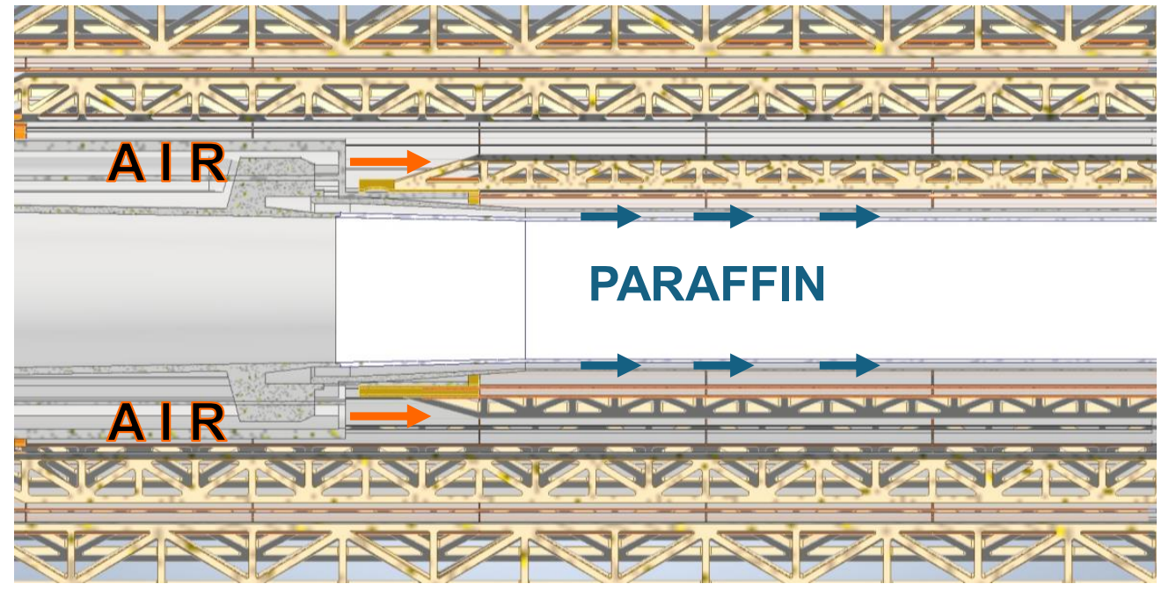
Services integration challenges
There are two problematic areas for the services integration.
Lumical
Cryostat
Beampipe
Interface with the cryomagnetic system.
NEG PUMP?
Bellows
Chamber and bellows
cooling pipes
Interface between the vacuum chamber and the vertex detector.
= Outlet cooling
= Inlet cooling
= Electric cables
= Nitrogen pipe
= Coaxial cable
= Signal cable

Slide 11
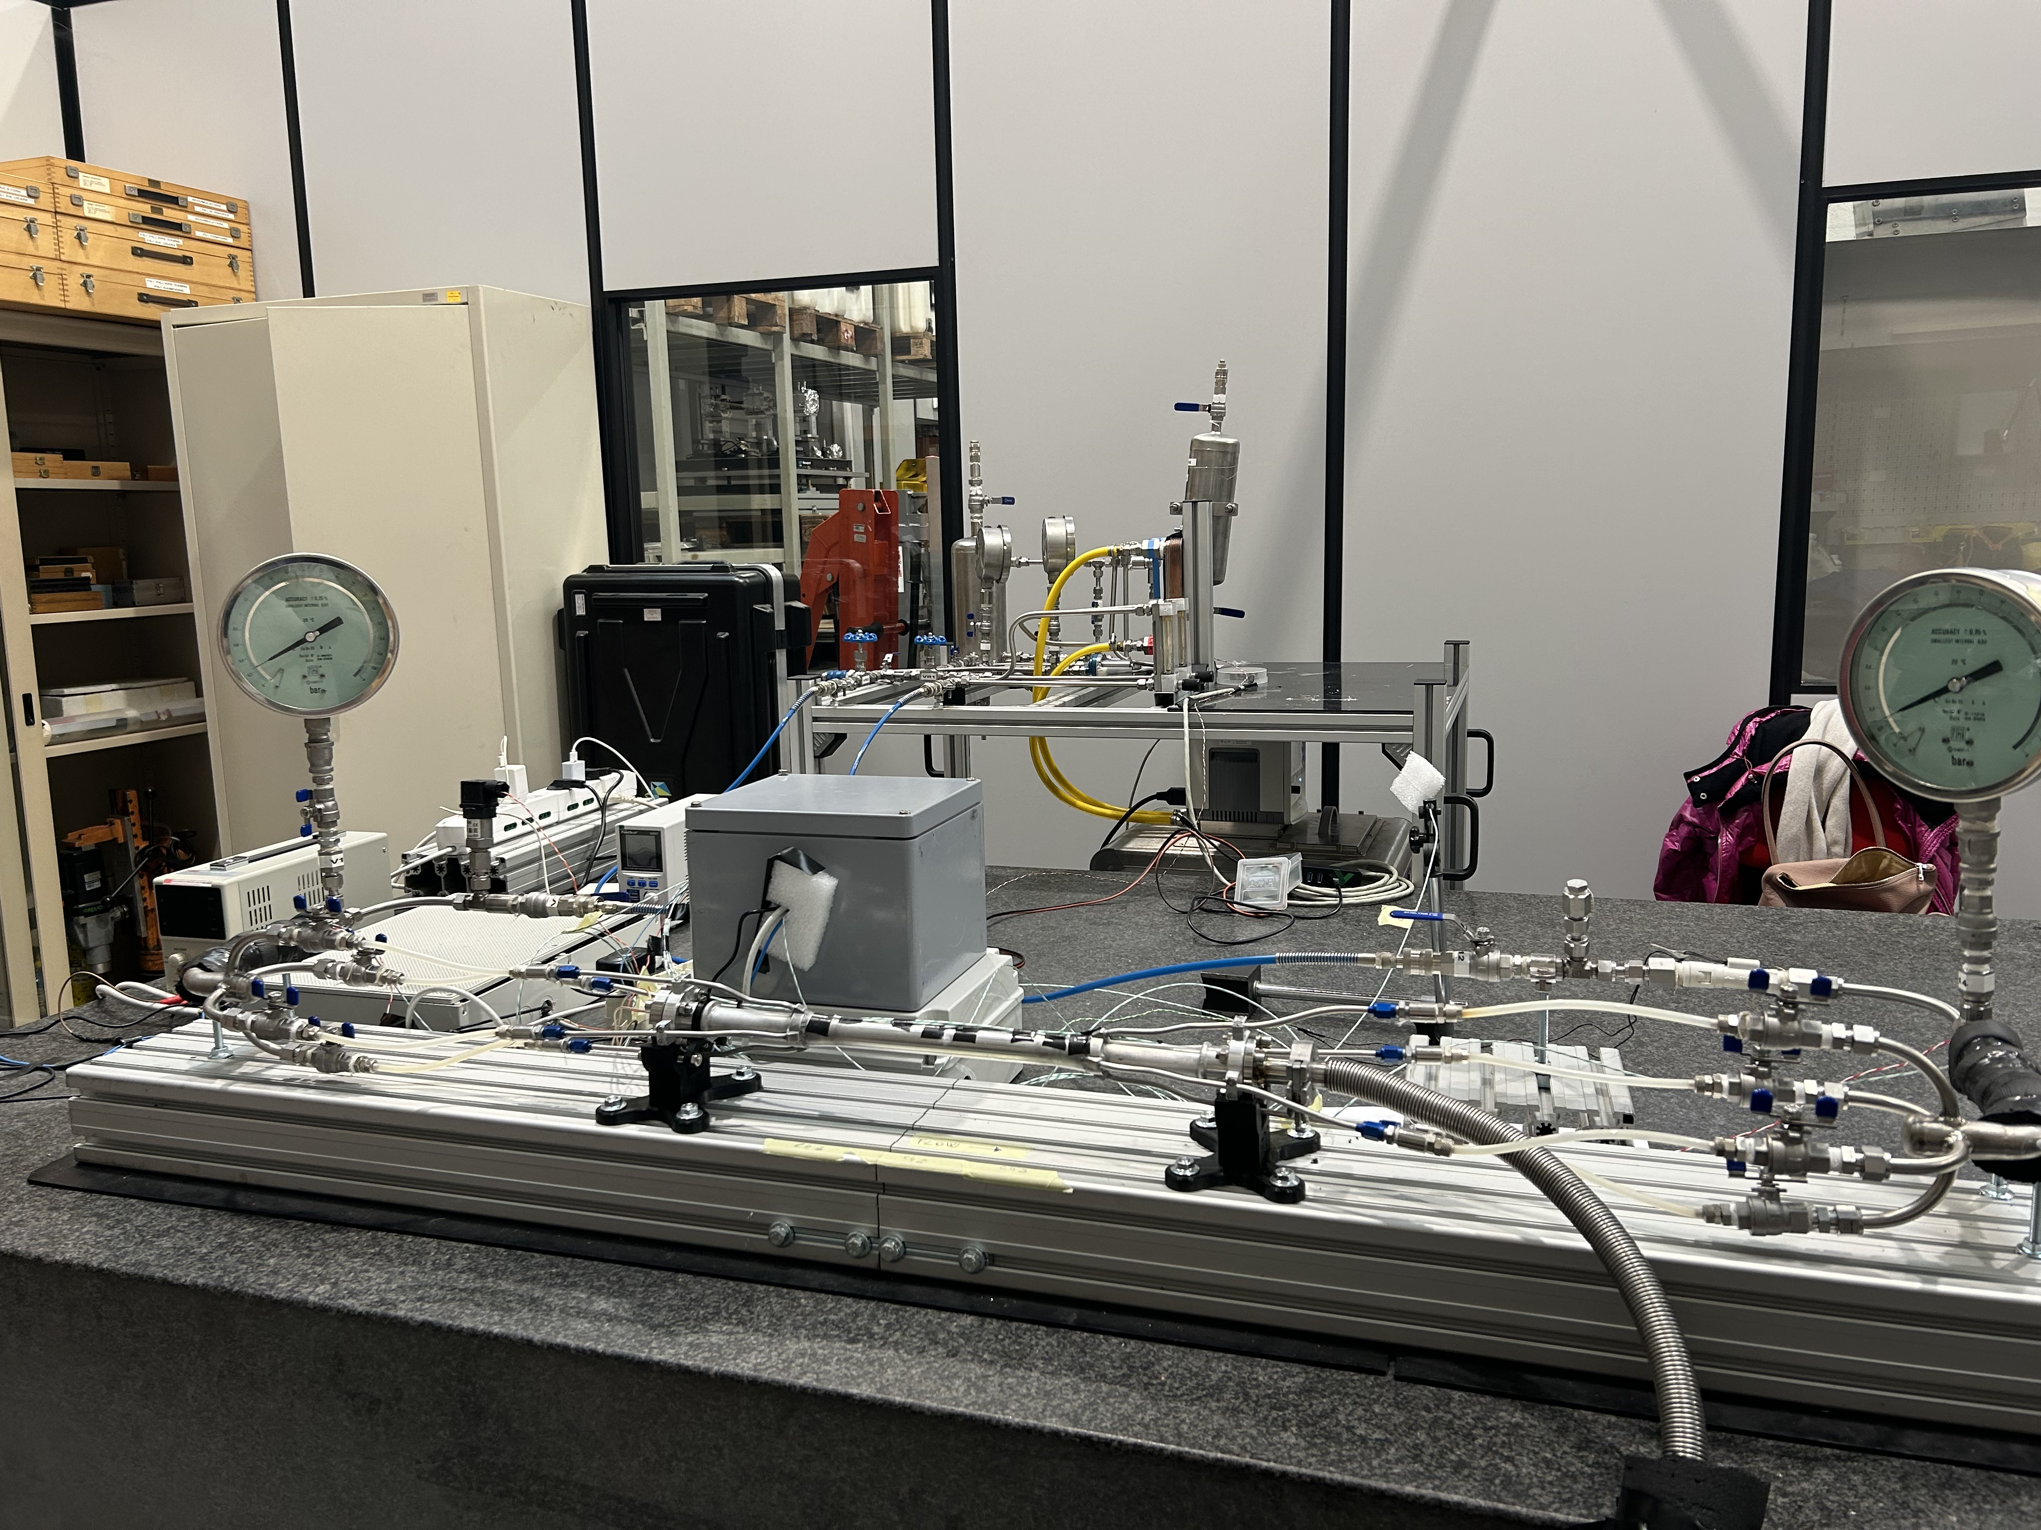
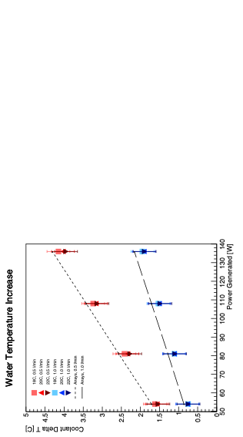
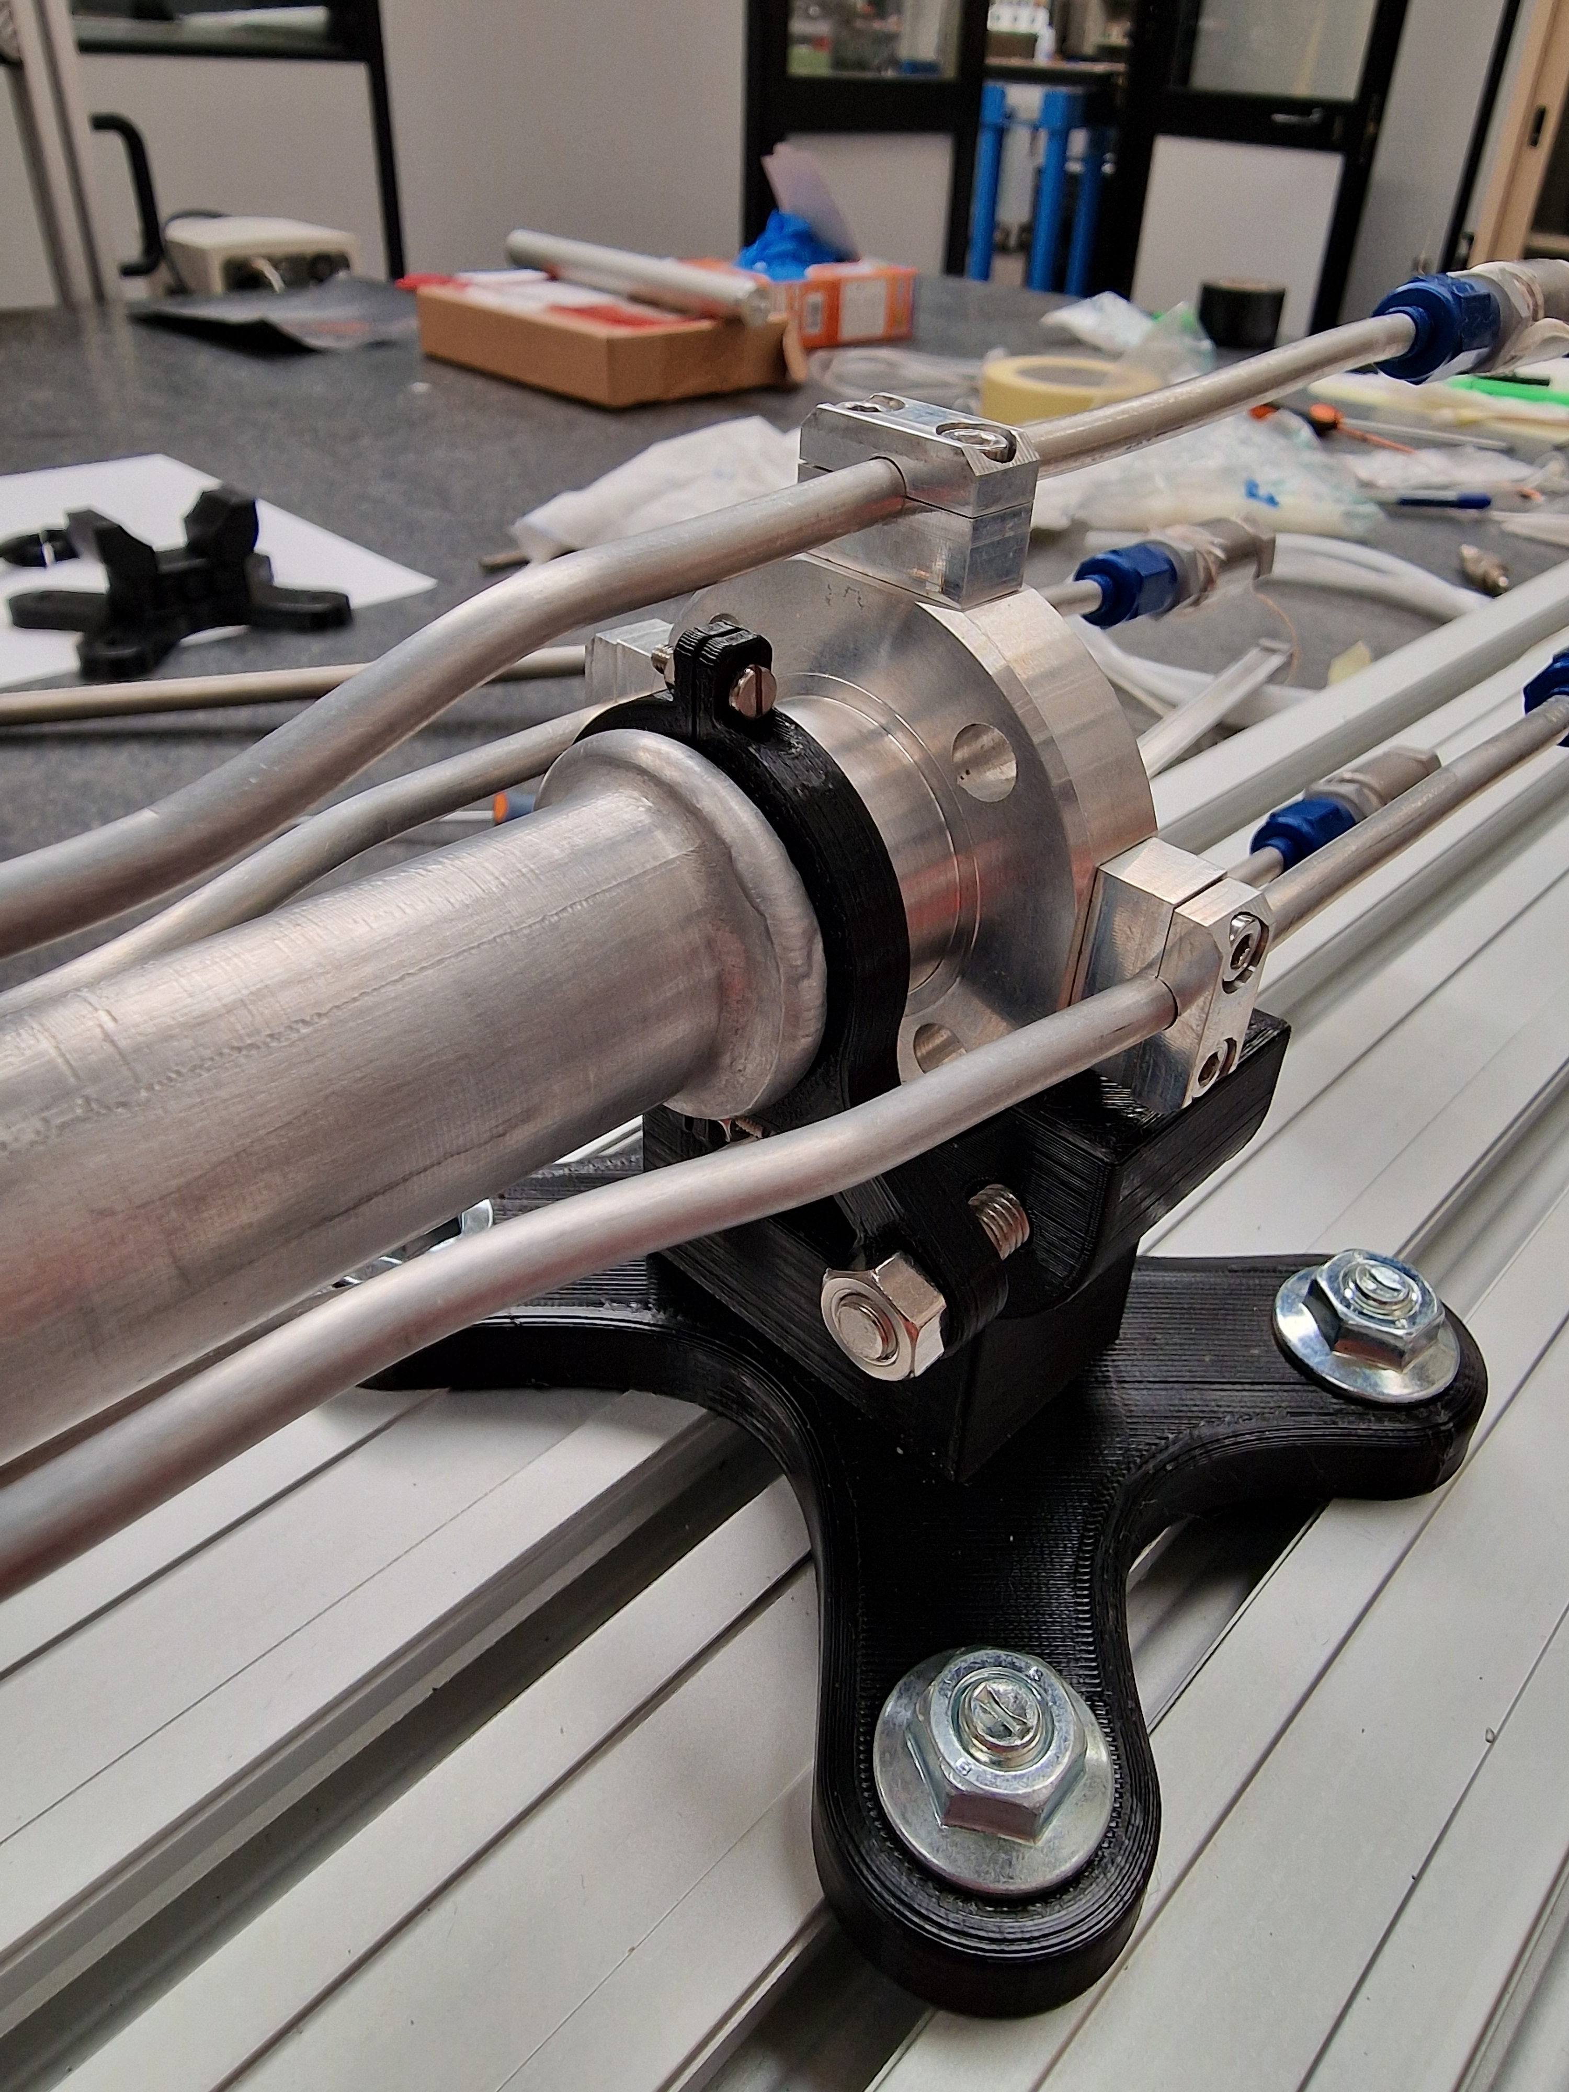
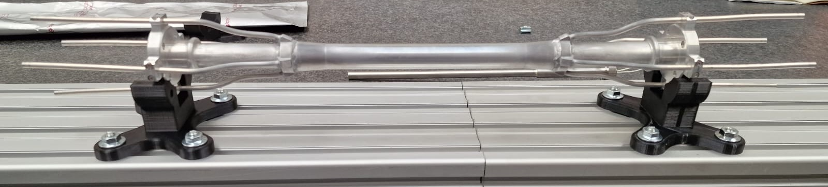
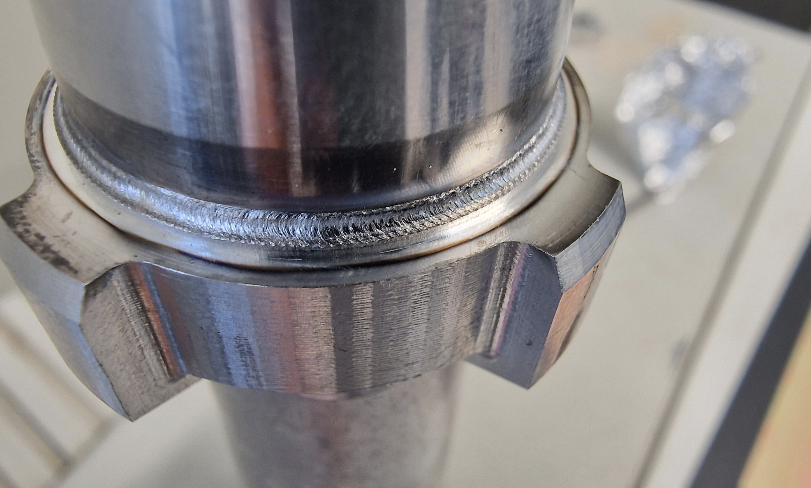
FCC-ee Interaction Point Mock-up at INFN-Frascati
Experimental validation of the IR beam pipes manufacturing and cooling system, vertex and LumiCal integration, vertex cooling, services and routings, and assembly.
cooling pipes manifolds

Slide 12
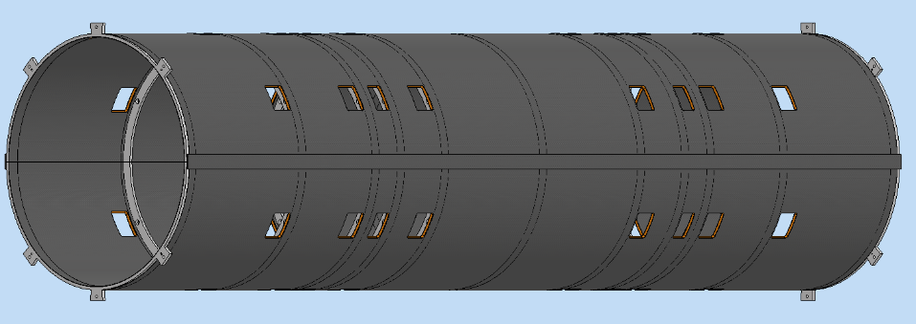
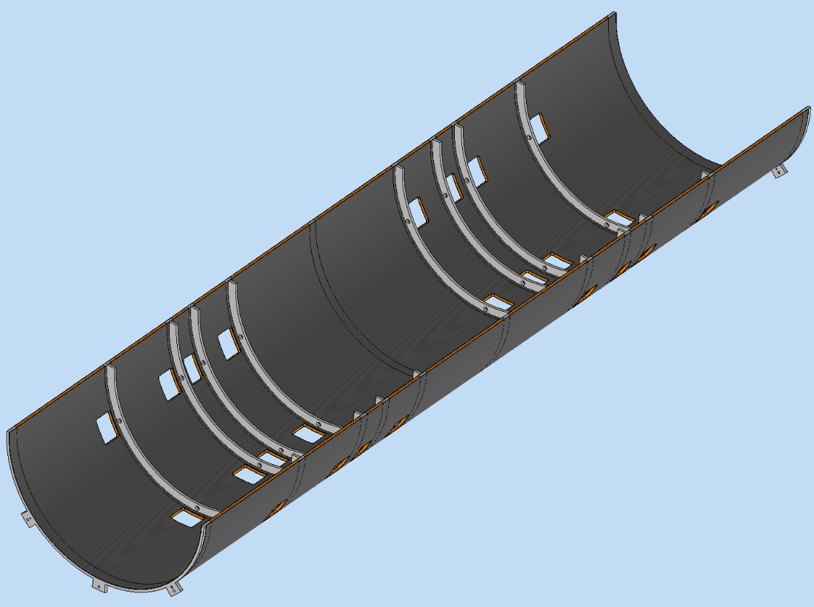
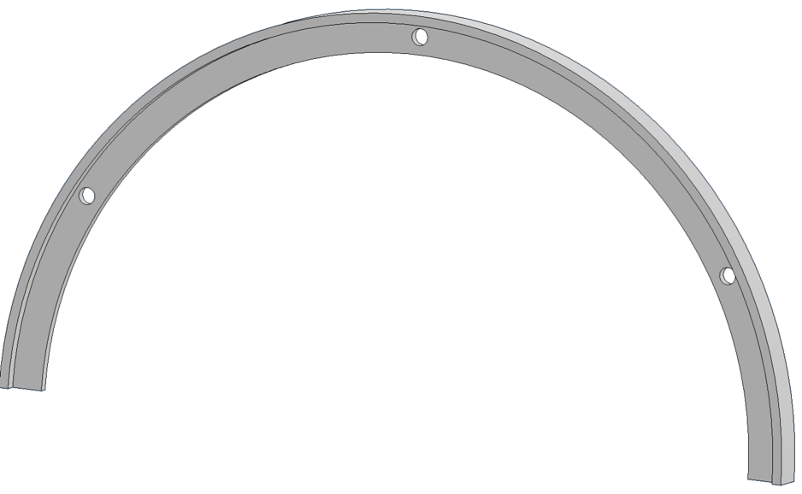
Support tube fabrication – expected by October
Two half shells made by carbon fiber sandwich panels and 9 ribs to guarantee cylindricity.
Holes allow the services to be routed.
For the mockup the sandwich panel is made by two Carbon T700 fiber tissue sheet of 1 mm thickness and a Nomex core of 8mm widht.
2800 mm
690 mm
Courtesy A. Moggi

Slide 13
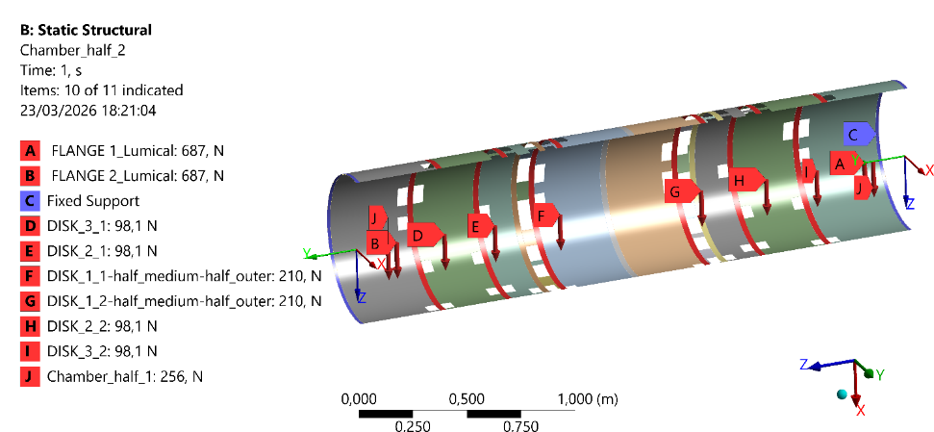
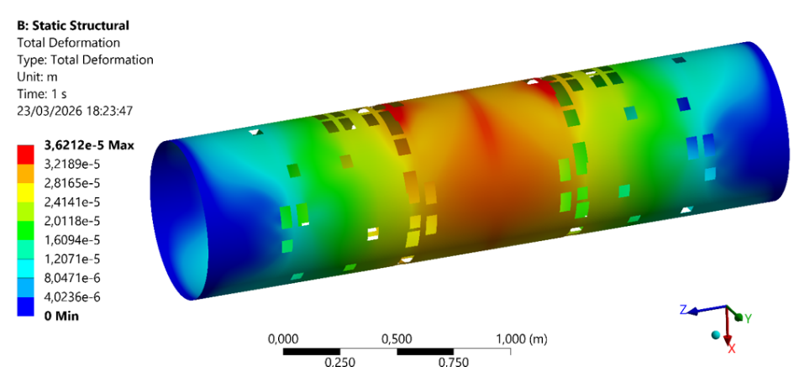
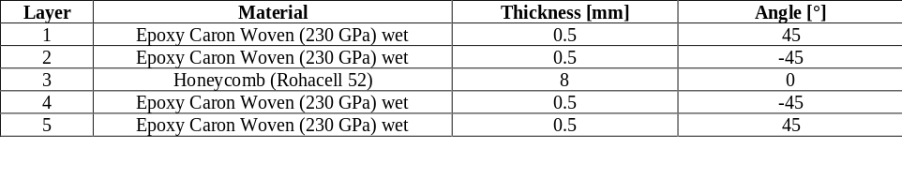
Preliminary structural verification performed :
Deformation results:
Load:
Maximum deformation 36 µm
Courtesy F. Fransesini

Slide 14
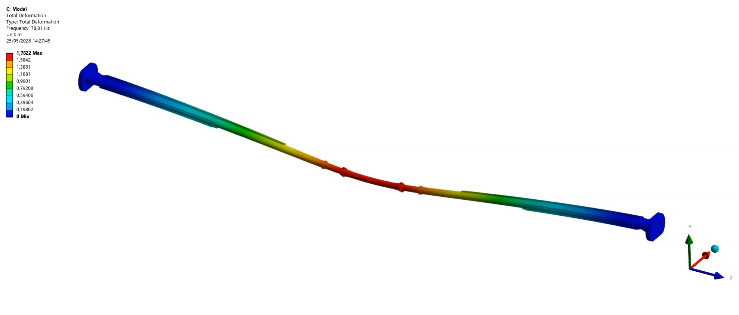
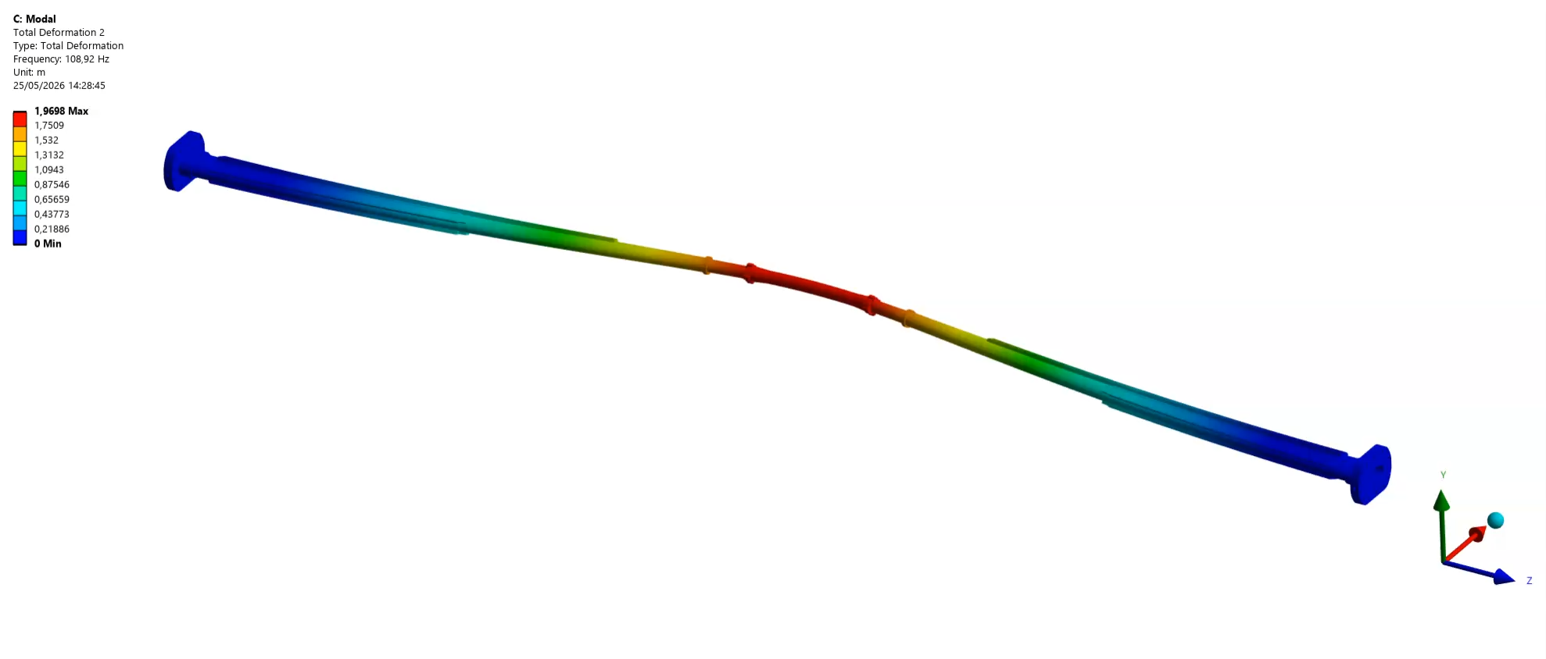
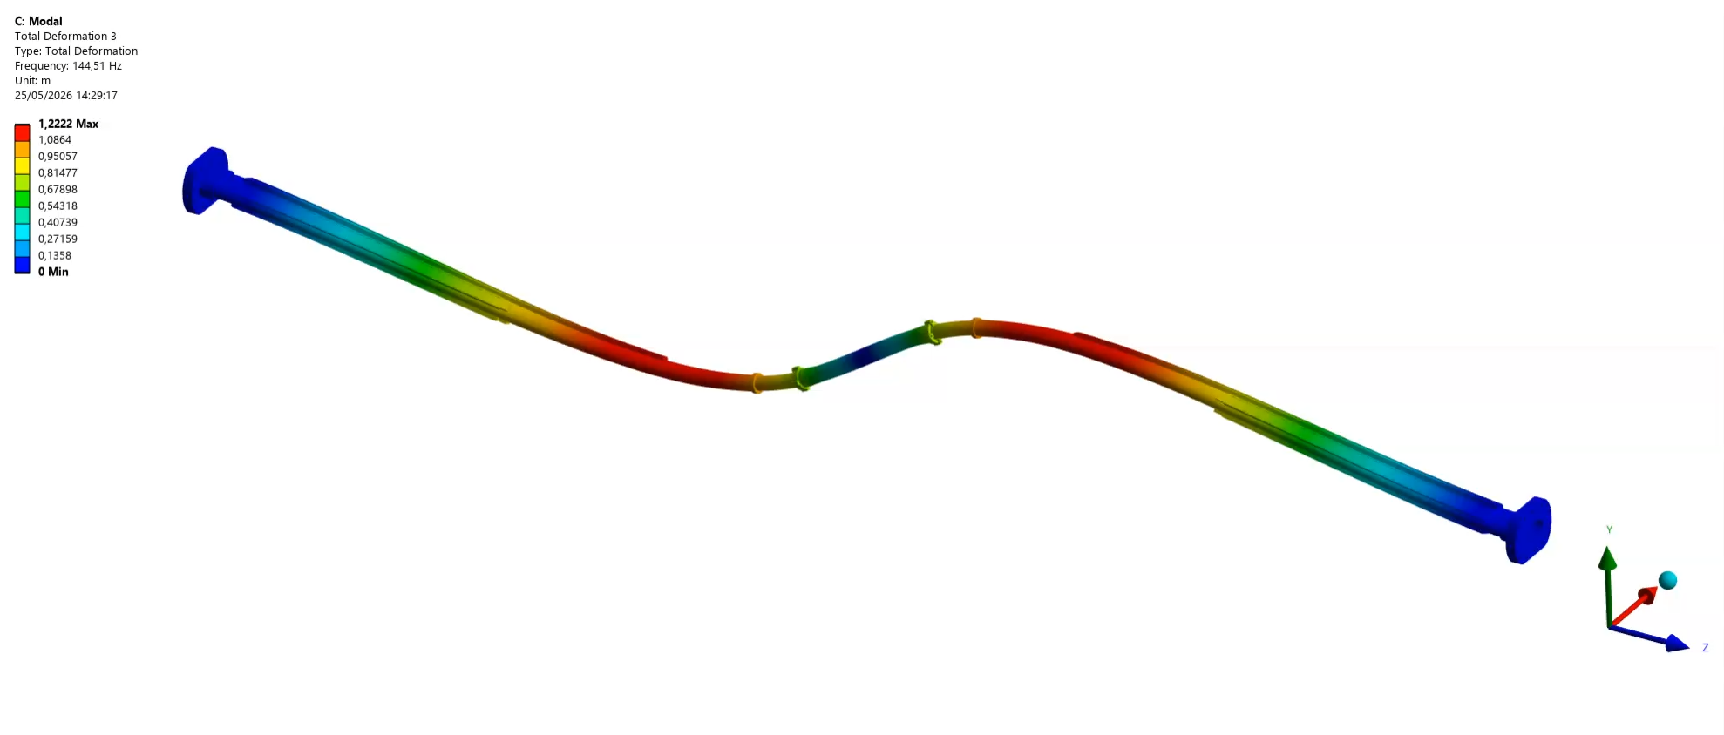
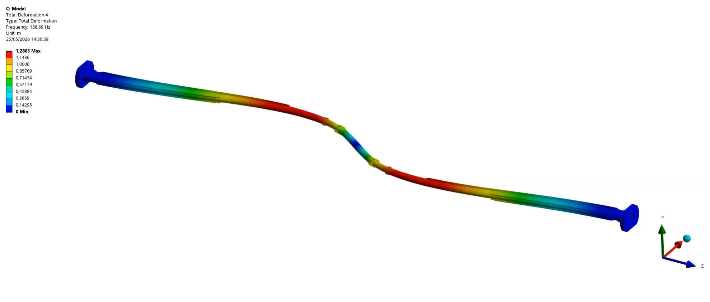
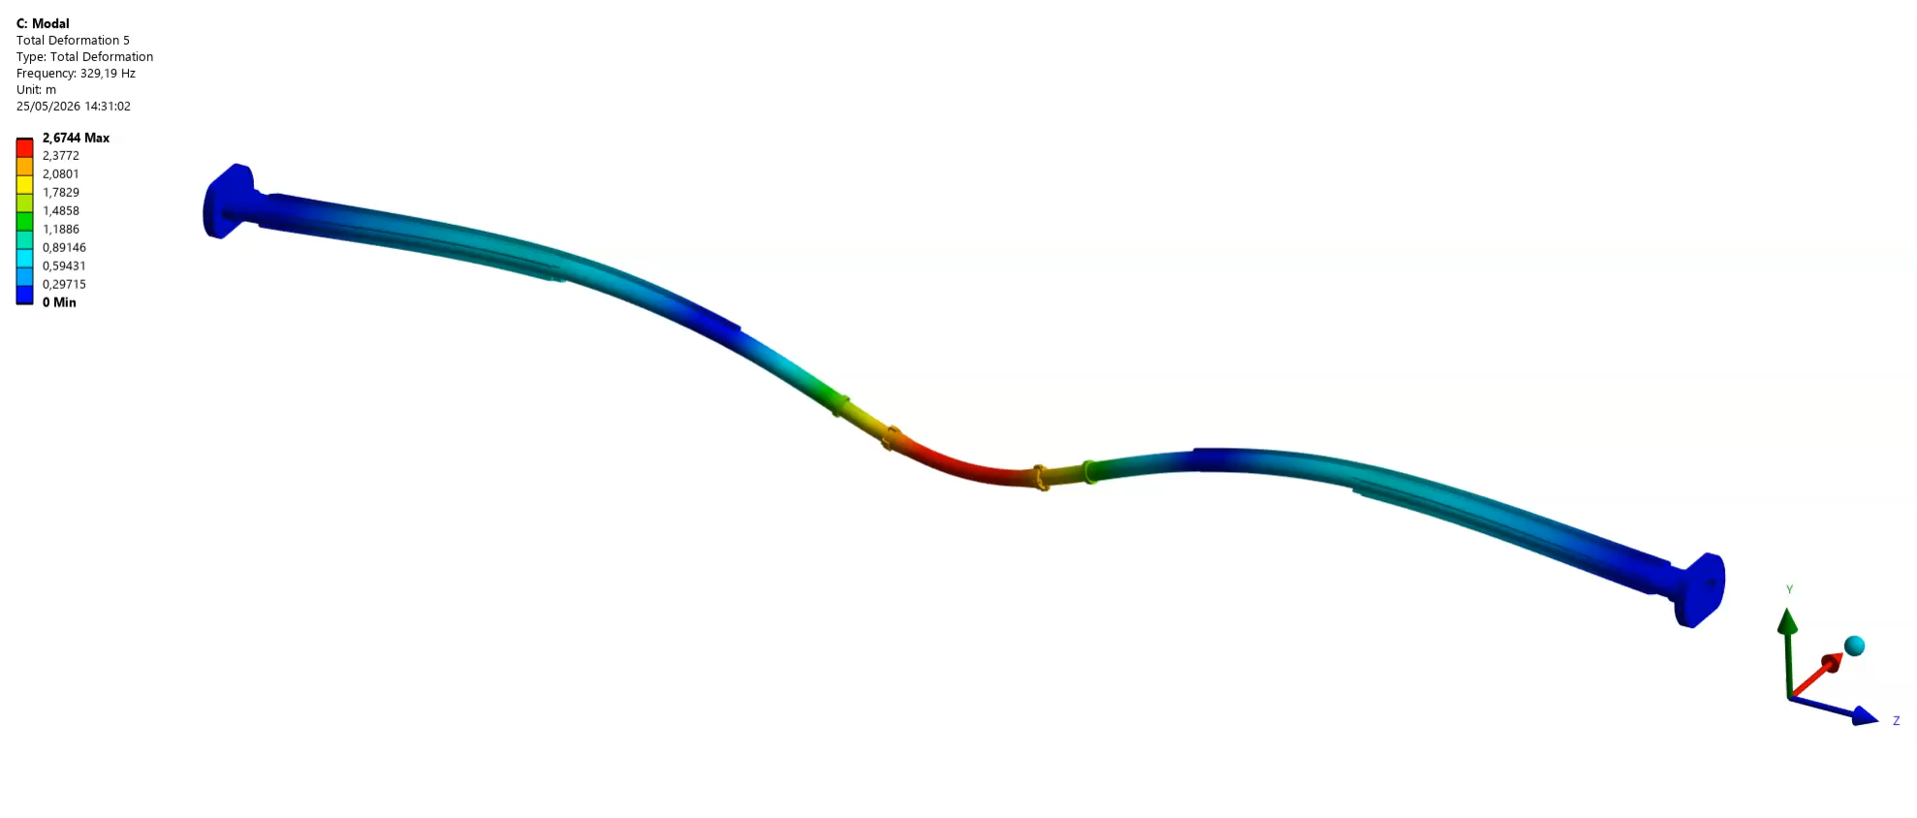
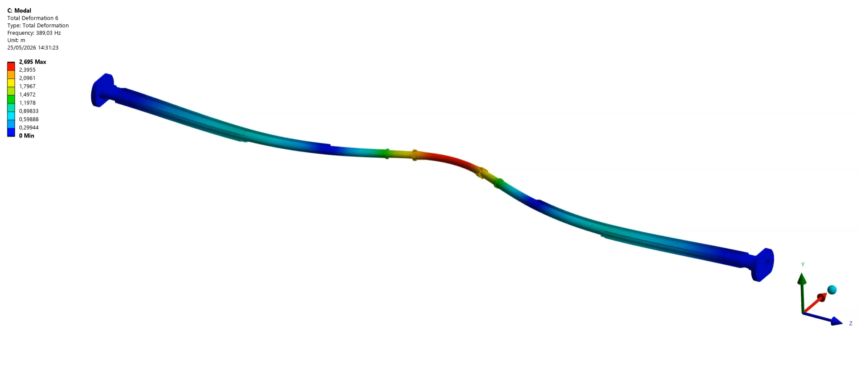
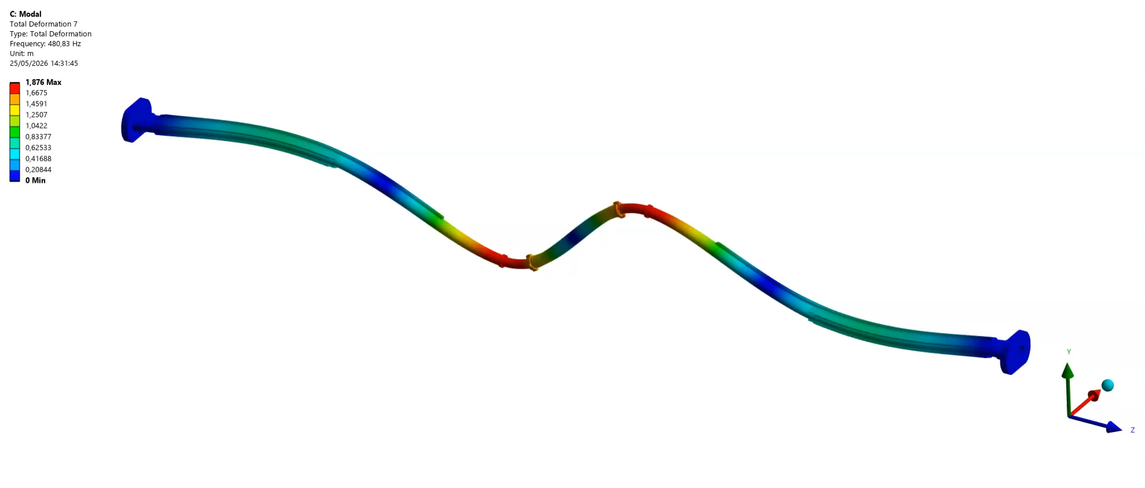
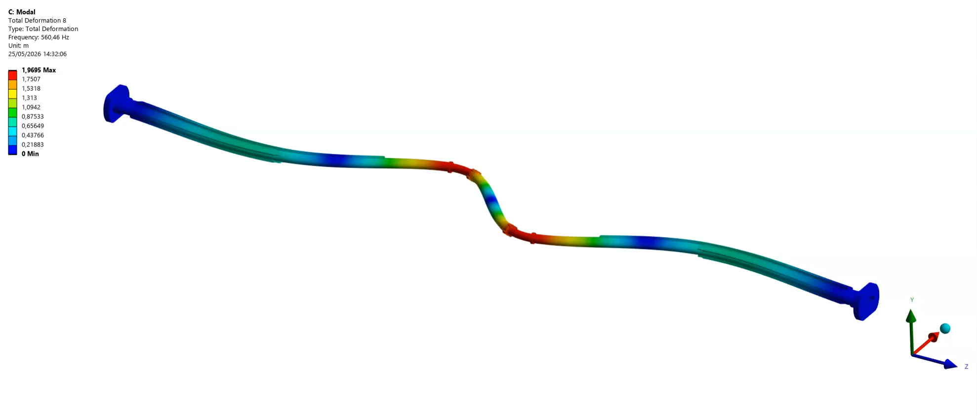
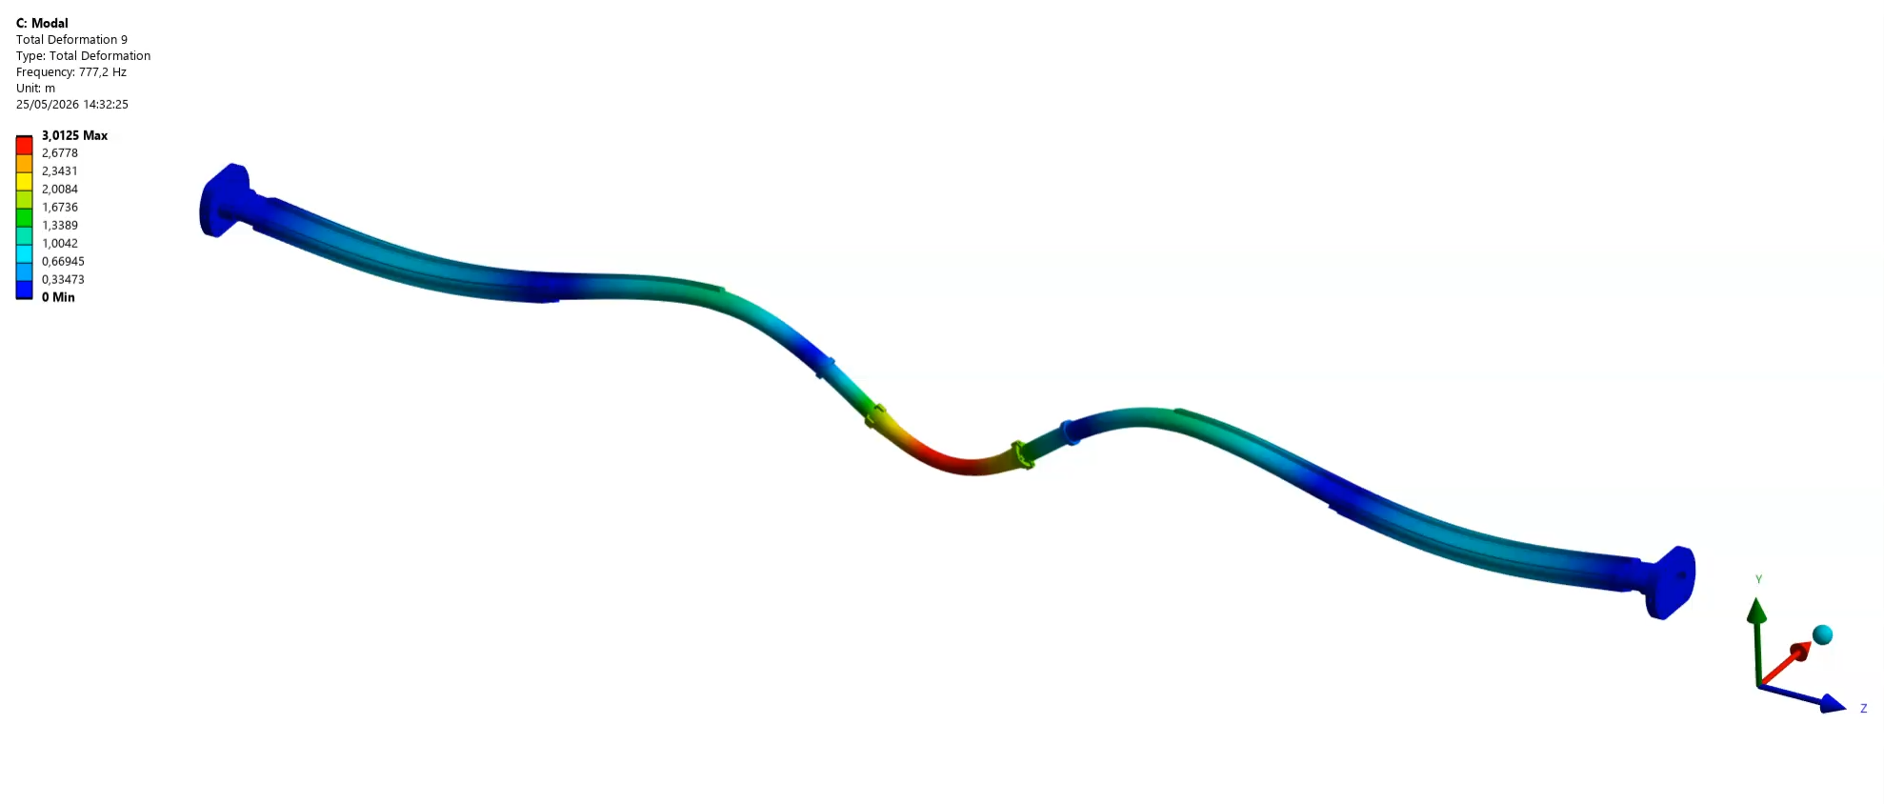
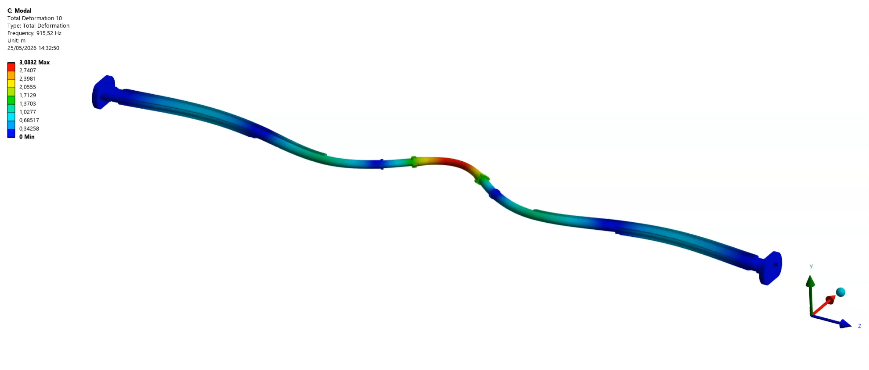
Engineered chambers- Modal analysis
Mode 1: 79 Hz
It is necessary to load the chamber with the actual PSD understand its behavior during operation.
We would probably need to add some wires to the beam pipe to increase the frequency of the first mode
Mode 2: 109 Hz
Mode 3: 145 Hz
Mode 4: 189 Hz
Mode 5: 329 Hz
Mode 6: 389 Hz
Mode 7: 480 Hz
Mode 8: 560 Hz
Mode 9: 777 Hz
Mode 10: 915 Hz

Slide 15
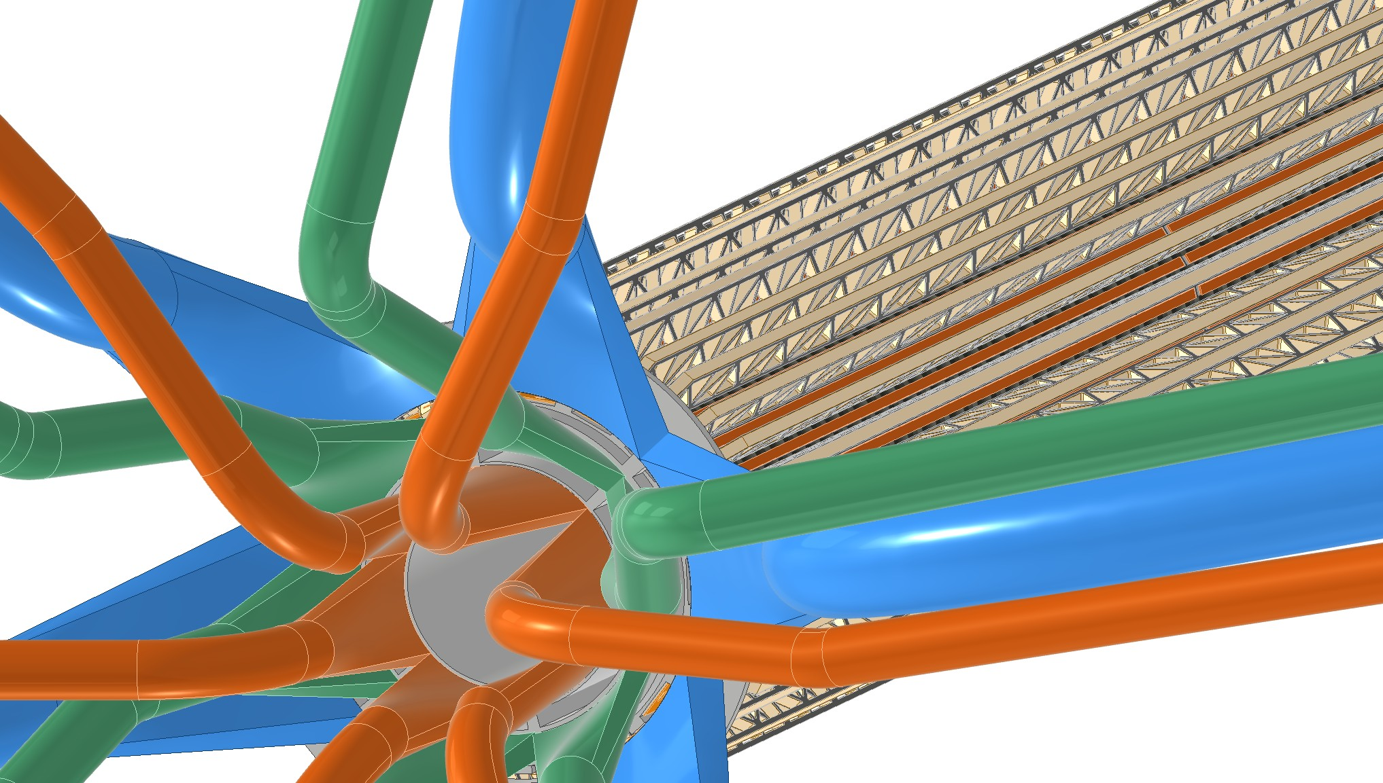
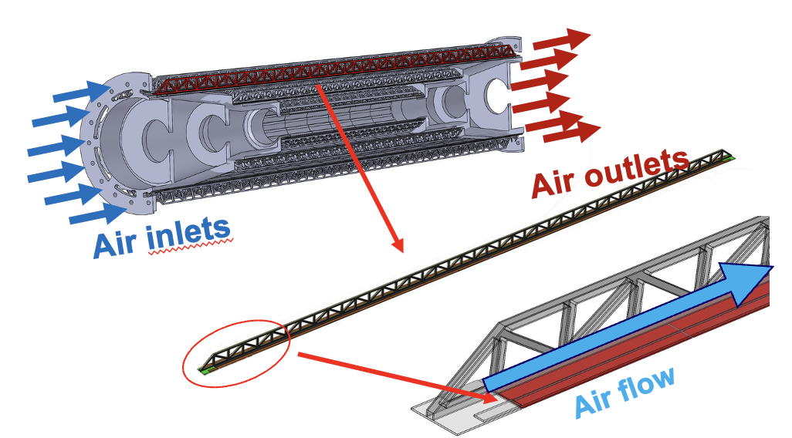
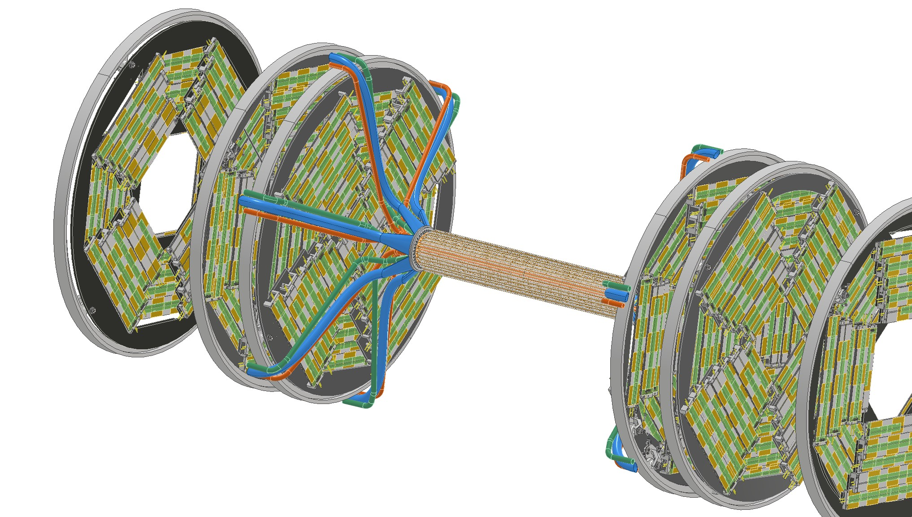
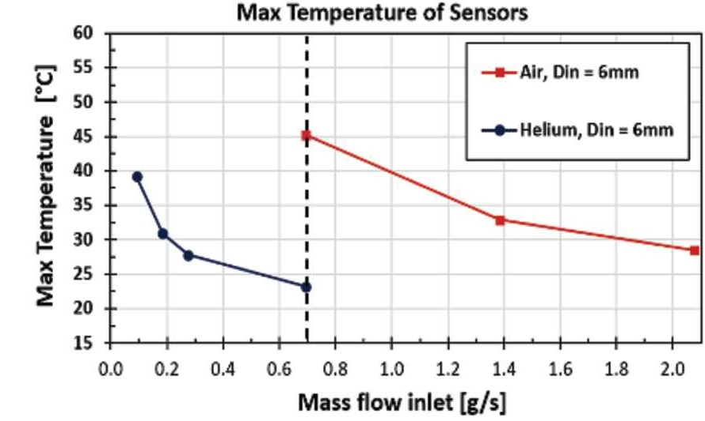
Vertex detector air-cooling
Cables inlet/outlet
Courtesy G. Ammirabile
Boscolo, M., Palla, F., Ammirabile, G. et al. Status of the FCC-ee interaction region design. EPJ Techn Instrum 12, 4 (2025). https://doi.org/10.1140/epjti/s40485-025-00117-3

Slide 16
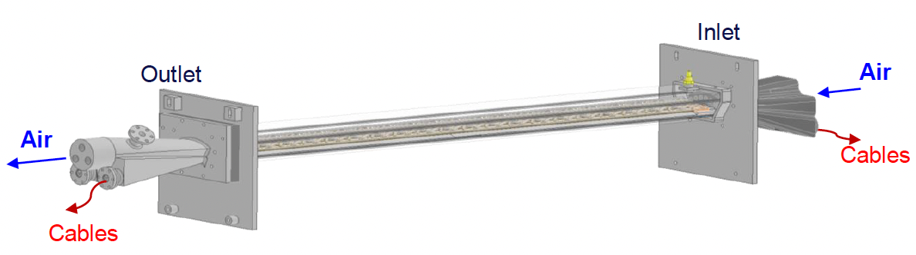
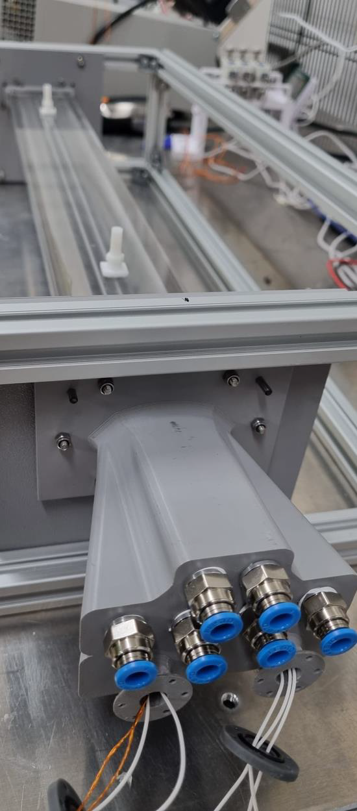
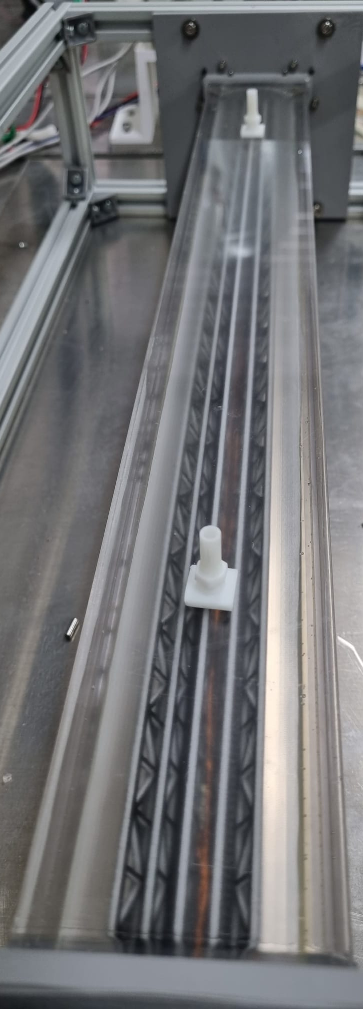
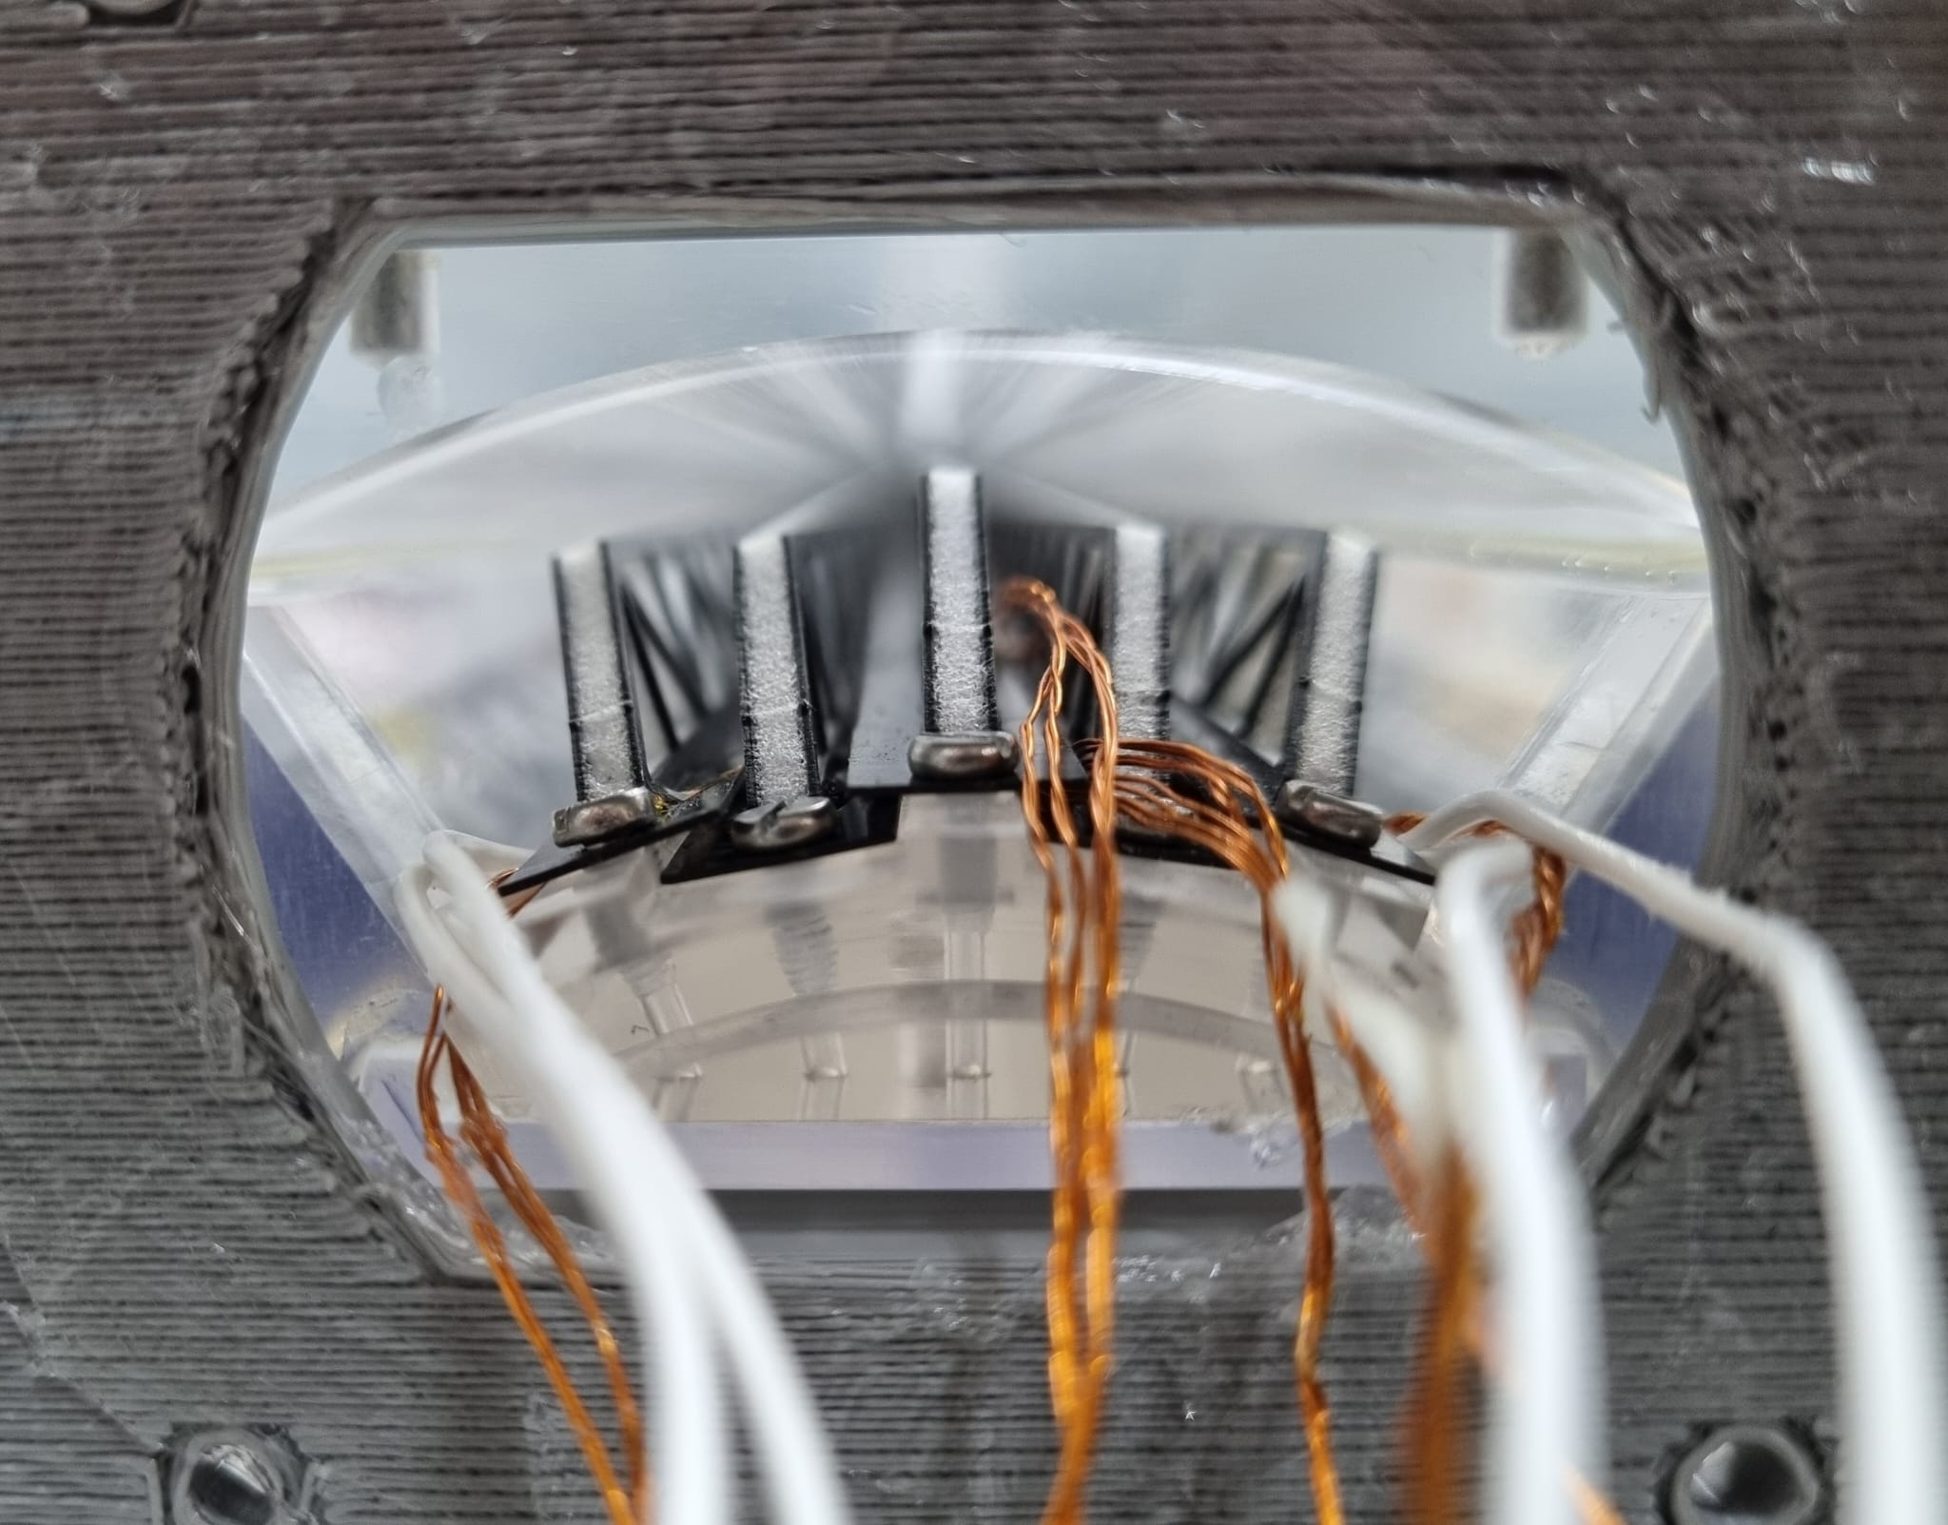
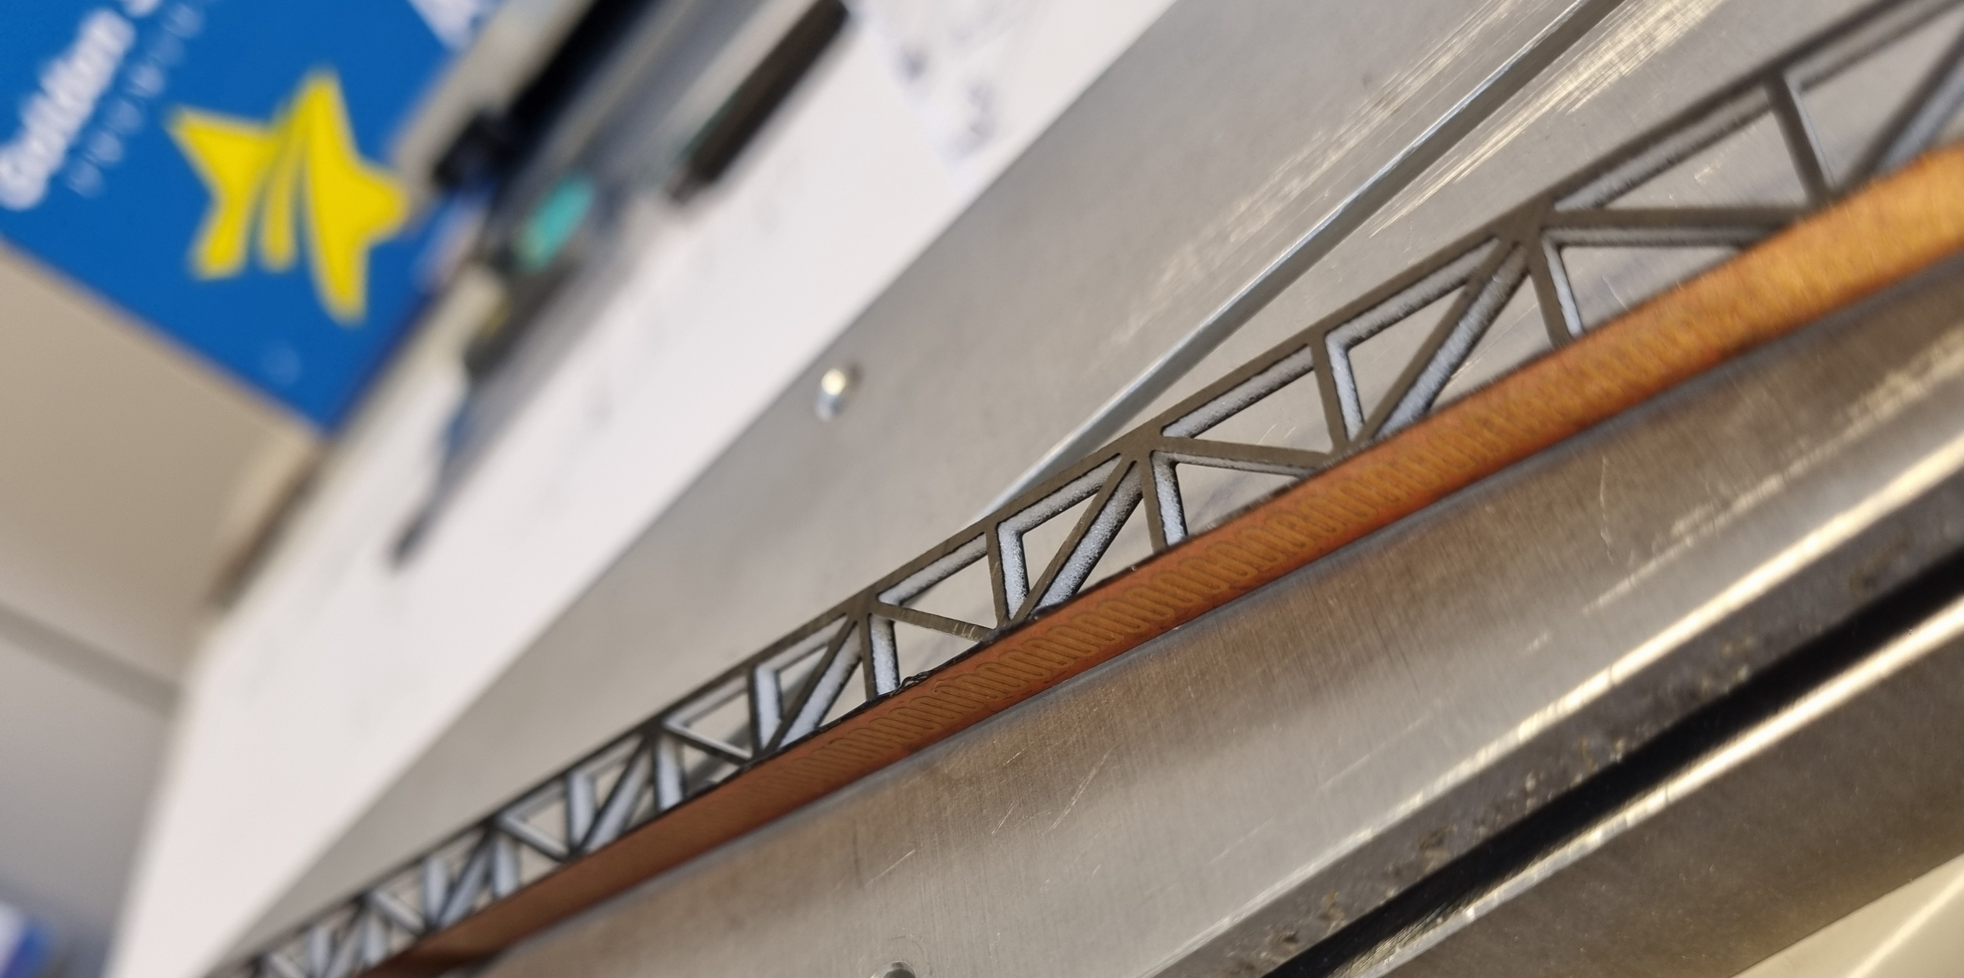
Air-cooling setup in Pisa
Courtesy G. Ammirabile
Mock up of the VXD staves with kapton heaters
STAVES

Slide 17
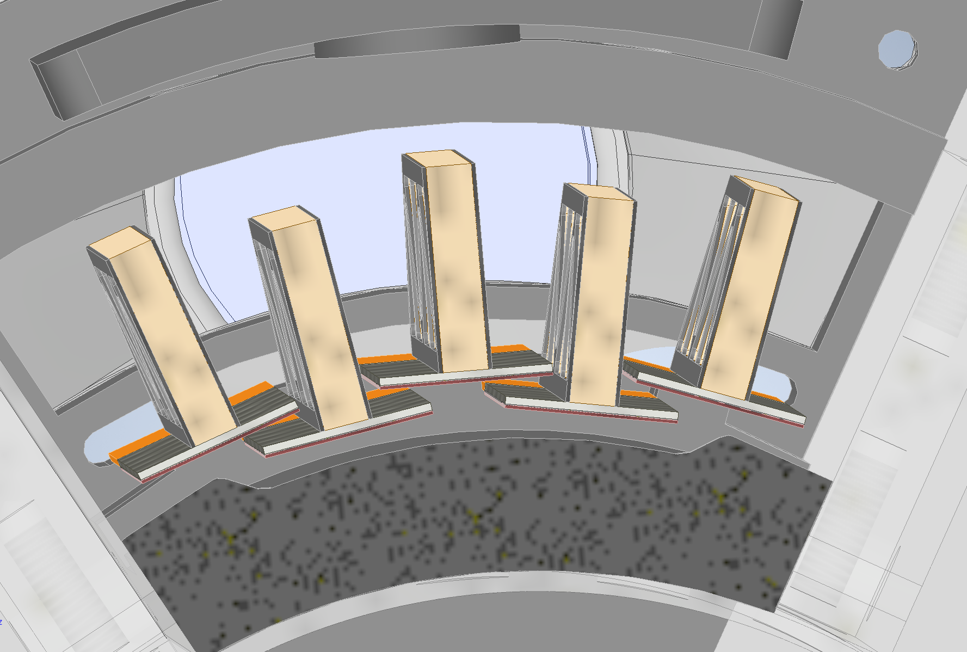
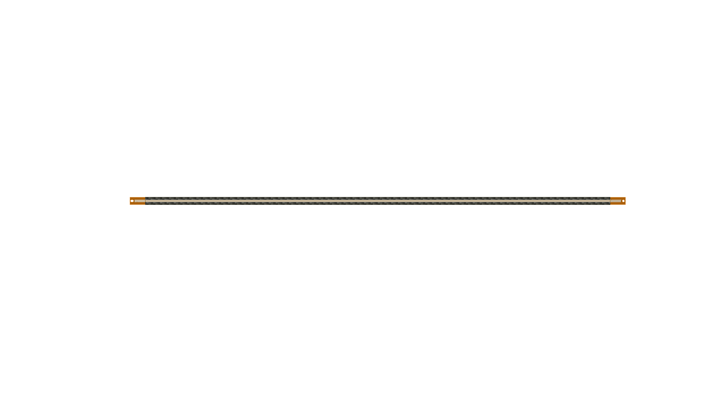
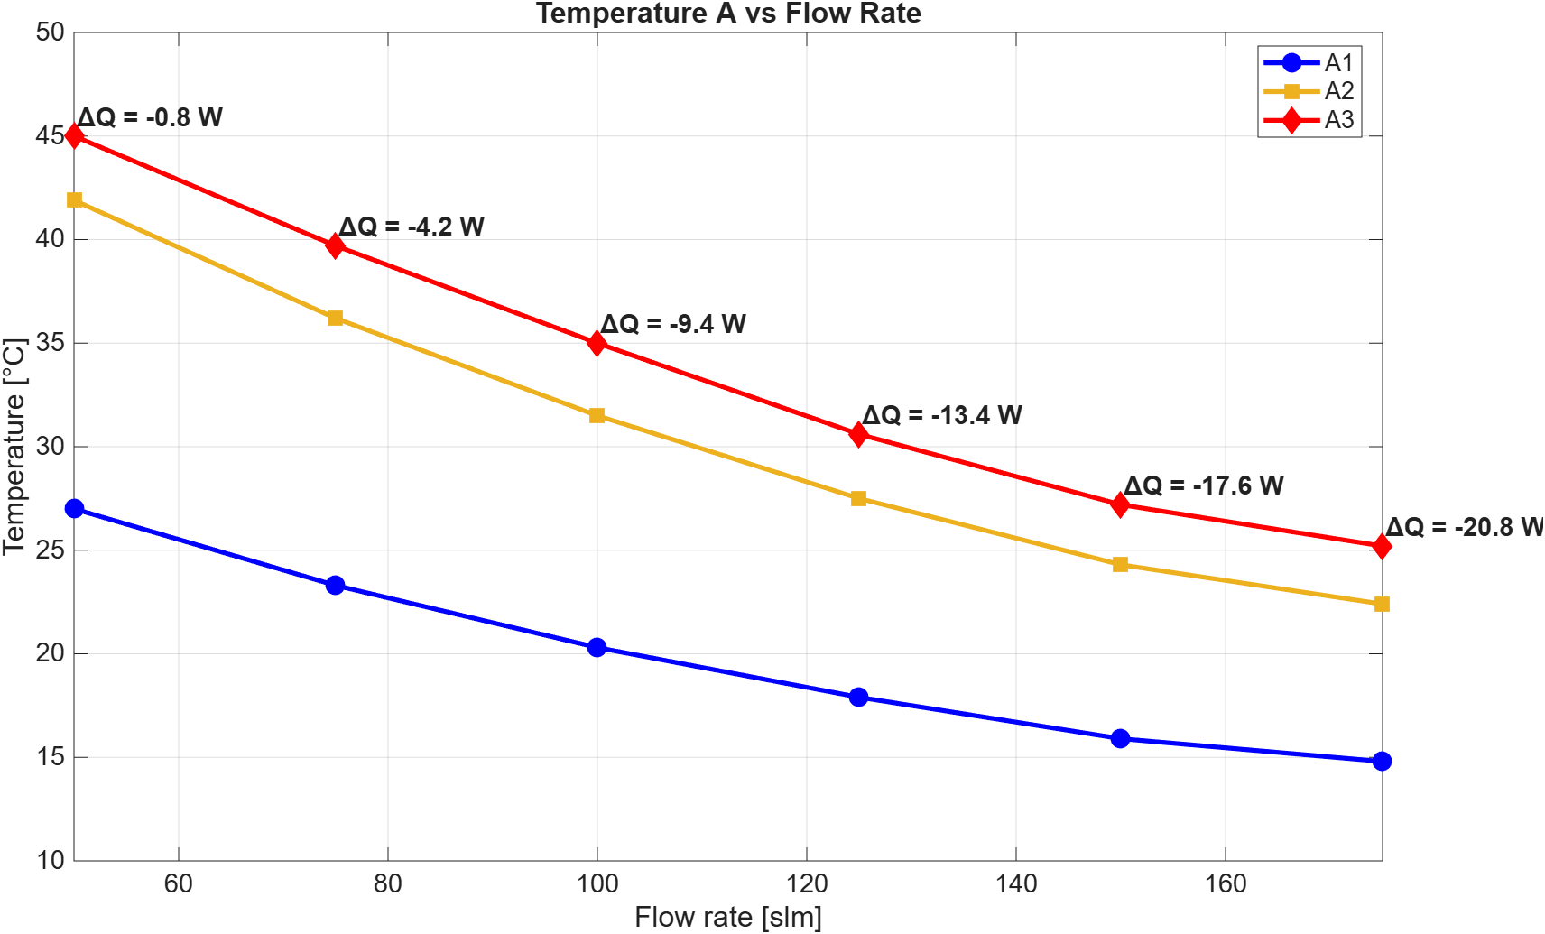
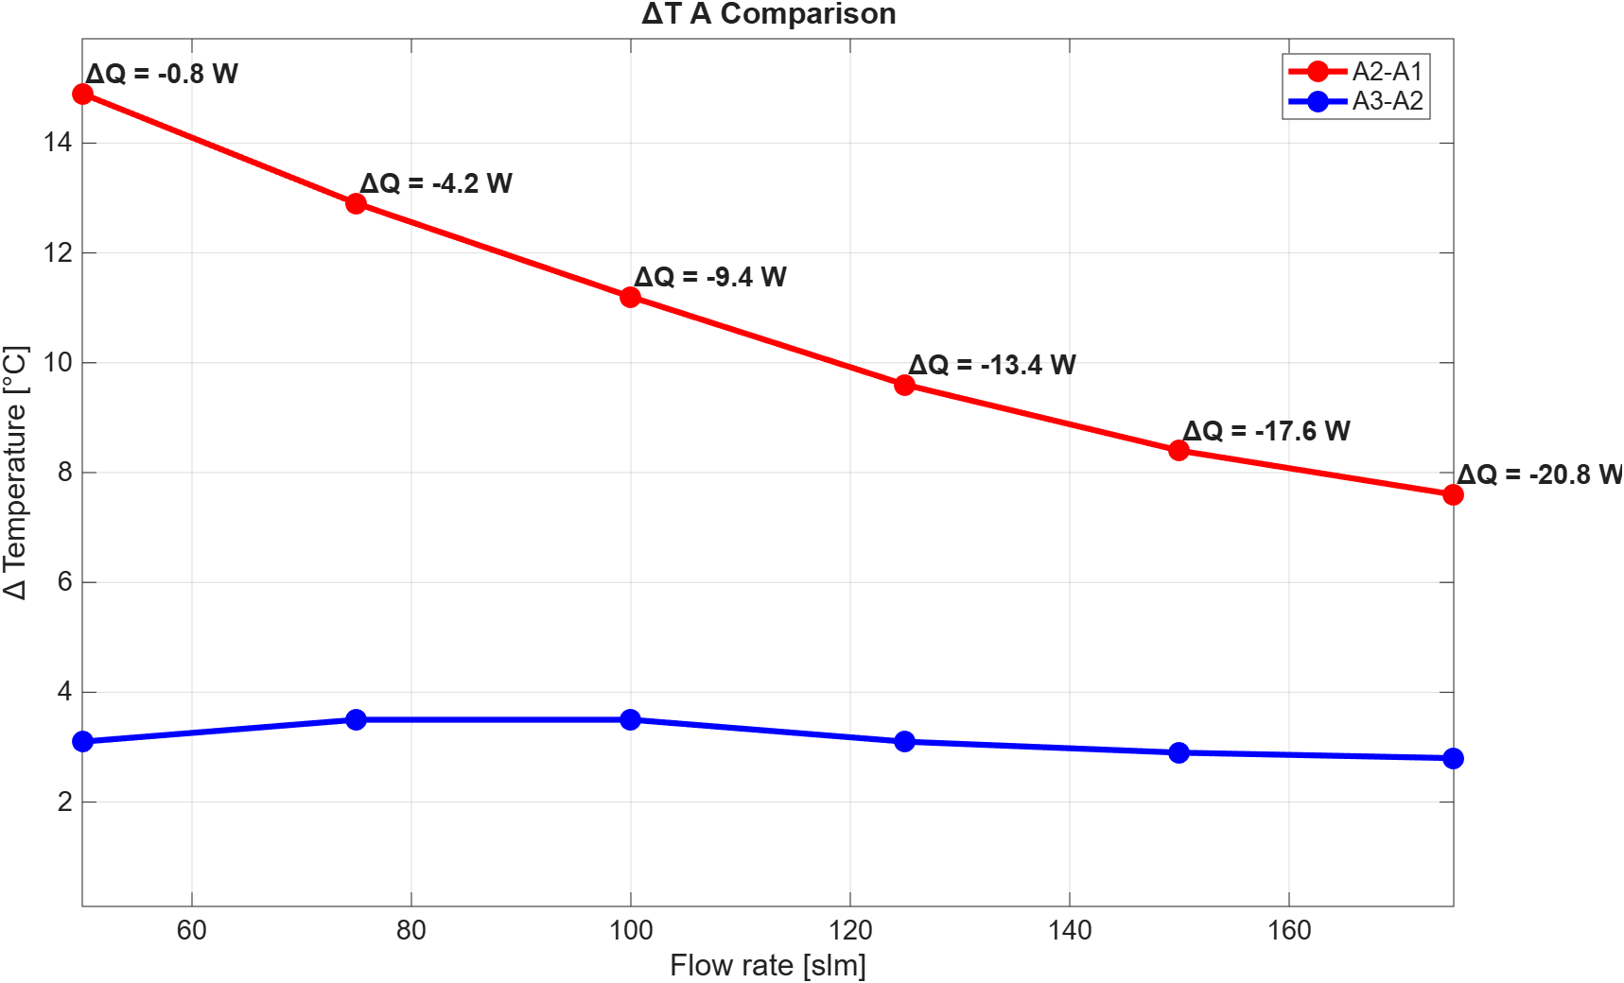






First test: 60° angular sector of only layer 3
PT1000
Power density (sensor) = 50 mW/cm²
Total power (each stave) = 2.15 W
$${∆T}_{B3−B2}$$
$${∆T}_{B2−B1}$$
Top view
B3
B2
B1
A3
A2
A1
B
A
$${∆T}_{A3−A2}$$
$${∆T}_{A2−A1}$$
FLOW
Staves under thermal testing
$${∆T}_{A3−A2}$$
Stave A is ‘stifled’ by B
$${∆T}_{A2−A1}$$
Air-cooling works. Closest point to the air-ducts is cooler than the others. Optimisation ongoing
Soon to study vibration induced displacements by air.
Courtesy G. Ammirabile

Slide 18
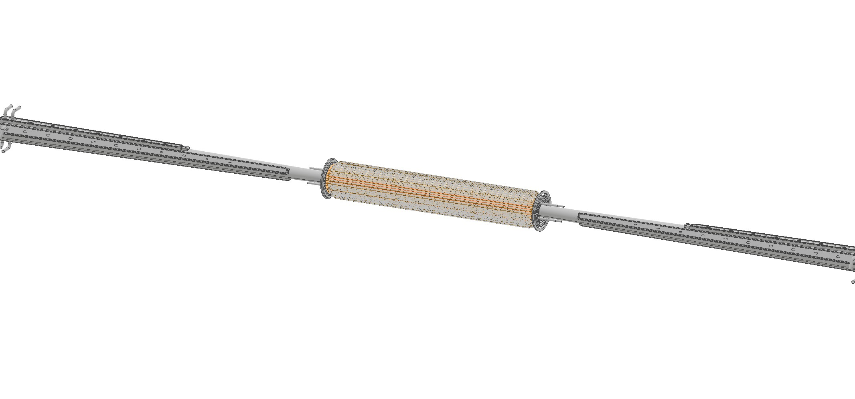


Possible assembly procedure
1
2
Beam pipe with inner vertex
Medium and outer vertex assembly
3
Layer 3 ducts
Layer 2 ducts
Layer 1 ducts
Inner vertex services assembly

Slide 19



Possible assembly procedure
4
5
SLOTS
Support tube closure
Disks assembly
Slots are required on the support tube to allow ducts entry and exit

Slide 20

Optimisation will be studied after the assembly experience
Thickness to reduce material budget while guaranteeing rigidity
Clamping of the vertex to the cylinder
Routing of the services (beam pipe, VTX, lumical) with the help of a supporting middle flange
Vibration studies
Final design of the bellows to guarantee connection with RVC

Slide 21

Studies of Lumical integration with ALFA
It does not use a service cylinder for LumiCal
Not yet clear how the beam pipes are supported
  LumiCal supported by a cone attached to ECAL
  Services run over the outer bore and out of the detector up the back-side of the ECAL endcap
  LumiCal plates are positioned with a ‘clutch basket’ style and fastened with through-bolts
  Current design is 5mm thick steel (Titanium under consideration)
G. Gilmore Kerr

Slide 22




Maximum deformation 47 µm
First modes ~78 Hz
structure then requires harmonic, random vibration and seismic analysis to be performed
G. Gilmore Kerr

Slide 23
Detector solenoid field and cryostat space
Increasing the detector solenoid field (from 2 T)
(Positive) impact on Detectors:
  Reduces IPC backgrounds (50% less from 2 to 3 T)
  Shrinks the dimensions (and cost!) of the detectors
  Improve detector performance (needs the with same radial dimensions)
Impact on Collider:
  Increases emittance → reduces the luminosity
  Needs a higher compensation → Could be achieved with semi-local scheme, but cryostat needs to be placed closer to IP (also affecting LumiCal backgrounds)
  Needs an higher anti-solenoid field → higher currents in the coils (See Vikas presentation)
  Next Monday Sep. 14th dedicated presentation on MDI general meeting https://indico.cern.ch/event/1719205/

Slide 24

Compensation schemes
Local
Non -Local
Courtesy A. Ciarma

Slide 25

Non-local Solenoid Compensation Scheme
A Screening Solenoid shields the Final Focus Quads
Two Compensating Solenoids to cancel the longitudinal field integral
Skew quadrupolar components in the FFQs align the magnet axis to the rotated reference frame of the beam
Correctors right after the beam pipe separation and around the FFQs compensate the orbit distortion generated by the horizontal crossing angle in the detector field

Slide 26





Effects on Lumical backgrounds
LumiCal is behind the fringing fields of the shielding solenoid
Low p_{T} particles spiralise along these lines and cause backgrounds
  Radial component of the field, as a function of the screening solenoid start (2T)
    z$=1.23 m {⇒ B}_{r}<0.15 T$
    z$=1.5 m⇒ B_{r}\sim 0 T$
Courtesy of A. Ciarma

Slide 27

Courtesy V. Teotia
Optimisation ongoing

Slide 28


Cryostat considerations
Little space to accommodate radial buildup with overall constraints
  Largest constraint is the 100 mrad cone allocated to Collider.
  Helium vs Helium-II may make some difference in thermal shielding
  Depends on L* (increased from 2.2 m to 2.4 m to allow for more space)
  Shielding due to radiative Bhabha energy deposition (W shielding)
  Depends on diameter of pipes (physical aperture dictated by collimators)
  Need to contain BPM (optics tuning (BBA) needs 1 per segment)
Increasing separation between QD0 and QF1 helps reducing SR
  See M. A. Jebramcik presentation at the SR task force meeting
N.B. SuperKEKB did not have space for common external screening solenoid and opted for an embedded screening only around HER

Slide 29

L* = 2.4 m
V. Teotia, B. Parker, A. Ciarma, J. Seeman

Slide 30

Work on the cryostat
Design of the FFQ cryostat and interface to the RVC ongoing at SLAC
Courtesy of J. Seeman

Slide 31

What is the envelope of the cryostat?
Initial studies based on construction mechanical tolerances, structural deformations (gravity and shrinkage), positioning (floor/rail), dynamic (failures etc).
Assume M. Koratzinos cryostat design
First estimate
  Total Dynamic Envelope
  15.5 mm transverse
  18.75 mm longitudinal
Courtesy O. Beltramello

Slide 32


Detector opening scenario
Courtesy O. Beltramello
Baseline: move longitudinally the FFQ by removing collider beampipes
Open the detector longitudinally and access internal structures
Very tight requirements on realigning the final focus quadrupoles (30 µm)
No way to open for small interventions
Need to estimate time for re-start operations after YETS

Slide 33


Slide 34


Monitoring system
The alignment monitoring system aims to give info about the situation inside without the need to open. Correctors and tunning could then be operated remotely thanks to this data.
1:2 Mock up at CERN
May also need active re-alignment, and gives operational advantages: it would enable remote realignment of the components without reopening the QC1 assembly.
Such an adjustment system could be carefully tailored according to the available space, required adjustment range, precision targets, and operational constraints.
Courtesy L. Watrelot

Slide 35
Conclusions
The interaction region of FCC-ee needs to accommodate several contrasting requirements.
A thorough understanding of the needs and technological solutions are needed to accomplish the task
Several options are being evaluated and would need to investigated to make sure we reach our goals.
Every detector concept should be involved

