Slide 1
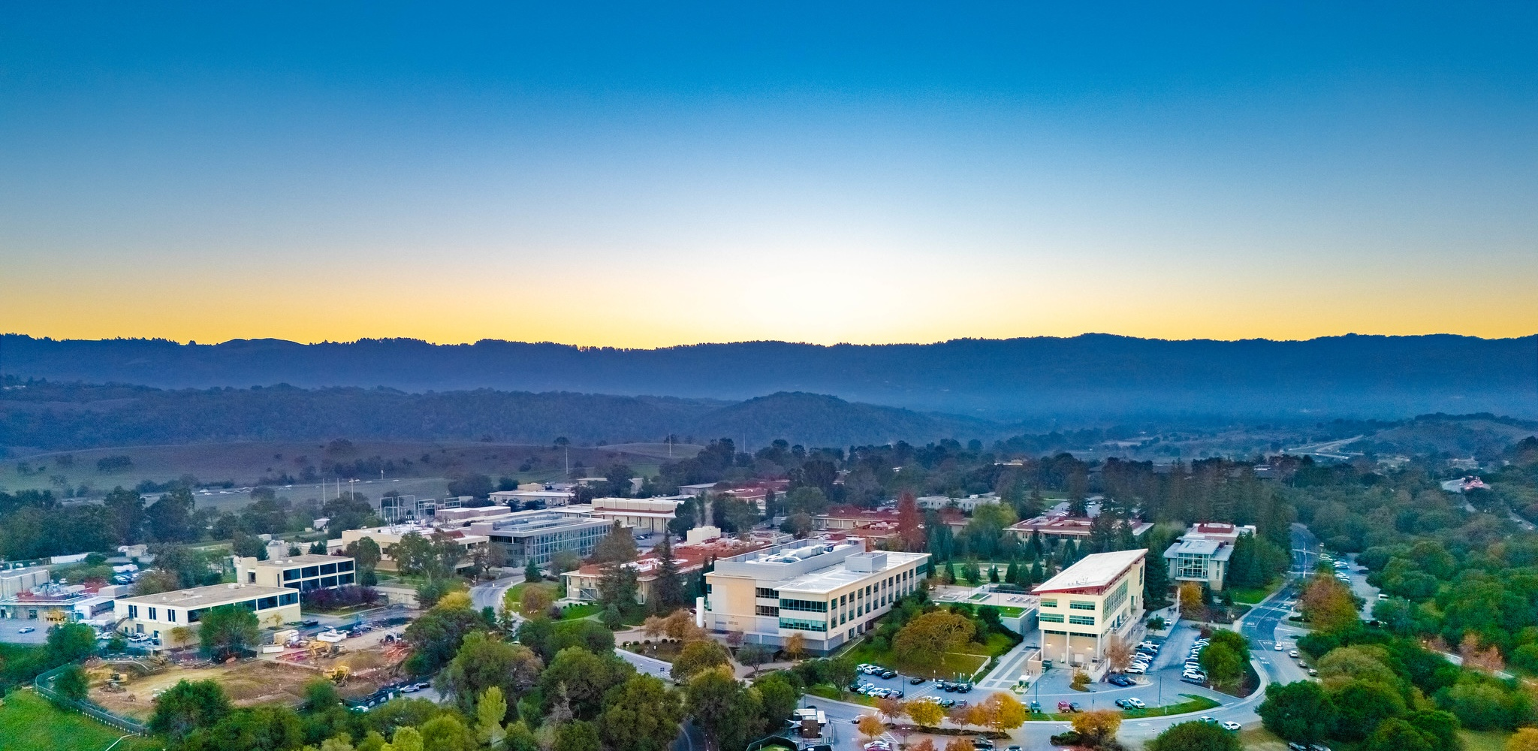
Integrated US SRF Program for FCC-ee
Matthias Liepe
Professor of Physics; Head Cornell SRF Group
Cornell University
For Program Partner Institutions
M. Liepe, Cornell University Fourth US FCC meeting, 2026, September 10 Slide 1

Slide 2
Integrated US SRF Program for FCC-ee
US Strategic Participation in the FCC-ee Nb SRF Development
Motivation / introduction
Proposed Scope
Proposed Timeline
US Rapid Development Program for Nb₃Sn SRF Technology
Motivation / introduction
Proposed Scope
Proposed Timeline
M. Liepe, Cornell University Fourth US FCC meeting, 2026, September 10 Slide 2

Slide 3
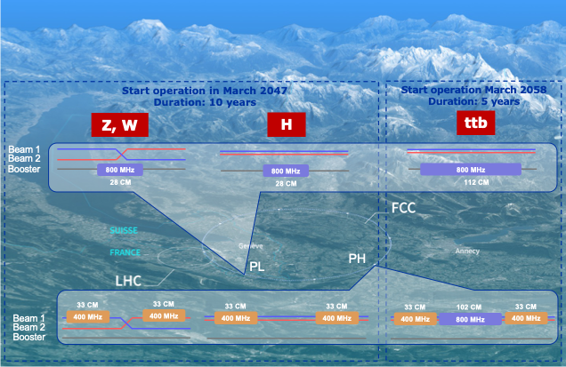
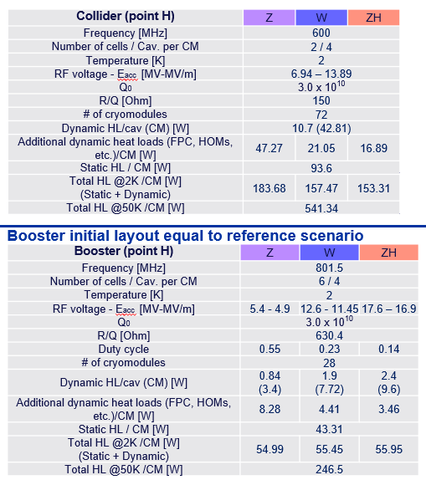
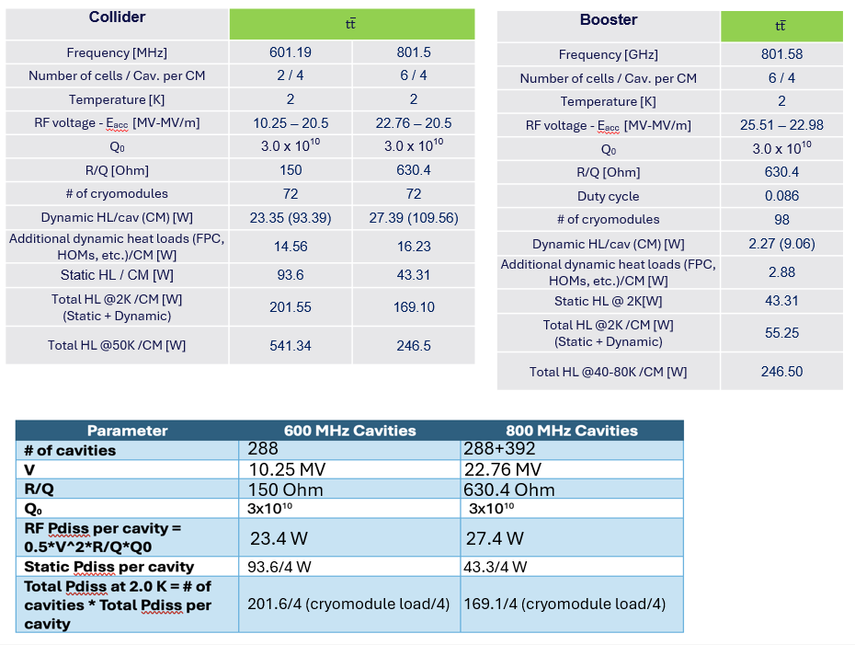
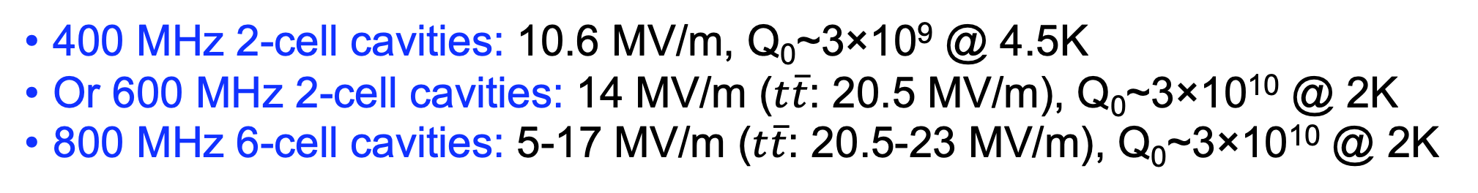
FCC-ee SRF Layout and Specifications
400 MHz 2-cell cavities: 10.6 MV/m, Q₀~3×10⁹ @ 4.5K
Or 600 MHz 2-cell cavities: 14 MV/m ($t\overline{t}$: 20.5 MV/m), Q₀~3×10¹⁰ @ 2K
800 MHz 6-cell cavities: 5-17 MV/m ($t\overline{t}$: 20.5-23 MV/m), Q₀~3×10¹⁰ @ 2K
M. Liepe, Cornell University Fourth US FCC meeting, 2026, September 10 Slide 3

Slide 4
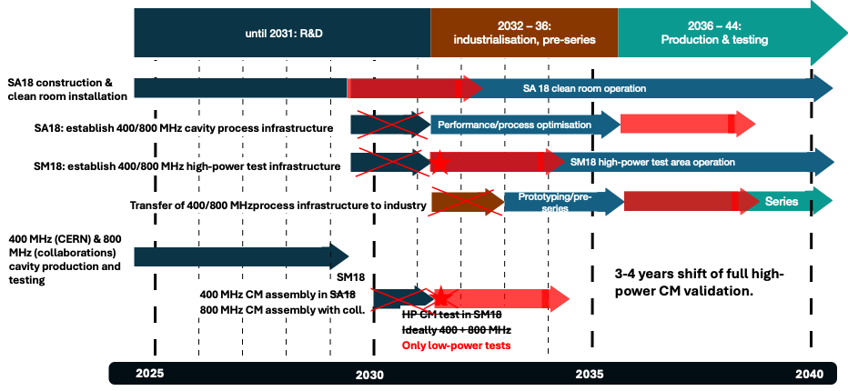
FCC-ee SRF Roadmap
Slide credit: Adopted from F. Gerigk, FCC Week 2026
~8 years till full power CM test; ~ 12 years till start of CM production
Low power CM testing ~2031
CM production start ~2038
Full power CM testing ~2034
M. Liepe, Cornell University Fourth US FCC meeting, 2026, September 10 Slide 4

Slide 5
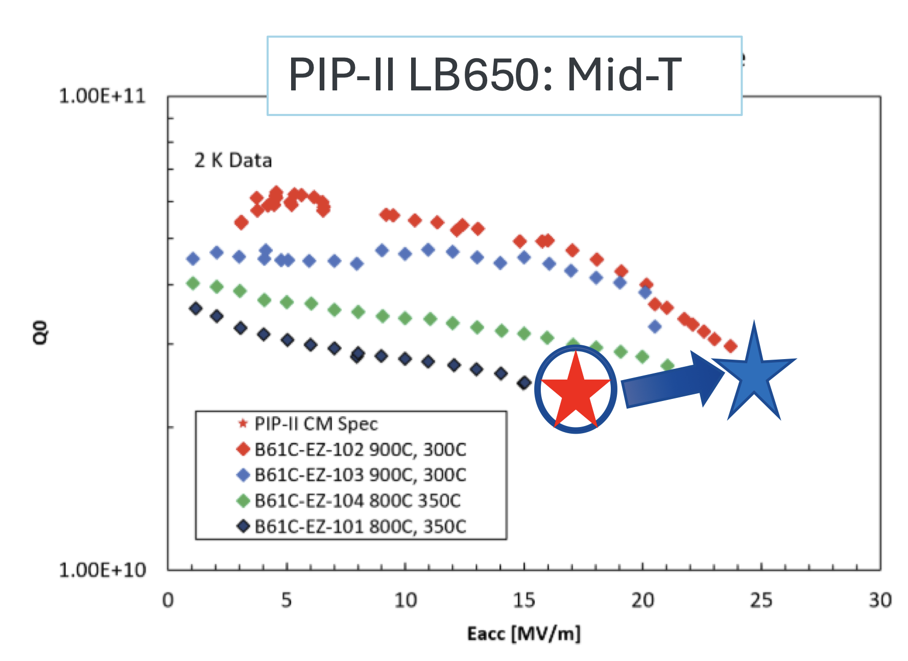
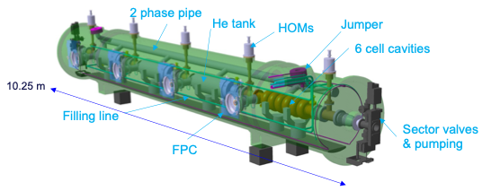
U.S. Superconducting RF R&D Leadership
U.S. is a leader in SRF science and technology
  LCLS-II high-Q (nitrogen doping) and cryomodules (FNAL, TJNAF, SLAC, Cornell)
  PIP-II high-Q cavity and full system development (FNAL)
  EIC SRF (TJNAF, BNL)
  FRIB SRF (MSU)
  LHC crab cavity development (FNAL, TJNAF)
  SNS Energy Upgrade (TJNAF, SNS)
  General SRF R&D (GARD): high Q, high gradient, Nb₃Sn…
U.S. is well positioned to take on SRF R&D leadership for FCC-ee
  800 MHz cavity and prototype cryomodule development (FNAL)
  High Q₀ R&D (FNAL, TJNAF, ANL, Cornell)
  Breakthrough Nb₃Sn R&D (Cornell, FNAL, TJNAF)
Beyond FCC-ee, continued SRF R&D highly relevant for other future accelerator projects, e.g., EIC, FRIB energy upgrade, industrial accelerators…
FCC-ee SRF R&D aligns well with the U.S. long-term priorities.
Continued focus on SRF R&D with sustained support and investment critical for future colliders and workforce development
High-Q₀ SRF cavity process R&D
FCC-ee 800 MHz prototype cryomodule design at Fermilab
M. Liepe, Cornell University Fourth US FCC meeting, 2026, September 10 Slide 5

Slide 6



Integrated US SRF Program for FCC-ee
Our vision:
Establish a nationally coordinated effort on SRF
  Like the U.S. LHC Accelerator Research Program(LARP) collaboration on LHC magnet development
Well-aligned with (updated) DOE GARD RF Roadmap => see Sam’s talk
Focused on high-impact for FCC-ee and the US accelerator program
Closely coordinated with CERN
Funded via US FCC-ee support and DOE GARD
Proposed US Institutional participation: ANL, Cornell, JLab, Fermilab,…
M. Liepe, Cornell University Fourth US FCC meeting, 2026, September 10 Slide 6

Slide 7
Integrated US SRF Program for FCC-ee
US Strategic Participation in the FCC-ee Nb SRF Development
Motivation / introduction
Proposed Scope
Proposed Timeline
US Rapid Development Program for Nb₃Sn SRF Technology
Motivation / introduction
Proposed Scope
Proposed Timeline
M. Liepe, Cornell University Fourth US FCC meeting, 2026, September 10 Slide 7

Slide 8
US Strategic Participation in the FCC-ee Nb SRF Development
CERN FCC-ee leadership wants the US to contribute in the area of SRF, and to ramp up our engagement as much as possible.
The HENP budget remains constrained due to the imperative to deliver on major commitments (HL-LHC, LBNF/DUNE, PIP-II).
US FCC-ee activity at this time must be scoped in this context.
Small, strategic program proposed here for US institutions.
Program carefully designed to align with CERN’s priorities.
Gives the US a chance to make meaningful contributions to ongoing FCC-ee accelerator efforts.
Program is aimed to show US commitment and position the US to play a significant role should CERN give the green light in 2028, all while maintaining a limited budget.
M. Liepe, Cornell University Fourth US FCC meeting, 2026, September 10 Slide 8

Slide 9
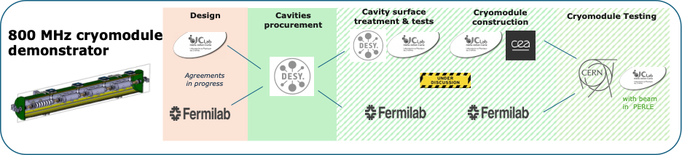
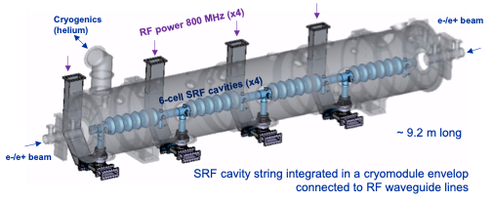
FCC-ee Nb SRF Development Program
SRF system where CERN has sought outside contributions so far has been the 800 MHz cryomodules.
Through the INFRA-TECH 2026 European call, European institutions plan to build an 800 MHz FCC-ee cryomodule demonstrator.
  CERN, IJCLab, CEA, ESS, DESY, HZB
  Not realistic building a prototype module in the US at this time.
But: Opportunity to contribute to a European prototype cryomodule, leaning on US strengths in high-performance SRF.
  Makes the US an intellectual and technological partner in this development.
US partner institutions
M. Liepe, Cornell University Fourth US FCC meeting, 2026, September 10 Slide 9

Slide 10
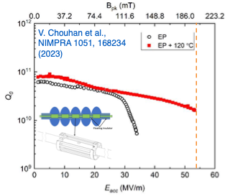
US Capability and Experience for FCC-ee Nb SRF Development
800 MHz modules: bulk niobium cavities requiring high Q at medium fields.
  FCC 800 MHz cavity performance goals are challenging but seem within reach of current advanced techniques with focused R&D.
US leadership and capability in high Q, high gradient cavities and cryomodules is highly relevant here:
  N-doping breakthrough development
  Low-T and mid-T heat treatment development
  Optimized EP development
  LCLS-II, LCLS-II HE, PIP-II
Image credit: Daniel Bafia
M. Liepe, Cornell University Fourth US FCC meeting, 2026, September 10 Slide 10

Slide 11
Proposed Scope: Overview
Perform high Q process R&D at 800 MHz.
Transfer optimal processing steps to 800 MHz 6-cell cavities.
Treat and test 800 MHz cavities for prototype cryomodule
TBC: Weld helium tanks to prototype module cavities and retest.
TBC: Design of 800 MHz cavity frequency tuner and test.
Note: This 800 MHz high-Q Nb development is relevant for FCC SRF in the 600 – 800 MHz range.
Deliverable: 4 qualified, jacketed 6-cell 800 MHz cavities with tuners, plus 1 spare.
CERN FCC-ee leadership voiced strong support for this proposed US scope.
M. Liepe, Cornell University Fourth US FCC meeting, 2026, September 10 Slide 11

Slide 12
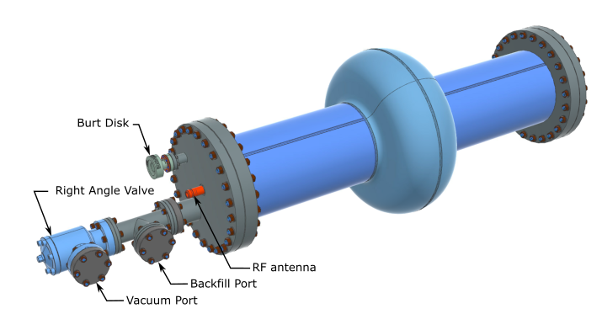
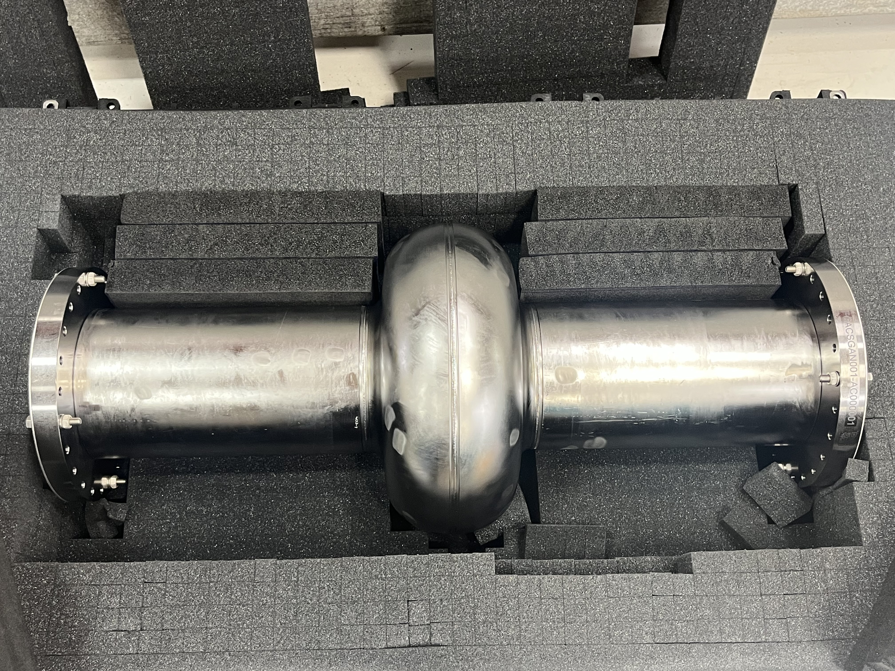
Proposed Scope: Details
Perform high Q process R&D at 800 MHz:
Goal: Determine best treatment process at 800 MHz.
  Note: 800 MHz sits between the PIP-II (650 MHz) and LCLS-II (1300 MHz) frequencies.
Fabricate 3 to 4 single-cell 800 MHz cavities (in addition to those provided by CERN).
Conduct systematic single cell 800 MHz cavity treatment optimization.
  E.g., EP baseline, followed by mid-T at various temperatures.
  Cross-US-facility performance validation.
Process R&D primarily funded by GARD.
M. Liepe, Cornell University Fourth US FCC meeting, 2026, September 10 Slide 12

Slide 13
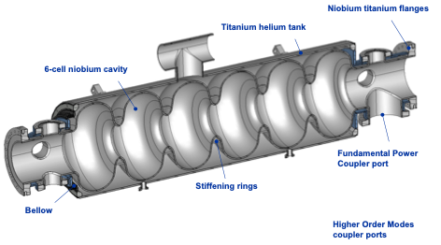
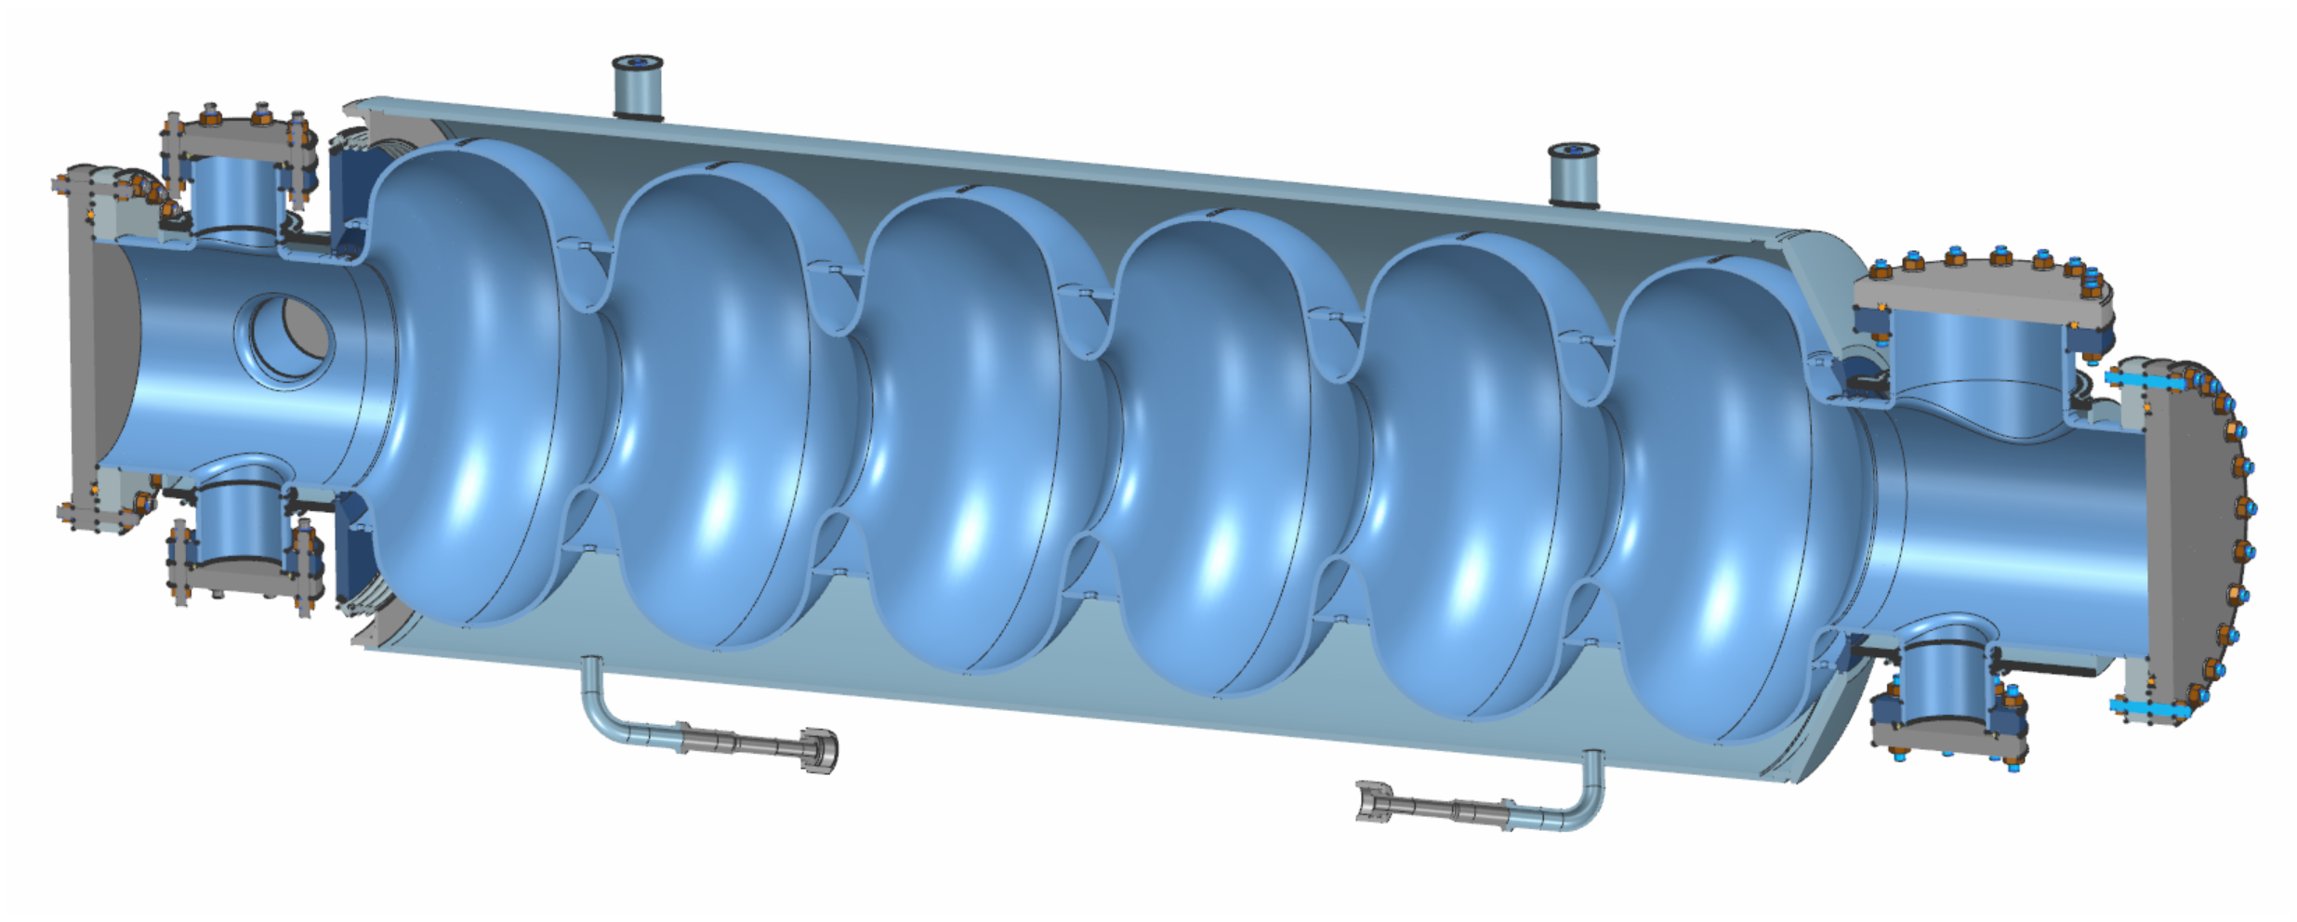
Proposed Scope: Details (cont.)
Transfer optimal processing steps to 800 MHz 6-cell cavities.
Five 6-cell 800 MHz prototype cavities to be sent to the US from Europe for high Q and high gradient treatment.
Tooling and infrastructure preparations for 800 MHz cavities
Perform a limited number of treatment cycles to establish optimal steps.
Treat and test 800 MHz cavities for prototype cryomodule
Using optimized process, perform treatment of 4+1 cavities.
TBC: Weld helium tanks to prototype module cavities and retest.
Tanks provided by European partners
TBC: Design of 800 MHz cavity frequency tuner and test.
Use FNAL experience in cavity tuners to modify existing design to 800 MHz cavity and test with cavity.
M. Liepe, Cornell University Fourth US FCC meeting, 2026, September 10 Slide 13

Slide 14
Timeline
Task | FY27 | FY28 | FY29 | FY30
800 MHz single-cell fabrication
800 MHz single-cell high Q process R&D
Tooling and infrastructure preparations
Receive 800 MHz 6-cell cavities from CERN
Treatment and vertical performance testing of 800 MHz 6-cell cavities
Helium tank welding and final test
Frequency tuner development
Send qualified, jacketed 6-cell 800 MHz cavities to CERN for module assembly
FCC-ee go/no-go decision
Cavity delivery in time for string and cavity assembly of 800 MHz cryomodule by European partners planned for CY 2030/31.
M. Liepe, Cornell University Fourth US FCC meeting, 2026, September 10 Slide 14

Slide 15
Some Notes on Cost (for the proposed initial scope)
Smooth ramp up in funding assumed with limited funds before go/no-go decision
  Estimate: Initial ~$200k/year, ramping up to ~$500k+/year
  Detailed bottom-up budget estimate currently under development with partner institutions (ANL, Cornell, Jlab, Fermilab)
Costs will be augmented by synergistic efforts, including existing R&D efforts under GARD as well as internal lab funds.
  Indication of support and buy-in for participation in the FCC-ee program.
The program would leverage existing investments in treatment and testing facilities at labs and universities.
M. Liepe, Cornell University Fourth US FCC meeting, 2026, September 10 Slide 15

Slide 16
Integrated US SRF Program for FCC-ee
US Strategic Participation in the FCC-ee Nb SRF Development
Motivation / introduction
Proposed Scope
Proposed Timeline
US Rapid Development Program for Nb₃Sn SRF Technology
Motivation / introduction
Proposed Scope
Proposed Timeline
M. Liepe, Cornell University Fourth US FCC meeting, 2026, September 10 Slide 16

Slide 17
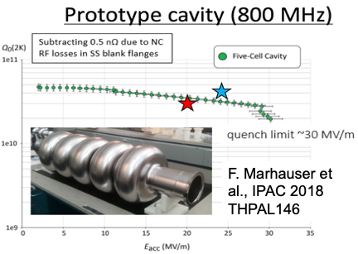
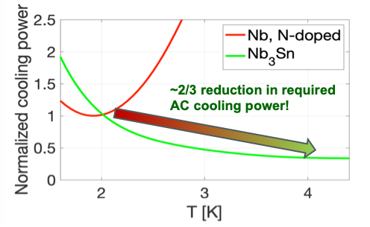
Nb₃Sn Breakthrough
Nb₃Sn is a transformative material option for SRF (T_{c}=18K vs 9.2K).
Nb₃Sn SRF breakthrough achieved by US institutions, supported by DOE HEP, especially HEP GARD (Cornell, FNAL, JLab).
Key benefit: SRF operation at 4.5K instead of 2K with similar Q₀.
  Factor of 3 to 4 times higher overall efficiency!
M. Liepe, Cornell University Fourth US FCC meeting, 2026, September 10 Slide 17

Slide 18
Nb₃Sn Benefits for FCC-ee
Using 4.5K Nb₃Sn in SRF systems offers 3 significant advantages compared to using Nb:
  Higher cryogenic efficiency, meaning that a smaller cryoplant can be used, reducing infrastructure costs.
  Smaller cryogenic plan requires less power, lowering operating costs.
  Cryogenic system at 4.5 K reduces operational risk.
Factor of ~3 reduction in carbon footprint for cryo!
Translates into cryoplant construction cost savings of several tens of $M and 10-year operating cost reduction of the order of $100M.
M. Liepe, Cornell University Fourth US FCC meeting, 2026, September 10 Slide 18

Slide 19
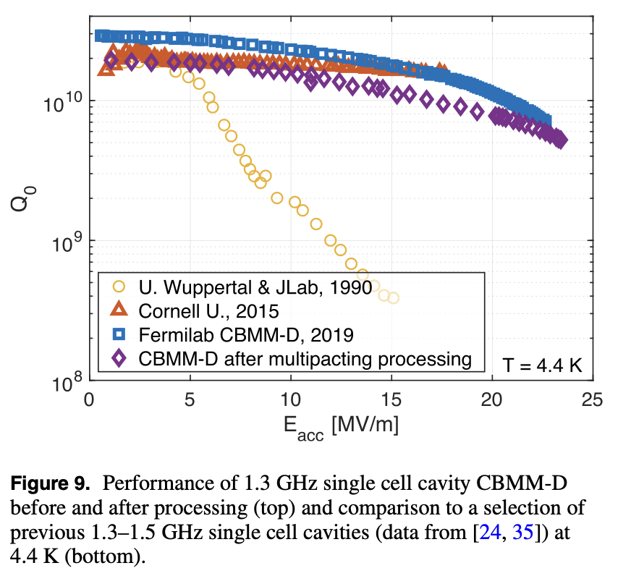
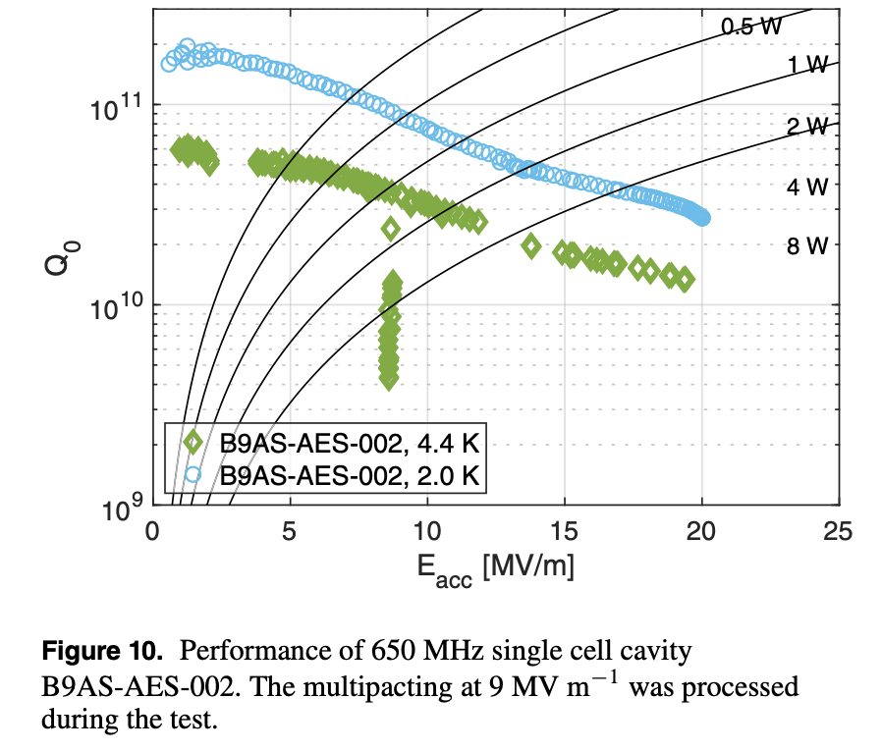
Nb₃Sn State of the Art Performance
1.3 GHz
650 MHz
Supercond. Sci. Technol. 34 (2021) 025007
Supercond. Sci. Technol. 34 (2021) 025007
Gradients 20+ MV/m on single-cell cavities, meeting FCC-ee needs
Q₀ > 10¹⁰ at 4.5K
M. Liepe, Cornell University Fourth US FCC meeting, 2026, September 10 Slide 19

Slide 20
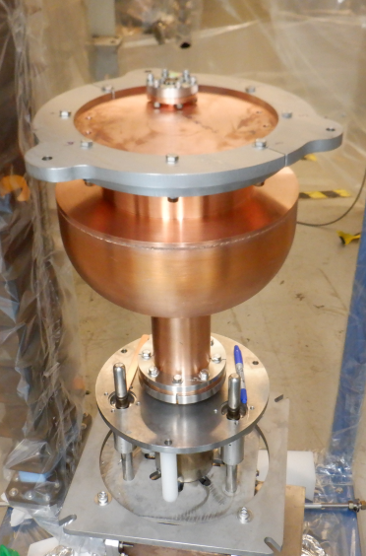
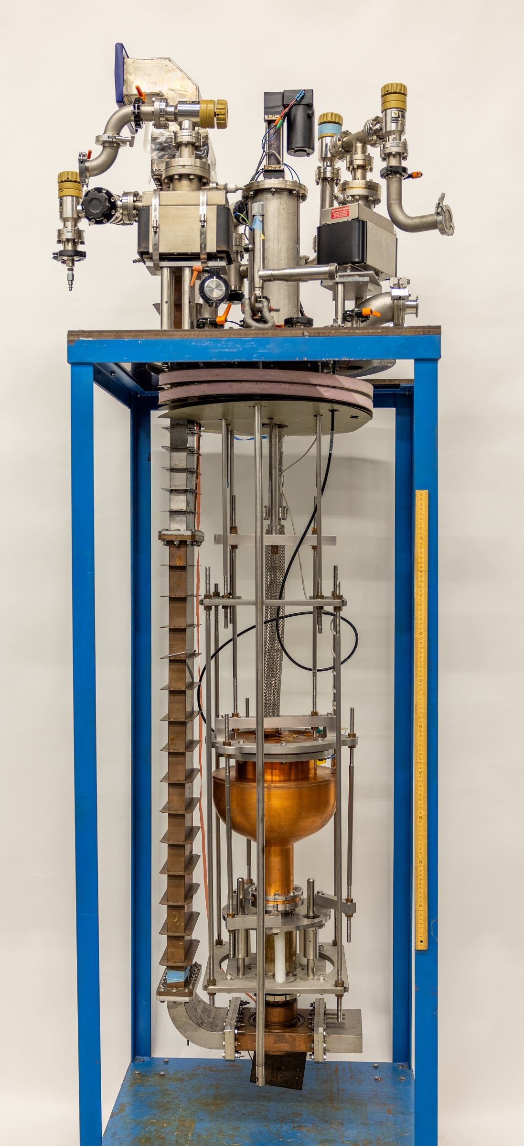
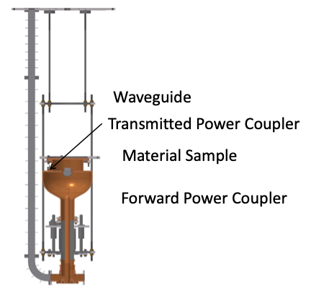
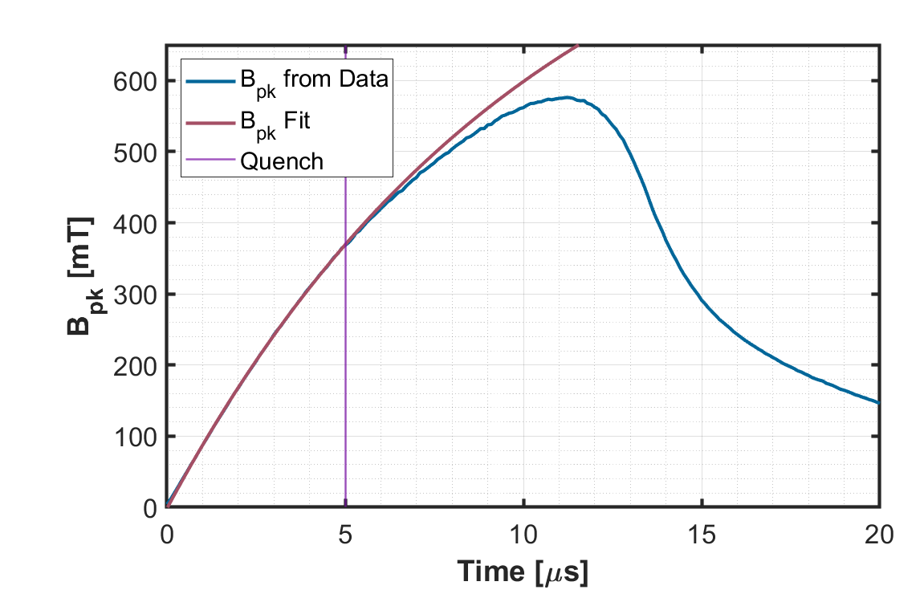
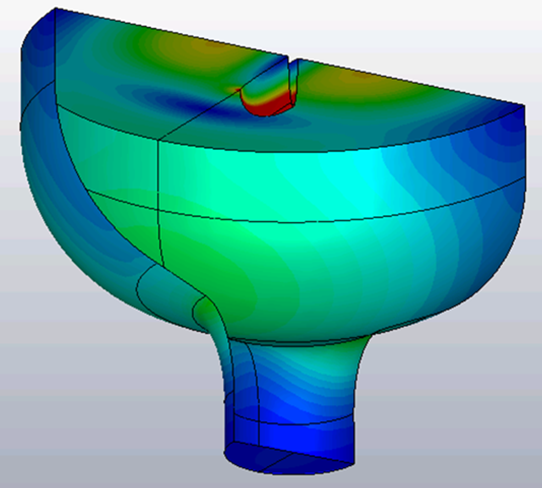
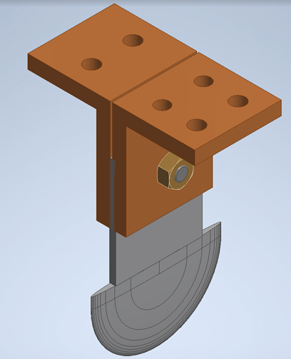
Nb₃Sn Field Potential Demonstration at Cornell
Reached ~400 mT (corresponding to ~100 MV/m) in short-pulse RF operation on a Nb₃Sn coated sample, 2x Nb limit.
Highest RF magnetic field achieved on a superconductor
Quench at ~370 mT!
M. Liepe, Cornell University Fourth US FCC meeting, 2026, September 10 Slide 20

Slide 21
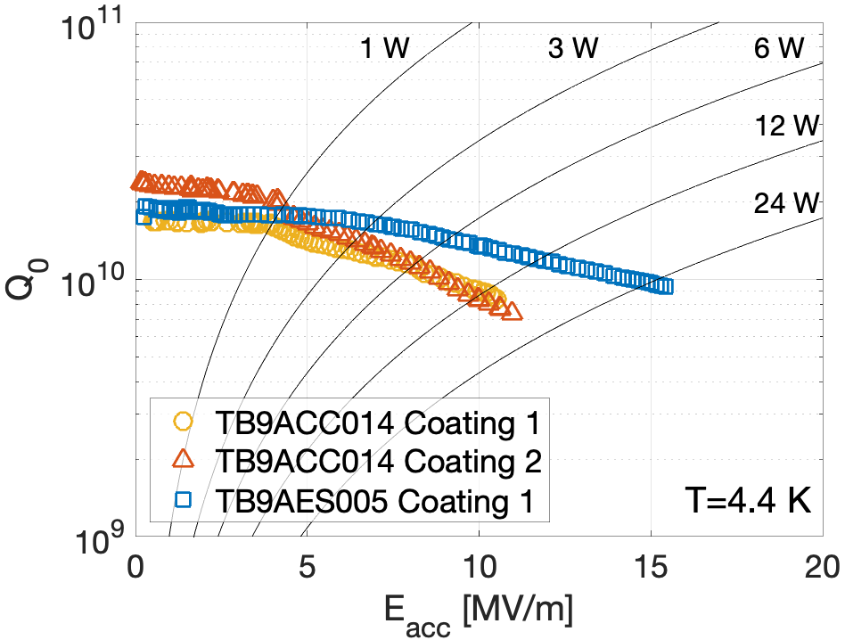
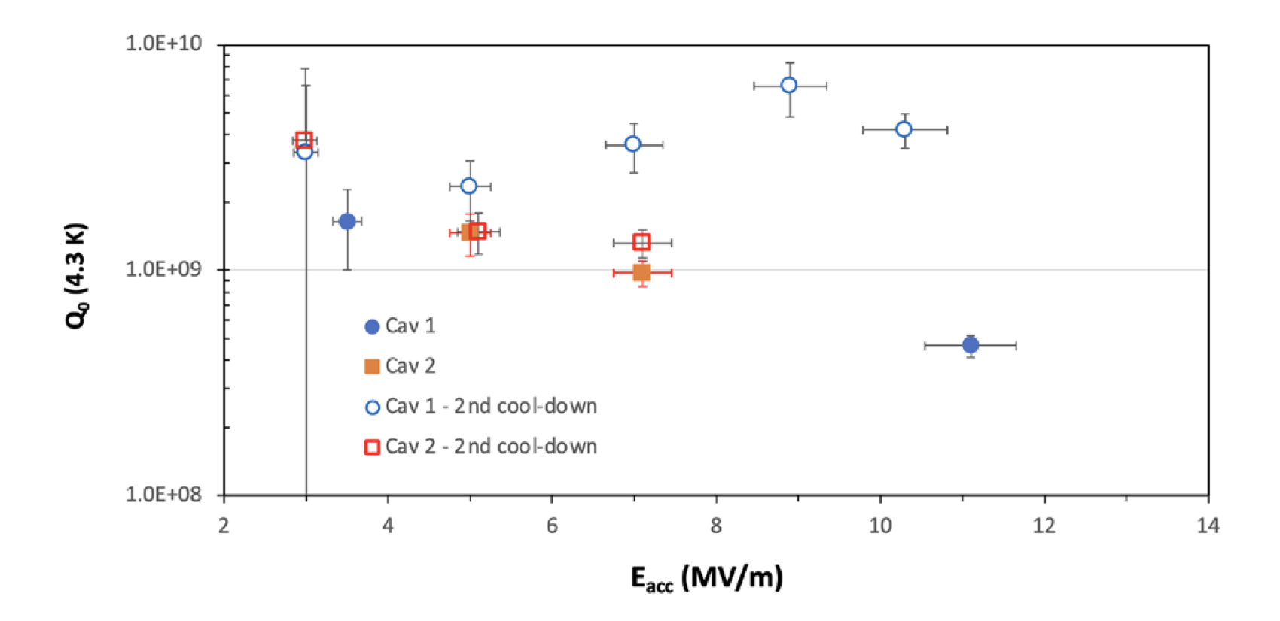

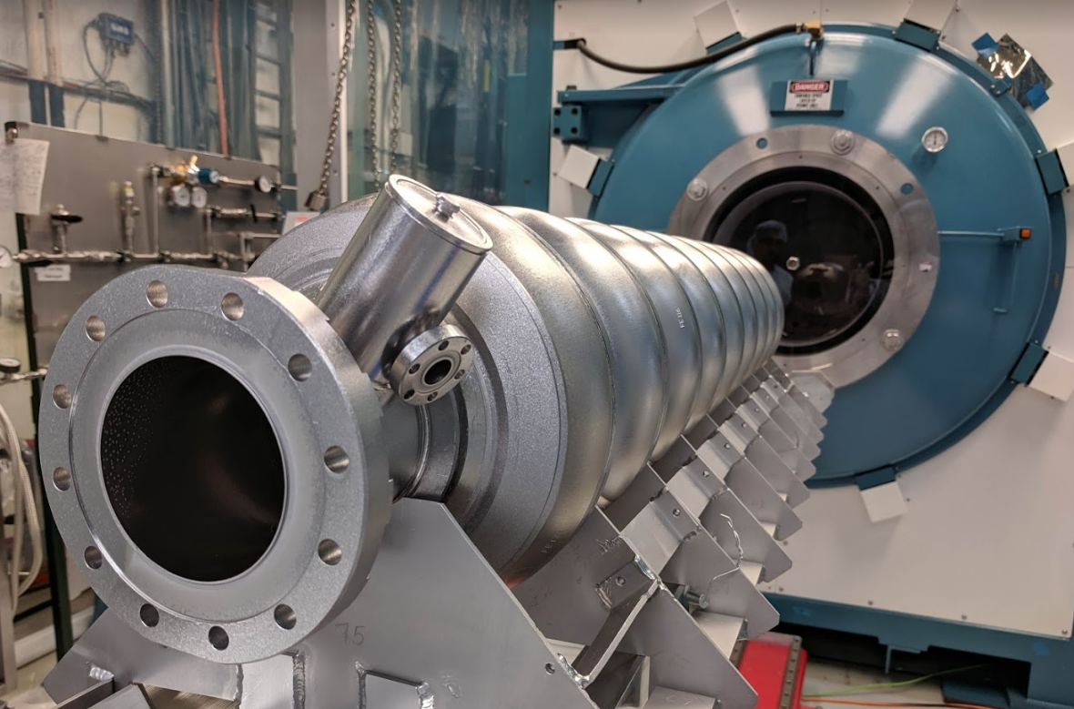
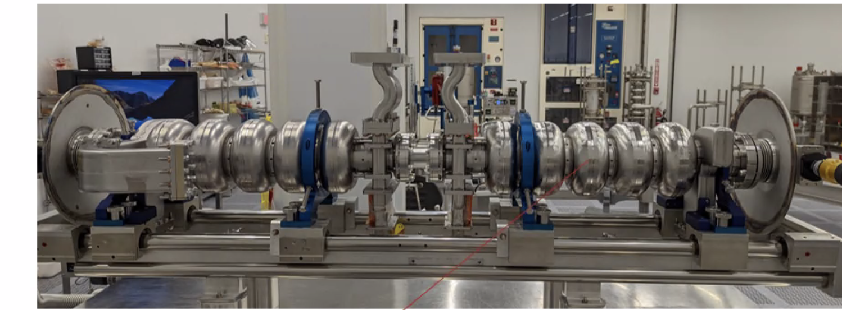
Towards Applications: Practical Nb₃Sn Cavities
Fermilab: 9-cell 1.3 GHz cavities
CEBAF-style quarter module using Nb₃Sn 5-cell cavities
4.4 K Q₀ > 9x10⁹ at quench
>15 MV/m with Q₀~10¹⁰ at 4.4K on accelerator structures!
=> Becoming an option for accelerator projects!
M. Liepe, Cornell University Fourth US FCC meeting, 2026, September 10 Slide 21

Slide 22
US Rapid Development Program for Nb₃Sn SRF Technology
So far: Individual U.S. Nb₃Sn SRF research programs
  Coating process developments and breakthrough performance demonstrations, with 1-cell cavity performance approaching FCC-ee needs
  More development efforts are needed now to demonstrate performance in a cryomodule.
  If higher Q₀ values are obtained in those demonstrations, the Nb₃Sn benefits will be similarly improved.
Now: Need a coordinated effort involving all key US players in this development to fully develop Nb₃Sn technology at the cryomodule level and to demonstrate project readiness.
M. Liepe, Cornell University Fourth US FCC meeting, 2026, September 10 Slide 22

Slide 23
US Rapid Development Program for Nb₃Sn SRF Technology
A US Nb₃Sn initiative could enable Nb₃Sn SRF to be a part of the baseline for FCC-ee with substantial benefits for infrastructure and cryogenic energy savings.
Benefits reach far beyond FCC-ee:
  Lower construction and operating costs for SRF driven lights sources, neutron sources, muon collider…. Revolution in SRF technology
  Nb₃Sn enabling technology for taking SRF into industrial settings
    Conduction-cooled, cryocooler-based Nb₃Sn SRF
    Nb₃Sn highly beneficial and sought-after technology for large industrial accelerators, for example for semiconductor lithography and subcritical reactors.
  Program would cement U.S. leadership in (Nb₃Sn) SRF technology with huge benefits to all further SRF driven accelerators.
M. Liepe, Cornell University Fourth US FCC meeting, 2026, September 10 Slide 23

Slide 24
Nb₃Sn Program Specifics
3 major program parts:
  Enabling Nb₃Sn R&D
    Coating optimization (at FCC frequencies)
    Transfer to multi-cell cavities (at FCC frequencies)
    Nb₃Sn cavity technology R&D (handling, tuning, tank welding…)
  Nb₃Sn Coating Scale-Up and Industrialization
    Dedicated Nb₃Sn coating facility development and deployment
    Multiple coating facilities for cross-checking between institutions (as was done for N-doping development for LCLS-II)
    Technology transfer and licensing to industry
M. Liepe, Cornell University Fourth US FCC meeting, 2026, September 10 Slide 24

Slide 25
Nb₃Sn Program Specifics
  Prototype Cryomodules
    Approach: Program sized to providing data needed to support baseline change of FCC-ee from Nb SRF to Nb₃Sn SRF
    FCC cavity coating and performance testing at multiple institutions
      20 cavities at given frequency to demonstrate performance yield
      Goal: Consistent performance demonstration meeting FCC specs
    Nb₃Sn prototype cryomodue(s) design, production, assembly and test
      Goal: Lower frequency (600/650 MHz) prototype fully tested by CERN’s ~2034 target
      Goal: Higher frequency (800/1300 MHz) prototype fully tested in time for ttbar upgrade
M. Liepe, Cornell University Fourth US FCC meeting, 2026, September 10 Slide 25

Slide 26
12-Year Timeline
Area | Tasks | Year 1 | Year 2 | Year 3 | Year 4 | Year 5 | Year 6 | Year 7 | Year 8 | Year 9 | Year 10 | Year 11 | Year 12
Enabling R&D
 | Substrate optimization and specification R&D
 | Single cell 600 MHz R&D
 | Single cell 800 MHz R&D
 | Multicell 600 MHz R&D
 | Multicell 800 MHz R&D
 | Tuning/handling development
 | Helium tank integration development
Nb3Sn Coating Scale-Up and Industrialization
 | Design furnace
 | Set up facility for prototype furnace – utilities, space, etc.
 | Deploy, commission, and debug first furnace
 | Set up facilities for subsequent furnaces
 | Build subsequent furnaces (2)
 | Technology transfer & licensing to industry
Color scheme
 | 600/650 MHz
 | 800/1300 MHz
 | Generic
M. Liepe, Cornell University Fourth US FCC meeting, 2026, September 10 Slide 26

Slide 27
12-Year Timeline (Cont.)
Area | Tasks | Year 1 | Year 2 | Year 3 | Year 4 | Year 5 | Year 6 | Year 7 | Year 8 | Year 9 | Year 10 | Year 11 | Year 12
Prototype Cryomodule
 | Cavity production (20 of each frequency)
 | Cavity coating at multiple US facilities
 | Consistent performance demonstration
 | Alternative 1 (new 4K CM Design)
 | New 4K cryomodule design
 | Horizontal tests for design verification
 | Full scale prototype 4 K cryomodule production
 | Full scale prototype 4 K cryomodule test
 | Alternative 2 (Usage of existing PIP-II "650MHz" Design)
 | "650 MHz" cryomodule Procurement
 | "650 MHz" cryomodule Production
 | "650 MHz "cryomodule Test
 | Transportation testing
 | Microphonics studies as needed
 | High current beam test at Cornell
 | Integrated cryomodule test at CERN
Color scheme
 | 600/650 MHz
 | 800/1300 MHz
Meets CERN timeline for (low-power) CM testing in 2031
M. Liepe, Cornell University Fourth US FCC meeting, 2026, September 10 Slide 27

Slide 28
Some Notes on Cost
Major multi-institution U.S. initiative, similar to magnet program of the the U.S. LHC Accelerator Research Program (LARP) collaboration (~$6M/year in 2000 era dollars).
Working on putting together detailed budget estimate, including alternative options / budget scenarios.
  (a) Rapid program to impact FCC-ee baseline covering two RF frequencies or (b) single-frequency timeline that leads to prototype to impact ttbar upgrade.
  (a) New 4.5K Nb₃Sn FCC cryomodule design or (b) use of existing PIP-II module design.
  Flexible to adjust to final FCC-ee frequency choice.
M. Liepe, Cornell University Fourth US FCC meeting, 2026, September 10 Slide 28

Slide 29
Integrated US SRF Program for FCC-ee
US Strategic Participation in the FCC-ee Nb SRF Development
Motivation / introduction
Proposed Scope
Proposed Timeline
US Rapid Development Program for Nb₃Sn SRF Technology
Motivation / introduction
Proposed Scope
Proposed Timeline
M. Liepe, Cornell University Fourth US FCC meeting, 2026, September 10 Slide 29

Slide 30
Key Takeaways
Exciting opportunities for the US for leadership in high-impact SRF technology development
  Opportunity to contribute to a European prototype cryomodule, leaning on US strengths in high-performance SRF
    Shows US commitment and positions the US to play a significant role should CERN give the green light in 2028, all while maintaining a limited budget.
  US Rapid Integrated Development Program for Nb₃Sn SRF Technology
    Major initiative that would be transformative for future SRF accelerators, including FCC-ee
M. Liepe, Cornell University Fourth US FCC meeting, 2026, September 10 Slide 30

Slide 31
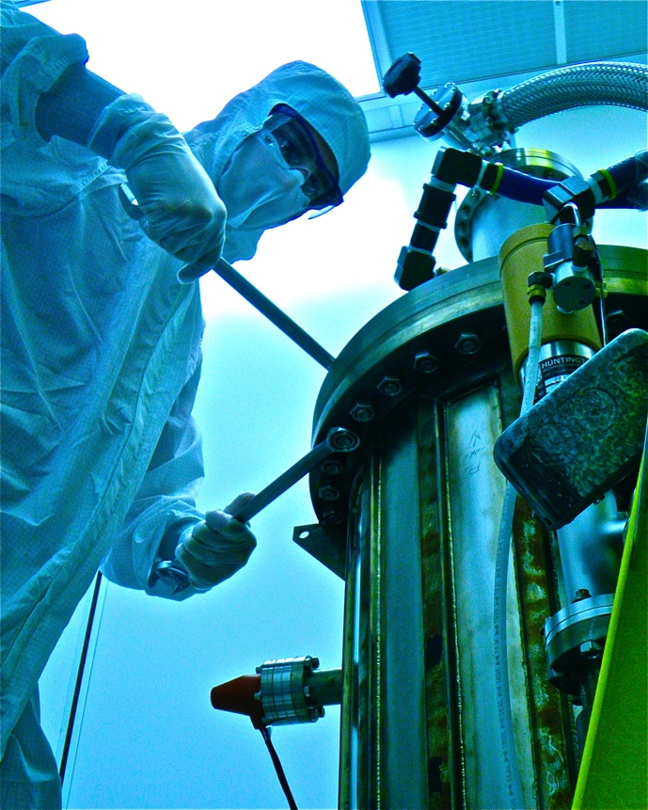
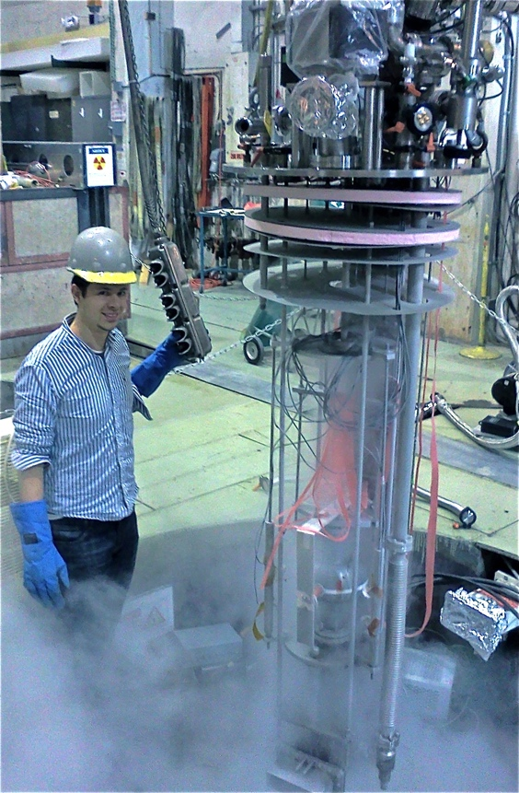
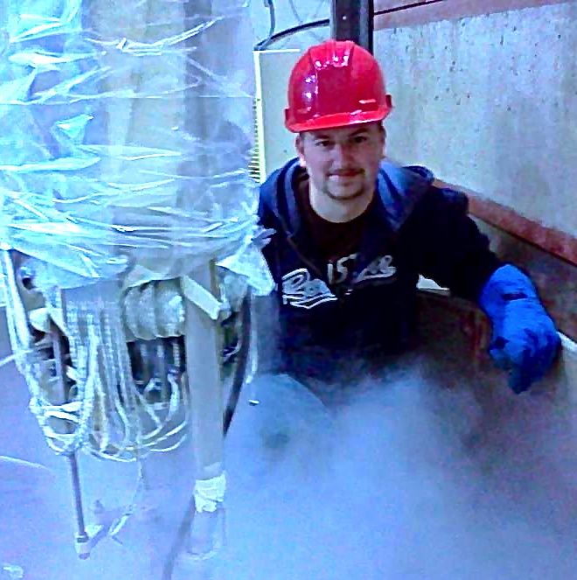
Thank you for your attention!
M. Liepe, Cornell University Fourth US FCC meeting, 2026, September 10 Slide 31

