Slide 1

FCC Physics Software and Computing
David Lange
Princeton University

Slide 2
FCC Reference Design Phase (RDP) goals
Goal: enable FCC-ee detector design optimization and leave a usable system for proto-collaborations
For the Physics/Experiments/Detectors (PED) area this means moving from parametrized physics-reach estimates to robust full-simulation implementations
Simulation software plays a crucial role in the design and optimization of future detectors and ensuring that the FCC project can demonstrate the necessary science reach and is approved in 2028

Slide 3
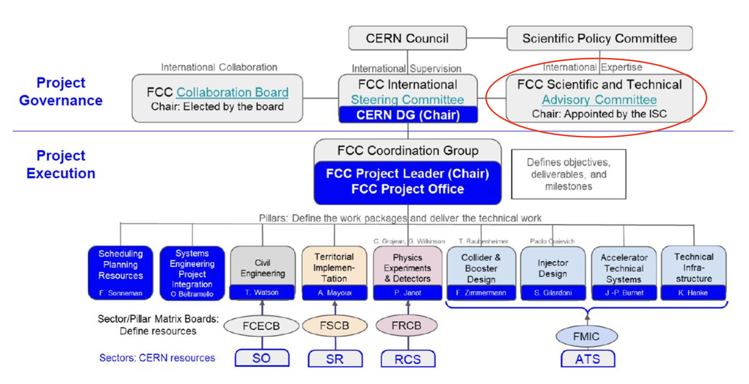
Apologies, 3 slides of organization charts starting with the
FCC Project at CERN

Slide 4
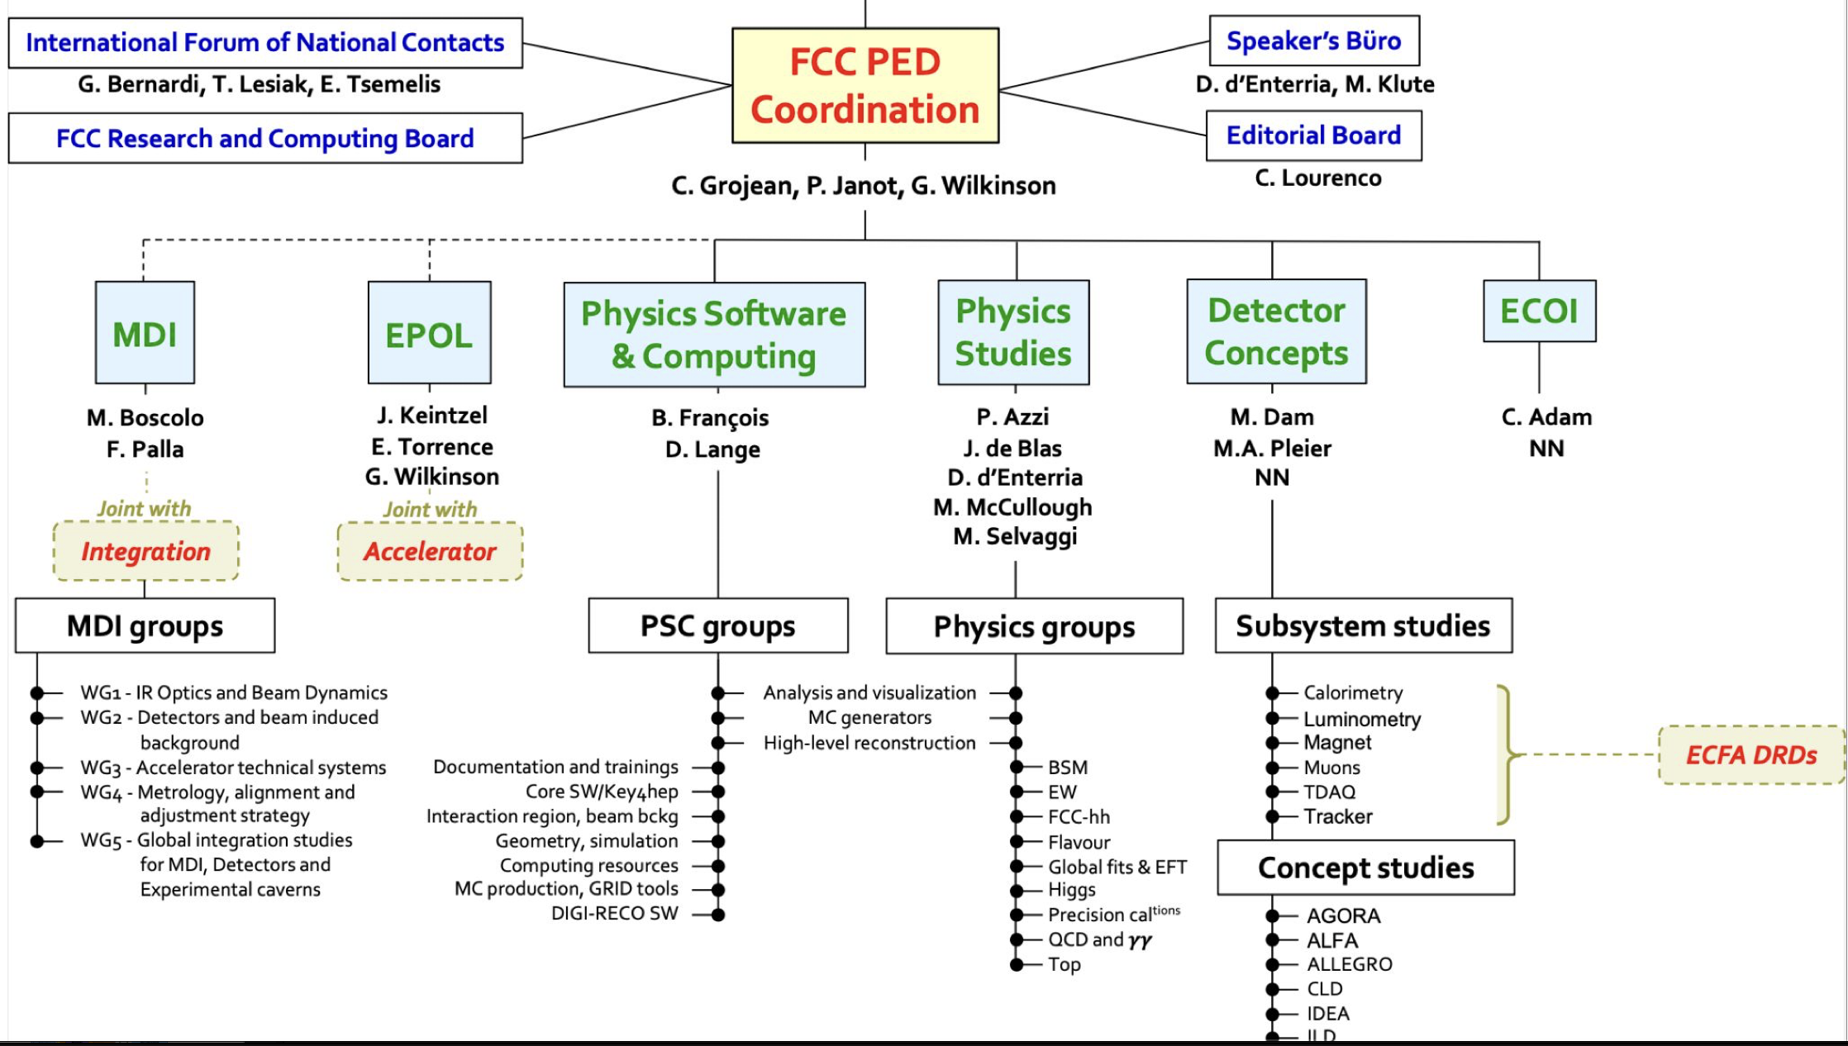
FCC PED organization
Notes:
Better to change this to be the FCC PED org chart

Slide 5
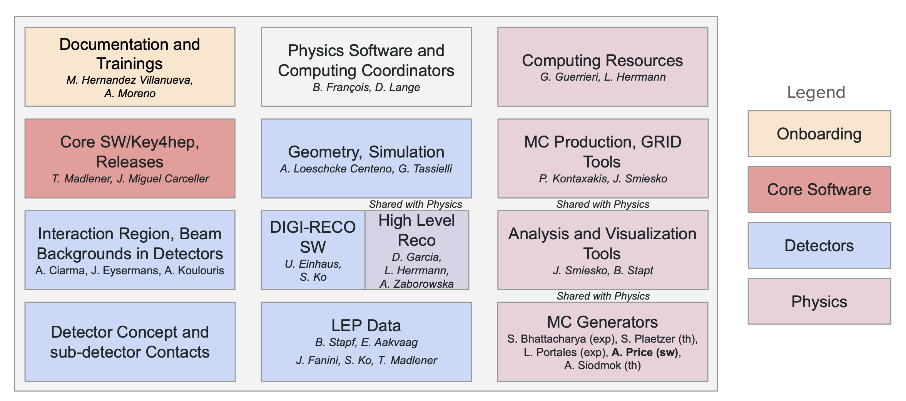
PSC Organization Chart (as of September 2026)
Still relatively new and fluid rather than an organization that will remain
static. Roles and relationships being understood and updated

Slide 6
RDP goals for PSC
Software suite for beam-induced background studies and mitigation, detector design optimization and physics studies which includes
Simulation and digitisation of all subsystems implemented for proposed detector concepts
Implementation of the updated IR geometry in Geant4
Reconstruction algorithms for all subsystems
Particle flow based physics object definitions for all detector concepts.
The analysis framework ready for distributed computing
All components for central event production in place, with an agreed data model
Distributed computing system for large event sample production (CERN + FCC computing GRID) including
Adequate computing resources, infrastructure, monitoring and user support
Completing sufficient Monte Carlo simulation samples to support RDP studies
A strategy for distributed computing system after the Reference Design Phase

Slide 7
Getting involved – Meetings and mailing lists
FCC PED indico: https://indico.cern.ch/category/5251/
Meeting | When | Indico Category | Mailing list
Full Simulation | Every other Wednesday alternating between 11:00 and 16:00 GVA | https://indico.cern.ch/category/16938/ | https://groups-portal.web.cern.ch/group/fcc-ped-softwareandcomputing-full-simulation/details
Reconstruction | Every other Thursday 16:00 | https://indico.cern.ch/category/19516/ | https://groups-portal.web.cern.ch/group/fcc-ped-physicsgroup-highlevelreco/details
Key4hep | Weekly, alternating between 9:00 and 16:00 | https://indico.cern.ch/category/11461/ | https://groups-portal.web.cern.ch/group/key4hep-sw/details
LEP Data | Every other Monday 14:00 | https://indico.cern.ch/category/20141/ | https://groups-portal.web.cern.ch/group/fcc-ped-softwareandcomputing-lepdata/details
Documentation | Every other Friday 16:00 | https://indico.cern.ch/category/21617/ | https://groups-portal.web.cern.ch/group/fcc-ped-softwareandcomputing-documentation/details
Analysis and MC production | Every other Wednesday 14:00 | https://indico.cern.ch/category/17971/ | https://groups-portal.web.cern.ch/group/fcc-ped-softwareandcomputing-analysis/details
More mailing lists:
Announcements: https://groups-portal.web.cern.ch/group/fcc-ped-softwareandcomputing/details
Generators: https://groups-portal.web.cern.ch/group/fcc-ped-softwareandcomputing-generators/details
MID: https://groups-portal.web.cern.ch/group/fcc-ped-softwareandcomputing-mdi/details
Or more generally - search for fcc-ped* lists (ignoring the ones ending in –admin)

Slide 8
FCC software components
The key4hep ecosystem keeps improving and helps to exploit synergies across projects (EIC, muon collider, across FCC detector concepts, etc)
  Adoption in FCC community has reached a critical mass of users. Adoption keeps growing via engagement of DRDs,
  CLD ported almost all its ILCSoft originating code to Key4hep ‘native’. ILD is starting
  to do the same
  CEPC froze the Key4hep version to write their TDR; now working to get back in sync
  Support for LEP data and analyses of it in edm4hep upcoming
FCCAnalyses used by most analyzers
  During the reference design phase: Plan to use FCCAnalyses as a hub for flagship physics analyses, kept maintained and ready to be run for any detector for optimization and performance benchmarking
We encourage everyone to develop in the common frameworks and tools, upstream your work; don’t work in a corner; reach out to people/forums

Slide 9
Key4hep building blocks: state of the art software with active user community
Algorithm orchestration framework: Gaudi (used in LHCb, ATLAS)
Data format for algorithm input/output: EDM4hep
  ROOT based, built with PODIO
Detector geometry description: DD4hep
Package manager building the software stack: Spack → LCGCMake (used by LHC)
Accessibility to the pre-existing linear collider software (ILCSoft)
  Based on the LCIO data model and Marlin orchestrator
  Can be used with EDM4hep data (converter), as Gaudi algorithms (wrappers)
Interoperability is at the core of the Key4hep philosophy
  Enabled by the compliance to the above (aka being 'Key4hep compliant')
  Promotes generic (e.g. detector agnostic) and modular implementations (i.e. avoid large monolithic algorithms doing many things in one step)

Slide 10
Getting started
Find recipes and examples in
  key4hep documentation
  FCC tutorials
  FCCAnalyses documentation
Testing an input for MC production? Want stability? Use the latest release
Developing something? Analyzing something recent? Use the nightlies
source /cvmfs/sw.hsf.org/key4hep/setup.sh
source /cvmfs/sw-nightlies.hsf.org/key4hep/setup.sh

Slide 11
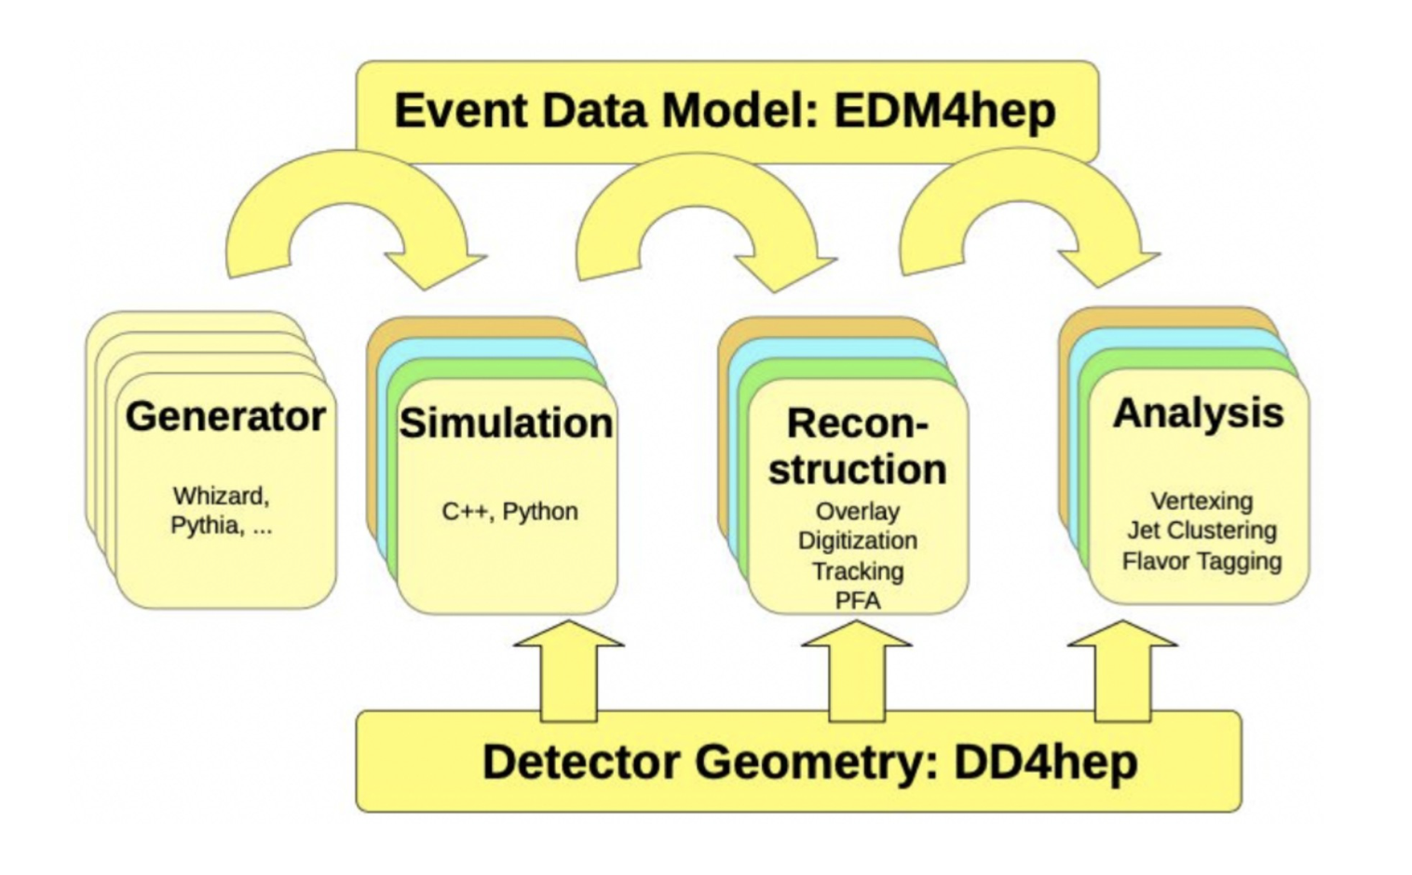
Current FCC application workflow
Interfaced to DD4Hep or via hepmc3 files (converted to edm4hep format)
RDataFrame based FCCAnalysis
Gaudi orchestrated
algorithms
ddsim + k4geo +
detector specific steering files

Slide 12
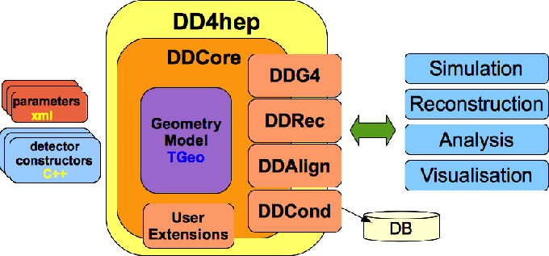
Geant4-based detector simulation is based on DD4hep
From the user perspective, DD4Hep is driven by
  C++ classes define generic geometry structure construction
  XML configuration to integrate detector concepts and for detector specific parameters
  Python wrapper ddsim used for application configuration and execution
Can be naively seen as an extra layer facilitating the interactions with Geant4 and extending it
  Makes sub-detector combination much easier

Slide 13
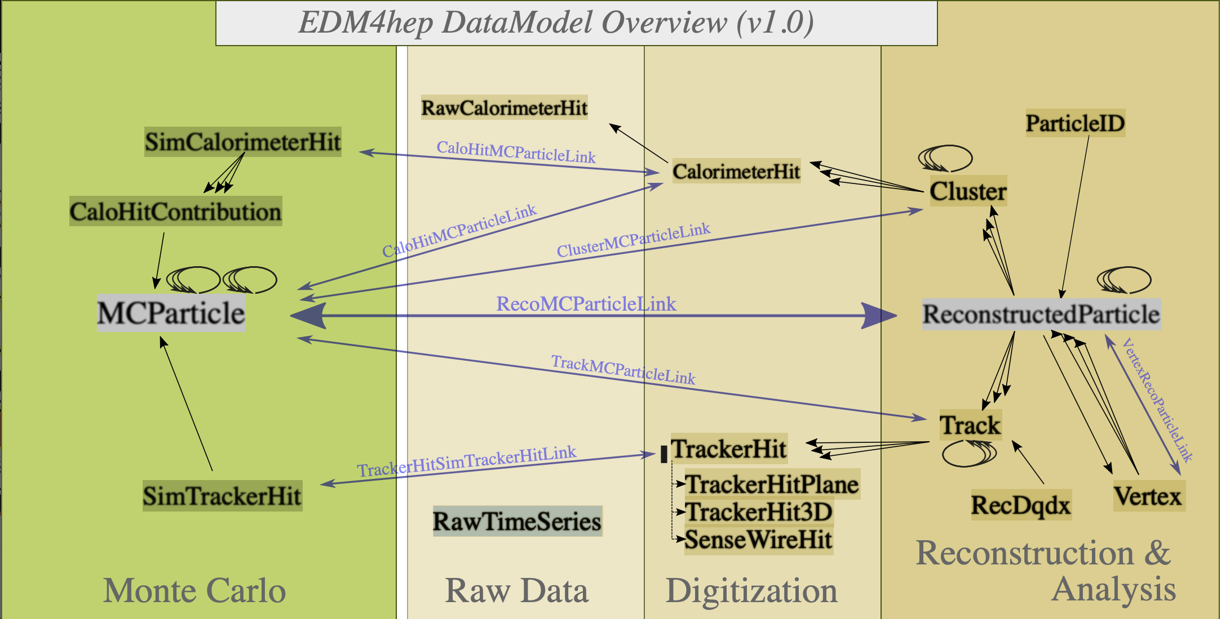
EDM4Hep data model has moved to v1.0
(which means a significant change in format since the winter23 samples)
Idea: A common (and therefore somewhat rigid) data model supports the goal of Key4hep to be able to share code from different projects
Implementation:
  EDM4Hep defines the object members and its relations with other objects in YAML
  PODIO automatically generates the C++ event data classes from the YAML description
https://edm4hep.web.cern.ch

Slide 14
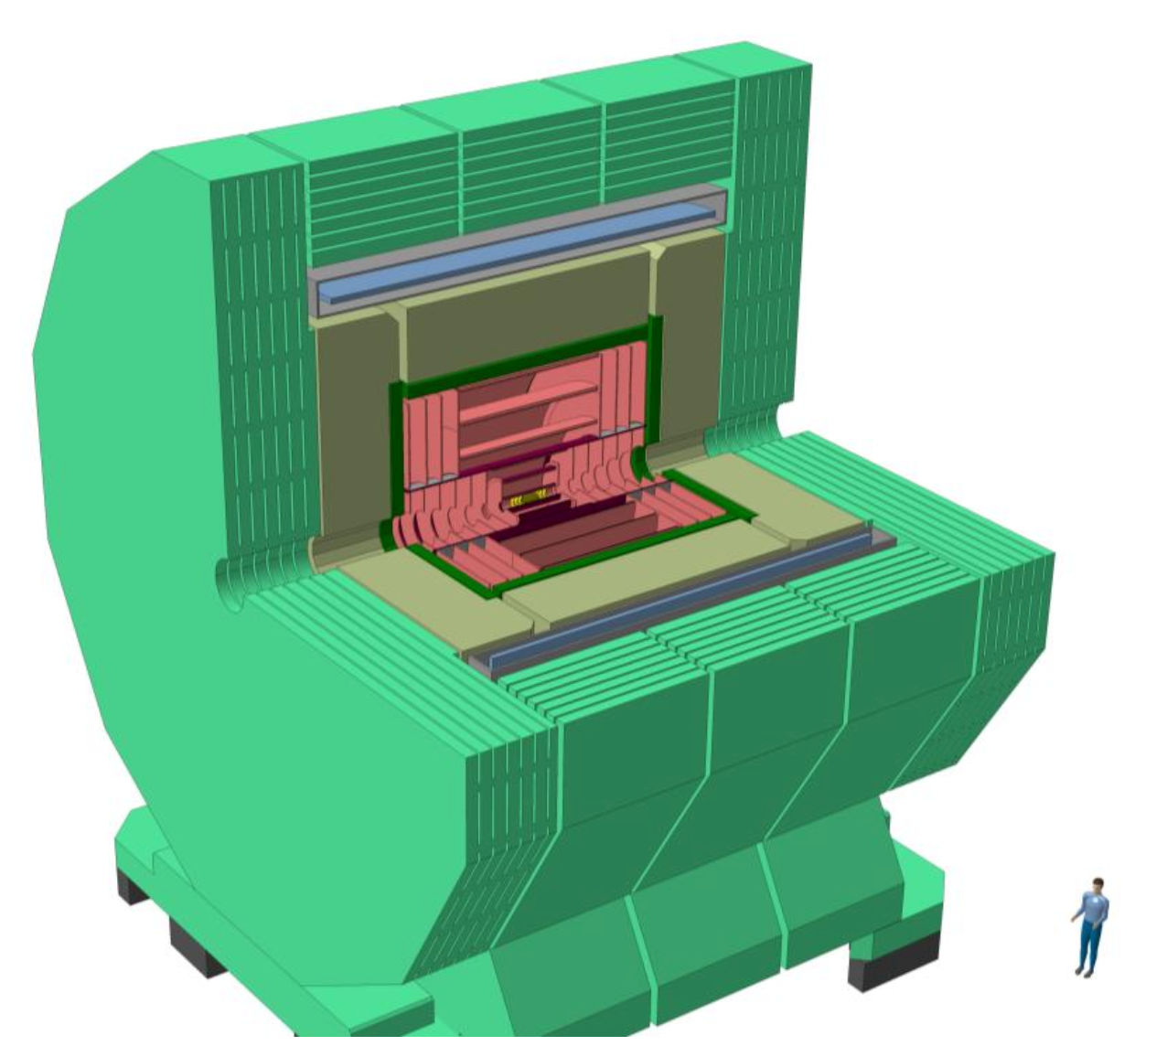
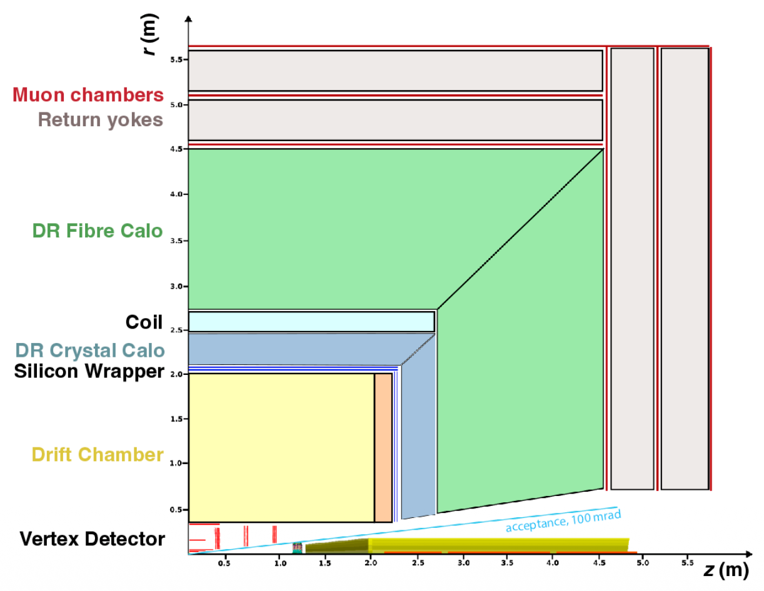
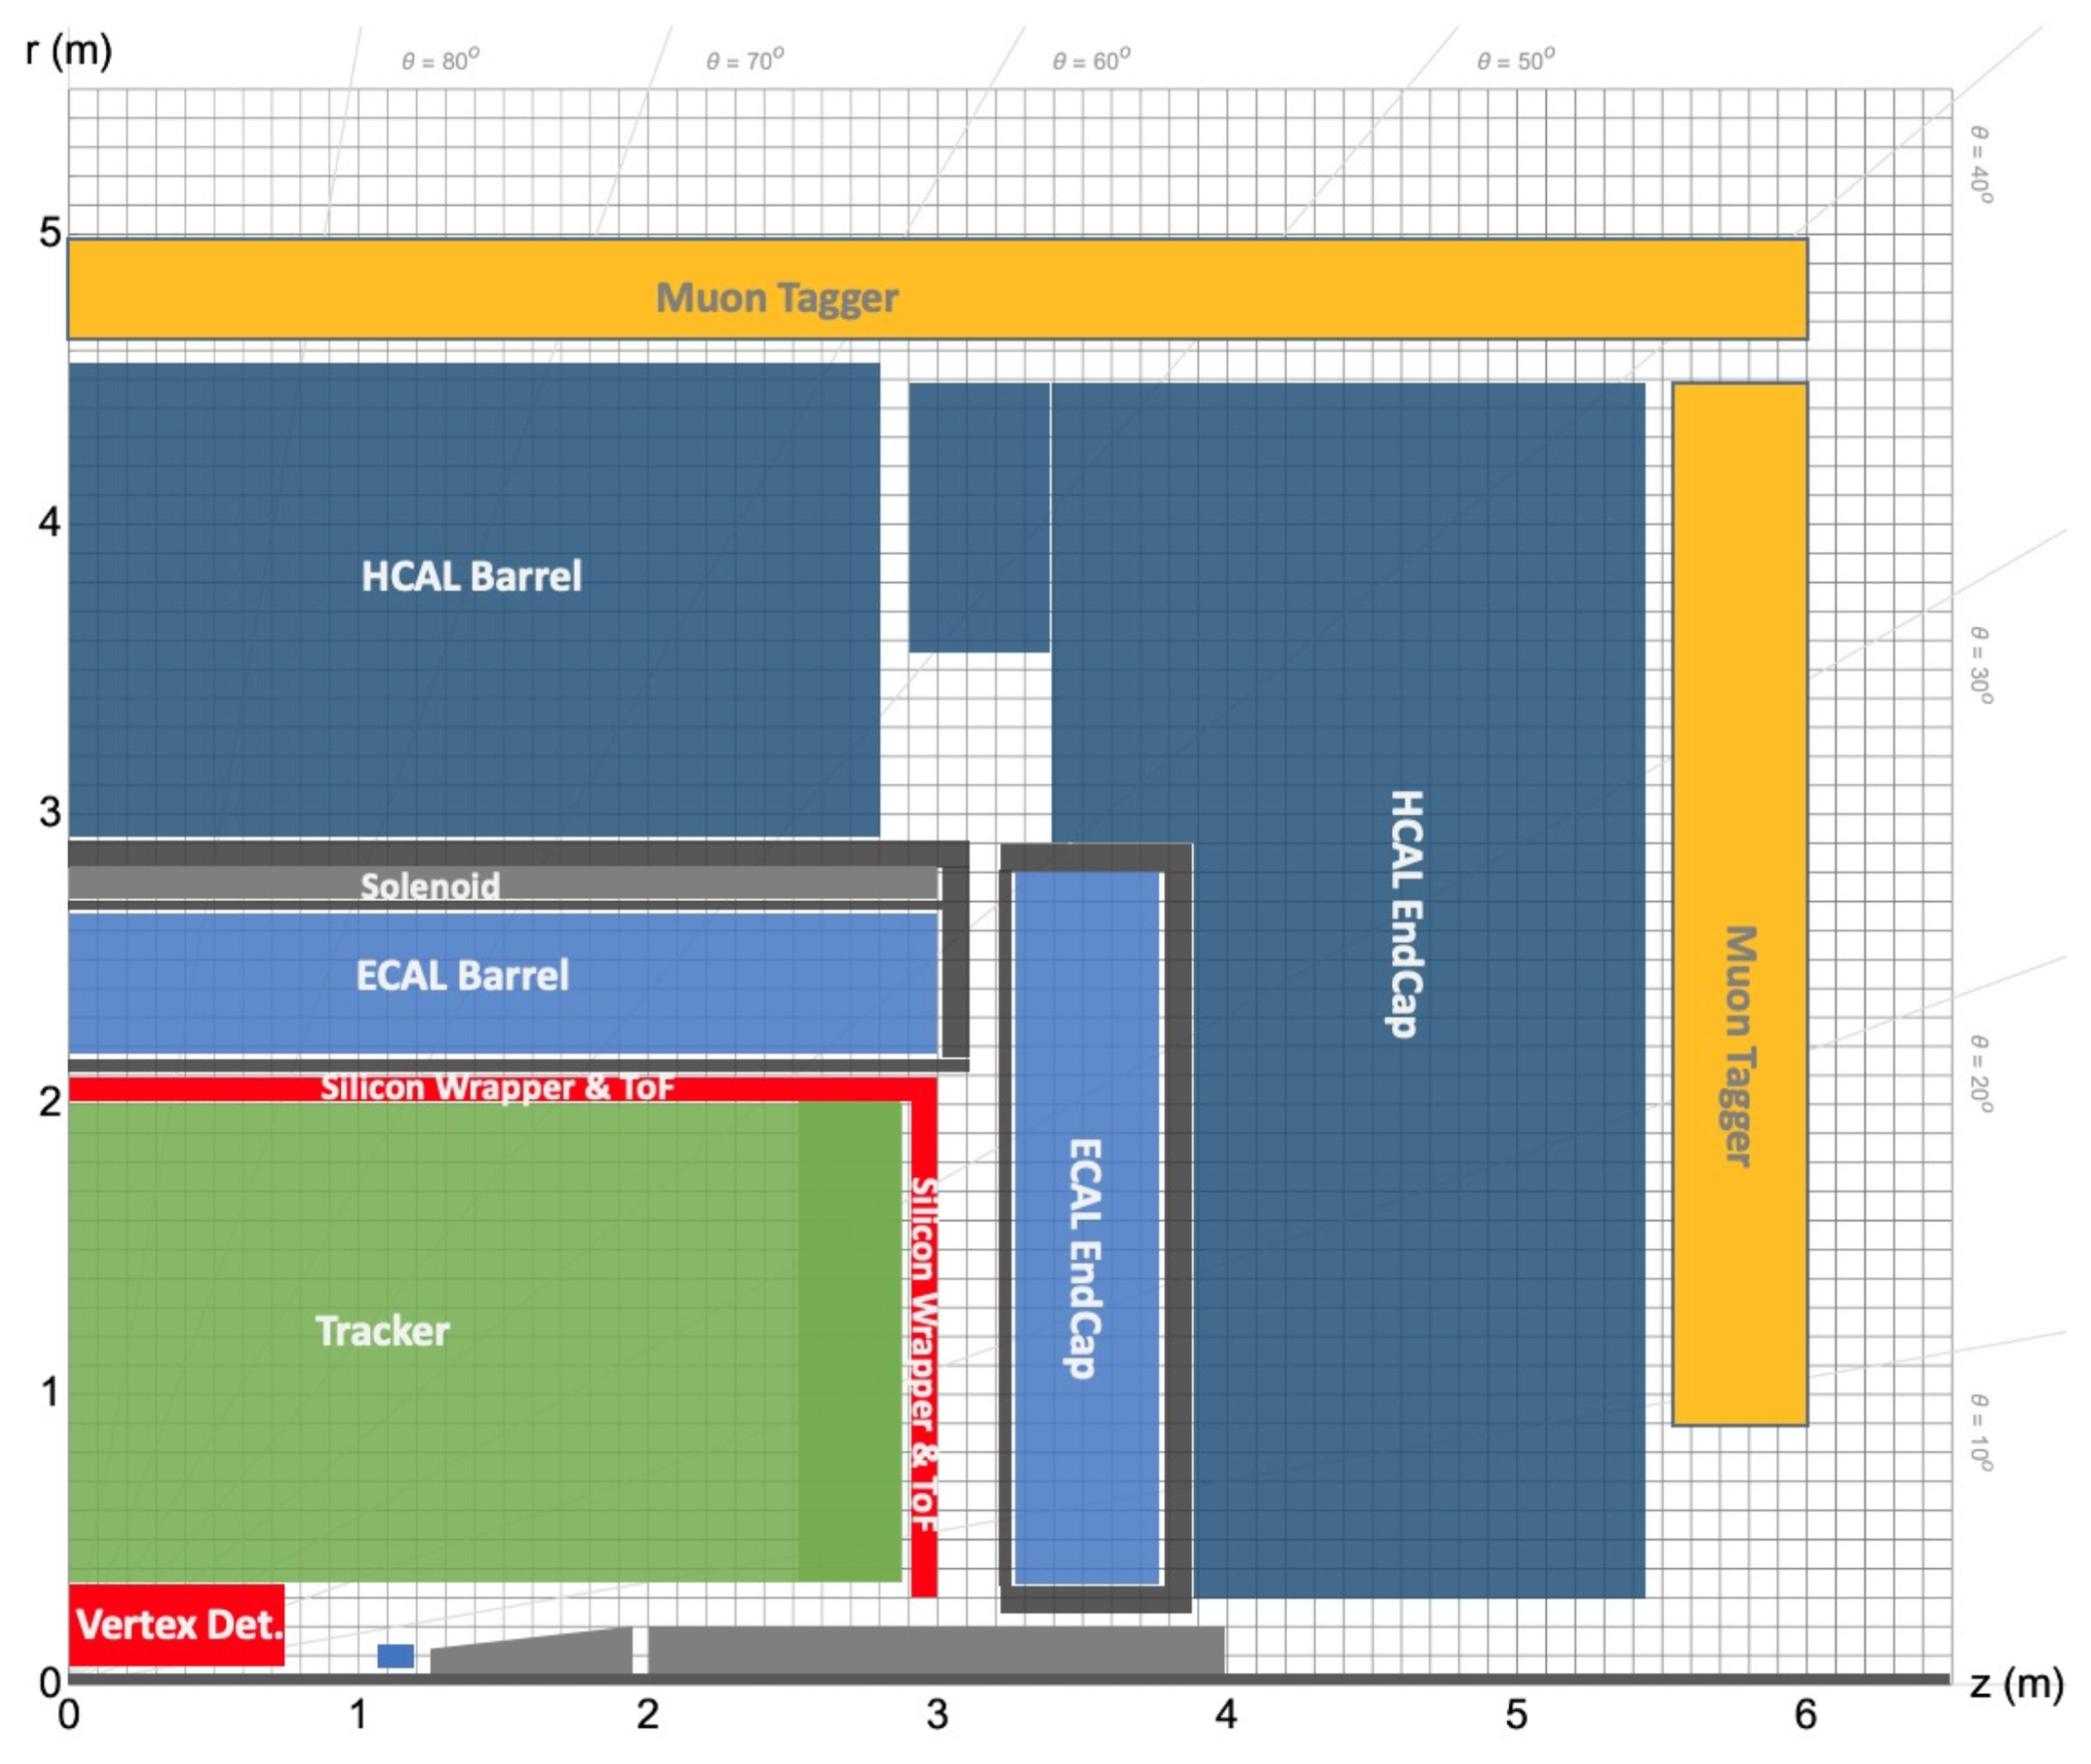
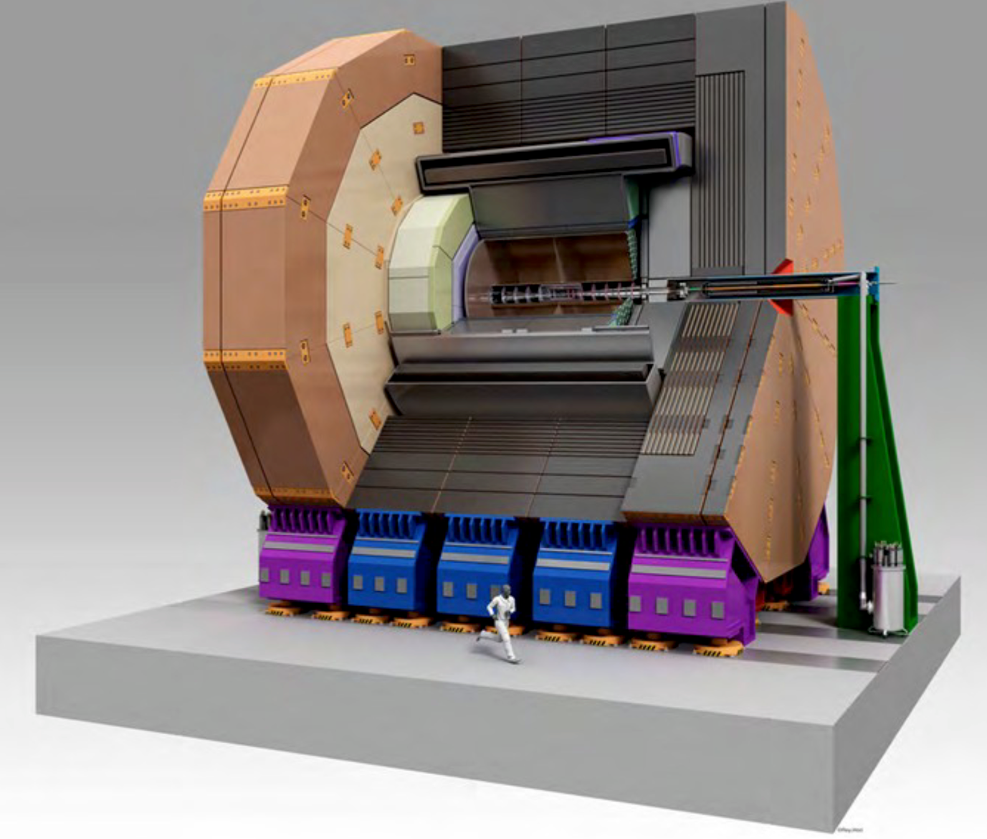
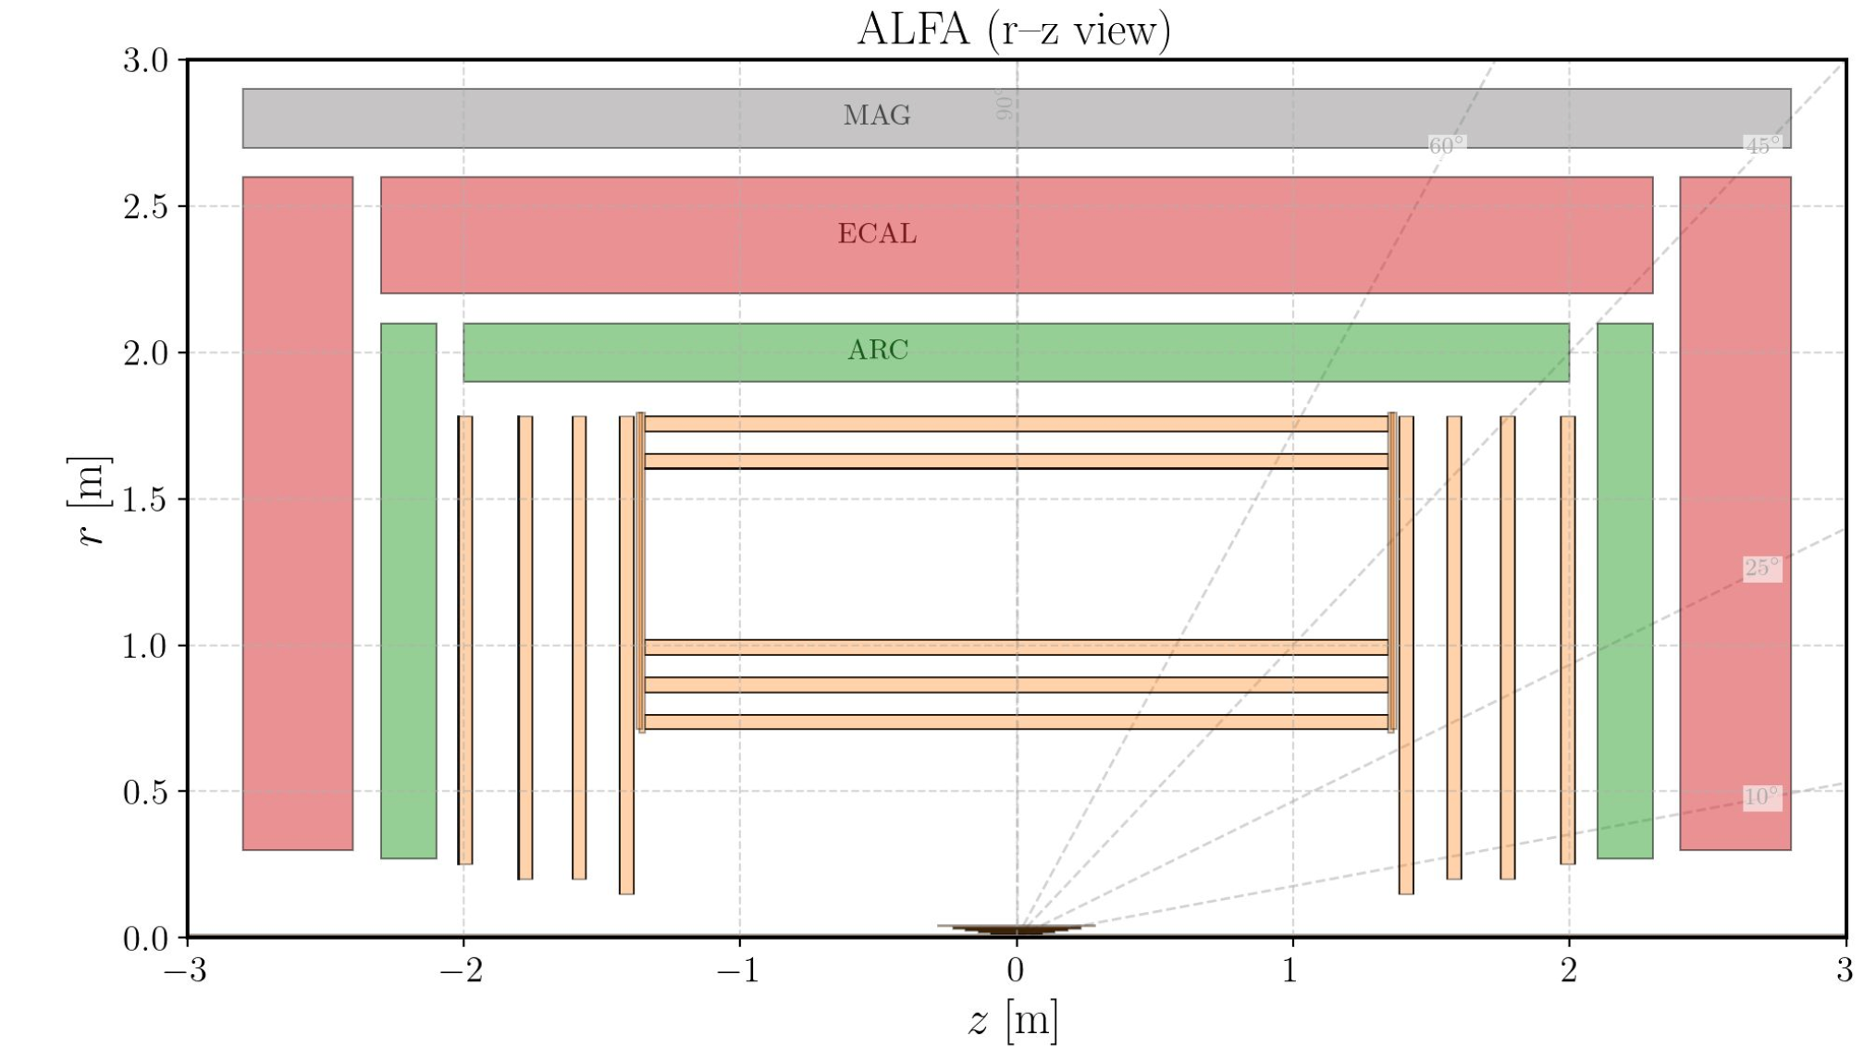
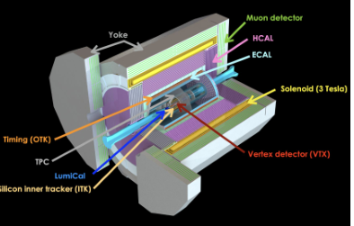
The key4hep/k4Geo repository tracks the geometry for all detector concepts
Det concept | Geometry options under consideration in k4geo
CLD | CLD_o2_v08: baseline (all-Si reference) CLD_o3_v01: Add ARC PID — RICH-based hadron ID (smaller tracker) CLD_o4_v05: w/ ALLEGRO Noble Liquid ECAL, cross-concept PandoraPFA dev
IDEA | IDEA_o1_v04: no crystals, older lineage IDEA_o2_v01: crystal dual-readout ECAL in front of fiber DR HCAL
ALLEGRO | ALLEGRO_o1_v03: drift chamber tracker, current baseline ALLEGRO_o2_v01: straw tube tracker to enable direct DCH vs straw comp.
ILD | ILD_FCCee_v01: larger TPC ILD_FCCee_v02: smaller TPC
ALFA | Coming soon.
AGORA | Catching up with current key4hep
Geometries and corresponding
algorithms versioned to track
significant changes and to support backwards compatibility

Slide 15
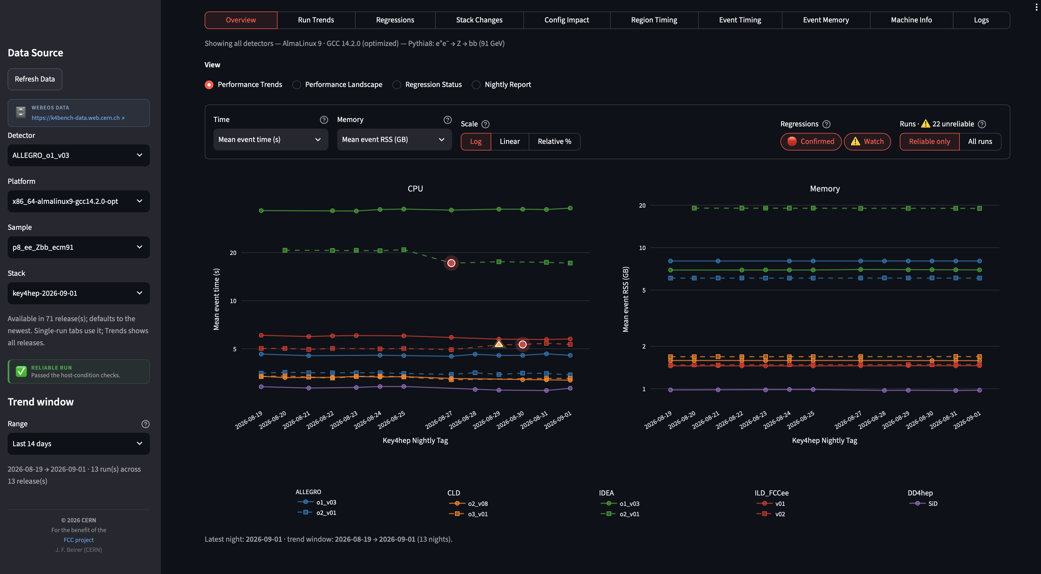
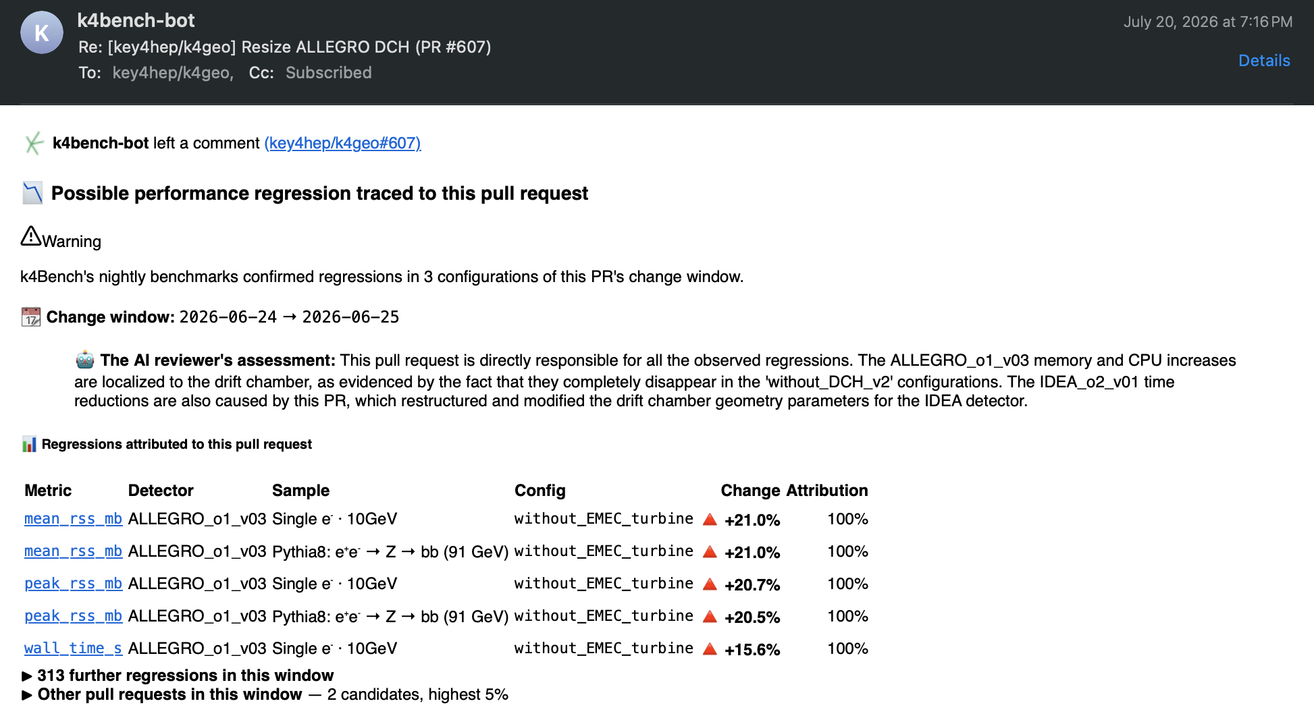
Key4hep packages: k4Bench for inspecting technical performance of simulation geometries and its evolution
https://k4bench-dashboard.app.cern.ch
Tracking day-by-day benchmark performance evolution. Automated reports made to most likely pull request(s) when changes happen
Documentation available at: https://key4hep.github.io/k4Bench/

Slide 16
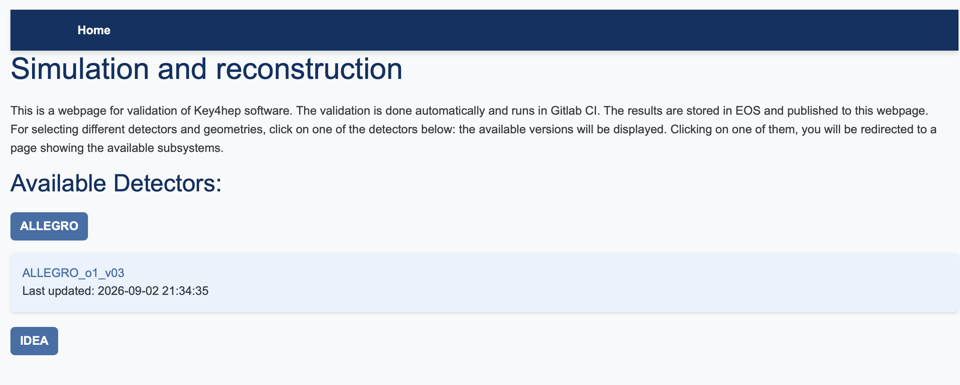
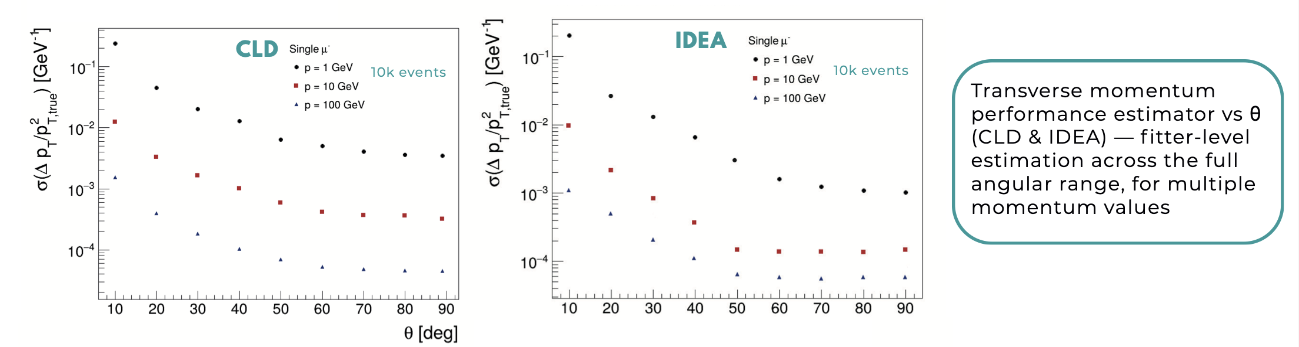
Beginnings of a validation and automated performance analysis
https://key4hep-validation.web.cern.ch
Designed to catch development regressions via histogram comparisons
Needs attention/interest from detector experts to implement geometry-specific useful set of comparisons to be monitored
Consumes EDM4hep collections and digi-to-sim truth association links to compare reconstructed track performance against MC truth expectations
k4DetectorPerformance

Slide 17
Towards a distributed computing system

Slide 18
So far, most production activities have been done using
CERN resources
Storage: ~700 TB on EOS for production samples and analysis
Compute:
  LXBatch: 9k HS23
  Some dedicated GPUs and development machines
  GPU allocation at BSC are being used for a number of tracking and particle flow algorithm developments
This is about 1% of what CMS or ATLAS has at CERN
We do not generally have a gen→sim→reco→analysis chain that is of sufficient quality to merit generating 10^12 Z events today, but as detector concepts mature, we need to facilitate higher statistics studies

Slide 19
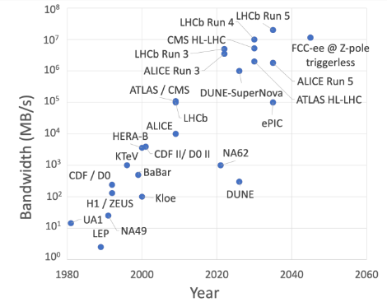
Growing towards a (needed) distributed computing system
Campana, CHEP 2026

Slide 20
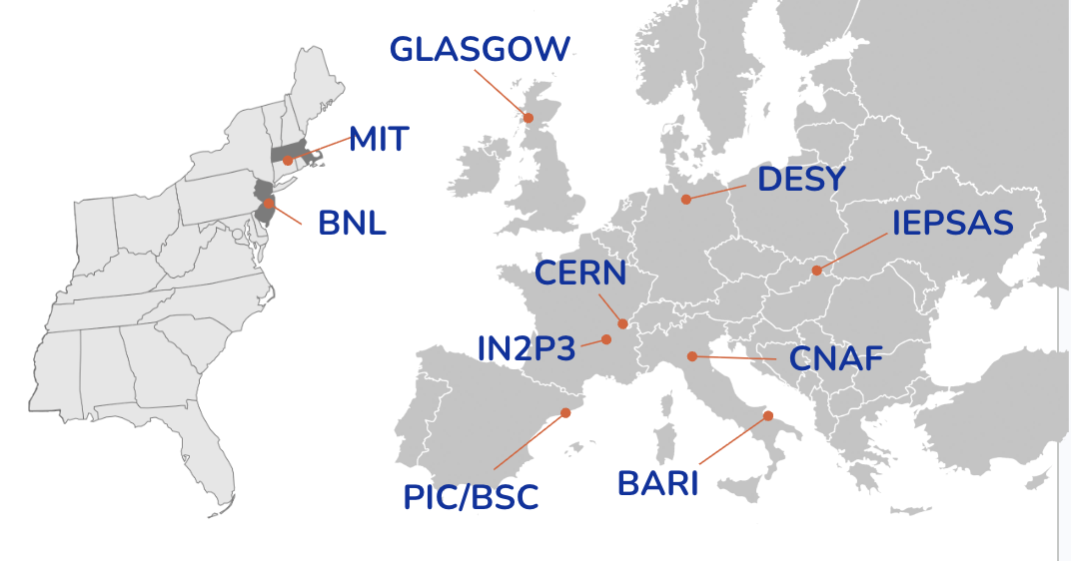
Start of a Rucio based data federation
All resources are unpledged at this point.
✅ (500+TB) CERN: online ✅ (>100TB) IEPSAS: online
✅ (100TB) BARI: online ✅ (100TB) CNAF: online
✅ (300TB) MIT: online ✅ (>100TB) DESY: online
🚧 (300TB) GLASGOW: debugging a VO issue
⚠️ BNL: negotiating
⚠️ PIC/BSC: negotiating
⚠️ IN2P3: negotiating

Slide 21
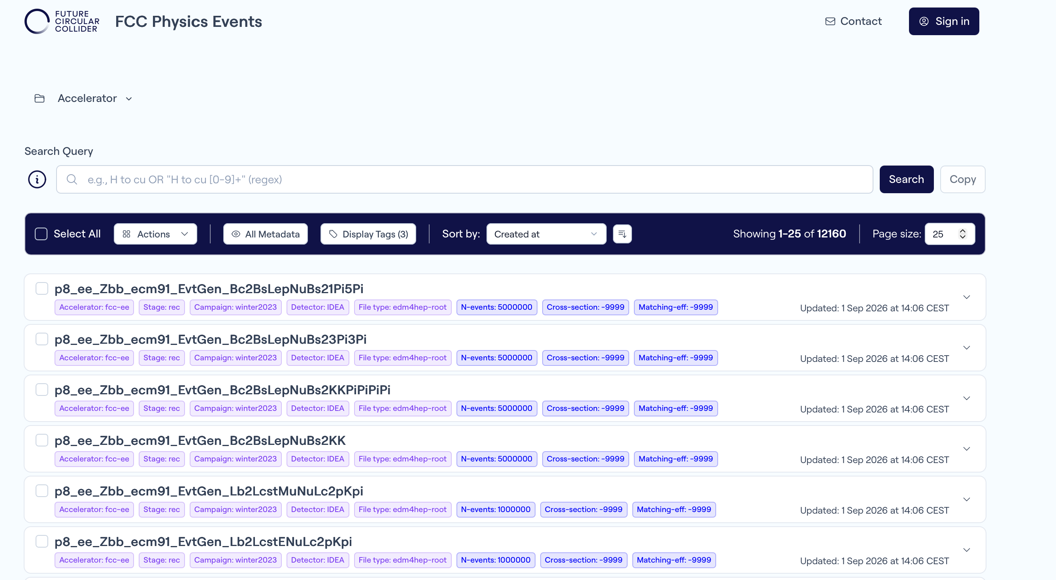
Existing samples and finding them
Delphes-based “winter23” campaign (edm4hep version <1.0)
Delphes-based “pre_summer2026” samples with recent key4hep stack
Methods for finding the samples you want
  https://fcc-physics-events.web.cern.ch
  or search directly on CERN EOS
  (Experimentally) find them with Rucio.
  proto-documentation for getting signed up
  - https://hep-fcc.github.io/fcc-sw-web/rucio
>rucio list-files winter2023:91.19gev/ee_Zbb/idea/delphes/00016139/005/

Slide 22
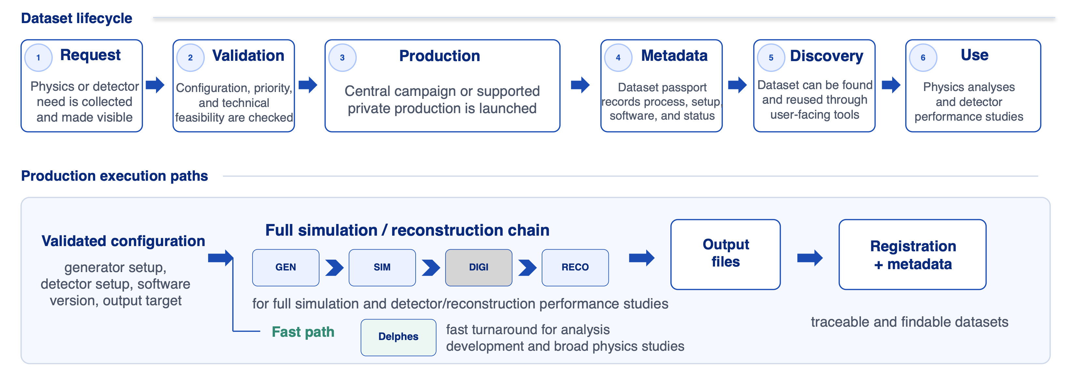
Simulation production plans this fall
Organization
  Dirac-based production with outputs into Rucio [most likely DIRAC v8]
  Requests organized via MC contacts (organized within physics groups) eventually via dedicated request system (https://fcc-drs.web.cern.ch/login)
Samples with Delphes and with the full simulation chain to be produced (with detector concepts to be decided..)

Slide 23
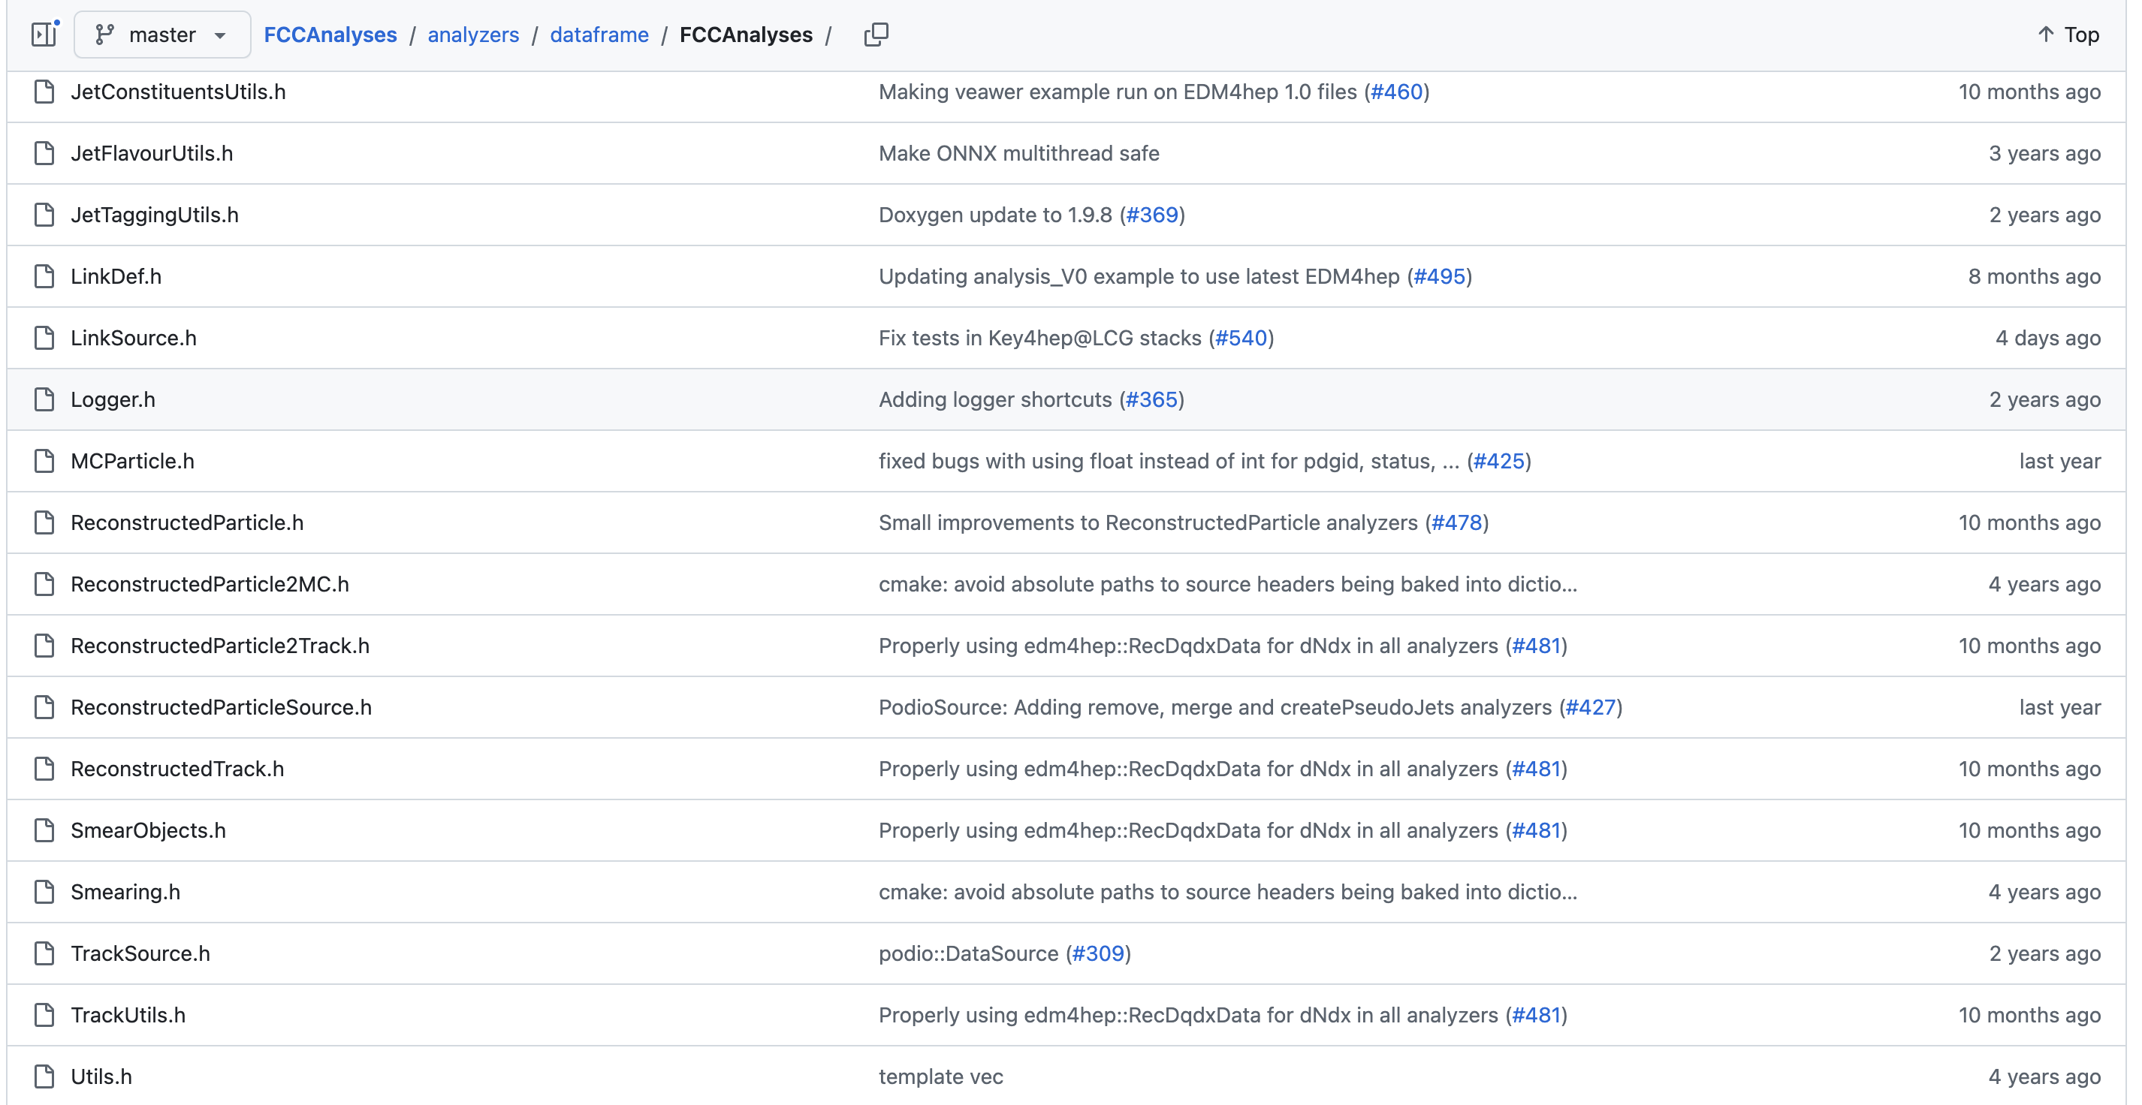
FCC Analyses package developed for edm4hep analysis workflows
Built on top of RDataFrame – so natively declarative, multi-threaded
  Reads edm4hep data natively
  (for better or worse - it is not columnar..)
  Supports C++ kernels with a Python
  user interface
  Analysis-specific extensions are JIT compiled at startup
  Handles complex multi-stage pipelines
  Some integration with batch systems implemented (eg, CERN HTCondor)
Investigating flexible distribution and/or orchestration layers
(eg, Flare, which is based on b2luigi)
The FCC analysis ecosystem also includes
  CMS Combine integration
  eedE: EDM4hep Event Data Explorer
  Phoenix event display

Slide 24
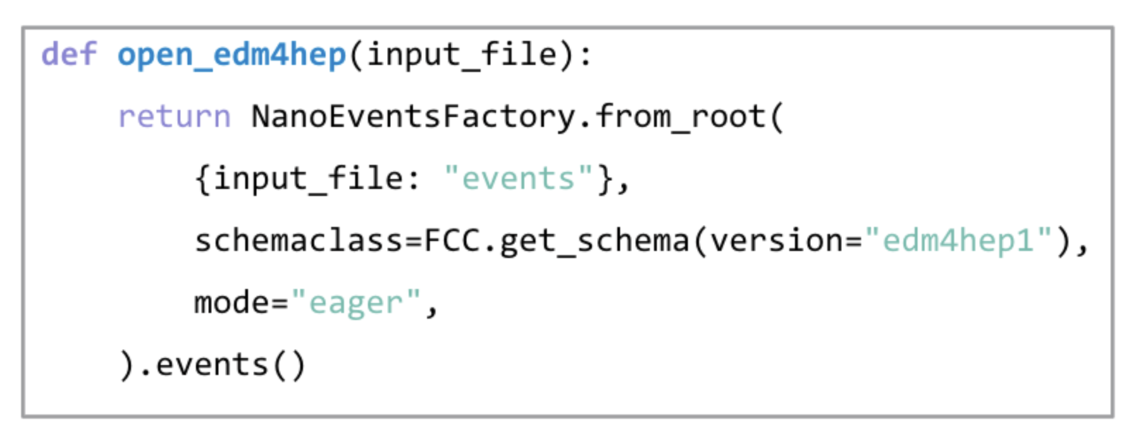
Coffea and edm4hep
Coffea has edm4hep support as well.

Slide 25
Recent software tutorials
DRD Calo April 2026 https://indico.cern.ch/event/1618975/sessions/635708/#20260409
BNL-CERN School September 2026 (aka, last week)
  https://indico.cern.ch/event/1661010/timetable/#45-software-for-physics
  https://indico.cern.ch/event/1661010/timetable/#23-software-tutorials-generato
  https://indico.cern.ch/event/1661010/timetable/#44-software-for-physics
  https://indico.cern.ch/event/1661010/timetable/#33-software-tutorials-full-sim

Slide 26
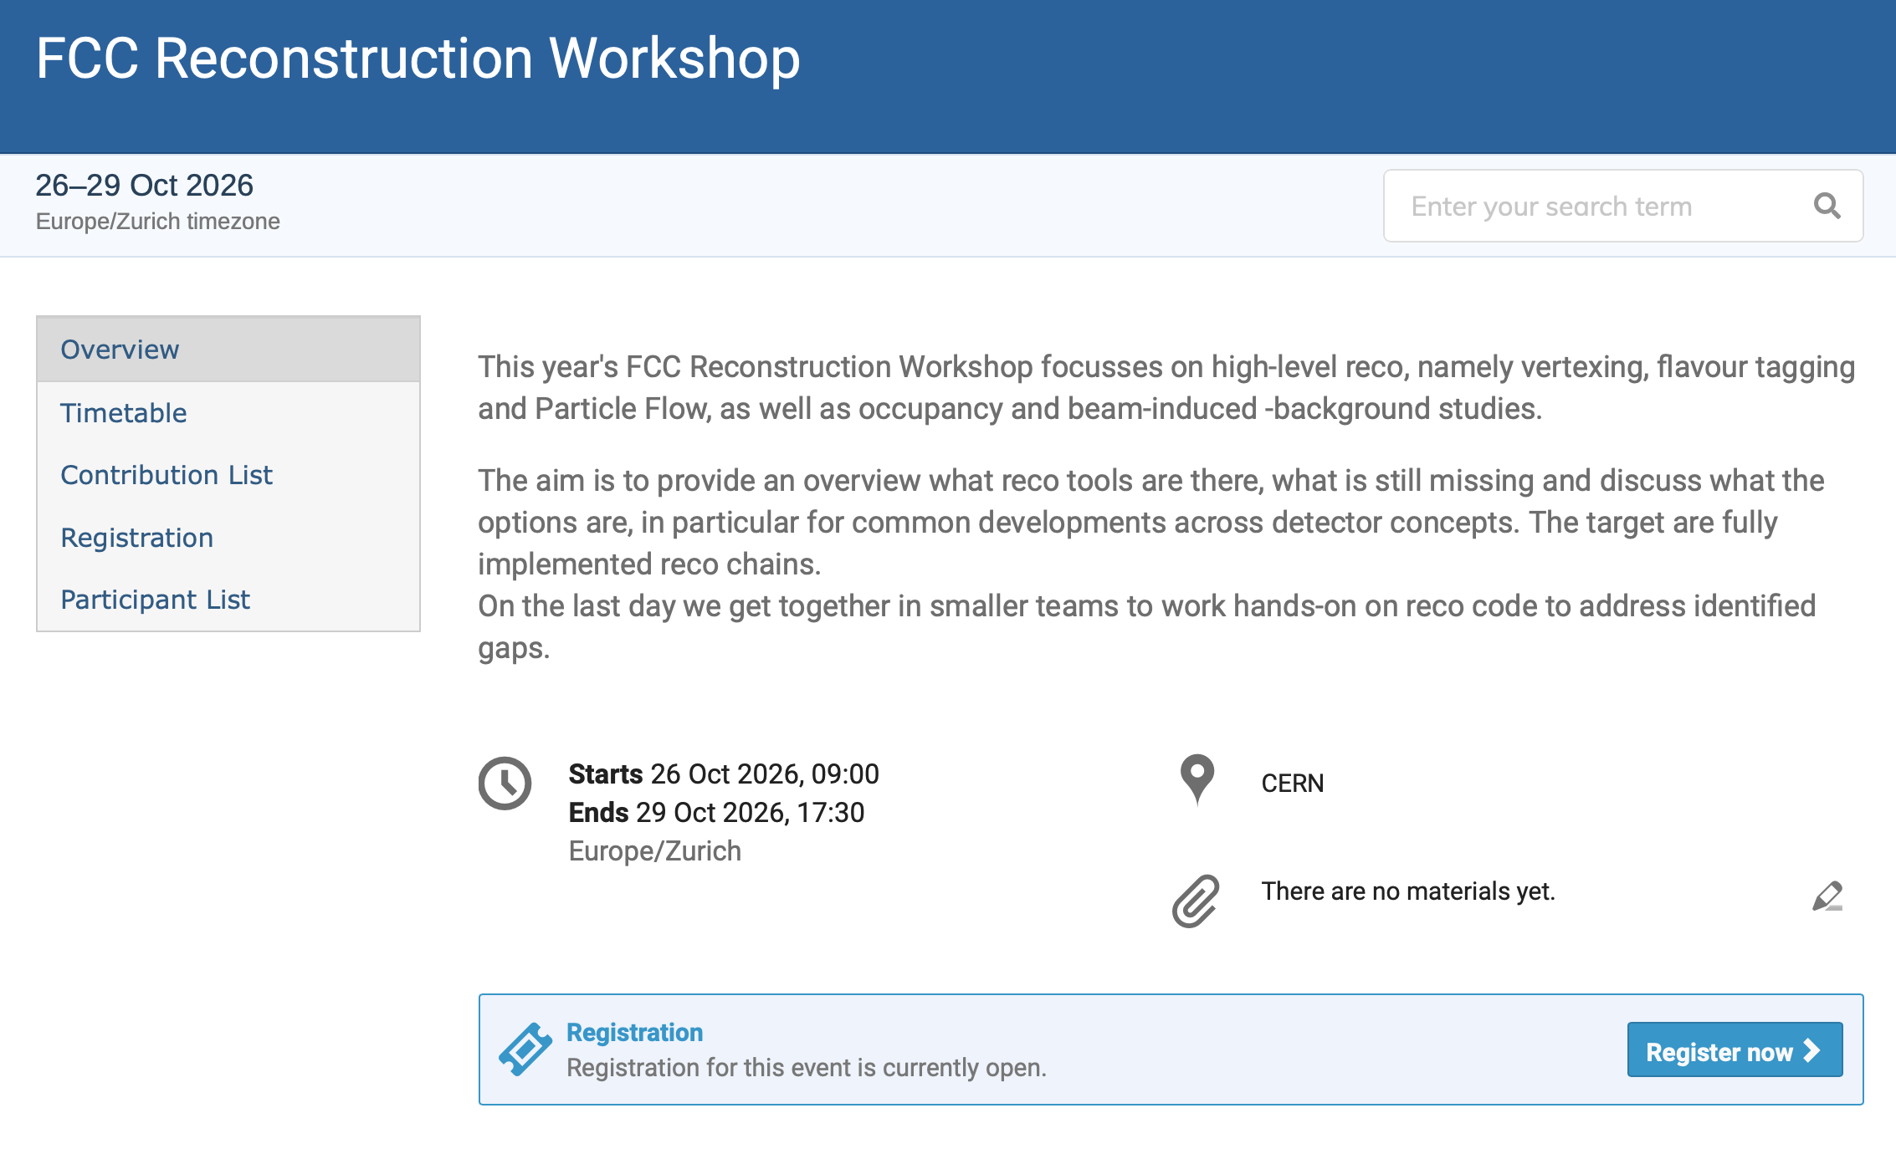
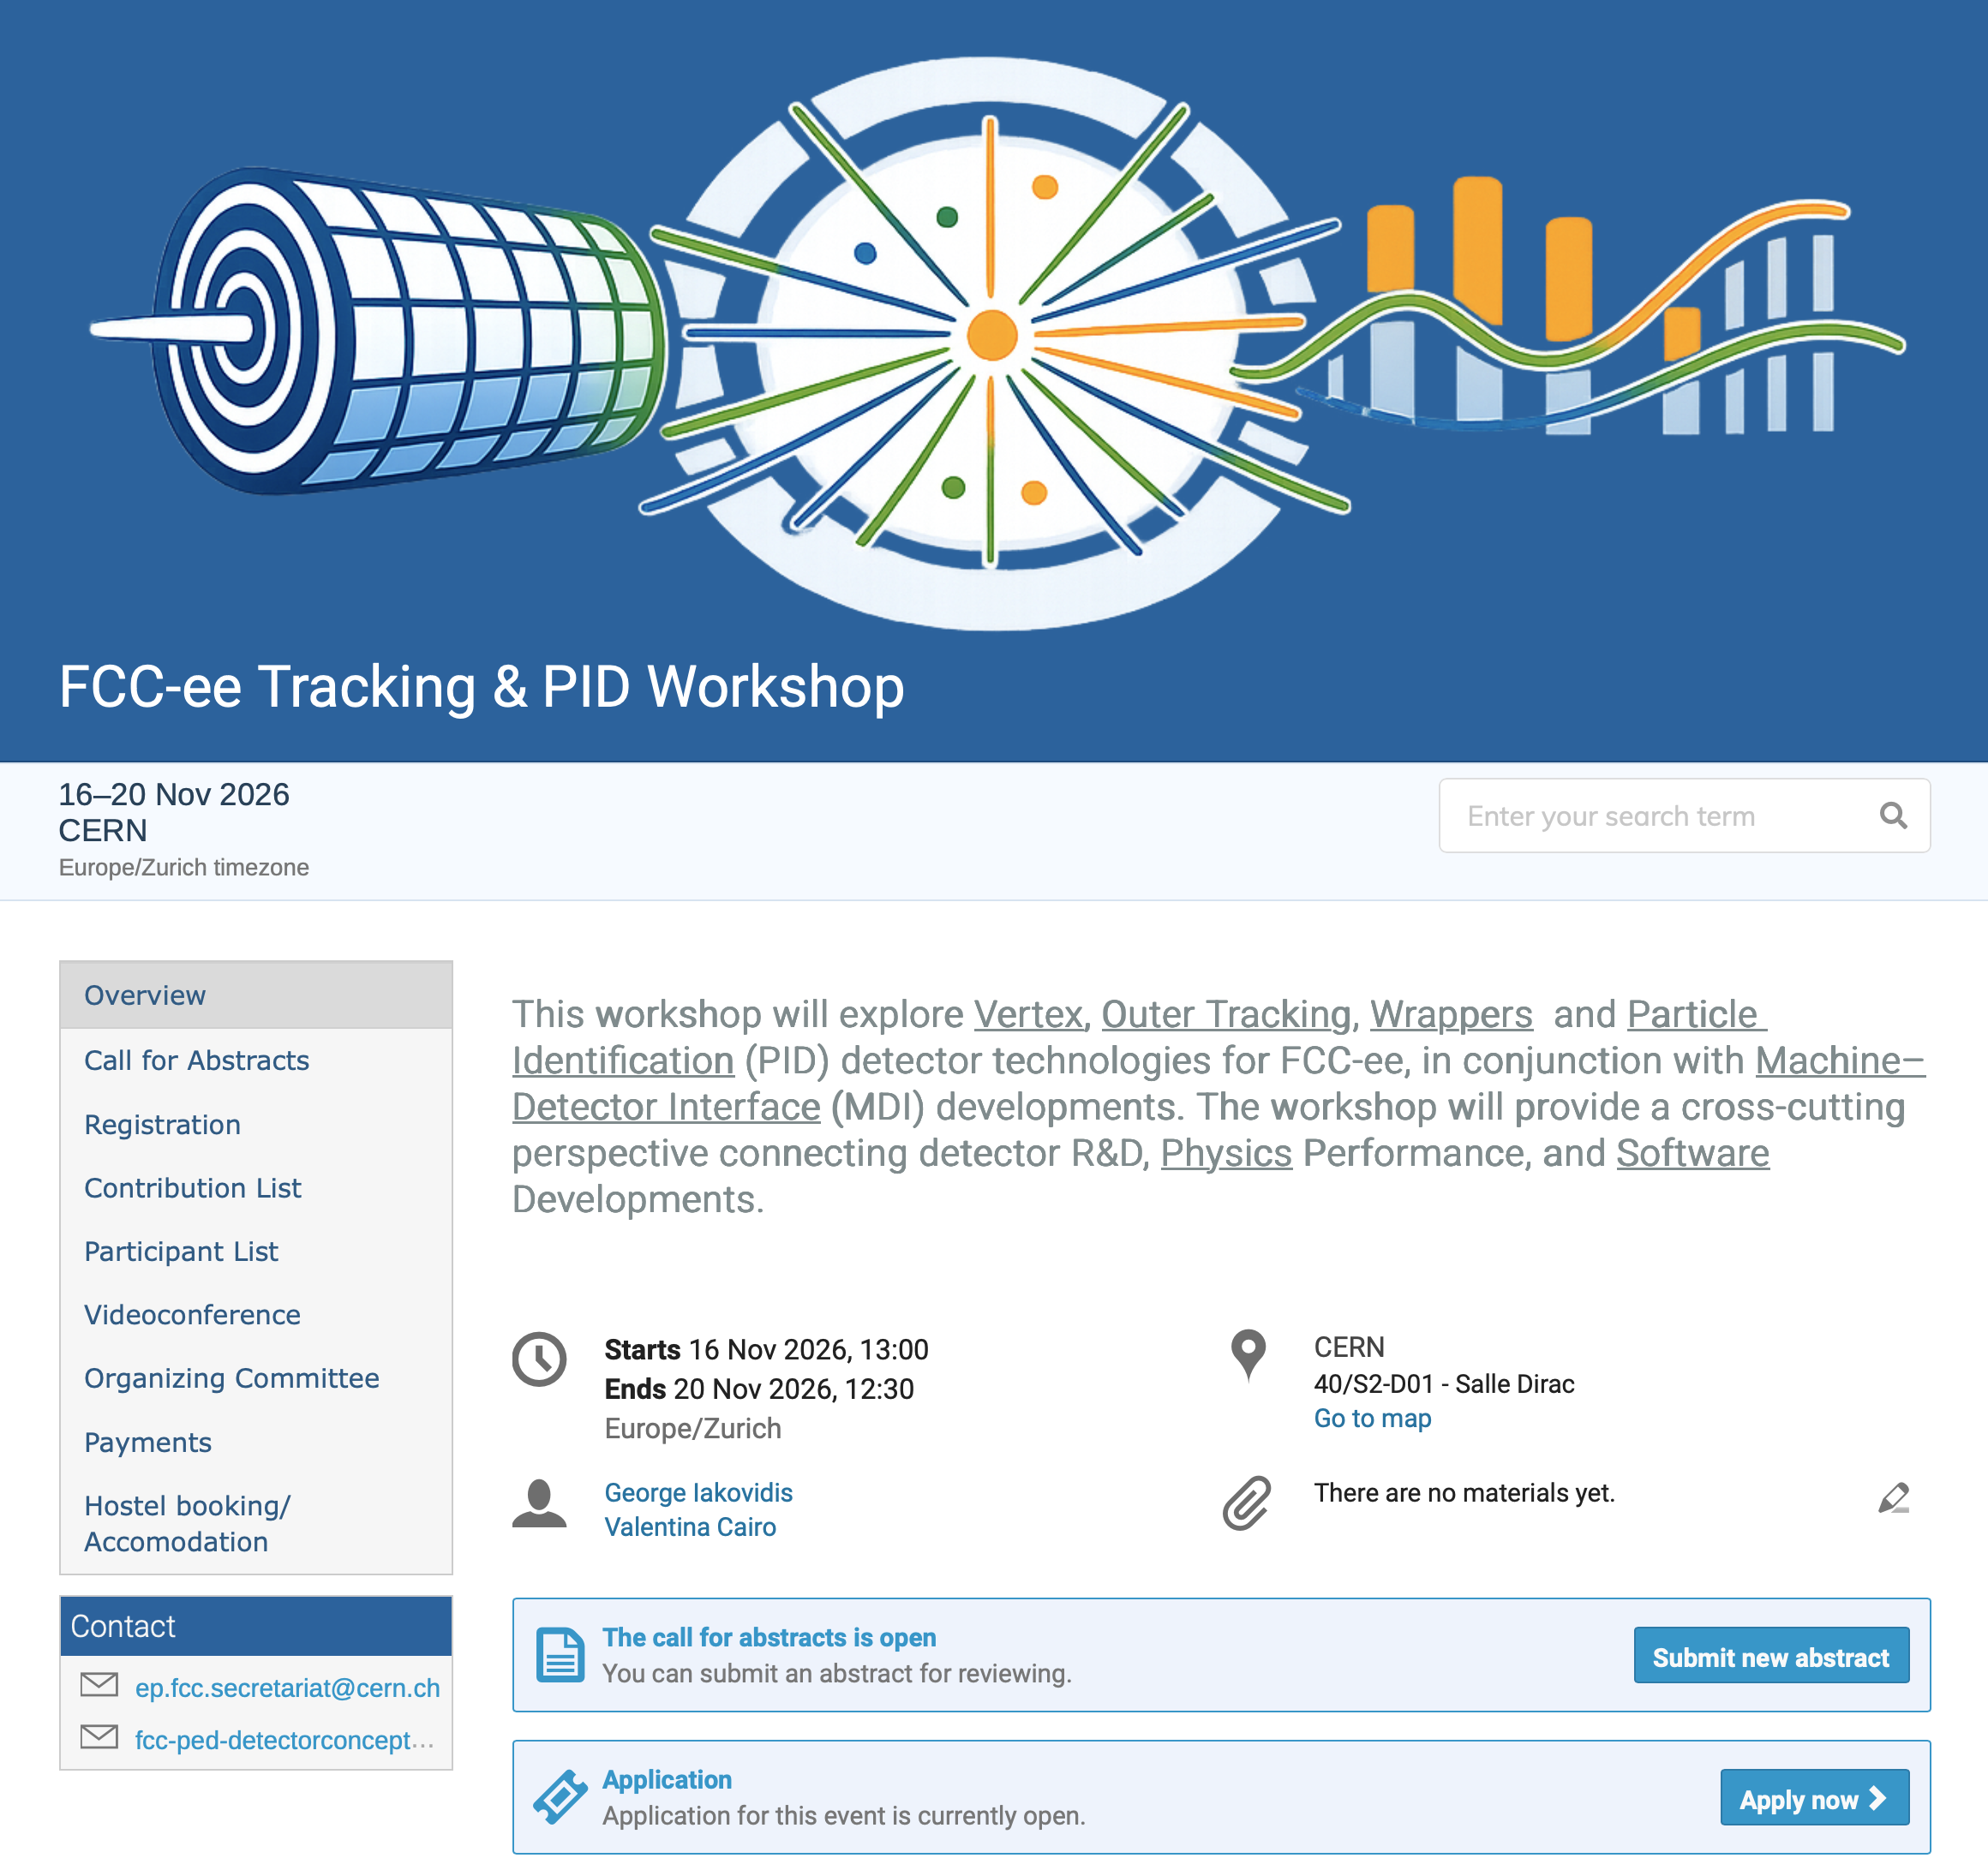
Upcoming events of interest
https://indico.cern.ch/event/1719015/
https://indico.cern.ch/event/1660971/

Slide 27
Ideas for getting involved
On request, I attemped a list of ideas
That said, the list of topics that do not have opportunities for newcomers to get involved is rather short.. You should not see large barriers for getting involved (well, ok, getting pull requests integrated needs patience these days…)

Slide 28
Ideas for getting involved
Extend US-based computing integration with Rucio and Dirac for grid computing (both storage and compute)
Generalize FCCAnalyses to work well on US sites. Bring Coffea to the same level of integration with FCC simulation samples including implementing library of standard functions for analysis
Implement real (and reproducible) AI/ML algorithm support in FCC reconstruction and analysis [ML as a first class citizen]
Even more so than before the LLM era, leading contributors that ”feel responsible” for contributions and components; that can help with code review, support newcomers, etc
Working in DRDs? Made sure R&D results from your DRD make it into detector concepts implemented in key4hep
Contribute to the simulation and reconstruction of your favorite detector or physics algorithm.
Add validation and performance components for your favorite detector or physics quantity (and hope understand how those should be developed further)
Improve user friendliness and technical performance across software environment
Consider how your favorite tool suite from LHC can be brought into key4hep ecosystem

