Slide 1

Advanced Modeling Program
Jean-Luc Vay
(with contributions from many)
US Beam Physics and AI/ML R&D
Fourth US FCC meeting
SLAC – Sept. 8-11, 2026

Slide 2
Outline
The US DOE HEP GARD Accelerator & Beam Physics (ABP) program
  Mapping of GARD ABP to FCC-ee
ABP and high-performance computing
  Scientific Discovery through Advanced Computing (SciDAC) program
ABP and AI/AML
  The Genesis Mission and the Multi-Office Accelerator Team (MOAT) program
Conclusion and Outlook
Notes:
ABP
mapping ABP to FCC-ee
codes & tools: BLAST, PALS
SciDAC
Genesis
Differentiability, Cheetah

Slide 3
DOE Office of High Energy Physics General Accelerator R&D (GARD)
GARD Thrustst
Accelerator and Beam Physics (ABP)
  Theory, modeling and beam diagnostics and instrumentation
Advanced Accelerator Concepts (AAC)
  Beam- and Laser-driven plasma wakefield acceleration, advanced beam manipulations and high gradient RF etc.
Particle Sources & Targets
  High brightness sources (e-,e+ and ions) and high-power targets
Radio Frequency Technology (RF)
  High gradient SC and NC RF cavities, RF sources, Nb3Sn film etc
Superconducting Magnets & Materials
  High field magnets, HTS and LTS, conductors and wires
Notes:
Cpu/gpu=>compilers=>libraries=>codes=>managers
US codes: BMAD, pyOrbit, Impact, Synergia, Helix

Slide 4
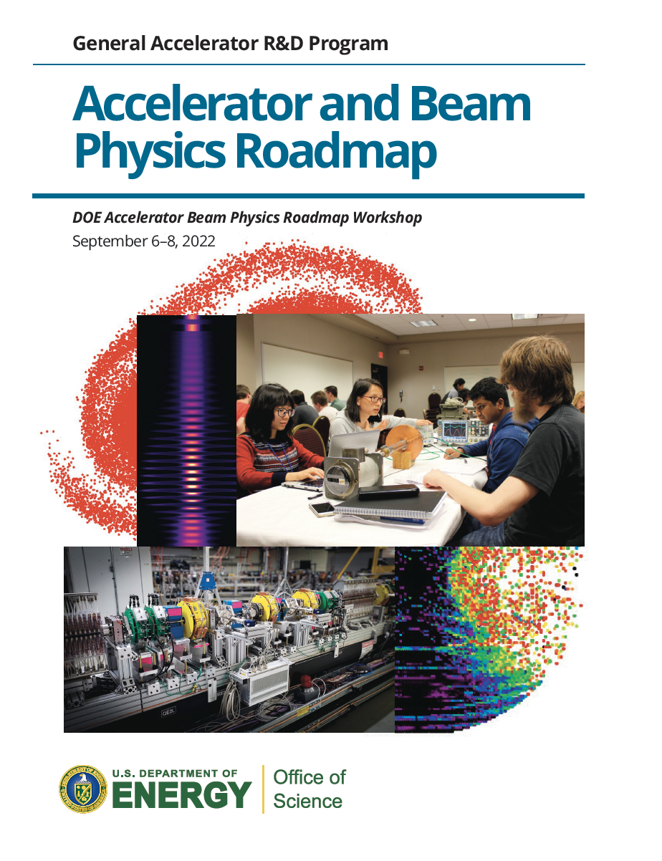
GARD Roadmap organized around 4 Grand Challenges
Grand challenge #1 (beam intensity): How do we increase beam intensities by orders of magnitude?
Grand challenge #2 (beam quality): How do we increase beam phase-space density by orders of magnitude, towards the quantum degeneracy limit?
Grand challenge #3 (beam control): How do we control the beam distribution down to the level of individual particles?
Grand challenge #4 (beam prediction): How do we develop predictive “virtual particle accelerators”?
Accelerator and
Beam Physics
Roadmap (2023)
Notes:
Cpu/gpu=>compilers=>libraries=>codes=>managers
US codes: BMAD, pyOrbit, Impact, Synergia, Helix

Slide 5
GARD Roadmap organized around 4 Grand Challenges
Grand challenge #4 (beam prediction): How do we develop predictive “virtual particle accelerators”?
  Developing virtual particle accelerators will provide predictive tools that enable fast computer modeling of particle beams and accelerators at unprecedented levels of accuracy and completeness.
  These tools will enable or speed up the realization of beams of extreme intensity and quality.
  It will also enable much better control of the beam distribution, eventually reaching down to the level of individual particles.
  ➔ Foundational for all grand challenges.
Accelerator and
Beam Physics
Roadmap (2023)
Notes:
Cpu/gpu=>compilers=>libraries=>codes=>managers
US codes: BMAD, pyOrbit, Impact, Synergia, Helix

Slide 6
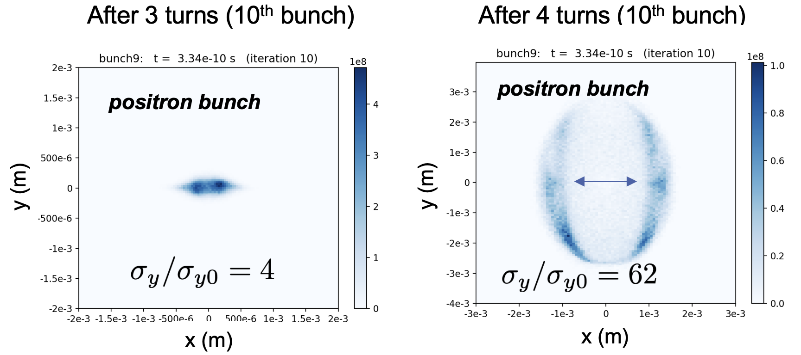
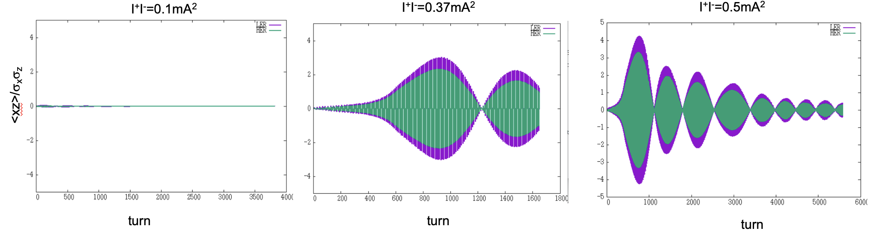
U.S. Higgs Factory Circular Collider (HFCC) ABP activities
Beam-dust studies of SuperKEKB relevant to FCC-ee
  Chad Mitchell, 4th US FCC meeting, Sept. 8, 2:15PM
  Map to ABP beam intensity, beam control, and beam prediction.
Beam-beam studies of SuperKEKB relevant to FCC-ee
  Ji Qiang, 4th US FCC meeting, Sept. 8, 4:30PM
  Map to ABP beam quality and beam prediction.
Notes:
Cpu/gpu=>compilers=>libraries=>codes=>managers
US codes: BMAD, pyOrbit, Impact, Synergia, Helix

Slide 7
Outline
The US DOE HEP GARD Accelerator & Beam Physics (ABP) program
  Mapping of GARD ABP to FCC-ee
ABP and high-performance computing
  Scientific Discovery through Advanced Computing (SciDAC) program
ABP and AI/AML
  The Genesis Mission and the Multi-Office Accelerator Team (MOAT) program
Conclusion and Outlook
Notes:
ABP
mapping ABP to FCC-ee
codes & tools: BLAST, PALS
SciDAC
Genesis
Differentiability, Cheetah

Slide 8


US ABP leverages DOE HPC and AI/ML projects
HPC, AI/ML needed to realize Grand Challenges and applications to FCC-ee
  High-Performance Computing (HPC) ➔ fast and accurate simulations, large ensembles
  Artificial Intelligence/Machine Learning (AI/ML) ➔ ultrafast simulations and models, optimization in high-dimensional space, reasoning
US DOE HPC programs
  Scientific Discovery through Advanced Computing (SciDAC): 2001-
    Transitioned from serial CPU to parallel CPU to GPUs; terascale➔petascale➔exascale
  Exascale Computing Project (ECP): 2016-2023
    Accelerated CPU-to-GPU and exascale transitions
  Under SciDAC (& ECP), particle accelerator modeling has evolved
to open-source, high-performance, community code suites
developed jointly by international collaborations
of domain scientists + applied math. + computer scientists
from national labs, academia and industry
pool of closed (often serial) codes developed separately
by 1-2 domain scientists
2001
now
Notes:
Cpu/gpu=>compilers=>libraries=>codes=>managers
US codes: BMAD, pyOrbit, Impact, Synergia, Helix

Slide 9
The SciDAC program was designed to overcome several integration barriers that existed at the time
Custom codes: capability embedded in individual application teams
Separate disciplines: math, CS, and domain science often advanced on different tracks
Repeated rewrites: architectural shift created significant portability pain
Analysis methods lagged: I/O, visualization and analysis often lagged behind simulation scale
Limited reuse: many teams solved similar problems independently
SciDAC impact talk starter — revised
From “SciDAC's Journey from Terascale to AI: Changing how science is done” by Lori Diachin, LLNL, SciDAC PI Meeting, August 5, 2026.
Notes:
Use this slide to create contrast. The audience needs to see the starting world before the impact feels real. Source cue: original SciDAC plan emphasized gaps between hardware capability and usable scientific codes.

Slide 10
SciDAC* Partnerships across Office of Science & DOE
Advanced Scientific Computing Research
  Delivering world leading computational and networking capabilities to extend the frontiers of science and technology
Basic Energy Sciences
  Understanding, predicting, and ultimately controlling matter and energy flow at the electronic, atomic, and molecular levels
Biological and Environmental Research
  Understanding complex biological, earth, and environmental systems
Fusion Energy Sciences
  Supporting the development of a fusion energy source and supporting research in plasma science
High Energy Physics
  Understanding how the universe works at its most fundamental level
Nuclear Physics
  Discovering, exploring, and understanding all forms of nuclear matter
DOE Office of Nuclear Energy
Office of Nuclear Energy | Department of Energy
DOE Office of Electricity
Office of Electricity | Department of Energy
*https://www.scidac.gov/
Adapted from “The ASCR Perspective: SciDAC's 25-Year Journey” by Hal Finkel, ASCR Associate Director, SciDAC PI Meeting, August 5, 2026.
Notes:
Cpu/gpu=>compilers=>libraries=>codes=>managers
US codes: BMAD, pyOrbit, Impact, Synergia, Helix

Slide 11
The key components of the SciDAC* program are
the SciDAC institutes and SciDAC partnerships
The Institutes form the foundation for efforts by applied mathematicians and computer scientists to systematically address technical challenges that are inherent to new architectures and common across science topics.
The partnerships enable domain scientists to conduct complex scientific and engineering computations at a level of fidelity needed to simulate real-world conditions in targeted science projects.
Institutes
Partnerships
Advanced Scientific Computing Research
Basic Energy Sciences
High Energy Physics projects
CAMPA: Collaboration for Advanced Modeling of Particle Accelerators
Celeritas: GPU-accelerated particle transport for detector simulation in high energy physics experiments
Enabling Cosmic Discoveries in the Exascale Era
Multiscale acceleration: Powering future discoveries in High Energy Physics
Next Generation Precision for Neutrino and Collider Computations
FASTMath
Focus: scalable linear algebra, numerical methods, solvers
Biological and Environmental Research
Fusion Energy Sciences
RAPIDS
Focus: data management, storage architectures, optimization
High Energy Physics
Nuclear Physics
LEADS
Focus: scientific machine learning, foundation models, physics-informed AI
DOE Office of Nuclear Energy
DOE Office of Electricity
*https://www.scidac.gov/
Notes:
Cpu/gpu=>compilers=>libraries=>codes=>managers
US codes: BMAD, pyOrbit, Impact, Synergia, Helix

Slide 12
















DOE SciDAC program started in 2001
Modeling of particle accelerators has been part of ScIDAC since the beginning
2000 | 2005 | 2010 | 2015 | 2020 | 2025 | 2030
-1
-2
-3
-4
-5
+ institutes
Accelerator Science & Technology
AST
Community Project for Accelerator Science & Simulation
ComPASS
ComPASS
ComPASS
Collaboration for Advanced Modeling of Particle Accelerators
CAMPA
Codes
ACE3P suite
BeamBeam3D
Impact suite
Osiris
QuickPIC
Synergia
UPIC
Vorpal
Warp
Codes
Mars
Osiris
QuickPIC
Synergia
Codes
ACE3P suite
BeamBeam3D
Impact suite
ML/I
Osiris
QuickPIC
Synergia
UPIC
Vorpal
Codes
ACE3P suite
BeamBeam3D
Impact suite
Osiris
QuickPIC
Synergia
UPIC
Vorpal
Warp
Codes
FBPIC
HiPACE++
ImpactX
Osiris
QuickPIC
QPAD
Synergia
Wake-T
WarpX
12

Slide 13


New LBNL-SLAC-FNAL initiative:
Needs and considerations for
a consortium of accelerator modeling
x
  J.-L. Vay
  Lawrence Berkeley National Laboratory
Looking
back
in
time
J.-L. Vay, HB2014

Slide 14
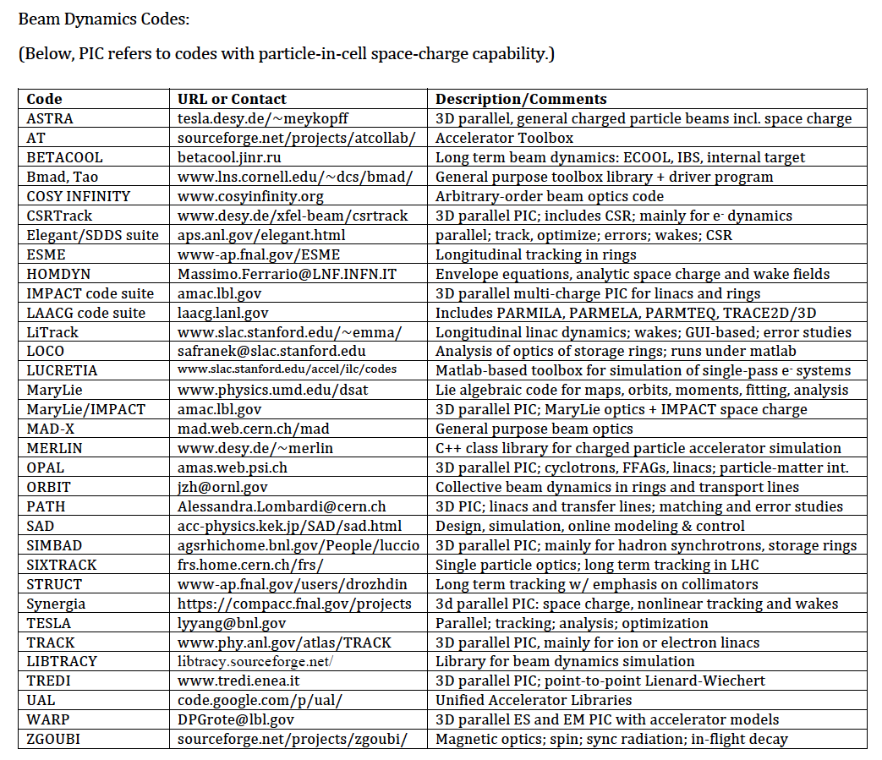
Example of duplication in beam dynamics codes
Codes section from Accelerator Handbook (A. Chao, 2013)
Looking
back
in
time
J.-L. Vay, HB2014

Slide 15
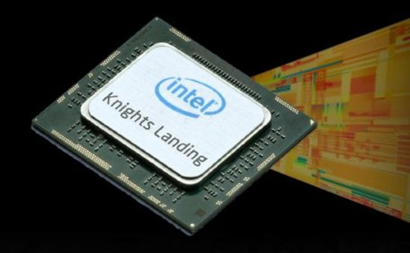



New environment creates opportunities
Novel architectures + integrated simulation tools can enable:
  virtual prototyping/experiments
  online tools for realtime feedback
➔ mitigating budget constraints
Status quo is risky
Requires
team work!!
Novel
computer
architectures
×2
Looking
back
in
time
OH, GREAT!
JUST WHEN I
FINALLY GET MY
SUPER BOWL
TICKETS!!
CODE
RUNNING!!
PROJECT
FUNDED!!
Budget
constraints
J.-L. Vay, HB2014
Community modeling effort will enable to adapt & thrive!!!

Slide 16
Mitigation of difficulties through adiabatic transition
    Existing set of separate codes ➔ ecosystem of interconnected codes
input
      Bridge codes to enable:
      unified input/output interface
      sharing of functionalities
      collaborative development of common units
      “natural” down selection of modules
      devel. & users playing Lego with “code genes”
code 1
code 2
input
input
      …
Looking
back
in
time
main
main
output
output
output
Common modules in libraries of compiled C, C++ or FORTRAN
Unified I/O and framework in Python:
Python scripting language has unique attributes:
  rapid development and prototyping of scientific applications
      on par with e.g. Maple, Matlab (which it is often supplanting)
    is expandable and couples to FORTRAN, C and C++
“Top-down” path followed by XSuite
J.-L. Vay, HB2014

Slide 17




DOE SciDAC program started in 2001
Modeling of particle accelerators has been part of ScIDAC since the beginning
2000 | 2005 | 2010 | 2015 | 2020 | 2025 | 2030
-1
-2
-3
-4
-5
+ institutes
Accelerator Science & Technology
AST
Community Project for Accelerator Science & Simulation
ComPASS
ComPASS
ComPASS
Collaboration for Advanced Modeling of Particle Accelerators
CAMPA
CAMPA
(HEP GARD)
Consortium for Advanced Modeling of Particle Accelerators
+
Linking codes with Standards
➔ ecosystem
ECP
Input scripts
Output data
WarpX
17

Slide 18
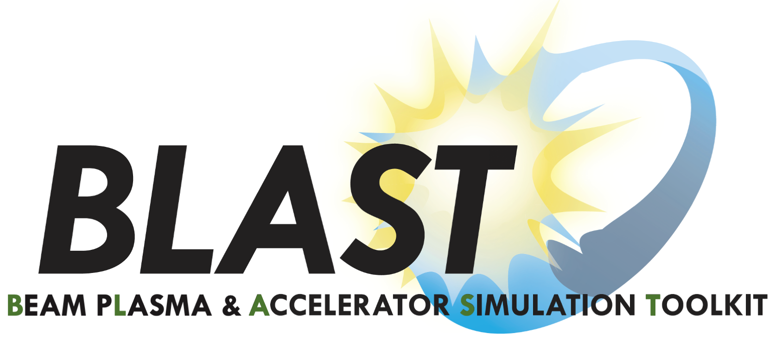



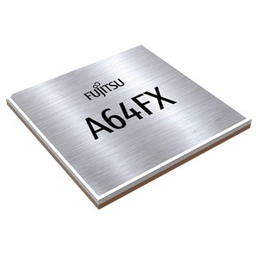
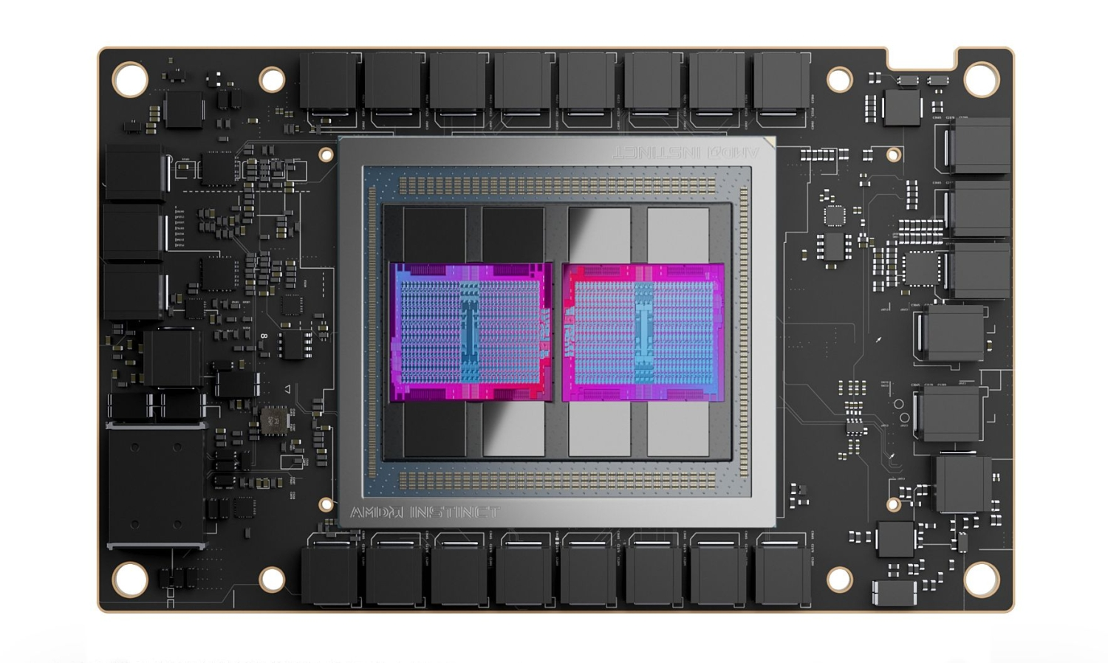
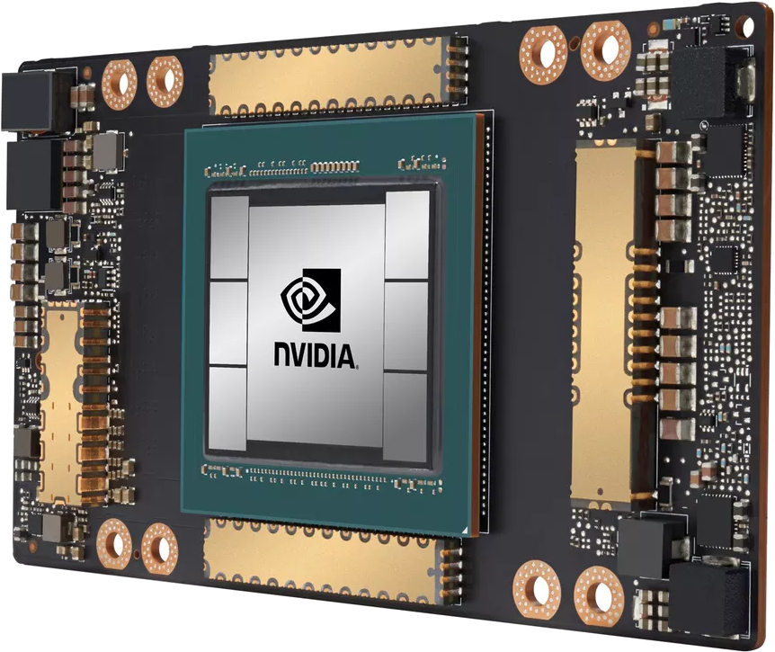
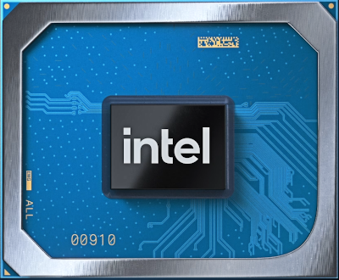
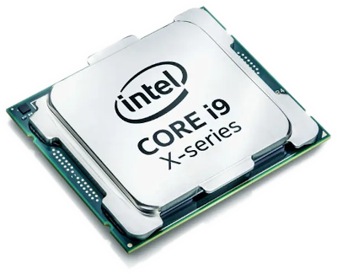
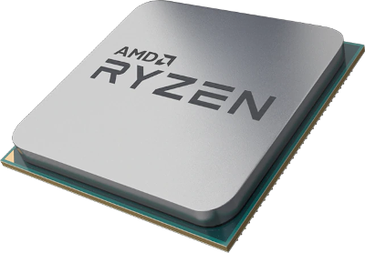

Pruning, consolidation & bottom-up approach
adopted for the CAMPA software stack
Applications
OSIRIS/QPAD¹
Synergia²
ImpactX
WarpX
HiPACE++
Libraries
Performance Portability
PIC Algorithms
ABLASTR
direct
direct
Communication
AMReX
Over the course of this project:
consolidation of codes around one main software stack,
based on C++ and AMReX
(for parallelization &
performance portability)
Kokkos
Programming
Models
/ HIP
Languages extensions & libraries
Hardware

Slide 19





BLAST also offers Python bindings at the top of the stack
Desktop
to
HPC
Notes:
Figure shows BLAST’s software dependencies. Upper components depend on and share lower blocks in the schema.
Vendor frameworks for a variety of hardware architectures
Computer science – portability layer & data structures of AMReX, scalable I/O, common math packages
Shared libraries – ABLASTR contains common particle-in-cell routines for re-use
Applications – domain-specific BLAST codes
Python bindings and standardized interfaces are used for coupling to AI/ML frameworks.

Slide 20
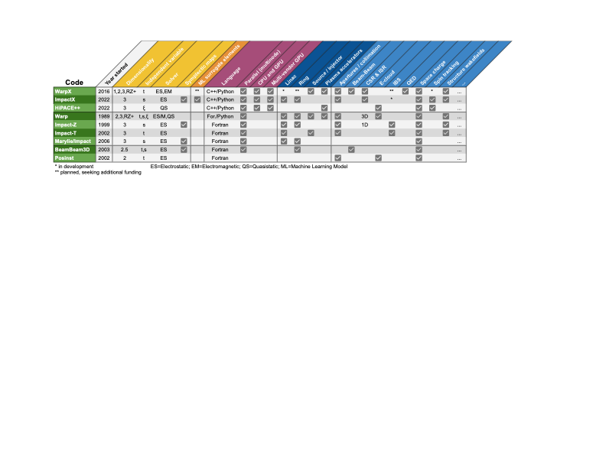


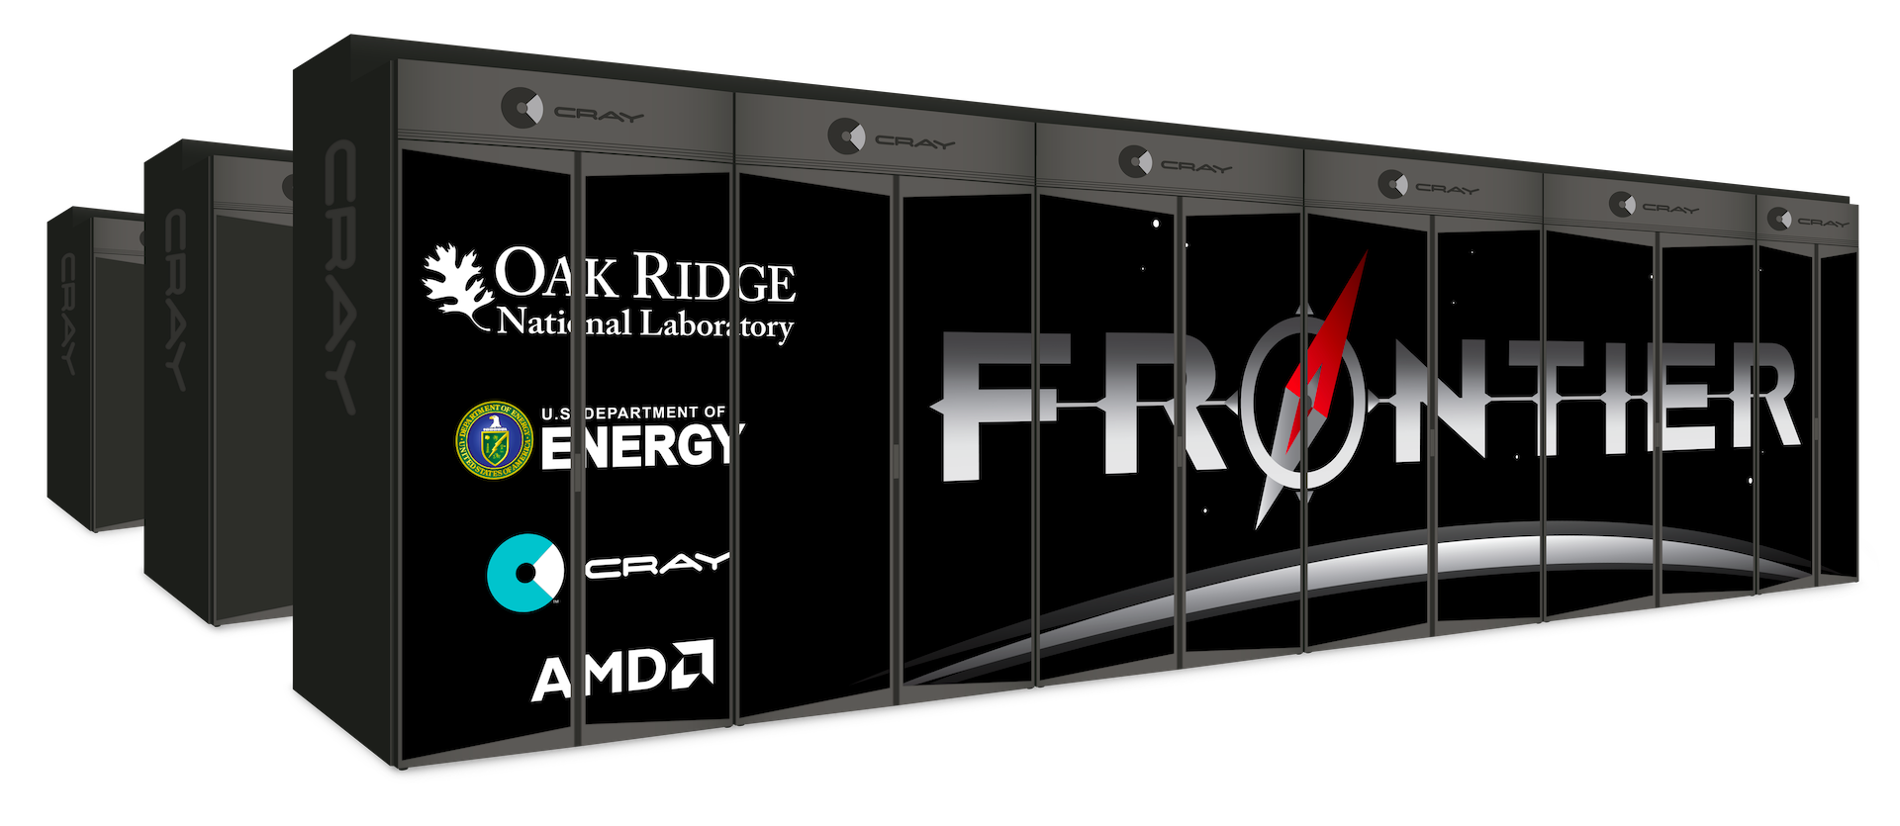





blast.lbl.gov
BLAST now includes a new integrated set of codes
New
integrated
General purpose
Legacy
Single purpose
Most legacy codes were developed by one (or a handful at most) researcher(s)
New set of codes is integrated around a common, portable, open-source, high-performance infrastructure w/CPU+GPU, major OS (linux+MacOS+Windows) and AI/ML support
Standards & workflows
Data
Input
Accelerator
Lasers
Optimize

Slide 21
The Vision
PALS: The Particle Accelerator Lattice Language Standard is being developed as:
        A standard for the sharing of lattice information to describe particle accelerators and storage rings.
      Due to the needs of AI/digital twins the scope is being expanded:
        A broader language describing accelerator objects, hierarchy, roles, parameters, capabilities, signals, constraints, and links to facility-specific controls and data systems
David Sagan

Slide 22









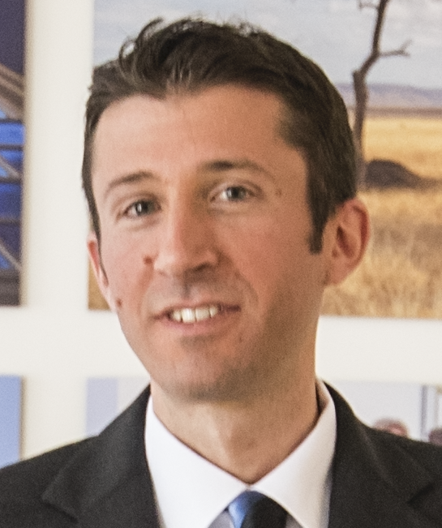






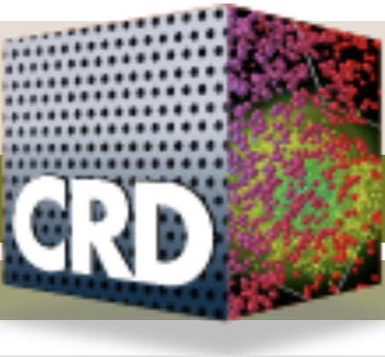

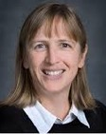






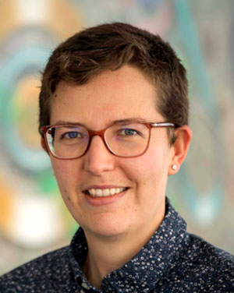








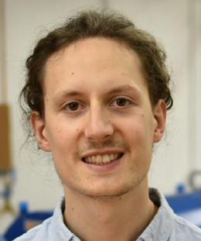


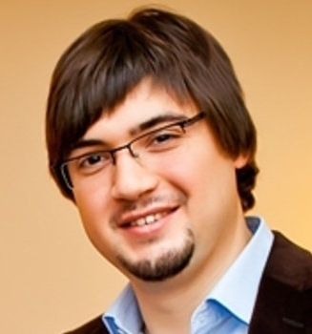





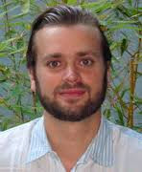




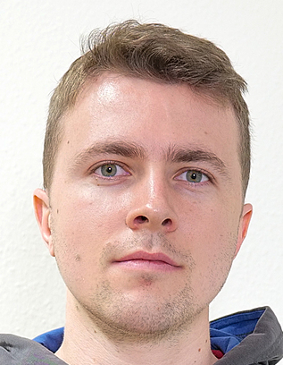




Developed by an international, multidisciplinary team
WarpX open governance
Jean-Luc
Vay
Ji
Qiang
Arianna Formentii
Axel
Huebl
Rémi
Lehe
Chad
Mitchell
Olga Shapoval
Edoardo
Zoni
David
Grote
Justin
Angus
Ann
Almgren
Kevin
Gott
Junmin
Gu
Revathi
Jambunathan
Andrew
Myers
Weiqun
Zhang
Kale Weichmann
Roelof Groenewald
Eric
Clark
Prabhat Kumar
AM
Germany
Maxence Thévenet
Alexander
Sinn
Ángel
Ferran Pousa*
Rob
Shalloo
Igor
Andriyash
Severin
Diederichs
Lixin
Ge
France
Switzerland
Henri
Vincenti
Luca
Fedeli
Thomas
Clark
Pierre
Bartoli*
Franz
Poeschel
Ryan
Sandberg
Marco Garten
over 120
contributors,
incl. from the
private sector
France
*former members
Notes:
Cross-expertise teamwork:
In AMP we have a diverse set of backgrounds and leading people who are strong in at least two backgrounds out of applied math, physics and HPC
For software collabs: facilitate that code or library users can contribute to each other’s projects
Connect to and maintain relationships with: Hardware specialists and vendors, algorithms people, I/O folks, visualization experts, domain scientists

Slide 23
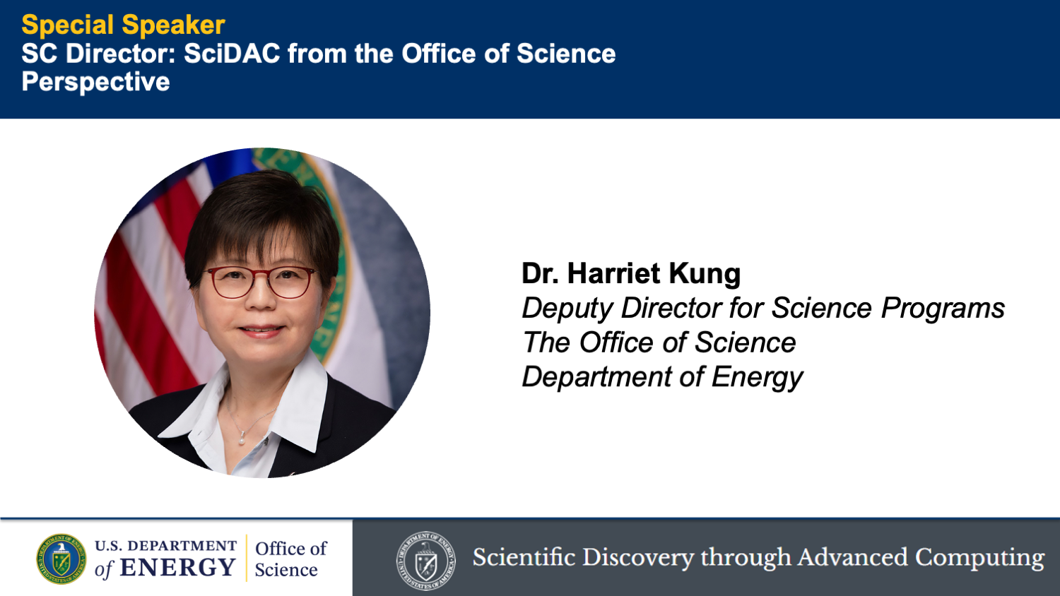
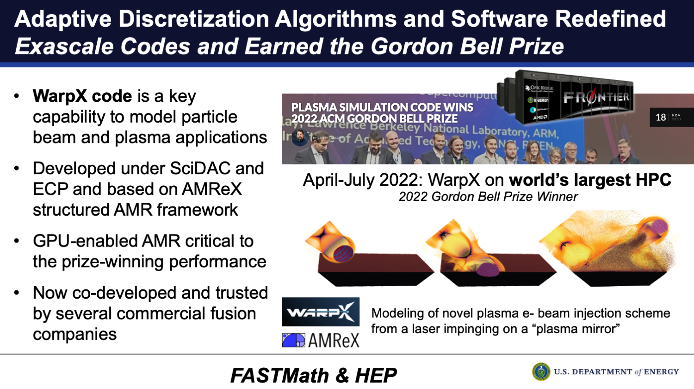
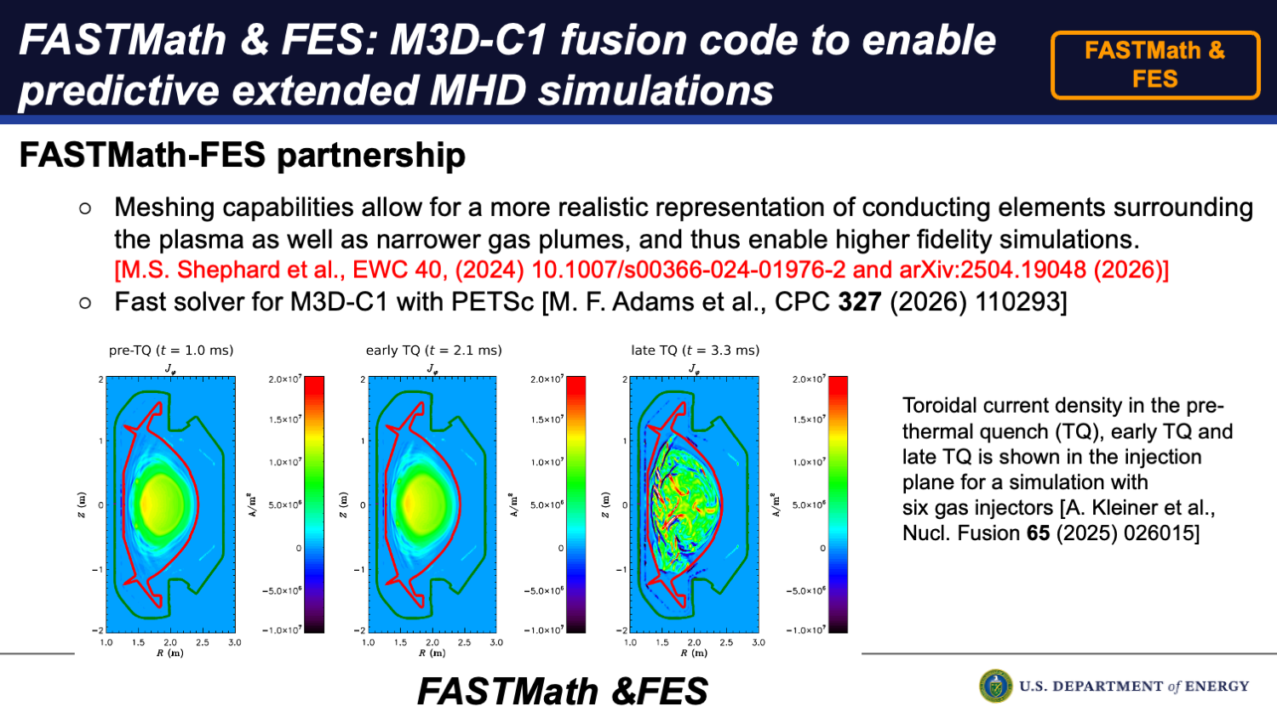
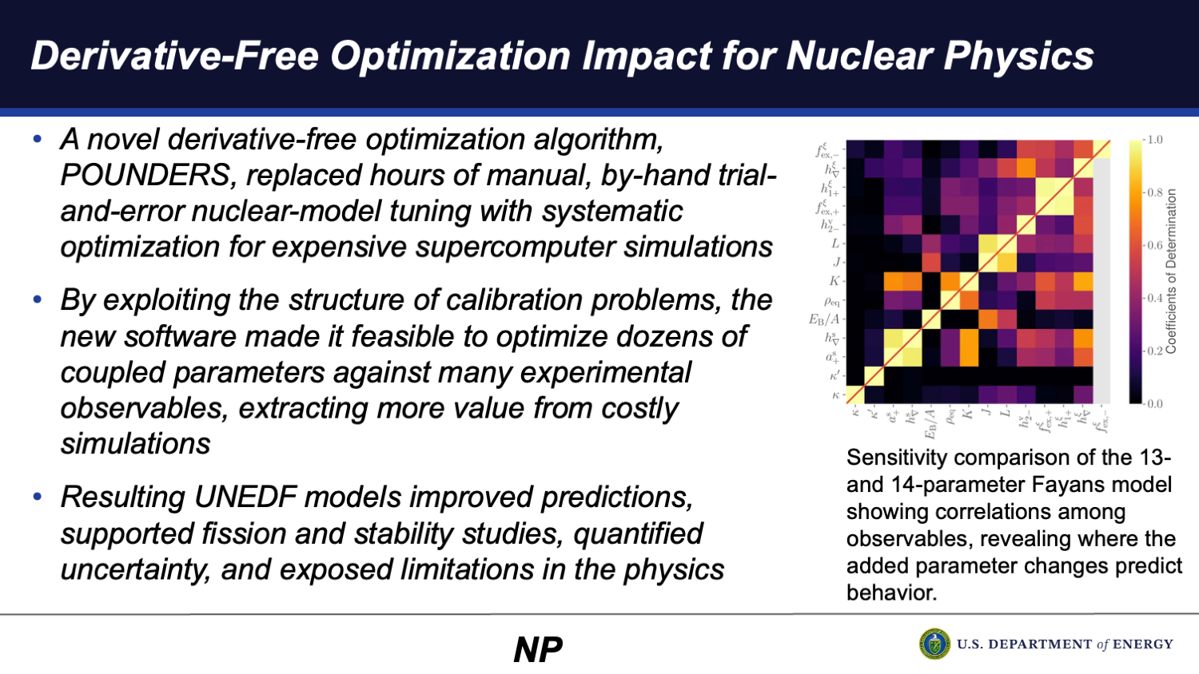
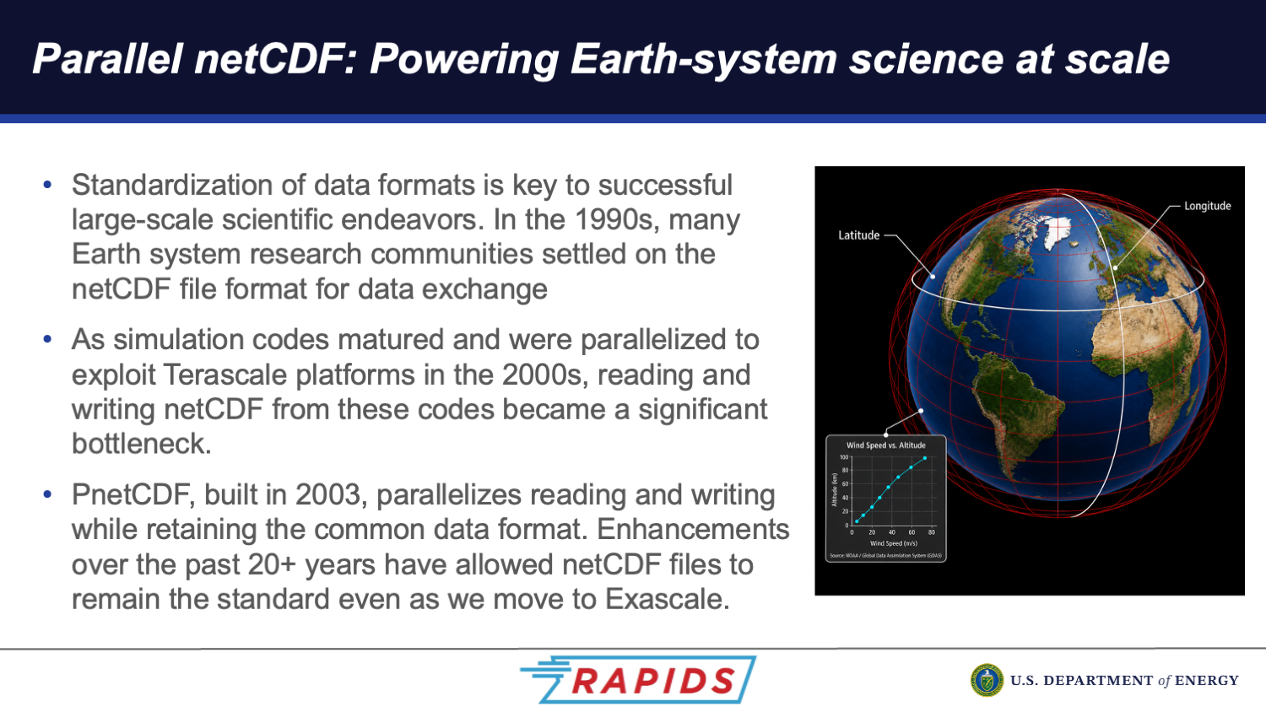
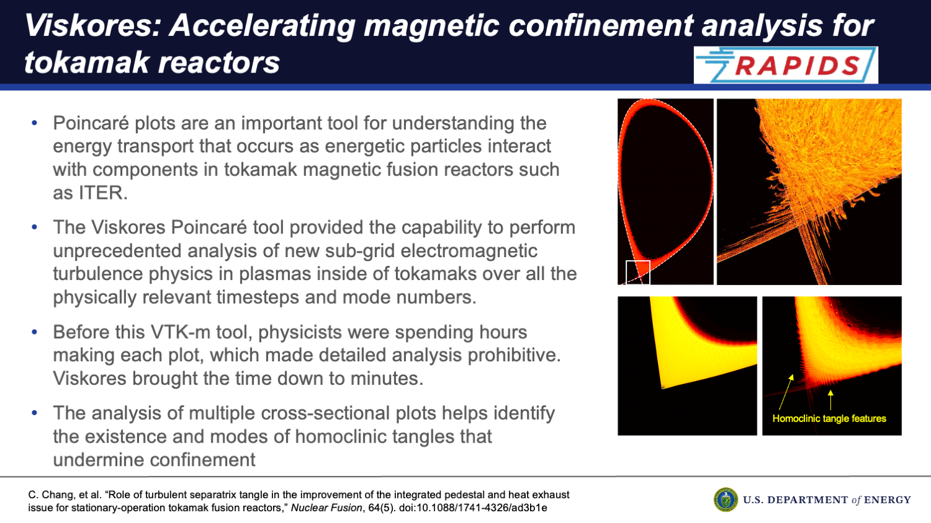
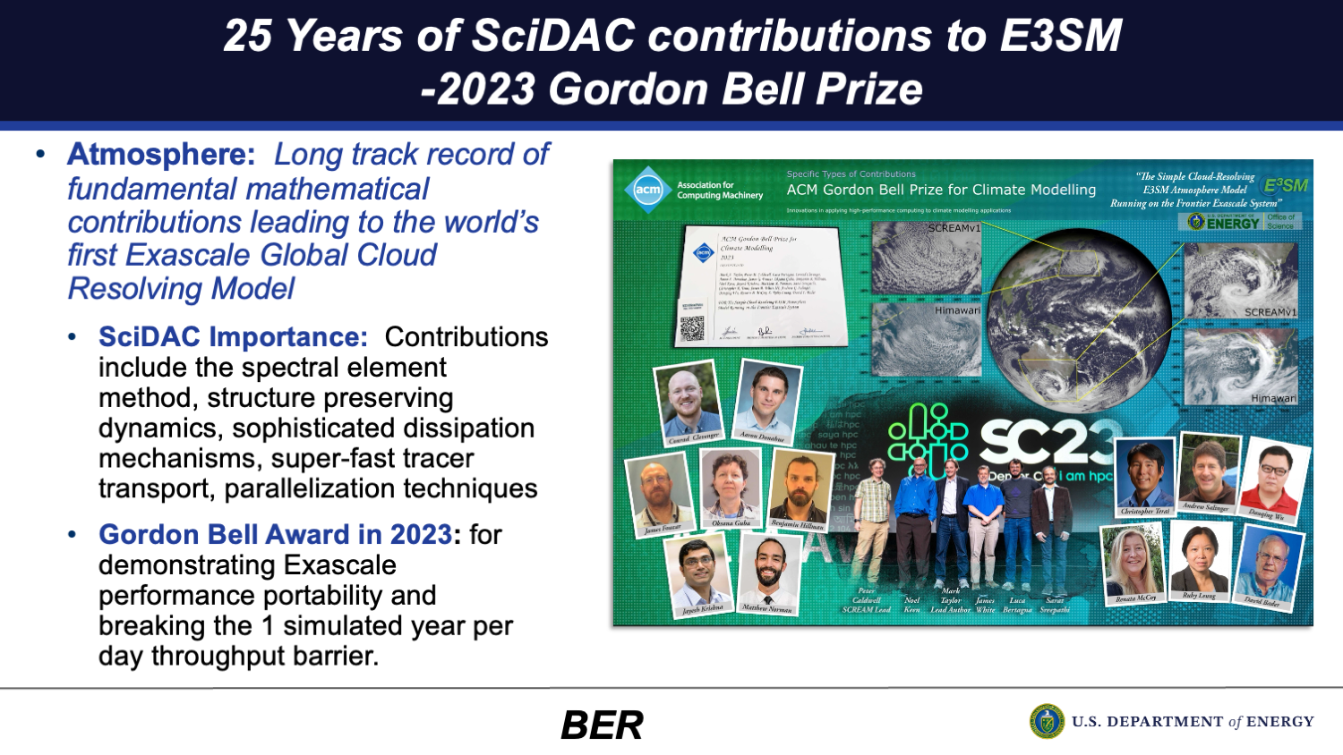
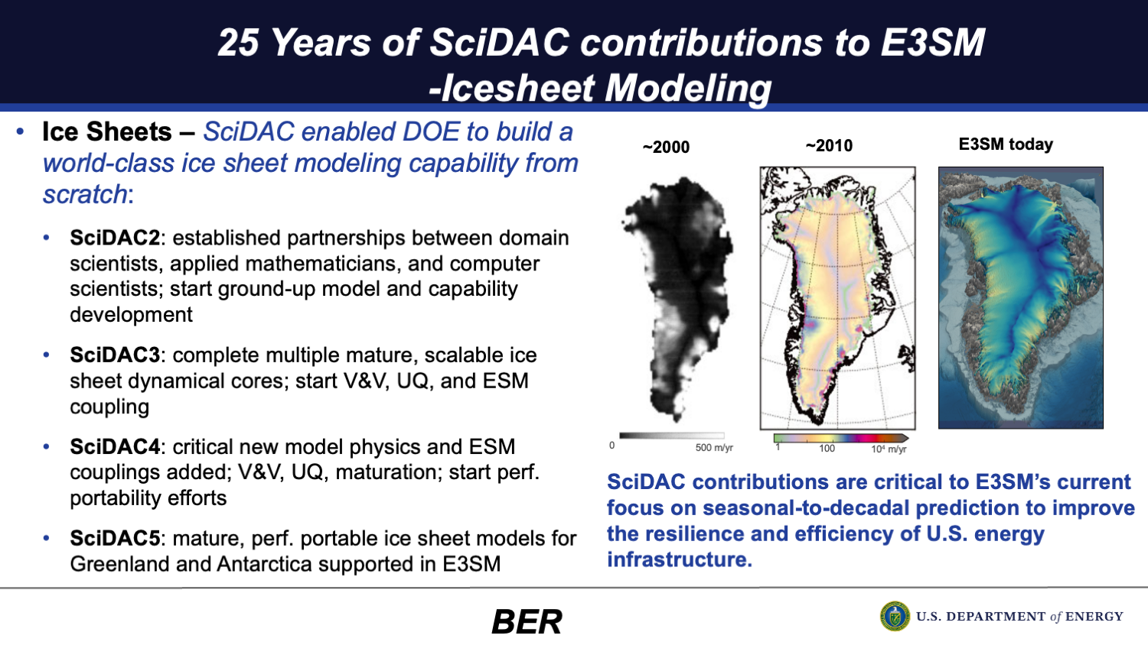
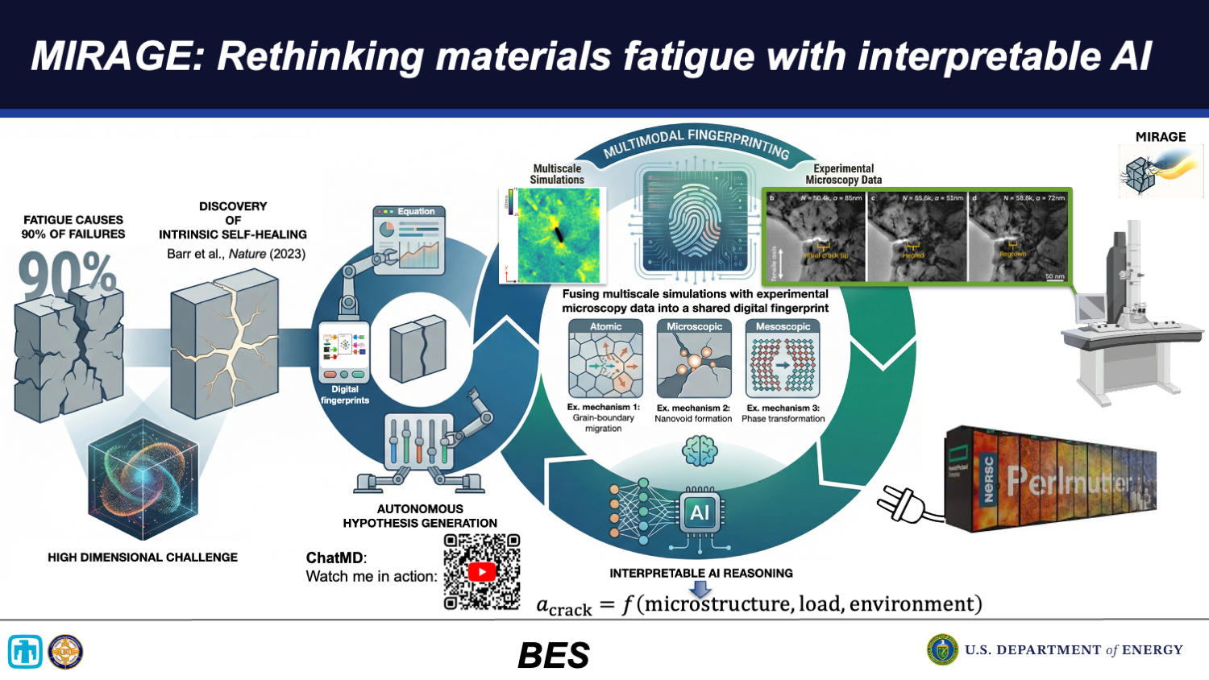
CAMPA code WarpX part of 8 highlights at SciDAC 25th anniversary plenary talk by Harriet Kung, DOE Deputy Director for Science
Notes:
Cpu/gpu=>compilers=>libraries=>codes=>managers
US codes: BMAD, pyOrbit, Impact, Synergia, Helix

Slide 24
Example of duplication in beam dynamics codes: 2026 update
Codes section from Accelerator Handbook (A. Chao, 2013)
New codes/suites since 2014 (partial list):
Xsuite
ImpactX
WarpX
pyOrbit
SciBmad
Cheetah
Helix
…
J.-L. Vay, HB2014

Slide 25
Outline
The US DOE HEP GARD Accelerator & Beam Physics (ABP) program
  Mapping of GARD ABP to FCC-ee
ABP and high-performance computing
  Scientific Discovery through Advanced Computing (SciDAC) program
ABP and AI/AML
  The Genesis Mission and the Multi-Office Accelerator Team (MOAT) program
Conclusion and Outlook
Notes:
ABP
mapping ABP to FCC-ee
codes & tools: BLAST, PALS
SciDAC
Genesis
Differentiability, Cheetah

Slide 26
With AI/ML, the need to adapt has never been bigger
AI/ML
×3
“Vibe coding”* enables very rapid development
      sign of the effect depends on quality of production: i.e., producing good or bad code faster
      Surrogates can be developed to “replace” components or full simulations; differentiability interest; …
➔ Need to adapt to new environment
Changing
computer
architectures
Upcoming Nvidia GPUs hardware support for double precision may be very limited.
Studies & solutions underway or planned by LDRDs, ASCR, SciDAC, etc.
Note: AMD plans to continue hardware support for DP.
OH, GREAT!
JUST WHEN I
FINALLY GET MY
SUPER BOWL
TICKETS!!
CODE
RUNNING!!
PROJECT
FUNDED!!
Budget
constraints
*“Vibe coding” is a new and loosely defined term in software development that refers to the practice of prompting AI tools to generate code rather than writing code manually.
Source: https://www.ibm.com/think/topics/vibe-coding

Slide 27
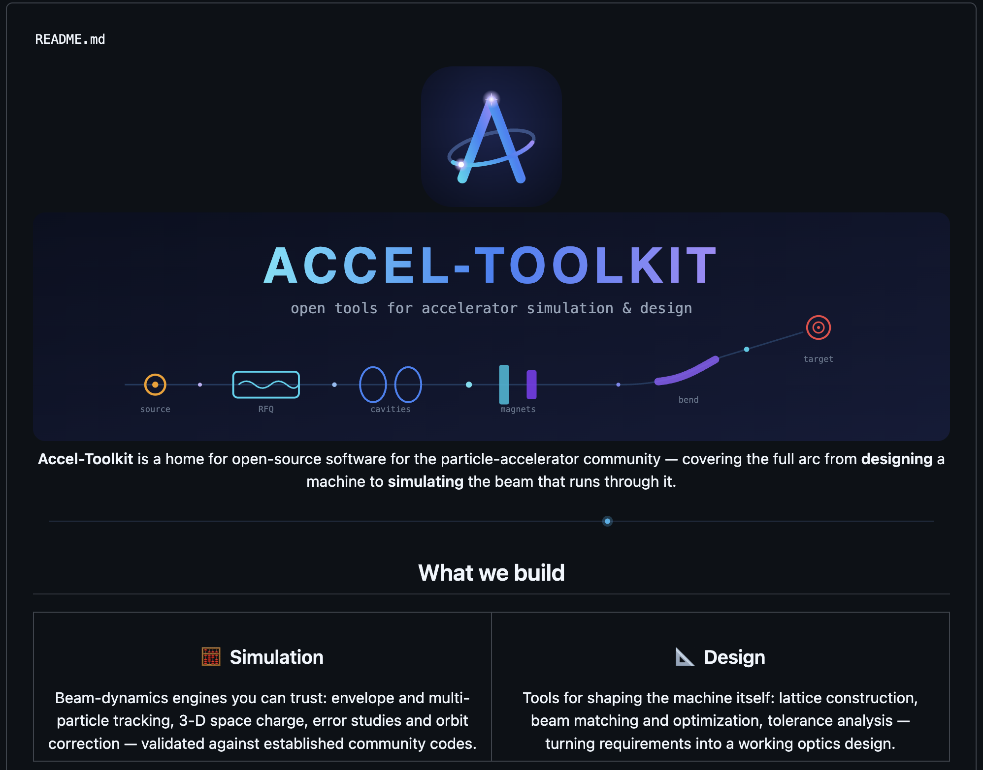
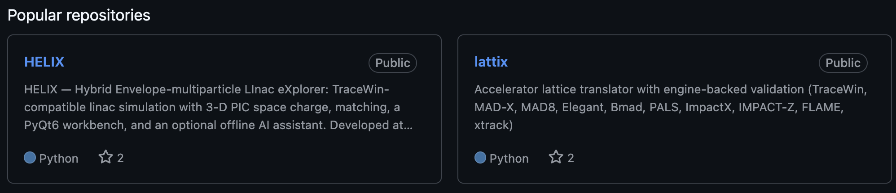
One can now “vibe code” entire accelerator toolkits with agentic AI in record time!
Robust validation and verification is needed!
https://github.com/Accel-Toolkit
Because LLMs can draw from large community frameworks (XSuite, BLAST, Bmad, etc.), one can now "vibe code" entire accelerator toolkits with agentic AI in record time.
Robust validation and verification is needed!
Note: Composing with or extending community frameworks with LLMs as a team is more reproducible, reliable, and sustainable than vibe coding hundreds of thousands of lines from scratch.

Slide 28
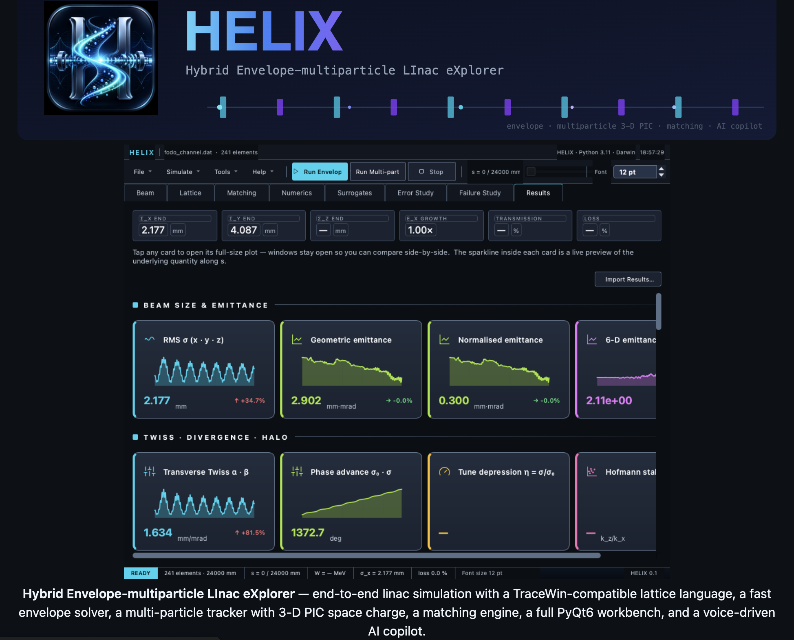
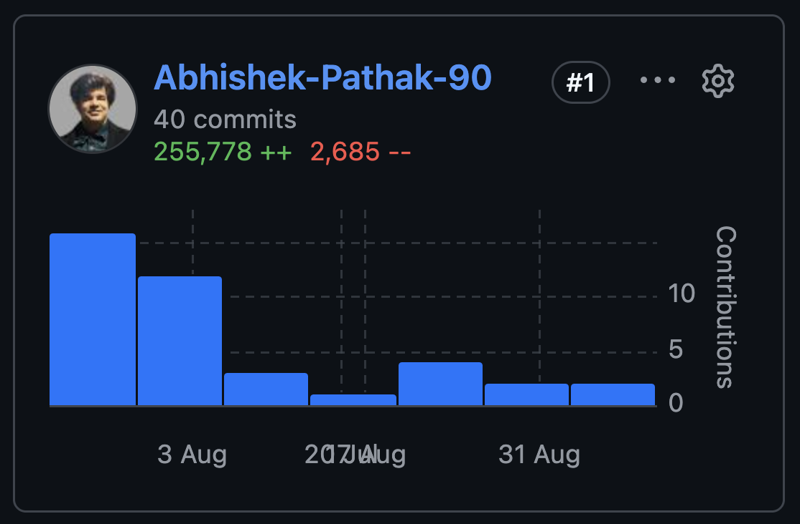
One can now “vibe code” entire accelerator toolkits with agentic AI in record time!
Robust validation and verification is needed!
https://github.com/Accel-Toolkit/HELIX

Slide 29
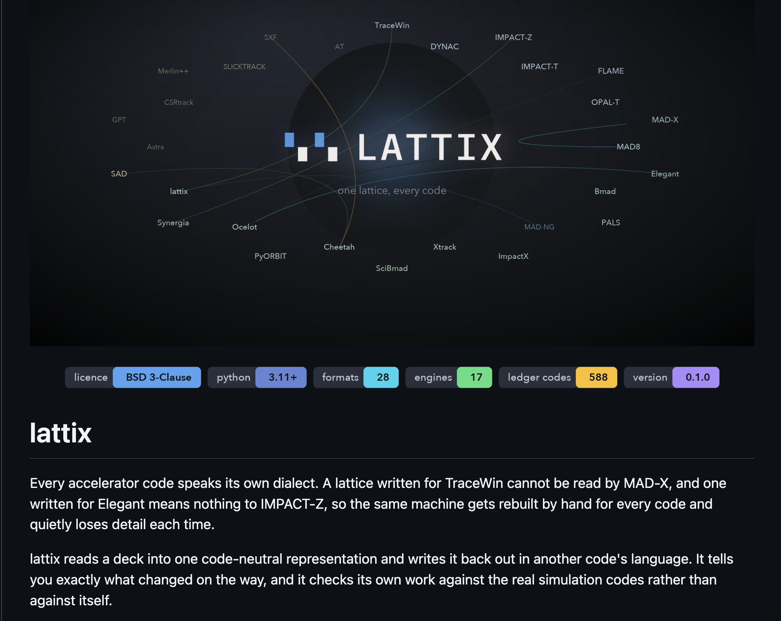
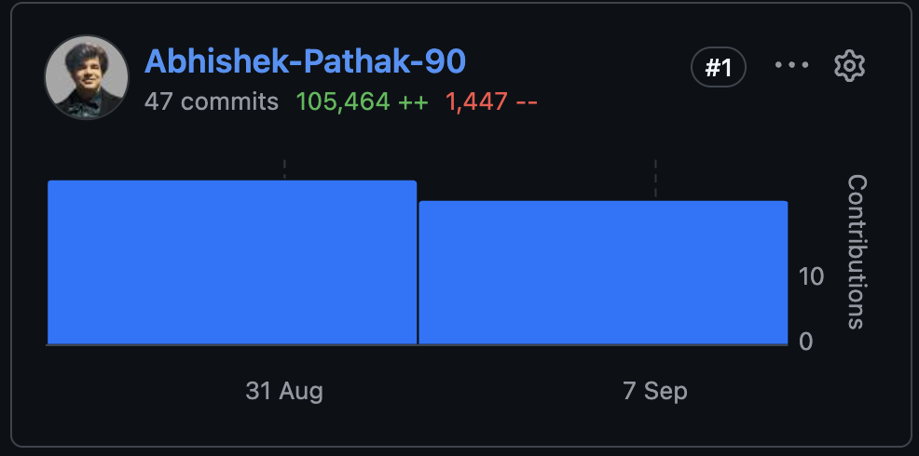
One can now “vibe code” entire accelerator toolkits with agentic AI in record time!
Robust validation and verification is needed!
https://github.com/Accel-Toolkit/lattix

Slide 30
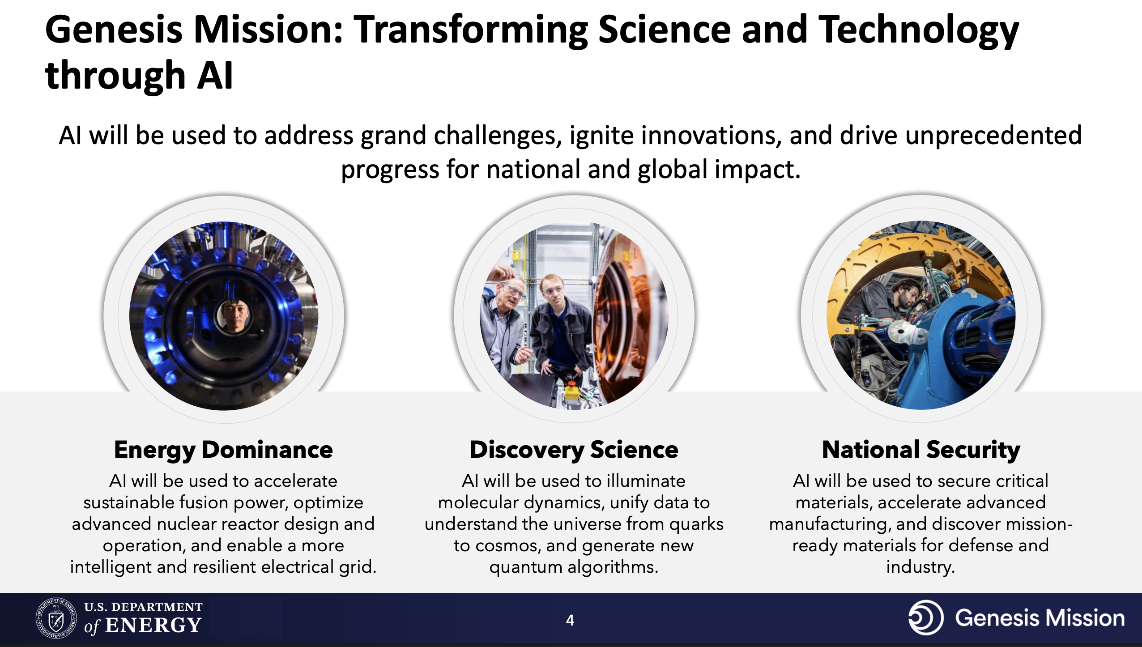
Genesis Mission: A National Mission to Accelerate Science Through AI
Launched in November 2025
https://genesis.energy.gov
SNS
IOTA

Slide 31
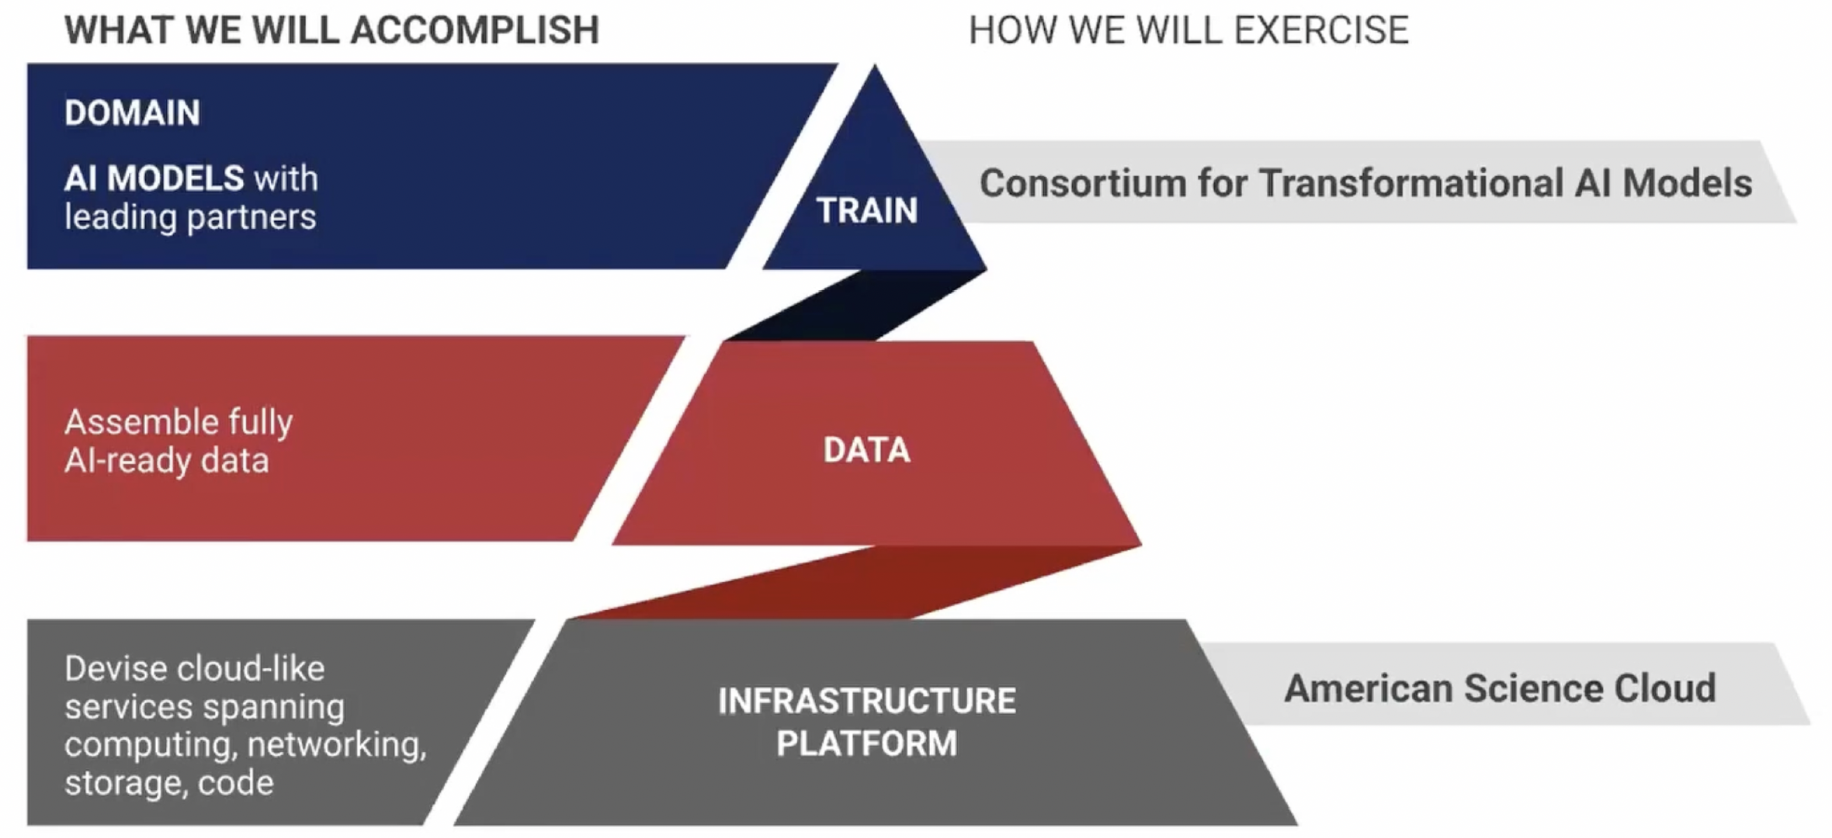
Genesis simplified structure*
Software
(ModCon)
Data
Standardization, AI-readiness
(DaPP)
Hardware
(AmSC)
*From "Introduction to the American Science Cloud (AmSC) : Part One” – 11/13/2025
https://vimeo.com/1137699305

Slide 32
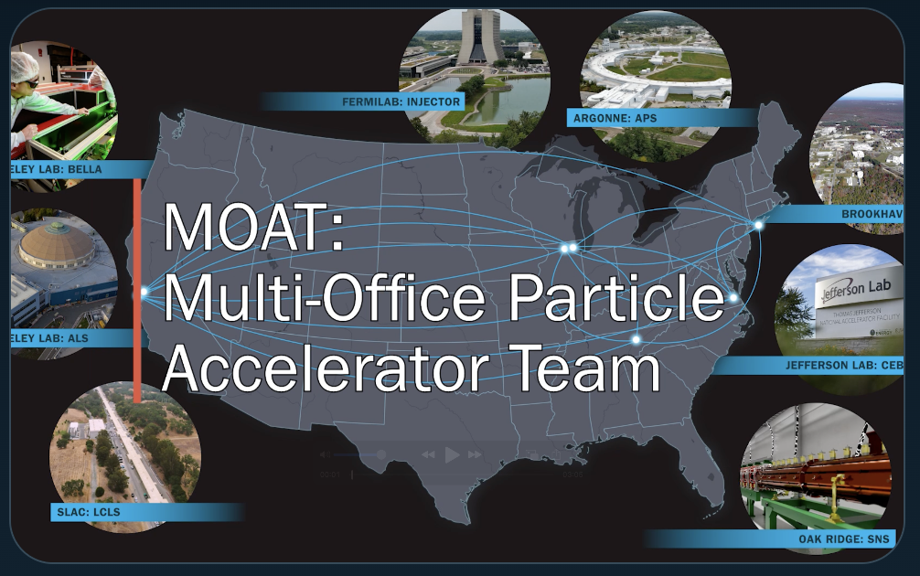
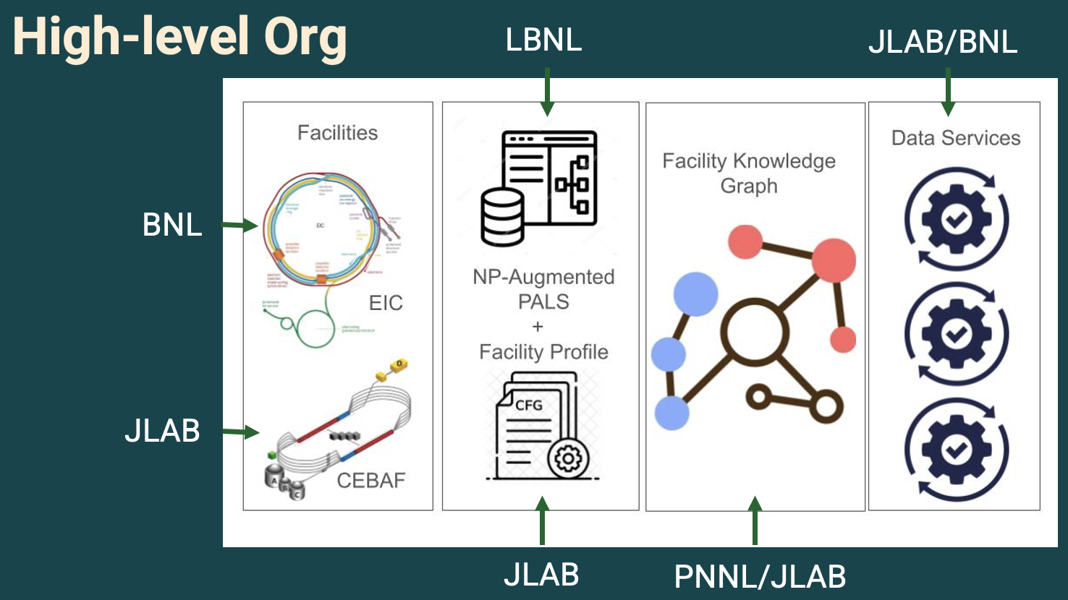
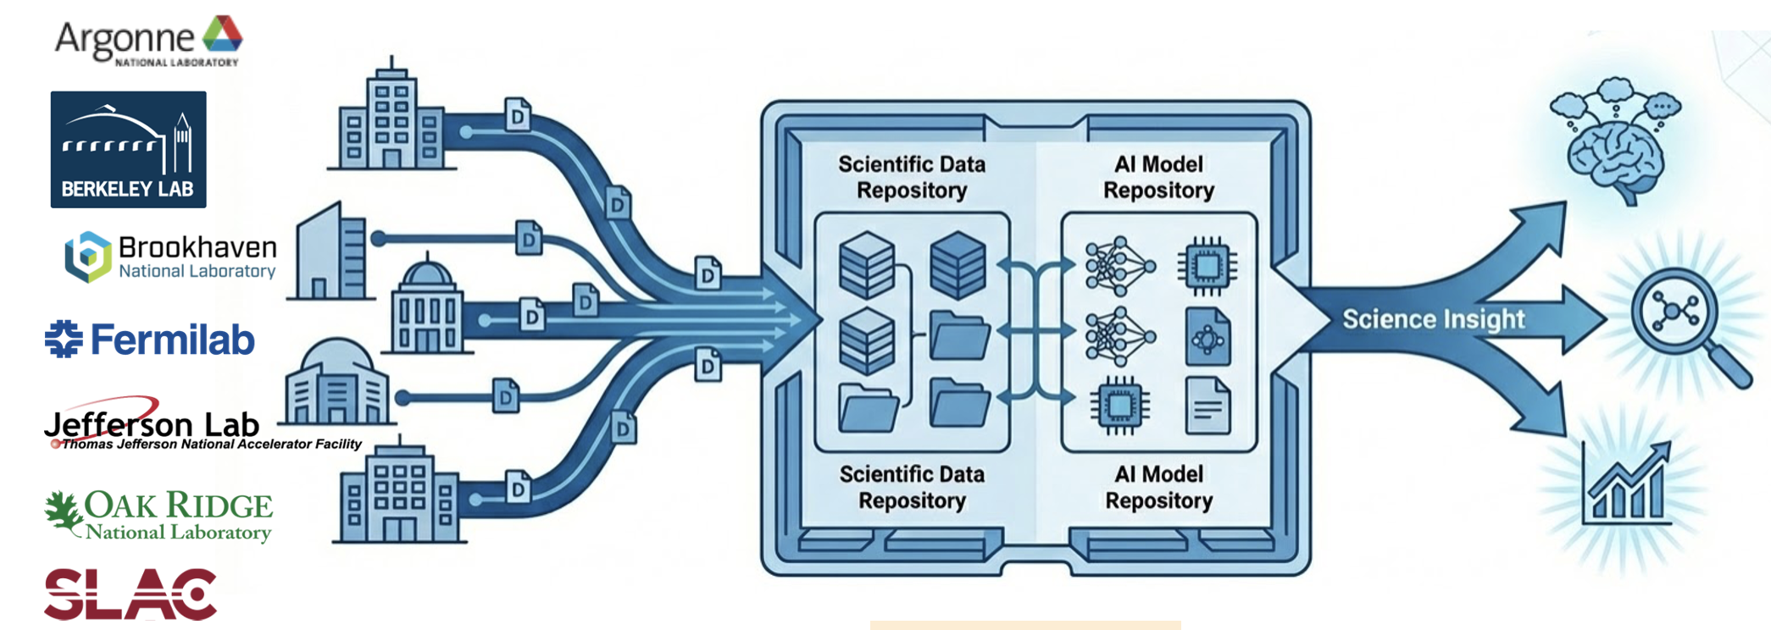
Initial accelerator projects embedded at all levels of Genesis
Multi-Office Accelerator Team (MOAT) seed
Oct. 2025-Jun.
2026
+?
7 nat. labs: LBNL, ANL, BNL, FNAL, JLAB, ORNL, SLAC (BES+HENP)
Deployment of shared accelerator agentic AI software across facilities (~10 to date)
Deployment of digital twin prototypes across facilities (3 to date)
Nuclear Physics AI-Ready Accelerator Data (NARAD)
JLAB, BNL, LBNL, PNNL; NP-focused, but coordinating with all US accelerators
Augments the Particle Accelerator Language Standard (PALS) with facility‑specific profiles and a shared ontology; Delivers cross‑facility knowledge graph tools that supports subgraph extraction for diagnostics/optimization tasks
2025-2027
AmSC Scientific User Facility IP
7 nat. labs: LBNL, ANL, BNL, FNAL, JLAB, ORNL, SLAC (BES+HENP)
Establish Genesis as a shared platform to host and distribute AI models and scientific data for (mostly accelerator-based) BES, HEP, and NP Scientific User Facilities (SUFs), along with their industry and research partners
2025+

Slide 33
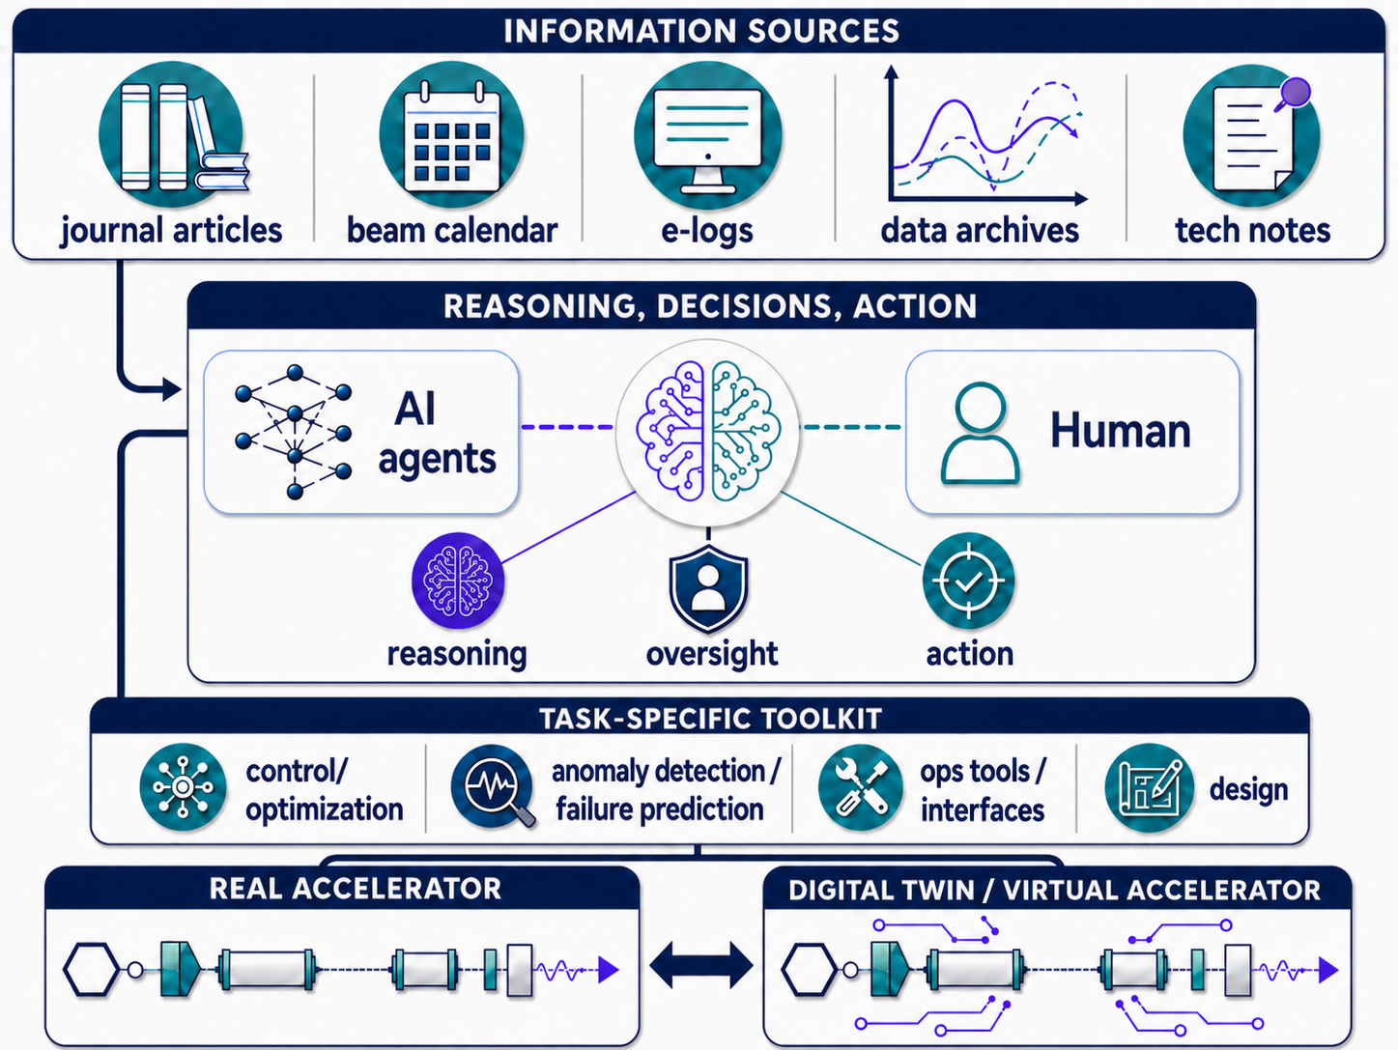

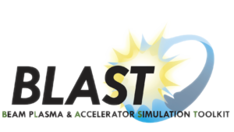



MOAT focus: develop an Agentic AI framework for Accelerators
Beam dynamics tools essential to provide data and models
Codes
source/doc
AI agents use information sources and tools to assist accelerator activities:
design
tuning
anomaly detection & prevention
workforce development
…
*
OSPREY
33
Leverages investments in SciDAC
ImpactX
Agentic AI can also help build and keep the trust in the beam dynamic tools of the community.
*Powered Osprey https://github.com/als-apg/osprey

Slide 34
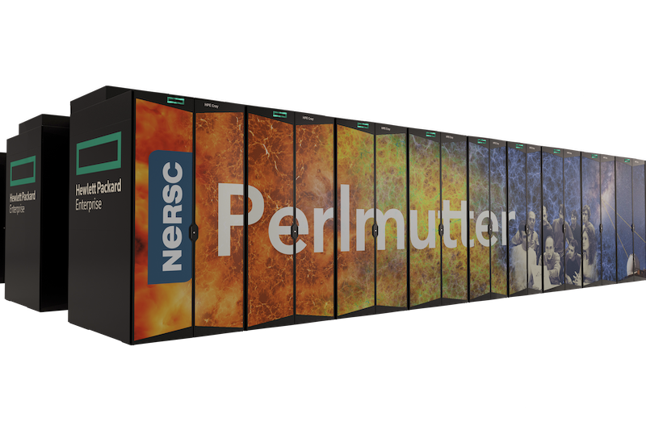

AI-assisted Benchmarking
Correctness, Model Convergence & Performance
Systematic Benchmarking is Needed
Many codes, with widely varying
  Models
  Inputs (& outputs)
  Numerical (e.g., convergence) behavior
  Performance
Scientific reproducibility and exchangeability is needed.
Approach
Design of benchmarks for important accelerator scenarios, test stands & facilities.
  1) model correctness, then
  2) model convergence, then
  3) performance
Open repo on GitHub*: review, adjust and add
Run on a single CPU or GPU of NERSC Perlmutter, scenario:
Given constrained resources, we solve important problems to convergence.
Science goal: getting a simulation done as fast as possible, while being correct/predictive.
*Reproduce, improve, or contribute:
github.com/BLAST-ImpactX/impactx-benchmarks
Notes:
Haha, w
Like slides 19-22 here?: https://docs.google.com/presentation/d/1KlUmk4WsFJ5OdeDfC5lpZZLeJRLPg9uUbhZy7ZGIXXU/edit#slide=id.g21855d4698d_41_182
Ahhh, it was GATech, not google :D I knew it!
(from paper) We also identified a commonly used algorithmic and simulation pattern for which in situ visualization would be ideally suited, but are not aware of any implemented solution yet: rendering of spatially-sliced data pipelines. In a large class of modeling codes, efficient solutions can be calculated by splitting the 3D domain over one axis. Instead of advancing the whole domain by an update, algorithms update a slice of the domain, e.g., from the back to the front of the 3D domain, and parallelize for the third spatial axis in time. Without spatially sliced rendering tools, a large number of algorithms and codes currently need to fall back to costly data output to “reconstruct” the spatial data domain that is required at once in offline visualization. Examples in laser-plasma and accelerator physics are the boosted frame technique [15–17] as shown in figure 1 (a more meaningful representation would transform slice-wise to the laboratory frame), the quasi-static method [1], or representations in reference trajectory space instead of time and space [4].

Slide 35

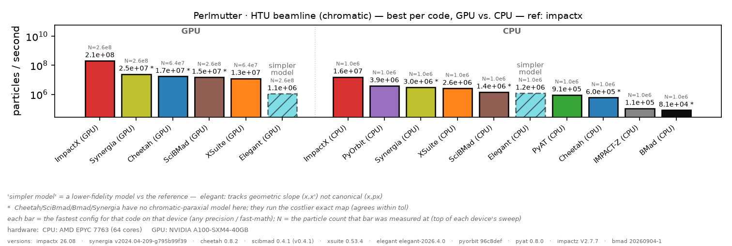
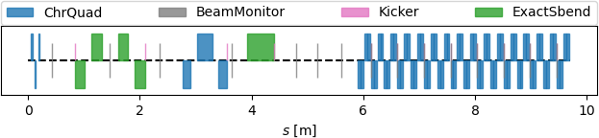
AI-assisted Benchmarking
Tracking through a Chromatic Beamline
Measurements here are a first draft and
very preliminary, please expect them to change..
Scientist opens a Pandora Box
Higher is better, results in log scale: >2000x performance difference.
This is just a capability demo on a very simple example. FCC-ee relevant physics is much more complex!.
Reproduce, improve, or contribute:
github.com/BLAST-ImpactX/impactx-benchmarks
Notes:
Haha, w
Like slides 19-22 here?: https://docs.google.com/presentation/d/1KlUmk4WsFJ5OdeDfC5lpZZLeJRLPg9uUbhZy7ZGIXXU/edit#slide=id.g21855d4698d_41_182
Ahhh, it was GATech, not google :D I knew it!
(from paper) We also identified a commonly used algorithmic and simulation pattern for which in situ visualization would be ideally suited, but are not aware of any implemented solution yet: rendering of spatially-sliced data pipelines. In a large class of modeling codes, efficient solutions can be calculated by splitting the 3D domain over one axis. Instead of advancing the whole domain by an update, algorithms update a slice of the domain, e.g., from the back to the front of the 3D domain, and parallelize for the third spatial axis in time. Without spatially sliced rendering tools, a large number of algorithms and codes currently need to fall back to costly data output to “reconstruct” the spatial data domain that is required at once in offline visualization. Examples in laser-plasma and accelerator physics are the boosted frame technique [15–17] as shown in figure 1 (a more meaningful representation would transform slice-wise to the laboratory frame), the quasi-static method [1], or representations in reference trajectory space instead of time and space [4].

Slide 36
Outline
The US DOE HEP GARD Accelerator & Beam Physics (ABP) program
  Mapping of GARD ABP to FCC-ee
ABP and high-performance computing
  Scientific Discovery through Advanced Computing (SciDAC) program
ABP and AI/AML
  The Genesis Mission and the Multi-Office Accelerator Team (MOAT) program
Conclusion and Outlook
Notes:
ABP
mapping ABP to FCC-ee
codes & tools: BLAST, PALS
SciDAC
Genesis
Differentiability, Cheetah

Slide 37
Conclusion & Outlook
DOE HENP GARD roadmap Grand Challenges and activities are very relevant to FCC-ee
Cross-DOE office program like SciDAC enable the development of accelerator and beam physics ecosystems that push the frontier with HPC
AI/ML brings great disruptions and opportunities ➔ The Genesis Mission offers a path toward an open, community, intelligent ecosystem for accelerator operations, design, workforce development, etc, in which accelerator and beam physics codes play a central role
All these are very relevant to colliders like FCC-ee and should be coordinated with other efforts: CERN, EIC, etc
Discussions about more formal collaborations have been happening (including at IPAC26) and are ongoing
Notes:
Cpu/gpu=>compilers=>libraries=>codes=>managers
US codes: BMAD, pyOrbit, Impact, Synergia, Helix

Slide 38
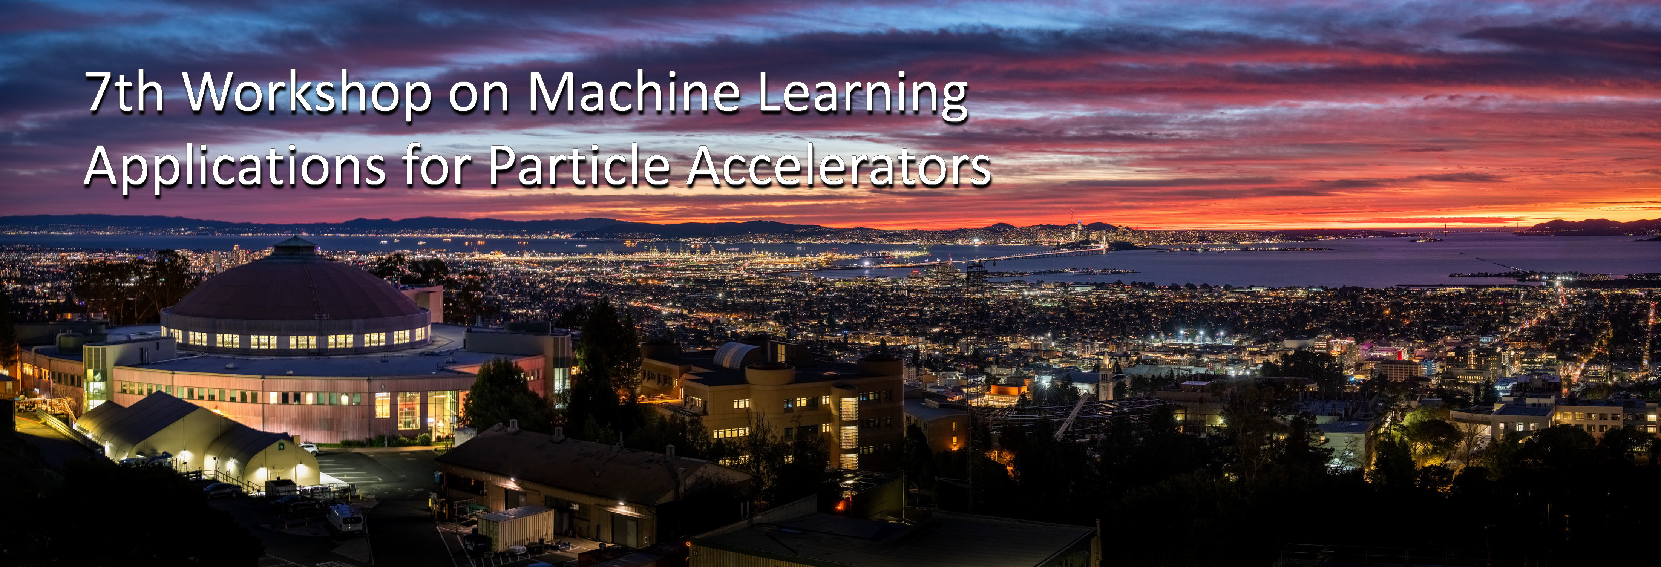
Mark your calendar: the 7th Workshop on Machine Learning (and AI) Applications for Particle Accelerators (MaLAPA) is scheduled for April 26-29, 2027 in Berkeley!
Stay tuned!
Notes:
Cpu/gpu=>compilers=>libraries=>codes=>managers
US codes: BMAD, pyOrbit, Impact, Synergia, Helix

Slide 39
Thank You!

