Slide 1
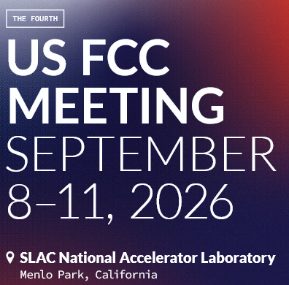

Next Steps in Defining a Magnet R&D Program
Giorgio Ambrosio (FNAL) and GianLuca Sabbi (LBNL)
Fourth US FCC meeting
SLAC, September 8, 2026

Slide 2
Steering Committee Guidance on R&D Plans
Select a set of R&D topics that will contribute to the Higgs Factory designs, augment core capabilities in the US and potentially lead to a significant role in a future construction project
Encourage the development of proposals from US participants for collaborations on relevant topics within the scope of each L2 subject area
  Based on US expertise, capabilities and historical achievements
  Think about interplay with other L2s and PED and where joint projects can benefit both
  Work with project management to ensure our input is relevant and desired
Start to develop a list of possible tasks with rough funding levels

Slide 3
Organization and Call for Proposals (2025)
Established POCs with US magnet programs to help us reach out to the community
  Labs/Universities: BNL, FNAL, LBNL, TAMU, OSU, PPPL, FRIB/MSU, JLAB, ANL, ORNL, SLAC
  Projects/Collaborations: MDP, HL-LHC AUP, USLUA, EIC, MC
Established magnet POCs with FCC-ee (and ILC)
Solicited proposals in April-June 2025
  No established budget: initial goal was to support discussions with DOE on R&D plans and funding
Committee chairs requested that each L2 ranks their proposals based on the primary criteria:
  Relevance to a future HF
  Benefit to the US program
  Interest from the HF projects
Reviewed and ranked 5 proposals that were formally submitted to the magnet L2, including discussion and feedback from CERN POCs and other L2s (e.g. MDI, sustainability)
Helped review magnet-related proposals that were submitted to other L2s (e.g. instrumentation, MDI)

Slide 4
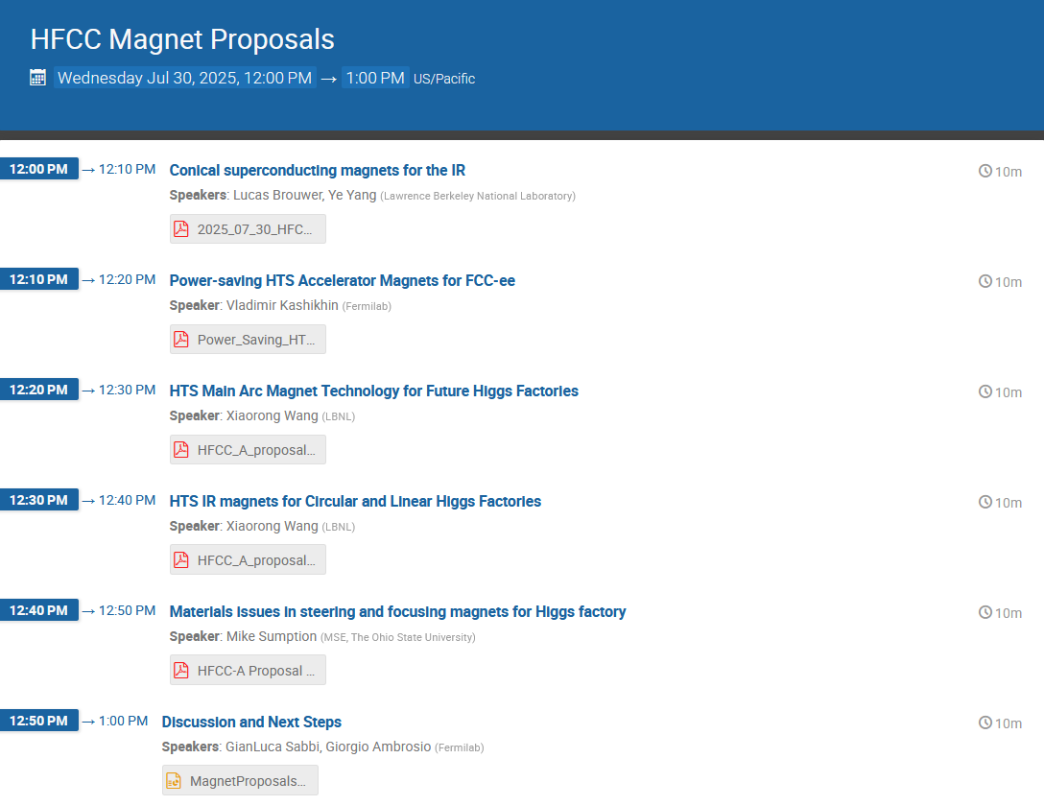
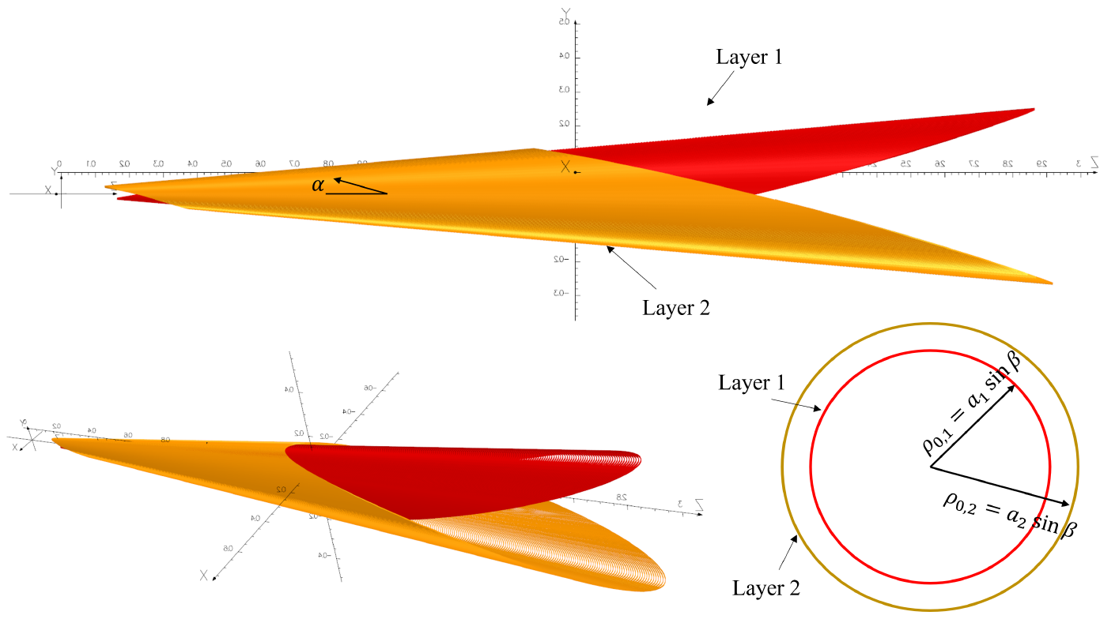
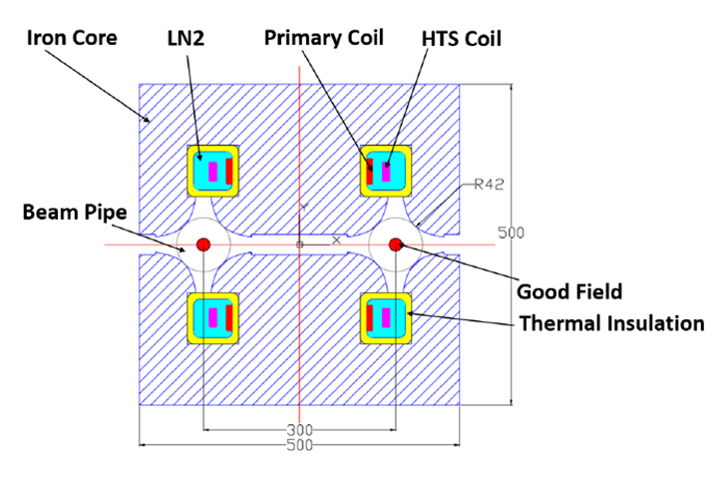
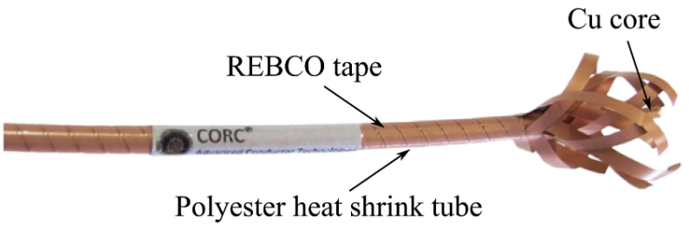
Magnet Proposals

Slide 5
Magnet L2 Proposals Evaluation
Proposal Number | Title | Lead author | Lab | Funding | Eval #1 | Eval #2 | Eval #3 | Average | Comment
GR4-01 | Conical superconducting magnets for the IR | Brouwer, Yang | LBNL | 65 | 1 | 1 | 2 | 1.3 | Good potential to contribute to existing FCC IR effort. Discuss with MDI L2 and CERN POCs (magnets and MDI)
GR4-02 | Power-saving HTS Accelerator Magnets for FCC-ee | Kashikhin | FNAL | 150 | 2 | 1 | 3 | 2 | Very interesting but need to clarify CERN position on HTS magnets for the arcs. To be discussed with CERN sustainability POCs
GR4-03 | HTS Arc Magnet Technology for Future Higgs Factories | Wang | LBNL | 200 | 2 | 2 | 3 | 2.3 | Complementary to GR4-02 focusing on conductor options/selection. Also in this case, need to clarify CERN position on HTS magnets for the arcs. To be further discussed with POCs at CERN (sustainability, magnets) and US L2s
GR4-04 | HTS IR magnets for Circular and Linear Higgs Factories | Wang | LBNL | 52 | 1 | 2 | 2 | 1.7 | Good potential to contribute to existing FCC IR effort. Discuss with MDI L2 and CERN POCs (magnets and MDI)
GR4-05 | Materials issues in steering and focusing magnets for HF | Sumption | Ohio State | 52 | 3 | 3 | 3 | 3 | Focus on more fundamental R&D issues, broadly relevant but not HF specific. Some aspects could be integrated with other proposals.
total |  |  |  | 519 | HF relevance | US benefit | HF interest
Some feedback from discussions with CERN POCs
HTS magnets for FCC-ee: need to integrate with past/ongoing efforts at PSI and INFN on SSS magnets. EU studies indicated that dipoles do not benefit from HTS, but ok to discuss
IR quadrupoles: need to show substantial improvements relative to current baseline (CCT). It seems difficult to make a strong case for HTS, in particular because of field quality requirements
Much work is needed on the normal conducting arc magnets: US help would be very welcome, but no proposals was received despite our attempts to reach out to the relevant groups

Slide 6
Additional proposals with magnet connections
GR2 (Diagnostics and Instrumentation)
GR2-02 | Magnetic Field Vibration with Nanometer Sensitivity | Vikas Teotia | BNL | 50 | 1 | 2 | 1 | 1.33 | Addresses beam stability in FFs, much equipment exists (funded previously in ILC context) but project halted with end of ILC-funding support. Equipment recently moved to SuperKEKB. Synergies with IR magnet development and applicable for tests at FCC IR mockup.
GR2-07 | Machine Learning-Enhanced Real-Time Control for HTS Magnet Quench Protection | Dan Wang and Tengming Shen | LBNL | 100 | 1 | 1.5 | 1 | 1.17 | AI/ML-based instrumentation for application in medium- to long-term accelerator R&D developments (if for FCC-hh) in HTS magnets.
GR5 (MDI)
GR5-02 | MDI Engineering | Seeman | SLAC | 250 | 1 | 1 | 1 | 1 | Fully endorse items 1.1, 1.2, 1.3. Items 1.4 and 1.5 should be in different proposals. $250k/year is probably not enough to fund the engineering design.
GR5-03 | IR Magnet Design | Teotia | BNL | 75 | 2 | 2 | 2 | 2 | Need input from Manuela and Fabrizio to understand impact on FCC given current status of IR design. Need input from Gianluca Sabbi and Giorgio Ambrosio.
GR5-04 | IR Magnet Tolerances | Nosochkov | SLAC | 200 | 1.5 | 1.5 | 1.5 | 1.5 | Need feedback from CERN contacts. Synergy with proposal GR5-03 with regard to magnet tolerances. Budget is missing.
L1 guidance strongly encourages activities that bring together expertise from different areas
Ongoing discussions on how to evaluate and manage proposals that are at the interface between L2s

Slide 7
Updates and Current Status of Magnet Proposals
Due to very limited HFCC funding in FY26, it was not possible to support any of the magnet proposals
In agreement with HFCC, we encouraged the PIs to seek alternative funding sources
Three LDRD proposals were submitted:
  LBNL: X. Wang, “HTS technology to enhance performance and reduce power consumption of FCC-ee”
    Combines the two HFCC proposals on HTS magnets for the Arcs and for the and IR Magnets
    Awarded 170k$ in FY27 (Starting in October)
  LBNL: L. Brouwer, Y. Yang, “Conical Superconducting Magnets for the IR of a Future Higgs Factory”
    Based on HFCC proposal, which had received positive feedback from CERN and a high ranking
    Not awarded
  FNAL: V. Kashikhin, “Combined Function Double Aperture HTS Magnet for the Persistent Current Operation”
    Evolution of HFCC dipole/quadrupole proposals toward a combined function magnet
    Passed the first selection round at Fermilab, waiting for award selection information
In addition, BNL has been contributing to IR magnet and accelerator development coordinated by the HFCC MDI L2 supported by Lab funding

Slide 8
Plans for HTS magnet development
The R&D plans formulated in the LDRD proposals can serve as a starting point, however they need to be coordinated with CERN and updated to reflect the latest machine design evolution
  In particular, the requirements for the arc quadrupoles and sextupoles are significantly different with the new optics, and results from past studies of HTS magnet options are not directly applicable
For the same reasons, CERN is in the process of updating their plans and strategy for HTS magnets. We will continue the discussion with our POCs in the next 1-2 months.
After CERN’s strategy is better defined, we plan to arrange broader discussions initially via zoom and later in person
There also are significant opportunities for US contributions to the IR magnets. We strongly support continuing the work underway at BNL in the context of the USFCC MDI activities, and we will continue to seek additional support and involvement by the US magnet community.

Slide 9
Thank you

