Slide 1
MDI Engineering
and
Cryomodule Concept
for
FCCee
John T. Seeman (SLAC)
Sept 8, 2026
4th Annual Higgs Factory-Future Circular Collider Workshop at SLAC

Slide 2
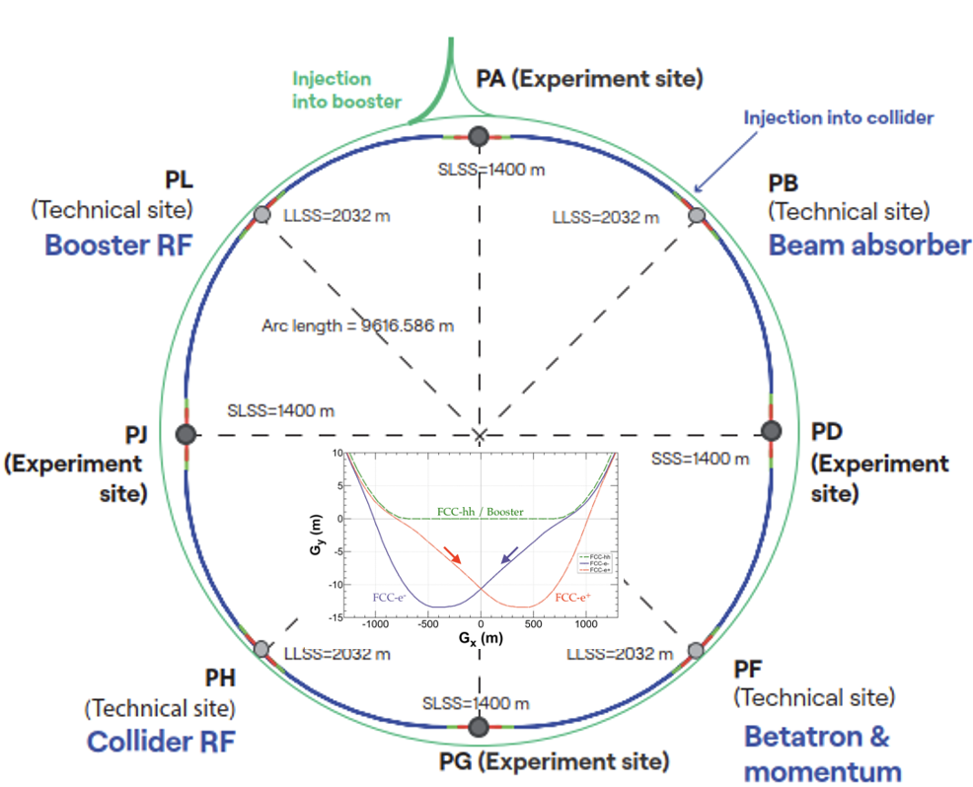
Thank you for FCCee cryostat technical inputs/discussions:
O. Beltramello
P. Borges de Sousa
M. Boscolo
A. Ciarma
S. DeBarger
D. Diyalov
F. Fransesini
S. Gessner
G. Iadarola
G. Kerr
M. Koratzinos
T. Montagne
A. Novokhatski
K. Oide
F. Palla
B. Parker
L. Pollastrini
P. Raimondi
T. Raubenheimer
K. Suguitan
V. Teotia
F. Zimmermann
And others

Slide 3
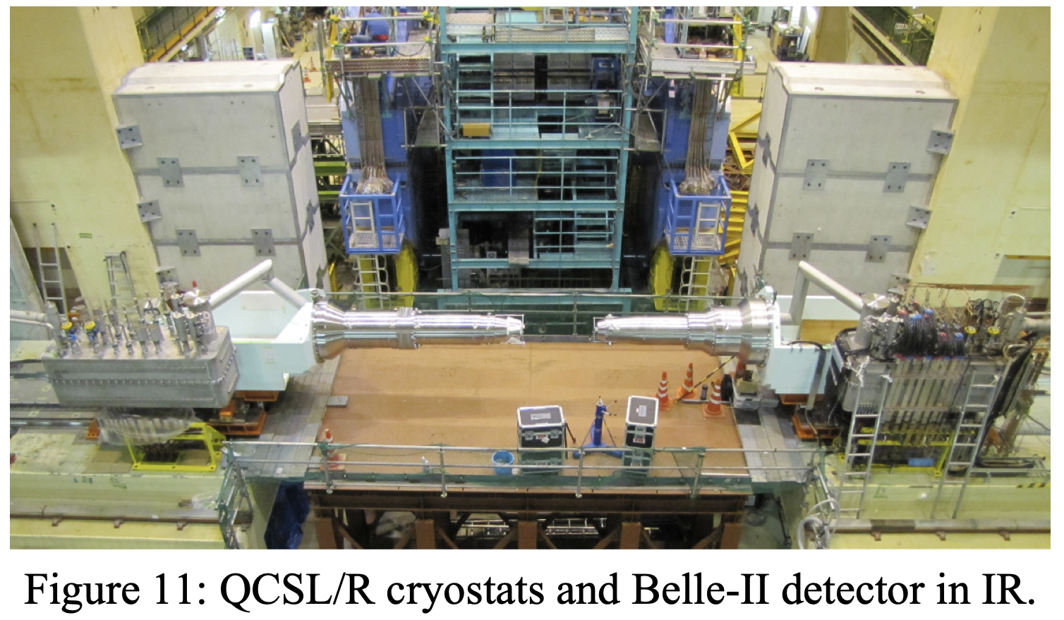
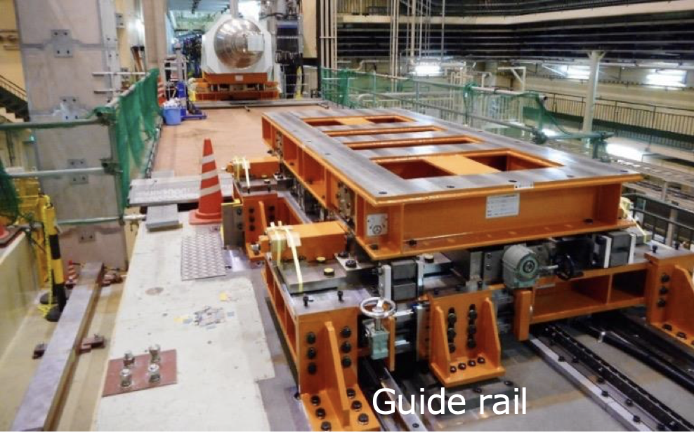
FCCee IR is similar to the SuperKEKB with Cantilevered IR Cryostats
Guide rails to remove
FF quadrupole cryostat
QF2 mounted in
white support
IP Magnet Cryostat
Cryogenic Junction Box

Slide 4
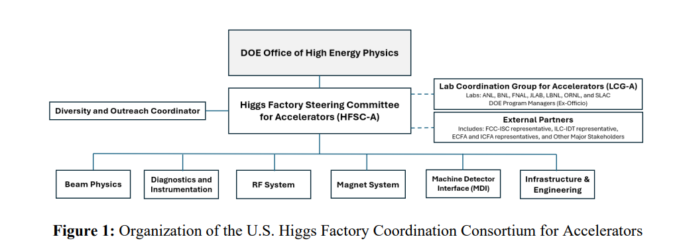
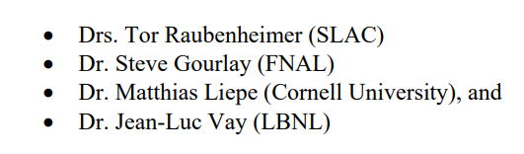
Near Term Work at SLAC on FCCee from HFCC
HFSC-A members
HFSC-A grant: Cryostat Design Grant (J. Seeman, A. Novokhatski et al):
---Work on cryostat design: layout, reentrant welder, assembly, clearances,
forces, beam pipe, HOMs, backgrounds, and heating. Will engage a Mechanical
(Cryogenic) Engineer in July 2026.
HFSC-A grant: Beam-Beam Physics Grant: (S. Gessner, P. Kicsiny, et al)
---Beam-beam forces, quantum effects, speed-up calculations, code bench-marking,
systematics of luminosity measurements. Work has started.
SLAC LDRD 2026: LumiCal Supports and Utilities Layout: (C. Vernieri, S. Gessner,
L. Pollastrini) Layout, installation, tolerances.

Slide 5
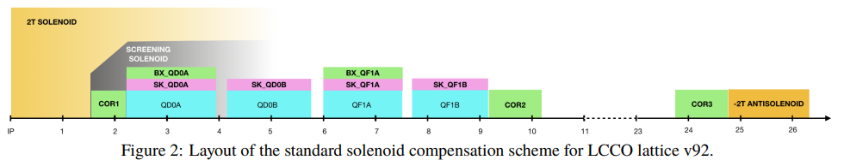
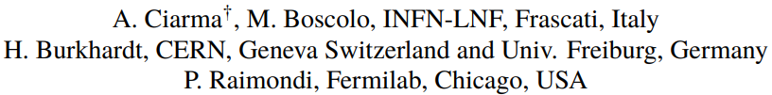
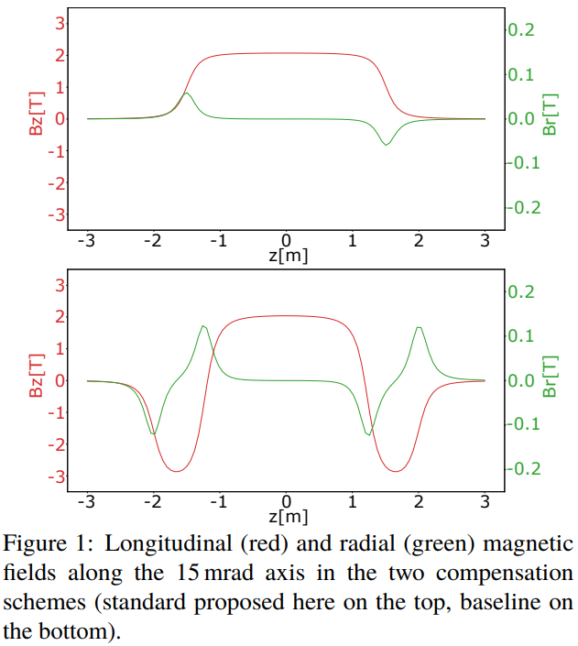
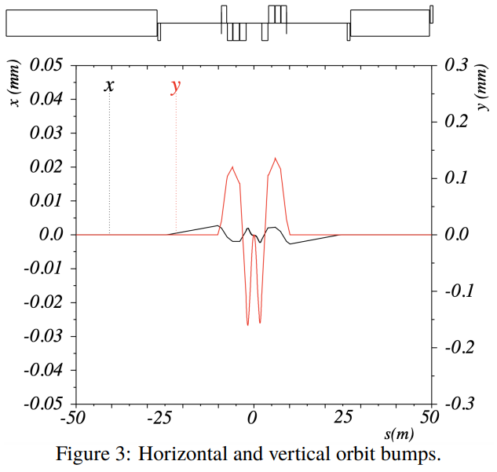
FCCee IR Solenoid Compensation Scheme (LCC)
P. Raimondi will soon provide a new IR lattice design for LCC (~Sept 2026).

Slide 6
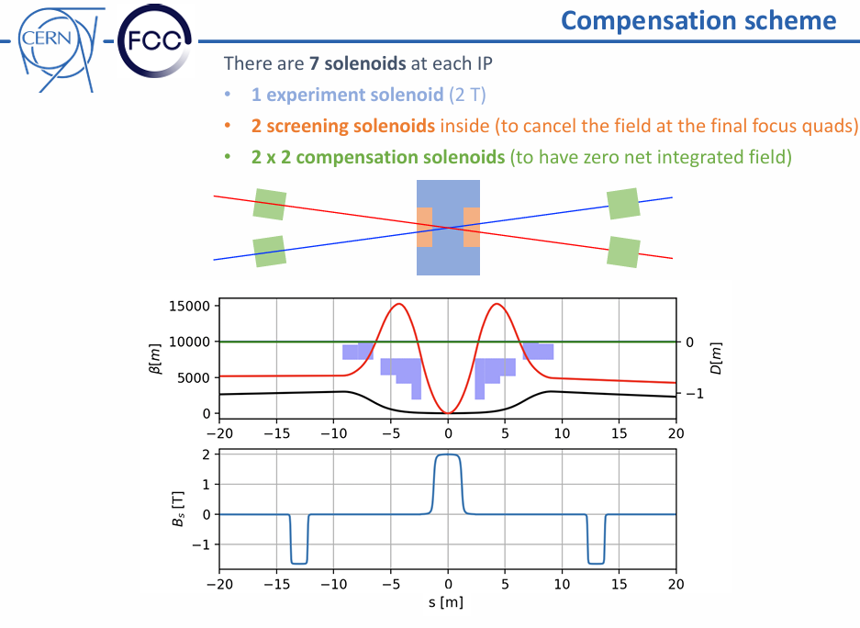
Ongoing study of Solenoid Compensation
B. Parker, V. Teotia, G. Iadarola
Transitioning from detector field: 2T to 3T.

Slide 7
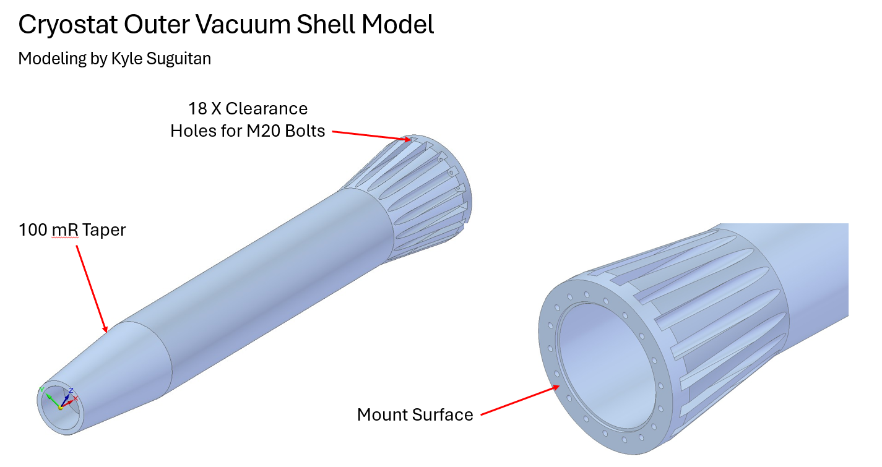
Cryostat Modeling starting with FCCee IR Magnet Cryostat Outer Surface
August 2026
Funding: DOE HFSC-A grant in 2026.
T. Montagne, K. Suguitan, J. Seeman

Slide 8
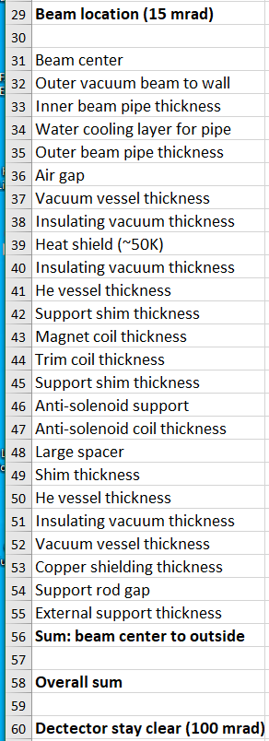
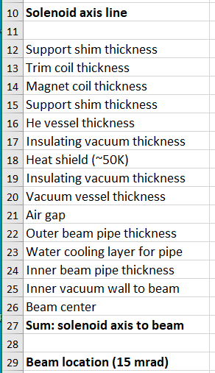
IR cryostat component layers identified
J. Seeman (~2025)

Slide 9
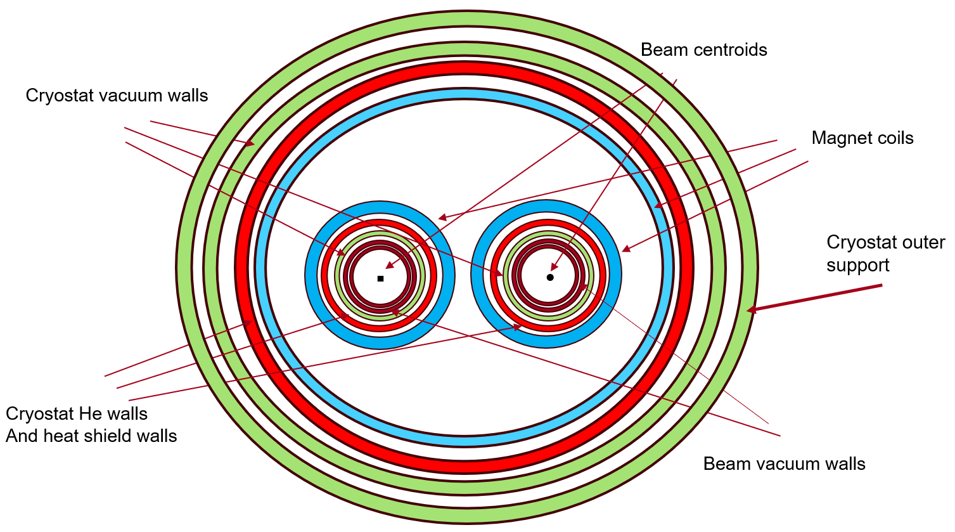
Transverse Schematic QC1 Cryostat Layers with Warm Beam Chambers
He bath
(J. Seeman ~2024)

Slide 10
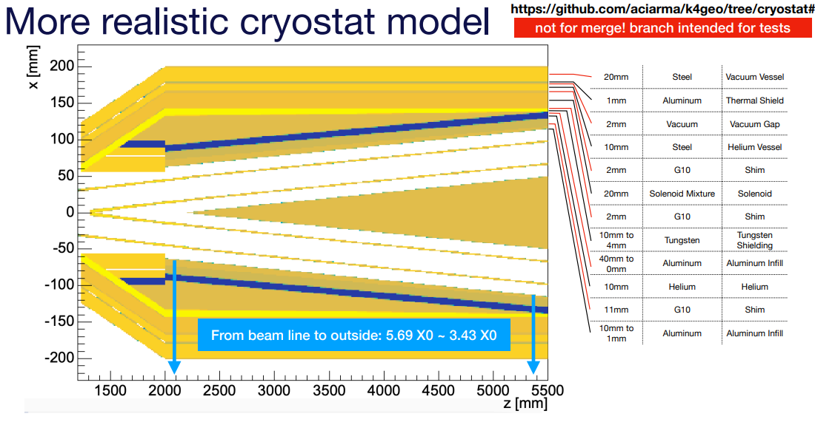
Andrea Ciarma (MDI Mtg March 10, 2026)
Reduced
to 10 mm.
Studying if
10 mm He
Vessel can
hold 30 tons.
Vacuum vessel
and two 1 mm beam
pipes, etc, not listed
here

Slide 11
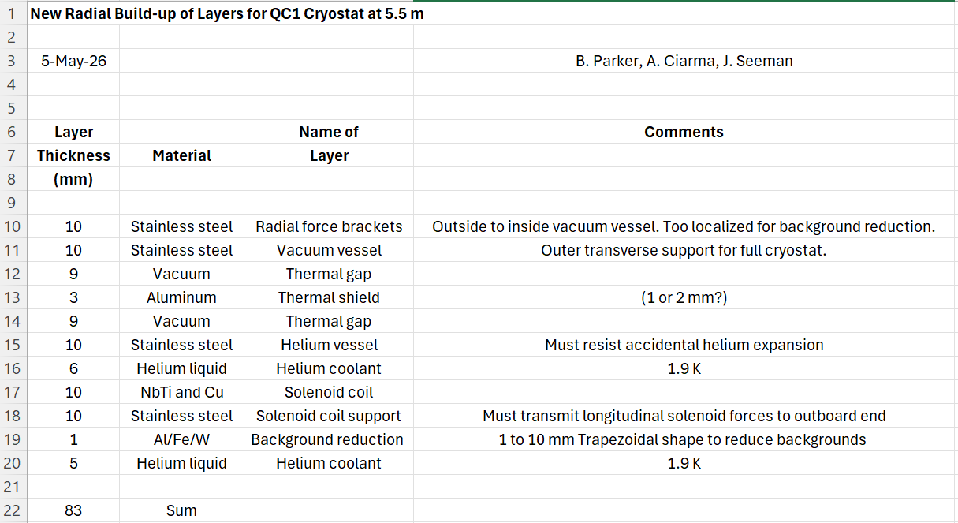
Agreed Radial Buildup from the May 5 Meeting

Slide 12
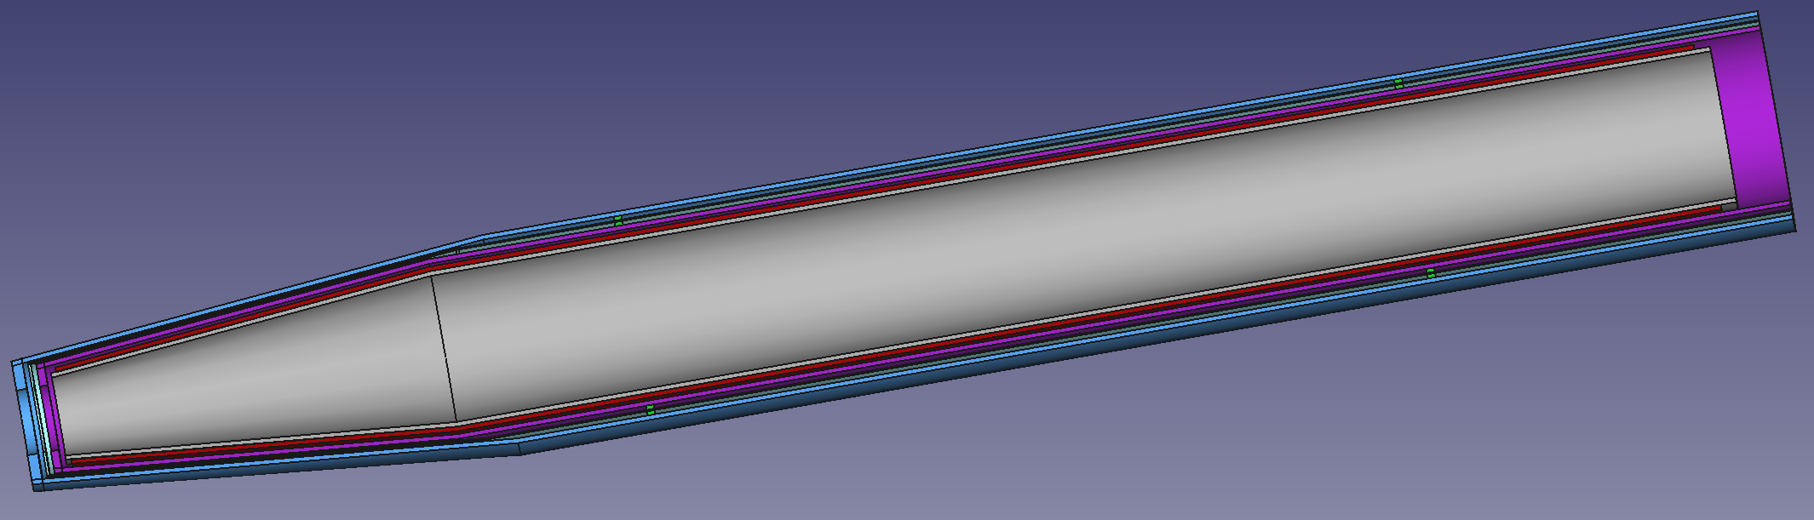
Transverse: Outer Shell (Solenoids) Cryostat Layout (B. Parker, V. Teotia, May 2026)
Thermal shield
Outer vacuum vessel SS steel
and exterior support
Radial supports
Helium vessel
Magnet coil and
SS steel mandrel
Cold mass thermal contraction (~1 cm)
Generic front end

Slide 13
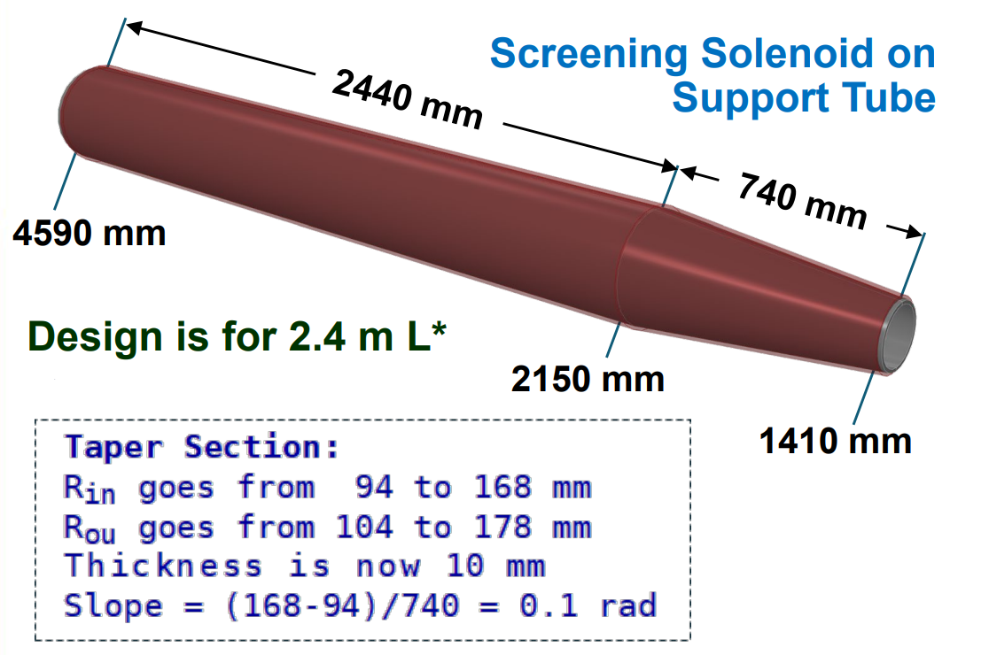
Screening Solenoid dimensions (B. Parker, V. Teotia, May 2026)

Slide 14
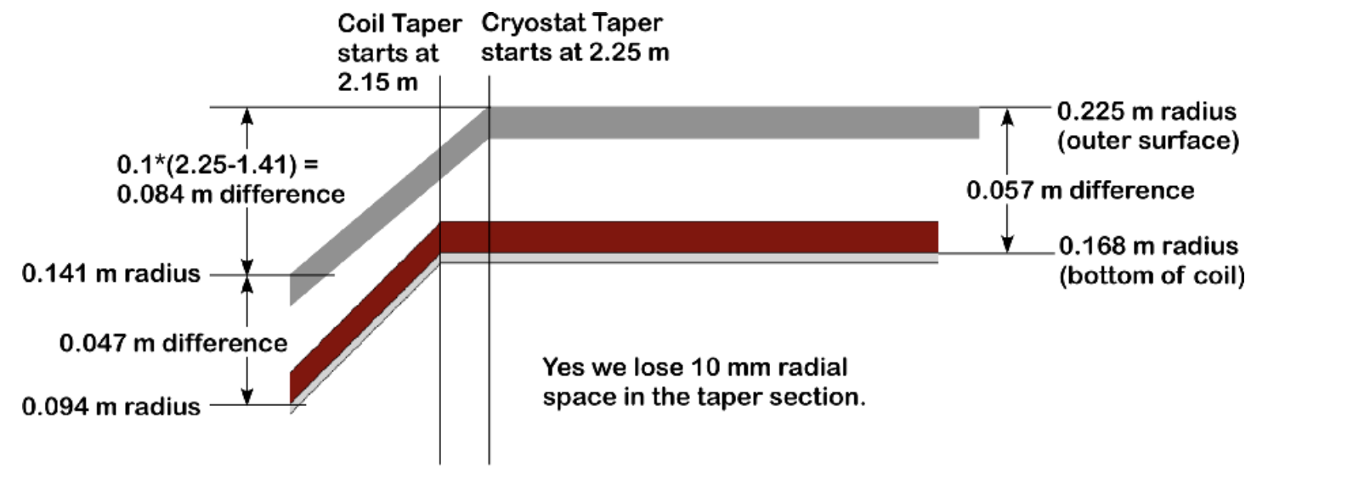
B. Parker, A. Ciarma, V. Teotia (~April 2026)
Radial taper dimensions for screening-solenoids
He vessel and magnet coil
mandrel are separated.

Slide 15
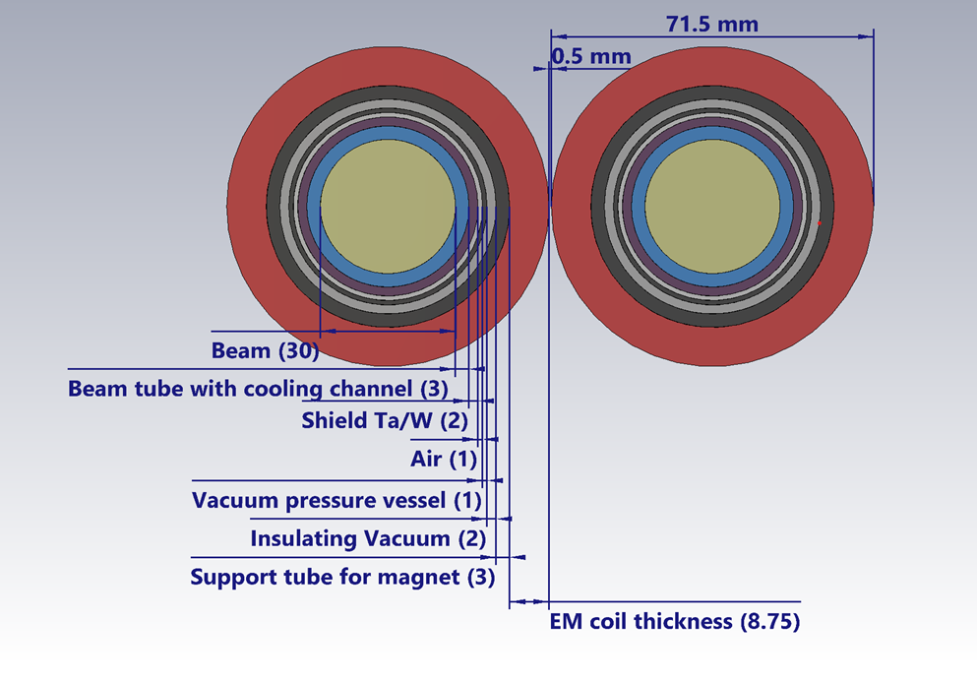
Radial Layout in the Front of full QC1A (March 2026)
Here the magnet
coil mandrel is,
also, the helium
vessel
Now all layers
fit due to
L* = 2.4 m
Direct wind
SC magnets on
helium vessel.
Beam tube =
1 mm SS, 1 mm H2O, 1 mm SS
Shielding
cooled
by beam
tube
L* = 2.4 m
V. Teotia, B. Parker, A. Ciarma, J. Seeman

Slide 16
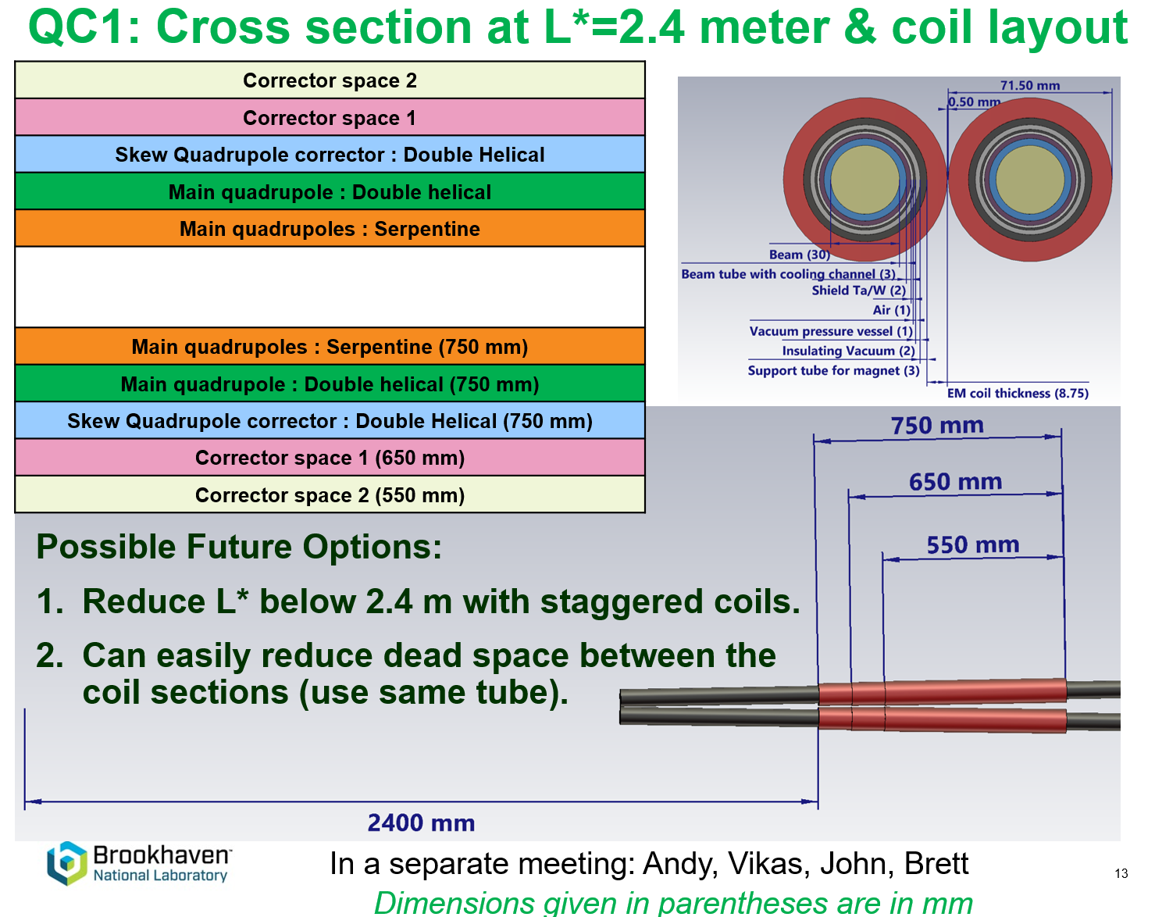
Internal dimensions near inboard end of QC1A
B. Parker,
V. Teotia,
…

Slide 17
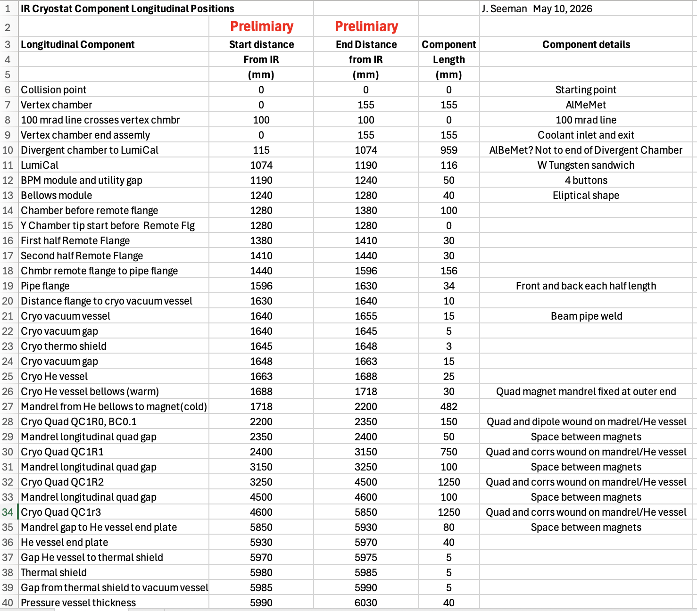
Longitudinal length build up from IP to end of QC1C.

Slide 18
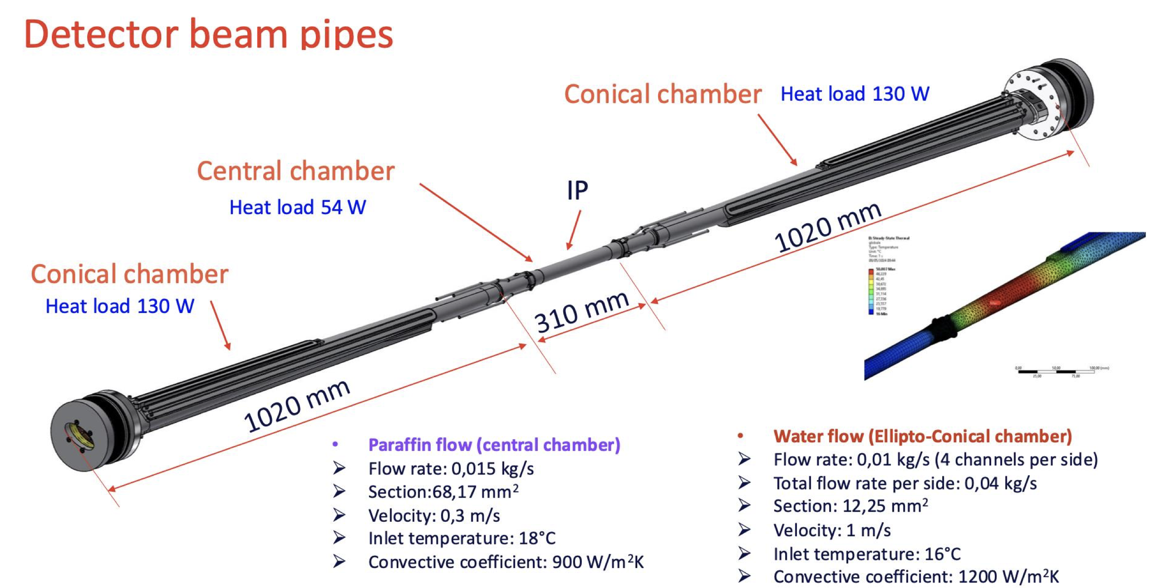
Longitudinal: Vertex & divergent chambers (A. Ciara, F. Fransesini)
November 2025

Slide 19
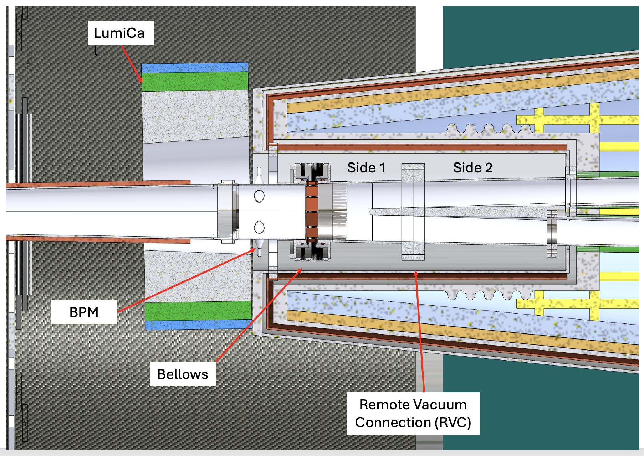
Present FCCee IR magnet cryostat (Francesco Fransesini)
Circa ~2024

Slide 20
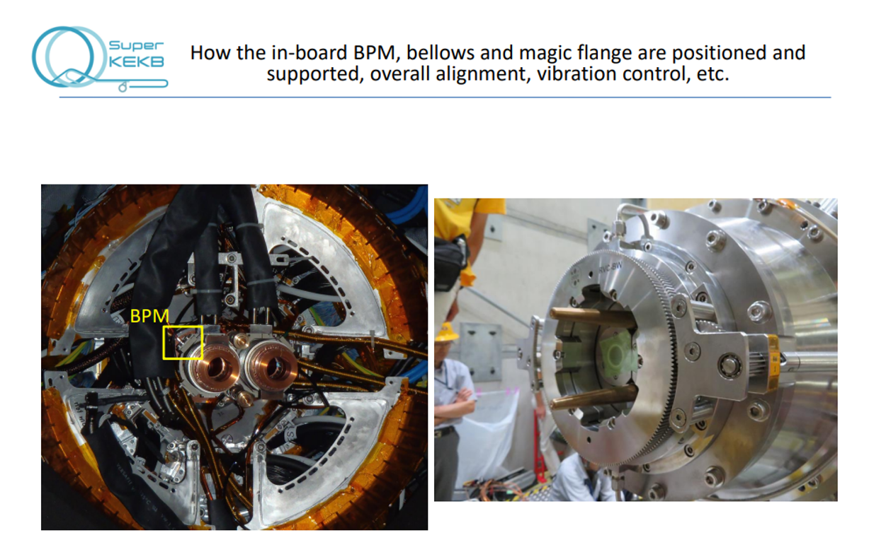
Remote Flange at SuperKEKB (before pipe merger)
Dual bores
DESY design
(M. Tobiyama et al)

Slide 21
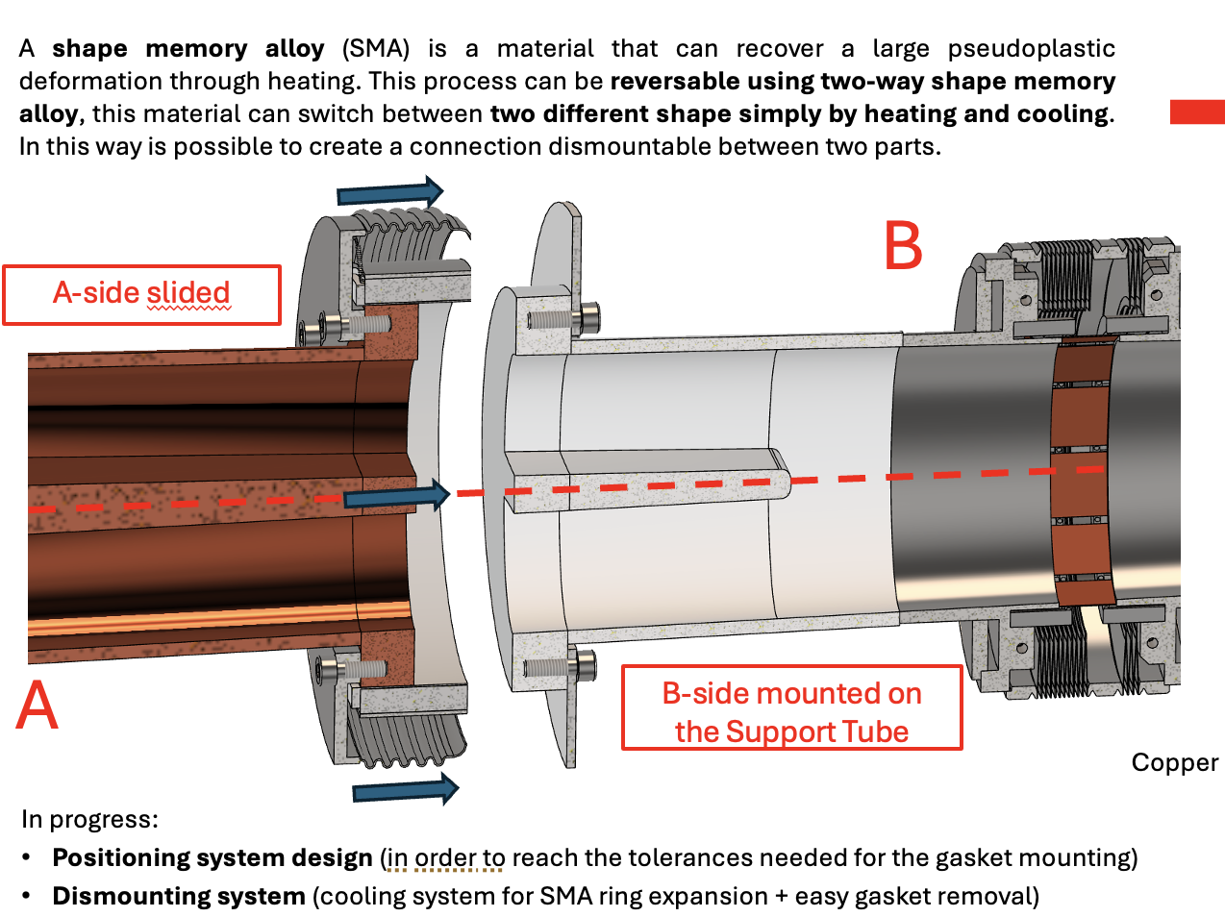
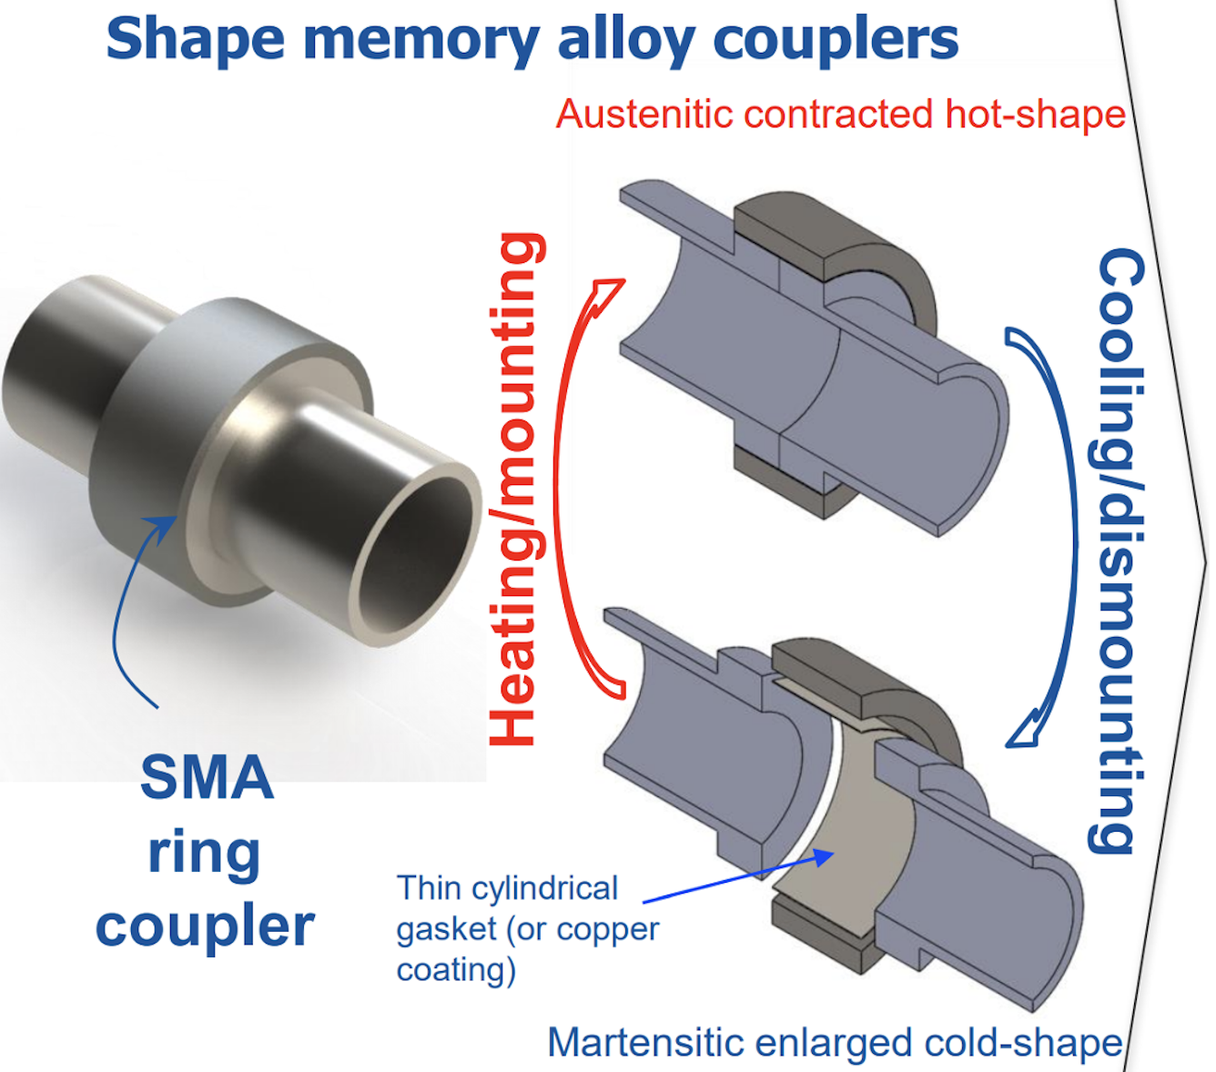
Concept for FCC Remote Flange: Shape Memory Alloy
Complex sealing surface and alignment
F. Niccoli, F. Fransesini ~2024

Slide 22
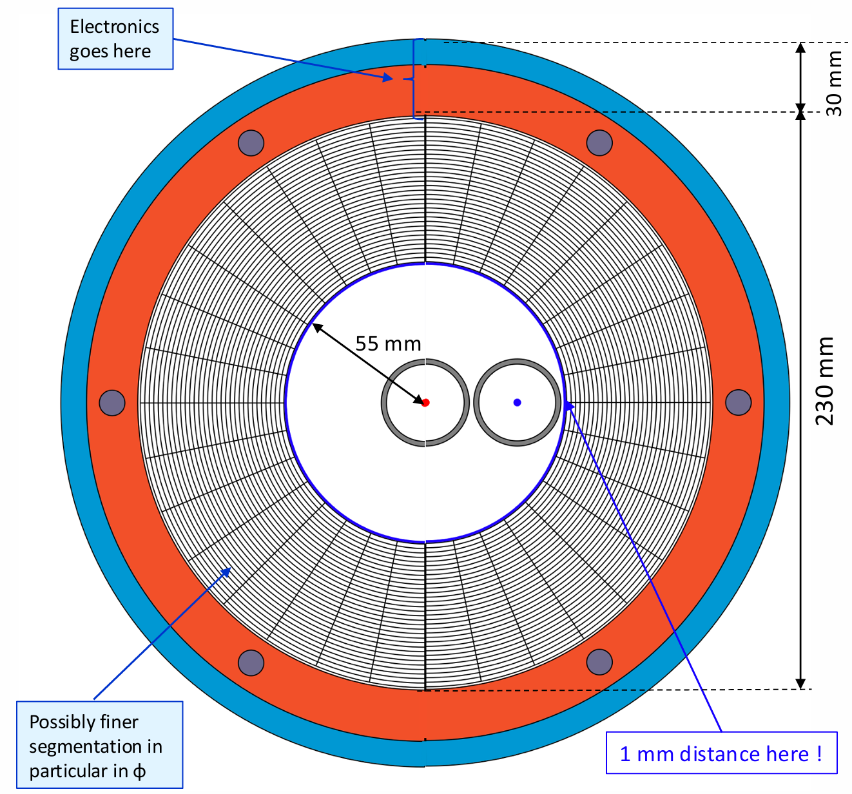
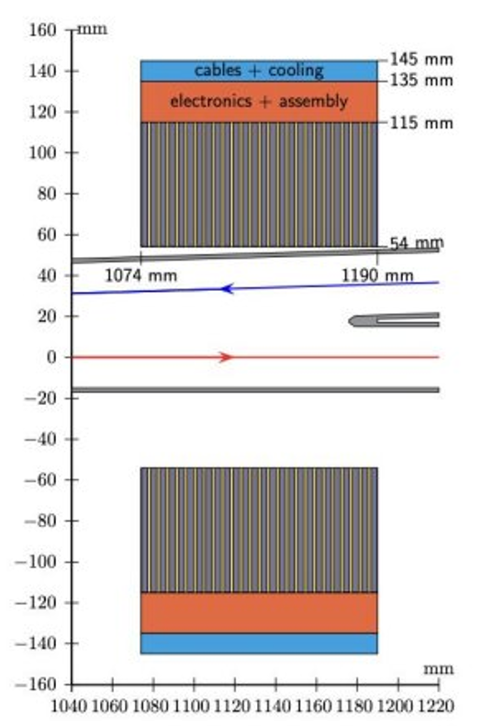
LumiCal Dimensions
LumiCal bore allows accelerator bellows and remote vacuum flange to pass.
Outgoing
beam is
Centered.
Goal: 10-4
luminosity
tolerance
(M. Dam, F. Palla, …)

Slide 23
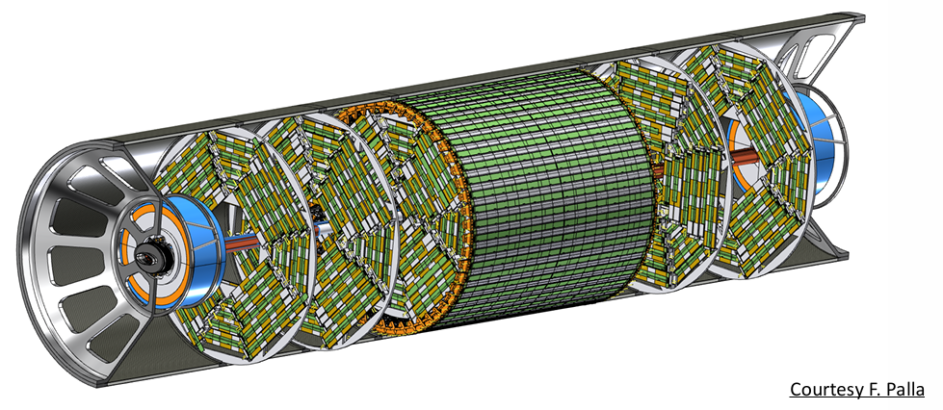
Central Chamber with IDEA Detector Components
LumiCal supported
by Carbon Fiber Tube

Slide 24
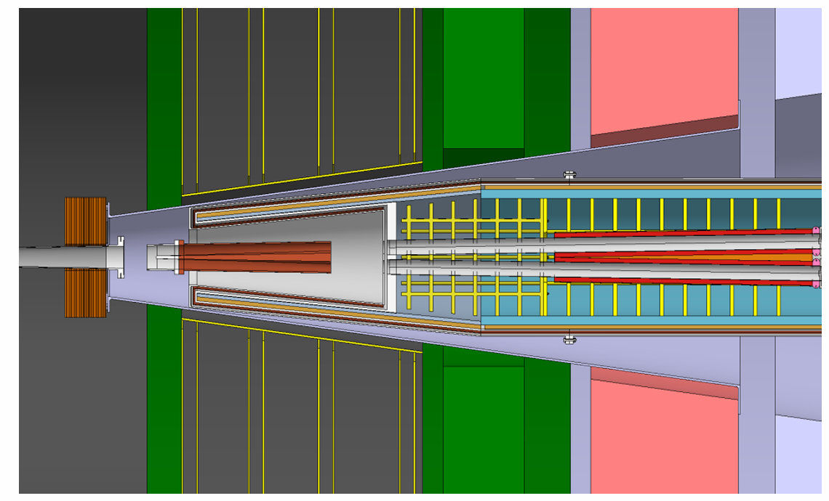
LumiCal support concept for the ALFA Detector
Where does moving detector endcap start?
End LumiCal support
Need space for
cryostat utilities
LumiCal bore too small?
G-G Kerr, O. Beltramello

Slide 25
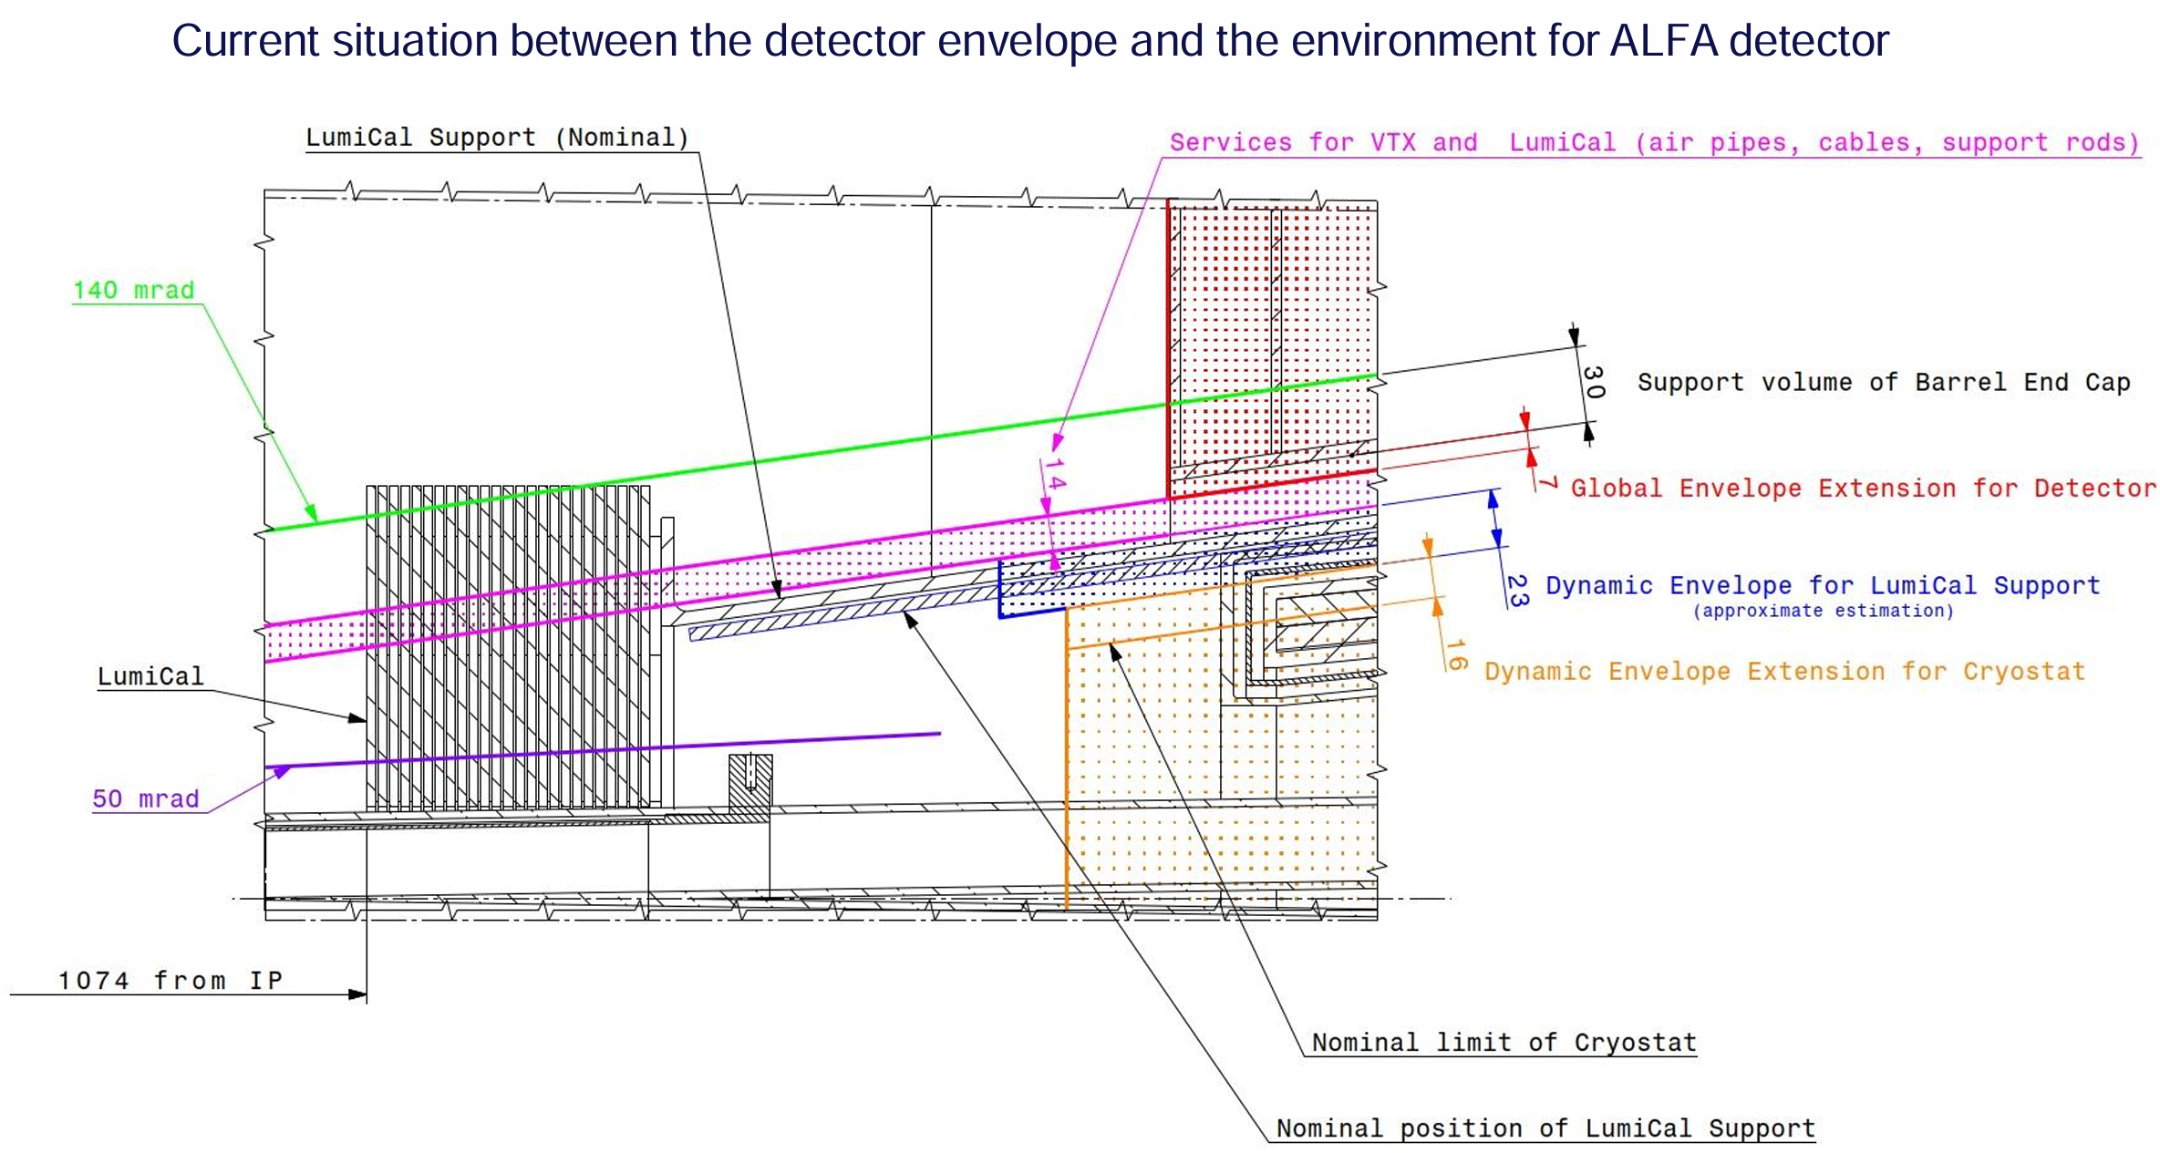
Interface between the Magnet Cryostat and ALFA Utilities
In development
D. Diyalov, O. Beltamello

Slide 26
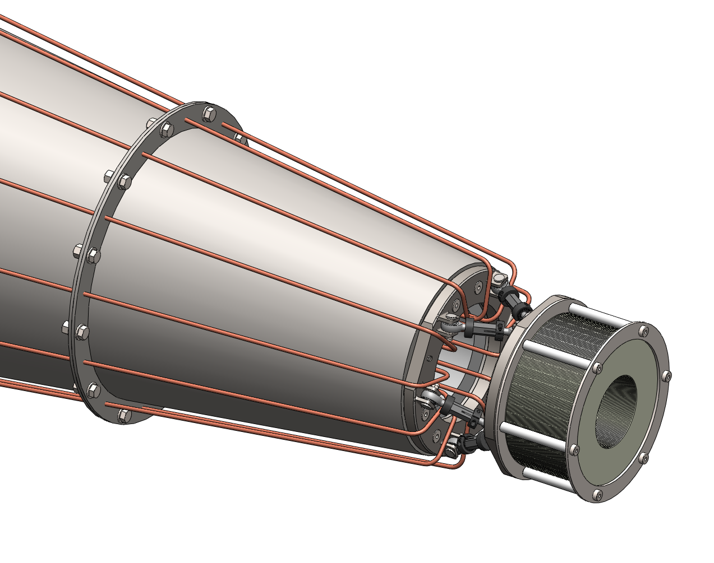
LumiCal Support and Utilities (SLAC)
LumiCal support design with
conical connection.
HFSC-A grant 2025 and SLAC LDRD
L. Pollastrini, C. Vernieri, S. Gessner

Slide 27
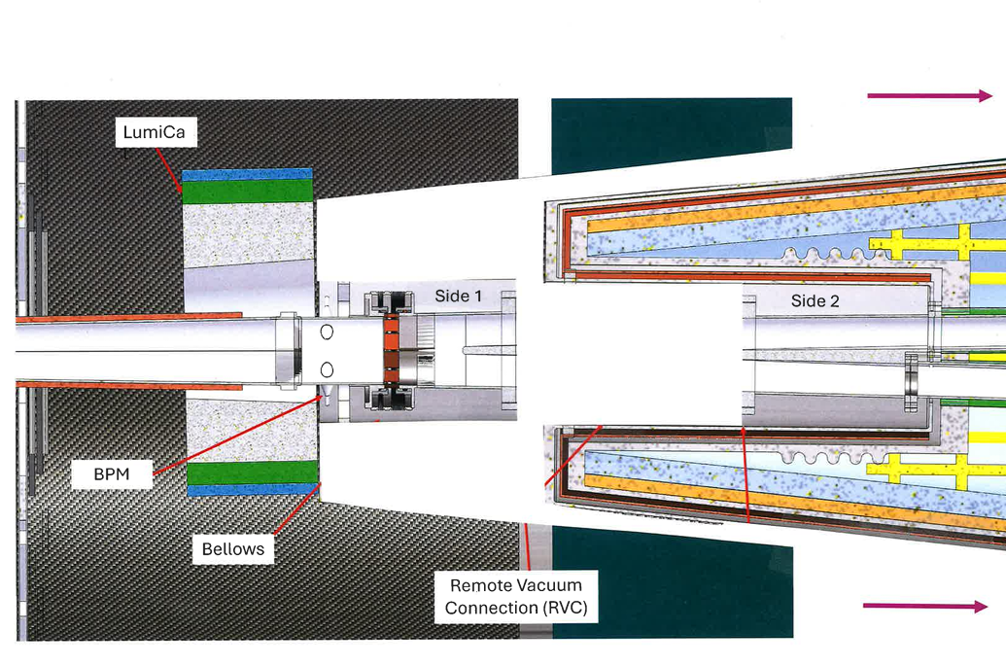
Removal of the SC Magnet Cryostat: Utilities and Supports?
Supports and Alignment?
Needs “rails” for support and alignment!

Slide 28
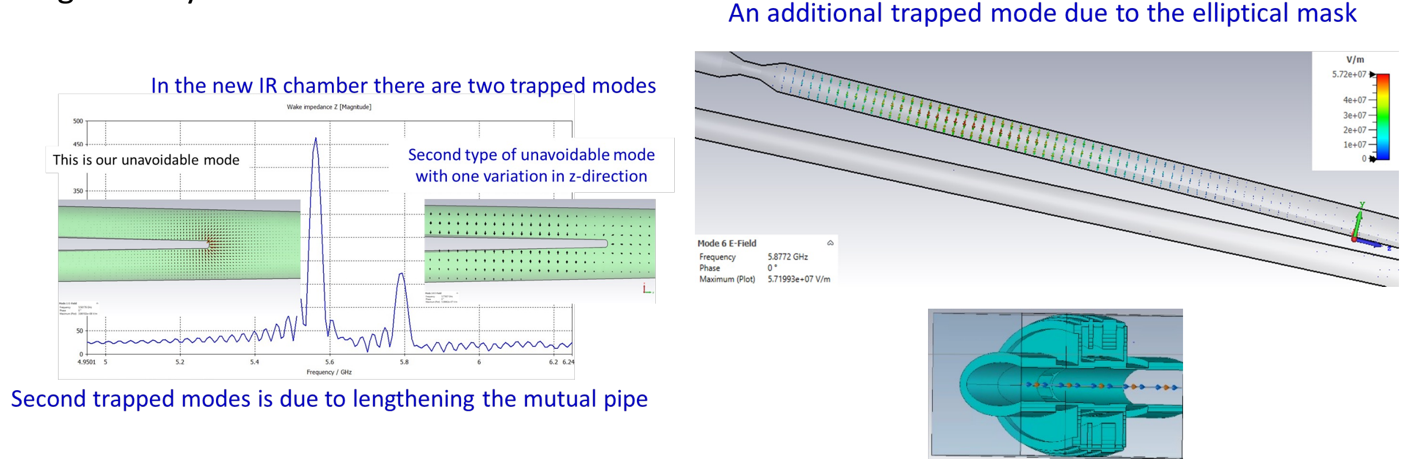
Vacuum Chamber Higher Order Modes (HOMs) (A. Novokhatski Jan 2026)
Two trapped modes leading
to heating in Y chamber
Trapped mode between
SR mask and IP
Beam heating in
IP bellows by
small HOMs

Slide 29
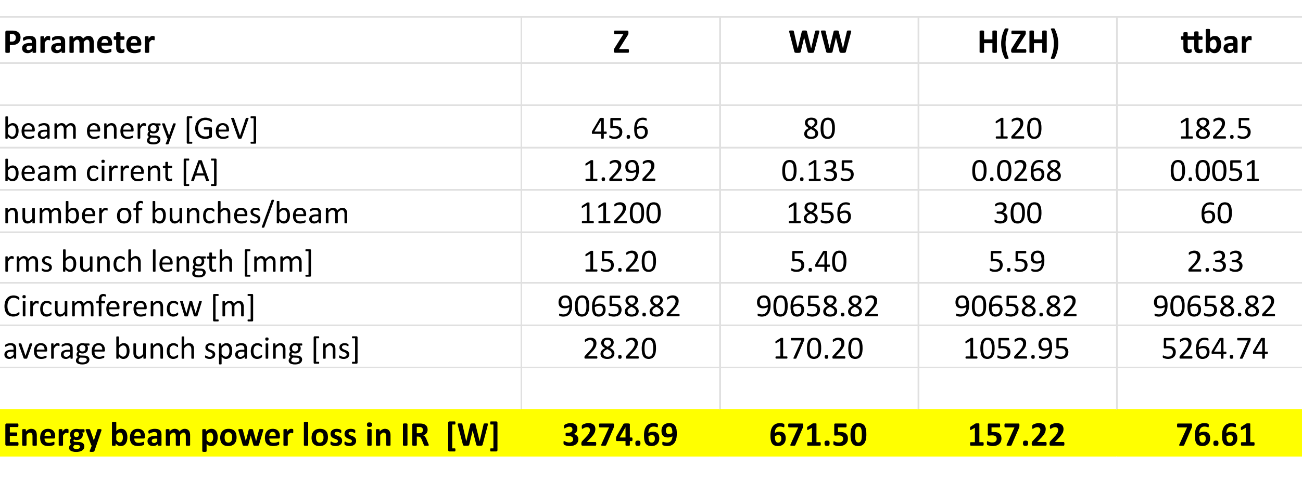
Total Beam Heating in IR (A. Novokhatski Jan 2026)
Some IR HOM beam power travels down the beam chambers away from the IR.
Some IR HOM beam power is absorbed in the IR chambers, shown in table below.
All IR chambers must be water cooled (only allow ~1 cm gap in cooling).

Slide 30
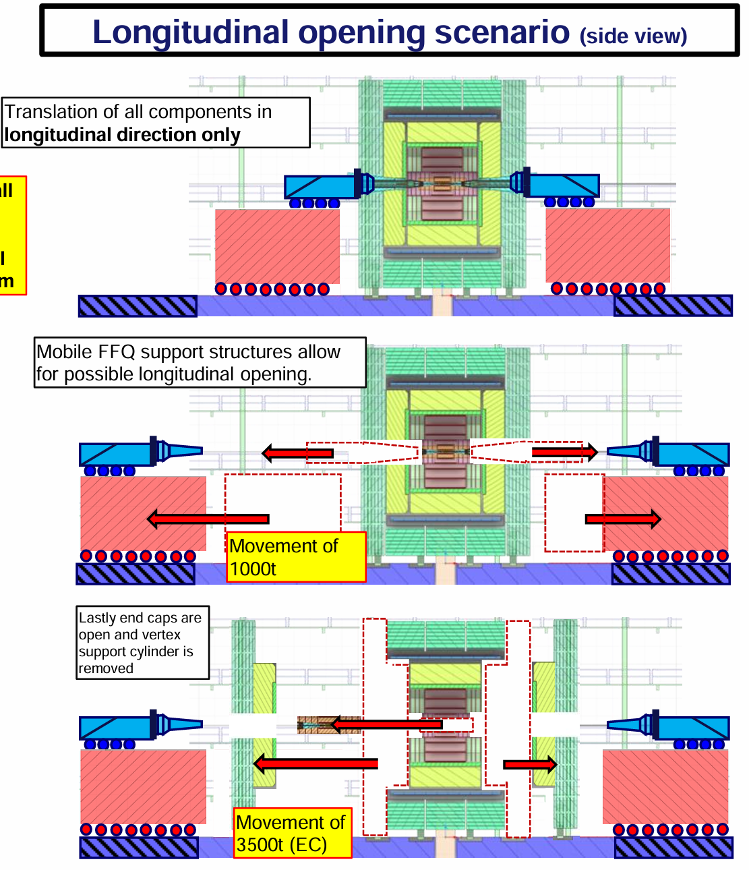
Magnet Cryostat in the Detector Cavern
Detector endcap
is removed
longitudinally after
magnet cryostat is
removed.
O. Beltramello

Slide 31
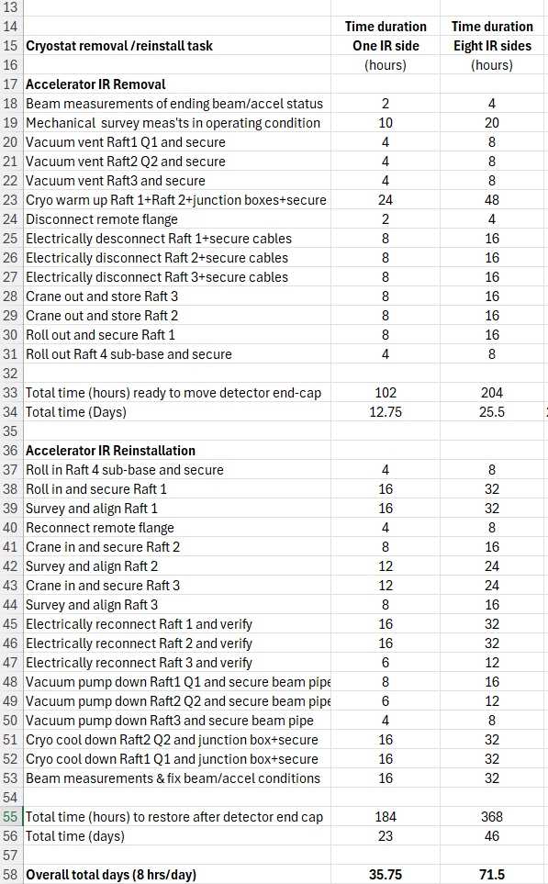
Estimated Calendar Time required to remove and replace magnet cryomodules during CERN Year End Technical Stops YETS
J. Seeman June 2026
Assumed shared crews.
36 days for 1
detector endcap
72 days for 8
detector endcaps

Slide 32
Forward cryostat tasks
Identify near-IR differences between detectors (~5) relative to their cryostats.
Finalize screening solenoid specifications.
Specify all cryostat beamline magnet correctors.
Determine cryostat front-end (reentrant) components (inboard of 2.4 m).
Develop concepts for support of beamline components, LumiCal, and VTX.
Define utility pathways between cryostat and the detector fiducial volume.
Collect safety requirements (pressure & He vessels, earthquakes, assembly)

Slide 33
Thank you for your participation.
END
FIN
FINE
ENDE
LOPPUA

