Slide 1
Machine Detector Interface MDI
John T. Seeman
SLAC National Accelerator Laboratory
September 8, 2026
4th Annual Higgs Factory-Future Circular Collider Workshop at SLAC

Slide 2
Machine Detector Interface (MDI) Tutorial
John Seeman (SLAC)
September 8, 2026
The Interaction Region IR in a high-current high-luminosity e⁺e⁻ collider is compact and complex, combining many of the most difficult aspects of the accelerator and detector. MDI helps coordinate plans for the highly interconnected interface between detector and accelerator to facilitate that both are successful even at the highest luminosities, often at several center-of-mass energies, for example from the Z pole to the t-tbar threshold. The accelerator and detector layouts integrate accelerator components such as lightweight and actively cooled beampipes, superconducting IR-magnets, bellows, and remote vacuum connections with detector components of inner detectors, vertex chamber, diagnostics, luminosity detectors, and utilities (cables, cooling, power, supports). This tutorial will cover more than thirty interface topics (from SC magnets, shielding solenoids, vacuum chamber masks, and inner detector elements to IR beam physics, beam loss sources, various beam backgrounds, and irradiation protection shielding). Examples from past and present colliders (KEKB, PEP-II, SuperKEKB) and future colliders under design (FCCee, ILC) will be used. Attendee interactions are encouraged.

Slide 3
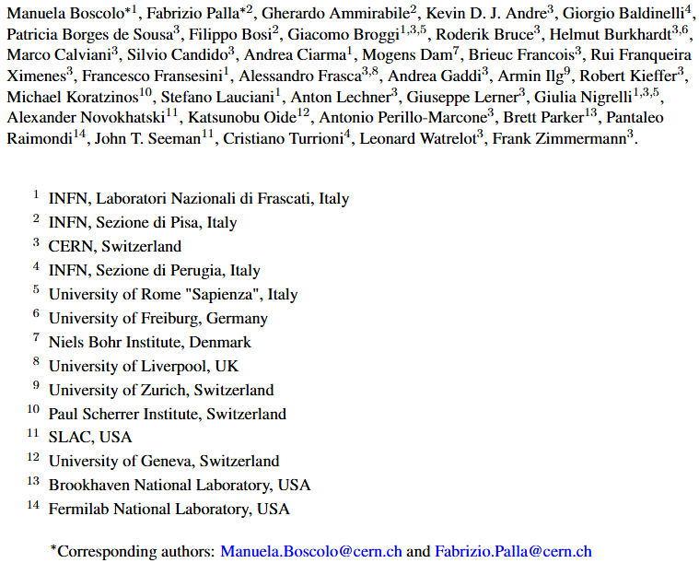
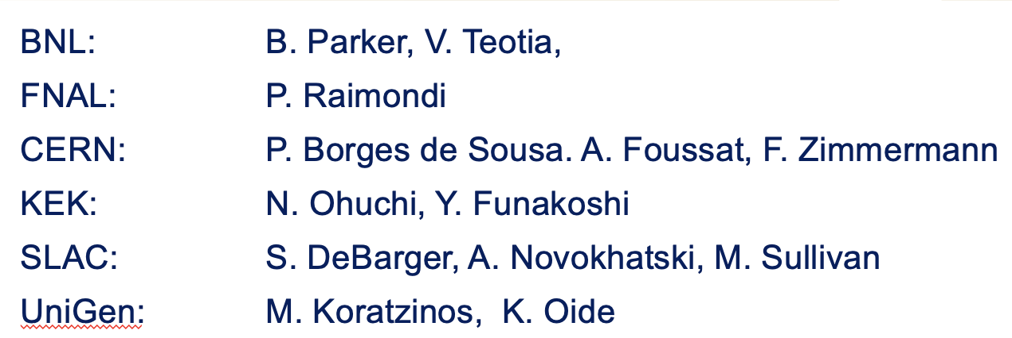
MDI inputs from these people and others.
T. Raubenheimer, S. Gessner, T. Montagne, C. Niebuhr, K. Suguitan, G. Kerr, L. Pollastrini

Slide 4
MDI Tutorial Topics
1) General overview and IR layouts for various colliders
2) Main IR parameters
3) IR Comparison of various colliders
4) IP beta function versus L*
5) Detector requirements
6) Detector sub-components
7) IR accelerator requirements
8) Accelerator sub-components
9) Detector-Accelerator Interferences
Main collider goal
MDI compromises
Detector end cap withdrawal
10) Luminosity measurement
Lumi-Cal at 1.076 m
-11) Vacuum Chambers
IR chamber design +/-0.5 m
Y chamber 0.5-2 m
Y chamber HOM issues and reduction
Lumi-Cal at 1.8 m
Remote flanges (e.g. CESR, SuperKEKB, SMA)
12) Magnet cryostat 2.4 to 7 m
Cryostat cryogen feed
lines and splice box
Q1 magnet in 3 pieces
Q2 magnet in 2 pieces
Compensating and screening solenoids
Correction magnet coils
13) Component assembly
14) Installation
15) Vibration control
16) Polarization
17) Background sources
Beam background types
Beam gas, Touschek, synchrotron radiation, non-Gaussian tails, luminosity,

Slide 5
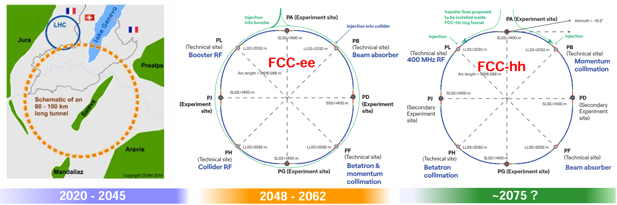
FCCee Rings and IR beam lines

Slide 6
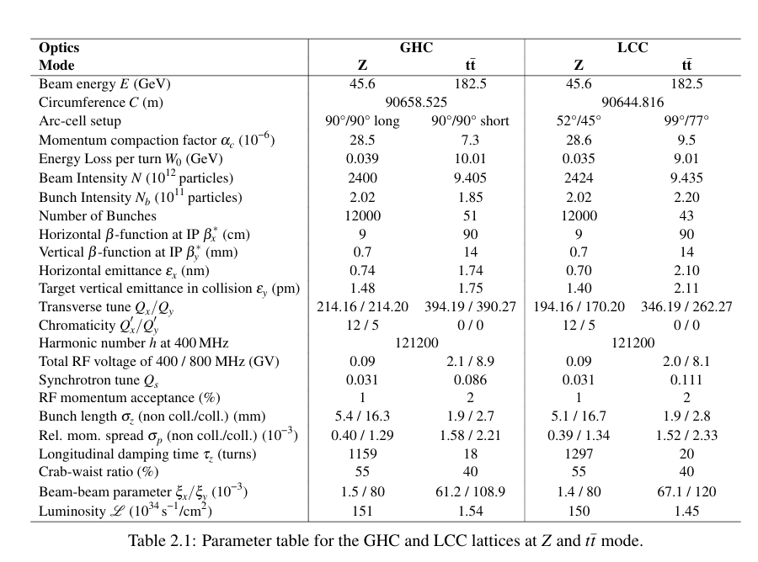
Main Parameters for FCC at Jan 26 Lattice Review: LCC chosen.

Slide 7
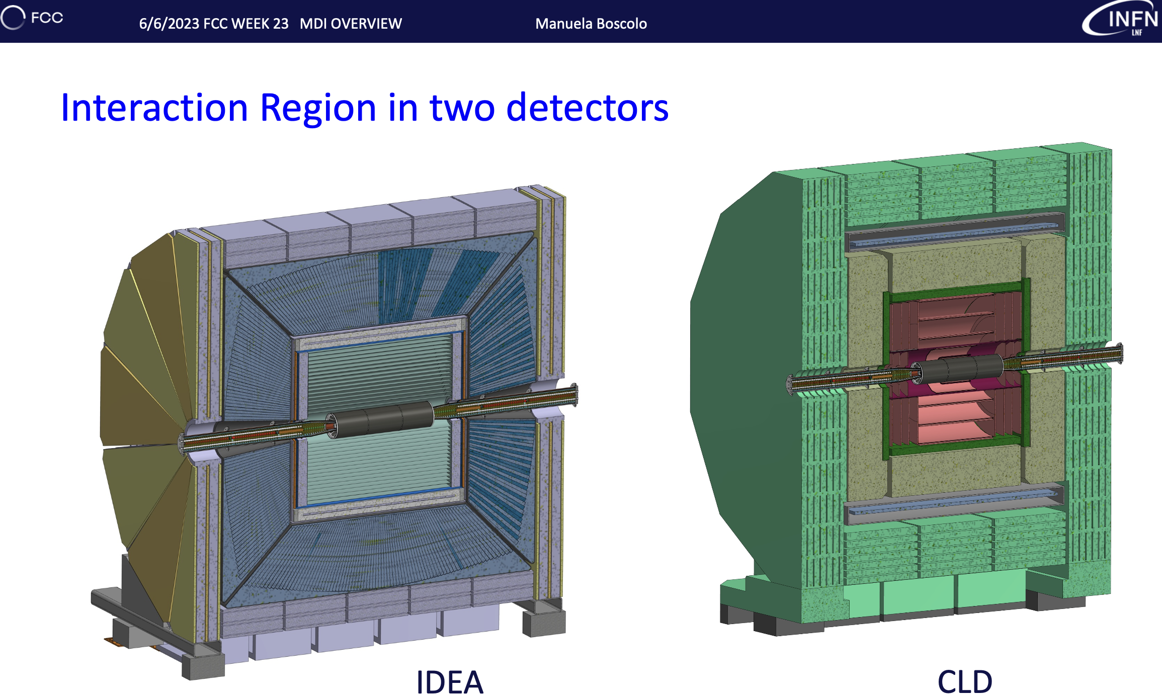
General Detector-Collider Overviews (M. Boscolo)
New: ALFA + two more!
FCC Detector Concepts (IR accelerator inside detector)

Slide 8
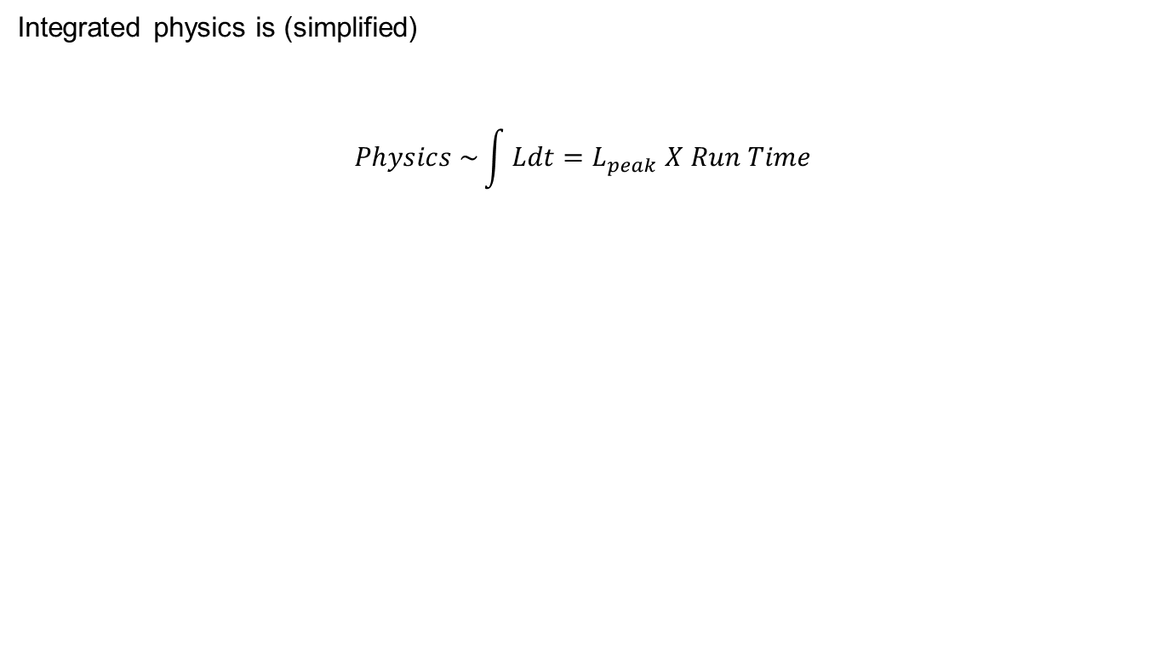
Integrated Physics
Integrated physics is (simplified)
$$Physics \sim \int{Ldt=L_{peak} X Run Time}$$

Slide 9
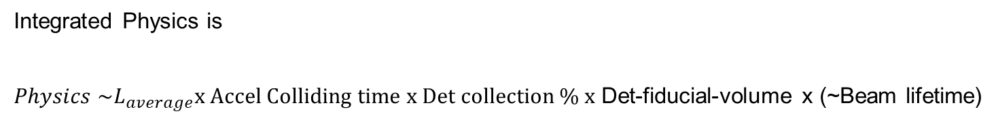
Practical Integrated Physics
Integrated Physics is
$Physics \sim L_{average}x Accel Colliding time x Det collection \% x$ Det-fiducial-volume x (~Beam lifetime)
L_{average} = L_{peak} x (1-L_{decay})-beam real-time lattice/coupling variations
Accel colliding time = colliding time – running down times - maintenance stops
(Maintenance time: PEP-II = 1 month/yr, CERN =3 months/yr (YETS)
Detector collection= (1 - recording deadtime) (1-injection deadtime)
Detector fiducial volume = ~0.99
To go to 0.995 → need to squeeze final quads out (L* x 2 distance) and will,
thus, lower peak Lumi by ~1/2. Caution: a push for +5% could lose -50% in
physics.
Beam lifetime ~ 10 min. Injection detector time veto is a few msec per injection.

Slide 10
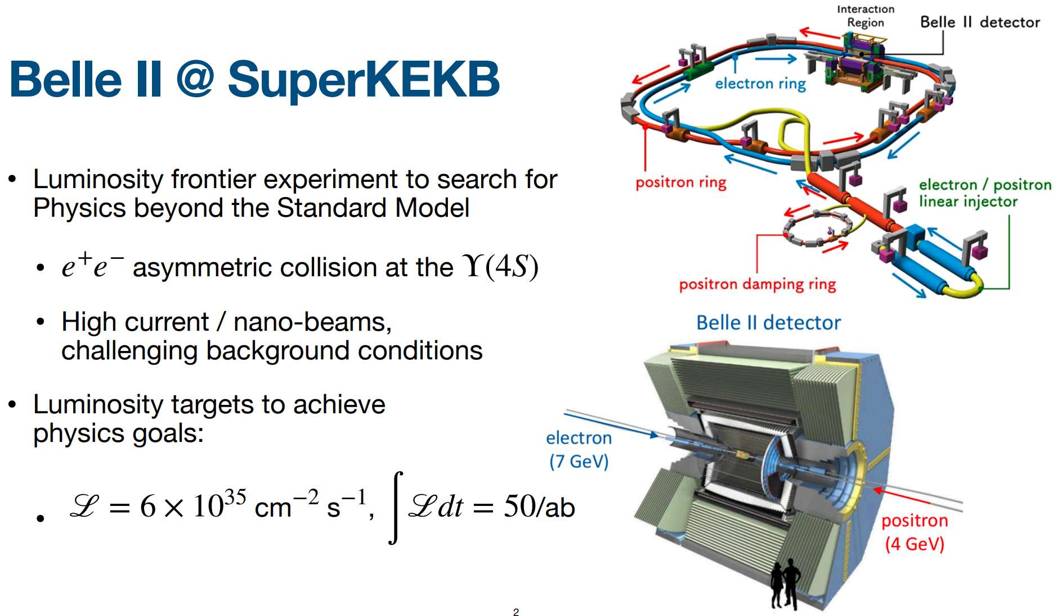
SuperKEKB and Belle-II
A new record of peak luminosity of 5.32x10^34 was achieved
(Belle II HV off) and the integrated luminosity reached 914 /fb .

Slide 11
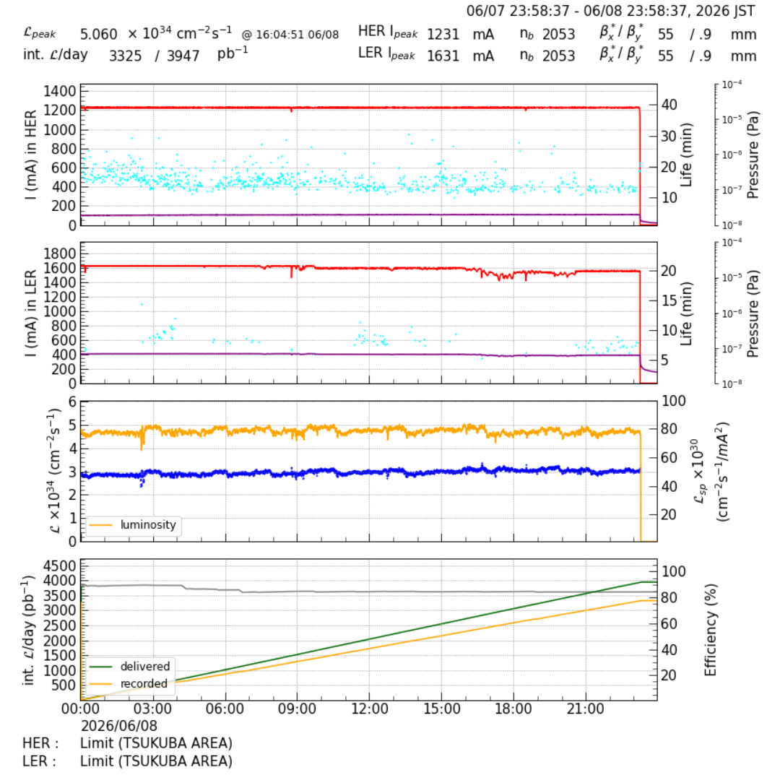
Example: SuperKEKB Operations (June 8, 2026) (courtesy KEK)
Top-up injection
for both beams.
Lifetimes =
HER ~ 39 min
LER ~ 20 min
Luminosity lifetime ~13 min
HER one
beam trip
LER unstable current + one beam trip
Belle-II data
collection
is about 80%

Slide 12
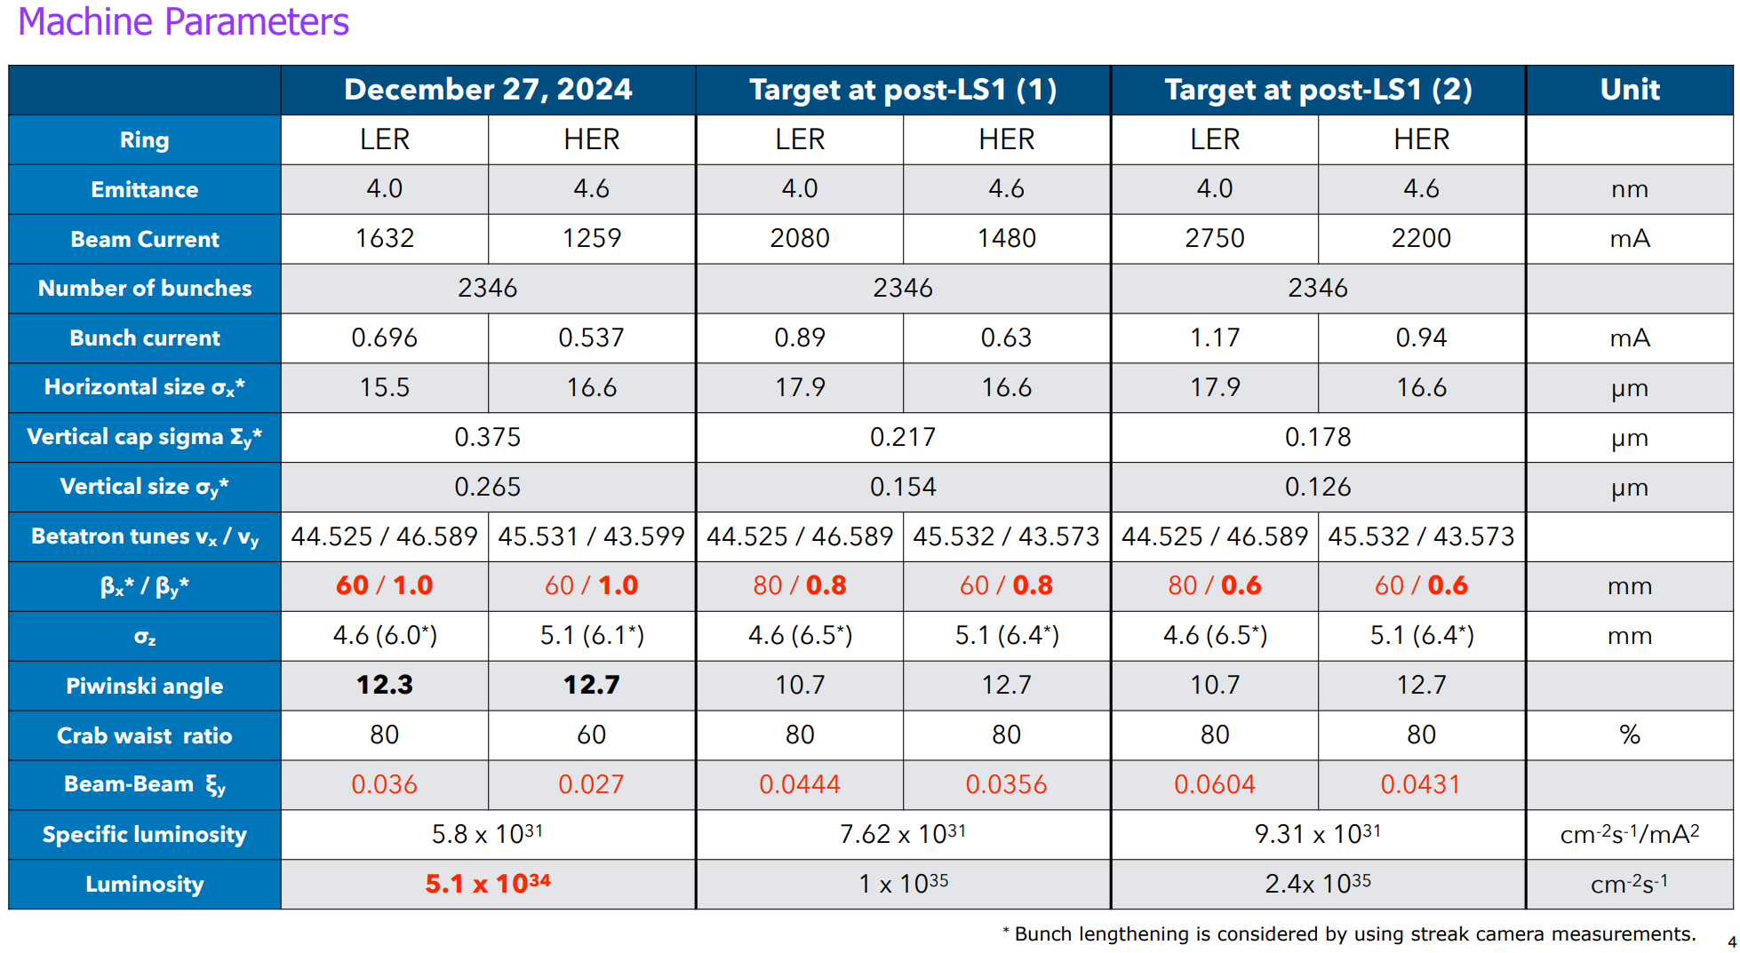
SuperKEKB Parameters

Slide 13
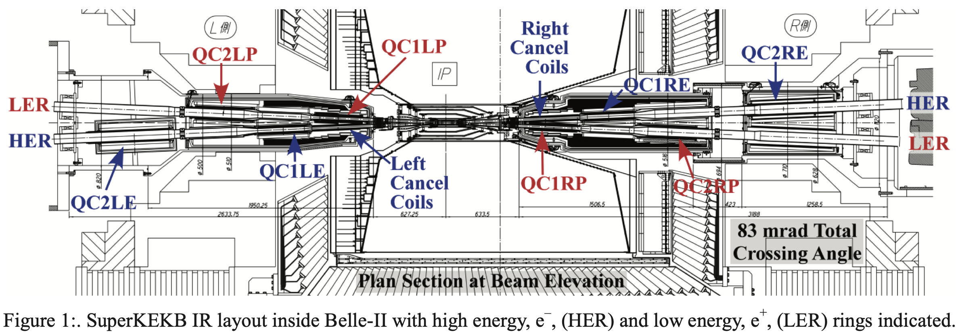
Overall SuperKEKB IR Layout

Slide 14
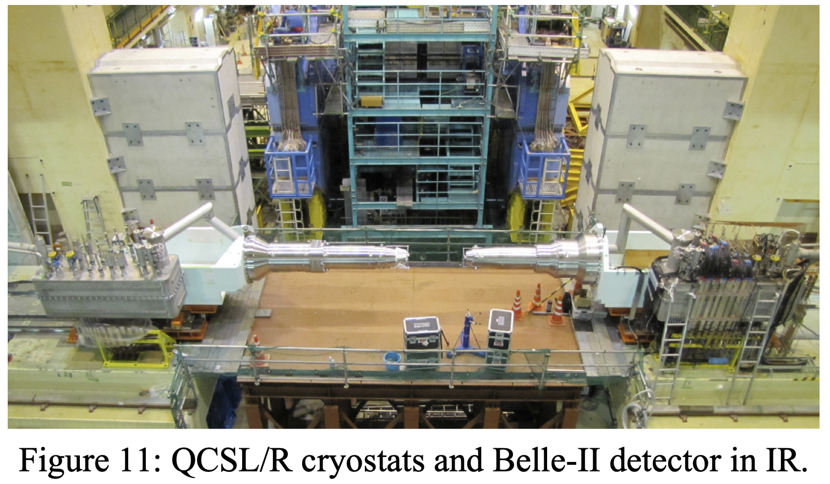
SuperKEKB IR Cryostats

Slide 15
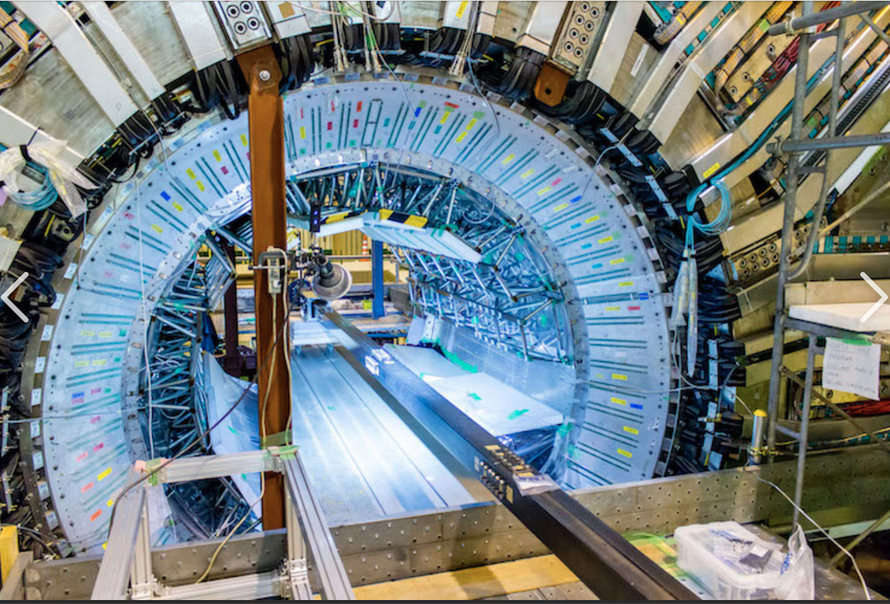
Belle-II Center View

Slide 16
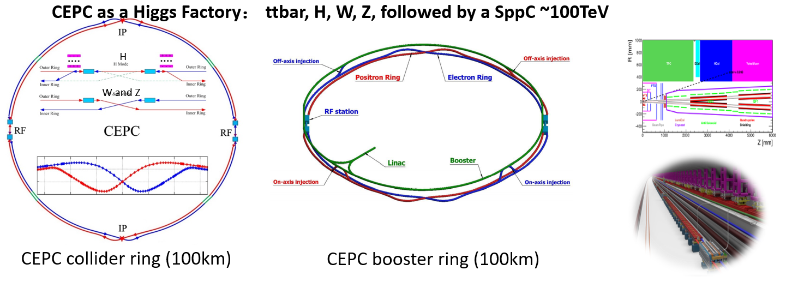
CEPC Overview (~2023)

Slide 17
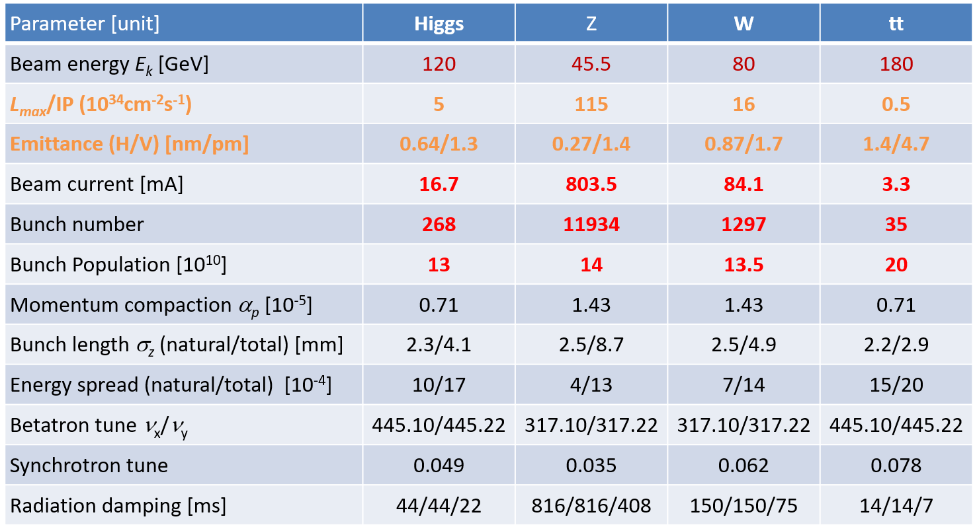
CEPC Parameters

Slide 18
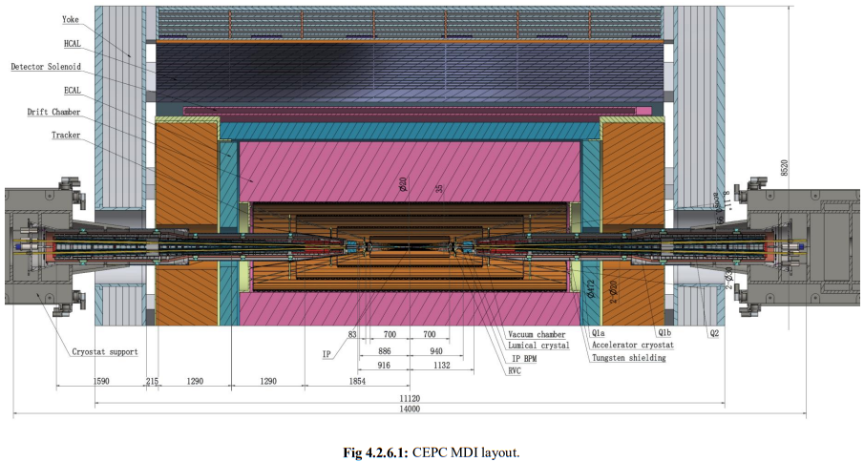
CEPC IR magnets and cryostats (Dec 2023)

Slide 19
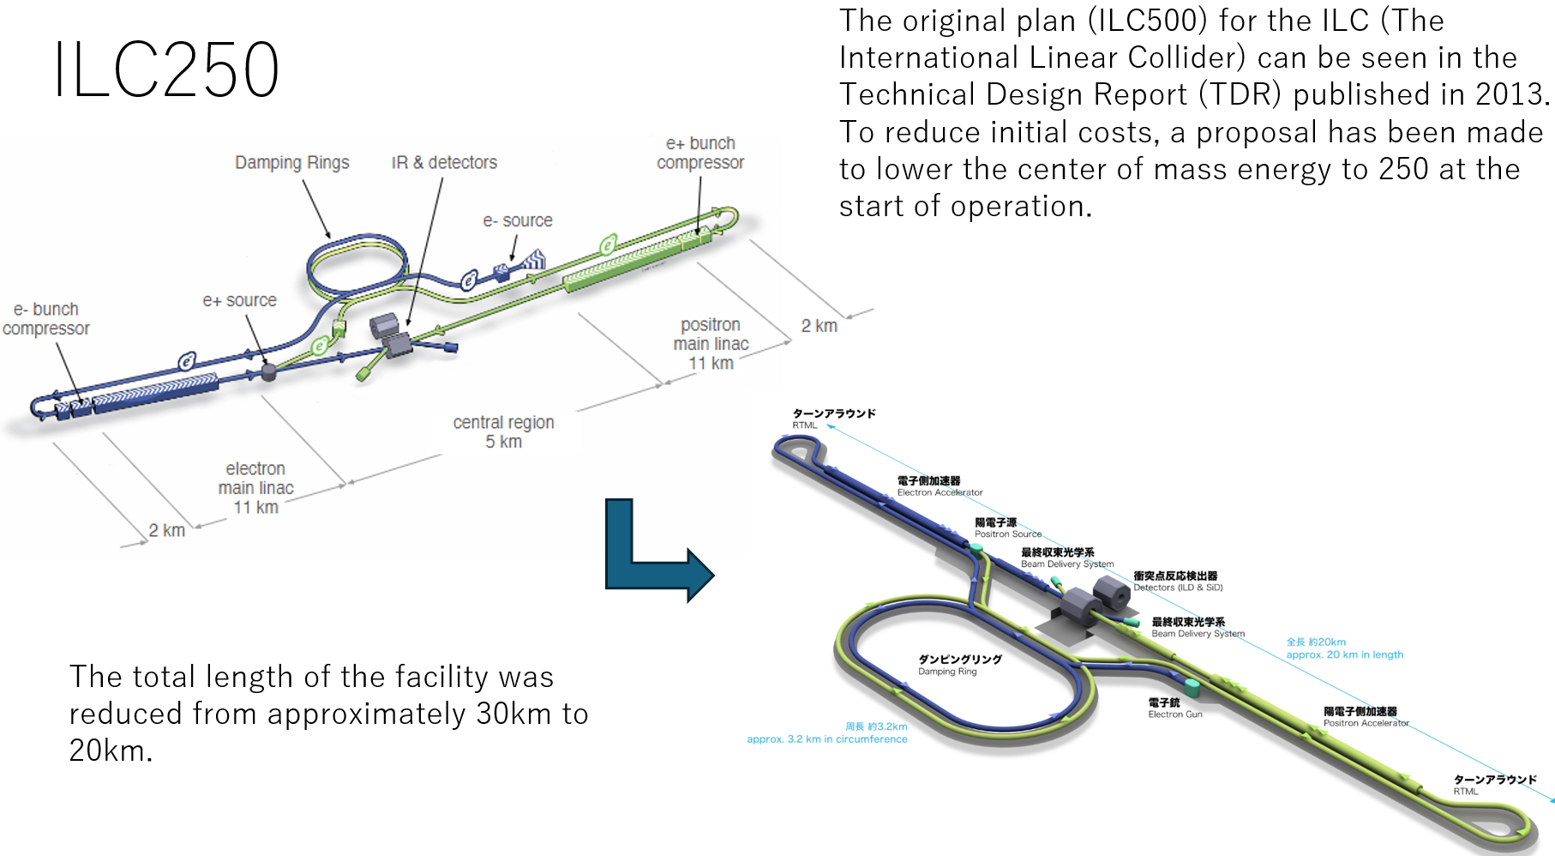
ILC layout

Slide 20
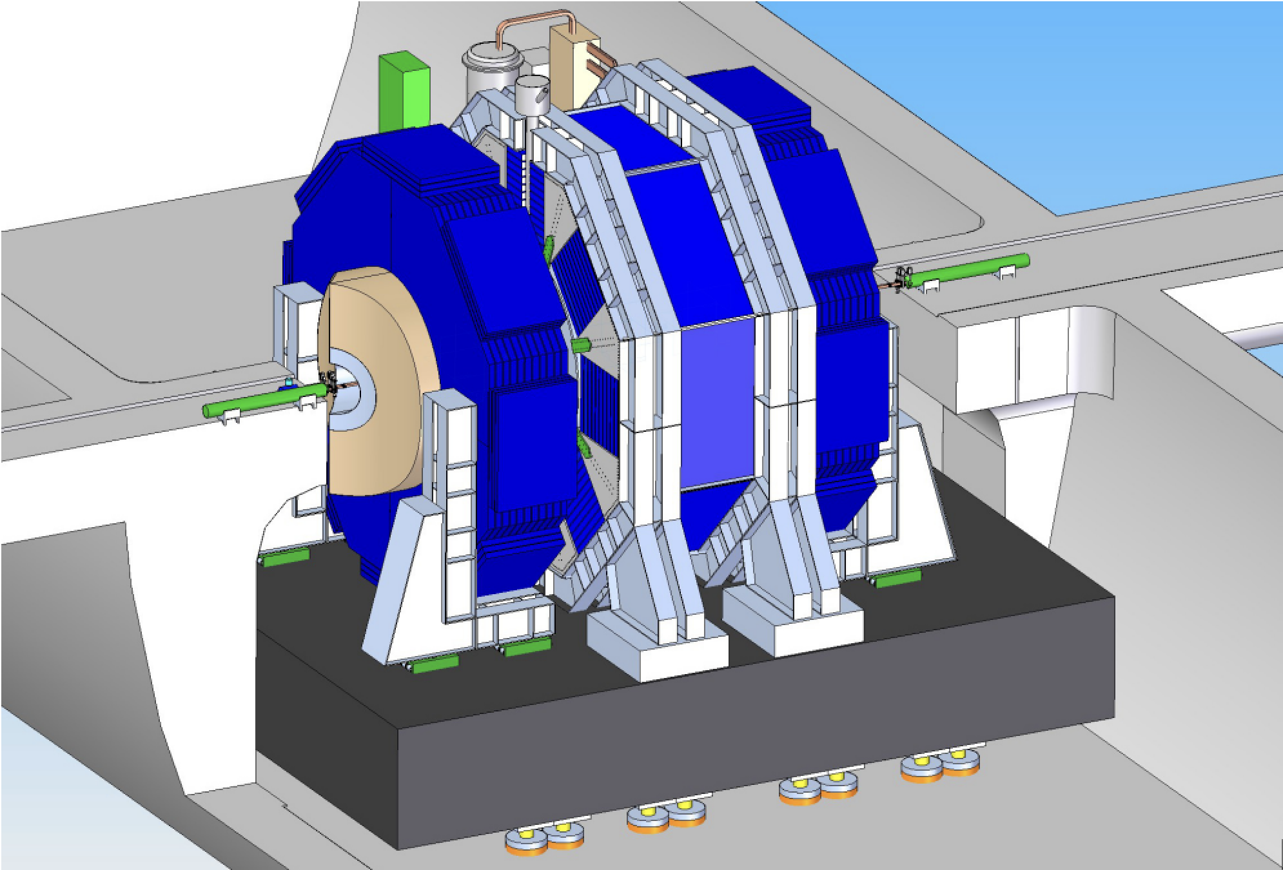
ILC Detector Concept (Accelerator IR Quads Magnets Outside)

Slide 21
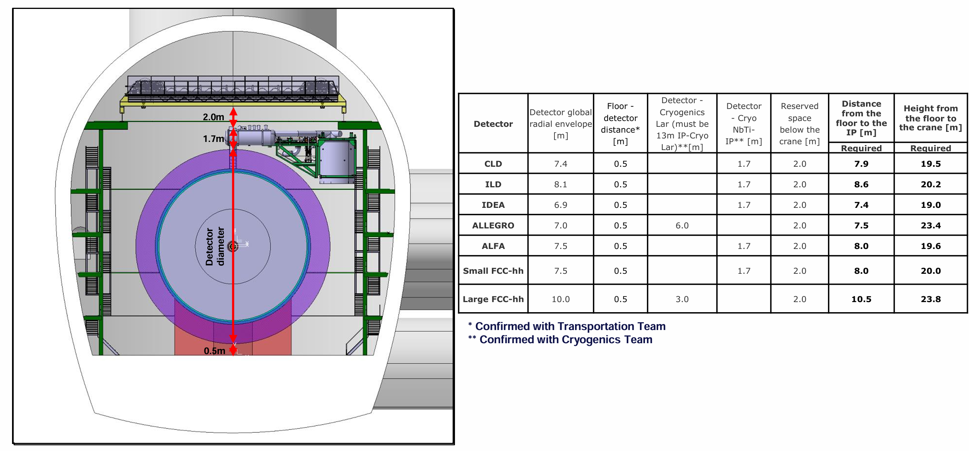
FCC tunnel cavern possibilities
(J. Szaga)

Slide 22
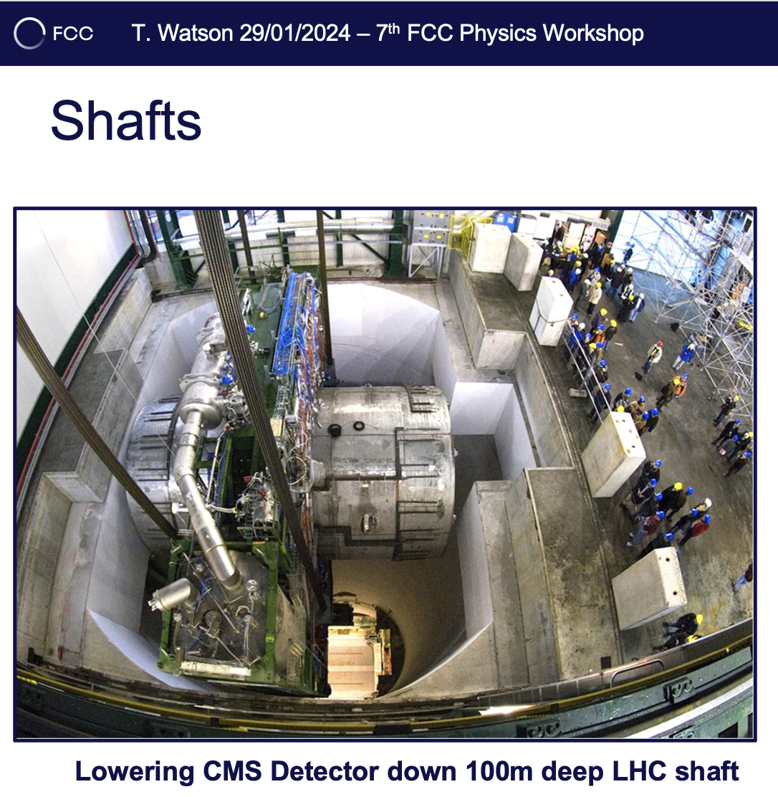
Lowering LHC Detector Components

Slide 23
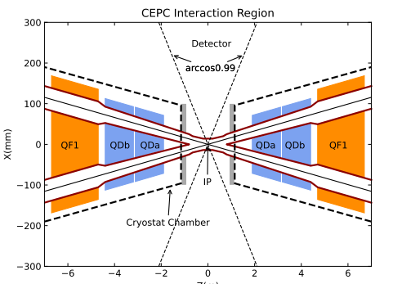
IR Layout

Slide 24
Comparisons of IR (features for FCCee, CEPC, ILC, SuperKEKB)
Machine |  | FCCee | CEPC | ILC | SuperKEKB
Crossing-angle | mrad | 30 | 33 | 14 | 83
L* | m | 2.2 | 1.9 | 3.5 | 0.935
L* x Cross-angle | mm | 66 | 63 | 49 | 78
Vertical β_{y}* at IP | mm | 0.7-1.6 | 0.9-2.7 | 0.4 | 0.3
Detector soln field | T | 2/3 | 3 | 3.5/5 | 1.5
Detector stay clear | mrad | 100 | 118/141 | 90 | 350/436
He temperature | K | 1.9 | 4.2 | 4.5 | 4.5
QC1s side-by-side |  | Yes | Yes | No | No

Slide 25
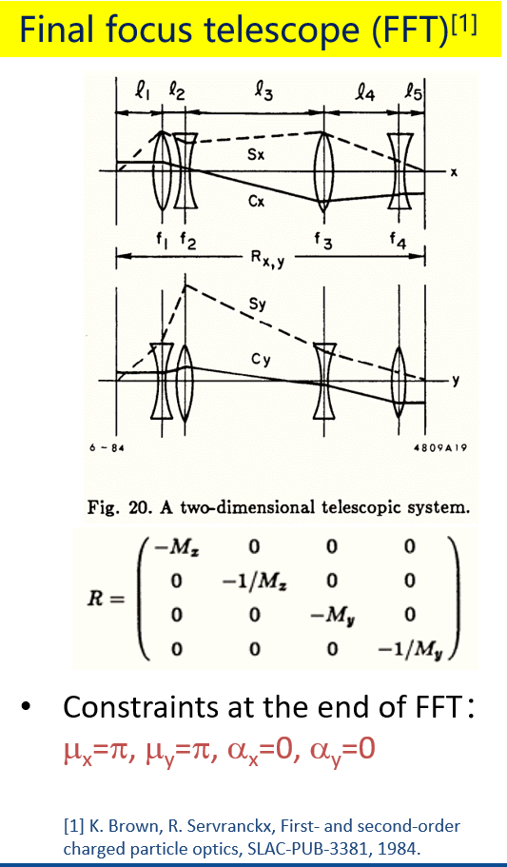
IR Final Focus Optics 1984 (SLC at SLAC)
Vertical plane
Horizontal plane

Slide 26
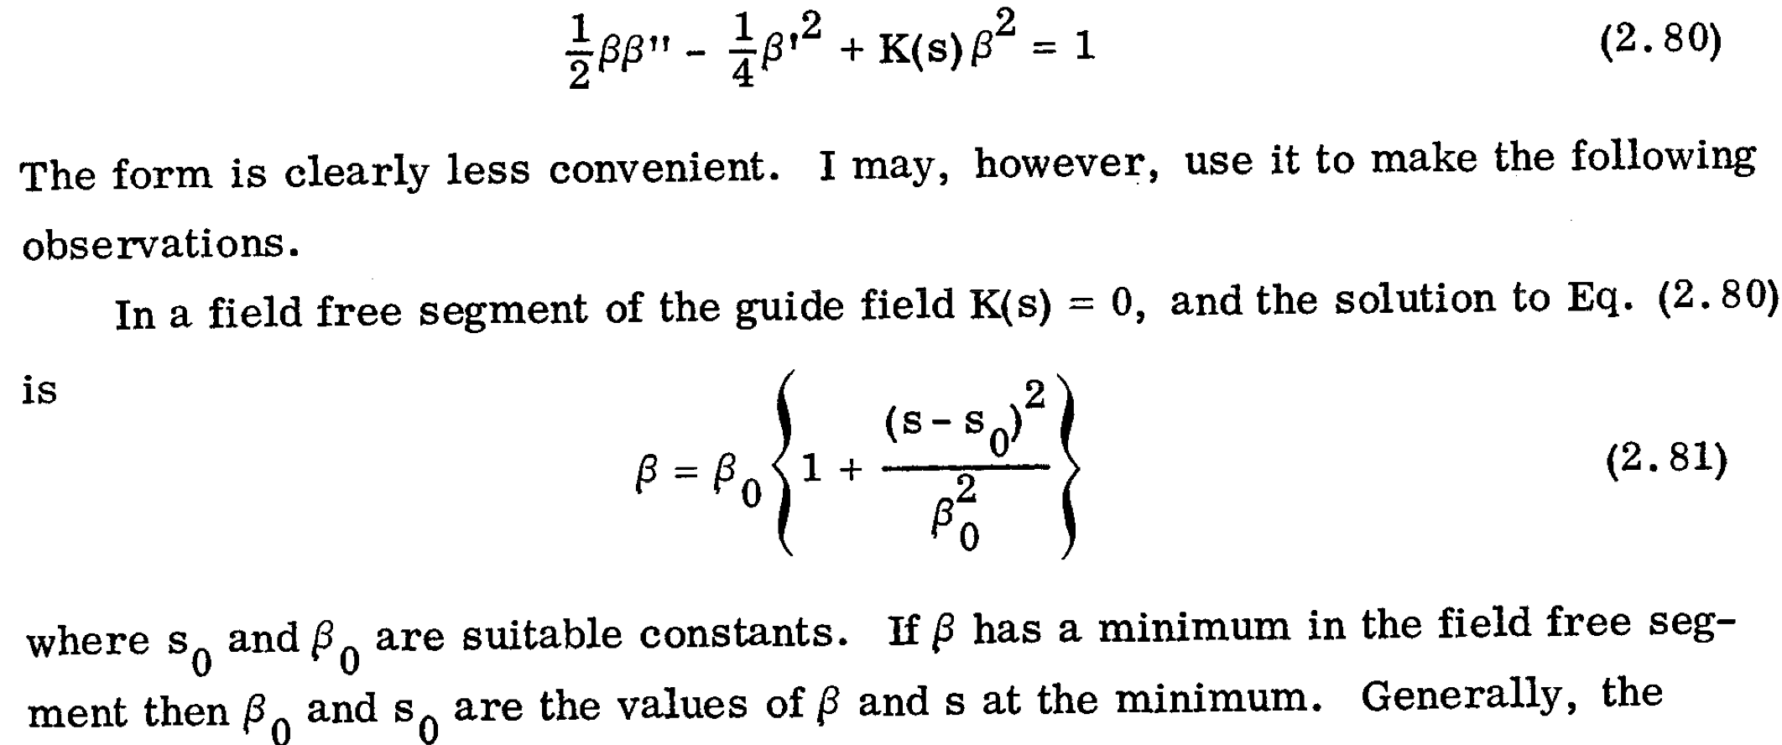
Beta functions grow quadratically away from the IR
~s²/β*
Beam size grows linearly from IP.
FF Quad size is limited by beam sizes/backgrounds.
Quad aperture limits lowest β_{y}* .
(Matt Sands)

Slide 27
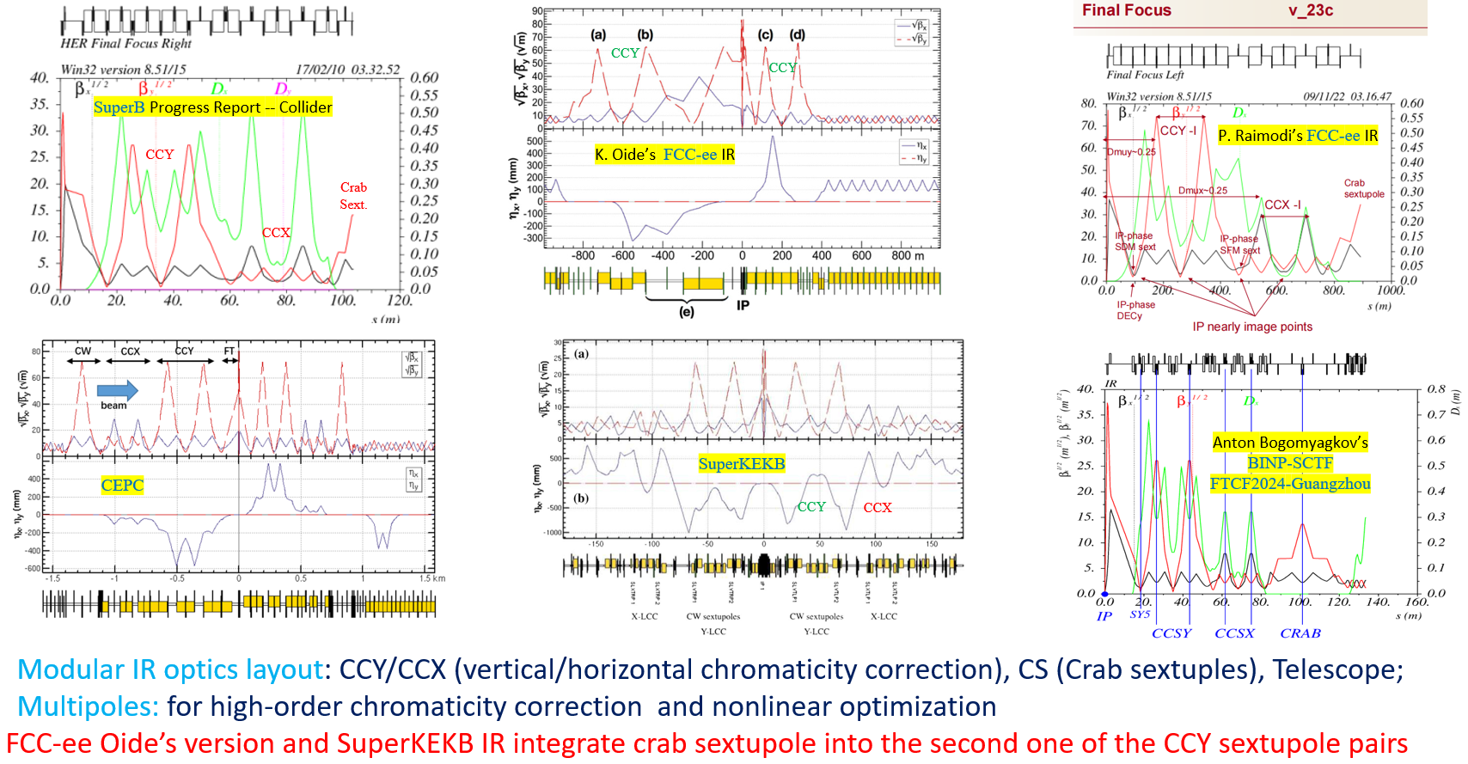
IR accelerator optics for various colliders

Slide 28
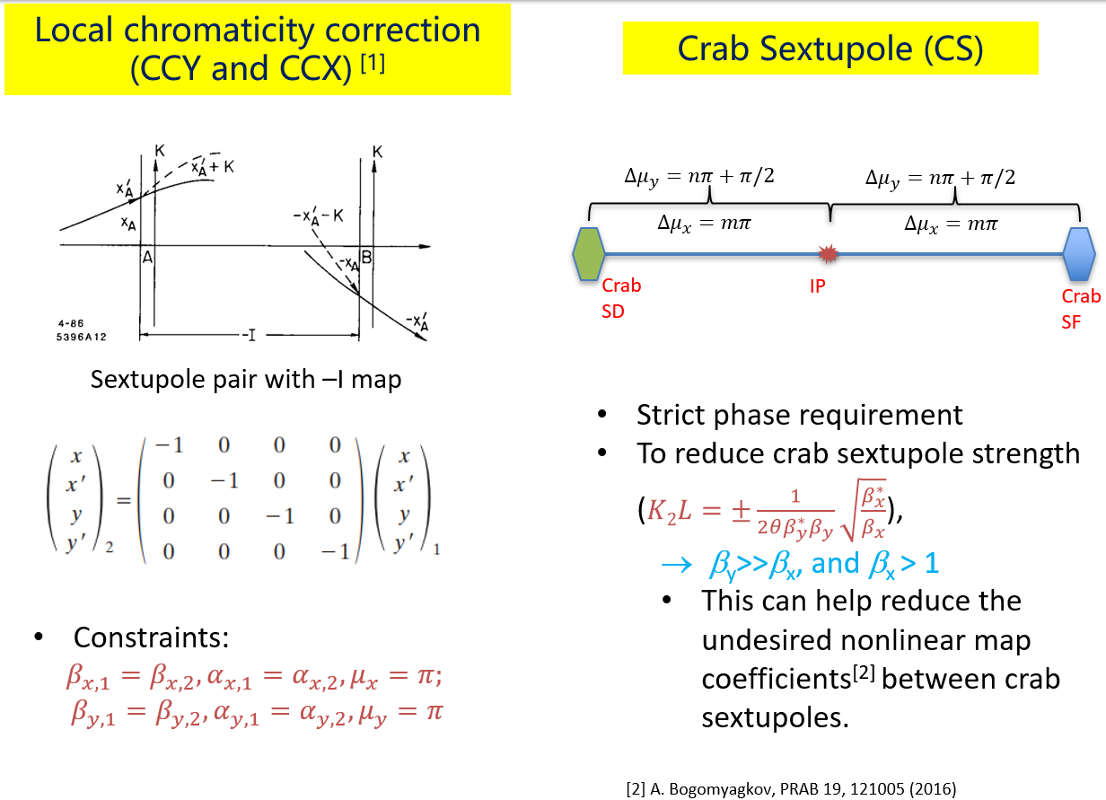
IP off energy corrections and crab waist

Slide 29
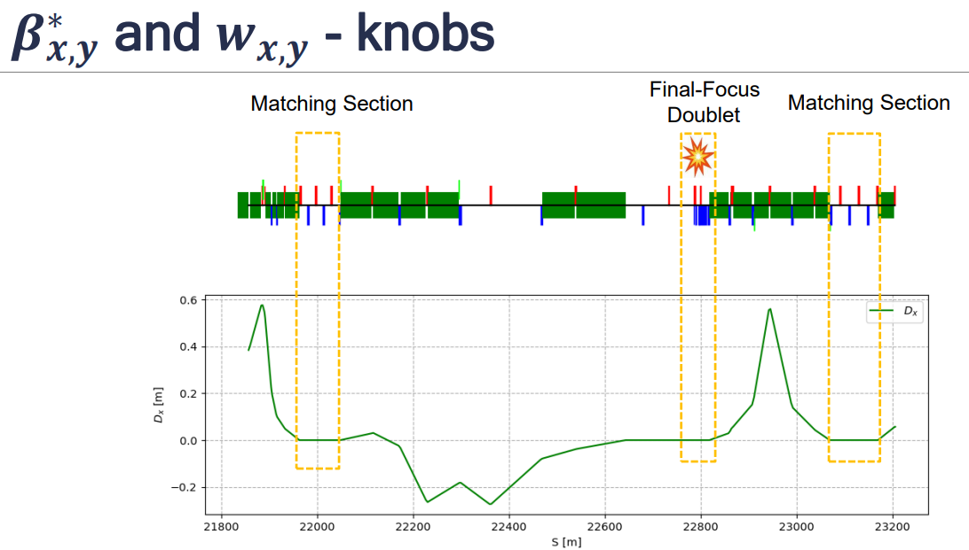
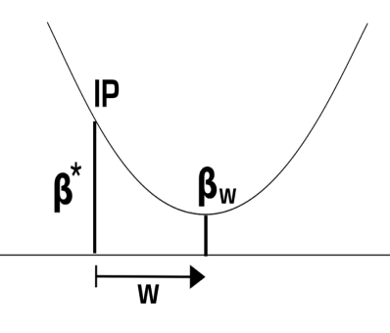
Accelerator Knobs for IP Tuning

Slide 30
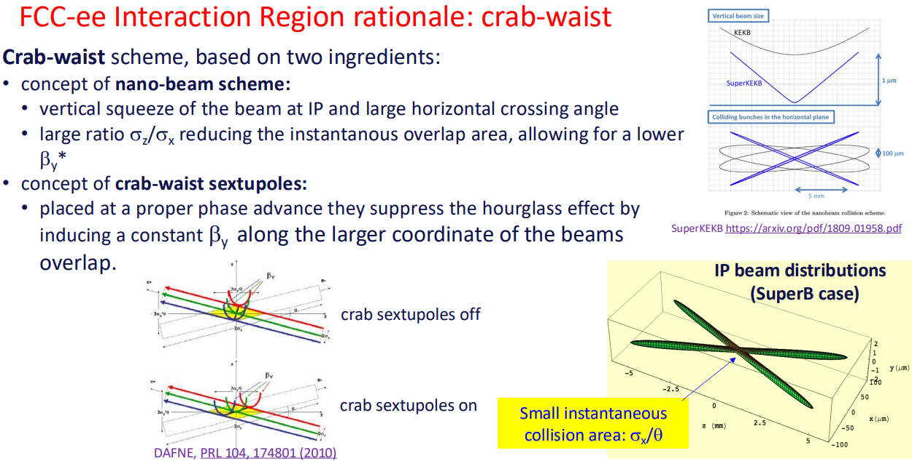
FCCee Machine Detector Interface (M. Boscolo)

Slide 31
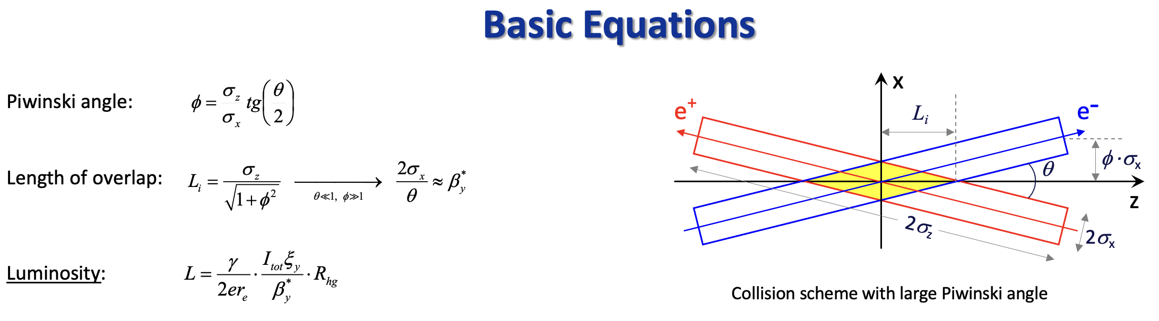
Luminosity Equations

Slide 32
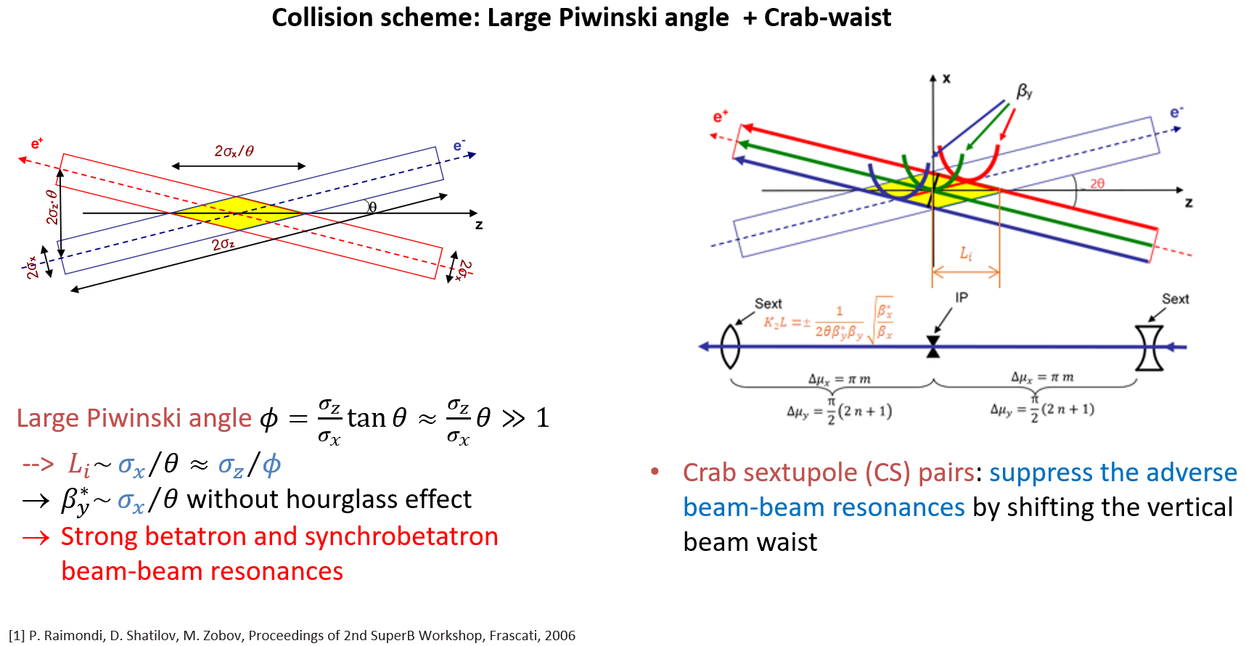
Crab Waist Collision Scheme

Slide 33
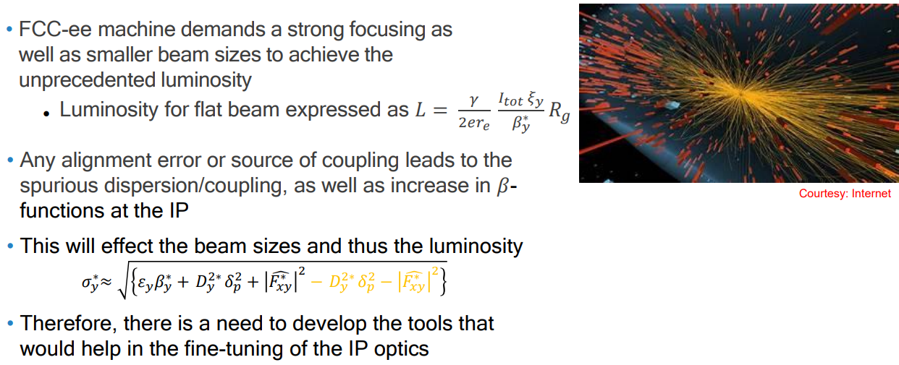
Lattice and Beam Issues that affect the luminosity

Slide 34
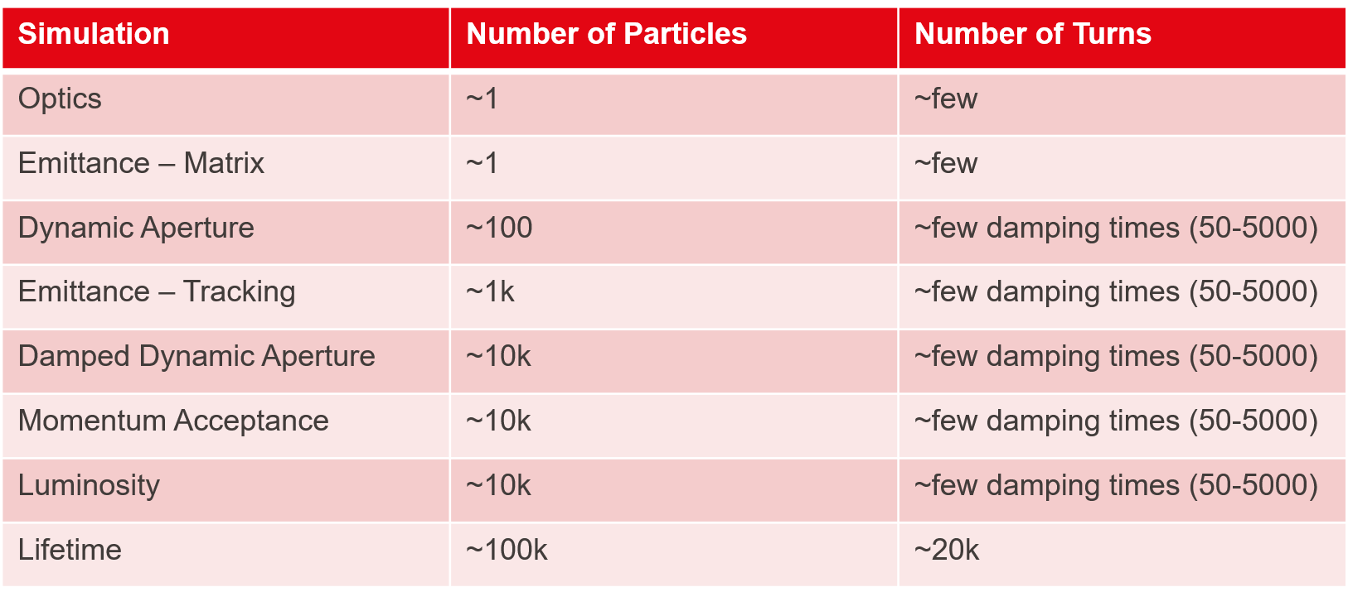
Tracking times for different effects

Slide 35
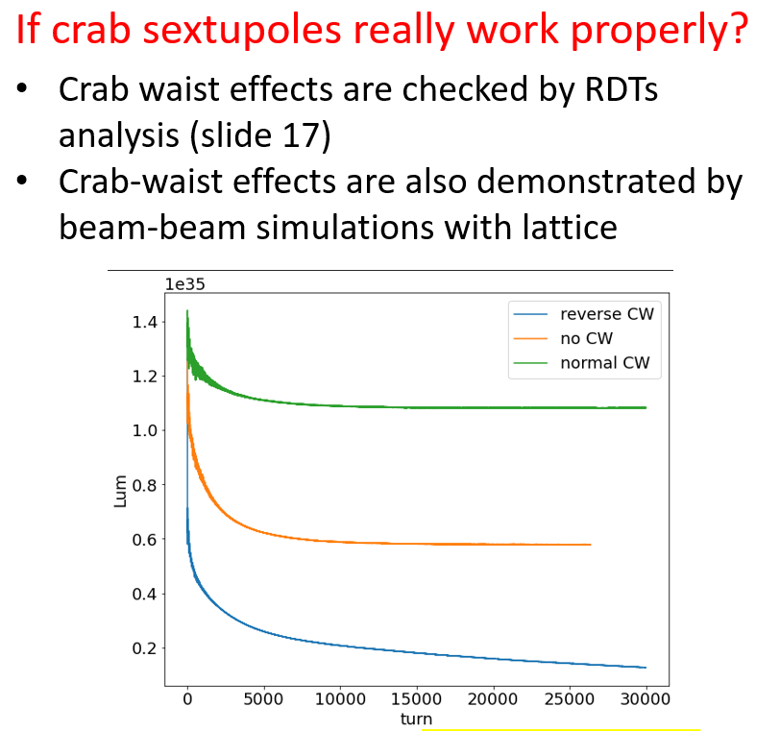
Crab waist strength and luminosity (for SuperKEKB)

Slide 36
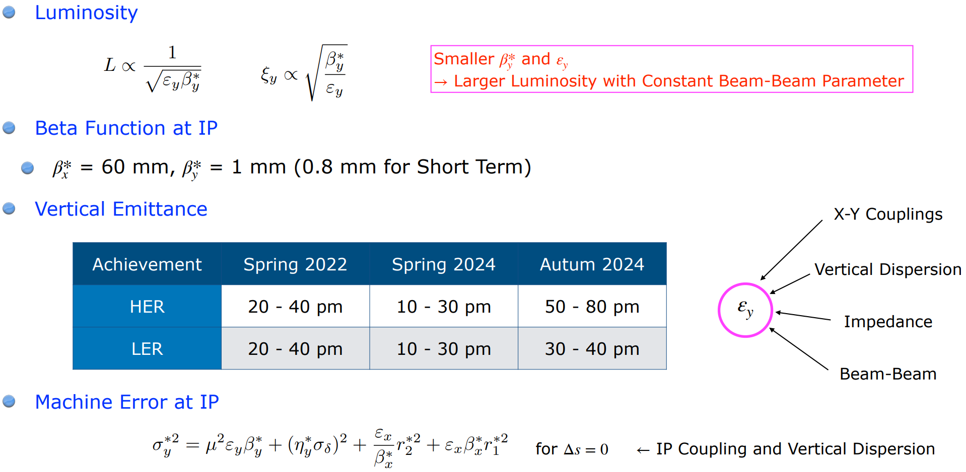
IP beam size and errors (SuperKEKB, Funakoshi)

Slide 37
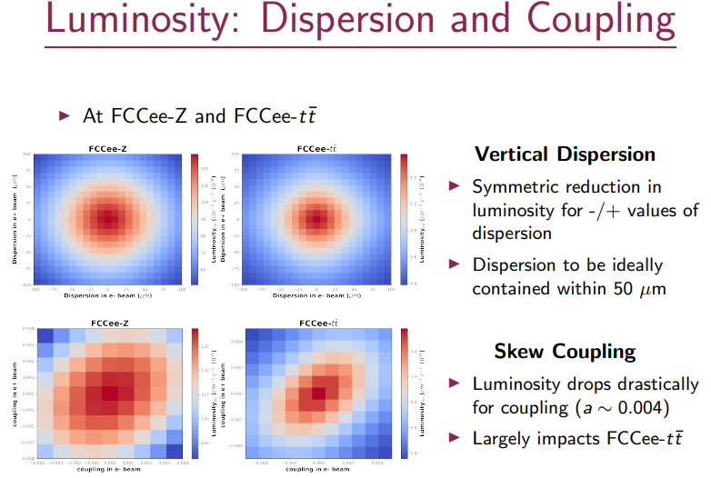
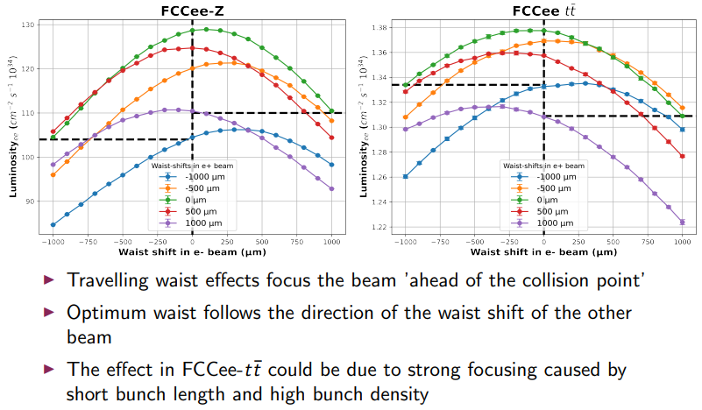
Luminosity Tuning

Slide 38
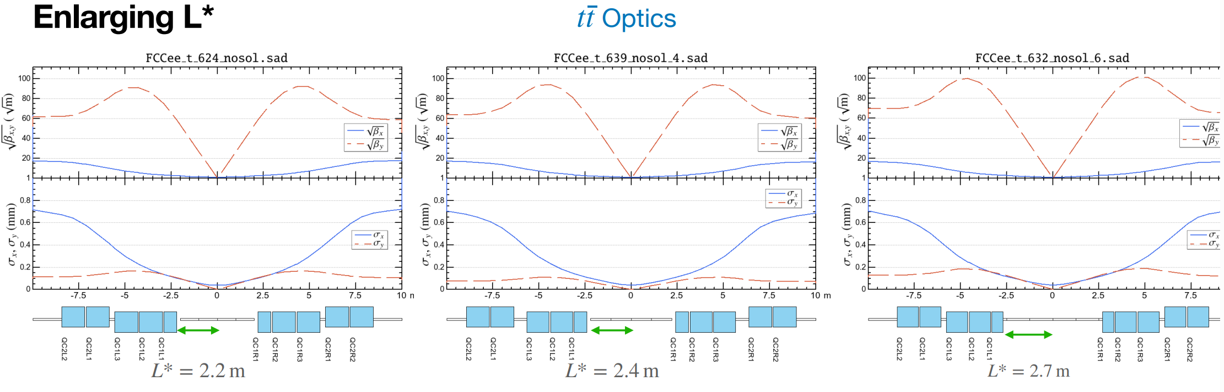
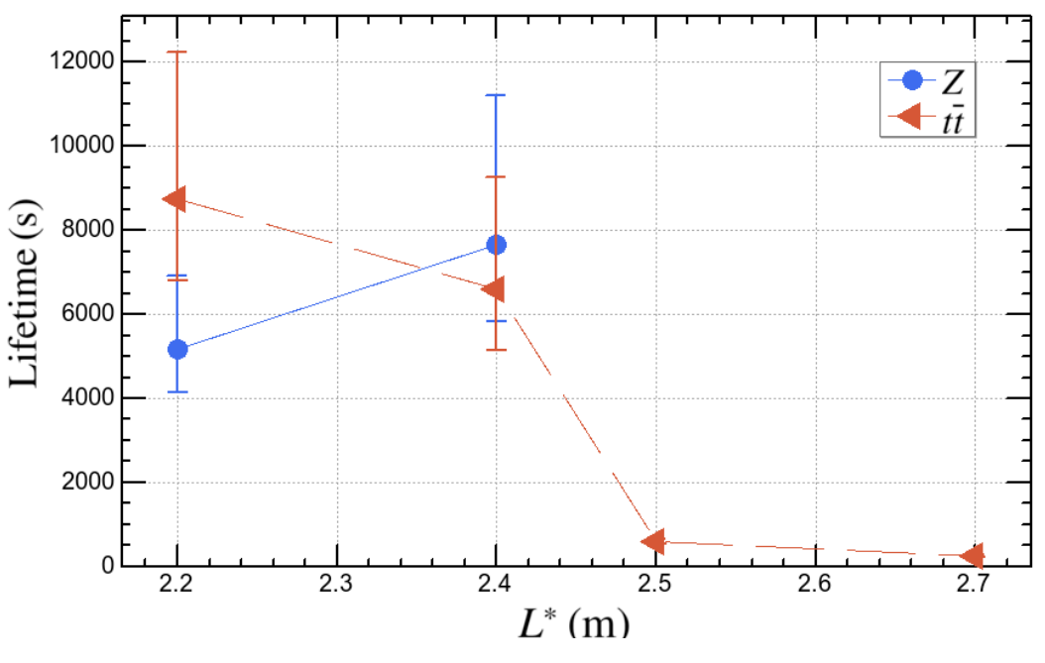
FCCee IR Optics for FCCee (L* study) (K. Oide March 2025)
Study effects of L* on Luminosity In FCCee

Slide 39
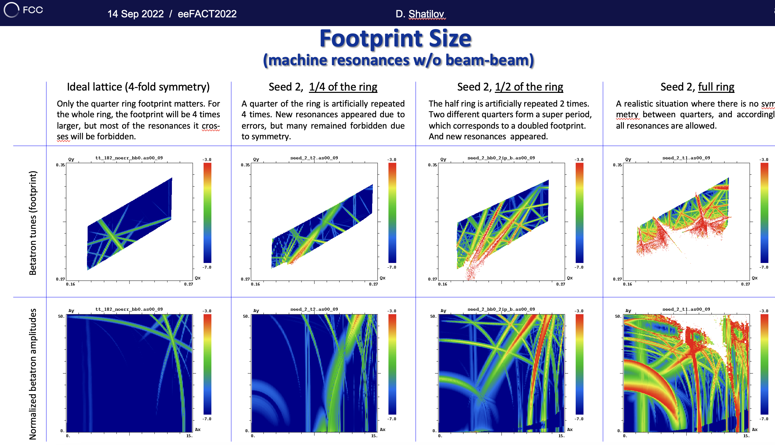
Beam–beam resonances in FCCee with different symmetries

Slide 40
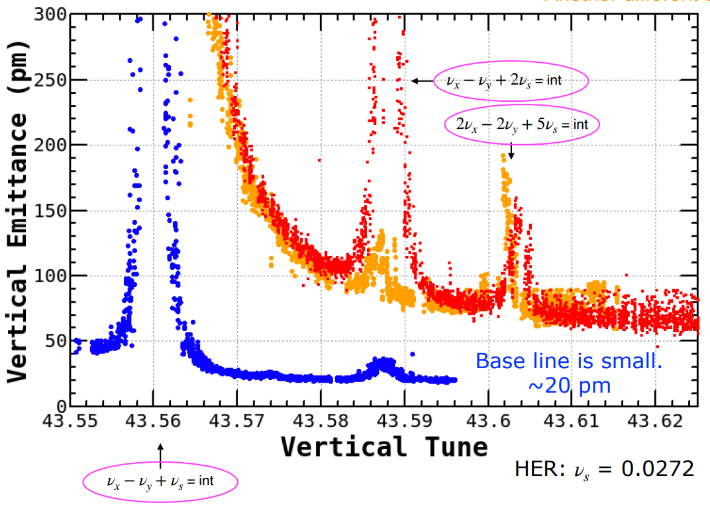
SuperKEKB Vertical tune and Vertical Emittance
Bunch core particles are at a different tune than the bunch tail particles.

Slide 41
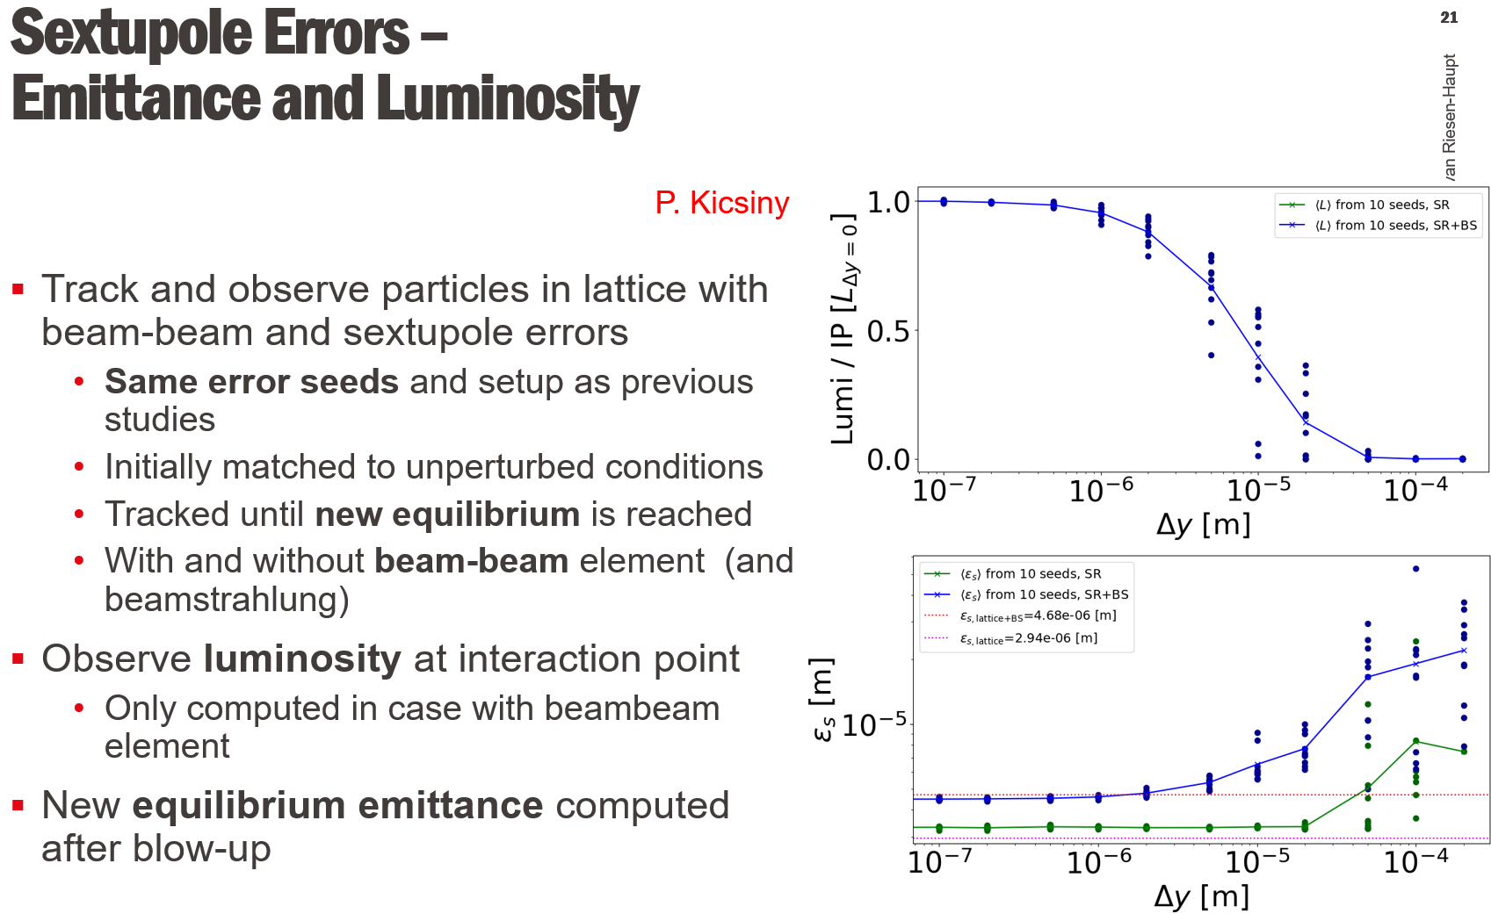
Tracking and errors tolerances for Luminosity

Slide 42
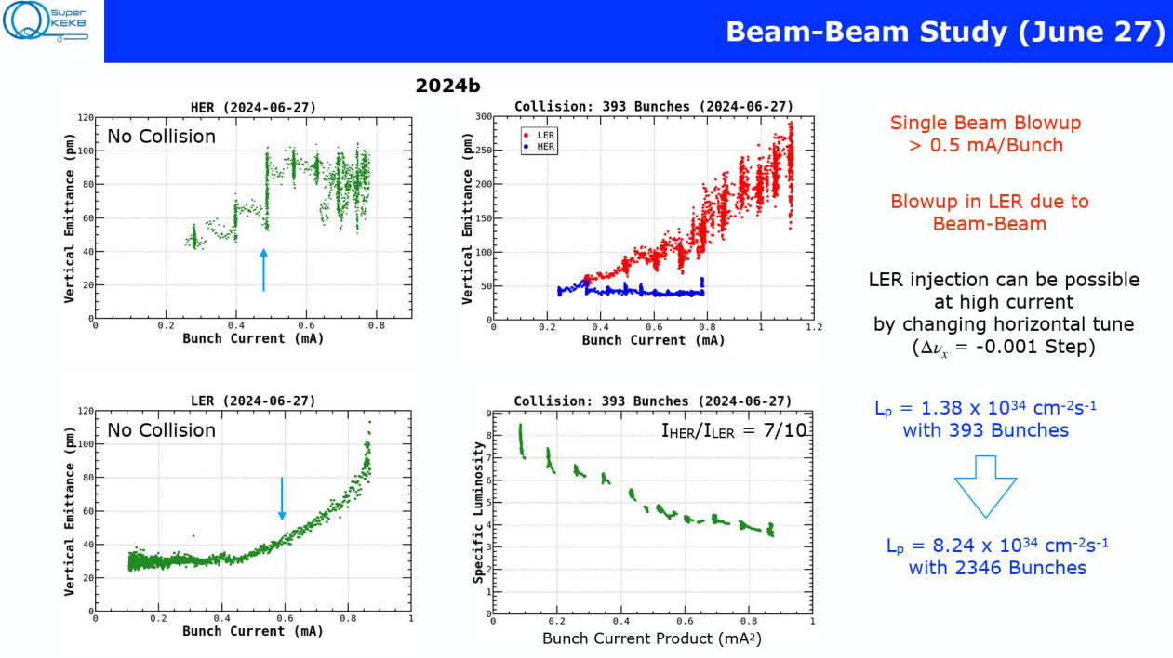
SuperKEKB Beam-Beam Measurements (Funakoshi)

Slide 43
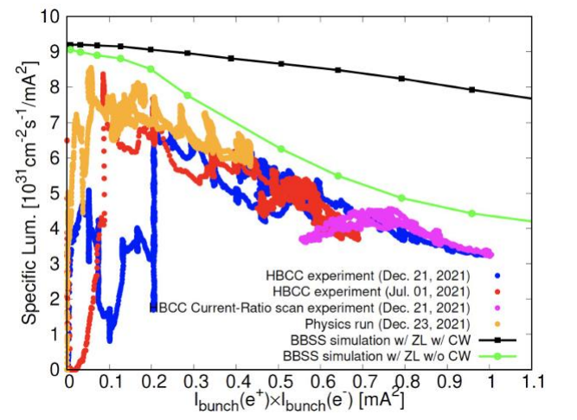
SuperKEKB Specific Luminosity

Slide 44
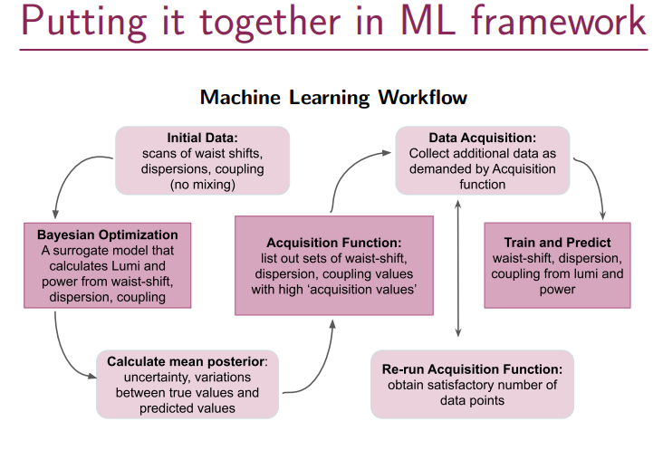
Future: AI and Machine Learning for Luminosity Tuning

Slide 45
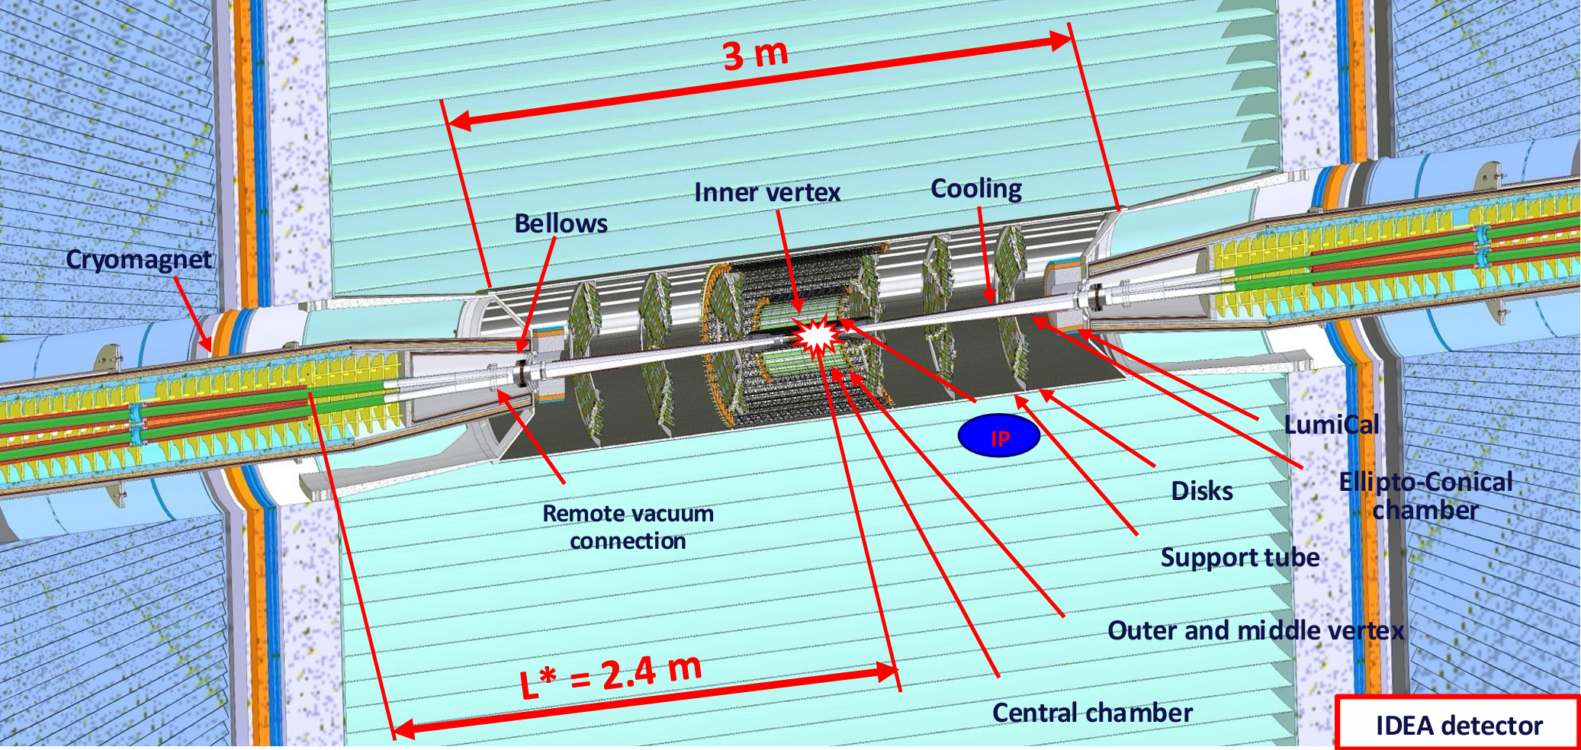
Near Detector IDEA with L* of 2.4 m to front of QC1A.

Slide 46
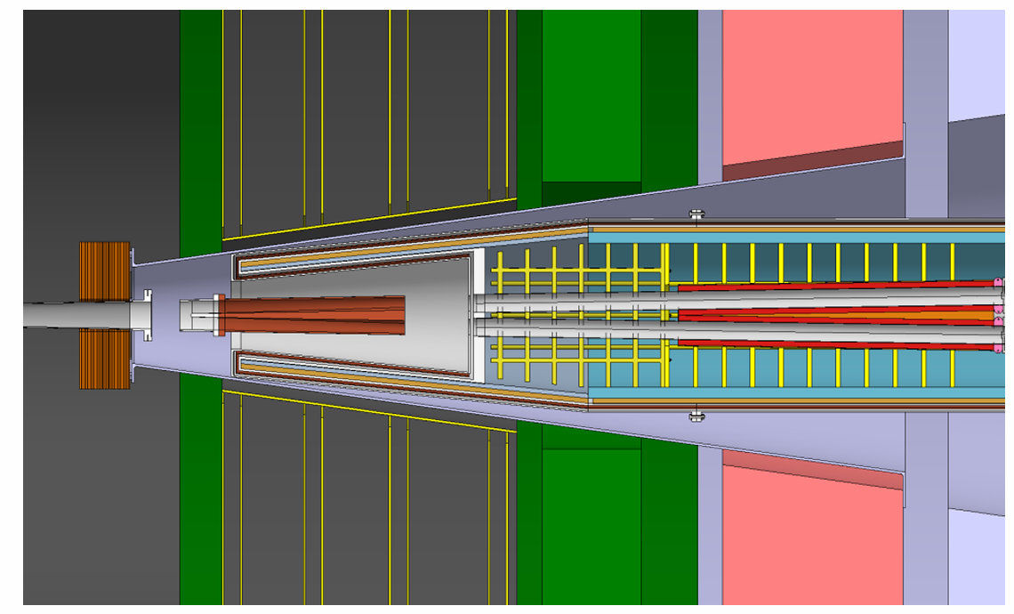
FCCee ALFA Detector near the FCCee IP
IP
L* = 2.4 m
Face of QC1A

Slide 47
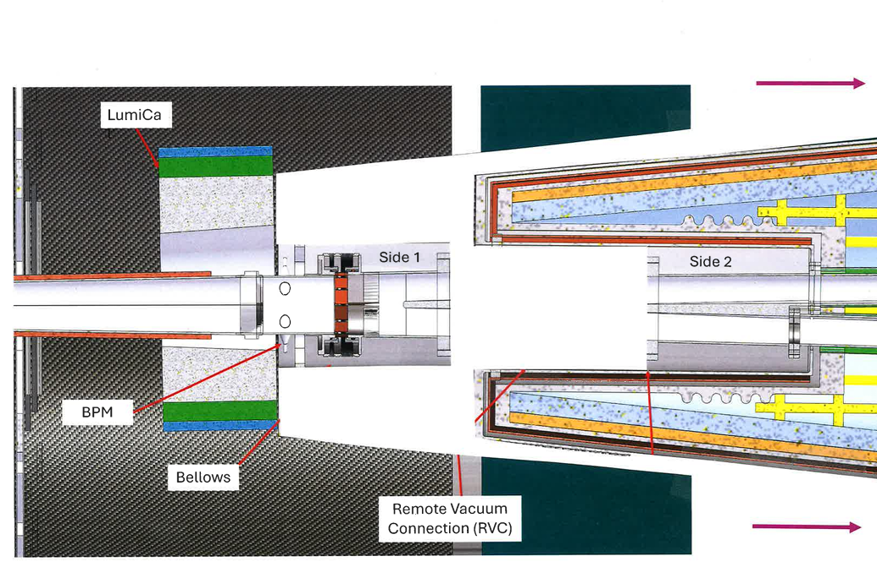
Remote Flange disconnect (IDEA detector + Accelerator Cryostat

Slide 48
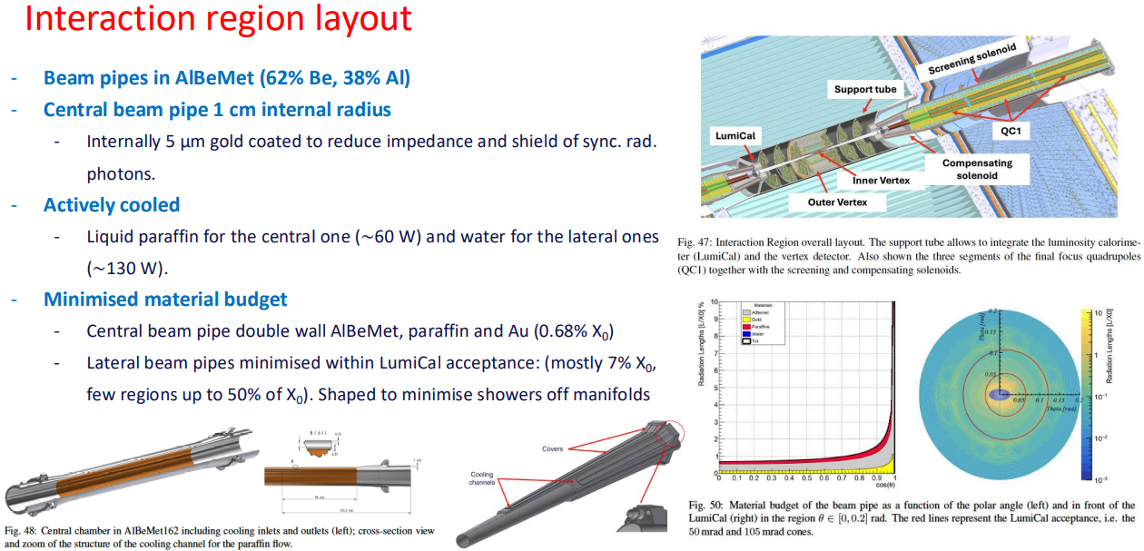
IR accelerator Components Inside the Detector

Slide 49
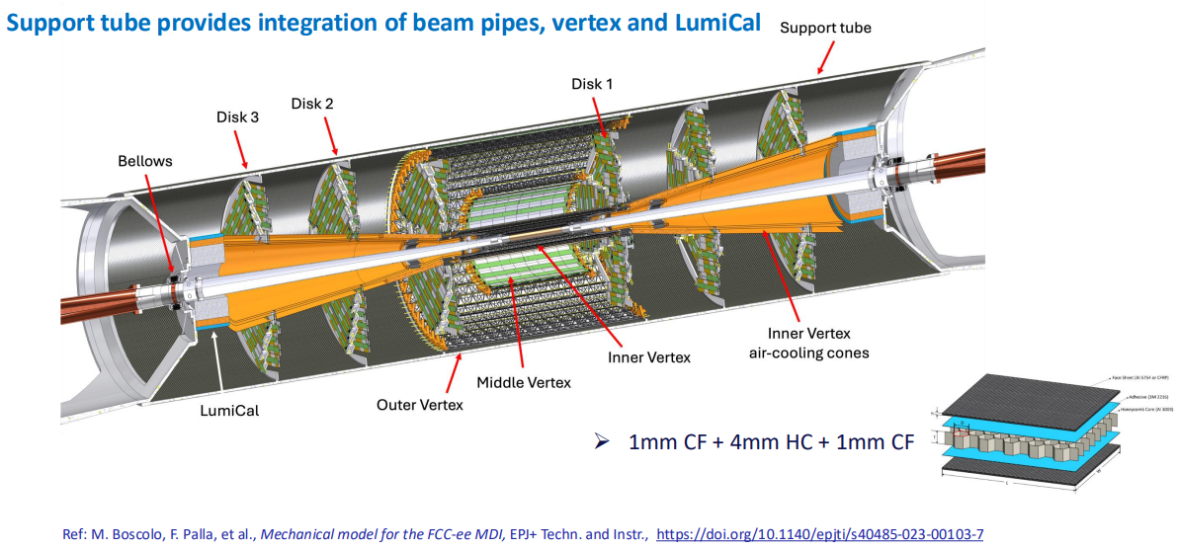
Central Beam Pipe, Vertex and Lumi-Cal Integration

Slide 50
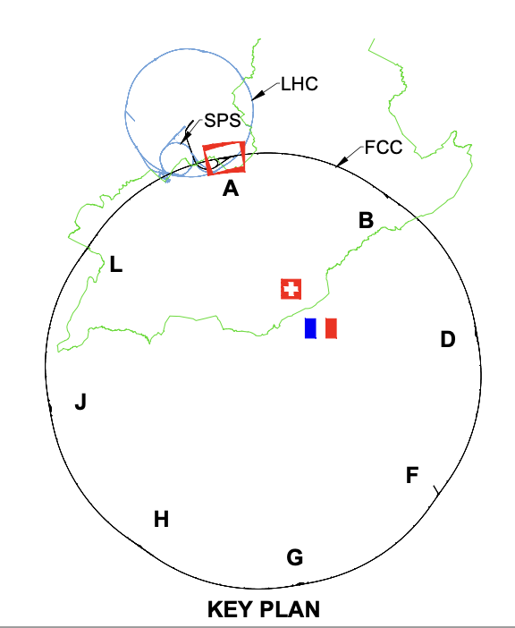
Luminosity Monitors
None
Robert Kieffer
Each of the four experimental IPs will be equipped with a pair of Beamstrahlung extraction lines and associated dump.
Each of these extraction lines will be equipped with the same instrumentation systems (8 lines total).
Monitoring of the Beamstrahlung signal and the Bhabha scattering events will allow precise IP tuning for increased luminosity.
Beamsstrahlung photons
Beamsstrahlung photons
Positron Beam
Electron Beam

Slide 51

FCCee Accelerator IR Vacuum Chamber (Mock-up)
M. Boscolo et al)

Slide 52

IR Mechanical Design

Slide 53

FCCee Interaction Pont Mock-up at INFN-Frascati
Manuela Boscolo et al + …

Slide 54

KEKB IR Layout and Cryo-plant Overview

Slide 55

SuperKEKB SC magnet cryostat and feedlines

Slide 56



For comparison: SuperKEKB IR SC Magnet System
Norihito Ohuchi (2013): “IR SC magnet system
is the most important and complicated
hardware in SuperKEKB.”
SuperKEKB IR SC magnets:
8 quadrupoles, 4 solenoids, 43 correctors

Slide 57

SuperKEKB SC magnet cryostat and slice box

Slide 58

First look at IR accelerator 1.9 deg cryo-plant (P. Borges de Sousa…)

Slide 59

Remote Vacuum Connection Details (KEK and DESY)

Slide 60

Remote Vacuum Flange (SuperKEKB, Ohuchi)

Slide 61

New concept: Remote connection option : SMA
F. Niccoli,
F. Fransesini
…

Slide 62

FCCee Detector End-caps Open Longitudinally
J. Szaga,
O. Beltramello …

Slide 63

Magnets: Beam trajectories in FCCee IR

Slide 64

IR MAGNETS: longitudinal locations, lengths, and strengths (K. Oide)
K. Oide is available to discussion any needed changes. P. Raimondi’s lattice
has more space from QC1 to QC2.

Slide 65

FCCee some cryo-stat dimensions
Cross section
views
M. Koratzinos, M. Boscolo

Slide 66

IR Magnet Cross Section View (front and end of each magnet)
Showing separated heat shield and vacuum vessel.
Beam centroids
Cryostat vacuum walls
Magnet coils
.
Cryostat outer
support
Cryostat He walls
And heat shield walls
Beam vacuum walls
J. Seeman November 2023

Slide 67


IR cryostat component dimensions

Slide 68
FCCee IR Cryostat (preferred option):
IR QC1 and QC2 in different cryostats but one integrated raft (not to scale)
Need to make space for cryogens, leads, and cantilever supports.
QC1-1
QC1-2
QC1-3
QC2-1
QC2-2
2.2 m to IP
3.36 m
~1.5 m
2.58 m

Slide 69
Needed functions for the space between QC1 and QC2
Beam pipes (cold vs warm)
e+ and e- BPMs (radial space)
Cantilevered supports (many forces)
Detector shielding near beam pipe (backgrounds and magnet quenches)
Vibration mitigation and control (orbit control)
Two cryostat end caps, cryogenic ports, disconnects (cryogen flow, heat load)
Magnet leads (warm to cold)
Alignment (internal positioning, remote)
Instrumentation (what to measure and how)
Remote operation flange controls and access (design, safe operation)
Vacuum disconnects (locations)
Assembly strategy (order of installation)
Cool down radial differential movements (Δr/r ~3x10^-3, 0.5 mm movements)
Cables (routes, numbers)

Slide 70


CEPC IR 6.8 m cryostat (Dec 2023)

Slide 71


ILC IR magnet locations (2013)

Slide 72

ILC IR magnets (2013)

Slide 73

Canted Cosine Theta quadrupoles and direct wind (BNL)

Slide 74

SC CCT QC1 quadrupole field measurements (M. Koratzinos …)

Slide 75

Detector and accelerator solenoid magnetic fields

Slide 76

IR Accelerator Optics – Solenoid Compensation

Slide 77




Alternative IR Solenoid Compensation Scheme

Slide 78

Solenoid Compensation Scheme (B. Parker, V. Teotia, BNL)

Slide 79

PEP-II IR BaBar detector field measurements

Slide 80

PEP-II IR rafts near BaBar detector

Slide 81

Cables: Example BaBar Vertex Chamber
Assembly instructions has >100 pages!

Slide 82

PEP-II IR Vacuum Chamber with 3D structures

Slide 83

FCCee Center Accelerator Vacuum Chamber (Fransesini)

Slide 84

IP Vacuum Chamber Design (Fransesini)

Slide 85


Vacuum and Cryogenic Failure Modes:
Inner He vessel in cryostat may crush if quench or vacuum loss
Example at SLAC of thin-walled water chamber:
Water pump pulled ~1 Bar pressure on water tank at SLAC causing it to crush.

Slide 86

Accelerator and Detector Survey and Alignment

Slide 87




HOM calculations of IP vacuum Chambers (A. Novokhatski)

Slide 88


IR Trapped HOM Mode at Y chamber (Novokhatski)
Trapped mode is part vertical, horizontal, and longitudinal: Hybrid mode.

Slide 89

FCCee IR bellows has HOM Losses
Central chamber has 1.5 Amp x 2 beams = 3 Amps of short length bunches!

Slide 90

HOM Modes in IR bellows design

Slide 91

SuperKEKB beam impedance to study beam instabilities

Slide 92


Polarization and Energy Calibration

Slide 93

Beam polarization measurement near the IP

Slide 94

FCC background studies

Slide 95

Comprehensive collimation systems

Slide 96

Radiative Bhabha’s in SuperKEKB IR

Slide 97

BELLE-II and SuperKEKB backgrounds

Slide 98

PEP-II Synchrotron Radiation Fans

Slide 99


SR scattering from FCCee Mask Tips (M. Sullivan)

Slide 100

Background sources

Slide 101

FCC IR Background Simulations

Slide 102

Inputs for IP local background simulations

Slide 103

Direct observation of background spectra
The Beamstrahlung spectra should reach down to optical wavelengths.
Another possibility is to use glassy carbon screens (super light weight) to monitor Beamstrahlung photons in the optical range.
To be evaluated: the quantity of visible photons generated by Beamstrahlung.
And the BS to SR radiation levels with IP shielding against SR.

Slide 104

Large tails on beam shape due to Beamstrahlung

Slide 105

Beamstrahlung Radiation Spectrum

Slide 106

Beam Synchrotron Radiation in FCCee IR

Slide 107
Zero degree: Straight Ahead Detector
None
Robert Kieffer
None
Optical line to monitor a scintillating screen on the extraction line.
Could be inserted at low intensity for IP tuning procedures
Heat deposition study: Monte Carlo simulation of particle matter interaction.
Cooling system for the screen?
The study will define the accessible range of bunch-charge (Beamstrahlung at the IP / heating the screen)
Positioning: Be as far as possible from IP (dilution) and not to close from the dump (radiation background).
Camera in shielding
Actuated
Insertable screen
Mirror
Viewport
From IP
Beamsstrhalung photons
To Dump

Slide 108

Beam gas scattering

Slide 109

Secondary scatters

Slide 110

Radiative Bhabha Impact on IR Accelerator Quadrupoles
(May not be up to date)

Slide 111
Thank you for your participation!
Many FCCee topics to study!
FIN
Questions?

