Slide 1
4th US FCC Collaboration Meeting
US FCC Accelerator Efforts
September 9, 2026
Tor Raubenheimer

Slide 2
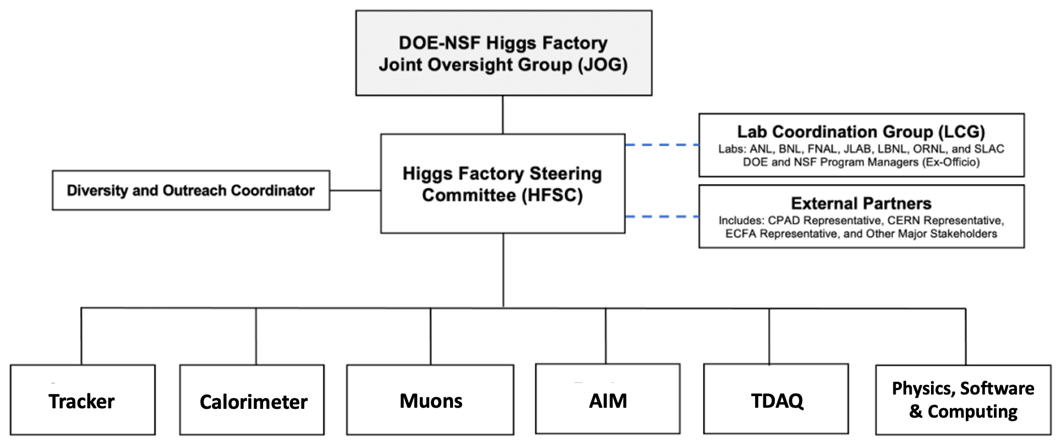
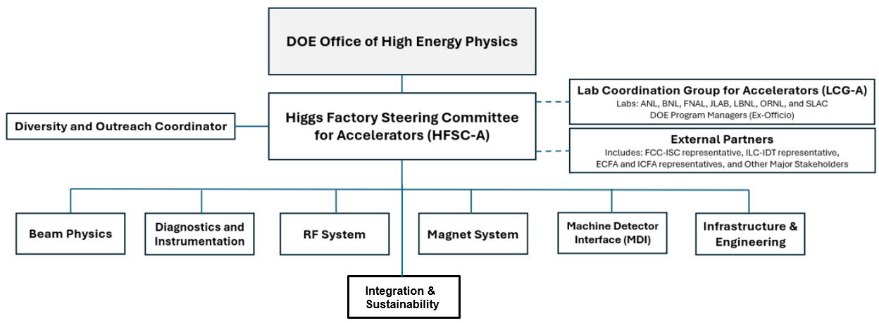
2025 U.S. Higgs Factory Circular Collider (HFCC)
Physics, Experiment & Detector (PED)
Created by DOE and NSF in 2024 to provide strategic direction and leadership for the U.S. community to engage, shape, and thereby advance the development of the PED and Accelerator program for a potential future Higgs factory; and to ensure cooperation with our partners in the international program.
Led by Higgs Factory Steering Group
(HFSC-PED & HFSC-ACC)
Accelerator (ACC)

Slide 3
HFCC Charge
HFCC should coordinate efforts in the following areas:
  Physics and technical feasibility studies, including any associated design and R&D efforts, to advance detector concepts and accelerator designs for a future e+/e- Higgs factory;
  Prioritization and stewardship of the national R&D efforts;
  Development of the pre-project R&D scope that will be required to initiate a project;
  Conceptualization of the software & computing for the experiments and accelerator;
  Develop various funding models that will be required to support the R&D efforts;
  Ensure collaborations by the U.S. with our partners are cost-effectively carried out to advance the future Higgs factory initiatives.

Slide 4
HFSC-A Organization Diagram (2025)
DOE Office of High Energy Physics
Lab Coordination Group for Accelerators (LCG-A)
Labs: ANL, BNL, FNAL, JLAB, LBNL, ORNL, and SLAC
DOE Program Managers (Ex-Officio)
Accelerator Advisory Committee - TBD
Higgs Factory Steering Committee for Accelerators (HFSC-A)
US - CERN FCC
Coordination Committee
External Partners
Includes: FCC-ISC representative, ILC-IDT representative, ECFA and ICFA representative, and Other Major Stakeholders
Beam Physics
Diagnostics and Instrumentation
RF System
Magnet System
Machine Detector Interface
Infrastructure & Engineering
Integration & Sustainability

Slide 5
HF Steering Committee (HFSC-A)
HFSC-ACC (2025)
Tor Raubenheimer (chair)
Steve Gourlay (deputy)
Matthias Liepe
Jean-Luc Vay
Vladimir Shiltsev (Community Engagement)
US CERN FCC Coordination Committee:
Benedikt, Janot, Rajagopalan, Raubenheimer, Tsesmelis, Zimmermann

Slide 6
HFSC-A L2 Members
L2 Topic
Beam Physics | Ji Qiang (LBNL) | Vadim Sajaev (ANL)
Diagnostics and Instrumentation | Sasha Aleksandrov (ORNL) | Michiko Minty (BNL)
RF Systems | Sergey Belomestnykh (FNAL) | Tianhuan Luo (LBNL)
Magnet Systems | Giorgio Ambrosio (FNAL) | Gianluca Sabbi (LBNL)
Machine Detector Interface (MDI) | Andrei Seryi (JLAB) | Spencer Gessner (SLAC)
Infrastructure & Engineering | Damien Dockery (FNAL) | Vasiliy Morozov (ORNL)
Integration & Sustainability | Roger Ruber (JLAB) | Mei Bei (SLAC)

Slide 7
HFCC-A Activities over two last years
Launch the HFCC-A organization at FNAL in January 2025
Development of HFCC White Paper for ESG in Feb/March, 2025
HFCC-A call for proposals received in June, 2025 and reviewed over summer
FY26 Funding confirmation from DOE in August
Re-organization of HFSC in September
Selection of HFCC-A program in November and efforts started in 2026
Review of program in Spring 2026 with adjustments following FCC Week 2026
Planning for 2027 with funding confirmation received in August

Slide 8
US Program for FCC-ee
The US will contribute to both the PED and Accelerator
  US aspires to significant contributions to the detectors, perhaps leading one or more detector collaborations
  There are some places where the US has clear leadership and can contribute to the accelerator: bulk Nb SRF, IR magnets, HPC+ modeling, Nb3Sn
  The US has aging but relevant experience with e+/e- and is aiming build the EIC having many synergies with FCC-ee
  Other topics on the accelerator that nobody really leads: Iron manet/vacuum technologies, diagnostics, controls, RF power sources, power distribution, …
Working on the IR and MDI would be a natural synergy with a future PED effort
SRF, HPC+ modeling, and synergies with EIC will augment US capabilities

Slide 9
Guidelines for HFCC-A R&D Contributions
Identify potential areas where US can make leading and significant contributions grounded on our historical achievements and our expertise & capabilities
Collect input from community and encourage proposal submissions
Think about interplay with HFSC-PED and where joint projects can benefit both
Work with project management to ensure our input is relevant and desired
There are some collaborations with CERN that have already been established and we will become responsible for tracking and advising on these
    Civil design work with Fermilab
    800 MHz cryomodule design with Fermilab
    Interaction region magnets with Brookhaven
Groups in the US developed submitted some initial ideas for contributions to P5

Slide 10
FCC Contact List
Requested a list of contacts from the FCC project for guidance on topics and help in establishing collaborations
Beam Physics: Katsunobu Oide katsunobu.oide@cern.ch (optics)
Xavier Buffat xavier.buffat@cern.ch (beam-beam)
Mauro Migliorati mauro.migliorati@uniroma1.it (impedances)
Diagnostics: Robert Kieffer
RF: Olivier Brunner Olivier.Brunner@cern.ch
Franck Peauger Franck.Peauger@cern.ch
Magnet Systems: Bernhard Auchmann bernhard.auchmann@psi.ch (SC, HTS and low field)
Daniel Schoerling Daniel.Schoerling@cern.ch (warm magnets)
MDI : Manuela Boscolo Manuela.Boscolo@lnf.infn.it
Fabrizio Palla fabrizio.palla@cern.ch
Infrastructure & engineering : Jean-Paul Burnet Jean-Paul.Burnet@cern.ch
Integration & Sustainability: Johannes Gutleber Johannes.Gutleber@cern.ch

Slide 11
Simplified HFCC Proposal Guidance
R&D topics proposals should be relevant to an off-shore Higgs Factory (FCC-ee) that could morph into a significant contribution from the US to such a project
  For example: the 800 MHz CM for FCC-ee
US National efforts should follow DOE programmatic priorities and guidance and be aligned with international initiatives and efforts
Proposals should identify partner efforts including (but not limited to) HEP GARD, the FCC Feasibility Study, ICFA, ECFA and other major stakeholders
Consider impact and synergies with other DOE programs such as Muon Collider and Electron Ion Collider
Max two pages

Slide 12
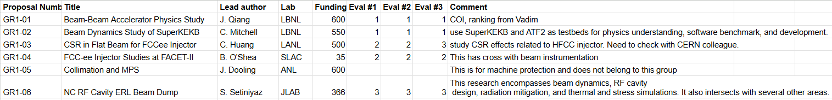
FY26 Proposals and Review
43 2-page proposals received by June 10 with funding request exceeded 12 M$
Proposals reviewed over summer by L2 coordinators (some cases of COI)
  Relevance to a Future Higgs Factory
  Benefit to the US program (including MC and EIC)
  Interest from the Higgs Factory projects
L2’s interacted with proponents to gather additional information and inquired with FCC contacts for clarification and interest in cases
Example: Beam Dynamics

Slide 13
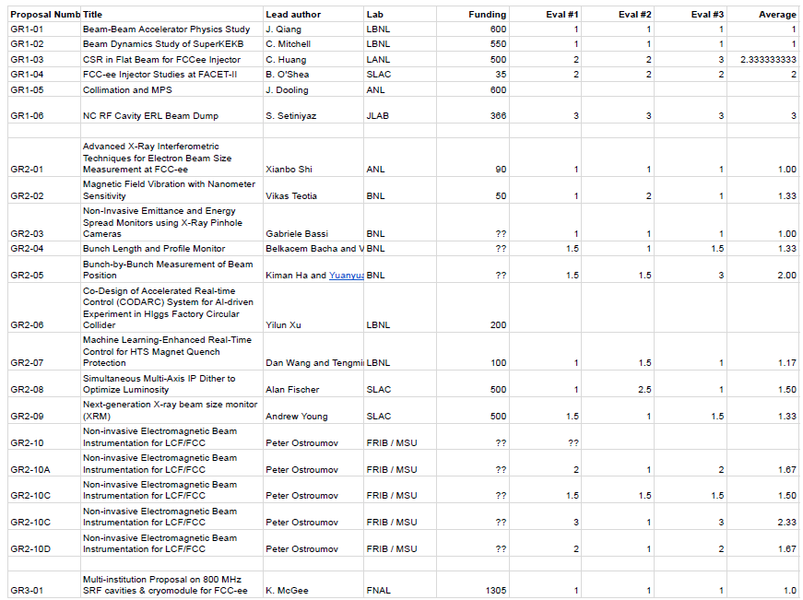
Example: Beam Dynamics

Slide 14
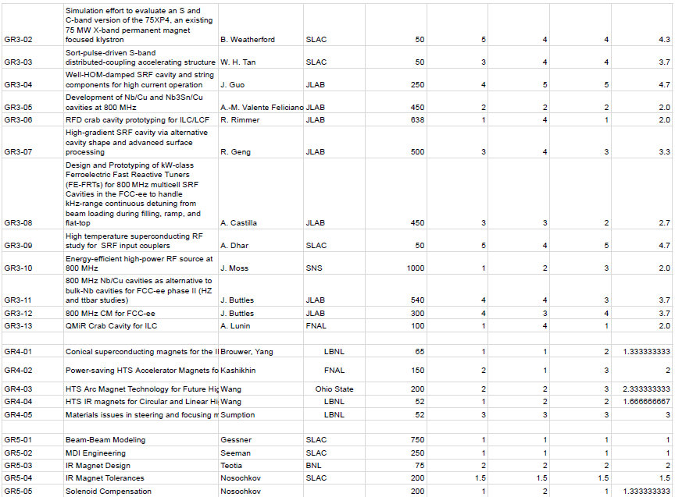

Slide 15
Selected Program
FY26 funding is $500k and told to expect $500k / yr in FY27/FY28
  Hard to support effort toward FCC-ee TDR with $500k/yr
  Leverage other funding sources, e.g. GARD, LDRD, ….
Selected program is well aligned with FCC-ee and US strengths
  SRF technology, Beam-Physics, MDI
Request FY26 Funding
800 MHz SRF CM | Kellen McGee | FNAL et al | $1305k | 250k
Beam-Physics and SuperKEKB | Ji Qiang / Chad Mitchell | LBNL et al | $1100k | 100k
Luminosity meas. systematics | Spencer Gessner | SLAC et al | $750k | 50k
MDI CM Engineering | John Seeman | SLAC et al | $250k | 50k

Slide 16
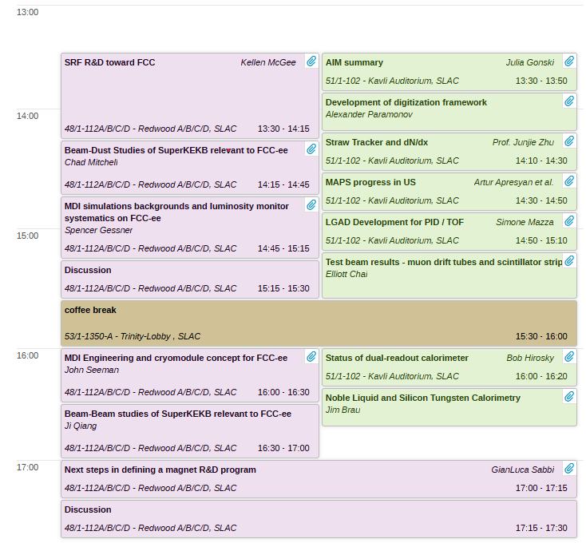
R&D Progress
Presentations by all efforts directly supported by HFCC-ACC Tuesday pm
There are other on-going efforts:
BNL LDRD supporting IR magnet studies based on direct-wind
Studies at FACET on Injector beam dynamics
Two new LDRD’s will be started: LBNL on HTS magnets and SLAC on MDI.
Plus there are three additional LDRD or PD’s under review at SLAC and Fermilab

Slide 17
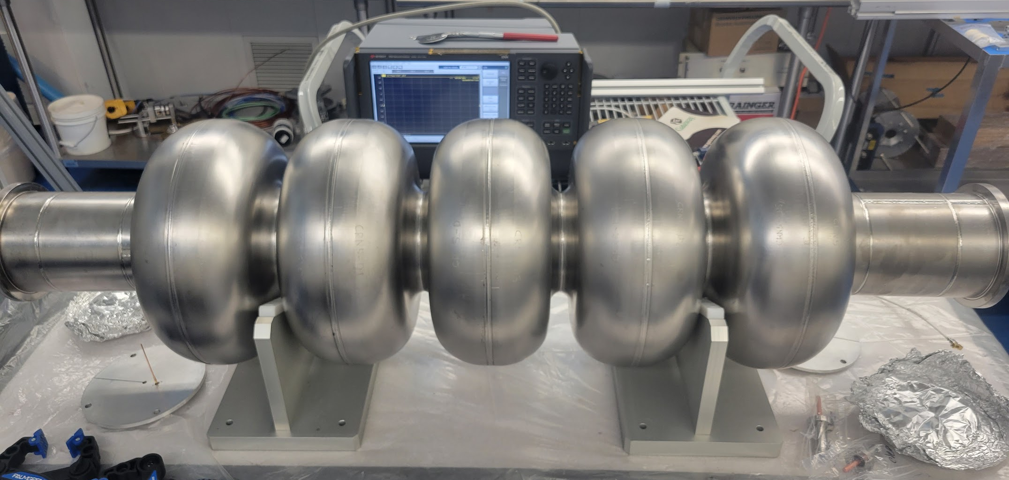
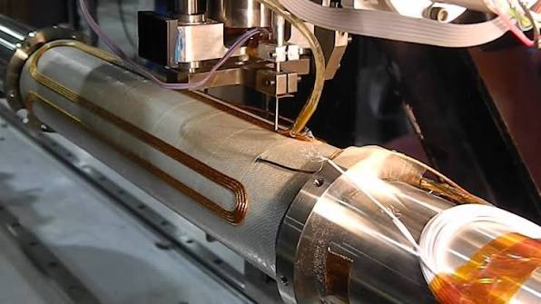
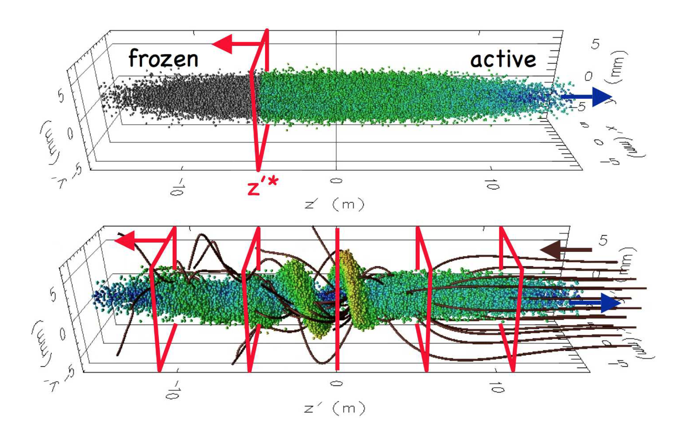
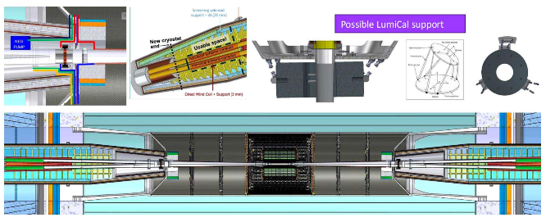
FCC Accelerator R&D Currently Underway in the US
FNAL
BNL
800 MHz SRF design
Direct wind magnets for MDI
SLAC
LBNL
MDI design with BNL
Beam-beam modeling with LBNL
Injector tests at FACET
RF sources
Advanced accelerator modeling

Slide 18
Plans for FY27
Funding guidance of $500k for FY27
This collaboration meeting is being used to review program and consider new contributions
Adjust as FCC Design evolves, e.g. SRF Review and HTS plan update this Fall
Meet with OHENP in late Fall to clarify future program
Hold in-person L2 meeting on February timescale, before FCC Week 2027
Update proposals for FY28 in late Spring
Hold 5th US HFCC meeting in early September 2027
Leverage US GARD funding as well as laboratory LDRD and PD funding

Slide 19
Summary
HFCC-A program has begun
Start was slower than expected
R&D efforts for FY26 were launched and plans for FY27 are being developed
  Some redirection of efforts has been required as CERN plans and FCC design have evolved during the Reference Design
  Need to work with evolving FCC Project to clarify HFCC - FCC interaction
  Working to have impact by establishing collaborations however given funding levels have limited participation in building prototypes
  Looking to establish broader programs in SRF and RF power similar to magnet R&D program

Slide 20
US FCC Collaboration Meeting Accelerator Parallels
Tuesday afternoon: review of on-going R&D programs
Wednesday afternoon: US Accelerator R&D and FCC-ee R&D opportunities
Thursday morning: New R&D opportunities for the US
Thursday afternoon: Discussion and prioritization

