Slide 1
Report from DOE High Energy and Nuclear Physics (HENP)
Regina Rameika, Associate Director,
Offices of High Energy and Nuclear Physics
Fourth US FCC Meeting
September 8-11, 2026

Slide 2
Topics for this talk
Overview of High Energy and Nuclear Physics Office at DOE
Strategic Planning in HENP
HENP Budgets
Summary of Projects
Overview of HENP facilities
QIS in HENP
GENESIS Mission
Status of executing the “P5 Plan”
HEP Cost Drivers
HEP Priorities
Thoughts about FCCee
Summary and Take-aways

Slide 3
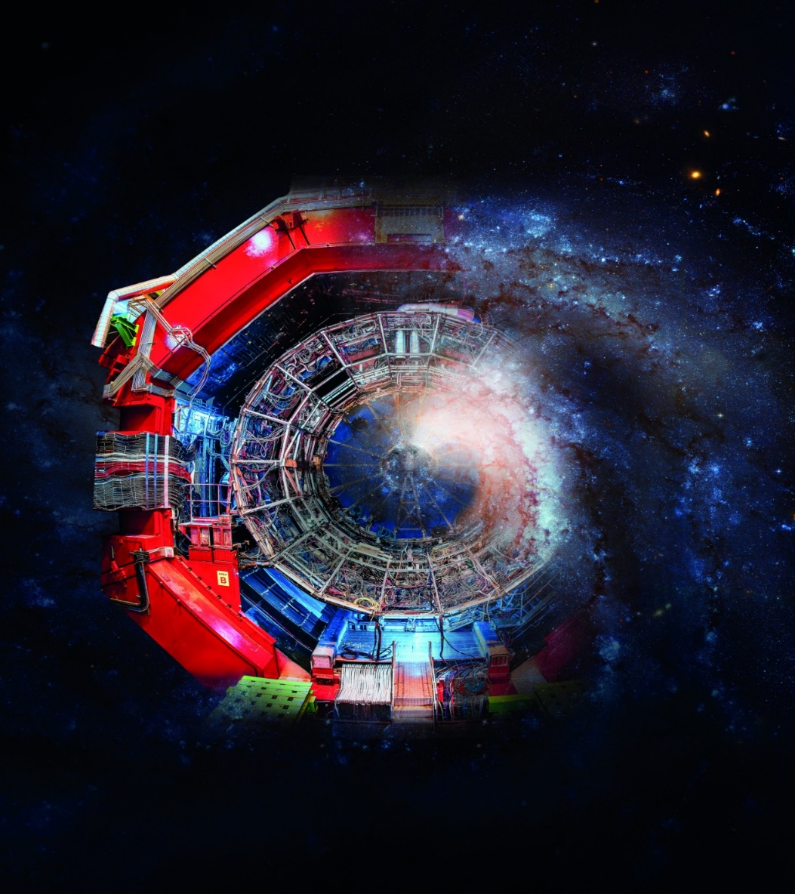
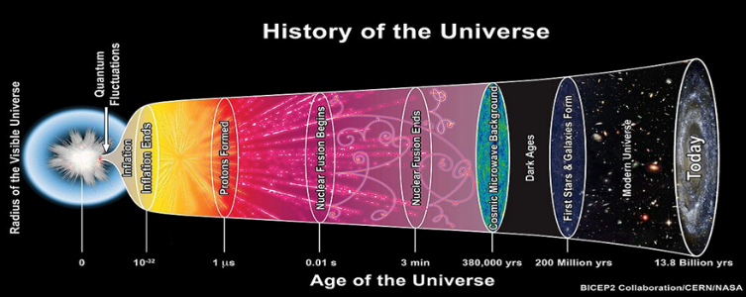
Missions of High Energy and Nuclear Physics
The HEP mission is to understand all forms of matter, energy space and time from the quarks to the cosmos.
In NP, the mission is to discover, explore and understand, all forms of nuclear matter

Slide 4
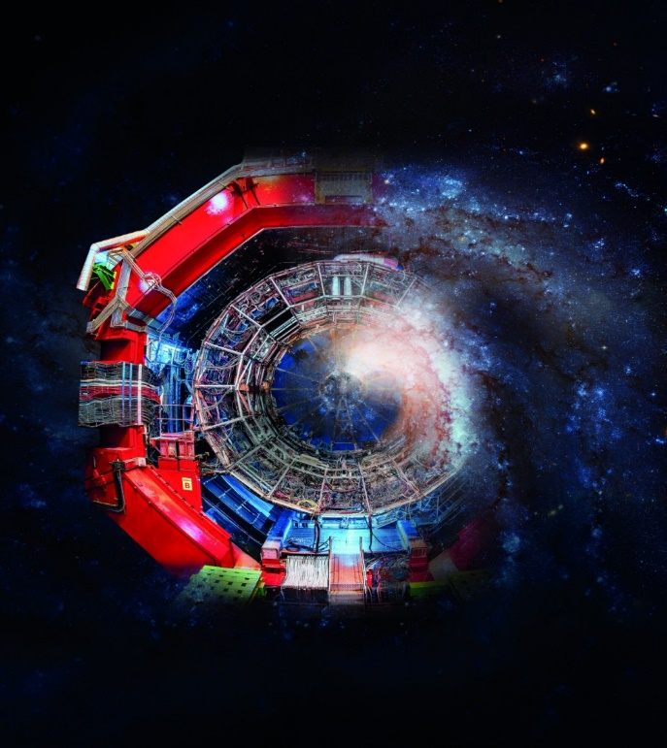
Mission of High Energy and Nuclear Physics
The mission of High Energy and Nuclear Physics is to understand how the universe works at its most fundamental level by discovering and investigating the elementary constituents of matter and energy, probing the interactions between them, and exploring the basic nature of space and time.

Slide 5
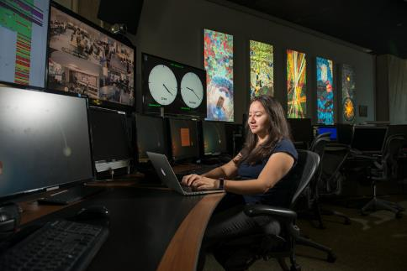
Office of High Energy Physics at a Glance
FY 2026 Enacted: $1,235M
As the largest funder of particle physics in the U.S. (~85%), HEP also supports international experiments in Canada, Chile, Japan, and Switzerland
Research: 35%, $430.6M
~30% of Research to Universities
Snowmass 2022
1,003 Ph.D. Scientists and
448 Grad Students Supported
Funding at 12 DOE National Labs, and >175 Academic Institutions, Small Businesses, Non-Profits, and Other Federal Agencies
VCR Operations in Chile
Facility Operations: 32%, $392.1M
Outfitting of DUNE caverns at SURF for first far detector cryostat
Projects: 33%, $412.4M
HEP supports 3 SC User Facilities and 2387 Users at BNL, FNAL, and SLAC

Slide 6
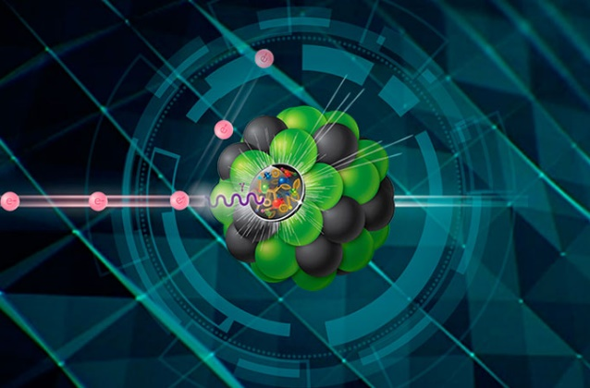
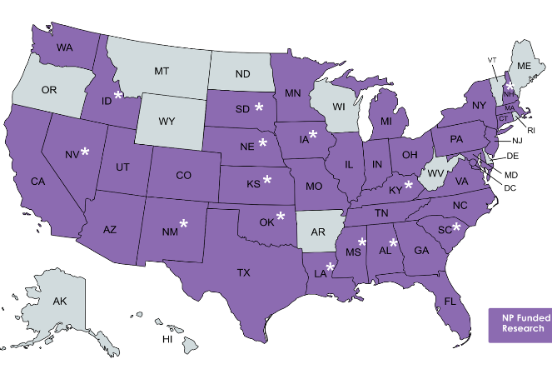
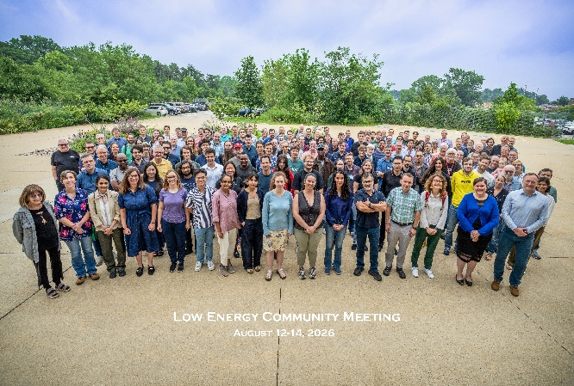
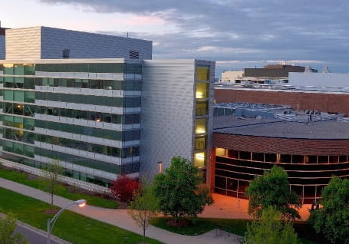
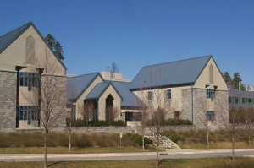
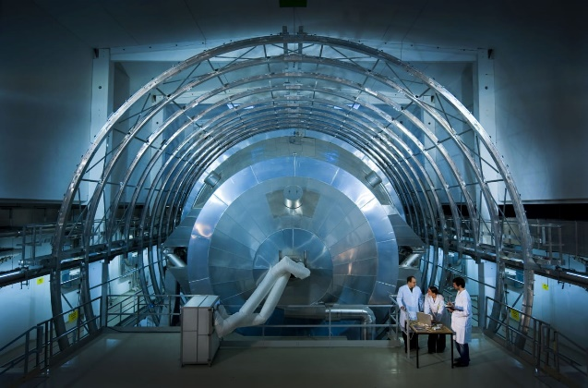
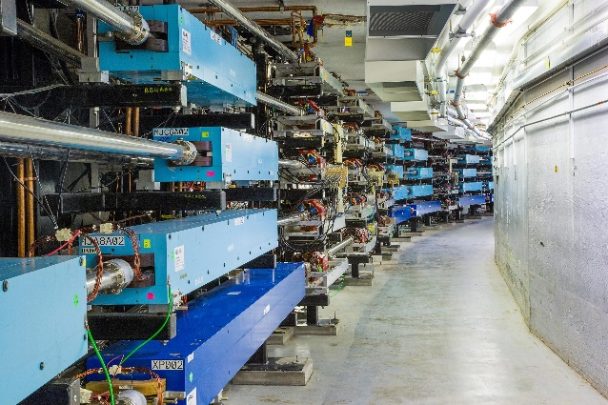
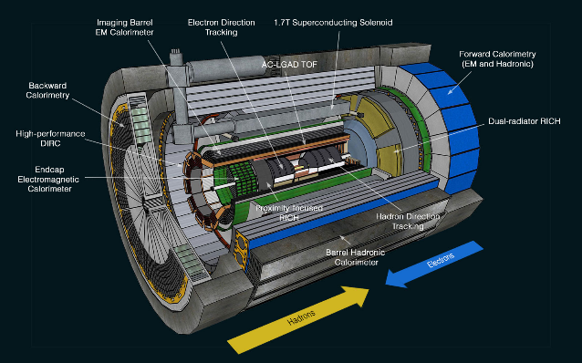
Office of Nuclear Physics at a Glance
FY 2026 Enacted: $866M
DOE is the largest funder of nuclear physics in the U.S. (>95%)
Funding at 10 DOE National Labs, and >120 Academic Institutions, Small Businesses, Non-Profits, and Other Federal Agencies
Attendees of the 2026 Low Energy Community Meeting held at ANL
1,001 Ph.D. Scientists and
331 Grad Students Supported
Facility for Rare Isotope Beams at Michigan State University
NP supports 4 SC User Facilities and 4,000 Users at TJNAL, BNL, ANL and MSU
Triangle Universities Nuclear Laboratory at Duke University
~50% of Research to Universities
KATRIN experiment to measure the neutrino mass
Research: 24%, $206.1M
Magnetic arcs at the CEBAF user facility at TJNAF
Facility Operations: 56%, $481.4M
Schematic of the ePIC detector under construction within the EIC project
Projects: 20%, $174.9M
CUI//SP-BUDG

Slide 7

Office of Nuclear Physics
Regina Rameika, Associate Director (Acting)
Associate Director’s Office Staff
Dannette Keen, Financial Management Analyst
Linnette Quick, Program Assistant (CONTR)
Physics Research Division
Sharon Stephenson, Director
Saryna Cameron, Program Support Specialist (CONTR)
Facilities & Project Management Division
Paul Mantica, Director
Saryna Cameron, Program Support Specialist (CONTR)
Heavy Ion Nuclear Physics Spyridon Margetis
Medium Energy & Quantum Information Science Gulshan Rai, Technical Advisor
Nuclear Structure & Nuclear Astrophysics Spyridon Margetis
Nuclear Theory Astrid Morreale
Nuclear Data Keith Jankowski
Fundamental Symmetries Paul Sorensen
Advanced Technology R&D Vacant
Nuclear Physics Facilities Manouchehr Farkhondeh
Nuclear Physics Major Inititives Ivan Graff
Nuclear Physics Instrumentation Elizabeth Bartosz
Industrial Concepts Michelle Shinn

Slide 8
HEP Budget and Planning
Michelle Bandy
Erin Cruz
Alan Stone
Office of High Energy Physics
Regina Rameika, Associate Director
Eric Colby, Sr. Technical Advisor
Abid Patwa, International Coordination
Zina Alyousff, Program Support Specialist
HEP Support
Christie Ashton
David Bogley
Kathy Yarmas
Advanced Technology Division
Research Division
Regina Rameika, Acting Director
Facilities and Projects Division
Glen Crawford, Acting Director
Glen Crawford, Acting Director
Accelerator Stewardship
Eric Colby
Energy Frontier
Abid Patwa
Facility Lab Operations
Eric Colby (FNAL Accel Complex, BNL ATF)
Eric Feng (FNAL Det Comp, DUNE, FACET-II)
Clayton Hollowell (SURF)
Abid Patwa (LHC Ops)
Kathy Turner (Cosmic Experiments)
Accelerator Programs
Derun Li
Eric Colby
La’Nese Lovings (AAAS Fellow)
Intensity Frontier
Brian Beckford
Cosmic Frontier
Bryan Field
Kathy Turner
Projects
Eric Colby (PIP-II, ACORN)
Glen Crawford (Mu2e)
Joseph Diehl (LBNF/DUNE)
Athans Hatzikoutelis (LBNF/DUNE)
Abid Patwa (HL-LHC)
Instrumentation & Detector R&D
Helmut Marsiske
AI/ML, Computational HEP
Jeremy Love
Theory
William Kilgore
QIS
Zachary Goff-Eldredge
May 2026
SBIR/STTR
Eric Colby

Slide 9
HENP Budget Staff
Michelle Bandy (Budget Execution)
Erin Cruz (Budget Formulation)
Dannette Keen (Budget Execution)
Office of High Energy and Nuclear Physics (HENP)
Regina Rameika, Associate Director
Paul Mantica, Deputy AD
Eric Colby, Sr. Technical Advisor
Abid Patwa, International Coordination
Zina Alyousef, Administrative Support
Saryna Cameron, Administrative Support (CONTR)
HENP Office Staff
Christie Ashton (Program Analyst)
David Bogley (Program Support)
Linnette Quick (Program Support, CONTR)
Kathy Yarmas (Program Analyst)
Advanced Technology (AT)
Glen Crawford, Division Director
Research (RD)
Sharon Stephenson, Division Director
Facilities and Projects (FP)
Paul Mantica, Division Director
Alan Stone (Operations Infrastructure)
Zachary Goff-Eldredge (QIS)
Abid Patwa (Energy Frontier)
Projects Team
Paul Mantica, Lead
Facilities Team
Eric Colby (Fermi Acc), Lead
Derun Li (GARD)
Brian Beckford (Intensity Frontier)
Abid Patwa (HL-LHC)
M. Farkhondeh (SUF)
La’Nese Lovings (AAAS)
Bryan Field (Cosmology)
Joseph Diehl (LBNF/DUNE)
Eric Feng (DUNE, FNAL Det & Comp, FACET-II)
Jeremy Love (Comp, AI)
Keith Jankowski (Nuclear Data, NSNA)
Athans Hatzikoutelis (LBNF/DUNE)
Kathy Turner (Cosmic)
Helmut Marsiske (Detector R&D)
Paul Sorensen (Fundamental Symmetries)
Elizabeth Bartosz (MOLLER, ACORN, LEGEND-1000)
Clayton Hollowell (SURF)
Gulshan Rai (QIS)
William Kilgore (HEP Theory)
Vacant (major facilities)
Abid Patwa (LHC)
Michelle Shinn (Industrial Concepts)
Astrid Morreale (NP Theory)
Coming Soon
Spyridon Margetis (QCD Experiments)

Slide 10
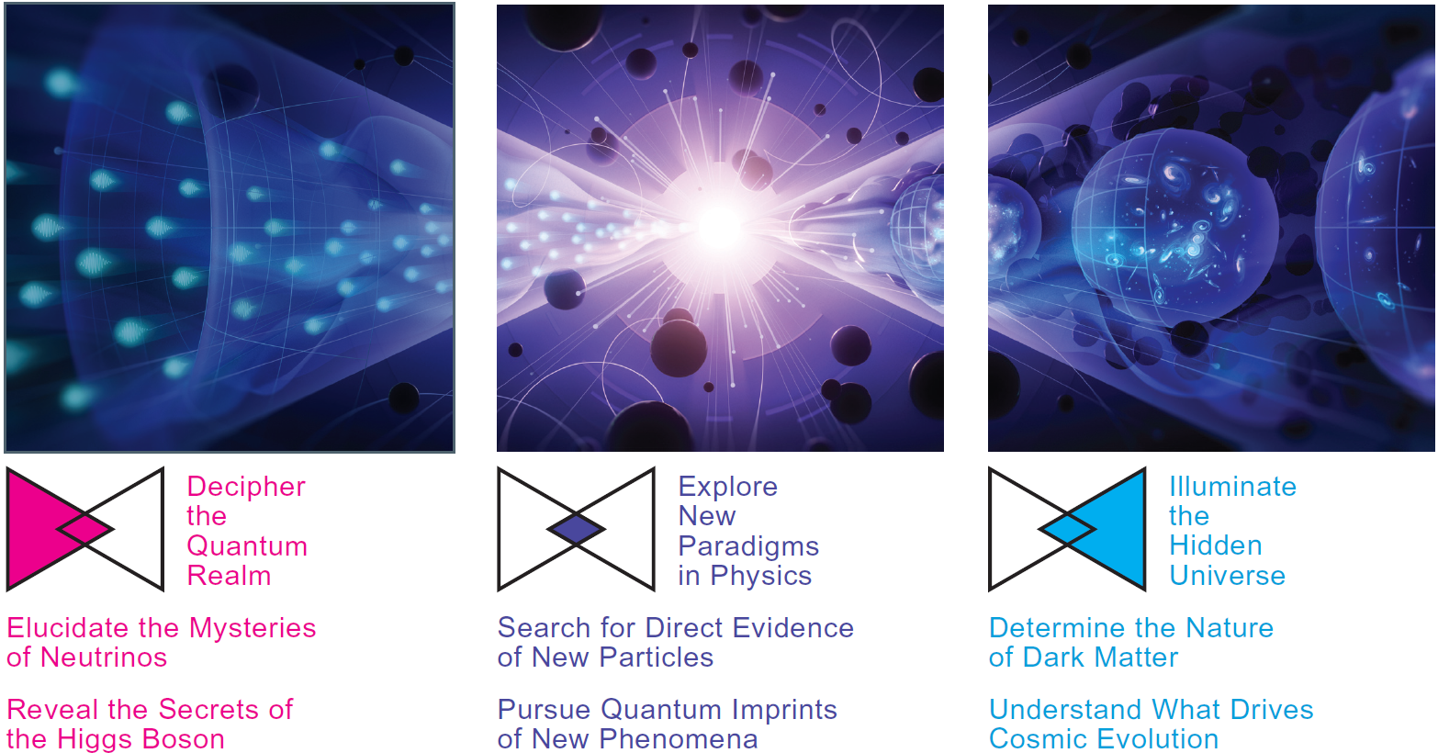
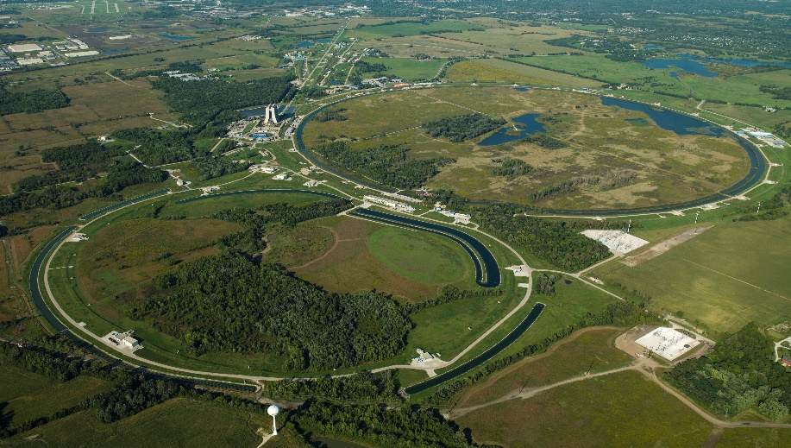
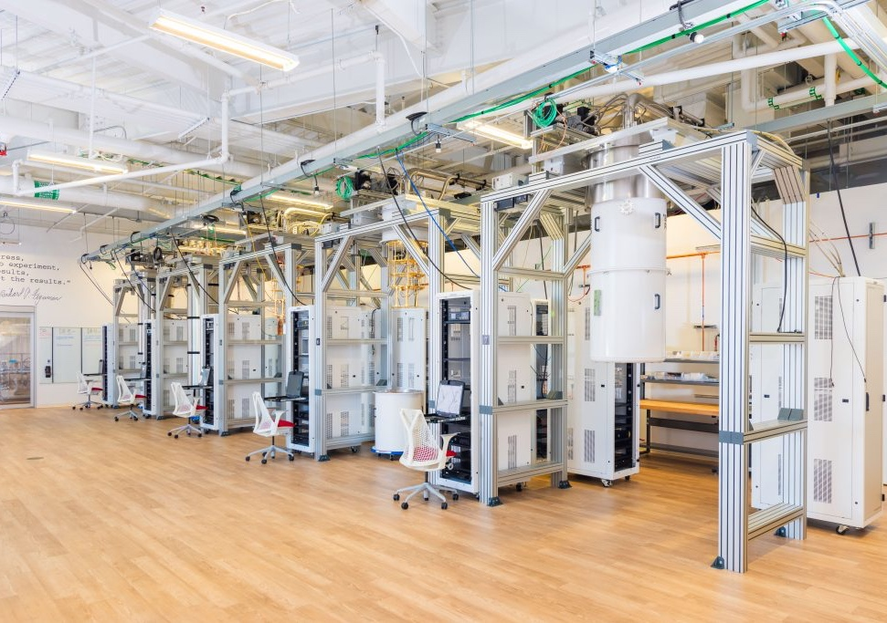
HENP research answers fundamental questions while developing breakthrough technologies
Physics Research
Accelerator Research
Technology Research
High Energy and Nuclear Physics explores what the universe is made of and how it works at the smallest and largest scales, seeking new discoveries from the tiniest particles to the outer reaches of space.
HENP develops new accelerator, detector, and computational tools to open new doors to discovery science,
Through Accelerator Stewardship, HENP works to make transformational accelerator technology widely available to science and industry.
HENP research is inspired by some of the biggest questions about our universe.
Finding these answers requires development of state of the art detectors using cutting edge technologies
Technology development inspires young minds, trains an expert workforce, and drives innovation that improves the nation’s health, wealth, and security.
Notes:
1) New Mechanism Explains Rapid Energy Sharing Across Atomic Semiconductor Junctions
Electron transfer between atomically thin materials triggers the ultrafast release of heat.
2) Improved Fuel Cell Catalysts with Less Platinum
A new catalyst design meets cost, activity, and durability goals by leveraging ultralow loadings of platinum with platinum-free supports.
3) Underground Storage of Carbon Dioxide—as a Solid
Nanoscale features in rocks enable more carbon dioxide to be trapped as a solid carbonate material underground.

Slide 11
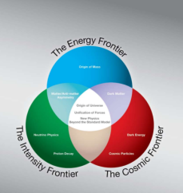
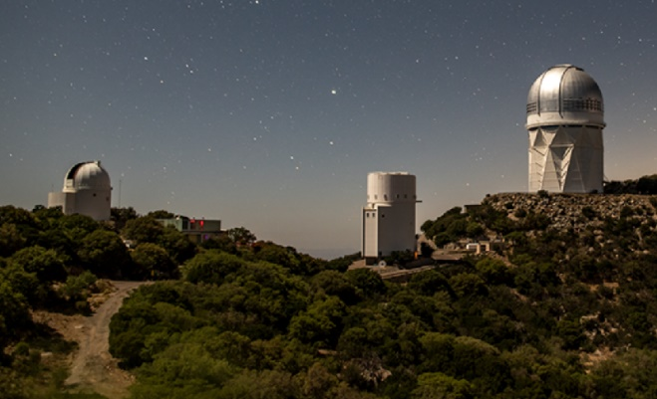
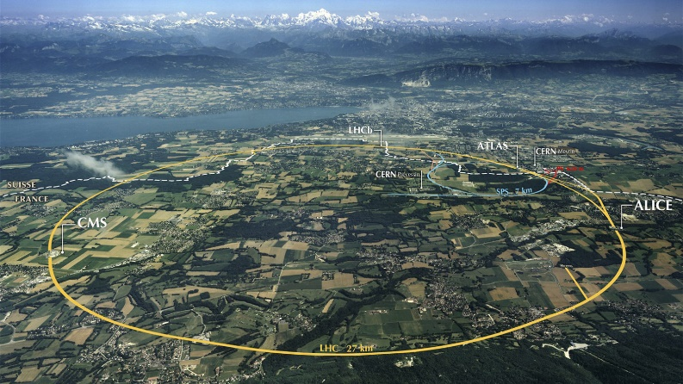
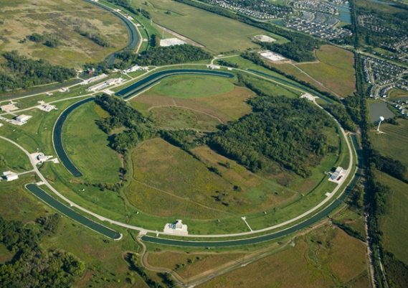
HENP Avenues for Discovery – HEP Frontiers
Energy Frontier
Intensity Frontier
Cosmic Frontier
Accelerate particles to the highest energies ever made by humanity and collide them to produce and study the fundamental constituents of matter
  The Large Hadron Collider at CERN is currently the centerpiece.
  US researchers play major roles in the ATLAS and CMS experiments
Researchers use intense particle beams and highly sensitive detectors to make precise measurements and search for new physics.
  The Fermilab accelerator in Batavia, Illinois is currently the heart and home of this research.
  Intensity research focuses on understanding neutrinos and searching for new physics in the lepton sector.
Cosmic researcher seek to reveal the nature of dark matter and dark energy with a program that uses naturally occurring sources.
  Tools include telescopes, ground-based and in orbit and a variety of underground sensitive detectors.
Crosscutting: Theory, AI, QIS, Advanced Computing, Accelerator & Detector R&D

Slide 12
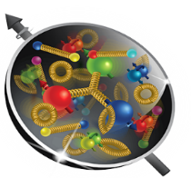
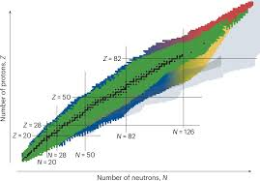
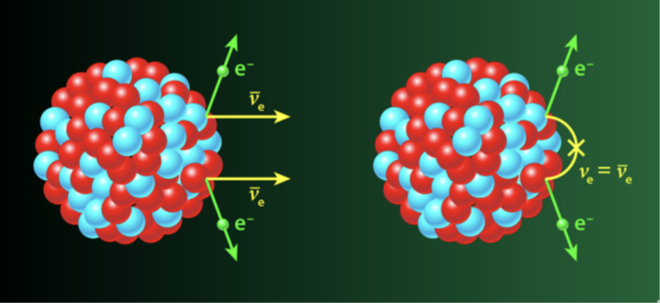
HENP Avenues for Discovery – NP Thrusts
Hot and Cold QCD
Nucleon Structure and Nuclear Astrophysics
Fundamental Symmetries
Study the dynamics, structure, and spin for protons and neutrons
  Heavy ion collisions and electron scattering informs our understanding of nuclear phenomena and the formation of the universe
  U.S. provides the world’s highest intensity, polarized electron beams for this science
Enables element and isotope discovery
  Reaction rates and structure data for national priorities
  Superheavy elements provide a fertile ground for tests of theory
  Nuclear data and capabilities for characterization of electronics (e.g., defects, radiation-induced failures)
Targets natural processes that break conservation laws and symmetries
  Data-driven science to explain the matter-antimatter balance
  Extreme high-precision detectors translate to other applications
  Nuclear-science-based innovation for Quantum Information Science
Crosscutting: Theory, AI, QIS, Advanced Computing, Accelerator & Detector R&D

Slide 13
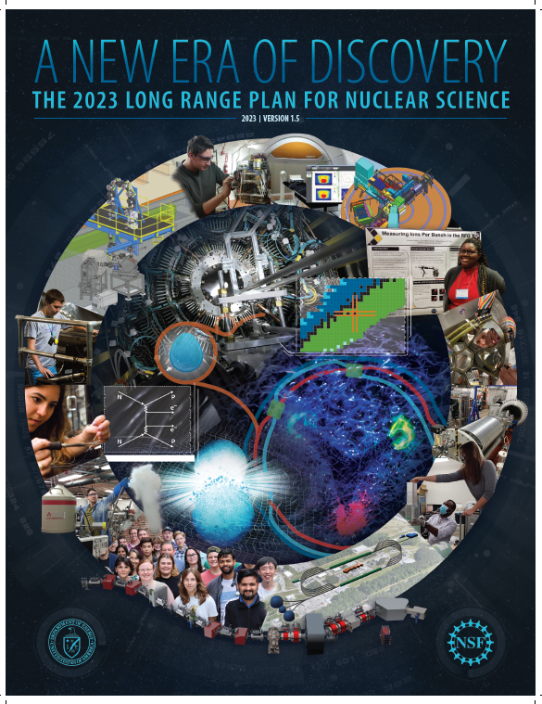
NP Long-range Strategic Planning
Four Recommendations :
  The highest priority of the nuclear science community is to capitalize on the extraordinary opportunities for scientific discovery made possible by the substantial investments of the United States. We must draw on the talents of all in the nation to achieve this goal.
  As the highest priority for new experiment construction, we recommend the United States lead an international consortium that will undertake a neutrino-less double beta decay campaign, featuring the expeditious construction of ton-scale experiments using different isotopes and complimentary techniques.
  We recommend the expeditious completion of the EIC as the highest priority for facility construction
  We recommend capitalizing on the unique ways in which nuclear physics can advance discovery science and applications for society by investing in additional projects and new strategic opportunities

Slide 14

HEP Long-range Strategic Planning
Six major recommendations and 20 “area” recommendations
  As the highest priority independent of the budget scenarios, complete construction projects and support operations of on-going experiments and research to enable maximum science. We reaffirm the previous P5 recommendations on major initiatives : HL-LHC, PIP-II and DUNE Phase I, Rubin Observatory.
  Construct a portfolio of major projects that collectively study nearly all fundamental constituents of our universe and their interactions, as well as how those interactions determine both the cosmic past and future. Plan and start the following new initiatives in order of priority : CMB-S4, DUNE Phase II, off-shore Higgs factory, G3 DarkMatter, IceCube-Gen2.
  Create an improved balance between small, medium and large-scale projects to open new scientific opportunities and maximize their results, promote creativity and compete on the world stage.
  Support a comprehensive effort to develop the resources- theoretical, computational, and technological-essential to our 20-year vision for the field. This includes an aggressive R&D program that, while technologically challenging, could yield revolutionary accelerator designs that chart a realistic path to a 10TeV pCM collider.
  Invest in initiatives aimed at developing the workforce, broadening engagement, and supporting ethical conduct in the field. This commitment nurtures an advanced technological workforce not only for particle physics, but the nation as a whole.
  Convene a targeted panel with broad membership across particle physics later this decade that makes decisions on the US accelerator-based program at the time when major decisions concerning an offshore Higgs factory are expected, and/or significant adjustments within the accelerator-based R&D portfolio are likely to be needed. A plan for the Fermilab accelerator complex consistent with the long-term vision of this report should be reviewed.

Slide 15
HEP Budget ($K): Research, Facilities & Projects
FY 2001 – FY 2023
HEP Budget ($K): Research, Facilities, & Projects
ARRA 2009 funds supported Research, Facilities, and Projects
IRA 2022 funds supported Projects only
One Big Beautiful Bill Act (OBBA) of FY 2025 funds Research only
Beginning FY 2026: formerly ARDAP program funds are merged into the HEP Budget

Slide 16
HEP Budget ($K): Research, Facilities, & Projects
Inflation Reduction Act (IRA) of 2022 funds supported Projects only
One Big Beautiful Bill Act (OBBBA) of 2025 funds supported AI/ML Research only
Beginning FY 2026: formerly ARDAP program funds are merged into the HEP Budget

Slide 17
NP Budget ($K): Research, Facilities & Projects

Slide 18
HEP Projects Status
Project | Location | Status | Cost | CD-4
Construction Projects
Long Baseline Neutrino Facility/Deep Underground Neutrino Experiment (LBNF/DUNE) | FNAL, SURF | Various* | $3.1B to $3.7B (Est) | Q1 FY35 (Est)
Proton Improvement Plan II (PIP-II) | FNAL | CD-3 | $978M (TPC) | Q1 FY33
Muon to Electron Conversion (Mu2e) Experiment | FNAL | CD-3 | $316M (TPC) | Q2 FY28
Major Items of Equipment
High-Luminosity LHC (HL-LHC) Accelerator Upgrade | CERN | CD-3 | $266M (TPC) | Q1 FY30
HL-LHC ATLAS Detector Upgrade | CERN | CD-2/3 | $200M (TPC) | Q1 FY31
HL-LHC CMS Detector Upgrade | CERN | CD-2/3 | $200M (TPC) | Q1 FY31
Accelerator Controls and Operations Research Network (ACORN) [to be delegated after CD-1] | FNAL | CD-0 | $134-197M (Est) | TBD
*LBNF/DUNE is composed of 5 subprojects, each with different costs and schedules. Far Site work is well advanced with excavation nearly complete (CD-4) and infrastructure outfitting proceeding; Far Site Detectors and Cryogenics are expected to be baselined in Summer 2026. Near Site conventional facilities and Beamline are at CD-2/3 and the Near Detectors are not yet baselined.

Slide 19
NP Projects Status
Project | Location | Status | Cost | CD-4
Major Items of Equipment
Gamma Ray Energy Tracking Array (GRETA) ^{Fully Funded, Delegated} | LBNL | CD-4A | $58.3M (TPC) | Q2 FY28
Measurement of a Lepton-Lepton Electroweak Reaction (MOLLER) ^{Fully Funded} | TJNAF | CD-2/3 | $48.66M (TPC) | Q4 FY28
High Rigidity Spectrometer (HRS) High Transmission Beam Line (HTBL) SPectrometer Section (SPS) | MSU | CD-2/3 CD-1 | $49.7M (TPC) $65.5M - $87.3M (Est) | Q3 FY30 Q2 FY32 (Est)
Ton Scale Neutrinoless Double Beta Decay (TS-NLDBD) Near-term LEGEND-1000 | ORNL | CD-0 | $409M to $665M (Est) | Q4 FY43 (Est)
Construction Projects
Electron-Ion Collider (EIC) | BNL | CD-3B | $1.7B to $2.8B (Est) | Q1 FY36 (Est)
TBD

Slide 20
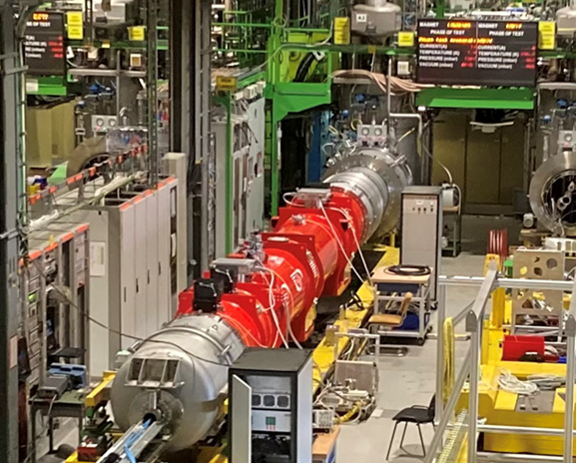
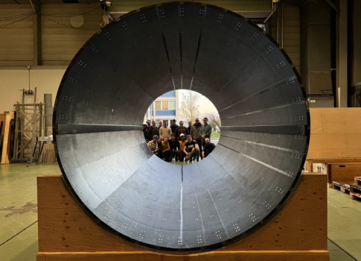
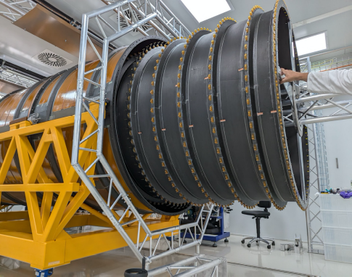
U.S. HL-LHC/Phase-II Upgrade Projects
DOE HL-LHC Accelerator Upgrade Project (AUP)
  DOE Critical Decision (CD)-0 [Mission Need] approved in Apr 2016 ⇒
  initiated the ‘project’
  Project is now baselined (CD-2) and in production
  DOE total project cost for U.S. HL-LHC AUP at $266 million
  Since Nov 2023, delivery to CERN of U.S.-built magnet assemblies ongoing
  All project funding delivered
DOE HL-LHC ATLAS and CMS Detector Upgrades
  DOE CD-0 approved in Apr 2016 ⇒ initiated each ‘project’
  Both ATLAS and CMS HL-LHC [Phase-II] upgrade projects are baselined (CD-2)
  Different detector subsystems are now in fabrication mode (or are nearing their respective production phases)
  DOE total project cost for U.S. ATLAS & CMS HL-LHC projects each at $200 million
Project funding is complete i
HL-LHC AUP: Cyro-Assembly #1 at CERN.
CMS HL-LHC: Outer Tracker-BTST at CERN.
Project funding is completed in FY27; I&I will be covered on the operations budget
ATLAS HL-LHC: Barrel Detector’s Carbon Fiber Cylinder layers nested at CERN.

Slide 21
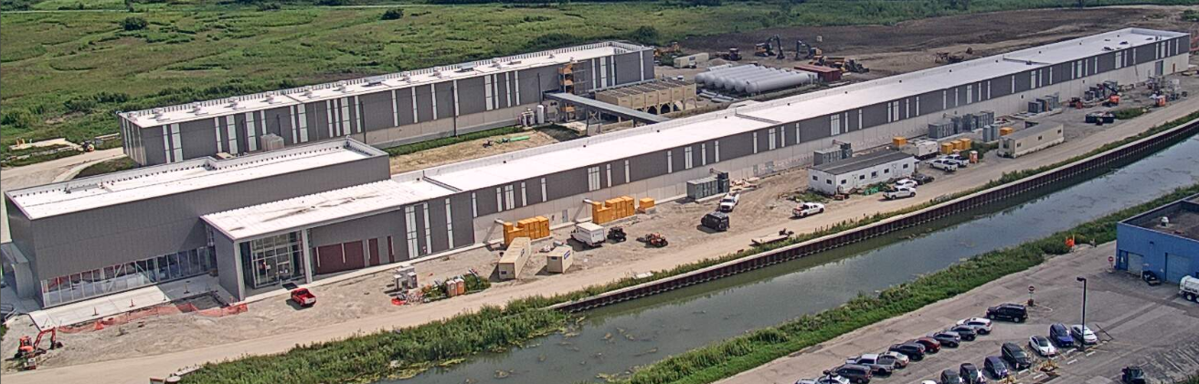
PIP-II Construction Project
New Superconducting Linac will replace Fermilab’s 50-year-old front-end infrastructure, increasing beam power, energy, reliability, flexibility and upgradability.
Extends Fermilab’s leadership with world’s most intense neutrino beam for long baseline experiment and other scientific opportunities.
DOE Total Project Cost = $978 M
    CD-3 4/18/2022 Approved Start of Construction
    CD-4 1Q FY 2033 Forecast for Project Completion
      “Early” CD-4 : Q2FY30
Photo: 8/25/2026
CUI//SP-BUDG

Slide 22
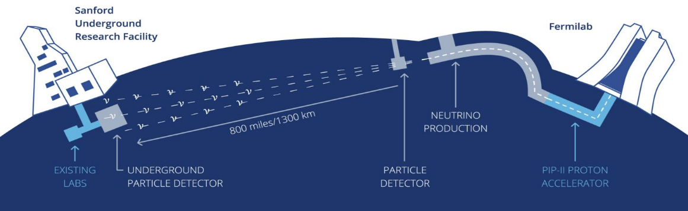
U.S. Project Scope. Delivered at Two Sites through Five Subprojects
LBNF/DUNE Construction Project
Far Site – SURF in Lead, SD
Facility/Infrastructure and Far Detectors
Near Site – FNAL in Batavia, IL
Facility/Infrastructure, Neutrino Beamline, and Near Detectors
Three subprojects
Two subprojects
FSCF-EXC – Far Site Excavation (CD-3)
FSCF-BSI – Far Site Building & Site Infrastructure (CD-3)
FDC – Far Detectors and Cryogenic Infrastructure (CD-3c)
NSCF+B – Near Site Conventional Facilities + Beamline (CD-3a)
ND – Near Detectors (CD-1RR)
↑ Funding limited schedule
↑ Technically limited schedule
Largest DOMESTIC project in Office of Science (TPC range = $3.1- $3.7B)
22
CUI//SP-BUDG

Slide 23
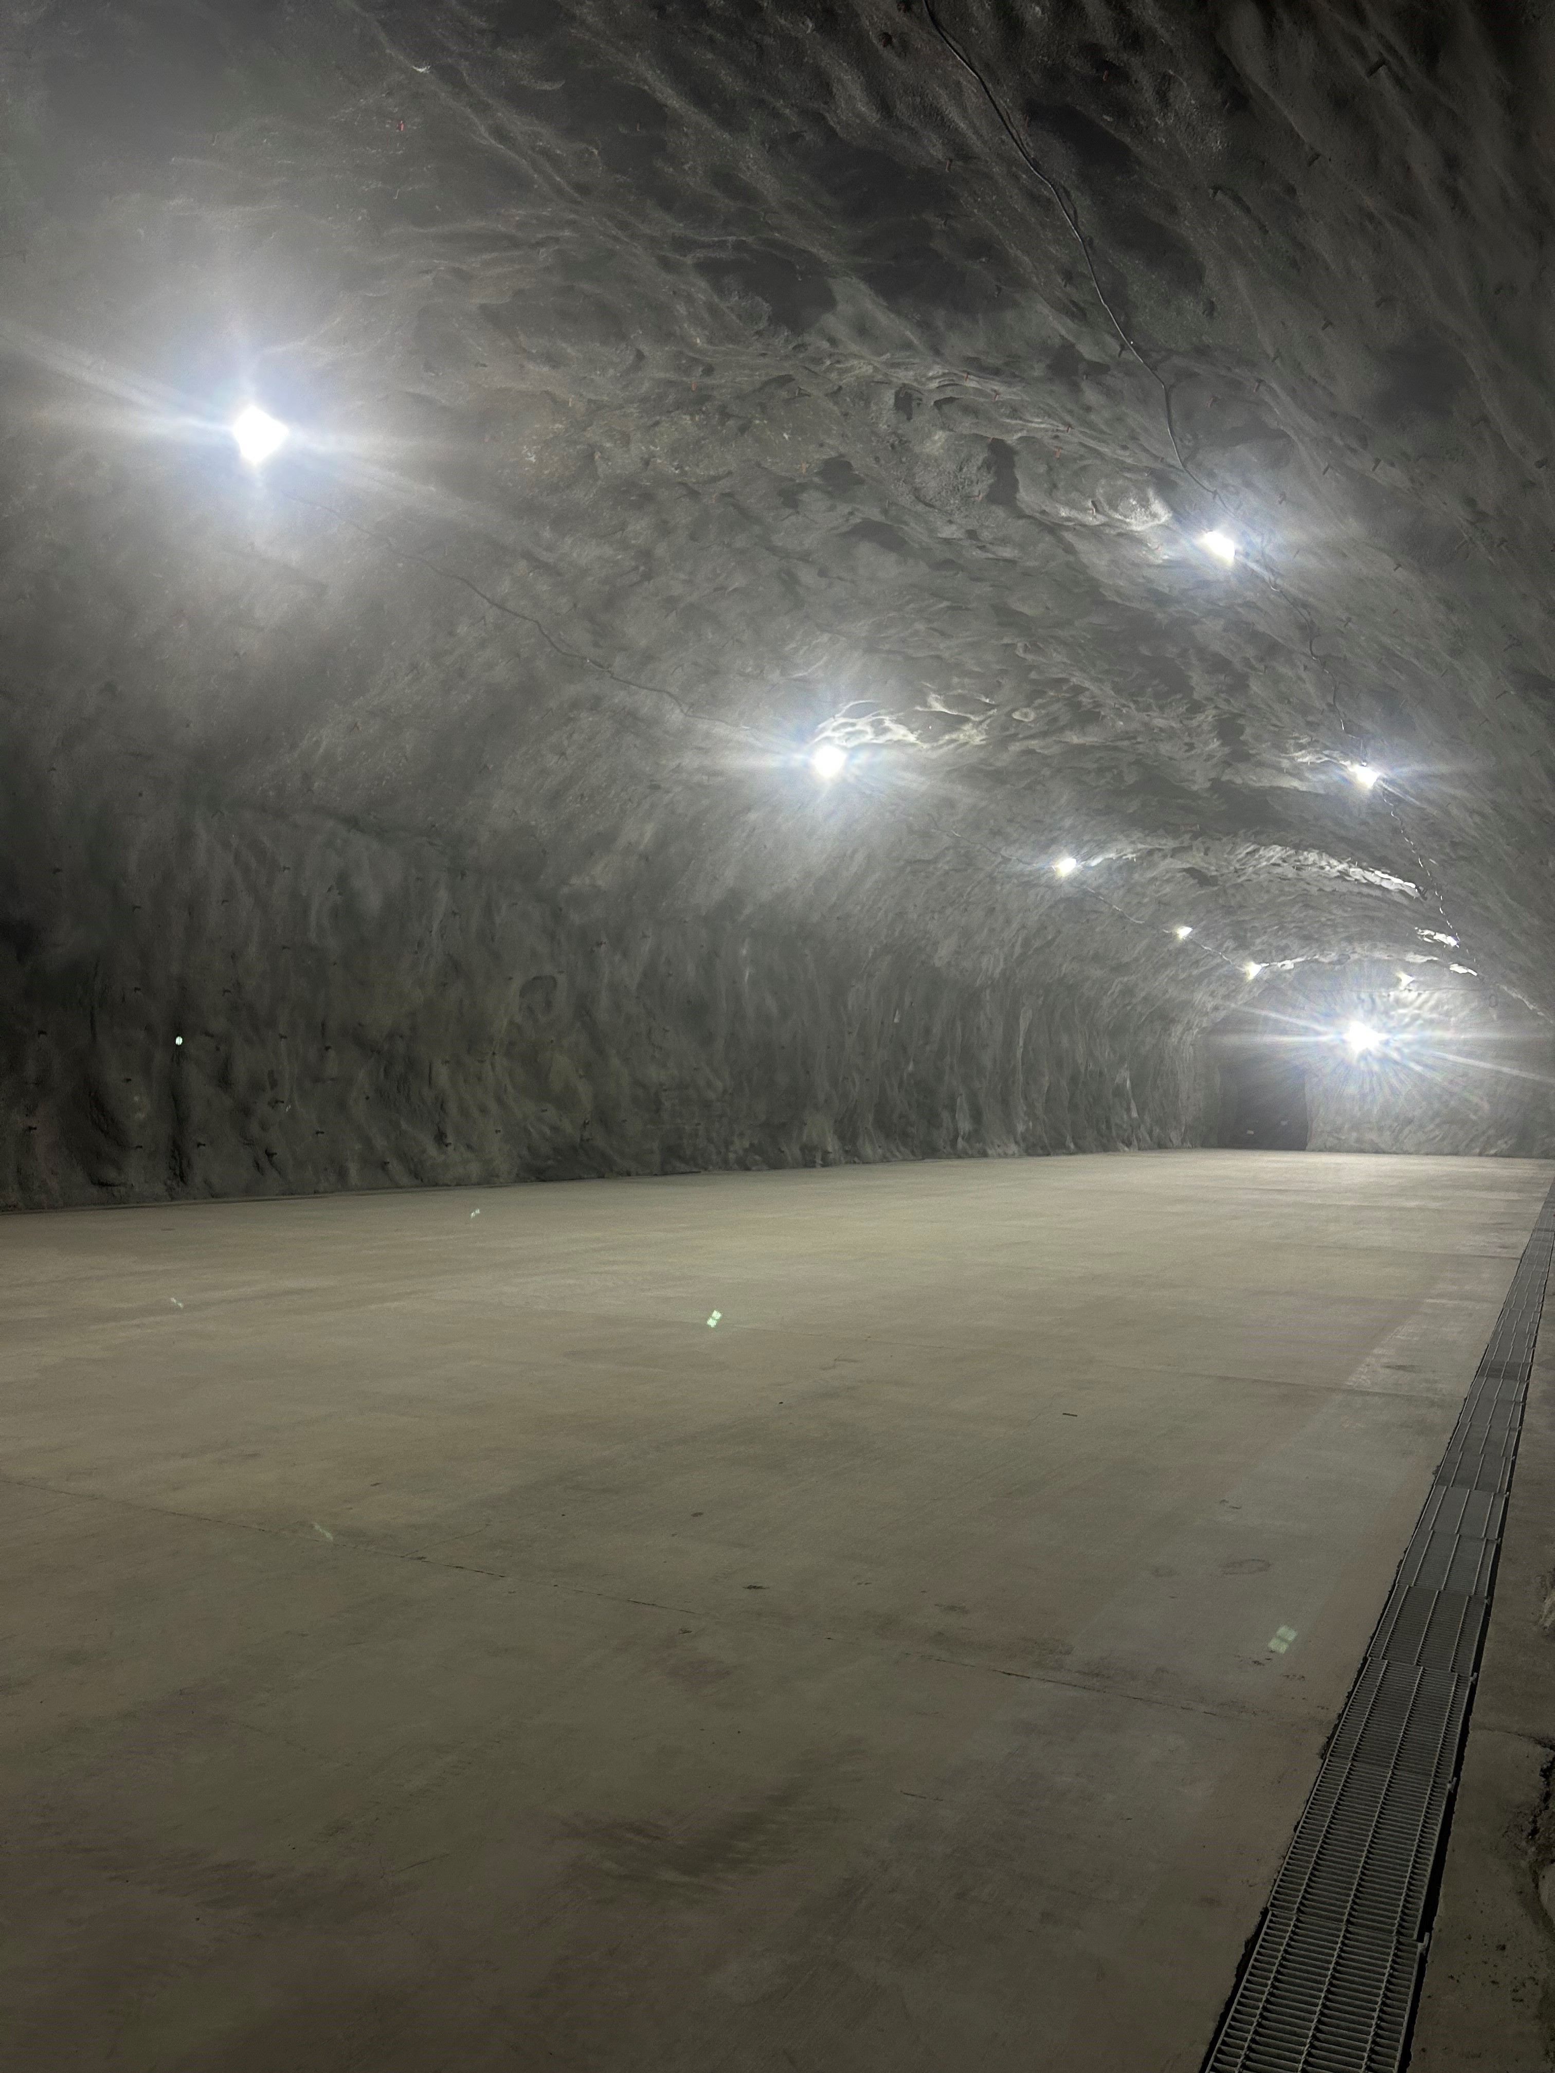
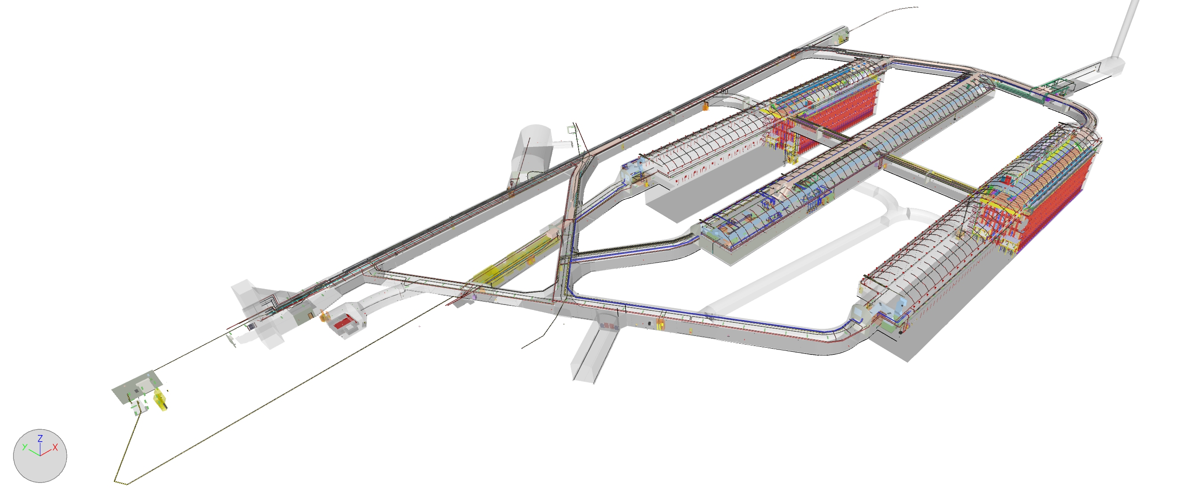
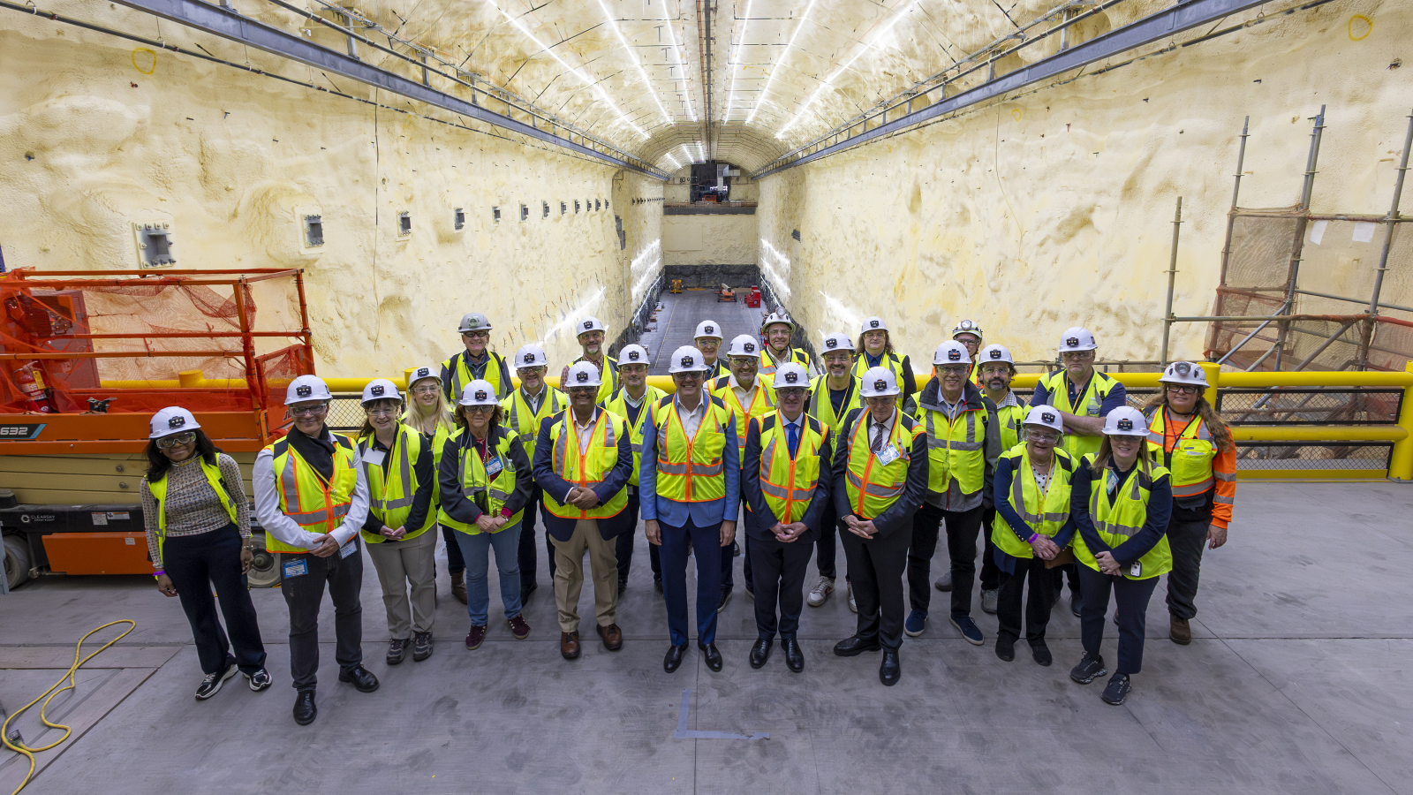
DUNE Far Detector space @ SURF
August 2024
May 2026

Slide 24
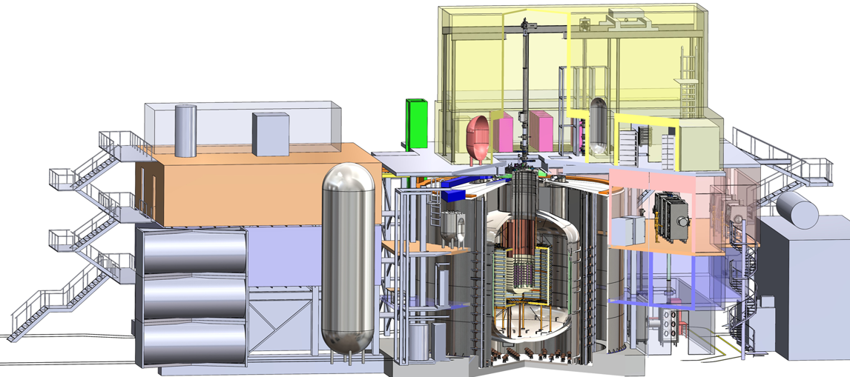
Neutrinoless Double Beta Decay: Top Priority for New Experiment Construction in NP Long-range plan
NP supported pre-R&D and conceptual design for three technologies: CUPID, LEGEND-1000, and nEXO.
In December 2024, LEGEND-1000 selected as the first priority for NP investment.
(est. DOE cost $483M)
U.S. provides intellectual and funding
(70% of total cost) leadership.
Key partners: NSF (U.S.), INFN (Italy), BMFTR (Germany), MPIK (Germany).
Project ready for CD-1 approval. FY 2028 Above Guidance level will support long lead procurement of enriched germanium-76.
TeO₂ Crystals from CUORE
Schematic of LEGEND-1000 experiment to be deployed at the underground facility in Gran Sasso, Italy.
24

Slide 25
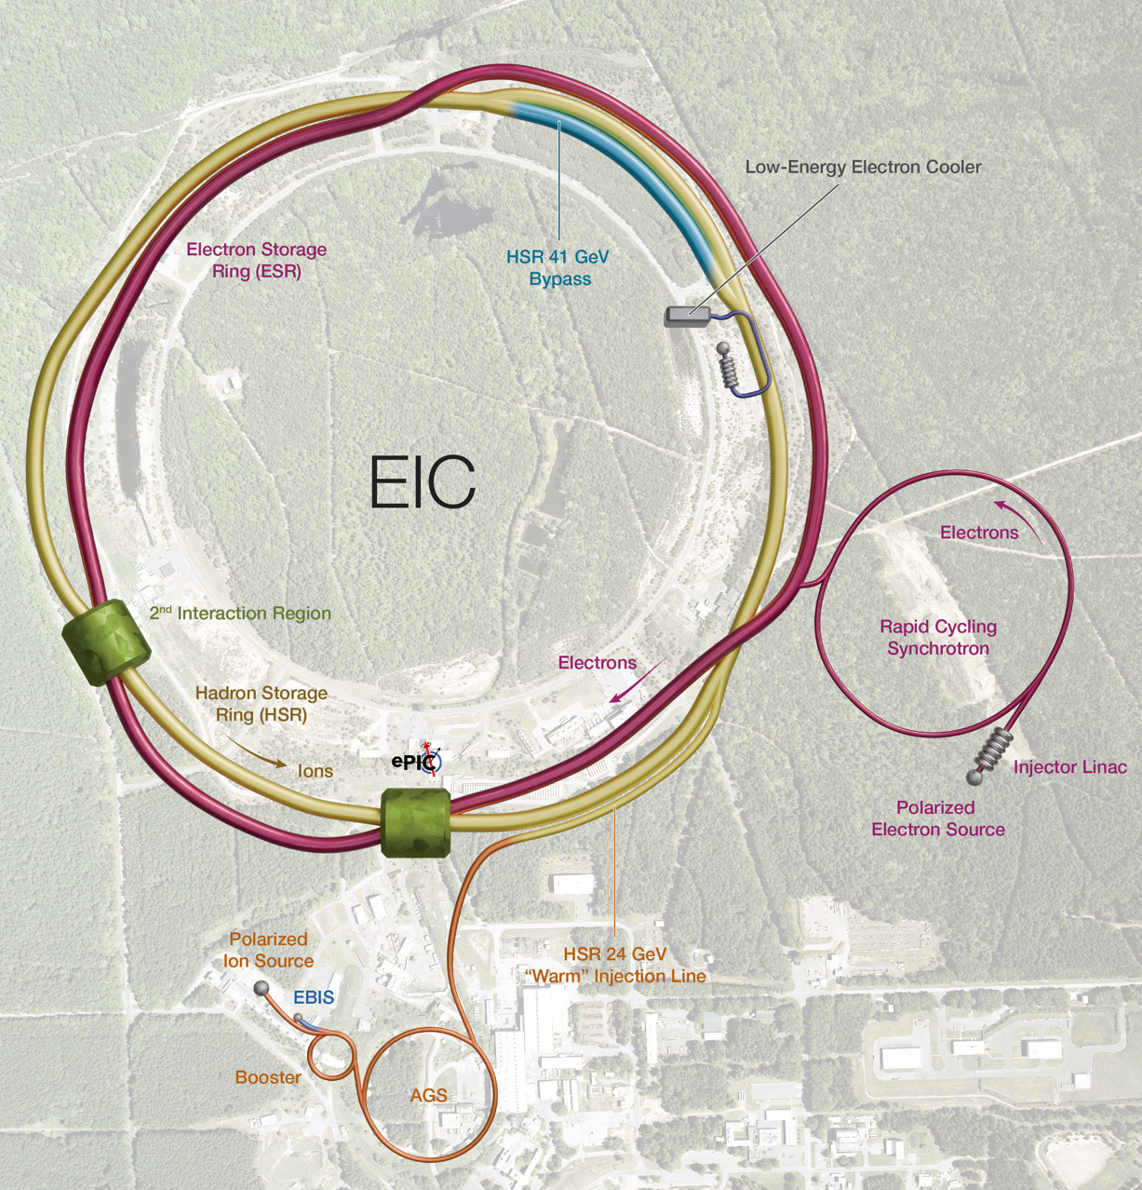
Electron-Ion Collider: Top Priority for New Facility Construction in the Nuclear Science Long Range Plan
Located at BNL, using existing RHIC assets, with TJNAF as a major partner
CD-1 cost rage of $1.7 billion to $2.8 billion; current estimated TPC at ~$3.5B
In-kind contributions: New York State and International partners
  $100M grant from New York supports civil construction
  ~$90M anticipated for the detector ePIC (~30%)
  ~$50M anticipated accelerator scope (~5%)
Critical Decision-3A (long lead procurement): March 2024
Critical Decision CD-3B (second long lead procurement request) approved January 2026
Project elaborating its subproject strategy
Notes:
NASEM: A US-based EIC will uniquely answer: How does the mass of the nucleon arise? How does the spin of the nucleon arise? What are the emergent properties of dense systems of gluons?

Slide 26
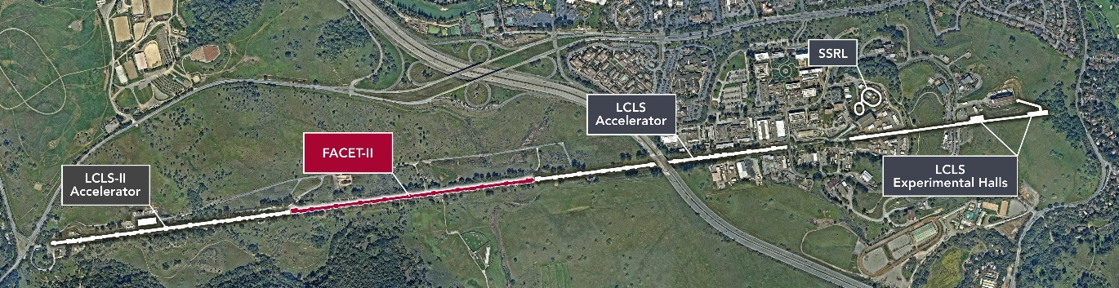
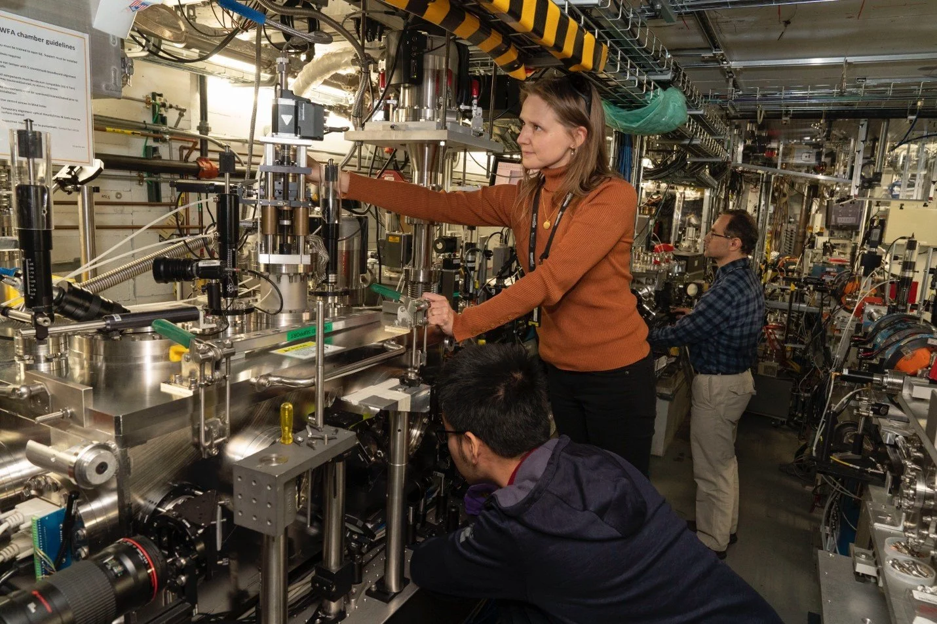
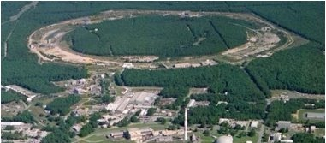
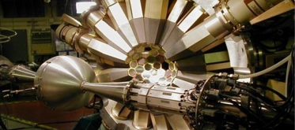
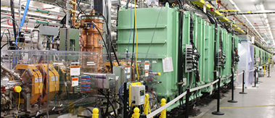
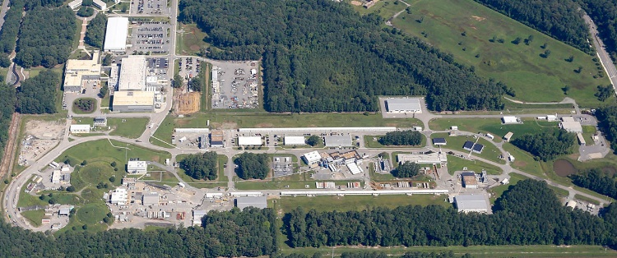
HENP user facilities provide critical capabilities to maintain U.S. scientific leadership
CC
Fermilab
Facility for Rare Isotope Beams and Argonne Tandem Linac Accelerator System study how protons and neutrons combine to form the atomic nucleus.
Continuous Electron Beam Accelerator Facility seeks to understand quarks and gluons, the elementary building blocks of protons and neutrons.
Relativistic Heavy Ion Collider ended operation in FY 2026 – support continues for users to analyze data and for hadron injector operations for isotopes and microelectronics testing missions.
Fermilab Accelerator Complex enables cutting-edge muon and neutrino experiments
SLAC FACET-II is an electron beam-driven plasma wakefield acceleration facility, now completing a current advanced accelerator research program.
BNL ATF is an accelerator test facility delivering unique accelerator test capabilities for users.
Over 6,000 users from the scientific community access these facilities annually.
FACET-II@SLAC
ATF@BNL
RHIC@BNL
ATLAS@ANL
FRIB@MSU
CEBAF@TJNAF

Slide 27
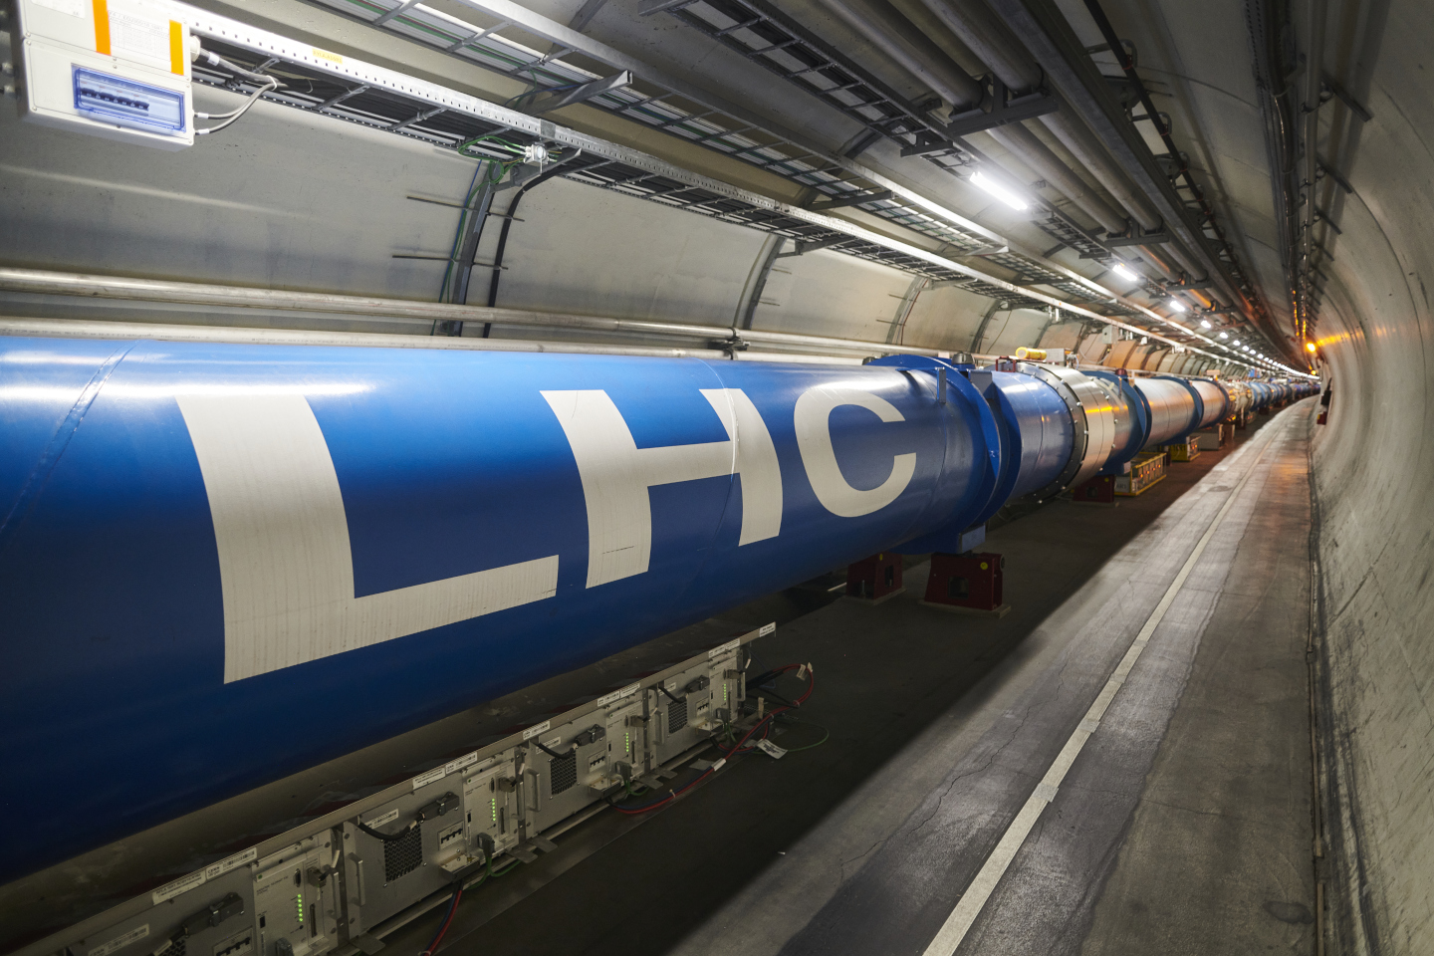
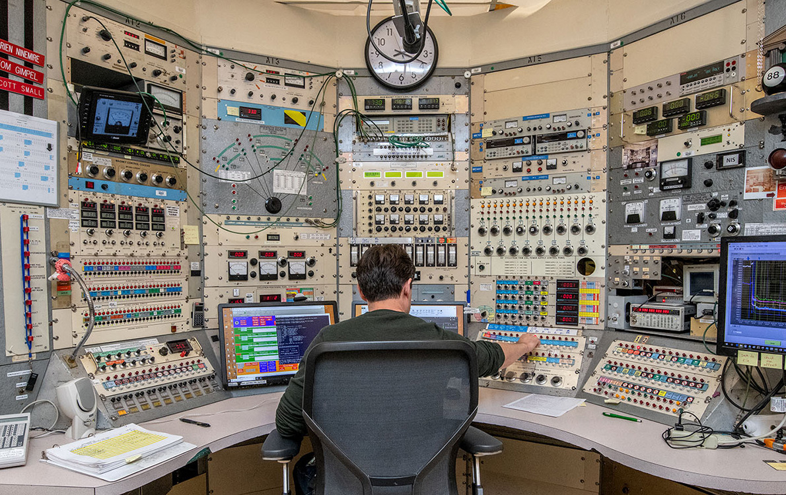
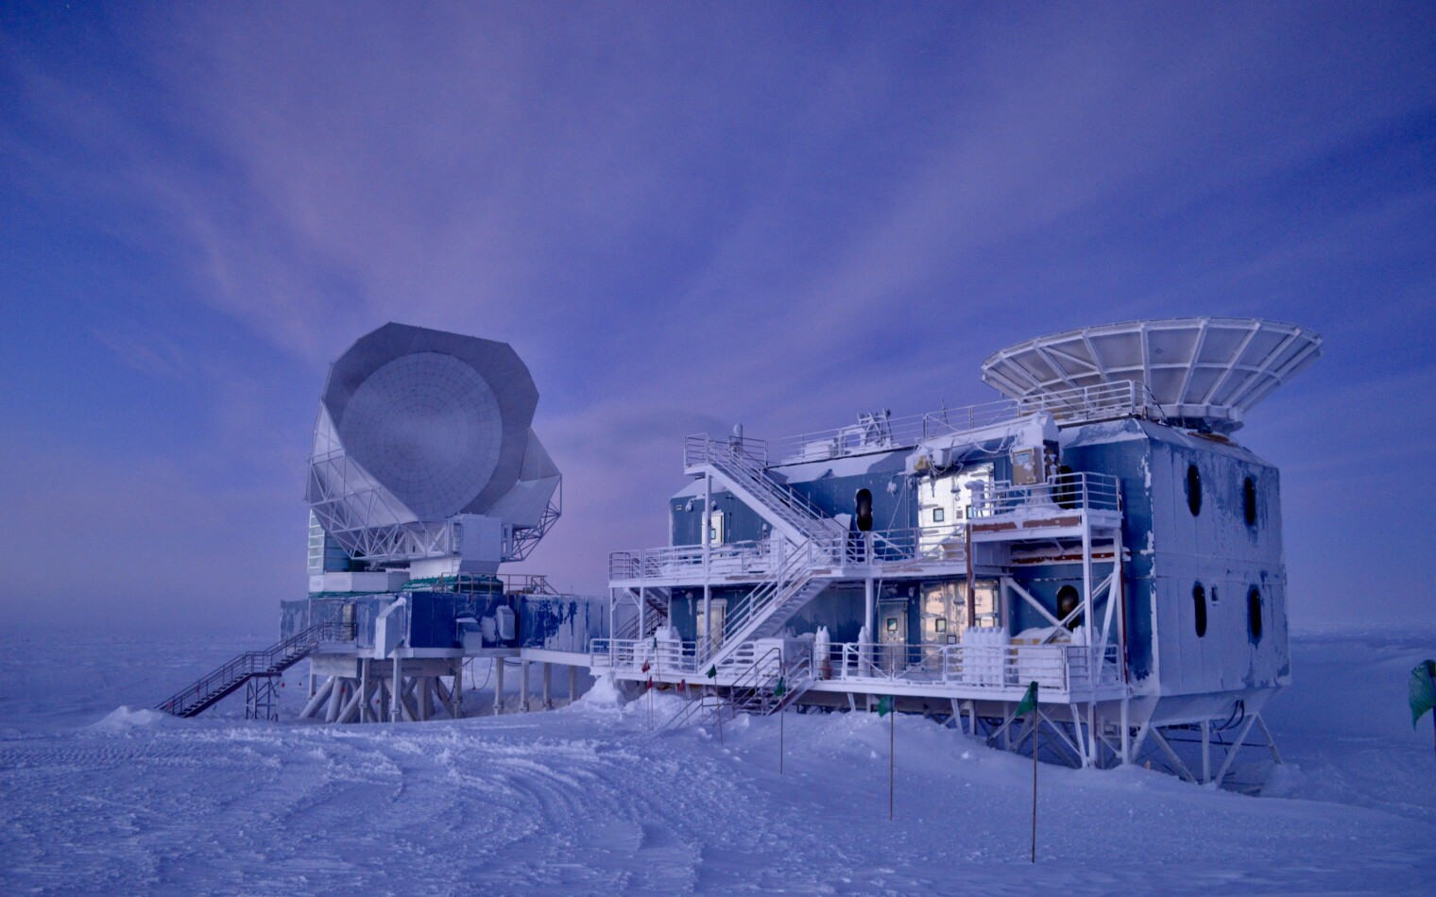
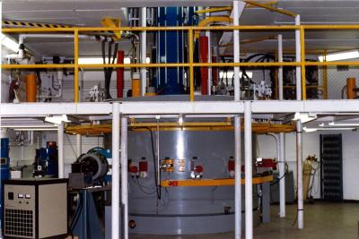
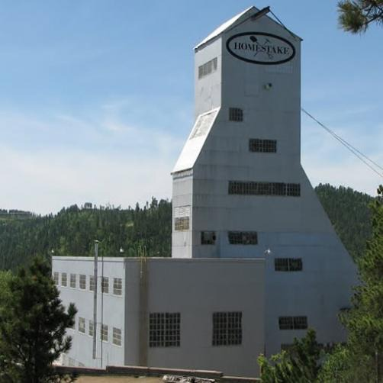
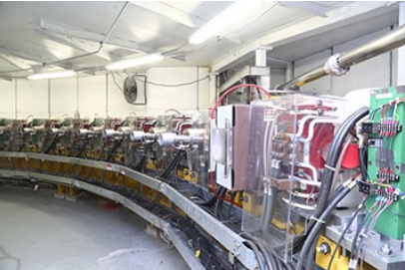
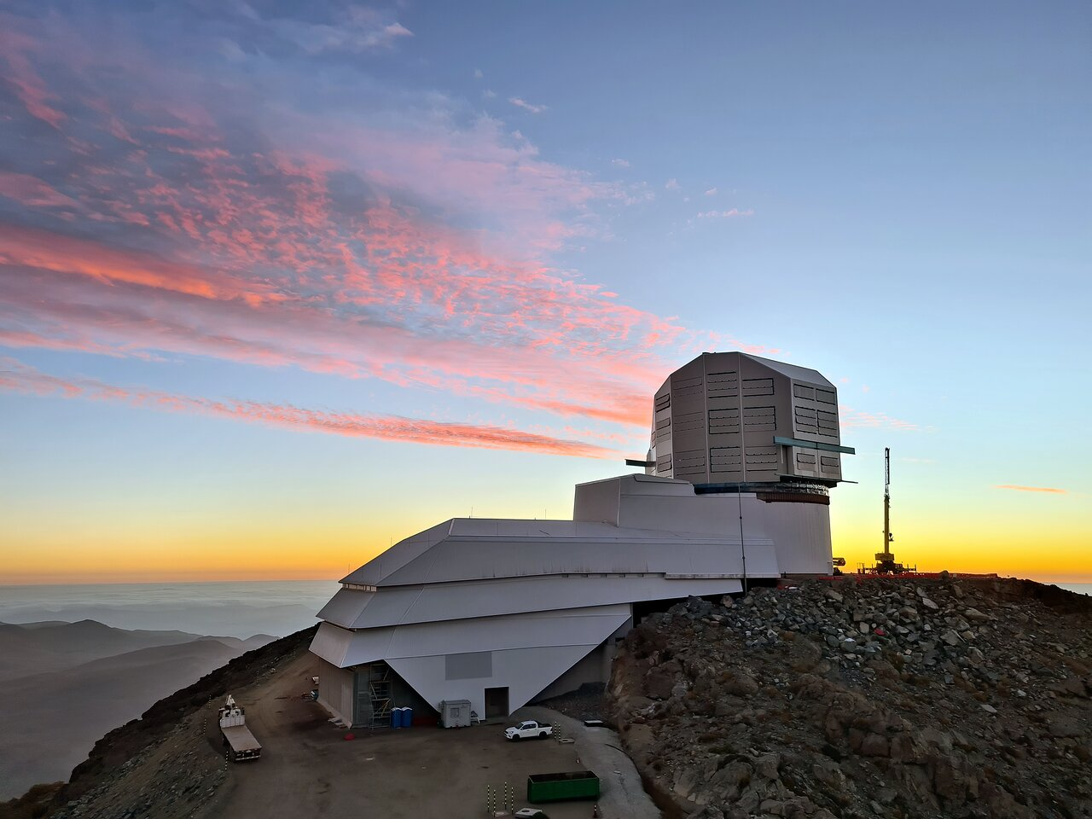
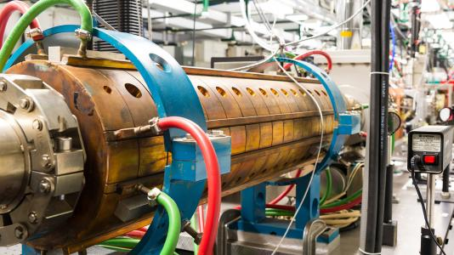
HENP: Additional Facility Operations
U.S. LHC Detector Operations
DESI
Operations at Kitt Peak
88” cyclotron @ LBNL
Sanford Underground
Research Facility
TAMU K500 cyclotron
South Pole Observatory
NSF-DOE
Vera C. Rubin Operations
Argonne
Wakefield Accelerator
TUNL High
Intensity
Gamma-ray
Source
CUI//SP-BUDG

Slide 28
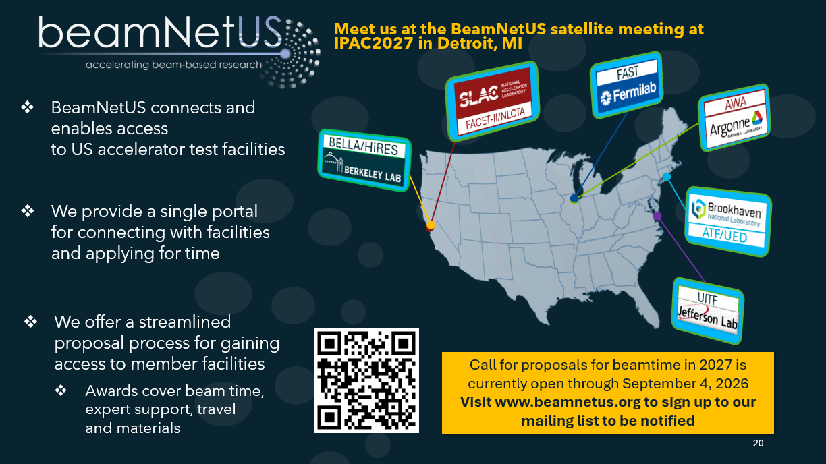
BeamNetUS is streamlining access to US accelerator test facilities
BeamNetUS provides a single portal through which academic and industrial users can learn about DOE’s unique accelerator test facilities, contact representatives for information, and apply for time.
HEP is evolving its user support model for accelerator R&D users
Academic and industrial accelerator users’ needs are topically broad and geographically distributed
A decentralized model is optimal
BeamNetUS provides access to 13 different facilities across the country through a streamlined merit-based proposal process
Facilities are funded based on demand
Slide courtesy of BeamNetUS

Slide 29



HENP in Quantum Information Science
National QIS Research Centers:
SQMS (Fermilab): Developing superconducting quantum technologies for scalable computing and HEP-specific sensing and computing targets.
Q-NEXT (Argonne): Quantum networking and integration across heterogeneous devices; applying entanglement-enhanced sensing across a range of distances for gravitational physics.
C²QA (BNL) : partners with IBM, PNNL, and 25 other institutions to build tools for scalable fault-tolerant quantum systems

Slide 30
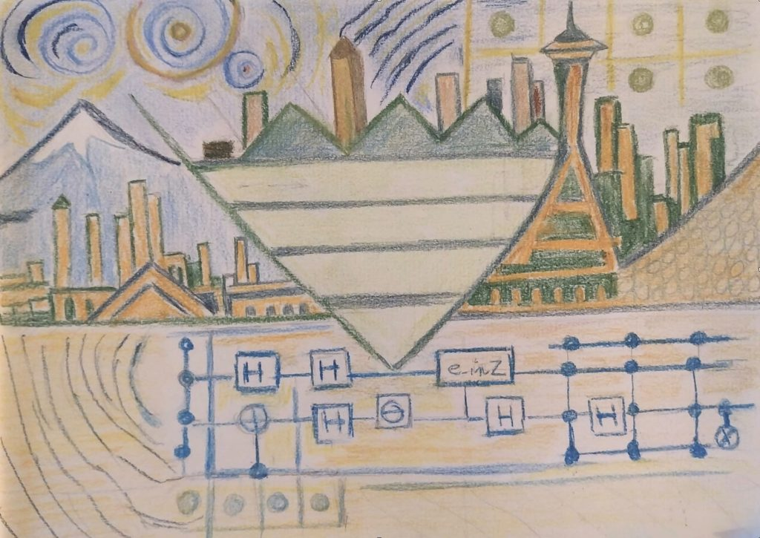
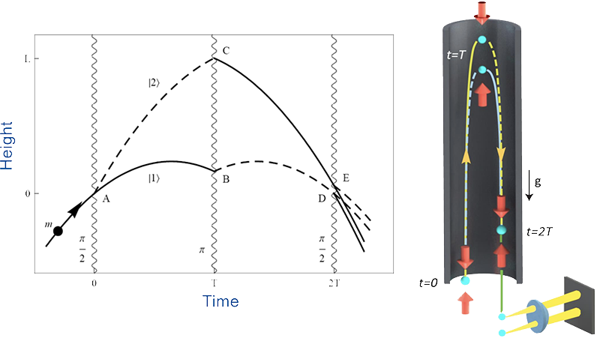
HENP in Quantum Information Science
MAGIS-100
Sensing. World record search for dark photon dark matter using qubit readout to reduce noise nearly 16 dB below SQL
InQubator for Quantum Simulation (IQuS)
, Univ. of Washington.
Large-scale academic institution focused on enabling quantum simulation for nuclear problems.
The InQubator for Quantum Simulation (IQuS) accelerates progress toward quantum computing providing predictive capabilities for the dynamics and properties of matter in extreme conditions beyond what is possible with classical computing and formal techniques alone.
Building and operating a world-record 100m atomic interferometer at Fermilab enabling new dark matter and gravitational wave searches.

Slide 31




HENP and the Genesis Mission
HENP’s unique expertise plays a key role in the Genesis Mission
  The Genesis Mission Platform: integrate cutting edge technologies in experiment’s large collaborative efforts and partner to ensure the computing ecosystem can deliver HENP discovery science
    As Infrastructure Partners use experience to further AI and Computing tools along the road to widespread deployment
    Through Pilot Intelligent Data Activities curate AI-ready datasets
    Through Seedling Model Teams develop AI tools that can understand the fundamental constituents of the universe
  Genesis Mission National Challenges: HENP is advancing
  emerging technologies and fundamental science of
  national interest:
    Discovering Quantum Algorithms with AI
    Realizing Quantum Systems for Discovery
    Recentering Microelectronics in America
    Enhancing Particle Accelerators for Discovery
    Unifying Physics from Quarks to the Cosmos
Event Reconstruction with
Geometric Deep Learning

Slide 32

Recommendation 1
DOE HEP is in complete agreement
with this recommendation for a, b and c;
However :
Not Rank-Ordered
As the highest priority independent of the budget scenarios, complete construction projects and support operations of ongoing experiments and research to enable maximum science. We reaffirm the previous P5 recommendations on major initiatives:
HL-LHC (including ATLAS and CMS detectors, as well as Accelerator Upgrade Project) to start addressing why the Higgs boson condensed in the universe to search for direct evidence for new particles to pursue quantum imprints of new phenomena and to determine the nature of dark matter.
The first phase of DUNE and PIP-II to determine the mass ordering among neutrinos, a fundamental property and a crucial input to cosmology and nuclear science.
The Vera C. Rubin Observatory to carry out the LSST, and the LSST Dark Energy Science Collaboration, to understand what drives cosmic evolution.
Final funding for HL-LHC in FY27 completes the baseline
funding level of $200M for each detector. However,
significant activities, including some deliverables and I&I are
going to have to be funded from the operations budget.
The estimate at this time is a need for an additional $25M
per detector, over the years FY27 –FY30, above the
annual operations budgets of $25-27M per detector.
There are many issues with DUNE, including the current
Total Project Cost, which needs to increase to accommodate
the cost of the near site conventional facilities which came in
a factor of 2 higher than planned at CD-1RR
The Rubin Observatory is now in operations, with an annual
operations need of $35M

Slide 33
Recommendation 2
Rank-Ordered
Construct a portfolio of major projects that collectively study nearly all fundamental constituents of our universe and their interactions, as well as how those interactions determine both the cosmic past and future. Plan and start the following major initiatives in order of priority from highest to lowest
CMB-S4, which looks back at the earliest moments of the universe to probe physics at the highest energy scales. It is critical to install telescopes at and observe from both the South Pole and Chile sites to achieve the science goals.
Re-envisioned second phase of DUNE with an early implementation of an enhanced 2.1 MW beam—ACE-MIRT—a third far detector, and an upgraded near-detector complex as the definitive long-baseline neutrino oscillation experiment of its kind.
An off-shore Higgs factory, realized in collaboration with international partners, in order to reveal the secrets of the Higgs boson. The current designs of FCC-ee and ILC meet our scientific requirements. The US should actively engage in feasibility and design studies. Once a specific project is deemed feasible and well-defined (see also Recommendation 6), the US should aim for a contribution at funding levels commensurate to that of the US involvement in the LHC and HL-LHC, while maintaining a healthy US on-shore program in particle physics.
An ultimate Generation 3 (G3) dark matter direct detection experiment reaching the neutrino fog, in coordination with international partners and preferably sited in the US.
IceCube-Gen2 for study of neutrino properties using non-beam neutrinos complementary to DUNE and for indirect detection of dark matter covering higher mass ranges using neutrinos as a tool.
DOE (along with NSF) have ended the CMB-S4 project; however, the agencies are working together to support a modest upgrade to SPT-3G and Bicep as the South Pole Observatory (SPO); DOE is also planning a modest contribution to operations at the Simon’s Observatory in Chile. These efforts together will achieve significant sensitivity to inflation signatures that the terminated CMB-S4 program proposed.
We will not consider beginning a second phase of DUNE until after Phase-1 construction is nearing completion. (~ 2030)
We have paused any consideration of a G3 dark matter project. We continue to develop a strategy for the dark matter search program.
DOE is not involved in IceCube-Gen 2.
DOE HEP is considering what level of involvement in the off-shore Higgs Factory that can be supported at this time and in the future.

Slide 34
Recommendation 3
Create an improved balance between small-, medium-, and large-scale projects to open new scientific opportunities and maximize their results, enhance workforce development, promote creativity, and compete on the world stage.
In order to achieve this balance across all project sizes we recommend the following:
Implement a new small-project portfolio at DOE, Advancing Science and Technology through Agile Experiments (ASTAE), across science themes in particle physics with a competitive program and recurring funding opportunity announcements. This program should start with the construction of experiments from the Dark Matter New Initiatives (DMNI) by DOE-HEP (section 6.2).
Continue Mid-Scale Research Infrastructure (MSRI) and Major Research Instrumentation (MRI) programs as a critical component of the NSF research and project portfolio.
Support DESI-II for cosmic evolution, LHCb upgrade II and Belle II upgrade for quantum imprints, and US contributions to the global CTA Observatory for dark matter (sections 4.2, 5.2, and 4.1).
The Belle II recommendation includes contributions towards the SuperKEKB accelerator.
DOE HEP supports the concept of having a balanced program of small, medium and large scale projects.
At this time, we believe that our current portfolio includes small, medium and large programs.
However, in the current budget climate, we have concluded that we will not be able to pursue launching a formal call for new proposals for smaller scale projects as the ASTAE program proposed by P5.
We are supporting TESSARACT (off-shore dark matter) at the <$10M scale.
We are studying the options for continued operation and enhancements of DESI (Run 2).
We are not planning to support a BELLE-II upgrade.

Slide 35
Recommendation 4
Support a comprehensive effort to develop the resources—theoretical, computational, and technological—essential to our 20-year vision for the field. This includes an aggressive R&D program that, while technologically challenging, could yield revolutionary accelerator designs that chart a realistic path to a 10 TeV pCM collider. Investing in the future of the field to fulfill this vision requires the following:
a. Support vigorous R&D toward a cost-effective 10 TeV pCM collider based on proton, muon, or possible wakefield technologies, including an evaluation of options for US siting of such a machine, with a goal of being ready to build major test facilities and demonstrator facilities within the next 10 years.
b. Enhance research in theory to propel innovation, maximize scientific impact of investments in experiments, and expand our understanding of the universe.
c. Expand the General Accelerator R&D (GARD) program within HEP, including stewardship.
d. Invest in R&D in instrumentation to develop innovative scientific tools.
e. Conduct R&D efforts to define and enable new projects in the next decade, including detectors for an e+e– Higgs factory and 10 TeV pCM collider, Spec-S5, DUNE FD4, Mu2e-II, Advanced Muon Facility, and line intensity mapping.
f. Support key cyberinfrastructure components such as shared software tools and a sustained R&D effort in computing, to fully exploit emerging technologies for projects. Prioritize computing and novel data analysis techniques for maximizing science across the entire field.
g. Develop plans for improving the Fermilab accelerator complex that are consistent with the long-term vision of this report including neutrinos, flavor, and a 10 TeV pCM collider.
This recommendation would translate into an additional $120M/year (10%) increase in the annual budget

Slide 36
2023 P5 Budget Scenarios
Inflation Reduction Act of 2022 provided supplemental funding of +303.6M for HEP projects

Slide 37
2023 P5 Budget Scenarios
Inflation Reduction Act of 2022 provided supplemental funding of +303.6M for HEP projects
$1.235

Slide 38
Comments on Recommendation 4
We will not be able to support vigorous R&D toward a cost-effective 10 TeV pCM collider based on proton, muon, or possible wakefield technologies, including an evaluation of options for US siting of such a machine, with a goal of being ready to build major test facilities and demonstrator facilities within the next 10 years.
b. We will not be able to enhance research in theory to propel innovation, maximize scientific impact of investments in experiments, and expand our understanding of the universe.
c. We will not be able to expand the General Accelerator R&D (GARD) program within HEP, including stewardship. In fact, we plan to reduce it.
d. We will continue to invest in R&D in instrumentation to develop innovative scientific tools. Albeit at a reduced level.
e. For the next 5 years we will have limited R&D efforts to define and enable new projects in the next decade, including detectors for an e+e– Higgs factory and 10 TeV pCM collider, Spec-S5, DUNE FD4, Mu2e-II, Advanced Muon Facility, and line intensity mapping.
f. We will support key cyberinfrastructure components such as shared software tools and a sustained R&D effort in computing, to fully exploit emerging technologies for projects. Prioritize computing and novel data analysis techniques for maximizing science across the entire field (section 6.7). This will be in support of the DOE-wide Genesis Mission
g. We will develop plans for improving the Fermilab accelerator complex
It is not clear if they will be consistent with the long-term vision of this report including neutrinos, flavor, and a 10 TeV pCM collider.

Slide 39
Recommendation 6
Convene a targeted panel with broad membership across particle physics later this decade that makes decisions on the US accelerator-based program at the time when major decisions concerning an offshore Higgs factory are expected, and/or significant adjustments within the accelerator-based R&D portfolio are likely to be needed. A plan for the Fermilab accelerator complex consistent with the long-term vision in this report should also be reviewed. The panel would consider the following:
a. The level and nature of US contribution in a specific Higgs factory including an evaluation of the associated schedule, budget, and risks once crucial information becomes available.
b. Mid- and large-scale test and demonstrator facilities in the accelerator and collider
R&D portfolios.
c. A plan for the evolution of the Fermilab accelerator complex consistent with the long term vision in this report, which may commence construction in the event of a more favorable budget situation.
DOE HEP intends to generally follow this recommendation, albeit with separate panels for a and c;
It is unlikely that we initiate any new major construction projects in the next 6-7 years;
we will probably not do a panel for b in the near term.

Slide 40
HENP Research, Facilities and Project Balance
$100,000K

Slide 41
HEP Priorities in next 5 years (2027 – 2032)
#1: complete on-going projects : PIP-II, HL-LHC, LBNF/DUNE-I
#2: ensure that the FNAL accelerator complex can deliver beam to DUNE
#3: ensure that the SURF complex can safely host DUNE
#4: operate Rubin/LSST and DESI
#5: support proposed upgrades to SPT-3G and BICEP as SPO

Slide 42
Closing Take-away
HENP have significant portfolios of projects and operating facilities that are underway, completing and some just getting started.
We are endeavoring to manage the balance of resources among the projects, facilities and research; research budgets are challenging.
The LBNF-DUNE Project MUST succeed.
  It is the highest priority in planning the HEP budgets for FY27-31
  The TPC must increase to the upper end of the CD-1RR range; this is not yet approved or guaranteed!
HL-LHC upgrades, including installation and commissioning MUST succeed
  These put additional burden on the facility operations budgets, since they must now support installation tasks, at the level of a 20% increase per year for the next 4 years
What is happening with future project planning?
    HEP : DUNE Phase-II, Higgs Factory, Spec-S5, XLZD, Muon Collider demonstrator ….
    NP : EIC, LEGEND-1000

Slide 43
Spring 2026 - Office of Science Advisory Committee (SCAC) Charges
Facilities of the Future Charge
Review proposed facilities and upgrades, identify any gaps, and prioritize the facilities that are most crucial to the needs of the nation for the next ten years (2026-2036) Consider how proposed facilities integrate with and support the Genesis Mission for AI and QIS, as well as other Administration priorities in fusion, microelectronics, biotechnology, and discovery science
AI for Transformative Science Charge
Identify how to prioritize SC resources to accelerate the application of AI for transformative scientific and engineering discovery focused on pressing national science and technology challenges Create a decadal roadmap articulating near, mid, and long-term priorities for SC to achieve the Genesis Mission
Quantum Computing Roadmap Charge
Create a roadmap to identify near-term steps to a concrete 2028 goal of an error-corrected quantum computer capable of revolutionary science Assess current landscape, noting technical opportunities, gaps, and public-private partnerships to leverage impact
Reports presented July 17
Report in November
Notes:
Just verbally speak to the projects that have been discussed with the sub-committee.

Slide 44


HENP future facilities in SCAC prioritization list
LEGEND-1000
Also in 2024 HEPAP facility evaluation, also :
Full DUNE-II, Spec-S5, Test facilities
DUNE FD-3

Slide 45
What about new ideas and opportunities?
In particular, medium and small scale….
There are rules regarding MIE funding and when CD-0’s are required.
MIE’s > $10M requires congressional notification (generally 2 yr in advance of the year you want the funding).
At this time, new starts are on hold; we consider minor upgrades to existing experiments on a case by case basis.
Notes:
Just speak to this. No details in print. We listen, we collect information, but hopefully, we are honest with the community about constraints and budgets. Misunderstandings about “under $10M cap”….

Slide 46
Long term planning for success
HEP strength is in the breadth of its exploration from Quarks to the Cosmos, and all of the neutrinos and rare processes in between.
Future projects at the energy frontier, the intensity frontier and in cosmic surveys will continue to offer avenues of discovery.
As budgets permit, we will endeavor to support future project development.
Significant support for new projects will take time, and we will not launch new, expensive projects pre-maturely…
  No new project starts before good understanding of cost and scope
Be patient; Stay tuned.

Slide 47
Thoughts about FCCee
What would a U.S. contribution look like ?
Things to consider :
  International Governance Structure
  Geopolitical Sensitivities
  Domestic Governance Structure
  What can we afford? Over what time period? Total? Annual?
  Structure ? DOE 413? Line item? Major Item of Equipment?
  Balance with the domestic program
Technical Scope
  Machine
  Detectors
Costing Model : DOE Full Cost Accounting compared to CERN Costing

Slide 48
HENP Summary
HEP and NP programs focus on answering the most fundamental questions about matter, energy, space and time.
We do this by building and operating state-of-the-art facilities and instruments, collecting and analyzing large, complex data sets and publishing scientific results. Facility operations and data processing continue to be enhanced by the application of AI tools.
Both programs have been guided by planning processes that evaluate the science and set priorities such that the focus remains centered on answering the most pressing and compelling questions.
  Budget realities have not matched outyear scenarios, making it challenging to execute the vision set out in the plans
  HEP and NP are executing a portfolio of projects launched this decade and should have construction completed within the coming decade, setting us up for producing record breaking quantities of data and world leading results for decades to come.

Slide 49
Thank you!

